Slide 1
Summary of RT08 proposals
^{5th}November 2025
M. Baruzzo, V. Igochine
On behalf of WPTE TFLs
M. Baruzzo, V Igochine, D. Keeling, A. Hakola, B. Labit, E. Tsitrone, N. Vianello

Slide 2
Introduction

Slide 3
Scientific Objectives and Machine Time
#
D1 | Consolidate understanding of flux pumping mechanism and extrapolate to ITER/DEMO/JT-60SA
D2 | Quantify compatibility of high βN long-pulse with mitigated ELMs and/or with exhaust in metallic wall devices in view of extrapolating scenario to JT-60SA W-wall operation
D3 | Characterize the fast and thermal ion transport together with the ExB, magnetic shear, and turbulence conditions in steady-state scenarios at high-q
D4 | Validate state of the art models for scenario extrapolation towards future devices
D5 | Develop an intrinsically steady-state solutions at high βN (>3) in terms of q/pressure profile with mild MHD activity. Investigate the dependence of the scenario to the available actuators, and compare it to the expected JT-60SA and DEMO scenarios particularly in terms of extending operational space toward high Gw fractions
D6 | Develop steady-state scenarios in metallic devices at high βN in conditions of MHD characteristics close or above the no-wall ideal limit. Investigate the dependence of the scenario to the actuators and characteristics expected to be used in JT-60S
 | AUG | TCV | MAST-U | WEST
Tentative allocation 26 | 32 | 70 | 24 | 15
Tentative allocation 27 | 16 | 110 |  | 15
Total proposed | 100 | 206 | 96 | 145
Scientific/dev. | 45/55 | 116/90 | 80/16 | 125/20

Slide 4
Summary of proposals (14)
No | RT | Proposal name | Proposer
178 | RT08 | Hybrid-like scenario at high βN with 3/2 tearing mode on MAST-U | Gianluca Pucella et al.
179 | RT08 | Flux pumping studies at low aspect ratio on MAST-U | Sam Blackmore et al
180 | RT08 | Pushing fast-ion-induced ITBs to the edge for turbulence measurements | Davide Silvagni et al
181 | RT08 | Hybrid scenario development on MAST-U: current rampup strategies | Fulvio Auriemma et al.
182 | RT08 | Flux Pumping Parameter Space Determination on AUG | Alexander Bock et al.
183 | RT08 | EC+IC+LH synergy in view of H-mode and Long Pulse operation in WEST | Ernesto Lerche
184 | RT08 | Long pulse operation in radiative divertor regime | Remi Dumont et al.
185 | RT08 | High density, high betap | Christopher Ham et al.
186 | RT08 | TWA+EC+LH synergy in view of H-mode and Long Pulse operation in WEST | Vincent Maquet
187 | RT08 | Early Heating Reversed Shear Discharges on AUG | Lea Hollendonner, Alexander Bock et.al.
188 | RT08 | TWA Bi-Frequency Heating for Long Pulse operation in WEST | Vincent Maquet et al
189 | RT08 | Development and optimization of high-bootstrap, high-beta tokamak scenarios towards steady-state | Stefano Coda, Chiara Piron, Irina Voitsekhovitch
190 | RT08 | Study of MHD activities with machine learning in high beta scenarios. | Luca Bonalumi, Edoardo Alessi, Carlo Sozzi
203 | RT08 | Investigation of internal transport barriers induced on TCV | Sergei Sharapov
⬅ coming from RT09

Slide 5
Summary of proposals (14)
Flux pumping, Hybrid scenario, ITB scenario, Heating synergy
No | RT | Proposal name | Proposer
178 | RT08 | Hybrid-like scenario at high βN with 3/2 tearing mode on MAST-U | Gianluca Pucella et al.
179 | RT08 | Flux pumping studies at low aspect ratio on MAST-U | Sam Blackmore et al
180 | RT08 | Pushing fast-ion-induced ITBs to the edge for turbulence measurements | Davide Silvagni et al
181 | RT08 | Hybrid scenario development on MAST-U: current rampup strategies | Fulvio Auriemma et al.
182 | RT08 | Flux Pumping Parameter Space Determination on AUG | Alexander Bock et al.
183 | RT08 | EC+IC+LH synergy in view of H-mode and Long Pulse operation in WEST | Ernesto Lerche
184 | RT08 | Long pulse operation in radiative divertor regime | Remi Dumont et al.
185 | RT08 | High density, high betap | Christopher Ham et al.
186 | RT08 | TWA+EC+LH synergy in view of H-mode and Long Pulse operation in WEST | Vincent Maquet
187 | RT08 | Early Heating Reversed Shear Discharges on AUG | Lea Hollendonner, Alexander Bock et.al.
188 | RT08 | TWA Bi-Frequency Heating for Long Pulse operation in WEST | Vincent Maquet et al
189 | RT08 | Development and optimization of high-bootstrap, high-beta tokamak scenarios towards steady-state | Stefano Coda, Chiara Piron, Irina Voitsekhovitch
190 | RT08 | Study of MHD activities with machine learning in high beta scenarios. | Luca Bonalumi, Edoardo Alessi, Carlo Sozzi
203 | RT08 | Investigation of internal transport barriers induced on TCV | Sergei Sharapov
⬅ coming from RT09

Slide 6
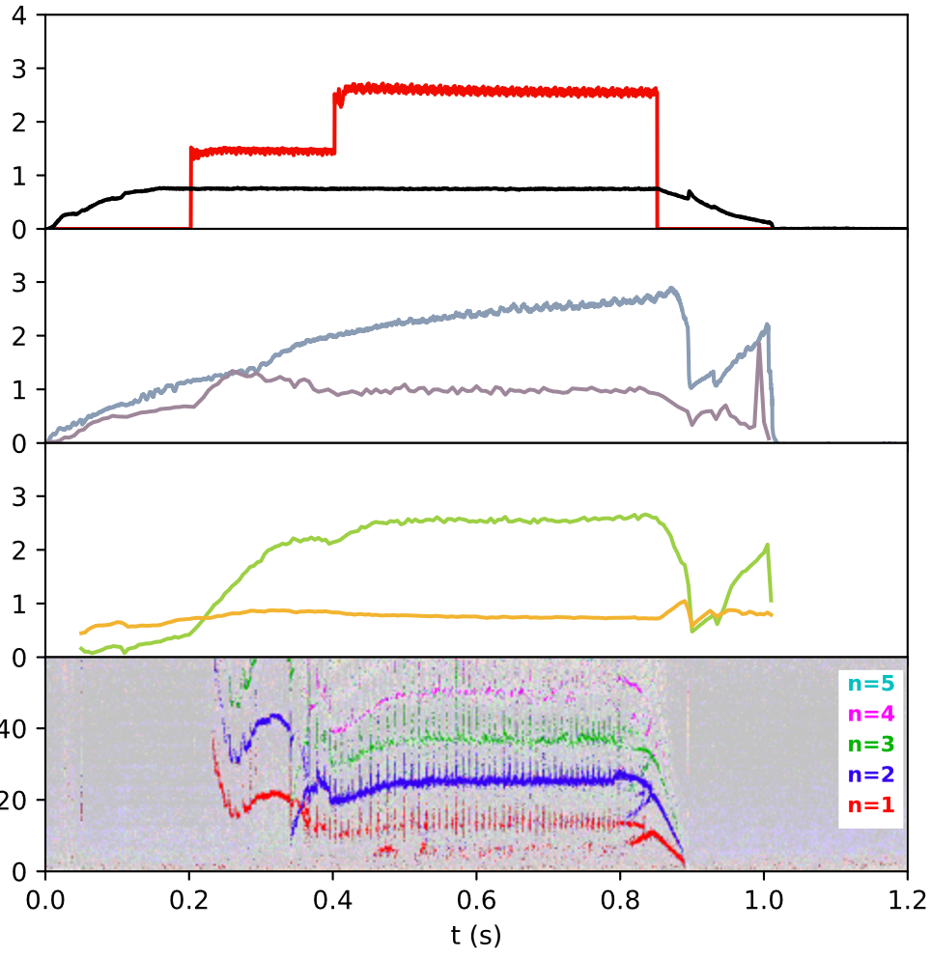
P178: Hybrid-like scenario at high β_{N} with 3/2 tearing mode on MAST-U
Proponents and contact person
P_{NBI} (MW)
2.5
Gianluca Pucella (gianluca.pucella@enea.it)
Fulvio Auriemma, Edmondo Giovannozzi, Francesco Orsitto, Chiara Piron, Luca Senni,
Sam Blackmore, Daniele Brunetti, Luca Garzotti, …
I_{p} (MA)
n_{e}l (10²² m⁻²)
Scientific background & Objectives
T_{e} (keV)
Recent experiments on MAST-U allowed to obtain a hybrid-like scenario at relatively high beta values (β_{N} =2.5-2.6) with mild MHD activity (3/2 tearing mode).
2.5
β_{N}
Determine the β_{N} threshold for 3/2 mode destabilization in heated pulses without IREs during the Ohmic ramp-up phase (dI_{p}/dt = 3 MA/s)
Investigate the possible flux-pumping mechanism with the 3/2 mode
Investigate the possible existence of an upper limit in β_{N} to avoid the destabilization of a 2/1 mode in the second half of the pulse
Dependence of the maximum β_{N} achievable as function of B_{T} and I_{p}
l_{i}
Experimental strategy/Machine constraints and diagnostic
Proposed pulses
On-axis NBI power scan (0.5-2.0 MW), with t_{inj} ≈ 200 ms
Off-axis NBI power scan (0.5-2.0 MW), with t_{inj} ≈ 400 ms, in pulses with on-axis NBI (1.5-2.0 MW) from 200 ms and stationary 3/2 mode
I_{p} < 1.0 MA (“overshoot” in pulses at lower I_{p} tbc), B_{T} < 0.7 MA, 1-4 MW NBI
SXR, Magnetic pick-up coils, Thomson scattering, Interferometer, MSE
Device | # Pulses/Session | # Development
AUG
MAST-U | 24 / 3 | 8 / 1
TCV
WEST

Slide 7
P178: Hybrid-like scenario at high β_{N} with 3/2 tearing mode on MAST-U
Proponents and contact person
P_{NBI} (MW)
2.5
Gianluca Pucella (gianluca.pucella@enea.it)
Fulvio Auriemma, Edmondo Giovannozzi, Francesco Orsitto, Chiara Piron, Luca Senni,
Sam Blackmore, Daniele Brunetti, Luca Garzotti, …
Priority: P1_MAST-U – important scenario development, which is continuation of the previous activity, reduce by 30%
I_{p} (MA)
n_{e}l (10²² m⁻²)
Scientific background & Objectives
T_{e} (keV)
Recent experiments on MAST-U allowed to obtain a hybrid-like scenario at relatively high beta values (β_{N} =2.5-2.6) with mild MHD activity (3/2 tearing mode).
2.5
β_{N}
Determine the β_{N} threshold for 3/2 mode destabilization in heated pulses without IREs during the Ohmic ramp-up phase (dI_{p}/dt = 3 MA/s)
Investigate the possible flux-pumping mechanism with the 3/2 mode
Investigate the possible existence of an upper limit in β_{N} to avoid the destabilization of a 2/1 mode in the second half of the pulse
Dependence of the maximum β_{N} achievable as function of B_{T} and I_{p}
l_{i}
Experimental strategy/Machine constraints and diagnostic
Proposed pulses
On-axis NBI power scan (0.5-2.0 MW), with t_{inj} ≈ 200 ms
Off-axis NBI power scan (0.5-2.0 MW), with t_{inj} ≈ 400 ms, in pulses with on-axis NBI (1.5-2.0 MW) from 200 ms and stationary 3/2 mode
I_{p} < 1.0 MA (“overshoot” in pulses at lower I_{p} tbc), B_{T} < 0.7 MA, 1-4 MW NBI
SXR, Magnetic pick-up coils, Thomson scattering, Interferometer, MSE
Device | # Pulses/Session | # Development
AUG
MAST-U | 24 / 3 | 8 / 1
TCV
WEST

Slide 8
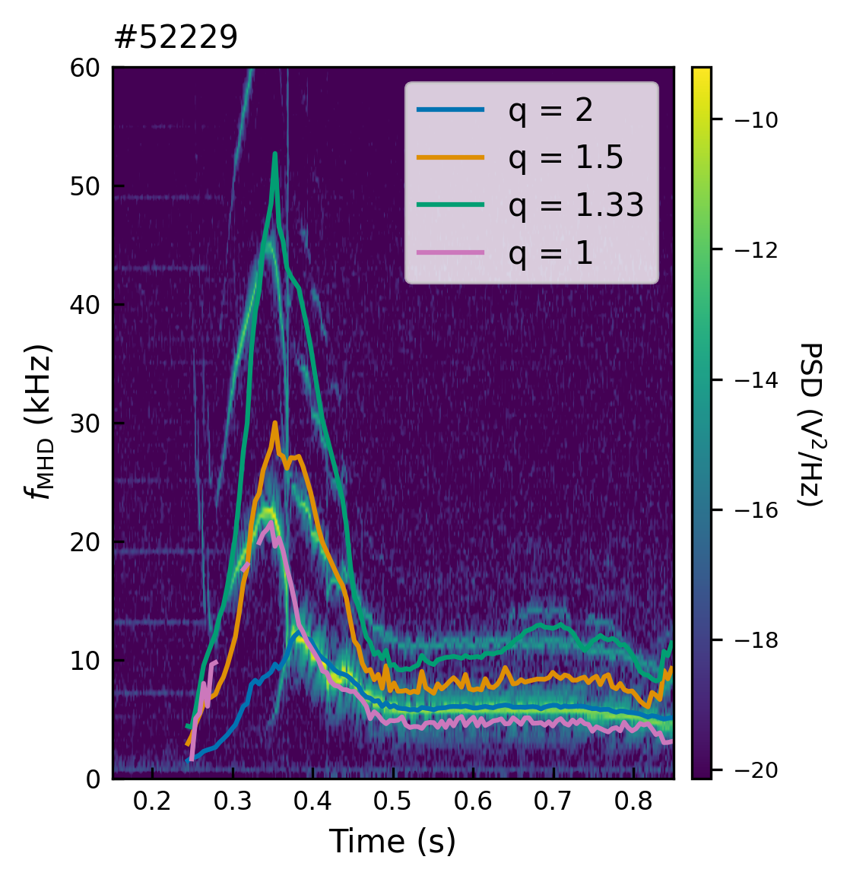
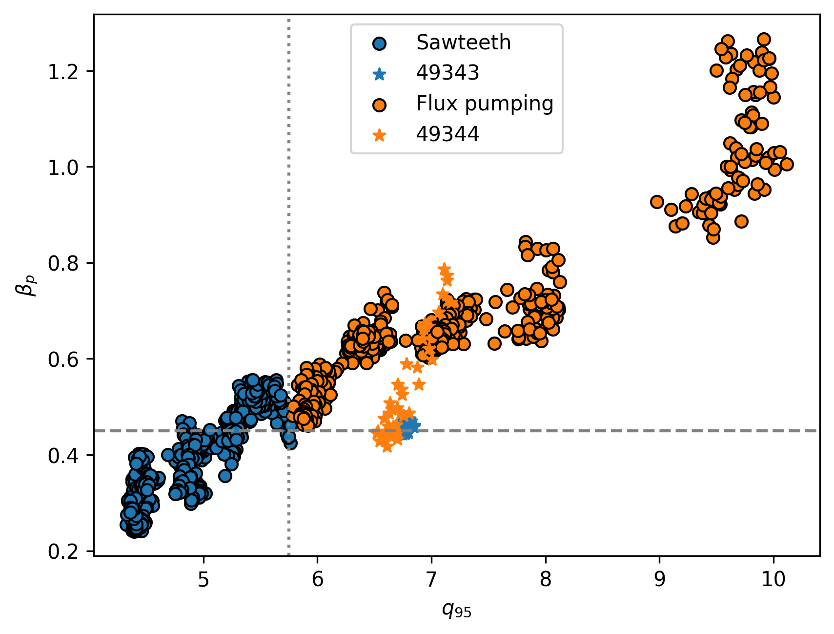
P179:Flux pumping studies at low aspect ratio on MAST-U
Proponents: S. Blackmore, A. Bock, C. Ham, F. Auriemma
Email: Sam.blackmore@ukaea.uk
Scientific Background & Objectives
Flux pumping (FP) present in MAST-U scenarios via 2/1 tearing mode. Goals for this experiment are to:
Perform a q95 scan to determine optimal q shear for flux pumping.
Demonstrate transition from 'non flux pumping' (ie. sawteeth) to 'flux pumping' state, using NBI heating to scan beta poloidal.
Couple flux pumping core scenario with an alternative divertor solution eg. Super-X, X-point radiator or other concept to demonstrate core-exhaust integration.
Experimental Strategy
Continue from MU04 internal MHD-04 flux pumping program and RT08 2025 scenario development of 750kA plasma
Modify q95 in flux pumping scenario.
Beta poloidal scan using NBI heating.
Establish FP with alternative divertor configuration eg. super-X sweep or inject gas recipe from X point radiator scenario.
Possible summary figures
MAST-U scenario with 1/1 MHD activity before 2/1 mode is triggered.
q95 vs beta poloidal for various sawtoothing / flux pumping MAST-U pulses – Target q95 ~ 6 and beta pol ~ 0.5
Proposed pulses
Device | # Pulses/Session | # Development
AUG
MAST-U | 16 | 8
TCV
WEST
  MAST-U: 3MW NBI, MSE / CXRS / RGB / TS

Slide 9
P179:Flux pumping studies at low aspect ratio on MAST-U
Proponents: S. Blackmore, A. Bock, C. Ham, F. Auriemma
Email: Sam.blackmore@ukaea.uk
Scientific Background & Objectives
Flux pumping (FP) present in MAST-U scenarios via 2/1 tearing mode. Goals for this experiment are to:
Perform a q95 scan to determine optimal q shear for flux pumping.
Demonstrate transition from 'non flux pumping' (ie. sawteeth) to 'flux pumping' state, using NBI heating to scan beta poloidal.
Couple flux pumping core scenario with an alternative divertor solution eg. Super-X, X-point radiator or other concept to demonstrate core-exhaust integration.
Experimental Strategy
Continue from MU04 internal MHD-04 flux pumping program and RT08 2025 scenario development of 750kA plasma
Modify q95 in flux pumping scenario.
Beta poloidal scan using NBI heating.
Establish FP with alternative divertor configuration eg. super-X sweep or inject gas recipe from X point radiator scenario.
Priority: P1_MASTU – Very reduced programme. 8 pulses to match AUG FP programme
Possible summary figures
MAST-U scenario with 1/1 MHD activity before 2/1 mode is triggered.
q95 vs beta poloidal for various sawtoothing / flux pumping MAST-U pulses – Target q95 ~ 6 and beta pol ~ 0.5
Proposed pulses
Device | # Pulses/Session | # Development
AUG
MAST-U | 16 | 8
TCV
WEST
  MAST-U: 3MW NBI, MSE / CXRS / RGB / TS

Slide 10
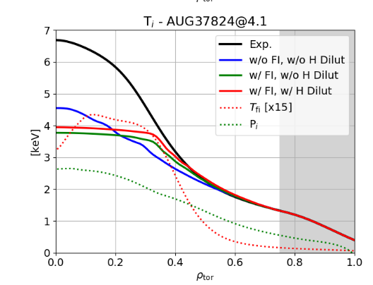
P180: Pushing fast-ion-induced internal transport barriers towards the edge for turbulence measurements
Proponents and contact person:
D. Silvagni, R. Bilato, A. Bock etc. (full list in wiki)
Scientific Background & Objectives
  Fast ions (FI) can help reducing turbulence in the plasma core and foster ITB formation. However, direct measurement of turbulence characteristics within ITB not possible so far. Goals:
    Develop a stable scenario with a fast-ion-induced internal transport barrier (ITB) towards the edge
    Measure turbulence characteristics inside the ITB
    Compare with gyrokinetic simulations results, to deepen physics understanding and prediction capabilities
Experimental Strategy/Machine Constraints and essential diagnostic
  H(D) minority heating scenario: start from 37824, increase field to move ITB towards edge & find sweet-spot for turbulence measurements (#4)
  3He(D) minority heating scenario (only from 2027 as it requires 22 MHz generators): scenario development and optimization for turbulence measurement (#7)
  Essential diagnostics: Doppler reflectometry and CECE
[Bilato et al. AIP 2023]
Proposed pulses
Device | # Pulses/Session | # Development
AUG | 4 | 7
MAST-U
TCV
WEST

Slide 11
P180: Pushing fast-ion-induced internal transport barriers towards the edge for turbulence measurements
Proponents and contact person:
D. Silvagni, R. Bilato, A. Bock etc. (full list in wiki)
Scientific Background & Objectives
  Fast ions (FI) can help reducing turbulence in the plasma core and foster ITB formation. However, direct measurement of turbulence characteristics within ITB not possible so far. Goals:
    Develop a stable scenario with a fast-ion-induced internal transport barrier (ITB) towards the edge
    Measure turbulence characteristics inside the ITB
    Compare with gyrokinetic simulations results, to deepen physics understanding and prediction capabilities
Experimental Strategy/Machine Constraints and essential diagnostic
  H(D) minority heating scenario: start from 37824, increase field to move ITB towards edge & find sweet-spot for turbulence measurements (#4)
  3He(D) minority heating scenario (only from 2027 as it requires 22 MHz generators): scenario development and optimization for turbulence measurement (#7)
  Essential diagnostics: Doppler reflectometry and CECE
Priority: P2_AUG – this is an interesting physics proposal but we decided to prioritize flux-pumping on AUG.
[Bilato et al. AIP 2023]
Proposed pulses
Device | # Pulses/Session | # Development
AUG | 4 | 7
MAST-U
TCV
WEST

Slide 12
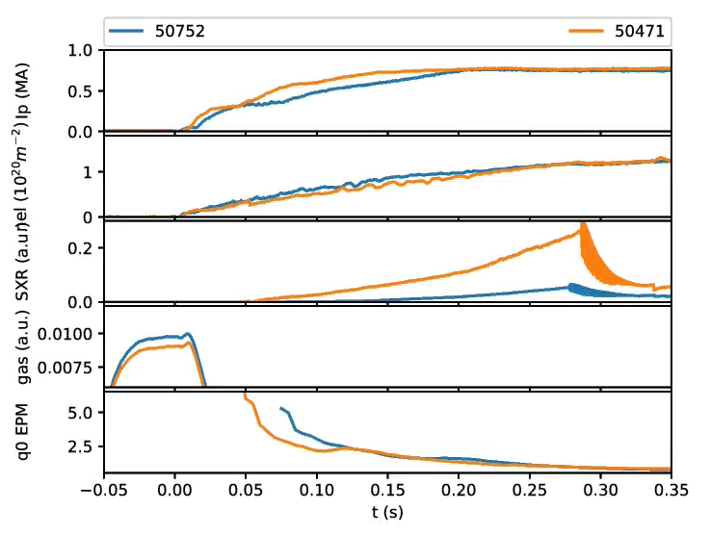
P 181: Hybrid scenario development on MAST-U: current ramp-up strategies
Std: 3.0MA/s
CREATE: 5.0MA/s
Proponents and contact person:
F. Auriemma G. Pucella Francesco Paolo Orsitto C. Vincent Luca Senni …
Scientific Background & Objectives
  Hybrid-like plasma q profile depends on the current profile evolution during the ohmic
  ramp-up phase. Good ohmic references obtained in 2024 identifying the (not optimized)
  ramp-up rate (3.0MA/s)
  The proposal aims at optimizing such preliminary results, performing:
  Gas scan at 600kA and 750kA to obtain 2 set of comparable pulses with
  standard (3.0MA/s) and CREATE-ILC controller
  Development of the current overshoot by means of the CREATE-ILC controller
  Development of an effective strategy to simulate the ramp up:
    Compute q profile with different resistivity models→ match the evolution of MHD markers
Experimental Strategy/Machine Constraints and essential diagnostic
From reference pulses 600kA: 50903(std); 51130(CREATE) ;750kA: 50752(std); 50471(CREATE) run the density scan
1 session dedicated to current OS technique at 600kA and 750kA of flattop current
TRANSP/ASTRA analysis of q evolution, comparison with MHD markers as q=1 arrival time (t_{q=1}) and q=1 radial position (R_{q=1})
Possible summary figures
Proposed pulses
Device | # Pulses/session | # Develop.
MAST-U | 24/3

Slide 13
P 181: Hybrid scenario development on MAST-U: current ramp-up strategies
Std: 3.0MA/s
CREATE: 5.0MA/s
Proponents and contact person:
F. Auriemma G. Pucella Francesco Paolo Orsitto C. Vincent Luca Senni …
Scientific Background & Objectives
  Hybrid-like plasma q profile depends on the current profile evolution during the ohmic
  ramp-up phase. Good ohmic references obtained in 2024 identifying the (not optimized)
  ramp-up rate (3.0MA/s)
  The proposal aims at optimizing such preliminary results, performing:
  Gas scan at 600kA and 750kA to obtain 2 set of comparable pulses with
  standard (3.0MA/s) and CREATE-ILC controller
  Development of the current overshoot by means of the CREATE-ILC controller
  Development of an effective strategy to simulate the ramp up:
    Compute q profile with different resistivity models→ match the evolution of MHD markers
Experimental Strategy/Machine Constraints and essential diagnostic
From reference pulses 600kA: 50903(std); 51130(CREATE) ;750kA: 50752(std); 50471(CREATE) run the density scan
1 session dedicated to current OS technique at 600kA and 750kA of flattop current
TRANSP/ASTRA analysis of q evolution, comparison with MHD markers as q=1 arrival time (t_{q=1}) and q=1 radial position (R_{q=1})
Possible summary figures
Priority: P2_MAST-U – Large proposal, merge with 178
Proposed pulses
Device | # Pulses/session | # Develop.
MAST-U | 24/3

Slide 14
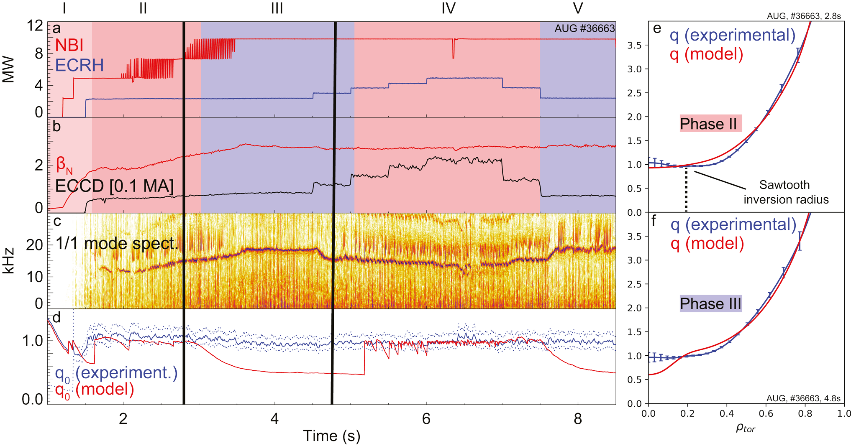
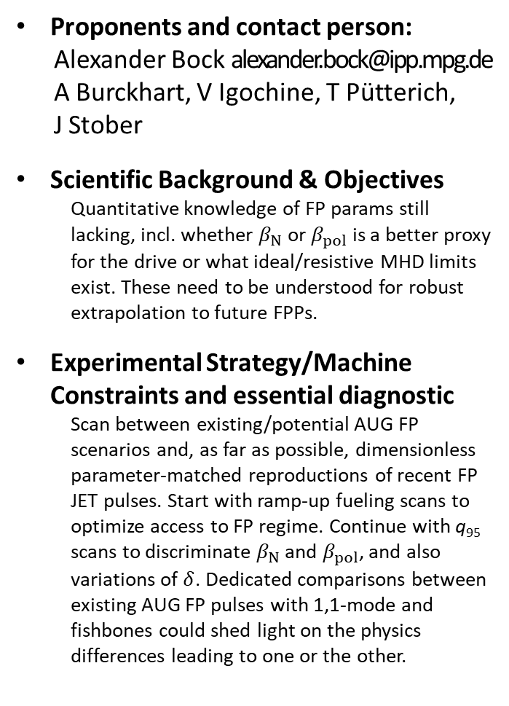
P182: Investigating 1,1 Flux Pumping Parameter Dependence
Proponents and contact person:
Alexander Bock alexander.bock@ipp.mpg.de
A Burckhart, V Igochine, T Pütterich,
J Stober
Scientific Background & Objectives
  Quantitative knowledge of FP params still lacking, incl. whether $β_{N}$ or $β_{pol}$ is a better proxy for the drive or what ideal/resistive MHD limits exist. These need to be understood for robust extrapolation to future FPPs.
Experimental Strategy/Machine Constraints and essential diagnostic
  Scan between existing/potential AUG FP scenarios and, as far as possible, dimensionless parameter-matched reproductions of recent FP JET pulses. Start with ramp-up fueling scans to optimize access to FP regime. Continue with q₉₅ scans to discriminate $β_{N}$ and $β_{pol}$, and also variations of $δ$. Dedicated comparisons between existing AUG FP pulses with 1,1-mode and fishbones could shed light on the physics differences leading to one or the other.
Possible summary figures
Proposed pulses
Device | # Pulses/Session | # Development
AUG | 25 | 30
MAST-U
TCV
WEST
  Machine req AUG: 15MW NBI, 5MW ECRH, (I)MSE

Slide 15
P182: Investigating 1,1 Flux Pumping Parameter Dependence
Proponents and contact person:
Alexander Bock alexander.bock@ipp.mpg.de
A Burckhart, V Igochine, T Pütterich,
J Stober
Scientific Background & Objectives
  Quantitative knowledge of FP params still lacking, incl. whether $β_{N}$ or $β_{pol}$ is a better proxy for the drive or what ideal/resistive MHD limits exist. These need to be understood for robust extrapolation to future FPPs.
Experimental Strategy/Machine Constraints and essential diagnostic
  Scan between existing/potential AUG FP scenarios and, as far as possible, dimensionless parameter-matched reproductions of recent FP JET pulses. Start with ramp-up fueling scans to optimize access to FP regime. Continue with q₉₅ scans to discriminate $β_{N}$ and $β_{pol}$, and also variations of $δ$. Dedicated comparisons between existing AUG FP pulses with 1,1-mode and fishbones could shed light on the physics differences leading to one or the other.
Possible summary figures
Priority: P1_AUG_2026 work horse proposal for understanding FP
Proposed pulses
Device | # Pulses/Session | # Development
AUG | 25 | 30
MAST-U
TCV
WEST
  Machine req AUG: 15MW NBI, 5MW ECRH, (I)MSE

Slide 16
183: IC / EC / LH synergy in view of H-mode and Long Pulse operation
62247
Proponents and contact person:
E. Lerche, X. Litaudon, R. Dumont, J. Hillairet, L. Colas, S. Mazzi, P. Manas,
P. Maget, T. Fonghetti, …
Scientific Background & Objectives
  ICRH works well in WEST (without impurity issues) in high density / low temperature plasmas (cold-branch) but high power LHCD is challenging in these conditions (W radiation, MHD, …)
  Applying ICRH in the ‘hot-branch’ discharges is also challenging because of low coupling and interference with the high power LHCD system operation
  ECRH can help on both strategies, namely avoiding W accumulation and MHD (flatter q-profile) when starting in the ‘cold-branch’ and allowing less LHCD power request to reach the hot-branch (potentially larger ICRH)
  Objectives:
  Develop a high-performance discharge with combined ECRH+ICRH+LHCD
  Determine best heating mix and heating sequence
  Potentially achieve H-mode with extra 1-2 MW of ECRH
  Contribute to increase the performance of the t>1000s long pulses with efficient hating mix
Exp. Strategy/Machine Constraints and diagnostics
  Start from known plasma scenarios in the ‘cold-branch’ and in the ‘hot-branch’ and change the heating sequence to find the best recipe for optimal operation (‘W burn-through’, minimize MHD, etc.)
  All heating systems to be fully operational
  Standard diagnostics for plasma performance (focus on core physics); Accurate H minority control
Example of WEST discharge with P_{sep} close to P_{L-H} power threshold (LH+IC=6.5MW )
Proposed pulses
Device | # Pulses/Session | # Development
WEST | 2 Sessions (with full power) | 1 session for scenario development + heating set-up

Slide 17
183: IC / EC / LH synergy in view of H-mode and Long Pulse operation
62247
Proponents and contact person:
E. Lerche, X. Litaudon, R. Dumont, J. Hillairet, L. Colas, S. Mazzi, P. Manas,
P. Maget, T. Fonghetti, …
Scientific Background & Objectives
  ICRH works well in WEST (without impurity issues) in high density / low temperature plasmas (cold-branch) but high power LHCD is challenging in these conditions (W radiation, MHD, …)
  Applying ICRH in the ‘hot-branch’ discharges is also challenging because of low coupling and interference with the high power LHCD system operation
  ECRH can help on both strategies, namely avoiding W accumulation and MHD (flatter q-profile) when starting in the ‘cold-branch’ and allowing less LHCD power request to reach the hot-branch (potentially larger ICRH)
  Objectives:
  Develop a high-performance discharge with combined ECRH+ICRH+LHCD
  Determine best heating mix and heating sequence
  Potentially achieve H-mode with extra 1-2 MW of ECRH
  Contribute to increase the performance of the t>1000s long pulses with efficient hating mix
Exp. Strategy/Machine Constraints and diagnostics
  Start from known plasma scenarios in the ‘cold-branch’ and in the ‘hot-branch’ and change the heating sequence to find the best recipe for optimal operation (‘W burn-through’, minimize MHD, etc.)
  All heating systems to be fully operational
  Standard diagnostics for plasma performance (focus on core physics); Accurate H minority control
Priority: P2_WEST. WEST specific
Example of WEST discharge with P_{sep} close to P_{L-H} power threshold (LH+IC=6.5MW )
Proposed pulses
Device | # Pulses/Session | # Development
WEST | 2 Sessions (with full power) | 1 session for scenario development + heating set-up

Slide 18
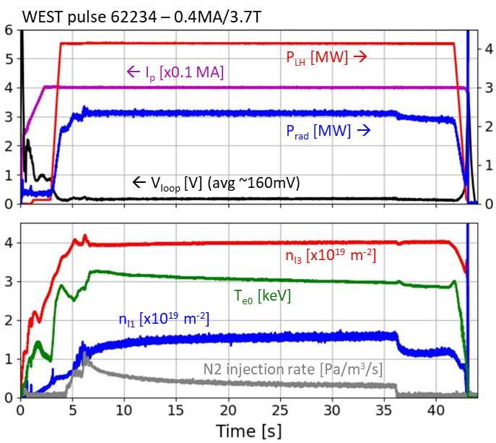
P184: Long pulse operation in radiative divertor regime
Proponents and contact person:
  R. Dumont (remi.dumont@cea.fr), P. Maget , P. Manas, N. Fedorczak, A. Fil, T. Fonghetti, P. Forestier-Colleoni, J. Gunn, E. Lerche, J. Morales, N. Rivals
Scientific Background & Objectives
  Background
    Radiative divertor regime required to prevent UFO events on long plasma durations
    Demonstrating a fully controlled radiative divertor regime on long durations is challenging
    Achieving high performance (high β) in XPR/low loop voltage pulses requires optimization
    Development work in detached regime has already started within RT08
    Challenges to address:
      N2 injection rate optimization
      XPR transition identification at low plasma currents
      LHCD efficiency optimization (could be compensated by confinement improvement)
  Objectives
    Extend fully non-inductive scenarios to XPR regimes
      Demonstrate RT control of loop voltage in the presence of controlled N2 (or Ne) injection to maintain XPR at low currents
      Qualify confinement, W sources and contamination. Compare to attached regime
    Maximize performance of detached steady-state pulses
      Continue ramp-up/current profile optimizations
      Apply ECRH/CD to enlarge parameter space
      Test Ne injection (better exhaust than N₂), depending on progress on XPR developments in internal program & RT05 (divertor detachment)), RT06 (PFC testing, high fluence)
Experimental Strategy/Machine Constraints and essential diagnostic
  Reference pulse : WEST pulse 62234 (V_{loop}~160 mV) - LSN plasma with LHCD, N₂ seeding
    Decrease current, add ECRH/ECCD
    For each value of current, test various levels of N2 injection in feed-forward
      several plateaus in development pulses, checking XPR transitions using Langmuir probes
    Once adequate N2 level determined for a given current, go to feedback control on edge interf. measurement
    Scans in plasma current, electron density, …
  Essential diagnostics: SXR, HXR, XICS, visible and VUV spectroscopy, Langmuir probes
Possible summary figures
Overview of XPR pulse 62234 (V_{loop}~160 mV)
Proposed pulses
Device | # Pulses/Session | # Development
AUG
MAST-U
TCV
WEST | 40/2 | 20

Slide 19
P184: Long pulse operation in radiative divertor regime
Proponents and contact person:
  R. Dumont (remi.dumont@cea.fr), P. Maget , P. Manas, N. Fedorczak, A. Fil, T. Fonghetti, P. Forestier-Colleoni, J. Gunn, E. Lerche, J. Morales, N. Rivals
Scientific Background & Objectives
  Background
    Radiative divertor regime required to prevent UFO events on long plasma durations
    Demonstrating a fully controlled radiative divertor regime on long durations is challenging
    Achieving high performance (high β) in XPR/low loop voltage pulses requires optimization
    Development work in detached regime has already started within RT08
    Challenges to address:
      N2 injection rate optimization
      XPR transition identification at low plasma currents
      LHCD efficiency optimization (could be compensated by confinement improvement)
  Objectives
    Extend fully non-inductive scenarios to XPR regimes
      Demonstrate RT control of loop voltage in the presence of controlled N2 (or Ne) injection to maintain XPR at low currents
      Qualify confinement, W sources and contamination. Compare to attached regime
    Maximize performance of detached steady-state pulses
      Continue ramp-up/current profile optimizations
      Apply ECRH/CD to enlarge parameter space
      Test Ne injection (better exhaust than N₂), depending on progress on XPR developments in internal program & RT05 (divertor detachment)), RT06 (PFC testing, high fluence)
Experimental Strategy/Machine Constraints and essential diagnostic
  Reference pulse : WEST pulse 62234 (V_{loop}~160 mV) - LSN plasma with LHCD, N₂ seeding
    Decrease current, add ECRH/ECCD
    For each value of current, test various levels of N2 injection in feed-forward
      several plateaus in development pulses, checking XPR transitions using Langmuir probes
    Once adequate N2 level determined for a given current, go to feedback control on edge interf. measurement
    Scans in plasma current, electron density, …
  Essential diagnostics: SXR, HXR, XICS, visible and VUV spectroscopy, Langmuir probes
Possible summary figures
Priority: P1_WEST unique Proposal in bridging long pulse with radiative divertor, reduce of 40%
Overview of XPR pulse 62234 (V_{loop}~160 mV)
Proposed pulses
Device | # Pulses/Session | # Development
AUG
MAST-U
TCV
WEST | 40/2 | 20

Slide 20
P185: High density, high β_{p} scenario
Proponents and contact person: Christopher.Ham@ukaea.uk, Chiara Piron, Stefano Coda, Fulvio Auriemma, Alex Bock, Olivier Sauter
Scientific Background & Objectives
  Increase plasma performance
  (high β_{p}) on MAST-U and TCV and show that very high Greenwald fraction is possible. Recent DIII-D experiments have shown high β_{p} exists with high density. This is very power plant relevant
  P1 proposal in 2025. Initial work on MAST-U showed route to higher power density with USN. Initial work on TCV had significant MHD which is being worked on.
  Establish this regime on AUG. Support ITPA-IOS JEX3.2
Experimental Strategy/Machine Constraints and essential diagnostic
  In MAST-U use USN to reduce plasma volume and increase power density, then increase density with early on-axis NBI
  In TCV reduce plasma current from initial attempts and optimise ECRH heating. Use Raptor modelling to assist scenario development
  In AUG develop scenario
Possible summary figures
Ding, S., Garofalo, A.M., Wang, H.Q. et al. A high-density and high-confinement tokamak plasma regime for fusion energy. Nature 629, 555–560 (2024).
Proposed pulses
Device | # Pulses/Session | # Development
AUG | 16 shots
MAST-U | 16 shots
TCV | 16 shots
WEST

Slide 21
P185: High density, high β_{p} scenario
Proponents and contact person: Christopher.Ham@ukaea.uk, Chiara Piron, Stefano Coda, Fulvio Auriemma, Alex Bock, Olivier Sauter
Scientific Background & Objectives
  Increase plasma performance
  (high β_{p}) on MAST-U and TCV and show that very high Greenwald fraction is possible. Recent DIII-D experiments have shown high β_{p} exists with high density. This is very power plant relevant
  P1 proposal in 2025. Initial work on MAST-U showed route to higher power density with USN. Initial work on TCV had significant MHD which is being worked on.
  Establish this regime on AUG. Support ITPA-IOS JEX3.2
Experimental Strategy/Machine Constraints and essential diagnostic
  In MAST-U use USN to reduce plasma volume and increase power density, then increase density with early on-axis NBI
  In TCV reduce plasma current from initial attempts and optimise ECRH heating. Use Raptor modelling to assist scenario development
  In AUG develop scenario
Possible summary figures
Ding, S., Garofalo, A.M., Wang, H.Q. et al. A high-density and high-confinement tokamak plasma regime for fusion energy. Nature 629, 555–560 (2024).
Priority: P2-AUG, P1-TCV, P2-MAST-U, no budget for MAST-U. pursued in internal campaign
Proposed pulses
Device | # Pulses/Session | # Development
AUG | 16 shots
MAST-U | 16 shots
TCV | 16 shots
WEST

Slide 22
P186: TWA EC LH synergy
Proponents
V. Maquet, R. Ragona, J. Hillairet, E. Lerche, X. Litaudon, R. Dumont, L. Colas, D. Van Eester, S. Mazzi, P. Manas, P. Maget, T. Fonghetti, P. Dumortier, et al.
Scientific Objectives
The WEST TWA consists of 2 strap arrays stacked on top of each other, fed by two independant generators with possibly two different RF frequencies. Each array features a narrow k// spectrum, allowing localized frequency-dependant power deposition.
Goal: Develop a high-performance discharge with the combined power capabilities of TWA/ECRH/LHCD.
  Experimental Strategy
  Start from known plasma scenarios (“cold” and “hot” branch) and find recipe for a high-performance discharge with the combined power capabilities of TWA/ECRH/LHCD.
  All heating system to be fully operational.
  Standard diagnostics for plasma performance control monitoring and accurate H minority control.
Expected Outcomes
  Compare plasma performances with different heating mix and sequences.
  Find optimal recipe.
  Validate predictive modelling.

Slide 23
P186: TWA EC LH synergy
Proponents
V. Maquet, R. Ragona, J. Hillairet, E. Lerche, X. Litaudon, R. Dumont, L. Colas, D. Van Eester, S. Mazzi, P. Manas, P. Maget, T. Fonghetti, P. Dumortier, et al.
Scientific Objectives
The WEST TWA consists of 2 strap arrays stacked on top of each other, fed by two independant generators with possibly two different RF frequencies. Each array features a narrow k// spectrum, allowing localized frequency-dependant power deposition.
Goal: Develop a high-performance discharge with the combined power capabilities of TWA/ECRH/LHCD.
  Experimental Strategy
  Start from known plasma scenarios (“cold” and “hot” branch) and find recipe for a high-performance discharge with the combined power capabilities of TWA/ECRH/LHCD.
  All heating system to be fully operational.
  Standard diagnostics for plasma performance control monitoring and accurate H minority control.
Expected Outcomes
  Compare plasma performances with different heating mix and sequences.
  Find optimal recipe.
  Validate predictive modelling.
Priority: P2_WEST. WEST specific

Slide 24
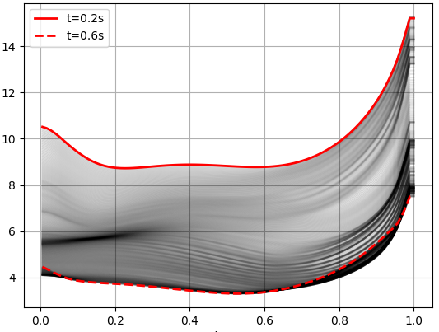
P187: Extend the negative magnetic shear region in early-heating scenarios on AUG
First simulations in ASTRA explore the effect of early off-axis ECRH on the q-profile evolution
Possible summary figures
Proponents and contact person:
  Lea.Hollendonner@ipp.mpg.de
  Alexander.Bock@ipp.mpg.de
Scientific Background & Objectives
  Study the relation between ITBs and magnetic shear
  Extended regions of negative shear can be achieved with early off-axis heating (limitation: X-point formation)
Experimental Strategy
  Early X-point formation for early heating onset
  Off-axis heating by ECRH to reduce current diffusion into the core
  On-axis counter-ECCD to actively remove current from the core (and prevent tungsten accumulation)
Diagnostics and Machine Technical requirements
  IMSE
  co-/counter-ECCD, NBI
heating onset
q
ρ_{tor}
start flattop
Proposed pulses
Device | # Pulses/Session | # Development
AUG | 0 | 18
MAST-U
TCV
WEST

Slide 25
P187: Extend the negative magnetic shear region in early-heating scenarios on AUG
First simulations in ASTRA explore the effect of early off-axis ECRH on the q-profile evolution
Possible summary figures
Proponents and contact person:
  Lea.Hollendonner@ipp.mpg.de
  Alexander.Bock@ipp.mpg.de
Scientific Background & Objectives
  Study the relation between ITBs and magnetic shear
  Extended regions of negative shear can be achieved with early off-axis heating (limitation: X-point formation)
Experimental Strategy
  Early X-point formation for early heating onset
  Off-axis heating by ECRH to reduce current diffusion into the core
  On-axis counter-ECCD to actively remove current from the core (and prevent tungsten accumulation)
Diagnostics and Machine Technical requirements
  IMSE
  co-/counter-ECCD, NBI
Priority: P2_AUG. Technically difficult. Current hole inherently difficult to control
heating onset
q
ρ_{tor}
start flattop
Proposed pulses
Device | # Pulses/Session | # Development
AUG | 0 | 18
MAST-U
TCV
WEST

Slide 26
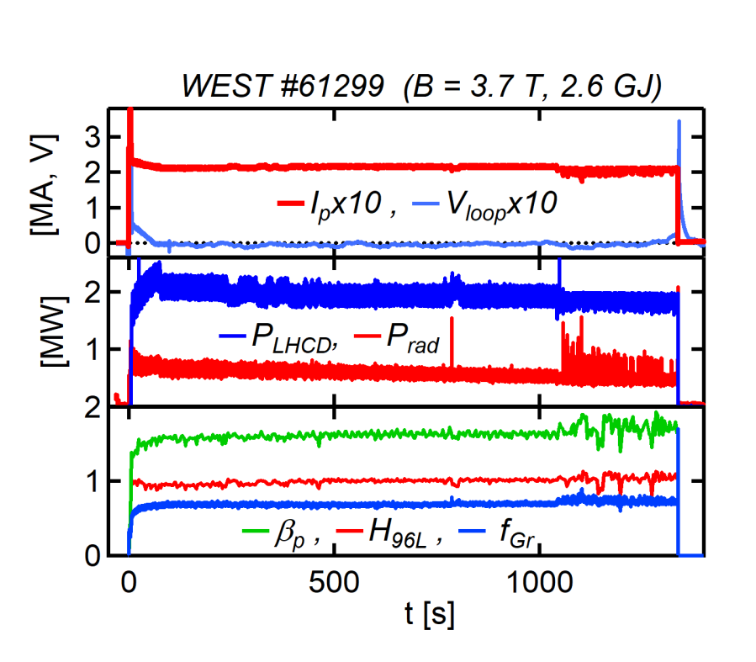
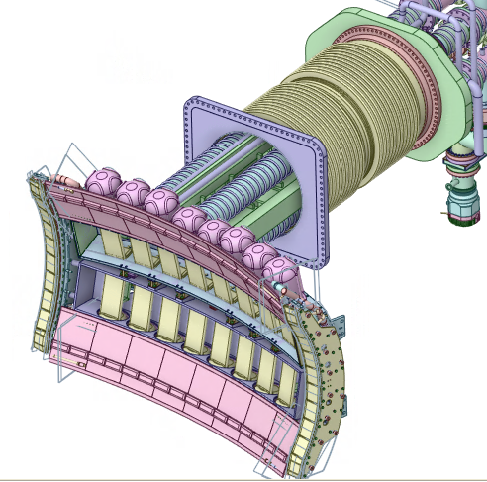
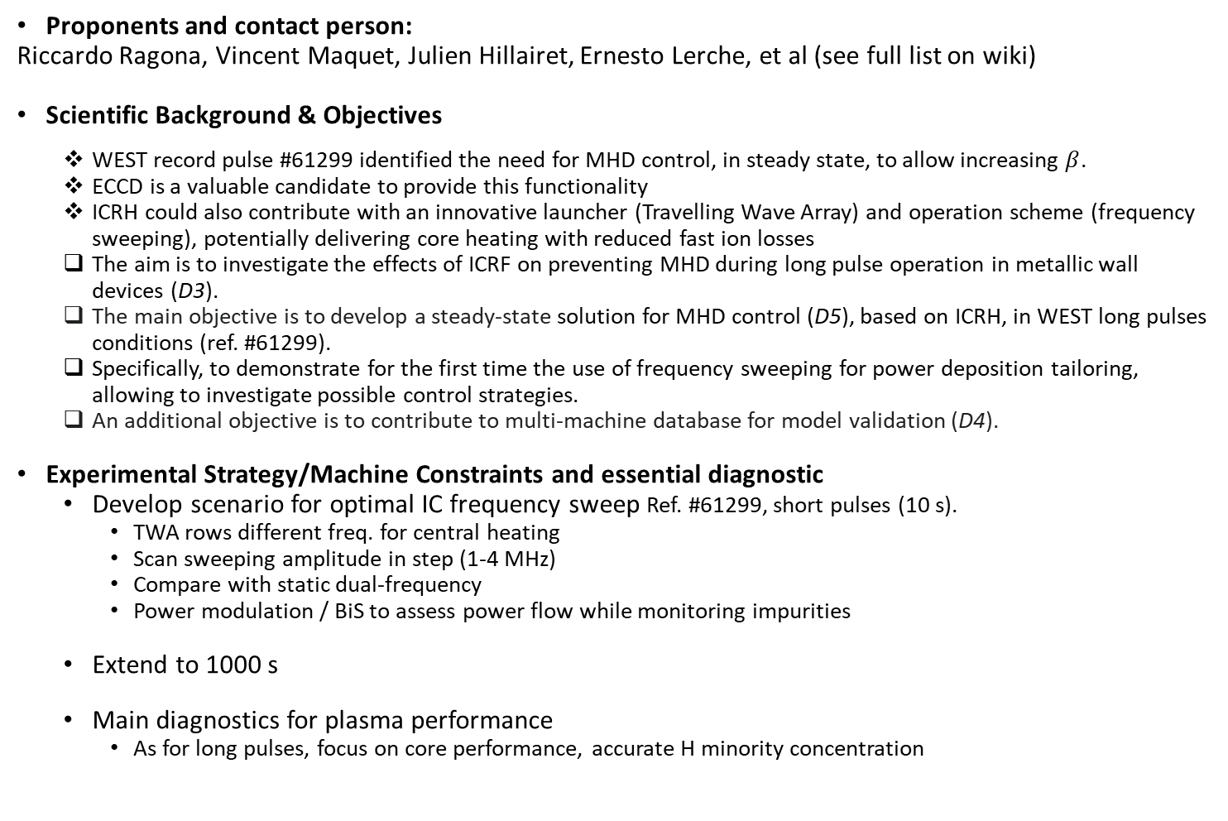
P188: TWA dual-frequency sweep for long pulse operation in WEST
Proponents and contact person:
Riccardo Ragona, Vincent Maquet, Julien Hillairet, Ernesto Lerche, et al (see full list on wiki)
Scientific Background & Objectives
  WEST record pulse #61299 identified the need for MHD control, in steady state, to allow increasing $β$.
  ECCD is a valuable candidate to provide this functionality
  ICRH could also contribute with an innovative launcher (Travelling Wave Array) and operation scheme (frequency sweeping), potentially delivering core heating with reduced fast ion losses
  The aim is to investigate the effects of ICRF on preventing MHD during long pulse operation in metallic wall devices (D3).
  The main objective is to develop a steady-state solution for MHD control (D5), based on ICRH, in WEST long pulses conditions (ref. #61299).
  Specifically, to demonstrate for the first time the use of frequency sweeping for power deposition tailoring, allowing to investigate possible control strategies.
  An additional objective is to contribute to multi-machine database for model validation (D4).
Experimental Strategy/Machine Constraints and essential diagnostic
  Develop scenario for optimal IC frequency sweep Ref. #61299, short pulses (10 s).
    TWA rows different freq. for central heating
    Scan sweeping amplitude in step (1-4 MHz)
    Compare with static dual-frequency
    Power modulation / BiS to assess power flow while monitoring impurities
  Extend to 1000 s
  Main diagnostics for plasma performance
    As for long pulses, focus on core performance, accurate H minority concentration
Possible summary figures
Proposed pulses
Device | # Pulses/Session | # Development
AUG
WEST | 1.5 session (2027) + 2/3 long discharges

Slide 27
P188: TWA dual-frequency sweep for long pulse operation in WEST
Proponents and contact person:
Riccardo Ragona, Vincent Maquet, Julien Hillairet, Ernesto Lerche, et al (see full list on wiki)
Scientific Background & Objectives
  WEST record pulse #61299 identified the need for MHD control, in steady state, to allow increasing $β$.
  ECCD is a valuable candidate to provide this functionality
  ICRH could also contribute with an innovative launcher (Travelling Wave Array) and operation scheme (frequency sweeping), potentially delivering core heating with reduced fast ion losses
  The aim is to investigate the effects of ICRF on preventing MHD during long pulse operation in metallic wall devices (D3).
  The main objective is to develop a steady-state solution for MHD control (D5), based on ICRH, in WEST long pulses conditions (ref. #61299).
  Specifically, to demonstrate for the first time the use of frequency sweeping for power deposition tailoring, allowing to investigate possible control strategies.
  An additional objective is to contribute to multi-machine database for model validation (D4).
Experimental Strategy/Machine Constraints and essential diagnostic
  Develop scenario for optimal IC frequency sweep Ref. #61299, short pulses (10 s).
    TWA rows different freq. for central heating
    Scan sweeping amplitude in step (1-4 MHz)
    Compare with static dual-frequency
    Power modulation / BiS to assess power flow while monitoring impurities
  Extend to 1000 s
  Main diagnostics for plasma performance
    As for long pulses, focus on core performance, accurate H minority concentration
Possible summary figures
Priority: P2_WEST. WEST specific
Proposed pulses
Device | # Pulses/Session | # Development
AUG
WEST | 1.5 session (2027) + 2/3 long discharges

Slide 28
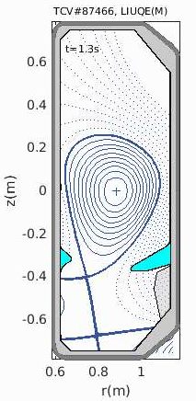
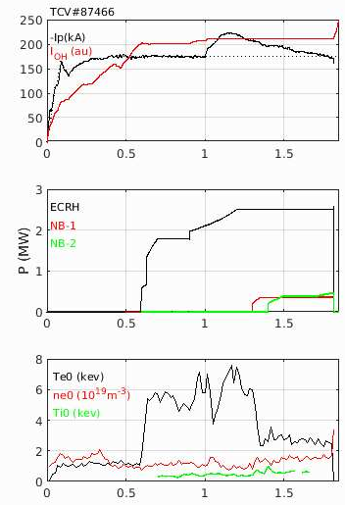
189: Development and optimization of high-bootstrap, high-beta tokamak scenarios towards steady state
Proponents and contact person:
S. Coda, C. Piron, I. Voitsekhovitch
Scientific Background & Objectives
This proposal extends the work done at TCV within WPTE RT08 in 2024/25 [WPTE-RT08 Review Meeting]
Identify maximum achievable betaN in fully non-inductive mode and in stationary conditions with the additional ECRH power that will be available.
Explore parameter space to determine whether, for equal betaN, steeper gradients can be achieved to increase bootstrap current fraction.
Achieve CS-free operation from the RU to the end of FT with the maximum possible plasma current and maximum possible betaN, enabling the NBI operation with the minimised fast-ion losses.
Demonstrate CS-free exhaust-compatible operation in the X-point Target Radiator configuration, and document core transport and confinement relative to the previously standard LSN configuration.
Validate transport models in reversed/low-shear plasmas and identify the dominant micro-instabilities controlling the anomalous transport in such configurations.
Fully document roles of fast electrons and fast ions in long-pulse scenarios developed, as well as scrape-off layer characteristics (width, fluctuations, etc).
Experimental Strategy/Machine Constraints and essential diagnostic
Optimize shape and ECCD deposition to reach Ip>130kA in CS-free RU scenario in LSN. Develop a similar CS-free RU scenario in XPTR.
Fine-tune the heating recipe in the 2025 CS-free FT scenario in XPTR to avoid MHD. Verify if detachment can accessed in this scenario.
Exploit the additional P_{EC}=0.95MW from G12 for scenario development and MHD control
NINO/SILO configuration, P_{EC}=2.6(+0.95)MW + P_{NB-[1,2]}=2.6MW
Essential diagnostics: TS, MAG, CXRS, cECE, TPCI, FIDA, SPR, THB, LPs, IR, MSE
t(s)
Proposed pulses
Device | # Pulses/Session | # Development
AUG
MAST-U
TCV | 80 | 80
WEST

Slide 29
189: Development and optimization of high-bootstrap, high-beta tokamak scenarios towards steady state
Proponents and contact person:
S. Coda, C. Piron, I. Voitsekhovitch
Scientific Background & Objectives
This proposal extends the work done at TCV within WPTE RT08 in 2024/25 [WPTE-RT08 Review Meeting]
Identify maximum achievable betaN in fully non-inductive mode and in stationary conditions with the additional ECRH power that will be available.
Explore parameter space to determine whether, for equal betaN, steeper gradients can be achieved to increase bootstrap current fraction.
Achieve CS-free operation from the RU to the end of FT with the maximum possible plasma current and maximum possible betaN, enabling the NBI operation with the minimised fast-ion losses.
Demonstrate CS-free exhaust-compatible operation in the X-point Target Radiator configuration, and document core transport and confinement relative to the previously standard LSN configuration.
Validate transport models in reversed/low-shear plasmas and identify the dominant micro-instabilities controlling the anomalous transport in such configurations.
Fully document roles of fast electrons and fast ions in long-pulse scenarios developed, as well as scrape-off layer characteristics (width, fluctuations, etc).
Experimental Strategy/Machine Constraints and essential diagnostic
Optimize shape and ECCD deposition to reach Ip>130kA in CS-free RU scenario in LSN. Develop a similar CS-free RU scenario in XPTR.
Fine-tune the heating recipe in the 2025 CS-free FT scenario in XPTR to avoid MHD. Verify if detachment can accessed in this scenario.
Exploit the additional P_{EC}=0.95MW from G12 for scenario development and MHD control
NINO/SILO configuration, P_{EC}=2.6(+0.95)MW + P_{NB-[1,2]}=2.6MW
Essential diagnostics: TS, MAG, CXRS, cECE, TPCI, FIDA, SPR, THB, LPs, IR, MSE
Priority: P1-TCV, main work horse for TCV non inductive scenario
t(s)
Proposed pulses
Device | # Pulses/Session | # Development
AUG
MAST-U
TCV | 80 | 80
WEST

Slide 30
P190: Study of MHD activities with machine learning in high beta scenarios.
Proposed pulses
Device | # Pulses/Session | # Development
AUG | 0 | 0
MAST-U
TCV | 0 | 0
WEST
Proponents and contact person:
Luca Bonalumi (luca.bonalumi@istp.cnr.it)
Edoardo Alessi
Carlo Sozzi
Edmondo Giovannozzi
Scientific Background & Objectives
Neural networks shown potential in predicting tearing mode triggering probability (tearability) starting from snapshot representing the plasma state
Interpreting network's behavior can provide physical insight, revealing key parameters that precede the instability and are hidden by the black-box nature of neural networks
Aim of the present proposal is to:
Compare the network behavior across different devices to highlight possible physical differences in the triggering mechanisms of NTMs.
Assess how far the interpretation of tearability can be generalized to other machines (JT-60SA), offering insights for high-β studies
Experimental Strategy/Machine Constraints and essential diagnostic
  Development of the network for tearability
  Train two separate NNs for high beta scenarios in TCV and in AUG
  Evaluate the reliability of the NNs
  Interpret the behavior of the NNs (XAI, eXplainable Artificial Intelligence; L. Bonalumi et al. Front.Phys. 12 2024)
  Extrapolate results for JT-60SA high beta scenario

Slide 31
P190: Study of MHD activities with machine learning in high beta scenarios.
Proposed pulses
Device | # Pulses/Session | # Development
AUG | 0 | 0
MAST-U
TCV | 0 | 0
WEST
Proponents and contact person:
Luca Bonalumi (luca.bonalumi@istp.cnr.it)
Edoardo Alessi
Carlo Sozzi
Edmondo Giovannozzi
Scientific Background & Objectives
Neural networks shown potential in predicting tearing mode triggering probability (tearability) starting from snapshot representing the plasma state
Interpreting network's behavior can provide physical insight, revealing key parameters that precede the instability and are hidden by the black-box nature of neural networks
Aim of the present proposal is to:
Compare the network behavior across different devices to highlight possible physical differences in the triggering mechanisms of NTMs.
Assess how far the interpretation of tearability can be generalized to other machines (JT-60SA), offering insights for high-β studies
Experimental Strategy/Machine Constraints and essential diagnostic
  Development of the network for tearability
  Train two separate NNs for high beta scenarios in TCV and in AUG
  Evaluate the reliability of the NNs
  Interpret the behavior of the NNs (XAI, eXplainable Artificial Intelligence; L. Bonalumi et al. Front.Phys. 12 2024)
  Extrapolate results for JT-60SA high beta scenario
Priority: Parasitic

Slide 32
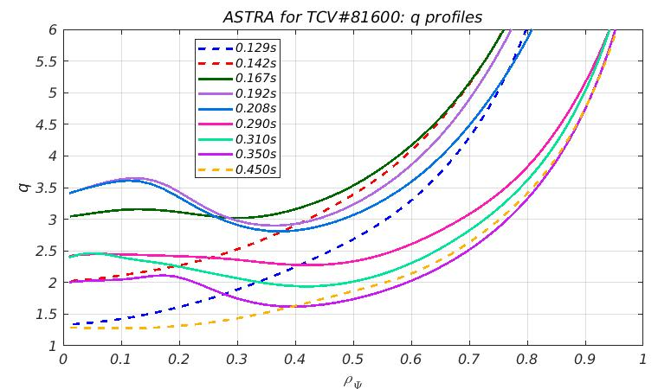
P203: Density versus Temperature ITBs in TCV
Proponents and contact person:
Sergei.Sharapov@ukaea.uk
Scientific Background & Objectives
  During previous RT09 experiments on TCV on “Physics understanding of energetics particles confinement and their interplay with thermal plasma” a number of transient ITBs was observed. Some of these ITBs were in plasma density, but not in temperature (similar to, e.g. C-MOD), and other – in temperature, but not in density (like on JET). Technically, the switch on TCV was simple. However, we still don’t understand how this switch works as not all diagnostics were available and more data is needed.
Experimental Strategy/Machine Constraints and essential diagnostic
  Type of plasma scenario or parameter explored to answer the main questions: Reference pulse #81511
  Scan in vertical position of plasma with dominant NBI heating
  Thomson scattering, CXRS, MSE, and NPA are essential diagnostic
Evolution of q-profile in these reversed-shear TCV plasmas
Proposed pulses
Device | # Pulses/Session | # Development
AUG
MAST-U
TCV | 20/2 | 10/1
WEST

Slide 33
P203: Density versus Temperature ITBs in TCV
Proponents and contact person:
Sergei.Sharapov@ukaea.uk
Scientific Background & Objectives
  During previous RT09 experiments on TCV on “Physics understanding of energetics particles confinement and their interplay with thermal plasma” a number of transient ITBs was observed. Some of these ITBs were in plasma density, but not in temperature (similar to, e.g. C-MOD), and other – in temperature, but not in density (like on JET). Technically, the switch on TCV was simple. However, we still don’t understand how this switch works as not all diagnostics were available and more data is needed.
Experimental Strategy/Machine Constraints and essential diagnostic
  Type of plasma scenario or parameter explored to answer the main questions: Reference pulse #81511
  Scan in vertical position of plasma with dominant NBI heating
  Thomson scattering, CXRS, MSE, and NPA are essential diagnostic
Evolution of q-profile in these reversed-shear TCV plasmas
Priority: P1-TCV, Possibly merged with 190
Proposed pulses
Device | # Pulses/Session | # Development
AUG
MAST-U
TCV | 20/2 | 10/1
WEST

