Slide 1
RT-06 “Preparation of efficient Plasma Facing Components (PFC) operation for ITER, DEMO and HELIAS”
05^{th uof} November 2025
Discussion on proposals and allocated priorities
E. Tsitrone
On behalf of WPTE TFLs
E. Tsitrone, N. Vianello, M. Baruzzo, V. Igochine, D. Keeling, A. Hakola, B. Labit
Research Topic Coordinators
Y. Corre, A. Kirschner, K. Krieger. Many thanks to A. Widdowson !
Reference TFL
E. Tsitrone, A. Hakola

Slide 2
Introduction
RT-06 is part of mission 2 on plasma exhaust, with a focus on the plasma facing components and PWI
RT-06 is focussed on metallic devices (AUG, JET and WEST) for preparing next step fusion devices

Slide 3
Scientific Objectives of RT-06 : focus on ITER new baseline (W first wall + boronisation)
Scientific Objectives
D1 | Quantify local power load distributions on castellated and shaped PFCs for ITER and DEMO, including melting events
D2 | Assess the impact of sustained high power / high particle fluence plasma exposure on the thermo-mechanical properties of metallic PFCs as well as on plasma operation
D3 | Quantify material erosion sources from metallic walls under ITER relevant plasma conditions and determine material migration pathways, in particular to assess W sources from the first wall and the net erosion rates.
D4 | Quantify fuel retention in devices with metallic walls, with a focus on long pulse operation, including the impact of boronisations and using laser-based diagnostics where available
D5 | Assess fuel-removal efficiency in metallic devices, including the impact of boronisations and propose fuel removal procedures for next step metallic devices
D7 | Assess the efficiency and lifetime of wall conditioning methods in metallic devices, with a focus on boronisation
2024 : D3 and D6 on material migation merged into D3 (D6 suppressed to avoid confusion)
Dedicated objective D7 added to address boronization related issues in 2024
2025 : further minor amendments

Slide 4
Scientific objectives of RT06 cover 3 R&D areas
Scientific Objectives
D1 | Quantify local power load distributions on castellated and shaped PFCs for ITER and DEMO, including melting events
D2 | Assess the impact of sustained high power / high particle fluence plasma exposure on the thermo-mechanical properties of metallic PFCs as well as on plasma operation
D3 | Quantify material erosion sources from metallic walls under ITER relevant plasma conditions and determine material migration pathways, in particular to assess W sources from the first wall and the net erosion rates.
D4 | Quantify fuel retention in devices with metallic walls, with a focus on long pulse operation, including the impact of boronisations and using laser-based diagnostics where available
D5 | Assess fuel-removal efficiency in metallic devices, including the impact of boronisations and propose fuel removal procedures for next step metallic devices
D7 | Assess the efficiency and lifetime of wall conditioning methods in metallic devices, with a focus on boronisation
PFC evolution / damage under plasma exposure
(Focus : impact of RE on first wall)
Material migration
(Focus : W first wall source)
Fuel retention / recovery and vessel conditioning (Focus : complete boronisation related work, GD for Dec 2026)
ID | Deliverables Table | Date
TE.D.18 | Report on providing input on design and operation of conditioning systems for next step full W devices and focus on standard boronization systems | Dec 2026

Slide 5
Proposal received : significant overbooking on AUG/WEST
Tentative allocation of discharges*
 | AUG |  | TCV |  | MAST-U | WEST
 | 2026 | 2027 | 2026 | 2027 | 2026 | 2026 | 2027
Tentative allocation* | 24 | 32 |  |  |  | 150 | 90
Total proposed | 99 |  |  |  |  | 804
Overbooking | 1,8 |  |  |  |  | 3,3
* : to be reassessed after GPM
RT06 :
largest share of TE experimental time on WEST,
medium share of TE experimental time on AUG, as priority on upper divertor upgrade for Mission 2
RT06 specific features :
Requests for divertor / midplane manipulators of AUG : to be coordinated
Boronisation specific requests : boronisation set ups + regular reference pulses
Close link to WP PWIE for post exposure PFC analysis and modelling

Slide 6
Overview of proposals : 27 proposals received, 3 R&D areas well covered
No | Proposal title | Main proponents
114 | Multi-scale melt dynamics across PFC gaps | K. Krieger, S. Ratynskaia
115 | Thermomechanical resilience of tungsten heavy alloys at high temperatures | K. Krieger, R. Pitts, S. Ratynskaia
116 | W PFC damage induced by runaway electron incidence | S. Ratynskaia, K. Krieger, Y. Corre
134 | Exposure of pre-damaged INTERFACE components | A. Durif
135 | Exposure of pre-damaged divertor components (pred#2 & #3) | A. Durif
118 | Study of accelerated material damage under a high fluence of helium in WEST | C.Guillemaut
136 | Characterization of the heat load on castellated PFC: optical hot spot, toroidal gap and far SOL power width in WEST L-mode plasma | Y. Corre
121 | Calorimetry power balance and ripple effect modulation | J. Gerardin
131 | Low-Density ICRF + XPR Mitigation: Scenario development & Trade‑off Study | G. Urbanczyk
132 | Low-Density ICRF: Electron Heating & Impurity Transport Validation | G. Urbanczyk
119 | Comparing W production and core plasma contamination by 2x2 strap Ion Cyclotron Antenna and Travelling Wave Array | L. Colas, E. Lerche
130 | TWA poloidal phase scan for impurity minimization in WEST | V. Maquet
133 | LH Power Loss Characterization at high coupling with TWA | V. Maquet
138 | Studying Ti/Te ratio and Ti decay length | J. Kovačič
139 | W-migration in lower X-point height geometries in WEST accounting for 3D realistic walls and magnetic geometry for the validation of tokamak boundary simulations | D. Sales de Oliveira
120 | Effect of second harmonic ECH resonance on arcing risks inside the EC launcher | M. Schneider
117 | Validation of the modelling of boron powder injection and boron film deposition | S. Ratynskaia, K. Krieger
127 | Effect of spatially (non-)uniform boronization on plasma parameters, wall retention and B-rich layer properties | A. Gallo
128 | Minimum boronization (B2D6 quantity) to restart WEST operations after a vent | A. Gallo
129 | Boronization with and without glow discharge at various wall temperatures in WEST | A. Gallo
124 | Development of ICWC boronization for ITER | E. Lerche, J. Hillairet
140 | Preparation of B reference samples | T. Dittmar
125 | Particle balance in AUG as a measure of global D retention in pulses following fresh boronisation | D. Matveev
126 | Estimation of H/D retention in boronized fusion devices through D-to-H-to-D changeover experiments in WEST | J. Denis
122 | Study about the outgassing of the deposit layer | J. Gerardin
123 | Impact of ICWC on plasma operation | E. Lerche, J. Hillairet
137 | ICWC operation with TWA | R. Ragona
PFC evolution / damage under plasma exposure
(D1, D2)
Material migration
(D3)
Fuel retention / recovery and vessel conditioning
(D4, D5, D7)

Slide 7
Prioritization scheme and criteria
Proposal Evaluated according to the criteria:
DEMO Physics
Adherence to the Scientific Objectives
Team effort
Size and feasibility
RT Scientific Objectives
All these aspects were considered by the TFLs when setting the priorities – according to the following scheme
  P1-2026-DEV: experimental priority for 2026: machine time granted but pulse budget might need reduction
  P1-2027-DEV: experimental priority for 2027: machine time granted but pulse budget might need reduction
  P2-DEV: will be done if time allows after *all* P1 proposals are completed
  P3: low priority programme/out of scope
  PB: piggy-back experiment/pure analysis proposal
ITER Research Plan

Slide 8
PFC evolution / damage under plasma exposure
(D1/D2)

Slide 9
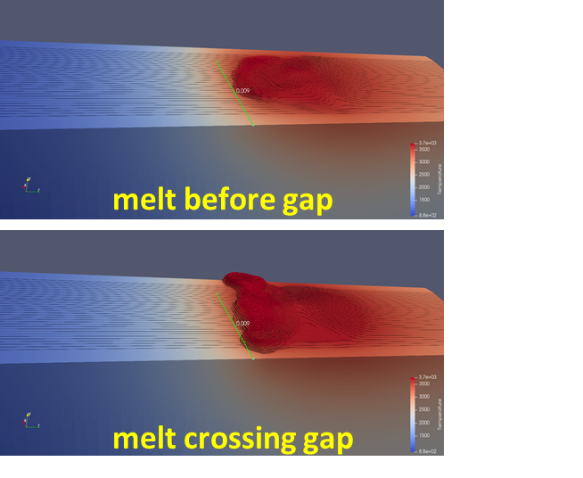
#114: Multi-scale melt dynamics across PFC gaps
Proponents and contact person:
K. Krieger karl.krieger@ipp.mpg.de, S. Ratynskaia,
P. Tolias, Y. Corre, R. A. Pitts
Scientific Background & Objectives
Gap infiltration (JET, sustained melt) vs pure gap bridging (AUG, transient melt).
The 2022 AUG gap melting exposure featured a W leading edge and led to transient melt pools.
New AUG gap melting exposure to realize ITER-relevant case of sustained melt crossing a PFC gap (that avoids transient step-by-step bridging) at shallow inclination.
Preparation
AUG exposures were proposed in WPTE and prioritized for 2024/2025 but postponed due to technical issues.
MEMENTO predictive modelling to optimize geometry, material composition and transient heat loads.
Two castellated W samples of varying gap width already manufactured following the MEMENTO design guidelines.
Experimental / Essential diagnostic
NBI+ECRH, ELMing H-mode, local sample instrumentation, IR/VIS observation cameras
Detailed ex-situ analysis of macroscopic surface deformation, melt bridge and gap amassment.
Modelling of large scale melt flows and final deformation profile with MEMENTO.
Dimensionless fluid analysis of infiltration vs bridging regimes.
Possible summary figures
W AUG
MEMENTO
2022 AUG gap melt experiment: S. Ratynskaia, K. Paschalidis, K. Krieger et al., Metallic melt transport across castellated tiles, Nucl. Fusion 64, 036012 (2024).
Predictive modelling
by MEMENTO
Device | # Pulses/Session | # Development
AUG | 10 | 1-2

Slide 10
#114: Multi-scale melt dynamics across PFC gaps
Proponents and contact person:
K. Krieger karl.krieger@ipp.mpg.de, S. Ratynskaia,
P. Tolias, Y. Corre, R. A. Pitts
Scientific Background & Objectives
Gap infiltration (JET, sustained melt) vs pure gap bridging (AUG, transient melt).
The 2022 AUG gap melting exposure featured a W leading edge and led to transient melt pools.
New AUG gap melting exposure to realize ITER-relevant case of sustained melt crossing a PFC gap (that avoids transient step-by-step bridging) at shallow inclination.
Preparation
AUG exposures were proposed in WPTE and prioritized for 2024/2025 but postponed due to technical issues.
MEMENTO predictive modelling to optimize geometry, material composition and transient heat loads.
Two castellated W samples of varying gap width already manufactured following the MEMENTO design guidelines.
Experimental / Essential diagnostic
NBI+ECRH, ELMing H-mode, local sample instrumentation, IR/VIS observation cameras
Detailed ex-situ analysis of macroscopic surface deformation, melt bridge and gap amassment.
Modelling of large scale melt flows and final deformation profile with MEMENTO.
Dimensionless fluid analysis of infiltration vs bridging regimes.
Possible summary figures
Priority: P1-AUG-26
Gap bridging under W melting : important topic for ITER
Re-submitted from 2025 (P1), was prepared but could not be executed
W AUG
MEMENTO
2022 AUG gap melt experiment: S. Ratynskaia, K. Paschalidis, K. Krieger et al., Metallic melt transport across castellated tiles, Nucl. Fusion 64, 036012 (2024).
Predictive modelling
by MEMENTO
Device | # Pulses/Session | # Development
AUG | 10 | 1-2

Slide 11
#115: Thermomechanical resilience of tungsten heavy alloys at high temperatures
Proponents and contact person
K. Krieger karl.krieger@ipp.mpg.de, R. A. Pitts, S. Ratynskaia,
R. Neu, P. Tolias
Scientific Background & Objectives
Due to their room temperature ductility, WHAs (W95NiCu, W97NiFe) are used as PFMs in current devices (AUG, W7-X) and considered as PFMs in future devices (ITER, SPARC).
Unlike pure metallic melts, the WHA response to very high transient heat fluxes might be characterized by droplet ejection and irregular flows due to the admixtures.
Provide experimental data for the WHA thermomechanical response to intense transient heat loads.
Model melt motion with the MEMENTO code which includes the effects of admixtures in the thermophysical properties up to the binder phase melting point.
Check whether any near-surface WHA cracking occurs in subsequent weak thermal excursions.
Experimental Strategy & Essential diagnostic
NBI+ECRH, ELMing H-mode, local sample instrumentation, IR/VIS observation cameras.
Predictive modelling with MEMENTO to fine tune scenario.
Detailed ex-situ analysis of surface deformation and near-surface composition.
Modelling of large scale melt flows and final deformation profile with MEMENTO.
High heat flux tests (e.g. GLADIS) to confirm resilience.
SEM (a,b), digital microscope (c) and FIB (d) investigation of the thermally overloaded part of a W97NiFe tile mounted in the divertor of AUG. Due to the accidental nature of the melting, there is no information on the incident heat flux and thus no evaluation of the maximum surface temperatures reached [R. Neu et al., J. Nucl. Mater. 511, 567 (2018)].
Device | # Pulses | # Development
AUG | 5 | Reference pulses to be identified from previous studies

Slide 12
#115: Thermomechanical resilience of tungsten heavy alloys at high temperatures
Proponents and contact person
K. Krieger karl.krieger@ipp.mpg.de, R. A. Pitts, S. Ratynskaia,
R. Neu, P. Tolias
Scientific Background & Objectives
Due to their room temperature ductility, WHAs (W95NiCu, W97NiFe) are used as PFMs in current devices (AUG, W7-X) and considered as PFMs in future devices (ITER, SPARC).
Unlike pure metallic melts, the WHA response to very high transient heat fluxes might be characterized by droplet ejection and irregular flows due to the admixtures.
Provide experimental data for the WHA thermomechanical response to intense transient heat loads.
Model melt motion with the MEMENTO code which includes the effects of admixtures in the thermophysical properties up to the binder phase melting point.
Check whether any near-surface WHA cracking occurs in subsequent weak thermal excursions.
Experimental Strategy & Essential diagnostic
NBI+ECRH, ELMing H-mode, local sample instrumentation, IR/VIS observation cameras.
Predictive modelling with MEMENTO to fine tune scenario.
Detailed ex-situ analysis of surface deformation and near-surface composition.
Modelling of large scale melt flows and final deformation profile with MEMENTO.
High heat flux tests (e.g. GLADIS) to confirm resilience.
Priority: P1-AUG-26
W alloys considered for ITER first wall
Re-submitted from 2025 (P1), was prepared but could not be executed
SEM (a,b), digital microscope (c) and FIB (d) investigation of the thermally overloaded part of a W97NiFe tile mounted in the divertor of AUG. Due to the accidental nature of the melting, there is no information on the incident heat flux and thus no evaluation of the maximum surface temperatures reached [R. Neu et al., J. Nucl. Mater. 511, 567 (2018)].
Device | # Pulses | # Development
AUG | 5 | Reference pulses to be identified from previous studies

Slide 13
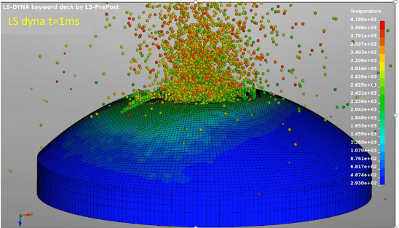
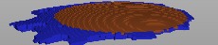
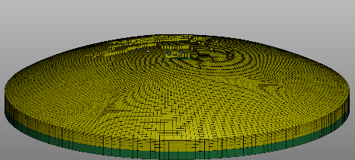
#116: W PFC damage induced by runaway electron incidence
Proponents and contact person
S. Ratynskaia srat@kth.se, P. Tolias, K. Krieger, Y. Corre, M. Hoppe,
C. Reux, B. Sieglin, R. A. Pitts, V. Dimitriou, E. Kaselouris, G. Papp, E. Nardon, M. Hoelzl, E. Gauthier, J. Gerardin, M. Diez
Scientific Background & Objectives
RE impact leads to PFC explosion accompanied by the expulsion of fast solid dust which leads to wall cratering.
RE-induced damage modelling has significantly advanced for graphite (benefitting from the multiple controlled DIII-D experiments) but lies at its infancy for tungsten.
Empirical data from controlled W experiments necessary to understand the underlying physics and to validate the ongoing thermomechanical modelling effort.
Experimental Strategy & Essential diagnostic
First WEST experiment partially successful (the RE beam scraped the instrumented tile). Repeat in WEST & AUG.
With lessons learnt from WEST & DIII-D experiments, expose smart W samples or tiles (TCs, shunt resistors).
Observe evolution of PFC damage and extract size / speed of solid debris by IR/VIS cameras.
Utilize witness plates to document impact cratering and compare with existing damage laws.
Extensive post-mortem analysis including residual radioactivity and transmutation profiles.
Validate GEANT4+LS-DYNA workflow with constrained RE input from DREAM+SOFT codes and - later - from JOREK code
Controlled damage of W tiles in WEST (April 2025). Feasibility of the exposures has been demonstrated, but REs barely deposited energy on the TC equipped W tile. Mounting of multiple instrumented tiles will decrease the demand for extreme RE beam control.
GEANT4+LS-DYNA modelling of RE-driven graphite explosions in DIII-D
DIII-D experiment
Geant4+LS-DYNA
failed volume
Geant4+LS-DYNA
explosion
Device | # Pulses | # Development
AUG | 10-12 | 2-4 with reference pulses to be identified from previous studies
WEST | 10 | Reference pulses to be identified from previous studies

Slide 14
#116: W PFC damage induced by runaway electron incidence
Proponents and contact person
S. Ratynskaia srat@kth.se, P. Tolias, K. Krieger, Y. Corre, M. Hoppe,
C. Reux, B. Sieglin, R. A. Pitts, V. Dimitriou, E. Kaselouris, G. Papp, E. Nardon, M. Hoelzl, E. Gauthier, J. Gerardin, M. Diez
Scientific Background & Objectives
RE impact leads to PFC explosion accompanied by the expulsion of fast solid dust which leads to wall cratering.
RE-induced damage modelling has significantly advanced for graphite (benefitting from the multiple controlled DIII-D experiments) but lies at its infancy for tungsten.
Empirical data from controlled W experiments necessary to understand the underlying physics and to validate the ongoing thermomechanical modelling effort.
Experimental Strategy & Essential diagnostic
First WEST experiment partially successful (the RE beam scraped the instrumented tile). Repeat in WEST & AUG.
With lessons learnt from WEST & DIII-D experiments, expose smart W samples or tiles (TCs, shunt resistors).
Observe evolution of PFC damage and extract size / speed of solid debris by IR/VIS cameras.
Utilize witness plates to document impact cratering and compare with existing damage laws.
Extensive post-mortem analysis including residual radioactivity and transmutation profiles.
Validate GEANT4+LS-DYNA workflow with constrained RE input from DREAM+SOFT codes and - later - from JOREK code
Controlled damage of W tiles in WEST (April 2025). Feasibility of the exposures has been demonstrated, but REs barely deposited energy on the TC equipped W tile. Mounting of multiple instrumented tiles will decrease the demand for extreme RE beam control.
Priority: P1-AUG-26 and P1-WEST-26
High priority for ITER first wall, first successful attempt in WEST in 2025
Technical feasibility still to be confirmed (MEM for AUG, multiple TC for WEST).
To be linked to PWIE for post mortem
GEANT4+LS-DYNA modelling of RE-driven graphite explosions in DIII-D
DIII-D experiment
Geant4+LS-DYNA
failed volume
Geant4+LS-DYNA
explosion
Device | # Pulses | # Development
AUG | 10-12 | 2-4 with reference pulses to be identified from previous studies
WEST | 10 | Reference pulses to be identified from previous studies

Slide 15
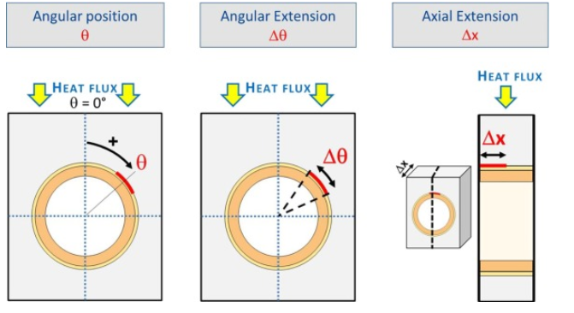
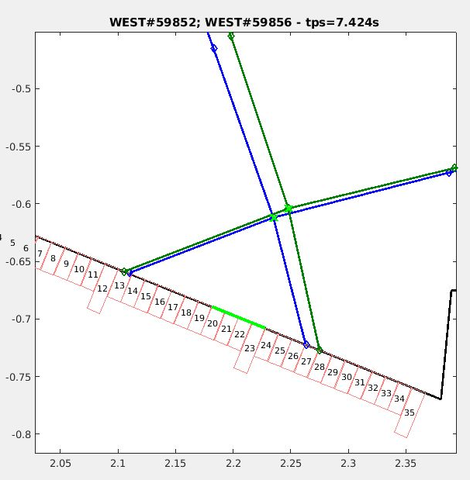
#134: Exposure of pre-damaged INTERFACE components – follow-up
Proponents and contact person:
A. Durif (alan.durif@cea,fr), M. Richou, Y. Corre, J. Gaspar, M. Missirlian, T. Wauters
Possible summary figures
Scientific Background & Objectives
Provide Structural Health Monitoring (SHM) keys for ITER/DEMO to monitor and follow in real time non expected hot spots related to internal PFU defects via IR diagnostics:
  Precise the defect acceptance criteria for PFCs (θ, Δθ, Δ𝑋)
  “in-situ” hotspots monitoring → Reactor maintenance scheme optimization → SHM
  Experiment links with WPTE / WPDIV and ITPA / IO
59852
dX=95mm
Experimental Strategy/Machine Constraints and essential diagnostic
Experiment achieved throughout dedicated sessions / plasma scenario baseline #59852/ Aim: positioned the strike line on MB13 at high injected power (>5 MW)
  Density scan in LSN plasma with LH heating (potentially EC if available to expose the PFU to H-mode plasma)
  Wide angle IR camera and spectrometer as essential diagnostic (PFU positioned in Q1B)
Proposed pulses
Device | # Pulses/ Session | # Development
WEST | 30/2 | Existing scenario

Slide 16
#134: Exposure of pre-damaged INTERFACE components – follow-up
Proponents and contact person:
A. Durif (alan.durif@cea,fr), M. Richou, Y. Corre, J. Gaspar, M. Missirlian, T. Wauters
Possible summary figures
Priority: P2-WEST
#135 has more priority. Limited heat flux available at ISP. More analysis needed to prepare experiment (modelling of surface temperature for interface MB to check if defect detection possible)
Scientific Background & Objectives
Provide Structural Health Monitoring (SHM) keys for ITER/DEMO to monitor and follow in real time non expected hot spots related to internal PFU defects via IR diagnostics:
  Precise the defect acceptance criteria for PFCs (θ, Δθ, Δ𝑋)
  “in-situ” hotspots monitoring → Reactor maintenance scheme optimization → SHM
  Experiment links with WPTE / WPDIV and ITPA / IO
59852
dX=95mm
Experimental Strategy/Machine Constraints and essential diagnostic
Experiment achieved throughout dedicated sessions / plasma scenario baseline #59852/ Aim: positioned the strike line on MB13 at high injected power (>5 MW)
  Density scan in LSN plasma with LH heating (potentially EC if available to expose the PFU to H-mode plasma)
  Wide angle IR camera and spectrometer as essential diagnostic (PFU positioned in Q1B)
Proposed pulses
Device | # Pulses/ Session | # Development
WEST | 30/2 | Existing scenario

Slide 17
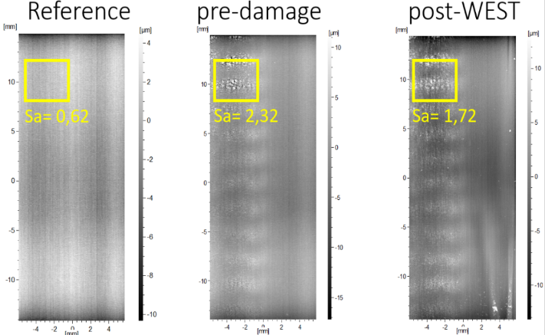
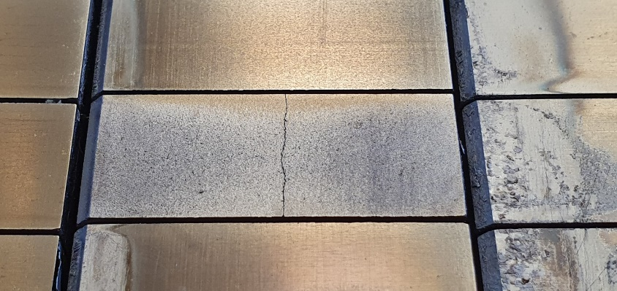
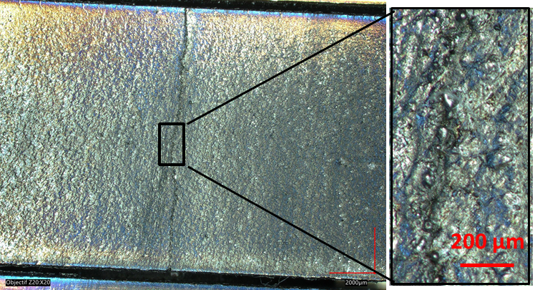
#135 : Exposure of pre-damaged ITER-like divertor component (pred#2 & #3) – follow-up
(Crack-network)
Proponents and contact person:
A. Durif (alan.durif@cea.fr), Y. Corre, M. Richou, J. Gaspar, T. Wauters
Possible summary figures
Scientific Background & Objectives
Assumption: ITER divertor lifetime >10 years - need for divertor components testing in tokamak environment, including damaged components. Operation with actively cooled ITER-like PFU with crack network and self-castellation
Determine the impact of different kind of damages (crack network pred#2 MB25 and self-castellation pred#3 MB27) on power exhaust and plasma operation
Assess the W source and temperature on the leading edge of the self-castellation and assess how the cracks propagates in W monoblock (MB)
Assess consequences for plasma operation: determine the potential short and long term limitations (reduction of the power exhaust and consequently overheating of the damaged block)
Characterize the surface texture evolution (confocal, X-ray tomography measurements) of pre-existing damages (comparative study)
Experimental Strategy/Machine Constraints and essential diagnostic
Pred#2 located on PFU 7 (sector Q3B) for visible spectroscopy measurement and pred#3 MB27 (sector Q3B) give the opportunity to expose continuously the cracks to radiation only and specific session positioning the strike point on MB27 will allow direct plasma/heat loading steady state interactions (plasma scenario baseline #59852).
Scan of the RF power: comparison W sources with OSP on MB26 (undamaged) and MB27 (self-castellated).
Self-castellation before C9 WEST campaign
Optical microscopy post C11 WEST campaign
Proposed pulses
∼80 µm width
Device | # Pulses/ Session | # Development
WEST | 30/2 | Existing scenario
MB27
[A. Durif et al., PFMC 2023]
MB28

Slide 18
#135 : Exposure of pre-damaged ITER-like divertor component (pred#2 & #3) – follow-up
(Crack-network)
Proponents and contact person:
A. Durif (alan.durif@cea.fr), Y. Corre, M. Richou, J. Gaspar, T. Wauters
Possible summary figures
Scientific Background & Objectives
Assumption: ITER divertor lifetime >10 years - need for divertor components testing in tokamak environment, including damaged components. Operation with actively cooled ITER-like PFU with crack network and self-castellation
Priority: P1-WEST-26
Focus : complete self castellation high heat flux exposure before non destructive analysis of crack evolution
Determine the impact of different kind of damages (crack network pred#2 MB25 and self-castellation pred#3 MB27) on power exhaust and plasma operation
Assess the W source and temperature on the leading edge of the self-castellation and assess how the cracks propagates in W monoblock (MB)
Assess consequences for plasma operation: determine the potential short and long term limitations (reduction of the power exhaust and consequently overheating of the damaged block)
Characterize the surface texture evolution (confocal, X-ray tomography measurements) of pre-existing damages (comparative study)
Experimental Strategy/Machine Constraints and essential diagnostic
Pred#2 located on PFU 7 (sector Q3B) for visible spectroscopy measurement and pred#3 MB27 (sector Q3B) give the opportunity to expose continuously the cracks to radiation only and specific session positioning the strike point on MB27 will allow direct plasma/heat loading steady state interactions (plasma scenario baseline #59852).
Scan of the RF power: comparison W sources with OSP on MB26 (undamaged) and MB27 (self-castellated).
Self-castellation before C9 WEST campaign
Optical microscopy post C11 WEST campaign
Proposed pulses
∼80 µm width
Device | # Pulses/ Session | # Development
WEST | 30/2 | Existing scenario
MB27
[A. Durif et al., PFMC 2023]
MB28

Slide 19
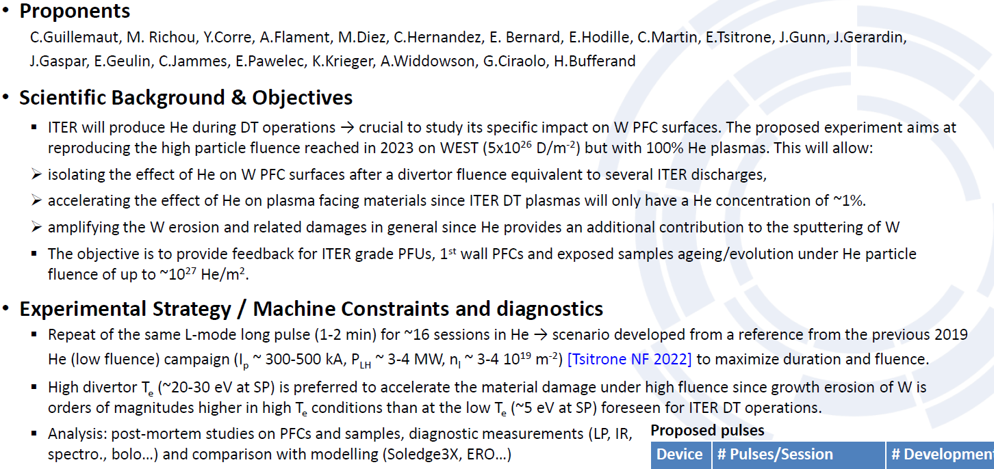
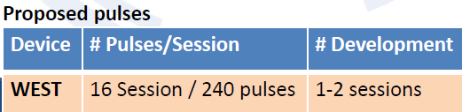
#118 : Accelerated material damage under a high fluence of helium in WEST

Slide 20
#118 : Accelerated material damage under a high fluence of helium in WEST
Priority: P2-WEST
Proposal to be refined : main interest would be change of thermo mechanical properties under He, which requires lower fluence than stated here. No high fluence foreseen in 26 if high fluence XPR run in 2025. Proposal for high fluence to be considered for 2027, but most interesting plasma conditions tbd, (presumably H mode in D if scenario available, rather than He)

Slide 21
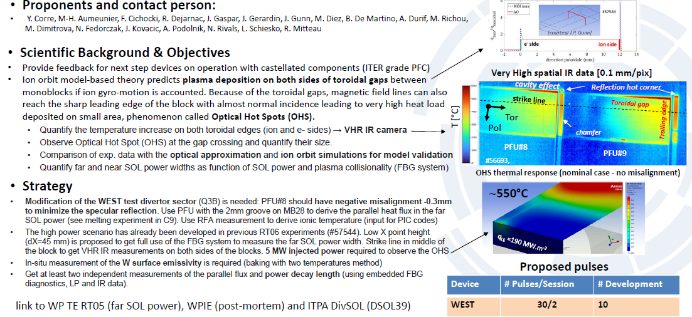
#136 : Characterisation of the heat load on castellated PFCs: optical hot spot, toroidal gap and far divertor SOL power width in L-mode plasmas (WEST)

Slide 22
#136 : Characterisation of the heat load on castellated PFCs: optical hot spot, toroidal gap and far divertor SOL power width in L-mode plasmas (WEST)
Priority: P1-WEST-27
Nice idea building on previous results to evidence OHS in operando, but requires PFU machining / dedicated Q3B divertor sector settings ➔2027

Slide 23
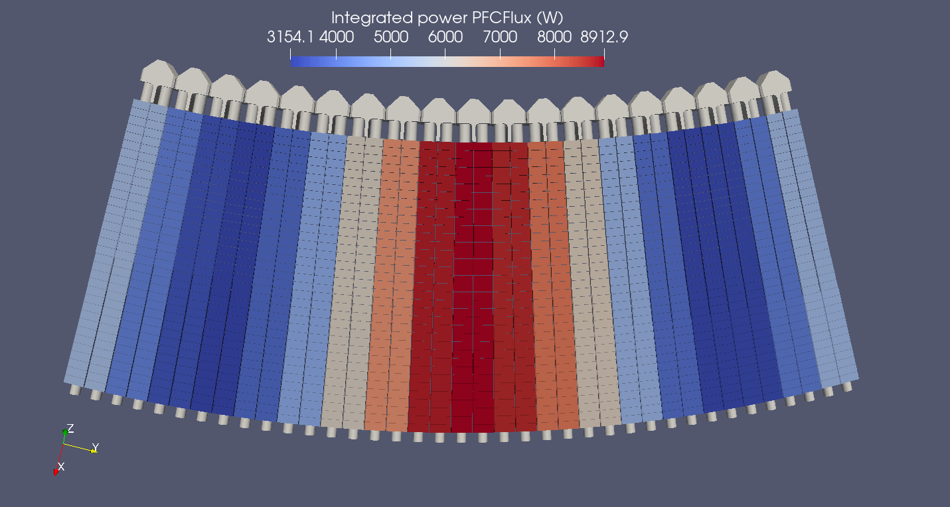
#121 : Calorimetry power balance and ripple effect modulation
Proponents and contact person:
Jonathan.gerardin@cea.fr
Yann.corre@cea.fr
Jonathan.gaspar@univ-amu.fr
Scientific Background & Objectives
  Almost all WEST PFCs are actively cooled and water temperature inside each group of PFCs is monitored, allowing calorimetry measurement for power balance.
  The strong water flow leads to small increase of water temperature and large uncertainties of measurement (e.g 25% of uncertainties on extracted power from the lower divertor). The power balance is not closed yet (only 85% of the injected power is retrieved, a part is missing due to uncertainties)
  The objective is to assess the power balance on WEST tokamak on a large set of reference scenarios, using a reduced water flow to increase the accuracy of the power balance.
  New probes allow to perform calorimetry on pair of lower divertor W-PFU. Ripple modulation can be measured by these probes and compared with modelling.
Experimental Strategy/Machine Constraints and essential diagnostic
  Redo several existing reference scenarios of WEST with reduced cooling water flow :
    High fluence, high fluence XPR, long pulse, high power, double null, upper single null
    Duration : 30s-45s
    At least 2MW of injected power, higher is better, depending on the scenario
  Perform a scan of IP of a reference scenario to modify the ripple modulation on the lower divertor :
    IP from 400kA to 600kA
    Duration : 30s-45s
    LH power : 4MW
  Essential diagnostic : calorimetry
Proposed pulses
Device | # Pulses/Session | # Development
WEST | 15 pulses | 0

Slide 24
#121 : Calorimetry power balance and ripple effect modulation
Proponents and contact person:
Jonathan.gerardin@cea.fr
Yann.corre@cea.fr
Jonathan.gaspar@univ-amu.fr
Scientific Background & Objectives
  Almost all WEST PFCs are actively cooled and water temperature inside each group of PFCs is monitored, allowing calorimetry measurement for power balance.
  The strong water flow leads to small increase of water temperature and large uncertainties of measurement (e.g 25% of uncertainties on extracted power from the lower divertor). The power balance is not closed yet (only 85% of the injected power is retrieved, a part is missing due to uncertainties)
  The objective is to assess the power balance on WEST tokamak on a large set of reference scenarios, using a reduced water flow to increase the accuracy of the power balance.
  New probes allow to perform calorimetry on pair of lower divertor W-PFU. Ripple modulation can be measured by these probes and compared with modelling.
Priority: P1-WEST-27
Interesting proposal benefitting from WEST extensive calorimetry system, but to be refined with more physics objectives (far SOL physics and wall loads) ➔ 2027.
Ripple modulation to the internal programme.
Max power with reduced flow rate to be checked.
Add comparison with previous AUG calorimetry analysis.
Experimental Strategy/Machine Constraints and essential diagnostic
  Redo several existing reference scenarios of WEST with reduced cooling water flow :
    High fluence, high fluence XPR, long pulse, high power, double null, upper single null
    Duration : 30s-45s
    At least 2MW of injected power, higher is better, depending on the scenario
  Perform a scan of IP of a reference scenario to modify the ripple modulation on the lower divertor :
    IP from 400kA to 600kA
    Duration : 30s-45s
    LH power : 4MW
  Essential diagnostic : calorimetry
Proposed pulses
Device | # Pulses/Session | # Development
WEST | 15 pulses | 0

Slide 25
Material migration
(D3)

Slide 26
# 131 : Low-Density ICRF + XPR Mitigation: Scenario development & Trade‑off Study
Proponents and contact person:
  Guillaume URBANCZYK (guillaume.urbanczyk@univ-lorraine.fr), Raymond Diab, Laurent Colas, Jamie Gunn
Scientific Background & Objectives
  Sheath Rectification Physics Across Lower-Hybrid Resonance.
    Quantify scaling of rectified potentials (Vₚ) and W sputtering as SOL density crosses S=0.
    Test hypothesis: weak rectification at low density reduces net limiter particle/heat flux despite high RF voltages
    Validate fixed-voltage operation (22-28 kV) to decouple Vₚ from coupling variations
  Coupling Optimization at Low Density.
    Determine minimum antenna-plasma gap (ROG) yielding ≥250-500 kW at ≤28 kV with stable VSWR
    Map coupling efficiency in propagative slow-wave regime (nₑ < n_{LH})
  XPR Compatibility with Low-Density ICRF.
    Demonstrate cold divertor operation (Tₑ,_{div} ≤3 eV) via N₂ seeding while maintaining low antenna-edge density
    Demonstrate kinetic electron effects regularize S=0 resonance
    Assess sensitivity to N₂ injection location (midplane vs. private zone) on W sources and core contamination
  Geometry optimization.
    Test triangularity (δ) scan at constant midplane gap to reduce antenna corner hot-spots
    Identify optimal δ balancing coupling efficiency and plasma-wall interaction mitigation
Experimental Strategy/Machine Constraints and essential diagnostic
  Phase I - Baseline Characterization (Pulses 1-3, Ant. Q2) → Establish Vₚ-nₑ trends crossing S=0 + Dynamic ROG scan (15→35 mm)
  Phase II - XPR Integration (Pulses 4-5, Antenna Q2) → Demonstrate XPR formation with N₂ midplane injection & modulations (1 Hz)
  Phase III - Shape Optimization (Pulses 6-7, Antenna Q2) → Triangularity scan: δ≈0.25 and δ≈0.55 at constant ROG + Compare corner heat loads via IR
  Phase IV - Validation & Sensitivity (Pulses 8-10, Antenna Q1) → Reproduce best-case scenario on Q1 for symmetry check + N₂ location sensitivity test
  Diagnostics: Emissive probe (Q3A or Q4B), RFA () (direct f(ε) measurements), visible spectro, Bolometry/interferometry, Reflectometry: S=0 layer tracking
Proposed pulses
Device | # Pulses/Session | # Dev
WEST | 10 / 1 | 5

Slide 27
# 131 : Low-Density ICRF + XPR Mitigation: Scenario development & Trade‑off Study
Proponents and contact person:
  Guillaume URBANCZYK (guillaume.urbanczyk@univ-lorraine.fr), Raymond Diab, Laurent Colas, Jamie Gunn
Scientific Background & Objectives
  Sheath Rectification Physics Across Lower-Hybrid Resonance.
    Quantify scaling of rectified potentials (Vₚ) and W sputtering as SOL density crosses S=0.
    Test hypothesis: weak rectification at low density reduces net limiter particle/heat flux despite high RF voltages
    Validate fixed-voltage operation (22-28 kV) to decouple Vₚ from coupling variations
  Coupling Optimization at Low Density.
    Determine minimum antenna-plasma gap (ROG) yielding ≥250-500 kW at ≤28 kV with stable VSWR
    Map coupling efficiency in propagative slow-wave regime (nₑ < n_{LH})
  XPR Compatibility with Low-Density ICRF.
    Demonstrate cold divertor operation (Tₑ,_{div} ≤3 eV) via N₂ seeding while maintaining low antenna-edge density
    Demonstrate kinetic electron effects regularize S=0 resonance
    Assess sensitivity to N₂ injection location (midplane vs. private zone) on W sources and core contamination
  Geometry optimization.
    Test triangularity (δ) scan at constant midplane gap to reduce antenna corner hot-spots
    Identify optimal δ balancing coupling efficiency and plasma-wall interaction mitigation
Experimental Strategy/Machine Constraints and essential diagnostic
  Phase I - Baseline Characterization (Pulses 1-3, Ant. Q2) → Establish Vₚ-nₑ trends crossing S=0 + Dynamic ROG scan (15→35 mm)
  Phase II - XPR Integration (Pulses 4-5, Antenna Q2) → Demonstrate XPR formation with N₂ midplane injection & modulations (1 Hz)
  Phase III - Shape Optimization (Pulses 6-7, Antenna Q2) → Triangularity scan: δ≈0.25 and δ≈0.55 at constant ROG + Compare corner heat loads via IR
  Phase IV - Validation & Sensitivity (Pulses 8-10, Antenna Q1) → Reproduce best-case scenario on Q1 for symmetry check + N₂ location sensitivity test
  Diagnostics: Emissive probe (Q3A or Q4B), RFA () (direct f(ε) measurements), visible spectro, Bolometry/interferometry, Reflectometry: S=0 layer tracking
Priority: P2-WEST
Requires challenging scenario development (low ne vs XPR, XPR with ICRH only …). Can it be done in AUG more easily ?
Proposed pulses
Device | # Pulses/Session | # Dev
WEST | 10 / 1 | 5

Slide 28
#132 : Low-Density ICRF: Electron Heating & Impurity Transport Validation
Proponents and contact person:
  Guillaume URBANCZYK (guillaume.urbanczyk@univ-lorraine.fr), Leonel Tsowemoo-faabomve, Raymond Diab, Laurent Colas, Jamie Gunn, Volodymyr BOBKOV, Roman OCHOUKOV, Ralph Dux, Wouter Tierens, Atul Kumar, Stéphane Heuraux, Jérôme Moritz
Scientific Background & Objectives
  Measure Electron Heating Mechanism at Low density
    Direct measurement of electron distribution functions f(ε) via RFA across τₑ/τ_{RF} ≈ 0.1-10
    Validate PIC predictions: ΔTₑ ~ 50-100 eV enhancement when nₑ ≈ n_{low} (resonant heating condition)
    Test frequency scaling: n_{low} ∝ ω² by scanning ICRF frequency (WEST: 55-57 MHz; AUG: 30-36.5 MHz)
  Confirm Enhanced Impurity Redeposition at Low Density
    Measure penetration factors η_{pen} = Φ_{core}/Γ_{gross} across density regimes (challenging for W in WEST but OK for Mo in AUG)
    Test λion < s criterion: when ionization occurs within expanded sheath, prompt redeposition dominates
    Expected transition: ηpen ~ 0.3-0.5 (high nₑ) → 0.05-0.15 (low nₑ) representing order-of-magnitude reduction in net erosion
  Lower-Hybrid Singularity Resolution
    Explain benign AUG observation: no deleterious effects when slow wave propagative (nₑ < n_{LH})
    Hypothesis: kinetic electron heating regularizes S=0 singularity via modified dielectric response
    Critical for ITER scenarios with local gas puffing near antennas
Experimental Strategy/Machine Constraints and essential diagnostic
  WEST (L-mode, LSN, 550-650 kA, 3.7 T, reference shots #61403-16)
    10 discharges systematically scanning density, ROG, ICRF power, triangularity
    RFA probe + W-I spectroscopy for electron heating & erosion measurements
    N₂ seeding for XPR to isolate antenna sources
  AUG (H-mode, LSN, 800 kA, 2.5 T, reference shot #37963)
    6 discharges with Mo-tracer tiles at antenna limiters
    Density ramp crossing nLH and nlow thresholds
    Matched high/low density comparisons with RF power scans
    Local gas injection test (ITER-relevant scenario)
  Diagnostics
    RFA: f(ε) measurements (multiple plunges/discharge)
    Visible spectroscopy: Gross erosion (W-I/Mo-I lines)
    UV spectroscopy: Core influx (W continuum in WEST / Mo³¹⁺-Mo³²⁺ in AUG)
    Langmuir/emissive probes: Local nₑ, Tₑ, Vp profiles
    Reflectometry: S=0 layer tracking
Proposed pulses
Device | # Pulses/Session | # Dev
AUG | 6 | 1
WEST | 10 / 1 | 5

Slide 29
#132 : Low-Density ICRF: Electron Heating & Impurity Transport Validation
Proponents and contact person:
  Guillaume URBANCZYK (guillaume.urbanczyk@univ-lorraine.fr), Leonel Tsowemoo-faabomve, Raymond Diab, Laurent Colas, Jamie Gunn, Volodymyr BOBKOV, Roman OCHOUKOV, Ralph Dux, Wouter Tierens, Atul Kumar, Stéphane Heuraux, Jérôme Moritz
Scientific Background & Objectives
  Measure Electron Heating Mechanism at Low density
    Direct measurement of electron distribution functions f(ε) via RFA across τₑ/τ_{RF} ≈ 0.1-10
    Validate PIC predictions: ΔTₑ ~ 50-100 eV enhancement when nₑ ≈ n_{low} (resonant heating condition)
    Test frequency scaling: n_{low} ∝ ω² by scanning ICRF frequency (WEST: 55-57 MHz; AUG: 30-36.5 MHz)
  Confirm Enhanced Impurity Redeposition at Low Density
    Measure penetration factors η_{pen} = Φ_{core}/Γ_{gross} across density regimes (challenging for W in WEST but OK for Mo in AUG)
    Test λion < s criterion: when ionization occurs within expanded sheath, prompt redeposition dominates
    Expected transition: ηpen ~ 0.3-0.5 (high nₑ) → 0.05-0.15 (low nₑ) representing order-of-magnitude reduction in net erosion
  Lower-Hybrid Singularity Resolution
    Explain benign AUG observation: no deleterious effects when slow wave propagative (nₑ < n_{LH})
    Hypothesis: kinetic electron heating regularizes S=0 singularity via modified dielectric response
    Critical for ITER scenarios with local gas puffing near antennas
Experimental Strategy/Machine Constraints and essential diagnostic
  WEST (L-mode, LSN, 550-650 kA, 3.7 T, reference shots #61403-16)
    10 discharges systematically scanning density, ROG, ICRF power, triangularity
    RFA probe + W-I spectroscopy for electron heating & erosion measurements
    N₂ seeding for XPR to isolate antenna sources
  AUG (H-mode, LSN, 800 kA, 2.5 T, reference shot #37963)
    6 discharges with Mo-tracer tiles at antenna limiters
    Density ramp crossing nLH and nlow thresholds
    Matched high/low density comparisons with RF power scans
    Local gas injection test (ITER-relevant scenario)
  Diagnostics
    RFA: f(ε) measurements (multiple plunges/discharge)
    Visible spectroscopy: Gross erosion (W-I/Mo-I lines)
    UV spectroscopy: Core influx (W continuum in WEST / Mo³¹⁺-Mo³²⁺ in AUG)
    Langmuir/emissive probes: Local nₑ, Tₑ, Vp profiles
    Reflectometry: S=0 layer tracking
Priority: P2-AUG, P2-WEST
Slow wave ICRH propagation could happen in ITER, higher priority than #131 but propose to focus on analysis of AUG experiments with Mo antenna tiles performed in 2025 before granting additional experimental time
Proposed pulses
Device | # Pulses/Session | # Dev
AUG | 6 | 1
WEST | 10 / 1 | 5

Slide 30
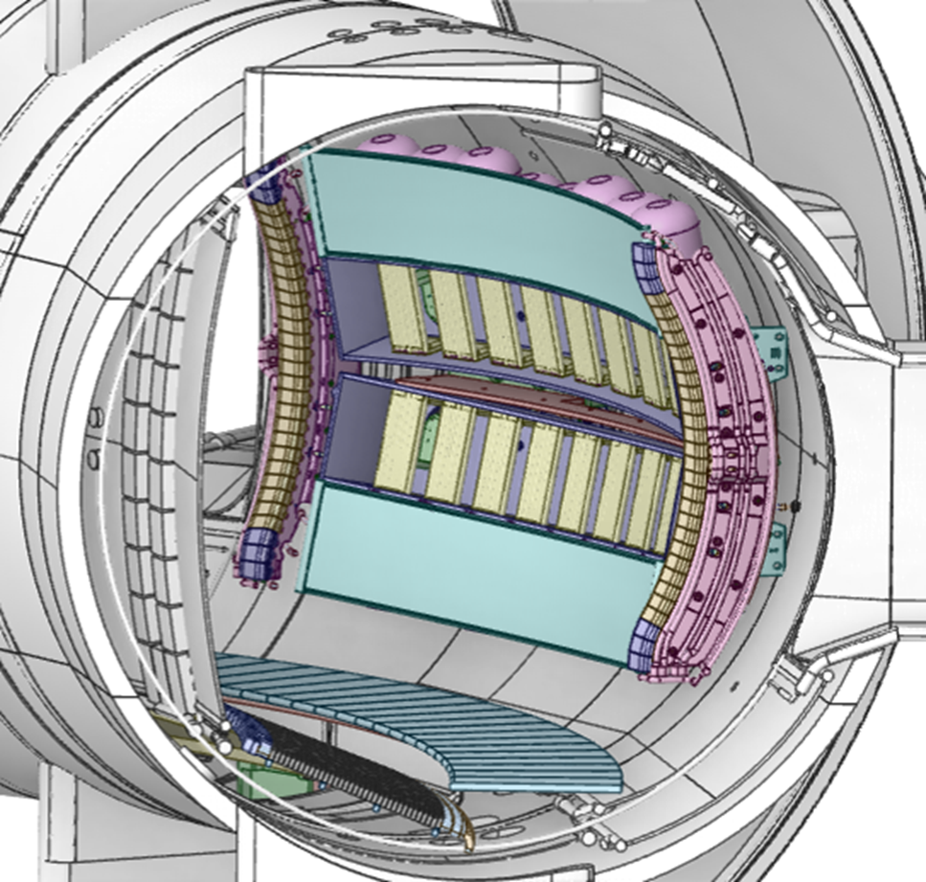
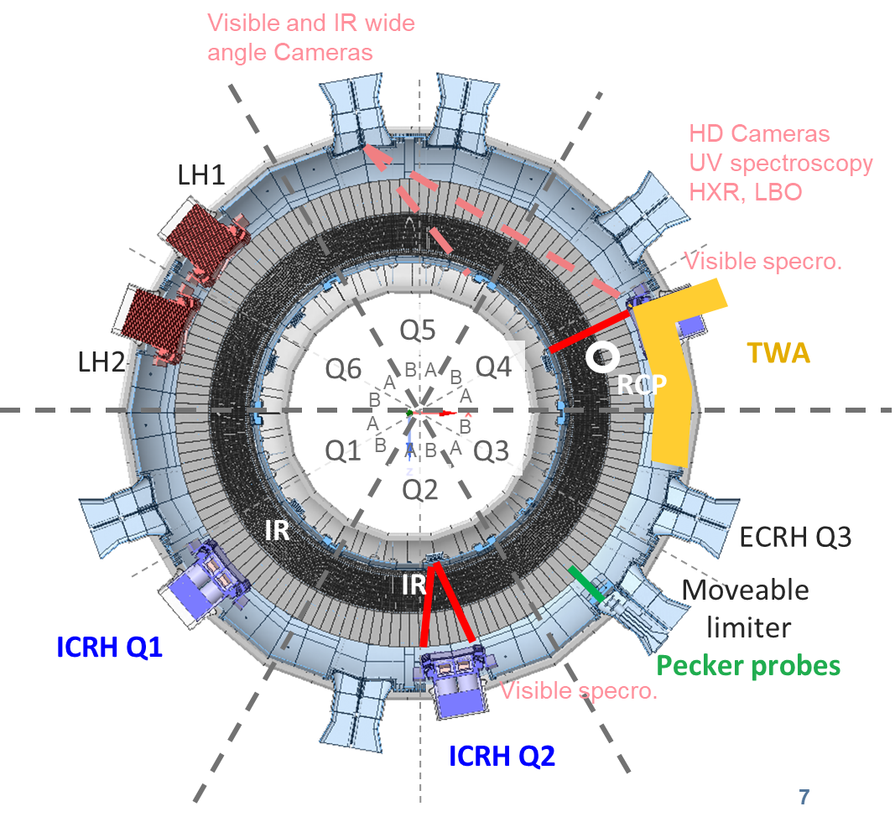
#119 : Comparing W production and core plasma contamination by 2×2 strap Ion Cyclotron Antenna and Travelling Wave Array
Part of ITPA IOS and DSOL
Proponents and contact person:
L. Colas, E.Lerche, J. Hillairet, R. Ragona, V. Maquet, R. Diab, G. Urbanczyk, W. Tierens.
Scientific Background & Objectives
  In present-day full-metal magnetic Fusion devices, most of the high-Z impurity influx contaminating the core plasma arises from the low-field side of the main chamber. Ion Cyclotron antennas are located there and enhance the wall erosion via RF sheath rectification.
  In next-step devices, it is important to find optimal strategies to operate these ICRF systems. This optimization often boils down to a trade-off between power coupling and W contamination.
  A Travelling Wave Array is attractive in this prospect.
    For the same coupled power and similar antenna position, the TWA is expected to excite lower rectified potentials compared to classic
    the TWA is supposed to excite efficiently the fast wave from radial positions far way from the separatrix, where the particle fluxes onto the antenna structures are low.
    Increasing the antenna / plasma gap also reduces the impurity penetration.
  Objectives:
    Direct comparison of impurity production and core plasma contamination by RF-sheath rectification from different antenna types on the same plasma, using visible spectroscopy, emissive probes and core plasma measurements.
    Determine a distance antenna / separatrix that offers the best trade-off between power coupling capabilities and plasma contamination. Figures of merit could be maximal P_{coupled}-P_{rad} or maximal W_{MHD}. Optimal setting may depend on the antenna type.
    Check for any detrimental plasma-wall interaction associated with LH resonance and/or propagative Slow Wave. No sign of such effect was so far detected with classical antennas.
    Validate RF-sheath modelling of classical and TWA IC wave launchers.
Exp. Strategy/Machine Constraints and diagnostics
  LSN L-mode plasma of interest for scenario development.
  Toggle TWA top, TWA bottom and classical 2×2-strap arrays (Q2 equipped with visible spectroscopy, Q1 connected to RCP) at same coupled power levels and side limiter radial position.
  Scan the plasma external radius on a pulse to pulse basis, hence the local density at the antennas, across the Lower Hybrid resonant layer, below which the Slow Wave becomes propagative.
Planned antenna & diag. setup for WEST in 2027
Proposed pulses
Device | # Pulses/Session | # Development
WEST | 1 Session (2027) | Scenario is ready

Slide 31
#119 : Comparing W production and core plasma contamination by 2×2 strap Ion Cyclotron Antenna and Travelling Wave Array
Part of ITPA IOS and DSOL
Proponents and contact person:
L. Colas, E.Lerche, J. Hillairet, R. Ragona, V. Maquet, R. Diab, G. Urbanczyk, W. Tierens.
Scientific Background & Objectives
  In present-day full-metal magnetic Fusion devices, most of the high-Z impurity influx contaminating the core plasma arises from the low-field side of the main chamber. Ion Cyclotron antennas are located there and enhance the wall erosion via RF sheath rectification.
  In next-step devices, it is important to find optimal strategies to operate these ICRF systems. This optimization often boils down to a trade-off between power coupling and W contamination.
  A Travelling Wave Array is attractive in this prospect.
    For the same coupled power and similar antenna position, the TWA is expected to excite lower rectified potentials compared to classic
    the TWA is supposed to excite efficiently the fast wave from radial positions far way from the separatrix, where the particle fluxes onto the antenna structures are low.
    Increasing the antenna / plasma gap also reduces the impurity penetration.
  Objectives:
    Direct comparison of impurity production and core plasma contamination by RF-sheath rectification from different antenna types on the same plasma, using visible spectroscopy, emissive probes and core plasma measurements.
    Determine a distance antenna / separatrix that offers the best trade-off between power coupling capabilities and plasma contamination. Figures of merit could be maximal P_{coupled}-P_{rad} or maximal W_{MHD}. Optimal setting may depend on the antenna type.
    Check for any detrimental plasma-wall interaction associated with LH resonance and/or propagative Slow Wave. No sign of such effect was so far detected with classical antennas.
    Validate RF-sheath modelling of classical and TWA IC wave launchers.
Exp. Strategy/Machine Constraints and diagnostics
  LSN L-mode plasma of interest for scenario development.
  Toggle TWA top, TWA bottom and classical 2×2-strap arrays (Q2 equipped with visible spectroscopy, Q1 connected to RCP) at same coupled power levels and side limiter radial position.
  Scan the plasma external radius on a pulse to pulse basis, hence the local density at the antennas, across the Lower Hybrid resonant layer, below which the Slow Wave becomes propagative.
Priority: P1-WEST-27
Leading proposal on W sources linked to ICRH. Requires TWA to be operational ➔ 2027.
Planned antenna & diag. setup for WEST in 2027
Proposed pulses
Device | # Pulses/Session | # Development
WEST | 1 Session (2027) | Scenario is ready

Slide 32
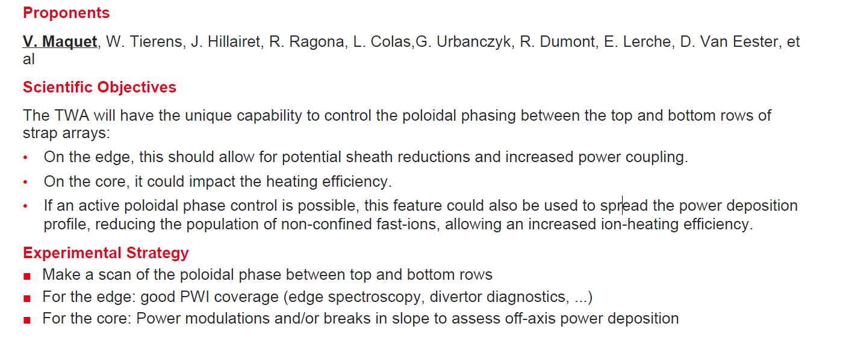
#130 : Travelling Wave Array poloidal phase scan for impurity minimization in WEST
Proposed pulses
Device | # Pulses/Session | # Development
WEST | 15 pulses /1 session

Slide 33
#130 : Travelling Wave Array poloidal phase scan for impurity minimization in WEST
Priority: to be merged with # 119
Proposed pulses
Device | # Pulses/Session | # Development
WEST | 15 pulses /1 session

Slide 34
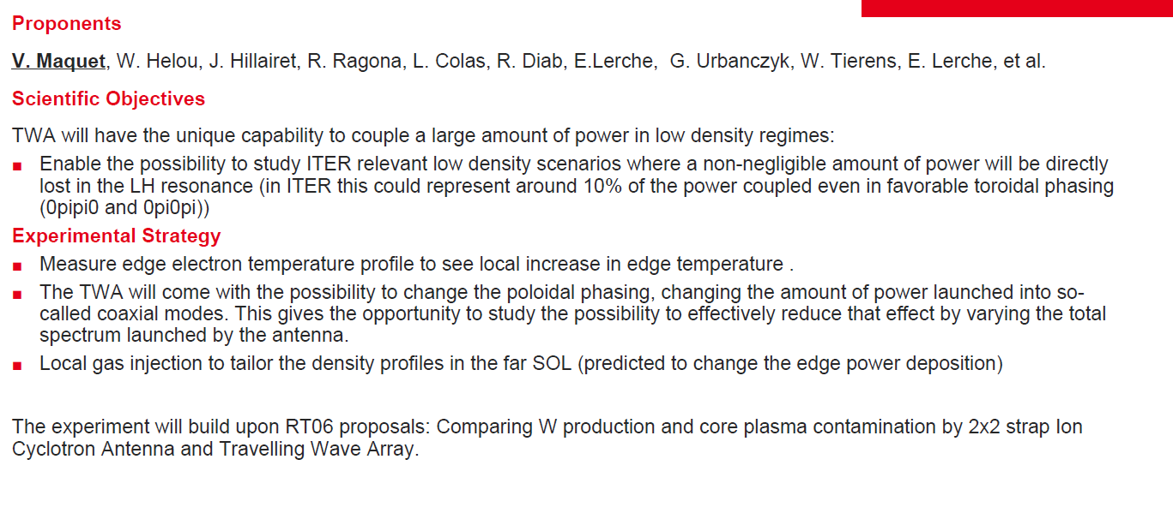
#133 : TWA LH Power Loss Characterization
Proposed pulses
Device | # Pulses/Session | # Development
WEST | 15 pulses /1 session

Slide 35
#133 : TWA LH Power Loss Characterization
Priority: P2-WEST
Less priority than #119 (W source focus)
Proposed pulses
Device | # Pulses/Session | # Development
WEST | 15 pulses /1 session

Slide 36
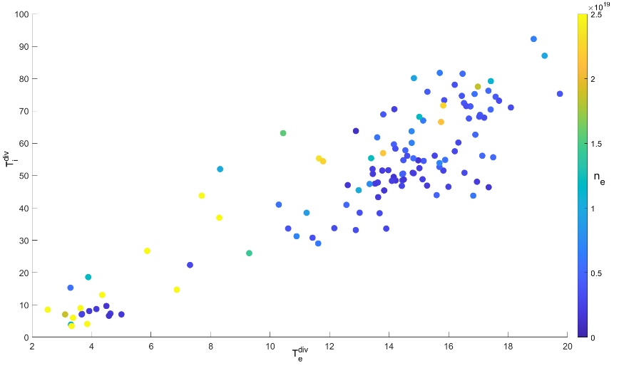
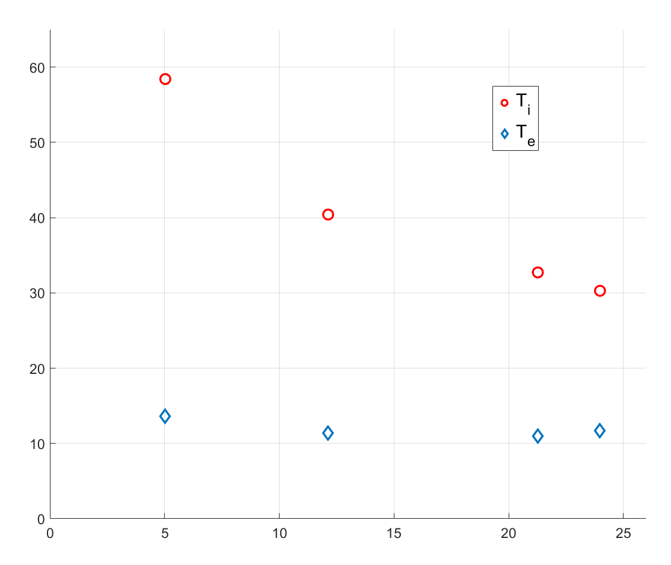
#138 : Studying Ti/Te ratio and Ti decay length
RT06: Preparation of efficient Plasma Facing Components (PFC) operation for ITER, DEMO and HELIAS
Proponents and contact person:
Jernej Kovačič (jernej.kovacic@fs.uni-lj.si), Miglena Dimitrova, Pavlina Ivanova, Bianca De Martino, Jamie Gunn, Tomaž Gyergyek
Scientific Background & Objectives
Divertor Ti crucial missing component in heat and erosion calculations
Obtain local divertor Ti and Te values and define Ti/Te ratio in ohmic and LH plasmas in WEST tokamak
Quantify Ti decay length for pure ohmic and LH heated plasma at various densities in WEST tokamak
Experimental Strategy/Machine Constraints and essential diagnostic
Density scan with LSN at fixed P_{ohm}/P_{LH}
RFA is fixed at MB#28/#29-> use fixed strike point with density ramp
Next shot move the strike point position to obtain radial profile of Ti/Te
4-5 radial points needed to define Ti decay length
Needed: RFA + LP + Pecker probes + IR
Fig.: T_{i}^{div}/ T_{e}^{div} (up) database with density colorbar;
Radial profile of T_{i}^{div} and T_{e}^{div} for attached WEST plasma (left)
Proposed pulses
Device | # Pulses/Session | # Development
AUG | - | -
MAST-U | - | -
WEST | 20 pulses / 2 sessions | 4 pulses

Slide 37
#138 : Studying Ti/Te ratio and Ti decay length
RT06: Preparation of efficient Plasma Facing Components (PFC) operation for ITER, DEMO and HELIAS
Proponents and contact person:
Jernej Kovačič (jernej.kovacic@fs.uni-lj.si), Miglena Dimitrova, Pavlina Ivanova, Bianca De Martino, Jamie Gunn, Tomaž Gyergyek
Scientific Background & Objectives
Divertor Ti crucial missing component in heat and erosion calculations
Obtain local divertor Ti and Te values and define Ti/Te ratio in ohmic and LH plasmas in WEST tokamak
Quantify Ti decay length for pure ohmic and LH heated plasma at various densities in WEST tokamak
Experimental Strategy/Machine Constraints and essential diagnostic
Density scan with LSN at fixed P_{ohm}/P_{LH}
RFA is fixed at MB#28/#29-> use fixed strike point with density ramp
Next shot move the strike point position to obtain radial profile of Ti/Te
4-5 radial points needed to define Ti decay length
Needed: RFA + LP + Pecker probes + IR
Priority: P1-WEST-26
Ti key to assess W erosion
Link to RT05 proposal for Ti in XPR
Fig.: T_{i}^{div}/ T_{e}^{div} (up) database with density colorbar;
Radial profile of T_{i}^{div} and T_{e}^{div} for attached WEST plasma (left)
Proposed pulses
Device | # Pulses/Session | # Development
AUG | - | -
MAST-U | - | -
WEST | 20 pulses / 2 sessions | 4 pulses

Slide 38
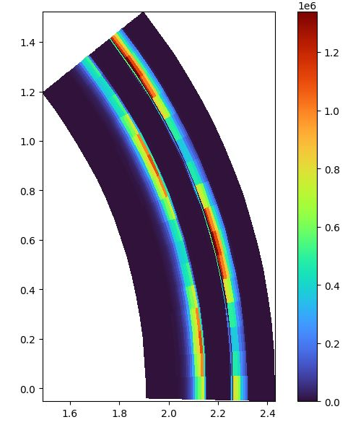
#139 : W-migration in lower X-point height geometries in WEST accounting for 3D realistic walls and magnetic geometry for the validation of tokamak boundary simulations
Proponents and contact person:
Diego Sales de Oliveira (diego.salesdeoliveira@cea.fr)
Alex Grosjean, Guido Ciraolo, Alexis Huart
Scientific Background & Objectives
- Validate 3D W-migration modelling using SOLEDGE3X+ERO2.0 accounting for realistic wall and magnetic (ripples) geometries
- Produce datasets for different values of density and Psol
- Characterize the strength and position of the W-source, the main routes for core-contamination, and the impact of ripples and non-axisymmetric walls in the overall W-dynamics using ERO2.0 simulations
- Investigate the W-screening efficiency in lower X-point height geometries
Experimental Strategy/Machine Constraints and essential diagnostic
  Repeats for shots from C10/9 WEST campaign for lower X-point height and 2MW LHCD/400kA (f. e. 61488) and improve the minimum incident angle for FMP
  Langmuir probes in the max and min probe locations, RCP, McPherson
  Development of the higher density and Psol scenarios from the reference scenario
Proposed pulses
Device | # Pulses/Session | # Development
WEST | 15 | 5

Slide 39
#139 : W-migration in lower X-point height geometries in WEST accounting for 3D realistic walls and magnetic geometry for the validation of tokamak boundary simulations
Proponents and contact person:
Diego Sales de Oliveira (diego.salesdeoliveira@cea.fr)
Alex Grosjean, Guido Ciraolo, Alexis Huart
Scientific Background & Objectives
- Validate 3D W-migration modelling using SOLEDGE3X+ERO2.0 accounting for realistic wall and magnetic (ripples) geometries
- Produce datasets for different values of density and Psol
- Characterize the strength and position of the W-source, the main routes for core-contamination, and the impact of ripples and non-axisymmetric walls in the overall W-dynamics using ERO2.0 simulations
- Investigate the W-screening efficiency in lower X-point height geometries
Experimental Strategy/Machine Constraints and essential diagnostic
  Repeats for shots from C10/9 WEST campaign for lower X-point height and 2MW LHCD/400kA (f. e. 61488) and improve the minimum incident angle for FMP
  Langmuir probes in the max and min probe locations, RCP, McPherson
  Development of the higher density and Psol scenarios from the reference scenario
Priority: P1-WEST-26-PB ?
Perform data mining first. Rationale for additional pulses not clear (diagnostics settings ?)
Focus of 3D modelling should be on discrete limiters rather than impact of ripple.
Proposed pulses
Device | # Pulses/Session | # Development
WEST | 15 | 5

Slide 40
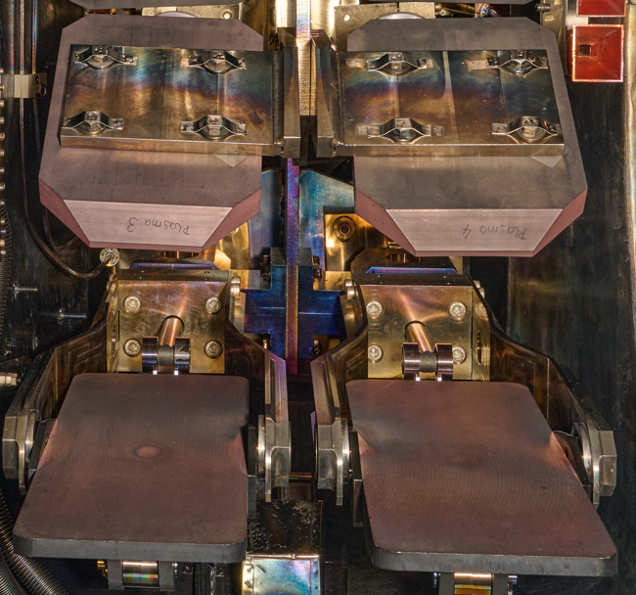
#120 : Effect of second harmonic ECH resonance on arcing risks inside the EC launcher
Proponents and contact person:
Mireille Schneider (mireille.schneider@iter.org)
Alessandro Danisi (alessandro.danisi@iter.org)
Melanie Preynas (melanie.preynas@iter.org)
Jörg Stober (joerg.stober@ipp.mpg.de)
Alberto Loarte (alberto.loarte@iter.org)
Tom Wauters (tom.wauters@iter.org)
Lena Delpech (lena.delpech@cea.fr)
Scientific Background & Objectives
In ITER EC launchers (equatorial and upper), the existence of higher harmonics of EC resonance can pose arcing risks
The arcing risk is due to either neutral gas breakdown or secondary electron emission.
This issue potentially threatens the correct and continuous operation of the EC launchers.
Such arcing risks have materialised in arcing events observed on several devices (e.g. FTU, DIII-D, Tore-Supra).
The first objective is to observe the phenomena by modifying the EC launcher layout with stainless elements in the EC second harmonic resonance location.
The measurable objectives is to record diagnostic signals or visual evidence of the arcing.
In a second campaign, replace the stainless steel elements with surface-treated elements according to identified mitigation strategies.
The measurable objectives is to record diagnostic signals or visual evidence of the arcing with the aim to record the effectiveness (or not) of the surface treatment.
Experimental Strategy/Machine Constraints and essential diagnostic
  Operation with pulses with Gyrotron 2 (Sector 6) at max reliable power with:
    B = -3.17 T (this fixes the second harmonic region between the stainless steel plates)
    Plasma Current = 1 MA with 5 MW NBI power
    Pressure to be safely maximised
    Density = 8E19 m⁻³ (Ref. 26864), high enough to operate without central EC
    Steering angles = poloidal 10deg, toroidal 0-25deg (TBD – these values roughly corresponds to 0%-30% X-mode power fraction)
    2 ports for diagnostics for arc detection: one with sniffer probe and one with video system. Alternatives for using a optical fibers can be discussed.
Proposed pulses
Device | # Pulses/Session | # Development
AUG | 10 | 0

Slide 41
#120 : Effect of second harmonic ECH resonance on arcing risks inside the EC launcher
Proponents and contact person:
Mireille Schneider (mireille.schneider@iter.org)
Alessandro Danisi (alessandro.danisi@iter.org)
Melanie Preynas (melanie.preynas@iter.org)
Jörg Stober (joerg.stober@ipp.mpg.de)
Alberto Loarte (alberto.loarte@iter.org)
Tom Wauters (tom.wauters@iter.org)
Lena Delpech (lena.delpech@cea.fr)
Scientific Background & Objectives
In ITER EC launchers (equatorial and upper), the existence of higher harmonics of EC resonance can pose arcing risks
The arcing risk is due to either neutral gas breakdown or secondary electron emission.
This issue potentially threatens the correct and continuous operation of the EC launchers.
Such arcing risks have materialised in arcing events observed on several devices (e.g. FTU, DIII-D, Tore-Supra).
The first objective is to observe the phenomena by modifying the EC launcher layout with stainless elements in the EC second harmonic resonance location.
The measurable objectives is to record diagnostic signals or visual evidence of the arcing.
In a second campaign, replace the stainless steel elements with surface-treated elements according to identified mitigation strategies.
The measurable objectives is to record diagnostic signals or visual evidence of the arcing with the aim to record the effectiveness (or not) of the surface treatment.
Experimental Strategy/Machine Constraints and essential diagnostic
  Operation with pulses with Gyrotron 2 (Sector 6) at max reliable power with:
    B = -3.17 T (this fixes the second harmonic region between the stainless steel plates)
    Plasma Current = 1 MA with 5 MW NBI power
    Pressure to be safely maximised
    Density = 8E19 m⁻³ (Ref. 26864), high enough to operate without central EC
    Steering angles = poloidal 10deg, toroidal 0-25deg (TBD – these values roughly corresponds to 0%-30% X-mode power fraction)
    2 ports for diagnostics for arc detection: one with sniffer probe and one with video system. Alternatives for using a optical fibers can be discussed.
Priority: out of scope for RT06
High priority issue for ITER, but not in the objectives of RT06.
Proposed to be shifted to RT04 or integrated in AUG internal programme
Proposed pulses
Device | # Pulses/Session | # Development
AUG | 10 | 0

Slide 42
Fuel retention / recovery and vessel conditioning
(D4, D5, D7)

Slide 43
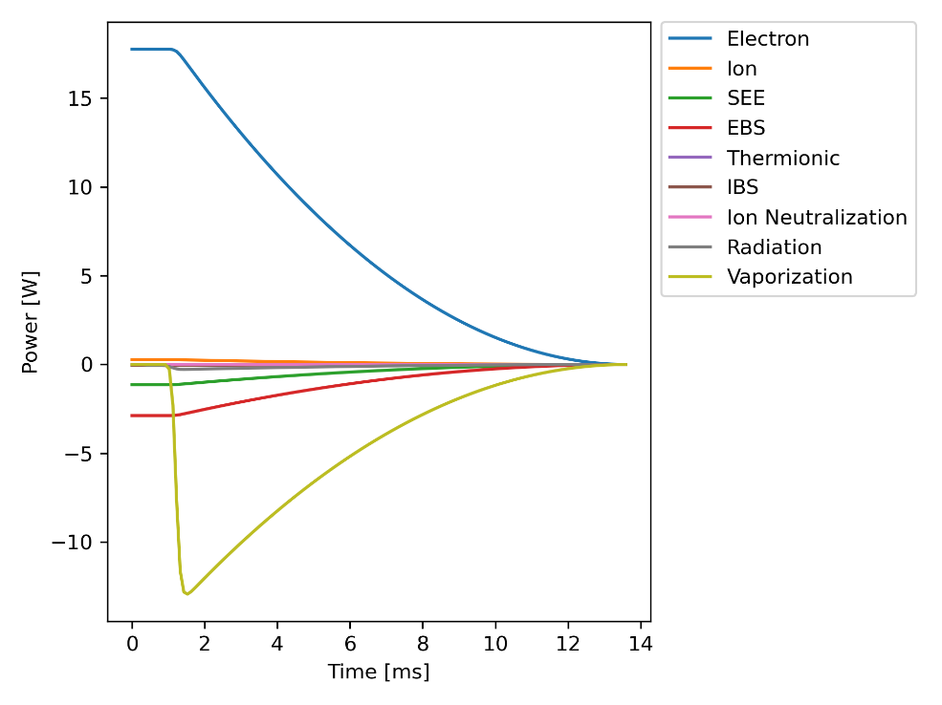
#117 : Validation of the modelling of boron powder injection and boron film deposition
Proponents and contact person
S. Ratynskaia srat@kth.se, P. Tolias, S. Brezinsek, K. Krieger, V. Rohde, T. Lunt, D. Matveev, J. Romazanov, M. De Angeli, T. Wauters, R. A. Pitts
Scientific Background & Objectives
Validate the modelling of boron dust transport and ablation in fusion plasmas with a focus on the impurity source term due to boron dust vaporization.
Provide experimental data for intense boron dust-plasma interaction resulting in dust ablation.
Model boron dust transport and vaporization with MIGRAINe → provide impurities as input to ERO 2.0
Experimental Strategy & Essential diagnostic
Impurity powder dropper or piezoelectric injector.
Small and large size monodisperse boron populations to probe different dust plasma collection regimes.
Record the injected dust trajectories.
Observe the ablated material and transported impurities with spectroscopic means.
Install witness plates on the divertor and mid-plane manipulators to measure the boron film deposition.
Validate the MIGRAINe code and the MIGRAINe + ERO 2.0 workflow for boron – a material with poorly known surface properties
Names can be deceiving: “dust transport codes” are often less about transport and more about heating
MIGRAINe boasts a complete description of microphysical processes & features a reactor-relevant plasma collection model, both critical for accurate heat balance predictions. The MIGRAINe state-of-the-art plasma-surface interaction models were very recently extended to boron.
Device | # Pulses | # Development
AUG | 8 | 1-2 (reference L-mode scenario tbd)

Slide 44
#117 : Validation of the modelling of boron powder injection and boron film deposition
Proponents and contact person
S. Ratynskaia srat@kth.se, P. Tolias, S. Brezinsek, K. Krieger, V. Rohde, T. Lunt, D. Matveev, J. Romazanov, M. De Angeli, T. Wauters, R. A. Pitts
Scientific Background & Objectives
Validate the modelling of boron dust transport and ablation in fusion plasmas with a focus on the impurity source term due to boron dust vaporization.
Provide experimental data for intense boron dust-plasma interaction resulting in dust ablation.
Model boron dust transport and vaporization with MIGRAINe → provide impurities as input to ERO 2.0
Experimental Strategy & Essential diagnostic
Impurity powder dropper or piezoelectric injector.
Small and large size monodisperse boron populations to probe different dust plasma collection regimes.
Record the injected dust trajectories.
Observe the ablated material and transported impurities with spectroscopic means.
Install witness plates on the divertor and mid-plane manipulators to measure the boron film deposition.
Validate the MIGRAINe code and the MIGRAINe + ERO 2.0 workflow for boron – a material with poorly known surface properties
Priority: P1-AUG-27
Good proposal but lower priority than P1-26 on standard boronisation
Names can be deceiving: “dust transport codes” are often less about transport and more about heating
MIGRAINe boasts a complete description of microphysical processes & features a reactor-relevant plasma collection model, both critical for accurate heat balance predictions. The MIGRAINe state-of-the-art plasma-surface interaction models were very recently extended to boron.
Device | # Pulses | # Development
AUG | 8 | 1-2 (reference L-mode scenario tbd)

Slide 45
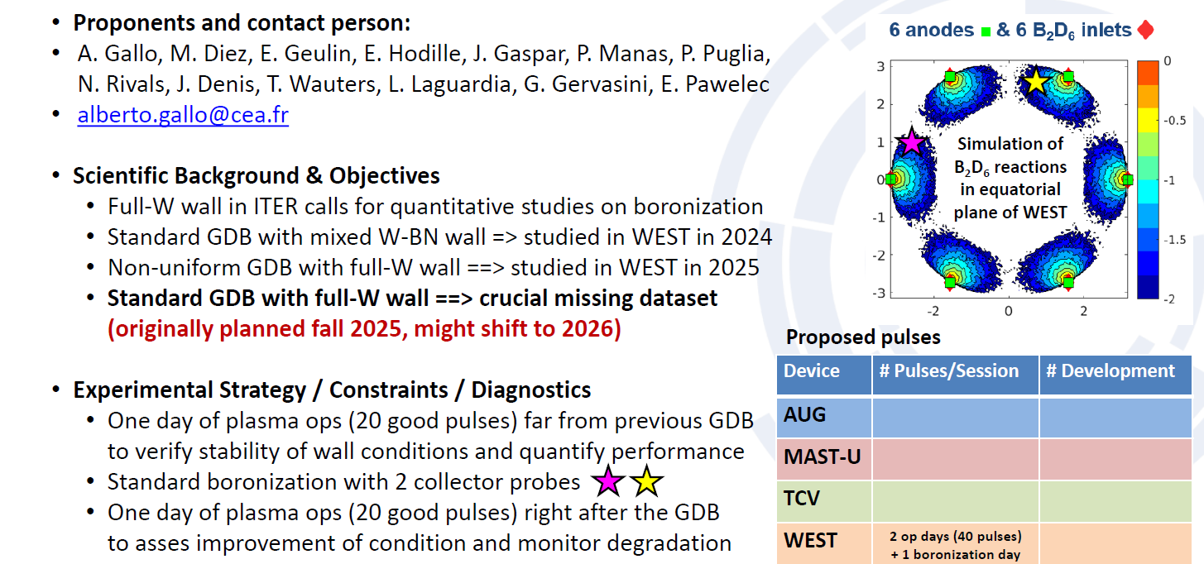
#127 : Effect of spatially (non--)uniform boronization on plasma parameters, wall retention and B rich layer properties

Slide 46
#127 : Effect of spatially (non--)uniform boronization on plasma parameters, wall retention and B rich layer properties
Priority: P1-WEST-26 (re-submitted)
Is pre GDB session needed (already performed) ? To be cancelled in case standard uniform GDB successful in 2025 (sample exposure performed yesterday)

Slide 47
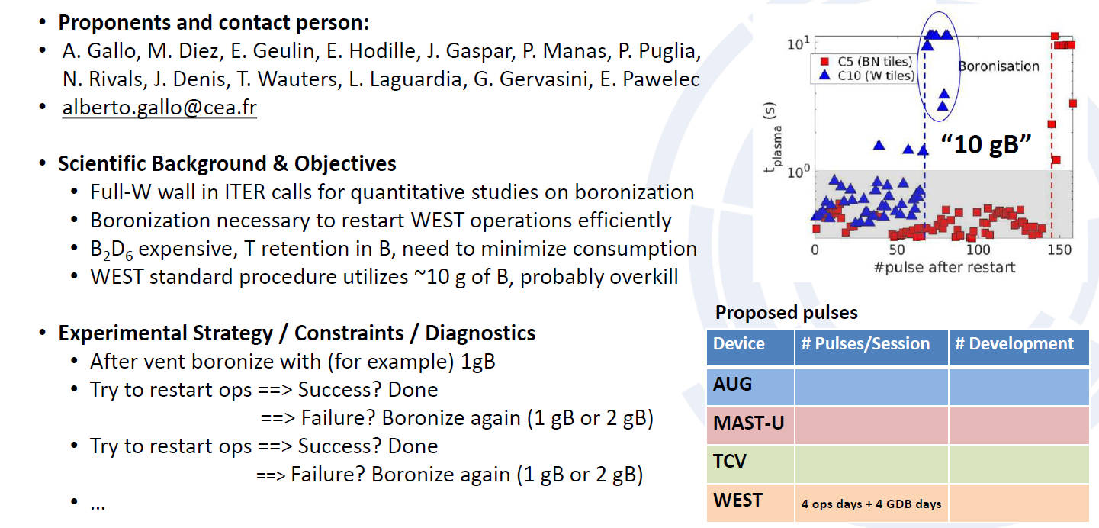
#128 : Minimum B2D6 quantity to restart WEST operations

Slide 48
#128 : Minimum B2D6 quantity to restart WEST operations
Priority: P1-WEST-26
Important topic for ITER where B needs to be minimized to avoid fuel retention.
More analysis needed (B thickness estimate etc) to define minimum amount of B to be tried.

Slide 49
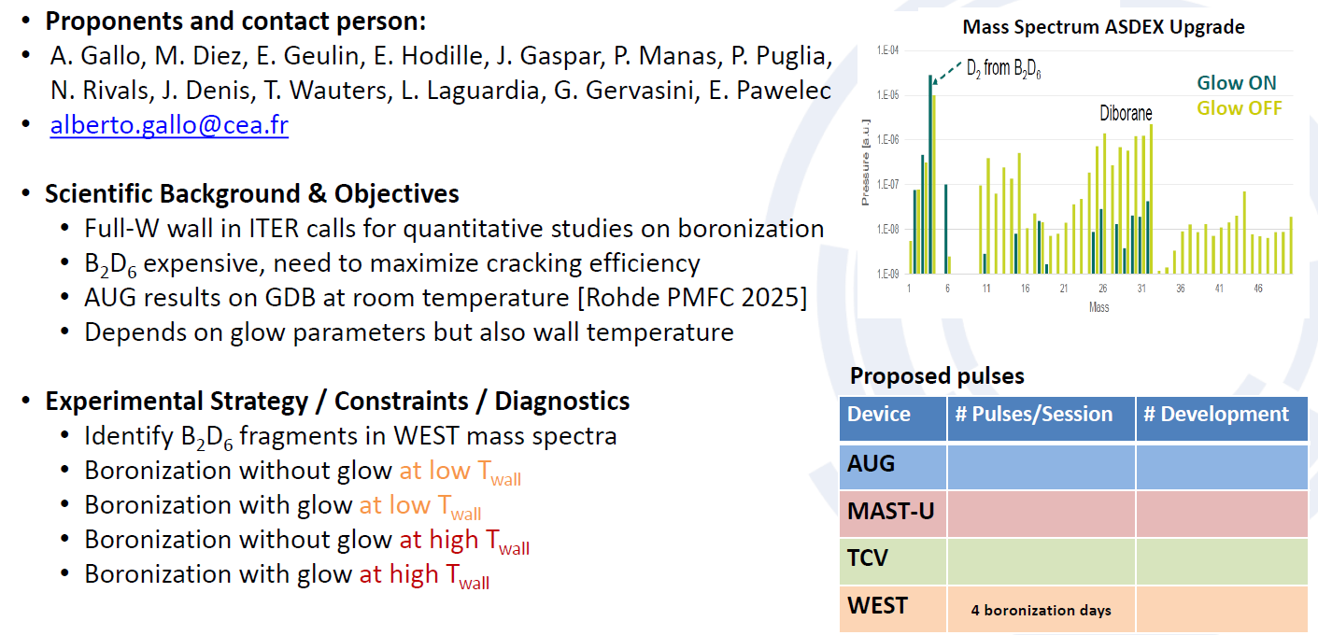
#129 : Boronization with and without glow discharge in WEST

Slide 50
#129 : Boronization with and without glow discharge in WEST
Priority: P2-WEST
Feasibility to be assessed (boro w/o GDC and/or ICWC)
Need for reference discharges to qualify boronisation efficiency afterwards not included.
To be combined with alternative to standard GDB #124.
Need to streamline on most urgent item (Twall vs ICWC boronisation vs pure boronisation) to be discussed with IO

Slide 51
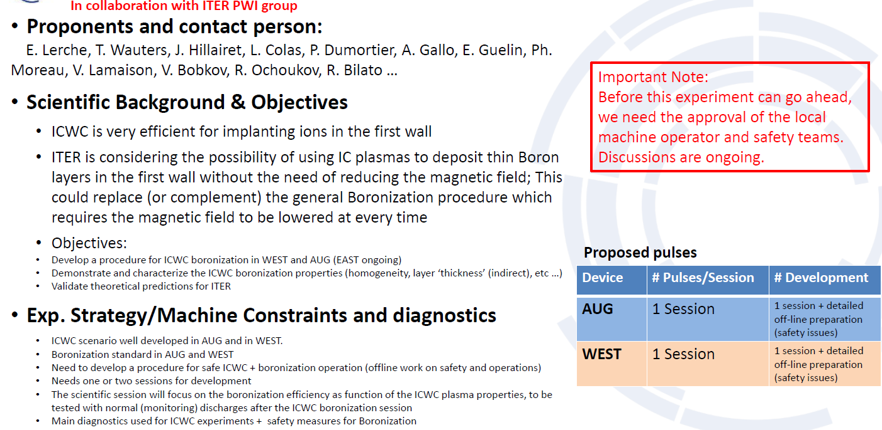
#124 : Developmentof ICWC assisted boronization

Slide 52
#124 : Developmentof ICWC assisted boronization
Priority: P1-AUG-26, P1-WEST-26
Innovative, multi machine, great gain for ITER if boronisation can be perfomed w/o lowering B field. To be discussed in conjunction with proposal # 129.
Technical feasibility to be confirmed

Slide 53
#140 : Preparation of B reference samples
Proponents and contact person:
T.dittmar@fz-juelich.de
An.houben@fz-juelich.de
Scientific Background & Objectives
  Investigation of B coatings fabricated in different fusion devices:
  - Comparison of composition of B layer
  - Study of the mechanism of the impurity gettering of the boron layer during boronization
  - Comparison with laboratory samples
  - Identical tungsten substrate samples
Experimental Strategy/Machine Constraints and essential diagnostic
- Pre-characterized samples exposed on
manipulator systems during boronization
- samples must be retrieved before normal plasma
Operation and should be carried in air/humidity
tight containers.
Proposed pulses
Device | # Pulses/Session | # Development
AUG | During boronization
MAST-U
TCV
WEST | During boronization

Slide 54
#140 : Preparation of B reference samples
Proponents and contact person:
T.dittmar@fz-juelich.de
An.houben@fz-juelich.de
Scientific Background & Objectives
  Investigation of B coatings fabricated in different fusion devices:
  - Comparison of composition of B layer
  - Study of the mechanism of the impurity gettering of the boron layer during boronization
  - Comparison with laboratory samples
  - Identical tungsten substrate samples
Experimental Strategy/Machine Constraints and essential diagnostic
- Pre-characterized samples exposed on
manipulator systems during boronization
- samples must be retrieved before normal plasma
Operation and should be carried in air/humidity
tight containers.
Priority: P1-AUG-26-PB and P1-WEST-26-PB
Would provide tokamak relevant B layers to be studied in WP PWIE
Readiness of samples + compatibility with AUG/WEST exposure devices to be confirmed
Sample management challenging (no air exposure desirable)
Proposed pulses
Device | # Pulses/Session | # Development
AUG | During boronization
MAST-U
TCV
WEST | During boronization

Slide 55
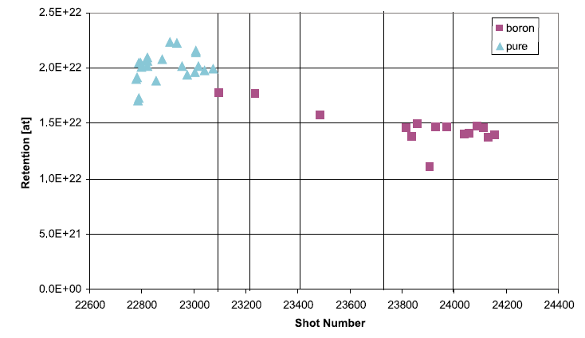
#125 : Particle balance in AUG as a measure of global D retention in pulses following fresh boronisation
Proponents and contact person
  D. Matveev, S. Brezinsek, V. Rohde, T. Wauters, …
Scientific Background & Objectives
  Fuel retention in as-deposited and re-deposited boron layers is a potential safety issue in full W ITER. Predictive estimates require validation in existing full W devices. Earlier analysis [1] mostly focused on pulses without boronisation.
  Apply global particle balance analysis method to follow the evolution of in-vessel fuel retention in-pulse and in short-term as a function of plasma time after boronization.
Experimental Strategy & Essential Diagnostic
  Re-calibrate all relevant neutral gas diagnostics
  (pressure gauges, pumping speeds, RGAs, …)
  Execute reference pulses prior and repetitively after boronization to follow the evolution of in-vessel retention
  Essential diagnostics:
    Pressure gauges
    Optical Penning
    RGAs
    Plasma spectroscopy
    Core plasma density (LIDAR/HRTS/…)
Wall retention needed to reach steady-state conditions
Cyan triangles - data for non-boronized wall
Magenta squares - after boronizations (vertical lines)
[2] V. Rohde et al., PPPCF 51 (2009) 124033 doi:10.1088/0741-3335/51/12/124033
Device | # Pulses | # Development
AUG | >10+7 | Reference pulse to be identified from previous studies and in connection to relevant proposals, such as “Boronization efficiency”
[1] V. Rohde et al., JNM 390–391 (2009) 474
doi:10.1016/j.jnucmat.2009.01.047

Slide 56
#125 : Particle balance in AUG as a measure of global D retention in pulses following fresh boronisation
Proponents and contact person
  D. Matveev, S. Brezinsek, V. Rohde, T. Wauters, …
Scientific Background & Objectives
  Fuel retention in as-deposited and re-deposited boron layers is a potential safety issue in full W ITER. Predictive estimates require validation in existing full W devices. Earlier analysis [1] mostly focused on pulses without boronisation.
  Apply global particle balance analysis method to follow the evolution of in-vessel fuel retention in-pulse and in short-term as a function of plasma time after boronization.
Experimental Strategy & Essential Diagnostic
  Re-calibrate all relevant neutral gas diagnostics
  (pressure gauges, pumping speeds, RGAs, …)
  Execute reference pulses prior and repetitively after boronization to follow the evolution of in-vessel retention
  Essential diagnostics:
    Pressure gauges
    Optical Penning
    RGAs
    Plasma spectroscopy
    Core plasma density (LIDAR/HRTS/…)
Priority: P3 (re submitted)
High priority topic, but no in house AUG support available to bring particle balance diagnostics at accuracy needed
Wall retention needed to reach steady-state conditions
Cyan triangles - data for non-boronized wall
Magenta squares - after boronizations (vertical lines)
[2] V. Rohde et al., PPPCF 51 (2009) 124033 doi:10.1088/0741-3335/51/12/124033
Device | # Pulses | # Development
AUG | >10+7 | Reference pulse to be identified from previous studies and in connection to relevant proposals, such as “Boronization efficiency”
[1] V. Rohde et al., JNM 390–391 (2009) 474
doi:10.1016/j.jnucmat.2009.01.047

Slide 57
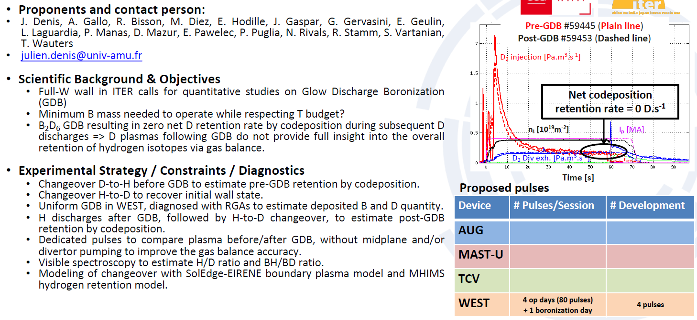
#126 : Estimation of the H/D retention by codeposition in boronized fusion devices through D-to-H-to-D changeover in WEST

Slide 58
#126 : Estimation of the H/D retention by codeposition in boronized fusion devices through D-to-H-to-D changeover in WEST
Priority: P1-WEST-27
Interesting conceptual idea but need to refine numbers at stake (codep with B compared to injected/exhaust flux).
To be combined with post mortem at the end of a campaign (but post mortem difficult with H).
Previous changeover in WEST to be looked at in more details from particle balance point of view.
Priority to be re assessed once we have more analysis.

Slide 59
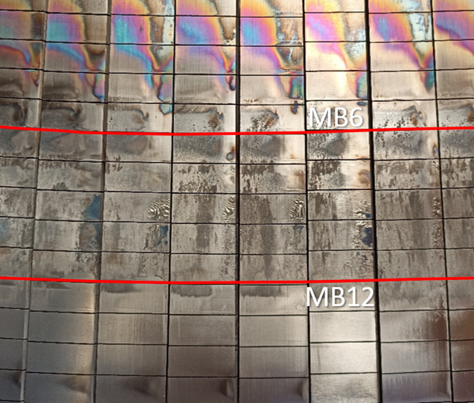
#122 : Study about the outgassing of the deposit layer
Proponents and contact person:
Jonathan.gerardin@cea.fr, Yann.corre@cea.fr, Eleonore.geulin@cea.fr, agrosjea@utk.edu, Etienne.hodille@cea.fr, Jonathan.gaspar@univ-amu.fr, ewap@uni.opole.pl,
Scientific Background & Objectives
  During campaign, a deposit layer appears on the inner side of the lower divertor, from MB7-11,
  The thick deposit contains light impurities and probably also trapped fuel. Heating the deposit to high temperature lead to outgassing from the deposit (twice more light impurities released, from C10 experiment) → improve the conditioning for next pulses
  Objectives :
    Study the light impurities and molecular deuterium particle flux when the plasma is on the deposit
    Compare the impurities extracted at beginning and end of session
    Determine how many pulses are needed to outgas the deposit from light impurities.
    Follow up from campaign to campaign could be done to evaluate the content of the deposit.
Experimental Strategy/Machine Constraints and essential diagnostic
  LSN, FXP (100mm-120m) LH 4MW, 400kA → FISP (scenarios already exists)
  Use visible spectroscopy and LP probes to measure particle flux of light impurities
  Use RGA to detect the light impurities extracted
  Estimate the particle balance evolution from pulse to pulse.
  1 session to study the outgassing, and some pulses on different campaign to follow from campaign to campaign.
  Diagnostic needed :
    Visible and EUV spectroscopy – RGA to monitor impurities extracted from the deposit.
    LP needed to estimate flux of impurities.
    Optional : TC-FBG for heat flux. IR VHR on Q3B PFU19-20 MB11 to follow some modification of deposit pattern (1 PFU not cleaned by laser after C11).
Proposed pulses
Device | # Pulses/Session | # Development
AUG | 0 | 0
MAST-U | 0 | 0
TCV | 0 | 0
WEST | 30 | 0

Slide 60
#122 : Study about the outgassing of the deposit layer
Proponents and contact person:
Jonathan.gerardin@cea.fr, Yann.corre@cea.fr, Eleonore.geulin@cea.fr, agrosjea@utk.edu, Etienne.hodille@cea.fr, Jonathan.gaspar@univ-amu.fr, ewap@uni.opole.pl,
Scientific Background & Objectives
  During campaign, a deposit layer appears on the inner side of the lower divertor, from MB7-11,
  The thick deposit contains light impurities and probably also trapped fuel. Heating the deposit to high temperature lead to outgassing from the deposit (twice more light impurities released, from C10 experiment) → improve the conditioning for next pulses
  Objectives :
    Study the light impurities and molecular deuterium particle flux when the plasma is on the deposit
    Compare the impurities extracted at beginning and end of session
    Determine how many pulses are needed to outgas the deposit from light impurities.
    Follow up from campaign to campaign could be done to evaluate the content of the deposit.
Experimental Strategy/Machine Constraints and essential diagnostic
  LSN, FXP (100mm-120m) LH 4MW, 400kA → FISP (scenarios already exists)
  Use visible spectroscopy and LP probes to measure particle flux of light impurities
  Use RGA to detect the light impurities extracted
  Estimate the particle balance evolution from pulse to pulse.
  1 session to study the outgassing, and some pulses on different campaign to follow from campaign to campaign.
  Diagnostic needed :
    Visible and EUV spectroscopy – RGA to monitor impurities extracted from the deposit.
    LP needed to estimate flux of impurities.
    Optional : TC-FBG for heat flux. IR VHR on Q3B PFU19-20 MB11 to follow some modification of deposit pattern (1 PFU not cleaned by laser after C11).
Priority: P2-WEST
Interesting but need to find a method to assess cleaning efficiency (combine with LIBS once available at end of the campaign ?).
Proposal to be refined after more analysis of spectroscopy etc on previous one.
In any case, need to wait for deposits to grow after divertor cleaning in summer 2025 …
Proposed pulses
Device | # Pulses/Session | # Development
AUG | 0 | 0
MAST-U | 0 | 0
TCV | 0 | 0
WEST | 30 | 0

Slide 61
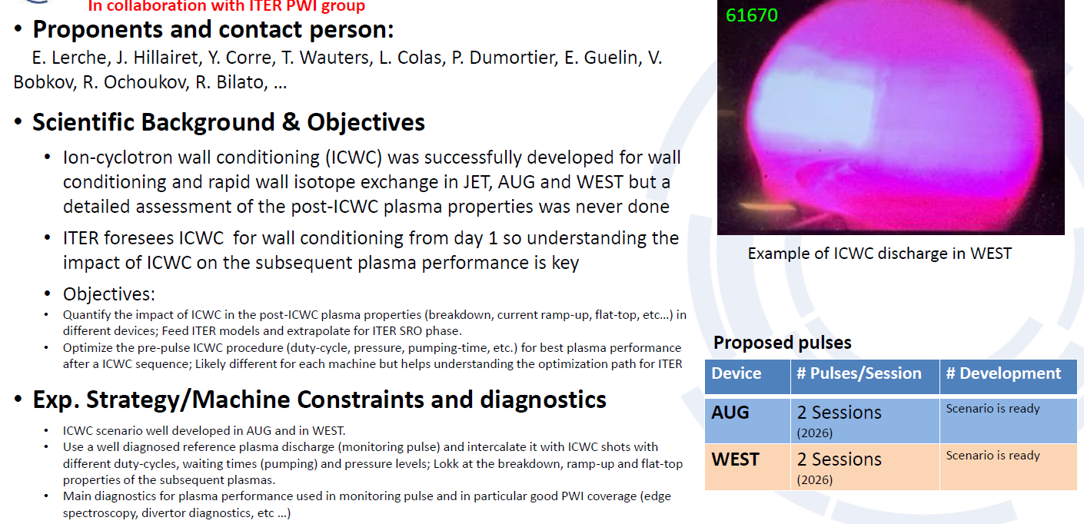
#123 : Impact of ICWC on plasma operation

Slide 62
#123 : Impact of ICWC on plasma operation
Priority: P2-AUG, P2-WEST
Interesting proposal but criteria to analyze benefit of ICWC on subsequent plasma ops would be useful.
Propose to focus on analysis of previous data in 2026 (data mining on plasma operation following ICWC sessions) then priority could be re assessed for 2027

Slide 63
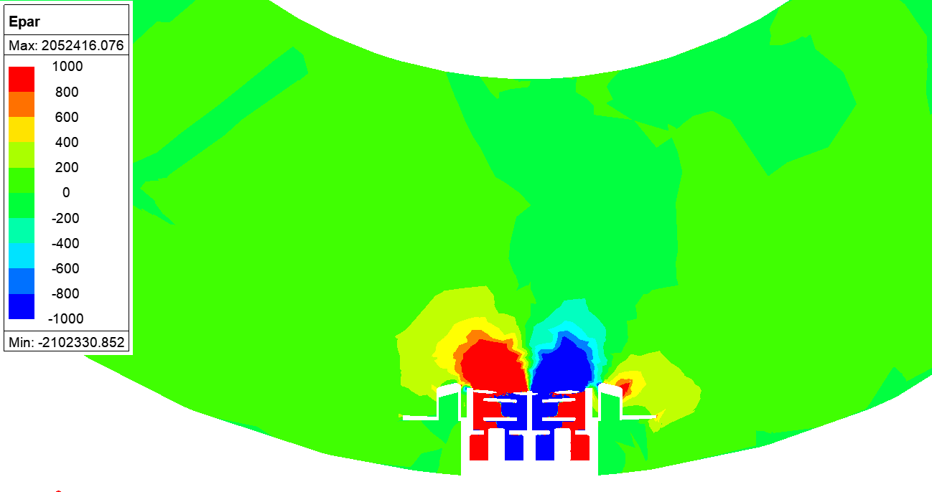
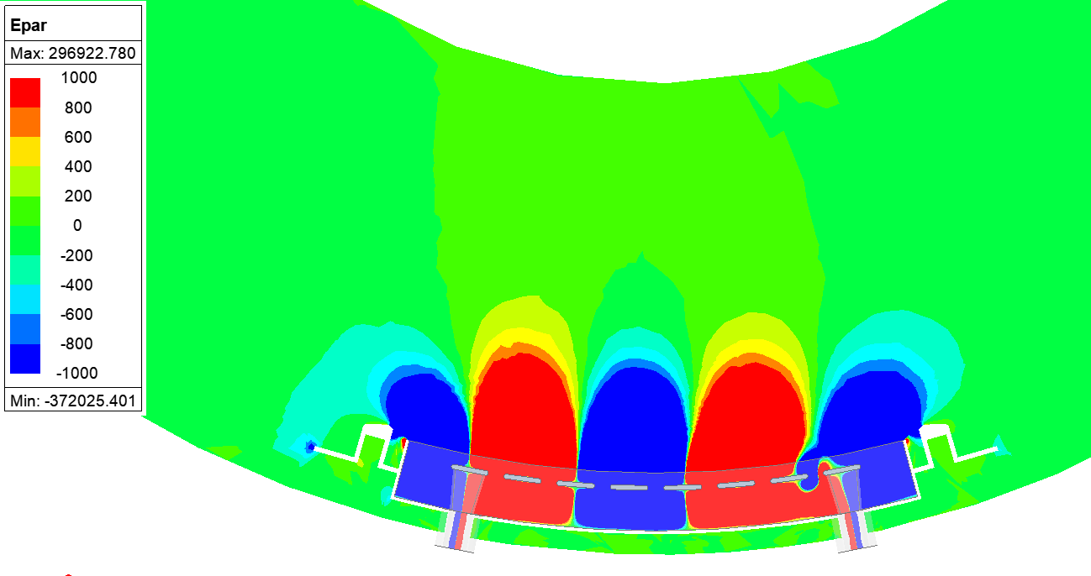
#137 : ICWC operation with TWA
Proponents and contact person:
R. Ragona, E. Lerche, V. Maquet, J. Hillairet, et al
Scientific Background & Objectives
  ITER foresees Ion-cyclotron wall conditioning (ICWC) from day 1 so understanding the impact of ICWC on the subsequent plasma performance is key
  ICWC successfully developed in JET, AUG and WEST
  Detailed assessment of the post-ICWC plasma properties expected in 2026
  New WEST IC launchers (Travelling Wave Array) will be ready for operation in 2027
  New features that could positively impact ICWC (larger area, freq. modulation, no FS, …)
  Builds on top of 2026 proposal “Impact of ICWC on plasma operation”
  Objectives
  Quantify the impact on post-ICWC plasma properties (breakdown, Ip ramp-up, flat-top, …)
  Contribute to ITER models database and to the extrapolation for ITER SRO phase.
  Consolidate the pre-pulse ICWC procedure (launcher configuration, duty-cycle, pressure, pumping-time, etc.) for best pulse performance.
  Document the effect of area, freq. modulation and launcher phasing on plasma production. (Input for breakdown and PWI models)
Experimental Strategy/Machine Constraints and essential diagnostic
  Repeat scenario developed for WEST
    Well diagnosed monitoring pulses interleaved with ICWC pulse trains
  Explore new parameter space
    Frequency modulation, launcher phasing
    Find optimal power level and timings
  Main diagnostics for plasma performance used in monitoring pulse
    Good PWI coverage (edge spectroscopy, divertor diagnostics, …)
Proposed pulses
Device | # Pulses/Session | # Development
AUG
MAST-U
TCV
WEST | 1 session (2027)

Slide 64
#137 : ICWC operation with TWA
Proponents and contact person:
R. Ragona, E. Lerche, V. Maquet, J. Hillairet, et al
Scientific Background & Objectives
  ITER foresees Ion-cyclotron wall conditioning (ICWC) from day 1 so understanding the impact of ICWC on the subsequent plasma performance is key
  ICWC successfully developed in JET, AUG and WEST
  Detailed assessment of the post-ICWC plasma properties expected in 2026
  New WEST IC launchers (Travelling Wave Array) will be ready for operation in 2027
  New features that could positively impact ICWC (larger area, freq. modulation, no FS, …)
  Builds on top of 2026 proposal “Impact of ICWC on plasma operation”
  Objectives
  Quantify the impact on post-ICWC plasma properties (breakdown, Ip ramp-up, flat-top, …)
  Contribute to ITER models database and to the extrapolation for ITER SRO phase.
  Consolidate the pre-pulse ICWC procedure (launcher configuration, duty-cycle, pressure, pumping-time, etc.) for best pulse performance.
  Document the effect of area, freq. modulation and launcher phasing on plasma production. (Input for breakdown and PWI models)
Experimental Strategy/Machine Constraints and essential diagnostic
  Repeat scenario developed for WEST
    Well diagnosed monitoring pulses interleaved with ICWC pulse trains
  Explore new parameter space
    Frequency modulation, launcher phasing
    Find optimal power level and timings
  Main diagnostics for plasma performance used in monitoring pulse
    Good PWI coverage (edge spectroscopy, divertor diagnostics, …)
Priority: P2-WEST
Requires TWA to be operational
Would grant priority to W sources study with TWA first (#119)
Proposed pulses
Device | # Pulses/Session | # Development
AUG
MAST-U
TCV
WEST | 1 session (2027)

Slide 65
High priority items to be continued from JET
Fuel retention / recovery
Further analysis of overall gas balance in DTE3 (+DTE2) (in particular once T accountancy completed, planned in spring 2026)
Modelling of fuel retention during DTE3 / fuel recovery post DTE3
Further analysis of LID QMS data (qualitative ➔ quantitative data), in particular evolution during DTE3 clean up
Comparison of LIBS s LID QMS data for consistency (with PWIE)
(Much) longer term : consistency of gas balance / laser diags measurements / sample post mortem analysis (PWIE)
Material migration
Further analysis and modelling of W prompt redeposition experiment
Completion of Be erosion studies + publication : still pending
He campaign
Further analysis / modelling of the (no) W fuzz formation (more insight from visual inspection once tiles removed ?)
NB : data analysis from previous campaigns under RT11

Slide 66
RT06 analysis and modelling needs (non exhaustive)
PFC evolution / damage
Heat loads, power balance : thermal diagnostics (IR, TC/FBG, calorimetry, LP ...)
Field line tracing codes, melting and RE modelling, material modelling (crack formation and propagation)
Material migration
W sources : visible spectroscopy, bolometry
Plasma background (SOLEDGE, SOLPS wide grid ...), material migration modelling (ERO, Walldyn ...)
Fuel retention
Gas balance : barometry, RGA + laser based diagnostics
Fuel retention / removal modelling (MIMHS ...)
Conditioning modelling (boronisation, ICWC ...)
Strong links with WP PWIE

Slide 67
In summary ...

Slide 68
Overview of RT06 proposals assessment
No | Proposal title | Main proponents | Prioriity
114 | Multi-scale melt dynamics across PFC gaps | K. Krieger | P1-AUG-26
115 | Thermomechanical resilience of tungsten heavy alloys at high temperatures | K. Krieger | P1-AUG-26
116 | W PFC damage induced by runaway electron incidence | S. Ratynskaia | P1-:AUG-26, P1-WEST-26
134 | Exposure of pre-damaged INTERFACE components | A. Durif | P2-WEST
135 | Exposure of pre-damaged divertor components (pred#2 & #3) | A. Durif | P1-26-WEST
118 | Study of accelerated material damage under a high fluence of helium in WEST | C.Guillemaut | P2-WEST
136 | Characterization of the heat load on castellated PFC: optical hot spot, toroidal gap and far SOL power width in WEST L-mode plasma | Y. Corre | P1-WEST-27
121 | Calorimetry power balance and ripple effect modulation | J. Gerardin | P1-WEST-27
131 | Low-Density ICRF + XPR Mitigation: Scenario development & Trade‑off Study | G. Urbanczyk | P2-WEST
132 | Low-Density ICRF: Electron Heating & Impurity Transport Validation | G. Urbanczyk | P2-AUG, P2-WEST
119 | Comparing W production and core plasma contamination by 2x2 strap Ion Cyclotron Antenna and Travelling Wave Array | L. Colas | P1-WEST-27
130 | TWA poloidal phase scan for impurity minimization in WEST | V. Maquet | Merge with #119
133 | LH Power Loss Characterization at high coupling with TWA | V. Maquet | P3-WEST
138 | Studying Ti/Te ratio and Ti decay length | J. Kovačič | P1-WEST-26
139 | W-migration in lower X-point height geometries in WEST accounting for 3D realistic walls and magnetic geometry for the validation of tokamak boundary simulations | D. Sales de Oliveira | P1-WEST-26-PB
120 | Effect of second harmonic ECH resonance on arcing risks inside the EC launcher | M. Schneider | Shifted to RT04
117 | Validation of the modelling of boron powder injection and boron film deposition | S. Ratynskaia | P1-AUG-27
127 | Effect of spatially (non-)uniform boronization on plasma parameters, wall retention and B-rich layer properties | A. Gallo | P1-WEST-26 (if not 25)
128 | Minimum boronization (B2D6 quantity) to restart WEST operations after a vent | A. Gallo | P1-WEST-26
129 | Boronization with and without glow discharge at various wall temperatures in WEST | A. Gallo | P2-WEST-26
124 | Development of ICWC boronization for ITER | E. Lerche | P1-AUG-26, P1-WEST-26
140 | Preparation of B reference samples | T. Dittmar | P1-AUG-26-PB, P1-WEST-26-PB
125 | Particle balance in AUG as a measure of global D retention in pulses following fresh boronisation | D. Matveev | P3-AUG
126 | Estimation of H/D retention in boronized fusion devices through D-to-H-to-D changeover experiments in WEST | J. Denis | P1-WEST-27
122 | Study about the outgassing of the deposit layer | J. Gerardin | P2-WEST
123 | Impact of ICWC on plasma operation | E. Lerche | P2-AUG, P2-WEST
137 | ICWC operation with TWA | R. Ragona | P2-WEST

Slide 69
Concluding remarks
RT06 R&D area | AUG | WEST
PFC evolution / damage (D1-D2) | Runaway impact on first wall #116
 | Melting : gaps #114 + W alloy #115 | Self castellation exposure # 135 OHS and gap loads #136
 |  | Power balance calorimetry #121
Material migration (D3) |  | Divertor Ti/Te # 138
 |  | TWA W source # 119
 |  | W migration 3D (PB) # 139
Fuel retention/recovery/ wall conditioning (D4-D5-D7) | ICWC boronisation # 124 + sample # 140 (PWIE)
 | Boron powder injection # 117 | Non uniform boro #127, min boro #128 H/D retention from boro # 126
Proposed P1 shots | 49 | 364
Shot allocation* | 56 | 240
Proposals covering high priority issues for ITER new baseline with AUG/WEST cross machines comparison : runaway impact on first wall, boronisation
Strong overbooking of both machines, so that only P1 proposals could be accomodated as main programme
P1 proposals for WEST will need to be further streamlined (focus ➔ reduced number of shots) and/or refined (proposals in italic)
Missing items ?
  first wall W source, but activities under other RT (RT01, RT05) + analysis of first wall samples exposed in AUG in 2025
  disruption heat loads (RT03) (fast IR in WEST)
  * Tentative, to be re assessed after GPM
  Italic : proposals need to be refined
  Bold : technical feasibility to be confirmed
Now open for discussion !

