Slide 1
RT-09: Physics understanding of energetic particles confinement and their interplay with thermal plasma
3rd – 6th November 2025
D. Keeling
On behalf of RT-09 Team:
TFLs: D. Keeling, M. Baruzzo
Research Topic Coordinators
Y. Kazakov, J. Galdon-Quiroga, A. Jansen van Vuuren, R. Ochoukov

Slide 2
Scientific Objectives
Scientific objectives | Status as reported end of 2024
D1: Provide high quality demonstration of diagnostic techniques for the characterization of confined and lost fast ions with fast ion characteristics relevant for ITER and JT60-SA, qualify further diagnostic techniques required for deployment on JT-60SA | Mature - needs underpinning
D2: Quantify ion and electron heating and core-turbulence stabilisation by fast ions in view of JT-60SA, ITER and DEMO including tailored FI energy profiles and radial locations relevant to JT-60SA | Judgemental
D3: Quantify the impact of fast ions and fast ion driven MHD instabilities on transport in various scenarios including those relevant to JT-60SA | Judgemental
D4: Integrate the available heating, fast-ion and transport modelling tools for interpretation of experimental results in view of extrapolation of results to ITER and DEMO | Exploratory
D5: Quantify fast-ion losses and associated heat load from edge perturbations (ELMs and RMPs) | Judgemental
D7: Identification of AE control actuators and assessment for ITER and JT-60SA relevant scenarios | Judgemental

Slide 3
Proposals (summary table in here)
Proposal # | Title | Proponent(s)
191 | Study of hot ion mode on MAST-U | F. Orsitto, S. Blackmore, et al.
192 | Optimization of fast-ion confinement in tokamaks with externally applied 3D fields | Joaquin Galdon
193 | Fast-ion losses induced by edge instabilities across different confinement regimes | Joaquin Galdon
194 | Impact of Toroidal Alfvén Eigenmodes on Plasma Core Turbulence and Confinement | Paulo Puglia, Samuele Mazzi.
195 | Development of alpha-particle measurements in support of JT-60SA and ITER rebaseline | Yevgen Kazakov, Massimo Nocente
196 | Travelling Wave Array dual-frequency operation as a flexible tool to tailor fast ion populations and excite Alfvén Eigenmodes | Samuele Mazzi,Laurent Colas, et al.
197 | high frequency Alfven eigenmode studies with ITER and JT-60SA relevant AE actuators | Roman Ochoukov
198 | Stability and space structure of n=0 modes driven by energetic particles | Mykola Dreval
199 | Cross machine study of core ICE during sawtooth cycle | Mykola Dreval
200 | Alfvén Eigenmode Control in TCV via Systematic ECRH Scans | Anton Jansen van Vuuren
201 | Impact of Plasma Shaping on Fast-Ion Confinement and Alfvén Eigenmode Control in the TCV Tokamak | Anton Jansen van Vuuren
202 | Investigation of Upward Sweeping Fishbone modes on TCV | Sergei Sharapov
203 | Investigation of internal transport barriers induced on TCV | Sergei Sharapov
204 | Measurements of Ion Cyclotron Emission in WEST | Bernard B.C.G. Reman, Dmitry Moseev, et al.
205 | Optimization of active control of Alfvén Eigenmodes with externally applied 3D fields | Javier Gonzalez-Martin
206 | Study of phase-space islands induced by MHD fluctuations using the INPA diagnostic | Alex Reyner-Viñolas
207 | Exploitation of FILD4 real-time positioning capabilities | Lucia Sanchis
208 | Fast-ion effects on core turbulence at different Qi/Qe on ASDEX Upgrade | Roberto Bilato
209 | Fast-ion stabilization of ITG in WEST with TWA | Riccardo Ragona Roberto Bilato et al.
210 | Interplay of Fast Ion MHD ELMs | Javier Gonzalez-Martin

Slide 4
Summary of pulse requests vs. allocation
 | TCV (Scientific) | TCV (Sce dev.) | TCV (Total) | AUG | AUG (Pulse for Sce Dev) | AUG (Session total) | MAST-U (Scientific) | MAST-U (Sce dev.) | MAST-U (Total) | WEST (Scientific) | WEST (Sc. Dev) | WEST (Total) (Total 2026)
Tot. Requested | 200 | 90 | 290 | 115 | 10 | 125 | 98 | 20 | 118 | 112 | 28 | 140
Prov. Alloc. |  |  | 160 |  |  | 32 |  |  | 16 |  |  | 15
Factor |  |  | 1.8 |  |  | 3.9 |  |  | 7.4 |  |  | 9.3

Slide 5
Proposal Details

Slide 6
(#191)
An interesting proposal looking to establish, effectively, a new operational scenario on MAST-U relevant to a proposed VNS
Whilst relevant to VNS, relevance to ITER/DEMO is less well-established and links to RT Sci. Obj. also not clear.
Strategy also appears rather speculative, starting from a transient increase of Ti over Te and looking to spend a great many shots (~4 sessions) to perform parameter scans around this point to improve the Ti/Te factor - chances of success appear limited within the expt. time that could be given to this topic.
P3

Slide 7
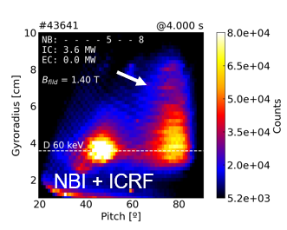
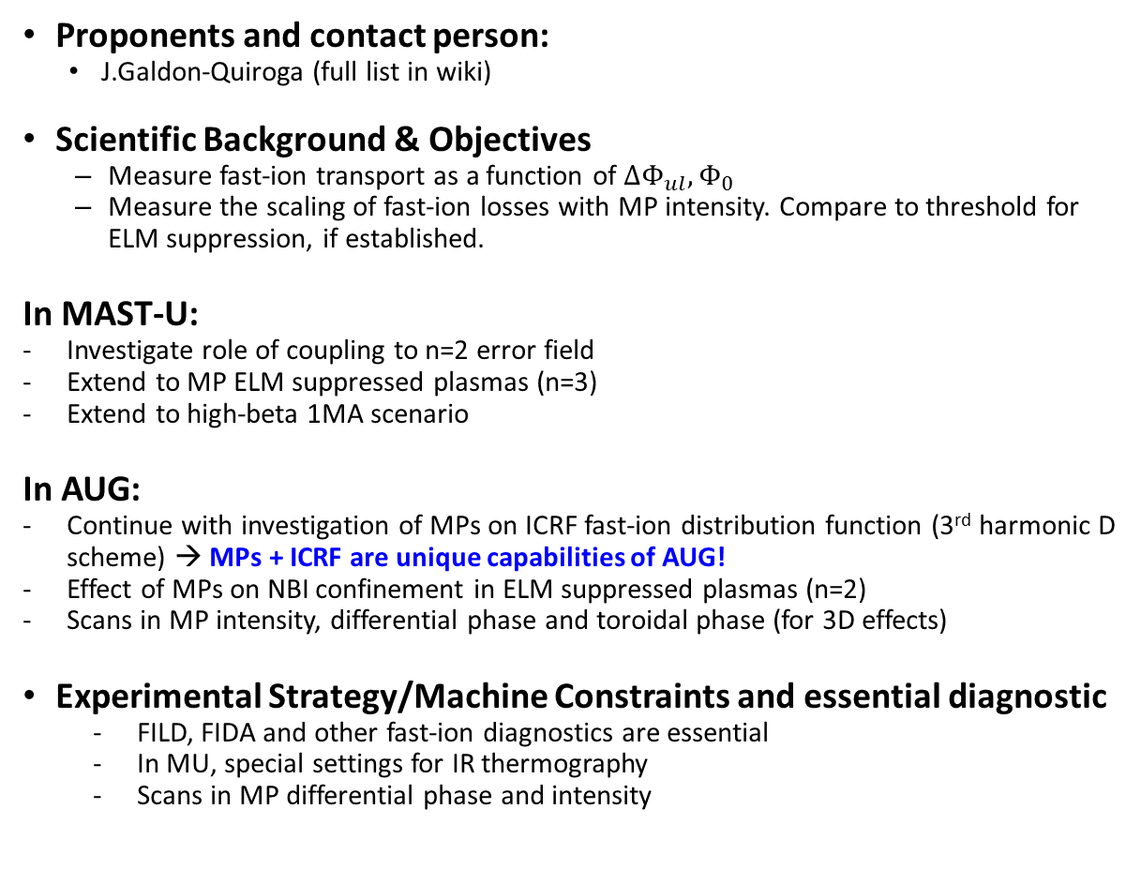
Optimization of fast-ion confinement in tokamaks with externally applied 3D fields (#192)
Proponents and contact person:
  J.Galdon-Quiroga (full list in wiki)
Scientific Background & Objectives
  Measure fast-ion transport as a function of $ΔΦ_{ul}, Φ_{0}$
  Measure the scaling of fast-ion losses with MP intensity. Compare to threshold for ELM suppression, if established.
In MAST-U:
Investigate role of coupling to n=2 error field
Extend to MP ELM suppressed plasmas (n=3)
Extend to high-beta 1MA scenario
In AUG:
Continue with investigation of MPs on ICRF fast-ion distribution function (3rd harmonic D scheme) → MPs + ICRF are unique capabilities of AUG!
Effect of MPs on NBI confinement in ELM suppressed plasmas (n=2)
Scans in MP intensity, differential phase and toroidal phase (for 3D effects)
Experimental Strategy/Machine Constraints and essential diagnostic
  FILD, FIDA and other fast-ion diagnostics are essential
  In MU, special settings for IR thermography
  Scans in MP differential phase and intensity
First measurements of ICRF (3rd harmonic D) fast-ion losses with RMPs in AUG [July 2025]
Continuation of P1 expt begun in previous year(s)
Directly linked to RT Sci. Obj. and ITPA JEX
Important to complete the dataset, especially on MAST-U in 2026
Note that extn. To 1MA on MAST-U may pose some difficulties due to lack of internal prog. Scenario development, to be discussed with ref. SL
Basis of expt. “block” on 3D magnetic fields (combine with #205)
P1-MASTU, P1.5-AUG
Proposed pulses
Device | # Pulses/Session | # Development
AUG | 14
MAST-U | 24 (3 sessions)

Slide 8
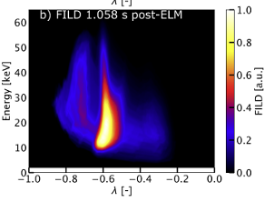
Fast-ion losses induced by edge instabilities across different confinement regimes (#193)
Proponents and contact person:
  J.Galdon-Quiroga (full list in wiki)
Scientific Background & Objectives
  Background: Type-I ELMs shown to produce fast-ion losses to the first wall.
  This proposal: impact of edge instabilities on fast-ions in diff. confinement regimes and machines:
Experimental Strategy/Machine Constraints and essential diagnostic
  FILD as essential diagnostic
  Mostly piggyback shots. Only specific dedicated shots for completing scans.
Velocity-space of FI losses induced by type-I ELM in TCV, showing high energy tail indicative of fast-ion acceleration [J.Poley-Sanjuan, Nuclear Fusion 2025]
Continuation of P1 expt begun in previous year(s)
Directly linked to RT Sci. Obj.
Proposed shots include small quantity of dedicated + piggy-back to other studies, principally RT-02 expts but also other RT-09 pulses
Careful planning should be able to gather majority of required info. in PB
PB (P1 but data to be gathered in PB)
Machine | Already explored | More work needed
AUG | Type-I ELMs, MP mitigated & suppressed ELMs, QCE, I-mode, QH-mode | I-mode (with PREs), MP ELM suppressed
TCV | Type-I ELMs (NBI 1) | Type-I ELMs (NBI2 higher energy); QCE
MAST-U | Type-I and Type-III ELMs (750 kA scen.) | Type-I ELMs (1MA scenario); MP mitigated / suppressed ELMs; QCE
Proposed pulses
Device | # Pulses/Session | # Development
AUG | 5 (+ piggyback)
MAST-U | 5 (+ piggyback)
TCV | 10 (+ piggyback)

Slide 9
Impact of Toroidal Alfvén Eigenmodes on Plasma Core Turbulence and Confinement (#194)
Proponents and contact person:
  Paulo Puglia (paulo.puglia@cea.fr), Samuele Mazzi (samuele.mazzi@cea.fr), Jesùs Poley (jesus.poley@epfl.ch), Anton Jansen van Vuuren (anton.jansenvanvuuren@epfl.ch)
    Alexander Karpushov, Rémi Dumont, Jeronimo Garcia, Mykola Dreval, Jorge Morales, Julien Hillairet, Laurent Colas, Roland Sabot, Philippe Huynh, Riccardo Ragona, Pierre Manas, Patrick Maget, Mario Podestà, Sergei Sharapov, Sergei Sharapov
Scientific Background & Objectives
Goal: Explore effects of Toroidal Alfvén Eigenmodes (TAEs) on plasma performance, particularly on microturbulence driven by the thermal plasma.
Based on recent JET results showing improved core confinement in D-D and D-T plasmas through ITG turbulence stabilization by TAEs.
Fast ions driven by ICRH waves trigger MHD modes, including core-TAEs, which stabilize microturbulence.
Recent evidence suggests increased zonal perturbations in the presence of TAEs, but questions remain regarding optimal TAE parameters and control in long-pulse scenarios.
Scientific Objectives:
Measure the impact of core-TAEs on thermal ion turbulence using advanced diagnostics.
Compare NBI (TCV) vs. ICRH (WEST) systems in triggering TAE-driven beneficial effects.
Assess TAE amplitude and position’s role in turbulence stabilization.
Explore control mechanisms for long-pulse integration.
Experimental Strategy/Machine Constraints and essential diagnostic
TCV:
Use reference scenario with unstable TAEs, move TAE position towards core via ECRH/ECCD.
Flip current direction for counter NB2 injection (higher fast ion energy).
Optimize density profile with NBI modulation/gas puffing for SPR measurements.
Configure plasma for turbulence diagnostics (Correlation-ECE, TPCI).
WEST:
Develop low magnetic field scenario for 2nd harmonic ICRH heating with H-minority.
Perform scenario scans with 20 pulses, adjusting H-minority concentration and ICRH power.
Use ECE/C-ECE diagnostics to measure core turbulence affected by TAEs.
Proposal is well-aligned with RT Sci. Obj.s (D2/3), ITPA-EP activity, and has a sound theoretical background also including JET
Combination of results with previous JET work would provide a multi-machine dataset to demonstrate the ITG turbulence stabilisation
Proposal was recognised previously as high prio but to be deferred on WEST.
Significant investment of shots needed, particularly on WEST cf. available expt. time, careful assessment of what may be achieved in limited expt. time needed – e.g. Can scenario development be carried out in int. prog?
P1-TCV, P1-WEST
Figure: Magnetic spectrogram of a JET pulse with fast-ion-driven TAEs unstable and confinement improvement
Proposed pulses
[Garcia Nat. Comm. 2024]
Device | # Pulses/Session | # Development
AUG
MAST-U
TCV | 30 / 2
WEST | 40 / 2 | 20 (within the 40 proposed)

Slide 10
Development of alpha-particle measurements on AUG in support of JT-60SA and ITER rebaseline (#195)
Proposed pulses
Proponents and contact person
Y. Kazakov (LPP-ERM/KMS), M. Nocente (Milano-Bicocca Univ.), V. Bobkov (IPP-Garching);
Full team: see the wikipage
Scientific Background & Objectives
  ITER with the full-W wall can’t use the reaction ⁴He + ⁹Be for α-particle measurements
  High-priority (cat. 1; A.13) R&D for ITER rebaseline [A. Loarte et al. (2025)], “Develop gamma-ray-based alpha-particle measurements w/o Be (e.g. with B or Ne)”
  Essential input for ITPA-EP joint experiments EP-27 and EP-13
  2025: started the development of the dedicated fast-ion scenario and diagnostics on AUG; a new compact spectrometer COSMONAUT validated for neutron measurements on AUG
  Synergy with the fast-ion programme on JT-60SA
  (development of compact neutron and GRS spectrometers; alpha studies and measurements in D-³He plasmas)
Experimental Strategy/Machine Constraints and essential diagnostics
  Step 1 (e.g. 2026): validate COSMONAUT for GRS measurements of fast deuterons
    Source of energetic D ions (~500keV): 3rd harmonic scenario ICRF+NBI, ω=3ω_{ci}(D) (ref. #43527: 1.7T/740kA, f = 41.8MHz; preference: 2.5T/~1MA with core ECRF, if ICRF 55MHz available)
    Source of B impurities: boron dropper (different BD settings tested in 2025)
  Step 2 (e.g. 2027): demonstrate α-particle measurements with GRS
    Source of alphas (#1): D-³He fusion, E_{D} ~ 500keV with ω=3ω_{ci}(D) as in step #1, add 5-10% of ³He
    Source of alphas (#2): p-¹¹B fusion, hydrogen minority ICRF (2.5T/~1MA)
    Source of B impurities: boron dropper
Device | # Pulses | Step 1 (e.g. 2026) | Step 2 (e.g. 2027)
AUG | 18 | 8 | 10
Proposal directly linked to a specific open question for ITER (Cat 1 R&D item in ITER re-baselining) which also prompted a new ITPA JEX (EP27)
Follows on from 2025 activity demonstrating COSMONAUT measurements on AUG
Second step (measurements with energetic alphas) requires ³He for 3 of 4 options. Will need careful scheduling within campaign.
Full proposal requires ~half AUG pulse allocation – careful planning to see what other work may be successfully combined without compromising result.
Unlike preliminary work in 2025, pulses need to be in Deuterium (not H) for compatibility with B-dropper.
P1-AUG
D + ¹¹B → ¹²C + n + γ (E_{γ} = 4.44MeV)
⁴He + ¹⁰B → ¹³C + p + γ (E_{γ} = 3.85MeV/3.68MeV/3.09MeV)

Slide 11
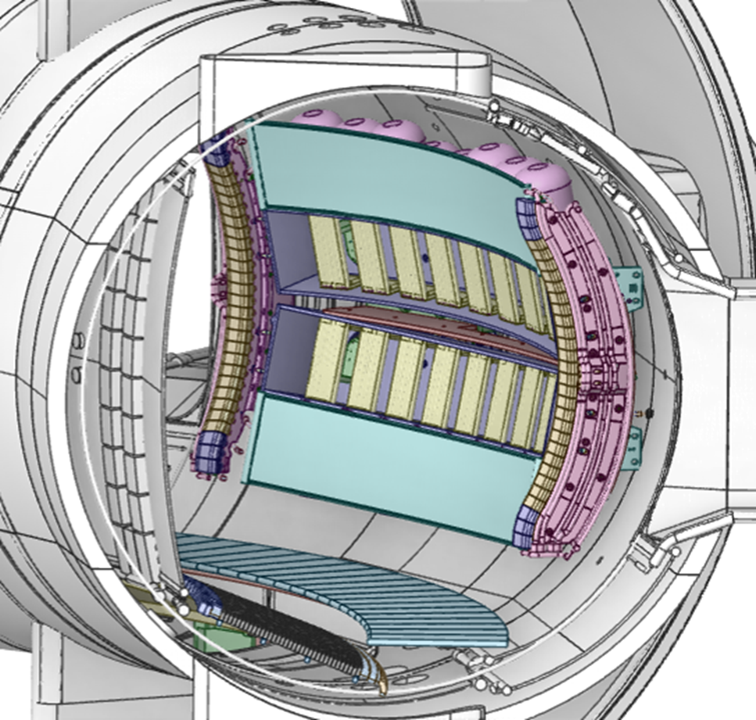
Travelling Wave Array bi-frequency operation as a flexible tool to tailor fast ion populations and excite Alfvén Eigenmodes (#196)
Proponents and contact person:
R. Ragona, L. Colas, V. Maquet, E. Lerche, J. Hillairet, R. Dumont, D. Van Eester, R. Sabot, S. Mazzi, P. Puglia.
Scientific Background & Objectives
  A Travelling Wave Array (TWA) in the Ion Cyclotron Range of Frequencies (ICRF) will be commissioned in WEST in 2027. It consists of 2 strap arrays stacked on top of each other, fed by two independant ICRF generators. Each array features a narrow k// spectrum, allowing localized frequency-dependant power deposition. These capabilities could be expoited to:
    spread the RF power deposition over a controllable radial range, effectively tailoring the production of non-confined fast-ions and/or taming turbulence (sawtooth pacing, ITG control, etc).
    excite Alfvén Eigenmodes via frequency beating (difference between ICRF frequencies of the two arrays) .
  Bi-frequency ICRF was already demonstrated, e.g. in JET. The TWA features a broader frequency bandwidth than conventional RF systems, allowing more flexible (possibly real-time?) operation.
  Objectives: demonstrate in open loop flexible
    RF heating optimization
    Control of temperature profile shapes and core MHD
    Flexible alternative method for Alfvén eigenmode excitation
Exp. Strategy / Machine Constraints and diagnostics
  LSN L-mode plasma of interest for scenario development. High Ip preferable for sawteeth.
  One TWA array operated at fixed frequency, fixed power for central heating.
  Session 1. Fixed frequency of second array scanned from pulse to pulse. Power modulations and/or breaks in slope to assess off-axis power deposition. Monitor core profiles, sawteeth and ion ripple losses over frequency scan. Try frequency steps / ramps in 1 pulse.
  Session 2. Fixed power levels scanned from pulse to pulse. Dynamic frequency wobulations of second array. Monitor Alfvénic activity destabilized by beat-waves using Mirnov coils, fast diagnostic acquisitions (ECE, interferometry), fast ion losses.
Proposal aims to exploit TWA hardware to be commissioned in 2027
Aimed at D7: identify AE control actuators
Quite speculative for now: wide parameter scans needed to assess if technique has required effects and if those effects (once observed) are significant
Careful planning of #194 may allow some data to be taken
P2 (TWA 2027)
CAD of 2-array TWA in WEST vacuum chamber
Proposed pulses
Device | # Pulses/Session | # Development
WEST | 2 Sessions (2027) | Scenario is ready, antenna to be commissioned

Slide 12
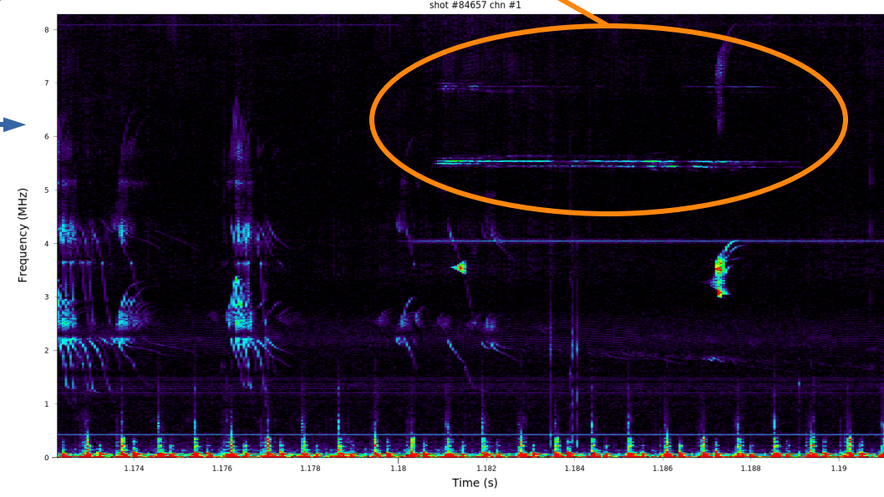
High frequency Alfvén eigenmode studies with ITER and JT-60SA relevant AE actuators (#197)
#84657, with possible GAE on TCV
Proponents and contact person:
rochouko@ipp.mpg.de Roman Ochoukov
Scientific Background & Objectives
  Addressed deliverables: D1, D3, D4, D7
  - Establish hf AE stability region on TCV in ω/ω_{ci} – v_{o}/v_{A} space
  - Modify q_{o} profile using ECCD on AUG and TCV
Experimental Strategy/Machine Constraints and essential diagnostic
  For TCV: use 84657 to establish scenario with steady GAE
  Modulate plasma parameters (B_{t}, n_{e}, T_{e}, NBI) to determine GAE stability boundary
  For both AUG and TCV: apply ECCD to discharge with steady GAE (36607 for AUG reference, 84657 for TCV reference), to modulate q-profile
  Rely on iMSE to measure q-profile modifications in presence of ECCD
  Rely on ICE diagnostic to characterize hf AE mode
Possible summary figures
The addition/improvement of ICE diagnostics to all machines has meant a good start to investigation of ICE←→FI interaction during 2025.
hf AEs are an area less well-documented from previous RT-09 work – diagnostics only available in more recent ops periods
This proposal therefore has merit from p.o.v. of D1 as well as well as D3/7
Combines well with #199 – TCV branch may be executed, AUG branch will need careful consideration – a number of required results can be obtained in PB
TCV part shots can be allocated., AUG part high prio but with reduced allocation of shots cf. request.
P1-TCV, P2-AUG
Proposed pulses
Device | # Pulses/Session | # Development
AUG | 15
MAST-U
TCV | 20 | 5
WEST

Slide 13
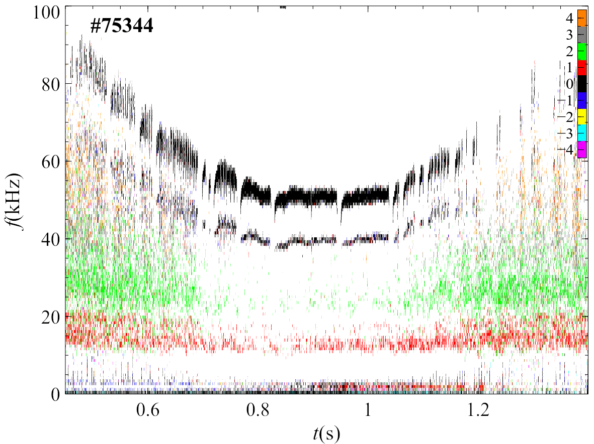
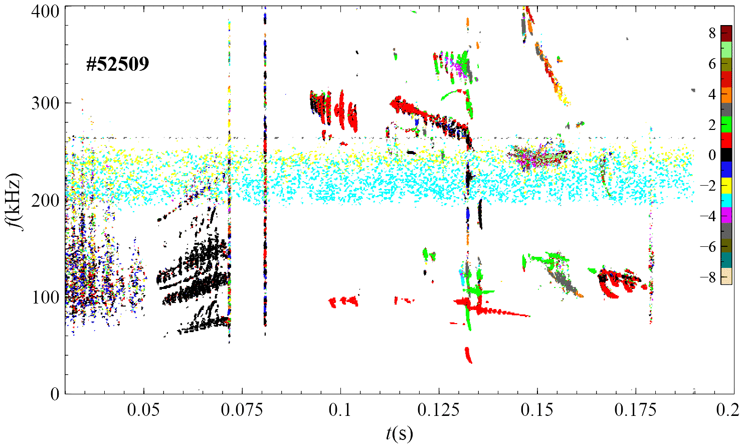
Investigation of stability and space structure of n=0 modes driven by energetic particles. (#198)
Proponents and contact person:
Mykola Dreval
mdreval@kipt.kharkov.ua
Scientific Background & Objectives
Clarify which experimental conditions lead to the observation of two unstable EGAMs simultaneously¹
Clarify conditions of excitation of EGAM at half frequency of GAM
Compare EGAM and GAM space structure
Role of q in EGAM excitation: EGAM is observed at elevated q in MAST-U and TCV
Clarify which experimental conditions lead to the observation of high frequency n=0 VDOM and GAE modes
Experimental Strategy/Machine Constraints and essential diagnostic
-Vertical plasma position (NBI deposition region) scan, elongation scan, ECRH power scan
-Mirnov coils used for n and magnetic field structure
-SXR used for spatial structure of mode density perturbations
- FILD, neutrons, ICE, FIDA, CNPA, (C-)ECE, (I-)MSE
Possible summary figures
Principally aligned with D7: Identify AE control actuators, with some relevance also to D3/4
n=0 modes observed previously on TCV and MAST-U… proposal is to start from previously identified scenarios and perform systematic scans.
Good starting point but could be expensive on shots to make significant progress
MAST-U part will combine well #193, TCV part should also combine reasonably with #200/201
P2
Fig. 1: Two coexisting EGAMs in TCV
Fig. 2: n=0 in MAST-U
Proposed pulses
Device | # Pulses/Session | # Development
AUG
MAST-U | 15 | 10
TCV | 30 | 15
WEST
¹M.B. Dreval et al 2025 Nucl. Fusion 65 016037

Slide 14
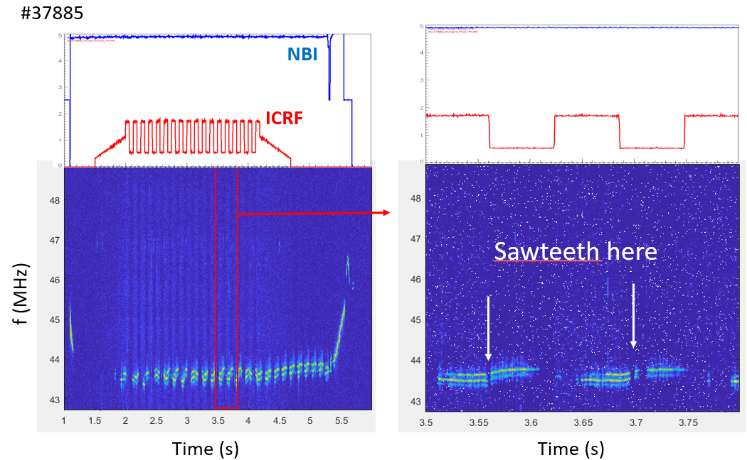
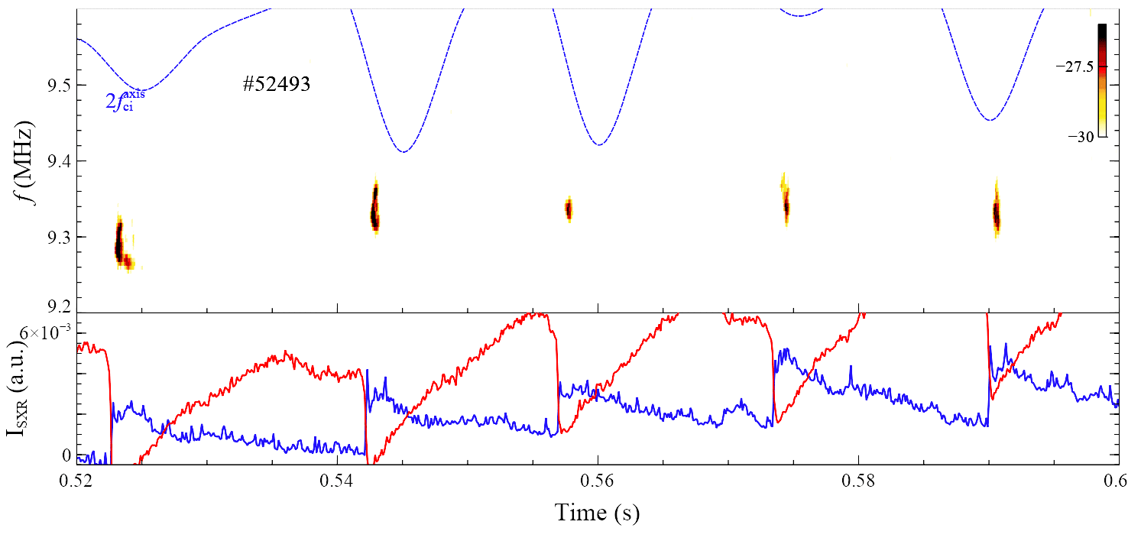
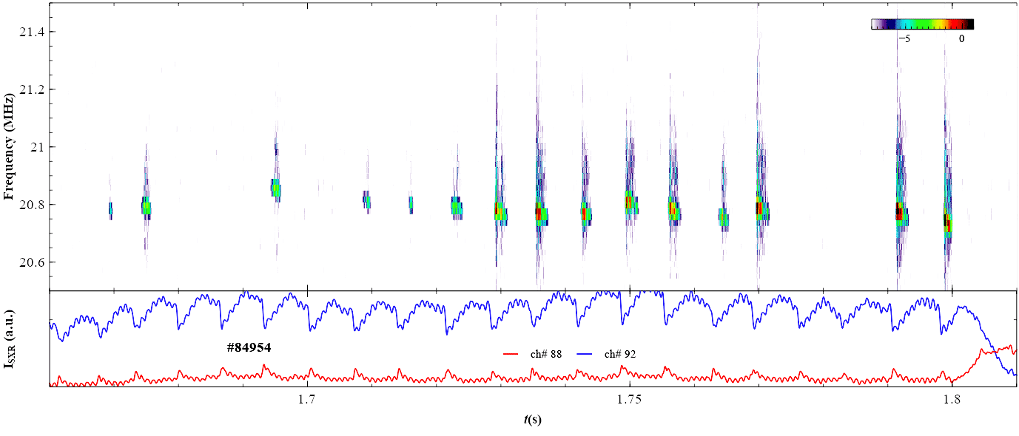
Cross-machine study of core ICE during sawtooth cycle (#199)
AUG 37885
AUG 37885
MU 52493
Proponents and contact person:
mdreval@kipt.kharkov.ua Mykola Dreval
Scientific Background & Objectives
  Addressed deliverables: D1, D3, D4, D7
  - AUG contains extensive shot database with sawteeth and core ICE
  - Results show co- and anti-correlation between core ICE strength and sawtooth cycles
  - Recently installed ICE diagnostics on TCV and MU now also detect core ICE in presence of sawteeth.
  Goal: determine dependence of core ICE activity on sawtooth phase/cycle
Experimental Strategy/Machine Constraints and essential diagnostic
  Establish reference discharge with sawteeth and steady core ICE: MU 52493, AUG 43009 (-2.5 T) or 37885 (-3.0 T), TCV 84954
  Use available actuators to modulate sawtooth cycle, such as NBI, ECCD, ICRF
  Monitor core ICE dynamics via ICE diagnostic
  Track q-profile via iMSE diagnostic
The addition/improvement of ICE diagnostics to all machines has meant a good start to investigation of ICE←→FI interaction during 2025.
Further exploitation of these diagnostics is a high priority to elucidate the
Combines well with #197 though AUG/MAST-U branch will need to be carefully considered
P1.5-TCV, P2-AUG/MAST-U
TCV
84954
Proposed pulses
Device | # Pulses/Session | # Development
AUG | 10
MAST-U | 10
TCV | 20
WEST

Slide 15
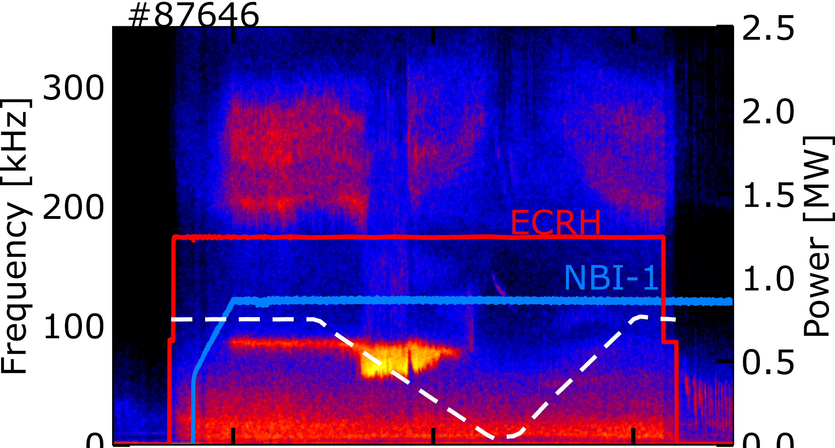
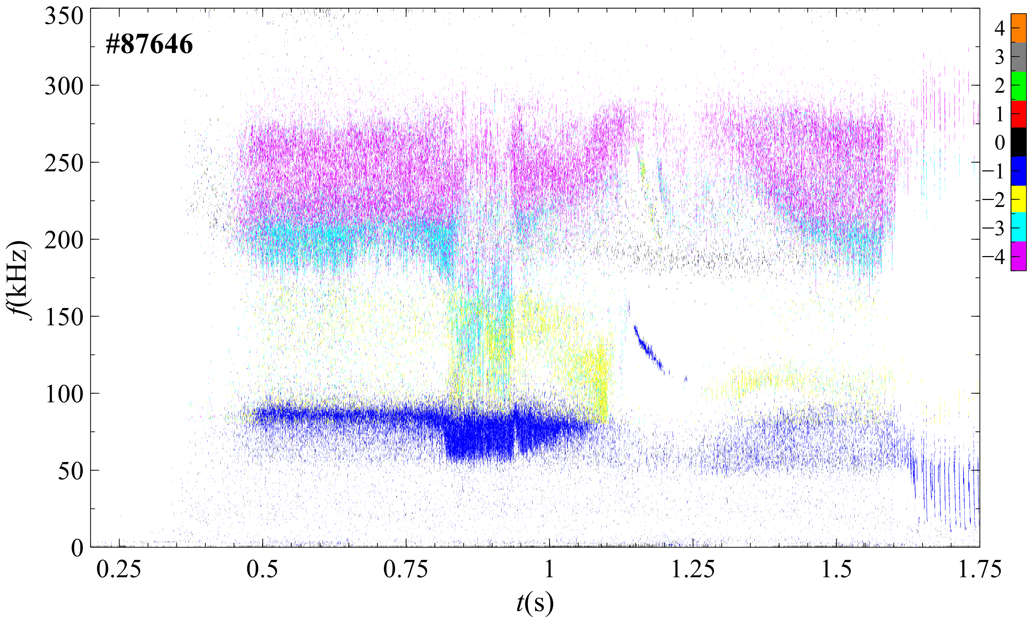
Systematic Control of Alfvén Eigenmodes in TCV Using Electron Cyclotron Resonance Heating (ECRH) (#200)
Anton Jansen van Vuuren (EPFL-SPC)
Co-proponents: J. Poley-Sanjuán, A. Karpushov, S. Mazzi, S. Sharapov, M. Dreval, M. L. Podestà, D. Testa
Scientific Background & Objectives
  Alfvén Eigenmodes (AEs) driven by energetic ions can degrade fast-ion confinement and heating efficiency, posing risks for ITER and DEMO performance. Recent TCV experiments demonstrated robust AE suppression via localized ECRH/ECCD, but the underlying stabilization mechanism—thermal-gradient versus magnetic-shear modification—remains unresolved.
  Main objectives:
  Perform systematic ECRH deposition scans in an established AE-active TCV scenario.
  Use the new Motional Stark Effect (MSE) diagnostic to measure q-profile and magnetic shear evolution.
  Correlate AE suppression with local shear changes to identify the dominant control mechanism.
Experimental Strategy/Machine Constraints and essential diagnostic
  Scenario:
  Established AE-active TCV plasma with NBI drive (Iₚ = 120 kA, Bₜ = 1.3–1.5 T, δ ≈ +0.3).
  Systematic ECRH scans: ρ= 0.2–0.7, multiple power levels.
  ~20 shots (≈ 10 development).
  Essential diagnostics:
  Mirnov arrays – AE amplitude and spectra
  MSE – q-profile & magnetic-shear evolution
  FILD / FIDA / ICE – fast-ion losses and redistribution
  Thomson / ECE – Te, ne, and ECRH deposition validation
Control/suppression of AEs and the resultant FI loss/redistribution is a primary aim of RT-09
This proposal should therefore feature highly within the TCV experimental branch.
P1-TCV
Proposed pulses
Device | # Pulses/Session | # Development
AUG
MAST-U
TCV | 20 | 10
WEST

Slide 16
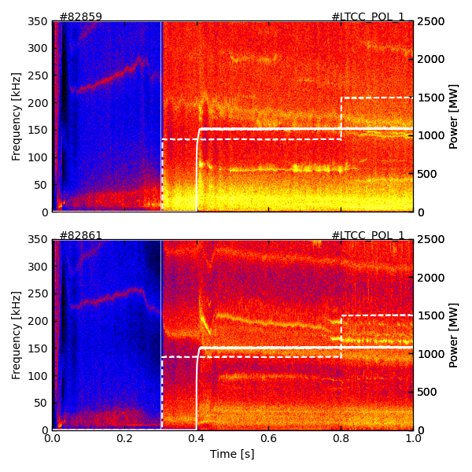
Impact of Plasma Shaping on Fast-Ion Confinement and Alfvén Eigenmode Control in the TCV Tokamak (#201)
Magnetics
NT: 82859
Proponents
  Anton Jansen van Vuuren, M. L. Podestà, J. Poley-Sanjuán, A. Karpushov, M. Rud, Q. Kernel, S. Mazzi, S. Sharapov, M. Dreval, D. Testa
Scientific Background & Objectives
  Plasma shaping (triangularity, elongation, squareness) has a strong impact on MHD stability and fast-ion confinement.
  Previous TCV experiments showed comparable fast-ion confinement in NT and PT plasmas but revealed AE activity sensitive to shape and profile control
  This proposal aims to determine how shaping affects AE excitation, frequency spectrum, and damping, and to identify conditions for AE suppression using ECRH/ECCD.
Experimental Strategy/Machine Constraints and essential diagnostic
  Perform shaping scans (δ ≈ –0.4 → +0.4, κ ≈ 1.3–1.8) in NBI-heated plasmas to study AE stability and fast-ion confinement.
  Apply localized ECRH/ECCD to test AE suppression and q-profile sensitivity.
  Use FIDA, FILD, ICE coils, Mirnov arrays, and reflectometry for comprehensive AE and fast-ion characterization.
Understanding the role of plasma shaping in moderating MHD (and thus FI loss/redistribution) is related to D7 as shaping and scenario can be classed as an actuator.
Work started in 2024/25 investigating PT vs. NT – this proposal looks to extend the work
A sound extension to work done previously though lesser prio than other proposals.
P2
PT: 82861
TAE
Proposed pulses
Device | # Pulses/Session | # Development
AUG
MAST-U
TCV | 25 | 5
WEST

Slide 17
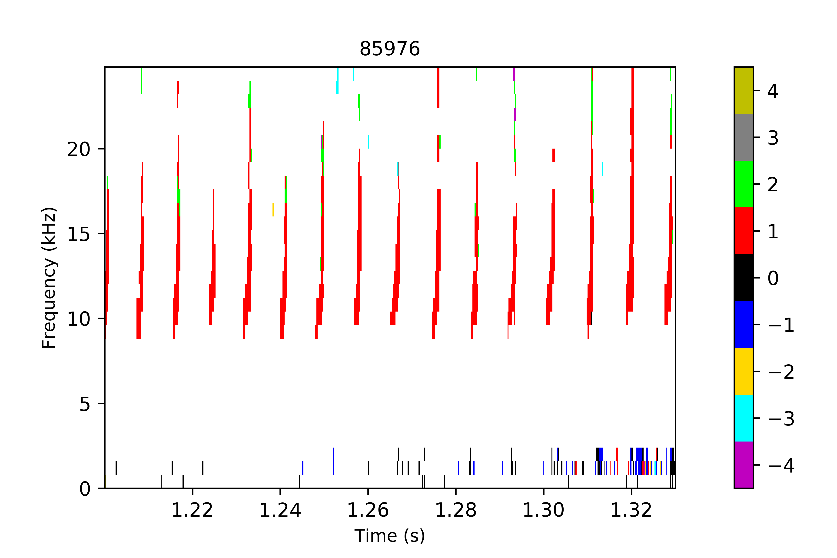
Fishbones with Upward Sweeping on TCV (#202)
An example of the upward-sweeping fishbones
Proponents and contact person:
Sergei.Sharapov@ukaea.uk
Scientific Background & Objectives
  Some TCV discharges exhibited recently an extremely rare phenomenon, fishbones with upward sweeping. Although such fishbones were observed for the first time experimentally (to my knowledge), theory has predicted possibility of such fishbones in 2001. The possible change in the frequency sweeping is likely to be caused by the dominant role of MHD nonlinearity in the vicinity of the q=1 surface. This is in contrast to the “usual” fishbones with dominant wave-particle nonlinearity that causes a down-sweep of the frequency.
  Objectives: establish the parameter space and conditions for the upward sweeping fishbones. Investigate possibly very different nonlinear effects in such fishbones (e.g. a sawtooth-type reconnection followed by NTM triggering, in contrast to the radial redistribution of energetic ions in the usual fishbones).
Experimental Strategy/Machine Constraints and essential diagnostic
  The Reference discharge is #85976
  Density scan in similar plasma configuration
  Thomson scattering, CXRS, NPA, SXR, ECE imaging as essential diagnostic
Upward frequency sweeping is a newly observed phenomenon
Whilst recognised that this is an important observation in terms of confirmation of a point of theory, not directly relevant to RT deliverables
P2
Proposed pulses
Device | # Pulses/Session | # Development
AUG
MAST-U
TCV | 20/2 | 10/1
WEST

Slide 18
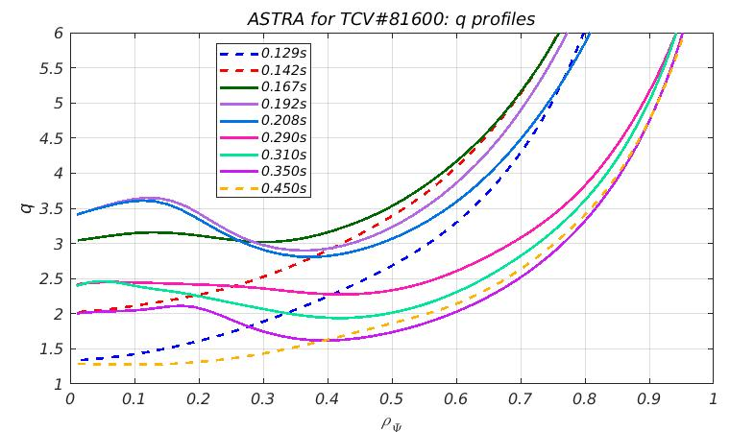
Density versus Temperature ITBs in TCV (#203)
Evolution of q-profile in these reversed-shear TCV plasmas
Proponents and contact person:
Sergei.Sharapov@ukaea.uk
Scientific Background & Objectives
  During previous RT09 experiments on TCV on “Physics understanding of energetics particles confinement and their interplay with thermal plasma” a number of transient ITBs was observed. Some of these ITBs were in plasma density, but not in temperature (similar to, e.g. C-MOD), and other – in temperature, but not in density (like on JET). Technically, the switch on TCV was simple. However, we still don’t understand how this switch works as not all diagnostics were available and more data is needed.
Experimental Strategy/Machine Constraints and essential diagnostic
  Type of plasma scenario or parameter explored to answer the main questions: Reference pulse #81511
  Scan in vertical position of plasma with dominant NBI heating
  Thomson scattering, CXRS, MSE, and NPA are essential diagnostic
ITBs not a topic within the RT-09 deliverables.
Propose move to RT-08
Proposed pulses
Device | # Pulses/Session | # Development
AUG
MAST-U
TCV | 20/2 | 10/1
WEST

Slide 19
(#204)
ICE measurements are a topic of interest for RT-09 on TCV/AUG/MAST-U
Potential to extend this to WEST is attractive
Limited expt. Time and lack of other FI diagnostics on WEST makes this potentially less viable
Suggest experimental diagnostic technique is implemented via internal prog. Utilised in PB with RT-09 WEST experimental branch.
Careful planning of #194 may allow some data to be taken
PB (TWA 2027)

Slide 20
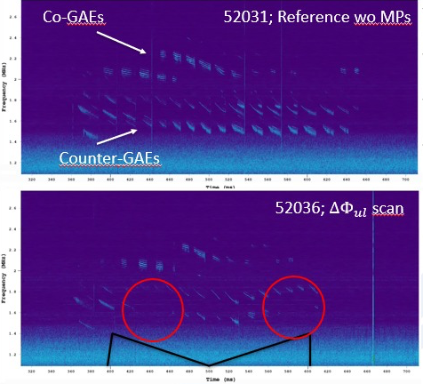
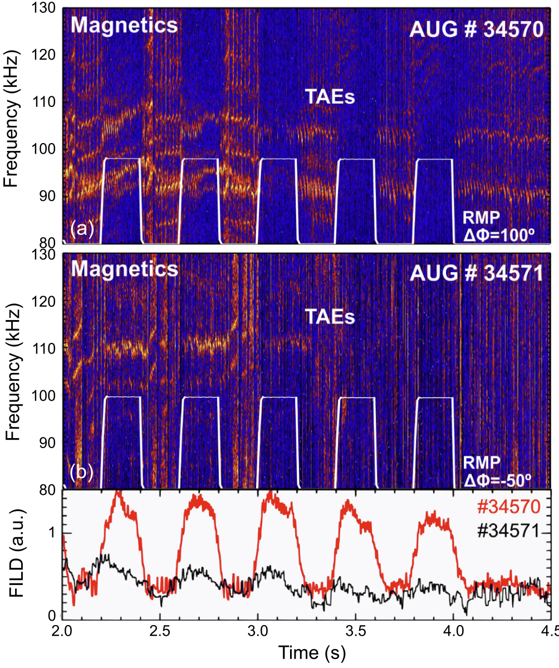
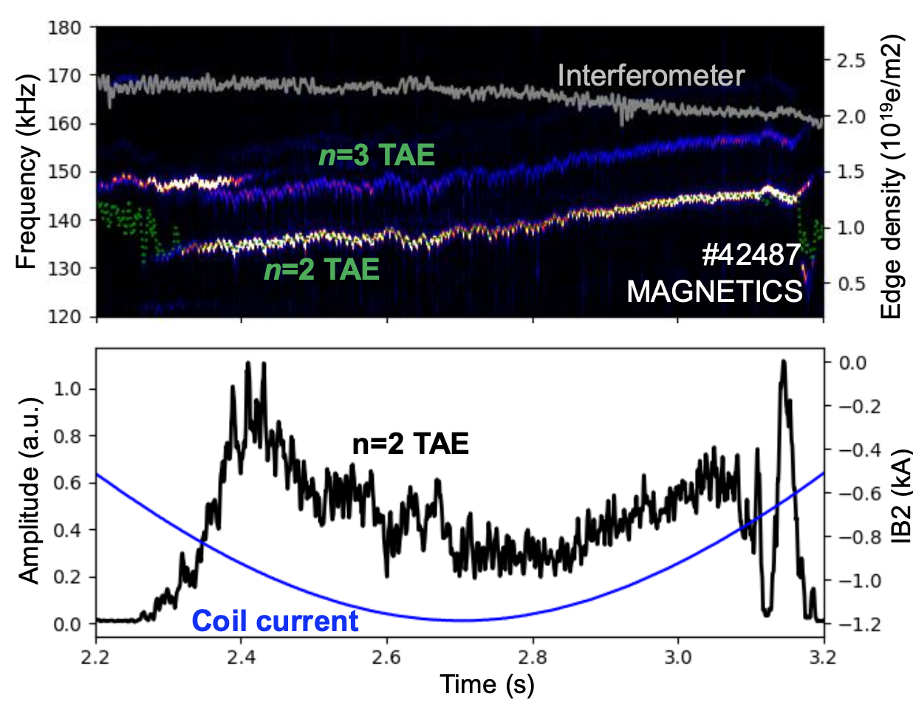
Optimization of active control of Alfvén Eigenmodes with externally applied 3D fields (#205)
GAEs Impacted by MPs in MAST-U
Proponents and contact person:
J. Gonzalez-Martin jgonzalez62@us.es
(full list in the wiki)
Scientific Background and Objectives
Expand control towards ICRH-driven AEs and high frequency AEs
Study impact on the global FI distribution
In AUG:
Control of high frequency AEs
Control of ICRH-driven AEs
Leveraging INPA capabilities
In MAST-U:
Control of high frequency AEs
Experimental Strategy/Machine Constraints and essential diagnostics
FILD, FIDA, INPA, and other fast-ion diagnostics are essential
In MU, special settings for IR thermography
Scans in MP differential phase
AUG: AE active control using n=2 [1]
This can be added to the RT-09 “3D fields block” of experiments
Spans AUG and MAST-U – both considerably oversubscribed by proposals.
Combine with #192
Some of AUG part may be possible to combine with aspects #195. RTCs/TFLs to consider further together with Proponents.
Similarly with all AUG proposals, careful planning will be needed to see what can be achieved amongst hi Prio. proposals in limited shots
P1-AUG, P1-MASTU
ICRH Driven AEs modulated by MPs in AUG
Proposed pulses
Device | # Pulses/Session | # Development
MAST-U | 14 | 0
AUG | 17 | 4
[1] J. Gonzalez-Martin et al., Phys. Rev. Lett (2023)

Slide 21
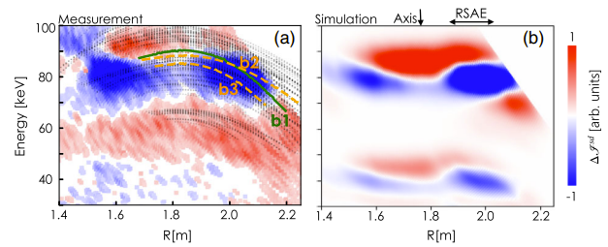
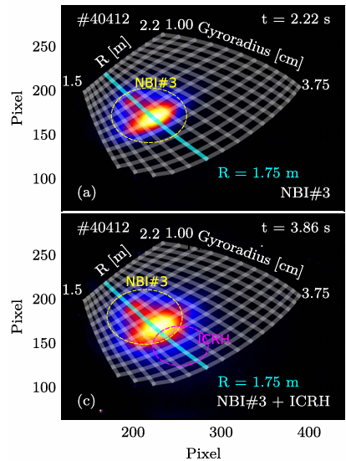
Investigation of phase-space flows induced by TAEs on ICRH heated plasmas (#206)
DIII-D INPA
measurement vs simulation
AUG INPA signals including ICRF
Proponents and contact person:
A. Reyner-Viñolas: alereyvinn@alum.us.es
(full list in the wiki)
Scientific Background and Objectives
Background: In DIII-D [X.Du PRL 2021] and AUG [J.Rueda NF 2024] phase space flows of NBI fast-ions induced by TAEs visualized using INPA diagnostic
Goal: use unique capabilities of AUG’s INPA diagnostic to measure this in ICRF fast-ion populations with high temporal resolution
Experimental Strategy/Machine Constraints and essential diagnostics
Reference scenario well established from WPTE 2021/22: ICRF driven TAEs w. counter-ECCD
Scan NBI power and sources (for 2nd harmonic D heating)
Monitor fast-ion distribution with whole suite of diagnostics: INPA, FIDA, FILDs, ICE, …
Proposed INPA measurements could prove a beneficial technique furthering RT-09 interests
Suggest experimental diagnostic technique is implemented/commissioned via internal prog. and utilised in PB with RT-09 AUG experimental branch with expt’s ensuring a suitable RF heated plasma phase is present.
PB
Proposed pulses:
Device | # Pulses/Session | # Development
AUG | 8 | -

Slide 22
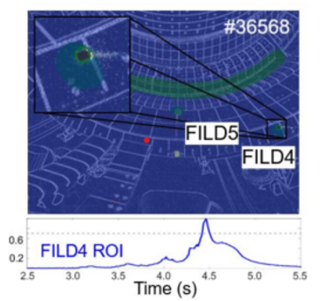
Exploitation of FILD4 real-time positioning capabilities (#207)
Proponents and contact person:
  L. Sanchis (full list in wiki)
Scientific Background & Objectives
Background: FILD 4 has recently proved its ability to move during plasma pulses and to radially measure MHD induced fast-ion losses
This proposal:
  Testing the FILD4 real-time control algorithms based on the VRT cameras
  Exploiting the active-positioning capabilities of FILD4 to obtain radially resolved measurements of fast-ion losses due to MHD perturbations
Experimental Strategy/Machine Constraints and essential diagnostic
  FILD4 as essential diagnostic
  Mostly piggyback shots. Only specific dedicated shots for testing ICRF power, USN vs LSN comparison and fine-tunning the control algorithm
Whilst the diagnostic technique looks potentially useful to RT-09 expts. The commissioning and demonstration of the technique should be an internal prog. activity
Exploitation of the diagnostic, once proven is then potentially of interest to WPTE
To assist, it recommended as much of this proposal as possible is executed in PB to the principal experiments.
PB
IR signal emitted by FILD4 (Upper). DCS aborts the discharge once the ROI signal reaches the threshold (Lower) . [J. Gonzalez-Martin]
Machine | Already explored | More work needed
AUG | FILD 4 capability for radial scans has already been commissioned | Testing the FILD4 real-time control algorithms based on the VRT cameras
Proposed pulses
Device | # Pulses/Session | # Development
AUG | 6 (+ piggyback)

Slide 23
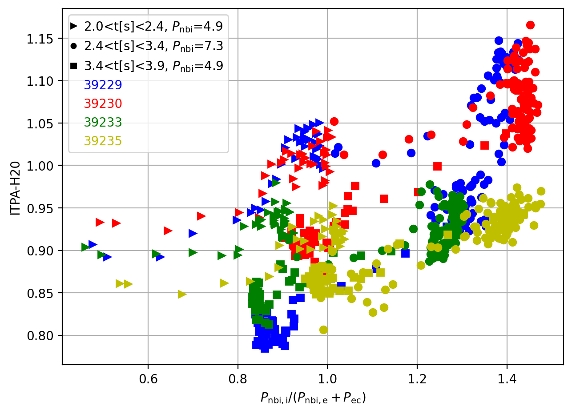
Fast-ion effects on core turbulence at different P_{i}/P_{e} on ASDEX Upgrade (#208)
Proponents and contact person:
  Roberto Bilato et al (see full list in wiki)
Scientific Background & Objectives
  The aim is to investigate the effects of NBI/ICRF fast ions (FIs) on core transport for different levels of turbulence (D2), which is controlled by changing the Pe/Pi ratio, where Pe and Pi are the auxiliary heating power to electrons and ions, respectively. The ultimate objective is to generate a set of well-diagnosticed discharges (D1), which will then be analysed using gyrokinetic codes interfaced with transport codes (D4). It also considers the FI impact on core turbulence mediated by FI-driven MHD instabilities, such as Fishbones (D3).
Experimental Strategy/Machine Constraints and essential diagnostic
This study uses the same scenarios developed in the frame of 2025-2026 proposal. All the three heating system of AUG should be available. The discharges are divided into three sets for analysis.
  (LSN, 0.8MA, -2.5T) Impact of P_{e}/Pi on plasma profiles when the FI content is kept constant (P_{nbi} and P_{icrf} constant) and P_{e}/P_{i} is varied by varying P_{ec} - the total auxiliary power, P_{aux}, is not constant.
  (LSN, 0.8MA, -2.5T) Impact of P_{e}/Pi when P_{aux} is the same (P_{icrf} replacing P_{ecrf}) and the FI content unavoidably varies.
  (USN, 0.8MA, +-2.5T) Impact of the gradB drifts: fav. vs unfav. configuration.
  (LSN, 0.4MA, -2.5T) Comparison with low-density (low plasma current) discharges where the dilution effect is more important.
  Diagnostics:
  Characterization the fast-ion population with NPA, FIDA, and FILD diagnostics.
  Good measurements of plasma profiles for n_{e}, T_{e}, T_{i}, and v_{tor}.
  Possibly Er measurements (CXRS and DR).
Continuation of a successful AUG expt from 2025
Recommend adoption of this proposal to complete the dataset aimed at elucidating the mechanisms of core-turbulence stabilisation
Similarly with all AUG proposals, careful planning will be needed to see what can be achieved amongst hi Prio. proposals in limited shots
P1-AUG
Proposed pulses
Device | # Pulses/Session | # Development
AUG | 10

Slide 24
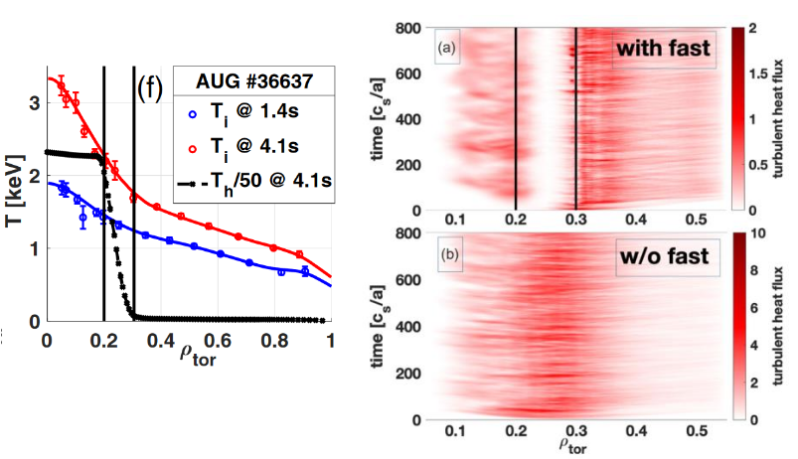
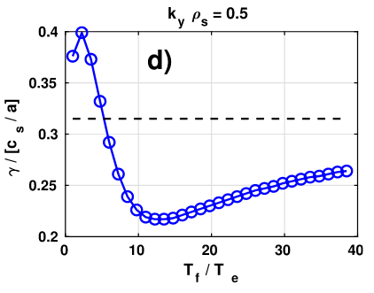
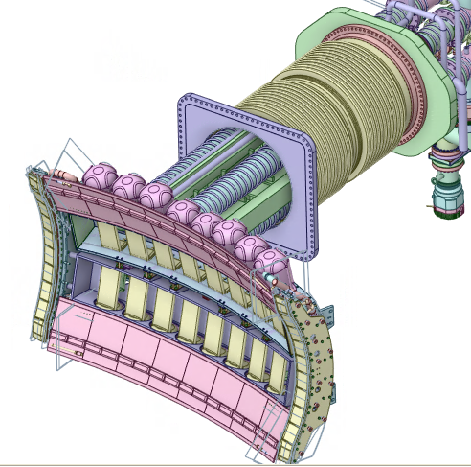
Fast-ion stabilization of ITG in WEST with TWA (#209)
Proponents and contact person:
Riccardo Ragona et al (see full list on wiki)
Scientific Background & Objectives
  GENE simulations and AUG experiments indicate possible linear mechanism for ITG turbulence mitigation via “slow” fast ions (FIs)
  New (operational in 2027) ICRF TWA launcher system allows possible control of Fis distribution via large frequency sweeping (innovative feature)
  Possible control of ITG? Threshold? Single actuator?
  The aim is to investigate the effects of ICRF FIs on core transport (D2).
  The main objective is to validate and extend the results obtained in AUG on the FI impact on core turbulence mediated by FI-driven instabilities (D3).
  An additional objective is to contribute to multi-machine database for gyrokinetic simulations interfaced with transport codes (D4).
Experimental Strategy/Machine Constraints and essential diagnostic
  Define WEST scenario (DN or LSN)
    Variation of dual-frequency scenario, high Ip, EC beneficial (if not essential)
    AUG as canvas – minority concentration is key
  Scan f-sweep amplitude and frequency
    Constant B – different central frequency – power steps (thresholds)
    Monitor impurity content
  Main diagnostics for plasma performance
    TS, fast-ECE, Fis-related PWI coverage (edge spectroscopy, divertor diag., …)
Possible summary figures
TWA commissioned in 2027
Scan over amplitude and frequency to determine effect on possible stabilization of the ITG instability
Potentially addresses several Sci. Obj. (2/3/4) and adds to similar AUG data for the multi-machine “flavour”
Potentially suffers from lack of direct FI diagnostics on WEST – relies on other measurements + modelling to interpret
Careful planning of #194 may allow some data to be taken
P2 (TWA 2027)
Di Siena PRL 127 (2021)
Di Siena POP 26 (2019)
Proposed pulses
Device | # Pulses/Session | # Development
AUG
WEST | 1 session (2027)

Slide 25
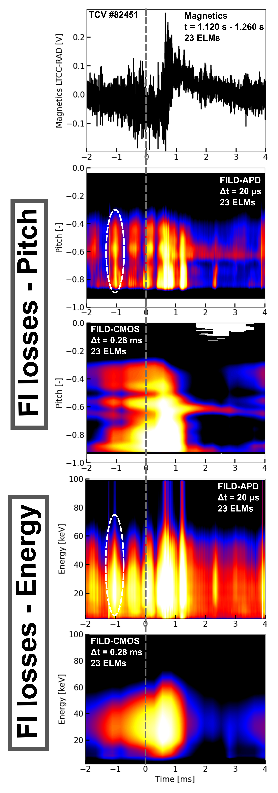
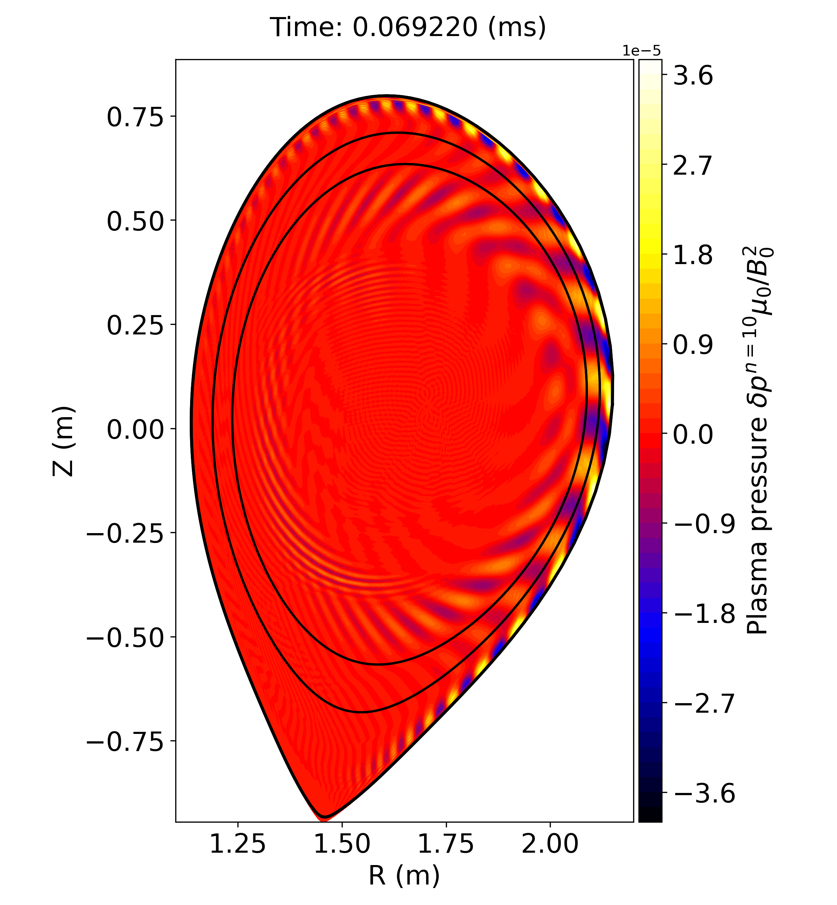
Characterization of the interplay between fast ions inter-ELM MHD activity and ELMs (#210)
Proponents and contact person:
J.Poley-Sanjuan (jesus.poley@epfl.ch) & M.Jimenez-Cómez (mjimenez37@us.es)
Scientific Background & Objectives
Background:
AUG: hybrid kinetic-MHD simulations suggest interplay between ELM and TAE close to the edge.
TCV: experimentally, fast-ion losses correlated with inter-ELM MHD activity observed in low vs high collisionality plasmas
Goals:
Investigate interplay between ELMs, inter-ELM MHD activity and fast-ions.
Experimental Strategy/Machine Constraints and essential diagnostic
AUG: develop scenario with NBI driven TAEs as much off-axis as possible to maximize ELM-AE interaction
TCV: Follow-up experiments attempting to minimize inter-ELM MHD activity using ECRH (for comparison with previous experiments). Compare scenarios with on- vs off- axis fast-ion distributions.
ELM effects on FI loss studied previously – this proposal intends to extend experimental work to a level of control of AE←→ELM loss mechanisms
TCV proposes scans in ECRH position (on to off-axis) and NBI energy.
AUG proposes to shift NBI off-axis by adjusting NBI geom. and plasma posn.
TCV branch looks more feasible – though AUG part may still fit with other proposals in a combined expt.
P2
AUG – MEGA simulation
TAE
ELM
Interaction layer
Proposed pulses
Device | # Pulses/Session | # Development
AUG | 12 | 4
TCV | 5 | 10

Slide 26
Prio. Summary and pulse allocation

Slide 27
Priority ratings
# | Title | Proponent(s) | Priority
191 | Study of hot ion mode on MAST-U | F. Orsitto, S. Blackmore, et al. | 3.00
192 | Optimization of fast-ion confinement in tokamaks with externally applied 3D fields | Joaquin Galdon | P1-MASTU, P1.5-AUG
193 | Fast-ion losses induced by edge instabilities across different confinement regimes | Joaquin Galdon | PB
194 | Impact of Toroidal Alfvén Eigenmodes on Plasma Core Turbulence and Confinement | Paulo Puglia, Samuele Mazzi. | P1-TCV, P1-WEST
195 | Development of alpha-particle measurements in support of JT-60SA and ITER rebaseline | Yevgen Kazakov, Massimo Nocente | P1-AUG
196 | Travelling Wave Array dual-frequency operation as a flexible tool to tailor fast ion populations and excite Alfvén Eigenmodes | Samuele Mazzi,Laurent Colas, et al. | P2 (TWA 2027)
197 | high frequency Alfven eigenmode studies with ITER and JT-60SA relevant AE actuators | Roman Ochoukov | P1-TCV, P2-AUG
198 | Stability and space structure of n=0 modes driven by energetic particles | Mykola Dreval | 2.00
199 | Cross machine study of core ICE during sawtooth cycle | Mykola Dreval | P1.5-TCV, P2-MASTU
200 | Alfvén Eigenmode Control in TCV via Systematic ECRH Scans | Anton Jansen van Vuuren | P1-TCV
201 | Impact of Plasma Shaping on Fast-Ion Confinement and Alfvén Eigenmode Control in the TCV Tokamak | Anton Jansen van Vuuren | 2.00
202 | Investigation of Upward Sweeping Fishbone modes on TCV | Sergei Sharapov | 2.00
203 | Investigation of internal transport barriers induced on TCV | Sergei Sharapov
204 | Measurements of Ion Cyclotron Emission in WEST | Bernard B.C.G. Reman, Dmitry Moseev, et al. | PB (TWA 2027)
205 | Optimization of active control of Alfvén Eigenmodes with externally applied 3D fields | Javier Gonzalez-Martin | P1-AUG, P1-MASTU
206 | Study of phase-space islands induced by MHD fluctuations using the INPA diagnostic | Alex Reyner-Viñolas | PB
207 | Exploitation of FILD4 real-time positioning capabilities | Lucia Sanchis | PB
208 | Fast-ion effects on core turbulence at different Qi/Qe on ASDEX Upgrade | Roberto Bilato | P1-AUG
209 | Fast-ion stabilization of ITG in WEST with TWA | Riccardo Ragona Roberto Bilato et al. | P2 (TWA 2027)
210 | Interplay of Fast Ion MHD ELMs | Javier Gonzalez-Martin | 2.00

Slide 28
P1 pulses/allocation
 | TCV (Scientific) | TCV (Sce dev.) | TCV (Total) | AUG | AUG (Pulse for Sce Dev) | AUG (Session total) | MAST-U (Scientific) | MAST-U (Sce dev.) | MAST-U (Total) | WEST (Scientific) | WEST (Sc. Dev) | WEST (Total) (Total 2026)
Tot. Requested | 60 | 40 | 100 | 64 | 6 | 70 | 43 | 0 | 43 | 40 | 20 | 60
Prov. Alloc. |  |  | 160 |  |  | 32 |  |  | 16 |  |  | 15
Factor |  |  | 0.63 |  |  | 2.2 |  |  | 2.7 |  |  | 4
TCV: space to execute also an amount of the Priority 2 proposals (145 pulses total)
AUG: some down-selection/combination needed
MAST-U/WEST: consolidation of which parts of proposals to execute needed – Some indication shown in assessments (i.e. some machines rated higher prio within individual proposals),but further work for TFL/RTCs

Slide 29
Initial grouping
High level topics | Proposal #
3D Fields and ELMs | 192, 193, 205
Core AE control and suppression | 200, 206, 207, 197, 198, 199, 202
Core turbulence control | 194, 208
AUG alpha measurements | 195
WEST expt. branch | 194, 196, 204, 209
Within a group, RTCs will allocate pulses-per-machine to the group.
P1 proposals already account for >100% of allocated pulses on AUG/MAST-U/WEST
Implies careful planning to ensure principal points of P1 proposals are covered: combine shots where possible, select specific physics to dedicate specific pulses where not
Experiments will be planned principally with P1 proposals in mind but P2 will be included where pulses may be adapted with no risk to P1 or (esp. TCV) where pulses available not required by P1.

Slide 30
Analysis and Modelling needs
Together with participation proposals for executing experiments based on the presented proposals, analysis & modelling needs for the RT (list defined within the call documents) are as follow:
Fast Ion Orbits, resonances and distribution function, Heating and fast-ion sources (ICRH, NBI)
  E.g. ASCOT TRANSP/NUBEAM, TORIC-SSFPQL, PION, Ebdyna,…
Interpretive modelling
  E.g. ASTRA, RAPTOR, ETS,…
Improved/RT equilibrium
  E.g. CLISTE, CHEASE, CREATE-NL
Pedestal Stability
  EPED,Europed,ELITE, MARS,..
MHD stability and Nonlinear MHD, response to RMP
  MHD(MISHKA, VMEC,…); Nonlinear(MEGA, JOREK,…); RMP(MARS-F, VMEC,…)
Synthetic diagnostics and tomography
  FIDASIM, FILDSIM, Velocity space tomography
Core Gyrokinetic
  E.g. GENE, GS2,…

