Slide 1
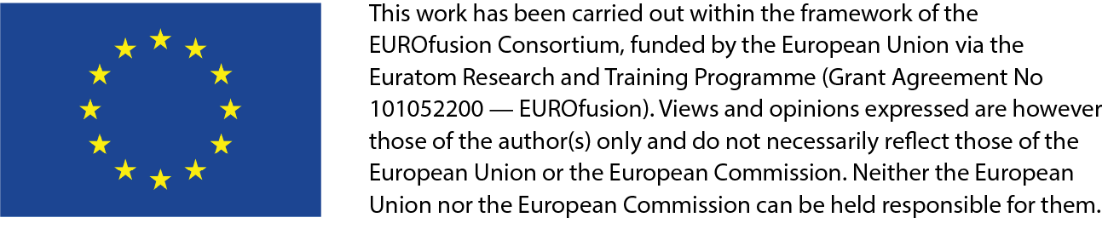
RT-03 Strategies for disruption and run-away mitigation
Discussion on proposals and allocated priorities
rTFLs: V. Igochine, A. Hakola
On behalf of the WPTE TFLs E. Joffrin, M. Wischmeier, M. Baruzzo, A. Kappatou, D. Keeling, A. Hakola, B. Labit, E. Tsitrone and N. Vianello

Slide 2
Introduction
ITER
DEMO
RT01: Core-Edge-SOL integrated H-mode
RT02: Alternative to type-I ELM regimes
Physics & Control integration
RT03: Disruption & RE mitigation strategies
RT04: Machine generic integrated control
RT05: Physics of divertor detachment
RT08: Physics of high β long pulse scenario
RT06: preparation of efficient PFC operation
RT09: Physics of energetic particles
RT07: Alternative divertor configuration
PEX
Mission 1
Mission 2

Slide 3
Scientific objectives and machine time
Scientific Objectives
D1 Optimize disruption mitigations by single and multiple shattered pellet injection (SPI) at high plasma current and energy content in an all-metal environment to validate the ITER disruption mitigation strategy
D2 Quantify the required neon quantity for SPI into dilution cooled plasmas for sufficient thermal and current quench mitigation in ITER and the synchronisation requirements for dual deuterium/neon SPI in ITER
D3 Characterize/optimize the RE impact mitigation schemes and flushing effect with different deuterium injections techniques
D4 Determine the physics mechanisms generating run-away electrons in the current quench and in the plasma start-up phase
D5 Interpretative modelling of disruption mitigation dynamics (TSVV-8, TSVV-9) and prediction for ITER
D6 Quantify the radiation asymmetry during disruption mitigation with SPI
D7 Validate the modelling of image currents in conducting structures during disruption with halo current measurements
The scientific objectives were revised and renumbered to emphasise advances and focus attention on the most important ITER problems.

Slide 4
Scientific objectives and machine time
New Scientific Objectives
D8 Develop an understanding of pellet assimilation for plasma densification in shattered pellet injection (SPI) experiments to avoid runaway electron (RE) generation
D9 Develop an understanding of SPI dynamics in off-normal plasmas, such as close to density limit and/or during impurity accumulation
D10 Determine the physics mechanisms leading to benign termination of RE with H and D, specifically in the ITER relevant parameter range
D11 Determine the physics mechanisms generating run-away electrons in the current quench, including during a vertical displacement event (VDE), and in the plasma start-up phase, including electron cyclotron (EC) pre-ionization and EC-assisted burn-through
D12 Perform interpretative modelling of disruption mitigation dynamics, specifically aiming at physics understandings of experimental measurements to extrapolate models to ITER (in collaboration with TSVV-F)
D13 Characterise disruption loads, in particular during VDEs, to improve predictions for ITER
D14 Investigate the role of plasma phenomena (turbulence, MHD, waves, fast ions etc) on the transport and confinement of REs
 | AUG | TCV | MAST-U | WEST
2026 -27 | 62 | 205 | 0 | 75
Nominated Research Topic Coordinators:
O. Ficker, C. Reux, U. Sheikh, IO
Allocation of discharges (tentative)

Slide 5
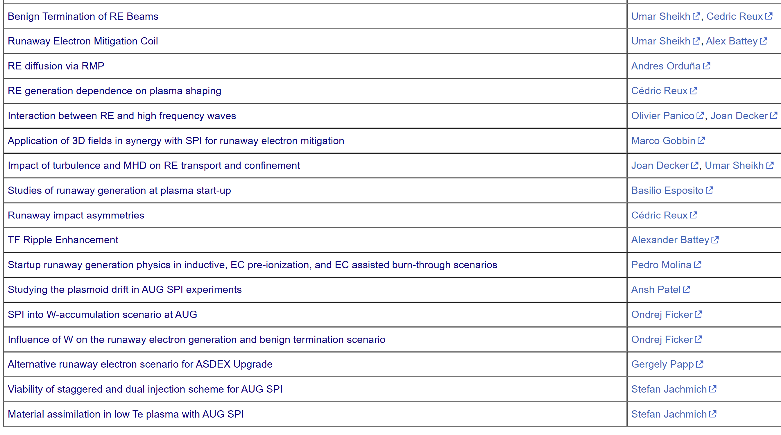
Summary of the proposals
Requested discharges vs. allocation
Device | # Scientific pulses | # Development pulses | # Allocated pulses | Overbooking fraction
AUG | 129 | 20 | 62 | 2.4
TCV | 190 | 65 | 205 | 1.25
WEST | 96 | 20 | 75 | 1.4

Slide 6
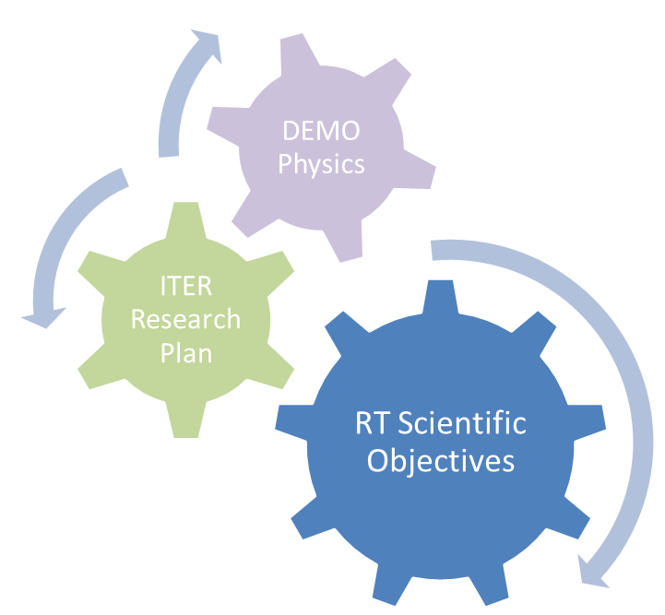
Prioritization scheme
All these aspects were considered by the TFLs when setting the priorities – according to the following scheme
  P1-2026-DEV: experimental priority for 2026: machine time granted but pulse budget might need reduction
  P1-2027-DEV: experimental priority for 2027: machine time granted but pulse budget might need reduction
  P2-DEV: will be done if time allows after *all* P1 proposals are completed
  P3: low priority programme/out of scope
  PB: piggy-back experiment/pure analysis proposal
Evaluated according to the criteria:
Meeting the set Scientific Objectives
Size and feasibility
Team effort

Slide 7
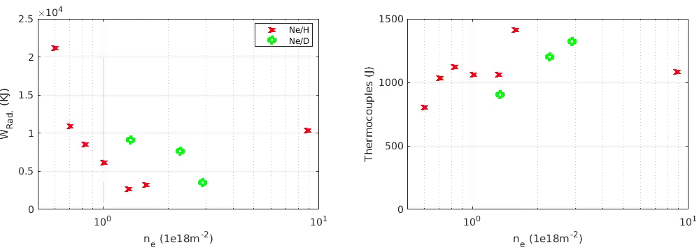
P36: Benign Termination of RE Beams
Proponents and contact person:
  Umar Sheikh (umar.sheikh@epfl.ch) et al.
Scientific Background & Objectives
  Benign Termination by D/H injection has scaling limits.
    The upper pressure limit is critical but unknown, as ITER's scheme exceeds preliminary predictions.
  TCV showed the RE final collapse depends on the hydrogenic species, not just density. This species effect is vital for ITER to understand (figures →).
  Modelling is starting to shed light on the mechanisms at the final collapse (see Sheikh IAEA FEC 2025)
Experimental Strategy etc:
  Establish the upper neutral pressure limit necessary for successful benign termination of the RE beam on AUG and WEST
  Systematically vary the ratio and timing of Ne and D2 injections to optimize the process and understand recombination timescales on TCV
  Determine why H and D lead to different final collapse dynamics (e.g., by changing resistivity without altering ne) on TCV and WEST
  Use new diagnostics (e.g., IR camera views) to get 3D information on the final RE beam collapse and study how the toroidal asymmetry evolves on TCV
  Compare the time to recombination using SPI vs. MGI on AUG
  Develop new benign termination scenarios on TCV: using pure D2​ only, and limiterless compression
Higher Wrad
at lower ne
Lower conducted
energy at lower ne
Device | # Pulses/Session | # Development
AUG | 8 | 4
TCV | 30 | 13
WEST | 30 | 4
V. Igochine| WPTE 2026-2027 Programme Meeting | 5/11/2025|

Slide 8
P36: Benign Termination of RE Beams
Proponents and contact person:
  Umar Sheikh (umar.sheikh@epfl.ch) et al.
Scientific Background & Objectives
  Benign Termination by D/H injection has scaling limits.
    The upper pressure limit is critical but unknown, as ITER's scheme exceeds preliminary predictions.
  TCV showed the RE final collapse depends on the hydrogenic species, not just density. This species effect is vital for ITER to understand (figures →).
  Modelling is starting to shed light on the mechanisms at the final collapse (see Sheikh IAEA FEC 2025)
Experimental Strategy etc:
  Establish the upper neutral pressure limit necessary for successful benign termination of the RE beam on AUG and WEST
  Systematically vary the ratio and timing of Ne and D2 injections to optimize the process and understand recombination timescales on TCV
  Determine why H and D lead to different final collapse dynamics (e.g., by changing resistivity without altering ne) on TCV and WEST
  Use new diagnostics (e.g., IR camera views) to get 3D information on the final RE beam collapse and study how the toroidal asymmetry evolves on TCV
  Compare the time to recombination using SPI vs. MGI on AUG
  Develop new benign termination scenarios on TCV: using pure D2​ only, and limiterless compression
Priority: P1_2026 – a backbone proposals for AUG, WEST and TCV to continue benign-termination studies
Higher Wrad
at lower ne
Lower conducted
energy at lower ne
Device | # Pulses/Session | # Development
AUG | 8 | 4
TCV | 30 | 13
WEST | 30 | 4
V. Igochine| WPTE 2026-2027 Programme Meeting | 5/11/2025|

Slide 9
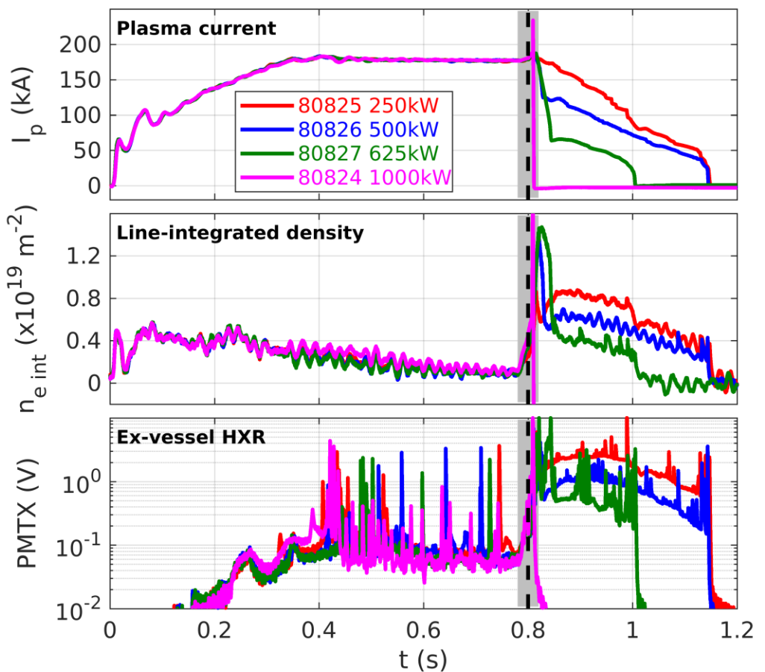
P37: Runaway Electron Mitigation Coil on TCV
Baseline partial CQ scenario to be
optimized for increased current
Proponents and contact person:
  Umar Sheikh, Alex Battey et al.
Scientific Background & Objectives
  The REMC is being developed for SPARC as the baseline RE mitigation technique.
    Goal is to introduce a 3D magnetic field to expel REs and prevent formation
  The REMC will be installed and exploited on TCV starting in 2026 under a EUROFusion grant.
Experimental Strategy etc:
  Complete scenario development for higher currents
    Establish reliable high current scenario (10)
    Scan Z position (5)
    Scan MGI (amount and species scan) (10)
  Explore effect of ECRH at the same time as NBH on partial current quench (10)
  Measure efficacy of REMC
    Do this with varying resistances in line to reduce coupled current in coil (20)
    Scan position of the plasma at the time of the disruption to explore coupling and efficacy when offset in position (10)
  Closed loop operation throughout shot (10)
    Done to mimic SPARC coil setup
  Test fast SPARC switch design (5)
Device | # Pulses/Session | # Development
TCV | 40 | 40
V. Igochine| WPTE 2026-2027 Programme Meeting | 5/11/2025|

Slide 10
P37: Runaway Electron Mitigation Coil on TCV
Baseline partial CQ scenario to be
optimized for increased current
Proponents and contact person:
  Umar Sheikh, Alex Battey et al.
Scientific Background & Objectives
  The REMC is being developed for SPARC as the baseline RE mitigation technique.
    Goal is to introduce a 3D magnetic field to expel REs and prevent formation
  The REMC will be installed and exploited on TCV starting in 2026 under a EUROFusion grant.
Experimental Strategy etc:
  Complete scenario development for higher currents
    Establish reliable high current scenario (10)
    Scan Z position (5)
    Scan MGI (amount and species scan) (10)
  Explore effect of ECRH at the same time as NBH on partial current quench (10)
  Measure efficacy of REMC
    Do this with varying resistances in line to reduce coupled current in coil (20)
    Scan position of the plasma at the time of the disruption to explore coupling and efficacy when offset in position (10)
  Closed loop operation throughout shot (10)
    Done to mimic SPARC coil setup
  Test fast SPARC switch design (5)
Priority: P1_2027 – 1) A new technique for dealing with runaways, which is currently the subject of active research.2) The installation of the coil was supported by EuroFusion.3) The request is too big to accommodate and has to be reduced.
Device | # Pulses/Session | # Development
TCV | 40 | 40
V. Igochine| WPTE 2026-2027 Programme Meeting | 5/11/2025|

Slide 11
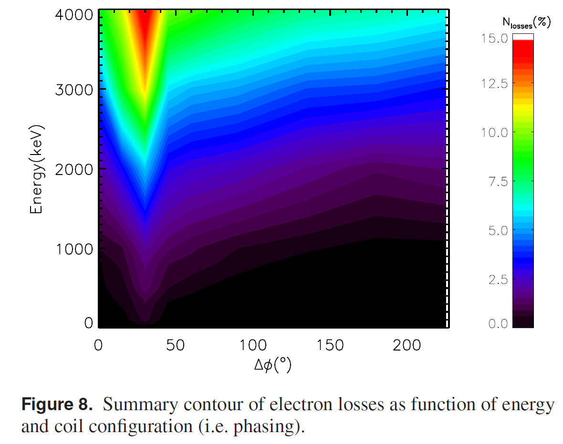
P38: RE diffusion via RMP
Proponents and contact person:
  A. Orduña: Andres.Orduna@ipp.mpg.de
  G. Papp
  A. Burckhart
  M. Willensdorfer
  P. Heinrich
  Sergei Gerasimov
Scientific Background & Objectives
  Find B-coils phasing that induces the most RE transport.
  Investigate the effect of the pitch angle on the diffusion coefficient.
  Compare observations with existing RE transport models.
  Validate RE distribution function reconstruction techniques.
Experimental Strategy/Machine Constraints and essential diagnostic
  Perform a phase scan of the B-coils based on past results (5)
  Displace the beam towards the LFS to increase the relative RMP strength (3)
  Decrease the background B strength with the same objective (3)
  Include MMI to increase the pitch angle and observe whether the diffusion behaves as expected (4)
M . Gobbin NF, 2021
Proposed pulses
Device | # Pulses/Session | # Development
AUG | 15
MAST-U
TCV
WEST
V. Igochine| WPTE 2026-2027 Programme Meeting | 5/11/2025|

Slide 12
P38: RE diffusion via RMP
Proponents and contact person:
  A. Orduña: Andres.Orduna@ipp.mpg.de
  G. Papp
  A. Burckhart
  M. Willensdorfer
  P. Heinrich
  Sergei Gerasimov
Scientific Background & Objectives
  Find B-coils phasing that induces the most RE transport.
  Investigate the effect of the pitch angle on the diffusion coefficient.
  Compare observations with existing RE transport models.
  Validate RE distribution function reconstruction techniques.
Experimental Strategy/Machine Constraints and essential diagnostic
  Perform a phase scan of the B-coils based on past results (5)
  Displace the beam towards the LFS to increase the relative RMP strength (3)
  Decrease the background B strength with the same objective (3)
  Include MMI to increase the pitch angle and observe whether the diffusion behaves as expected (4)
Priority: P2 – 1) It is unclear what the new substantial ingredient is compared to previous results.2) It could be given a higher priority, especially if it is combined with the other RMP proposals to join 38, 41 and 44.
M . Gobbin NF, 2021
Proposed pulses
Device | # Pulses/Session | # Development
AUG | 15
MAST-U
TCV
WEST
V. Igochine| WPTE 2026-2027 Programme Meeting | 5/11/2025|

Slide 13
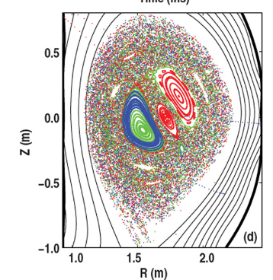
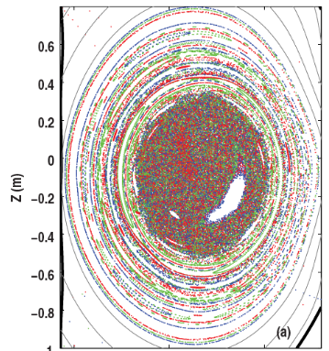
P39: Runaway generation dependence on plasma shaping
Proponents and contact person:
  Cédric Reux et al., cedric.reux@cea.fr
Scientific Background & Objectives
  Spontaneous runaway generation during disruptions is more frequent with tokamaks running circular, limited plasmas compared to elongated, diverted tokamaks
  ITER is a high-elongation, diverted machine ➔ crucial to understand how this observation could affect runaway generation on ITER
  Two effects studied: magnetic topology differences affecting the stochastization dynamics [Izzo et al., NF 2011] or vertical instability losing runaway before avalanche multiplication [Wang et al., NF 2025], but only in simulation
  Objective: disentangle effects experimentally (or confirm both are important)
    Influence of the presence/absence of an X-point
    Influence of the vertical instability growth rate
Experimental Strategy/Machine Constraints and essential diagnostics
  Scan the vertical instability growth rate in a limiter shape (trying to overlap the values from the next scan)
  Scan the vertical instability growth rate in a single-null diverted shape (trying to overlap the values from the previous scan). Repeat in double null.
  Scan the distance of the primary or secondary X-point from the wall, trying to keep the same elongation and/or vertical instability growth rates as close as possible to the previous scans
  Elongate a pre-existing beam in flight and check its effect on runaway survival.
Poincare plot of DIII-D simulations: divertor vs. limiter
[V. Izzo et al., NF 2011]
Proposed pulses
Device | # Pulses/Session | # Development
AUG
MAST-U
TCV
WEST | 20 pulses / 2 sessions | 6 pulses (shapes)
V. Igochine| WPTE 2026-2027 Programme Meeting | 5/11/2025|

Slide 14
P39: Runaway generation dependence on plasma shaping
Proponents and contact person:
  Cédric Reux et al., cedric.reux@cea.fr
Scientific Background & Objectives
  Spontaneous runaway generation during disruptions is more frequent with tokamaks running circular, limited plasmas compared to elongated, diverted tokamaks
  ITER is a high-elongation, diverted machine ➔ crucial to understand how this observation could affect runaway generation on ITER
  Two effects studied: magnetic topology differences affecting the stochastization dynamics [Izzo et al., NF 2011] or vertical instability losing runaway before avalanche multiplication [Wang et al., NF 2025], but only in simulation
  Objective: disentangle effects experimentally (or confirm both are important)
    Influence of the presence/absence of an X-point
    Influence of the vertical instability growth rate
Experimental Strategy/Machine Constraints and essential diagnostics
  Scan the vertical instability growth rate in a limiter shape (trying to overlap the values from the next scan)
  Scan the vertical instability growth rate in a single-null diverted shape (trying to overlap the values from the previous scan). Repeat in double null.
  Scan the distance of the primary or secondary X-point from the wall, trying to keep the same elongation and/or vertical instability growth rates as close as possible to the previous scans
  Elongate a pre-existing beam in flight and check its effect on runaway survival.
Priority: P2 – 1) Proposal is interesting but requires substantial number of pulses. 2) This year main aims are bening termination and impact of runaways on the wall
Poincare plot of DIII-D simulations: divertor vs. limiter
[V. Izzo et al., NF 2011]
Proposed pulses
Device | # Pulses/Session | # Development
AUG
MAST-U
TCV
WEST | 20 pulses / 2 sessions | 6 pulses (shapes)
V. Igochine| WPTE 2026-2027 Programme Meeting | 5/11/2025|

Slide 15
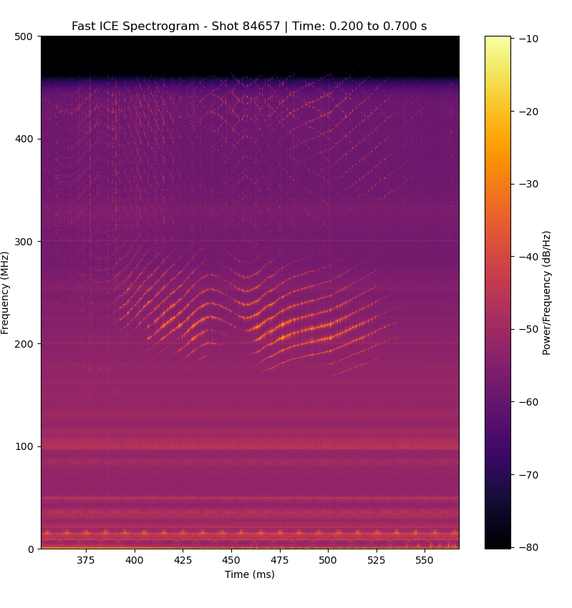
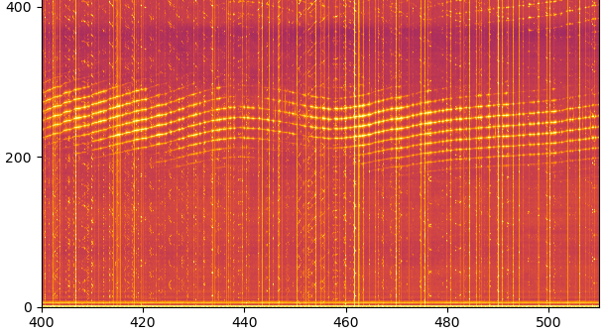
P40: Interaction between RE and high frequency waves
ICE
Proponents and contact person:
  Olivier Panico olivier.panico@epfl.ch et al.
Scientific Background & Objectives
  Runaway electrons (REs) can severely damage fusion reactors
  Recent experiments show that high frequency waves (whistlers) can mitigate RE beams:
    Expulse the RE seed => reduced post-disruption RE density
    Limit maximum energy of REs
  Objectives: characterize whistler waves together with RE dynamics
    Properly identify whistler waves and their dispersion relation
    Study impact of whistlers on RE dynamics
Experimental Strategy/Machine Constraints and essential diagnostic
  Develop a solid scenario with both whistlers and runaways [5 pulses]
  Verify theoretical scaling of whistler wave dispersion relation by scanning magnetic field, density and plasma current [10 pulses]
  Study role of whistler on RE dynamic: RE confinement and pitch angle scattering [10 pulses]
Diagnostics:
  RE: HXRS, LaBrDoRE, BGO, PMTX, FILD
  High frequency waves: ICE, LHPD, REWS
Frequency [MHz]
Whistler wave
#84657
Time [ms]
REWS
Frequency [MHz]
Whistler wave
#84657
Time [ms]
Proposed pulses
Device | # Pulses/Session | # Development
AUG
MAST-U
TCV | 20 | 5
WEST
V. Igochine| WPTE 2026-2027 Programme Meeting | 5/11/2025|

Slide 16
P40: Interaction between RE and high frequency waves
ICE
Proponents and contact person:
  Olivier Panico olivier.panico@epfl.ch et al.
Scientific Background & Objectives
  Runaway electrons (REs) can severely damage fusion reactors
  Recent experiments show that high frequency waves (whistlers) can mitigate RE beams:
    Expulse the RE seed => reduced post-disruption RE density
    Limit maximum energy of REs
  Objectives: characterize whistler waves together with RE dynamics
    Properly identify whistler waves and their dispersion relation
    Study impact of whistlers on RE dynamics
Experimental Strategy/Machine Constraints and essential diagnostic
  Develop a solid scenario with both whistlers and runaways [5 pulses]
  Verify theoretical scaling of whistler wave dispersion relation by scanning magnetic field, density and plasma current [10 pulses]
  Study role of whistler on RE dynamic: RE confinement and pitch angle scattering [10 pulses]
Diagnostics:
  RE: HXRS, LaBrDoRE, BGO, PMTX, FILD
  High frequency waves: ICE, LHPD, REWS
Priority: P1_2027 – 1) A new technique for dealing with runaways.2) If successful, it can be applied to ITER
Frequency [MHz]
Whistler wave
#84657
Time [ms]
REWS
Frequency [MHz]
Whistler wave
#84657
Time [ms]
Proposed pulses
Device | # Pulses/Session | # Development
AUG
MAST-U
TCV | 20 | 5
WEST
V. Igochine| WPTE 2026-2027 Programme Meeting | 5/11/2025|

Slide 17
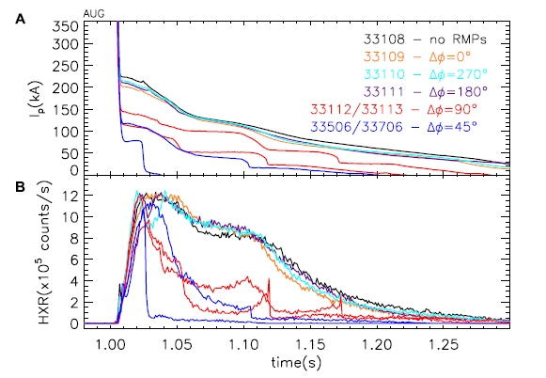
P41: Application of 3D fields in synergy with SPI for RE mitigation
Proponents and contact person:
M.Gobbin, O.Ficker, L.Marrelli, L.Pigatto, G.Papp, D.Terranova, E.Tomasina, E.Tomesova
marco.gobbin@igi.cnr.it
Scientific Background & Objectives
  Magnetic perturbations (MP) are still considered as complementary RE dissipation methods in more devices (DIII-D, JT-60SA,DTT,SPARC) and recently have been applied successfully in AUG and COMPASS [1-2].
  MP could be used to minimize the RE beam formation if applied prior to the current quench. The reduced RE beam current in this way could be more easily dissipated by SPI.
  In AUG during a RE beam scenario, we propose to:
  explore the possibility of reducing the final RE current acting with MP applied from the pre-disruption phase before the SPI injection;
  determine the B-coil configuration more efficient to guarantee the maximum RE reduction when MP are applied in combination with SPI injection;
  investigate the effect of MP on the SPI injection (also piggy-backed to other proposals).
Experimental Strategy/Machine Constraints and essential diagnostic
  The same scheme suggested in the proposal “SPI-triggered runaway electron scenario on AUG” could apply also to these experiments: 0-8-1MA/2.5T, IWL circular, ECRH 2-4 gyrotrons, D gas.
  Execution of one reference shot: generation of a RE beam followed by SPI during the RE beam phase without MP (1shot).
  Apply n=1 MP from a time preceding the disruption (500ms) and the SPI, performing a scan in the B-coil differential phasing (5 shots);
  Diagnostics: COO interferometer, bolometry, magnetics, fast visible cameras, fast IR camera (desired), HXR, ECE, Ar MGI or Ar SPI to generate the RE beam.
  For modelling/data interpretation: MARS-F, VMEC, ORBIT.
Possible summary figures
Past experiments with RE mitigation by MP in AUG: a reduction of the post-disruption RE current is obtained (down to -50%) for the differential phasing between upper/lower coils which maximizes the plasma response to the applied MP.
Proposed pulses
Device | # Pulses/Session | # Development
AUG | 6
[1] Gobbin M at al, Front. Phys. 12:1295082. (2024)
[2] Mlynar J et al, Plasma Phys. Control. Fusion 61 014010 (2019)
Note: This proposal was already submitted and approved (as P2) for the 2025 campaign. Preliminary modeling and analysis activity on the shots with SPI executed during this year is in progress. Some of these objectives require an already developed scenario with SPI injection during a RE beam phase that has not yet been developed.
V. Igochine| WPTE 2026-2027 Programme Meeting | 5/11/2025|

Slide 18
P41: Application of 3D fields in synergy with SPI for RE mitigation
Possible summary figures
Proponents and contact person:
M.Gobbin, O.Ficker, L.Marrelli, L.Pigatto, G.Papp, D.Terranova, E.Tomasina, E.Tomesova
marco.gobbin@igi.cnr.it
Scientific Background & Objectives
  Magnetic perturbations (MP) are still considered as complementary RE dissipation methods in more devices (DIII-D, JT-60SA,DTT,SPARC) and recently have been applied successfully in AUG and COMPASS [1-2].
  MP could be used to minimize the RE beam formation if applied prior to the current quench. The reduced RE beam current in this way could be more easily dissipated by SPI.
  In AUG during a RE beam scenario, we propose to:
  explore the possibility of reducing the final RE current acting with MP applied from the pre-disruption phase before the SPI injection;
  determine the B-coil configuration more efficient to guarantee the maximum RE reduction when MP are applied in combination with SPI injection;
  investigate the effect of MP on the SPI injection (also piggy-backed to other proposals).
Experimental Strategy/Machine Constraints and essential diagnostic
  The same scheme suggested in the proposal “SPI-triggered runaway electron scenario on AUG” could apply also to these experiments: 0-8-1MA/2.5T, IWL circular, ECRH 2-4 gyrotrons, D gas.
  Execution of one reference shot: generation of a RE beam followed by SPI during the RE beam phase without MP (1shot).
  Apply n=1 MP from a time preceding the disruption (500ms) and the SPI, performing a scan in the B-coil differential phasing (5 shots);
  Diagnostics: COO interferometer, bolometry, magnetics, fast visible cameras, fast IR camera (desired), HXR, ECE, Ar MGI or Ar SPI to generate the RE beam.
  For modelling/data interpretation: MARS-F, VMEC, ORBIT.
Priority: P2 – 1) It is unclear what the new substantial ingredient is compared to previous results.2) It could be given a higher priority, especially if it is combined with the other RMP proposals to join 38, 41 and 44.
Past experiments with RE mitigation by MP in AUG: a reduction of the post-disruption RE current is obtained (down to -50%) for the differential phasing between upper/lower coils which maximizes the plasma response to the applied MP.
Proposed pulses
Device | # Pulses/Session | # Development
AUG | 6
[1] Gobbin M at al, Front. Phys. 12:1295082. (2024)
[2] Mlynar J et al, Plasma Phys. Control. Fusion 61 014010 (2019)
Note: This proposal was already submitted and approved (as P2) for the 2025 campaign. Preliminary modeling and analysis activity on the shots with SPI executed during this year is in progress. Some of these objectives require an already developed scenario with SPI injection during a RE beam phase that has not yet been developed.
V. Igochine| WPTE 2026-2027 Programme Meeting | 5/11/2025|

Slide 19
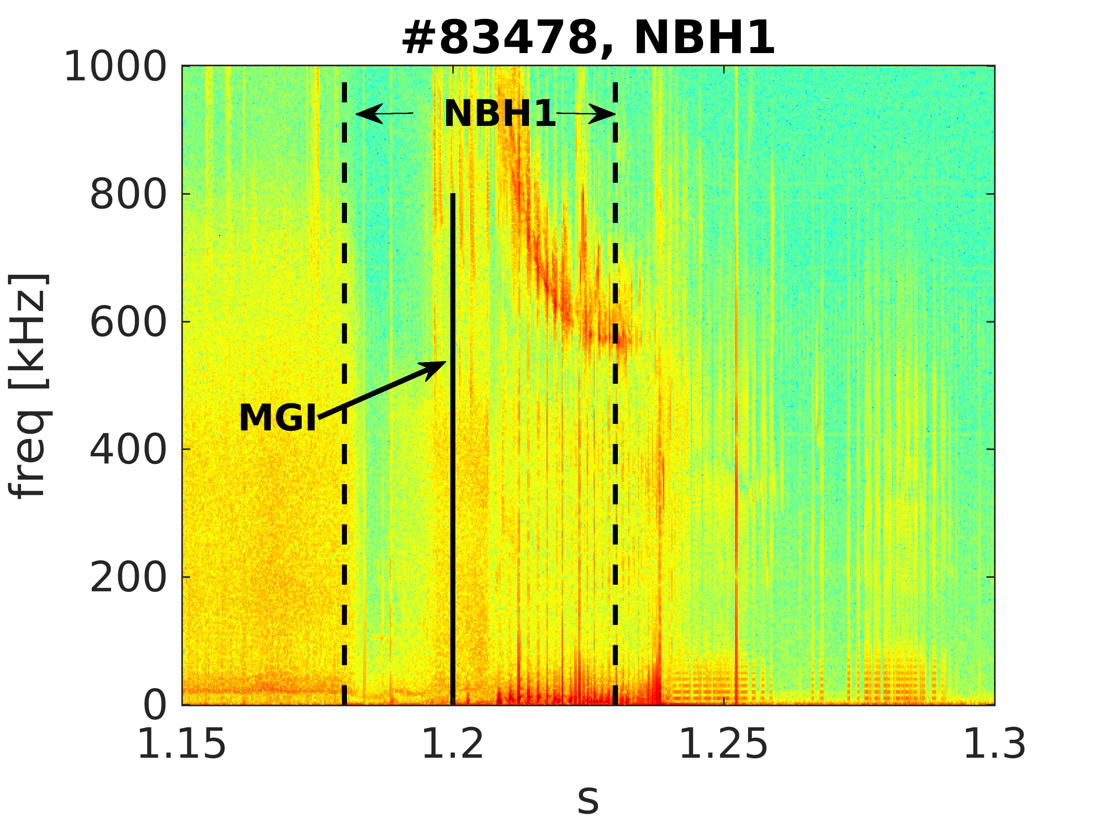
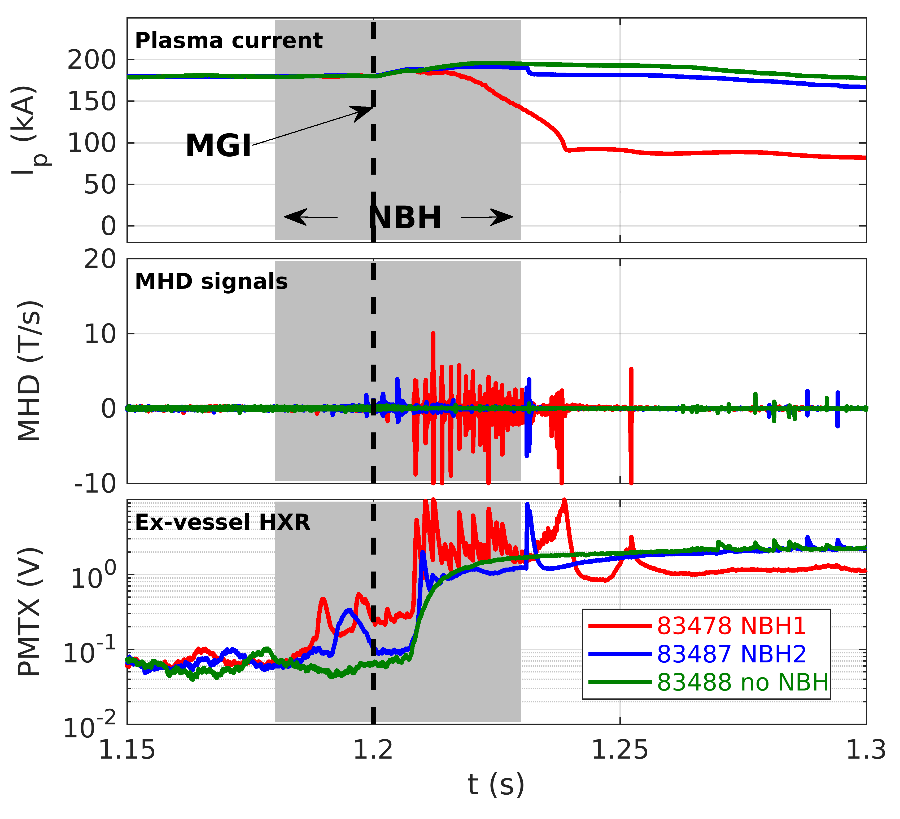
P42: Impact of turbulence and MHD on RE transport and confinement
Proponents and contact person
Joan Decker et al. (joan.decker@epfl.ch)
Scientific Background & Objectives
  Radial transport is the primary RE loss channel
  Characterising RE transport necessary to build predictive models
  MHD and turbulence can enhance RE transport significantly
    Characterise the effect of turbulence on RE transport
    Investigate the interplay between MHD and RE dynamics
    NBI-induced MHD and RE beam formation
Experimental Strategy/Machine Constraints and essential diagnostic
  Effect of turbulence on RE transport
    Build on ECRH-induced RE expulsion experiments, leverage new diags
    Characterise effect of shaping (triangularity) and ITB formation
  Interplay between MHD and RE dynamics
    Ohmic drive in high RE current regime -> MHD equilibrium and stability
    Apply to both pre- and post-disruption RE beams
  NBI-induced MHD and RE beam formation
    Build on existing NBI+MGI CQ scenario
    Characterise MHD activity and RE radial transport
Possible summary figures
Proposed pulses
Device | # Pulses/Session | # Development
AUG | 4
MAST-U
TCV | 60
WEST | 4
V. Igochine| WPTE 2026-2027 Programme Meeting | 5/11/2025|

Slide 20
P42: Impact of turbulence and MHD on RE transport and confinement
Proponents and contact person
Joan Decker et al. (joan.decker@epfl.ch)
Scientific Background & Objectives
  Radial transport is the primary RE loss channel
  Characterising RE transport necessary to build predictive models
  MHD and turbulence can enhance RE transport significantly
    Characterise the effect of turbulence on RE transport
    Investigate the interplay between MHD and RE dynamics
    NBI-induced MHD and RE beam formation
Experimental Strategy/Machine Constraints and essential diagnostic
  Effect of turbulence on RE transport
    Build on ECRH-induced RE expulsion experiments, leverage new diags
    Characterise effect of shaping (triangularity) and ITB formation
  Interplay between MHD and RE dynamics
    Ohmic drive in high RE current regime -> MHD equilibrium and stability
    Apply to both pre- and post-disruption RE beams
  NBI-induced MHD and RE beam formation
    Build on existing NBI+MGI CQ scenario
    Characterise MHD activity and RE radial transport
Possible summary figures
Priority: P1_TCV_2027 & P1_WEST_2027 This is interesting from a physics perspective and highly relevant to ITER.
Proposed pulses
Device | # Pulses/Session | # Development
AUG | 4
MAST-U
TCV | 60
WEST | 4
V. Igochine| WPTE 2026-2027 Programme Meeting | 5/11/2025|

Slide 21
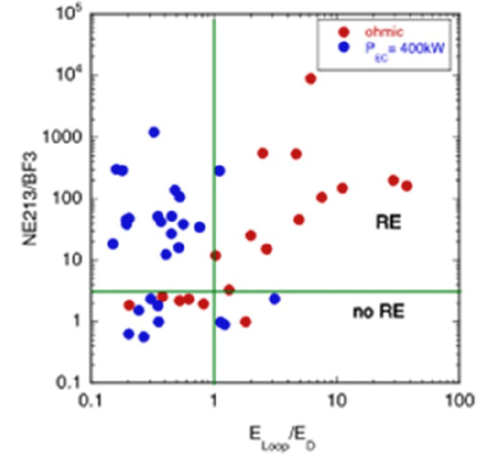

P43: Studies of runaway generation at plasma start-up
a)
Proponents and contact person:
basilio.esposito@enea.it , cedric.reux@cea.fr, gustavo.granucci@istp.cnr.it, et al.
Scientific Background & Objectives
  Background
  Low pre-filled gas pressure for ohmic plasma initiation required in ITER → possibly leading to exceeding threshold electric field for the effective Dreicer generation.
  Alternative: ECRH assisted plasma initiation may allow operation at a higher pre-fill gas pressure, → in principle beneficial environment to avoid runaways
  However, some experimental evidence (FTU)and theoretical predictions show that ECRH may affect electron distribution function
    possibility of runaway electrons in ITER when using ECRH assisted plasma initiation cannot be completely excluded see Figures.
  Objectives
  1) explore runaway dynamics at plasma start-up both with and without the use of ECRH
  2) determine the most favourable conditions to avoid runaway generation at start-up by varying the following parameters: (gas pre-fill, with/without ECRH, ECRH power, ECRH injected mode (OM1 and/or XM1 by mode conversion at inner wall reflection with toroidal angle 20° tbc).
Experimental Strategy/Machine Constraints and essential diagnostic
  low density discharge scenario from RT03-2025 runaway experiments
  REIS, visible and fast infrared cameras, ECE, neutrons, ME-HXR
Possible summary figures
Runaway electron presence in EC-assisted start-up discharges in FTU
as a function of E/E_{D}
as a function of pressure
b)
Proposed pulses
Device | # Pulses/Session | # Development
WEST | 15 | 2
V. Igochine| WPTE 2026-2027 Programme Meeting | 5/11/2025|

Slide 22
P43: Studies of runaway generation at plasma start-up
a)
Proponents and contact person:
basilio.esposito@enea.it , cedric.reux@cea.fr, gustavo.granucci@istp.cnr.it, et al.
Scientific Background & Objectives
  Background
  Low pre-filled gas pressure for ohmic plasma initiation required in ITER → possibly leading to exceeding threshold electric field for the effective Dreicer generation.
  Alternative: ECRH assisted plasma initiation may allow operation at a higher pre-fill gas pressure, → in principle beneficial environment to avoid runaways
  However, some experimental evidence (FTU)and theoretical predictions show that ECRH may affect electron distribution function
    possibility of runaway electrons in ITER when using ECRH assisted plasma initiation cannot be completely excluded see Figures.
  Objectives
  1) explore runaway dynamics at plasma start-up both with and without the use of ECRH
  2) determine the most favourable conditions to avoid runaway generation at start-up by varying the following parameters: (gas pre-fill, with/without ECRH, ECRH power, ECRH injected mode (OM1 and/or XM1 by mode conversion at inner wall reflection with toroidal angle 20° tbc).
Experimental Strategy/Machine Constraints and essential diagnostic
  low density discharge scenario from RT03-2025 runaway experiments
  REIS, visible and fast infrared cameras, ECE, neutrons, ME-HXR
Possible summary figures
Priority: P1_WEST_27 and try to do this partially in piggy-back
Runaway electron presence in EC-assisted start-up discharges in FTU
as a function of E/E_{D}
as a function of pressure
b)
Proposed pulses
Device | # Pulses/Session | # Development
WEST | 15 | 2
V. Igochine| WPTE 2026-2027 Programme Meeting | 5/11/2025|

Slide 23
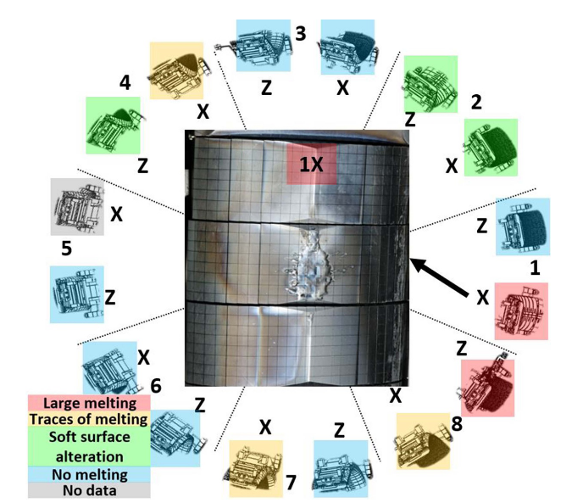
P44: Runaway impact asymmetries
Proponents and contact person:
  Cédric Reux et al., cedric.reux@cea.fr
Scientific Background & Objectives
  Runaway electron beam impacts are known to be toroidally asymmetrical (Reux et al. NF 2015, Jepu et al., NF 2024), focusing heat loads on an even smaller area.
  The pattern is consistent over several years of experiments, but is neither completely deterministic on a pulse-by-pulse basis, nor exhibits a defined toroidal period.
  Two assumptions can be made to explain the pattern:
    PFC misalignments
    Intrinsic 3D nature of the beam either due to TF ripple or MHD instabilities locking always at eh same places due to error fields, or a combination of both
  The objective is to determine which factors play the largest role in the pattern.
    Measure the minimal misalignment needed to focus the impact on a single limiter
    Measure the dependence between the magnitude of the error field and the asymmetry (if any)
Experimental Strategy/Machine Constraints and essential diagnostics
  Use the longest possible runaway beam scenario
  Scan the position of the sample manipulator from behind all other limiters +2 cm up to fully brought forward, if possible ahead of other objects radially.
  Scan the magnitude of the RMP using B-coils in a n=1 perturbation.
  Repeat the RMP scan with a n=2 pattern
  On WEST (exploratory) : scan the ripple by switching off one or several TF coils, depending on what is technically possible.
Runaway impact pattern over the whole JET-ILW lifetime – Jepu et al., NF 2024
Proposed pulses
Device | # Pulses/Session | # Development
AUG | 28 | 0
MAST-U
TCV
WEST | 4 (exploratory) | 4
V. Igochine| WPTE 2026-2027 Programme Meeting | 5/11/2025|

Slide 24
P44: Runaway impact asymmetries
Proponents and contact person:
  Cédric Reux et al., cedric.reux@cea.fr
Scientific Background & Objectives
  Runaway electron beam impacts are known to be toroidally asymmetrical (Reux et al. NF 2015, Jepu et al., NF 2024), focusing heat loads on an even smaller area.
  The pattern is consistent over several years of experiments, but is neither completely deterministic on a pulse-by-pulse basis, nor exhibits a defined toroidal period.
  Two assumptions can be made to explain the pattern:
    PFC misalignments
    Intrinsic 3D nature of the beam either due to TF ripple or MHD instabilities locking always at eh same places due to error fields, or a combination of both
  The objective is to determine which factors play the largest role in the pattern.
    Measure the minimal misalignment needed to focus the impact on a single limiter
    Measure the dependence between the magnitude of the error field and the asymmetry (if any)
Experimental Strategy/Machine Constraints and essential diagnostics
  Use the longest possible runaway beam scenario
  Scan the position of the sample manipulator from behind all other limiters +2 cm up to fully brought forward, if possible ahead of other objects radially.
  Scan the magnitude of the RMP using B-coils in a n=1 perturbation.
  Repeat the RMP scan with a n=2 pattern
  On WEST (exploratory) : scan the ripple by switching off one or several TF coils, depending on what is technically possible.
Priority: P2 – 1) It requires the amount of discharges for AUG which we don’t have 2) It could be given a higher priority, especially if it is combined with the other RMP proposals to join 38, 41 and 44.
Runaway impact pattern over the whole JET-ILW lifetime – Jepu et al., NF 2024
Proposed pulses
Device | # Pulses/Session | # Development
AUG | 28 | 0
MAST-U
TCV
WEST | 4 (exploratory) | 4
V. Igochine| WPTE 2026-2027 Programme Meeting | 5/11/2025|

Slide 25
P45: Toroidal Field Ripple Manipulation for RE Studies
Proponents and contact person:
  Alexander.battey@epfl.ch
  Umar Sheikh
  Basil Duval
  Joan Decker
Scientific Background & Objectives
  Explore the resonance between runaway electrons and toroidal field ripple
  Novel hardware upgrade will allow for the ripple amplitude to be scanned for systematic comparison with modeling
  Determine the effect of ripple n-number and amplitude on maximum RE energy as measured by MANTIS
Experimental Strategy/Machine Constraints and essential diagnostic
  Leverages the existing RE scenario
  MANTIS
  Standard RE diagnostic suite
Possible summary figures
T.A. Wijkamp etal 2024 Nucl.Fusion 64 016021
Proposed pulses
Device | # Pulses/Session | # Development
AUG
MAST-U
TCV | 20 | 5
WEST
V. Igochine| WPTE 2026-2027 Programme Meeting | 5/11/2025|

Slide 26
P45: Toroidal Field Ripple Manipulation for RE Studies
Proponents and contact person:
  Alexander.battey@epfl.ch
  Umar Sheikh
  Basil Duval
  Joan Decker
Scientific Background & Objectives
  Explore the resonance between runaway electrons and toroidal field ripple
  Novel hardware upgrade will allow for the ripple amplitude to be scanned for systematic comparison with modeling
  Determine the effect of ripple n-number and amplitude on maximum RE energy as measured by MANTIS
Experimental Strategy/Machine Constraints and essential diagnostic
  Leverages the existing RE scenario
  MANTIS
  Standard RE diagnostic suite
Possible summary figures
Priority: P1_TCV_2027 trying to gain a deeper understanding of the physics of runaways for ITER by using new hardware.
T.A. Wijkamp etal 2024 Nucl.Fusion 64 016021
Proposed pulses
Device | # Pulses/Session | # Development
AUG
MAST-U
TCV | 20 | 5
WEST
V. Igochine| WPTE 2026-2027 Programme Meeting | 5/11/2025|

Slide 27
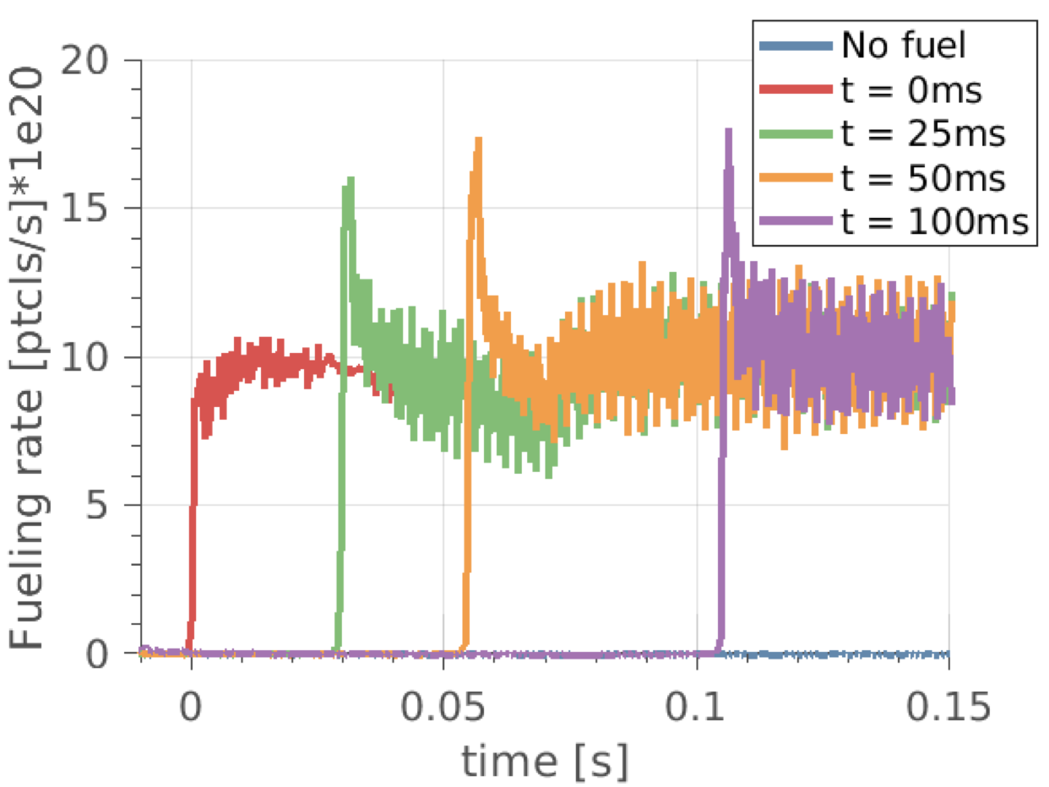
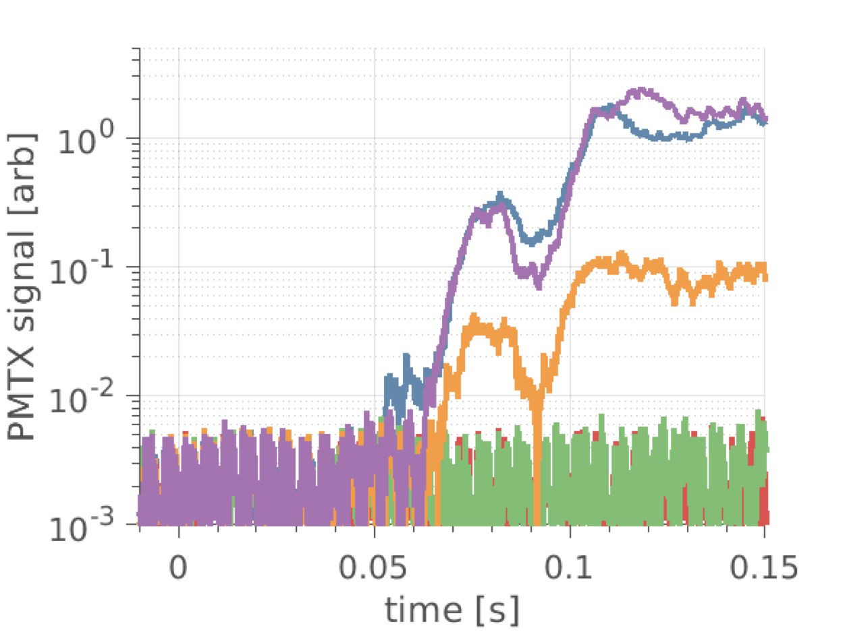
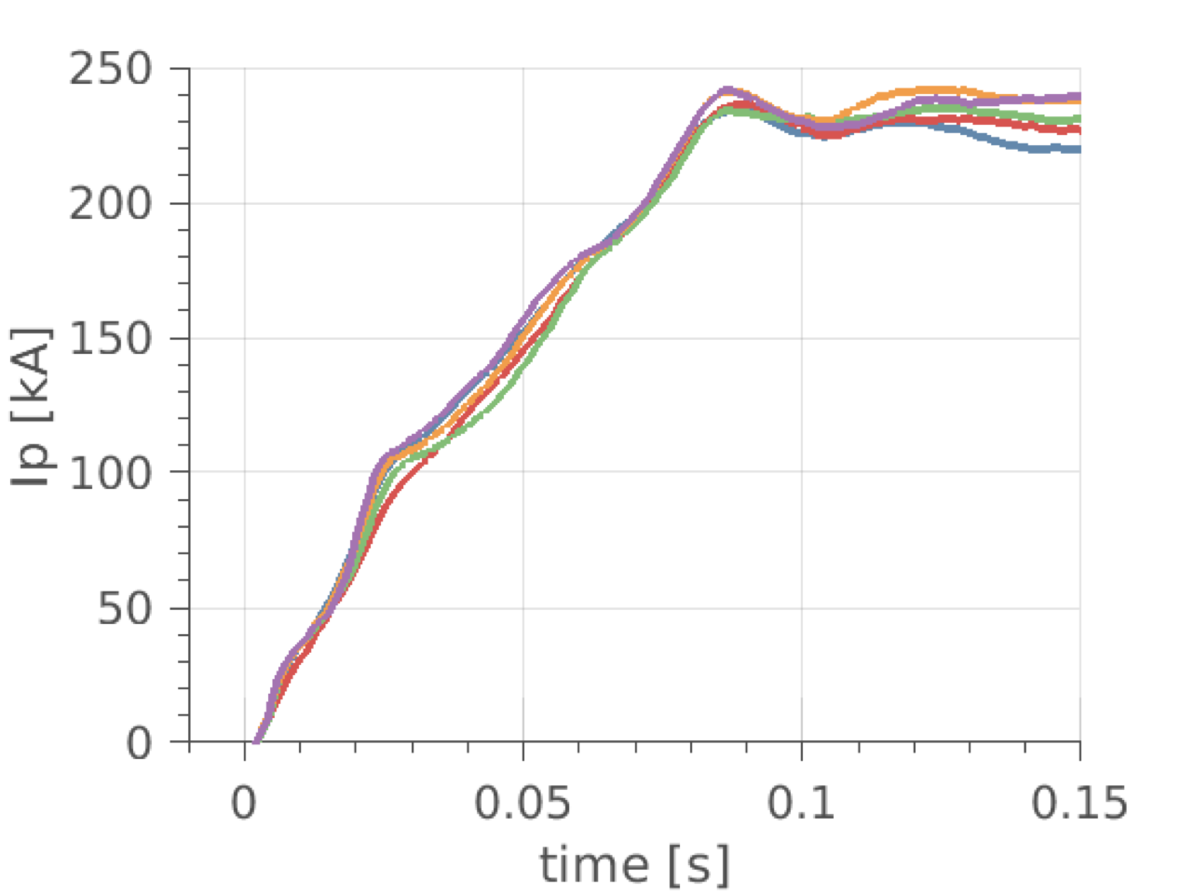
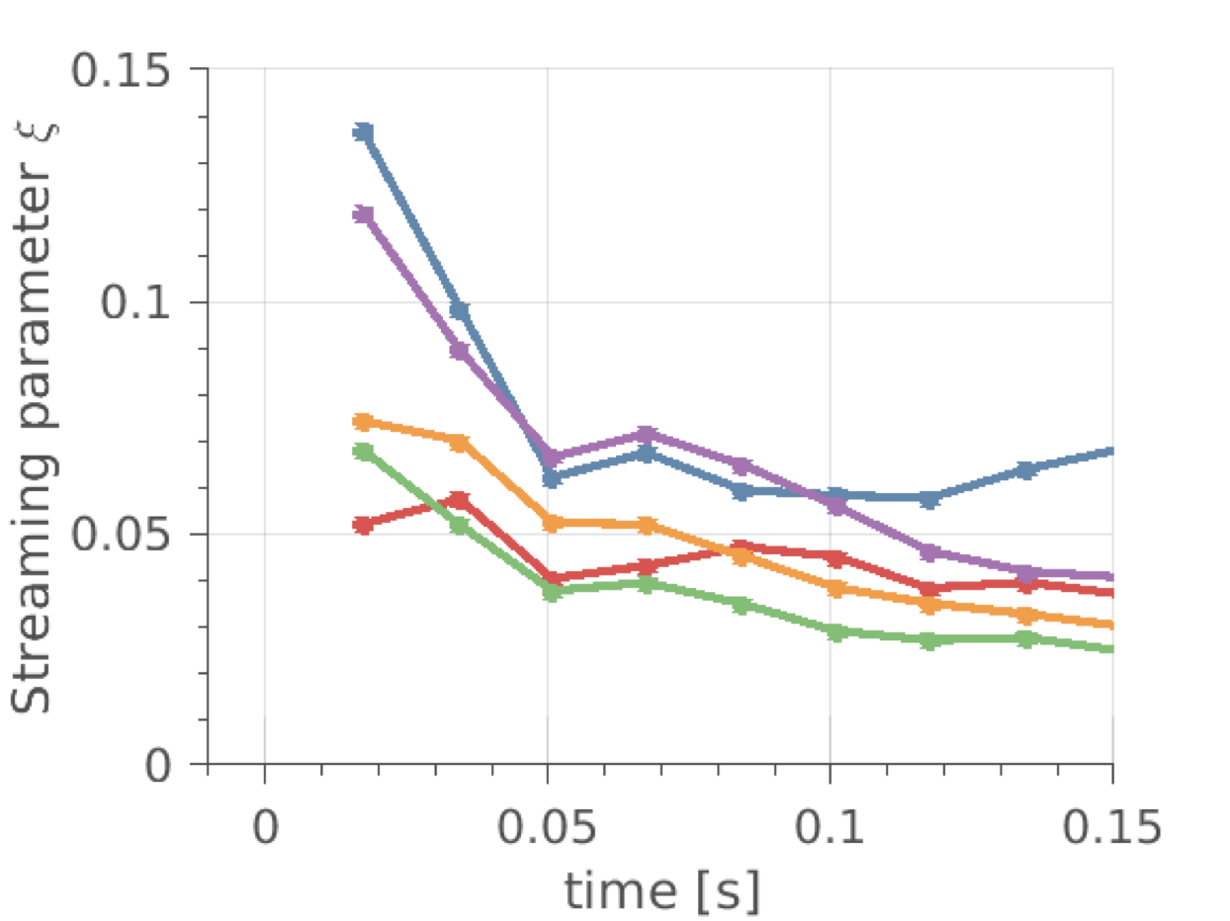
P46: Physics of runaway generation during the tokamak start-up phase including inductive, EC assisted burn-through and EC pre-ionization
Fueling timing scan in TCV
ex-vessel H-XRays
Possible summary figures
Proponents and contact person:
  Pedro Molina-Cabrera, Mathias Hoppe, Joan Decker, Stefano Coda, Panagiotis Papagiannis, Christos Tsironis, Dimosthenis Vallis, Umar Sheikh
Scientific Background & Objectives
  Burn-through simulations are actively progressing but must move towards rigorous validation including uncertainty quantification and a comparison metric.
  Burn-through simulations including runaway electrons have only been compared with experiments in the JET tokamak.
  Experiments are proposed in AUG, TCV, and WEST to develop well-diagnosed plasmas with and without runways during the startup to serve as a comprehensive data-set for validation and to test our understanding of the effects of size, B-field, and wall material
  Once a robust scenario is developed, it is proposed to apply EC power before and after the breakdown to observe the effects EC power has on the runaway generation and transport.
Experimental Strategy/Machine Constraints and essential diagnostic
  Develop identical plasma shape LSN, delta = 0.3, and kappa = 1.3 on all 3 machines
  Vary prefill density and fuelling during burn-through/ramp-up phase while maintaining a large E field to develop a large amount of start-up runaways. Scan both density and applied E-field once a robust scenario is found
  Apply EC power before and after the breakdown to see effects on runaway population. Scan power input and timing after breakdown.
  Runaway diagnostics in every machine are vital for this mission (H-Xrays, ECE, Neutron detectors, visible-light cameras)
Proposed pulses
Device | # Pulses/Session | # Development
AUG | 12 | 10
MAST-U | 0 | 0
TCV | 20 | 2
WEST | 20 | 2
V. Igochine| WPTE 2026-2027 Programme Meeting | 5/11/2025|

Slide 28
P46: Physics of runaway generation during the tokamak start-up phase including inductive, EC assisted burn-through and EC pre-ionization
Fueling timing scan in TCV
ex-vessel H-XRays
Possible summary figures
Priority: P1_TCV_2026 & P1_WEST_2026 important startup studies but P2_AUG due to lack of required pulses.
Proponents and contact person:
  Pedro Molina-Cabrera, Mathias Hoppe, Joan Decker, Stefano Coda, Panagiotis Papagiannis, Christos Tsironis, Dimosthenis Vallis, Umar Sheikh
Scientific Background & Objectives
  Burn-through simulations are actively progressing but must move towards rigorous validation including uncertainty quantification and a comparison metric.
  Burn-through simulations including runaway electrons have only been compared with experiments in the JET tokamak.
  Experiments are proposed in AUG, TCV, and WEST to develop well-diagnosed plasmas with and without runways during the startup to serve as a comprehensive data-set for validation and to test our understanding of the effects of size, B-field, and wall material
  Once a robust scenario is developed, it is proposed to apply EC power before and after the breakdown to observe the effects EC power has on the runaway generation and transport.
Experimental Strategy/Machine Constraints and essential diagnostic
  Develop identical plasma shape LSN, delta = 0.3, and kappa = 1.3 on all 3 machines
  Vary prefill density and fuelling during burn-through/ramp-up phase while maintaining a large E field to develop a large amount of start-up runaways. Scan both density and applied E-field once a robust scenario is found
  Apply EC power before and after the breakdown to see effects on runaway population. Scan power input and timing after breakdown.
  Runaway diagnostics in every machine are vital for this mission (H-Xrays, ECE, Neutron detectors, visible-light cameras)
Proposed pulses
Device | # Pulses/Session | # Development
AUG | 12 | 10
MAST-U | 0 | 0
TCV | 20 | 2
WEST | 20 | 2
V. Igochine| WPTE 2026-2027 Programme Meeting | 5/11/2025|

Slide 29
P47: Studying the plasmoid drift in AUG SPI experiments
Proponents and contact person:
Patel Ansh, G. Papp, P. Heinrich, S. Jachmich, U. Sheikh, A. Moreau, W. Tang, M. Hoelzl, P. Halldestam
Anshkumar.Patel@ipp.mpg.de
Scientific Background & Objectives
  Quantify the plasmoid drift effect for different fragment parameters (size and speed) along with possible drift suppression with neon doping in the pellet
  AUG SPI in unique position due to multiple guide tubes and shatter heads configuration
  First dedicated shots to study the effect of different fragment sizes and speeds on the drift
Experimental Strategy/Machine Constraints and essential diagnostic
  Standard SPI H-mode model used in previous campaigns, utilizing the flexible AUG SPI system
  5 different shattering configurations (for different frag sizes and speeds) and 4 different neon content values (=20 shots)
  Better usage/upgrades of diagnostics
    Fast cameras observing material penetration tested with different filter and exposure settings
    New dispersion interferometer tested in 2025 allowed for measurements of fast transients of density rise
    Updated time difference between pellet arrival and Thomson Scattering laser firing to allow for material assimilation measurements while avoiding strong ablation background light
Possible summary figures
Proposed pulses
Device | # Pulses/Session | # Development
AUG | 20
MAST-U
TCV
WEST
V. Igochine| WPTE 2026-2027 Programme Meeting | 5/11/2025|

Slide 30
P47: Studying the plasmoid drift in AUG SPI experiments
Proponents and contact person:
Patel Ansh, G. Papp, P. Heinrich, S. Jachmich, U. Sheikh, A. Moreau, W. Tang, M. Hoelzl, P. Halldestam
Anshkumar.Patel@ipp.mpg.de
Scientific Background & Objectives
  Quantify the plasmoid drift effect for different fragment parameters (size and speed) along with possible drift suppression with neon doping in the pellet
  AUG SPI in unique position due to multiple guide tubes and shatter heads configuration
  First dedicated shots to study the effect of different fragment sizes and speeds on the drift
Experimental Strategy/Machine Constraints and essential diagnostic
  Standard SPI H-mode model used in previous campaigns, utilizing the flexible AUG SPI system
  5 different shattering configurations (for different frag sizes and speeds) and 4 different neon content values (=20 shots)
  Better usage/upgrades of diagnostics
    Fast cameras observing material penetration tested with different filter and exposure settings
    New dispersion interferometer tested in 2025 allowed for measurements of fast transients of density rise
    Updated time difference between pellet arrival and Thomson Scattering laser firing to allow for material assimilation measurements while avoiding strong ablation background light
Possible summary figures
Priority: P1_AUG_2026 1)High importance for modelling and ITER. 2) Numbers should be reduced (50%?). We can not afford to make all these pulses.
Proposed pulses
Device | # Pulses/Session | # Development
AUG | 20
MAST-U
TCV
WEST
V. Igochine| WPTE 2026-2027 Programme Meeting | 5/11/2025|

Slide 31
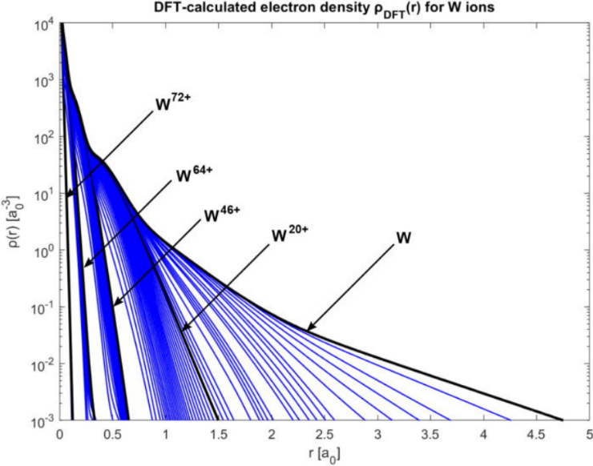
P48: Influence of tungsten (W) on the runaway electron generation and benign termination scenario
Proponents and contact person:
Ondrej Ficker (ficker@ipp.cas.cz), Umar Sheikh, Cédric Reux, Jedrzej Walkowiak, Axel Jardin, Vladislav Plyusnin, Sergei Gerasimov, Gergely Papp, Matthias Hoppe, Peter Halldestam and others
Scientific Background & Objectives
  Addressing RT3 D10 and D11
  ITER relevant impurity affecting RE generation and mitigation?
[1] Design scenario with enhanced W concentration during disruption with RE generation
[2] Quantify the effect of tungsten if possible.
[3] Increase the W concentration in post-disruption RE beam and observe the effects on benign termination if any.
Experimental Strategy/Machine Constraints and essential diagnostic
  Standard or alternative RE scenario at AUG and WEST
  Optimise timing of W LBO during MGI/SPI disruption with RE beam generation
  Depending on observed results select a suitable scan (current, Ar pressure, etc.)
  For effects on benign termination, trigger LBO in the recombined phase and terminate the beam by compression after a delay allowing the spreading of the W pollution
Working RE generation and benign termination scenario crucial.
All available RE, disruption and W diagnostics desirable.
Possible summary figures
Possible summary figures
High Z impurities now being added to RE codes using approximate models for collisional operators
Proposed pulses
[Walkowiak et al. Phys. Plasmas 29, 022501 (2022)]
Device | # Pulses/Session | # Development
AUG | 4 | 1
MAST-U
TCV
WEST | 3 | 1
V. Igochine| WPTE 2026-2027 Programme Meeting | 5/11/2025|

Slide 32
P48: Influence of tungsten (W) on the runaway electron generation and benign termination scenario
Proponents and contact person:
Ondrej Ficker (ficker@ipp.cas.cz), Umar Sheikh, Cédric Reux, Jedrzej Walkowiak, Axel Jardin, Vladislav Plyusnin, Sergei Gerasimov, Gergely Papp, Matthias Hoppe, Peter Halldestam and others
Scientific Background & Objectives
  Addressing RT3 D10 and D11
  ITER relevant impurity affecting RE generation and mitigation?
[1] Design scenario with enhanced W concentration during disruption with RE generation
[2] Quantify the effect of tungsten if possible.
[3] Increase the W concentration in post-disruption RE beam and observe the effects on benign termination if any.
Experimental Strategy/Machine Constraints and essential diagnostic
  Standard or alternative RE scenario at AUG and WEST
  Optimise timing of W LBO during MGI/SPI disruption with RE beam generation
  Depending on observed results select a suitable scan (current, Ar pressure, etc.)
  For effects on benign termination, trigger LBO in the recombined phase and terminate the beam by compression after a delay allowing the spreading of the W pollution
Working RE generation and benign termination scenario crucial.
All available RE, disruption and W diagnostics desirable.
Possible summary figures
Possible summary figures
Priority: P2 – 1) It's interesting, but we can't afford to conduct all the studies, and this is not the most urgent issue for ITER currently.
High Z impurities now being added to RE codes using approximate models for collisional operators
Proposed pulses
[Walkowiak et al. Phys. Plasmas 29, 022501 (2022)]
Device | # Pulses/Session | # Development
AUG | 4 | 1
MAST-U
TCV
WEST | 3 | 1
V. Igochine| WPTE 2026-2027 Programme Meeting | 5/11/2025|

Slide 33
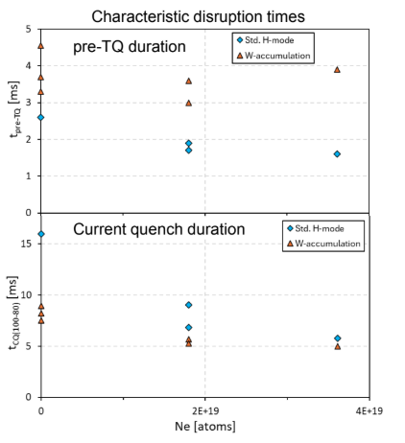
P49: SPI into tungsten accumulation at AUG
Proponents and contact person:
Ondrej Ficker (ficker@ipp.cas.cz), Stefan Jachmich, Umar Sheikh, Gergely Papp, Paul Heinrich, Peter Halldestam, Ansh Patel, Andres Orduna Martinez, Andrew Moreau
Scientific Background & Objectives
  Pre-TQ times significantly varied with W accumulation (both on JET and AUG)
  Crucial for proper DMS setup – is the MHD mode structure significantly affecting the characteristic times
  Characterize how W accumulation together with critical MHD instabilities affects the SPI disruption
  Understand whether prolongation of pre-TQ time
Experimental Strategy/Machine Constraints and essential diagnostic
Start with previous reference #43194
Enhance MHD activity (ideally mode lock) during SPI injection either by timing or using RMPs
SPI setup Pure D2 and 2 different Neon contents (same as in 2025)
Staggered scheme into the configuration with logest pre-TQ time
Complement internal proposal on W concentration influence on SPI disruptions
All available SPI diagnostics (Dispersion interferometer, fast cameras, bolometers, etc.) + W spectroscopy
Possible summary figures
AUG 2025
Proposed pulses
Device | # Pulses/Session | # Development
AUG | 6 | 2
MAST-U
TCV
WEST
V. Igochine| WPTE 2026-2027 Programme Meeting | 5/11/2025|

Slide 34
P49: SPI into tungsten accumulation at AUG
Proponents and contact person:
Ondrej Ficker (ficker@ipp.cas.cz), Stefan Jachmich, Umar Sheikh, Gergely Papp, Paul Heinrich, Peter Halldestam, Ansh Patel, Andres Orduna Martinez, Andrew Moreau
Scientific Background & Objectives
  Pre-TQ times significantly varied with W accumulation (both on JET and AUG)
  Crucial for proper DMS setup – is the MHD mode structure significantly affecting the characteristic times
  Characterize how W accumulation together with critical MHD instabilities affects the SPI disruption
  Understand whether prolongation of pre-TQ time
Experimental Strategy/Machine Constraints and essential diagnostic
Start with previous reference #43194
Enhance MHD activity (ideally mode lock) during SPI injection either by timing or using RMPs
SPI setup Pure D2 and 2 different Neon contents (same as in 2025)
Staggered scheme into the configuration with logest pre-TQ time
Complement internal proposal on W concentration influence on SPI disruptions
All available SPI diagnostics (Dispersion interferometer, fast cameras, bolometers, etc.) + W spectroscopy
Possible summary figures
Priority: P1_AUG_2027
AUG 2025
Proposed pulses
Device | # Pulses/Session | # Development
AUG | 6 | 2
MAST-U
TCV
WEST
V. Igochine| WPTE 2026-2027 Programme Meeting | 5/11/2025|

Slide 35
P50: Alternative runaway electron scenario for ASDEX Upgrade
Proponents and contact person:
Gergely Papp, P. Heinrich, P. Halldestam, A. H. Patel, A. Orduna-Martinez, J. Decker, U. Sheikh, O. Ficker, M. Hoppe, V. Bandaru
gergely.papp@ipp.mpg.de
Scientific Background & Objectives
  The goal is to develop an alternative runaway electron scenario on ASDEX Upgrade, and to perform param. scans.
    Modeling input for combined SPI+RE model validation
    (little data available so far)
    Potential alternative AUG RE scenario in case of in-vessel MGI valve issues mid-campaign
    Scenario development aided by DREAM simulations
Experimental Strategy/Machine Constraints and essential diagnostic
    Needs development of Ar SPI recipes on non-shot days!
    Injection of Ar pellets into typical MGI RE scenario plasmas, such as e.g. #41337 (limiter, L-mode, ne =3e19)
    If that fails, use fuelling valve argon injection or develop flat-top RE scenario
    Needs Ar SPI, disperision interferometry, bolometry, HXR, ECE, fast cameras (vis+IR), MANTIS
Shadowgraphy of argon pellets
during commissioning (PELIN)
Proposed pulses
Device | # Pulses/Session | # Development
AUG | 8 | 3
MAST-U | - | -
TCV | - | -
WEST | - | -
V. Igochine| WPTE 2026-2027 Programme Meeting | 5/11/2025|

Slide 36
P50: Alternative runaway electron scenario for ASDEX Upgrade
Proponents and contact person:
Gergely Papp, P. Heinrich, P. Halldestam, A. H. Patel, A. Orduna-Martinez, J. Decker, U. Sheikh, O. Ficker, M. Hoppe, V. Bandaru
gergely.papp@ipp.mpg.de
Scientific Background & Objectives
  The goal is to develop an alternative runaway electron scenario on ASDEX Upgrade, and to perform param. scans.
    Modeling input for combined SPI+RE model validation
    (little data available so far)
    Potential alternative AUG RE scenario in case of in-vessel MGI valve issues mid-campaign
    Scenario development aided by DREAM simulations
Experimental Strategy/Machine Constraints and essential diagnostic
    Needs development of Ar SPI recipes on non-shot days!
    Injection of Ar pellets into typical MGI RE scenario plasmas, such as e.g. #41337 (limiter, L-mode, ne =3e19)
    If that fails, use fuelling valve argon injection or develop flat-top RE scenario
    Needs Ar SPI, disperision interferometry, bolometry, HXR, ECE, fast cameras (vis+IR), MANTIS
Priority: P1_AUG_2026 This is because it is not possible to be certain that termination experiments for the high-pressure limit can be conducted without this, given the current situation with the gas valves in the AUG.
Shadowgraphy of argon pellets
during commissioning (PELIN)
Proposed pulses
Device | # Pulses/Session | # Development
AUG | 8 | 3
MAST-U | - | -
TCV | - | -
WEST | - | -
V. Igochine| WPTE 2026-2027 Programme Meeting | 5/11/2025|

Slide 37
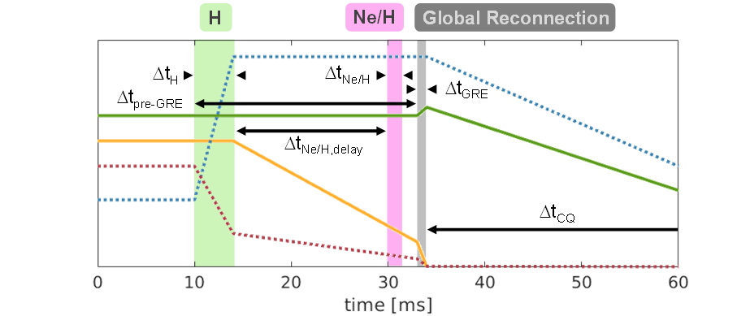
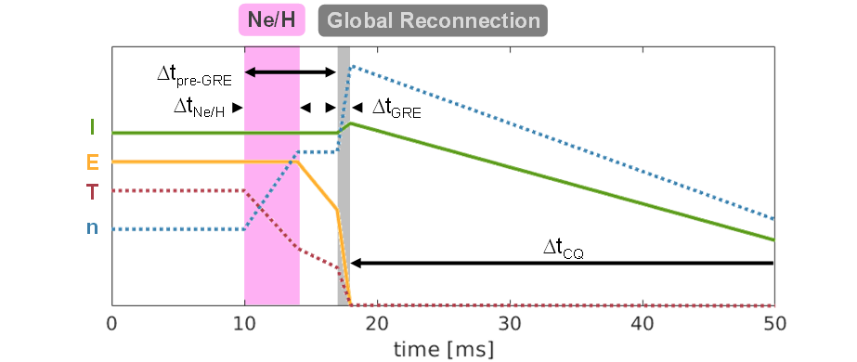
P51: Viability of staggered and dual injection schemes using AUG SPI
Proponents and contact person:
  Stefan Jachmich, Gergely Papp, Umar Sheikh, Ansh Patel, Paul Heinrich, Ondrej Ficker, Andrew Moreau
Scientific Background & Objectives
  The staggered injection scheme has several advantages:
    Slow energy loss
    Electron temperature cooling
    Less neon required for W_{th} load mitigation during GRE
  Issues arose from the limited core fuelling in the first phase due to plasmoid and rocket effect for LFS injection
  Studies been conducted to reduce plasmoid effect
  Objectives:
    How large is the densification prior CQ onset for RE avoidance?
    What is minimum required Neon amount for final thermal load mitigation during GRE?
    Is the scheme applicable to plasmas with intrinsic impurities (W, Ne)?
Experimental Strategy/Machine Constraints and essential diagnostic
  Essential: SPI, fast camera, bolometers, standard diagnostic for density measurements.
  First injection with D or Ne-trace D, followed by Ne/D when max density reached: might require small timing scan (+/- 2 ms)
  Reduce or increase Ne-fraction depending on outcome of previous pulse (frad?)
  Apply to second target plasma: either W-accumulation (if reproducible) or seeded
  References with dual injection (i.e. dt=0 ms) required
Staggered
Multiple Ne/H
Proposed pulses:
Device | # Pulses | # Development
AUG | 12 | 0
MAST-U | 0 | 0
TCV | 0 | 0
WEST | 0 | 0
V. Igochine| WPTE 2026-2027 Programme Meeting | 5/11/2025|

Slide 38
P51: Viability of staggered and dual injection schemes using AUG SPI
Proponents and contact person:
  Stefan Jachmich, Gergely Papp, Umar Sheikh, Ansh Patel, Paul Heinrich, Ondrej Ficker, Andrew Moreau
Scientific Background & Objectives
  The staggered injection scheme has several advantages:
    Slow energy loss
    Electron temperature cooling
    Less neon required for W_{th} load mitigation during GRE
  Issues arose from the limited core fuelling in the first phase due to plasmoid and rocket effect for LFS injection
  Studies been conducted to reduce plasmoid effect
  Objectives:
    How large is the densification prior CQ onset for RE avoidance?
    What is minimum required Neon amount for final thermal load mitigation during GRE?
    Is the scheme applicable to plasmas with intrinsic impurities (W, Ne)?
Experimental Strategy/Machine Constraints and essential diagnostic
  Essential: SPI, fast camera, bolometers, standard diagnostic for density measurements.
  First injection with D or Ne-trace D, followed by Ne/D when max density reached: might require small timing scan (+/- 2 ms)
  Reduce or increase Ne-fraction depending on outcome of previous pulse (frad?)
  Apply to second target plasma: either W-accumulation (if reproducible) or seeded
  References with dual injection (i.e. dt=0 ms) required
Staggered
Priority: P1_AUG_26 directly ITER relevant
Multiple Ne/H
Proposed pulses:
Device | # Pulses | # Development
AUG | 12 | 0
MAST-U | 0 | 0
TCV | 0 | 0
WEST | 0 | 0
V. Igochine| WPTE 2026-2027 Programme Meeting | 5/11/2025|

Slide 39
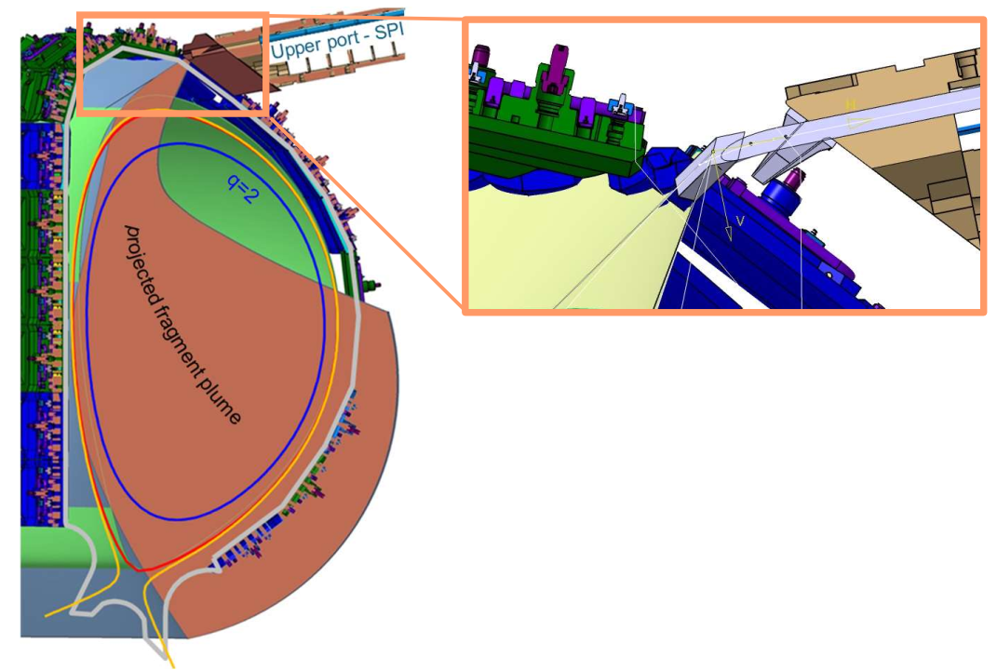
P52: Material assimilation in low Te plasma with AUG SPI
Proponents and contact person:
Stefan Jachmich (stefan.Jachmich@iter.org), Umar Sheikh, Javier Artola, Gergely Papp, Ansh Patel, Paul Heinrich, Ondrej Ficker, Peter Halldestam, Sergei Gerasimov
Scientific Background & Objectives
  The ITER DMS must provide a backup method for plasma termination and magnetic energy dissipation in the event of a missed pre-TQ injection.
  This function is essential due to the typically low electron temperature (Te) at this late stage, which severely compromises fuel assimilation.
  ITER DMS utilises toroidally tilted shatter heads.
    AUG SPI is the only system that can replicate this
Experimental Strategy/Machine Constraints and essential diagnostic
  Essential: Dispersion interferometer, SPI, fast camera, bolometers, TS.
  Build upon MGI injection for density limit scenario
    3-4 neon fractions (depending on results)
  SPI to be triggered on CQ-detection or pre-timed
ITER Shatter Head Geometry
Note toroidal angle
Proposed pulses
Device | # Pulses/Session | # Development
AUG | 5-6 | 0
MAST-U | 0 | 0
TCV | 0 | 0
WEST | 0 | 0
V. Igochine| WPTE 2026-2027 Programme Meeting | 5/11/2025|

Slide 40
P52: Material assimilation in low Te plasma with AUG SPI
Proponents and contact person:
Stefan Jachmich (stefan.Jachmich@iter.org), Umar Sheikh, Javier Artola, Gergely Papp, Ansh Patel, Paul Heinrich, Ondrej Ficker, Peter Halldestam, Sergei Gerasimov
Scientific Background & Objectives
  The ITER DMS must provide a backup method for plasma termination and magnetic energy dissipation in the event of a missed pre-TQ injection.
  This function is essential due to the typically low electron temperature (Te) at this late stage, which severely compromises fuel assimilation.
  ITER DMS utilises toroidally tilted shatter heads.
    AUG SPI is the only system that can replicate this
Experimental Strategy/Machine Constraints and essential diagnostic
  Essential: Dispersion interferometer, SPI, fast camera, bolometers, TS.
  Build upon MGI injection for density limit scenario
    3-4 neon fractions (depending on results)
  SPI to be triggered on CQ-detection or pre-timed
Priority: P1_AUG_2026 directly ITER relevant
ITER Shatter Head Geometry
Note toroidal angle
Proposed pulses
Device | # Pulses/Session | # Development
AUG | 5-6 | 0
MAST-U | 0 | 0
TCV | 0 | 0
WEST | 0 | 0
V. Igochine| WPTE 2026-2027 Programme Meeting | 5/11/2025|

Slide 41
Conclusions
The main objectives were reformulated due to archived progress and new questions for ITER
Largest contributor to the scientific programme is TCV in 2026 with dedicated experiments on AUG and WEST
  Aim to take the multimachine aspects into account even in the absence of JET
  Ample machine time on TCV to fit at least the P1 proposals in and time may allow executing also parts of P2 proposals
The programme focused primarily on the following subjects:
  Benning termination experiments (in particular high pressure limit)
  Unresolved problems of SPI
    Plasmoid drift
    Staggered and dual injection schemes
    Material assimilation
  Novel methods which should give the physical understanding
    Interaction with waves
    Interaction with coils

