Slide 1
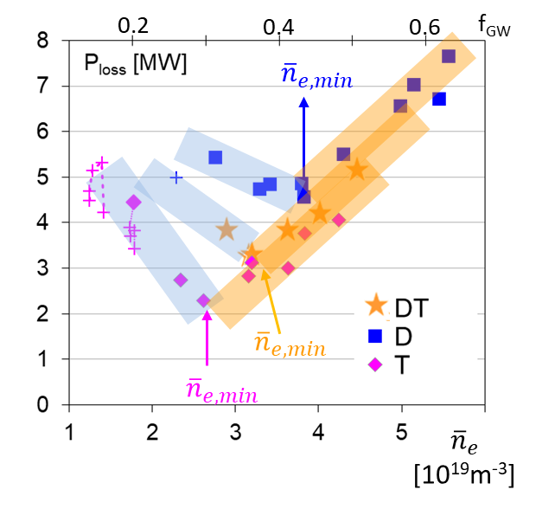
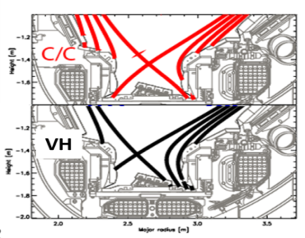
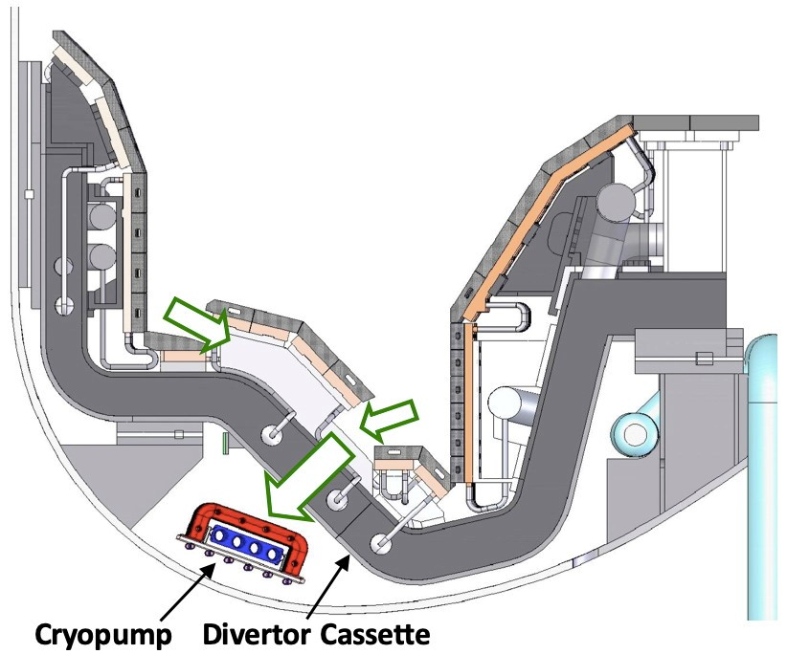
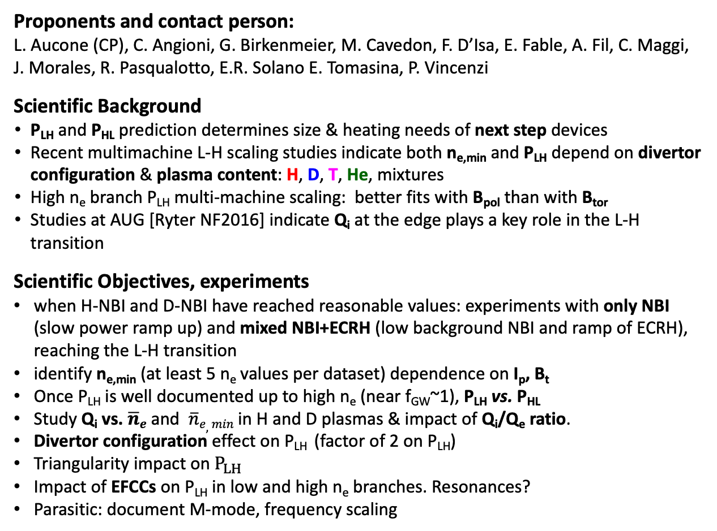
OP2: L-H power threshold characterization in H and D
Proponents and contact person:
L. Aucone (CP), C. Angioni, G. Birkenmeier, M. Cavedon, F. D’Isa, E. Fable, A. Fil, C. Maggi, J. Morales, R. Pasqualotto, E.R. Solano E. Tomasina, P. Vincenzi
Scientific Background
P_{LH} and P_{HL} prediction determines size & heating needs of next step devices
Recent multimachine L-H scaling studies indicate both n_{e,min} and P_{LH} depend on divertor configuration & plasma content: H, D, T, He, mixtures
High n_{e} branch P_{LH} multi-machine scaling: better fits with B_{pol} than with B_{tor}
Studies at AUG [Ryter NF2016] indicate Q_{i} at the edge plays a key role in the L-H transition
Scientific Objectives, experiments
when H-NBI and D-NBI have reached reasonable values: experiments with only NBI (slow power ramp up) and mixed NBI+ECRH (low background NBI and ramp of ECRH), reaching the L-H transition
identify n_{e,min} (at least 5 n_{e} values per dataset) dependence on I_{p}, B_{t}
Once P_{LH} is well documented up to high n_{e} (near f_{GW}~1), P_{LH} vs. P_{HL}
Study Q_{i} vs. $\overline{n}e$ and $\overline{n}e,min$ in H and D plasmas & impact of Q_{i}/Q_{e} ratio.
Divertor configuration effect on P_{LH} (factor of 2 on P_{LH})
Triangularity impact on $P_{LH}$
Impact of EFCCs on P_{LH} in low and high n_{e} branches. Resonances?
Parasitic: document M-mode, frequency scaling
JET 3T 2.5 MA Horizontal Target
JET
JT-60SA
HT
HT

Slide 2
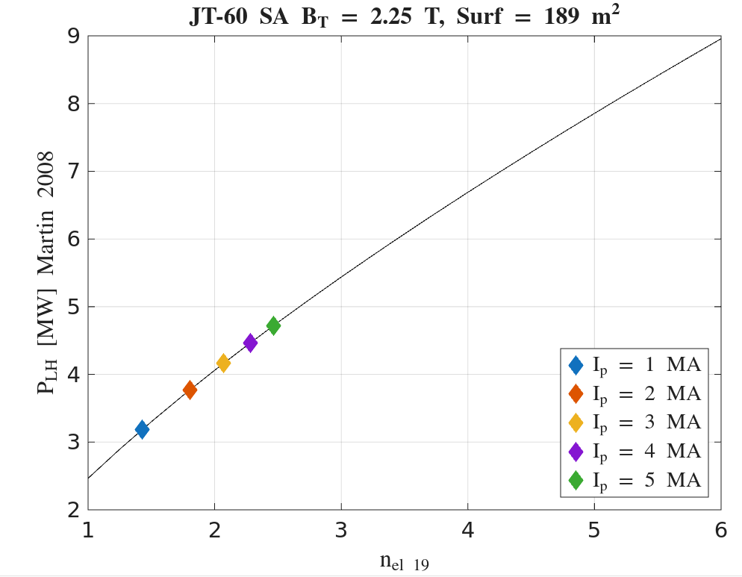
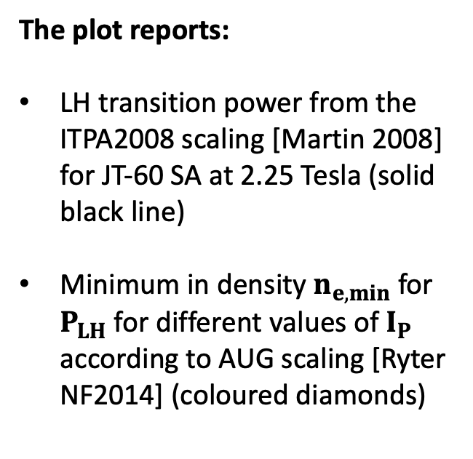
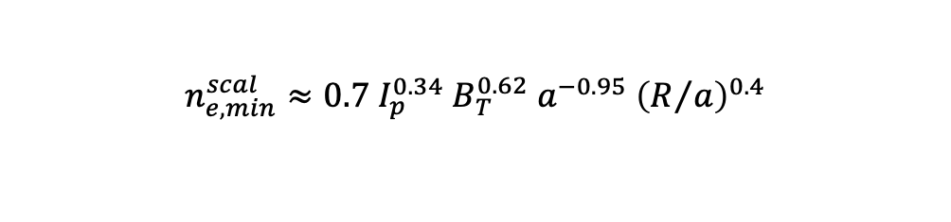
OP2: L-H power threshold characterization in H and D
The plot reports:
LH transition power from the ITPA2008 scaling [Martin 2008] for JT-60 SA at 2.25 Tesla (solid black line)
Minimum in density $n_{e,min}$ for $P_{LH}$ for different values of $I_{P}$ according to AUG scaling [Ryter NF2014] (coloured diamonds)
$$n_{e,min}^{scal}≈0.7 I_{p}^{0.34}{ B}_{T}^{0.62}{ a}^{−0.95} {\left(R/a\right)}^{0.4}$$

