Slide 1
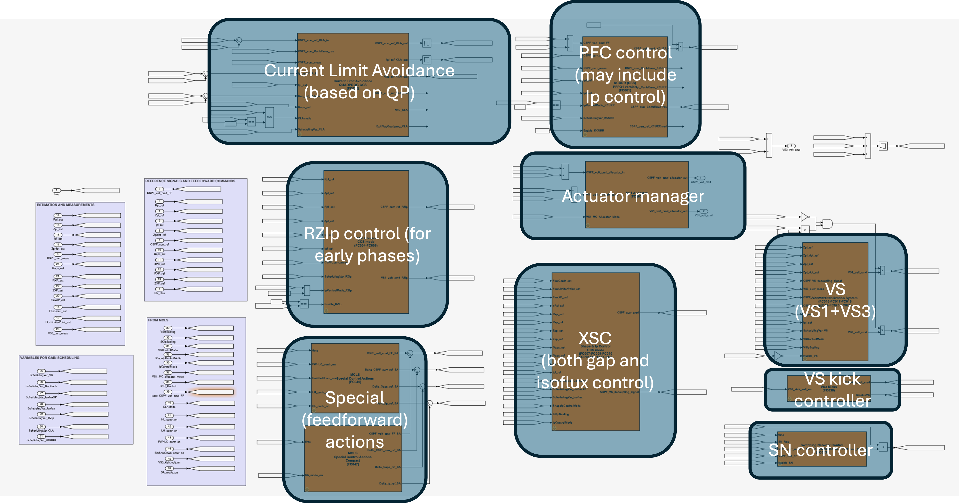
Test of ITER magnetic control schemes
Proponents and contact persons:
G. De Tommasi (detommas@unina.it)
M. Mattei (massimiliano.mattei@unina.it)
A. Pironti (pironti@unina.it)
L. di Grazia (luigiemanuel.digrazia@consorziocreate.it)
F. Fiorenza (federico.Fiorenza@unina.it)
Scientific Background & Objectives
Main aim: incremental validation of the ITER magnetic control algorithms (equilibrium control) on JT-60SA
Strategy: step-by-step test of the main architectural components
STEP #1: Integrated control of Ip and CS/EF currents
STEP #2: Vertical Stabilization using FPPC coils
STEP #3: Isoflux/gap plasma boundary control
Possible summary figures
P. de Vries et al., "Strategy to systematically design and deploy the ITER plasma control system: A system engineering and model-based design approach”, Fus. Eng. Des., 2024
M. Mattei et al., “Recent developments in ITER magnetic control algorithms”, Fus. Eng. Des., 2026

