Slide 1
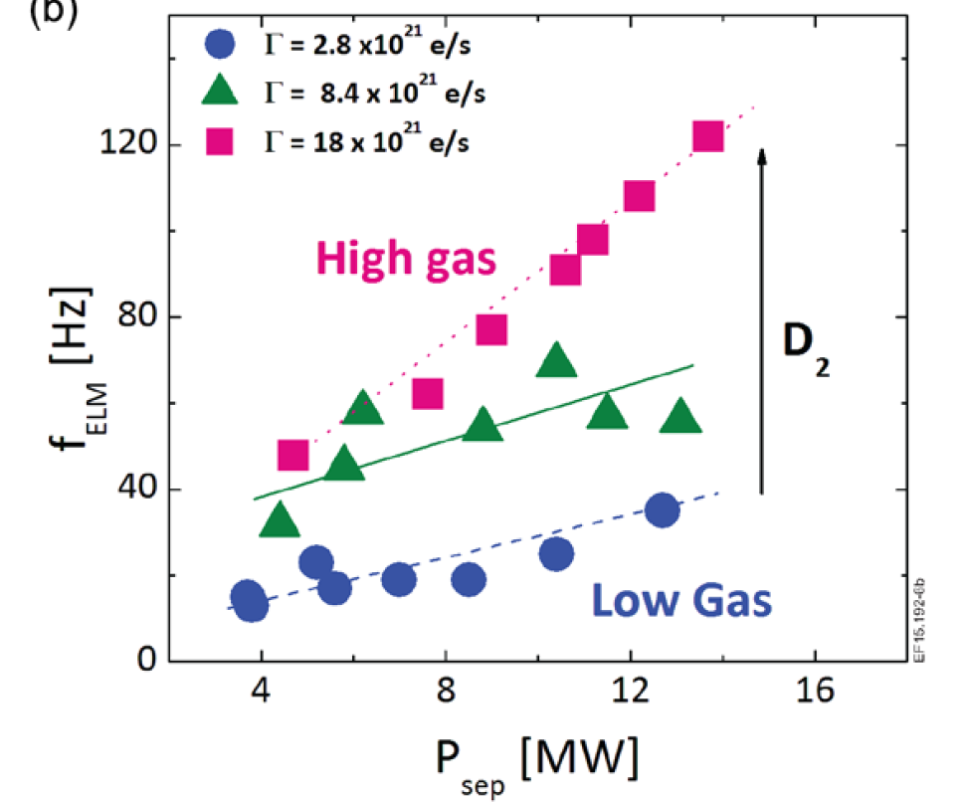
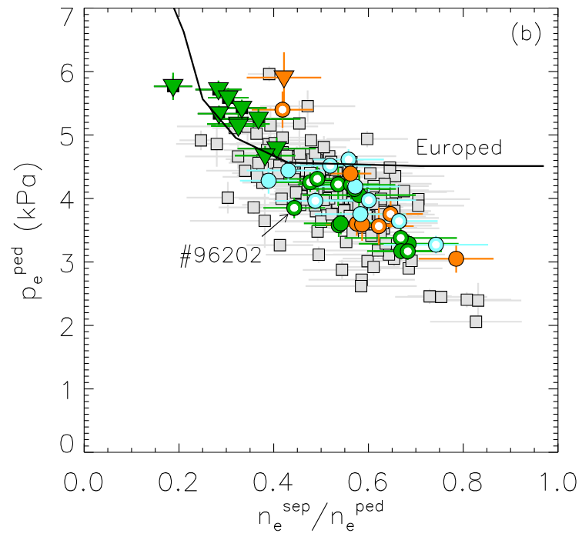
Pedestal structure, stability, transport and ELMs characterization
Proponents and contact person:
L. Frassinetti, S. Saarelma, O. Krutkin
Background
In JET-ILW at high power and high gas rate (→high n_{e}^{sep}/n_{e}^{ped}) the pedestal is not limited by ideal MHD but by resistive MHD [Maggi NF2015, Frassinetti NF2021, Nyström NF2023] and ETGs play a major role in the pedestal transport [Chapman NF2022, Krutkin PPCF2025].
Do we have and in which conditions similar phenomenology in JT-60SA?
This will provide a more general understanding of resisistive MHD and pedestal transport, that can help us for extrapolation to future machines.
Objectives
Direct objectives:
measure pedestal structure and ELMs in different plasma conditions
quantify the correlation of the pedestal with power and gas rate
quantify pedestal stability and GK turbulent transport characteristics
quantify the correlation between pedestal stability with n_{e}^{sep}/n_{e}^{ped}
Identify under which conditions resistive MHD and ETG pedestal transport start to be relevant in JT-60SA
compare the JT-60SA results with JET-ILW and JET-C
Indirect objectives (to be linked to other proposals):
Identify the P_{LH} threshold at different gas rates
Identify transition from type III ELMs to type I ELMs
Global confinement in H-mode and core transport
Limited by resistive MHD,
Strong ETG pedestal turbulence
[Maggi NF2015] and [Challis NF2015]
[Frassinetti NF2021]

Slide 2
Pedestal structure, stability, transport and ELMs characterization
Proponents and contact person:
L. Frassinetti, S. Saarelma, O. Krutkin
Background
In JET-ILW at high power and high gas rate (→high n_{e}^{sep}/n_{e}^{ped}) the pedestal is not limited by ideal MHD but by resistive MHD [Maggi NF2015, Frassinetti NF2021, Nyström NF2023] and ETGs play a major role in the pedestal transport [Chapman NF2022, Krutkin PPCF2025].
Do we have and in which conditions similar phenomenology in JT-60SA?
This will provide a more general understanding of resisistive MHD and pedestal transport, that can help us for extrapolation to future machines.
Objectives
Direct objectives:
measure pedestal structure and ELMs in different plasma conditions
quantify the correlation of the pedestal with power and gas rate
quantify pedestal stability and GK turbulent transport characteristics
quantify the correlation between pedestal stability with n_{e}^{sep}/n_{e}^{ped}
Identify under which conditions resistive MHD and ETG pedestal transport start to be relevant in JT-60SA
compare the JT-60SA results with JET-ILW and JET-C
Indirect objectives (to be linked to other proposals):
Identify the P_{LH} threshold at different gas rates
Identify transition from type III ELMs to type I ELMs
Global confinement in H-mode and core transport
Strategy:
Perform power scans at constant gas rate
Perform gas scan at constant power
Limited by resistive MHD,
Strong ETG pedestal turbulence
[Maggi NF2015] and [Challis NF2015]
[Frassinetti NF2021]
high gas
gas rate
medium gas
low gas
power

Slide 3
Pedestal structure, stability, transport and ELMs characterization
Proponents and contact person:
L. Frassinetti, S. Saarelma, O. Krutkin
Background
In JET-ILW at high power and high gas rate (→high n_{e}^{sep}/n_{e}^{ped}) the pedestal is not limited by ideal MHD but by resistive MHD [Maggi NF2015, Frassinetti NF2021, Nyström NF2023] and ETGs play a major role in the pedestal transport [Chapman NF2022, Krutkin PPCF2025].
Do we have and in which conditions similar phenomenology in JT-60SA?
This will provide a more general understanding of resisistive MHD and pedestal transport, that can help us for extrapolation to future machines.
Objectives
Direct objectives:
measure pedestal structure and ELMs in different plasma conditions
quantify the correlation of the pedestal with power and gas rate
quantify pedestal stability and GK turbulent transport characteristics
quantify the correlation between pedestal stability with n_{e}^{sep}/n_{e}^{ped}
Identify under which conditions resistive MHD and ETG pedestal transport start to be relevant in JT-60SA
compare the JT-60SA results with JET-ILW and JET-C
Indirect objectives (to be linked to other proposals):
Identify the P_{LH} threshold at different gas rates
Identify transition from type III ELMs to type I ELMs
Global confinement in H-mode and core transport
Strategy:
Perform power scans at constant gas rate
Perform gas scan at constant power
Indirectly → subset at constant β_{N} for pedestal stability studies
Limited by resistive MHD,
Strong ETG pedestal turbulence
[Maggi NF2015] and [Challis NF2015]
[Frassinetti NF2021]
high gas
gas rate
medium gas
subset at constant β_{N}
low gas
power

Slide 4
Pedestal structure, stability, transport and ELMs characterization
Proponents and contact person:
L. Frassinetti, S. Saarelma, O. Krutkin
Background
In JET-ILW at high power and high gas rate (→high n_{e}^{sep}/n_{e}^{ped}) the pedestal is not limited by ideal MHD but by resistive MHD [Maggi NF2015, Frassinetti NF2021, Nyström NF2023] and ETGs play a major role in the pedestal transport [Chapman NF2022, Krutkin PPCF2025].
Do we have and in which conditions similar phenomenology in JT-60SA?
This will provide a more general understanding of resisistive MHD and pedestal transport, that can help us for extrapolation to future machines.
Objectives
Direct objectives:
measure pedestal structure and ELMs in different plasma conditions
quantify the correlation of the pedestal with power and gas rate
quantify pedestal stability and GK turbulent transport characteristics
quantify the correlation between pedestal stability with n_{e}^{sep}/n_{e}^{ped}
Identify under which conditions resistive MHD and ETG pedestal transport start to be relevant in JT-60SA
compare the JT-60SA results with JET-ILW and JET-C
Indirect objectives (to be linked to other proposals):
Identify the P_{LH} threshold at different gas rates
Identify transition from type III ELMs to type I ELMs
Global confinement in H-mode and core transport
Strategy:
Perform power scans at constant gas rate
Perform gas scan at constant power
Indirectly → subset at constant β_{N} for pedestal stability studies
Limited by resistive MHD,
Strong ETG pedestal turbulence
[Maggi NF2015] and [Challis NF2015]
[Frassinetti NF2021]
high gas
gas rate
medium gas
subset at constant β_{N}
Related OP2 scientific topics
Initial characterization of H-mode confinement
L-H power threshold characterization in H and D
Pedestal and ELMs generation studies in different plasma conditions
low gas
power

