Slide 1
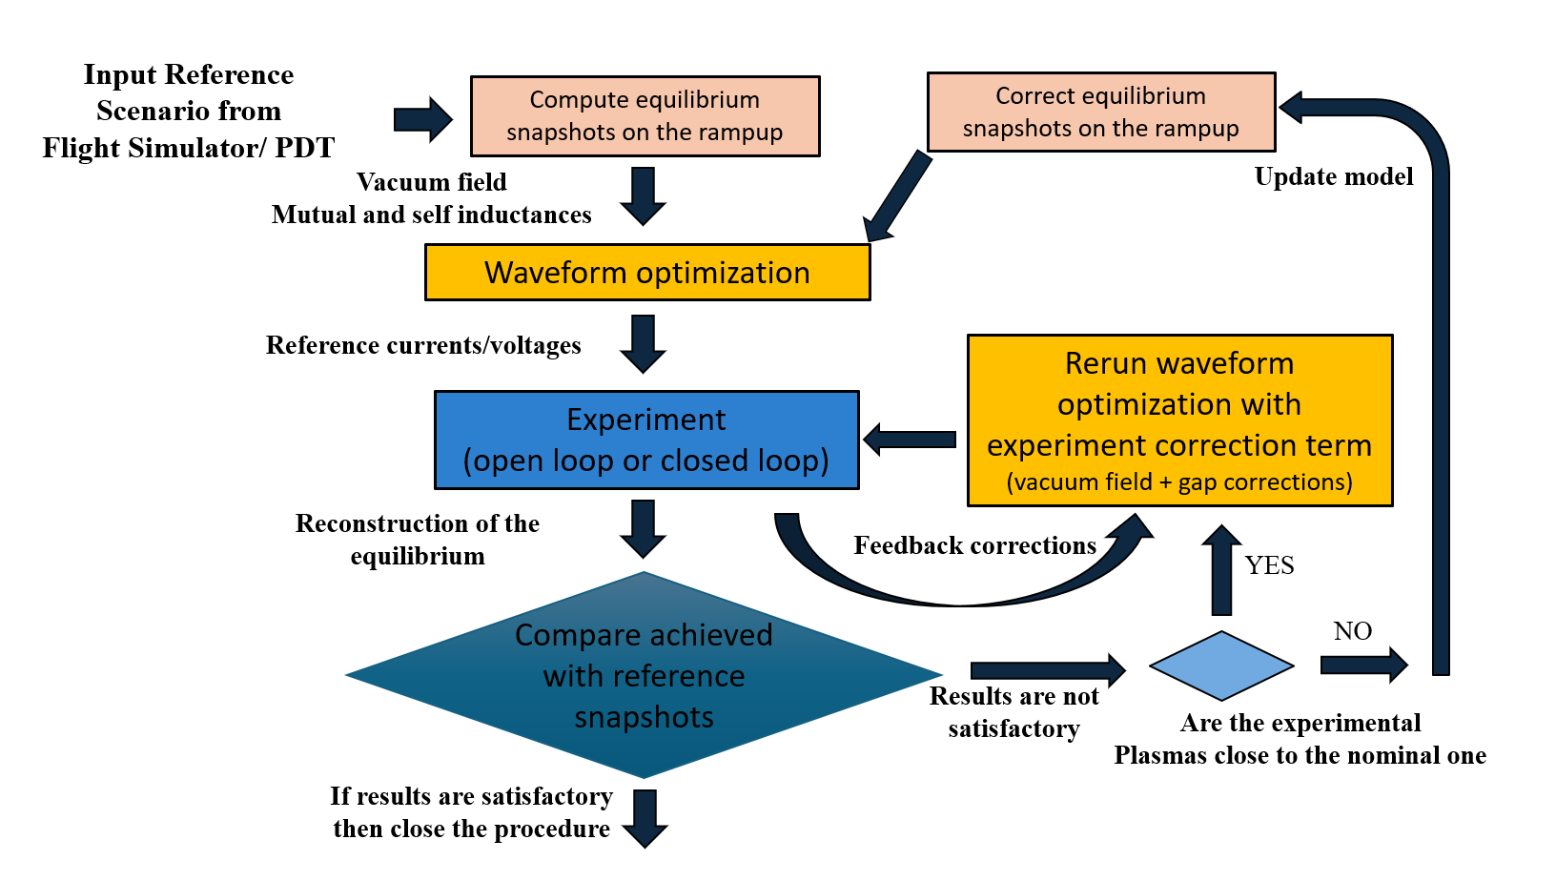
Iterative Learning Control for the design of Breakdown and ramp-up scenarios
Proponents and contact persons:
  M. Mattei (massimiliano.mattei@unina.it)
  L.E. Di Grazia (luigiemanuel.digrazia@consorziocreate.it)
Scientific Background & Objectives
Main aim: validation of an intra-shot design procedure to optimize breakdown and ramp-up scenarios on the basis of experimental results using a sequence of adjacent shots
Strategy: step-by-step test of the procedure
  STEP #1: Optimization of breakdown and early ramp-up current waveforms without any feedback on Ip and plasma shape/position descriptors
  STEP #2: Use of Ip and shape feedback for the optimization of the entire ramp-up (Ohmic conditions)
  STEP #3: Ramps with additional heating (possible synergy with other experiments)
M. Mattei, L.E. Di Grazia, and D. Frattolillo, “INTRA-SHOT Tools for Plasma Scenario Optimization and Magnetic Control”, IAEA FEC 2025 Conference
Di Grazia, L. E., et al., Nuclear Fusion, Automated shot-to-shot optimization of the plasma start-up scenario in the TCV, 64 (2024) 096032.
Di Grazia, L. E., et al., Optimization and Engineering, Iterative learning optimization and control of MAST-U breakdown and early ramp-up (2025) 1–22.
Di Grazia, L. E., Mattei, M., Fusion Engineering and Design, A numerical tool to optimize voltage waveforms for plasma breakdown and early ramp-up in the presence of constraints, 176 (2022) 113027
Di Grazia, L. E., et al., Magnetic control strategies for the breakdown and early ramp-up in large tokamaks,” Proc. IEEE Conference on Control Technology and Applications (2022), 837–844.

