Slide 1
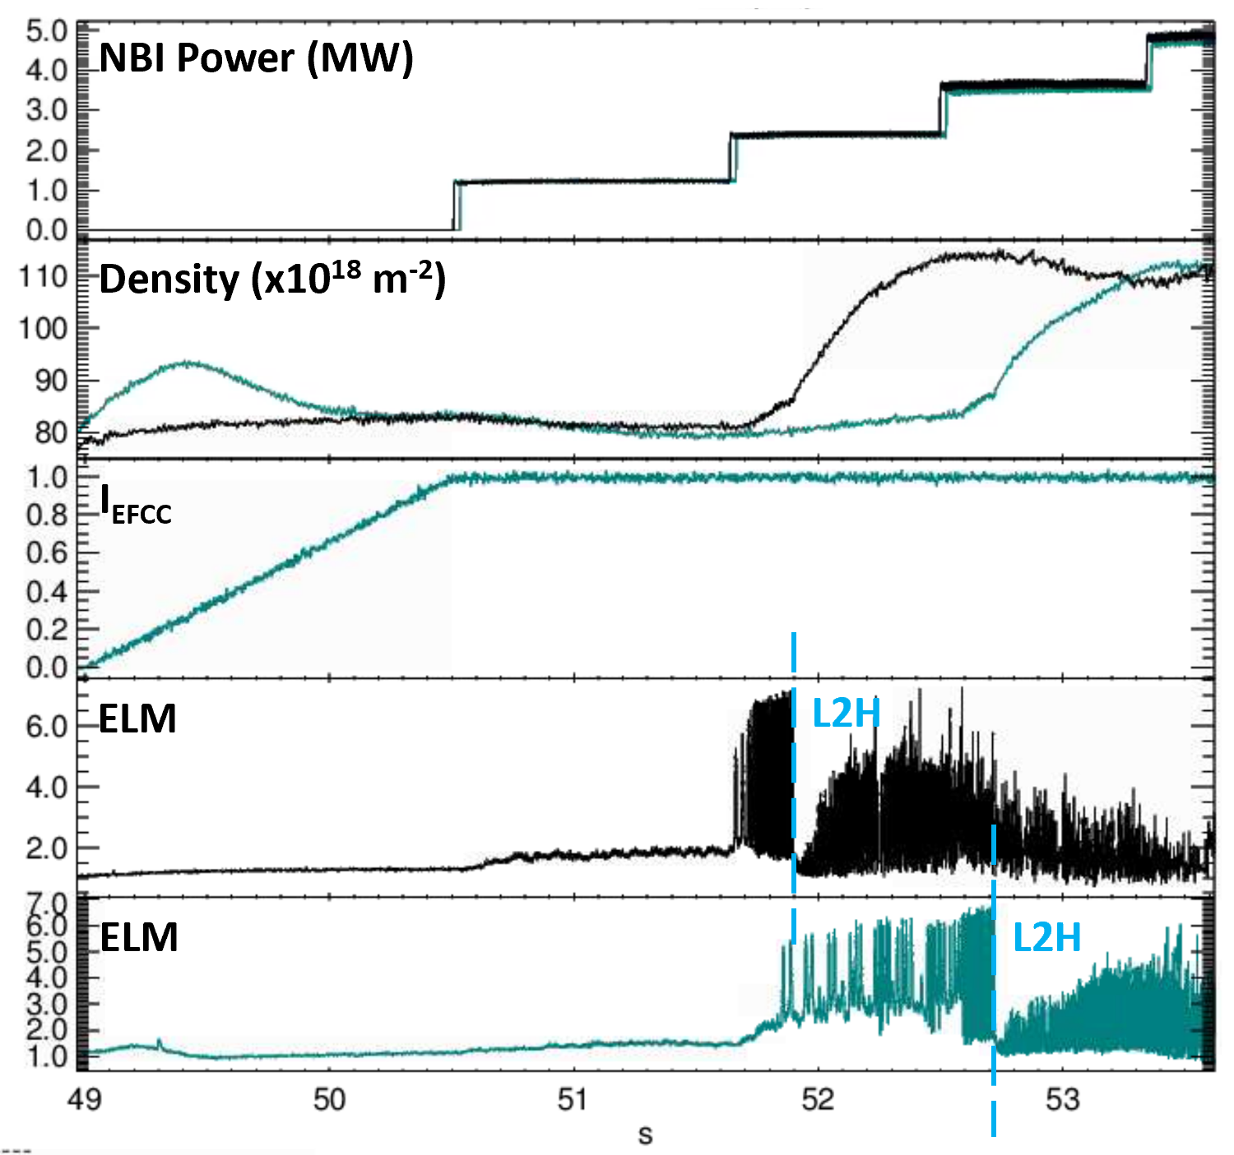
L2H and H mode control in presence of a proxy EF
Proponents and contact person:
Lidia Piron (lidia.piron@unipd.it)
Spyros Aleiferis
Olivier Sauter
Paolo Zanca
Alessandra Tonel
Scientific Background & Objectives
The L2H transition and the H mode can be inhibited because of the presence of an error field.
The effect of an n=1 proxy EF on the L2H transition is shown in these companion JET discharges.
A robust controller has been tested in D and DT plasmas which tailors the L2H transition and the ELM dynamics by acting on f ^{Net}_{LH} = P_{sep}/P_{LH.} The actuators used were NBI and gas [1,2].
In this proposal, we aim at
Implementing the f ^{Net}_{LH} = P_{sep}/P_{LH}
Test the f ^{Net}_{LH} controller during the main heating phase
Assess the behavior of the f ^{Net}_{LH} controller in presence of a disturbance (n=1, n=2 proxy EFs)
Possible illustrative figure
Number of shots required (8)
[1]L. Piron et al Fusion Engineering and Design 200 (2024) 114155
[2]L. Piron et al Plasma Phys. Control. Fusion 67 (2025) 055006

