Slide 1
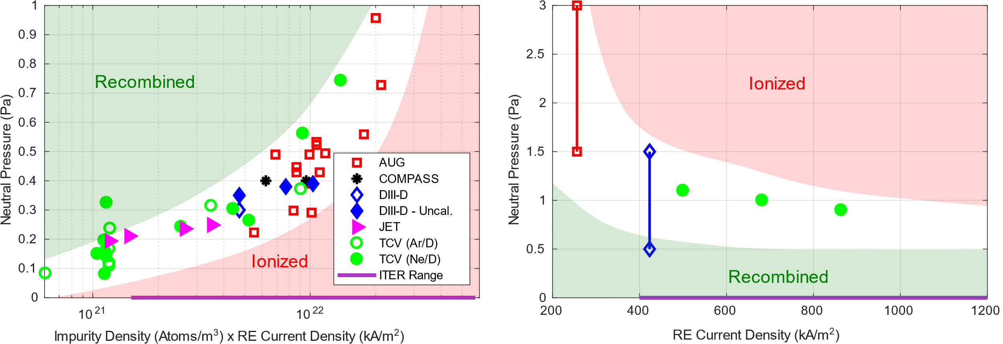
Benign Termination of RE Beams on JT60-SA
Proponents and contact person:
  U. Sheikh, J. Decker, A. Battey, C. Reux, M. Hoppe, C. Paz-Soldan, et al.
Scientific Background & Objectives
  Benign termination has been successfully demonstrated on 5 tokamaks (Sheikh IAEA FEC 2025)
    It has the ability to prevent damage from MA RE beams (Reux PRL 2021)
  OP1 already produced REs at low current
    RE beams are extremely likely on as we increase the current in OP2
    The machine must have a reliable mitigation strategy to prevent damage
    Benign termination is compatible with the MGI systems being installed
  Data from high current RE terminations on JT60-SA will be invaluable in understanding the physics and extrapolating this strategy to ITER
Experimental Strategy etc:
  Establish RE beam scenario and control
  Demonstrate benign termination at low RE currents
    Determine the operational domain (figures ->)
    Quantify heat fluxes, extrapolate to tungsten walls on JT60-SA and ITER
  Once reliable at low current, increase until max operational current
  Integrate benign termination into PCS to handle potential RE beams
Lower Pressure Limit
(Recombination)
Upper Pressure Limit
(Re-Ionization)
Device | # Pulses/Session | # Development
JT60-SA | 40 | 10

