Slide 1
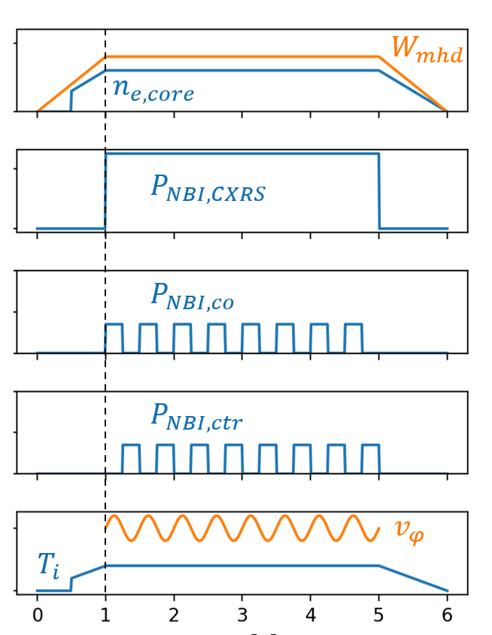
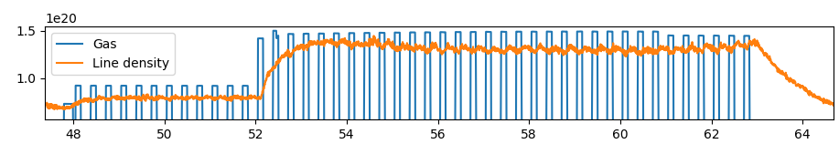
L-mode transport dependence on collisionality and I_{p}/q-profile
Proponents and contact person:
  Tuomas.Tala@vtt.fi, Antti.Salmi@vtt.fi, yoshida.maiko@qst.go.jp, edoardo.tomasina@igi.cnr.it
Scientific Background & Objectives
  Perform collisionality, temperature ratio T_{e}/T_{i} and I_{p}/q-profile scans to characterize heat, particle and momentum transport in JT-60SA L-mode plasmas
  Scan the power (ideally keeping the total power constant) from the NBI dominated (T_{e}/T_{i} < 1) ITG plasma to ECRH electron heating dominated L-mode plasma (T_{e}/T_{i} > 1), possibly dominated by TEM
  Use the NBI modulation technique with co- and counter-directed beams (keep power constant) with minimized temperature modulation (~linear response in momentum) in each of the scan to extract momentum diffusion, pinch and intrinsic torque source separately
  Use the gas puff modulation analogously to the NBI modulation to extract particle diffusion and pinch separately (and possible electron heat transport by the same modulation). Additional use ECRH modulation if interesting
  JT-60SA results on the level of transport coefficients are comparable against earlier similar experiments from JET, AUG, TCV and WEST (and DIII-D) to characterise the similarities and differences between those earlier results
  Main questions to be answered with respect to OP2 priorities
    [TC-1] Heat transport in electron heated dominated plasmas in L-mode
    [TC-2] Characterization of L-mode confinement
Momentum transport
Particle transport

