Slide 1
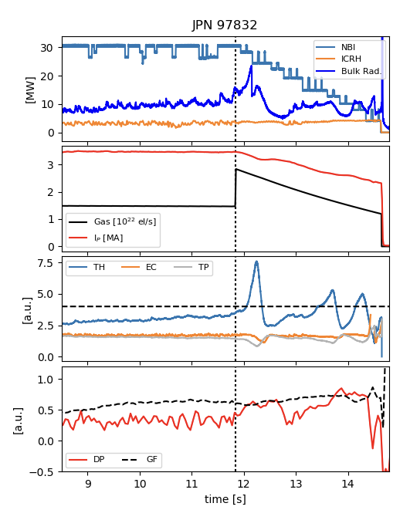
Proposal title: Optimization of the ramp-down phase
Proponents and contact person:
edoardo.alessi@istp.cnr.it, carlo.sozzi@istp.cnr.it, luca.bonalumi@istp.cnr.it
Scientific Background & Objectives
  Topic: [MHD-2] Disruption studies at high current in L mode and creation of disruption databases (ITER RP A.4, B.1.2, B.1.3, B.1.4, B.1.5, B.1.6)
  Rationale for the proposal and main questions to be answered with respect to OP2 priorities: [Safe step-by-step increase of plasma current up to 5.5 MA in L-mode; Disruption and mitigation technique studies; Studies of L-H back-transition] - Development of an optimized soft-stop strategy depending on the flat-top conditions (Ip, Additional power, Density, Scenario, Impurity concentration,…)
  Construction of a reward function to classify successful ramp-down cases (eg: low disruption forces, low recycling, low thermal loads, related mhd activity…)
  Characterization of the ramp-down phase against (this may involve definition of kinetic profile parameters to classify the plasma behavior during termination)
    Gas fueling rate
    Ip rate
    Additional power ramp-down
    Shape control (elongation)
  Construction of a ramp-down database
  Tentative extrapolation to higher engineering parameters
IP
D influx
Threshold for TH and EC
Electron Temperature profile
Greenwald fraction
Electron Density
profile
Density peaking
Number of sessions or shots required
Use of the database of all the experiments
1 dedicated session (12 shots) for variation of the parameters defining the safe region
WPTE | JT-60SA OP2 Proposal | 2026

Slide 2
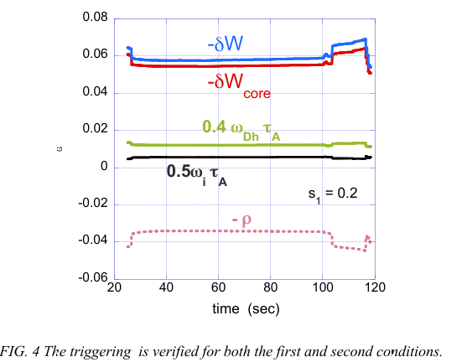
Proposal title: Characterization of the ECH/ECCD effect on sawtooth activity
Proponents and contact person:
edoardo.alessi@istp.cnr.it, carlo.sozzi@istp.cnr.it, silvana.nowak@istp.cnr.it, luca.bonalumi@istp.cnr.it
Scientific Background & Objectives
  [MHD-4] Sawtooth activity and modification by ECH/ECCD
  Rationale for the proposal and main questions to be answered with respect to OP2 priorities: [Initial integrated scenarios development towards high confinement H-mode operation ] – Characterization of the ECH/ECCD effect on sawtooth activity in order to control the sawtooth period, inversion radius, amplitude of 1,1 mode, determination of the limit to avoid NTM triggering
  Variation of
    ECH/ECCD power level from 1.5 to 3 MW
    Radial power deposition via poloidal steering
    Inside/outside q=1
    ECCD effects via toroidal steering
    Ip, density and additional heating
    (S.Nowak, NF 2014)
  Modeling of the sawtooth dynamics
Evaluation of ST triggering conditiond for plasma scenarios by METIS code.
S. Nowak et al., IAEA-FEC 2025
Number of sessions or shots required
2 sessions (12 shots each, one at Ip=3.5MA/Bt=1.7T, and one at Ip=4.6MA/Bt=2.2T)
  Changes on electron density, poloidal and toroidal steering
Low additional heating in piggy-back

