Slide 1
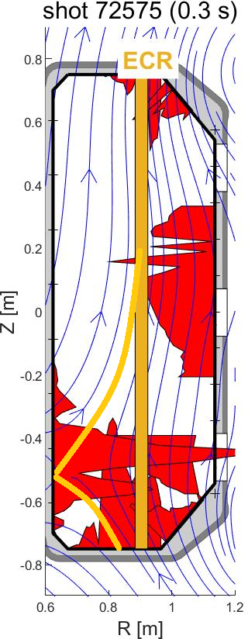
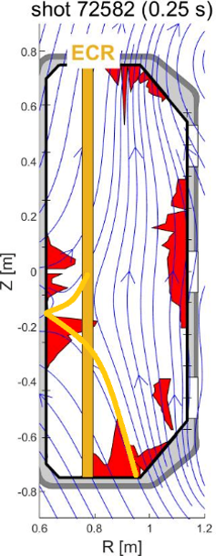
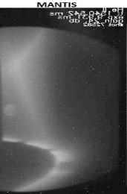
Exploration of optimal breakdown conditions and magnetic configurations for ECWC on JT-60SA
TCV experiments on ECWC³
Proponents and contact person:
johan.buermans@mil.be
kristel.crombe@ugent.be
laura.laguardia@istp.cnr.it
…
Scientific Background & Objectives
  Exploration of optimal breakdown conditions for ECWC⁴
    Fundamental wave @82GHz is optimal for breakdown, but encounters a density limit and possible parametric decay
    Second harmonic @138 GHz is optimal for increased plasma density, but can cause stray radiation and parametric decay
    => Combine both to mitigate the risks and increase the plasma flux
  Exploration of optimal magnetic configuration for ECWC¹²³⁴
    Determine the most polluted areas (HFS Langmuir probes + cameras)
    Determine magnetic configurations to direct the particle flux (HFS Langmuir probes) ³
    Evaluate the ECWC efficiency by RGA (calibration needed)
  Determine efficient ECWC scenarios to increase the plasma performance
    Duty cycle and power requirements
Number of session or shots required ?
¹M. Fukumoto et al, Nucl. Mater. Energy, 2017
²D. Douai et al, Nucl. Fusion, 2018
³J. Buermans et al, EPS plasma conference, 2022
⁴M. Fukumoto et al, Nucl. Mater. Energy, 2025

