Slide 1
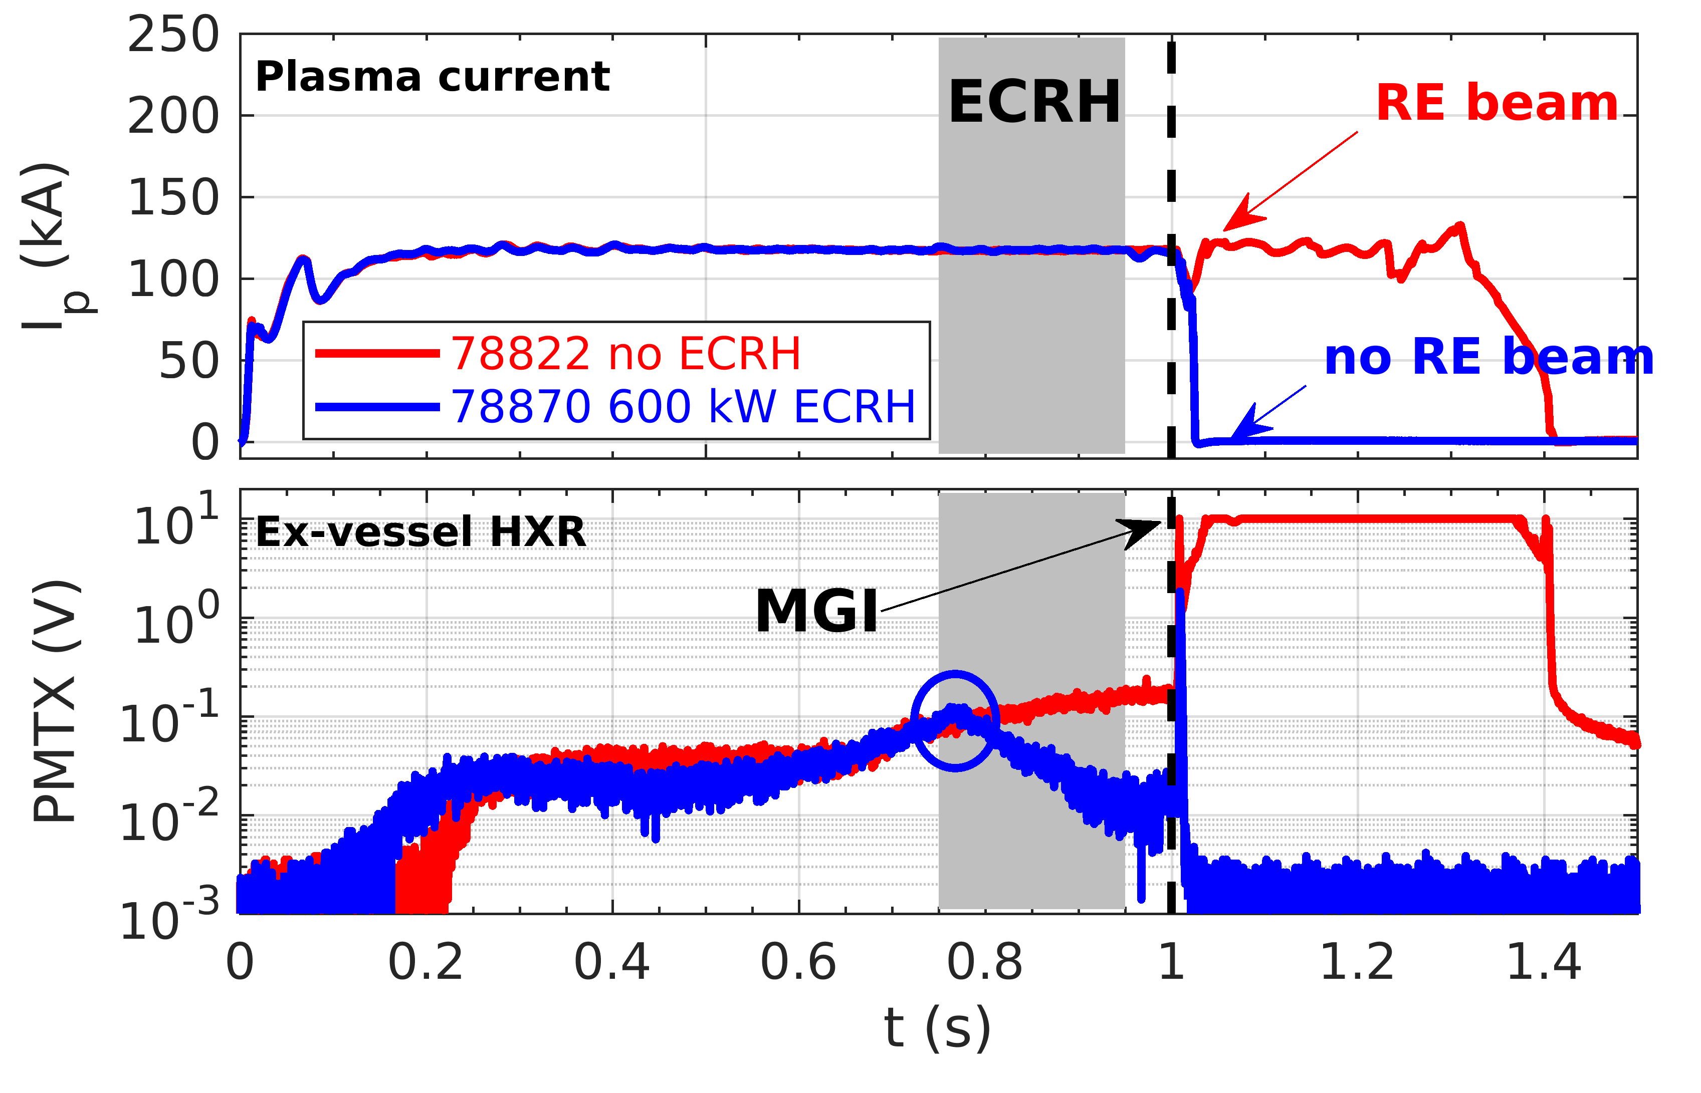
Runaway electron seed expulsion using ECRH/NBH on JT60-SA
Proponents and contact person:
  J. Decker, U. Sheikh, A. Battey, E. Devlaminck, M. Hoppe, I. Muzio, O. Panico, et al.
  joan.decker@epfl.ch
Scientific Background
  Runaway electrons (REs) are a serious concern for large tokamaks including JT60-SA
  RE research on JT60-SA is essential to validate models and extrapolate to ITER
  Pre-disruption RE seed strongly impacts post-disruption RE beam current
  In TCV, applying ECRH and/or NBH expels up to 99.9 % of RE seed population
  Results from combined effect of higher Te and enhanced RE transport
  Seed expulsion prevents formation of a RE beam in MGI-induced disruption
  [J. Decker et al. Nuclear Fusion 2024]
Objectives
  Study RE generation & transport in JT60-SA startup and hot plasmas
  Characterise RE seed expulsion using ECRH and/or NBH
  Determine impact of RE seed expulsion on post-disruption RE beam formation
Experimental Strategy
  Scan plasma fueling and ohmic drive to characterize RE generation and
  confinement [12 shots]
  Apply ECRH in presence of RE seed varying power, direction and location; follow with MGI-triggered disruption [15 shots]
  Apply NBH in presence of RE seed varying power, followed by MGI [8 shots]
Systems : OP2 heating (ECRH & NBH), MGI
Diagnostics : Neutrons, visible imaging, HXR (ex-vessel HXR system can be procured by EPFL)
Device | # Pulses/Session | # Development
JT60-SA | 35

