Slide 1
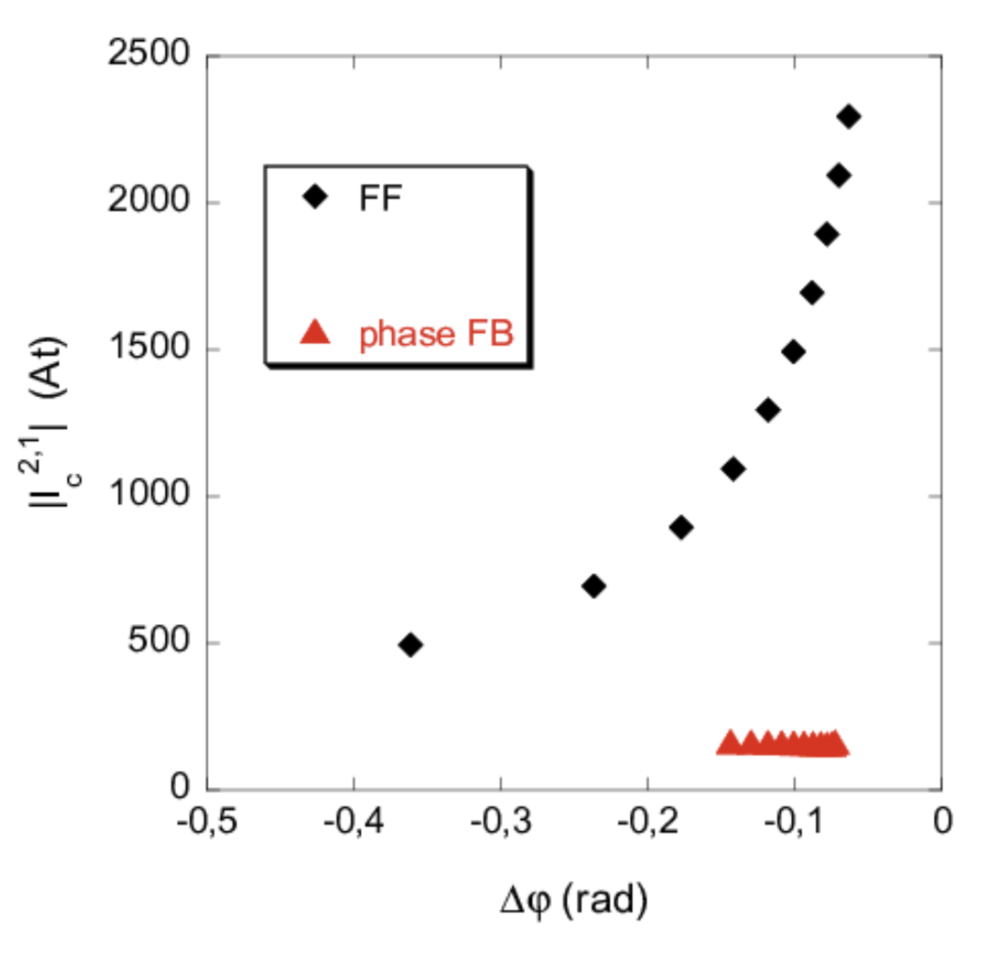
Face NTM position control toward ITER operation
Proponents and contact person:
Lidia Piron (lidia.piron@unipd.it)
Paolo Zanca
Giuseppe Marchiori
Olivier Sauter
Scientific Background & Objectives
In tokamaks, NTMs typically rotate while maintaining a small magnetic island width. As the mode slows down, the island width increases, potentially leading to plasma disruption. A robust and well-established technique used to stabilize NTMs involves using RF waves to drive current at the island O-point [1]. Stabilizing the 2/1 NTM during its rotating phase can be particularly challenging in ITER due to rapid mode locking and the broadening of the radial current profile driven by RF waves, which is caused by edge density fluctuations.
A promising solution is to induce a proxy EF using RMP coils positioned in front of the RF launcher. This enables the magnetic island to lock at the RF launcher [2], where the driven current can effectively suppress the mode.
In this proposal, we aim at
Test feedforward/feedback control on the rotating n=1 radial magnetic field
Test feedforward/feedback control on the static n=1 radial magnetic field
Possible illustrative figure
Number of shots required (10)
[1] F. Volpe et al. Phys Rev Lett 115 (2015)
[2] P. Zanca and G. Marchiori Plasma Phys. Control. Fusion 67 (2025) 105026

