Slide 1

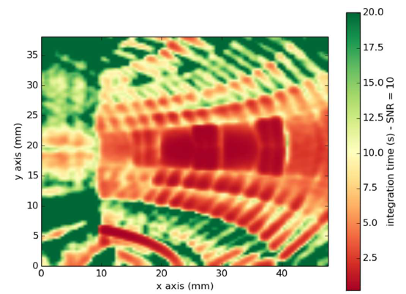

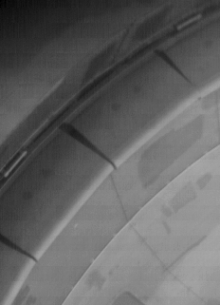
Wall inspection using EDICAM during ECWC
Simultaneous use of 20 views:
1 view is used for viewing
19 views are used for illumination
Proponents and contact person:
szepesi.tamas@ek.hun-ren.hu
lucas.moser@iter.org
Scientific Background
ITER investigates wall inspection methods with external lighting
Simulations revealed extremely low efficiency
- 12 orders of magnitude between laser power produced and laser light received at the cameras
Alternative inter-shot illumination methods: ECWC, ICWC
Scientific Objectives
Investigate wall inspection quality with EDICAM during ECWC
Assess image quality vs position of ECWC resonance
[Moser et al
47th ITPA meeting]
5 ms exposure
+contrast
E100552
EDICAM
Number of session or shots required
Inter-shot ECWC is OK, but if filters are used, it affects other shots

