Slide 1
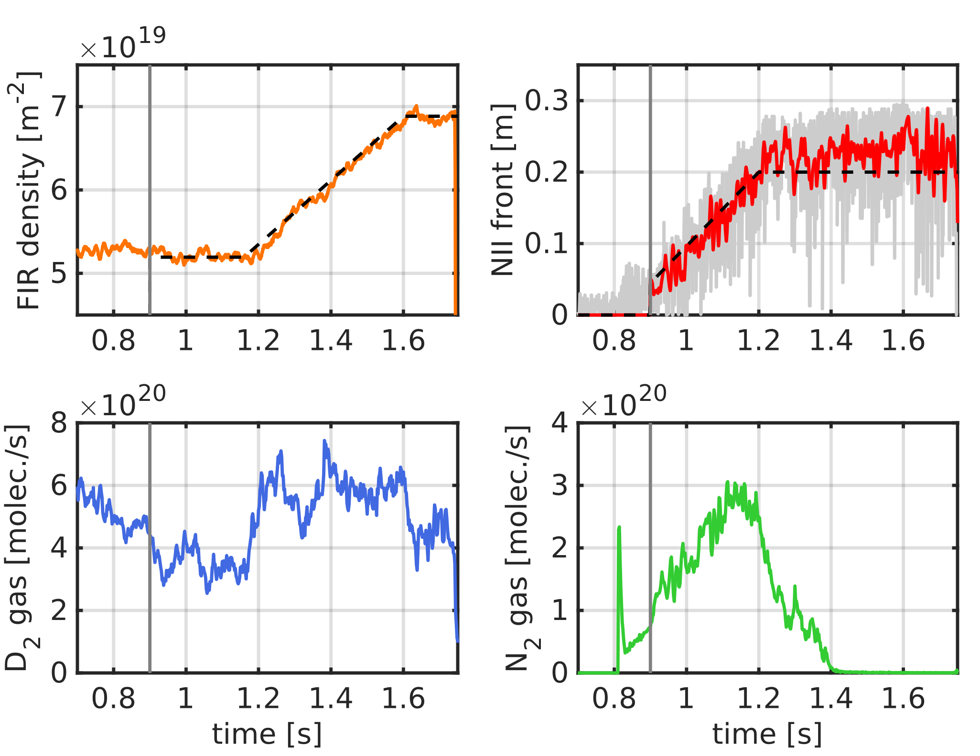

Joint core (density) control and exhaust (impurity) control
Proponents and contact person:
M. van Berkel (m.vanberkel@differ.nl), T. Nakano, G. L.
Derks, et al.
Scientific Background & Objectives
Joint core density and edge seeding (MIMO) control is crucial for current and future fusion reactors. On TCV, we have demonstrated the joint control of line-integrated density with impurity control.
Demonstration of MIMO control of the core density and divertor seeding with noble gasses using Bolometer Prad
This work connects to three main scientific topics:
Heat transport in electron heated dominated plasmas in L-mode and confinement: the core dynamics are crucial for the decoupling
Initial seeding studies and impact on the heat flux to divertor: seeding impacts both core and exhaust and decoupling is necessary to study it in detail
Compatibility of neutral gas penetration at high pedestal operation: the fueling will change and hence control will be necessary to have same core-densities even though neutral gas penetration decreases. The increased gas request will quantiyf the effectiveness neutral gas penetration.
Possible summary figures
TCV discharge 73544: simultaneous control of the detachment front control with nitrogen seeding. Note that both the deuterium and seeding has impact on core and exhaust consequently active decoupling is required. Koenders et al. Nucl. Fusion 2023

