Slide 1
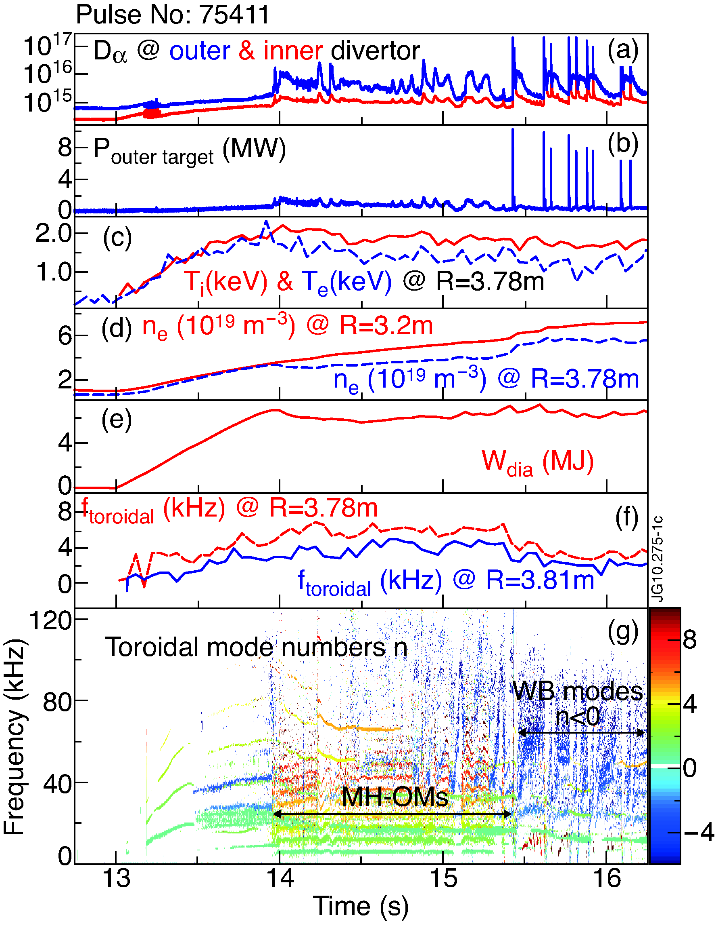
OP2 and/or OP3: QH-mode development
(29/10/2008)
Proponents and contact person:
emilia.solano@ciemat.es, eviezzer@us.es, samui.Saarelma@ukaea.uk, +?…
Scientific Background of Quiescent H-mode (QH)
ELM-less regime with high T_{i,ped}, low ν*, good confinement
development best done in hot ion regimes, most easily obtained with a C wall and low initial density
Wall conditioning to reduce recycling is key
DIII-D and AUG-C cn-NBI easier. QH in DIII-D can reach high n_{e,sep}, low T_{e,sep}
DIII-D observed co-NBI QH and cn-NBI Hydrogen QH-mode
Scientific Objectives, experiments
Within Scenario Development? Initial integrated scenarios development towards high confinement H-mode operation
when 15-20 MW NBI reached in OP2 without shine-through problems at low n_{e} & 2-3 MA, search for phases with EHOs. When found, initiate QH-mode development studies Gap scan.
Coordinated effort of many groups: ORD-4 (B9.8), TC-3 (B2.2), HEP-1(B11.2), PEP-2 (B2.5), DSOL-3 (B6.1-2)
EFCCs can contribute to induce QH-modes: systematic studies?
QH-modes compatible with ion ITBs, of interest to HEPB studies.
QH
Possible summary figures
JET-C
EHO
JET-C QH-mode (not optimized), 6kHz EHO
B_{t}=2.6 T, I_{p}=2.5 MA, 15 MW co-NBI
Density at start of EHO f_{GW}= 0.42,
reaches 0.68 n_{GW} at end.
Within OP2 capabilities?

Slide 2
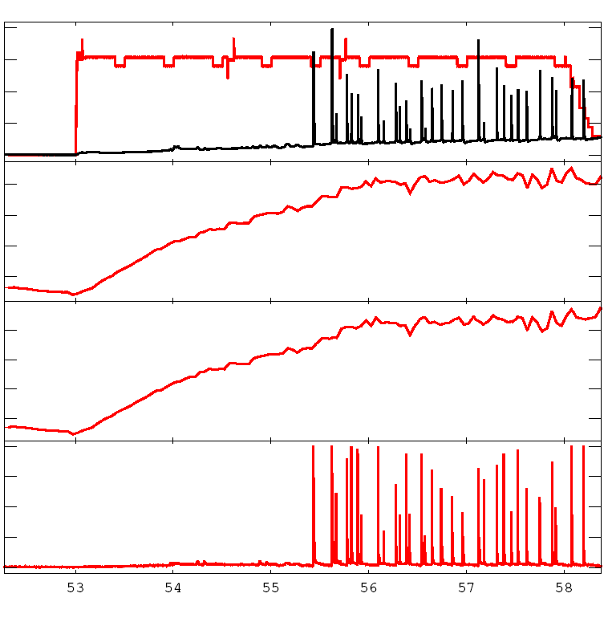
QH-mode characteristics at JET, JT-60U
JET-C 75411
(29/10/2008)
Record QH in JET-C: 1.4 s EHO duration, 2.1s ELM-free
Starts as Hot ion mode T_{i}=14keV, T_{e}=9keV, ends with T_{i}=T_{e}=7keV
Before NBI on: 0.9e19, 0.10 n_{GW}
At L2H: 1.3e19, 0.14 n_{GW}
At start of EHO: 4.0e19, 0.42 n_{GW}
At end of EHO: 6.6e19, 0.68 n_{GW}
B_{t}=2.6 T I_{p}=2.5 MA, 15 MW co-NBI, δ~0.4
20.
15.
10.
5.
8.0
6.0
4.0
2.0
n_{e} [10¹⁹m⁻³]
E.R. Solano et al., PRL 104, 185003 (2010)
QH-mode observed in JT-60U, with cn, co & mixed NBI
1MA, n_{e,ped}=1.3e19, 0.28 n_{GW}
EHO: 10 kHz, n=2 & n=4
Importance of plasma position: gap scan
0.8
0.6
0.4
0.2
f_{GW}
4.0
3.0
2.0
1.0
0.0
N. Oyama et al Nucl. Fusion 45 871 (2005)
K. Kamiya, et al. Commun Phys 4, 141 (2021).
D_{alpha}
EHO
Optimal conditions for QH in JT-60SA tbd, ask N. Aiba
Transient EHOs and QH phases observed in AUG-W USN co-NBI, work ongoing in WPTE RT-02… E. Viezzer
Ongoing collaboration with DIII-D…

Slide 3
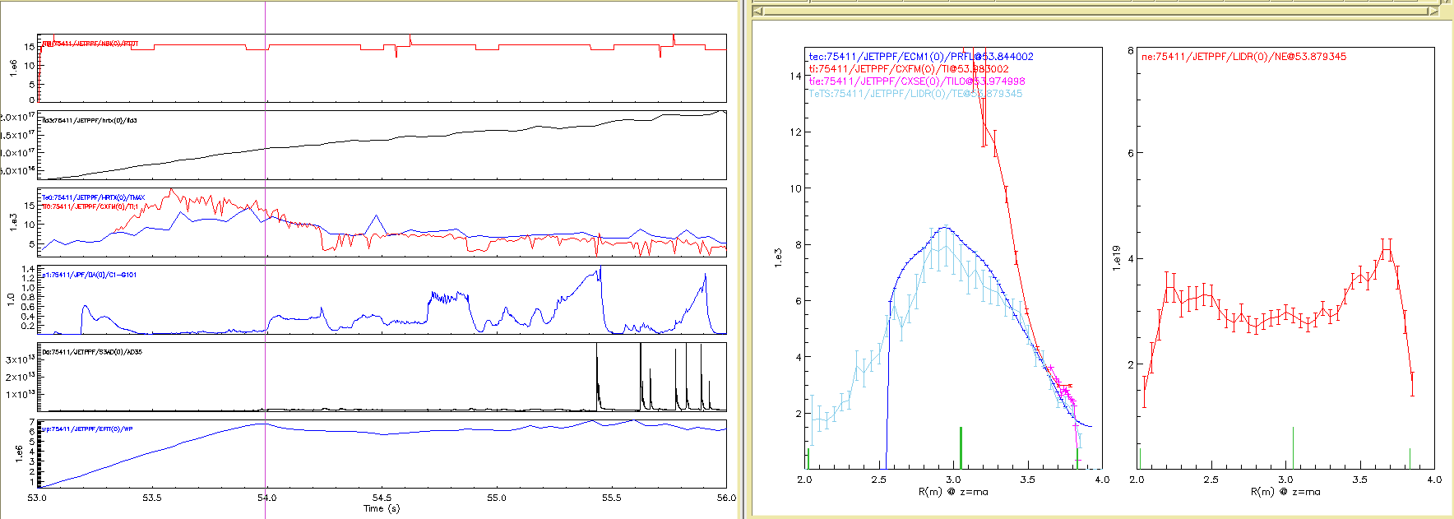
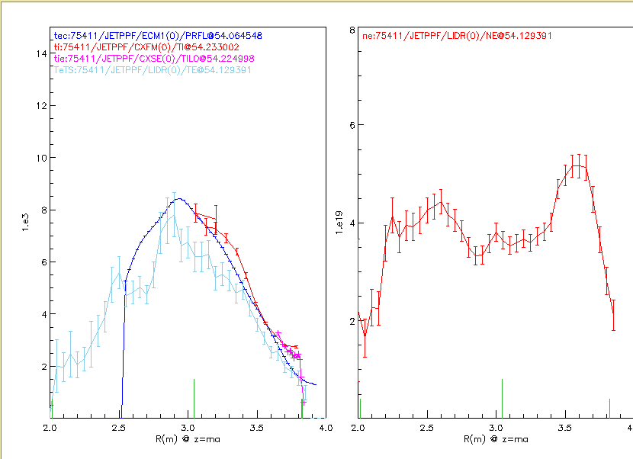
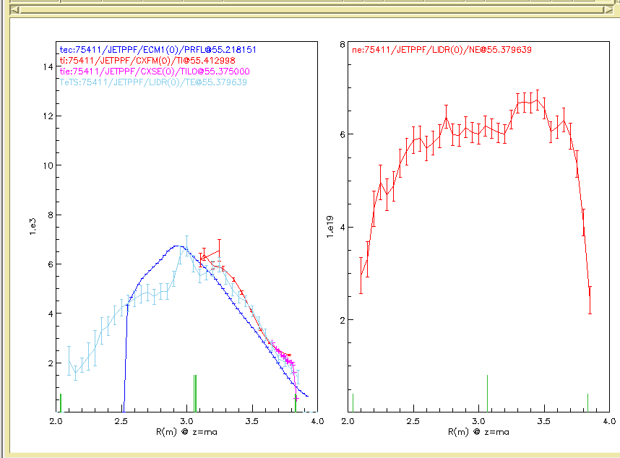
Profile evolutrion
In fact, hot ion regime lost with sawtooth at 54.2s

