Slide 1
The JT-60SA contribution into the European Tokamak Exploitation programme
WPTE GPM 2025
N. Vianello
E. Tsitrone, N. Vianello, M. Baruzzo, J. Garcia, D. Keeling, A. Hakola, V. Igochine, B. Labit

Slide 2
Tokamak Exploitation Research Structure pillars
The inclusion of JT-60SA activities reflected in the modification of Scientific Objectives for high-𝛽 and Energetic particle related Research Topic since 2025
JT-60SA unique features will expand the present operational space providing path towards advancement of SSRL
Identified High Level EUROfusion priorities for JT-60SA exploitation
Development and investigation of high performance scenarios compatible with future W-PFCs.
Avoidance and mitigation of disruptions and runaways
Fast ion physics
Development and validation of high level real-time control strategies
01
ITER Research Plan, including Rebaselining and ITPA
02
DEMO Physics Gaps
RT Scientific Objectives
03
PEX exploitation
04
Preparatory work for future JT-60SA exploitation

Slide 3
JT-60SA contribution to present WPTE program
Essential
Beneficial
 | Research Topics
RT01 | Core-Edge-SOL integrated H-mode scenario compatible with exhaust constraints in support of ITER
RT03 | Strategies for disruption and run-away mitigation in support of the ITER DMS
RT04 | Physics-based machine generic systems for an integrated control of plasma discharge
RT08 | Physics and operational basis for high beta long pulse scenarios
RT02 | Physics understanding of alternatives to Type-I ELM regime
RT09 | Physics understanding of energetics particles confinement and their interplay with thermal plasma
RT05 | Physics of divertor detachment and its control for ITER, DEMO and HELIAS operation
RT07 | Physics understanding of alternative divertor configurations as risk mitigation for DEMO
RT06 | Preparation of efficient Plasma Facing Components (PFC) operation for ITER, DEMO and HELIAS
JT-60SA
Control of run-away & disruption
Real time control and breakdown
Target scenario for JT-60SA
Target physics topic for JT-60SA
Not applicable
Not applicable in C environment
ITER Scenario
DEMO
Scenario
Burning plasma
Exhaust
PEX
PFC

Slide 4
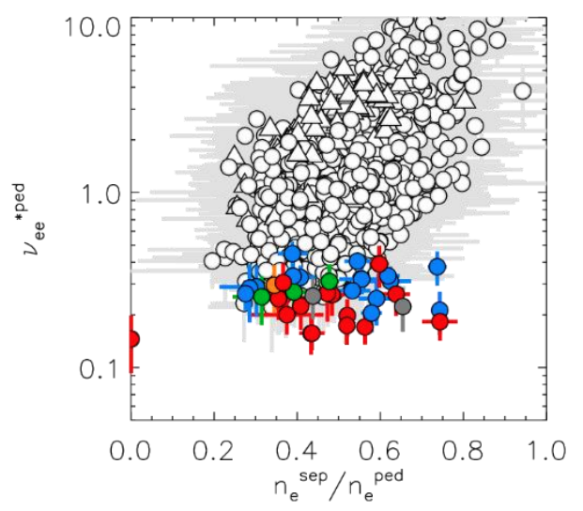
TG-ORD: operation regime development
#
ORD-1 | Break down and plasma formation studies in conditions of low loop voltage
ORD-2 | Safe increase of toroidal current up to 5.5MA in L-mode
ORD-3 | Test of plasma control schemes: current, position, density, heating
ORD-4 | Initial integrated scenarios development towards ITER-relevant H-mode scenario (H₉₈(y,2)~1, β_{N}~1.8), high beta (H₉₈(y,2)~1-1.2, β_{N}~3-3.5), and low collisionality
Expected contribution to WPTE Sobj
ORD-4: Expand dominant electron dominant heating scenario to high current and low collisionality → RT01 (D1, D5), RT08 (D3, D5, D6)
ORD-1: Breakdown studies at low loop-voltage → RT04 (D6)
ORD-3: Implement and validate control schemes developed in EU-devices → RT04 (all)
Projected JT-60SA collisionality at n/nG=0.5
Figure courtesy of L. Frassinetti

Slide 5
TG-MHD: MHD Stability and Control
#
MHD-1 | Error field measurement, characterization and impact on locked mode
MHD-2 | Disruption studies at high current in L mode and creation of disruption databases
MHD-3 | Runaway electrons generation/dissipation and control studies
MHD-4 | Sawtooth activity and modification by ECH/ECCD
Expected contribution to WPTE Sobj
MHD-1: Extend extensive EF studies on a superconducting larger devices → RT04 (D6, D7)
MHD-2/MHD-3: Disruption and runaway electron studies →RT03 (D11, D12, D13)
MHD-4: Sawtooth tailoring → RT04 (D6)

Slide 6
TG-T&C: Transport and Confinement
#
TC-1 | Heat transport in electron heated dominated plasmas in L-mode and H-mode
TC-2 | Characterization of L-mode confinement
TC-3 | Initial characterization of H-mode confinement
Expected contribution to WPTE Sobj
TC-1: Extend heat transport studies in electron dominated plasma in H-mode → RT01 D2

Slide 7
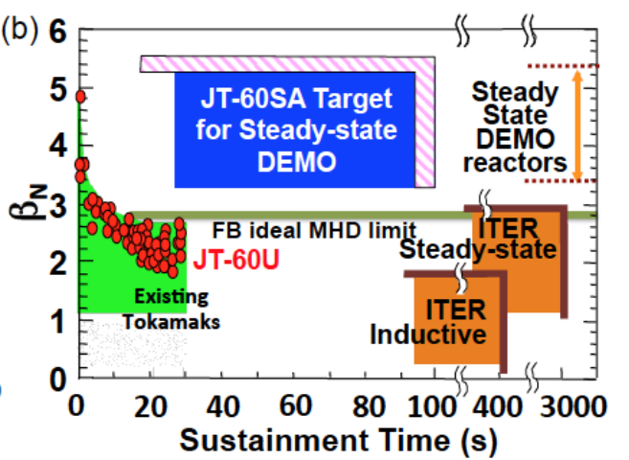
TG-HEP: High Energy Particle Behavior
#
HEP-1 | Shine-through studies in H and D, especially with N-NBI
HEP-2 | Initial studies of fishbone and Alfvén modes destabilization by N-NBI
HEP-3 | Neutron emission studies and reproducibility with codes
Expected contribution to WPTE Sobj
HEP-1: Shine-through studies → IO priorities
HEP-2: clear contribution to RT09 (D2, D3, D7)
HEP-3: clear contribution to RT09 (D1)

Slide 8
TG-PEP: Pedestal and Edge Physics
#
PEP-1 | L-H power threshold characterization in H and D
PEP-2 | Pedestal and ELMs generation studies in different plasma conditions
Expected contribution to WPTE Sobj
PEP-2: Expected contribution to RT01 D4

Slide 9
TG-DSOL: Divertor, Scrape Off Layer and Plasma-Material Interaction
#
DSOL-1 | SOL width scaling at high Ip
DSOL-2 | Divertor heat flux characterization in the ITER-relevant H-mode scenarios developed and neutral compression by the V-shaped corner.
DSOL-3 | Wall conditioning (ECWC)
Expected contribution to WPTE Sobj
DSOL-2: Expected contribution to RT05 (D1, D3)
DSOL-3: Although being C devices expected contribution to RT06-D7

Slide 10
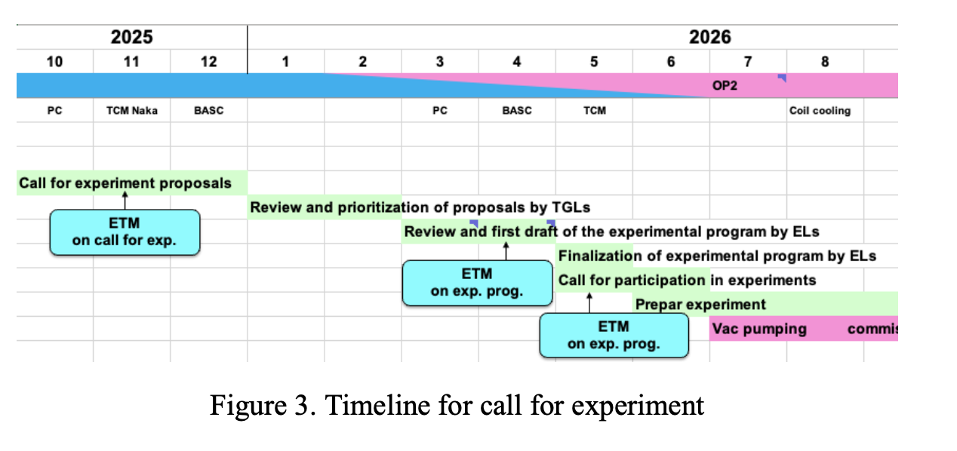
WPTE and JT-60SA operation timeline
WPTE call for participation for OP1 data analyses and
modelling/preparation
WPTE call for OP2 participation pending budget availability

