Slide 1
Uncertainties impact on DEMO Design Status and Mitigation
Clarisse Bourdelle,
the plasma system division,
WPDES, WPRD, TSVV11 teams
PSD² meeting, Oct 1st 2025

Slide 2
outline
Uncertainties in system code and mitigation action
Going up the ladder of models for a better understanding of uncertainties impact: Scaling laws with ad-hoc heat transport coefficients
High fidelity integrated modelling using turbulent transport models: validation
Gaps between today’s tokamak plasmas and ITER/DEMO
Verification against even higher fidelity integrated modelling
Extrapolation towards DEMO: status and plans
Side note on VNS
Conclusion

Slide 3
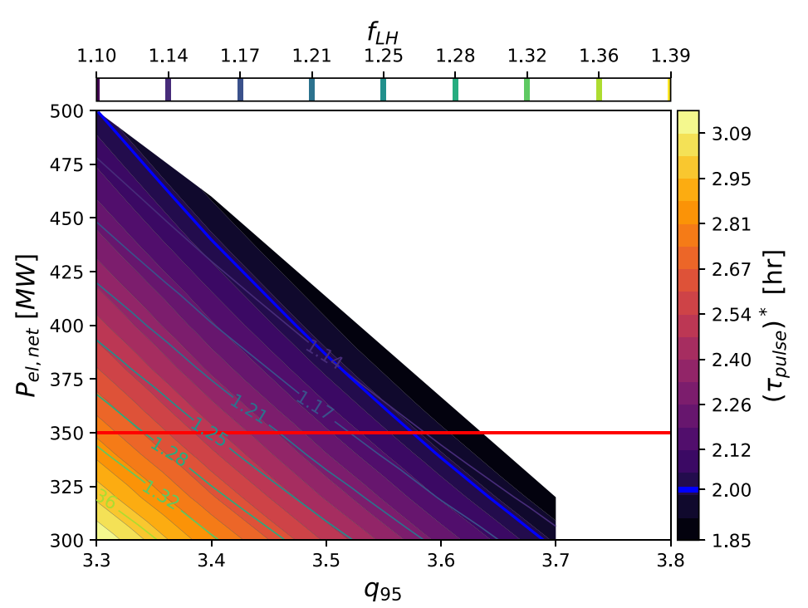
Definition of an EU-DEMO design point robust to epistemic plasma physics uncertainties
System code PROCESS
Design space for A=2.8, Ro=8.6 m
Design constrains:
P_{sep}B_{T}/(q₉₅AR₀) ≤ 6.0 MW·Tm⁻¹
β_{thermal} ≤ 0.03 I_{p}/(aB_{T})
H mode: P_{sep}≥ 1.1xP_{LH}
[Coleman et al NF 2025]
Physics model choices
energy content based on IPB98(y,2) with H radiation-corrected factor=1.1 but… depending on database selection, weighting of points, the prediction for ITER varies by a factor 2. Nuclear Fusion, Vol. 39, No. 12 (1999) + many other scalings
For the density: Greenwald fraction at separatrix, pedestal + core peaking
For the temperature : T_{ped} using a scaling derived at fixed B + peaking
Entry in H mode P_{LH} from Martin 2008
P_{fus}=1.6 GW
B=4.4 T I_{p}=18.8 Ma
Mitigation action to epistemic plasma physics uncertainties:
Design at q₉₅>3.3 to be able to increase I_{p} to compensate confinement loss

Slide 4
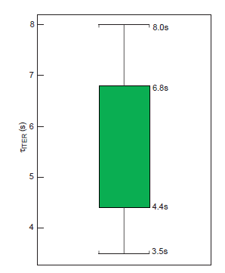
Using scaling laws in presence of Gaps
 | P_{fus} | P_{alpha}/P_{aux} | Q | β(core) | ν_{C} | ρ* | f_{rad} ρ<1 | Plasma energy
JET DT | 12.5 MW | 8 % | 0.4 | 2.2 % | 2.4e5 | 0.034 | ~20% | 9 MJ
ITER 15 MA | 500 MW | 200 % | 10 | 4-4.2 % | 1.3e5 | 0.021 | 4% | 300-400 MJ
DEMO A=2.8 | 1600 MW | 640 % | 32 | 4.9 % | 1.4e5 | 0.016 | ~60-70% | 600-1200 MJ
[M. Maslov NF2023]
[F. Eriksson NF2024]
Prediction for ITER [NF 99]
inner box indicates a ‘95% log-linear’ interval, whereas the region enclosed by the wiskers is an estimate of a ‘95% log-non-linear’ interval
scaling law IPB98(y,2)
DEMO/ITER similar dimensionless parameters
DEMO with H98(y,2) only, factor 2 uncertainty on τ_{E}
In PROCESS, optimization done using τ_{E} w/o uncertainty range

Slide 5
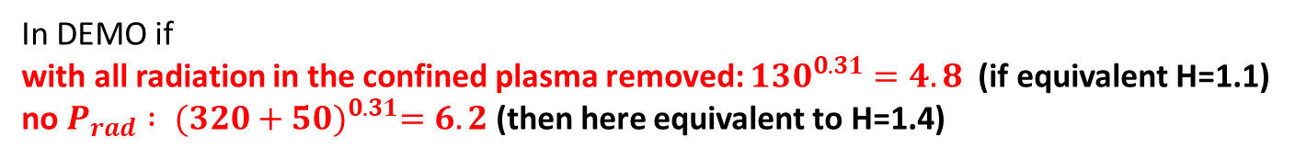
Using scaling laws in presence of Gaps: Example for f_{rad}
 | P_{fus} | P_{alpha}/P_{aux} | Q | β(core) | ν_{C} | ρ* | f_{rad} ρ<1 | Plasma energy
JET DT | 12.5 MW | 8 % | 0.4 | 2.2 % | 2.4e5 | 0.034 | ~20% | 9 MJ
ITER 15 MA | 500 MW | 200 % | 10 | 4-4.2 % | 1.3e5 | 0.021 | 4% | 300-400 MJ
DEMO A=2.8 | 1600 MW | 640 % | 32 | 4.9 % | 1.4e5 | 0.016 | ~60-70% | 600-1200 MJ
[M. Maslov NF2023]
[F. Eriksson NF2024]
Energy $=τ_{E}×{(P}_{aux}+P_{alpha}−P_{rad})$
$$=1.1×0.0562×I^{0.93}×B^{0.15}×{(P_{aux}+P_{alpha}−P_{rad})}^{0.31} ×n^{0.41}×M^{0.19}×R^{1.97}×κ^{0.78}×A^{−0.58}$$
In DEMO if
with all radiation in the confined plasma removed: ${130}^{0.31}=4.8$(if equivalent H=1.1)
no $P_{rad} : {(320+50)}^{0.31}=6.2$ (then here equivalent to H=1.4)
scaling law IPB98(y,2)

Slide 6
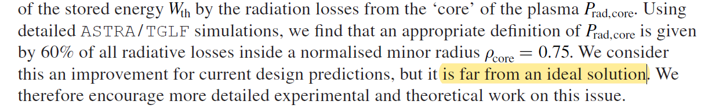
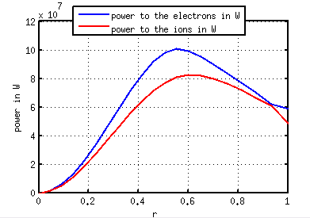
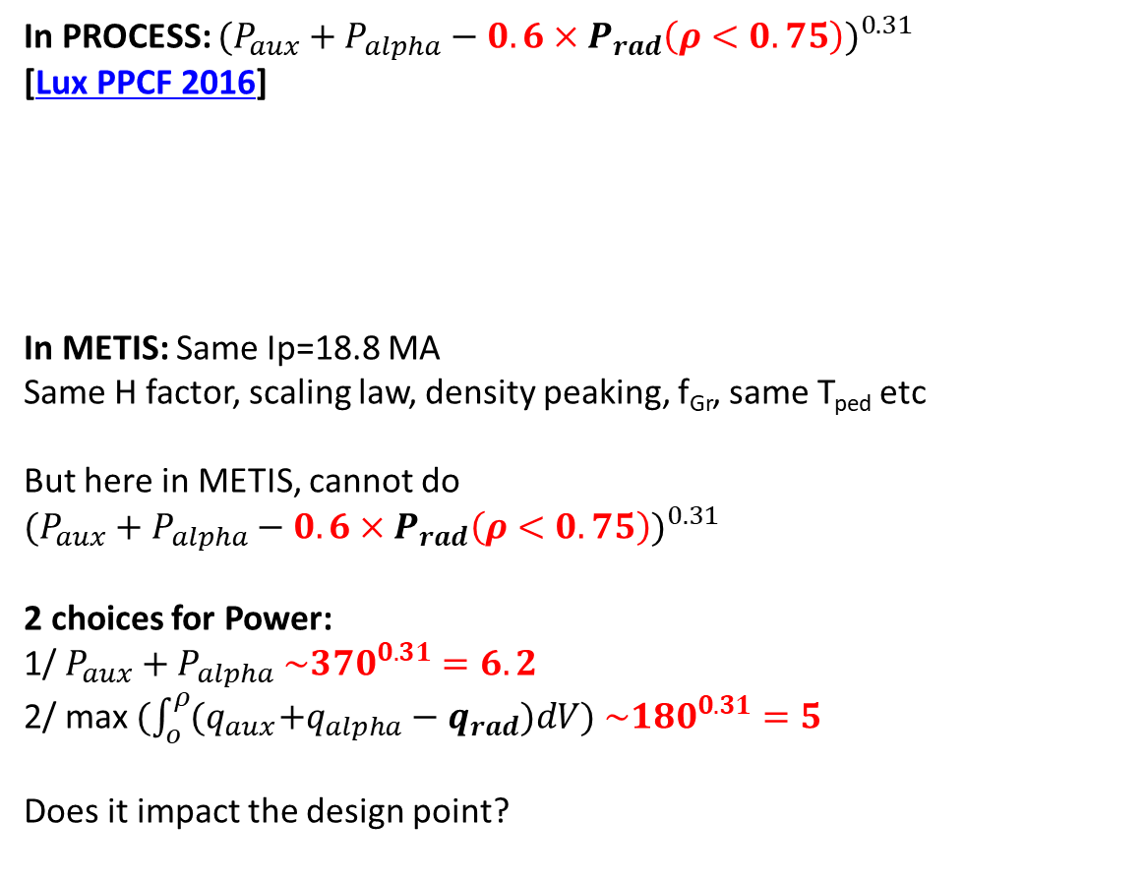
Going up the ladder of models for a better understanding of uncertainties impact: Scaling laws with ad-hoc heat transport coefficients
In PROCESS: ${(P_{aux}+P_{alpha}−{0.6×P}_{rad}\left(ρ<0.75\right))}^{0.31}$
[Lux PPCF 2016]
In METIS: Same Ip=18.8 MA
Same H factor, scaling law, density peaking, f_{Gr}, same T_{ped} etc
But here in METIS, cannot do ${(P_{aux}+P_{alpha}−{0.6×P}_{rad}\left(ρ<0.75\right))}^{0.31}$
2 choices for Power:
1/ $P_{aux}+P_{alpha}$ ${\sim 370}^{0.31}=6.2$
2/ max $(\int_{o}^{ρ}{{(q}_{aux}+q_{alpha}−q_{rad}})dV) {\sim 180}^{0.31}=5$
Does it impact the design point?

Slide 7
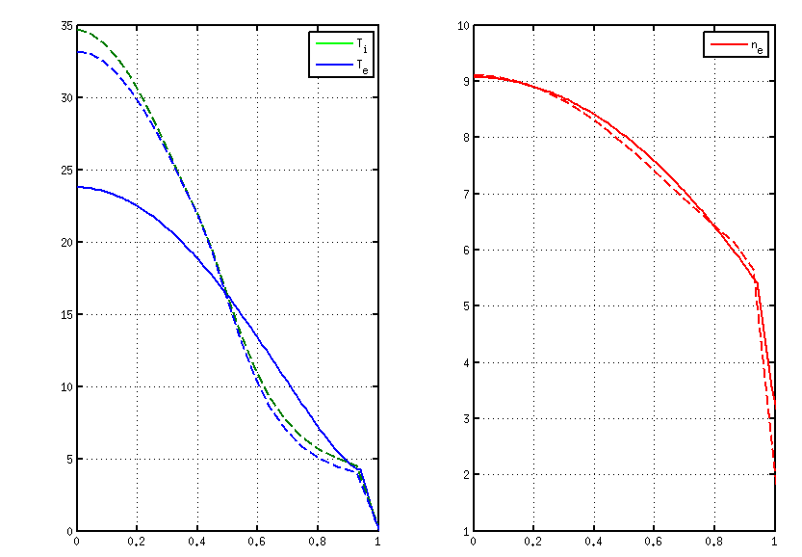
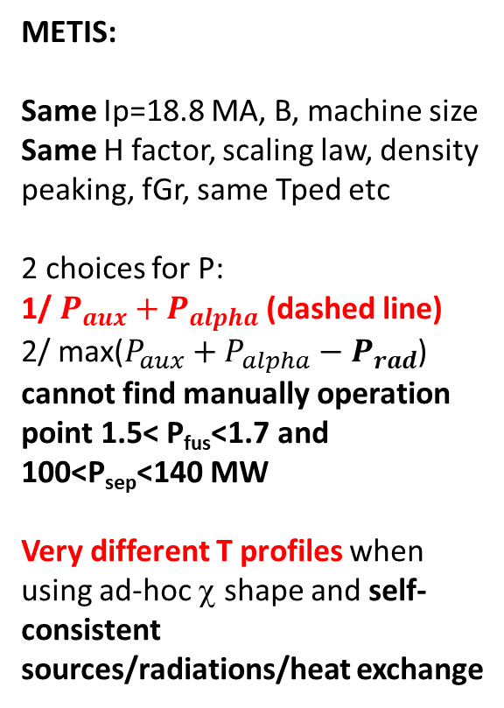
Going up the ladder of models for a better understanding of uncertainties impact: Scaling laws with ad-hoc heat transport coefficients
METIS:
Same Ip=18.8 MA, B, machine size
Same H factor, scaling law, density peaking, fGr, same Tped etc
2 choices for P:
1/ $P_{aux}+P_{alpha}$ (dashed line)
2/ max($P_{aux}+P_{alpha}−P_{rad}$) cannot find manually operation point 1.5< P_{fus}<1.7 and 100<P_{sep}<140 MW
Very different T profiles when using ad-hoc χ shape and self-consistent sources/radiations/heat exchange
METIS Ti, Te
Same density
PROCESS
Ti=Te

Slide 8

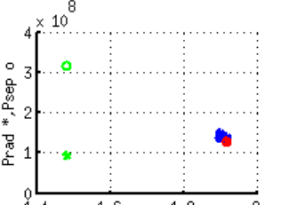
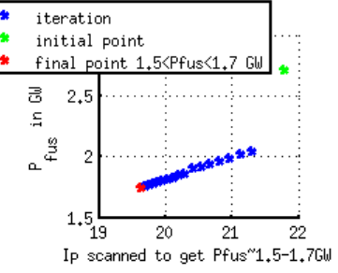
Uncertainty impact in METIS, assuming machine built, and constraining on 1.5< P_{fus}<1.7 GW and 100<P_{sep}<140 MW
The machine is assumed to be built, so the B and geometry are fixed.
1.5< P_{fus}<1.7 GW : hence scanning on Ip until P_{fus} is matched
100<P_{sep}<140 MW or 1.1<P_{sep}/P_{Martin}<1.3: hence scanning Xe content
All the other parameters are fixed: H factor, f_{Gr}, scaling law choice, density peaking choice, etc.
Their impact on I_{p} hence the pulse length can be studied one by one.
NB: fixing V_{loop} and let P_{fus} vary is also planned, not shown here

Slide 9
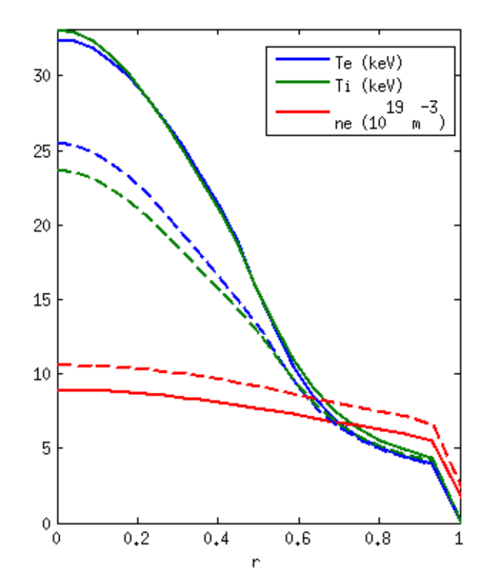
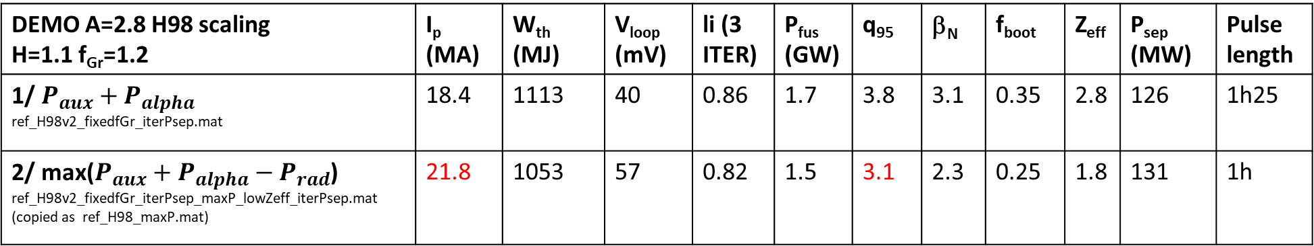
illustration 1/3: impact of P_{rad} in P used in scaling law: from 18.4 to 21.8 MA
DEMO A=2.8 H98 scaling H=1.1 f_{Gr}=1.2 | I_{p} (MA) | W_{th} (MJ) | V_{loop} (mV) | li (3 ITER) | P_{fus} (GW) | q₉₅ | β_{N} | f_{boot} | Z_{eff} | P_{sep} (MW) | Pulse length
1/ $P_{aux}+P_{alpha}$ ref_H98v2_fixedfGr_iterPsep.mat | 18.4 | 1113 | 40 | 0.86 | 1.7 | 3.8 | 3.1 | 0.35 | 2.8 | 126 | 1h25
2/ max($P_{aux}+P_{alpha}−P_{rad}$) ref_H98v2_fixedfGr_iterPsep_maxP_lowZeff_iterPsep.mat (copied as ref_H98_maxP.mat) | 21.8 | 1053 | 57 | 0.82 | 1.5 | 3.1 | 2.3 | 0.25 | 1.8 | 131 | 1h
Full line: Power w/o radiation subtracted
Dashed line: max power radially (as if radiation subtracted inside rho=0.6)

Slide 10
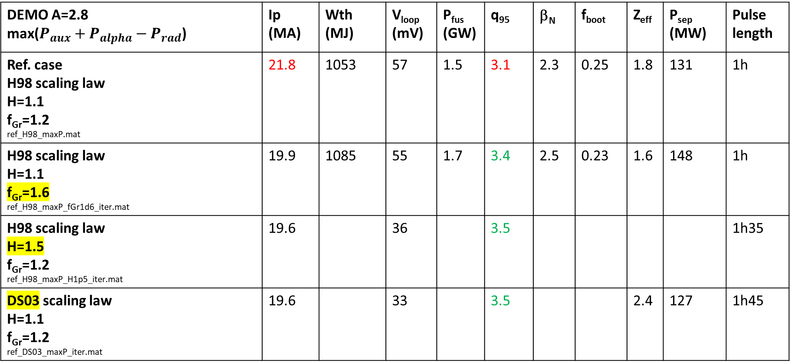
illustration 2/3: impact of H factor, f_{Gr} and scaling law
DEMO A=2.8 max($P_{aux}+P_{alpha}−P_{rad}$) | Ip (MA) | Wth (MJ) | V_{loop} (mV) | P_{fus} (GW) | q₉₅ | β_{N} | f_{boot} | Z_{eff} | P_{sep} (MW) | Pulse length
Ref. case H98 scaling law H=1.1 f_{Gr}=1.2 ref_H98_maxP.mat | 21.8 | 1053 | 57 | 1.5 | 3.1 | 2.3 | 0.25 | 1.8 | 131 | 1h
H98 scaling law H=1.1 f_{Gr}=1.6 ref_H98_maxP_fGr1d6_iter.mat | 19.9 | 1085 | 55 | 1.7 | 3.4 | 2.5 | 0.23 | 1.6 | 148 | 1h
H98 scaling law H=1.5 f_{Gr}=1.2 ref_H98_maxP_H1p5_iter.mat | 19.6 |  | 36 |  | 3.5 |  |  |  |  | 1h35
DS03 scaling law H=1.1 f_{Gr}=1.2 ref_DS03_maxP_iter.mat | 19.6 |  | 33 |  | 3.5 |  |  | 2.4 | 127 | 1h45

Slide 11
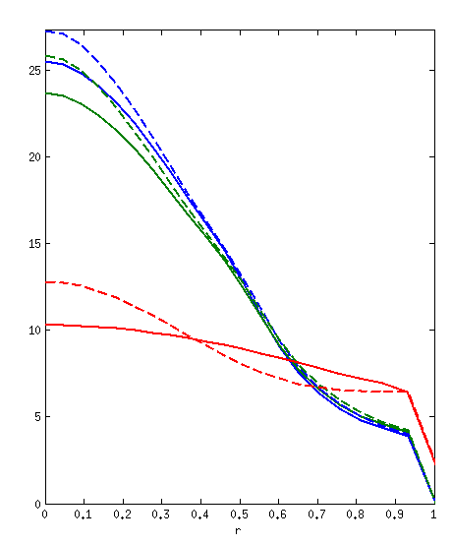
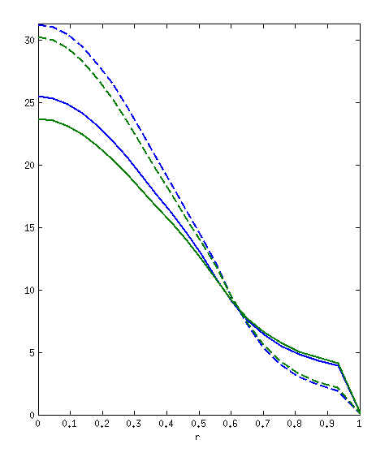
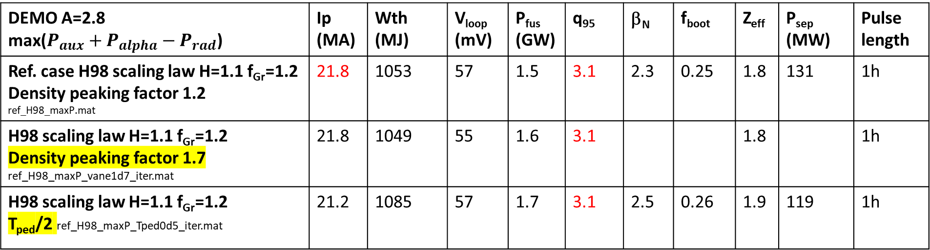
illustration 3/3: impact of profile choices when constraining energy and density on resp. H₉₈ and f_{Gr}
DEMO A=2.8 max($P_{aux}+P_{alpha}−P_{rad}$) | Ip (MA) | Wth (MJ) | V_{loop} (mV) | P_{fus} (GW) | q₉₅ | β_{N} | f_{boot} | Z_{eff} | P_{sep} (MW) | Pulse length
Ref. case H98 scaling law H=1.1 f_{Gr}=1.2 Density peaking factor 1.2 ref_H98_maxP.mat | 21.8 | 1053 | 57 | 1.5 | 3.1 | 2.3 | 0.25 | 1.8 | 131 | 1h
H98 scaling law H=1.1 f_{Gr}=1.2 Density peaking factor 1.7 ref_H98_maxP_vane1d7_iter.mat | 21.8 | 1049 | 55 | 1.6 | 3.1 |  |  | 1.8 |  | 1h
H98 scaling law H=1.1 f_{Gr}=1.2 T_{ped}/2 ref_H98_maxP_Tped0d5_iter.mat | 21.2 | 1085 | 57 | 1.7 | 3.1 | 2.5 | 0.26 | 1.9 | 119 | 1h
Easier than optimization loops in PROCESS
More physics at reach, can explore/understand one by one uncertainty impact
But… No profile stiffness, energy content constrained as well as line averaged density for more physical response : need turbulent transport model

Slide 12
outline
Uncertainties in system code and mitigation action
Going up the ladder of models for a better understanding of uncertainties impact: Scaling laws with ad-hoc heat transport coefficients
High fidelity integrated modelling using turbulent transport models: validation
Gaps between today’s tokamak plasmas and ITER/DEMO
Verification against even higher fidelity integrated modelling
Extrapolation towards DEMO: status and plans
Side note on VNS
Conclusion

Slide 13
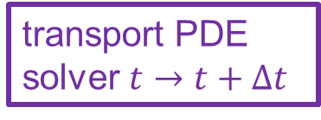
Instead of extrapolating with scaling laws and guessing profile shapes, need to use flux driven profile prediction
√ in today’s tokamaks
X in high β, 3.5 MeV alphas
Sources: ECRH, NBI,fusion power
Sinks: radiation
√
Turbulent transport fluxes
reduced models: TGLFsat2
Initial profiles
transport PDE solver $t→t+∆t$
Predicted Ti, density, profiles up to ρ=1
√
2D magnetic eq
ASTRA, HFPS …
Reduced turbulent transport models fast enough to be iterated with source and sink calculations as well as magnetic equilibrium reconstruction successfully validated against density and temperature profiles evolution in AUG, JET, WEST, TCV etc doing better than scaling laws, explaining ICRH/ECRH impact of radiative collapse, explaining the ‘cold pulse’ etc see for a review [Bourdelle PPCF 2025]

Slide 14
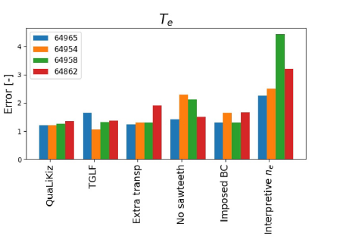
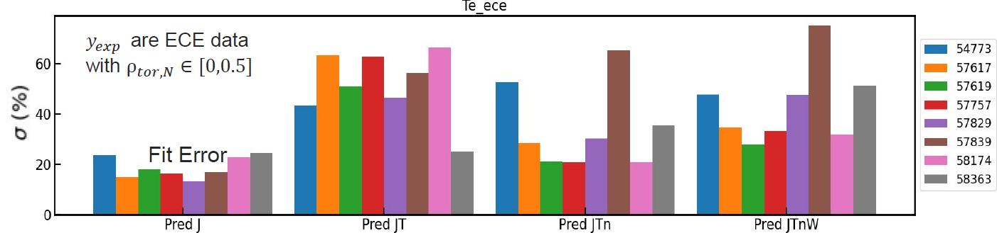
high fidelity integrated modelling: towards large scale validation
User independent: need automated validation (software support)
Quantification: need synthetic diagnostics vs measurements
Large amount of data manipulation, need support from UQ techniques and hardware for storage (LTSF)
Full radius prediction, input are engineering parameters and BC at separatrix
test of various settings. quantification prediction vs measure
4 TCV Ip ramps, 6 settings
[Marin NF 2025]
8 plasma phases in WEST, 4 settings
[Vergnaud TTF 2025]

Slide 15
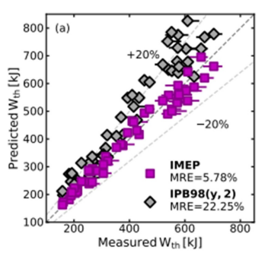
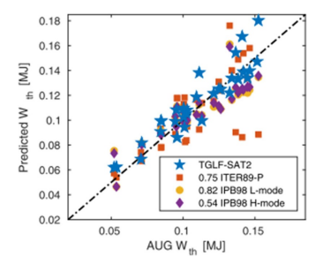
high fidelity integrated modelling: better than scaling laws
On ~50 L [C. Angioni NF 2022] & H modes on AUG, [T. Luda NF 2022],
ASTRA+TGLF up to separatrix in L mode, with IMEP pedestal model in H mode
better than scaling laws
see for a review [Bourdelle PPCF 2025]

Slide 16
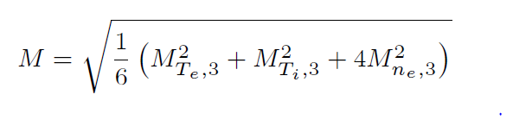
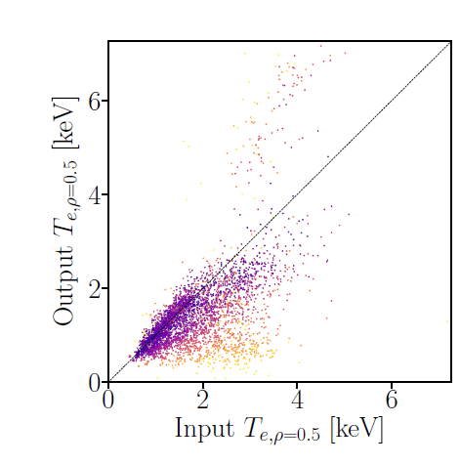
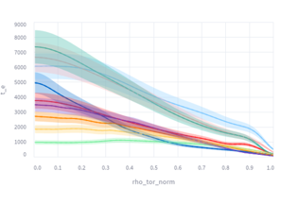
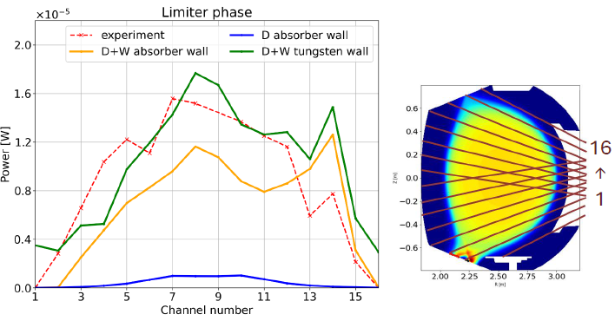
high fidelity integrated modelling: ready to use IMAS compatible toolboxes AND REPLACE SCALING LAWS
From a few to 1000s of plasma phases
Data Management Plan: all machine data accessible in IMAS
3936 predicted
0.5 s HFPS time
windows
Need to test various simulation settings:
Codes, BC etc
Metrics on T_{e}, Ti and n_{e}
And quantify using synthetic diags
[Azizi ArXiv 2024]
Ex. Anna Glasser TWINTOK
universal diagnostics digital twin
Here bolometry
JET
Surrogate models for turbulence, pedestal and SOL
Now: TGLFNN, MISHKANN, SOLPSNN, HPI2NN ready to go
QLKNN
Technically ready at least to get started: need manpower to work on such large scale validation project (TSVVH WP4) + support on soft/hardware and UQ
[A. Ho EPS/TTF 2023, C. Bourdelle PPCF 2025]

Slide 17
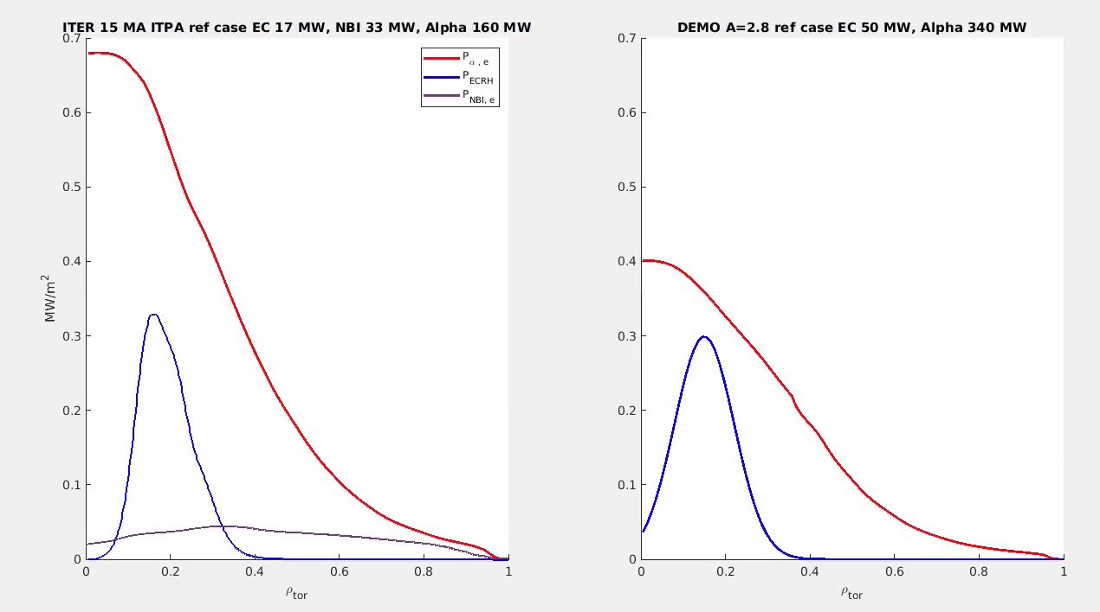
Back to the Gaps in parameters from today’s tokamak to Burning Plasmas
high β means more electromagnetic turbulence vs electrostatic turbulence
large fraction of Alphas at 3.5 MeV drive MHD modes which interplay with turbulence
 | P_{fus} | P_{alpha}/P_{aux} | Q | β(core) | ν_{C} | ρ* | f_{rad} ρ<1 | Plasma energy
JET DT | 12.5 MW | 8 % | 0.4 | 2.2 % | 2.4e5 | 0.034 | ~20% | 9 MJ
ITER 15 MA | 500 MW | 200 % | 10 | 4-4.2 % | 1.3e5 | 0.021 | 4% | 300-400 MJ
DEMO A=2.8 | 1600 MW | 640 % | 32 | 4.9 % | 1.4e5 | 0.016 | 90% | 600-1200 MJ
[M. Maslov NF2023]
[F. Eriksson NF2024]
Similar electron heat in MW/m³ from alpha power and ECRH in ITER and DEMO
ITER
Q=16
DEMO
Q=34

Slide 18
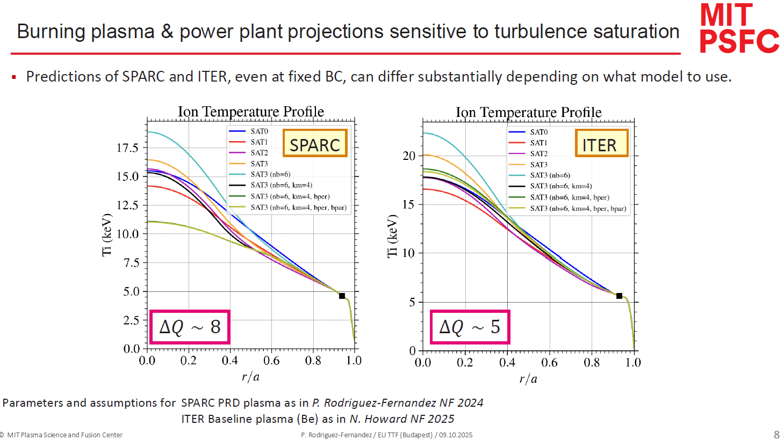
Reduced turbulent model, validated, not ready for high beta/ burning plasmas
Need higher fidelity code guidance

Slide 19
At high β, with energetic particles, no validated reduced turbulent transport model. Need to go up the fidelity ladder of turbulent transport models
Sources: ECRH, NBI, fusion power
Sinks: radiation
Turbulent transport fluxes: GENE, CGYRO,..
Global, electromagnetic, non-linear gyrokinetic
Initial profiles
transport PDE solver $t→t+∆t$
Predicted Ti, density, profiles
TANGO, PORTALS,…
2D magnetic eq
Frontier of what can be achieved presently using GPU acceleration
Being validated against high β, with fast ions experiments on AUG and JET
And used to predict ITER 15 MA
GENE-Tango [A. Di Siena et al, NF 2024]
CGYRO-PORTALS P. Rodriguez-Fernandez

Slide 20
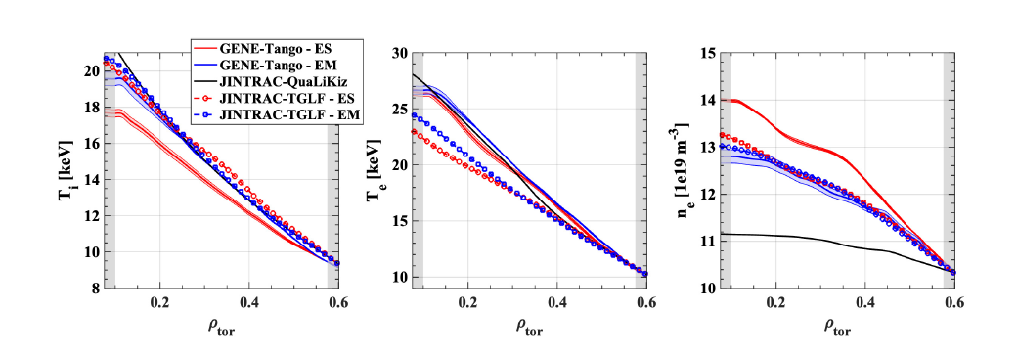
First global gyrokinetic profile predictions of ITER burning plasma inside ρ_{tor}=0.6 [A. Di Siena et al, submitted]
GENE-Tango: global, electromagnetic, nonlinear, flux matching 8 million CPUh for convergence tests + 70k node hours on GPU [A. Di Siena et al, submitted]
TGLFsat2-HFPS: TGLFsat2 settings optimized to handle electromagnetic KBM inside ρ=0.5 see E. Fransson’s poster for more details and [Najlaoui PPCF 2025] for verification TGLFsat2 / GKW on JET high β plasma
kygridmodel = 4, alphazf = −1, width = 3, filter =−0.1, minwidth = −0.3, nbasis = 6, useMHDrule = true,
usebperp = true and usebpar = false ~1000 CPUh
GENE-Tango - ES
GENE-Tango – EM
QuaLiKiz-HFPS
TGLFsat2-HFPS – ES
TGLFsat2-HFPS - EM

Slide 21
First global gyrokinetic profile predictions of ITER burning plasma [A. Di Siena et al, submitted]
GENE-Tango: with electromagnetic fluctuations, T_{i} is more peaked (as expected [Citrin, Mantica PPCF 2023], n_{e} flatter (as expected [Hein et al PoP 2010]), T_{e} unchanged. In TGLFsat2-HFPS only a slight density flattening is reported.
Good agreement between GENE-Tango electromagnetic and TGLFsat2-HFPS electromagnetic. For good or bad reasons? On-going verification GENE-GKW-TGLF on this ITER case
GENE-Tango - ES
GENE-Tango – EM
QuaLiKiz-HFPS
TGLFsat2-HFPS – ES
TGLFsat2-HFPS - EM
Next steps: adding alphas’impact on MHD/turbulence in GENE-Tango and improve physics of reduced models. Key to prepare JT60-SA operation, ITER, VNS, DEMO, etc

Slide 22
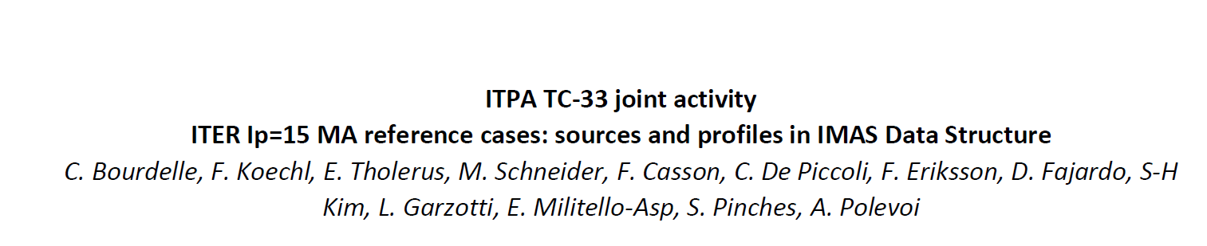
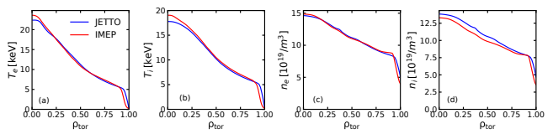
ITER benchmark case
On same case, highest fidelity modelling (GENE-Tango CGYRO-Portals) and ASTRA/HFPS-TGLF
ASTRA/HFPS-TGLF will be used to test impact of uncertainties: q, V_{tor}, W content etc on performance (D. Fajardo)
The most impacting parameters will be verified in GENE-Tango CGYRO-Portals
HFPS
ASTRA
[T. Luda et al sub. NF 2025]

Slide 23
outline
Uncertainties in system code and mitigation action
Going up the ladder of models for a better understanding of uncertainties impact: Scaling laws with ad-hoc heat transport coefficients
High fidelity integrated modelling using turbulent transport models: validation
Gaps between today’s tokamak plasmas and ITER/DEMO
Verification against even higher fidelity integrated modelling
Extrapolation towards DEMO: status and plans
Side note on VNS
Conclusion

Slide 24
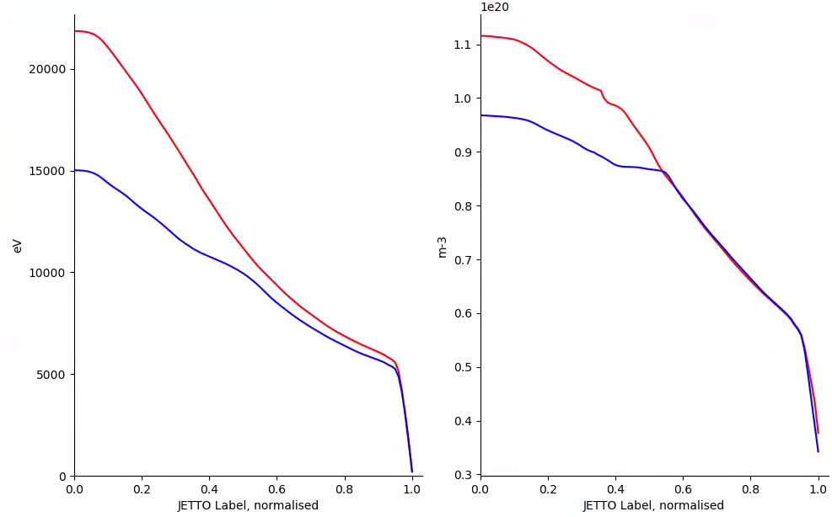
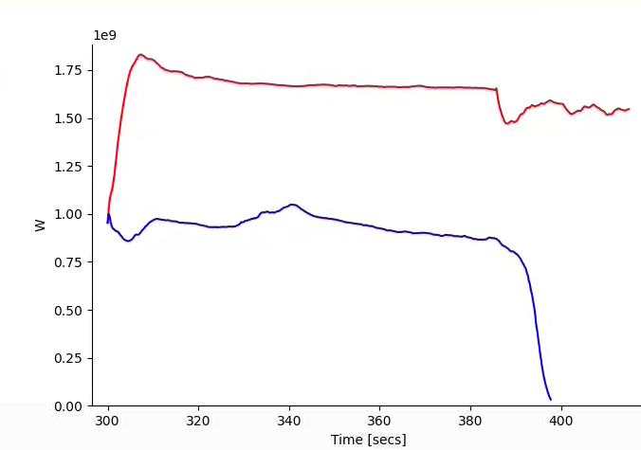
Impact of TGLFsat2 settings importance of resolving correctly the electromagnetic modes
T_{i} at 360s
n_{e} at 360s
TGLFsat2 | Electrostatic, default | Optimized, being verified [E. Fransson poster]
Min ky | 0.05 (grid 4) | 0.05 (grid 4)
filter | 2 | -0.1
width | 1.65 | 3
Alpha_zf | 1 | -1
Min width | 0.3 | -0.3
dBerp | off | on
dBparallel | off | off
Use_mhd-rule | false | true
P_{fus} in W
750 MW due to TGLFsat2 settings
! n_{e} flatter in electrostatic TGLFsat2 unlike expectation [Hein et al PoP 2010]) and unlike GENE-Tango

Slide 25
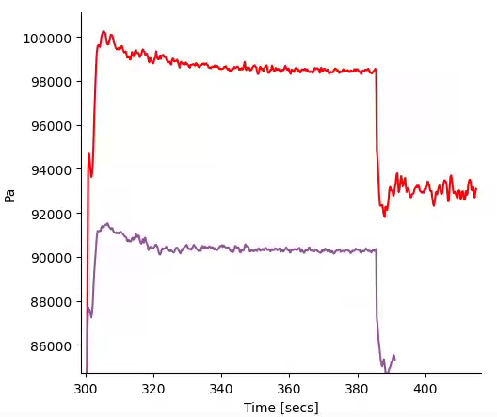
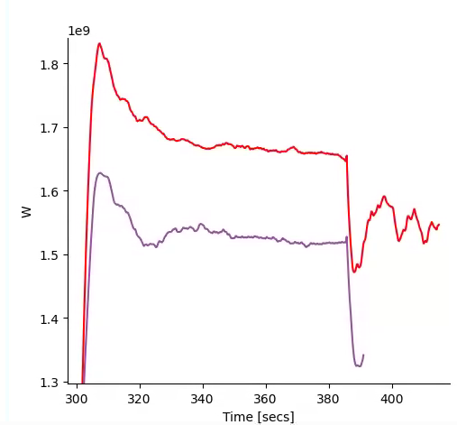
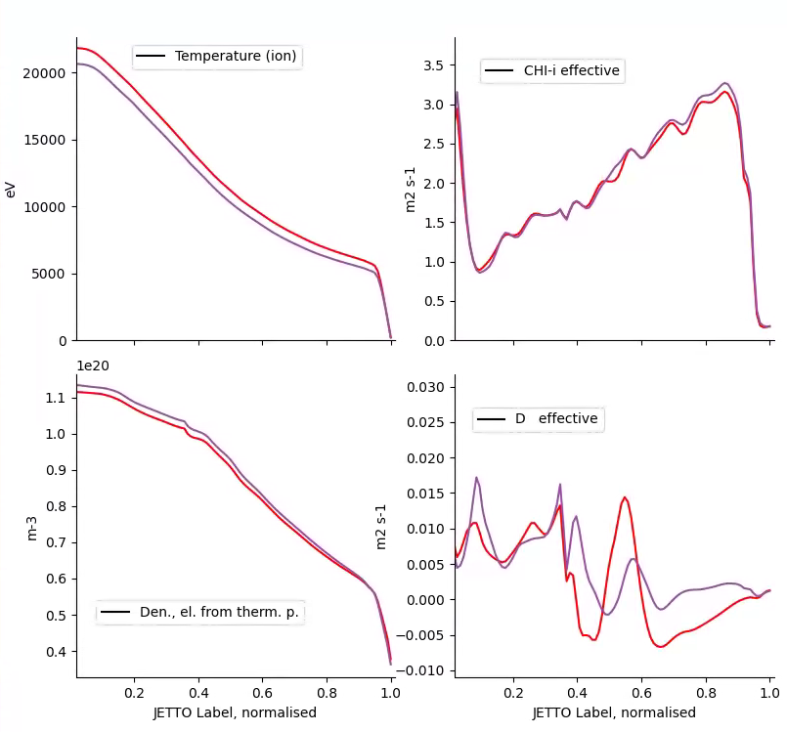

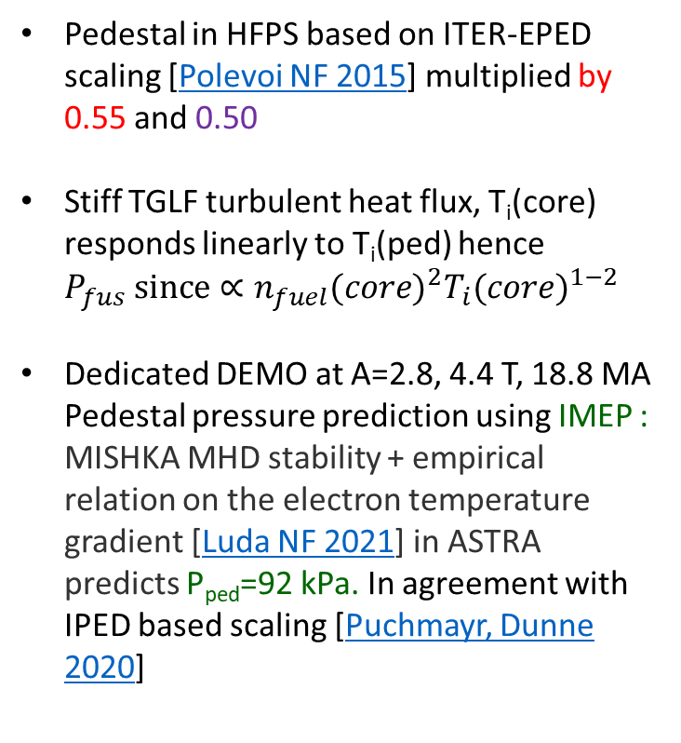
pedestal pressure impacts P_{fus} due to χ_{i} stiffness
P_{ped} in Pa
Pedestal in HFPS based on ITER-EPED scaling [Polevoi NF 2015] multiplied by 0.55 and 0.50
Stiff TGLF turbulent heat flux, T_{i}(core) responds linearly to T_{i}(ped) hence $P_{fus} since∝{n_{fuel}(core)}^{2}{T_{i}(core)}^{1−2}$
Dedicated DEMO at A=2.8, 4.4 T, 18.8 MA Pedestal pressure prediction using IMEP : MISHKA MHD stability + empirical relation on the electron temperature gradient [Luda NF 2021] in ASTRA predicts P_{ped}=92 kPa. In agreement with IPED based scaling [Puchmayr, Dunne 2020]
P_{fus} in W
+10%, +9kPa
IMEP
+9%, +140 MW
at 360 s

Slide 26
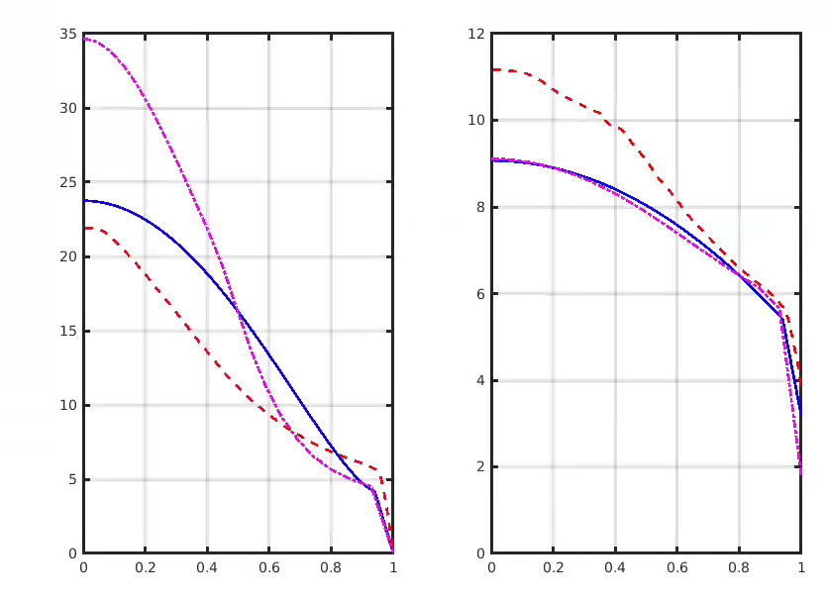
Physics based HFPS-TGLFsat2 profiles very different from assumed profiles in PROCESS for DEMO design
 | W_{th} (MJ) | V_{loop} (mV) | li | P_{fus} (GW) | q₉₅ | β_{N} | Z_{eff} | f_{boot}
METIS profiles | 1113 | 40 | 0.86 | 1.7 | 3.8 | 3.1 | 2.8 | 38%
HFPS | 1055 | ~50 | 0.71 | 1.7 | 3.9 | 2.6 | 1.7 | 40%
T_{i} in keV
n_{e} in 10¹⁹m⁻³
METIS-scaling on energy + ad-hoc shape
HFPS-TGLFsat2
PROCESS
METIS-scaling on energy + ad-hoc shape
HFPS-TGLFsat2

Slide 27
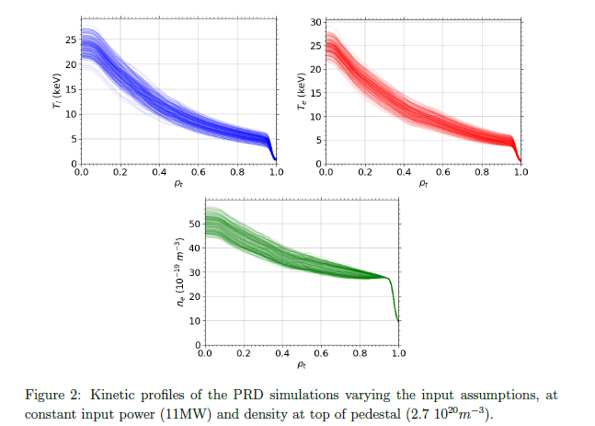
DEMO predictive modelling: what comes next?
Next:
Explore the impact of I_{p} on DEMO performance (with IMEP for pedestal). Verify scaling law based mitigation action to epistemic plasma physics uncertainties: Design at q₉₅>3.3 to be able to increase I_{p} to compensate confinement loss
Test other actuators: ECRH, density, fuel mix, etc
Add more nonlinear couplings (TSVV-H support):
Pellet ablation model (HPI2)
Alpha transport based on alpha driven MHD (ATEP)
Test impact of uncertain BC such as W content, of V_{tor} etc as done for SPARC [Muraca ArXiv 2025]
Ultimate goals:
Guide flight simulator physics content requirement. Prepare control schemes and adjust design accordingly
Guide DEMO design by reducing ad-hoc parameters in system code: energy, density, profiles, radiation
Synergies/collaborations tbd
Strong synergy with ITER 15 MA: ITPA T&C ITER 15 MA ref. case (EU-US, Spring 2026 report), more?
Possibly more with MIT team on SPARC
And STEP team at UKAEA

Slide 28
outline
Uncertainties in system code and mitigation action
Going up the ladder of models for a better understanding of uncertainties impact: Scaling laws with ad-hoc heat transport coefficients
High fidelity integrated modelling using turbulent transport models: validation
Gaps between today’s tokamak plasmas and ITER/DEMO
Verification against even higher fidelity integrated modelling
Extrapolation towards DEMO: status and plans
Side note on VNS
Conclusion

Slide 29
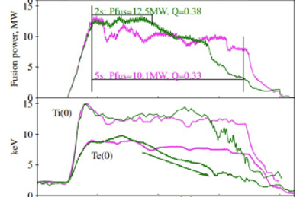
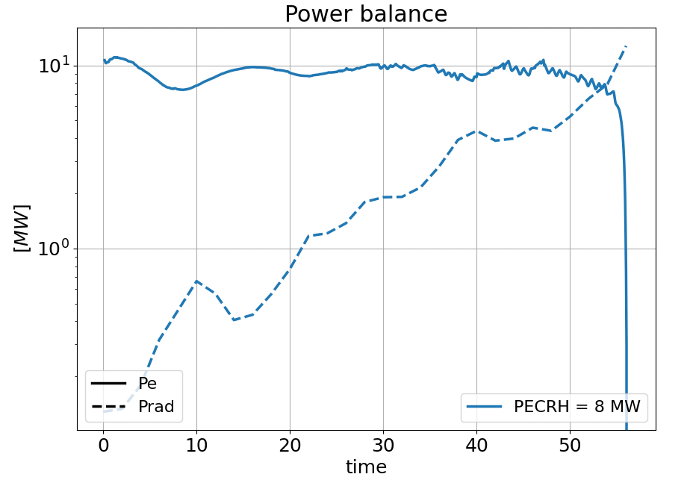
VNS predictive modelling
High fidelity integrated modeling settings as validated on JET/AUG NBI+EC/IC
TGLFsat2 for turbulent transport & FACIT for W neoclassical transport in ASTRA
E. Bray’s PhD U. Torino + C. Angioni, M. Siccinio, C. Bourdelle et al
Ia. Prediction of time evolution in VNS
Understand actuators: NBI torque/particle source, ECRH impact. Optimize machine design to delay radiative collapses
Ib. Validation on JET beam-target, to reduce range of uncertainnties
Which is what ITER is to DEMO.
Momentum transport and W content at separatrix
[Maslov NF2023]
Inside r/a<0.3
Power on electrons OH+NBI+ECRH+Alpha
Radiative power
II. After validation, explore uncertainties impact on time of radiative collapse and other key performances
Likely W content at separatrix
Pedestal transport hypothesis
Neutral particle source choices
Momentum transport etc
Time of radiative collapse

Slide 30
Conclusions: high fidelity modelling validation, getting ready for ITER, designing DEMO
Uncertainties in validation of High Fidelity Integrated Modelling in today's devices. Both on 1000s of plasmas and testing 10s of BC/code settings. Technically ready to go (including surrogates on main models)
Need to support (HiFi modelers, soft/hardware, data management plan, UQ) large scale automated validation of High Fidelity integrated modeling. All the IMAS interfaced tool boxes are available.
Compare to scaling law prediction capabilities, towards replacement of scaling laws
VNS: High Fidelity integrated modeling guiding the design. Validation on JET beam-target, then uncertainties impact on performances
Towards burning plasmas, gap between today’s tokamaks and ITER/DEMO : beta, fast particle fraction. But similarities between ITER/DEMO
Need verification of reduced models against GPU accelerated nonlinear global gyrokinetic codes. Need to join forces EU/US (and more) ITPA T&C TC33 on ITER 15MA ref case, on-going + SPARC?
On High Fidelity Integrated modeling: need to complexify coupling: pellet model, pedestal, EP transport
Yearly feedback on
flight simulator physics content requirement. Prepare control schemes and adjust design accordingly
Guide DEMO design by reducing ad-hoc parameters in system code: energy, density, profiles, radiation
Be ready for validation (STEP/SPARC/ITER), with a hierarchy of models. The fastest accurate validation on a burning plasma is the best way to accelerate DEMO.

Slide 31
Brainstorming ideas for on-site week
Hierarchy of models going up and down the ladder key to understand and mitigate uncertainties.
Quantifying the results against measurements when available as well
With EUROfusion whole device modelling spread in : WPTM (TSVV-H), Digital Solutions for fusion Office, DEMO Central team /WPDES.
Therefore on-site week could focus on activities aiming at whole device modelling, towards better than scaling laws.
Benchmark cases could be proposed to compare various fidelity levels.
Use and verify surrogates
Training/sharing UQ tools for large scale validation (e.g. in PROCESSFailure severity, probabilistic approach, Uncertainty theory )
IMAS experimental database made available, support for uniformizing IMAS input/output
Should be repeated yearly, ideal coordination platform
Physics understanding |  | Prepare operation |  | Design future devices
1st principle codes | High Fidelity Integrated Modeling |  | Pulse Design Tools Full pulse, testing controllers |  | System codes in/out are engineering parameters only
Validation against tokamak experiments

