Slide 1
Helium in W_{x}V_{(1-x)}
HeRHEA 6th meeting
Guanying Wei
10 Sep

Slide 2
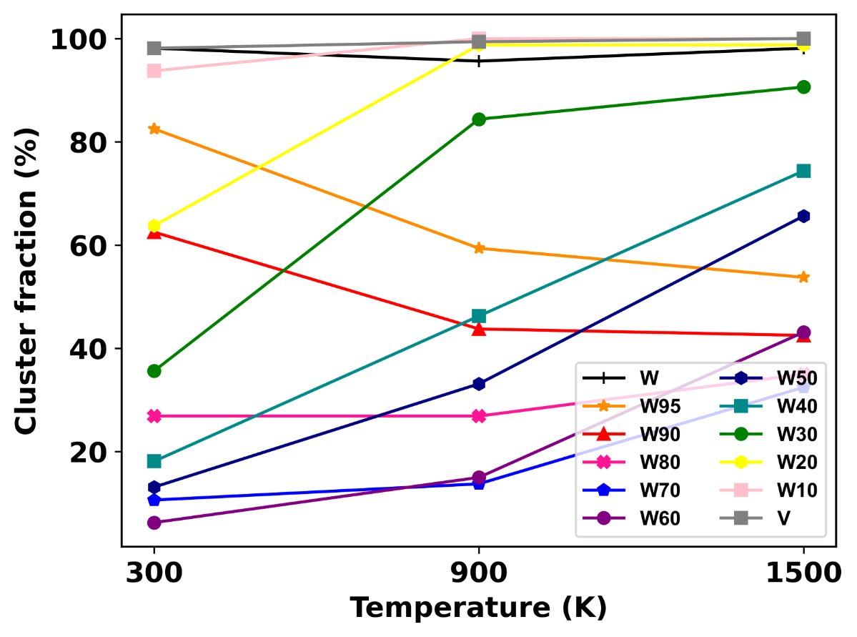
Different concentration of V element
Helium cluster fraction in W_{x}V_{1-x}
RT: He atoms move easily in large lattice constant environment.
W95V10, W90V10 : cluster fraction goes down with the increase of temperature.

Slide 3
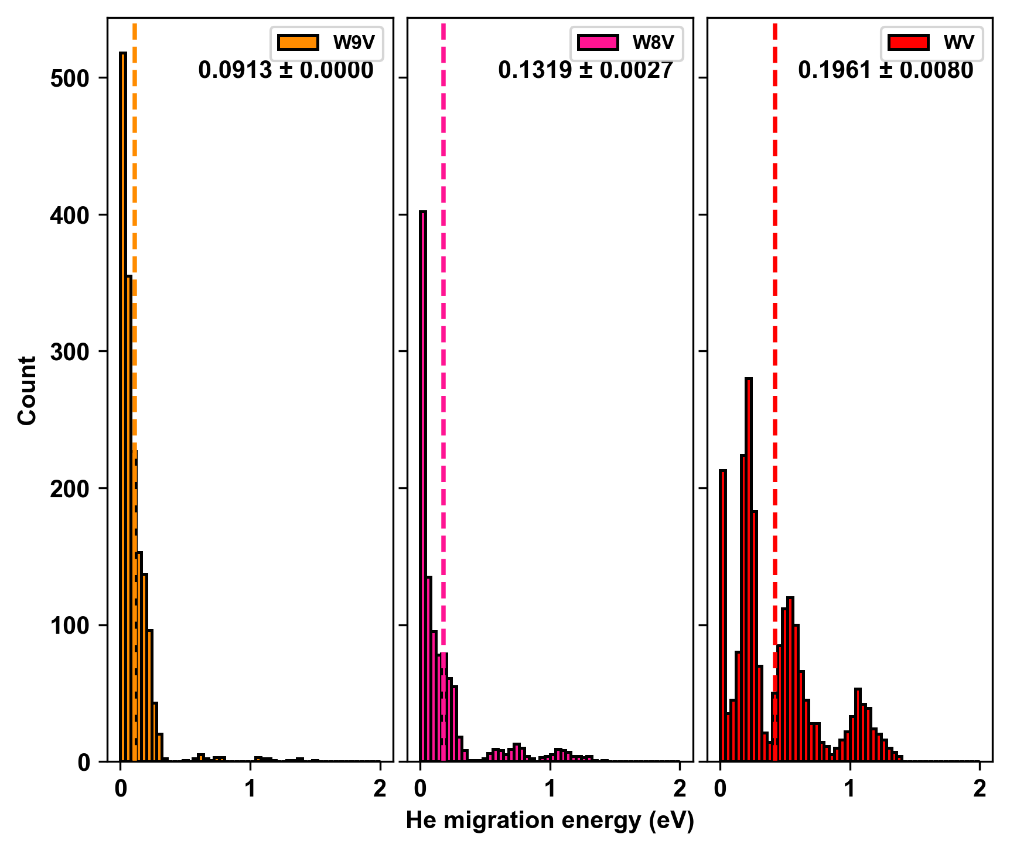
Migration energy

Slide 4
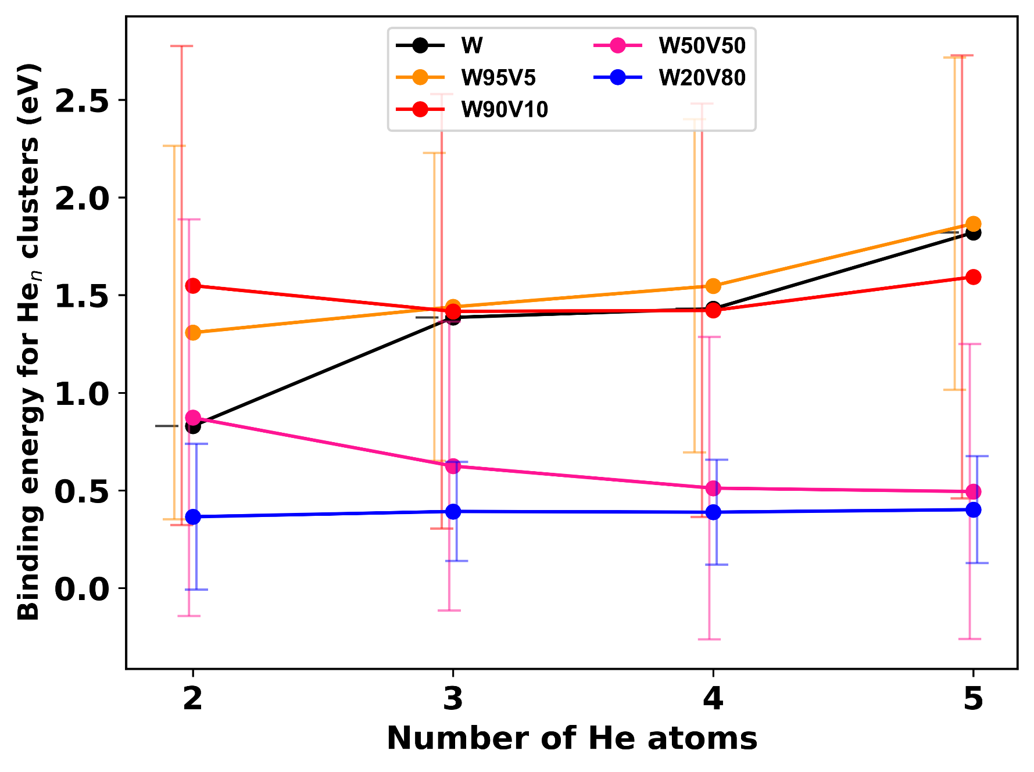
Binding energy

Slide 5
Thank you for your attention!
Notes:
Thanks

