Slide 1



Transmission Electron Microscopy of He ion implanted W-based HEA at IJCLab Stéphanie Jublot-Leclerc, Antoine Combrisson, Florian Pallier, Aurélie Gentils Université Paris-Saclay, CNRS/IN2P3, IJCLab, Orsay, France 10th September, 2025
HerHEA project, EUROfusion, ENR-MAT.02.VTT-T001
2024-2025
Contact: aurelie.gentils@ijclab.in2p3.fr

Slide 2
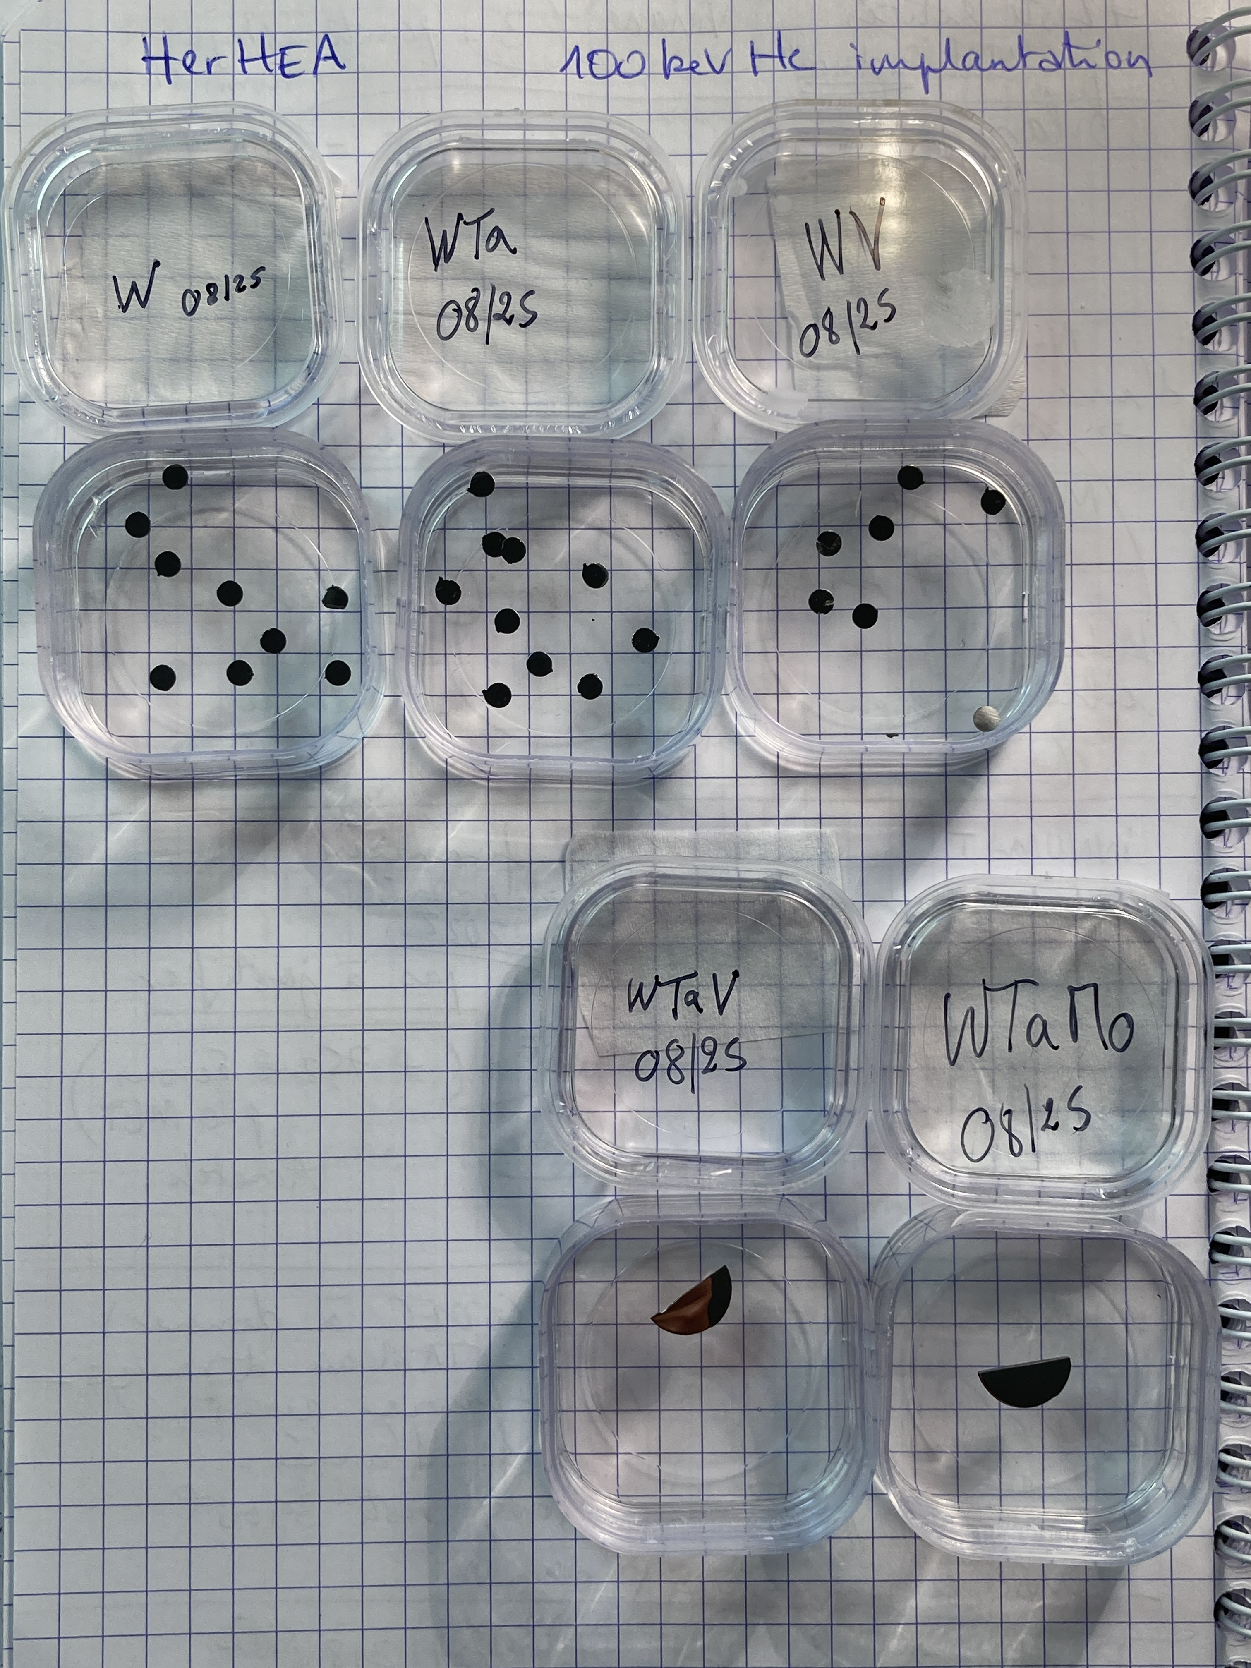
Updated status on HerHEA work at CNRS-IJCLab (10th Sept. 2025)
Materials sent to CNRS-CEMHTI and UHEL for ex situ ion implantation and characterizations
Material fabrication at VTT
Cutting of the bulk as-fabricated material
subcontractor in France for EDM cutting
squares
Available material(s) to be studied
W, W-Ta, W-Mo, W-V
Surface mechanical polishing
SEM-EDX characterization
(to be done ?)
Electrical Discharge Machining
3 mm diameter discs
Polishing performed on W, W-V, W-Ta and the ternary alloys
Other materials from Portugal
W-Ta-V, W-Ta-Mo
half discs
Mirror-polished samples (mid / end August)
HerHEA project, EUROfusion, ENR-MAT.02.VTT-T001, 2024-2025

Slide 3


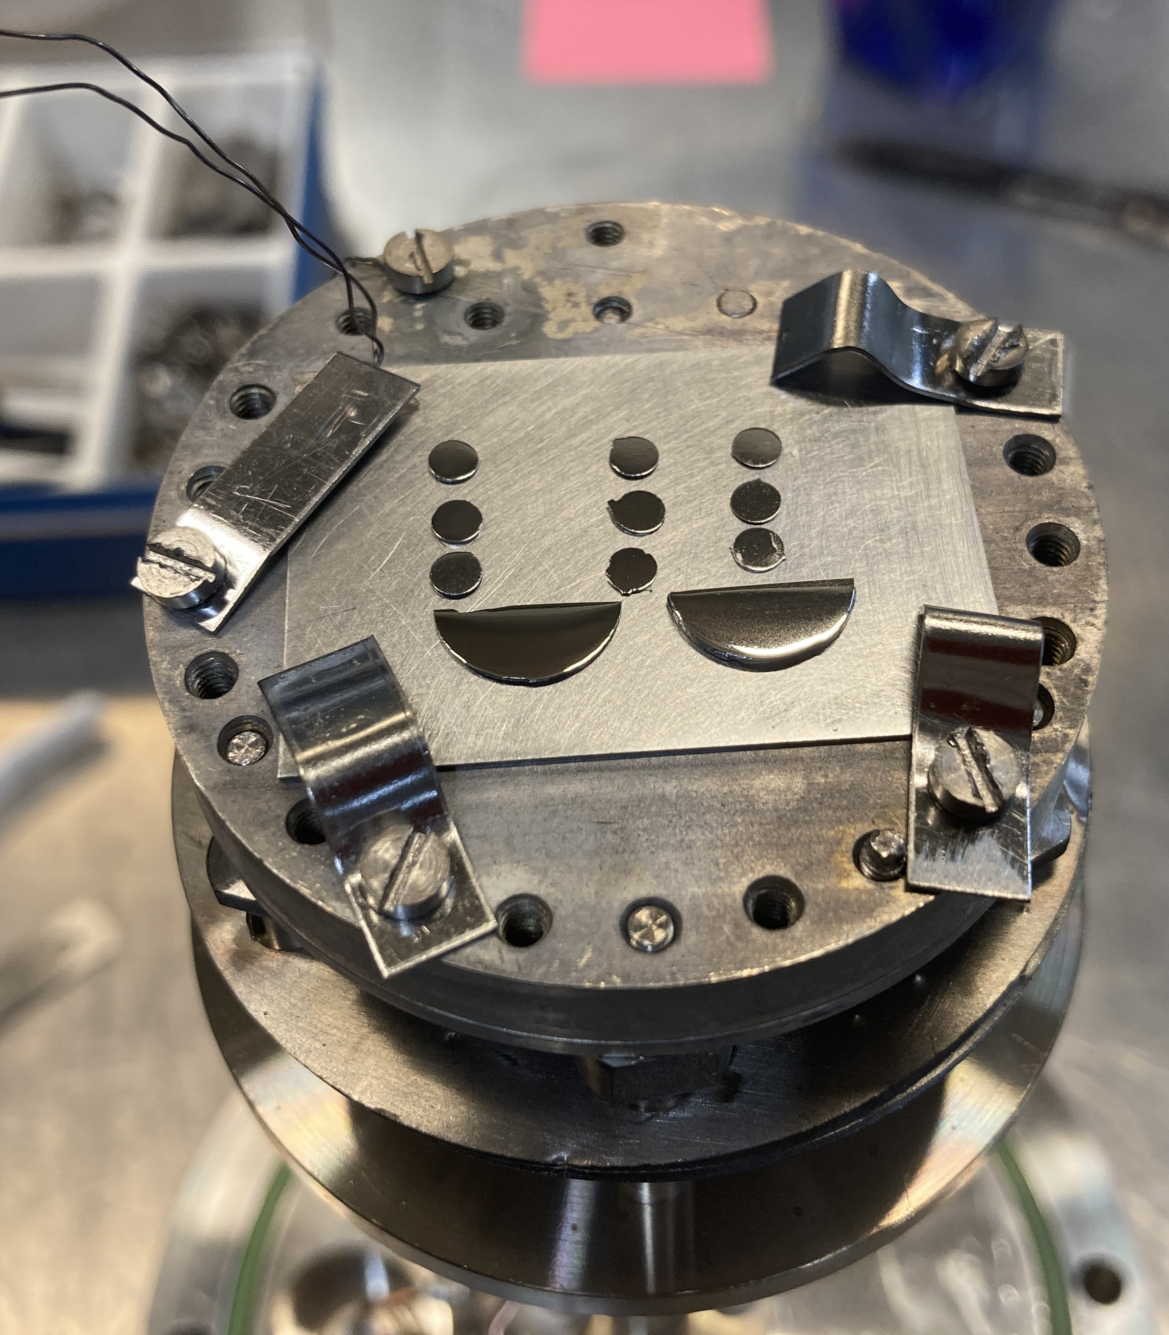
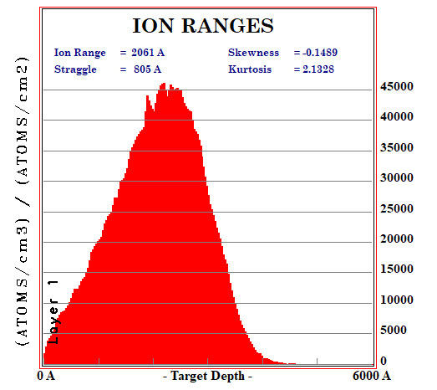
Updated status on HerHEA work at CNRS-IJCLab (10th Sept. 2025)
100 keV He ion implantation performed yesterday !
500°C (temperature of the samples)
Fluence 1x10¹⁷ cm⁻²
Orsay
https://mosaic.ijclab.in2p3.fr
SRIM calculations using average E_{d} = 44 eV, see J. Byggmästar, F. Djurabekova, and K. Nordlund, Phys. Rev. Materials 8 (2024) 115406, https://doi.org/10.1103/PhysRevMaterials.8.115406
Should be enough He to see bubbles in W
He bubbles observed in W by TEM starting 5x10¹⁵ cm⁻² fluence,
see F. Luo et al, Fusion Engineering and Design 125 (2017) 463
dx.doi.org/10.1016/j.fusengdes.2017.04.014
Implantation sample holder
HerHEA project, EUROfusion, ENR-MAT.02.VTT-T001, 2024-2025

Slide 4
Updated status on HerHEA work at CNRS-IJCLab (10th Sept. 2025)
Materials sent to CNRS-CEMHTI and UHEL for ex situ ion implantation and characterizations
Material fabrication at VTT
Cutting of the bulk as-fabricated material
subcontractor in France for EDM cutting
squares
Available material(s) to be studied
W, W-Ta, W-Mo, W-V
Surface mechanical polishing (done)
SEM-EDX characterization
to be done ?
Electrical Discharge Machining
3 mm diameter discs
Other materials from Portugal
W-Ta-V, W-Ta-Mo
Selection of the He ion implantation conditions
High T°C (500°C), one high fluence (1x10¹⁷ cm⁻²)
Energy 100 keV
half discs
Orsay
https://mosaic.ijclab.in2p3.fr
Observation if any He bubbles are seen
Transmission Electron Microscopy
ex situ
(in October)
Analyse the experimental data
Interpretation / Comparison with other HerHEA results / Publication
TEM thin foils preparation
by FIB (scheduled end Sept.)
M3.1 In situ TEM experiments performed (Links to D3.1) June 2025 → will be delayed to Nov. ?
HerHEA project, EUROfusion, ENR-MAT.02.VTT-T001, 2024-2025

