Slide 1

2025 Update / AWP 2026-2027 and CfP
WP Plasma-Wall Interactions and Exhaust
7th Physics Department Project Board
Sebastijan Brezinsek (PL)
Forschungszentrum Jülich
Heinrich-Heine-Universität Düsseldorf
J.W. Coenen (FZJ), A. Hakola (VTT), K. Schmid (MPG),
A. Kirschner (FZJ), A. Goriaev (ERM/KMS), J. Likonen (VTT), I. Classen (DIFFER) M. Reinhart (FZJ, PSO) and D. Douai (CEA, CO)

Slide 2
WPPWIE in AWP 2025

Slide 3
Focus: PWIE topics of relevance for ITER‘s new baseline with W and B
PWIE finally determines the lifetime of first wall components => armour thickness, melting and recrystallisation, heat exhaust capabilities of damaged PFCs (W)
PWIE has vital impact on machine and nuclear safety => license limits on fuel retention (B, T) and dust formation (B, W)
PWIE can negatively impact confinement and plasma performance => impurity influx and radiation (W, O, seed)
PWIE impacts the duty cycle of the device => frequency of boronisations (B, W, O) and fuel removal activities (T, B)
PWIE in steady-state conditions (with fluence) and during transient events (with energy and flux) to be controlled
Oxygen impurity
fuel retention
Boron
seed species
Tungsten PFC
dust formation
dust formation
erosion
pollution
erosion
Key areas for ITER to be addressed by experiments, testing, and/or simulations:
  Tungsten: Required W PFC armour thickness? Maximal tolerable tungsten influx form W wall for Q=10? High-Z dust?
  Boron: Which frequency of boronization and which layer thickness and homogeneity is required? Low-Z dust?
  Tritium: How to monitor, quantify, and if required remove it under controlled conditions? Frequency?

Slide 4
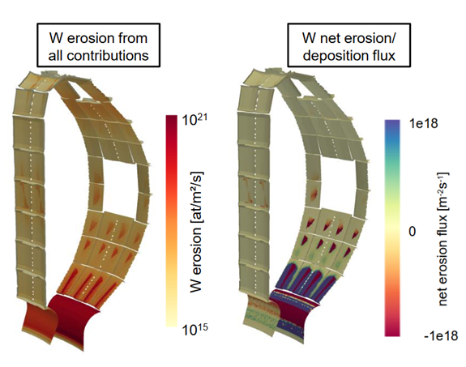
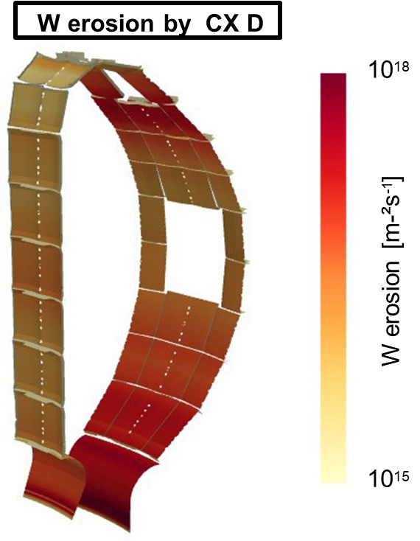
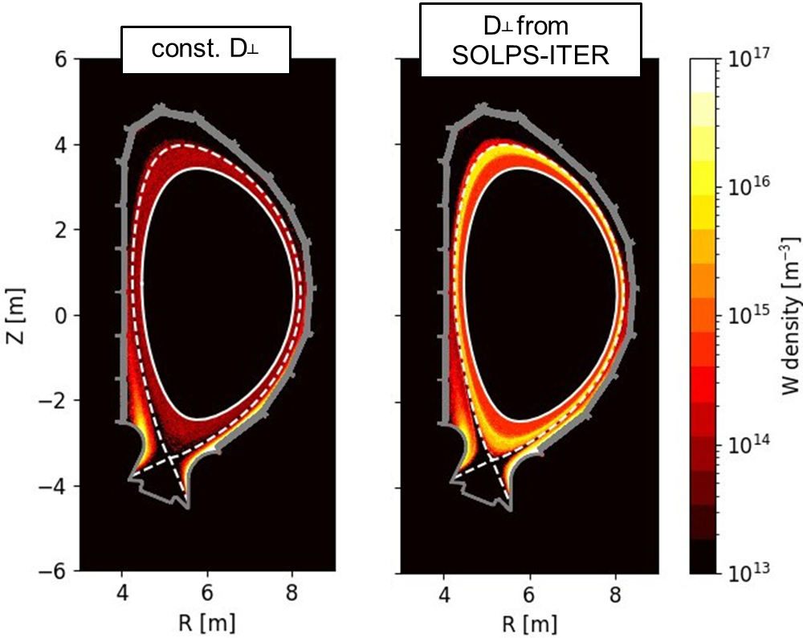
Simulation of W first wall erosion for ITER DT-1 plasmas
3D-resolved W erosion flux distribution for reference Q=10 DT plasma
  Plasma ions: D, H, seed impurity Ne (from SOLPS-ITER)
  Energetic CX neutrals: D (from EIRENE with energy and impact resolution)
3D-resolved W erosion flux distribution for reference Q=10 DT plasma
  Plasma ions: D, H, seed impurity Ne (from SOLPS-ITER)
  Energetic CX neutrals: D (from EIRENE with energy and impact resolution)
  W self-sputtering (from ERO2.0 inclduding diffusion coeffiecients for W)
  Dominant in ITER: Ne-induced sputtering followed by W-self sputtering
W erosion resources by RF-sheath effects on top
Benchmark experiment in ASDEX Upgrade performed in 2025 (analysis ongoing)
A. Loarte
Presemted at IAEA
Ch. Baumann
NF in preparation
A. Kirschner
Limiter plasmas submitted to NME
W self sputtering

Slide 5
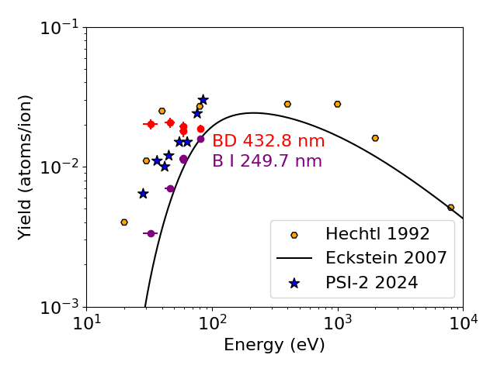
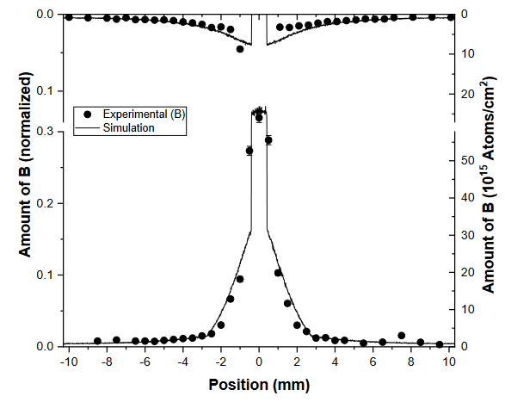
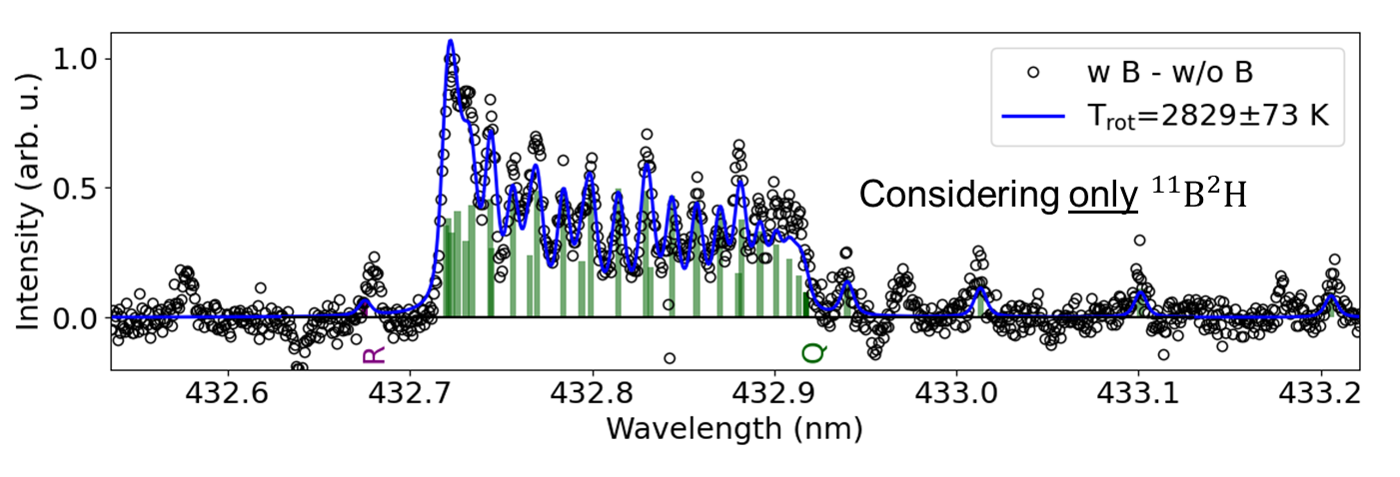
Boron sticking coefficients and boron chemistry
Standard boronisation is a glow discharge in He with 10% B₂H₆ carried out and sticking monitors installed
Two sticking species identified
Enhances the homogeneity of the B layer coverage
Boronization works with non-symmetric distribution
Feeds into boronization modelling (IO)
Will feeds into WallDYN-3D and ERO2.0
B layer on W substrate exposed to D plasma in PSI-2
Chemical and physical sputtering of boron separated
B layer sputtered by low energy hydrogen atoms/ions
Quantification by sample thickness and spectroscopy
Benchmark of atomic and molecular data in ERO2.0
M. Sackers et al.
NME 2025
M. Mayer et al.
NME 2025 2025

Slide 6
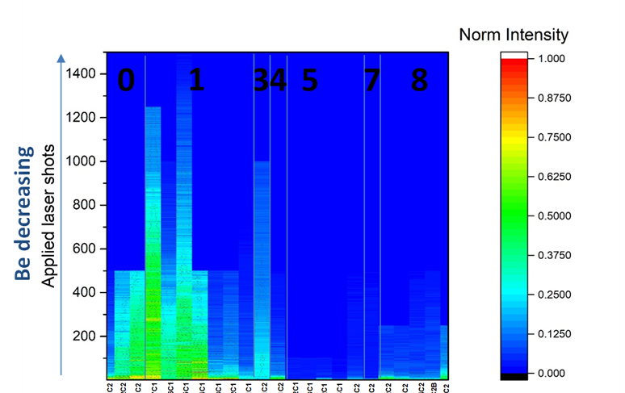
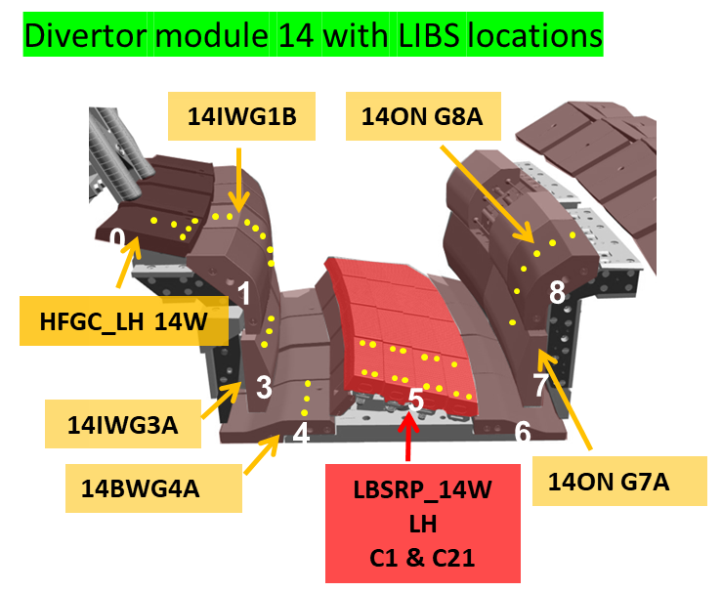
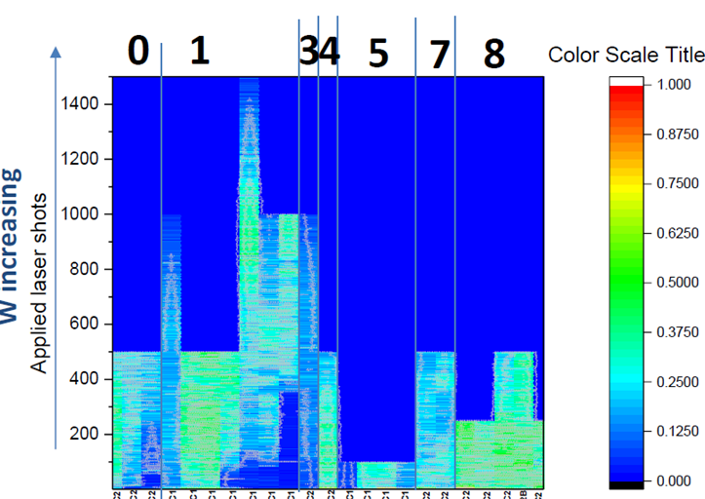
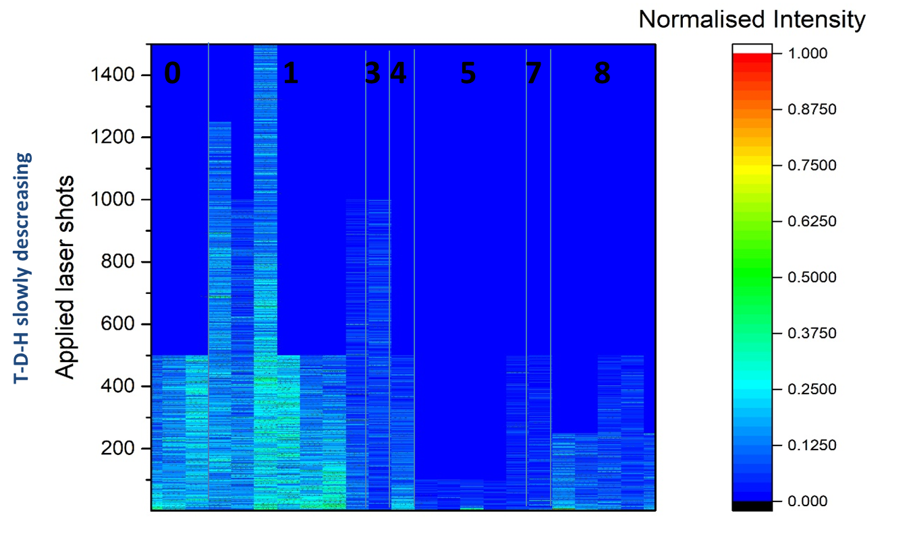
In-vessel ps-LIBS system in JET: H in Be layers => B in ITER
Beryllium
Erosion and deposition pattern in JET
quantified by ps-LIBS in W divertor
General pattern in agreement with previous post-mortem anaylsis
S. Almaviva et al.
PFCM2025
J. Likonen et al.
NME 2025
R. Yi et al.
NME 2025
Hydrogen Isotopes
Tungsten
Transfer to ITER (diagnostic candidate):
Diagnostic capability shown in JET
Technological capability shown in JET
Laboratory experiments to transfer
from Be to B layers (H. Wu et al. NME2025)
”Static” LIBS in WEST in preparation
(development under WPTE)

Slide 7
PWIE: GD status overview 2024/2025
In general, vast majority of residual GD and MS completed or on track.
"Title" in Sygma | Title in CWP | Due Date | Expected deliverable date | Status | Comments/Reason for delay
PWIE.D.14 | Properties of JET bulk tungsten and beryllium after extensive test under reactor conditions. | 31/12/2024 | 31/12/2025 | delayed | Delayed to 2025 to consider post DT samples as well.
PWIE.D.16 | Exploitation of experiments (WEST, JET, ASDEX Upgrade) related to material migration, fuel retention, and fuel recovery including interpretative plasma-edge and PWI modelling. | 31/12/2024 | 30/11/2025 | delayed | Delayed availability of contributing documentation needed for the compilation of the Grant Deliverable
PWIE.D.19 | Characterization and predictive modelling of plasma-wall interactions in He und He/H mixed plasmas for ITER in Pre-Fusion Power phase. | 31/12/2025 |  | on track
PWIE.D.20 | High fluence exposition of mono blocks made of references W and advanced W materials for DEMO, JT-60SA, DTT in MAGNUM-PSI and UPP including pre- and post-characterisation. | 31/12/2025 |  | on track
PWIE.D.22 | Comparison of in-situ (LID-QMS in JET) and ex-situ examination (FREDIS, TDS) of the laser-irradiated components regarding fuel/tritium content. | 31/12/2025 |  | on track
PWIE.D.23 | PSI modelling of DEMO main chamber erosion, deposition and fuel retention. PIC modelling of the sheath in the DEMO divertor (with TSVV7). | 31/12/2025 |  | on track
PWIE.D.24 | Neutral gas kinetics modular code upgraded and final verification/validation report (with TSVV5). | 31/12/2025 |  | on track
PWIE.D.25 | Initial PSI modelling of W sources, screening, transport and core concentration in full W-devices (with TSVV6). | 31/12/2025 |  | on track
PWIE.D.18 | Simulation of JET and PEX Upgrades results in view of ITER divertor and DEMO alternative configurations and its implementation in DTT. Quantitative comparison of potential benefits alternative configurations with respect to conventional solutions in view of exhaust performances and core compatibility (input to overarching PEX.M1 milestone). | 31/12/2024 | 30/11/2025 | delayed | Delayed availability of contributing documentation needed for the compilation of the Grant Deliverable
Report w/o DT samples as back-up
Report in progress (IAEA/PFMC)
ITER Be/W completed (NF paper)
Tests for JT-60SA will be skipped
Report in progress (PFMC/NF)
Report in progress (IAEA/NF)
Work done (IAEA/PET)
Report in progress (IAEA/NF)
Work done in 2022/2022 for DTT.
New data under WPTE (IAEA)
PEX-related PWIE GD 15 (2024) and GD 21 (2025) cancelled (PEX-HML owned by FZJ) => New GD in 2027

Slide 8
Summary WPPWIE 2025
Activities of all Subprojects in 2025 in general on track to be finished by end of the year with a few exceptions
  JET DT post-mortem analysis (major part of tiles) in 2026 and 2027 (plan exist / transfer)
  COMPASS-U PFC sample analysis delayed (tests done, but analysis not yet completed)
  Minor single tasks under risk
Key results presented at conferences including PFMC, EPS, AAPPS-DPP, PET, IAEA and ICFRM
Strong emphasis on ITER-related tasks (close collaboration with IO):
  to support physics assumptions for new baseline and provide predictions
  to support technical solutions for new baseline and help in open design issues
  to compare tokamak experiments in support of ITER regarding material migration, retention, and predictions
Support of reactor-related physics questions and PFC qualification with plasma
Annual meeting mid November in FZJ. Input to 2025 reporting (level 3)

Slide 9
WPPWIE in AWP 2026-2027

Slide 10
Main objectives AWP 2026-2027
Support program for ITER: W sources, transport, and deposition at the first wall and divertor |T retention, quantification, and removal | (temporary) first wall material qualification
Support program for JT60-SA/Wendelstein7-X: transfer from C towards W PFCs | power handling | material migration | divertor functionality | long-pulse operation simulation
Support program for fusion reactor (DEMO/VNS): (novel) material qualification | transients and high fluence
PFC qualification: synergistic effects in loading, damage matrix evolution, operation beyond damage
PWIE code development and benchmark experiments: pedestal⬄ plasma-wall interface ⬄ material using linear machines, laboratory experiments, and reference experiments in full-W devices
PWIE simulations for novel scenarios QCE, XPR in TE | first wall vs. divertor sources | material migration
Exploration of JUDITH-3/PSI-2 with tritiated or self-damaged or neutron-damaged tungsten and steel | revisit material from fission reactor exposure
Completion of JET components analysis: tungsten, steel, RE-damaged material, T retention, He content
Revision and benchmark of A&M data for H, D, T (atoms and molecules), W collisional-radiative models, B chemistry
In-operando diagnostics optimisation for material composition and retention | lessons learned from LIBS and LID-QMS at JET towards next step devices and analysis stations in hot cells
More information in AWP 2026-2027 plan – Task Descriptions in progress

Slide 11
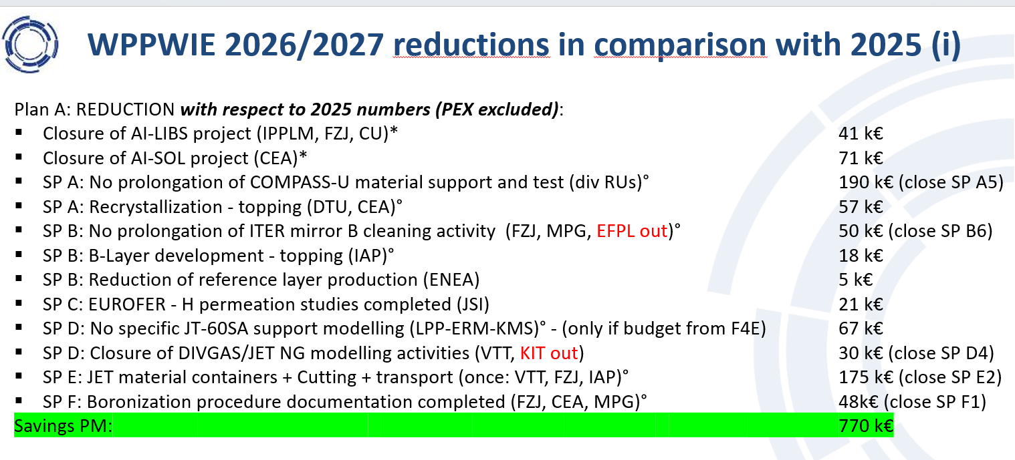
Resources in WPPWIE in AWP 2026-2027
Resources in AWP 2026/2027 for PWIE are reduced by ~40% with respect to the average of 2021-2025
About 33% reduction with respect to 2025 (WPPWIE resource profile and extra tasks in 2024/2025)
Refocus and closure of different activities with extra budget in 2024/2025 for 2026-2027
Remaining reduction by closure/pause of a few physics areas (prioritisation including Program Manager)
  Closure or strong reduction of all T-lab studies [risk to lose labs is high]
  Closure of dust related studies (tokamak analysis, predictions, modelling) [risk to lose labs is high]
  QSPA studies limited [budget to rebuild facilities from other area]

Slide 12
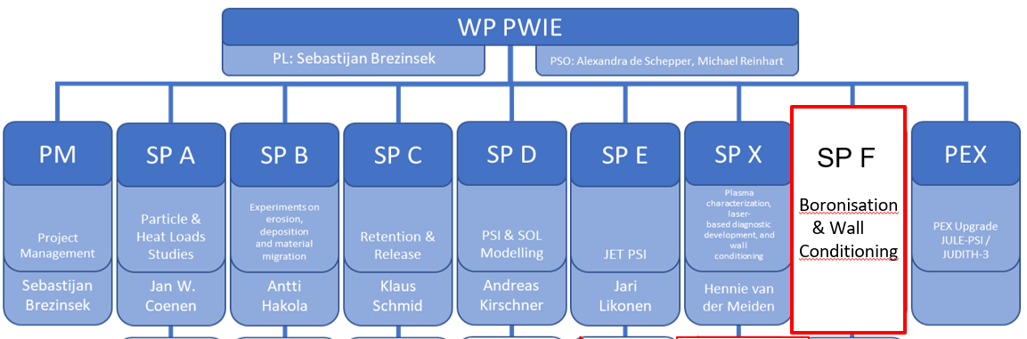
Structure 2026/2027
Basic structure of FP9 in 2026-2027 unchanged
Subprojects maybe technically be transferred into an increased number of Research Topics e.g
  Interpretative plasma-wall interaction and plasma simulations in linear and toroidal devices
  Predictive plasma-wall interaction and plasma-boundary simulations in core-edge compatible scenarios
  Identification of effective wall conditioning and fuel removal techniques for steady-state devices
  ... 10 more
Suitable to introduce scientific readiness scheme, but
Challenging to cover “service work” like reference samples, post-mortem analysis, A&M data production, MD simulations, code development, diagnostic development, generic material testing
Link between linear plasma/ HHF experiments – toroidal device experiments – future devices not featured

Slide 13
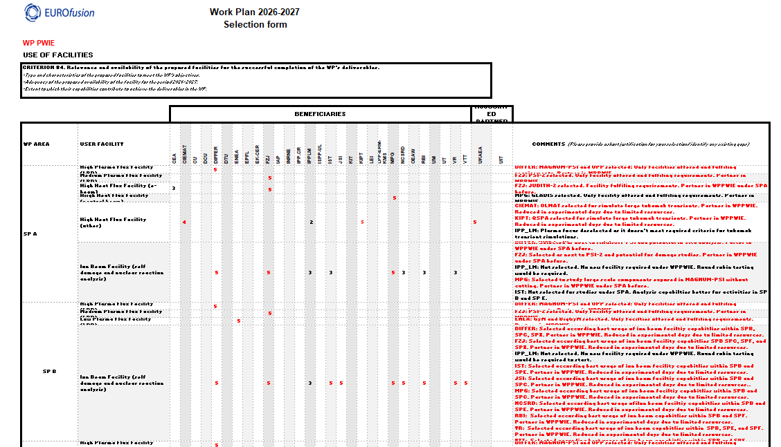
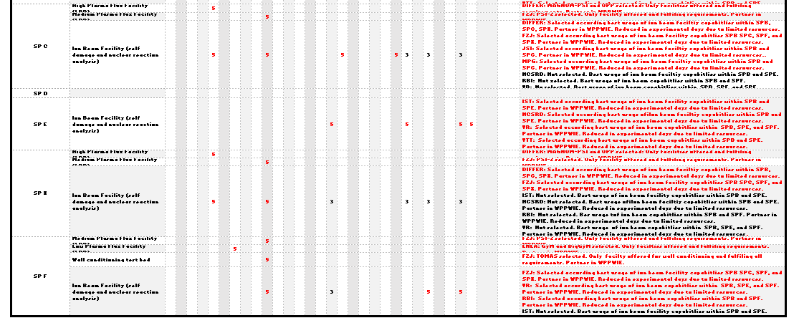
Call for Participation AWP 2026-2027 executed, analysed, and selected*
Successful CfP: Factor 2-3 oversubscription per subproject
Analysis careful done within 2 weeks and justification given as requested
26 of 27 RUs offering Human Resources and Expertise are selected
Results presented to HoD and PMU as requested
“outcome” on hold until approval of Programme Manager*
HUMAN RESOURCES

Slide 14
Human Resources WPPWIE in AWP 2026-2027*
Selection made and resources in PM balanced in different subprojects and tasks to be carried out
Detailed RU selection from point of view of PL exist, but
outcome depends on Programme Manager decision
Note that, the detailed Task Specification is usually done in consultation with the RUs to include priorities of labs (in agreement with local programme) and available personal (overbooking of human resources by RU). Not yet done!
Delay in set-up of 2026-2027 tasks specification, input into IMS etc. => risk of overlap with reporting period
*SUBJECT TO REVIEW AND APPROVAL
BY THE PROGRAMME MANAGER!

Slide 15
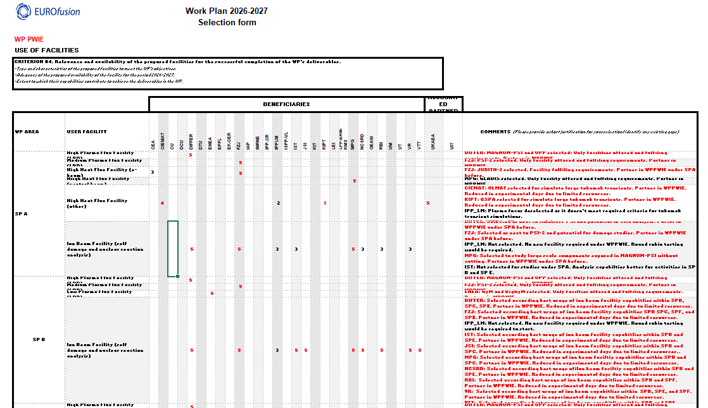
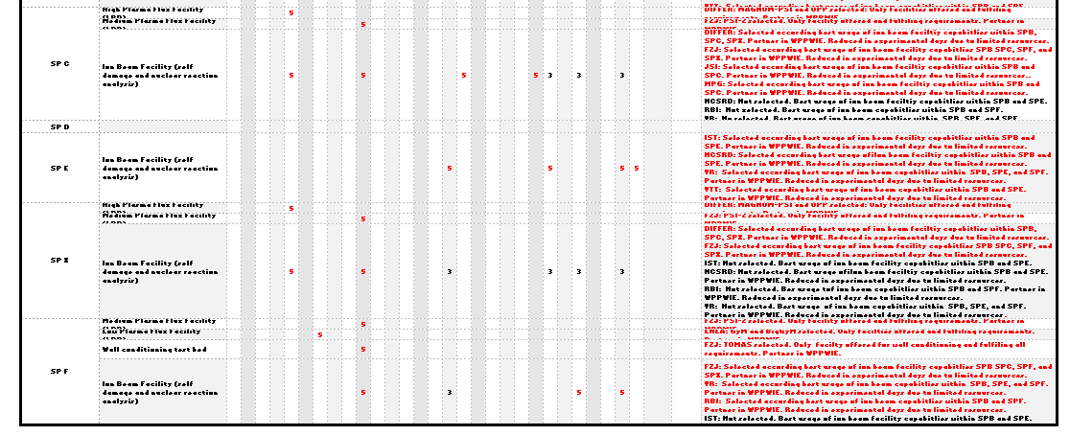
Call for Participation AWP 2026-2027 executed, analysed, and selected*
Successful CfP: Sufficient facilities offered, though exact cost not always clear
Analysis careful done within 2 weeks and justification given as requested
Facilities with unique capabilities, qualified, and established in PWIE preferred
Results presented to HoD and PMU as requested
“outcome” on hold until approval of Programm Manager*
FACILITY RESOURCES

Slide 16
Facilities WPPWIE in AWP 2026-2027*
Selection made by PL and SPL considering needs for WPPWIE tasks
Machine usage similar to 2024
Machine costs preliminary updated with RUs input in cause of evaluation
LPD resources slightly reduced (CfP)
Accelerator resources increased (CfP)
No selection if too expensive, out of scope, days not required etc.
*SUBJECT TO REVIEW AND APPROVAL
BY THE PROGRAMME MANAGER!

Slide 17
Private comments by the PL WPPWIE
Experienced project leader and task force leader since more than 15 years in EFDA and EUROfusion
Never seen such type of challenging situation in planning and organization (even not in EFDA->EUROfusion)
External reasons:
  Reduced budget in AWP 2026-2027 due to underspending in 2021-2025
  (No significant underspending in WPPWIE in EUROfusion so far!)
  Requested Call for Participation for all WPs and change in WP structure
  Overlap with major conferences in time of Call, Analysis, Selection, etc.
  Workload
Internal (EUROfusion) reasons:
  Line-of-command or decision blurred (e.g. between PL with HoD, PM, FD)
  Micro-management and too much reporting (e.g. PL to FD, to PMU, to EC ...)
  Communication and decision issues (e.g. revision over months)
  Disruptive decisions (e.g. TSVVs were indicated to be part of WPs – now PL/TFL not even formally involved)
Good management system in FSD/PSD science department is losing functionality this year
WPPWIE is working with 26 RUs. Communication and common research was highest good in last decade and key for scientific success. Need to respect that the work is funded only by 50% (co-funding principle).

Slide 18
Preliminary resource allocation summary AWP2026/2027
WBS ID | Sub-project | Manpower [PM] | E&GS (incl. use of facilities) [k€] | Missions (actual) [k€] | CC resources [k€] | Total resources [k€] | Related GD/GM | Involved Beneficiary(ies) / Affiliated Entities
PM | Project Management | 29.6 | - | 85 | 250.7 | 397 |  | FZJ, VTT, MPG, FZJ, VTT, LPP-ERM-KMS, DIFFER, FZJ, Not all
FOp | Facilities Operation | (114.2) | 75+697 | - | 1095.7 | 1946 |  | FZJ, DIFFER, MPG, KIPT, CIEMAT, ENEA, DIFFER, IST, NCSRD, VR, VTT, RBI, CEA, JSI
SPA | Particle & Heat Load Studies in preparation of the exploitation of ITER and DEMO | 100 | - | - | 345.6 | 691 |  | CEA, CIEMAT, DIFFER, DTU, FZJ, KIPT, LPP-ERM-KMS, MPG, VR, UKAEA
SPB | Experiments on erosion, deposition and material migration | 111 | - | - | 427.6 | 855 |  | CEA, CIEMAT, CU, DIFFER, ENEA, FZJ, IAP, IPP.CR, IPPLM, IST, JSI, MPG, NCSRD, OEAW, RBI, UT, VR, VTT, UKAEA
SPC | Retention and Release | 84 | - | - | 346.7 | 693 |  | CEA, DIFFER, ENEA, FZJ, IPPLM, ISSP-UL, JSI, KIT, MPG, OEAW, VR, UKAEA
SPD | Plasma-edge and plasma-wall interaction modelling | 91 | - | - | 362.3 | 725 |  | CEA, CIEMAT, DIFFER, ENEA, FZJ, IPP.CR, IPPLM, MPG, OEAW, VTT, UKAEA
SPE | PWI with Be, T and neutrons: focus on JET post-mortem analysis its interpretation | 83 | - | - | 197.1 | 394 |  | CU, ENEA, FZJ, IAP, IPPLM, ISSP-UL, IST, NCSRD, UT, VR, VTT, UKAEA
SPF | Wall Conditioning & Boronisation | 45 | - | - | 198.4 | 397 |  | CEA, ENEA, FZJ, IAP, KIPT, LPP-ERM-KMS, MPG, VR
SPX | Plasma characterisation, laser-based diagnostic development, and wall | 56 | - | - | 231.3 | 463 |  | CEA, CU, DIFFER, FZJ, IPPLM, ISSP-UL, MPG, UT, VTT
2026 Total |  | 599.6 (+ 114.2 UoF) | 75 (+ 697 UoF) | 85 | 3455.4 | 6561
*SUBJECT TO REVIEW AND APPROVAL BY THE PROGRAMME MANAGER!

Slide 19
Preliminary resource allocation summary AWP 2026/2027*
WBS ID | Sub-project | Manpower [PM] | E&GS (incl. use of facilities) [k€] | Missions (actual) [k€] | CC resources [k€] | Total resources [k€] | Related GD/GM | Involved Beneficiary(ies) / Affiliated Entities
PM | Project Management | 29.6 | - | 84 | 252.8 | 400 |  | VTT, FZJ, MPG, LPP-ERM-KMS, DIFFER, Not all.
FOp | Facilities Operation | (112.8) | 48+695 | - | 1082.5 | 1913 |  | VTT, JSI, CEA, ENEA, NCSRD, CIEMAT, FZJ, RBI, IST, KIPT, VR, DIFFER, MPG
SPA | Particle & Heat Load Studies in preparation of the exploitation of ITER and DEMO | 100 | - | - | 350.8 | 702 |  | LPP-ERM-KMS, CIEMAT, DTU, KIPT, CEA, MPG, VR, FZJ, DIFFER, UKAEA
SPB | Experiments on erosion, deposition and material migration | 110 | - | - | 429.2 | 858 |  | UT, IPP.CR, CU, CIEMAT, IST, IPPLM, RBI, NCSRD, JSI, OEAW, IAP, VR, VTT, ENEA, DIFFER, CEA, FZJ, MPG, UKAEA
SPC | Retention and Release | 84 | - | - | 351.9 | 704 |  | IPPLM, ENEA, VR, OEAW, ISSP-UL, DIFFER, KIT, JSI, FZJ, MPG, CEA, UKAEA
SPD | Plasma-edge and plasma-wall interaction modelling | 91 | - | - | 367.9 | 736 |  | CIEMAT, OEAW, DIFFER, IPPLM, IPP.CR, MPG, CEA, ENEA, VTT, FZJ, UKAEA
SPE | PWI with Be, T and neutrons: focus on JET post-mortem analysis its interpretation | 67 | - | - | 152.3 | 305 |  | IPPLM, NCSRD, VR, IST, IAP, ISSP-UL, VTT, FZJ, UKAEA
SPF | Wall Conditioning & Boronisation | 45 | - | - | 201.4 | 403 |  | KIPT, IAP, VR, ENEA, CEA, MPG, FZJ, LPP-ERM-KMS
SPX | Plasma characterisation, laser-based diagnostic development, and wall | 61 | - | - | 250.1 | 500 |  | ISSP-UL, VTT, ENEA, IPPLM, CU, UT, CEA, MPG, DIFFER, FZJ
2027 Total |  | 587.6 (+ 112.8 UoF) | 48 (+ 695 UoF) | 84 | 3438.9 | 6521
GRAND TOTAL |  | 1187.2 (+ 227 UoF) | 123 (+ 1392 UoF) | 169 | 6894.3 | 13082
*SUBJECT TO REVIEW AND APPROVAL OF THE PROGRAMME MANAGER!
Note: the overall EC contribution is ~40k€ above the allocated budget (of 6853k€ => ~0,6 %. CC contribution is exact!)

Slide 20
join Zoom Meeting
https://us02web.zoom.us/j/89976081773?pwd=ujRjXurfpNnPqQky9et4hGG60a3bYJ.1
Meeting ID: 899 7608 1773
Passcode: Board2025

Slide 21
AWP 2025 – Main objectives transferred into Tasks
Supporting ITER re-baselining and addressing critical question in experiments / modelling:
  Simulation of first wall W erosion, W deposition, and W screening in limited and diverted plasmas
  Boronization and B layers: homogeneity, B layer properties, lifetime, and impact of B on wall conditions
  T retention (scaling law), T removal techniques (ICWC, ECWC), T quantification (laser-techniques),
  active removal of B layer by erosion, dust formation, dust properties, and dust removal (incl. TOMAS and other facilities)
  Advanced modelling of B physical and chemical erosion process as input for PWIE models (MD simulations)
  Qualification of ITER TFW design solutions in HHF and plasma devices (inertially cooled PFCs)
  W PFCs damage predictions under VDE and RE impact in ITER (JET benchmark)
  Supporting ITER first mirror performance in the presence of boron (boronization / boronization + plasma)
Linked to ITPA activities and
needs defined in ITER research plan

Slide 22
AWP 2025 – Main objectives transferred into Tasks
Material qualification for DEMO and other facilities with plasma and combined load, damage evolution, limits
Support of WEST and ASDEX Upgrade experiments, analysis, and interpretative modelling
(PWIE aspects only e.g. migration, 3D aspects, layer formation, stability)
Address T-retention by trapping/diffusion/permeation in damaged tungsten/EUROFER PFCs
Prompt re-deposition physics of W and properties of re-deposited W (experiments and modelling)
Analysis of JET-LIBS data and prepare/start for post-DT tile analysis
Support of W7-X PWIE in long-pulse operation, wall conditioning, material migration, transfer to W
Properties of cold, recombining plasmas in view of molecular assisted processes in H,D
Development and application of laser-based technologies for in-situ and in-operando studies (W, steel, B)
Support of COMPASS-U (and JT60SA regarding transfer to W by modelling, divertor design, and PFC test)
In general very strong links with: WPTE and WPW7X as they offer platform to bridge: laboratory results with tokamak / stellarator via modelling
Strong link to technical departments: WPDES, WPDIV, WPMAT, WPSAE …

