Slide 1
WPTE: Status summary of 2025
PSD Project Board # 07
N. Vianello and E. Tsitrone for TE TFL
E. Tsitrone, N. Vianello, M. Baruzzo, J. Garcia, A. Hakola, V. Igochine, D. Keeling, B. Labit

Slide 2
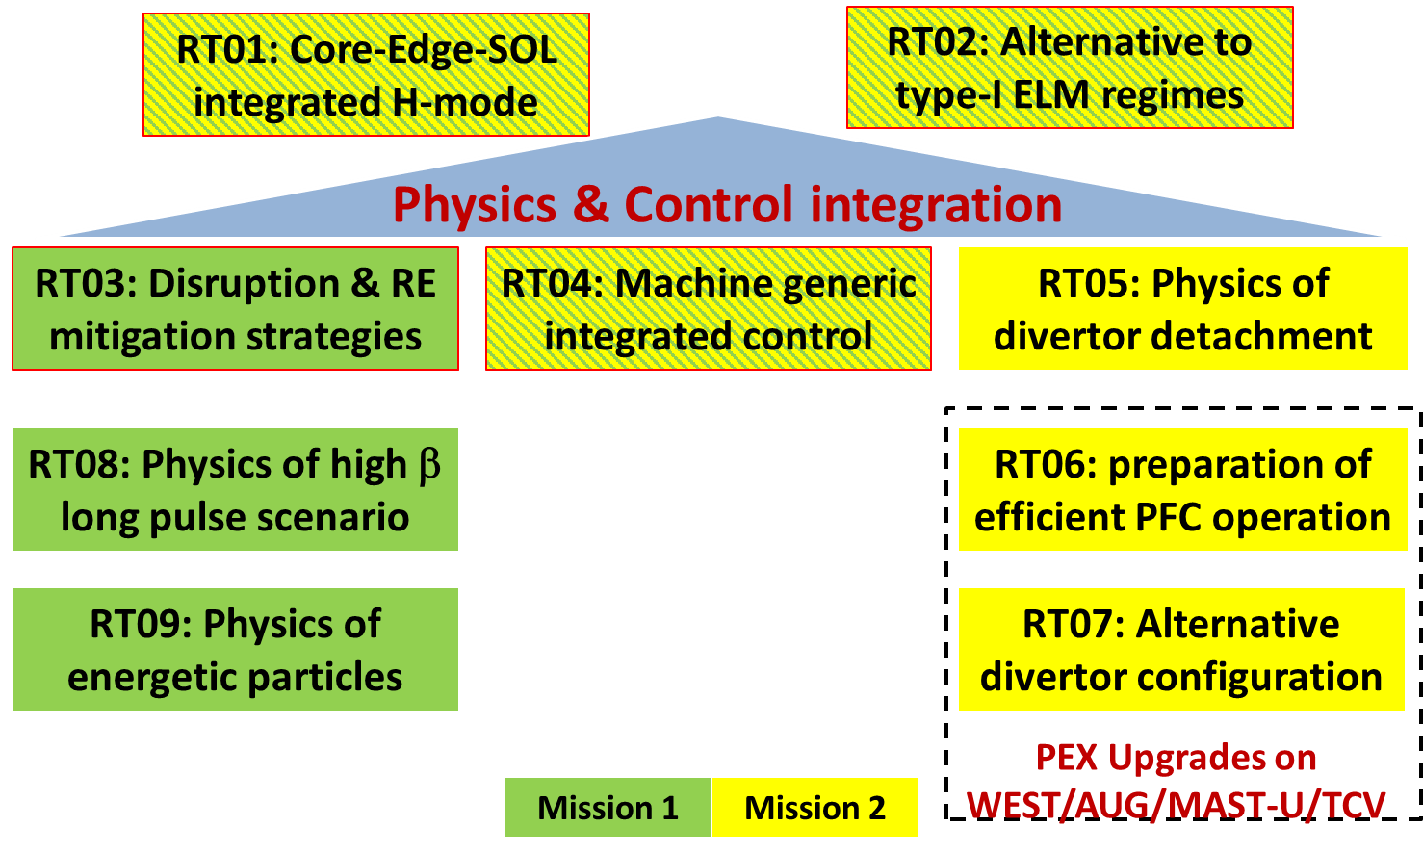
Research Structure kept in continuity during 2024-2025

Slide 3
2025 WPTE programme at a glance
 | Jan |  | Feb | Mar | April | May | June | July | Aug | Sept |  | Oct |  |  | Nov |  | Dec
AUG
TCV |  |  | NINO |  |  |  |  |  |  |  |  |  | SILO
MAST-U |  |  |  |  |  |  | MU04 |  |  |  |  |  |  |  |  | MU05
WEST |  |  | C11 |  |  |  |  |  |  |  |  |  |  | C12
WPTE run consistently in all 4 European devices in 2025
Several months with coordinated programs spanning 3 devices simultaneously

Slide 4
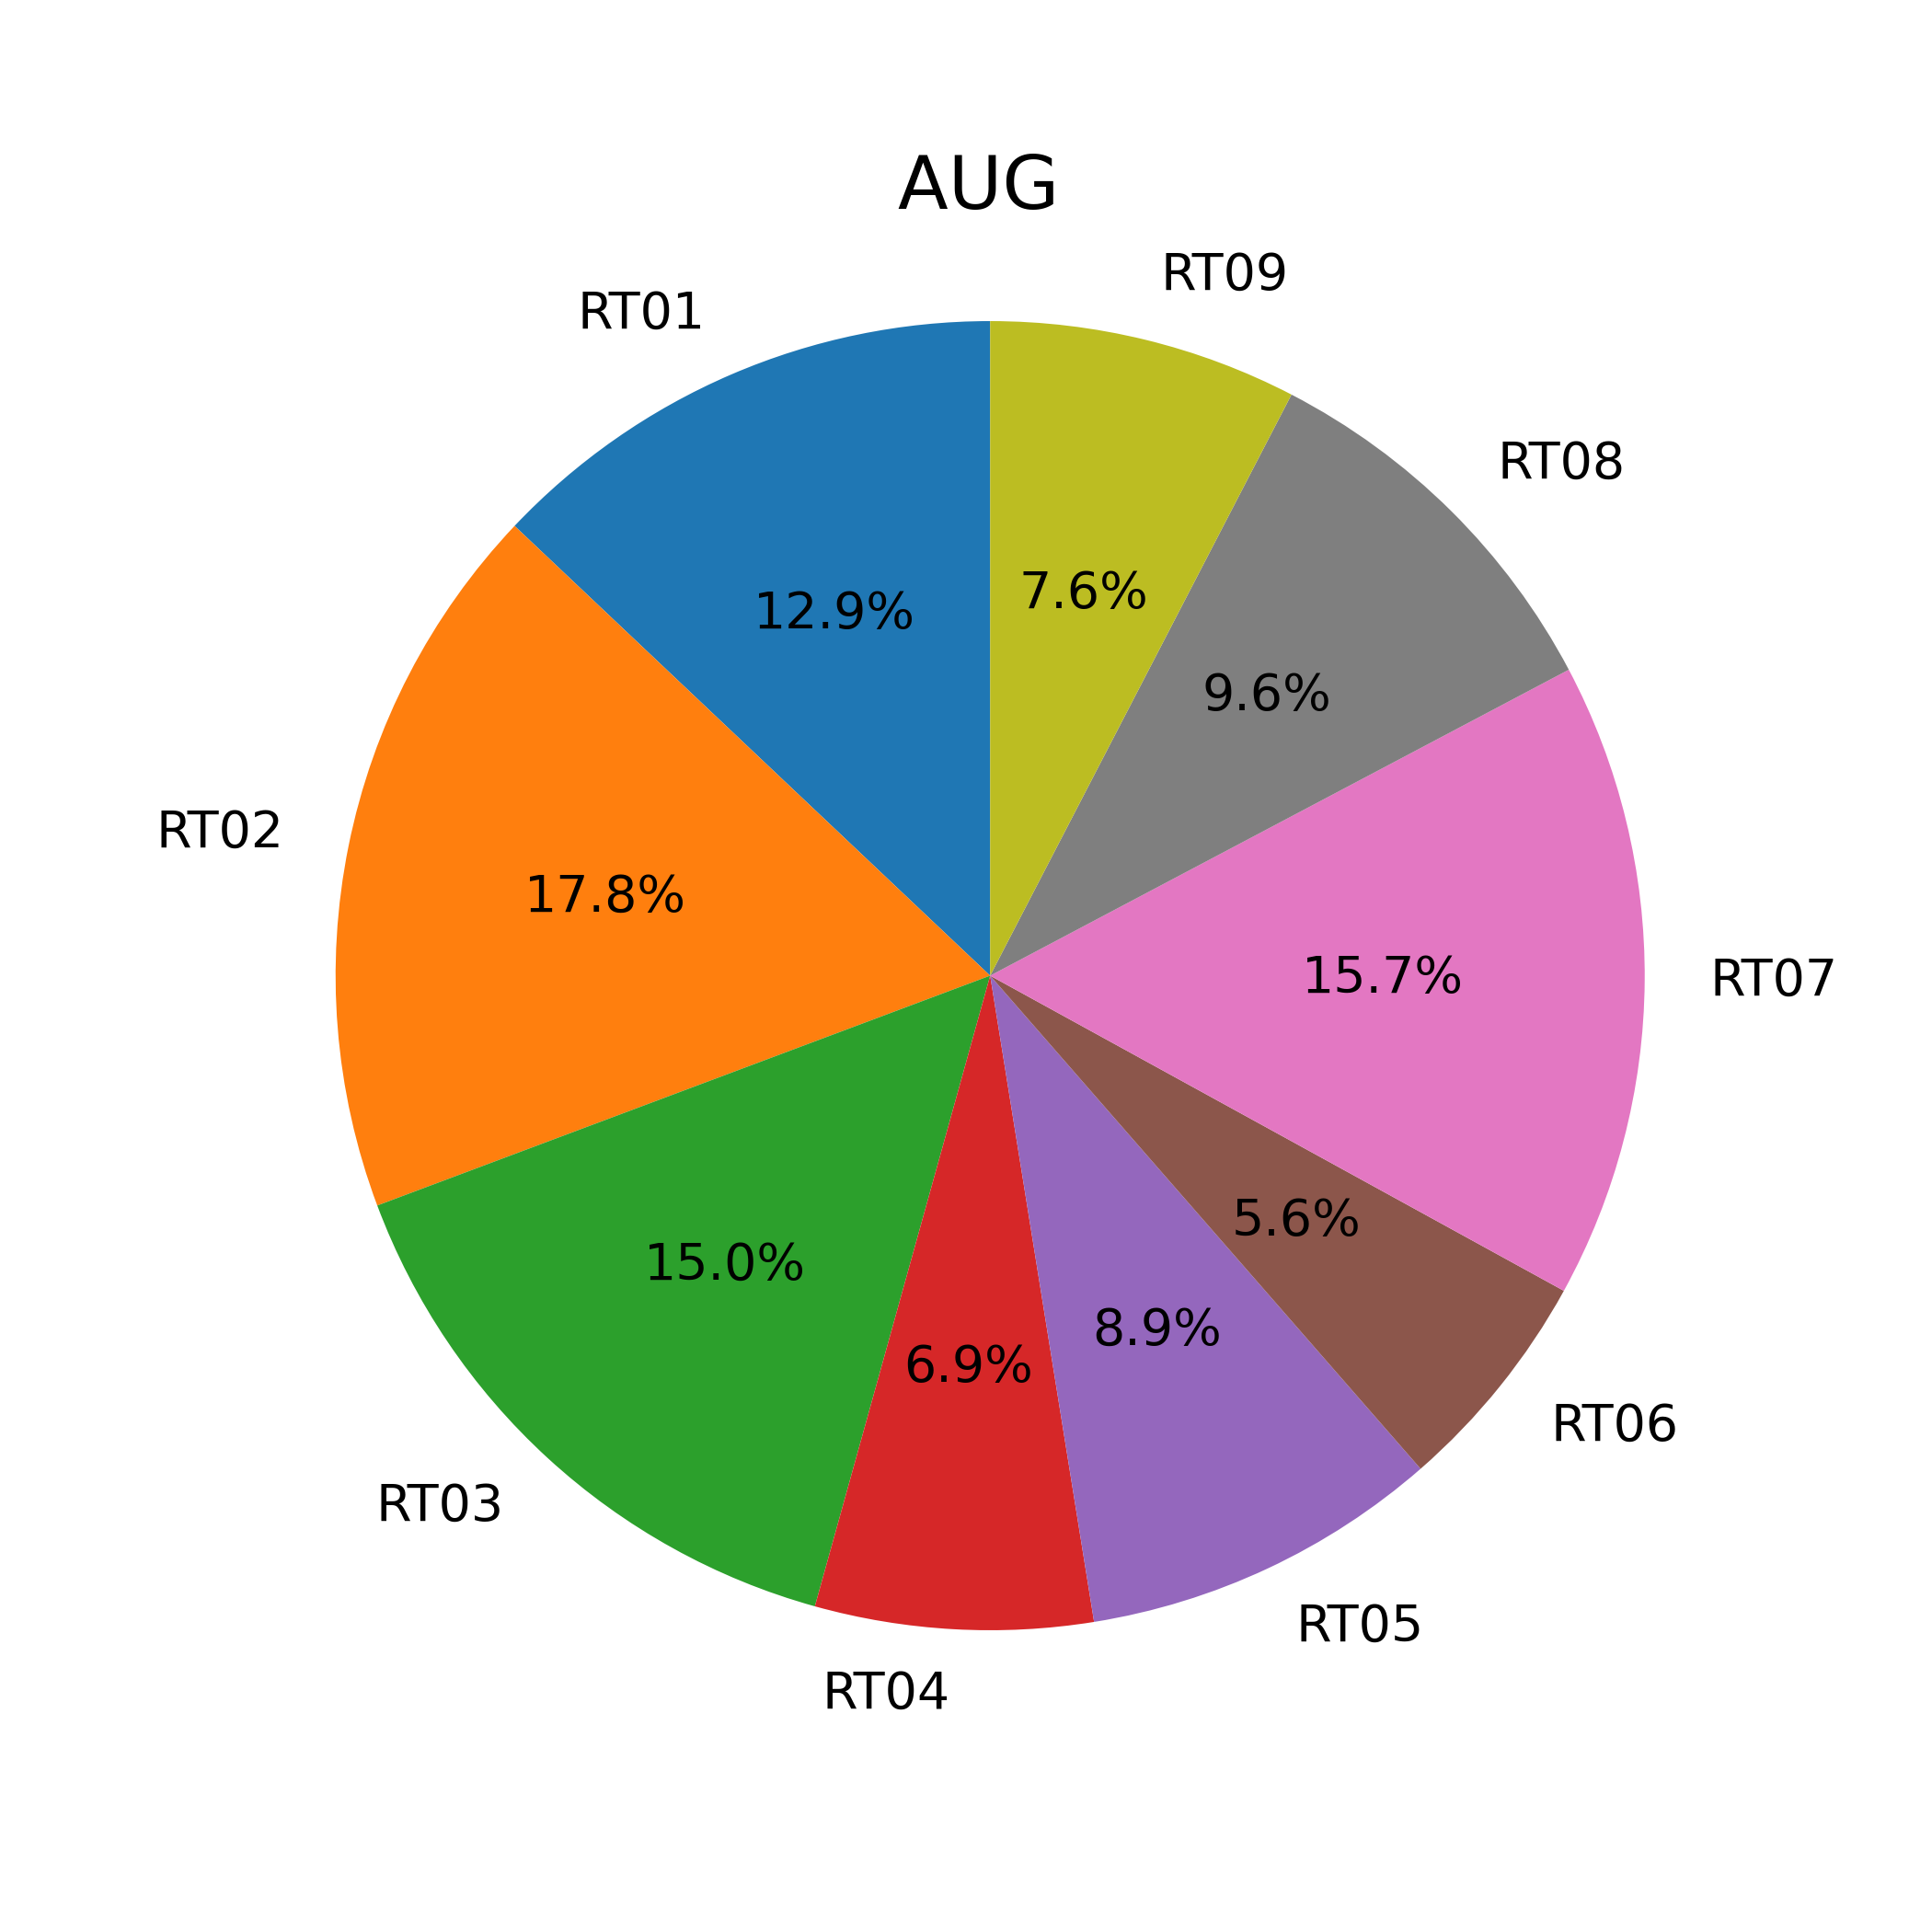
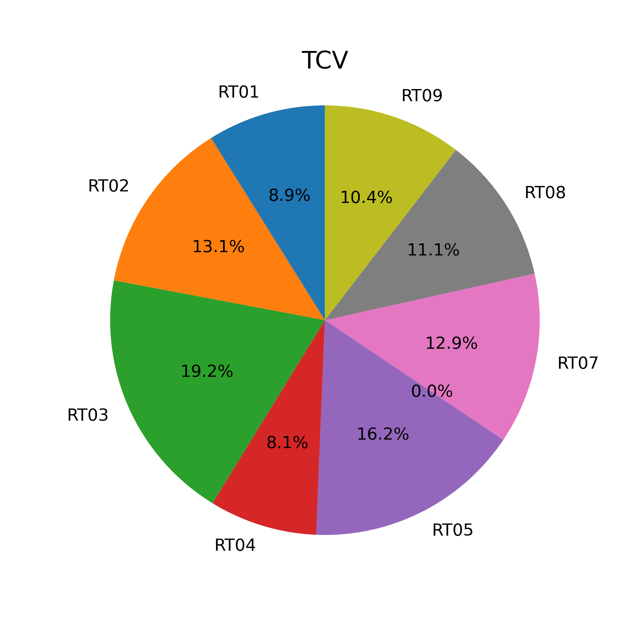
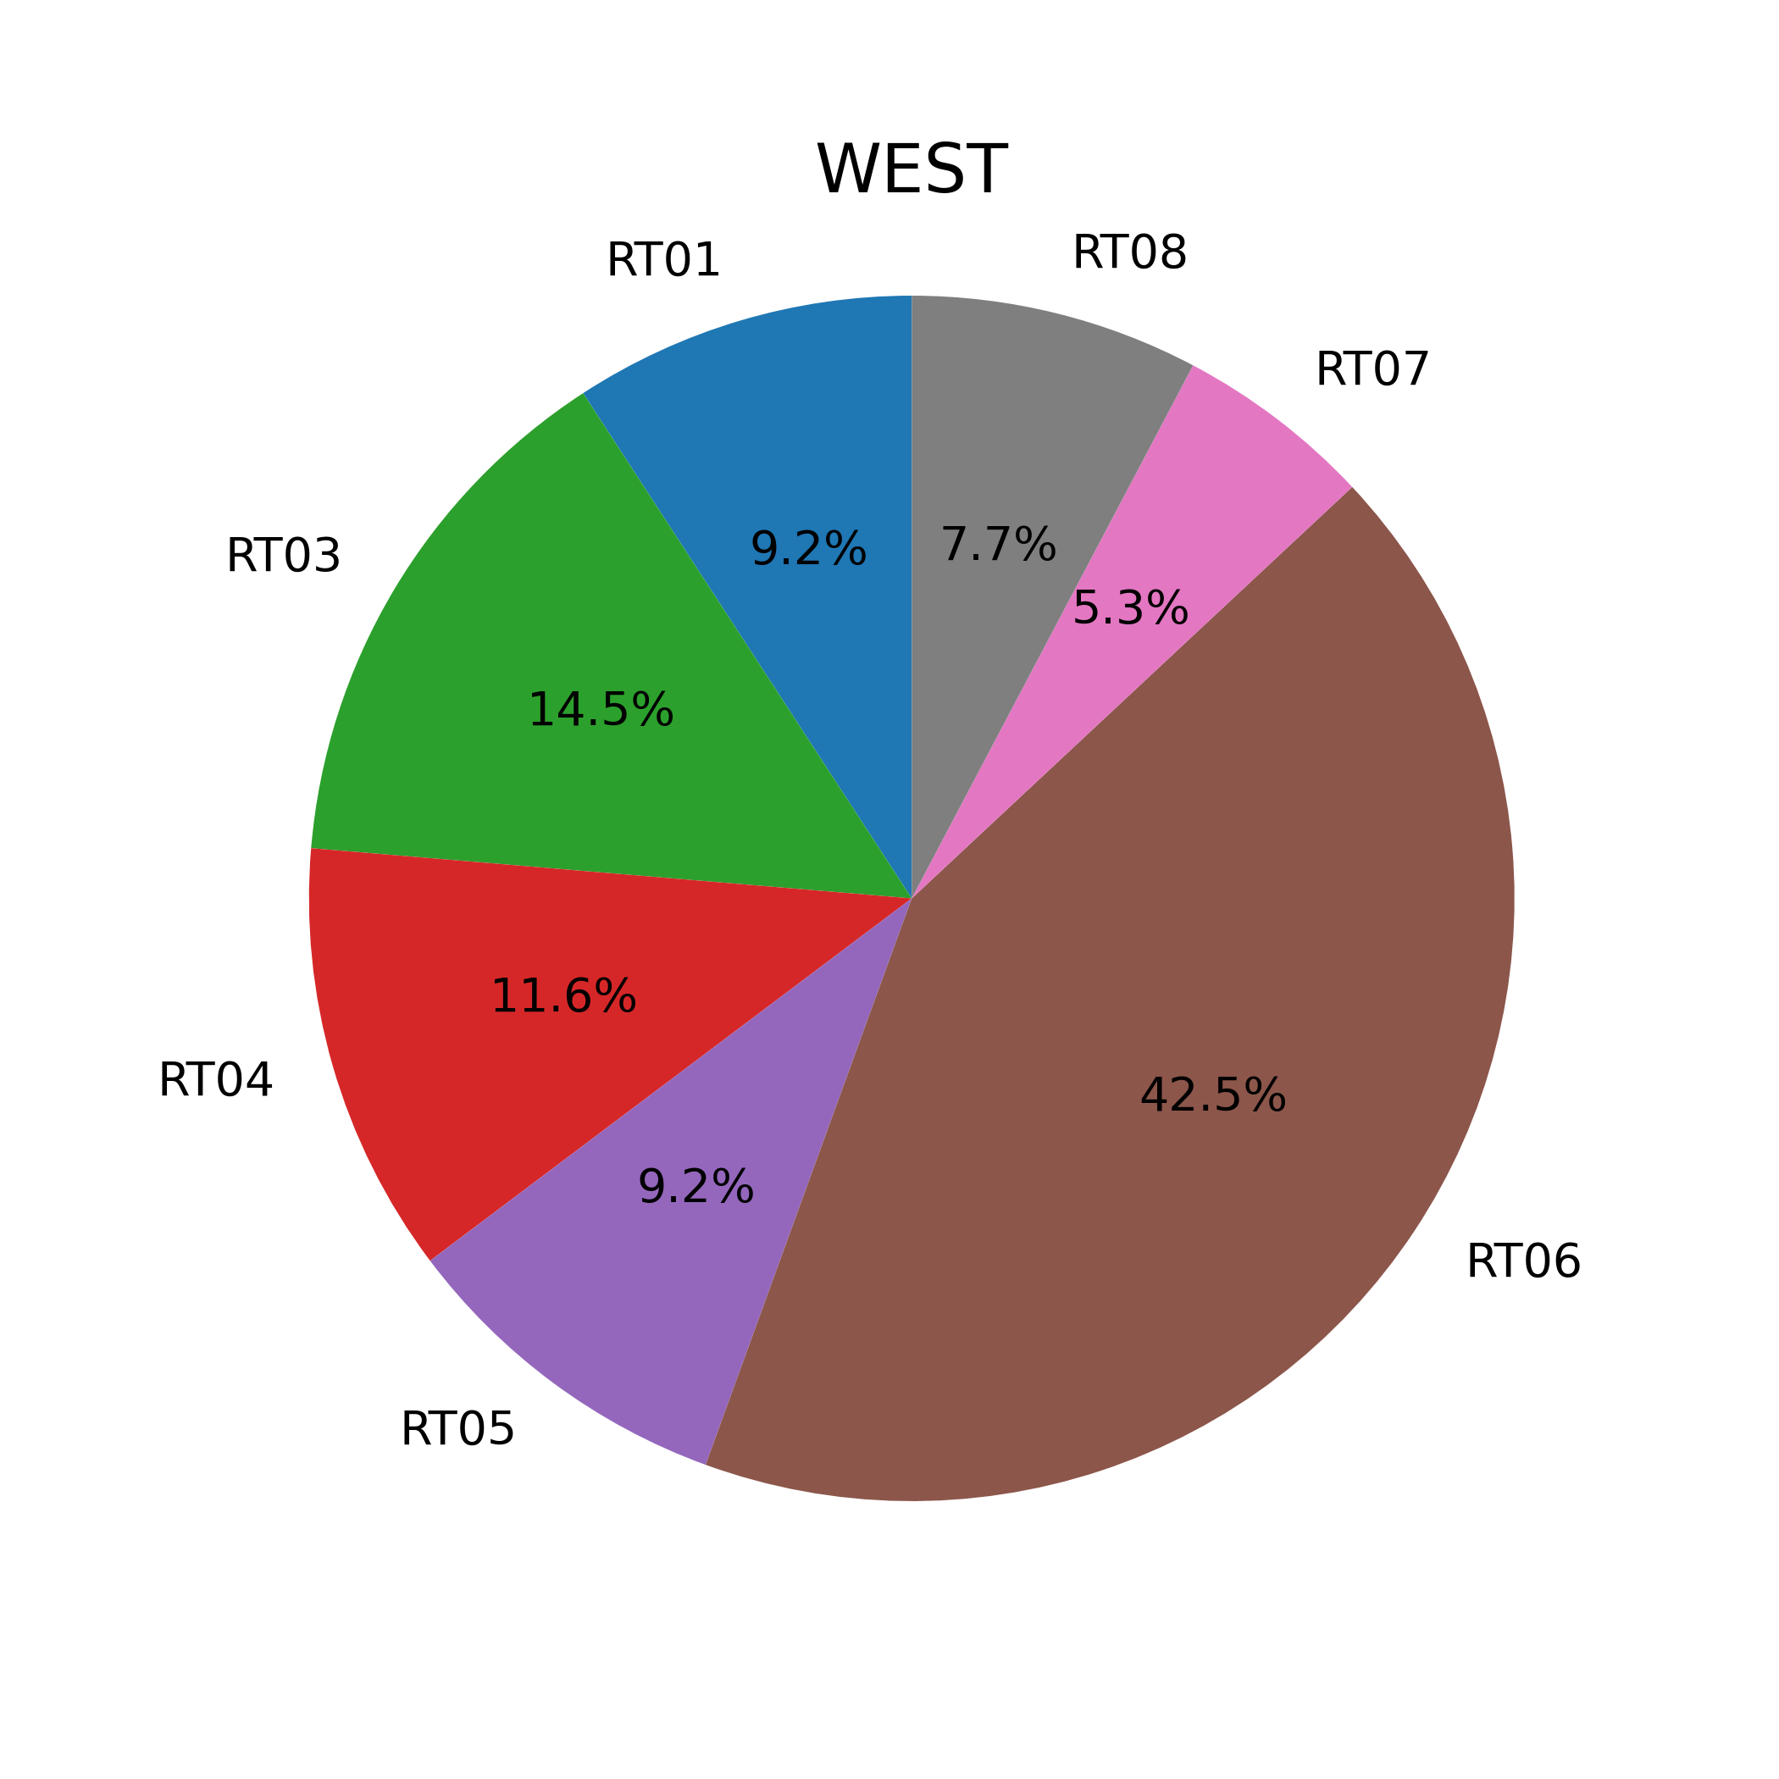
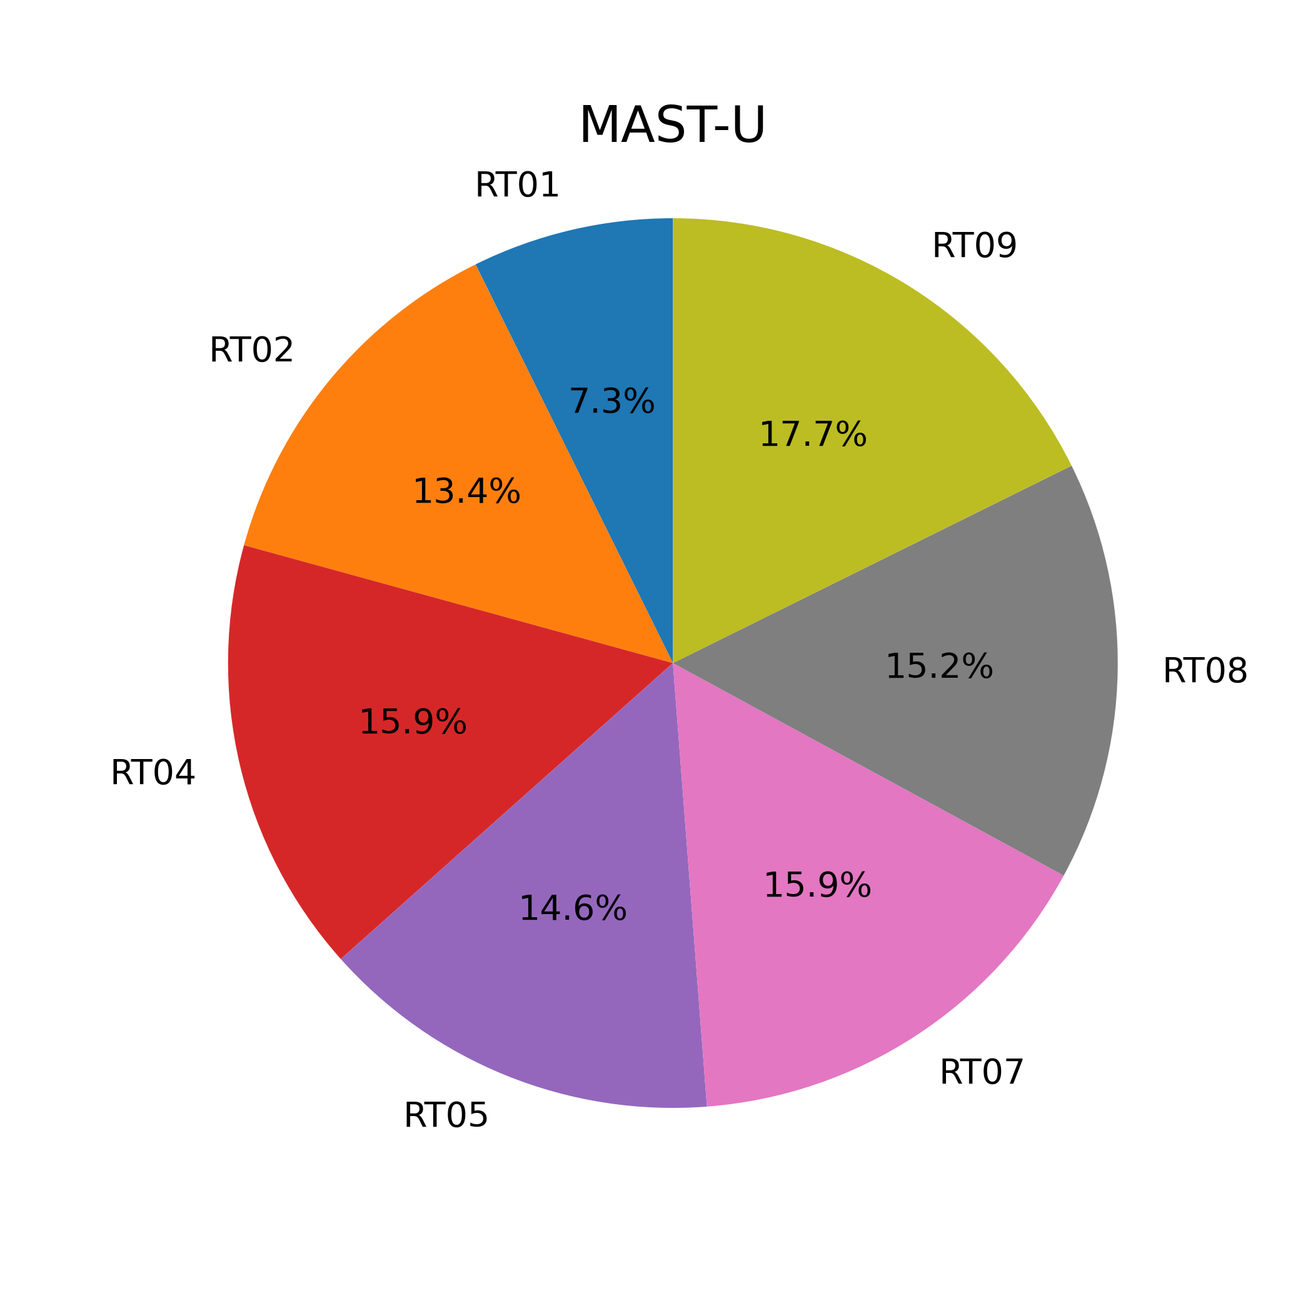
2025 Executed shots distribution up to 27.10.2025
Executed up to 27th October 2025
Planned for Nov-Dec 2025
RT | AUG | MAST-U | TCV | WEST
RT01 | 51 | 12 | 69 | 19
RT02 | 70 | 22 | 102 | 0
RT03 | 59 | 0 | 149 | 30
RT04 | 27 | 26 | 63 | 24
RT05 | 35 | 24 | 126 | 19
RT06 | 22 | 0 | 0 | 88
RT07 | 62 | 26 | 100 | 11
RT08 | 38 | 25 | 86 | 16
RT09 | 30 | 29 | 81 | 0
RT | AUG | MAST-U | TCV | WEST
RT01 | 0 | 16 | 64 | 0
RT02 | 0 | 24 | 31 | 15
RT03 | 0 | 0 | 35 | 0
RT04 | 0 | 0 | 29 | 15
RT05 | 0 | 0 | 25 | 0
RT06 | 0 | 0 |  | 90
RT07 | 0 | 16 | 58 | 0
RT08 | 0 | 16 | 46 | 0
RT09 | 0 | 0 | 18 | 0

Slide 5
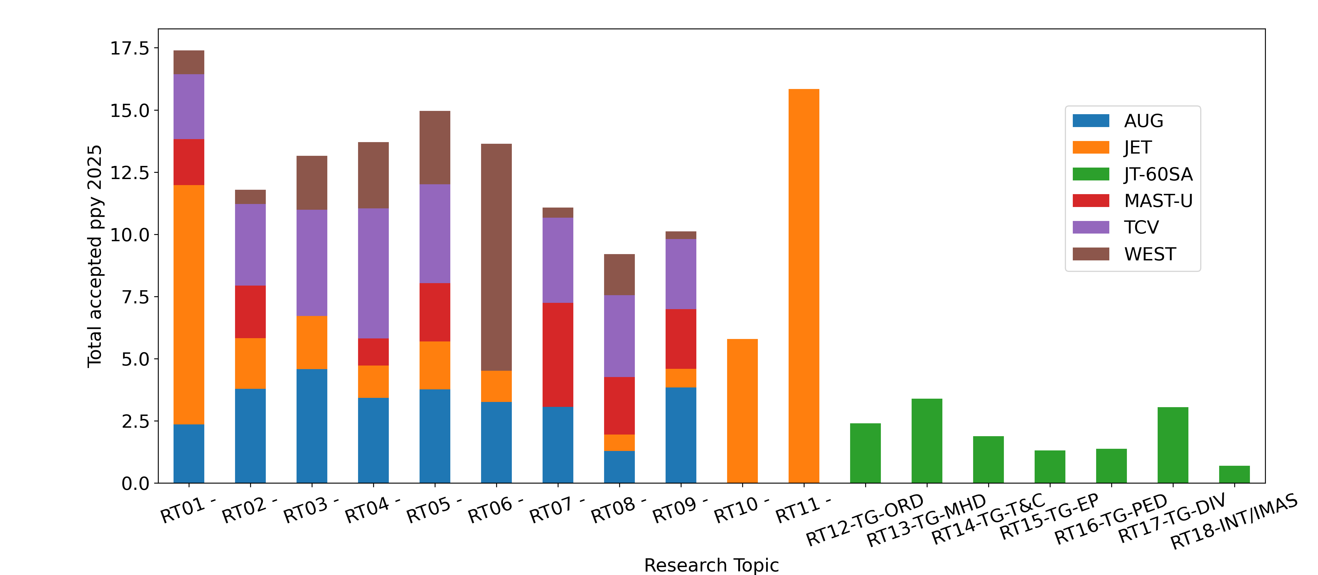
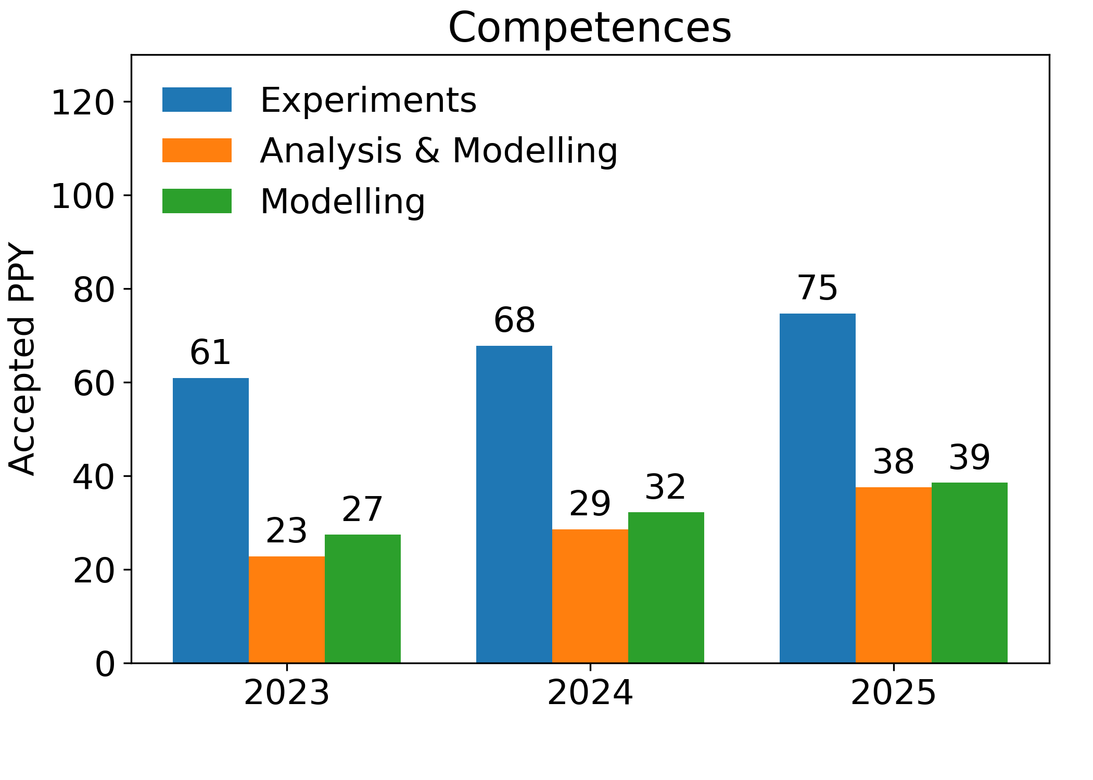
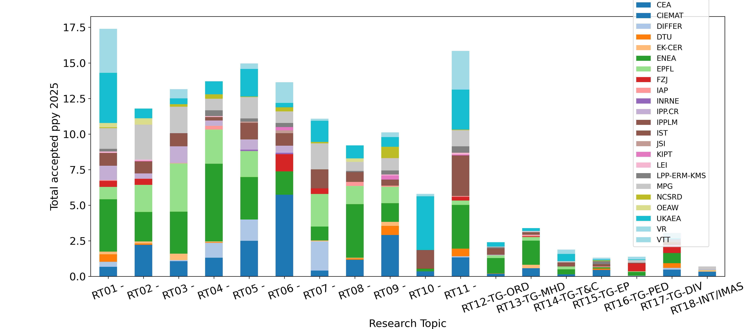
Resource distribution & Missions
Continuous increase of resources distributed to all beneficiaries throughout the year
Increasing effort on A&M throughout the year

Slide 6
Results Highlight

Slide 7
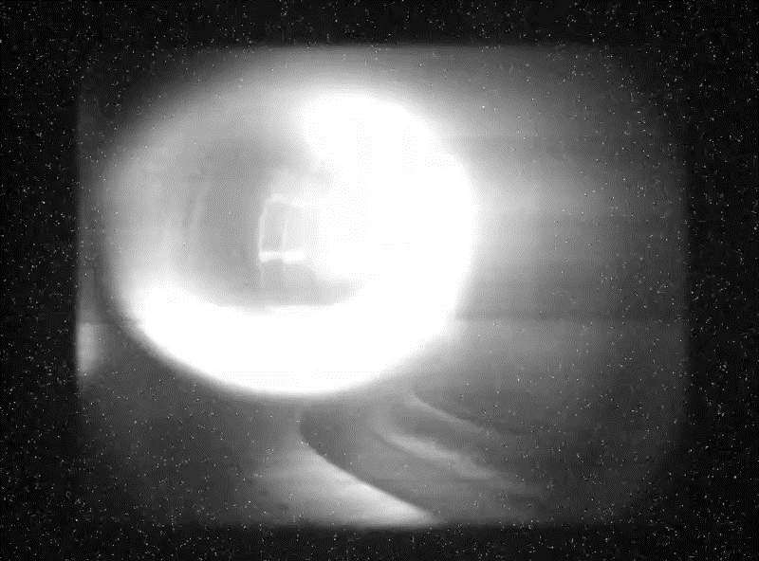
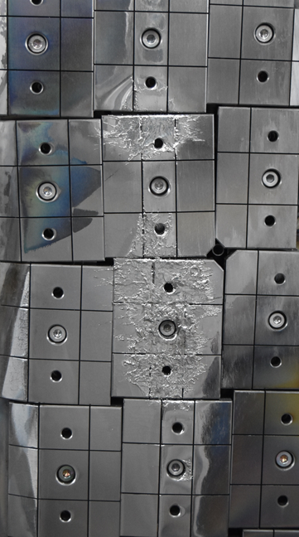
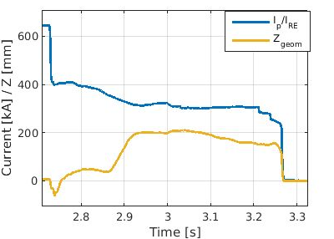
Controlled W damage experiments on WEST (RT03+RT06)
Impact duration, debris → Fast cameras (IR, visible)
RE beam energy distribution and pitch angle → Spectroscopic measurements (synchrotron)
Deposited energy → Embedded thermocouples, IR
REs crash on the inner bumper for ~3 ms (from fast visible camera)
Tile 4
disruption
Impact @ 230 kA
RE beam
Tile 5
midplane
Controlled Z movement
Tile 6
April 2025
RE impact above midplane (between T4 & T5)
RE impact below midplane (T6)
Tile 7
7

Slide 8
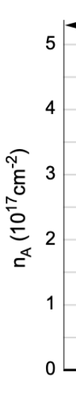
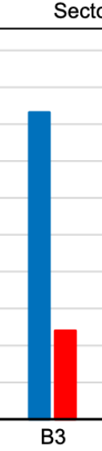
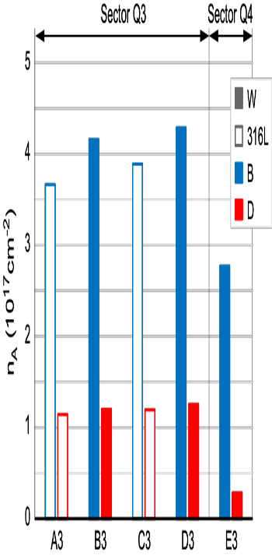
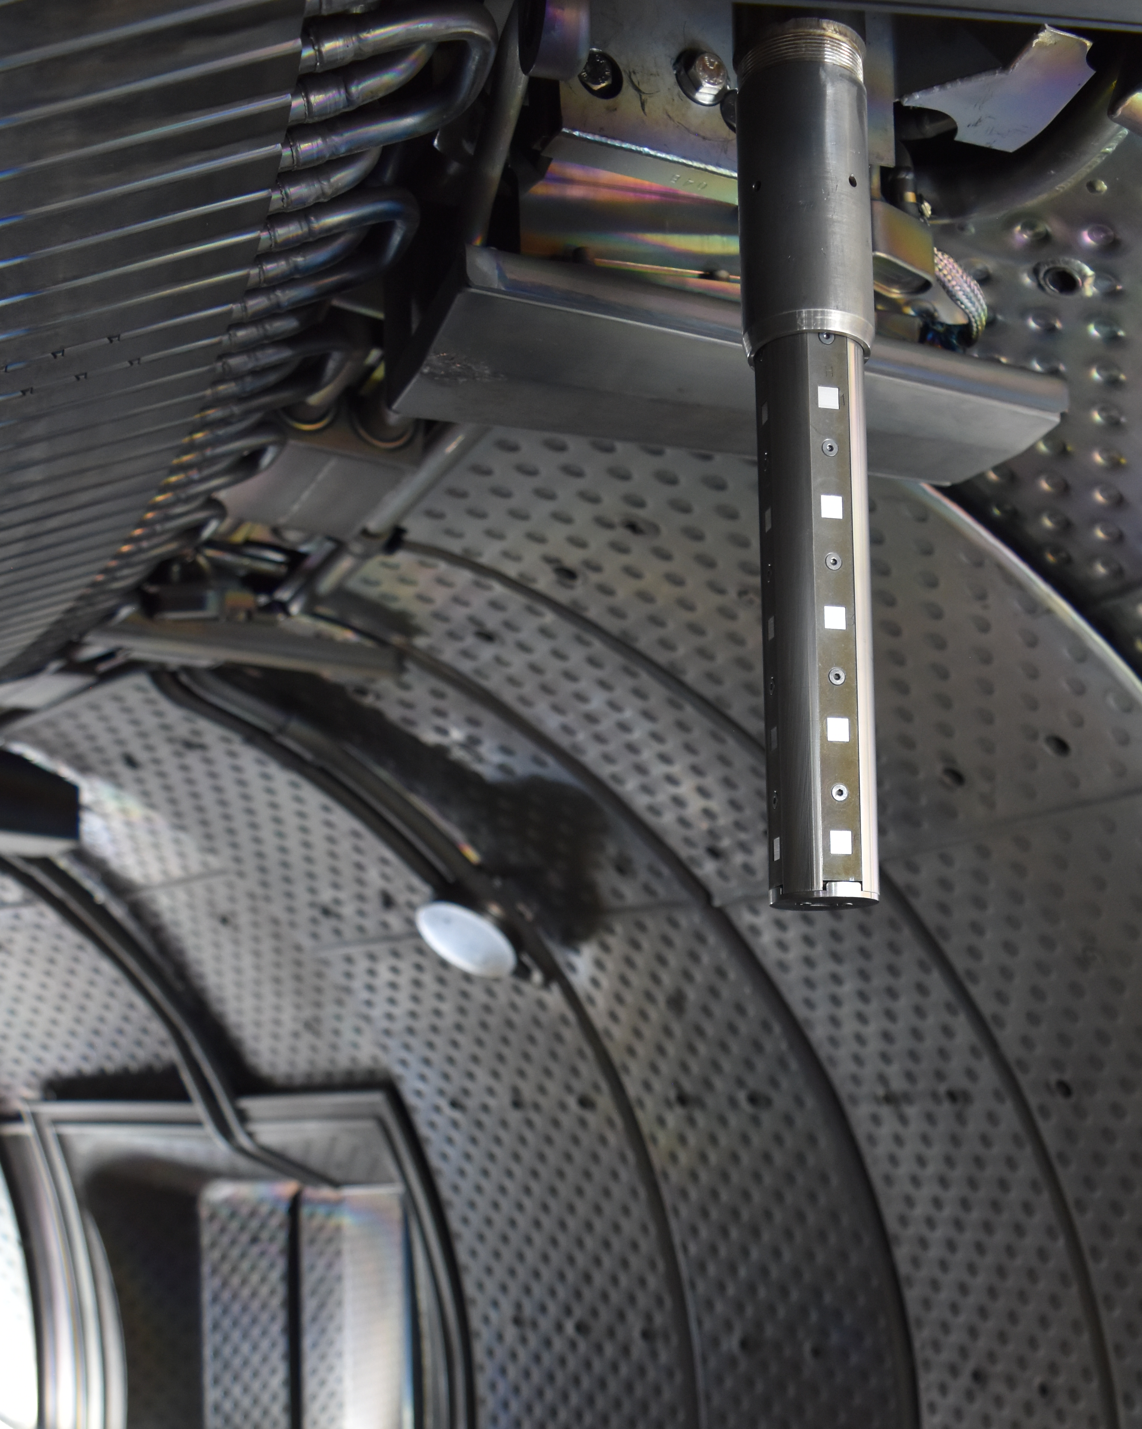
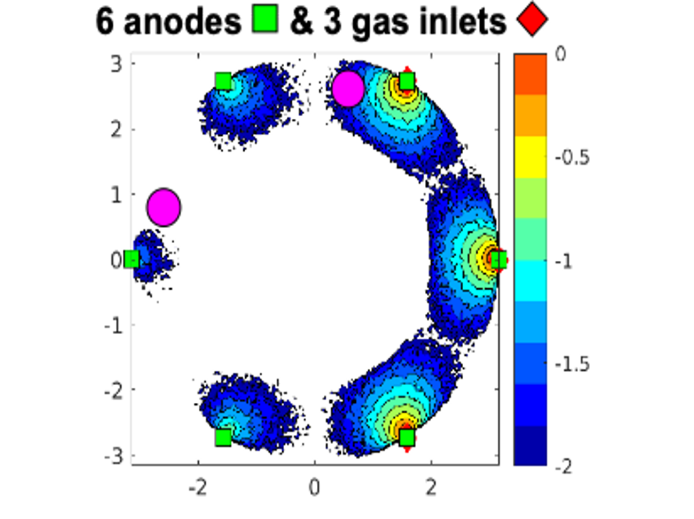
WP TE metallic devices used for R&D in support to the ITER W first wall
ITER SRO plans non-uniform boronization → tested in WEST and AUG
Plasma restart after a vent w/o boronization : challenging in both AUG and WEST, while start-up dramatically improved after non-uniform boronization (RT04)
Diborane dissociation / ionisation map for non uniform GDB in WEST
Q3 close to injection
Q4 away from injection
Samples probe in WEST
(TE Enhancement)
Q3 Probe
Q4
probe
T. Wauters (IO), NME 2025
B deposition lower away from injection points, but less asymmetry than predicted in preliminary modelling ➔ new insight for improving boronisation modelling for ITER (RT06)
P. Manas, EPS 2025, K. Krieger et al., AAPPS-DPP 2025, J. Bucalossi, FEC 2025, T. Puetterich, FEC 2025, J. Hobirk, FEC 2025, E. Geulin, FEC 2025

Slide 9
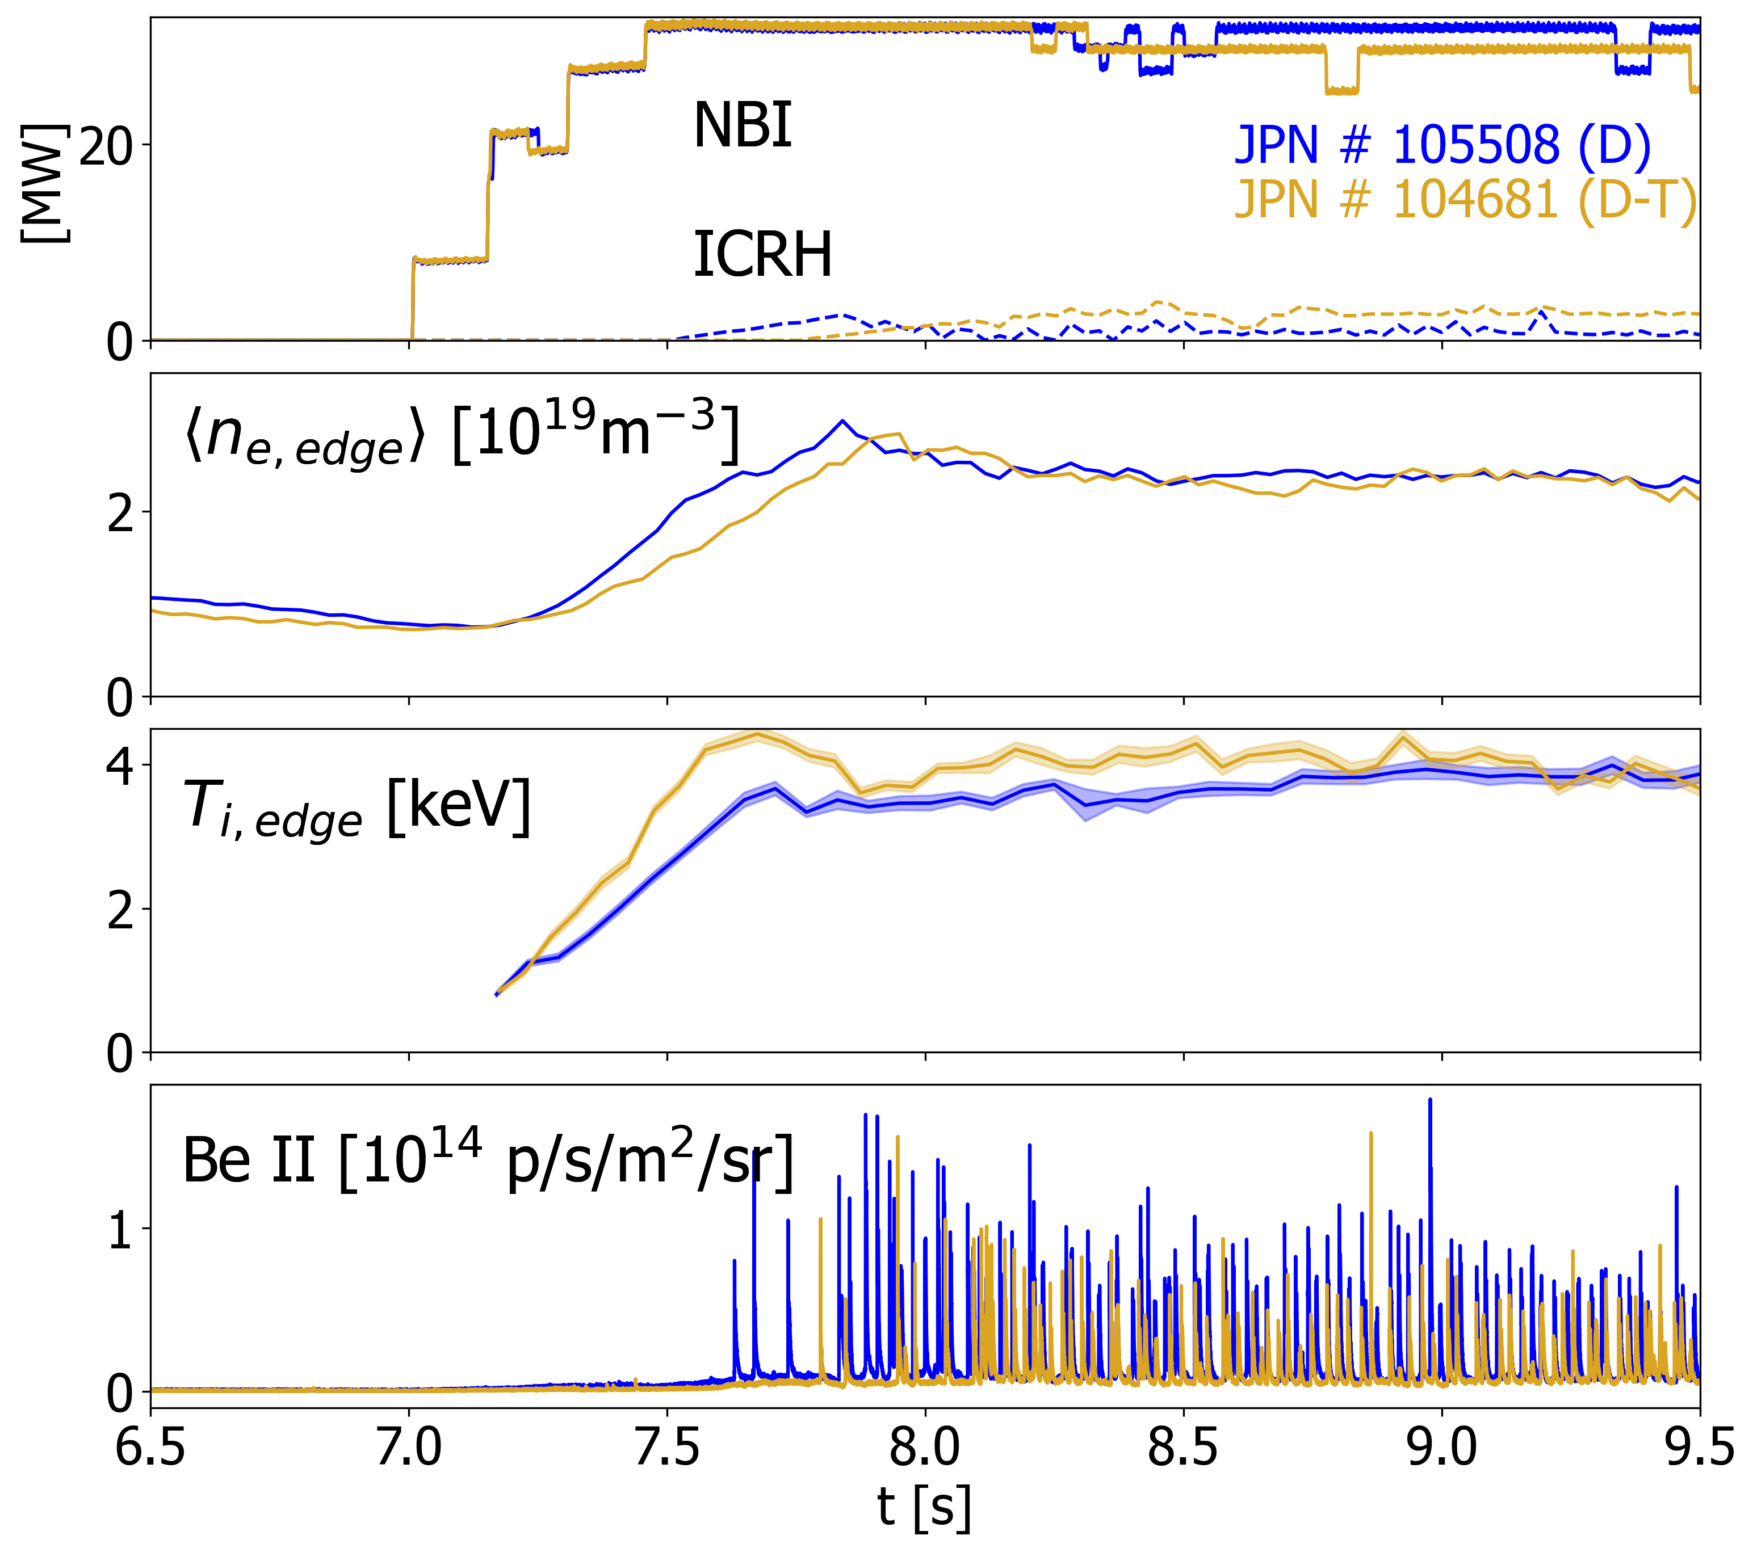
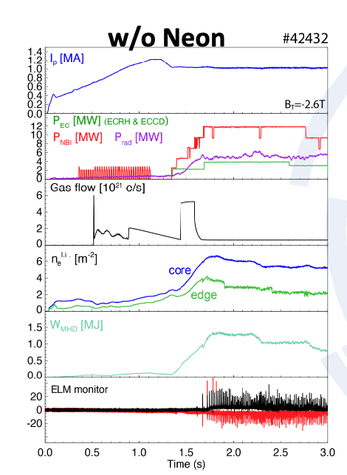
Operation with low W concentration and W screening
Progresses on analysis of W screening on JET optimized discharges (D. King, IAEA FEC and PPCF submitted)
NC computation via FACIT Code (D. Fajardo PPCF 2023) unable to reproduce the observed experimental screening (A. R. Field, submitted to NF): collisions with mid-Z impurities not accounted for? non-local effects? increased SOL screening?
𝑇_{𝑖}^{𝑝𝑒𝑑} ~2𝑘𝑒𝑉
𝑇_{𝑖}^{𝑐𝑜𝑟𝑒}~9𝑘𝑒𝑉
𝑛_{𝑒}^{𝑝𝑒𝑑}~4𝑒19𝑚⁻³
𝑛_{𝑒}^{𝑐𝑜𝑟𝑒}~9𝑒19𝑚⁻³
Scenario with high performance and high Ti achieved on AUG as well
Radiation at the impurity mantle is reduced in the high performance phase
Transport analysis (FACIT) → temperature screening(outward convection) of tungsten inside the pedestal top
Notes:
Thanks to these amelioration improved conditions for W screening achieved, with the remarkable 4 keV ion temperature pedestal achieved. Bolometry measurements confirmed a stronger W screening but FACIT code, applied to these scenarios, failed to reproduce the observed experimental screening: possible explanation being collisions with other mid-Z impurities not accounted for in the code, non-local effects or possibly increased SOL screening

Slide 10
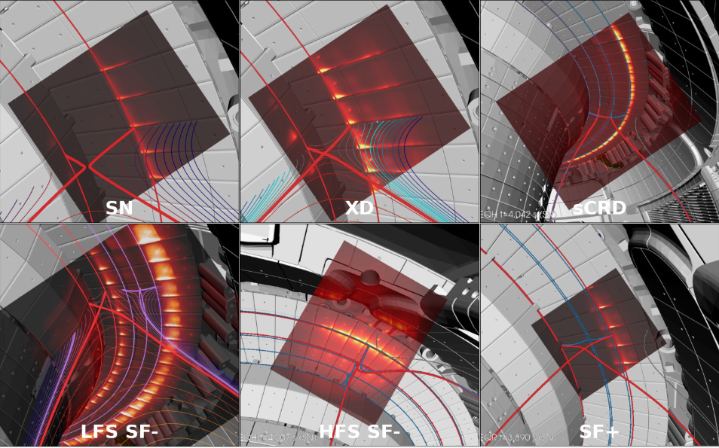
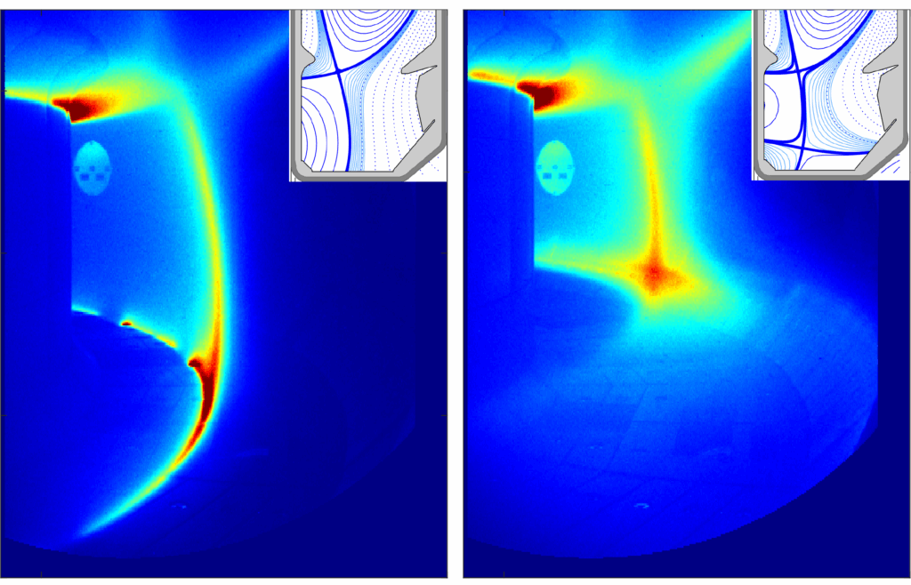
RT07-2025 Highlights
All ADC configuration achieved on AUG and exploration extended to power levels >20 MW
MAST-U: several results from super-X investigations published, both from physics and control aspects [2, 3]
[1] K. Lee et al., Phys. Rev. Lett 134 (2025) 185102; https://doi.org/10.1103/PhysRevLett.134.185102
[2] K. Verhaegh et al., Comm. Phys. 8 (2025) 215, https://doi.org/10.1038/s42005-025-02121-1
[3] B. Kool et al., Nature Energy, https://doi.org/10.21203/rs.3.rs-5059325/v1
TCV: a new alternative divertor configuration (ADC) called X-Point Target Radiator (XPTR) introduced and successfully demonstrated [1]

Slide 11
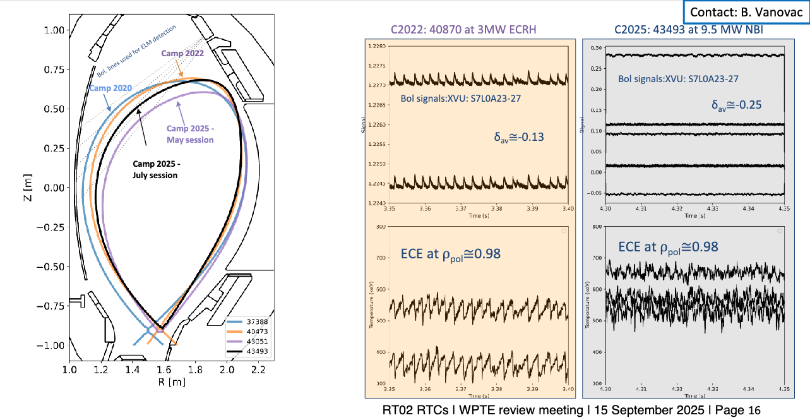
NT studies: Dithering behavior of NT edge in stronger shaping

Slide 12
TE Enhancements Questionnaire - Analysis
Monitored directly by PMU
TE Enhancements Questionnaire - Procedure
The PIs are to complete a status review process which is to be requested 3 times a year – 15 January, 15 May, 15 September
Questions focus on design (Q1), installation (Q2), plasma commissioning (Q3), deliverables/milestones (Q4), reporting (Q5), human resources (Q6), procurement (Q7), missions (Q8). Answers uses traffic light based replies
.
TE Enhancements Questionnaire – Outcome at 15 September 2025
The assessment is that currently most of the projects are not suffering from major delays but a small number requires special attention.

Slide 13
On track | Delays w/o significant impact on agreed deadline | Delays with impact on agreed deadline | Significant delay but project to be ended by 2027
Project | Status
Direct Digital Synthesis for the O-mode Profile Reflectometer at ASDEX Upgrade
Runaway electron mitigation and velocity analysis by magnetic-ripple manipulation [at TCV] | To be completed in 2025
LIBS4FUSION: in-vessel fuel Inventory and deposited layers composition in a full tungsten device | To be completed in 2026
ONCOMING-Optimized taNgentially spaCe resOlved geM ImagiNG [at MAST-U] | To be completed in 2025
Upgrade of the TCV ECRH high voltage power supply | Stopped by end of 2025
High DEfinition Visible Endoscope for WEST | Stopped by end of 2025
Neutron Detectors suite for 14 MeV neutron triton burnup and 2.5 MeV neutron spectroscopy measurements at MAST Upgrade
New 100-Hz Laser for the TCV Thomson Scattering System | Delay < 6 months
Real-time control system for ELM buffering at ASDEX Upgrade
Collective Thomson Scattering (CTS) diagnostic for TCV | Stopped by end of 2025
IRBO IR Bolometry for WEST | To be completed in 2026
Tungsten impurity monitoring and control at the COMPASS-U tokamak
Characterisation of advanced confinement modes at COMPASS-U
Upgrade of the TCV LHPI antenna | End in 2026
FIRE&GO - Fast Ion Research Enhancements and Gamma-ray Observations [at ASDEX]
Real-time spectroscopy at ASDEX Upgrade | Stopped by end of 2025
Ultra-fast-swept profile reflectometer on AUG
PFCs and diagnostics for power exhaust studies at COMPASS-U | Slight delay to Q1 2026
Implementation of the 4th dual-frequency gyrotron for TCV
Runaway Electron Mitigation Coil for TCV
Boronization Probes for WEST | Installation now scheduled end of 2026
Fast Ion Loss Detector in WEST | Delays ~ 3 months
A RETARDING FIELD ANALYZER FOR ION TEMPERATURE MEASUREMENTS IN THE SOL OF WEST

Slide 14
International collaborations
Collaboration with KSTAR
Scientific annexes of agreement between EUROfusion and KSTAR finalized by WP TE and KO counterparts
6 areas identified for collaboration :
Establishment of physics and operational understanding of long discharges in W environment at relevant plasma current and collisionality
Sustainability of no-ELM scenario in long pulses
Investigation of stable operation of long pulses in detached divertor conditions
Demonstration of integrated RMP control of long pulse H-mode high beta-N plasmas
Exploration of disruption & runaway electron mitigation and avoidance in long pulses
Implementation of wall monitoring and Plasma Facing Components characterization
Agreement now being finalized by PMU for signature between KO and 3 EU Beneficiairies (CEA, ENEA and VTT). More interested ?
Experimental proposals from CEA and ENEA submitted to KSTAR call for proposals 2025-2026

Slide 15
AI projects to be completed by end of 2025
# | Project Title | PI | Beneficiary
ENEA-03 | AI-assisted Causality Detection and Modelling of Plasma Instabilities for Tokamak Disruption Prediction and Control | R. Rossi | ENEA
ENEA-04 | Development of Physics Informed Neural Networks (PINNs) for Modelling and Prediction of Data in the Form of Time Series | M. Gelfusa | ENEA
IST-01 | Deep Learning for Spectrogram Analysis of Reflectometry Data | J. Vicente | IST
Reported in TFM https://wiki.euro-fusion.org/wiki/WPTE_wikipages:_Meetings:_Meetings2025#TE_Task_Force_Meeting_09th_June_2025
No major delays indicated on the agreed deliverables
Not all the project yet at level of maturity for being deployed to larger community but good progresses reported

Slide 16
Grant Deliverables 2025
"Title" in Sygma | Title in CWP | Initial due Date | Expected deliverable date
TE.D.09 | Establishment and comparison of N and Ne-seeded partially-detached divertor in high-power operations in view of ITER radiative scenario. | Dec 2023 | Dec 2025 | On track
TE.D.12 | The physics basis for the decision for an alternative divertor configuration for DEMO. | Dec. 2024 | Dec 2025 | On track
TE.D.13 | Recommendation on the seeding impurity mix in view of a future reactor. | Dec. 2024 | Dec 2025 | On track

Slide 17
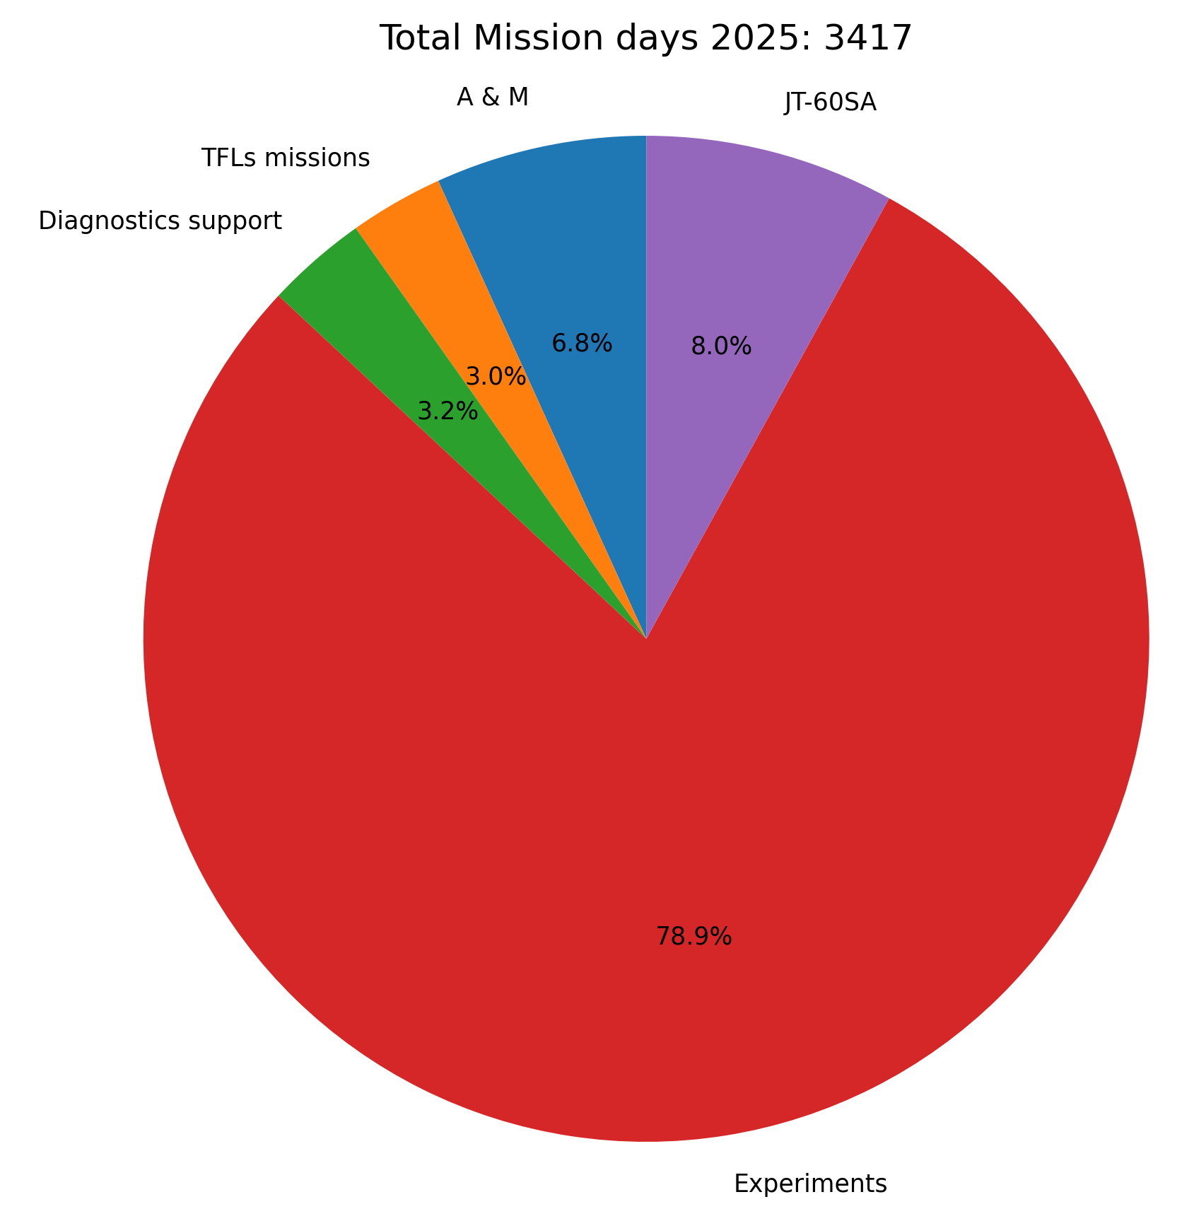
Topping up WP TE mission budget
As planned in WP TE 2025 provisional budget, additional resources required for missions (campaign participation in EU devices, A&M meetings in EU and JA, TSVV code training ...)
In order to do so, transfer of 120 kEuros CC cost to mission budget from :
Unused 2025 secondment budget : 70 kEuros CC cost, July 2025
Unused INCO TE funds : 30 kEuros CC cost, October 2025
Part of what we have kept under TE-2 (campaign participation) for that purpose : 20 kEuros CC cost, October 2025
Fine tuning of left INCO / TE-2 transfer vs mission budget towards the end of 2025 (expected to be < 50 kEuros CC cost)

Slide 18
Conclusions
WPTE program has run reliably over 2025
All FP9 TE Grant deliverables near completion (10/13 GD completed, 3 last GD on track for 2025)
WP TE devices have run reliably and have compensated on following campaigns in case of delay (cf AUG and WEST)
Large number of TE multi machine publications in major fusion conferences (see for instance IAEA FEC 2025 with 2 machine overviews (JET, JT-60SA) and several orals)
WPTE program demonstrated the capabilities to deliver consistently the objectives and properly use the available resources over FP9
It provides the framework for establishing a strong pan-European scientific team, allowing consistent multi machine scientific exploitation and enabling access to EU tokamaks for all European beneficiaries

