Slide 1
Work Packages Plans for 2026-27:
Work Package Tokamak Exploitation (WP TE)
PSD Project Board # 07
E. Tsitrone and N. Vianello for TE TFL
E. Tsitrone, N. Vianello, M. Baruzzo, A. Hakola, V. Igochine, D. Keeling, B. Labit

Slide 2
WP TE budget for 26-27 updated since last PB
Numbers to be checked by Admin
* Missions 2025 underestimated, ** secondment : for JET/JT-60SA, not shown here, *** AR not accounted for **** committment from FP8 > 3 Mio
Machine operation ~ back to nominal 40% level for 2026, lower % in 2027 (could be adjusted pending on budget availability)
Campaign participation increased to more manageable level (but decreased compared to 2025)
Mission budget still an issue
Management of PrIO database should now be under DSD
No support available yet for the scientific exploitation of JT-60SA (cf PCR)
MAST-U fraction expected at same level as 2025 (~22 %), tbc

Slide 3
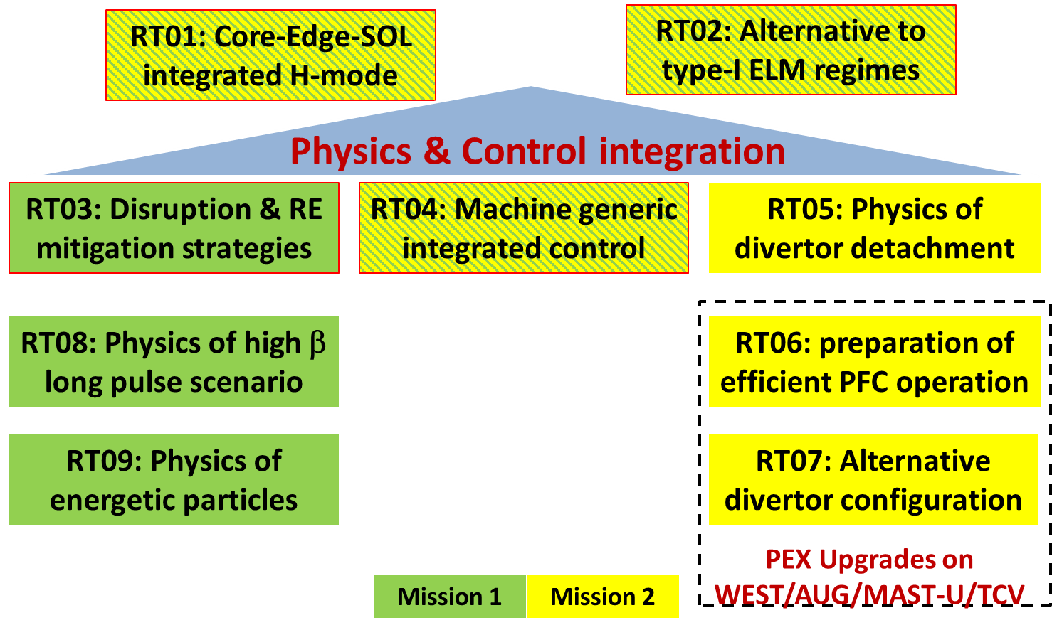
Strongly streamlined programme for WP TE in 26-27
High level objectives for 26-27
Address urgent R&D issues related to the new ITER baseline / Research Plan (full tungsten wall) : far SOL physics and wall loads; tungsten sources, transport and screening; startup on tungsten limiters; runaways damage of tungsten first wall components and efficiency of boronisation in full tungsten devices.
Provide a full qualification of the most promising no ELM scenario, focusing on X-point radiator (XPR) and quasi-continuous exhaust (QCE) now considered as a viable option for ITER / DEMO.
Support modelling efforts for interpretation of available data from TE devices (including JET DD and DT last campaigns)
Prepare the JT-60SA scientific exploitation in the OP2 and OP3 campaigns, pending resources becoming available.
Same structure retained for WP TE in 26-27
9 “programmatic” Research Topics (RT01 to RT09)
2 Research Topics dedicated to JET (RT10 for data validation, RT11 for analysis of JET campaigns performed before 2022 and related work)
8 Research Topics (RT12 to RT18) mapping the existing Topical Groups of the JT-60SA EU-JA Experimental Team.

Slide 4
Selected scientific objectives updated for 26-27
Scientific objectives of RT03 (dispruption & runaway) and RT04 (control) updated to account for progress achieved + minor amendment to others RT
New numbering in AWP 26-27 to avoid confusion with previous version
RT03
RT04
Correspondence between the new objectives for 2026-2027 and the original objectives for 2021-2025, including the attribution of SSRL starting level when applicable available upon request (WP TE wiki)

Slide 5
List of Grant Deliverables 2026-2027
ID | Deliverables Table | Date
TE.D.16 | Report on fully integrated simulation of high current partially detached plasma scenario including assessment of PFC erosion in D and DT plasma | Dec 2026
TE.D.17 | Report on reduced model validation for plasma reattachment on multiple devices and wide operational space | Dec 2026
TE.D.18 | Report on providing input on design and operation of conditioning systems for next step full W devices and focus on standard boronization systems | Dec 2026
TE.D.19 | Report on qualification with experiment/modelling of the most promising no-ELM scenario in terms of confinement, exhaust capabilities and plasma wall interaction | Dec 2027
TE.D.20 | Report on optimized scheme for “benign termination” of runaway beams documented in view of possible applicability for ITER | Dec 2027
List of Milestones 2026-2027
ID | Milestones Table | Date
TE.M.09 | Proper figure of merit for cross-scenario comparison among no-ELM / ADC defined | Dec 2026
TE.M.10 | First wall particle and heat fluxes quantified in XPR in metallic devices | Dec 2026
TE.M.11 | ADCs characterized in H-mode conditions in all relevant TE devices | Dec 2026
TE.M.12 | Modelling of SPI experiment on JET and ASDEX-Upgrade completed | Dec 2027
TE.M.13 | Impact of N-NBI on plasma behaviour documented in JT-60SA and extrapolation to ITER investigated* | Dec 2027
* Pending resources are made available for JT-60SA related work

Slide 6
Machine availability for 2026-2027
Tentative timeline for TE devices in 26-27
AUG and WEST running in usual ~ 6 / 3 months campaigns mode respectively
TCV running in ~ continuous mode but longer shutdown foreseen to install Tightly Baffled Long Leg Divertor (TBLLD)
MAST-U only available for 4 months early 2026
PEX enhancements now fully available (upper divertor in AUG, ITER grade divertor in WEST) + further upgrades (cryopump in MAST-U, ECRH in WEST and TCV + TE ENH diags)
JT-60SA
call for experimental proposals
call for participation
[BASC-34, December 2024]
Timeline for JT-60SA to be updated following BASC in December : delays expected for OP2

Slide 7
Call cycle of WP TE
Call for Proposal 2026-2027
September 2025 (included call for RTC) Deadline 10th of October
Call for participation 2026
November 2025 31/10-05/12 (Tentative)
Proposal assessment in IMS
Resources loaded by December 2025
Review meeting
September 2025 (RT01-RT11)
GPM
4-6/11/2025 in Lausanne Hybrid meeting
October 2025 (JT-60SA)
Call for experimental proposals for AUG/TCV/WEST/MAST-U for 2026-2027
Call for Research Topic Coordinators
To summarize the achievements of experimental campaigns in 2025, as well as planned ones. Include information on on-going modelling activites
Will include work in support of scientific exploitation of AUG/MAST-U/TCV/WEST/JET + JT-60SA OP1 analysis / modelling for preparation of OP2 / W transition (pending budget availability) but NOT participation to OP2
Will include dedicated session to discuss EU proposals to OP2

Slide 8
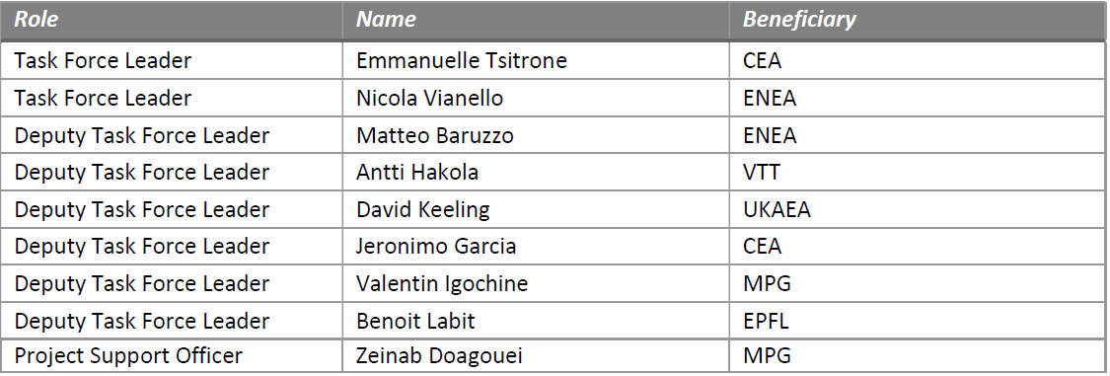
WP TE management team being set up for 26-27
Selection of DTFL ongoing
Selection ongoing
(EU ETL for JT-60SA)
Process under discussion
Team of Research Topic Coordinators (RTC) selected for 26-27 (present status)
New RTC for 26-27

Slide 9
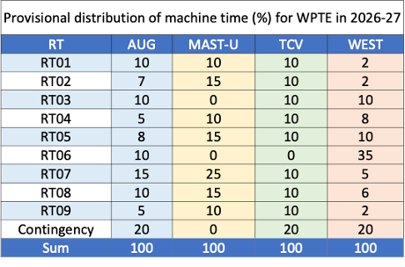
Overview of experimental proposals received for 26-27
Call for proposals : WP TE scientific objectives + reference documents on ITER new baseline and R&D priorities + indicative distribution of machine time provided to Beneficiaries
> 200 proposals received, distributed over TE devices / RT
Prioritization from WP TE TFL being finalized
To be discussed with the community next week at General Planning Meeting
* Taking into account 20% contingency, to be refined once consolidated shot allocation available from MR

Slide 10
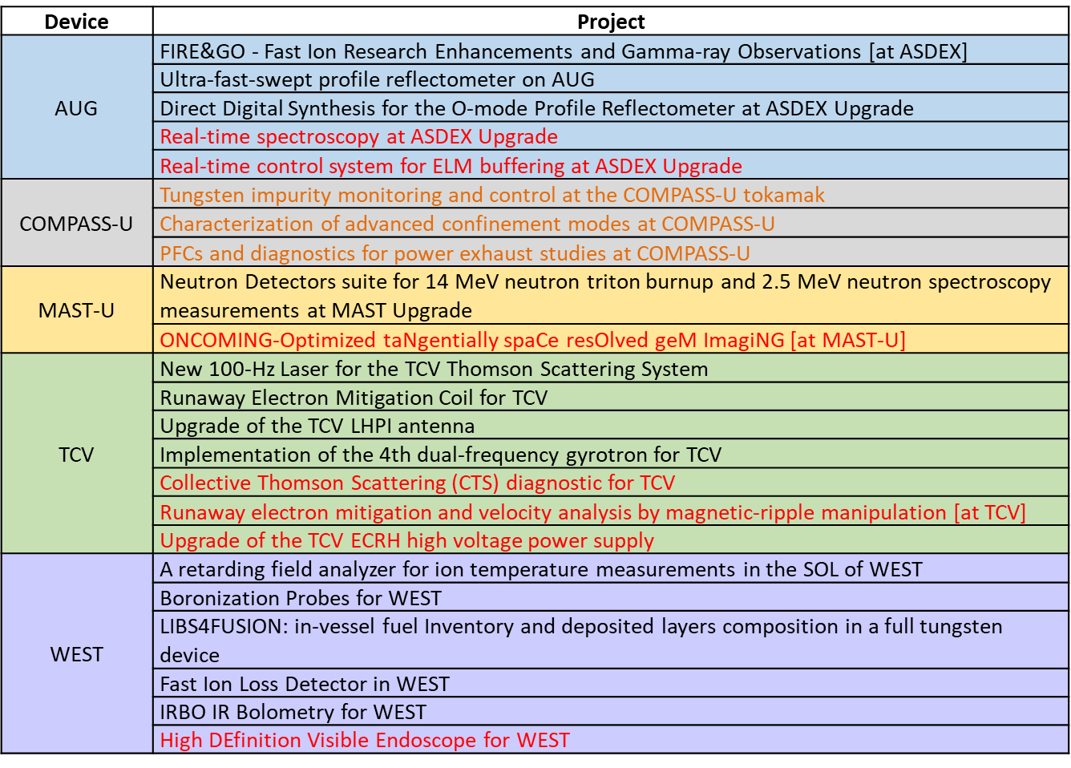
TE enhancements supported in 26-27 (managed by PFU)
TE enhancements launched in 2024, targeted at short lead items (2027 at the latest) : highest priority diagnostics supported in 26-27 (TE ranking)
COMPASS-U projects : cut of the budget across all 3 projects.
PMU has discussed with Beneficiaries involved in canceled projects
Red : no support in 2026-2027
Orange (COMPASS-U) : support reduced in 2026-2027

Slide 11
International collaborations
INCO support to missions to international devices in area where they can complement EU devices :
US : « no ELM / small ELM » collaboration
KSTAR : participation to 2026 campaign in areas identified in the collaboration agreement on « long pulse in W environment » then shutdown to install new W first wall
EAST : discussion ongoing on experiments for preparation of the BEST programme

