Slide 1
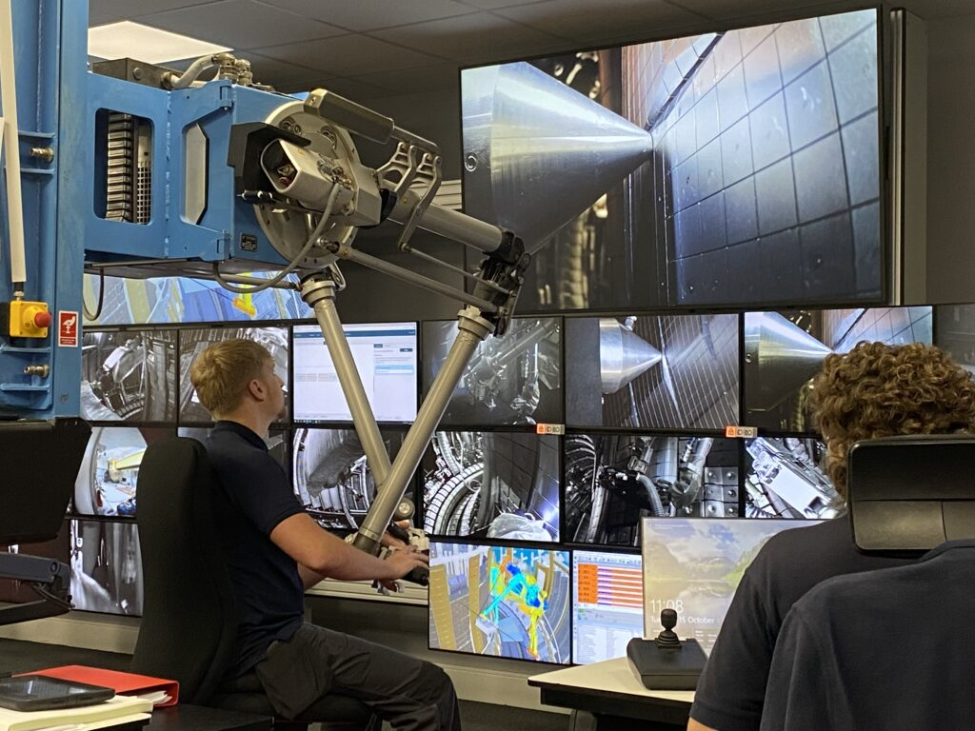


Progress in analysis of the JET LIBS data
PWIE, Juelich
Rongxing Yi et al.
Forschungszentrum Jülich GmbH, Institute of Fusion Energy
and Nuclear Waste Management – Plasma Physics,
Partner of the Trilateral Euregio Cluster (TEC), 52425 Jülich, Germany

Slide 2
Outline
Background
In-vessel LIBS applications at JET
First results of JET-LIBS
Results in the LID-QMS region(Module 14)
Outlooks and Conclusions

Slide 3

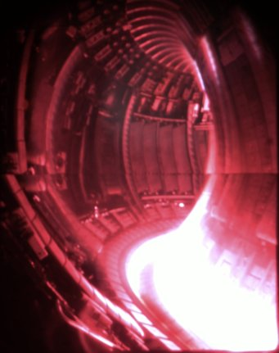
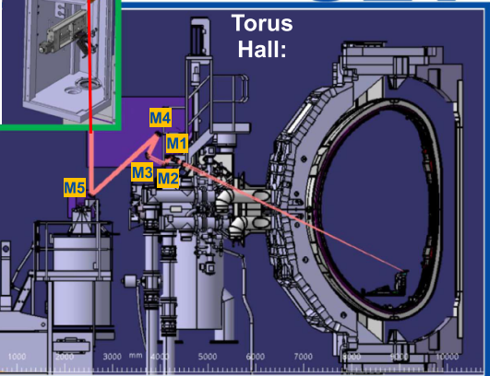
Background
Problem: Hydrogen isotope retention + erosion and co-deposition of wall material
D-T 3
JET-LID-QMS
Specific area
Fuel (high sensitive and quantitative)
JET-LIBS
Global
Fuel and PFM (low sensitive and quantitative in progress)

Slide 4
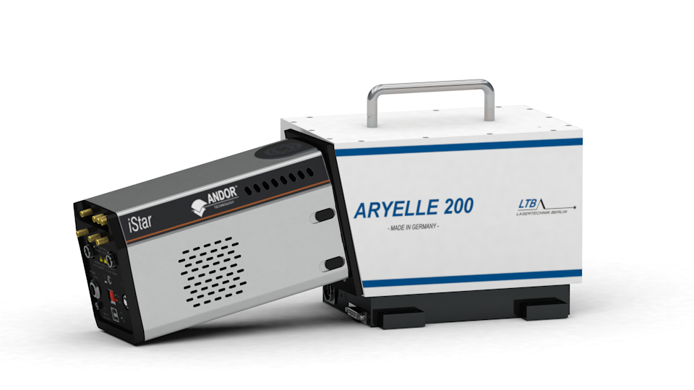
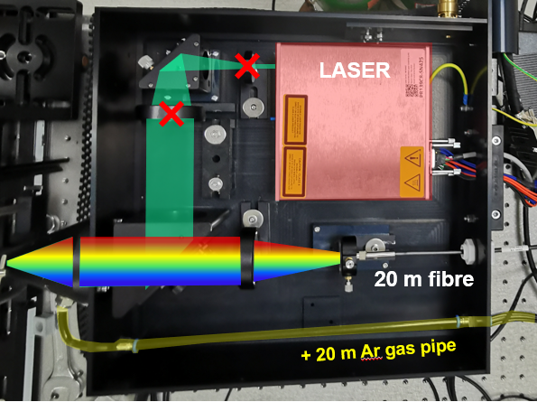
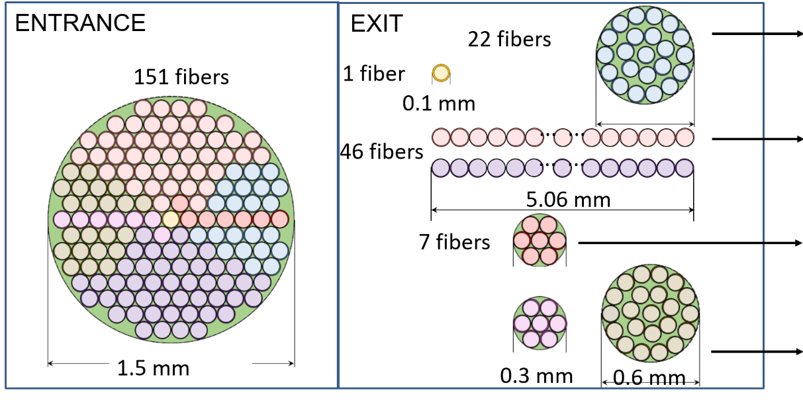
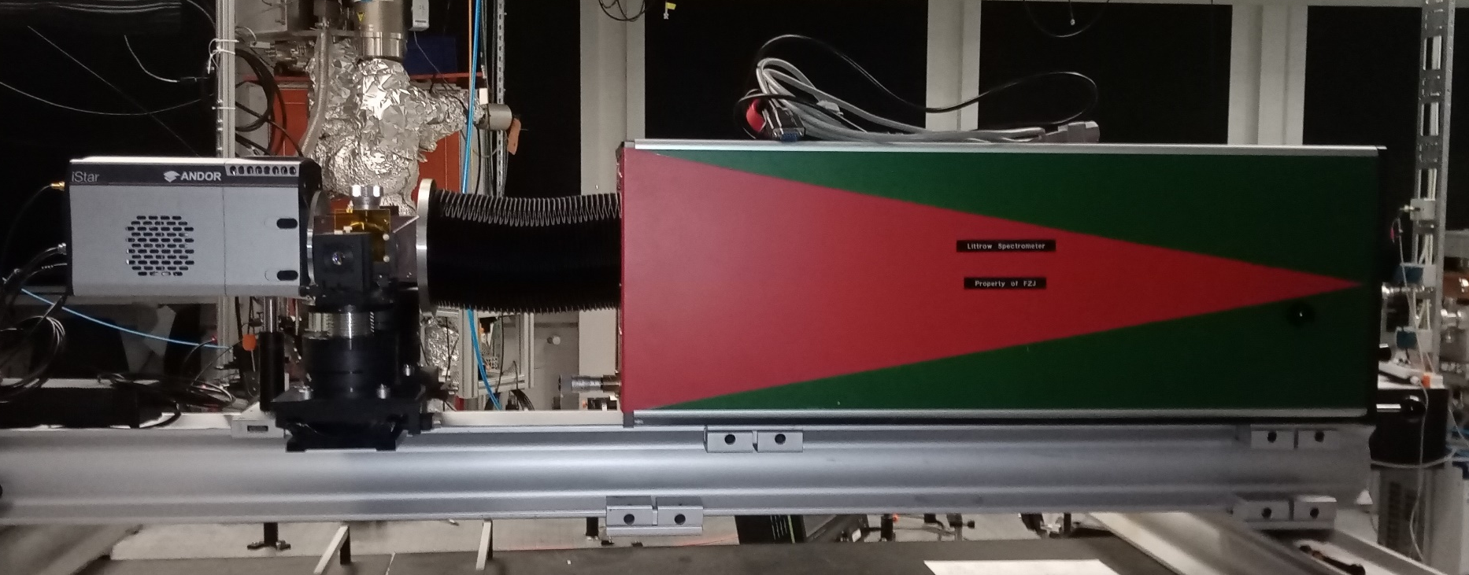
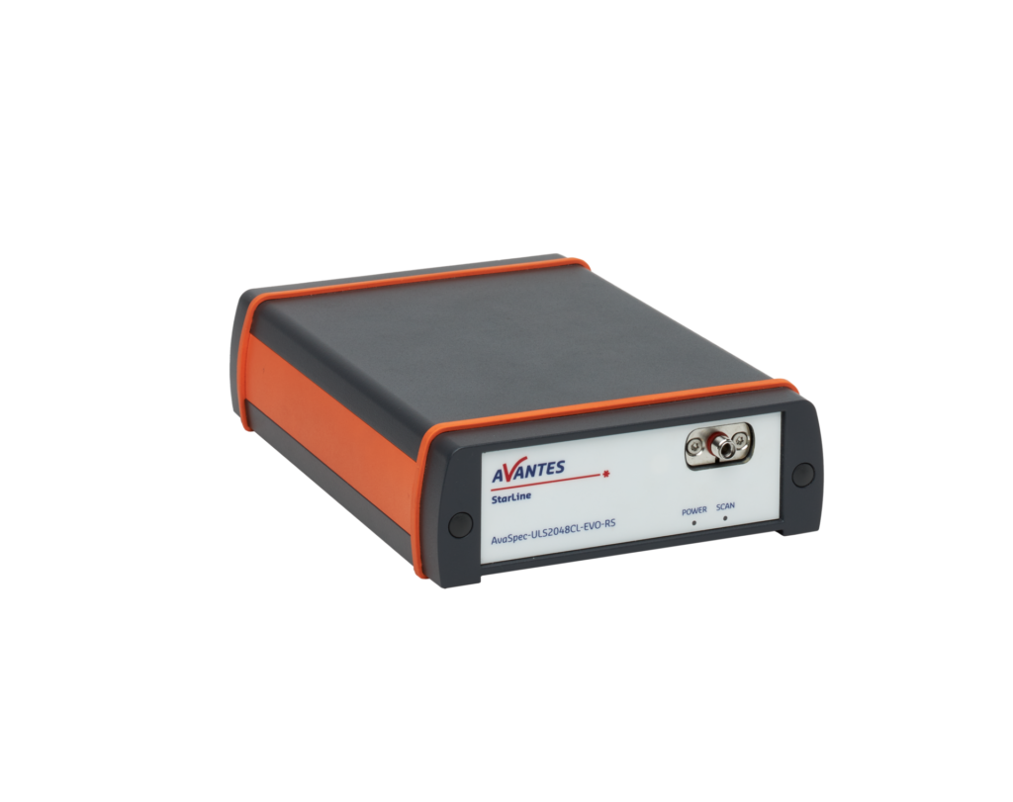
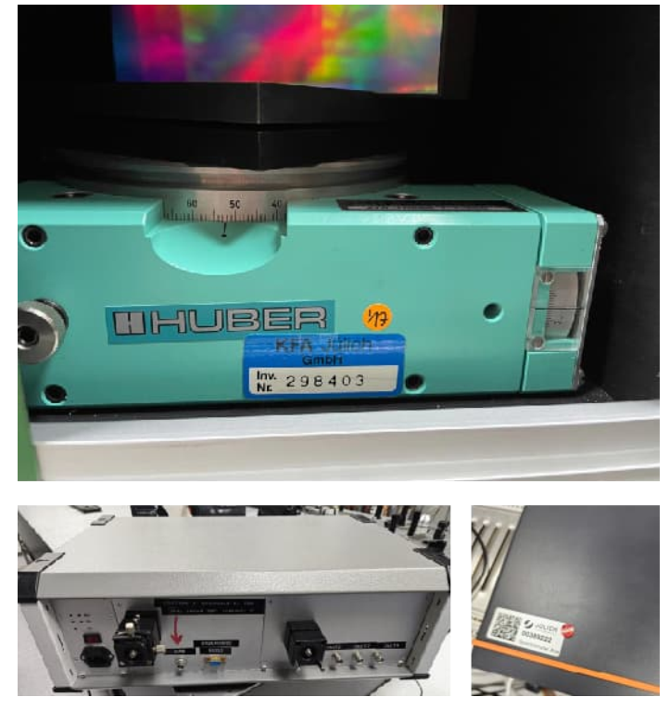
In-vessel LIBS applications at JET
JET-LIBS setup
Laser box
Fiber bundle
4 spectrometers
Optics Table
1
1
2
3
4
2
1. Echelle : F#10,resolution~70pm, 200-750 nm- T calculation
2.Littrow spectrometer: F#~4,resolution~30 pm(slit 100um), wavelength range 4 nm- Hα detection
3
3. Compact C-T spectrometer: resolution 0.5 nm, 300-1100 nm- Layer information
4. PMT :monochromator +3 different filters- Hα detection
4

Slide 5
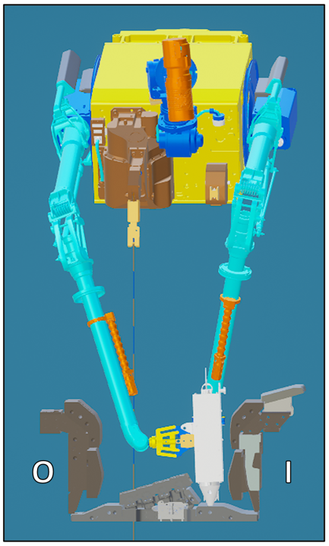
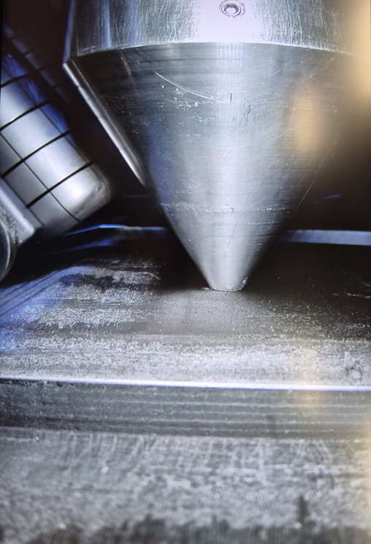
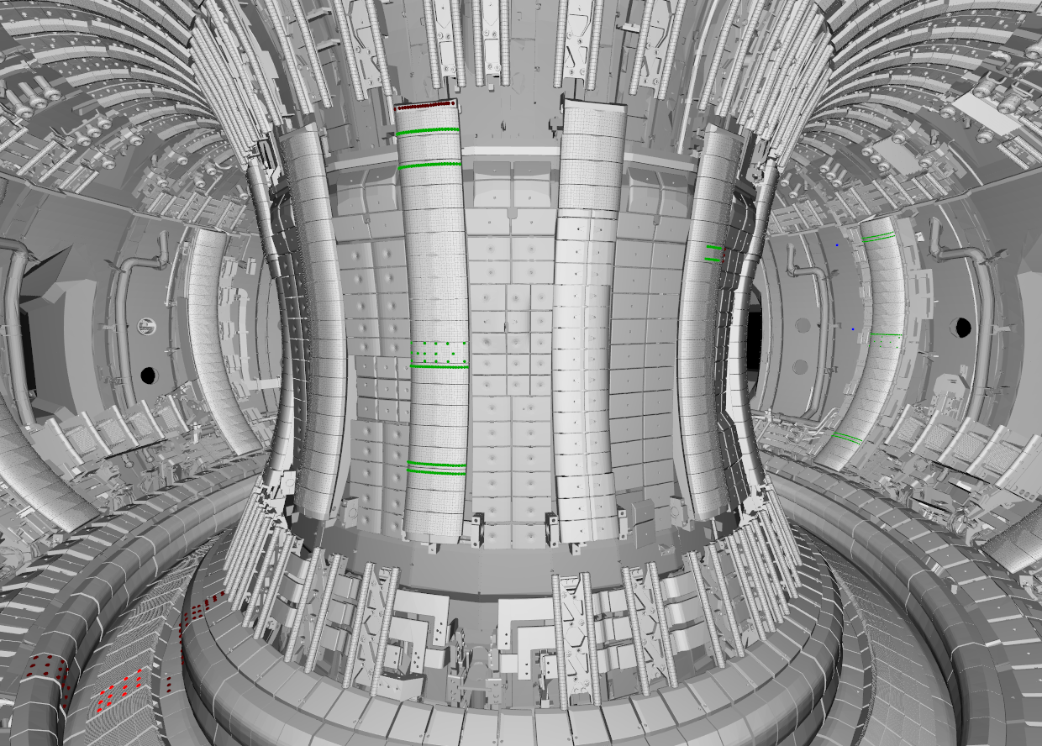
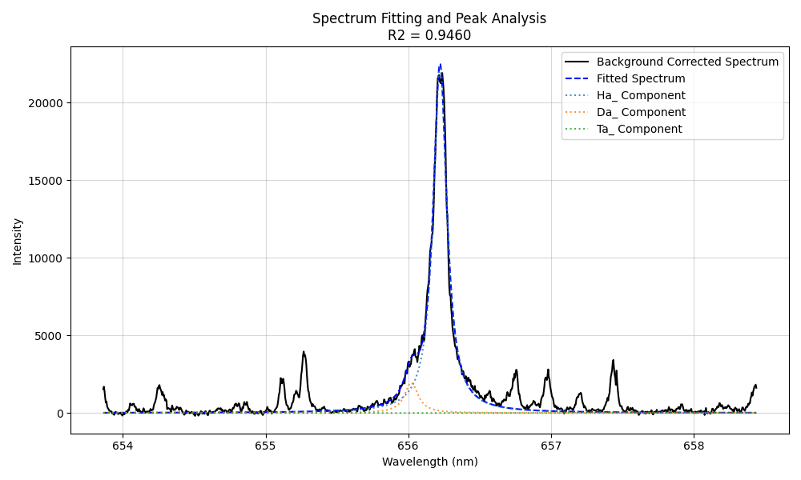
In-situ LIBS applications at JET
JET-LIBS setup with remote handling arm
MASCOT
Optics Table
Comprehensive detection capability in Vessel
H
JET-LIBS setup
W
D
W

Slide 6
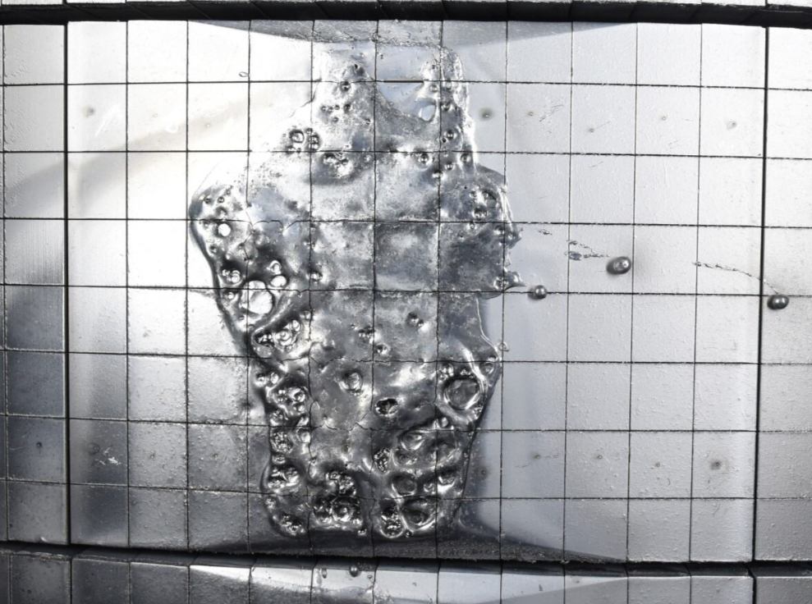
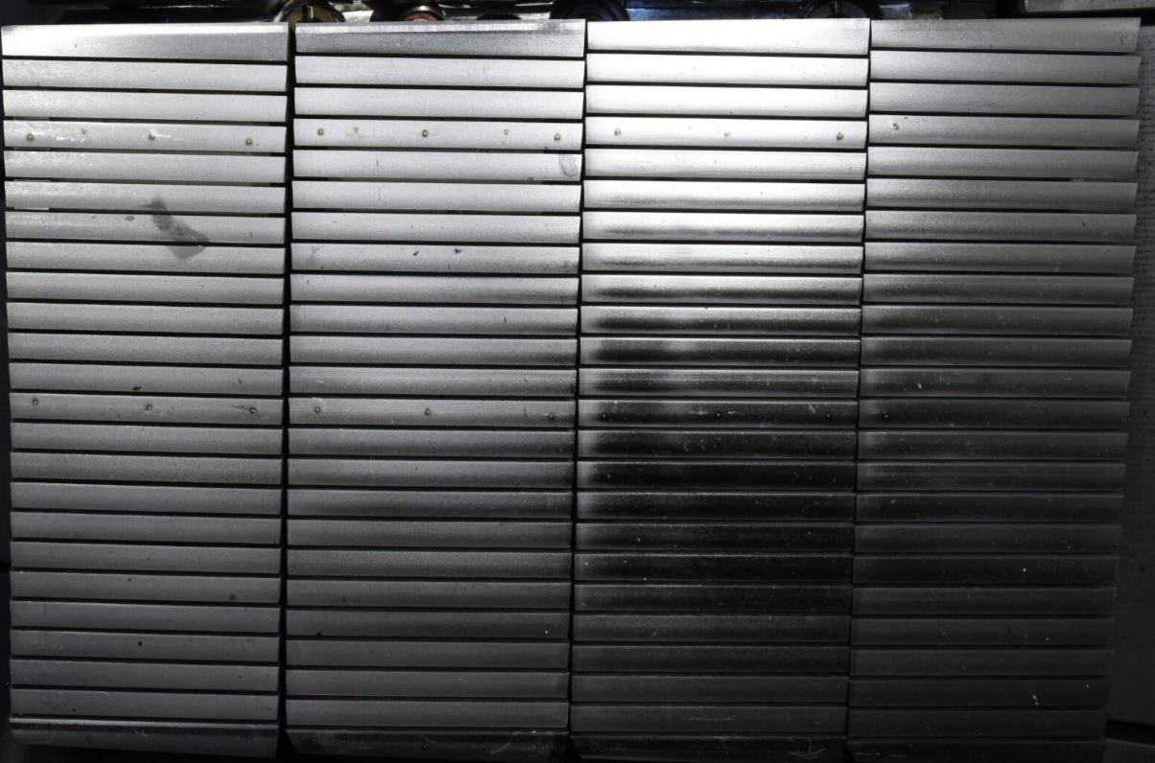
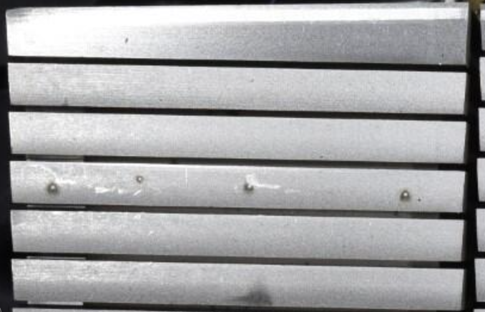
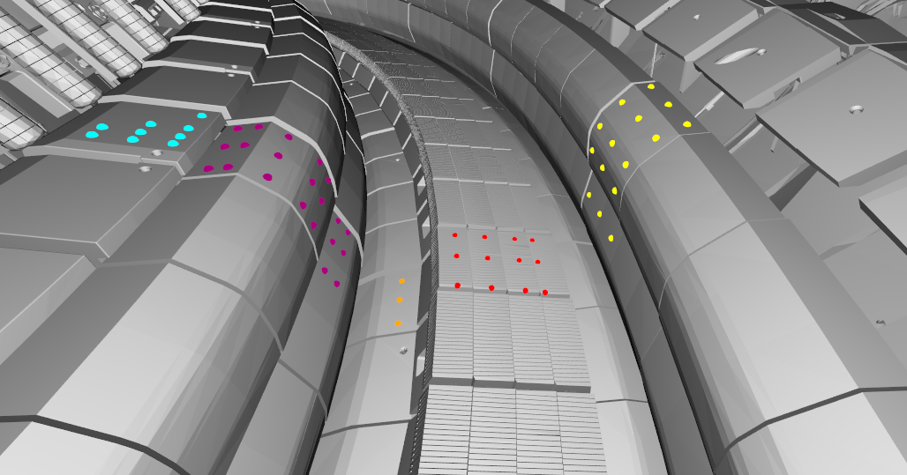
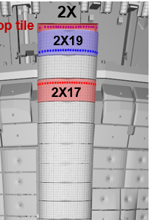
First results of JET-LIBS
Ablation craters on JET tiles
6 mm
HFGC_MOD2_RH2W
2IW G1B
LBSRP_2W_RH
2ON G8B
Position quite accurate
But profile not available
2ON G7A
2BW G4B
2IW G3A

Slide 7
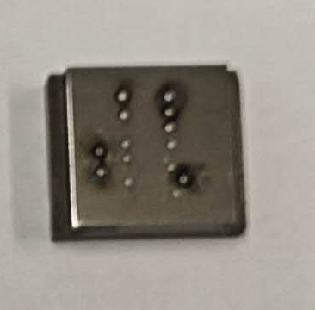
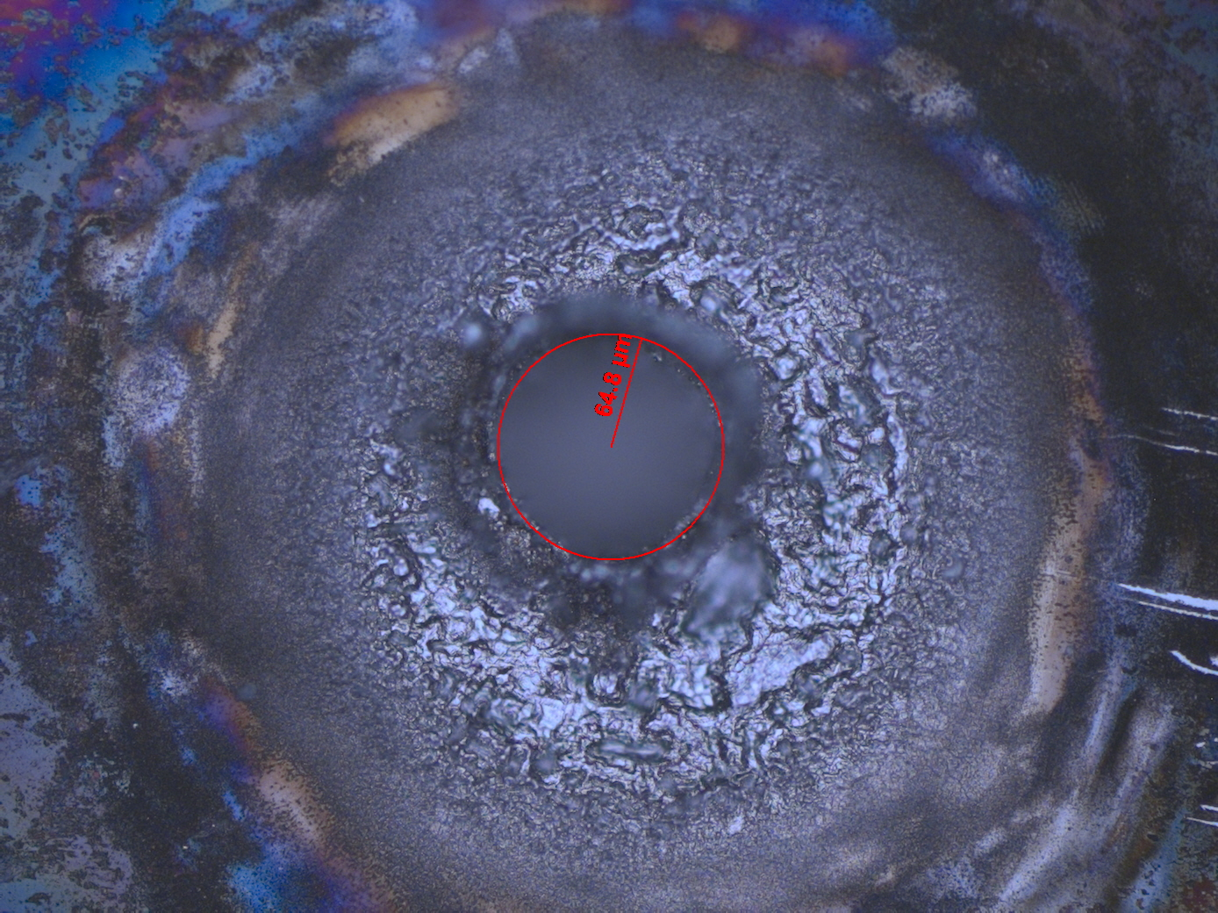
First results of JET-LIBS
Ablation rate and reference sample
Before we go into JET chamber, some test in lab give us crater info
Plansee W
d~130 μm
Ablation rate varies from the initial 30 pulses to 1000 pulses
Laser pulse number— real depth info

Slide 8
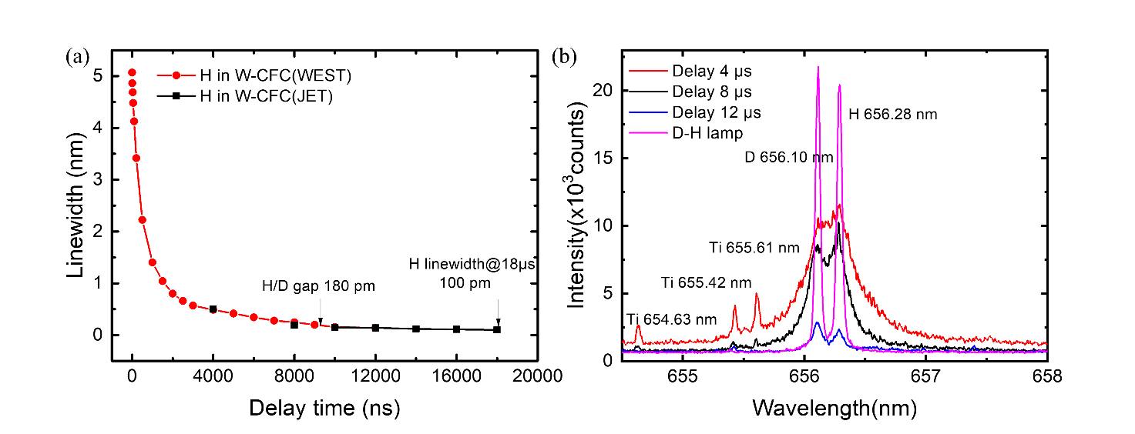
First results of JET-LIBS
Spectral data
Different delay time
FWHM of Ha is narrow enough to separate H/D after 8 μs. After 18 μs it reaches to 0.1 nm, which is still higher than the gap between T/D.
However, we can use voigt fitting to resolve them.

Slide 9
First results of JET-LIBS
Spectral fitting
Problems:
Read spectral data, check if there is significant (6 times larger than noise)W line @ 657.39nm (pixel 840+-5)
T changed in 2 weeks experiment
yes
no
Wavelength 6 pixels deviation
Use the W line do calibration, pixel difference between H D T, other W lines and W 657.39 nm is solid
Do the fitting directly with H. Set the original value for H peak position(526-531) , get the fixed value,
No solid initial value for H
Give the pixel position to each peak and do voigt fitting(solid and shared gaussian part, Lorentz part only shared by HDT )
W line interference make it difficult to find the accurate wavelength for H
Save all data, but in red color when signal intensity <6N(only when signal >6N, it is regarded good signal)

Slide 10
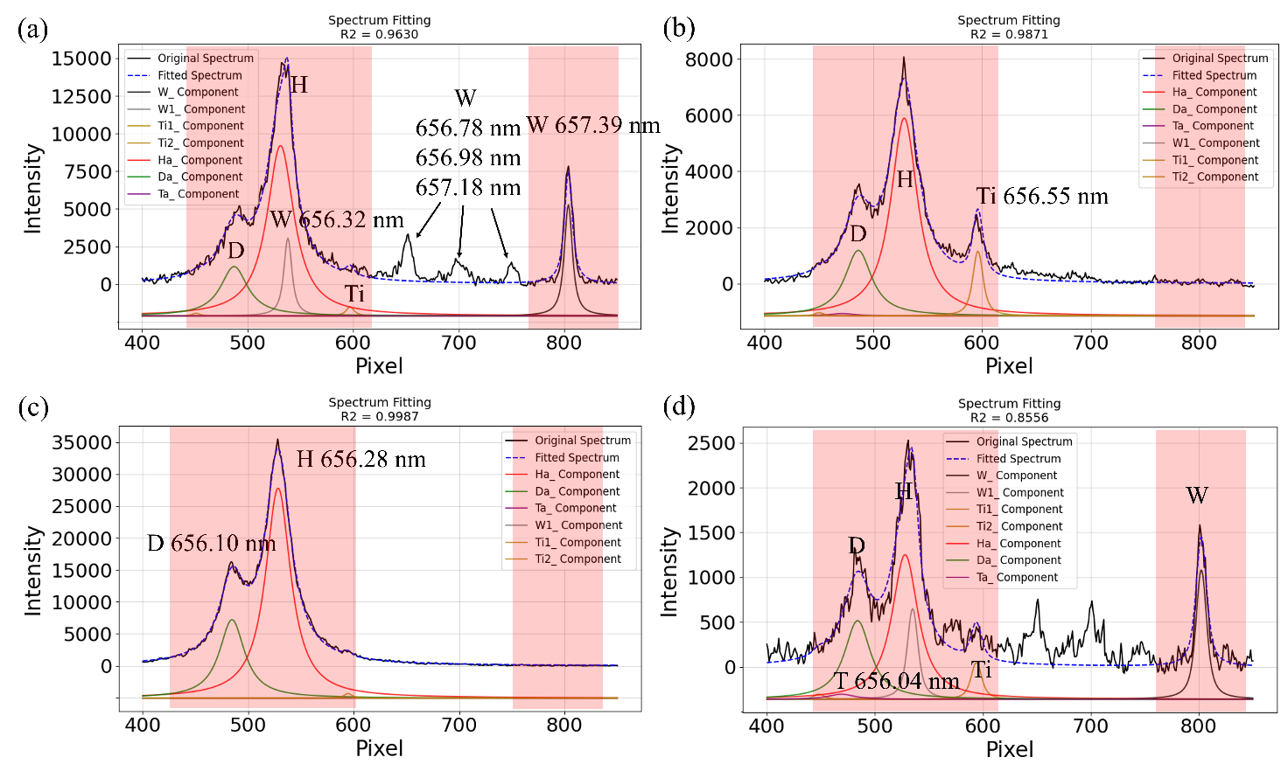
First results of JET-LIBS
Spectral fitting
4 typical spectra
Spectra with W and without W can both be fitted well.
Only when Ti peak appears, some unknow part make the spectral wings unfitted

Slide 11
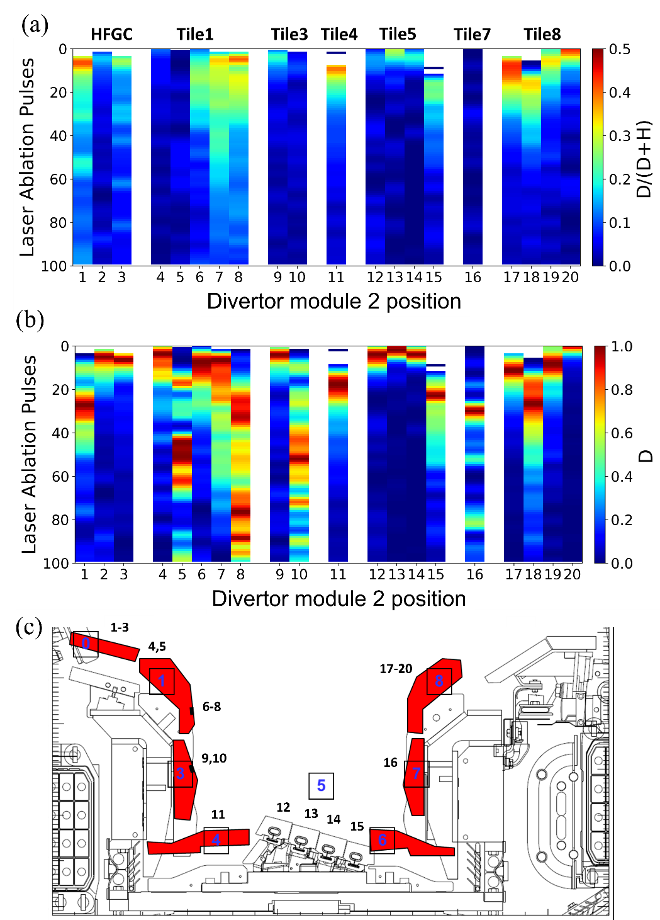
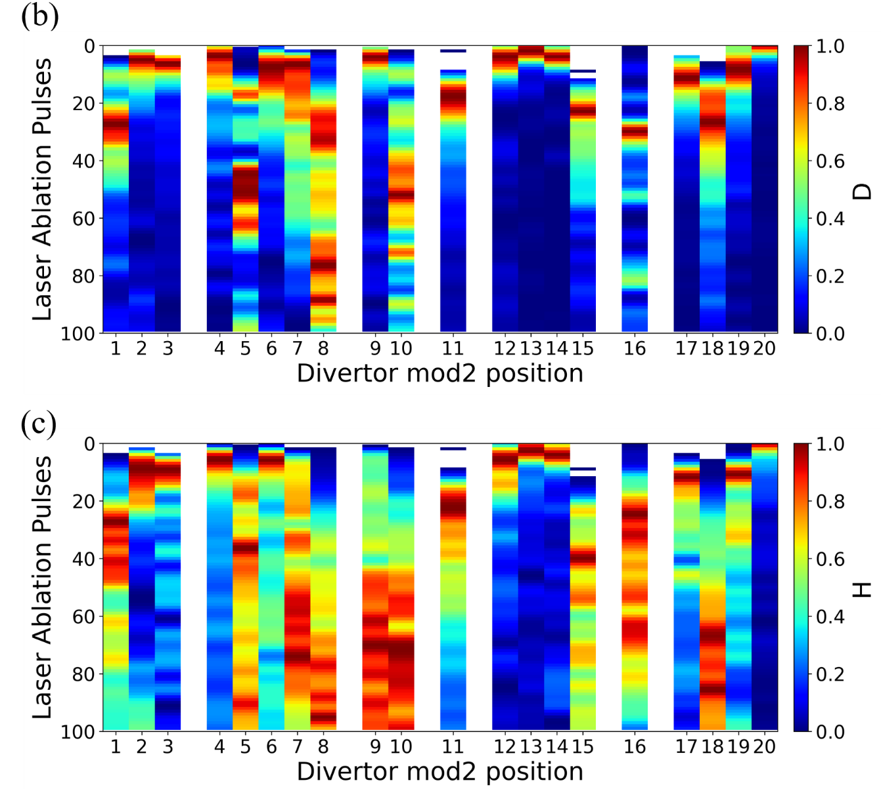
First results of JET-LIBS
Fuel retention in module 2 divertor(poloidal from HFGC-Tile8)
Too weak D

Slide 12
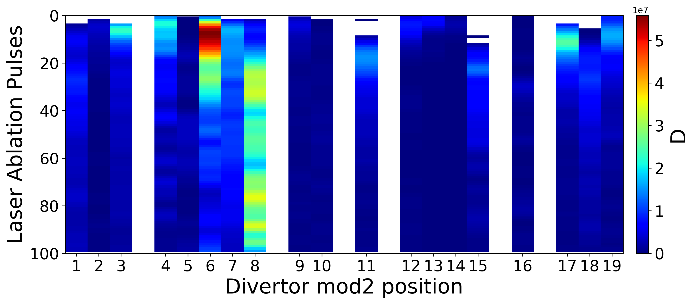
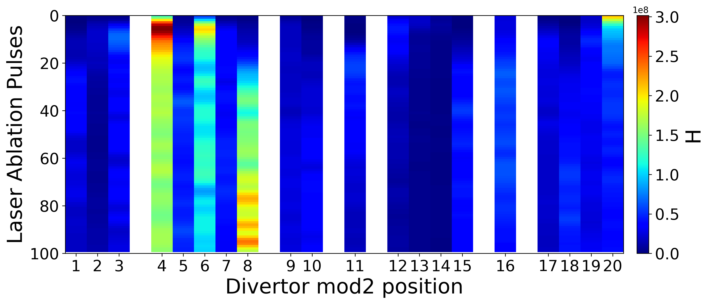
First results of JET-LIBS
Absolute value
Due to the different delay times and different matrix, this absolute value didn’t make too much sense here

Slide 13
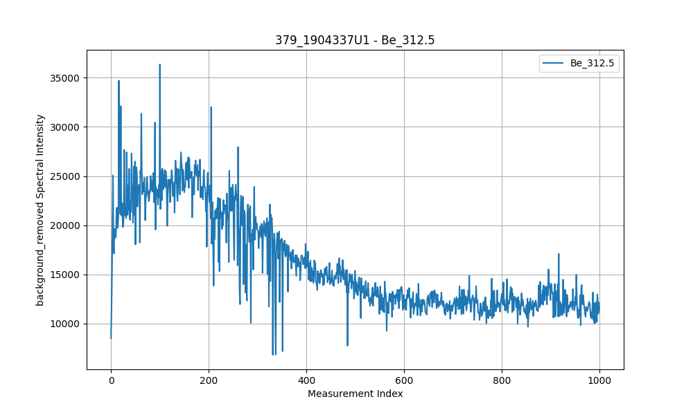
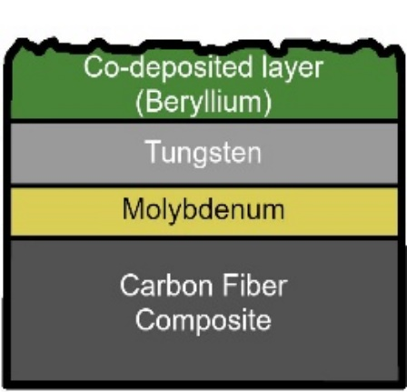
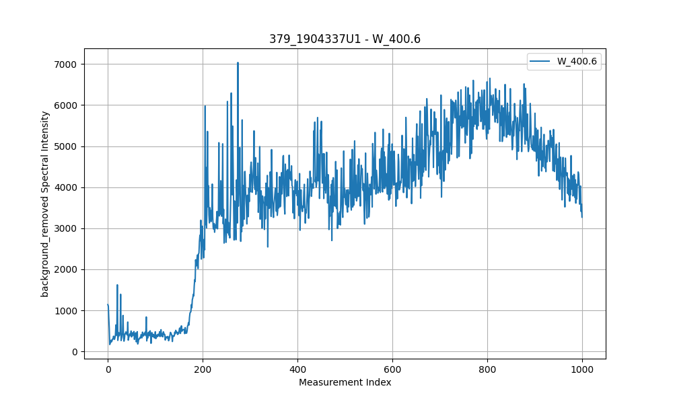
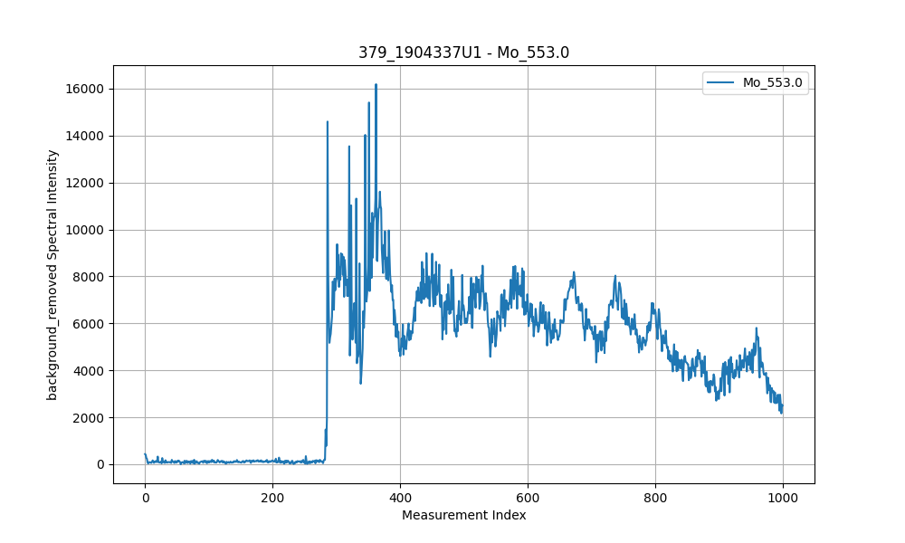
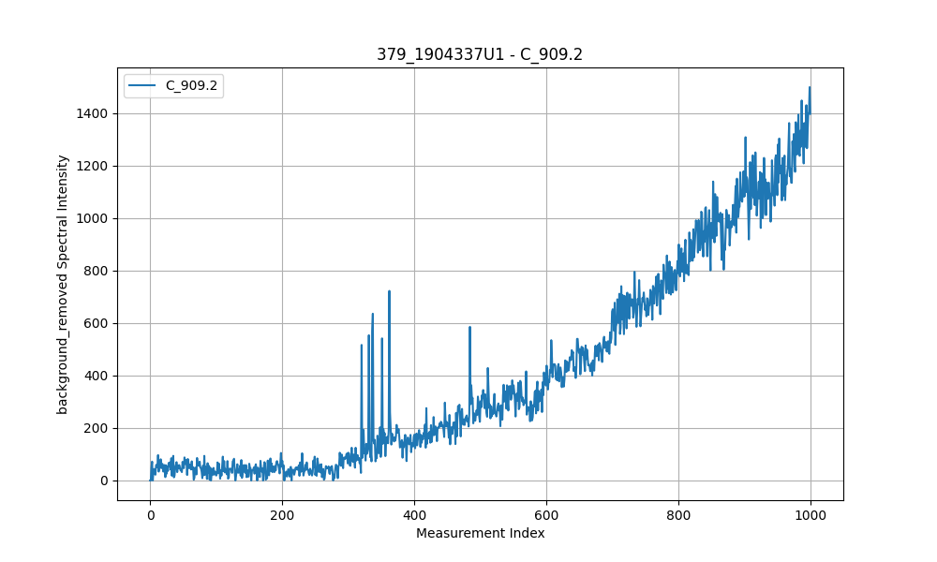
First results of JET-LIBS
Layer information—Avantes spectrometer
HFGC
co-deposition: Be
Intensity
Edge effect
Laser pulses
D1
D2
Intensity
Intensity
Intensity
D3
Laser pulses
Laser pulses
Laser pulses
Thickness—distance

Slide 14
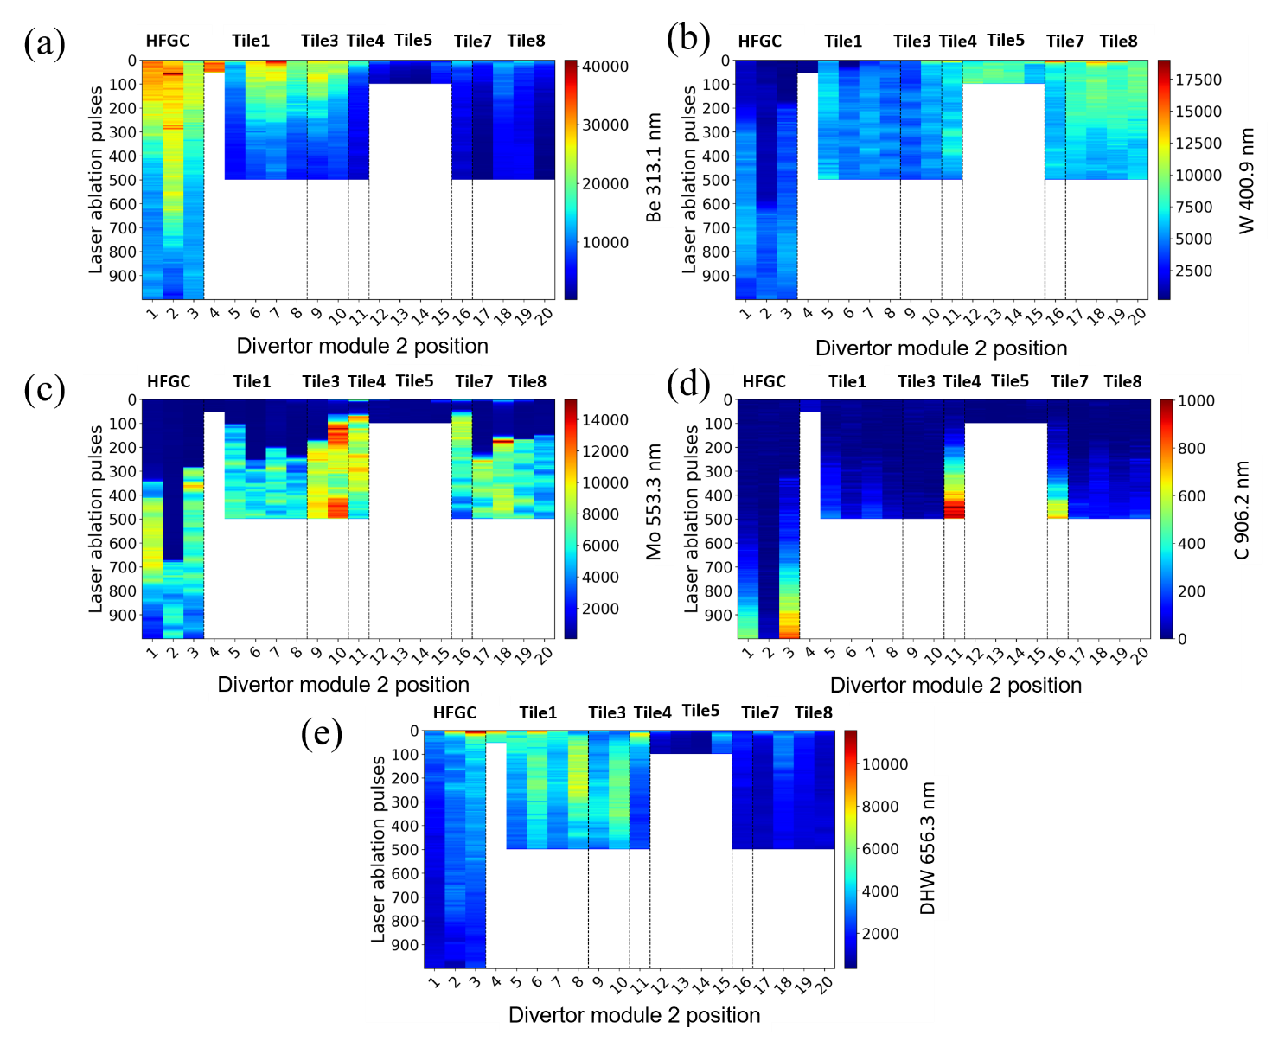
First results of JET-LIBS
2D layer information for PFM– Be, W, Mo, C also H isotopes

Slide 15
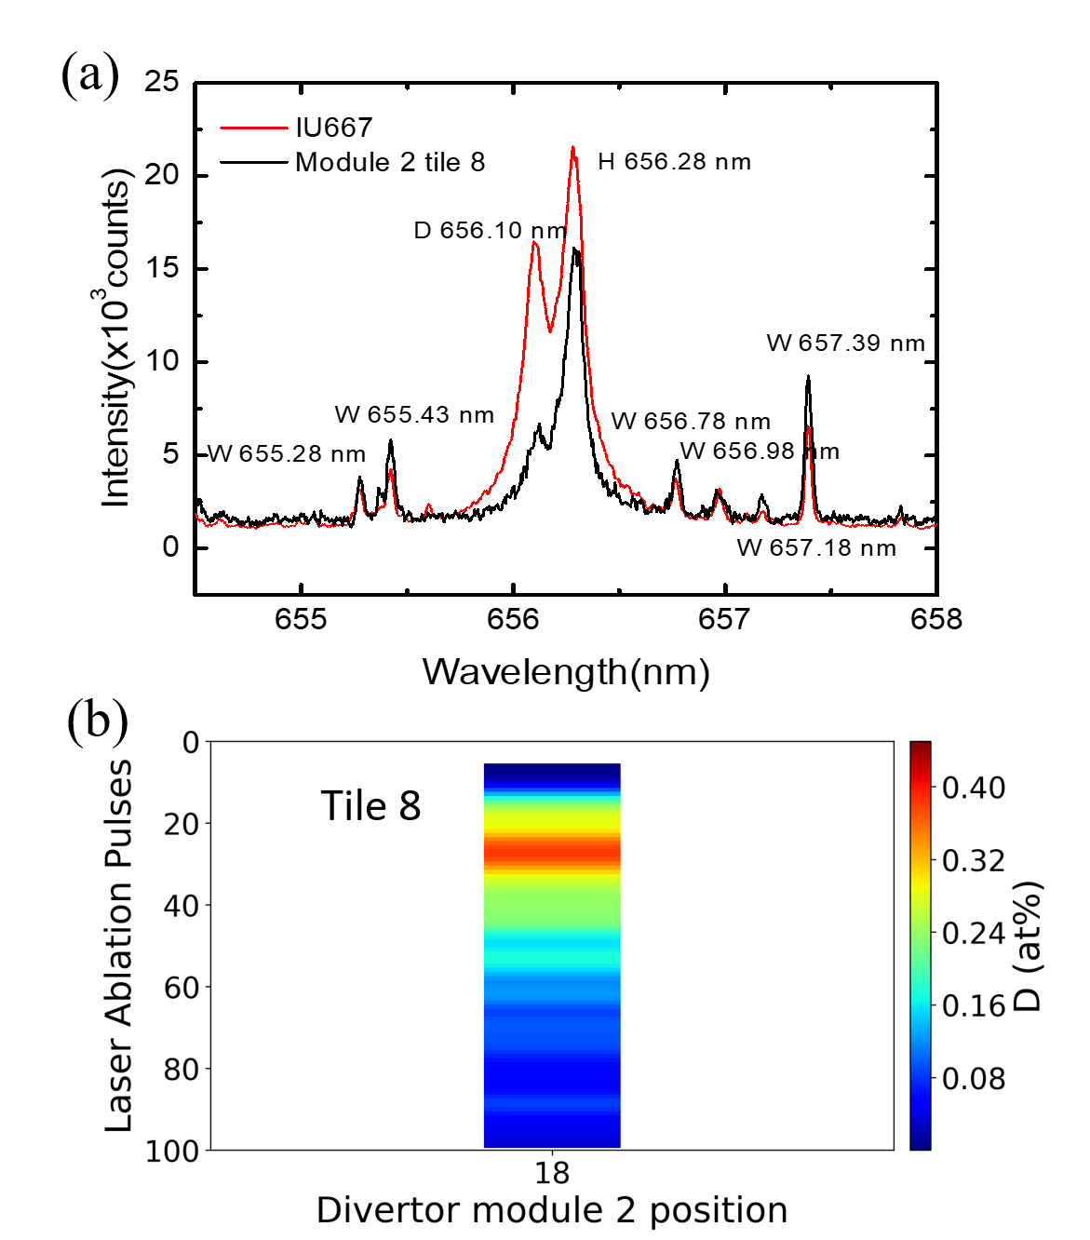
First results of JET-LIBS
Semi-quantitative analysis of the retained fuel composition
IU 667: 2 at% D in deposited W by NRA
As reference sample, W line 657.39 nm as the internal standard line
D concentration: Maximum of 0.5 at%,
slowly decreases to 0.1 at% by the 100th laser pulse.
D content in the initial 100 laser pulses~1.5×10¹⁷ D/cm² (tile 8, assuming 179 nm/pulse ablation rate and ignoring the initial 7 empty pulses, which correspond to a 1.3 μm surface layer).
LOD: 0.07 at% (noise from pixel around 655 nm)

Slide 16
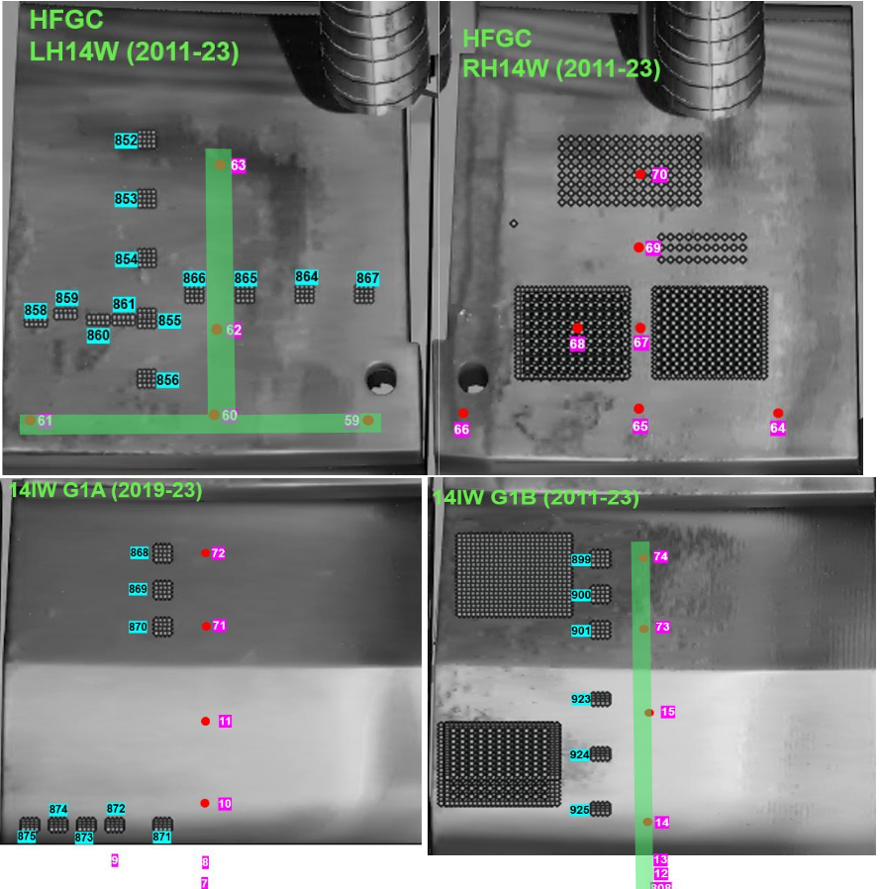
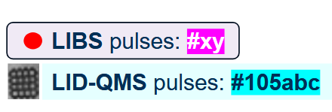
Results in the LID-QMS region (Module 14)
The locations where LIBS and LID-QMS shot
In Module 14, Divertor area:
Tile 0 and 1, 4 tiles were measured by both LIBS and LID-QMS
The results can be compared somehow

Slide 17
Results in the LID-QMS region (Module 14)
1
D empty position
10

Slide 18
Results in the LID-QMS region (Module 14)
1
Highest D ratio
11

Slide 19
Results in the LID-QMS region (Module 14)
1
6

Slide 20
Outlook and Conclusions
  Conclusions:
  H and D peaks are well separated
  T is too weak to be detected, which means a very low concentration( baking performance is good)
  Ideal depth profile was obtained for gas and wall materials
  Semi-quantitative results were obtained for tile 8

Slide 21
Outlooks and Conclusions
  Outlooks
  Calibration of echelle spectrometer for quantitative analysis
  Some unknow background in the H/D/T position to be studied
  Test JET-sample with LIBS-TALIF to measure T/D.

Slide 22
Thanks for your attention!

