Slide 1


Overview of UKAEA results under SPE: post-DTE3 component removal and distribution
Y. Zayachuk, I. Jepu, A. Widdowson, J. Likonen, JET contributors
WP PWIE review meeting
FZJ, Germany| 17-21.11.2025

Slide 2
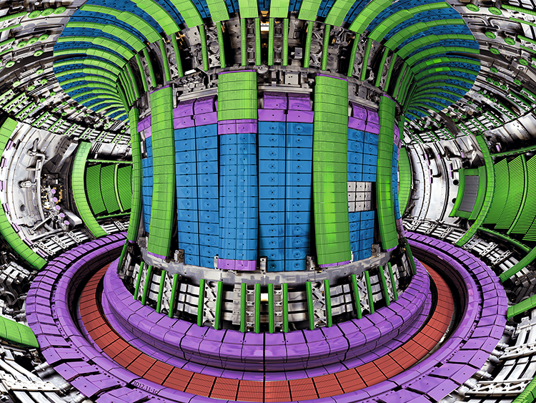
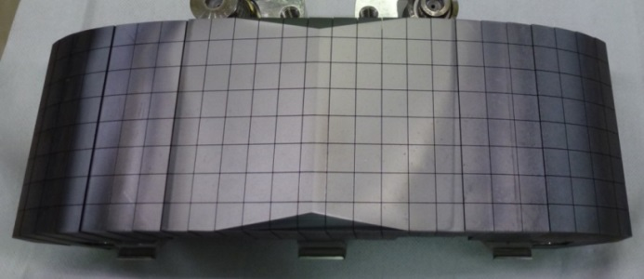
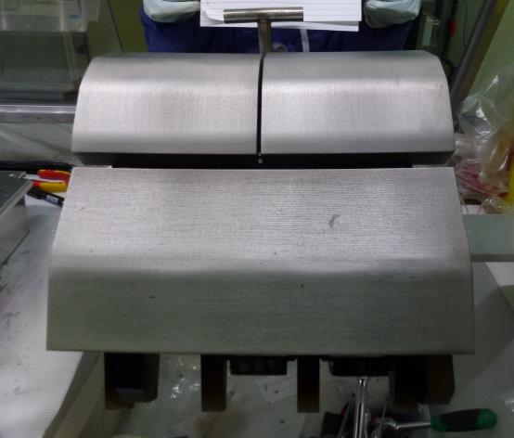
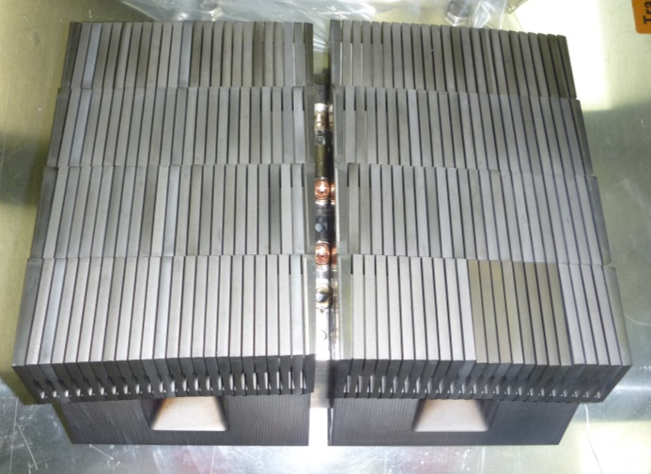
JET ILW
Bulk beryllium (Be)
Castellated structure
25 µm tungsten (W) coating on carbon-fibre composite (CFC) tile
Y. Zayachuk | HWS-17 | Chamonix | 20.05.2024 | Page 2
DT campaigns:
Tritium retention
Neutron-induced activation
Bulk tungsten (W)
Lamellar structure

Slide 3
Deuterium-tritium plasma campaigns
DT campaigns:
DTE2 – 2021.
DTE3 – 2023.
Components removed using remote handling (MASCOT) at the end of 2024.
Following removal components stored in the ISO container in the torus hall.
Components transferred to Beryllium Handling Facility (BeHF).

Slide 4
Deuterium-tritium plasma campaigns
Components of interest for PWIE-SPE (more were removed for internal/JDR (JET Decomissioning and Repurposing) analysis & waste characterisation):
W-CFC tiles: poloidal set (21 tiles with PWIE-SPE).
W lamellae: 3 LBSRP modules (36 lamellae, 12 W Langmuir probes with PWIE-SPE interest).
Be tiles: WPL, IWGL, UDP (20 tiles).
Inner wall protection: tiles and inserts.
Diagnostics: mirrors and mirror cassettes; sticking monitors; dust collectors; QMB covers & crystals; rotating collectors.

Slide 5
Handling of components
During 2025 components processed in BeHF:
Disassembled, photographed, weighed and boxed.
Gamma dose rate measurements taken of representative components at different distances (contact, 30 cm, 100 cm) using Ludlum gamma-detector → indicative of activation.
As part of JDR activities, samples of selected components were removed using band saw or coring drill, to be used in pyrolysis measurements → indicative of tritium content.
Off-gas measurements of selected components → indicative of tritium content.
Boxed components stored in BeHF – awaiting shipment.

Slide 6
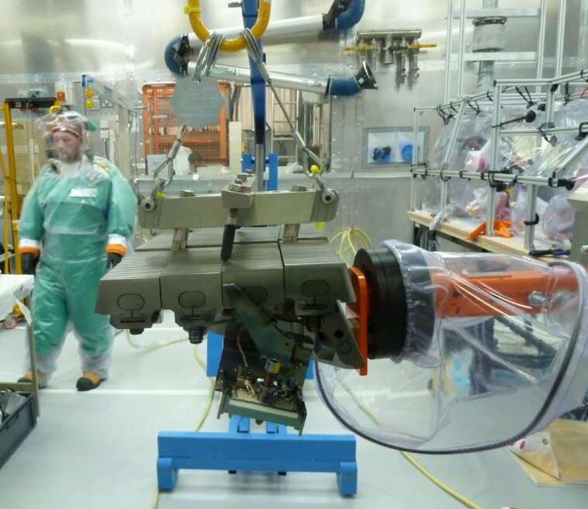
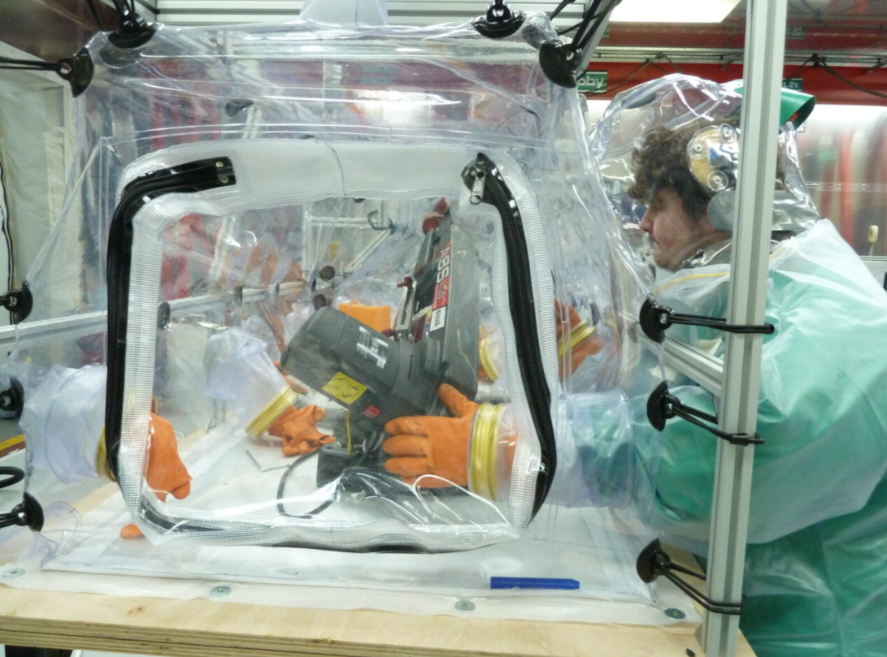
Handling of components
Activities performed in pressurized suits
Components handled in isolator (glove box)
Some “dirty” cutting done in-house for waste characterisation & detritiation studies

Slide 7
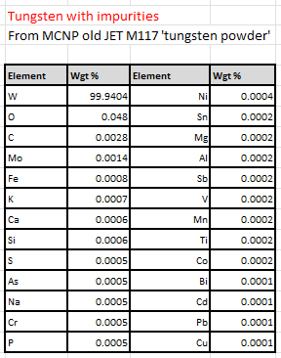
Neutron activation analysis
Neutron-induced activation:
Calculated using FISPACT-II neutronics code → for scientific and disposal purposes.
For each material – plasma-facing and structural → tungsten, beryllium, CFC, TZM, Nimonic, Inconel.
Time dependence of isotopic fingerprint → after final plasma.
Example of isotope fingerprint for W (LBSRP):
Assumed initial isotopic composition:
Assumed neutron spectra (DD and DT):

Slide 8
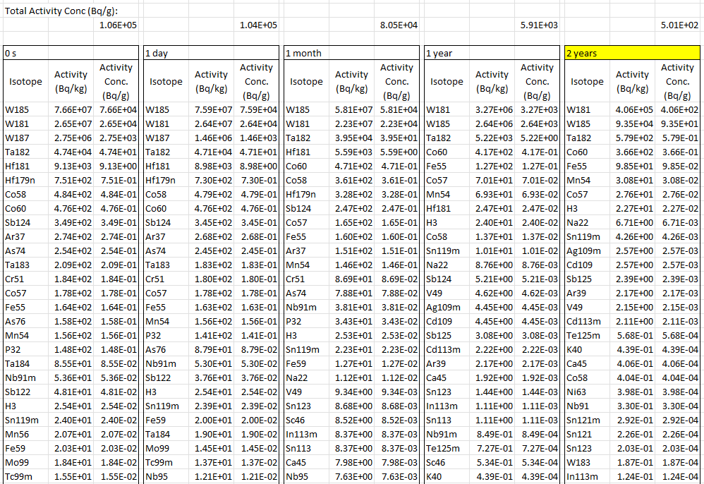
Neutron activation analysis
Example of isotope fingerprint for W (LBSRP):
W activation dominated by W181.
Some tritium generated by transmutation.
(~100 kBq/lamella@2 years – total).
Activity dominated by tritium introduced by plasma-wall interaction (implantation and deposition).
(~570 MBq/lamella (see slide 10)).

Slide 9
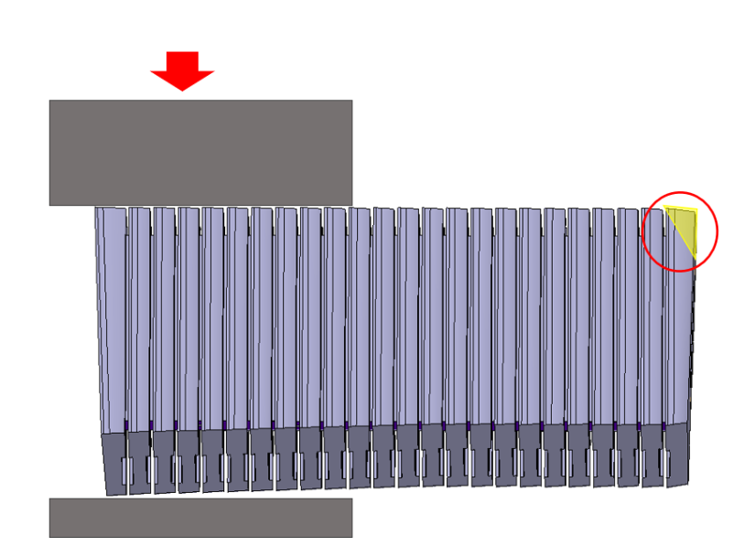
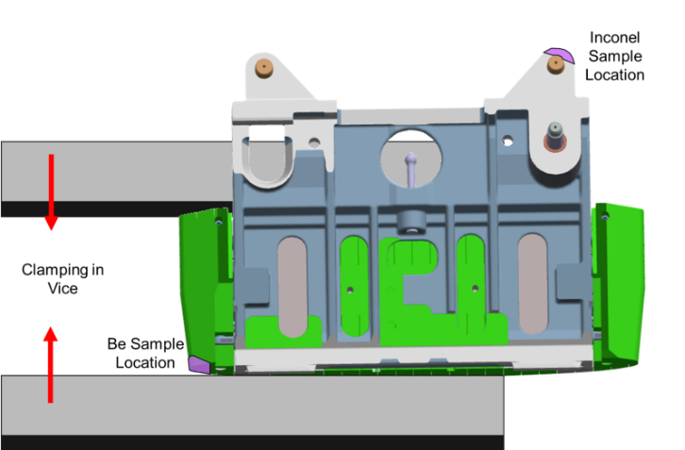
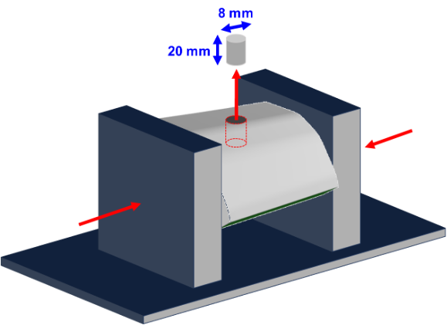
Results of pyrolysis
Pyrolysis performed at the Tritium Analysis Laboratory (TAL) at UKAEA by JDR team.
PFC Type | Mass of sample (g) | Sample inventory (MBq) | Inventory/g (MBq/g)
Be | 0.891 | 60.81 | 68.24
W | 8.37 | 64.92 | 7.76
W-CFC | 4.91 | 58.01 | 11.82

Slide 10
Total tritium content – extrapolation
Tritium content resulting from activation is small relative to tritium content resulting from plasma-wall interaction (implantation and co-deposition).
It can be assumed that majority of tritium is present in the vicinity of the plasma-exposed surfaces.
To obtain full tritium content in the component (lamella/tile) it would be incorrect to extrapolate the pyrolysis results to the entire volume of the component.
Near-surface regions, where pyrolysis samples are taken from, contain majority of total tritium content → pyrolysis results should be extrapolated only to the area of plasma-exposed surface of a component.

Slide 11
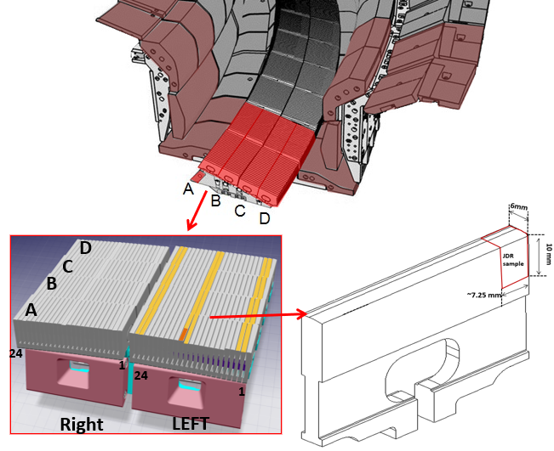
Total tritium content – extrapolation
Example – LBSRP W lamella:
Full lamellae length 60 mm.
Length of pyrolysis sample 7.25 mm → 8.28 top surface samples in a single lamella.
Full inventory of pyrolysis sample 65 MBq.
Inventory of full lamella (extrapolated to entire top surface 8.28 × 65 MBq = 537.58 MBq/Stack B W lamella

Slide 12
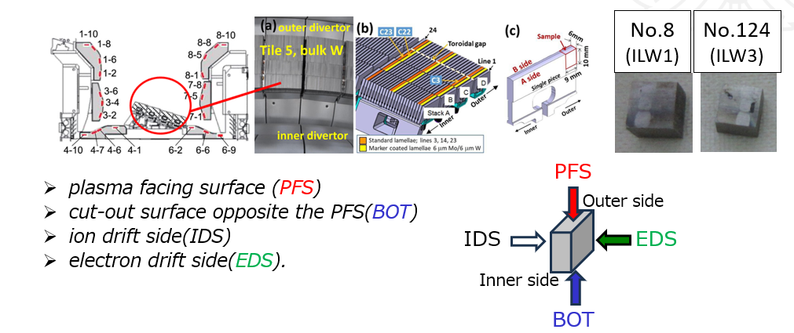
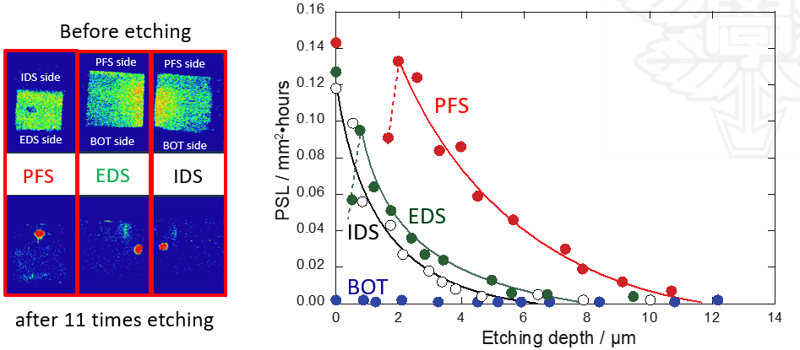
Total tritium content – extrapolation
Example – LBSRP W lamella (continued):
If specific inventory in the bulk of the tile is 3% of surface specific inventory:
Specific inventory from pyrolysis = 7.8 MBq/g × 0.03 = 0.23 MBq/g for the remaining bulk
Mass of bulk removing top surface (10 mm depth) = 200 g (nominal mass of W lamella) – 70 g (mass of top lamella) ≈ 130 g
Total inventory of a W lamella component
= 537.6 MBq + 0.24 MBq/g × 130g
≈ 567.8 MBq / full W lamella
Y. Torikai et al, PFMC20

Slide 13
Total tritium content – extrapolation
Similar calculations were made for different types of PFCs where pyrolysis was performed:
PFC Type | Based on pyrolysis of this component: | Total inventory, GBq/tile
Be | WPL 8D4 | 18.16
W | 15W RHB | 0.57
W-CFC | 2ON G8A | 9.43
Seemingly high activity associated with Be tiles.
Sample for pyrolysis likely to originate from deposition-dominated zone → potential overestimation, as it is not representative of the entirety of the tile.
Potentially also indicates a relatively lower efficiency of main-chamber clean-up.

Slide 14
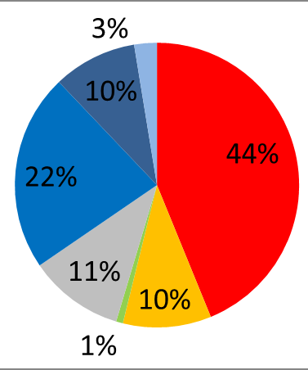
Tritium retention predictions
Tritium retention calculations based on the injected tritium content.
Total tritium injected – 7.27E+25 at / 363.5 g.
Fuel retention ratios established in post-mortem analysis of components removed in ILW1-3 campaigns.
Based on ILW results (in deuterium plasmas), it was established that long-term retention constitutes ~2-4% of injected deuterium → distributed across different components (Brezinsek et al NF 2013).
This can be further broken down by individual tiles using distribution from post mortem analysis.
~7-14 g of tritium retained.
Be castellation gaps
Main chamber
Recessed wall
Main chamber
Be limiters
Inner divertor
Remote divertor
Outer divertor
Divertor
bulk tungsten
A. Widdowson et al, Nuclear Fusion 57 (2017) 086045

Slide 15
Tritium retention predictions
Predicted retention at end DTE3 2% in-vessel & distribution based on post mortem analysis
Pyrolysis of samples at UKAEA by JET JDR team
Breakdown of tritium retention by component:
Individual tiles by type | T atoms per tile | T atoms/cm2 | Bq/cm2 | Pyrolysis of sample (Bq) | Approximate areal activity (Bq/cm2)
Tile 0/HFGC | 2.28E+21 | 1.28E+19 | 2.28E+10
Tile 1 | 2.42E+21 | 1.05E+19 | 1.88E+10
Tile 3 | 2.45E+21 | 5.34E+18 | 9.52E+09
Tile 4 | 1.10E+21 | 4.06E+18 | 7.23E+09
Tile 6 | 6.76E+20 | 2.34E+18 | 4.17E+09
Tile 7 | 1.75E+21 | 3.21E+18 | 5.72E+09
Tile 8 | 4.72E+20 | 1.59E+18 | 2.83E+09 | 5.80E+07 | 5.80E+07
Tile 5 Tungsten lamella | 9.43E+17 | 2.62E+17 | 4.67E+08 | 6.39E+07 | 6.39E+07
IWGL (5 tile pieces) | 2.19E+20 | 8.75E+17 | 1.56E+09
OPL (7 tile pieces) | 5.35E+20 | 1.27E+18 | 2.27E+09 | 6.08E+07 | 6.08E+07
IWC | 3.24E+20 | 1.17E+18 | 2.51E+09
DP | 1.08E+20 | 9.16E+17 | 8.75E+08

Slide 16
Tritium retention predictions
Individual tiles by type | Bq/cm2 (2% retention) | Bq/cm2 (pyrolysis) | Ratio Prediction/pyrolysis
Tile 8 | 2.83E+09 | 5.80E+07 | 48.8
Tile 5 Tungsten lamella | 4.67E+08 | 6.39E+07 | 7.3
OPL (7 tile pieces) | 2.27E+09 | 6.08E+07 | 37.3
Predictions consistently higher than indications of pyrolysis.
Certain discrepancy in how much higher – differs from component to component.
At least two mechanisms for this can be identified:
Clean-up.
Loss of tritium on venting (~0.4 g for whole vessel measured).

Slide 17
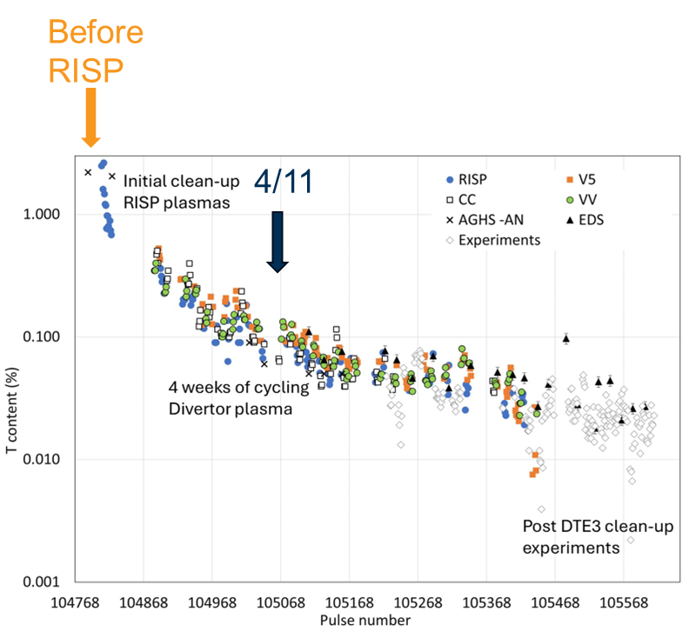
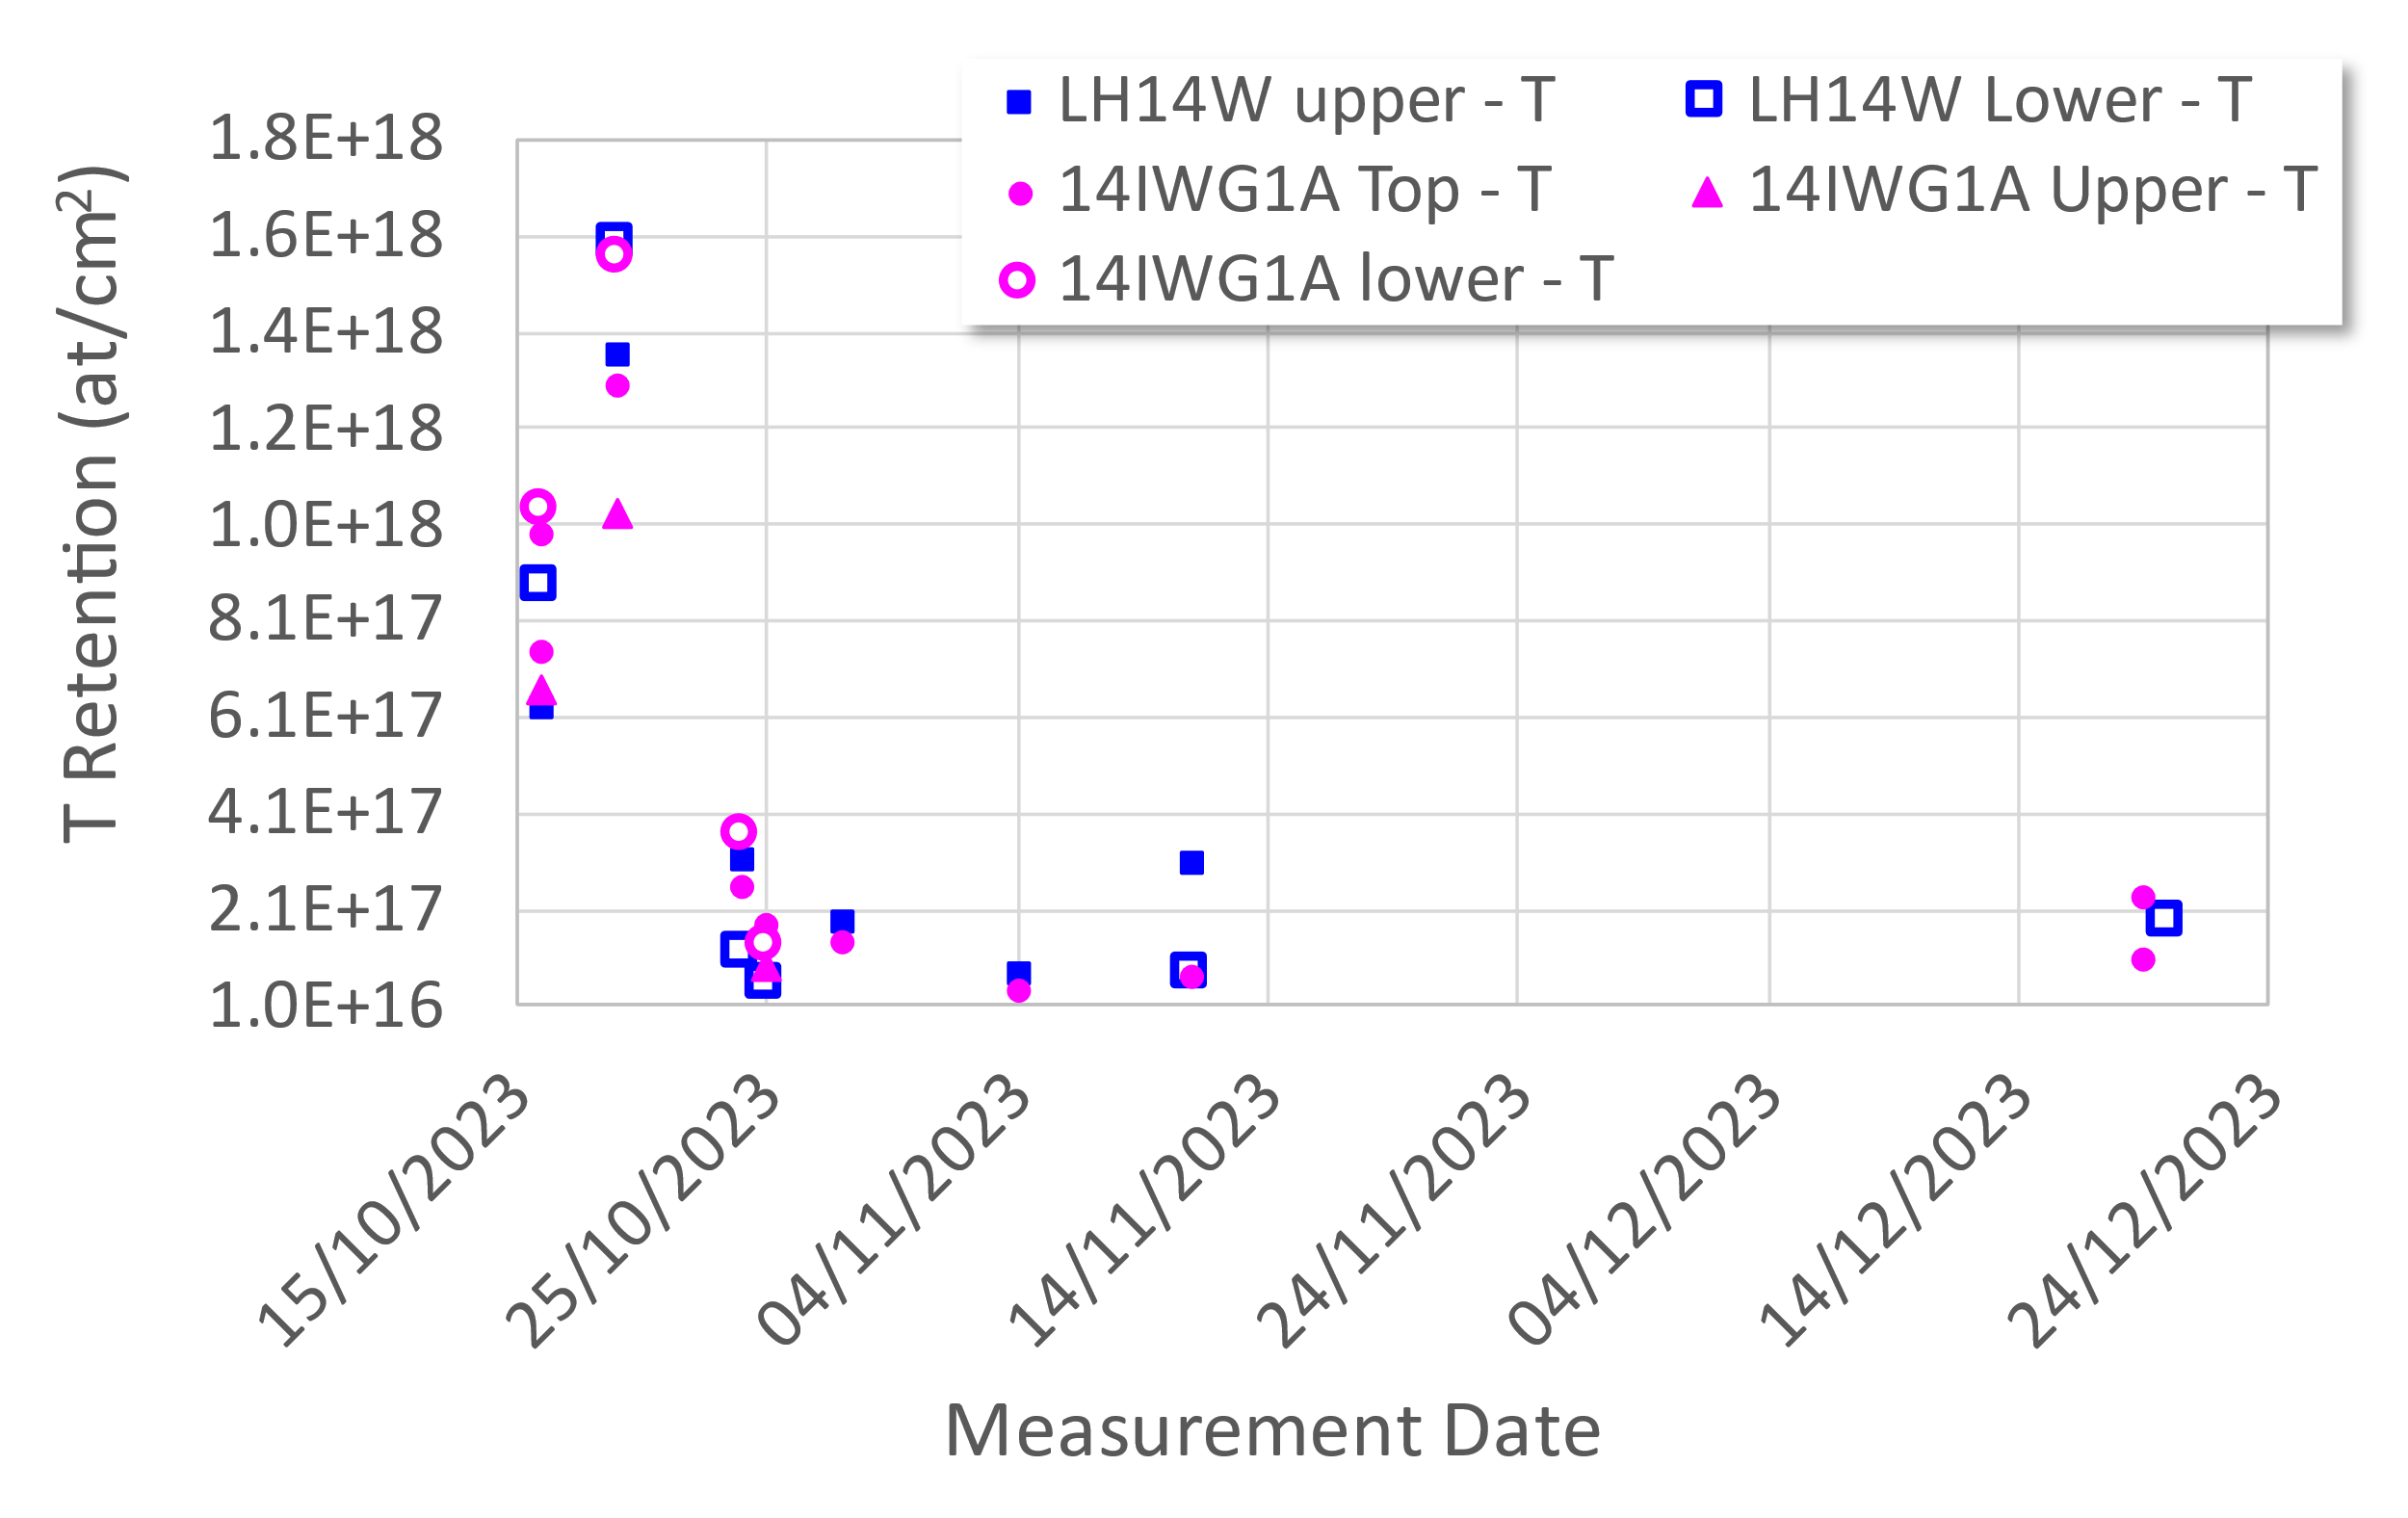
Tritium retention predictions
Following the end of DTE3, cleaning operations were performed.
LID-QMS was used to monitor the decrease of tritium content with time.
Measurements of 14 MeV neutron production were used in parallel to monitor the decrease of tritium content with time.
After vessel baking
Vessel baking
320°C
End of DTE3
End of T clean-up
End of JET ops
End of T clean-up
End of JET plasma ops
Factor ~5

Slide 18
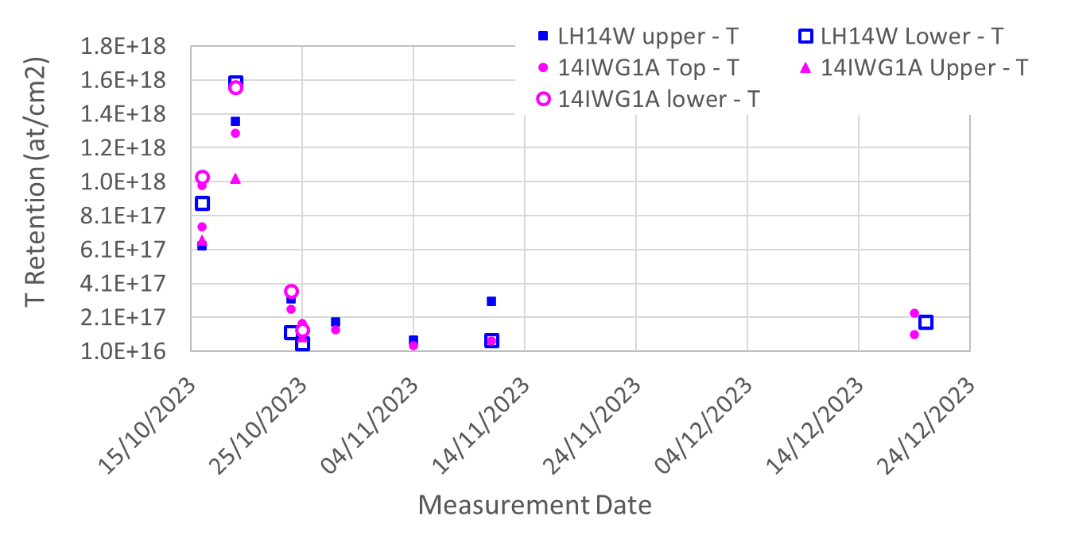
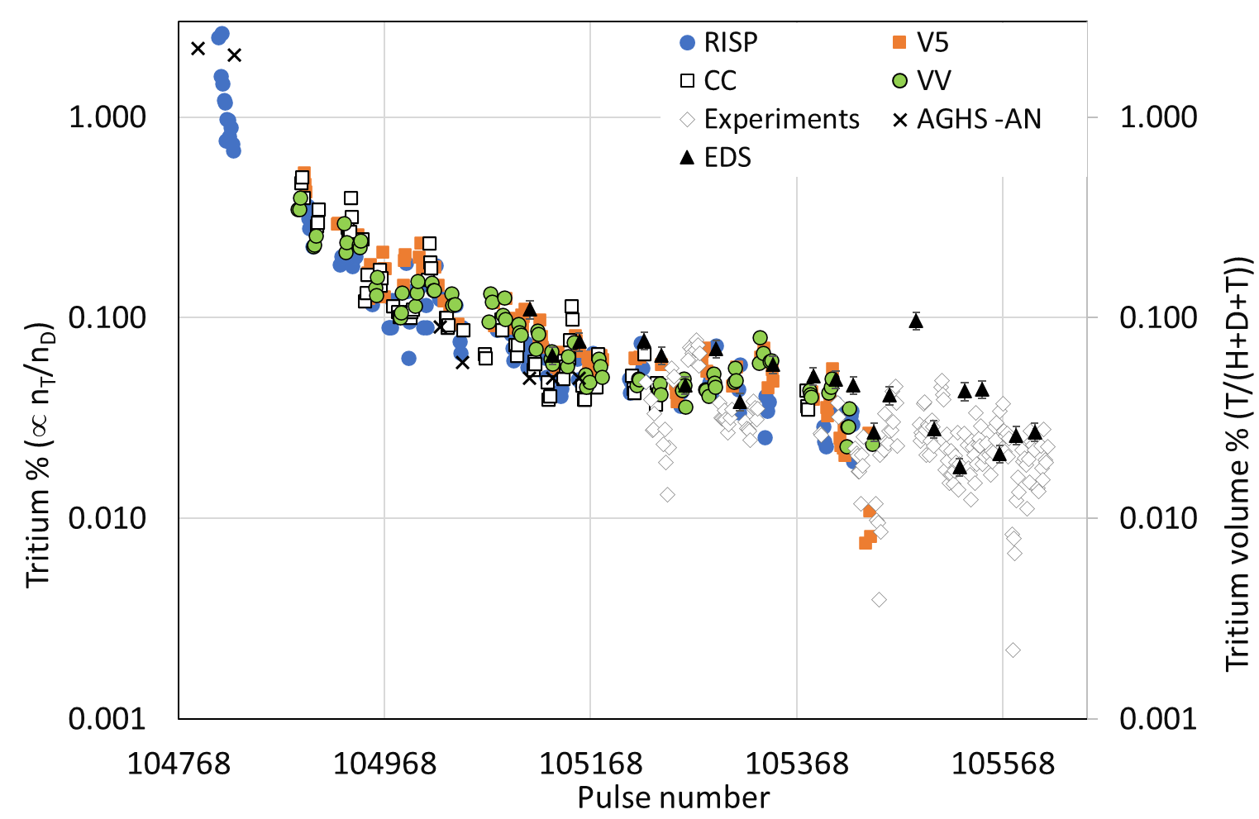
Tritium retention predictions
LID-QMS shows reduction in tritium retention ~ factor 5
14 MeV neutrons in plasma reduced by 2 orders of magnitude
Clean-up → decrease of tritium signal BUT potential discrepancy between the tritium reduction rates established by LID-QMS and neutron measurements.
LID-QMS ~factor 5 to 1 order of magnitude; neutron measurements ~2 orders of magnitude.
Possibly due to the difference in the location of measurement: LID-QMS – directly at the wall, neutrons – in the core plasma.
Regardless → tritium content at the end of ops lower by at least factor of ~5 then what accounting for only injected tritium would predict.

Slide 19
Tritium retention predictions
Preliminary summary:
At end of DTE3: 2% - 4% retention (of injected T) = 7.3 - 14.5 g T [Post mortem prediction without cleaning]
At end of T clean-up: 0.4% – 0.8% retention (of injected T) = 1.45 – 2.9 g T [factor 5 reduction in surface retention from LID-QMS]
Release on venting:
DTE1: ~33% of remaining fuel (6 g) released on venting → 2 g released on venting.
In DTE3 this corresponds to 0.48 – 0.96 g T released on venting.
Preliminary data of release on venting ~ 0.4 g T → roughly consistent.
Remaining T amount ~ 0.98 – 1.96 g T remaining → retention 0.27% - 0.54% of injected fuel
Individual tiles by type | Bq/cm2 (0.27% - 0.54% retention on removal) | Bq/cm2 (pyrolysis) | Ratio Prediction/pyrolysis
Tile 8 | 3.82 - 7.64 E+08 | 5.80E+07 | 6.5-13.0
Tile 5 Tungsten lamella | 6.30 - 12.6E+07 | 6.39E+07 | 0.99-1.98
OPL (7 tile pieces) | 3.07 - 6.14E+08 | 6.08E+07 | 5.0-10.1
Analysis ongoing

Slide 20
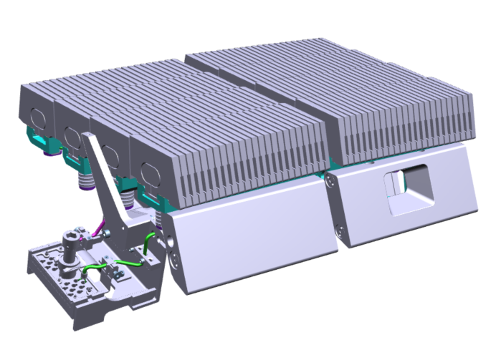
Plans for studies on W lamellae at UKAEA
First studies at UKAEA – microscopy on W lamellae.
Effects of He plasma interaction.
LIBS craters on W lamellae.
Microstructural changes.
3 lamellae selected.
Optical microscopy; SEM surface imaging; FIB cross-sectioning.
LH
D
UKAEA
3 lamellae
14W LBSRP LH
A21 ⇒ MAP-LAB ⇒ MRF
B21 ⇒ MAP-LAB ⇒ MRF
D12 ⇒ MRF
RH
1
C
B
24
A
14W-LBSRP

Slide 21
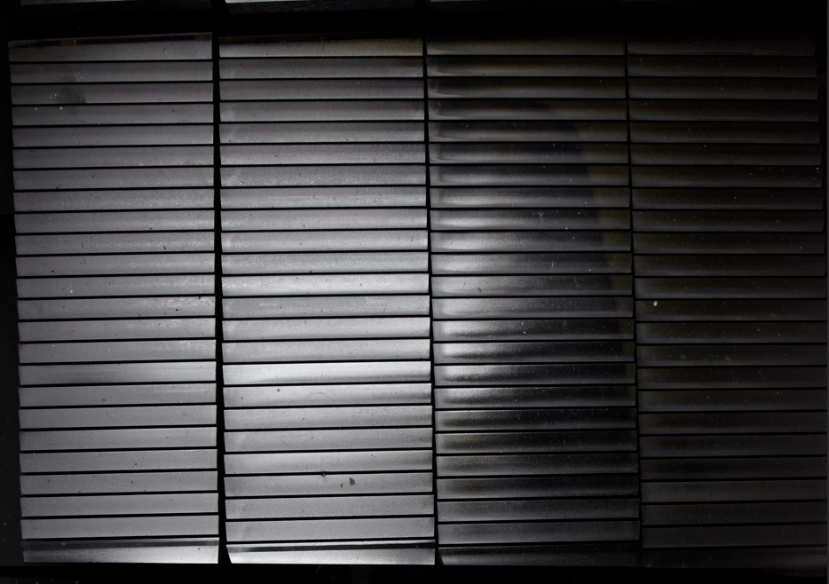
Plans for studies on W lamellae at UKAEA
LBSRP 14BN
Effects of He plasma interaction.
He plasma campaign (2022) → to “simulate” the then-planned He plasma campaign at ITER.
He fuzz observed in lab experiments → will it form in the tokamak?
A
B
C
D
No evidence of fuzz formation found during in-vessel imaging (even though conditions favourable, based on the results from linear plasma devices).
Approximate strike point position (highest heat flux)
Imaging artifact
Systematic feature on stack C
Origin unknown

Slide 22
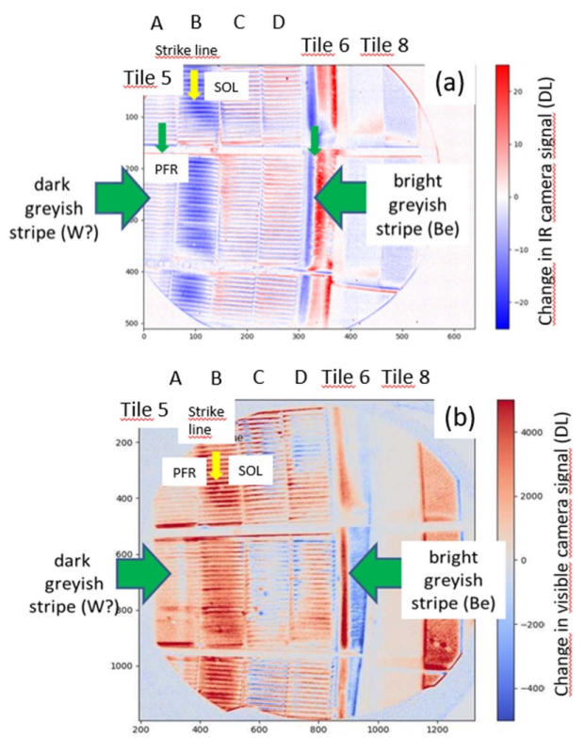
Plans for studies on W lamellae at UKAEA
Some evidence of surface modification found in the infrared and visible camera images.
Stack B – He strike point – appears to not be affected.
Stack A – private flux region – appears to form some features.
High-resolution surface SEM combined with FIB surface cross-sectioning → will there be any evidence for onset of fuzz formation?
Lamellae from stacks A and B to be investigated.
A. Hakola et al, Nucl. Fusion 64 (2024) 096022

Slide 23
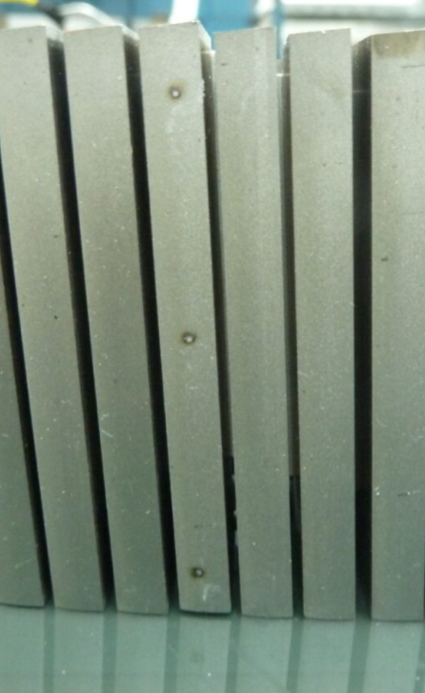
Plans for studies on W lamellae at UKAEA
LIBS craters on W lamellae.
Plans for experiments:
High-resolution optical imaging of craters → depth measurements.
High-resolution SEM imaging of craters.
FIB cross-sectioning of craters → depth measurements and studies of microstructural / morphological changes in the sub-surface region surrounding the craters.
Microstructural changes.
W lamella from stack D → strike point during DTE operations → high surface temperature and ion flux.
SEM and FIB to study microstructural effects (recrystallization?)

Slide 24
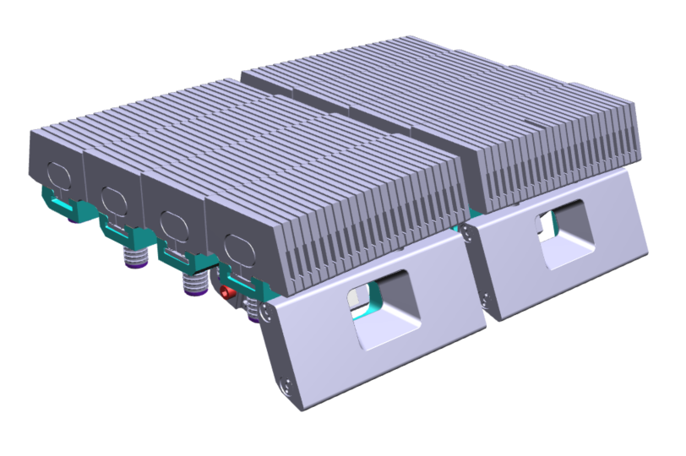
Plans for shipments of W lamellae
IAP
16 lamellae
14N LBSRP RH
A14/A15
B3/B4, B14/B15, B23/B24
C3/C4,C14/C15, C23/C24
D14/D15
Distribute samples for analysis
Cutting plan in preparation
14N-LBSRP
LH
RH
1
24
D
C
B
A
2013-14 & 2018-23
2018-2023
2011-12 & 2018-23
Assumed T content:
Max ~570 MBq / lamella
Even whole shipment of 16 lamella <40 GBq → excepted

Slide 25
Plans for shipments of W lamellae
FZJ
1 lamella
14W LBSRP LH
B12
IST
1 lamella for IBA
14W LBSRP LH
C12 ⇒ VTT (LIBS) ⇒ FZJ (LID-QMS)
VTT
2 lamellae for LIBS (Can be in 2026)
14W LBSRP LH
A12
D12 (after analysis at UKAEA) ⇒ FZJ (LID-QMS)
LH
D
RH
1
C
B
24
A
14W-LBSRP
2011-2023
2011-2023 & LIBS

Slide 26
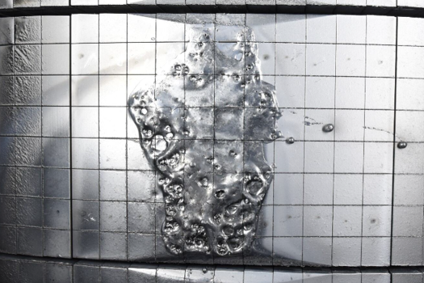
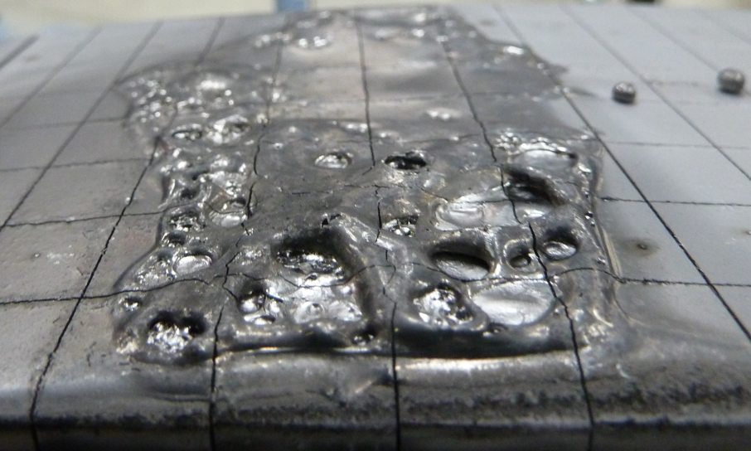
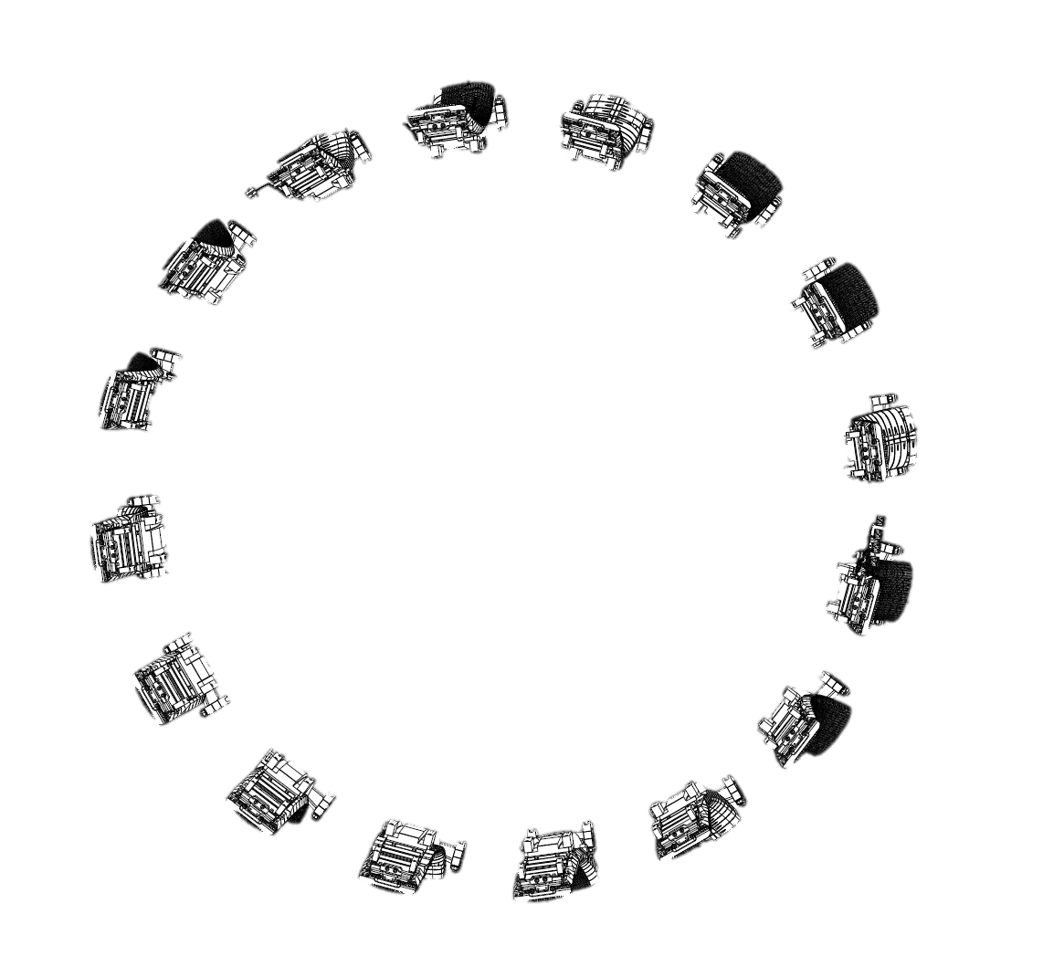
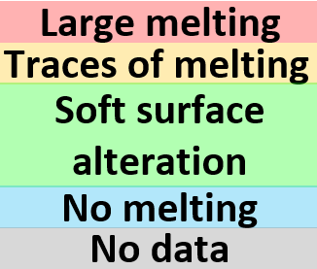
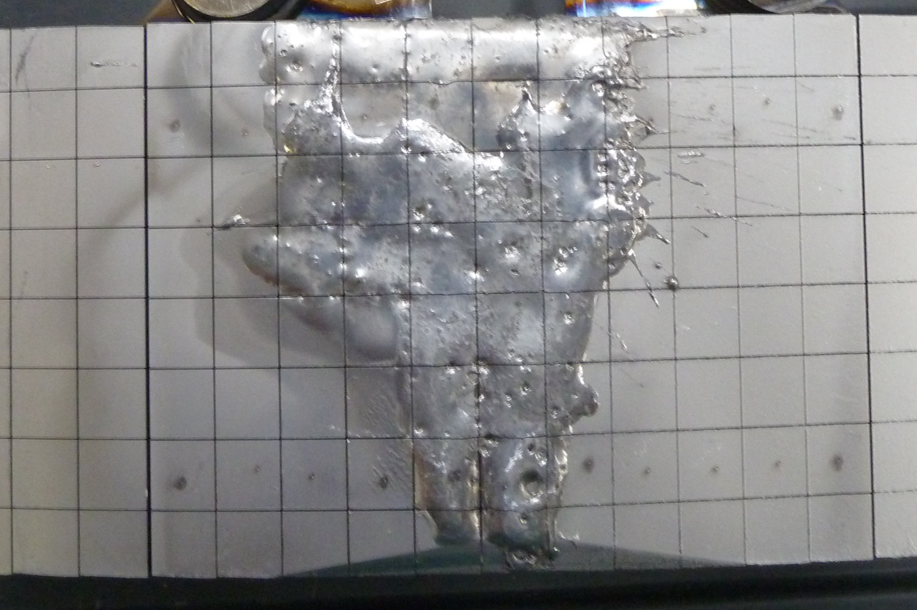
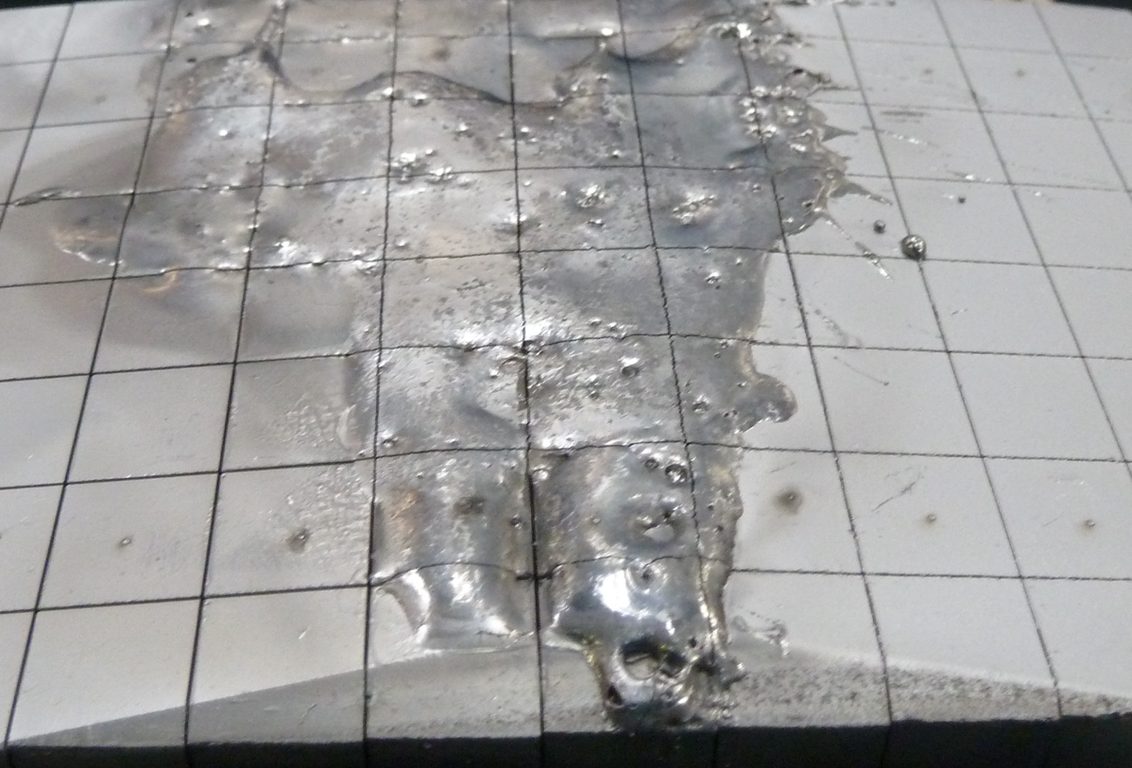
Plans for studies on the RE-induced damage on Be limiters
Toroidal limiter damage map due to RE impact
8
c)
3
7
4
Z
X
3X14
X
2
Z
d)
3X14 damage part of single day of ops (18th Dec 23)
Z
X
X
Z
5
1
Z
X
X
Z
8Z14
6
X
Z
X
Z
8
8Z14 damage part of multiple RE damages
(6th , 14th & 18th single RE shot Dec 2023)
7
Removed in the 2024 intervention
3X14 & 8Z14

Slide 27
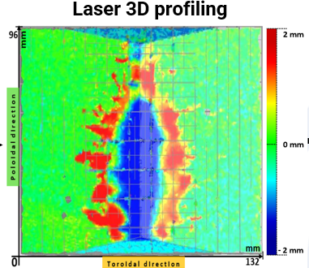
Plans for studies on the RE-induced damage on Be limiters
Near term (UKAEA):
High-resolution optical imaging of full tiles;
High-resolution optical imaging of LIBS craters;
Laser 3D profiling →;
Toroidal and poloidal assessments of LIBS spots for material composition and fuel retention (with the help of LIBS team).
Long term:
Cutting @ IAP;
Assessment of melt in gaps;
Fuel retention in and outside the RE damaged area (IBA/TDS)
Toroidal limiter damage map due to RE impact
8
c)
3
7
4
Z
X
3X14
X
2
Z
d)
SAMPLE
ONLY
Z
X
X
Z
5
1
Z
X
X
Z
8Z14
6
X
Z
X
Z
8
7
Removed in the 2024 intervention
3X14 & 8Z14

Slide 28
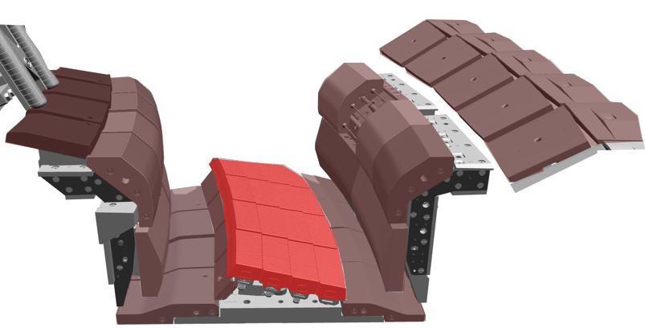
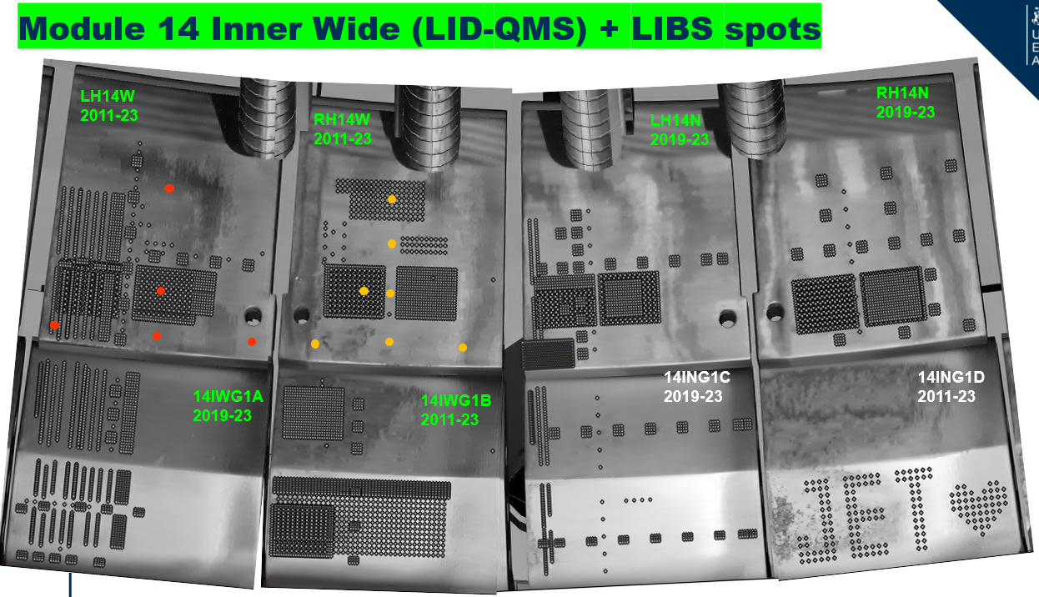
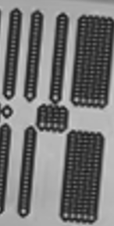
Plans for shipments of W-CFC divertor tiles
W-CFC tiles
0
1
8
3
5
7
4
6
HFGC: LH14W 2011-2023
HFGC: RH14W 2011-2023
HFGC: LH14N 2018-2023
HFGC: RH14N 2018-2023
LIBS points
LID-QMS points
Chosen tiles for SPE

Slide 29
Plans for shipments of W-CFC divertor tiles
0
8
 | VTT (coring) | Estimated tritium content, GBq/tile
2IW G1B (2010-2023) | X | 48.2
14N HFGC RH​ (2018-2023) | X | 45.6
14 IW G1A (2018-2023) | X | 48.2
14 BW G4A (2010-2023) | X | 22.1
1
5
7
3
LIBS
Tritium content is estimated based on pyrolysis results from tile 8 and relative distribution between the tiles established with ILW data.
LID-QMS
LIBS+LID-QMS
Above the excepted limit of 40 GBq/shipment
→ Type A container likely needed.

Slide 30
Summary of 2025 and outlook
Post-DTE component removal completed.
Processing of assemblies completed → plasma-facing components separated and boxed.
First batch of shipments of W lamellae imminent.
Samples packed and shipment requirements being assessed by UKAEA.
First results of microscopy on W lamella imminent (UKAEA).
Approval of transfer of first samples from DTE3 to UKAEA Materials Research Facility obtained.
Analysis planned near-term.
Shipments of W-CFC tiles in preparation for 2026.

Slide 31
SUPPORT SLIDES

Slide 32
Total tritium content – extrapolation to all divertor tile types
Extrapolation to all divertor tile types from pyrolysis measurements of JET tile samples
Order of magnitude lower inventory than previously estimated from worst case retention without cleaning and venting taken into account
Package limits:
Type A total T = 40 x10¹² Bq
Excepted package T
< 4 x 10¹⁰ Bq
Tile type | Location | Material | Tritium Bq/tile | Specific activity Tritium Bq/g
Tile 0/HFGC | Divertor | W-CFC | 4.56E+10 | 3.50E+07
Tile 1 | Divertor | W-CFC | 4.82E+10 | 1.72E+07
Tile 3 | Divertor | W-CFC | 4.88E+10 | 1.16E+07
Tile 4 | Divertor | W-CFC | 2.21E+10 | 1.05E+07
Tile 6 | Divertor | W-CFC | 1.35E+10 | 6.42E+06
Tile 7 | Divertor | W-CFC | 3.49E+10 | 7.11E+06
Tile 8 | Divertor | W-CFC | 9.43E+09 | 2.69E+06
Tile 5 lamella | Divertor | Tungsten | 5.67E+08 | 2.70E+06
Type A for W-CFC tile transport for cutting
“Excepted” likely for W lamellae
Prioritising W-lamellae and W-CFC → Be tiles still to be assessed

Slide 33
Total tritium content – old predictions
7.18x10²⁵ T atoms injected between 2020-2023
0.19% retention fraction
 | Whole tiles |  |  | Samples
Tile type | T atoms/tile | Bq/tile | Specific activity (Bq/g) | Bq/sample | Specific activity (Bq/g)
Tile 0/HFGC | 2.14E+20 | 4.00E+11 | 3.08E+08 | 6.00E+09 | 1.07E+09
Tile 1 | 2.27E+20 | 5.00E+11 | 1.79E+08 | 5.00E+09 | 8.82E+08
Tile 3 | 2.30E+20 | 5.00E+11 | 1.19E+08 | 3.00E+09 | 4.47E+08
Tile 4 | 1.04E+20 | 2.00E+11 | 9.52E+07 | 2.00E+09 | 3.40E+08
Tile 6 | 6.35E+19 | 2.00E+11 | 9.52E+07 | 1.00E+09 | 1.96E+08
Tile 7 | 1.64E+20 | 3.00E+11 | 6.12E+07 | 2.00E+09 | 2.69E+08
Tile 8 | 4.44E+19 | 8.00E+10 | 2.29E+07 | 7.00E+08 | 1.33E+08
Tile 5 Tungsten lamella | 8.86E+16 | 2.00E+08 | 1.00E+06 | 4.00E+07 | 2.31E+06
IWGL (5 tile pieces) | 2.05E+19 | 4.00E+10 | 1.60E+07 | 3.00E+08 | 7.32E+07
OPL (7 tile pieces) | 5.03E+19 | 9.00E+10 | 3.10E+07 | 4.00E+08 | 1.07E+08
IWC | 3.04E+19 | 6.00E+10 | 4.29E+07 | 6.00E+08 | 5.89E+07
DP | 1.02E+19 | 2.00E+10 | 2.86E+07 | 2.00E+08 | 6.35E+07
Package limits:
Type A total T = 40 x10¹² Bq
Excepted package T
< 4 x 10¹⁰ Bq
Type A for W-CFC tile transport for cutting
“Excepted” likely for W lamellae
Type A/Excepted border for Be tiles

