Slide 1
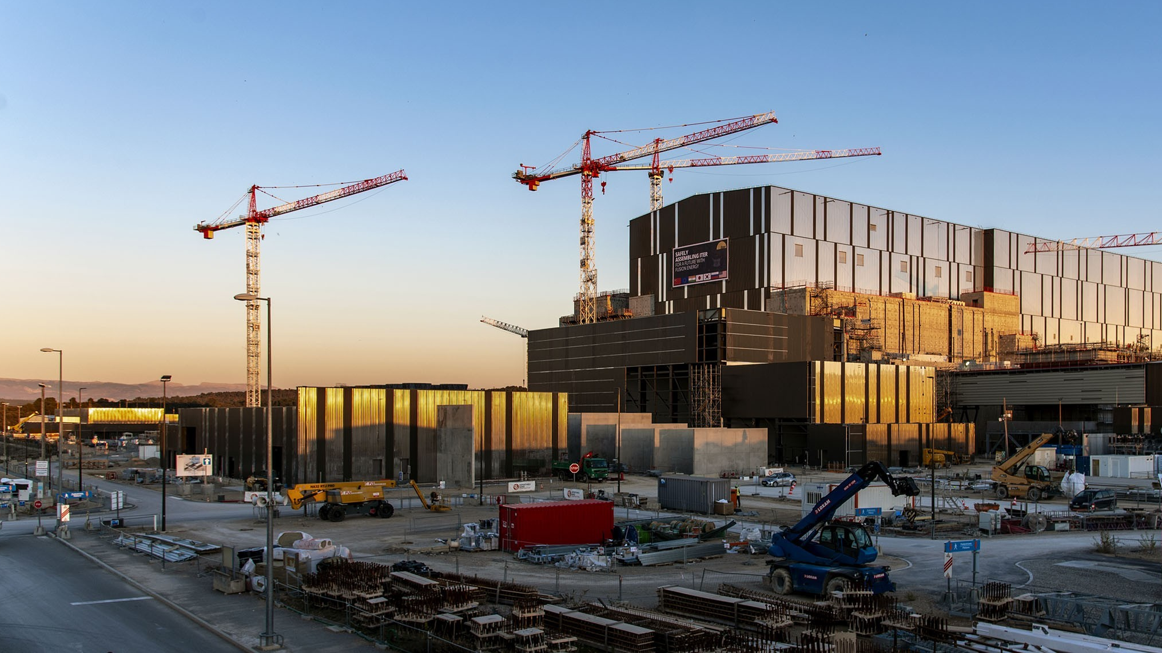

R&D issues for PWIE: Full Tungsten Walls and Boronization in ITER
Tom Wauters
WPPWIE Review Meeting, November 17th – 21st 2025

Slide 2
Outline
New baseline and IRP
Boronization and boron studies
Tritium transport in materials
Tritium retention and removal
Permeation during baking & mitigation
Open-source framework: PFC-Tritium-Transport
First wall of SRO and DT
Divertor
Conclusion
4
T_{melt} = 1287°C
Be
Baseline 2016
Beryllium
9.012
74
T_{melt} = 3422°C
W
5
Tungsten
B
183.84
Boron
Baseline 2024
10.81
* Application of thin boron coating on the W PFC’s to retrieve the gettering function of Be in the full-tungsten ITER

Slide 3
New Baseline rationale
Robust achievement of ITER Project goals, in view of past challenges (delays due to the Covid-19 pandemic, technical challenges in completing first-of-a-kind components and in nuclear licensing)
Realistic and reliable assembly – commissioning - operation
Achievement of earliest start of the ITER Nuclear Phase (DD operation) and minimization of technical risks → a new 1st phase “Start of Research Operation” (SRO)
Stepwise safety demonstration → 2 new DT phases (DT-1,2)
Key elements of the new baseline driven by physics/operations:
First Wall: beryllium (Be) → tungsten (W), start with inertially cooled W wall
Optimized heating mix + boronization → ease path to Q = 10 with added W

Slide 4
New Baseline publications
https://www.sciencedirect.com/science/article/pii/S2352179124002771?via%3Dihub
R&D needs for the new Baseline and the complete Level 3 ITER Research Plan now available as ITER Technical Reports:
https://doi.org/10.1088/1361-6587/add9c9

Slide 5
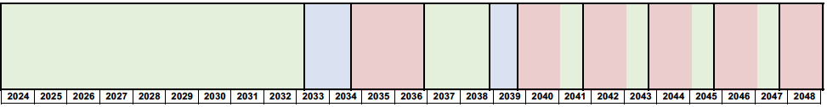
Overall Project Schedule for new Baseline
DT-1
Target dates:
Mar.
2033
Oct.
2034
Dec.
2036
Dec.
2038
Sep.
2039
Sep.
2041
Sep.
2043
Sep.
2045
Sep.
2047
Assembly-I
IC-I
SRO
Assem
bly-II
IC
-II
FPO-I
FPO-II
FPO-III
FPO-IV
FPO
-V
Operation
16 Months
Maintenance
8 Months
Operation
16 Months
Maintenance
8 Months
Operation
16 Months
Maintenance
8 Months
Operation
16 Months
Maintenance
8 Months
DT-2
18
Months
27 Months
24 Months
10 M
Operation
16 Months
Cryostat Closure
Full I_{p} & B_{T}
Q=10
>50s
Q=10
>300s
Full Field
Start DD operation
Divertor Plasma
IC: Integrated Commissioning
SRO: Start of Research Operation
FPO: Fusion Power Operation
Approval chronology:
ITER STAC-30 (May 2024) endorses Level 1 Research Plan and proposed Level 1 Construction Schedule
ITER Council 35 (Nov. 2024) endorsed the overall approach proposed for the 2024 Baseline
ITER STAC-32 (May 2025) endorses Level 2 and Level 3 Research Plan → reviewed favourably by ITER Council 36 in June 2025

Slide 6
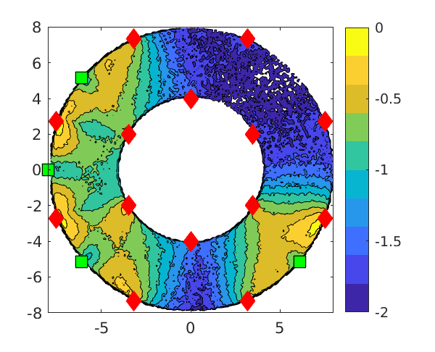
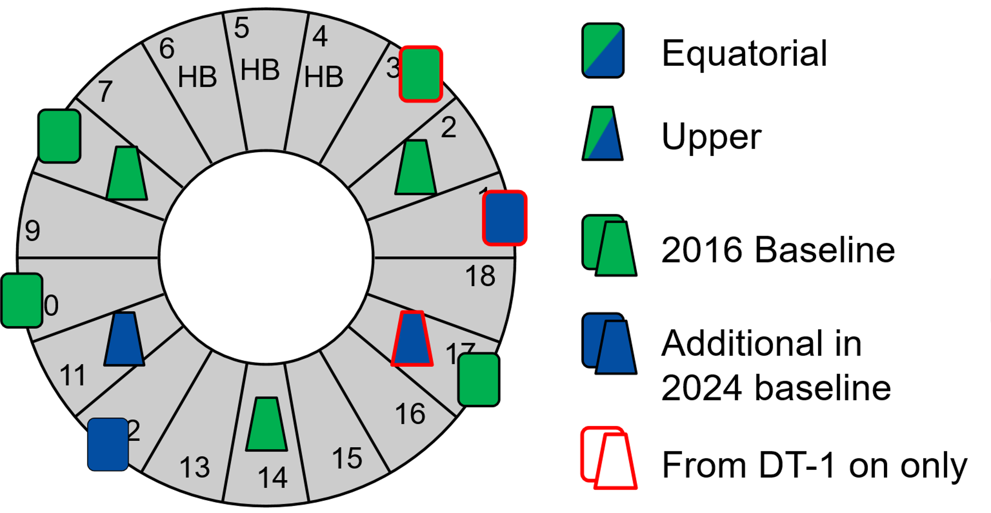
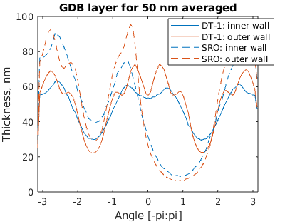
Boronization - I
Modelling of boronization GDC indicated need for LFS and HFS diborane injection points + 11 GCD anodes
Non-symmetric GDC anode distribution at in SRO & non-uniform boronization → experiments show boronization needed but spatial distribution not too critical
B₂H₆ ionization and dissociation in SRO
B deposition assuming 20% surface loss probability of [Mayer NME2025]
T. Wauters NME 2025
Need for validating and improving boronization simulations

Slide 7
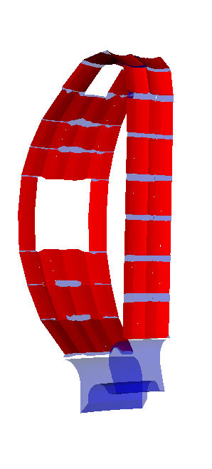
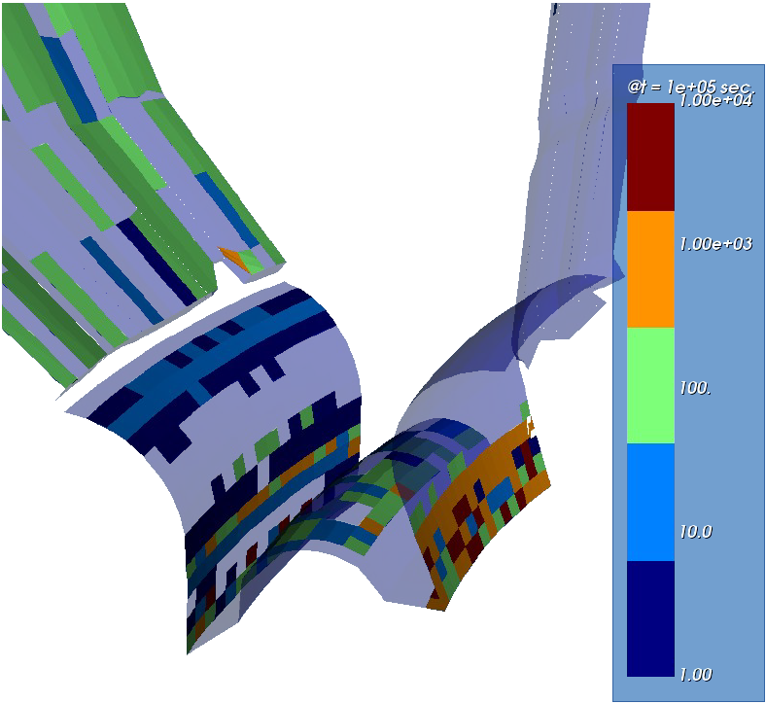
Boronization - II
Lifetime of B layer evaluated by erosion-deposition using WallDYN3D
short on plasma exposed areas
~ few 10⁴ s in remote areas → O₂ gettering not to cover W by B
50 nm B binds ∼1–5 × 10²⁰ O₂/m² → 10% wall area absorbs 2.5 -12.5 weeks 316 SL outgassing
K. Schmid NME 2024 and ISFN R&D
Maximum boronization frequency 2 weeks (STM)
Wall deposited B erodes and migrates to divertor or is covered by W
t = 10⁵ s
< 10 μm B:W
Need for (i) validating layer lifetime estimates and (ii) criteria for layer to dust conversion
t = 0 s
100 nm B

Slide 8
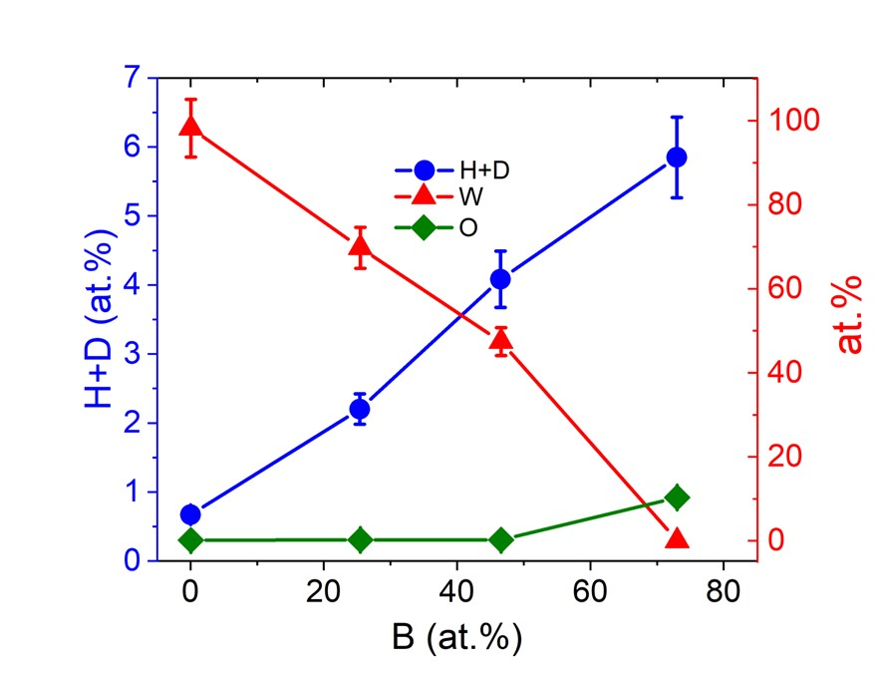
H retention in mixed material deposits
Boronization layers using B₂H₆, B₁₀H₁₂, B₂C₁₀H₁₂
W containing magnetron sputtered B layers, proxy (?) for divertor deposits
0.5 H/B
0.4 in DIII-D boronization mainly in B-C-D bond (10% of C in layer) [1]
0.1 H/B
W content lowers O uptake capability
0.1-0.25 in 3 AUG boronizations [2]
6.7% N 3.6% C
Gautam, PFMC O-4
Divertor co-deposits in C-mod [3] and AUG [4]: 0.1 H/B
Need for retention properties of ITER relevant deposits
[3] Wampler, JNM 1999
[4] Krieger, NME 2023
Pitts, NME 2025
[1] Abe, NME 2025
[2] Rohde, PFMC I-7
Notes:
Boron layers have the capability to take up significant amounts of H

Slide 9
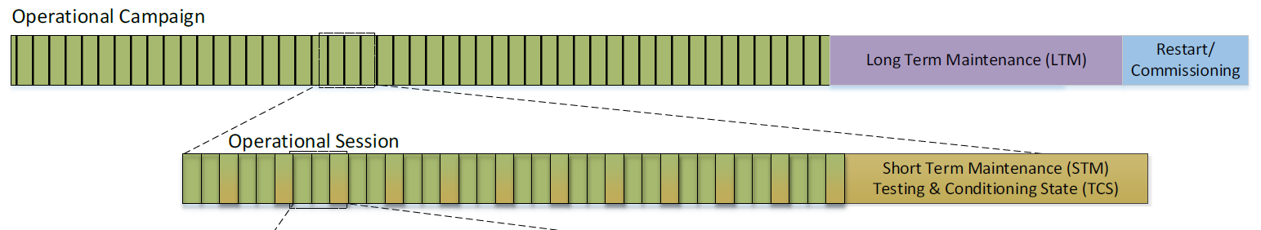
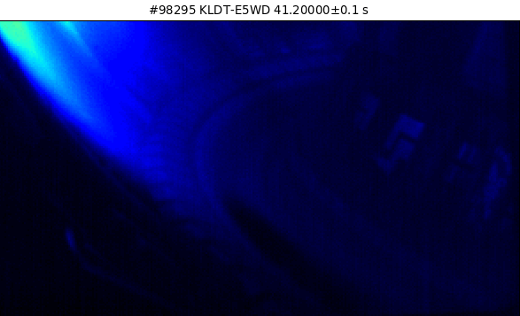
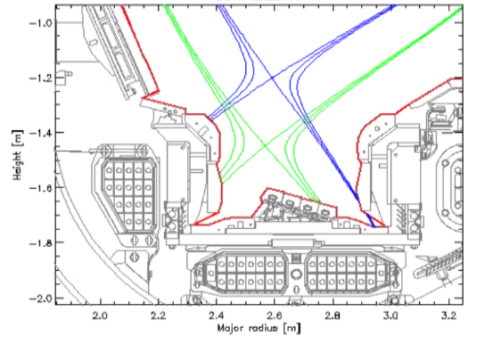
Outline ITER fuel removal strategy
T inventory management aims at 70-80% inventory reduction
Methods based on JET DTE-2 experience: Raised Inner Strike Point (RISP) + Ion Cyclotron Wall Conditioning (ICWC)
15% of DT-1 FPO campaign time allocated to T removal
B_{T} off: GDC and baking @ 240°C
10-12 operational days and 2-4 Short Term Maintenance days
RISP in JET
Dedicated time for T clean-up: e.g. 1 RISP + ICWC pulse per day
B_{T} off: GDC and GDC boronization @ 70ºC
RISP in JET
RISP
V5
Notes:
The removal strategy aims at an up to 80% reduction of the amounts shown on the previous slide

Slide 10
Outline ITER fuel removal strategy
T inventory management aims at 70-80% inventory reduction
Methods based on JET DTE-2 experience: Raised Inner Strike Point (RISP) + Ion Cyclotron Wall Conditioning (ICWC)
15% of DT-1 FPO campaign time allocated to T removal
B_{T} off: GDC and baking @ 240°C
10-12 operational days and 2-4 Short Term Maintenance days
Dedicated time for T clean-up: e.g. RISP + ICWC before STM / before boronization
B_{T} off: GDC and GDC boronization @ 70ºC
RISP in JET
RISP
Need for validating fuel recovery strategy in full-W devices with boronization
V5

Slide 11
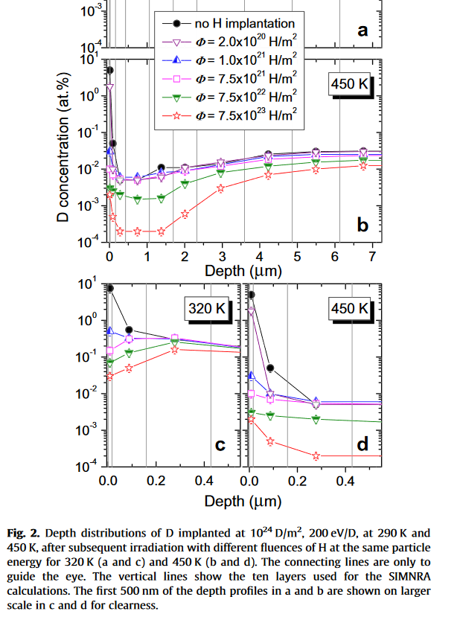
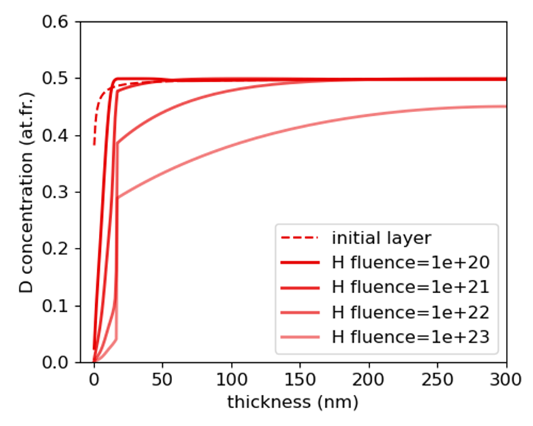
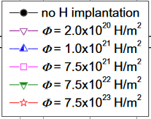
Isotope exchange from W and B
Fluence of 10²¹ H/m² sufficient to deplete near surface layers in W and B
Tungsten
Boron
W pre-loaded at 10²⁴ D/m²
Exposed to H (200 eV)
MHIMS simulation with material parameters of [Oya JNM 2004]
D concentration (at.%)
D concentration (at.%)
343 K
200 eV H
Hodille, ISFN
Roth, JNM 2013
10²¹ atoms/m² is feasible in 20 min ICWC in ITER at 15% duty cycle, based on
TOMAS and TORE SUPRA ICWC charge exchange spectra scaled to ITER power / surface area
EAST ICWC charge exchange spectra at ITER relevant power / surface area
Need to specify mechanisms for isotopic release/exchange from boron layers
Notes:
Isotope exchange experiments in W on the left and simulations for Boron on the right show that …

Slide 12
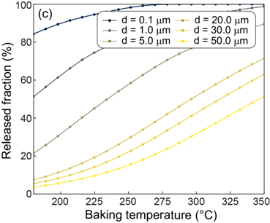
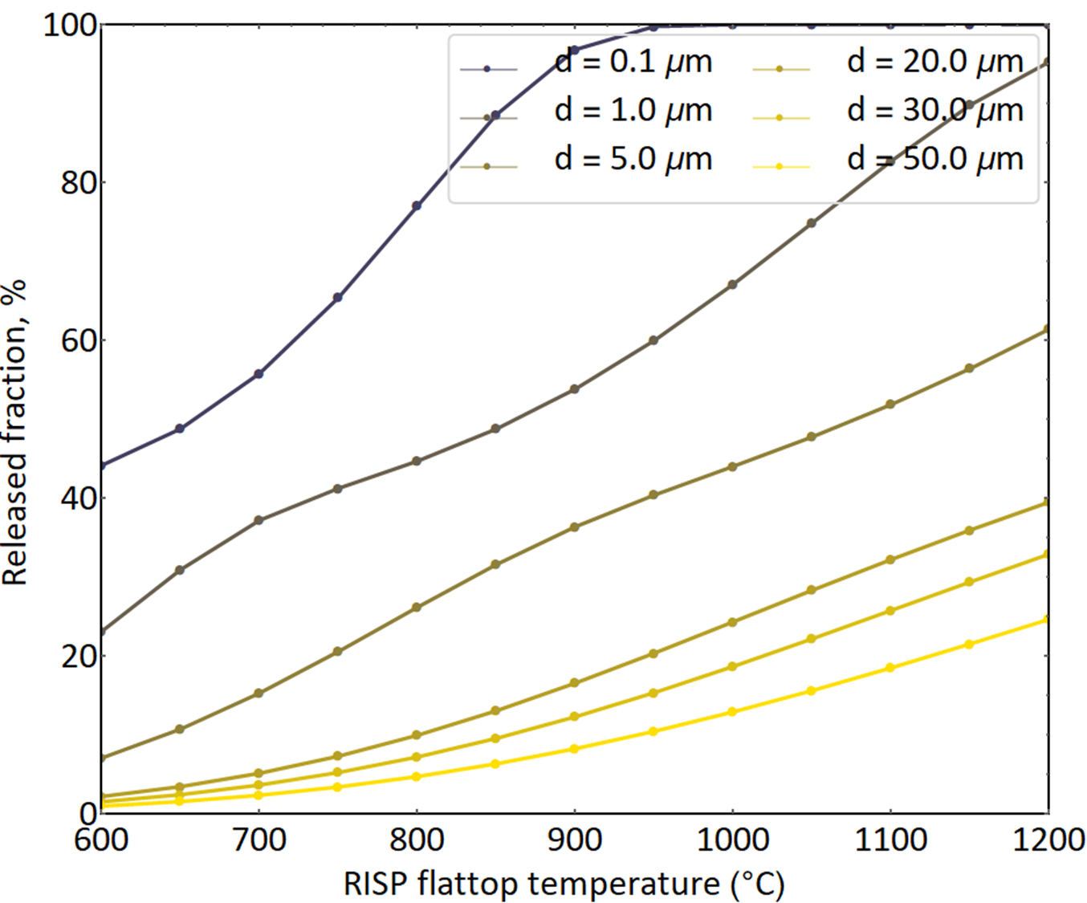
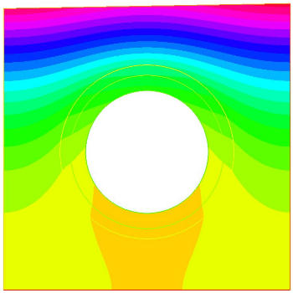
Thermal release from B layers
Thermal release from B layers simulated by CRDS [1] & MHIMS [2] in 1D
D trapping parameters in B adapted to experimental data of [3-5]
Baking for 2 weeks
10s of layer heating by plasma
Raised Inner Strike Point (RISP) scenario 10 MA deuterium L-mode 20 MW ECH [2]
Hodille, ISFN
Release fraction, %
MHIMS
Param: [5]
1 to 5 micron
CRDS [1]
Param: [3]
T release
B:D Deposit
~5 µm
20 to 50 micron
Rc
W monoblock
Layer temperature ºC
Baking at 220ºC is not efficient for removal from > 10 micron thick deposits
(Similar to Be [6])
[1] Matveev, Phys Scr 2020
[2] Hodille, JNM 2015
[3] Nakahata, JNM 2007
[4] Annen, J Non-Crystalline Solids 1997
[5] Oya, JNM 2004
[6] DeTemmerman, NME 2017
Notes:
Operating normal baking for several weeks, at the end of the campaign when layers are …

Slide 13
Thermal release from B layers
Thermal release from B layers simulated by CRDS [1] & MHIMS [2] in 1D
D trapping parameters in B adapted to experimental data of [3-5]
Baking for 2 weeks
10s of layer heating by plasma
Raised Inner Strike Point (RISP) scenario 10 MA deuterium L-mode 20 MW ECH [2]
Hodille, ISFN
Release fraction, %
MHIMS
Param: [5]
1 to 5 micron
Need for better understanding of
thermal release / isotopic exchange from ITER relevant material deposits (B/W/O)
means to improve baking efficiency (gas atmosphere or combined with GDC?)
release of T during vessel venting
CRDS [1]
Param: [3]
T release
B:D Deposit
~5 µm
20 to 50 micron
Rc
W monoblock
Layer temperature ºC
Baking at 220ºC is not efficient for removal from > 10 micron thick deposits
(Similar to Be [6])
[1] Matveev, Phys Scr 2020
[2] Hodille, JNM 2015
[3] Nakahata, JNM 2007
[4] Annen, J Non-Crystalline Solids 1997
[5] Oya, JNM 2004
[6] DeTemmerman, NME 2017
Notes:
Operating normal baking for several weeks, at the end of the campaign when layers are …

Slide 14
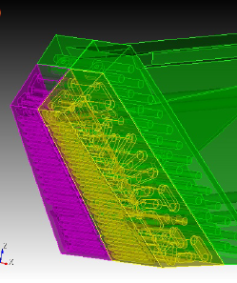
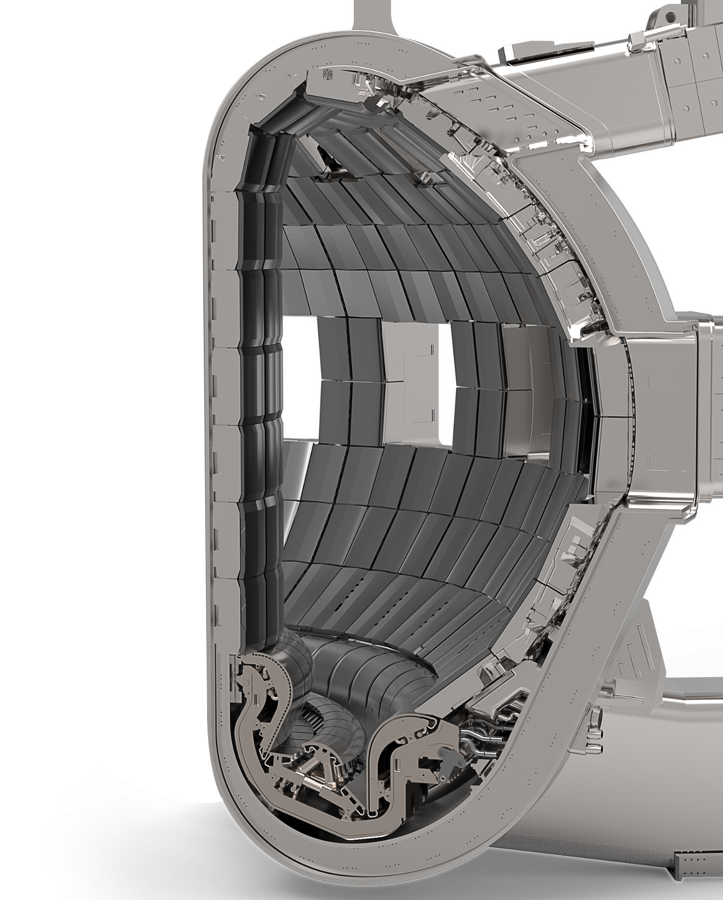
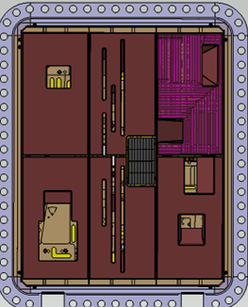
Permeation through SS316L diagnostic first wall
Depending on material parameters, permeation through Stainless Steel 316L surfaces during baking can be significant
Predictions for permeation barriers rely on material parameters and material interface conditions
Charge exchange atoms
W
1 mm
W
2 mm
50 µm
Cu
1 mm
SS
SS
50 µm
W
W
Al₂0₃
SS
SS
SS
SS
SS
SS
Need for hydrogen transport parameters for ITER materials and material interfaces
Need to assess role of boron layers on permeation and retention
Diagnostic first wall = water-cooled plasma-facing surface of ports with diagnostic apertures
5 mm
Integrated permeation flux into coolant (%)
100 | 74 | 3 | 0.2 | 10⁻⁷ | <10⁻⁷
Notes:
When ITER is baked, …

Slide 15
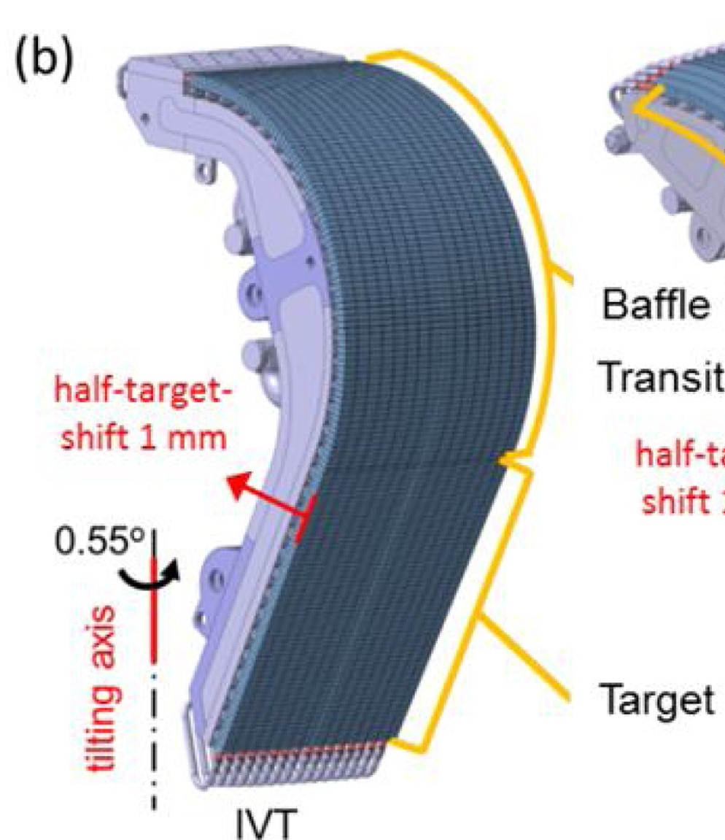
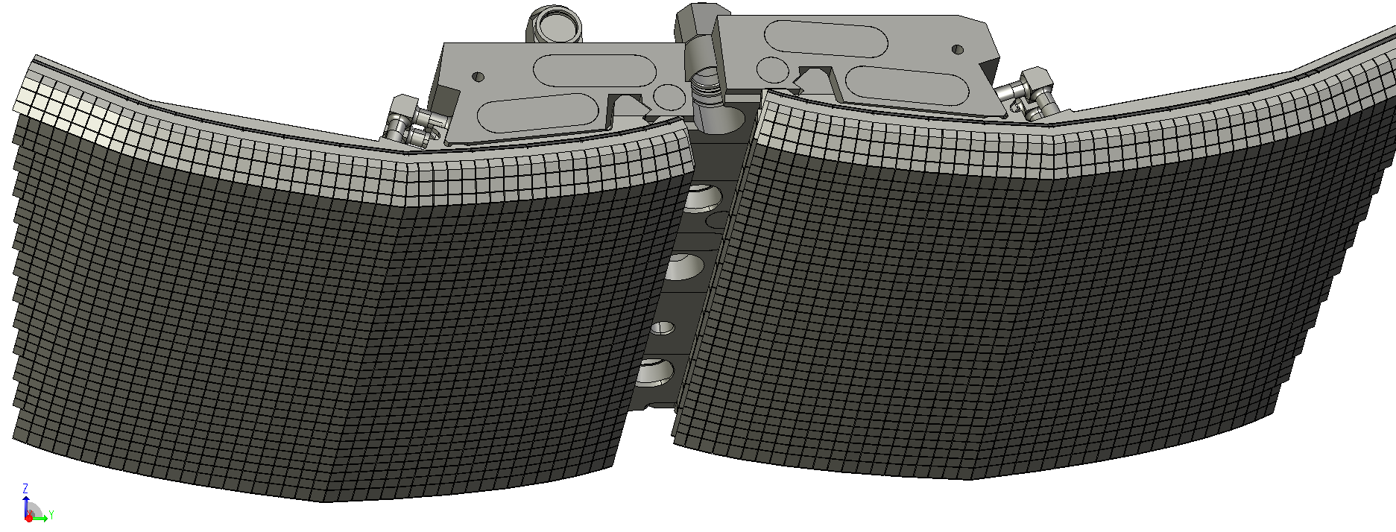
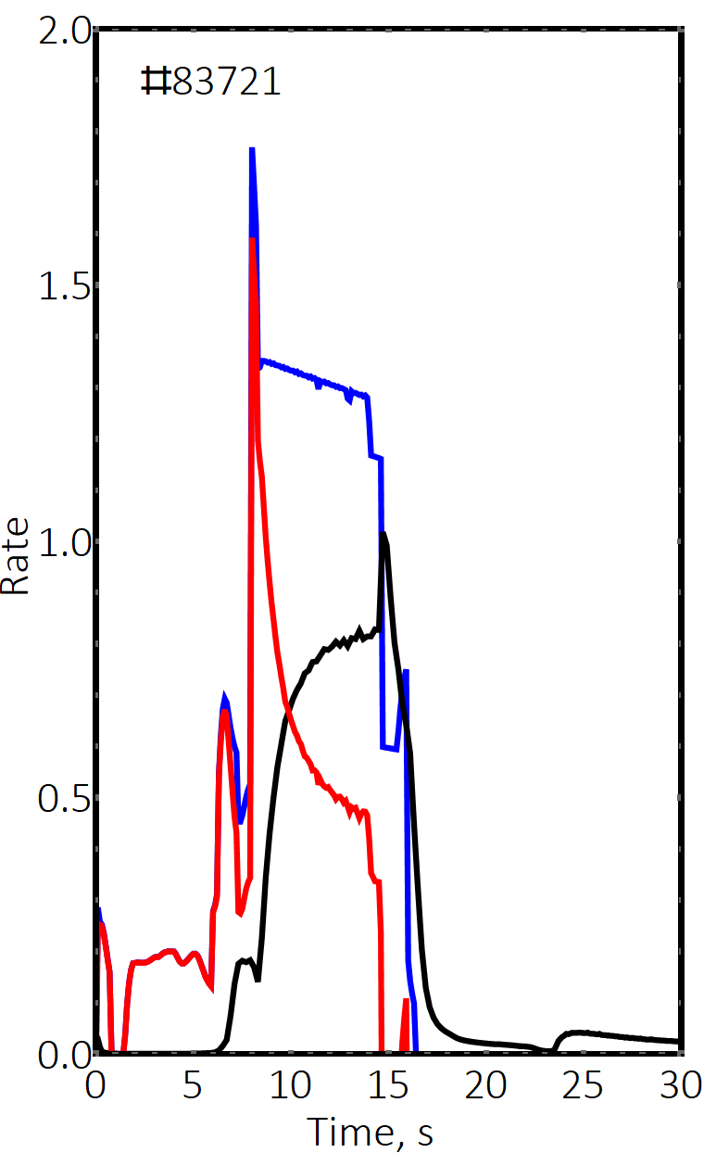
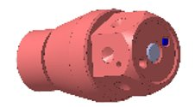
Fuel inventory measurements in ITER
Local measurement
Intra- and inter-shot gas balance
Global gas balance
Post-mortem analysis
Inter-shot
Short- or long-term
Single discharge
Single cryo-regeneration
Short-term retention
Multiple operation days
Includes inter-shot outgassing
Long-term retention
Entire campaign or longer
Long-term retention
①
JET example
Φ
injected
①
G_{in}
G_{wall}
Φ
Need for experience on in-vessel inventory measurement in W/B environment
Need for continued development of LIBS presently considered for in-between campaign surface characterization using Agile Robot Transport system in ITER
G_{out}
retained
②
Φ
~20 mm
pumped
②
① Tritium monitor (LID-QMS)
② Erosion monitor
In-vessel viewing system
Pressure gauges
Diagnostic RGA
PVTc analysis at Tokamak Exhaust Processing (TEP)
PVTc analysis at Storage and Delivery System (SDS)
① First wall samples
② Dust monitor
Notes:
Such simulations need of course to be supported by measurements…

Slide 16
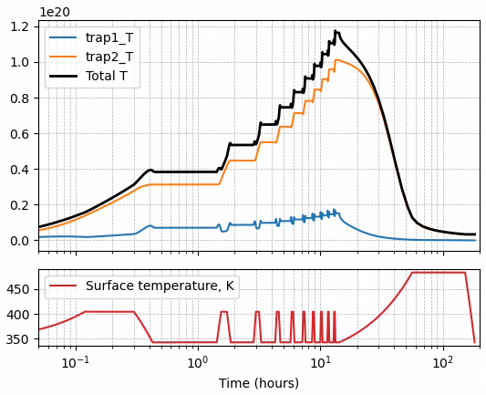
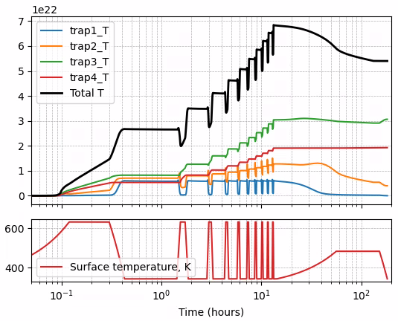
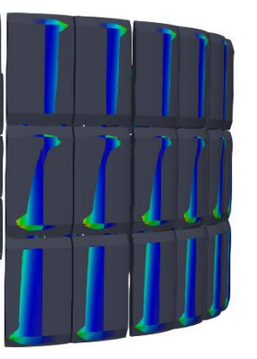
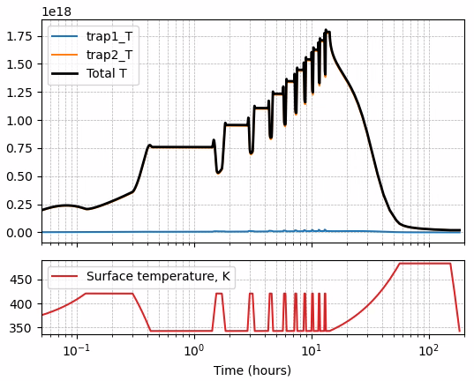

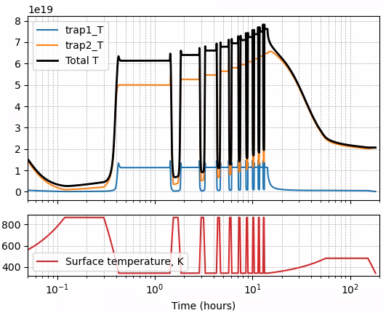
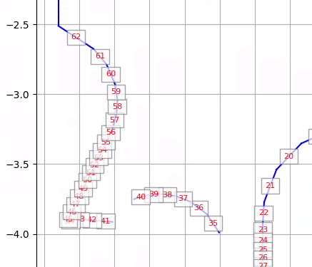
Numeric tracking of T inventory in ITER
Dunnell, to be submitted to NME
T inventory starting from empty surfaces:
W at inner divertor
5 µm boron deposit
1.2x10²⁰
Divertor 53
6 mm
6.8x10²²
10 days of DT pulses
Bake
Bake
Divertor 59
Bake
W at inner wall shadowed area
Atoms/m²
Atoms/m²
1.8x10¹⁸
First wall row 4
Shadowed
10 mm
Bake
Atoms/m²
W near inner strike point
Need to validate inventory tracking approach based on inventory measurement and simulations
7.6x10¹⁹
Divertor 47
6 mm
Bake
Atoms/m²
Tritium inventory determined by boron
Baking is effective for removal from W
Based on FESTIM2: https://github.com/iterorganization/PFC-Tritium-Transport + https://github.com/festim-dev/hisp
Based on MHIMS: https://git.iter.org/projects/BND/repos/hisp
Notes:
An example of a simulation performed using this platform, is shown on this slide…

Slide 17
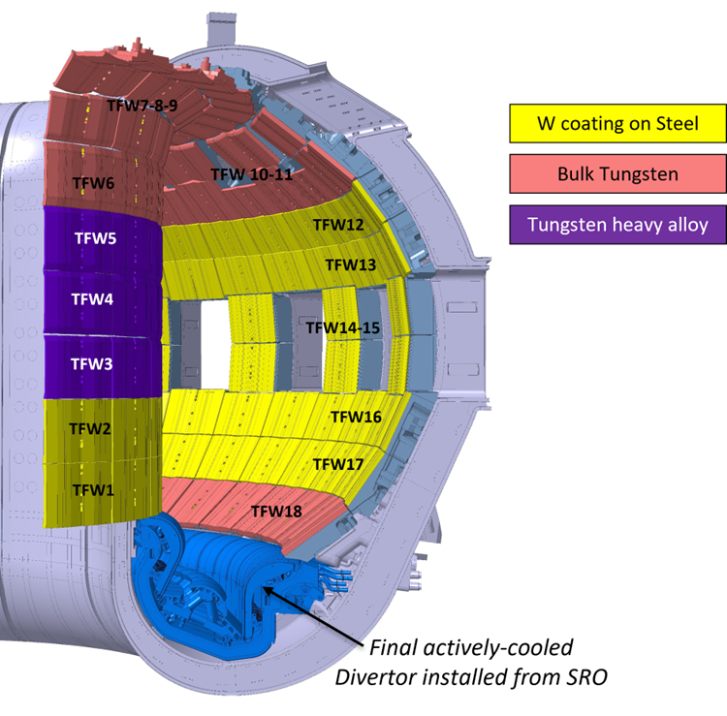
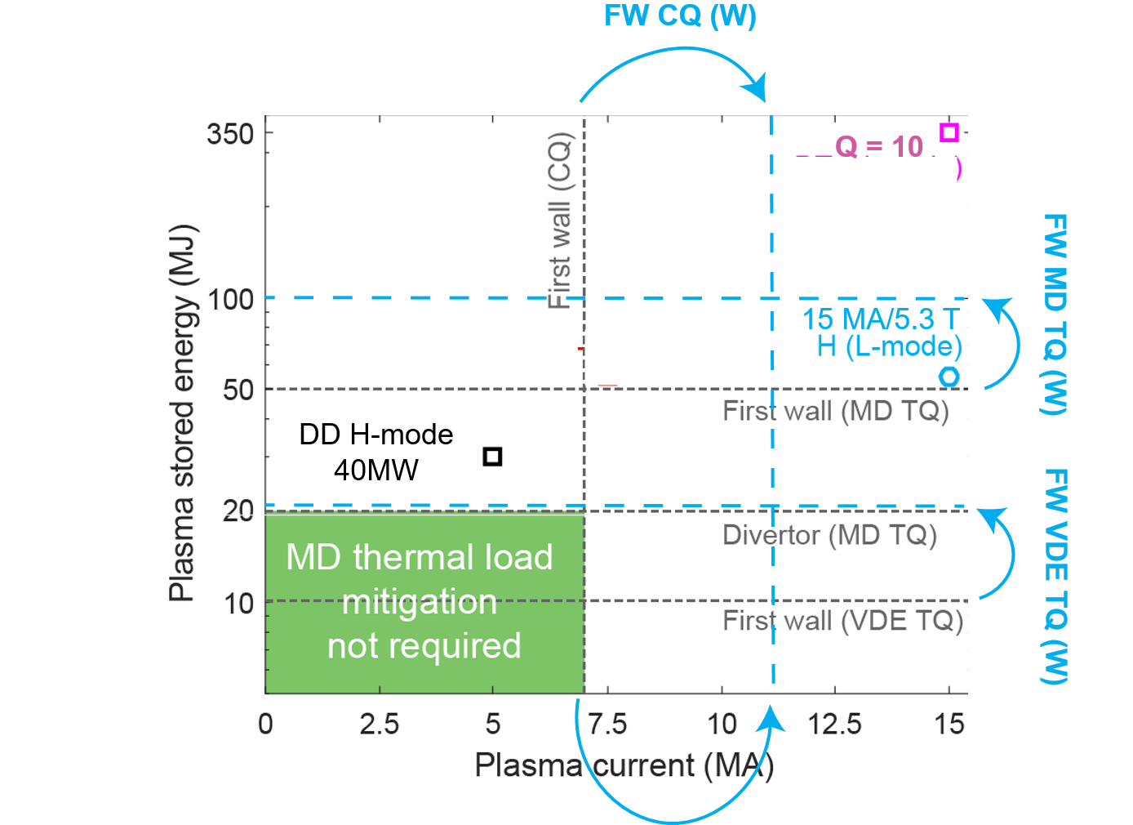
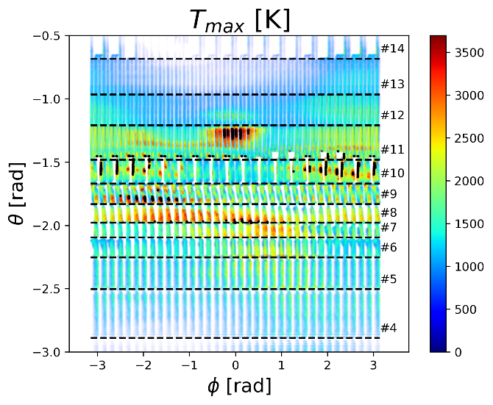
SRO wall : Scenarios + resilience to unmitigated loads :
Cost: choice of W material based on stationary & transient loads (up to 15 MA)
Optimized for resiliency to unmitigated/partially mitigated transient loads
ITER 15 MA unmitigated VDE – JOREK – Artola
T_{melt} ~ 3400 ºC
W (wt.%) 97
Ni (wt.%) 2
Fe (wt.%) 1
T_{melt}~1500 ºC
Need for qualifying W coatings and HWA under ITER relevant loads conditions
In-vessel VS to decrease risk of downwards VDE

Slide 18
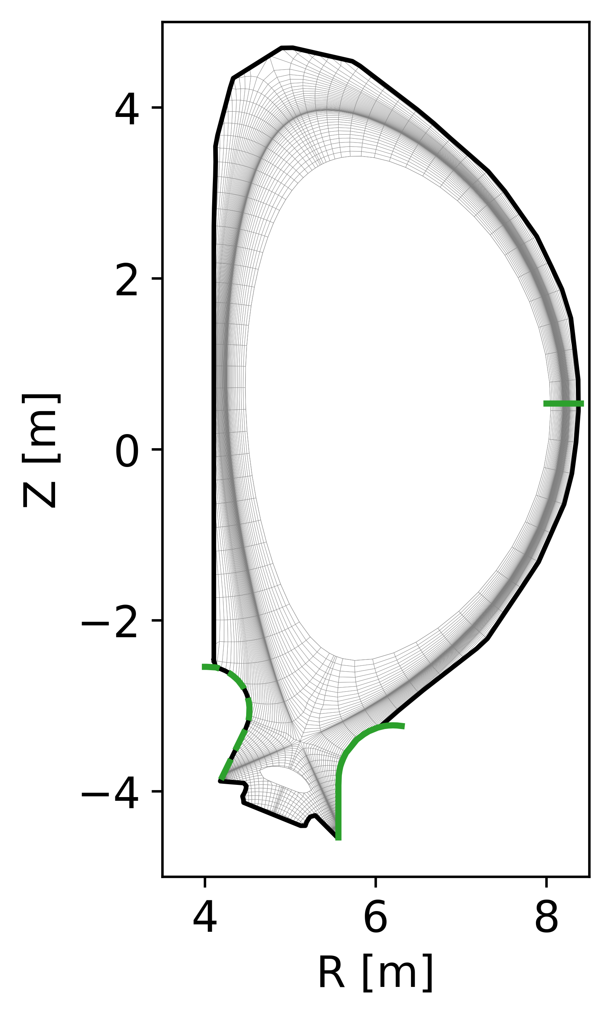
Impact of W wall on Q ≥ 10 is low/moderate
Suppressed/no-ELM regime required for Q ≥ 10 → modelled with D_{ped}, χ_{ped} anomalous for main ions and anomalous + neoclassical for W
Improved evaluations : W sources from modelling + self-consistent SOL plasma (largest P_{wall} and Γ_{wall} compatible with design) → Ne main driver for W wall source
ITER - SOLPS – Pshenov
ERO2.0 (W gross erosion) – C. Bauman
Need for validating W erosion/migration codes in present devices

Slide 19
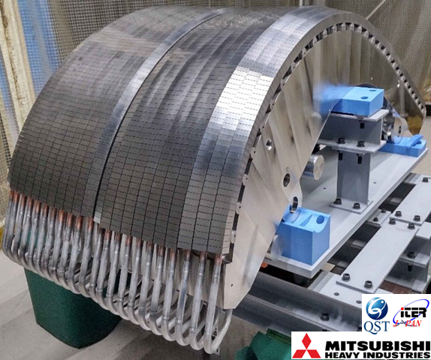
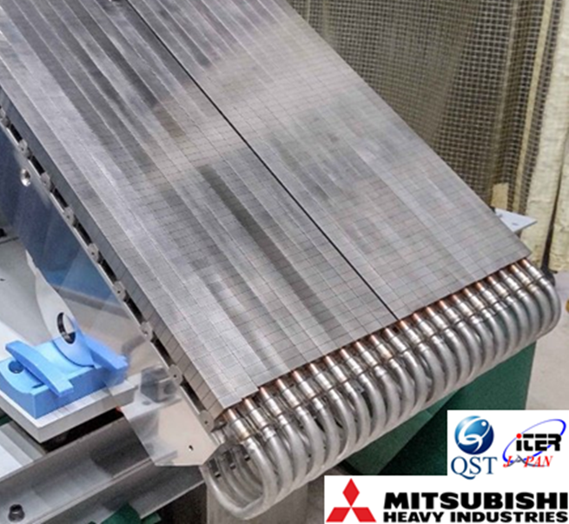
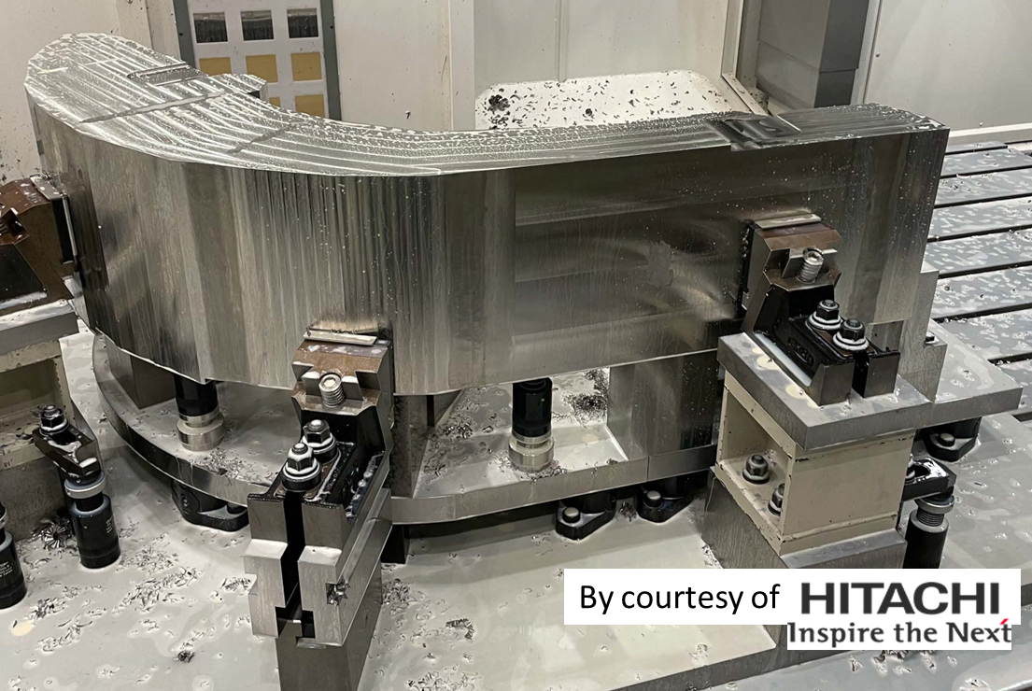
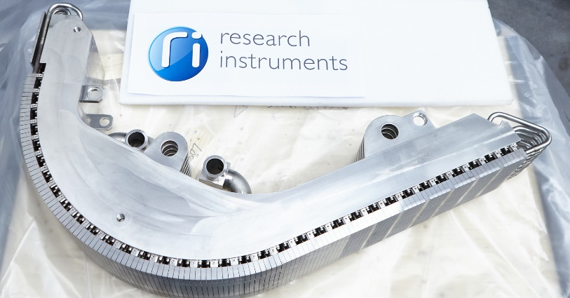
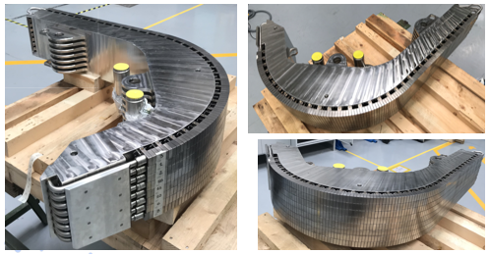
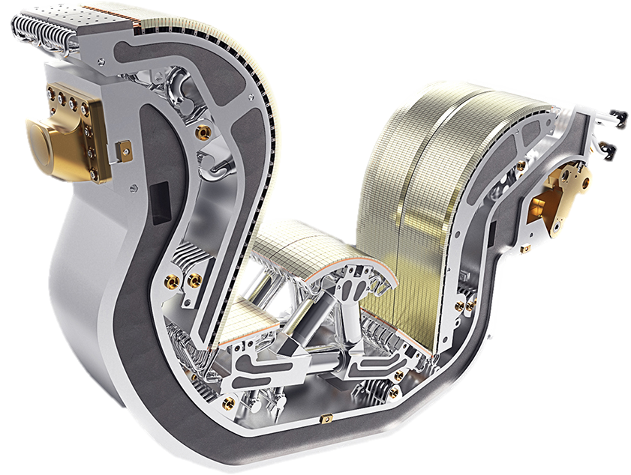
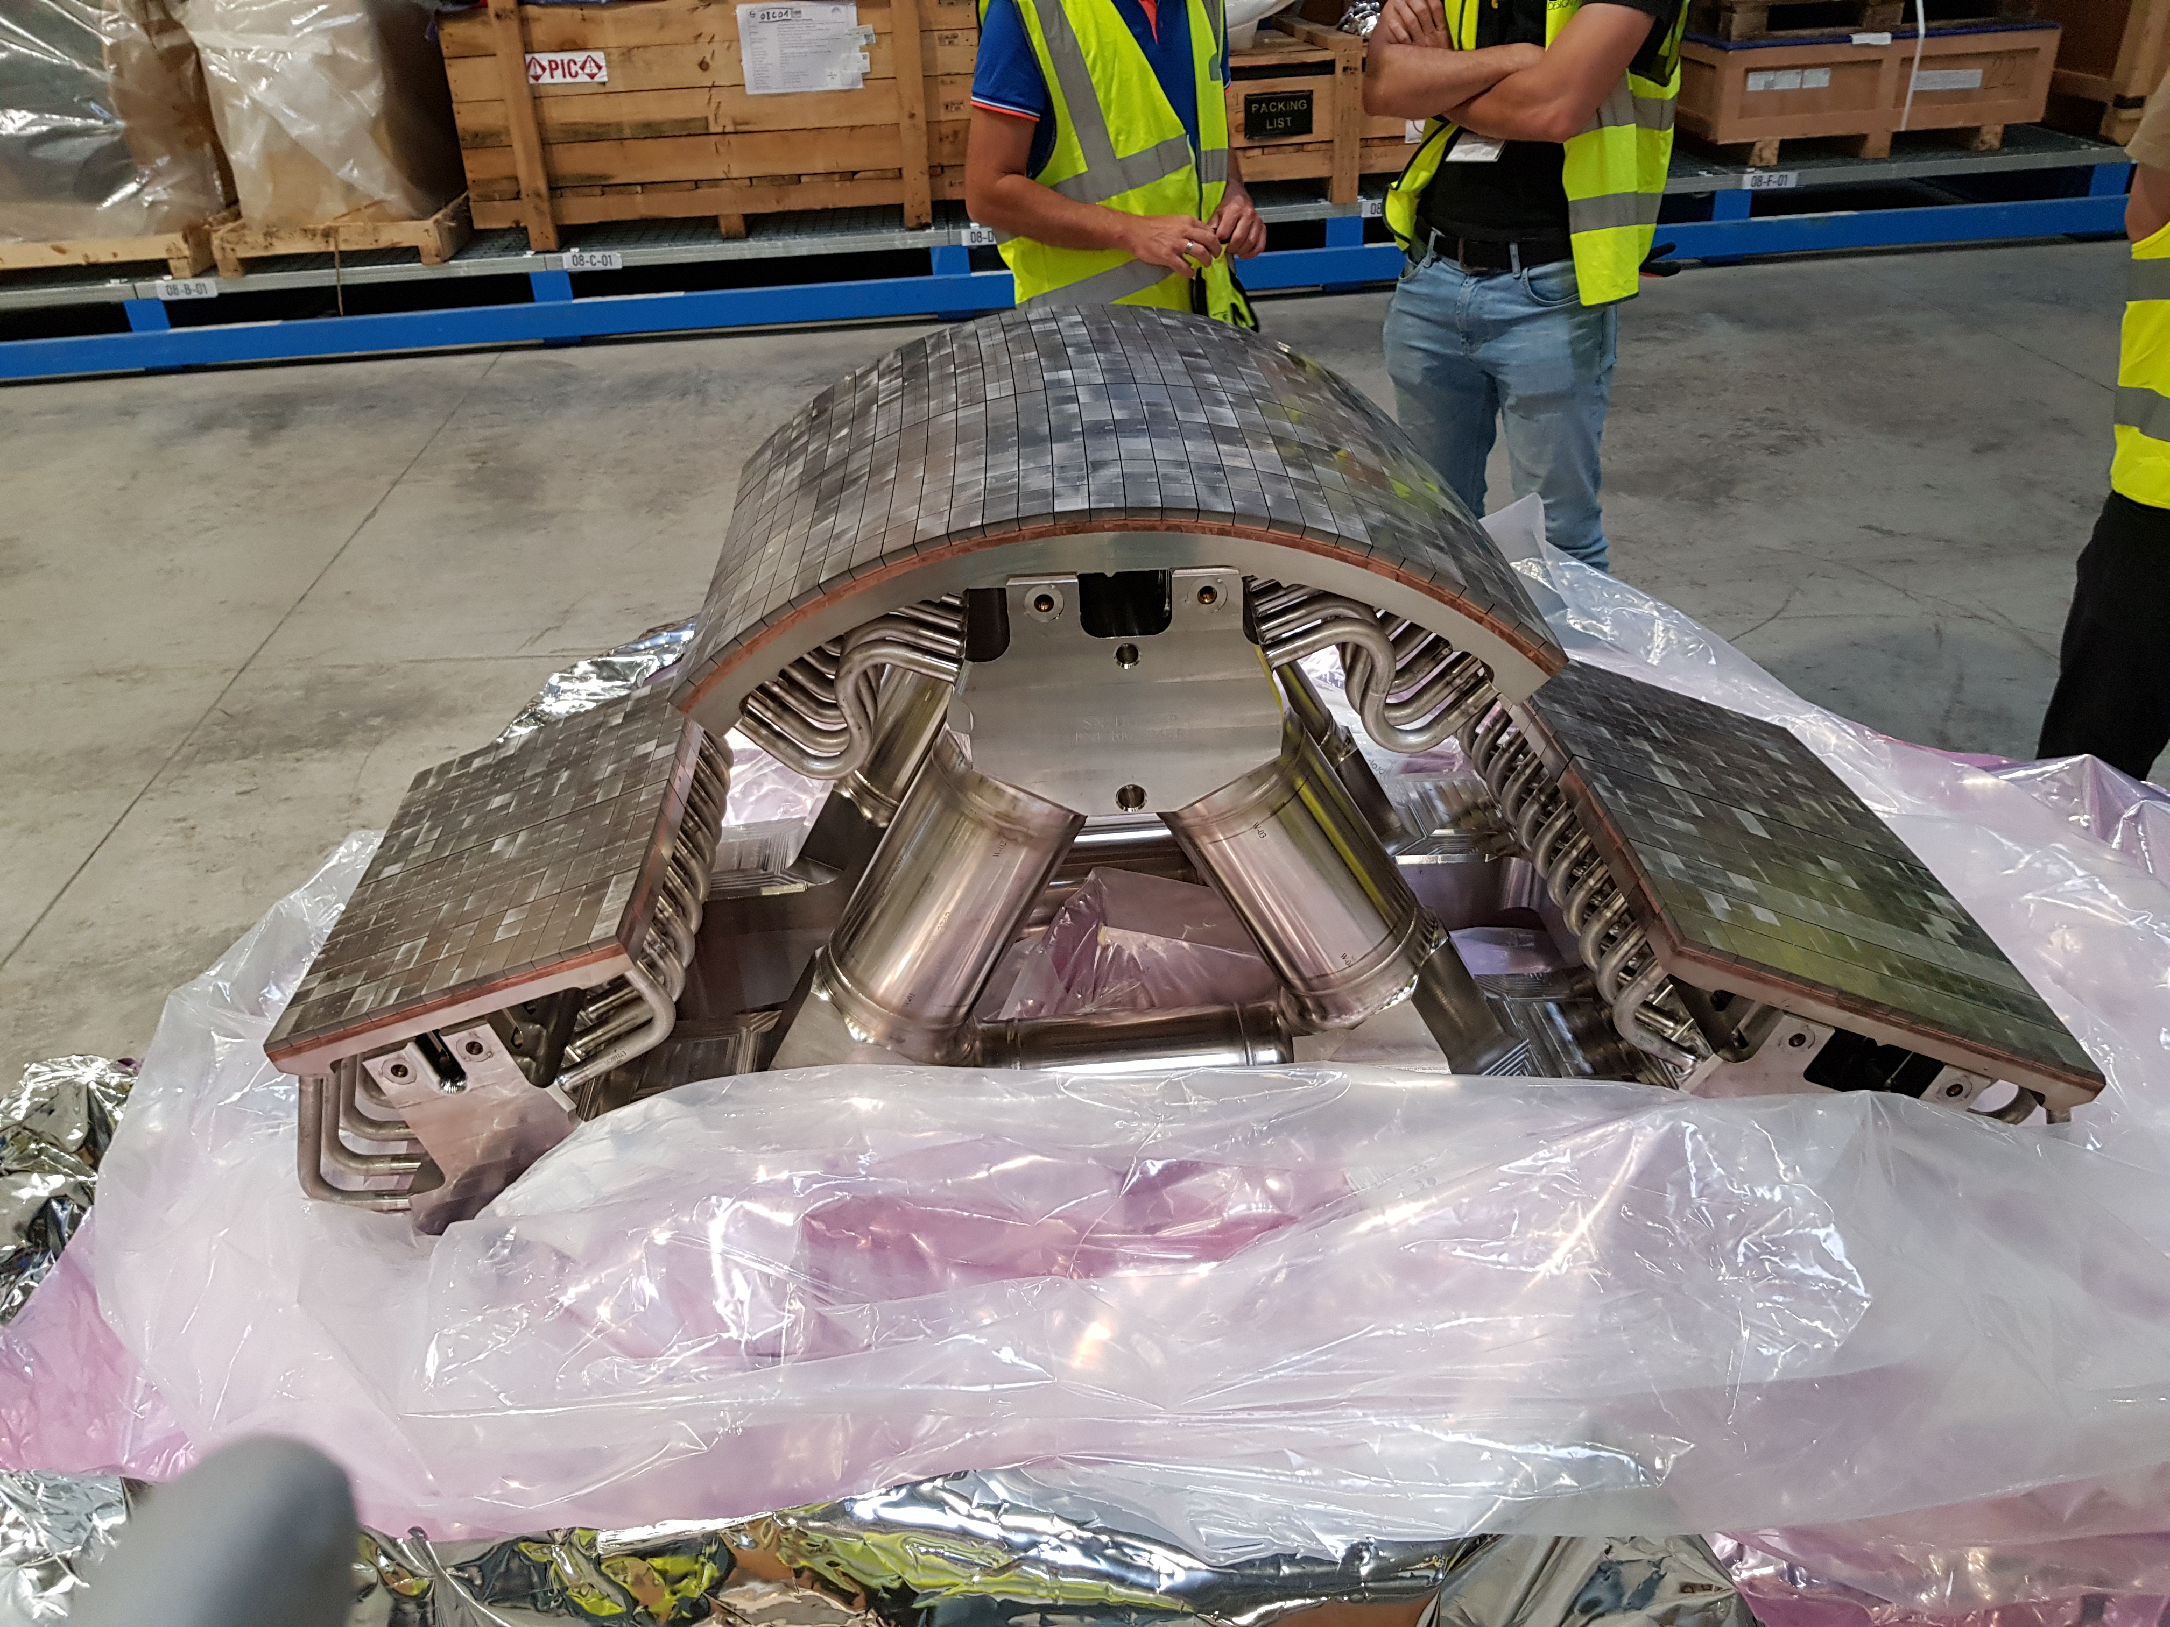
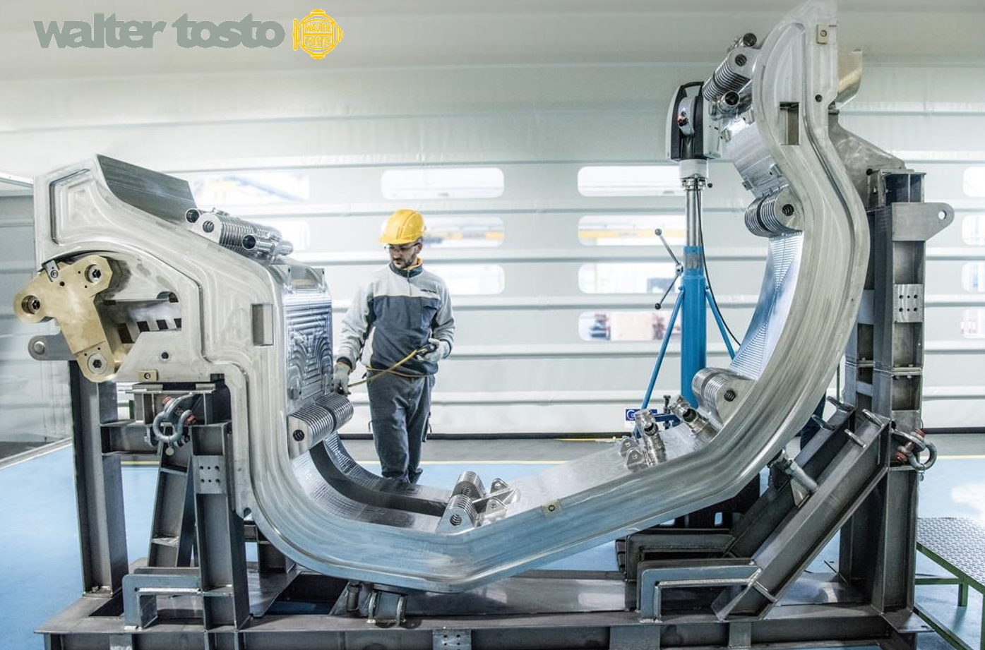
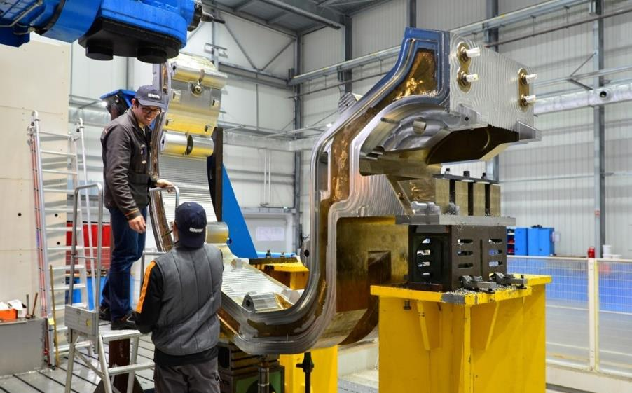


Divertor
54 Cassette Assemblies, 8 t each, ~140 m² W monoblocks and flat tiles
Full-scale prototypes complete for all major components (IVT, OVT, Dome, CB) → supply chains established for manufacture in all concerned DA’s → 3 OVT already completed at JA-DA
Need for experience on long-pulse operation with ITER-like PFUs, including performance limits and in-vessel monitoring, strategies for managing material deposits and handling of dust

Slide 20
Conclusion
New baseline includes new/modified systems and operational strategies to mitigate risks of W wall : boronization, increase of P_{ECH} & P_{tot} (also for Q ≥ 10 with 3.10²⁵ n in DT-1), operation with central ECH at 2.65 T and 5.3 T, etc.
Staged installation of systems (SRO and DT-1) includes risk minimization : inertially cooled W wall and ELM control schemes in SRO
In preparation of ITER operations, it is essential to assess the advantages/risks of W wall in ITER using experiments and modelling
Work of PWIE is essential and well aligned with open R&D issues ITR-25-005
Thank you for your support and I wish you a successful meeting

Slide 21
Video of sector installation in tokamak pit
18 June 2025

