Slide 1

WP PWIE - High heat flux testing of materials and components – 2020 - 2025
Mauricio Gago, Daniel Dorow-Gerspach, Marius Wirtz, Marcin Rasinski

Slide 2
Task Specification
This task contributes to the qualification of current baseline materials and beyond by different heat load treatment techniques and quantifying the difference in damage behavior by the different loading techniques as well as the additional impact of fuel species and other fusion relevant conditions. In addition, it helps with the long-term activities in the FSD and FTD to predict the power load capabilities and damage thresholds for materials envisioned for current and future fusion devices.
This includes the qualification of materials for W7-X (in collaboration with WPDIV and WPW7X) and preparation of exposures in WEST and ASDEX Upgrade (via WPTE). The basis for the tests are materials defined by WPMAT and WPDIV. ITER as baseline for the use in current devices as well as DEMO.
Samples from pre-damaged experiments in WEST /DEMO limiter samples (WPDIV)/Composite and Alloy Samples (WPPRD)
Tasks to be performed:
Establish a test matrix for materials utilized in WEST and ITER with respect to updated load specifications in the available devices
Study the impact of synergistic loads on ITER and DEMO relevant baseline Materials and new materials developments with laser and e-beam (JUDITH) as well as steady-state plasma exposure (He, H). A special focus will be the qualification of these materials under high cycle numbers and seed-impurities exposure. (FZJ)
Post-mortem analysis will characterize the induced surface modifications and damages as well as investigate changes of the materials properties due to e.g. recrystallization behavior and/or surface morphology changes.
Determine underlying mechanisms of evolution of crack propagation in materials for ITER and current day devices
Qualify W materials for use in W7-X
Synergy effects from sequential stationary (PSI-2 / MAGNUM-PSI, OLMAT) and transient (QSPA) plasma loads
Studies of fatigue cracks formation in deformed/re-crystalized W, fatigue damage of Wf/W wires, latticing W etc.
Combination of pulsed and steady state loading (e.g. behavior of QSPA pre-damaged targets in PSI-2, JUIDTH compared with reference samples)
Study the Behavior of pre-cracked samples under edge loading conditions - links to HHF facilities such as JUDITH and WEST.

Slide 3
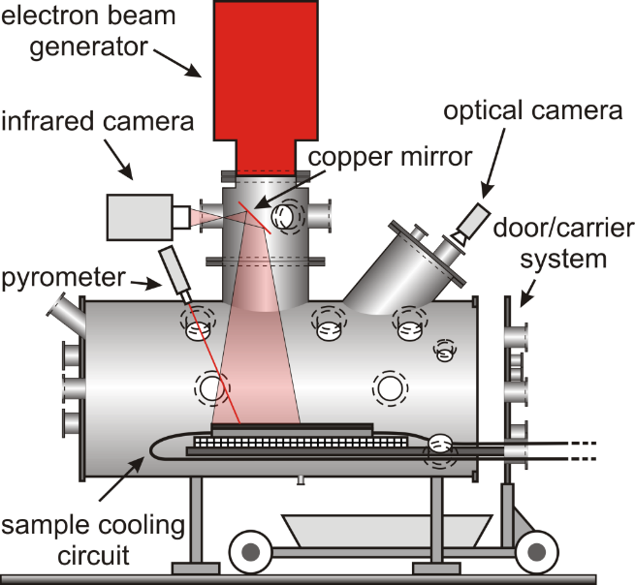

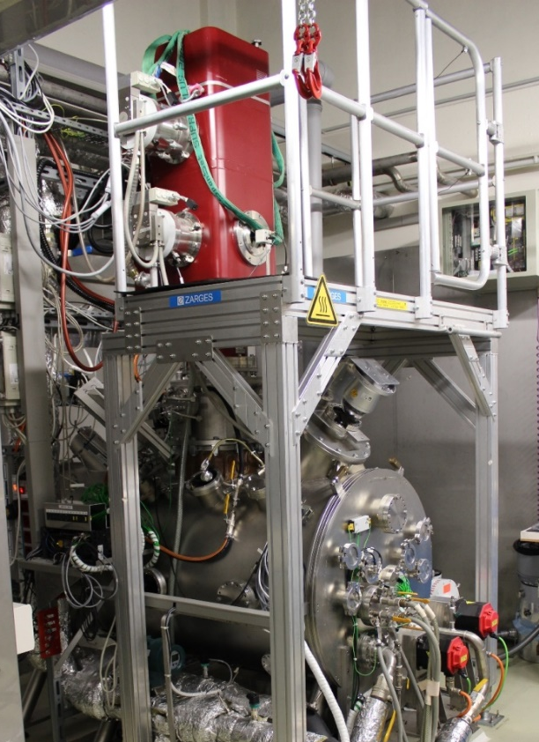
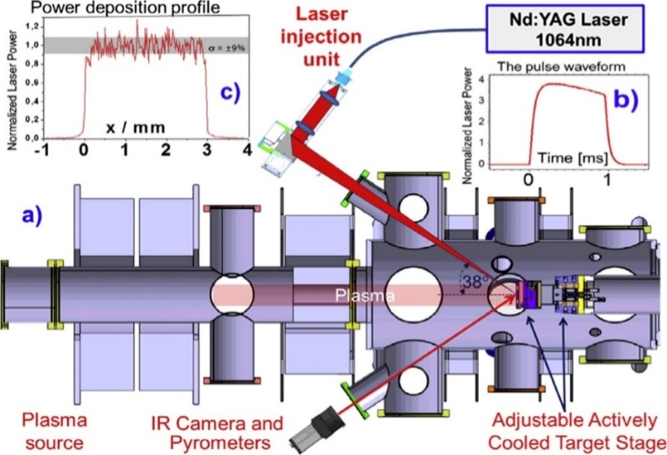
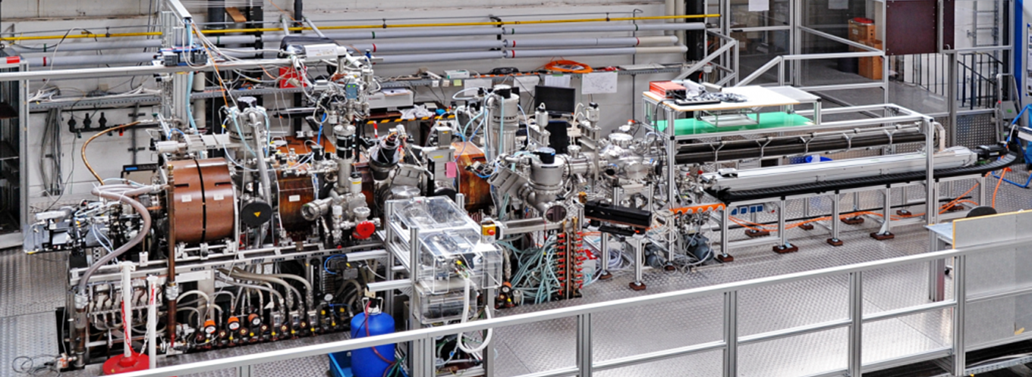
Experimental devices
JUDITH 2
PSI-2
Stationary loads
D, He, Ar, N plasma
Plasma column Ø 60 mm
Ion flux ≤ 10²³ m⁻²s⁻¹
Incident E_{i} (bias) 10 – 300 eV
Base temp. ≤ 1000 °C
ELM-like heat pulse
Nd:YAG laser λ 1064 nm
laser energy ≤ 72 J
Machine parameters
Total power: 200 kW
Acc. voltage: 40 – 60 kV
Irrad. area: 40 × 40 cm²
Power density: ≤ 2 GWm⁻²
Pulse length: 5 µs – cont.
Beam FWHM: 3 – 12 mm
(typ. 8 – 10 mm)
Cooling circuit
Temperature: 20 – 120 °C Max. pressure: 4 MPa
Max. flow: 200 l/min
Cooling power: ≤ 150 kW
Monitoring of water quality

Slide 4
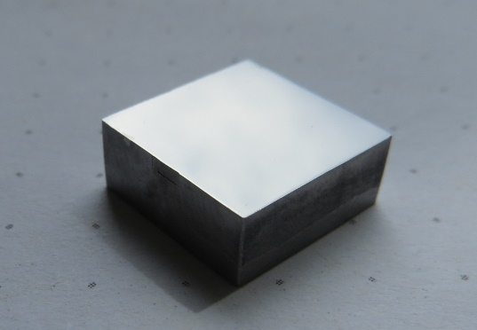
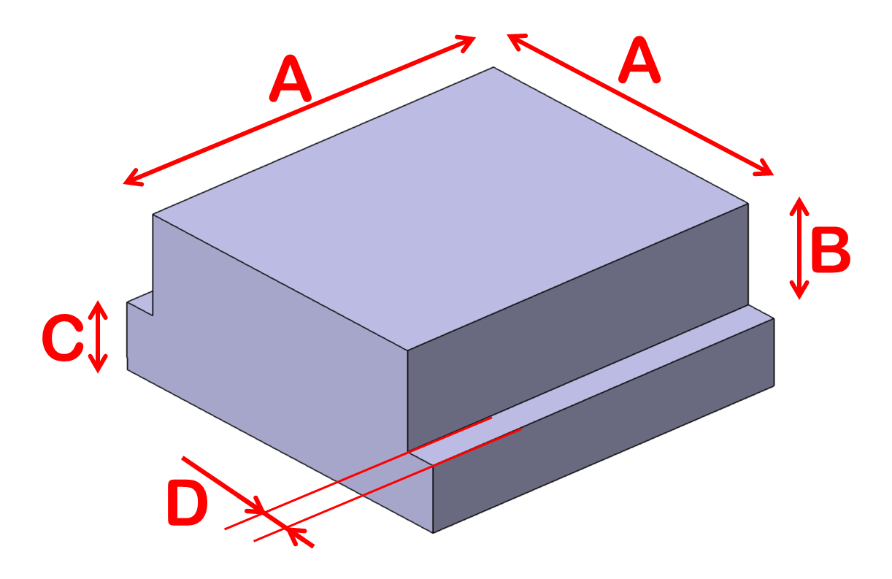
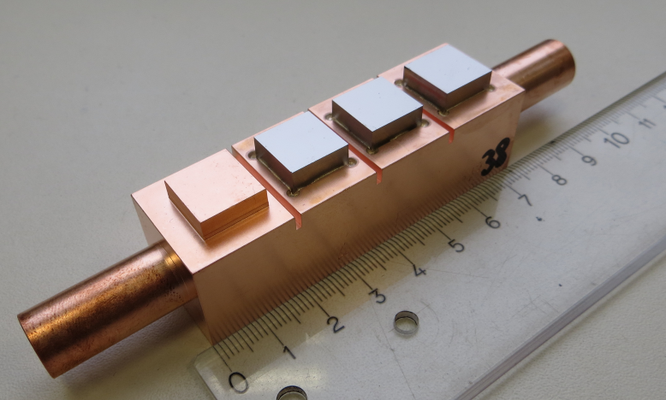
Sample geometries
JUDITH 2
PSI-2
Thermal shock (typical geometry): 12 × 12 × 5 mm³
A: 10 mm; B: 2 mm; C: 3 mm; D: 1 mm
Cooling connectors: pipes of 18 or 15 mm diameter or holes of 12 mm diameter

Slide 5
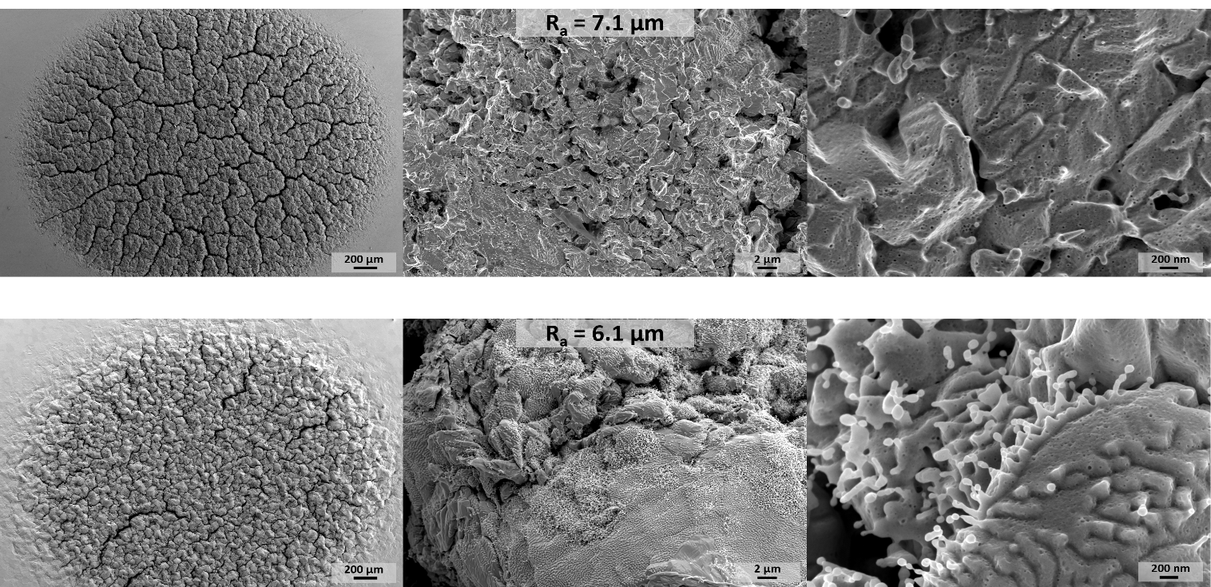
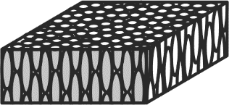
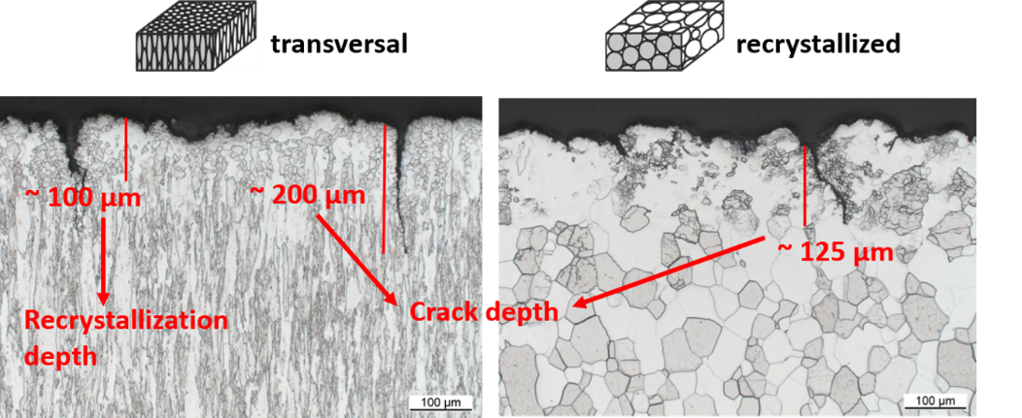

IGP-W High pulse number, synergistic effects tests
transversal
recrystallized
Similar behavior between transversal and recrystallized material
But less cracking on recrystallized sample
Base temp.: 700 °C
10⁶ pulses, 25 Hz freq., 0.5 ms pulses
Power dens. = 0.2 GWm⁻²
D/He(6%) plasma
Flux = ~ 3.8·10²¹ m⁻²s⁻¹
Fluence = ~ 2·10²⁶ m⁻²
Gago, M., Kreter, A., Unterberg, B., & Wirtz, M. (2021). Synergistic and separate effects of plasma and transient heat loads on the microstructure and physical properties of ITER-grade tungsten; Physica Scripta, 96(12), 124052. https://doi.org/10.1088/1402-4896/AC326C

Slide 6
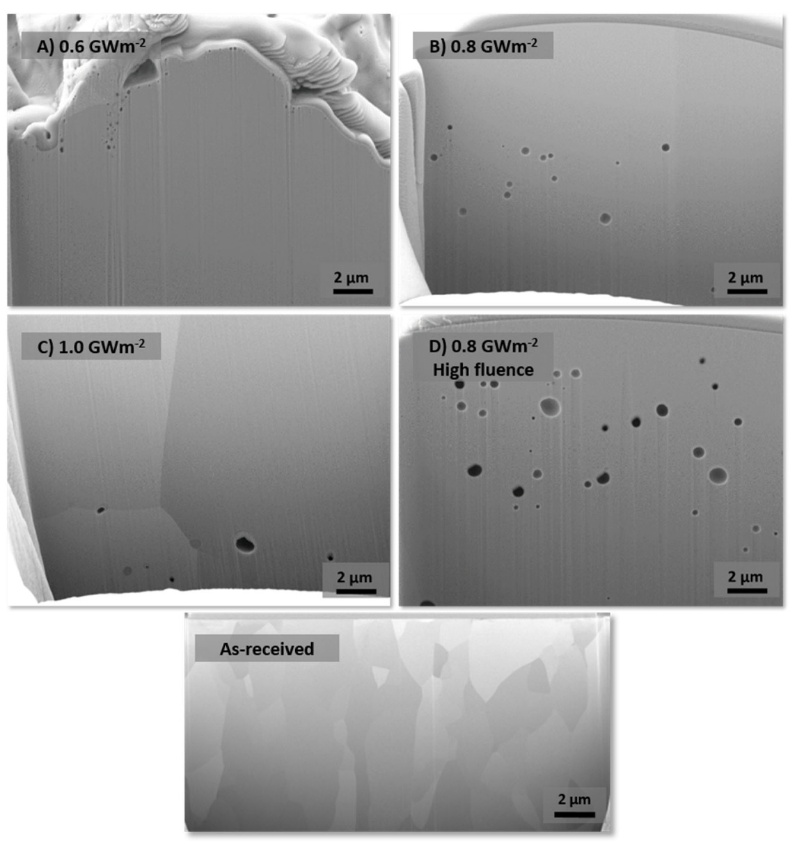
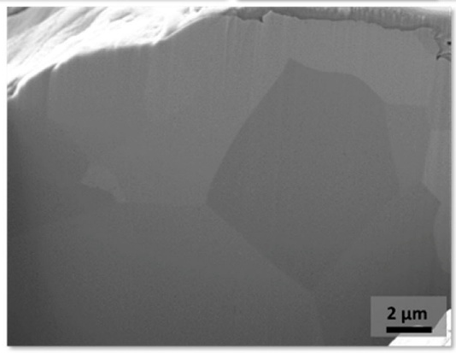
IGP-W High pulse number, synergistic effects tests
Bubble formation highly influenced by plasma flux and laser power density
Bubble formation only occurs when helium plasma is used, deuterium-only plasma shows no bubble formation
No helium:
Base temp.: 700 °C
10⁵ pulses, 10 Hz freq., 0.5 ms pulses
D/He(6%) plasma
Gago, M.; Kreter, A.; Unterberg, B.; Wirtz, M. Bubble Formation in ITER-Grade Tungsten after Exposure to Stationary D/He Plasma and ELM-like Thermal Shocks J. Nucl. Eng. 2023, 4, 204-212. https://doi.org/10.3390/jne4010016

Slide 7
















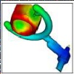







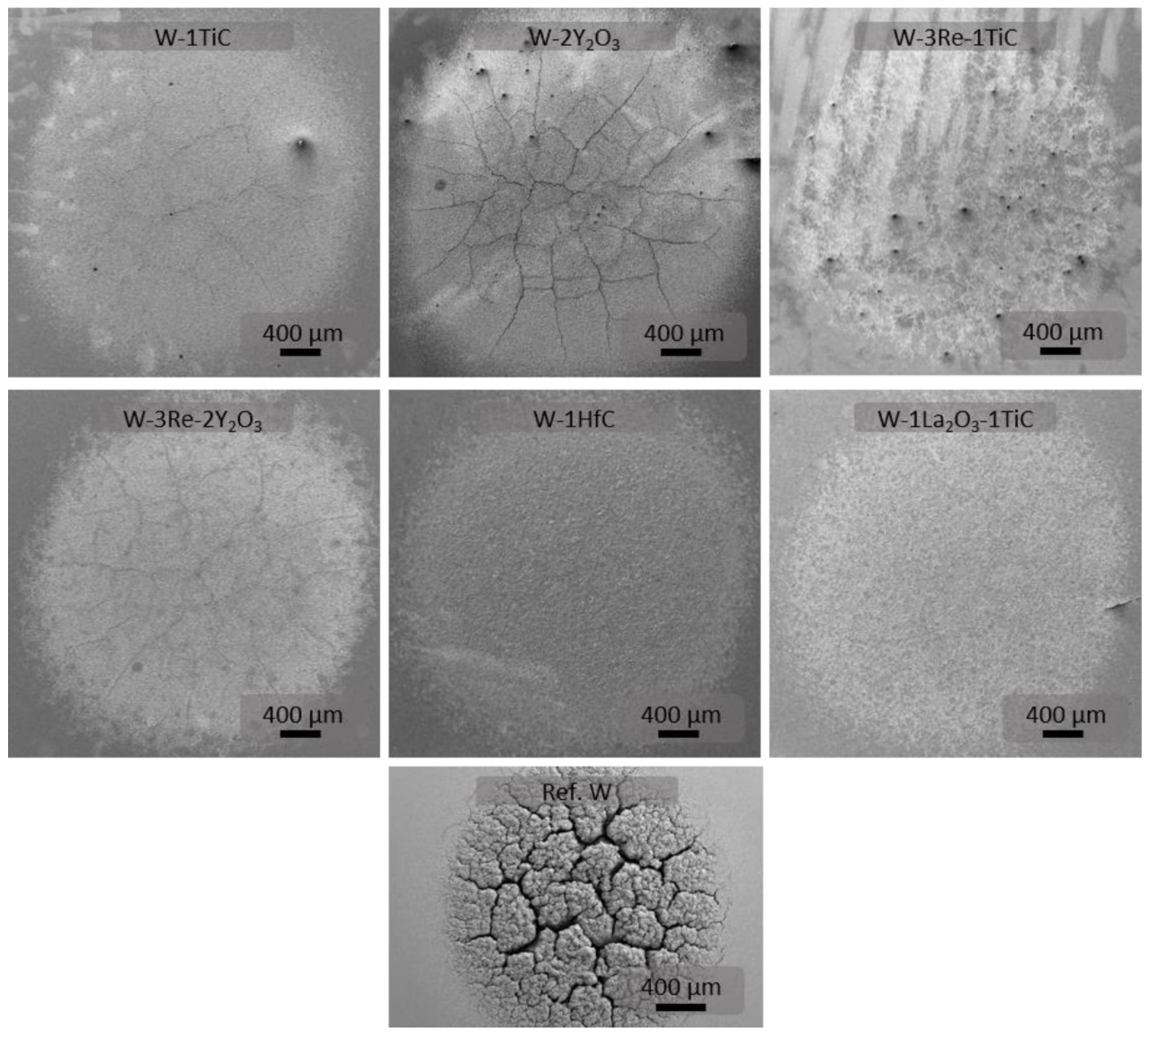
PIM-W samples, high pulse number, synergistic effect tests
Samples produced at KIT
Powder + Binder = Feedstock
Simulation
surface polishing
Fabrication of greenparts
~2000 °C
to mirror finish
PIM tool
Base temp.: 700 °C
10⁵ pulses, 10 Hz freq., 0.5 ms pulses
Power dens. = 0.4 GWm⁻²
D/He(6%) plasma
Flux = ~ 4·10²¹ m⁻²s⁻¹
Fluence = ~ 4·10²⁵ m⁻²
Much better resistance to thermal shocks than IGP-W
Gago, M.; Antusch, S.; Klein, A.; Kreter, A.; Linsmeier, C.; Rieth, M.; Unterberg, B.; Wirtz, M. Thermal Shock and Synergistic Plasma and Heat Load Testing of Powder Injection Molding Tungsten-Based Alloys. J. Nucl. Eng. 2025, 6, 25. https://doi.org/10.3390/jne6030025

Slide 8
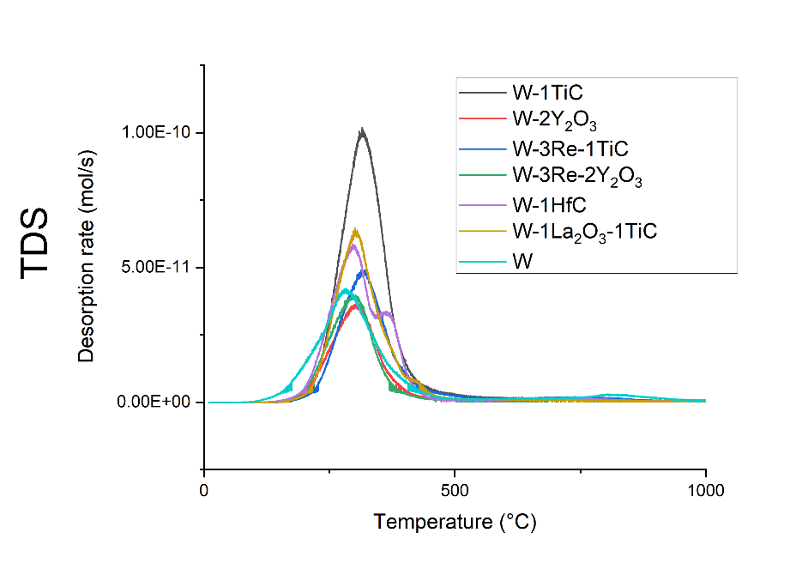
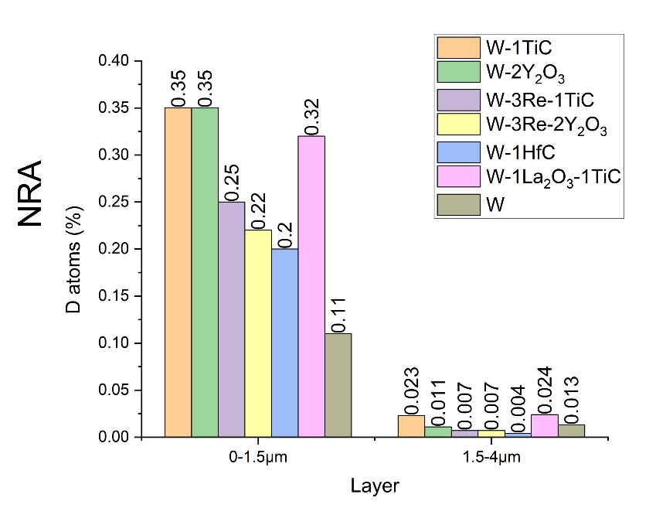
Deuterium retention in PIM-W alloys
PIM-W samples were exposed to deuterium plasma with a flux of 3.0 · 10²¹ m⁻² s⁻¹ for 85 minutes at a temperature of 280 °C in the PSI-2. Total D fluence of 15.3 · 10²⁵ m⁻²
Deuterium retention of the material was measured in-situ via LIBS and then ex-situ via NRA and TDS
Most of the deuterium retention is in the top layer, with a significant drop in retention after the first 1.5 µm. Some alloys increase D retention significantly

Slide 9
Off-Normal Loads for ITER
Full W fist wall for ITER - Qualification of W first wall components under VDE-like loads
First experiments have been performed in PSI-2
IGP WT reference material
Base temperature 1000 °C
Melting event 1.6 GW/m² for 2 ms and pulse number of 1, 10, 100
ELM-like event 0.38 GW/m² for 1 ms and pulse number of 1000, repetition 0.5 Hz
no melting events
1 melting event
100 melting events

Slide 10
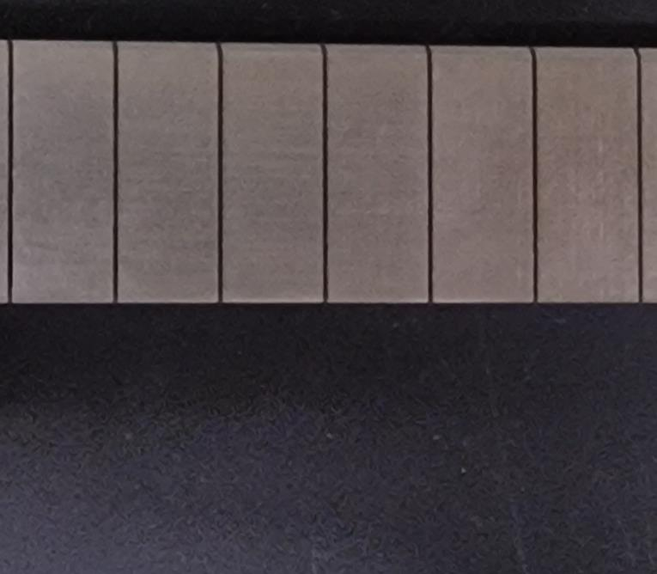
Self-castellation of WEST PFUs
Objectives:
Generating distinct macro crack within the MB
But: No reduction in cooling capability or reaching the cooling pipe
Finish to implement PFU 024 in C7 campaign autumn 2023
Plan for Stationary Heat Loads (SHLs)
Using MB 32 and 27 (31.3 and 30.5 mm wide)
10 MW/m² screening
50 cycles @ 16 MW/m²
50 cycles @ 18 MW/m²
20 cycles @ 20 MW/m²
10 MW/m² screening after crack initiated
MB 32
MB 27

Slide 11
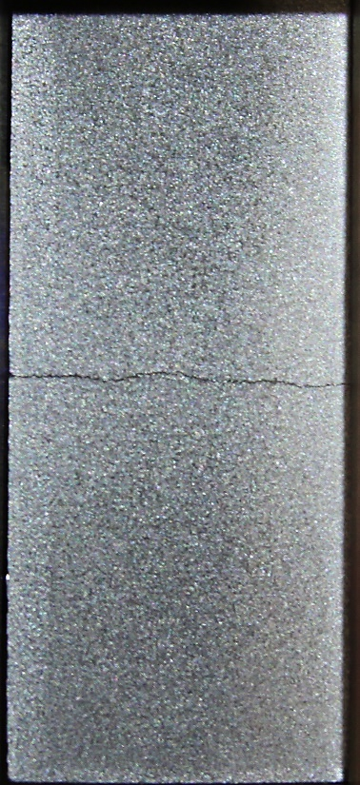
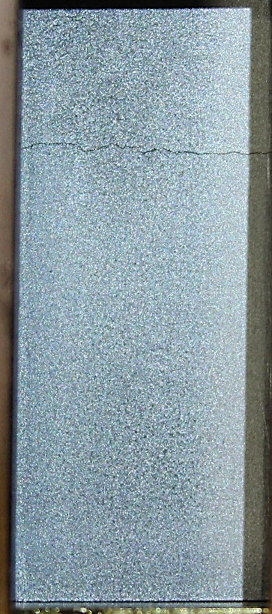
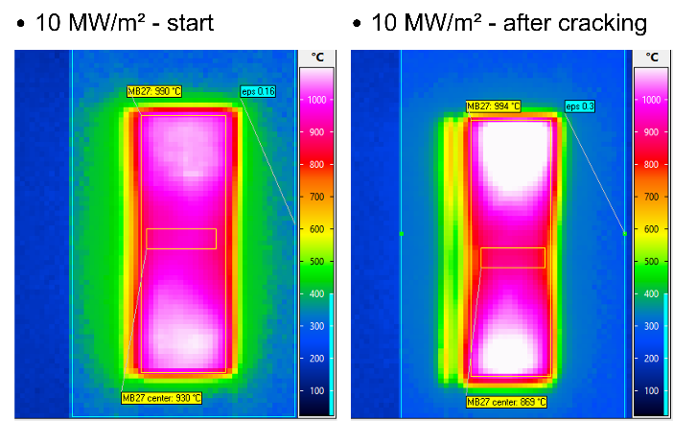

Self-castellation of WEST PFUs
Successful generation of distinct macro cracks within the WEST PFU MBs
Crack in the middle cannot be detected by IR
MB 27: @ 24 MW/m²
Cycle: 1 - 20
MB 32: @ 20 MW/m²
Cycle: 21 – 40

Slide 12

COMPASS-U Activities
Qualification of different materials and components for COMPASS-U (first wall and divertor)

Slide 13
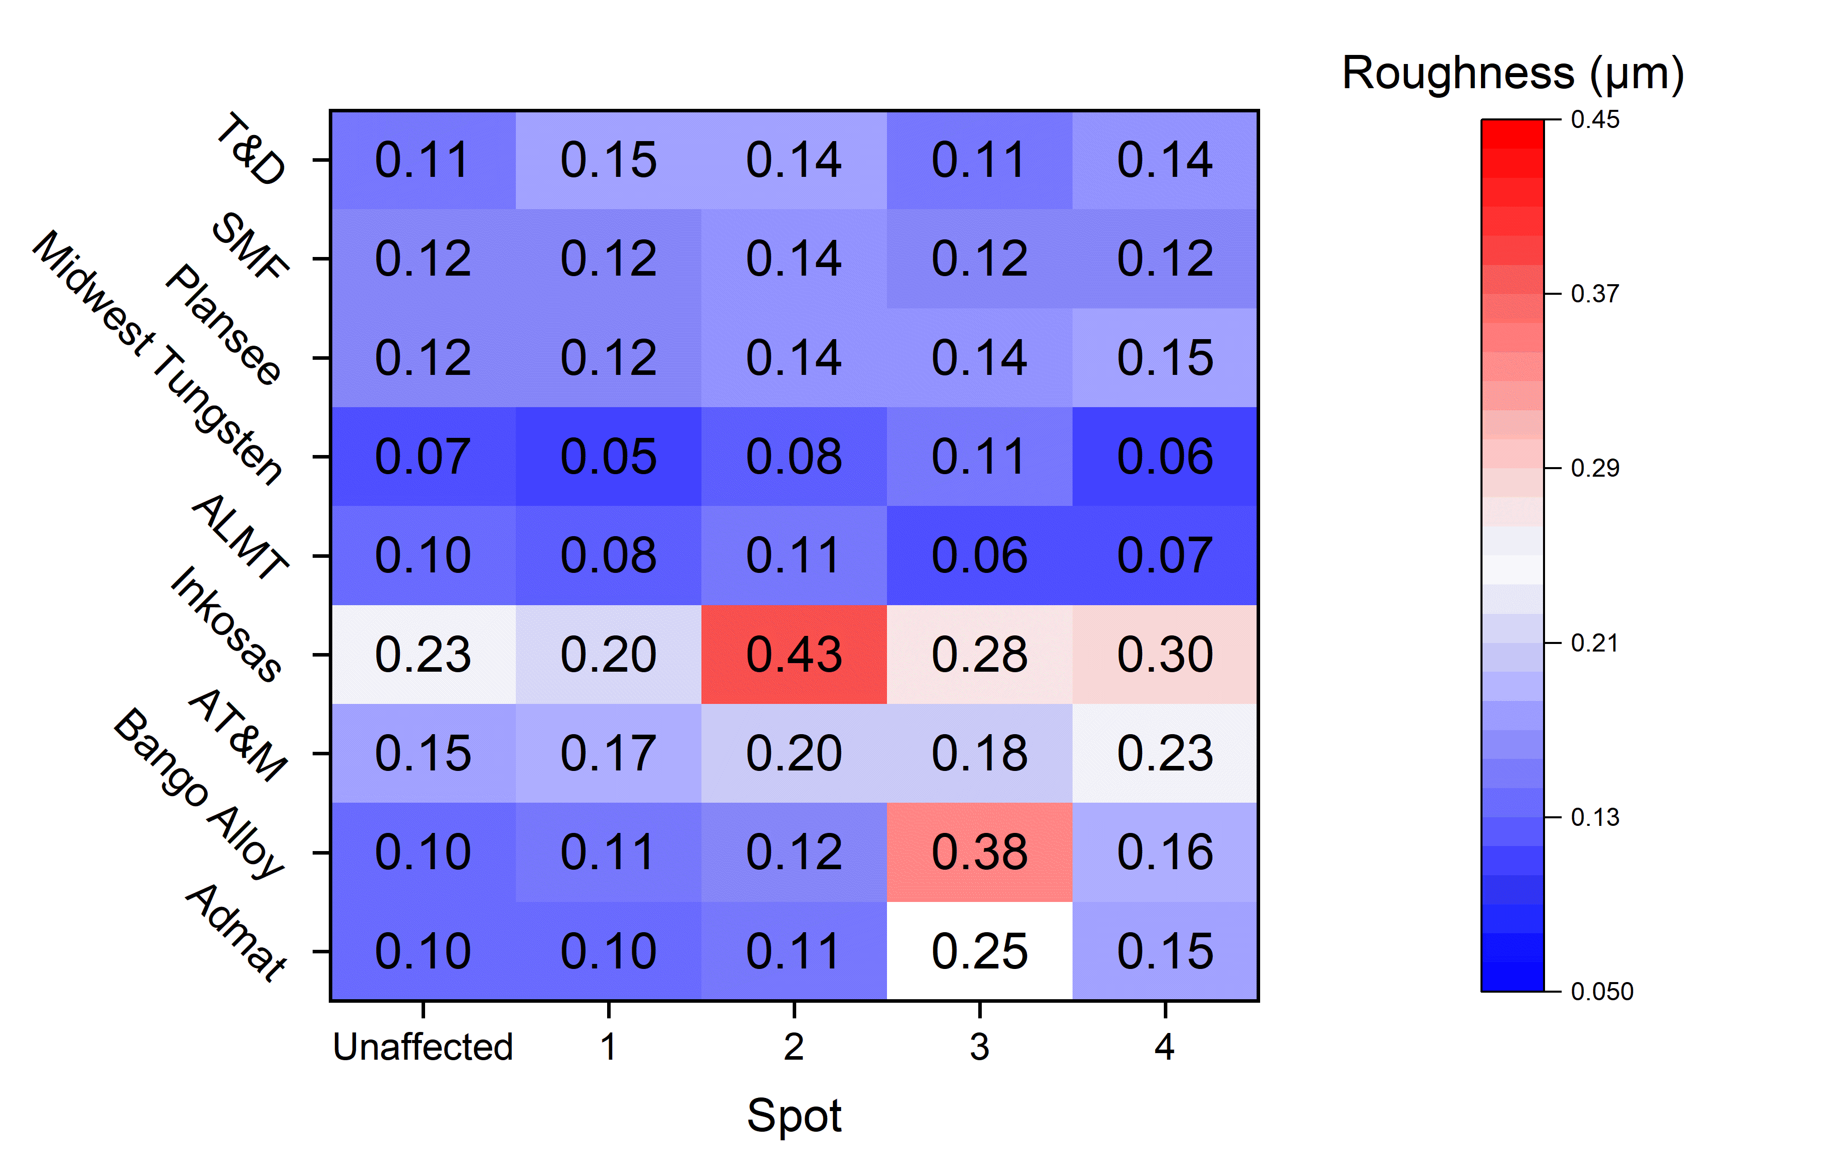
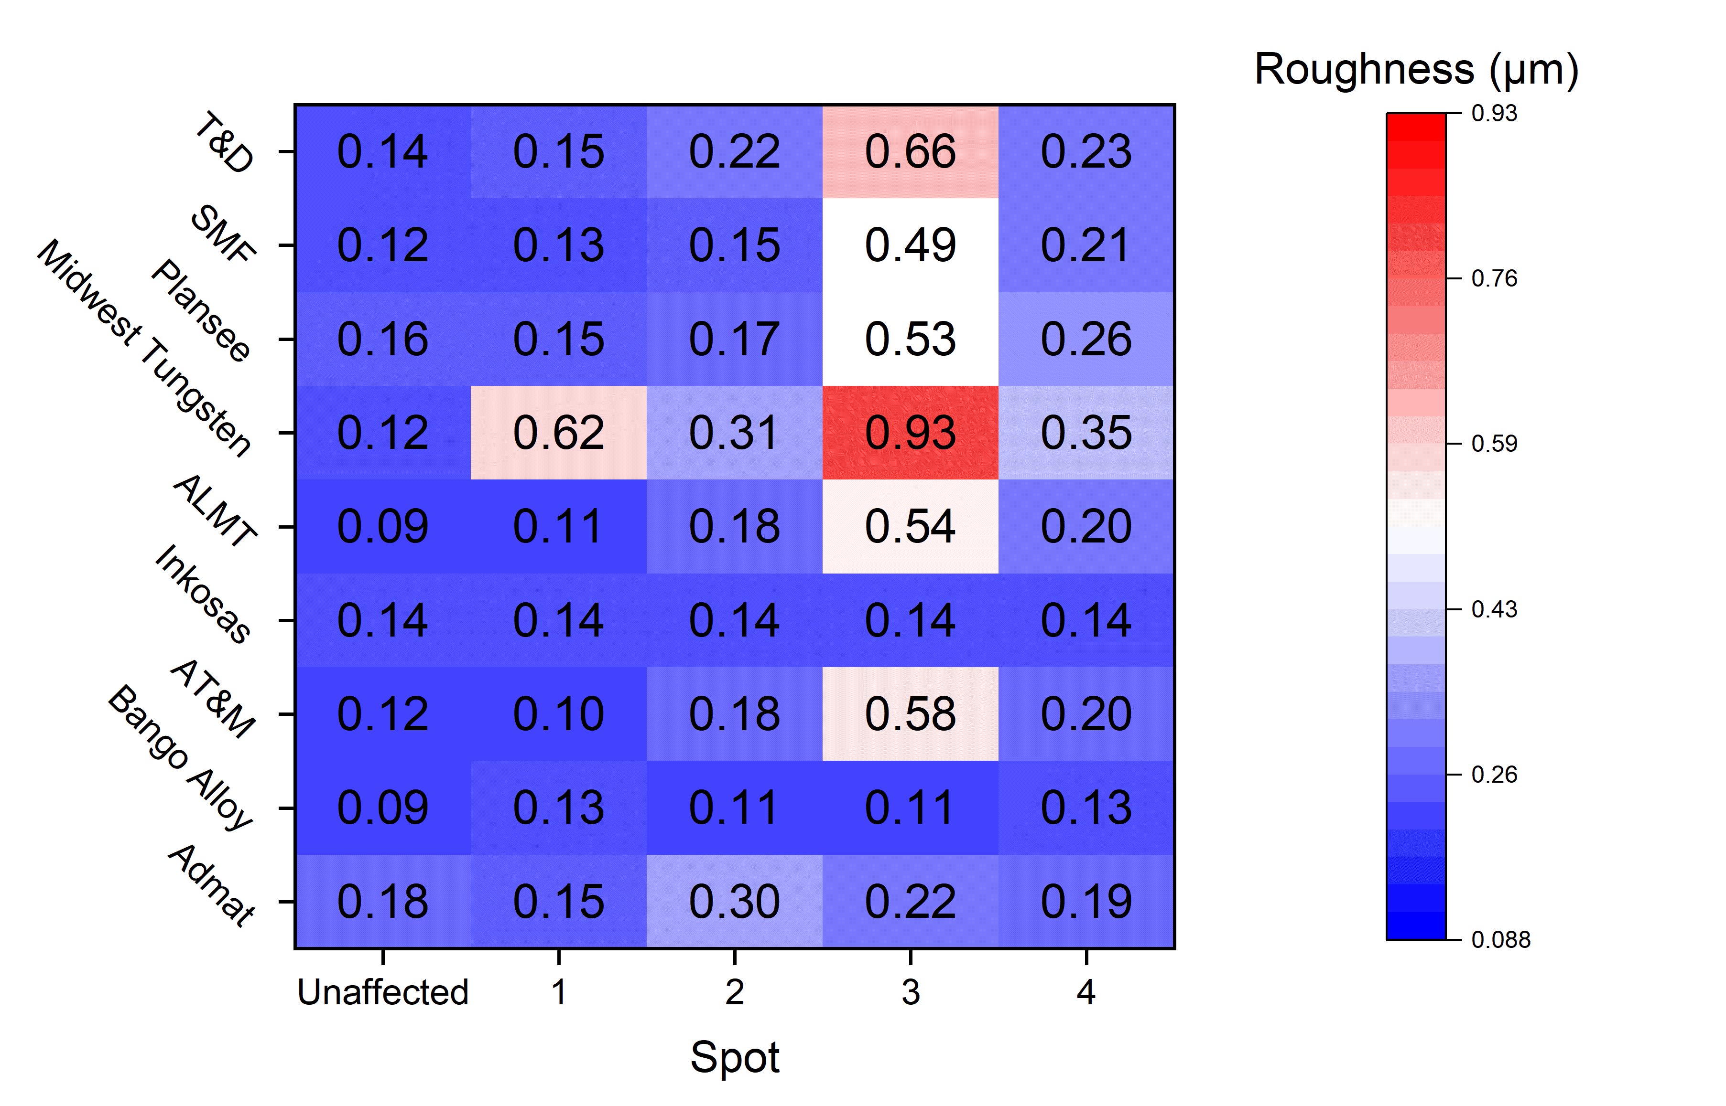
COMPASS-U Activities
Low pulse number testing of W samples from 9 different manufacturers
400 and 1000 °C base temperature
Further post-mortem characterization at IPP-Prague
400 °C
Spot | L (GW/m²) | Δt (ms) | F_{HF} (MW/m²s ^{½}) | Number
1 | 0.19 | 1 | 6 | 100
2 | 0.38 | 1 | 12 | 100
3 | 0.38 | 1 | 12 | 1000
4 | 1.6 | 2 | 72 | 1
1000 °C

Slide 14
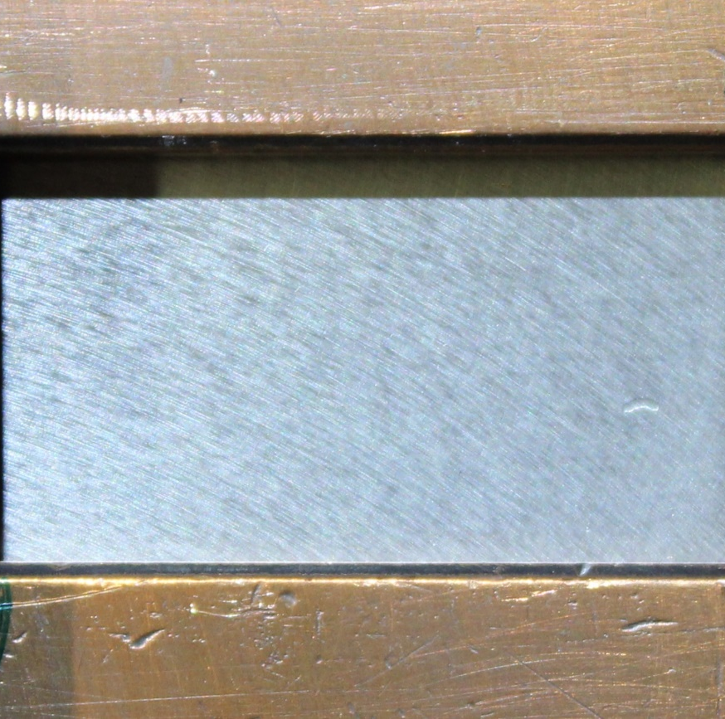
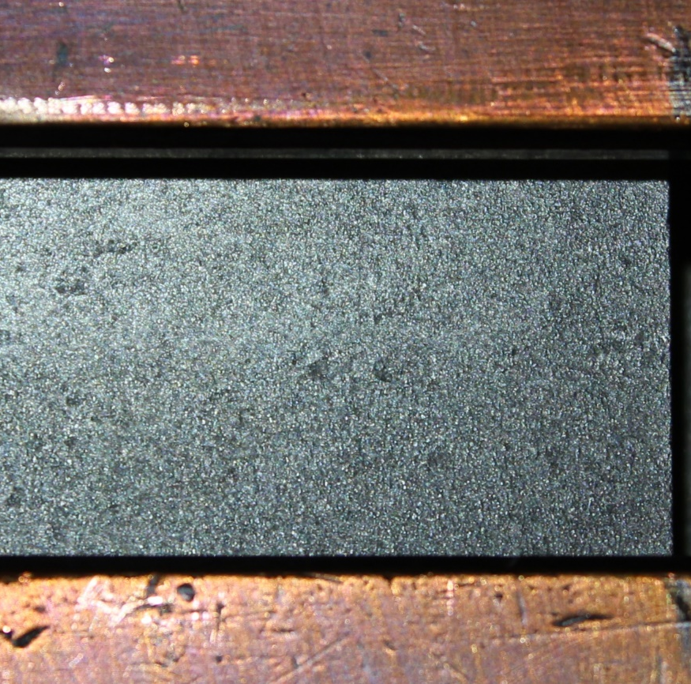
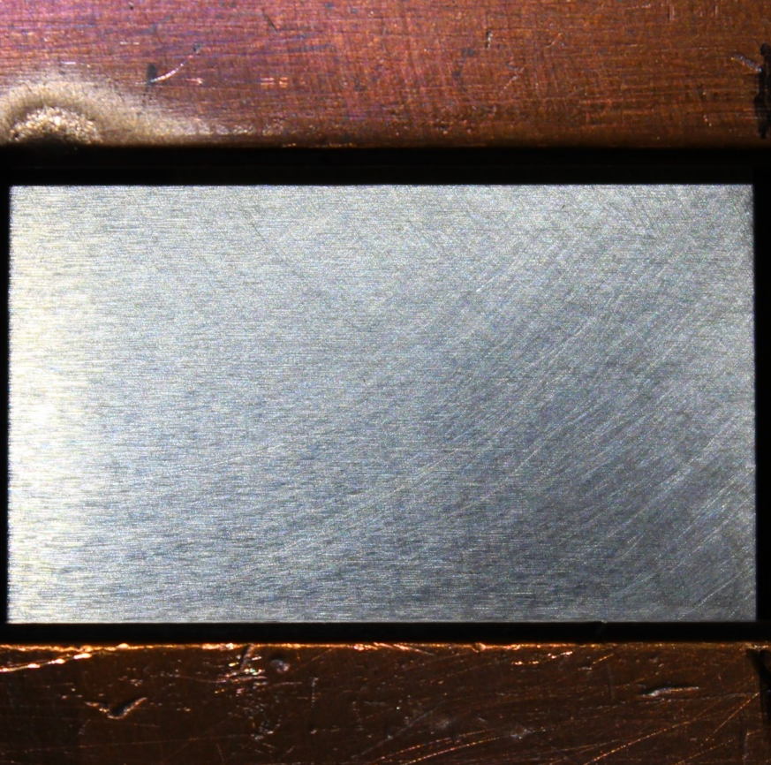
HHF tests on COMPASS-U tungsten OVT tiles
Samples – before HHF tests
Three W-tiles of very different quality and surface finish, with the one from Plansee being about 2 mm thinner than the others, complicating the mounting and heat removal
ALMT
Plansee
AT&M

Slide 15
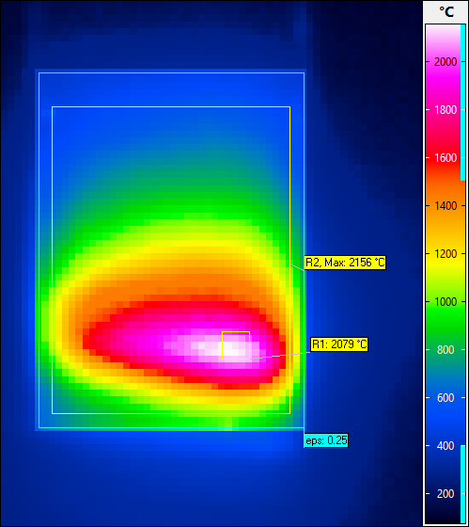
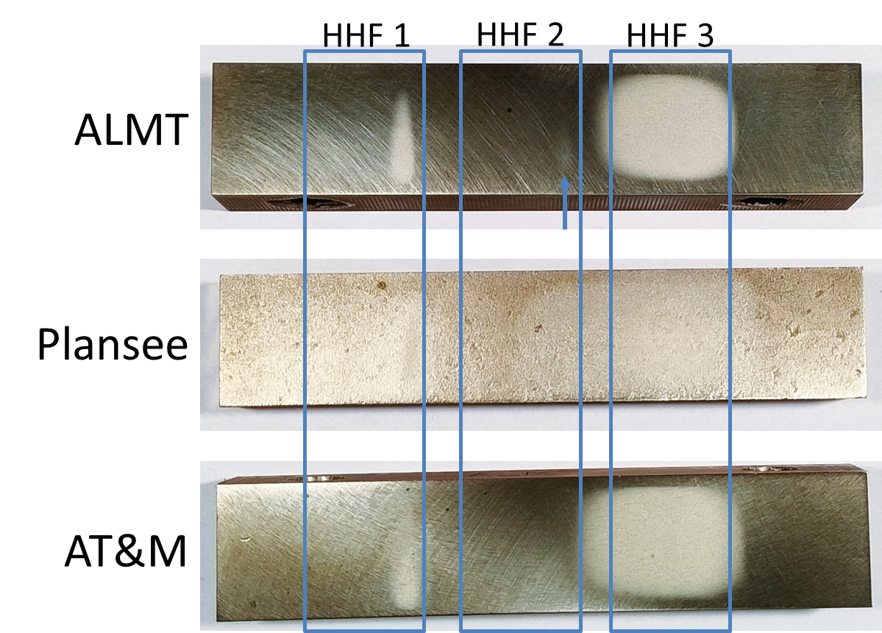
HHF tests on COMPASS-U tungsten OVT tiles - Conclusions
10 pulses with cooldown time in between
HHF 1: 70 MW/m² (max.), Eich profile distribution 0.5 s duration, reaching 2000°C
HHF 2: 35 MW/m² (max.), Eich profile distribution 3.0 s duration, reaching 1500°C
HHF 3: 20 MW/m², homogeneous rectangular 3.0 s duration, reaching 2000°C
Eich’s profile was used to simulate heat flux in COMPASS-U
All three W tiles sustained the HHF tests with no macroscopic damages
Eich’s profile

Slide 16
Analysis of PSI-2 exposed materials, focusing on finding the relevant regime for fuzz formation in AUG He campaign
Achieved in 2023-2024
Comparison between linear devices (PSI-2) and tokamak (AUG) environment for fuzz formation
Check previous exposures in PSI-2 with simultaneous plasma and laser loading
Check best conditions to reproduce AUG He fuzz
From existing exposures
New PSI-2 exposures
PSI-2 He exposure - Fuzz formation
Base Temperature ~ 900 °C
Ion Flux ~ 6 - 8 × 10²¹ m⁻²s⁻¹
Fluence ~ 1 × 10²⁵ m⁻²
Energy ~ 160 eV
Laser
200 MW/m² and 400 MW/m² 0.5 ms, 25 Hz
Temperature 1100 – 1700 °C
(600 °C increase during the laser shot)
Laser
100 MW/m² 0.5 ms, 25 Hz and 200 Hz
40 MW/m² 0.5 ms, 200 Hz

Slide 17
Results 2024
100 MW/m² 25 Hz - outside laser spot
x
PSI-2 He exposure - Fuzz formation
Base Temperature ~ 900 °C
Ion Flux ~ 6 - 8 × 10²¹ m⁻²s⁻¹
Fluence ~ 1 × 10²⁵ m⁻²
Energy ~ 160 eV
SEM images of the surface and FIB prepared cross-section of the W sample exposed to He plasma with 100 MW/m² 25 Hz laser loading
100 MW/m² 200 Hz - outside laser spot
SEM images of the surface and FIB prepared cross-section of the W sample exposed to He plasma with 100 MW/m² 200 Hz laser loading

Slide 18
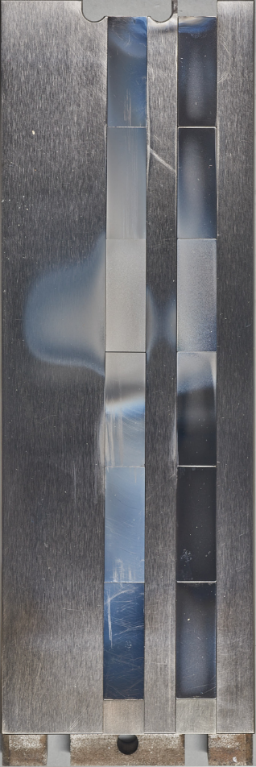
Results AUG - He
PSI-2
100 MW/m² 200 Hz inside the laser spot
100 MW/m² 200 Hz outside the laser spot
1
2
3
4
6
5
H-mode
Ф_{i} ~ 2-4 x 10²⁴ He/m²
2
4
6
Different exposure temperature (due to laser loading in the laser spot and outside laser) leads to formation of different fuzz structures in PSI-2.
Revealed structures fits with good agreements with surface morphology of W exposed in AUG He campaign. Locations above H-mode strike line exhibited different surface temperature.
L-mode
1
3
5

Slide 19
Conclusions
Fuzz formation during AUG He campaign very non-uniform and strongly dependent on surface temperature
Relatively good agreement between PSI-2 and AUG He W fuzz morphology for samples exposed to high frequency laser loading in PSI-2
Linear device can be a good proxy for mimicking the fuzz formation in tokamaks. Fuzz structures and bubble formation present after AUG He might be reproducible by simultaneous laser and plasma loading
Visible recrystallization of W in the laser spot position. Small grains still present beneath the fuzz – He effect on retarded recrystallization
Expose to mixed plasma 94% D + 5% He + 1% Ne plus laser loading to be finished in 2025

Slide 20
Results 2025
100 MW/m² 200 Hz - in the laser spot
PSI-2 94% D + 5% He + 1% Ne Base Temperature ~ 900 °C
Ion Flux ~ 2.5 × 10²¹ m⁻²s⁻¹
Fluence ~ 1 × 10²⁵ m⁻²
Energy ~ 175 eV
SEM images of the surface and FIB prepared cross-section of the W sample exposed to 94% D + 5% He + 1% Ne plasma with 100 MW/m² 200 Hz laser loading
Strong surface roughening inside the laser spot.
Nanobubble formation with the bubble size below 5 nm visible on the surface.

Slide 21
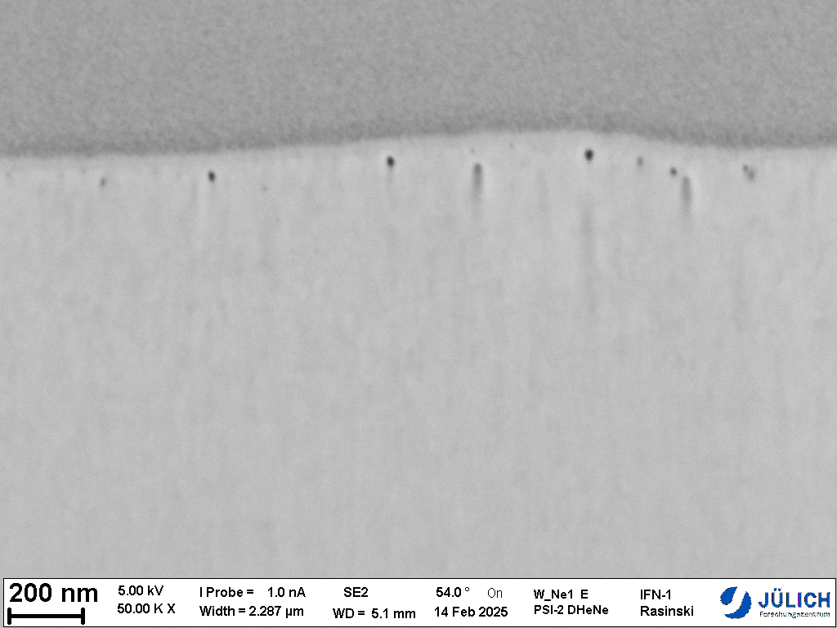
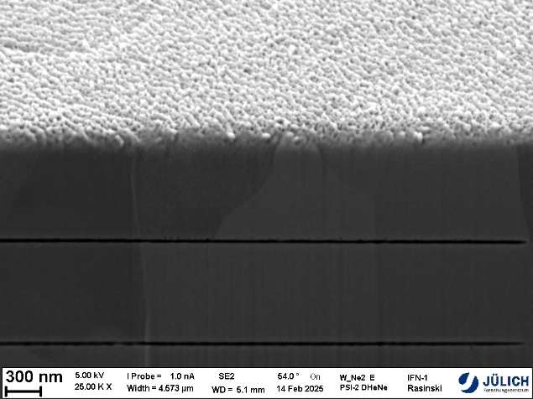
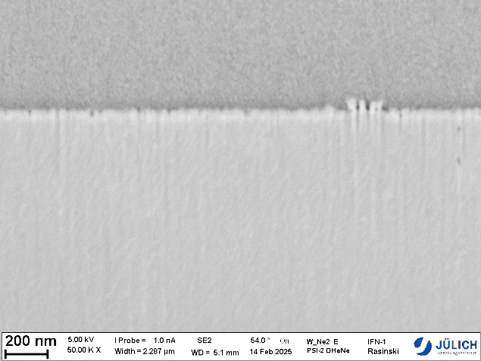
Results 2025
100 MW/m² 200 Hz - outside laser spot
350 nm
PSI-2 94% D + 5% He + 1% Ne Base Temperature ~ 900 °C
Ion Flux ~ 2.5 × 10²¹ m⁻²s⁻¹
Fluence ~ 1 × 10²⁵ m⁻²
Energy ~ 175 eV
SEM images of the surface and FIB prepared cross-section of the W sample exposed to 94% D + 5% He + 1% Ne plasma with 100 MW/m² 200 Hz laser loading
- no laser
Early stage of the fuzz formation on the sample exposed to plasma only (thickness of about 50 nm).
Measured erosion on the plasma only sample around 160 nm and 350 nm for the laser loaded sample (outside laser spot).
Nanobubble formation at the depth of 100 nm for the laser exposed sample.
160 nm
50 nm
SEM images of the surface and FIB prepared cross-section of the W sample exposed to 94% D + 5% He + 1% Ne plasma

Slide 22
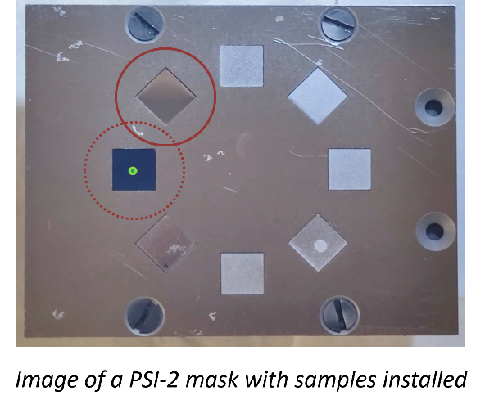
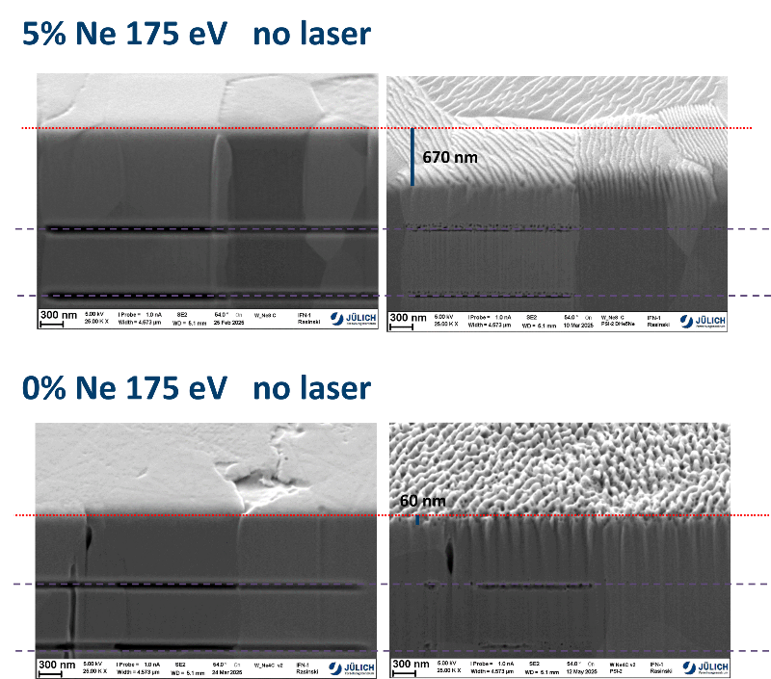
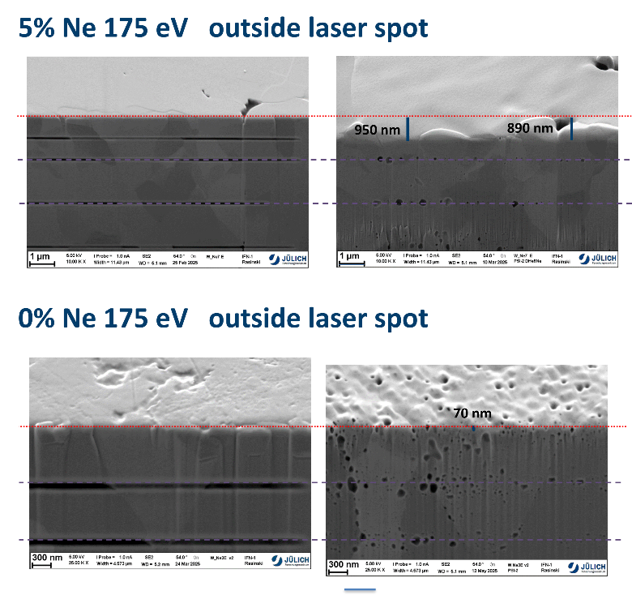
Influence of Ne on nanobubble and fuzz formation on tungsten
Assess the influence of seeding gases foreseen for ITER with relevant ELM like laser loading in the PSI-2
W samples exposed to mixed plasma containing 0, 1 and 5 % of Ne at 60 and 175 eV in PSI-2 (D + 5%He + Ne)
Erosion strongly dependent on Ne content - following the sputtering data of W by Ne
Early stage of fuzz formation for sample without laser loading and low Ne content
Sample exposed to simultaneous plasma and laser loading exhibit visible grain growth compared to sample without laser
Nano-bubble formation on and under the surface for samples exposed to simultaneous plasma and laser loading

Slide 23
General conclusion
Synergistic heat and plasma load testing performed in PSI-2. Crack networks, fuzz formation, bubble formation and recrystallization were observed on tungsten samples. PIM-W alloys were also tested and showed better damage resistance than reference W
Deuterium retention in PIM-W alloys and standard W was performed and compared with LIBS, NRA and TDS. Most alloys showed higher D retention than pure W
Effects of off-normal thermal loads were tested on W. Samples affected by off-normal events show faster damage evolution than as-received samples
HHF tests on COMPASS-U tungsten tiles, all W tiles sustained the HHF tests with no macroscopic damages
Fuzz formation during AUG He campaign was successfully replicated in PSI-2 under similar conditions.

Slide 24










WPMAT / WPPRD-MAT Members
Ecole Royale Militaire
Laboratory for Plasma Physics
Institute of Plasma Physics
Academy of Sciences of the
Czech Republic
Technical University
of Denmark
Technical Research Centre
of Finland
AUSTRIA
BELGIUM
Ruđer Bošković Institute
University of Tartu
FINLAND
CROATIA
CZECH REPUBLIC
DENMARK
ESTONIA
The French Alternative
Energies and Atomic Energy
Commission
National Centre for Scientific
Research “Demokritos”
Italian National Agency for
New Technologies, Energy
and Sustainable Economic
Development
Centre for Energy Research
FRANCE
GERMANY
GERMANY
GERMANY
GREECE
HUNGARY
ITALY
Institute of Plasma Physics
And Laser Microfusion
Institute for Atom Physics
Jožef Stefan Institute
LATVIA
POLAND
PORTUGAL
ROMANIA
SLOVENIA
Centre for Energy, Environment
And Technology Research
Swedish Research Council
Kharkov Institute of Physics
and Technology
SPAIN
SWEDEN
SWITZERLAND
UKRAINE
UNITED KINGDOM

