Slide 1

DIFFER SPA highlights 2020-2025
T.W. Morgan^{1,2}, G. Dose³, J. Hargreaves¹, Th. Loewenhoff⁴, S. Rocella⁵, M. Balden⁶, J.G.A. Scholte^{1,2}, J.H. You⁶
¹Dutch Institute for Fundamental Energy Research, Eindhoven, The Netherlands
²Eindhoven University of Technology, The Netherlands
³University of Rome "Tor Vergata", Rome, Italy
⁴Forschungszentrum Jülich, Jülich, Germany
⁵ENEA, Frascati, Italy
⁶Max Planck Institute for Plasma Physics, Garching, Germany

Slide 2
SPA overview: investigate combination HHF, plasma, transients on W, advanced materials, co-deposits Magnum-PSI
SPA | 2021 | 2022 | 2023 | 2024 | 2025
SPA1 | Pre-crack damage evolution I | Pre-crack damage evolution II | Pre-crack damage evolution III | Stability W re-deposits | Stability W re-deposits with ELMs
SPA2 | Steady-state ‘slow transient’ loading | Steady state ‘slow transient’ loading w/ ELMs I | Steady state ‘slow transient’ loading w/ ELMs II | Fatigue behaviour W under ‘strikepoint sweeping’ I | Fatigue behaviour W under ‘strikepoint sweeping’ II
SPA3 | Thermal shock CVD-W | Performance WfW | Performance UHTCs | RAFM steels under ‘disruption’ | W-coated RAFM steels under ‘disruption’
SPA5 |  |  |  | COMPASS-U W grades I | COMPASS-U W grades II
Influence of ELM damage on W lifetime
W re-deposit behaviour
W lifetime at high temperatures
W fatigue (high temperature)
Study advanced W and steels with high-flux plasma
Qualify COMPASS-U W

Slide 3
Steady state ‘slow transient’ loading

Slide 4
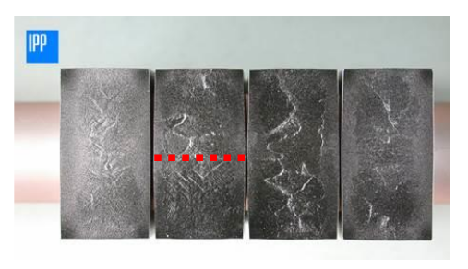
Beyond nominal: slow transients
Expect slow transients to lead to 20 MW m⁻² for up to 10 s, leading to temp up to ~2100 °C
Up til now tests mainly carried out with electron beam and neutral beam (GLADIS)
Strong plastic deformation behaviour seen for cyclical loading with GLADIS- what is driver for this?
Sometimes macrocracking observed – what will be the case here?
You FED 2022
Pintsuk International Journal of Refractory Metals & Hard Materials (2018)
Visca FED 2018

Slide 5
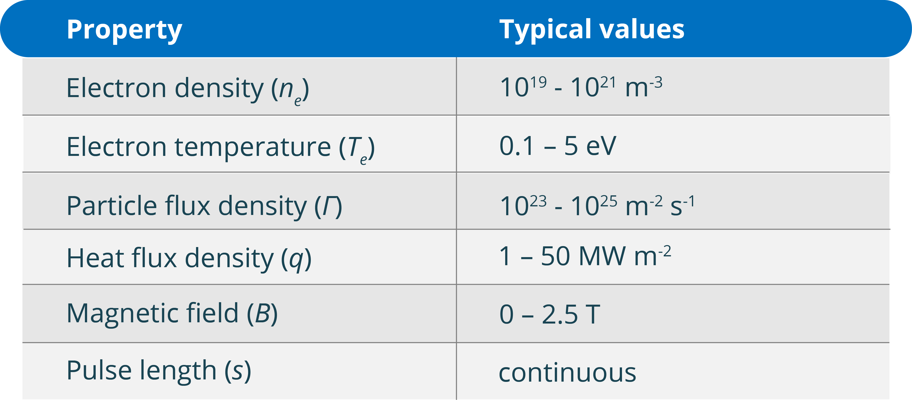
Magnum-PSI
Go to ‘slow transient’ conditions with Magnum-PSI (equiv. 20 MW m⁻²)
Compare plasma loading with e-beam loading without cycling

Slide 6
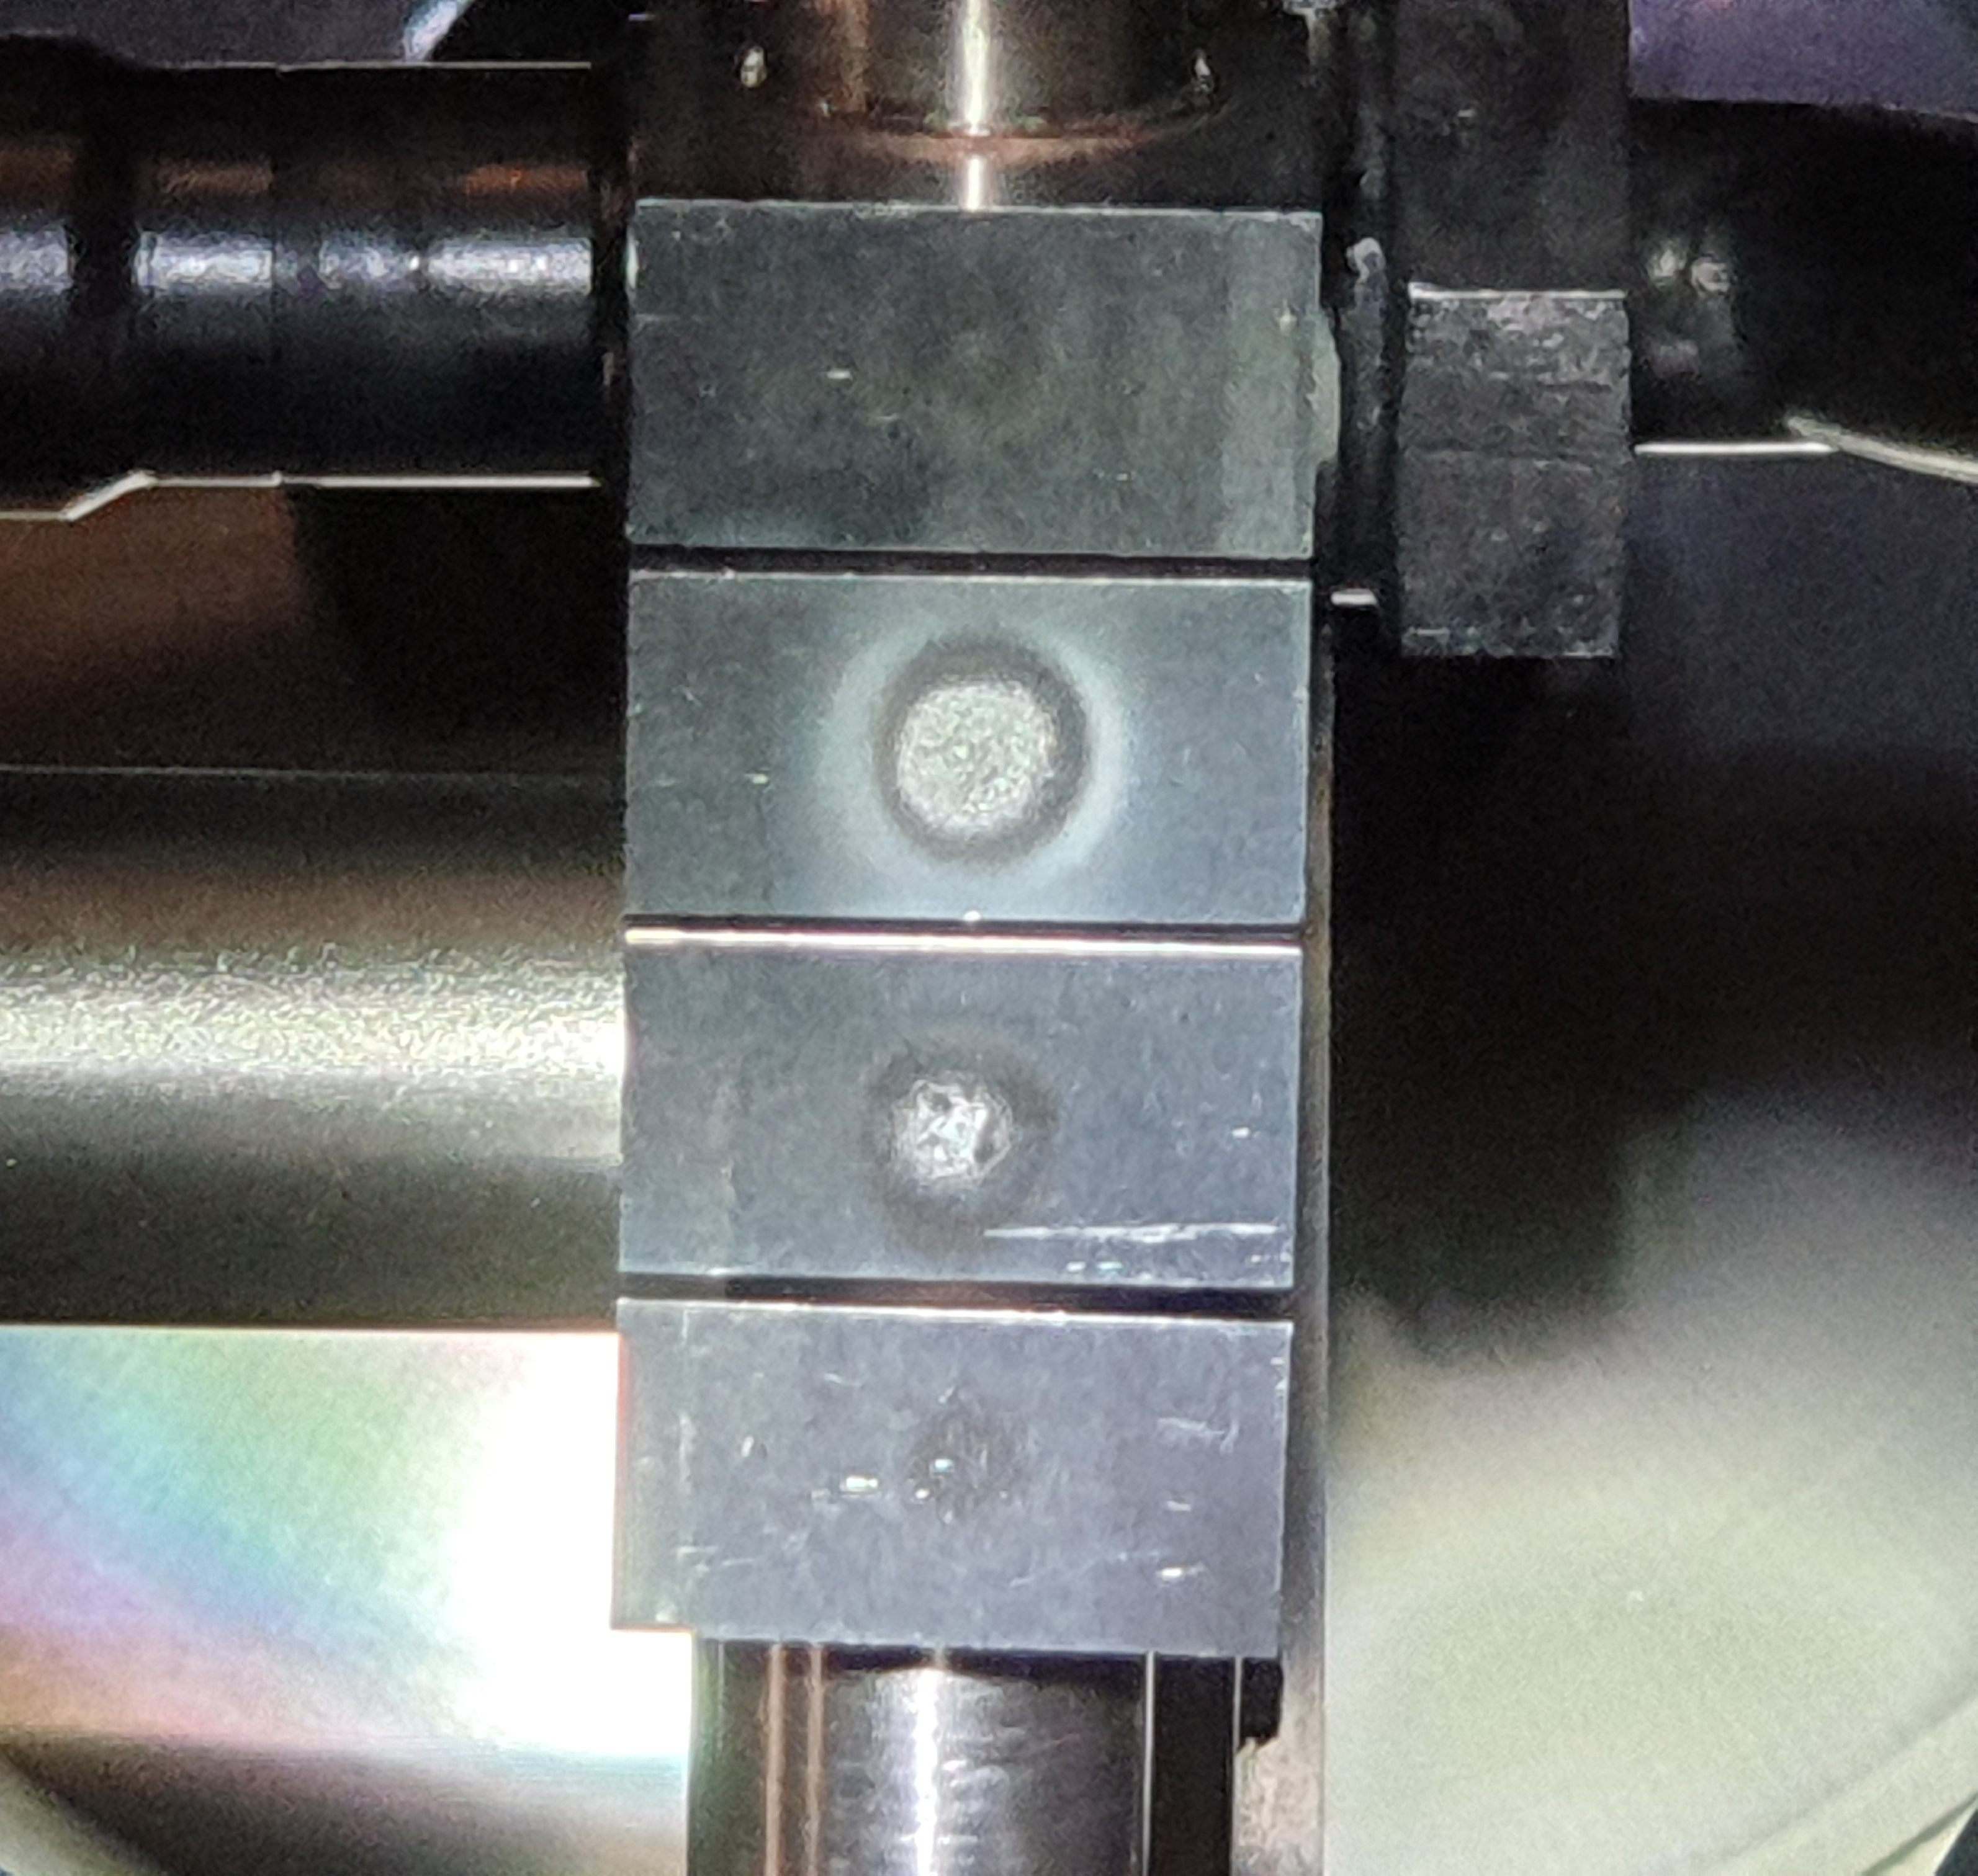
Experimental approach overview
Identical loading conditions were applied in JUDITH-II and Magnum-PSI
2x 4 block chains (2 grades)
Steady state loading at JUDITH-2 / Magnum-PSI at constant temperature, but different time of exposure for each block.
Both Gaussian beam shape at center of blocks, FWHM ~ 10 mm (match beam shape)
Tmax ~ 2250 °C
180 s
18000 s
1800 s
40 s

Slide 7
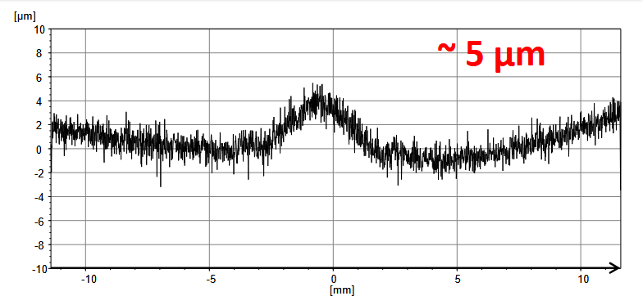
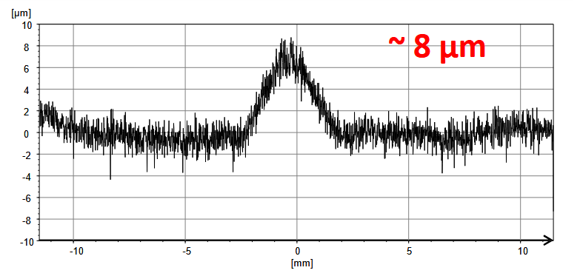
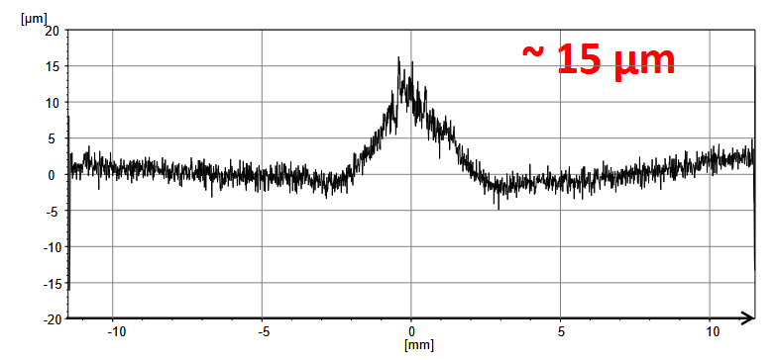
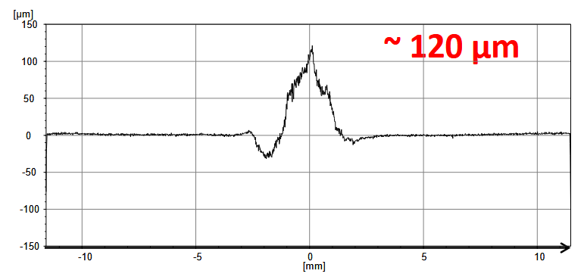

See plastic deformation in plasma and e-beam centre
H plasma ALMT
$$h∝t^{0.72±0.11}$$
40 s
180 s
1800 s
18000 s

Slide 8
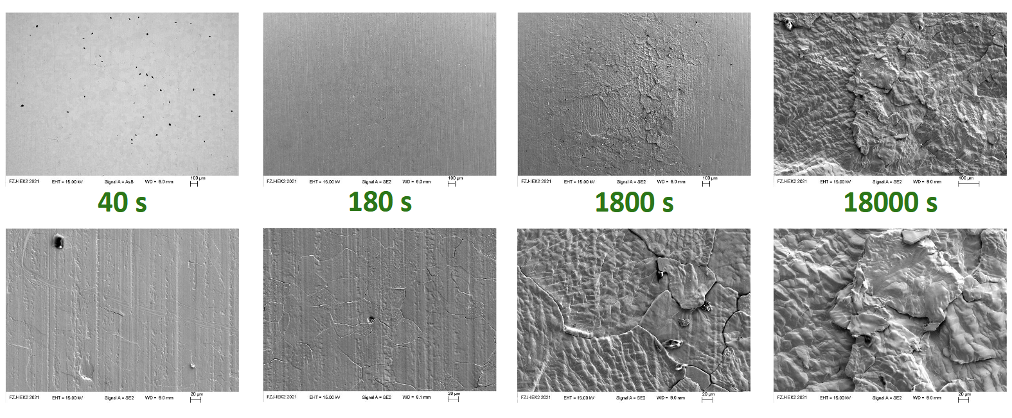
Magnum-PSI SEM: cracks, Rx, increasingly bigger structures and protrusions
H plasma ALMT
recrystallization
Cracking, increasing roughening

Slide 9
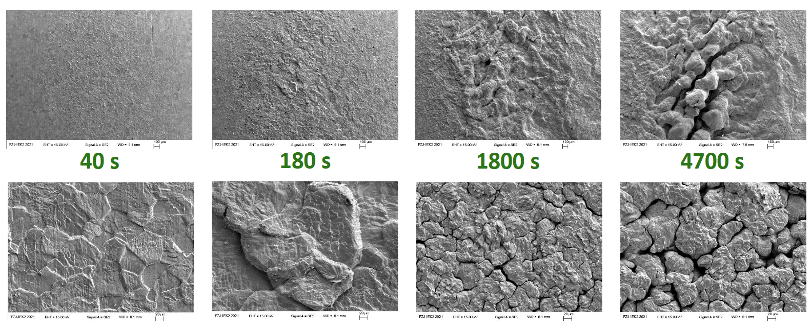
Judith 2 SEM: Same qualitative results but significantly more cracking and roughening (raster effect?)
e-beam ALMT

Slide 10
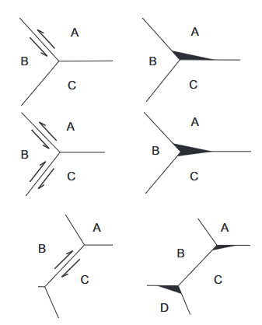

Mechanism for deformation: creep
Monotonic compressive stress towards centre (temperature gradient) leads to deformation
Stress can lead to intergranular cracking effect (GB motion)
Monotonic creep (simple model) fits: $ε/t=At^{−2/3}$
H.C. Chang and N.J. Grant, Mechanisms
of Intercrystalline Fracture, Trans. Am.
Inst. Min. Metall. Eng., Vol 206 (No. 5),
1956, p 545–551

Slide 11
ELM-loading combined with Steady state ‘slow transient’ loading

Slide 12
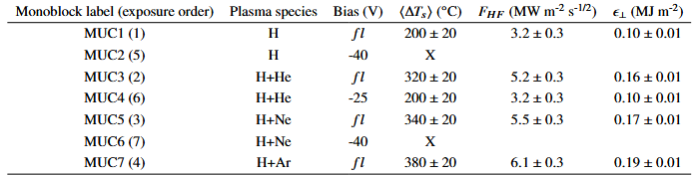

Create ELM-like loading with high power laser
Vary plasma species (H, H + He, Ne or Ar)
Include some biasing (sputter/effect by impurity)
T_{surf}~2050 °C
N_{pulses} = 10⁵
$ε_{⊥}$ either small or large

Slide 13
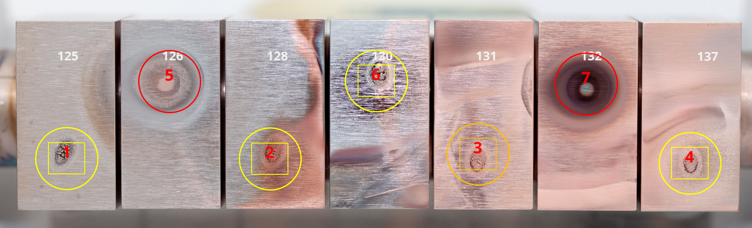
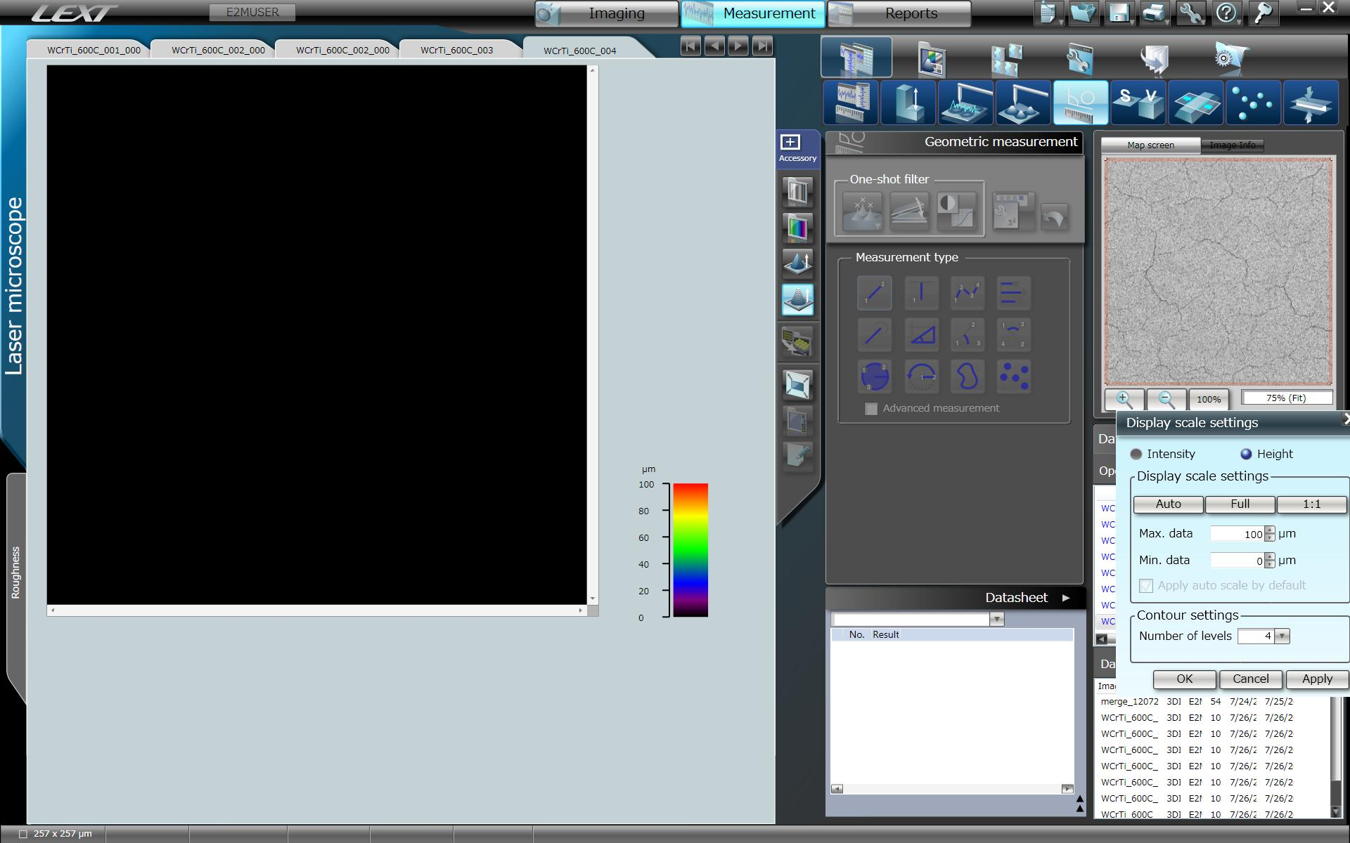
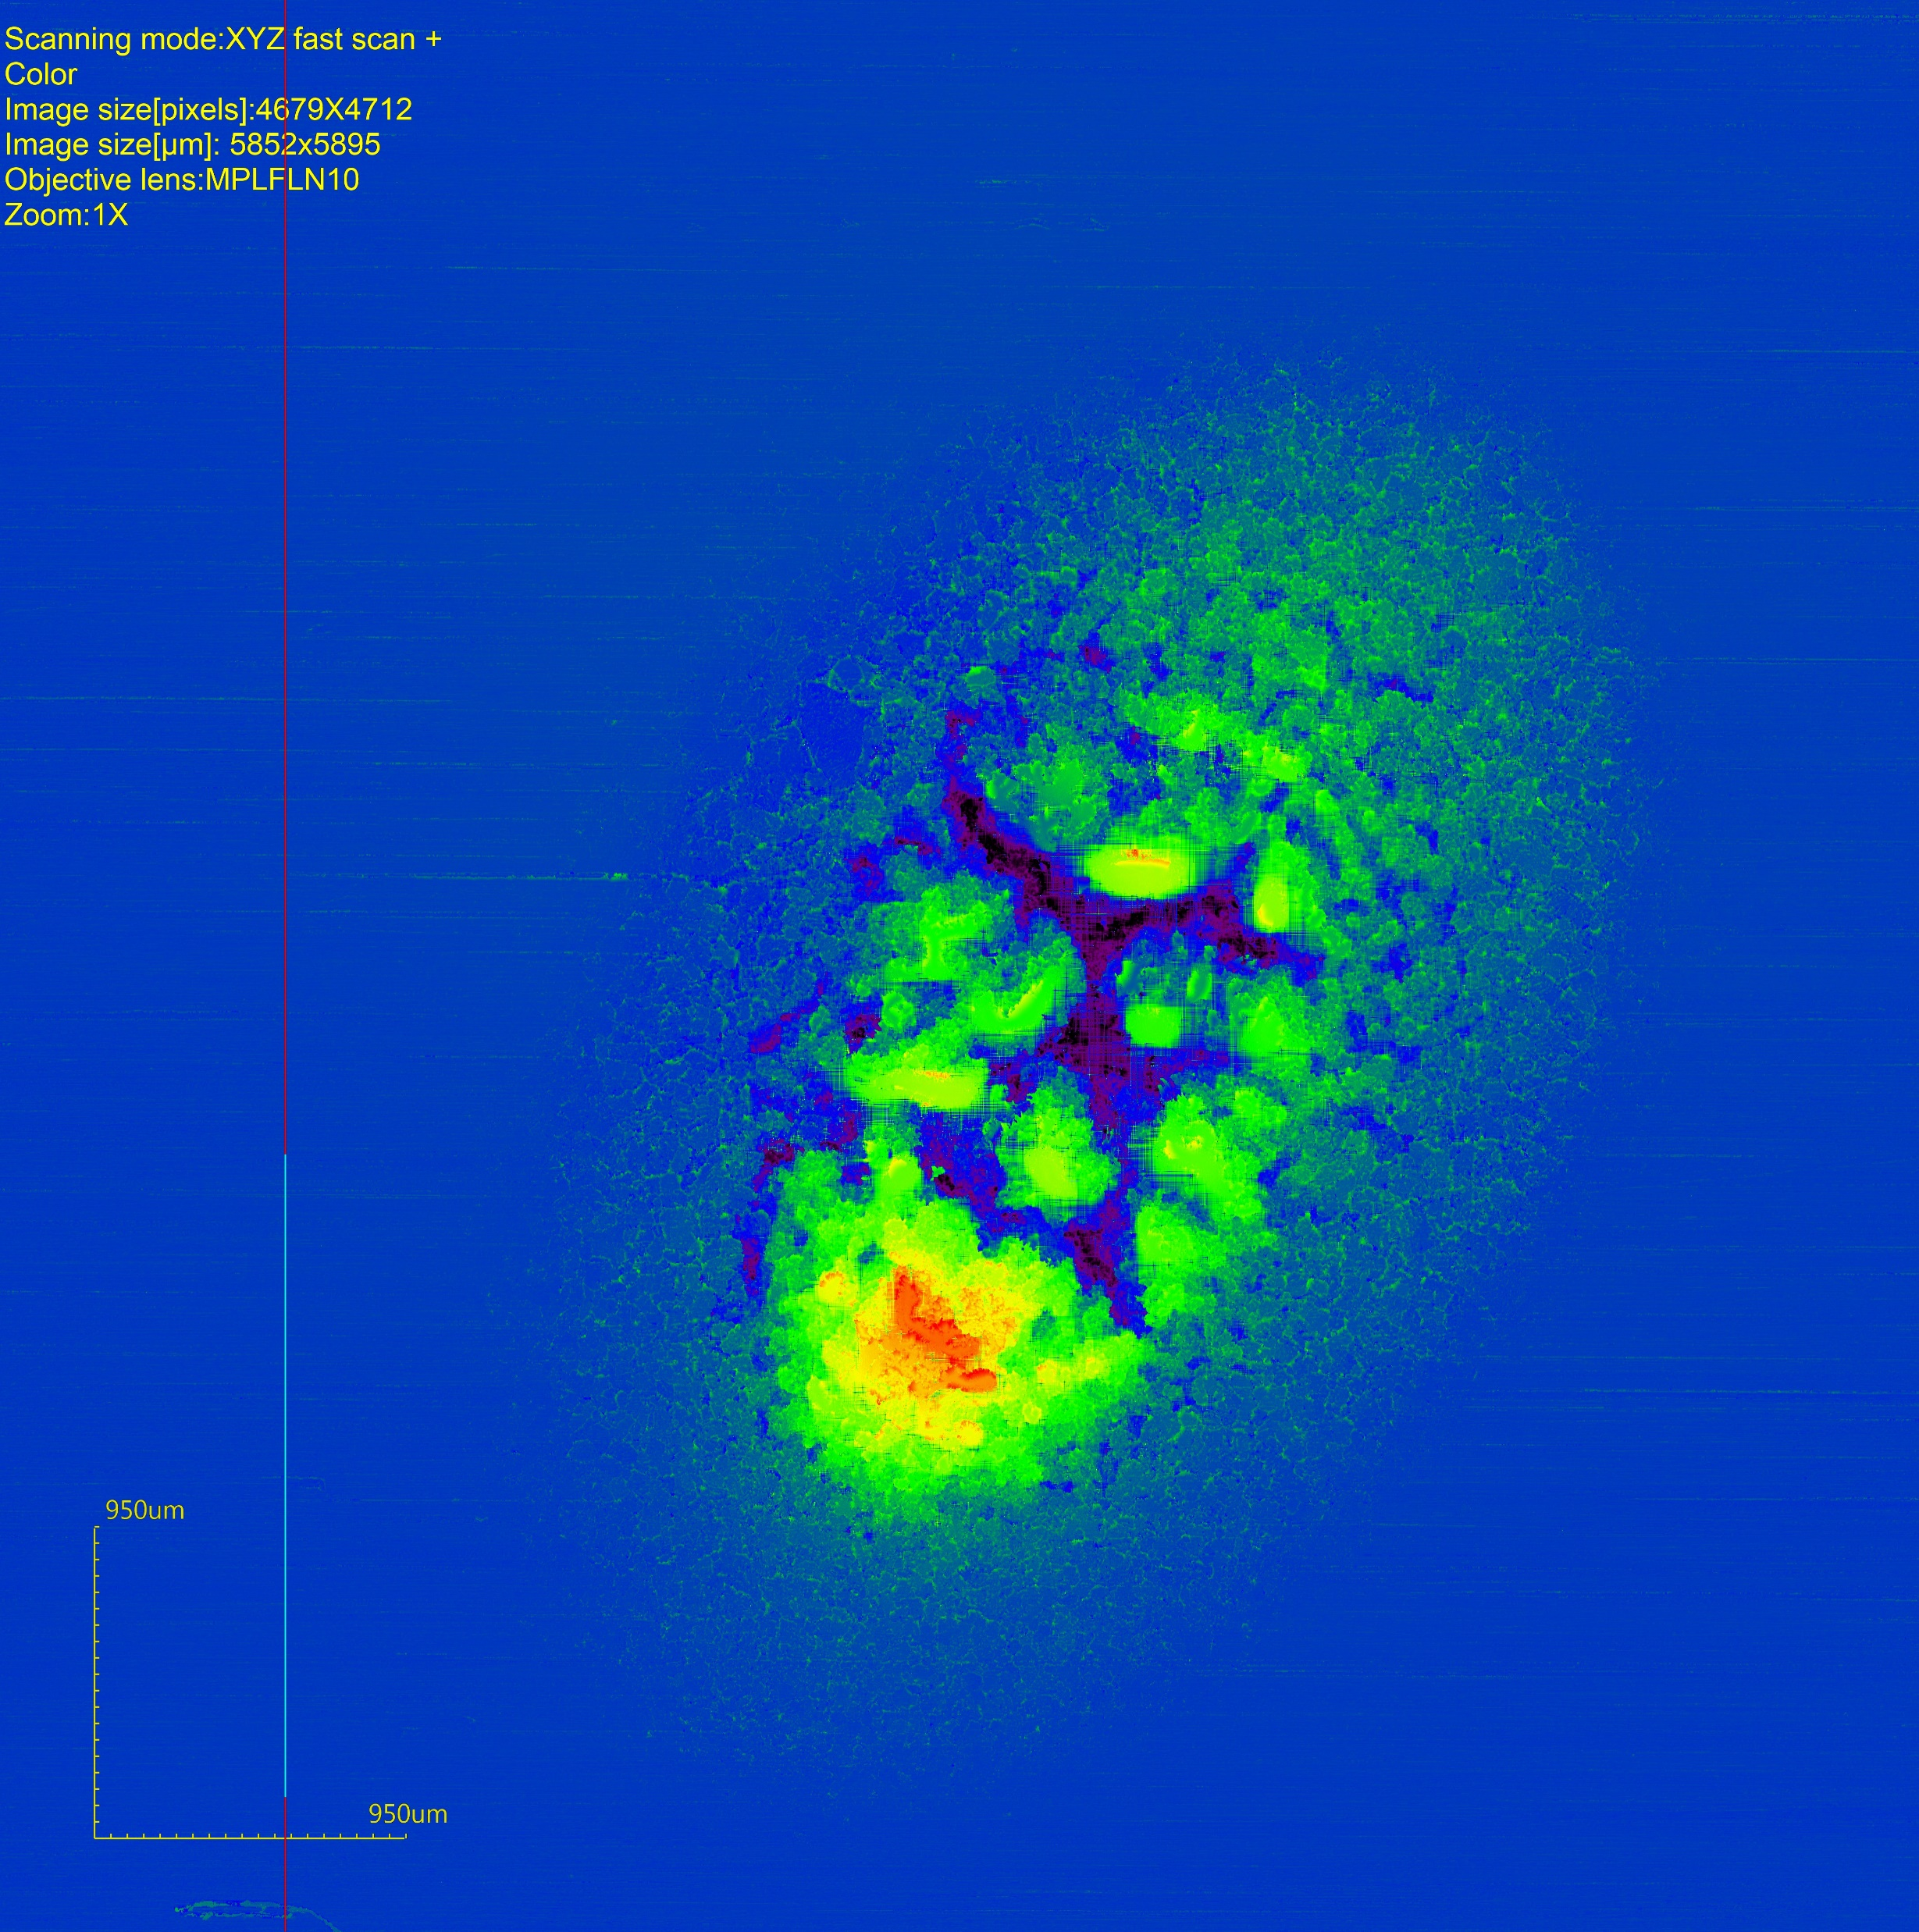
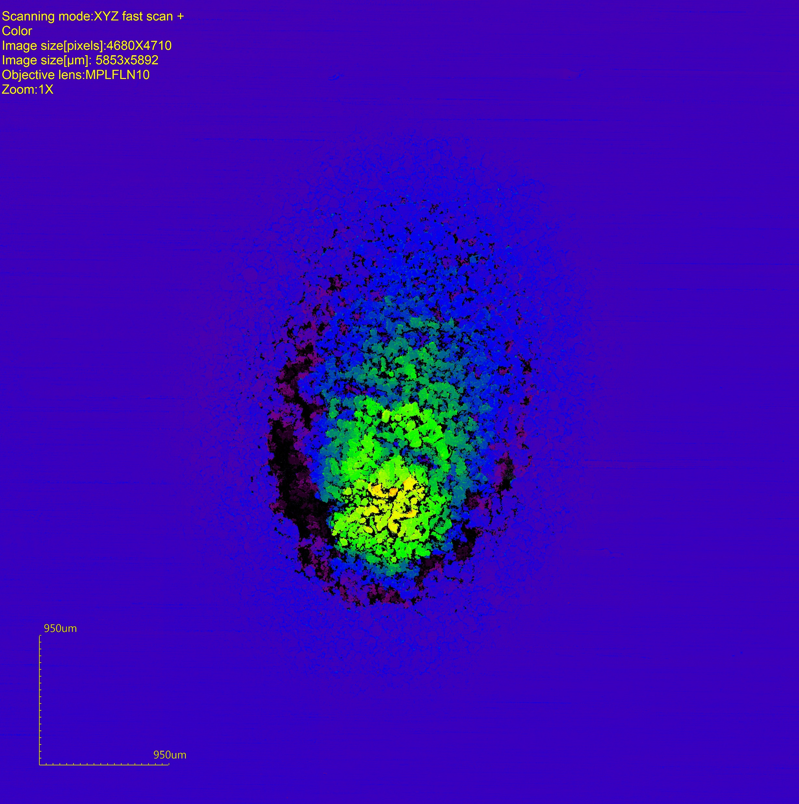
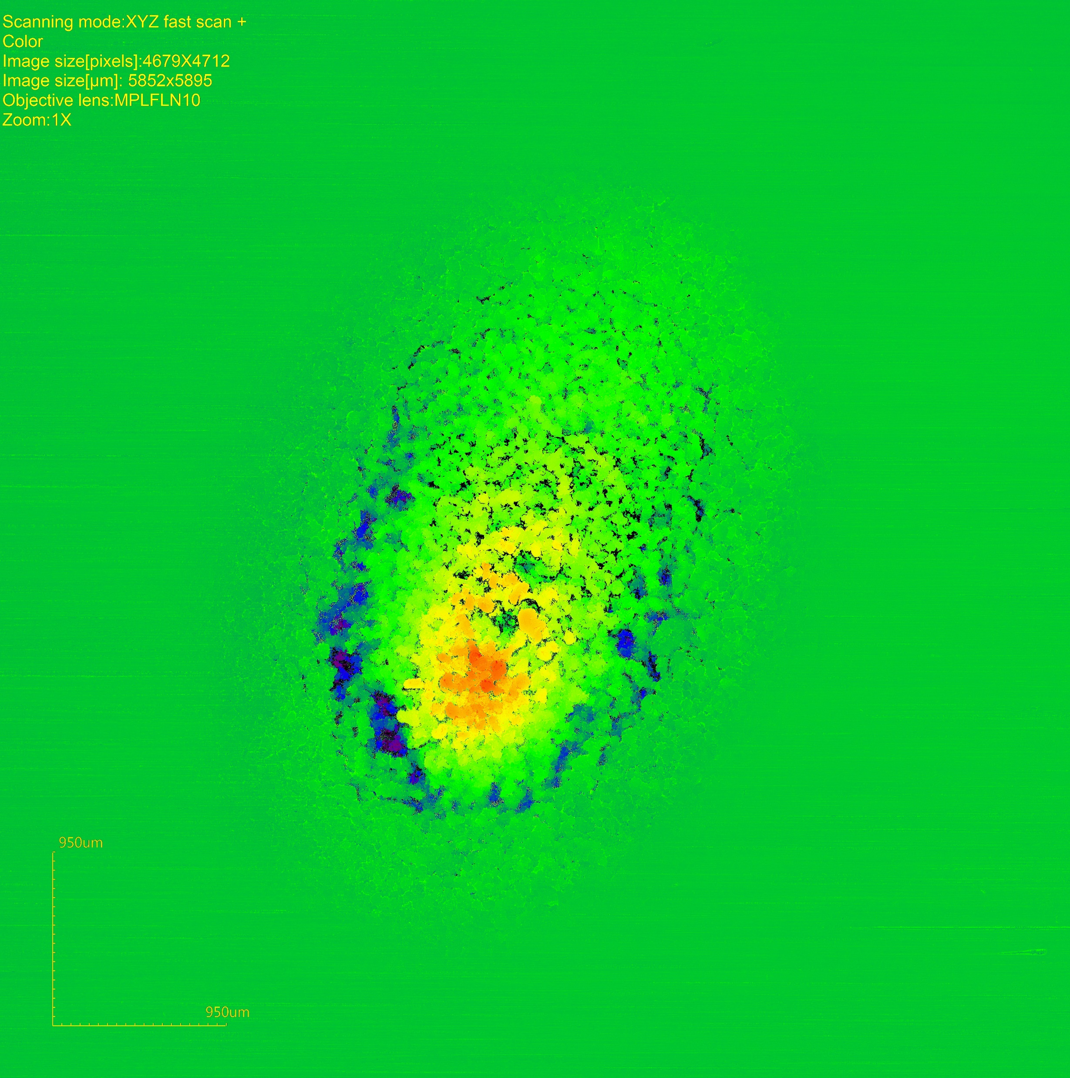
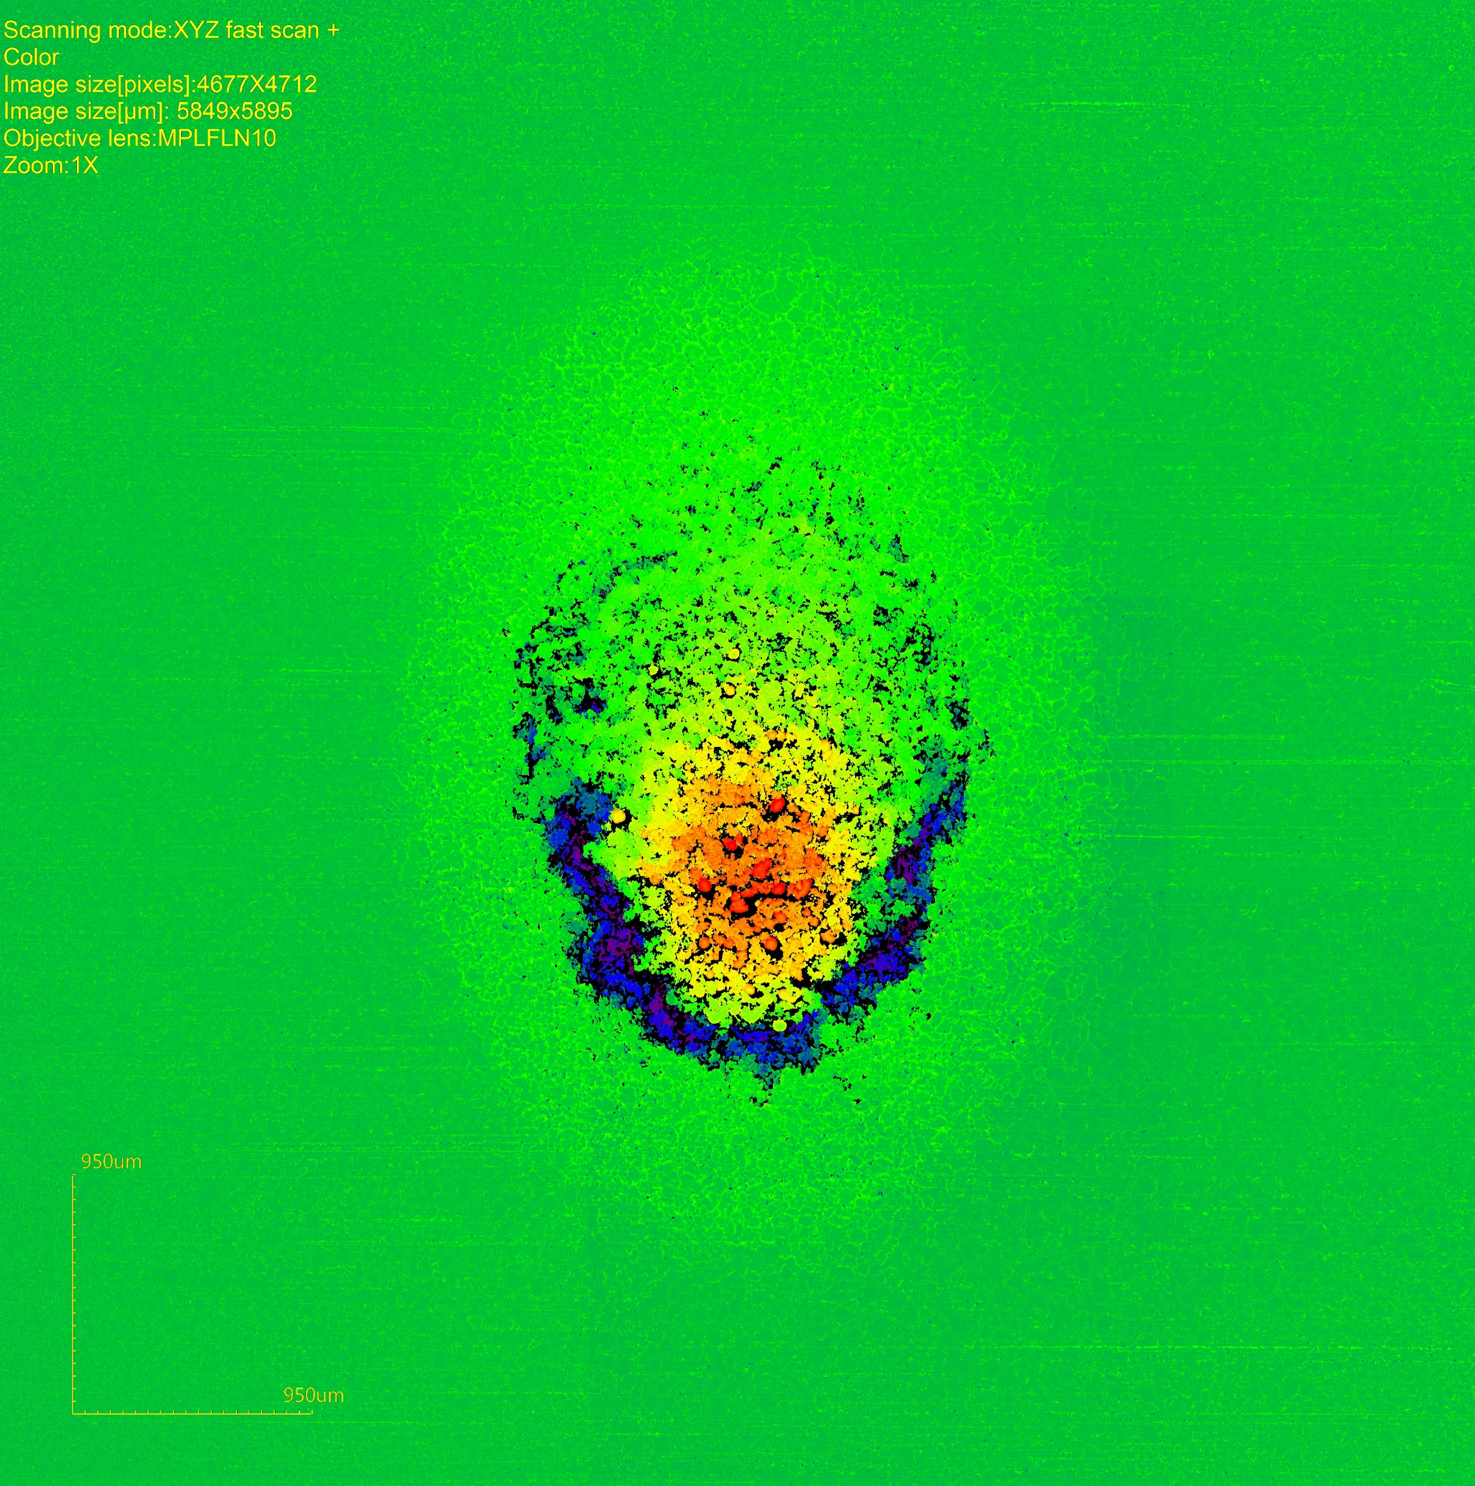
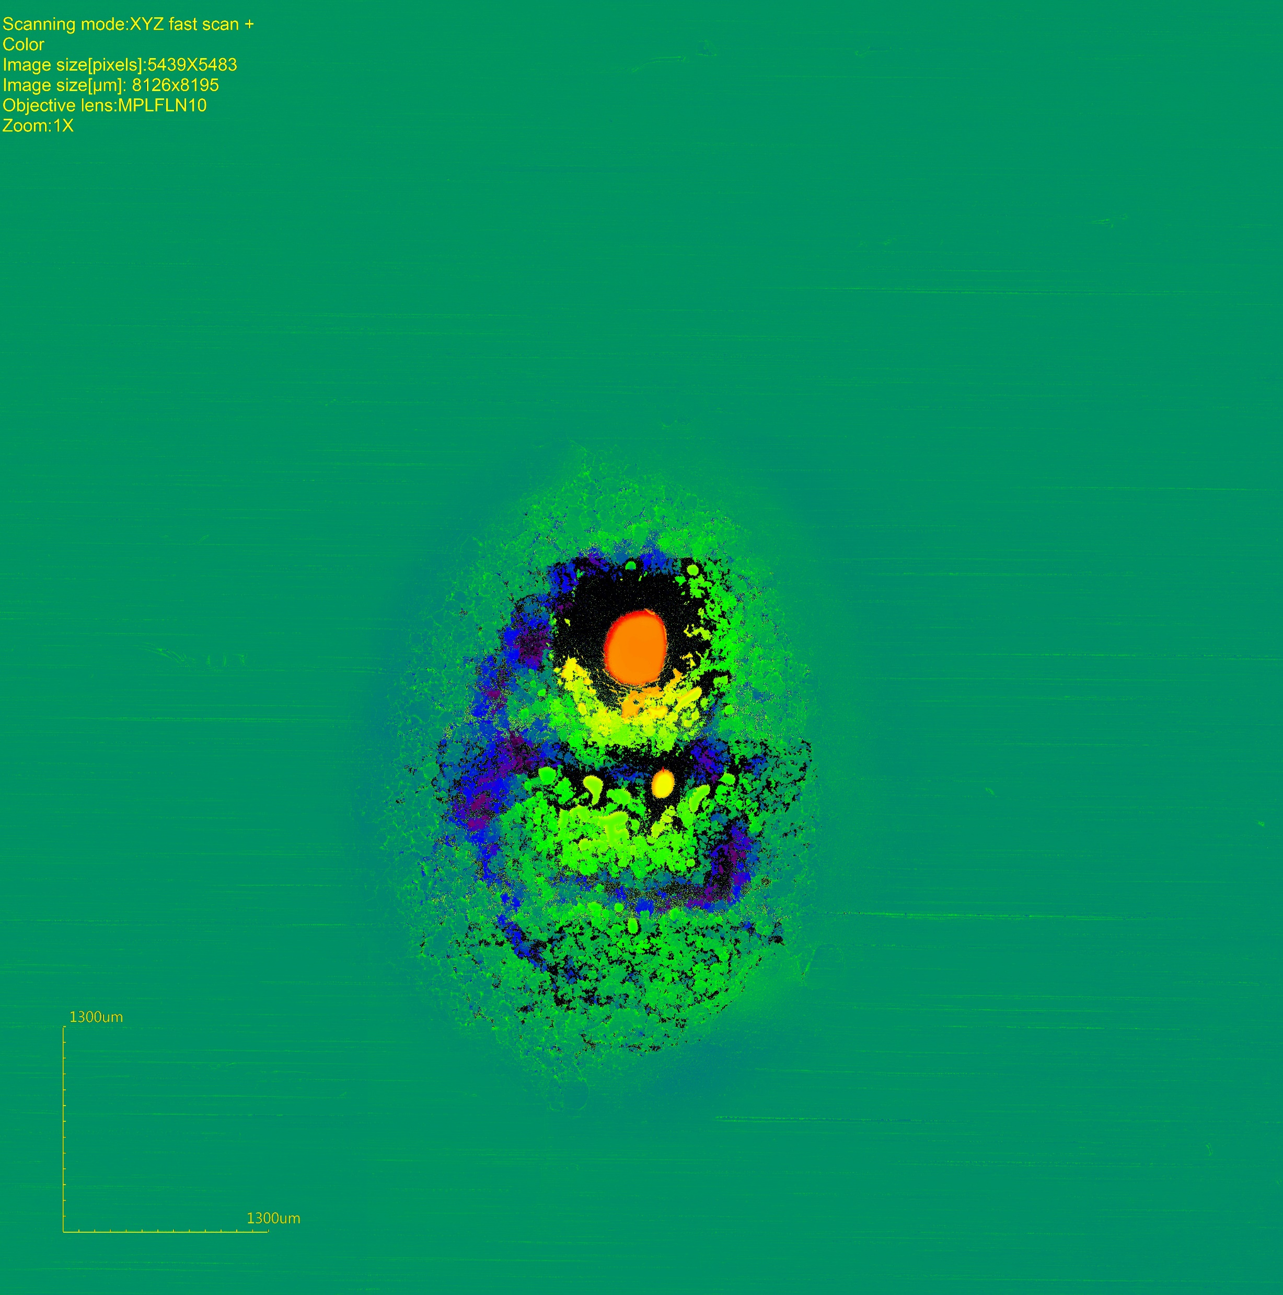
Laser spots: roughness
H, fl
H+Ne, fl
H-scale
1
3
Observations
Very roughened/cracked laser spots
Crack surrounding laser spot
Localized melting
H-scale: 690 µm
H-scale: 700 µm
0
2
4
6
H-scale: 700 µm
H-scale: 700 µm
H-scale: 1100 µm
H+He, fl
H+Ar, fl
H+He,-25V

Slide 14
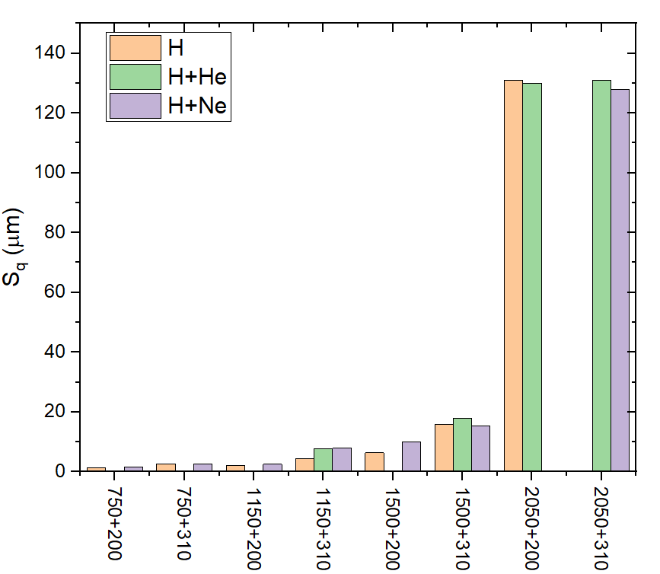
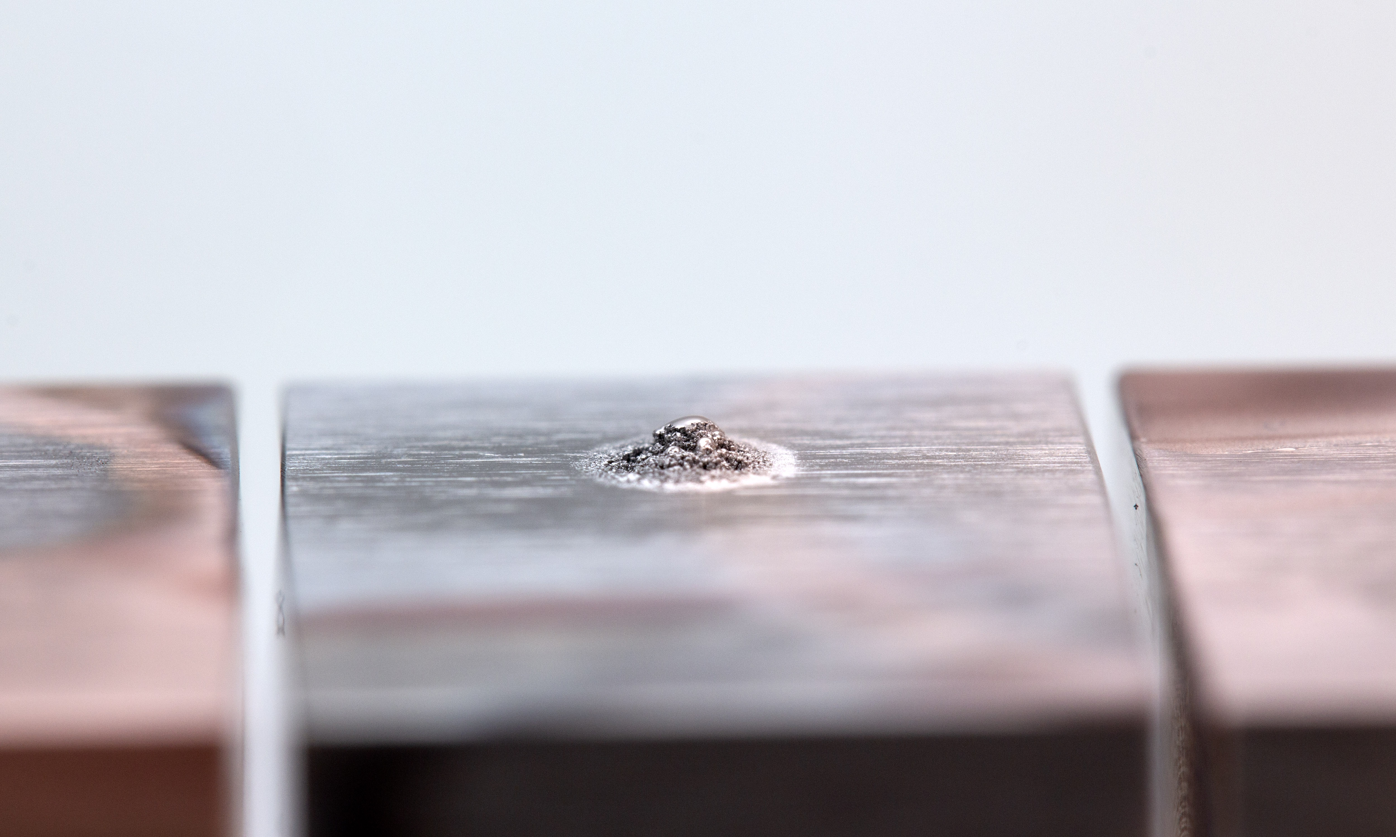
Roughness comparison
Strong deformation for very small ELM-like loads (F_{HF}~3-6 MW m⁻² ^{0.5})
No significant difference between different seeding options but significantly larger compared to lower T_{base}
Strikepoint protrusion = erosion/melting risk?
T_{base} + ΔT (°C)

Slide 15
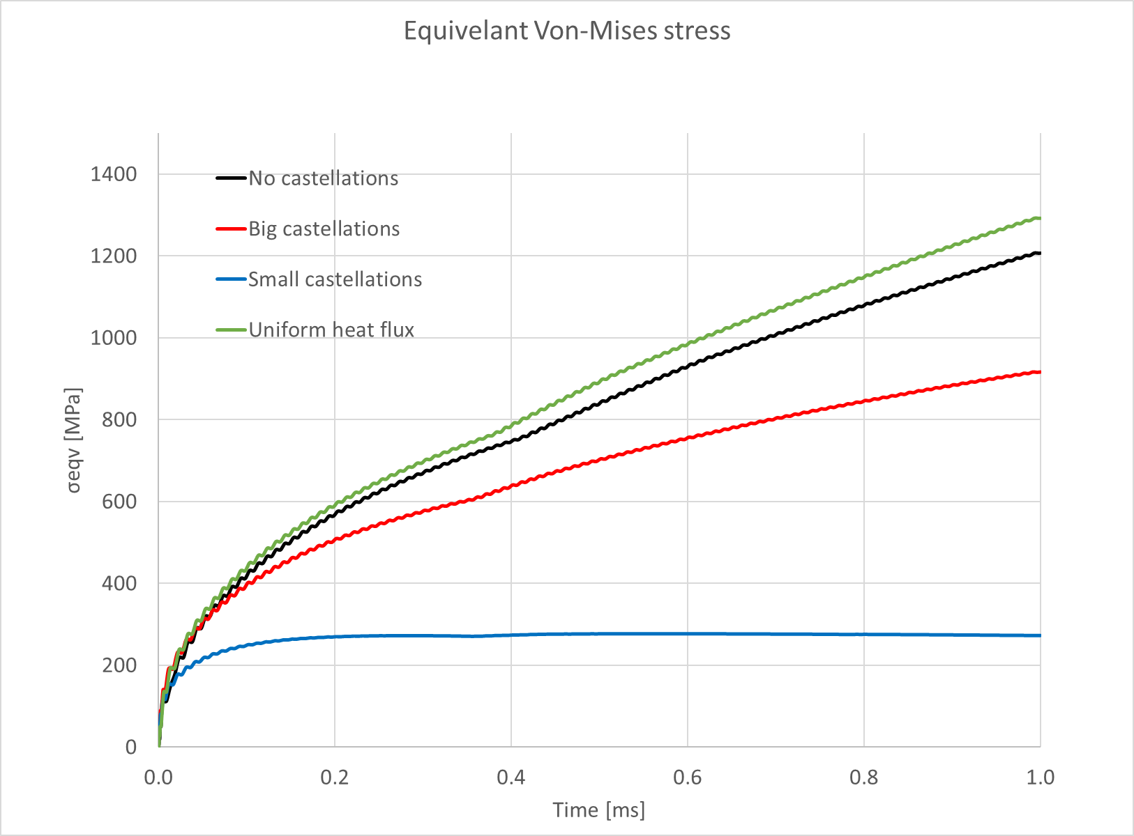
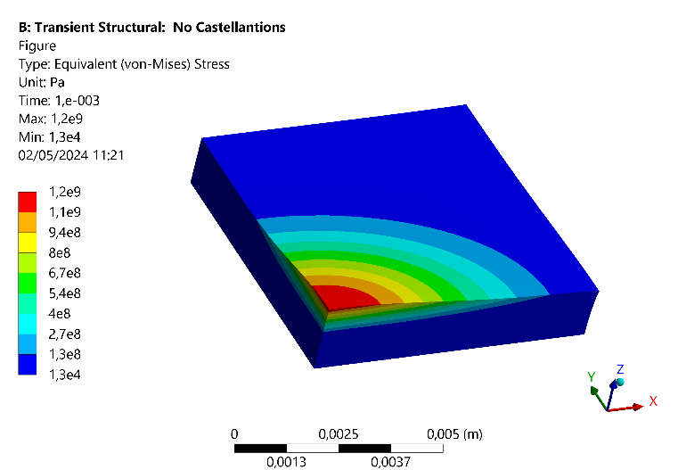
Mechanism of ELM-like effects
Stress field modelled in ANSYS for single ELM-like cycle
Stress predominantly σ_{zz}
For all cases exceed yield strength by ~comparison to UTS engineering stress early in pulse compared to lower T_{base}
Expect to readily see large-scale plastic deformation and cracking even for small N_{pulses}
* ITER materials handbook
** Nogami Fusion Eng. Des. 120 (2017)
UTS_{av} (non R_{x}) 800 °C*
UTS_{av} (R_{x}) 1200 °C*
Deformation enhancement: 400
UTS_{av} (R_{x}) 2000 °C**

Slide 16
H plasma effects on cyclical ‘slow transient’ loading (strikepoint sweeping)

Slide 17
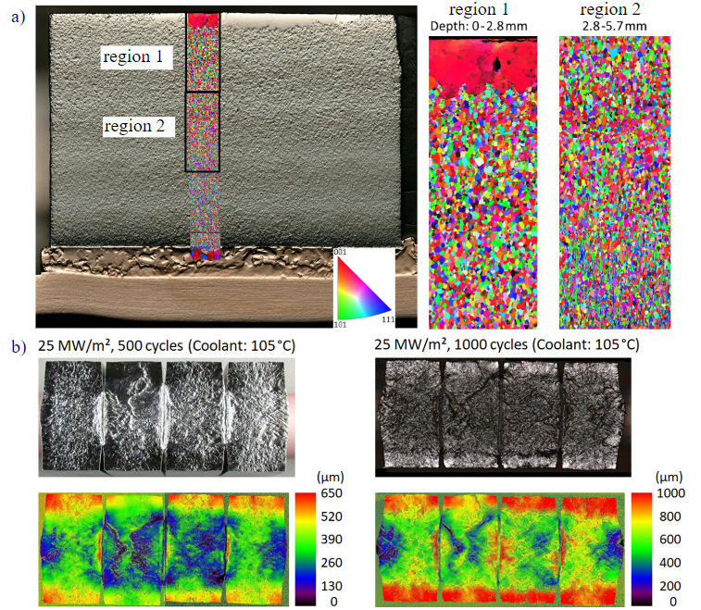
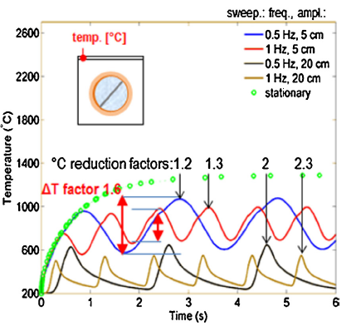
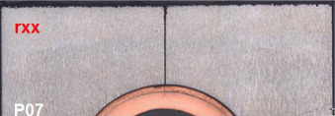
Motivation: Divertor Reattachment Events in DEMO
Divertor re-attachment events (slow transients) proposed to be mitigated in DEMO by strikepoint sweeping
This will impose cyclic thermal loads on the divertor of DEMO, giving rise to thermal fatigue.
Recrystalisation and surface roughening of ITER-like W monoblocks under ITER reattachment loading (J.H. You et. al. 2022)
Deep cracking of a W monoblock after 300 cycles of 20 MW m⁻² (M. Li et. al, 2015)
predicted monoblock temperature reduction achieved by strikepoint sweeping in DEMO (F. Maviglia et. al. 2021)
Notes:
Mention that each re-attachment event in ITER will constitute a thermal cycle
In DEMO strikepoint sweeping at 0.5 – 5 Hz and 50-400 mm under consideration, so each reattachement event can induce up to 50 cycles (at 5Hz)

Slide 18
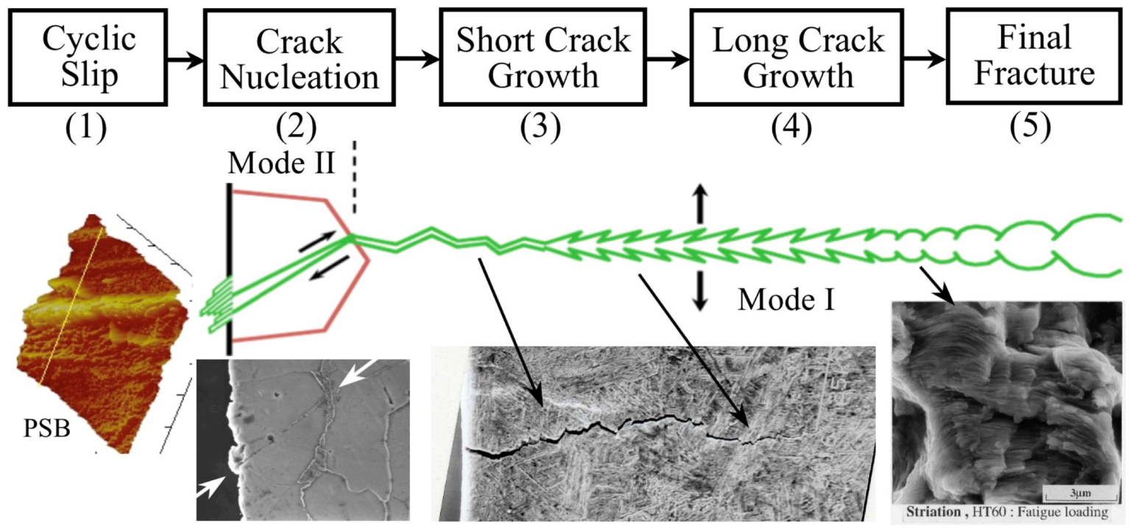
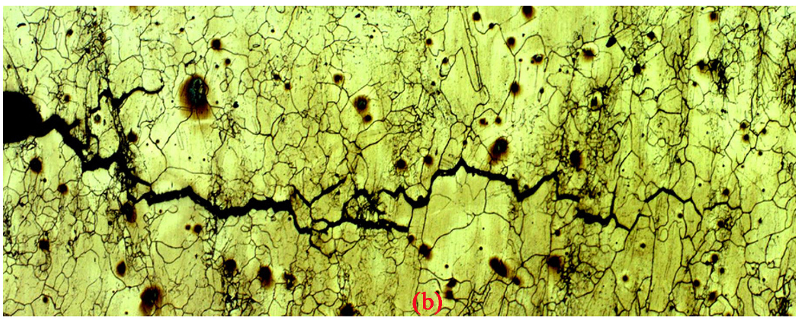
A short primer on thermal fatigue and creep-fatigue
Thermal fatigue: The Initiation and propagation of cracks due to cycles of thermal expansion and contraction.
Low-cycle thermal fatigue (LCF) progresses via 5 stages, across multiple length scales:
Fatigue cracks tend to nucleate at surfaces, on stress concentrators such as scratches, pits, roughness and indentations.
Fatigue crack propagation can also be accelerated by creep (creep-fatigue).
K > K_{IC}
The 5 stages of fatigue failure (F. Ellyin et. al. 1997)
Inter-granular creep cracking of 0.5CrMoV steel (L. Zhao et. al. 2017)
Notes:
Main focus of this slide is the sensitivity of fatigue behaviour to surface conditions, due to stress concentrators (pits, roughness, scratches etc).

Slide 19
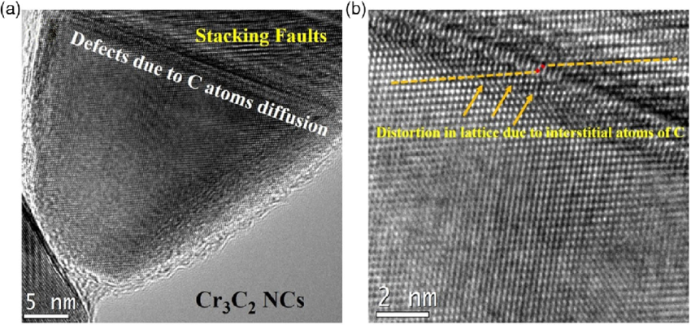
Some theories on the effects of implanted H on PSB formation Adapted from H embrittlement theory
H enhanced local plasticity (HELP)
H preferentially migrates to dislocation cores, forming a local ‘Cottrell’ H atmosphere
Cottrell atmosphere reduces lattice stresses imposed by the dislocation (elastic shielding effect)
Less dislocation entanglement and pile up, more glide
Promotes PSB formation
H enhanced decohesion (HEDE)
Interstitial H distorts crystal lattice, reducing energy needed to break atomic bonds
In turn, energy barrier for dislocation glide is reduced
Promotes PSB formation
H induced dislocation pinning (HIDP)
Formation of HELP-like Cottrell H atmospheres
But, H atmospheres must diffuse along with dislocations
Solute drag effect results in reduced dislocation glide
Inhibits PSB formation
Interplay of these mechanisms affected by:
Dislocation density, temperature, H concentration, applied stress/strain, microstructure (e.g. grain size, etc.)

Slide 20
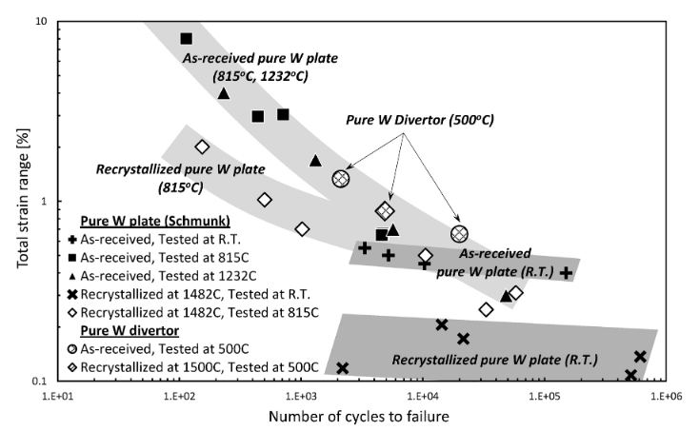
Method overview Using Magnum-PSI to explore PMI effects on W fatigue behaviour
Quantitative SEM image analysis
Supporting FEA
Magnum-PSI sweeping exposures
Q_{re} f_{SW} A_{SW}
Monoblock FEA
Δε_{zz}
M-PSI target FEA
ΔT
Thermal cycling
Plasma-material
interactions
Uniaxial fatigue data (Δε_{zz} vs N_{f})
S:N data
N_{f}
Nogami, Shuhei, Michitoshi Toyota, Wenhai Guan, Akira Hasegawa, and Yoshio Ueda. “Degradation of Tungsten Monoblock Divertor under Cyclic High Heat Flux Loading.” Fusion Engineering and Design 120 (July 1, 2017): 49–60. https://doi.org/10.1016/j.fusengdes.2017.04.102.
Notes:
Overview of approach – use FEA to scale reattachment thermal load (Q_{re}) and sweeping frequency (f_{SW}) and amplitude (A_{sw}) on a monoblock to a Magnum-PSI target, determining experiment parameters. Do exposure in Magnum-PSI, and assess number of cycles (N) to failure.

Slide 21
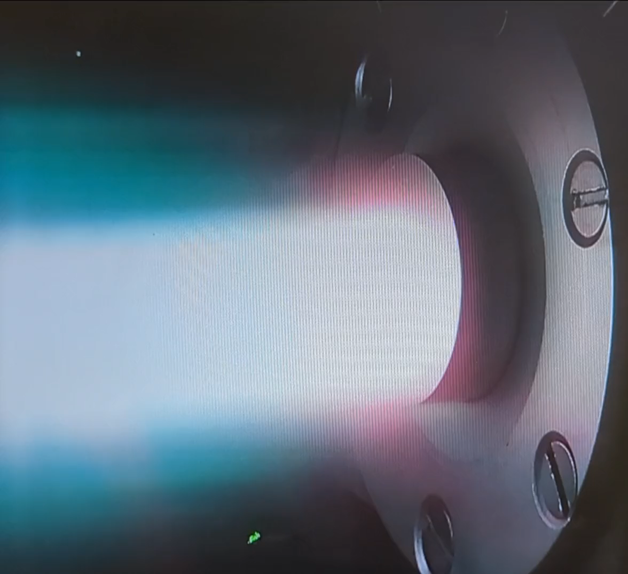
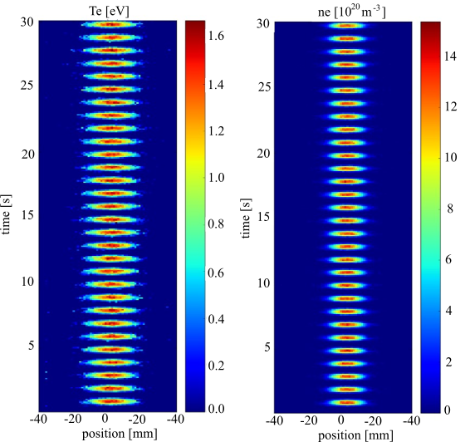
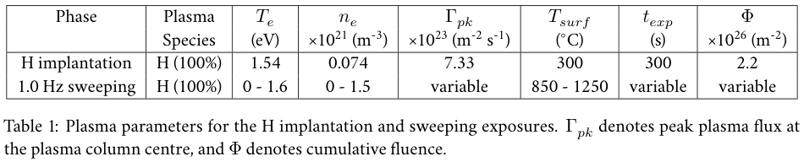
Emulating stikepoint sweeping using Magnum-PSI
Testing shows that current modulation is capable of replicating the range of strikepoint sweeping frequencies under consideration for DEMO (0.5 – 5Hz).
Pre-expose some targets to H plasma to induce blistering on targets and compare performance
video of plasma during loading cycles
Targets were notched via EDM prior to exposure to induce cracking at the target centre.
Synchronous TS measurements of T_{e} (left) and n_{e} (right) during H plasma pulsing,
Est. peak thermal flux = 40 MW m⁻²

Slide 22
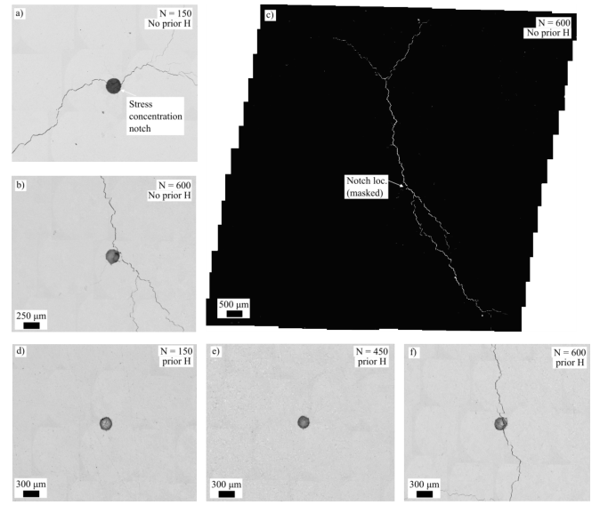
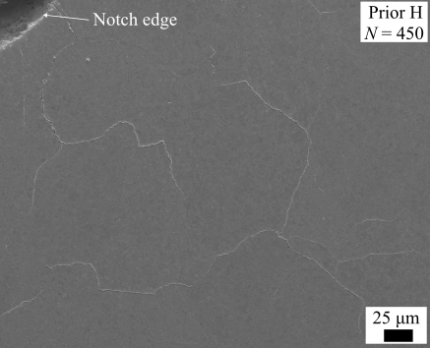

W targets with & without prior H implantation
mm-scale inter-granular cracking observed in all targets without prior H.
No mm-scale cracking observed in Prior H targets until N = 600 cycles
Fatigue cracking inhibited by prior H implantation
No prior H⁺
prior H⁺

Slide 23
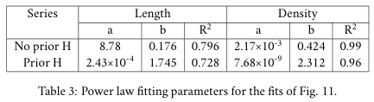
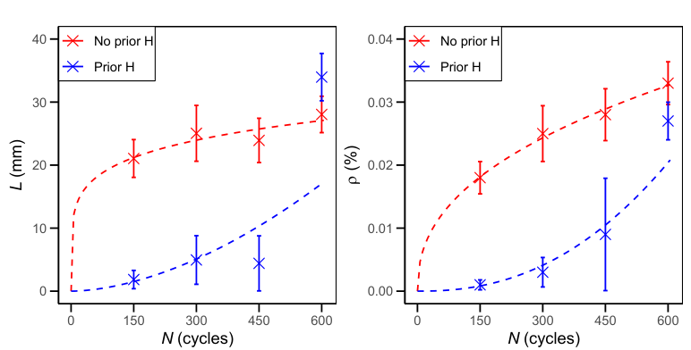
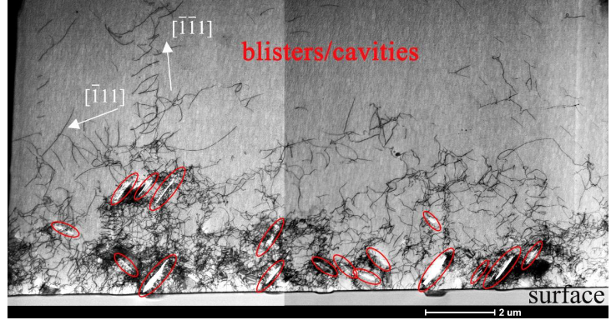


H implantation case hardening effect
Proposed mechanism:
H plasma induces voids/blisters near H super-saturated surface
Dislocation density greatly increased
More dislocation self-entanglement
PSB formation suppressed
Crack initiation delayed
H-induced dislocation loops in W (Chen et. al. 2020)

Slide 24
Conclusions
Magnum-PSI used to explore the performance of W under ‘slow transient’ conditions under SPA2 work-package in years 2021-2025
For 20 MW m⁻² loading, strong creep effects may be expected to lead to plastic deformation and intergranular cracking
Under ELM-like loading even very small ELM-like loads lead to strong deformation and cracking, localized melting on isolated regions
Slow transients could be mitigated by strikepoint sweeping, but this increases the chance of fatigue cracking
Prior H-plasma implantation leads to delay in cracking behaviour, likely due to ‘case hardening’ effect

