Slide 1
SP B status report 2025
WPPWIE Review Meeting, Jülich, 17-21 November, 2025
Antti Hakola
On behalf of the SP B team and task holders

Slide 2
Introduction – overview of SP B in 2025
SP B
Experiments on erosion, deposition and material migration
SP B.1
Physics of erosion and deposition
SP B.2
Material migration in toroidal devices
SP B.3
Characterization of plasma-exposed materials
SP B.4
Reference coatings for ITER and DEMO
SP B.5
Production of metallic dust in toroidal devices
SP B.6
B deposition on diagnostics mirrors
Resources: 26.2 PM
Machines:
MAGNUM-PSI (6 days)
GyM (20 days)
PSI-2 (10 days)
Accelerators (11 days)
Resources: 30.1 PM
Machines:
Accelerators (16 days)
Others:
25 k€ for diamond saw cutting
Resources: 39.1 PM
Machines:
Accelerators (33 days)
Resources: 42.3 PM
Machines:
Accelerators (15 days)
Resources: 26.0 PM
Machines:
Accelerators (8 days)
Resources: 8.0 PM
Huge number of tasks and deliverables (altogether 53) – most of them will be completed by the end of 2025
In many cases the work will continue in 2026-2027 within new tasks, with the scope and volume being re-adjusted

Slide 3
Overview of SP B in 2025 – high-level status of activities
Progress has been made in the following activity areas as follows
SP B.1: Physics of erosion and deposition - focus on cross-machine investigations
Several B samples exposed to plasmas (PSI-2, MAGNUM-PSI, GyM) to study physical and chemical erosion; W programme proceeding more slowly
Erosion rates at varying incident angles measured for W and B reference layers, exposure of W layers to dust impacts scheduled
SP B.2: Material migration in toroidal devices - concentrate on samples from boronization studies and WEST monoblocks
Results from WEST Phase 1 tiles and samples extensively reported (PFMC 2025), cutting of samples from Phase 2 PFUs ongoing
Several samples from AUG and WEST boronizations (uniform and non-uniform) analysed
Analysis of cavity samples from W7-X completed, measurements of divertor manipulator samples from AUG started
SP B.3: Characterization of plasma-exposed materials - samples coming from SP B.1 and SP B.2 (+ SP B.4)
Focus on WEST samples as well as samples from boronization experiments
SP B.4: Reference coatings for ITER and DEMO - production of B and W layers
Large programme to compare B layers produced by different labs by different techniques – all except VTT samples available (pure B layers)
W layers produced for targeted activities, highest interest for layers emulating re-deposits
SP B.5: Production of metallic dust in toroidal devices – re-scoping to primarily deal with dust analyses
W7-X dust samples available and their characterization chain agreed
Formation studies of B and W dust particles continued; this subtask will be largely finished by the end of 2025
SP B.6: B deposition on diagnostics mirrors
Mirrors exposed to AUG and W7-X boronizations/plasmas, analyses partly ongoing
In addition, meetings organized on (i) dust activities and analyses (March and September), (ii) production and analysis programme for B and W samples (July), and (iii) WEST analysis meeting (September)

Slide 4
Overview of SP B in 2025 – selected highlights per activity area
SP B.1: Physics of erosion and deposition
Thick B layers produced (MAGNUM-PSI) and their erosion (incl. chemical erosion) investigated
Erosion of nano-columnar W samples shows different dynamics than bulk W or W fuzz samples
SP B.2: Material migration in toroidal devices
Very thick deposited layers observed on WEST PFUs (up to 350 μm if never cleaned), erosion can reach values up to 20 μm (18 h of plasma)
Both on AUG and WEST, boronization layers show D/B fractions in the range of 0.1–0.3; B and D depleted upon exposure to air but at lower rates for the WEST samples
SP B.3: Characterization of plasma-exposed materials
WEST data shows consistent picture for the complex structure for the deposited layers after Phase 1 and Phase 2 operations
SP B.4: Reference coatings for ITER and DEMO
Pure B layers can be produced (impurity concentrations overall <10 at.%) but thicker ones required for linear machine experiments
SP B.5: Production of metallic dust in toroidal devices
Several elements already identified on the analysed W7-X dust samples, including (besides C) B, Fe, Cr, W, Ti, Ni, and Cu; large (mm-sized) and thick flakes of deposits with varying morphology and layered structure observed on the samples
Of the studied seeding gases, Kr is most efficient in producing W dust; collected dust contains both nanoparticles and larger agglomerates
SP B.6: B deposition on diagnostics mirrors
Reflectivities noticed to change following exposures, especially on the AUG case

Slide 5
High-level deliverables and milestones for SP B in 2025
Erosion and deposition patterns at the divertor and main-chamber structures of toroidal fusion devices following operations with and without boronizations
Reporting the role of fluence and pulse length in the erosion-deposition balance in toroidal fusion devices under reactor-relevant operational conditions
WMxx | SP B | Erosion rates of co-deposited/re-deposited W layers at reactor-relevant particle fluxes and fluences determined. (ITER+DEMO) | 31.12.2025
WMxx+1 | SP B | Material migration pathways elucidated for W and B in toroidal devices (AUG, WEST, W7-X) during and after boronizations. (ITER) | 31.12.2025
WMxx+2 | SP B | Erosion and deposition patterns on PFUs removed after Phase 1 and Phase 2 operations on WEST compared. (ITER) | 31.12.2025
WMxx+3 | SP B | Co-deposited boron layers with varying oxygen contents and surface morphologies delivered and characterized. (ITER) | 31.12.2025
WMxx+4 | SP B | W dust samples from toroidal fusion devices (AUG, WEST, W7-X) characterized and extrapolations made towards fusion reactors. (DEMO) | 31.12.2025
WMxx+5 | SP B | B contamination determined on diagnostics mirrors after AUG and W7-X boronization experiments. (ITER) | 30.06.2025

Slide 6
SP B.1 - Physics of erosion and deposition

Slide 7
SP B.1 deliverables 2025
Activity | Deliverable ID(s) | Title
SP B.1 | D001 3 PM | Erosion rates of W/B model systems and re-deposited W with different morphologies and compositions as well as the formation and erosion rates of thick re-deposits in MAGNUM-PSI with flux and fluence (DIFFER)
SP B.1 | D002 4 PM | Erosion rates of W/B model systems and re-deposited W with different morphologies and compositions in GyM with flux and fluence (ENEA)
SP B.1 | D003 7 PM | Erosion rates of W/B model systems and re-deposited W with different morphologies and compositions in PSI-2 with flux and fluence (FZJ)
SP B.1 | D004 5 PM | Erosion rates of co-deposited W- and B-based model systems following exposure to controlled ion beams (ÖAW)
SP B.1 | D005 1 PM | Erosion rates following high-energy dust impacts on W model systems and comparison to data from tokamaks (ENEA)

Slide 8
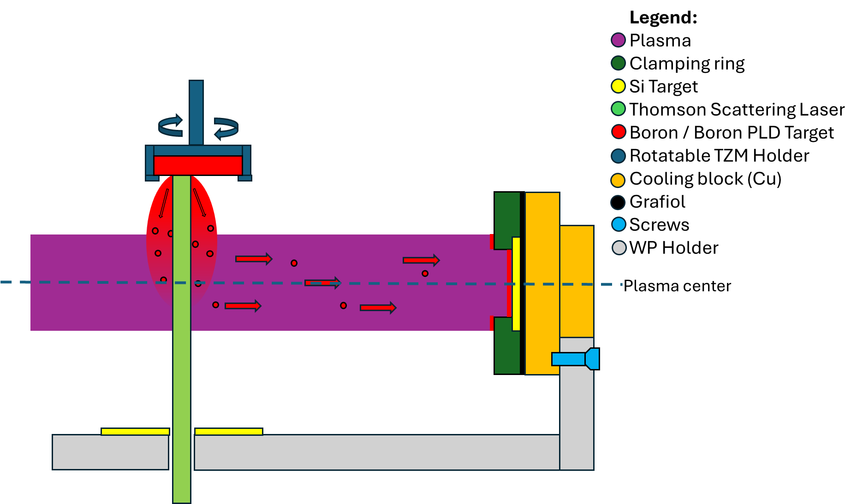
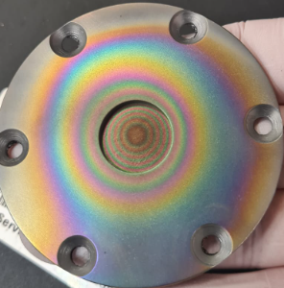
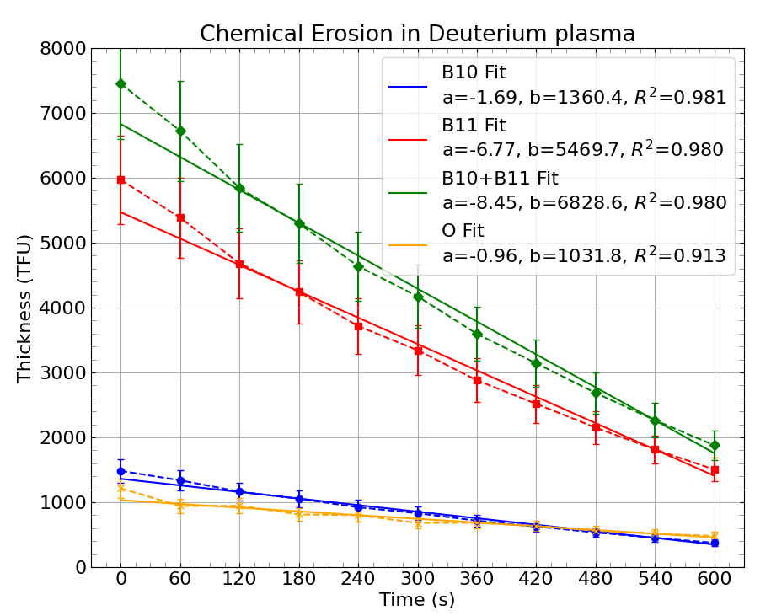
SP B.1: Production and erosion of thick re-deposition layers (DIFFER)
Task and questions to be addressed
Production of thick re-deposited B-containing layers as expected in ITER
Investigate chemical erosion of B
Approach
Use in-house developed plasma-assisted pulsed laser deposition (PLD) to grow thick B layers
Use lab-grown (PoliMo) 1-um thick B layers to study chemical erosion
Results
Using He plasma demonstrated for growing thick (~1 μm) B layers
Studied as a function of the deposition energy, pressure, and B-field
Impurity content ~20% O, some C and N
Chemical erosion dominant at low E_{ion}
Erosion rate for E_{ion} = 5 eV determined as 0.75 nm/s, Y=2.34×10⁻³
Erosion as function of ion energy experiments Nov 2025
Deliverable: PWIE-SP B.B1.T-T005-D001
Status: ongoing (to be completed Dec 2025)
Facilities: Magnum-PSI 6 days, UPP 3 days (0 granted), Accelerator 13 days
Linked WP or TSVV: SP B.4
T.W. Morgan, J.G.A. van Kesteren, C.J.D. Robben, B. Tyburska-Pueschel

Slide 9
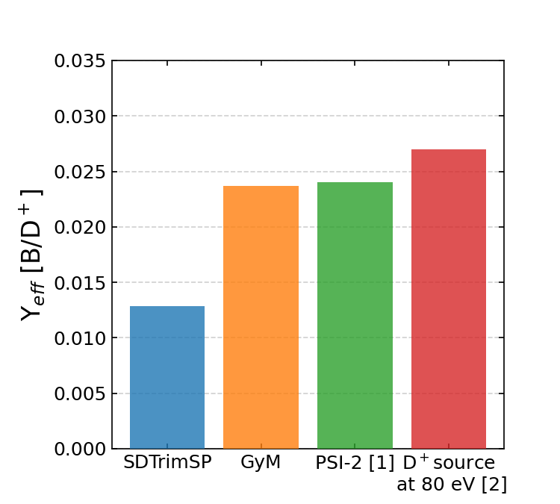
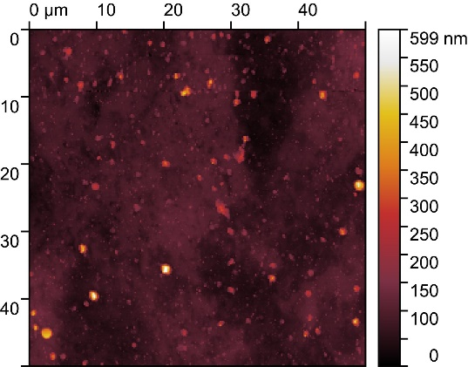
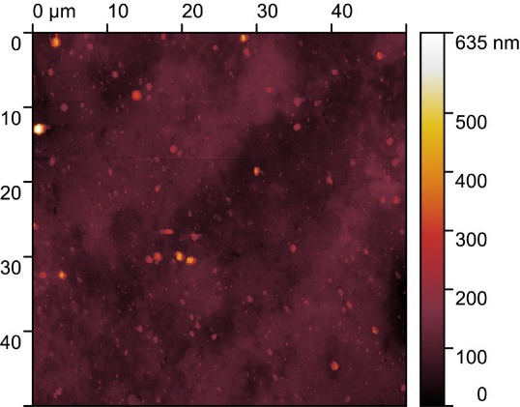

SP B.1: Erosion rates of W/B model systems and re-deposited W with different morphologies and compositions in GyM with flux and fluence (ENEA-CNR)
Task aims to broaden the understanding of W and B erosion physics, using linear device GyM. The work focuses on assessing erosion characteristics of different W or B-based materials or reference layers.
Task and questions to be addressed: Determine erosion characteristics of B films mimicking boronisation layers deposited on PFCs
Approach
D plasma exposure of 3 ns-PLD 100 nm-thick compact B films at Γ =3.4e20 D⁺ m⁻²s⁻¹
E_{ion} =76 eV according to PSI-2 experiments [1]
Φ =4e23 D⁺m⁻² (t_{exp} =20 min) chosen based on Y_{D→B,SDTrimSP}, to avoid full erosion of B films
Characterisations
Y_{eff} from mass loss: done
Surface topography by AFM: done
Surface composition by
ToF-ERDA, EBS+NRA+PIXE, ToF-MEIS
at Uppsala University: done
(see E. Pitthan’s slide)
SIMS at CIEMAT: ongoing
Raman and XPS at Aix Marseille Université: ongoing
Results
From ToF-ERDA B areal density (as dep. – after exposure)
AFM, As dep.
After exposure
Plasma sprayed B layer
RF magnetron sputtering B layer
ns-PLD B layer
Ra =21.9 nm
Ra =19.4 nm
[1] M. Sackers, et al., Nucl. Mater. Energy 45 (2025) 102003
[2] E. Hechtl, et al., J. Nucl. Mater. 196-198 (1992) 713-6
Deliverable: PWIE-SP B.B1.T-T005-D002
Status: completed
Facilities: GyM (20 days)
Linked WP or TSVV: SP B.4, SP D.1, SP D.3
A. Uccello, A. Cremona, F. Ghezzi, M. Pedroni, G. Alberti, D. Dellasega, M. Passoni

Slide 10
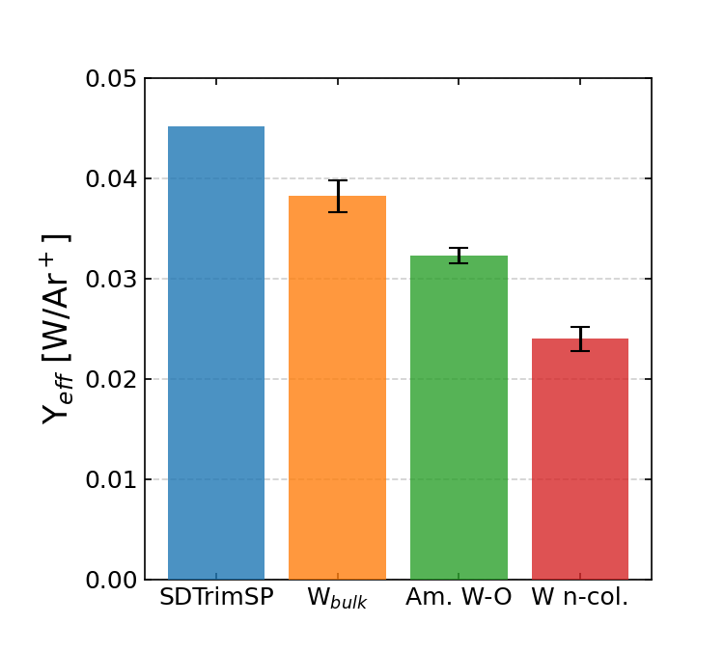
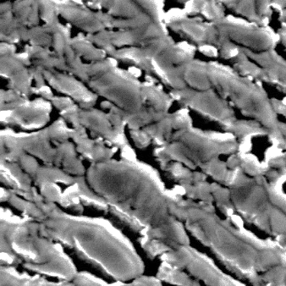
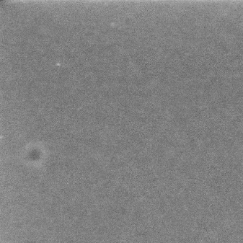
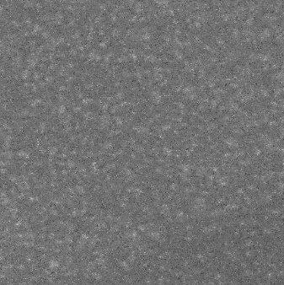
SP B.1: Erosion rates of W/B model systems and re-deposited W with different morphologies and compositions in GyM with flux and fluence (ENEA-CNR)
Task aims to broaden the understanding of W and B erosion physics, using linear device GyM. The work focuses on assessing erosion characteristics of different W or B-based materials or reference layers.
Task and questions to be addressed:
Determine the impact of plasma flux and sample morphology in erosion characteristics of W model systems (cross-machine experiment)
Approach
Ar plasma exposure at Γ =1.5e20 Ar⁺m⁻²s⁻¹
Φ =5.4e23 Ar⁺m⁻² and E_{ion} =90 eV, of:
Compact W films on Si w/ pyramids
W nano-columns
Amorphous W-O films (PoliMi)
W-O films (IAP)
Y_{eff} from mass loss: done
Surface topography by AFM: done
Surface structure by SEM: done
Main result
W nano-columns Y_{eff} ≅ 40% W_{bulk} Y_{eff} ⃪ Microscale morphology modelling with ERO2.0 carried out under SP D.3 (see G. Alberti’s talk)
W n-col.
As dep.
After exposure
1 μm
500 nm
500 nm
Am. W-O
As dep.
After exposure
1 μm
500 nm
500 nm
1 μm
Deliverable: PWIE-SP B.B1.T-T005-D002
Status: completed
Facilities: GyM (20 days)
Linked WP or TSVV: SP B.4, SP D.1, SP D.3
A. Uccello, A. Cremona, F. Ghezzi, M. Pedroni, G. Alberti, D. Dellasega, M. Passoni

Slide 11
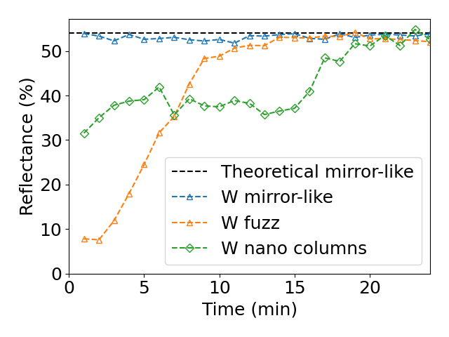
SP B.1: Erosion rates of W/B model systems and re-deposited W with different morphologies and compositions in PSI-2 with flux and fluence (FZJ)
Task and questions to be addressed
Establish the erosion rates for nano-columnar W coatings
Approach
Exposure of nano-columnar W coated samples in PSI-2 to Ar plasma for 25 min
Measurement of erosion rate by spectroscopy studies
Variation in intensity - sputtering yield
Variation in reflectance - optical properties
Results
Lower erosion rate of the coating compared to bulk W, confirmed by spectroscopy as well as post-mortem SEM/FIB analysis
SEM image of the surface and cross-section after PSI-2 exposure. Spot with coating leftover presents lower erosion rate as compared to bulk surrounding.
Deliverable: PWIE-SP B.B1.T-T005-D003
Status: completed
Facilities: PSI-2 (2 days)
Linked WP or TSVV: SP B.4
O. Marchuk

Slide 12
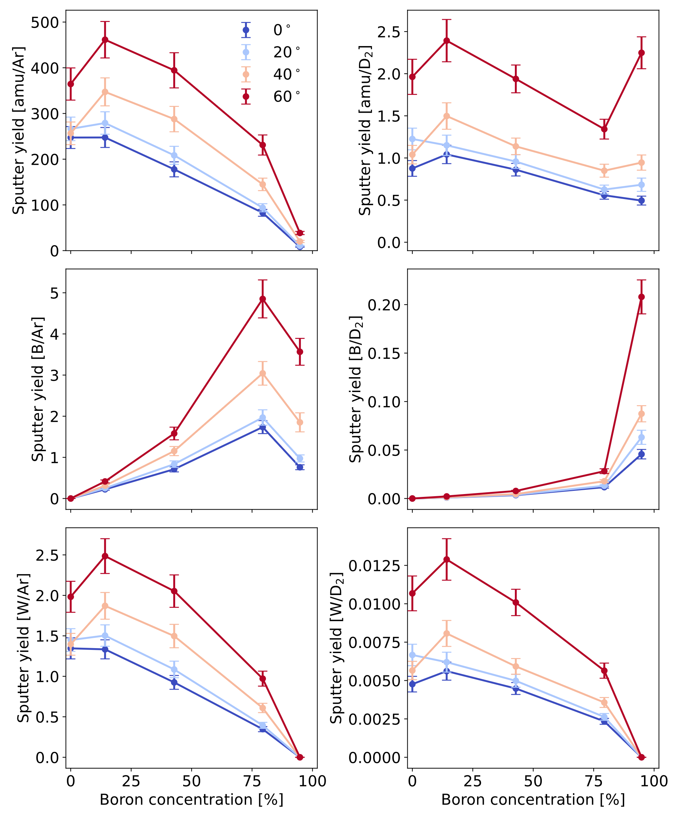
SP B.1: Erosion rates of co-deposited W- and B-based model systems following exposure to controlled ion beams (ÖAW)
Boronizations produce mixed tungsten-boron layers on plasma-facing surfaces, thereby influencing the erosion properties of the first wall
Task and questions to be addressed
Assess the erosion characteristics of co-deposited W- and B-based model systems upon exposure to different ion beams under laboratory conditions
Approach
Utilization of a Quartz Crystal Microbalance (QCM) to perform angle-dependent sputter yield measurements of samples with different tungsten-boron mixing ratio (W:B ≈ 1:0, 4:1, 1:1, 1:4, 0:1) under 2-keV Ar⁺ and 2-keV D₂⁺ irradiations
Results
General decrease in sputtered mass for increasing boron concentration for 2 keV Ar⁺ and 2 keV D₂⁺ irradiation
Decrease in sputtered tungsten particles and increase in sputtered boron particles with increasing boron concentration for 2-keV Ar⁺ and 2-keV D₂⁺ irradiation
2 keV Ar⁺
2 keV D₂⁺
Deliverable: PWIE-SP B.B1.T-T005-D004
Status: completed
Facilities: -
Linked WP or TSVV: ENR-MAT.02.VR
R. Gurschl, M. Fellinger,
B. Burazor Domazet, J. Brötzner,
G. Nagy, R.A. Wilhelm, F. Aumayr

Slide 13
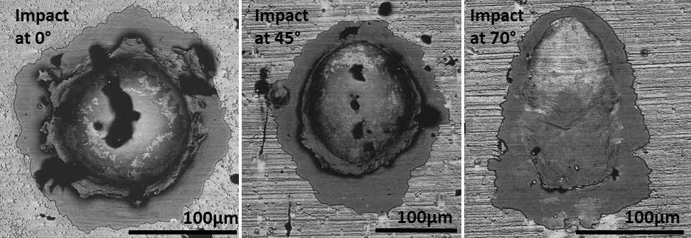
SP B.1: Erosion patterns on W model systems at high-energy dust impacts (ENEA)
Following the previous studies on the erosion patterns and material migration of W model systems upon dust impacts for normal impacts (i.e. at 0°), this task focuses on the erosion patterns at different dust impact angles.
Task and questions to be addressed
Determine the erosion and morphology of W systems impacted by high-speed dust at different angles
Approach
Shoot dust at three velocities (1, 2, 3 km/s) and three different impact angles (0, 45, 70°) on W model systems on Mo substrates
Analyse the damaged surfaces
Preliminary results
The eroded surface at 0° impacts are in line with previous investigations
The eroded surface is larger for samples 45° tilted respect to normal incidence
The eroded surface decreases at shallow dust impact angles
SEM images showing examples of delaminated surfaces of W model systems upon dust impacts for different impact angles. Dark color: Mo substrate and impurities; light color: W deposit.
Deliverable: PWIE-SP B.1.T-T005-D005
Status: ongoing (to be completed by the end of 2025)
Facilities: -
Linked WP or TSVV: SP B.4
M. De Angeli (ENEA), D. Ripamonti (ENEA), G. Daminelli (ENEA), P. Tolias (VR)

Slide 14
SP B.2 - Material migration in toroidal devices
SP B.3 - Characterization of plasma-exposed materials

Slide 15
SP B.2 deliverables 2025
Activity | Deliverable ID(s) | Title
SP B.2 | D001 6 PM | WEST campaigns: erosion and deposition patterns on PFUs after WEST Phase 1 (C1-C5) and Phase 2 (C6-C10) operations and thickness profile of layers originating from boronizations (CEA)
SP B.2 | D002 2 PM | WEST campaigns: microscopy investigations of He-exposed PFUs after Phase 1 and Phase 2 operations on WEST (CEA)
SP B.2 | D003 2 PM | WEST campaigns: detailed investigation of selected PFUs, including side faces of marker tiles, for their erosion, deposition, and surface-modification patterns at different locations with respect to magnetic ripple (MPG)
SP B.2 | D004 5 PM | AUG manipulator experiments: pre- and post characterization of samples exposed to AUG plasmas and/or boronizations on AUG for their erosion and surface-modification patterns as well as boron deposition profiles (MPG)
SP B.2 | D005 3 PM | AUG manipulator experiments: deposition profiles of B and D on samples exposed to AUG plasmas and/or boronizations on AUG at high spatial and depth resolution (VTT)
SP B.2 | D006 2 PM | AUG campaigns: deposition profiles on samples originating from boronizations on AUG (RBI)
SP B.2 | D007 2 PM | AUG campaigns: changes in the surface properties of samples exposed to AUG plasmas and/or boronizations on AUG (FZJ)
SP B.2 | D008 2 PM | W7-X manipulator experiments: erosion and deposition characteristics on manipulator and other samples exposed to OP2 plasmas on W7-X (FZJ)
SP B.2 | D009 3 PM | W7-X manipulator experiments: erosion and deposition patterns on manipulator samples and wall components from OP2 experiments and/or boronizations on W7-X (MPG)

Slide 16
SP B.3 deliverables 2025
Activity | Deliverable ID(s) | Title
SP B.3 | D001 2 PM | Depth profiles and surface morphology of selected B or W layers (CIEMAT)
SP B.3 | D002 4 PM | Surface modifications and fuel content of selected AUG, WEST, W7-X, and PSI-2 samples (FZJ)
SP B.3 | D003 2 PM | Composition of layers on selected WEST monoblock samples (IAP)
SP B.3 | D004 3 PM + 2 PM (AR) | Surface modifications of selected WEST, W7-X, MAGNUM-PSI, PSI-2, and GyM samples (IPPLM)
SP B.3 | D005 3 PM | Composition and fuel content of layers on selected WEST monoblock samples and on SP B.1 or SP X samples (IST)
SP B.3 | D006 3 PM | Micro- and macroscale composition of layers on selected AUG, WEST, MAGNUM-PSI, PSI-2, and GyM samples (JSI)
SP B.3 | D007 2 PM | Surface modifications and erosion/deposition profiles of samples and wall tiles from AUG, WEST, and W7-X (MPG)
SP B.3 | D008 5 PM | Surface modifications and composition of layers on selected WEST, MAGNUM-PSI, PSI-2, and GyM samples (NCSRD)
SP B.3 | D009 2 PM | Micro- and macroscale composition of layers on selected AUG, WEST, MAGNUM-PSI, PSI-2, and GyM samples (RBI)
SP B.3 | D010 1.5 PM | Erosion and deposition patterns on selected WEST samples as well composition of plasma-exposed B and W layers (VR)
SP B.3 | D011 2 PM | Depth profiles and composition of deposited layers of selected samples from AUG, WEST, W7-X, MAGNUM-PSI, PSI-2, and GyM (VTT)
SP B.3 | D012 2 PM | Depth profiles for layers on selected WEST monoblock samples (UT)

Slide 17
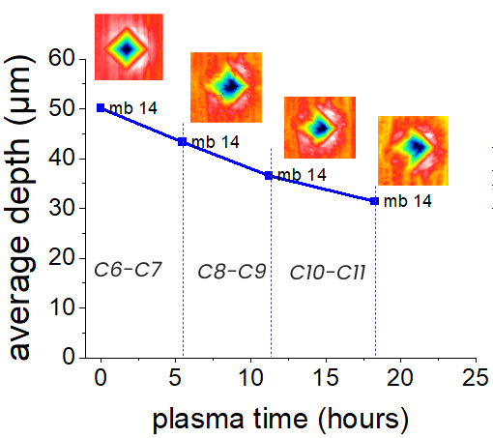
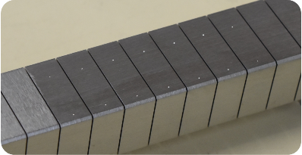
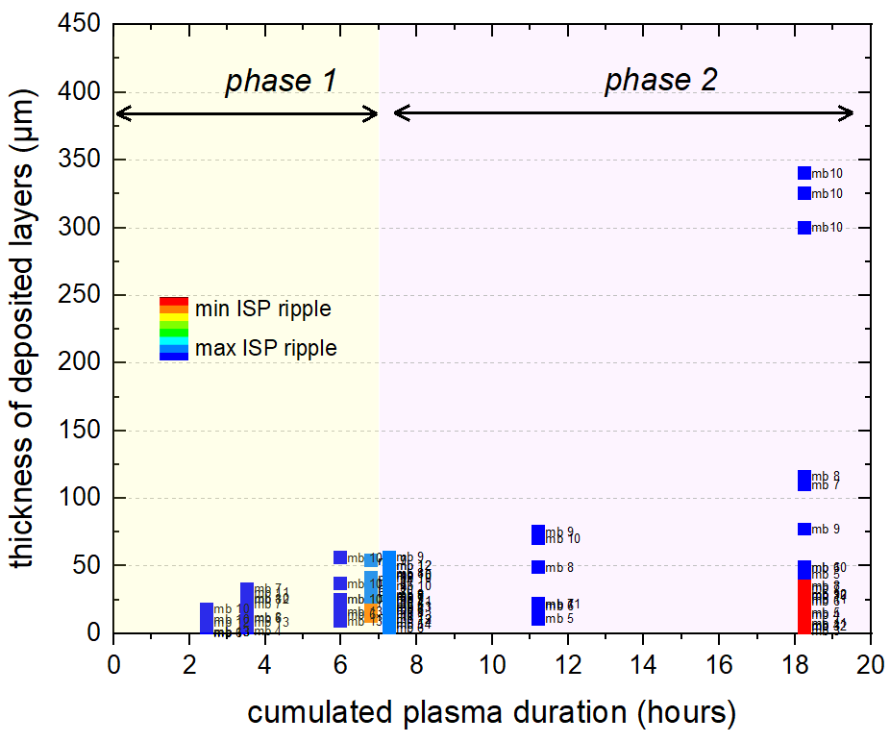
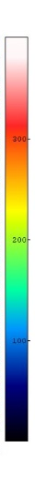
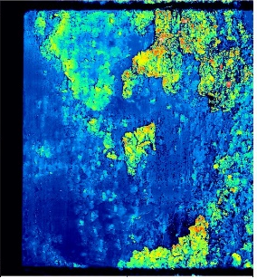
SP B.2: WEST analysis: erosion and deposition patterns on PFUs (CEA)
Task and questions to be addressed
Assess erosion of divertor PFUs phase 2
Approach
Fiducials on the surface of 4 PFUs (CEA)
Measurement of their depth using confocal microscopy – monitoring after each campaign (CEA)
FIB analyses of the fiducials (MPG)
Results
Fiducials clearly modified by plasma (change of depth, change of shape)
Erosion might reach 20 µm at ISP after 18h of plasma
Task and questions to be addressed
Evaluate deposition behaviour on PFUs during phase 2
Approach
Confocal microscopy on PFUs after C9 and C11 to determine thickness of deposited layers
Results
Layers > 100 µm during phase 2
If no cleaning is carried out, layers can even grow up to 350 µm
Deliverable: PWIE-SP B2.T-T005-D001
Status: completed
Facilities: 20 k€ consumables
Linked WP or TSVV: WPTE
M. Diez et al.

Slide 18


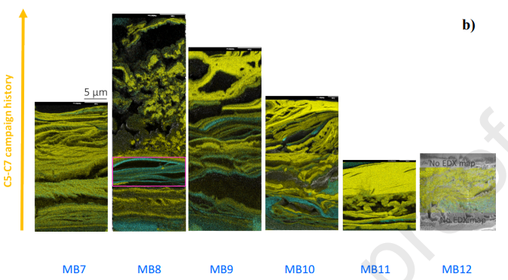


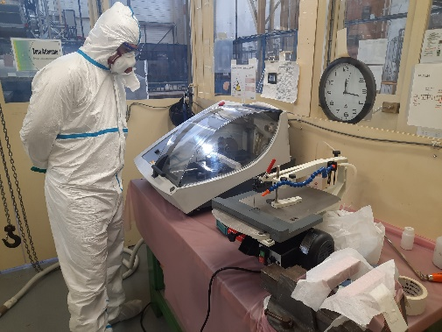
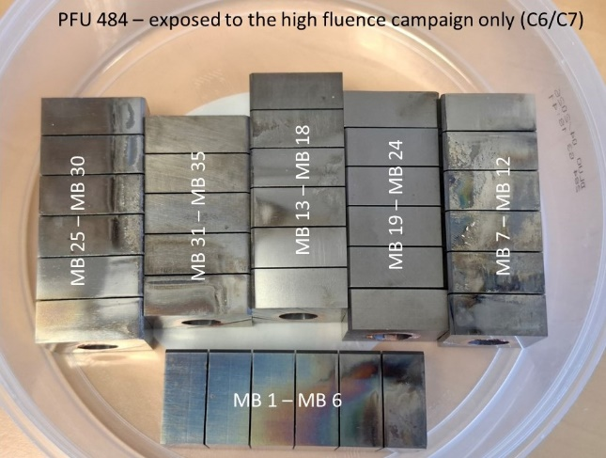
SP B.2: WEST analysis: analysis after the high-fluence campaign (CEA)
Task and questions to be addressed
Investigate/compare impact of high fluence campaigns (C7 and C12) on divertor targets
High fluence campaigns in WEST (C7, 2023 vs C12, 2025)
Dedicated to reach particle fluence of ITER shots (W erosion /migration expected)
Repetitive long discharges and 100s of pulses
Cumulated plasma time 5 h 30 min (C7)
Characterization plan and results
In-situ collection of deposits on 2 PFUs using sticky pads after C7 and analysis using SEM/EDX/FIB (CEA/AMU) – 2023/2024 → Dense W layers of 5-40 µm thickness [1]
Identification of 1 PFU exposed to C7 and cutting into segments (CEA) – 2025 - done
Plan : retention, morphology and thickness of deposits, cracks, morphology of flakes
Identification of 1 PFU to be exposed to C12
Pre-characterization using confocal microscopy (CEA/AMU) – 2025 done
Deliverable: PWIE-SP B2.T-T005-D001
Status: completed
Facilities: 20 k€ consumables
Linked WP or TSVV: WPTE
[1] C. Martin et al., Nucl. Mater. Energy 41 (2024) 101764
M. Diez, C. Martin et al.

Slide 19
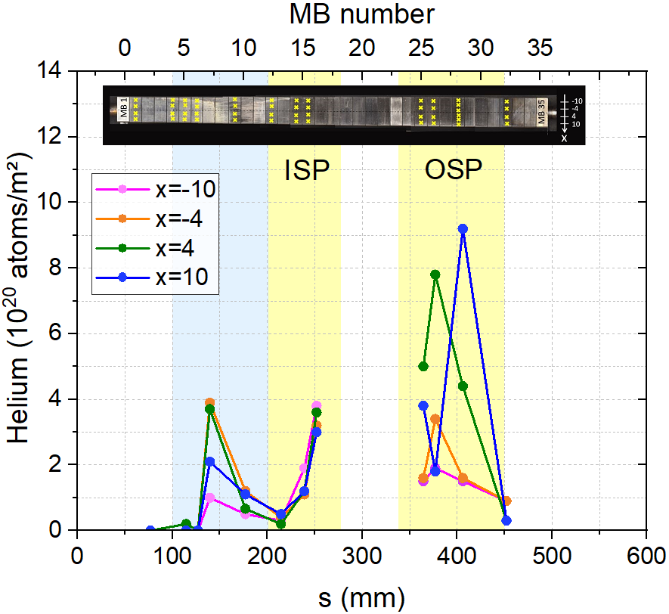
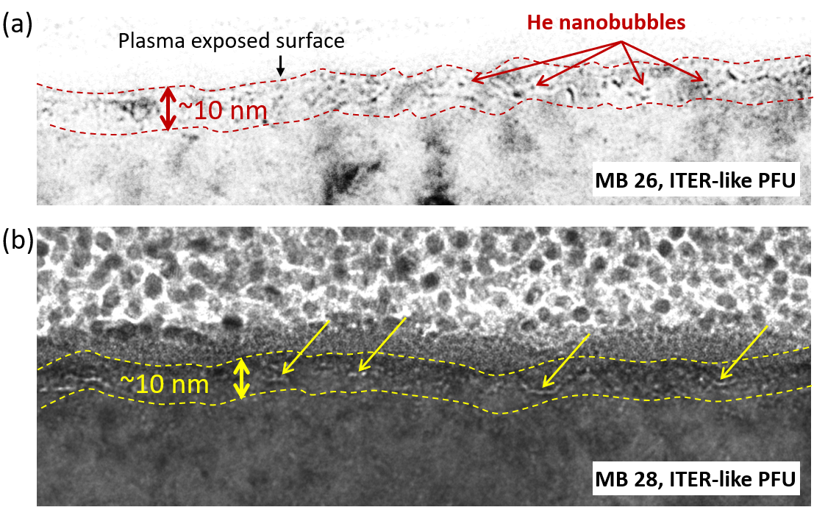
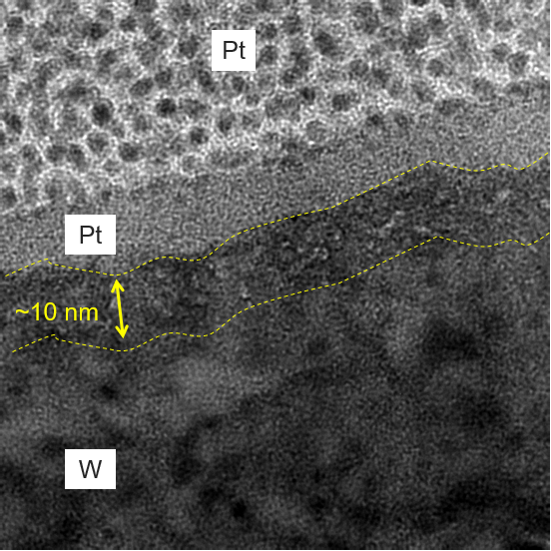
SP B.2: Microscopy investigations of He-exposed PFUs after WEST Phase 1 (CEA) SP B.3: Surface analyses of selected WEST monoblocks (RBI)
Task and questions to be addressed
Carry out ion-beam analyses for samples exposed to the helium plasma operations on WEST and determine accumulation of He and B on the PFUs
Investigate changes in the surface state of the He-exposed PFUs
Approach
TOF-ERDA analyses for samples from standard WEST Phase 1 PFUs as well as from 12 monoblock samples of the ITER-like PFU WECN001
SEM/FIB/TEM analyses on the same samples after the TOF-ERDA measurements
Results
Maximum He content found on SP (up at 10 at.%) on the standard tiles and ITER-like PFU
Maximum He content on leading edge
Evidence of He bubbles found on the standard tiles and ITER-like PFU
→ Paper to be submitted before the end of the year
He bubbles
Deliverable: PWIE-SP B.B3.T-T005-D009
Status: completed
Facilities: accelerator 4 days
Linked WP or TSVV: WPTE
Deliverable: PWIE-SP B2.T-T005-D002
Status: completed
Facilities: -
Linked WP or TSVV: WPTE
I. Bogdanovic Radovic et al.
C. Martin et al.

Slide 20
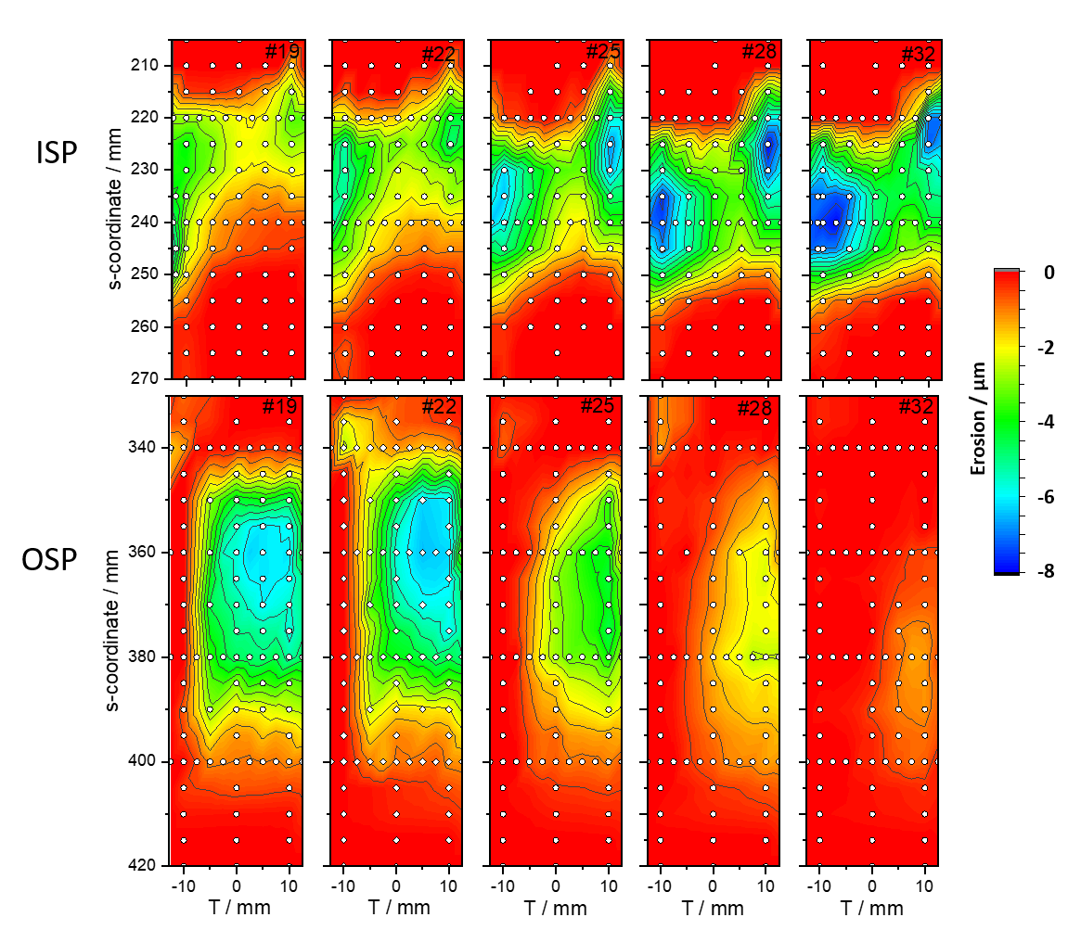
SP B.2: Analyses of (entire) WEST tiles (MPG) SP B.3: Erosion/deposition profiles on samples from WEST (MPG)
Task and questions to be addressed
Detailed investigation of selected PFUs from WEST, including side faces of marker tiles, at different locations with respect to magnetic ripple + IBA measurements of boronization samples
Approach
SEM and IBA measurements performed on marker and standard tiles after C3, C4, C5 campaigns (Phase 1)
First analysis of partial boronization (GDB) samples from WEST
Results
Standard tiles dismounted after C5 from different positions in respect to the ripple in WEST - 2D erosion pattern determined (PFMC)
Some ~5-10 times different erosion rates between minima and maxima of the ripple and with strong local variations
Highest erosion on each tile is not at the toroidal central line due to the beveling and shadowing of the tiles
Gap sides of marker tiles analyzed (SEM, IBA): no conclusive results achieved
Deliverable: PWIE-SP B.B2.T-T005-D003
Status: completed
Facilities: Accelerator 2 days
Linked WP or TSVV: WPTE
Deliverable: PWIE-SP B.B3.T-T005-D007
Status: completed
Facilities: Accelerator 3 days
Linked WP or TSVV: WPTE
M. Balden et al.

Slide 21
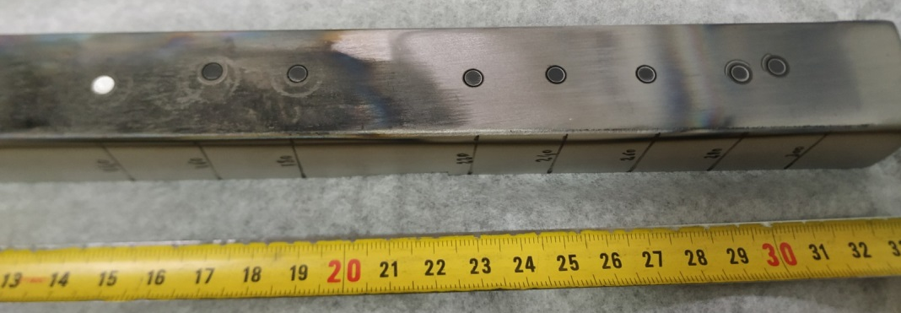
SP B.3: Composition of layers on WEST monoblock samples (IAP)
5 ISP and 5 OSP W coated tiles from different toroidal locations analyzed by GDOES
Task and questions to be addressed
Elemental depth profiles and erosion/deposition patterns evaluated
Results:
Inner tile #18
Outer tile #18
Inner tile #18
Conclusions:
B detected on all tiles, peaks on the inner side
Erosion/deposition patterns for W also available
Deliverable: PWIE-SP B.B3.T-T005-D003
Status: completed
Facilities: -
Linked WP or TSVV: -
Erosion/deposition, inner/outer tile #18
E. Grigore, F. Baiasu, M. Gherendi

Slide 22
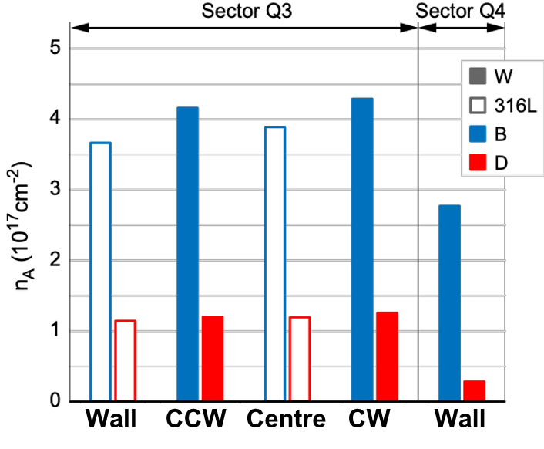
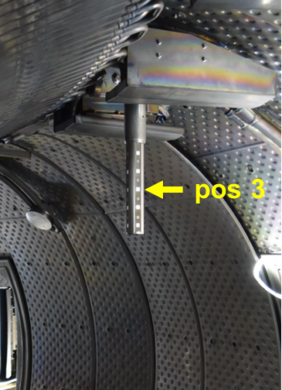
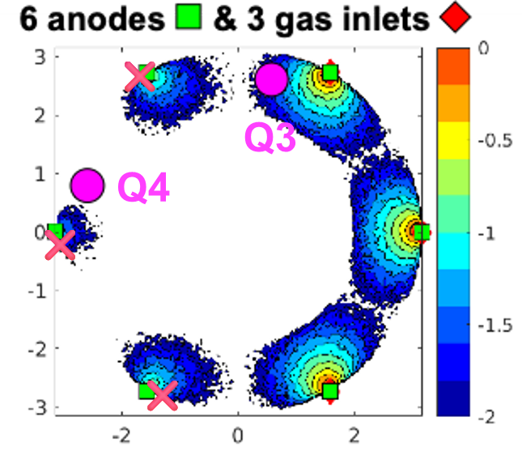
SP B.2: Analyses of (entire) WEST tiles (MPG) SP B.3: Erosion/deposition profiles on samples from WEST (MPG)
Task and questions to be addressed
Detailed investigation of selected PFUs from WEST, including side faces of marker tiles, at different locations with respect to magnetic ripple + IBA measurements of boronization samples
Approach
SEM and IBA measurements performed on marker and standard tiles after C3, C4, C5 campaigns (Phase 1)
First analysis of partial boronization (GDB) samples from WEST
Results
Samples (W, 316L steel) exposed during partial GDB by two manipulators
Deposition rate lower in sector Q4 but much smaller effect than predicted (×2.5 vs ×100)
No angular dependency of deposition on samples inside glow discharge
D/B fraction at Q4 factor 3 lower than at Q3 near active gas inlet
Deliverable: PWIE-SP B.B2.T-T005-D003
Status: completed
Facilities: Accelerator 2 days
Linked WP or TSVV: WPTE
Deliverable: PWIE-SP B.B3.T-T005-D007
Status: completed
Facilities: Accelerator 3 days
Linked WP or TSVV: WPTE
K. Krieger et al.

Slide 23
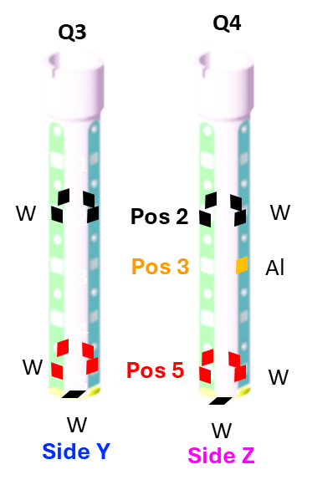
SP B.3: Surface modifications and composition of layers on selected WEST, MAGNUM-PSI, PSI-2, and GyM samples (NCSRD)
Boron
Motivation: In the initial phase of ITER operations (SRO), the boronization will be toroidally non-symmetric
Non uniform boronization performed at WEST
(20 samples from 2 sample holders, 4 sides and 3 positions were analyzed after)
Task and questions to be addressed
How uniform is the B layer formation after non-uniform boronization?
What is the modification of elemental composition after air exposure?
Methodology
RBS/NRA with d beam (1.4 MeV)
Results
Boron: No dependence on probe & side; dependence on vertical position (~3.5 × more B in pos 5 than in pos 2); No change after 22 days in air
Deuterium: Dependence on probe; dependence on vertical position only for Q3 (~3.5 × more D in pos 5 than in pos 2); 22% decrease after 22 days in air
Bottom sides
Pos 5
22 days later
Pos 2
Deuterium
Pos 5
22 days later
Pos 2
Deliverable: PWIE-SP B.B3.T-T005-D008
Status: completed
Facilities: Accelerator 4 days
Linked WP or TSVV: WPTE
P. Tsavalas, K. Mergia, A. Lagoyannis, M. Axiotis

Slide 24
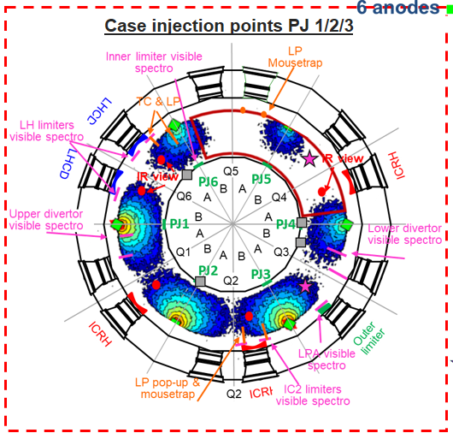
SP B.3: Ion Beam Analysis of boronization samples from WEST (VR)
Non-uniform boronization performed at WEST (PJ 1-3 out of 6).
Evaluate the uniformity of B layers in WEST:
Homogeneity in toroidal position and vertical direction.
Homogeneity in 4 toroidal directions.
Amount of oxygen trapped in the boron layers.
Presence of He in layers? Stability of layers in air?
Approach
Samples received: Au/boron layer/316L.
Combination of different ion beam techniques
(performed on different days, study ageing effect)
Results
Vertical direction: Boron layer in row 4 (A4-H4) significantly thicker than row 1 (A1-H1).
Toroidal Position: Higher oxygen + hydrogen and lower deuterium in E-H samples, further from PJ 1-3.
Oxygen trapped: Inverse correlation between boron and oxygen.
Future step: Compare with uniform boronization (PJ 1-6).
Row 1 (thin layers):
F
E
G
H
C
B
D
A
Row 4 (thick layers):
Deliverable: PWIE-SP B.B3.T-T005-D010
Status: completed
Facilities: Accelerator 2 days
Linked WP or TSVV: WPTE
E. Pitthan, P. Petersson, M. Dhar,
D. Gautam, M. Rubel, D. Primetzhofer

Slide 25
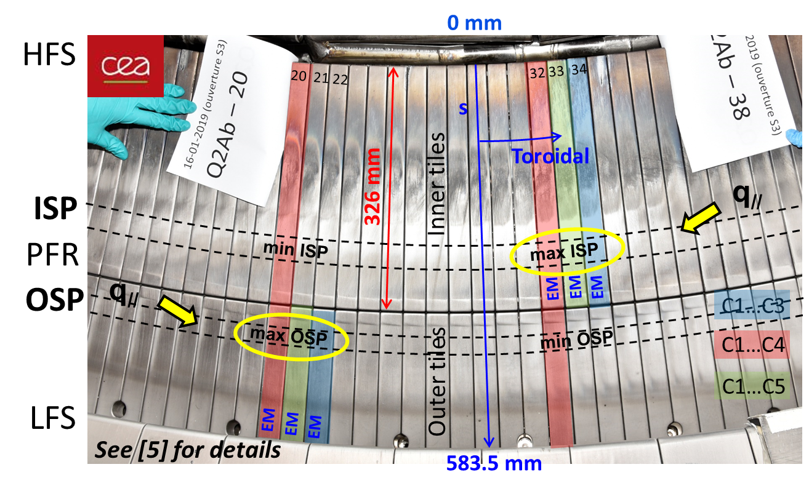
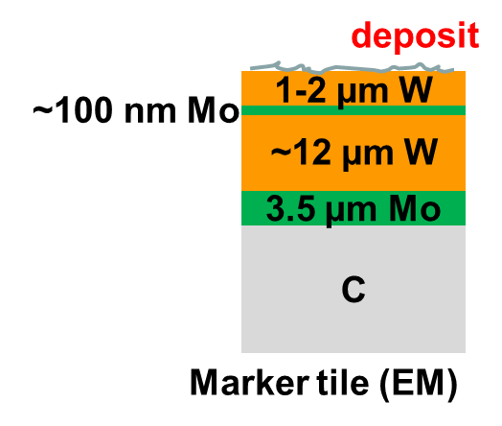
SP B.3: Composition of deposited layers on WEST during Phase 1 (VTT)
PFMC 2025 contribution
Altogether 8 marker tiles installed on the WEST divertor before Phase 1 and sequentially removed after C3, C4, and C5
This work: data reported from 6 tiles (HFS and LFS regions) around the maxima of the toroidal ripple
 | Plasma disch. | Cumulative time (s) | Disruptions | W_{LH} total (MJ) | W_{IC} total (MJ) | # Boro
C2 | 716 | 1553 | 282 | 95.5 | 0 | 0
Nov17-Feb18
C3 | 1076 | 7329 | 796 | 4947 | 105 | 3
July-Dec18
C4 | 1442 | 12669 | 1042 | 12123 | 1142 | 13
July-Nov19
C5 | 655 | 4630 | 460 | 2625 | 182 | 2
Nov20-Jan21
5 campaigns carried out in Phase 1 – more than 7 h of plasma exposure
Boronizations started during C3 and most of them (13) carried out in C4
Deliverable: PWIE-SP B.B3.T-T005-D011
Status: completed
Facilities: Accelerator 2 days
Linked WP or TSVV: WPTE
A. Hakola et al.

Slide 26
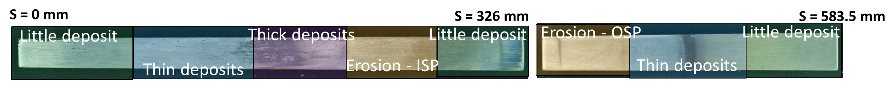
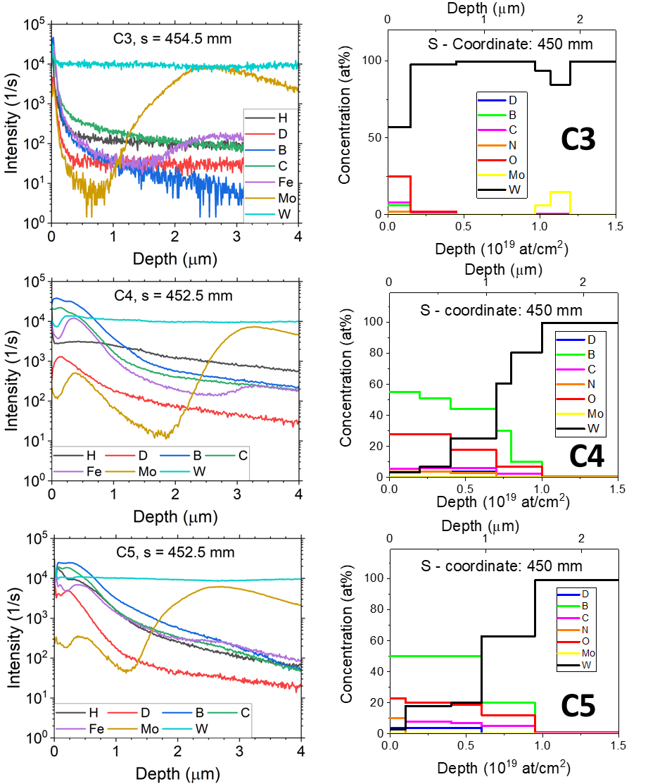
SP B.3: Composition of deposited layers on WEST during Phase 1 (VTT)
PFMC 2025 contribution
SIMS
NRA
THIN DEPOSITS (see figures)
Thickness considerably increases from C3 to C4 and a bit more to C5; surface layers strongly oxidized
Sublayers identified: (i) B-rich layer <0.5 μm, (ii) metallic impurities ~0.5-1 μm, (iii) Mo marker at ~1.5 μm
THICK DEPOSITS
Thickness increases from ~3 μm to >10 μm from C3 to C5 – all elements show relatively flat profiles
B at the top, metallic impurities deeper down (~1.5-3 μm), and D levels lower than on thin deposits
EROSION AREAS
Mixture of different elements, no clear deposition peaks
Erosion amplified from C3 to C5
Layers mainly consist of B, O, and C as well as W
Especially “thin deposits” show clear sublayers rich in B+C+O and/or metallic elements while stratified structures identified in the “thick deposits”
Deliverable: PWIE-SP B.B3.T-T005-D011
Status: completed
Facilities: Accelerator 2 days
Linked WP or TSVV: WPTE
A. Hakola et al.

Slide 27
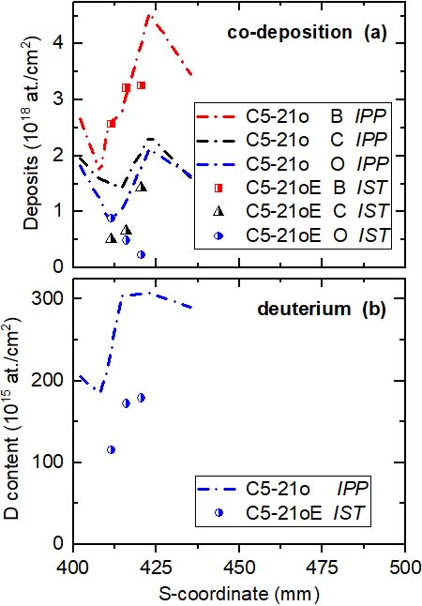
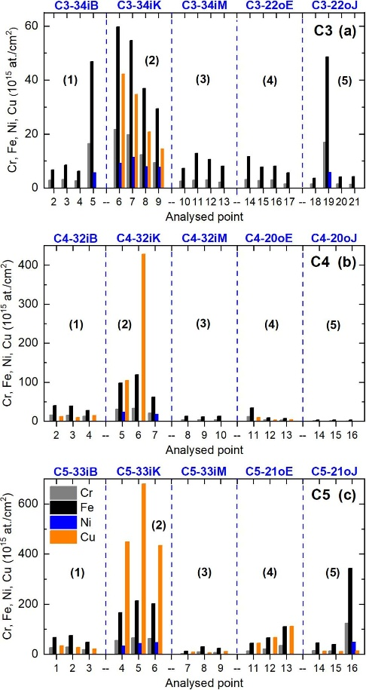
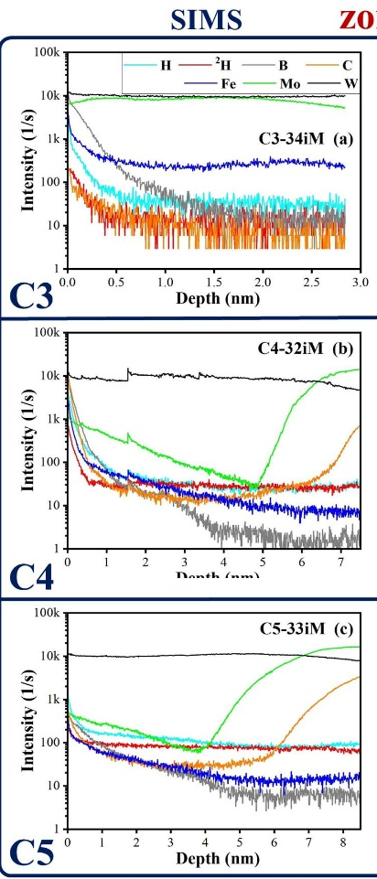
SP B.3: Composition and fuel content of layers on WEST samples (IST)
D, B, C, O content after the C5 campaign at s ∼ 415 mm (OSP region):
significant deposition behaviour (confirm the results from entire C5-21o tile (at IPP)
Mo-interlayer/graphite subst.
observed by SIMS after C4
Main conclusions
Erosion rate of 0.2-0.3 nm/s at ISP in Phase 1
Thick deposits after C4-C5 difficult to find
in the disks by IBA (stability of B-rich layers ?)
erosion rate evaluated by EBS
after C5 ∼ 0.2-0.3 nm/s
(∼7.3 h operation in Phase 1)
Deliverable: PWIE-SP B.B3.T-T005-D005
Status: completed
Facilities: Accelerator 5 days
Linked WP or TSVV: -
PIXE analysis:
Fe:Cr:Ni ratios → stainless steel
PIXE and IBA agree with each other
Detailed SIMS + EBS analysis
at s∼ 238 mm (ISP)
R. Mateus, N. Catarino, E. Alves

Slide 28
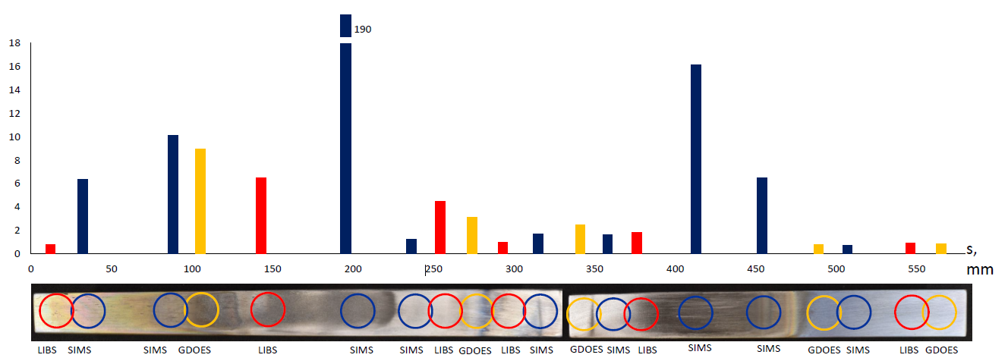
SP B.3: Depth profiles for layers on selected WEST samples (UT)
Task and questions to be addressed
Perform surface analyses (including LIBS) for selected WEST samples
Approach
Use ns-LIBS method for the composition analysis of the samples of interest, unfortunately the applied ns laser is now broken beyond repair
The scope of the task was therefore changed to more detailed analysis of the existing data and reporting the results in PFMC 2025
Results
LIBS allows determining the main elements of (W, Mo, C) + impurities (B) on C4 erosion marker tiles
Strongest B I lines near 250 nm overlap with W II lines but their influence can be accounted for by using the intensities of adjacent W II lines
LIBS depth profiles reproduced the layered structure on the erosion marker tiles similarly to SIMS, GDOES and other methods
Different methods give generally consistent B depth profiles and integral amounts with some outstanding cases on the thick deposits → most likely due to high ablation rate for porous co-deposits
Combination of data by LIBS, SIMS, and GDOES for integrated B content on the analyzed C4 marker tiles
Deliverable: PWIE-SP B.B3.T-T005-D012
Status: completed
Facilities: -
Linked WP or TSVV: -
I. Jõgi, P. Paris

Slide 29
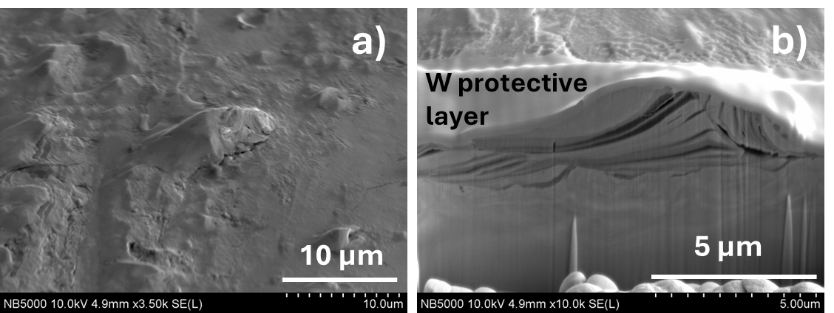
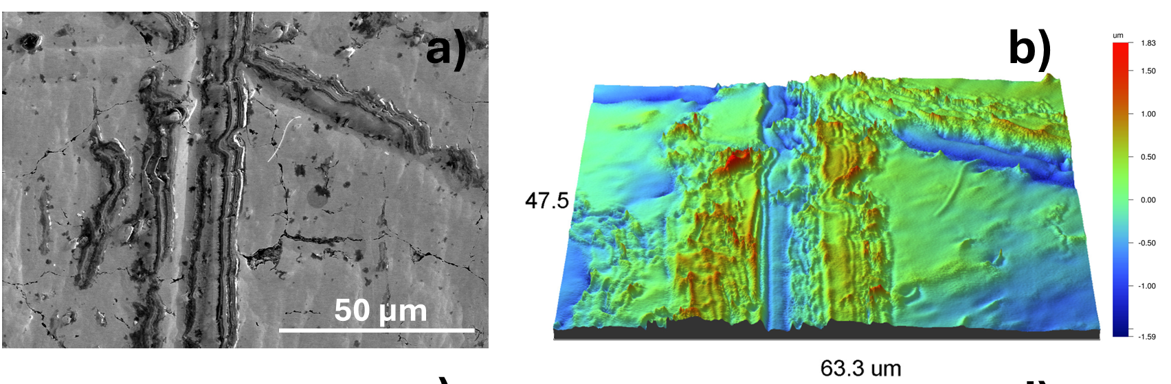
SP B.3: Surface modifications of selected WEST samples (IPPLM)
General Information
Examined samples: (i) WEST monoblock MB28, and (ii) 16 boronization samples from WEST
Task and questions to be addressed
assess surface modifications of the samples and (ii) co-deposits formed, including boron layers
Approach
Microscopic surface observations, EDX analysis, as well as FIB cross-sections and observations using optical profilometer studies
On each boronization sample, FIB cross-sections made to assess the thickness of the boron layers
Results – MB28
Only a small part of the surface covered with deposits (outer divertor region), mostly in shadowed areas. Deposits contain oxygen, boron, nitrogen, iron and copper
Numerous elongated objects/outgrowths with well-defined/specified directions and layered structure observed
SEM image of the outgrowth (a) and its FIB cross-section (b).
SEM image of the morphology of deposits (a) and its 3D map (b).
Deliverable: PWIE-SP B.B3.T-T005-D004
Status: completed
Facilities: -
Linked WP or TSVV: -
E. Fortuna-Zaleśna

Slide 30
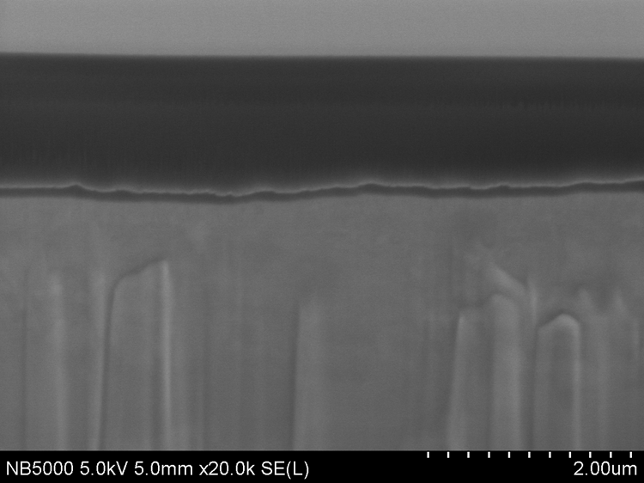
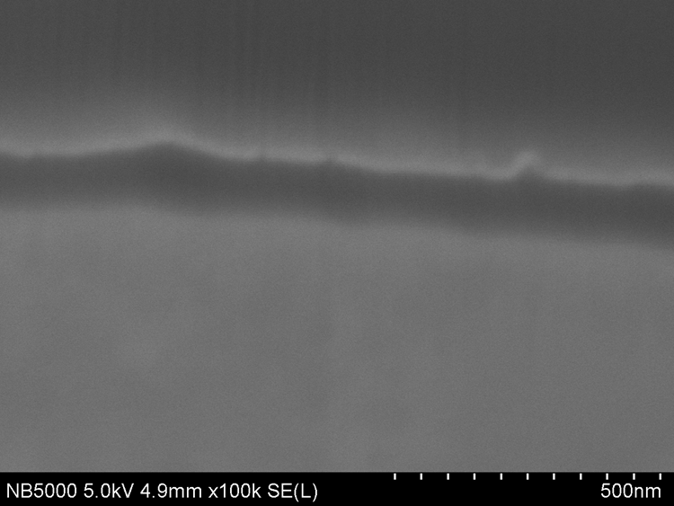
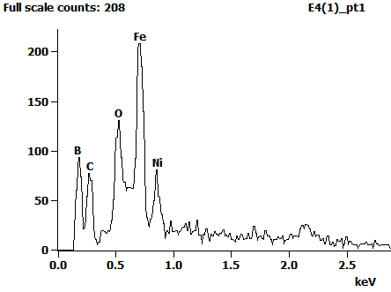
SP B.3: Surface modifications of selected WEST samples (IPPLM)
General Information
Examined samples: (i) WEST monoblock MB28, and (ii) 16 boronization samples from WEST
Task and questions to be addressed
assess surface modifications of the samples and (ii) co-deposits formed, including boron layers
Approach
Microscopic surface observations, EDX analysis, as well as FIB cross-sections and observations using optical profilometer studies
On each boronization sample, FIB cross-sections made to assess the thickness of the boron layers
Results – boronization samples
a)
Au layer/white thin strip
b)
SEM cross-section across the layer, sample E4 (a, b), and the corresponding EDX spectrum (c)
Protective Au layer on top
Presence of B in a thin layer between the steel substrate and the Au layer
Considerably thicker B layer on the A→H4 samples than on the A → H1 samples
marker dot
c)
steel substrate
B layer/dark strip
Deliverable: PWIE-SP B.B3.T-T005-D004
Status: completed
Facilities: -
Linked WP or TSVV: -
E. Fortuna-Zaleśna

Slide 31
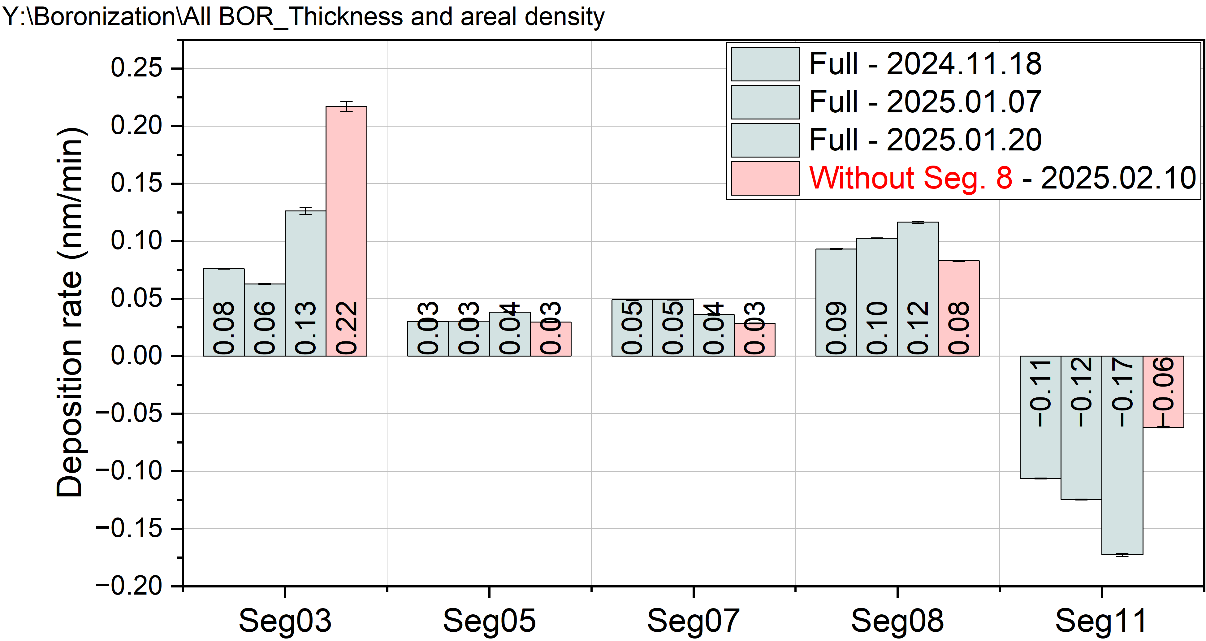
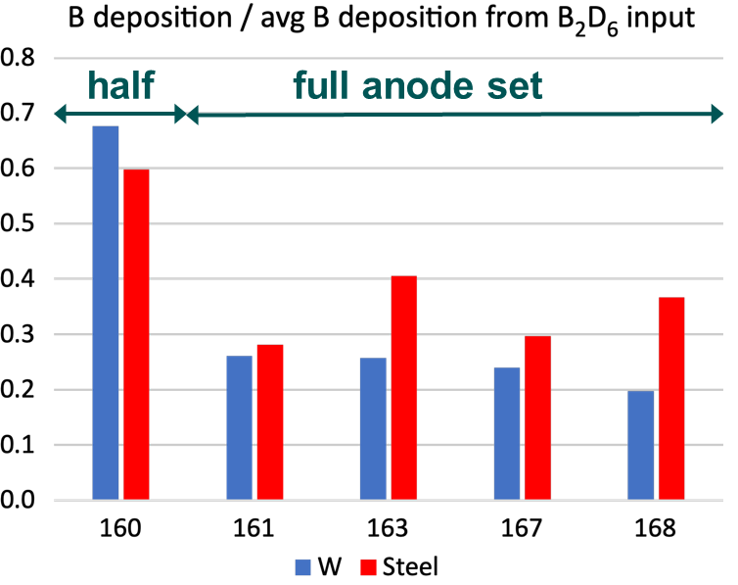
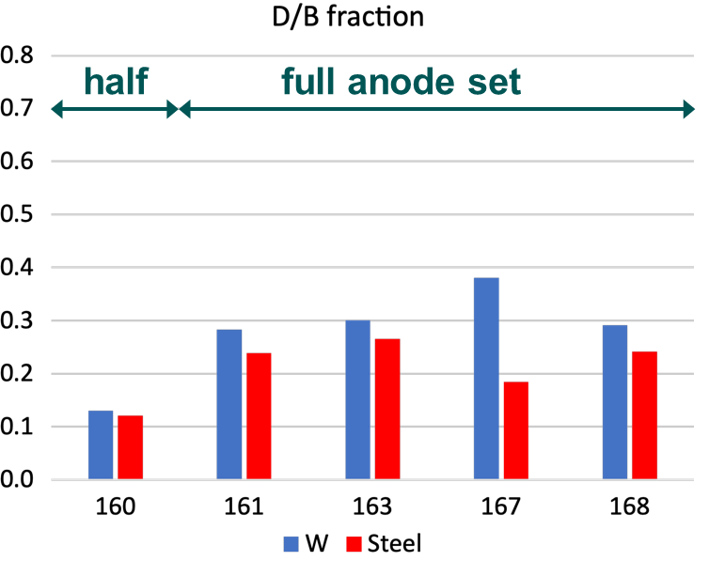
SP B.2: Analyses of samples from AUG (MPG)
General Information
Samples with Pt marker layers (as proxy for W) and FIB-created depth markers on bulk W exposed to dedicated AUG discharges with Ne seeding
Boron layers created during boronisations (GDB) studied by exposing witness samples during and immediately following GDBs
Task and questions to be addressed
Erosion and prompt redeposition of tungsten (and proxies to it)
Spatial distribution, properties, deposition rates and D-retention of boron layers created by GDB
Approach
Samples characterised by ion beam methods (RBS, NRA, PIXE) and SEM analysis before and after exposure
Results
Deposition efficiency of AUG boronisations using partial and full set of glow anodes assessed and compared to in situ QMBs
Erosion-deposition patterns of W in the divertor studied following the L- and H-mode experiments
Top: Deposition on QMBs shows significant toroidal variations and indicates that GDB not only deposits but also erodes material
Bottom: In contrast to QMB, higher B deposition on samples with half-GDB and lower D/B ratio
Deliverable: PWIE-SP B.B2.T-T005-D004
Status: completed
Facilities: Accelerator 5 days
Linked WP or TSVV: WPTE
NB! B&D depletion by exposure to air with lower rate compared to the WEST GDB layers → attributed to higher T_{wall}
M. Balden, K. Krieger et al.

Slide 32
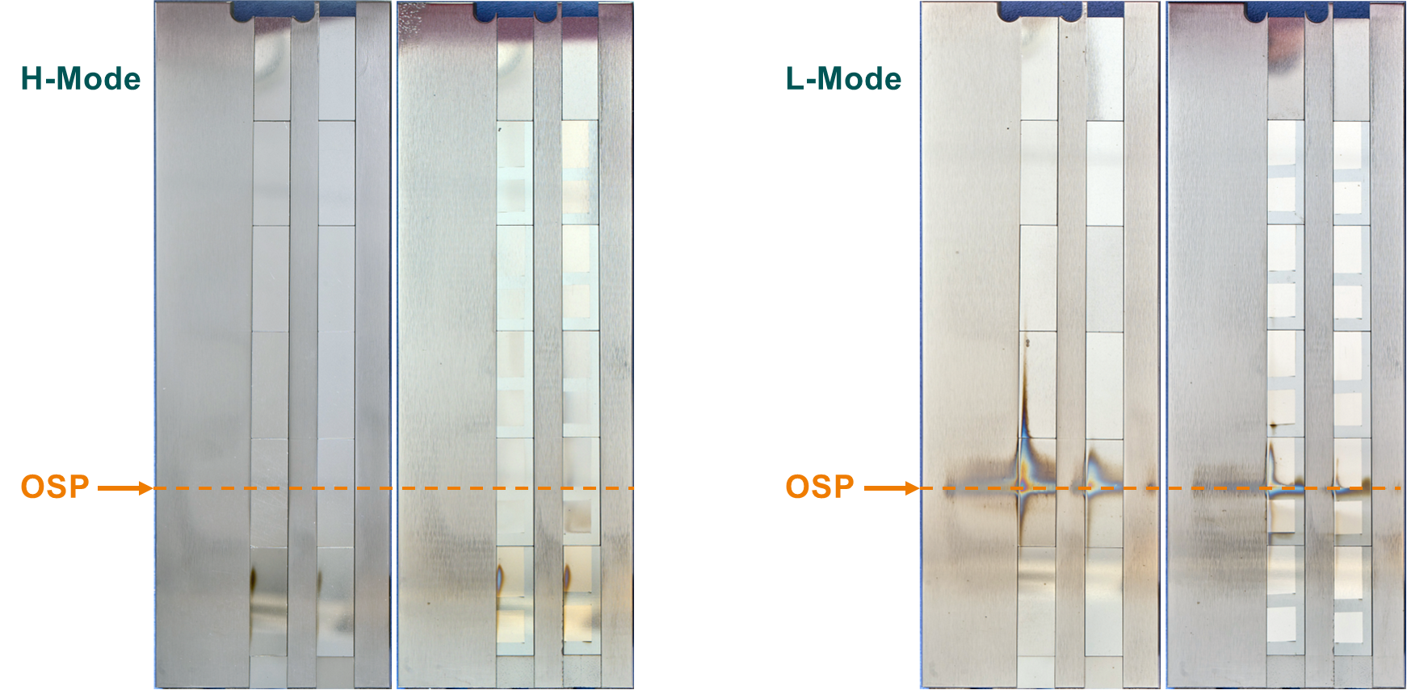
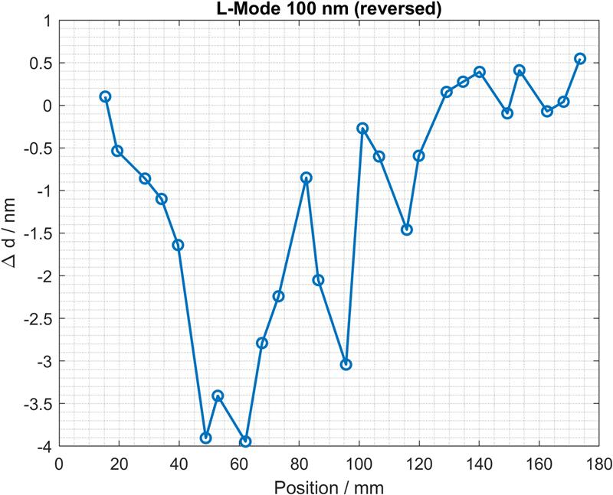
SP B.2: Analyses of samples from AUG (VTT) SP B.2: Deposition profiles on samples from AUG (RBI)
General Information
Samples with Pt marker layers (as proxy for W) and FIB-created depth markers on bulk W exposed to dedicated AUG discharges with Ne seeding
Task and questions to be addressed
Erosion and prompt redeposition of Pt as well as other elements on the samples, both macroscopically and in the μm scale
Approach
Samples characterised by ion beam methods (RBS, NRA, PIXE, TOF-ERDA) following their exposure to L- and H-mode discharges
Results
Large difference in the erosion characteristics of Pt markers after the L- and H-mode experiment
Deposition observed for the first time also between the markers, elemental composition still to be clarified
W
Mo
Pt
30 nm
100 nm
Mo
Photograph of divertor tiles exposed to AUG L-mode plasma discharges and poloidal erosion/deposition profile for the 100-nm thick Pt markers.
Deliverable: PWIE-SP B.B2.T-T005-D005
Status: completed
Facilities: Accelerator 2 days
Linked WP or TSVV: WPTE
Deliverable: PWIE-SP B.B2.T-T005-D006
Status: ongoing (to be completed in the end of 2025)
Facilities: Accelerator 2 days
Linked WP or TSVV: WPTE
A. Hakola, S. Saari

Slide 33
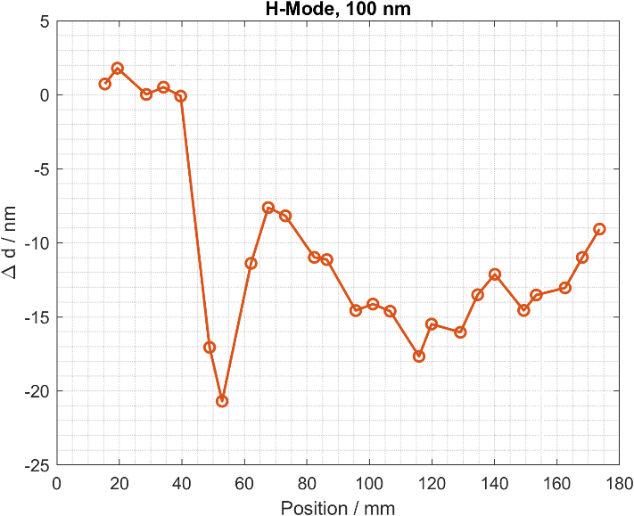
SP B.2: Analyses of samples from AUG (VTT) SP B.2: Deposition profiles on samples from AUG (RBI)
General Information
Samples with Pt marker layers (as proxy for W) and FIB-created depth markers on bulk W exposed to dedicated AUG discharges with Ne seeding
Task and questions to be addressed
Erosion and prompt redeposition of Pt as well as other elements on the samples, both macroscopically and in the μm scale
Approach
Samples characterised by ion beam methods (RBS, NRA, PIXE, TOF-ERDA) following their exposure to L- and H-mode discharges
Results
Large difference in the erosion characteristics of Pt markers after the L- and H-mode experiment
Deposition observed for the first time also between the markers, elemental composition still to be clarified
W
Mo
Pt
30 nm
100 nm
Mo
Photograph of divertor tiles exposed to AUG H-mode plasma discharges and poloidal erosion/deposition profile for the 100-nm thick Pt markers.
Deliverable: PWIE-SP B.B2.T-T005-D005
Status: completed
Facilities: Accelerator 2 days
Linked WP or TSVV: WPTE
Deliverable: PWIE-SP B.B2.T-T005-D006
Status: ongoing (to be completed in the end of 2025)
Facilities: Accelerator 2 days
Linked WP or TSVV: WPTE
A. Hakola, S. Saari

Slide 34

SP B.2: Changes in the surface properties of samples exposed on AUG (FZJ)
before
after
Task and questions to be addressed
Analysis of W and Mo samples exposed in AUG to L-mode and H-mode plasmas with Ne seeding
Approach
Set of samples were pre-characterized and prepared for the AUG exposure (FIB cross-sections for erosion/deposition studies)
After AUG exposures samples were characterized by means of electron microscopy techniques
Results
Low erosion spotted for Mo samples exposed to H-mode AUG plasma (at most 50 nm).
Erosion below 50 nm of W samples exposed to H-mode AUG plasmas
No visible erosion of both Mo and W exposed to L-mode AUG plasmas
W
Mo
50 nm
W
Mo
Deliverable: PWIE-SP B.B2.T-T005-D007
Status: completed
Facilities: -
Linked WP or TSVV: WPTE
x
x
H-mode
M. Rasinski

Slide 35

SP B.3: Analyses of wall tiles originating from AUG (MPG)
General Information
Determine erosion and deposition patterns on various plasma-exposed tiles
Task and questions to be addressed
Perform surface analyses for erosion, deposition and surface-modification patterns on wall components retrieved from AUG
Approach
SEM and IBA measurements performed at many analysed spots on several exposed tiles
Results
Erosion patterns on AUG ICRH limiter marker tiles determined: maximum erosion of Mo-coated graphite tiles below 1 µm → provides feedback to the dedicated ICRH experiment under WPTE
Thickness of deposits with respect to boron deposition determined on many long-term samples as well as on 8 pre-characterised tiles, exposed only during one campaign
Deliverable: PWIE-SP B.B3.T-T005-D007
Status: completed
Facilities: Accelerator 3 days
Linked WP or TSVV: WPTE
M. Balden

Slide 36



SP B.2: Analyses of W7-X samples (MPG) SP B.3: Erosion/deposition profiles of samples from W7-X (MPG)
Task and questions to be addressed
Determine erosion and deposition patterns on manipulator samples from OP2 experiments and boronizations on W7-X with the focus on the amount of B on selected locations
Approach
IBA measurements for all the available W7-X samples
Cavity samples to assess sticking of B (radicals)
B erosion and deposition rates during/after boronizations
Results
Surface loss probability β measured for boron radicals during boronizations on W7-X and AUG
Ions: β ≈ 0.2 Neutrals: β ≈ 1.0
Open question: Which ion/radical species: B⁺, BH⁺, BH₂⁺, … B₂H₆⁺?
Deliverable: PWIE-SP B.B2.T-T005-D009
Status: completed
Facilities: Accelerator 3 days
Linked WP or TSVV: WPW7X
Deliverable: PWIE-SP B.B3.T-T005-D007
Status: completed
Facilities: Accelerator 2 days
Linked WP or TSVV: WPW7X
M. Mayer, C.P. Dhard

Slide 37


SP B.2: Analyses of W7-X samples (MPG) SP B.3: Erosion/deposition profiles of samples from W7-X (MPG)
Task and questions to be addressed
Determine erosion and deposition patterns on manipulator samples from OP2 experiments and boronizations on W7-X with the focus on the amount of B on selected locations
Approach
IBA measurements for all the available W7-X samples
Cavity samples to assess sticking of B (radicals)
B erosion and deposition rates during/after boronizations
Results
No correlation between the substrate material or surface roughness and the boron layer thickness
Thicker boron layers present lower C/B and O/B ratios
Higher carbon concentrations in OP2.3 than in OP2.2
Deliverable: PWIE-SP B.B2.T-T005-D009
Status: completed
Facilities: Accelerator 3 days
Linked WP or TSVV: WPW7X
Deliverable: PWIE-SP B.B3.T-T005-D007
Status: completed
Facilities: Accelerator 2 days
Linked WP or TSVV: WPW7X
M. Mayer, C.P. Dhard

Slide 38
SP B.2: Analyses of samples from W7-X manipulator experiments (FZJ) SP B.3: Surface modifications and fuel content of selected W7-X samples (FZJ)
Task and questions to be addressed
Investigate erosion and surface modification of various samples exposed to W7-X plasmas
Perform surface analyses for erosion, deposition, fuel-retention, and surface-modification patterns on wall components and samples (including LIBS) retrieved from W7-X
Approach
Preparation and pre-characterization of W and Mo samples before W7-X OP2.3 exposures and post-exposure analyses using SEM, EDX, FIB, NRA, and LIBS after OP2.3
Results
All samples were pre-characterized, prepared and successfully exposed in W7-X using the MPM manipulator
Post characterization ongoing, to be continued in 2026
Deliverable: PWIE-SP B.B2.T-T005-D008
Status: completed
Facilities: Accelerator 2 days
Linked WP or TSVV: WPW7X
Deliverable: PWIE-SP B.B3.T-T005-D002
Status: completed
Facilities: Accelerator 1 day
Linked WP or TSVV: WPW7X
M. Rasinski, T. Dittmar

Slide 39
SP B.4 - Reference coatings for ITER and DEMO

Slide 40
SP B.4 deliverables 2025
Activity | Deliverable ID(s) | Title
SP B.4 | D001 3 PM | W- and B-based coatings with pre-defined composition and morphology for experiments in linear plasma facilities (ENEA)
SP B.4 | D002 4 PM | W-based coatings with pre-defined composition and morphology for experiments in linear plasma facilities (IAP)
SP B.4 | D003 6 PM | B reference layers with pre-defined composition and morphology for comparison with data from tokamaks (IAP)
SP B.4 | D004 2 PM | Raman analyses of selected B reference samples (CEA)
SP B.4 | D005 1 PM | SEM and SIMS analyses of selected B and W reference samples (CIEMAT)
SP B.4 | D006 2 PM | LIBS and SEM analyses of selected B reference samples (FZJ)
SP B.4 | D007 2 PM + 1 PM (AR) | Microscopy investigations of selected B and W reference samples (IPPLM)
SP B.4 | D008 5 PM | Ion-beam analyses of selected B and W reference samples (IST)
SP B.4 | D009 4 PM | XPS and TDS analyses of selected B reference samples (JSI)
SP B.4 | D010 5 PM | Ion-beam and structural analyses of selected B and W reference samples (NCSRD)
SP B.4 | D011 1 PM | TOF-ERDA analyses of selected B and W reference samples (RBI)
SP B.4 | D012 1.5 PM | Ion-beam analyses of selected B reference samples (VR)
SP B.4 | D013 1 PM | SIMS measurements and ion-beam analyses of selected B and W reference samples (VTT)

Slide 41

SP B.4: W-based reference coatings for linear-machine experiments (IAP)
Production of W coatings (5µm) on Mo substrate for experiments in linear plasma facilities
6 Samples deposited on 30 mm diameter Mo substrates (#1mm)
4 Samples deposited on 12x15 mm Mo substrates (#1mm)
Results:
GDOES data (for chemical composition and thickness) indicates: thickness 5 µm; no contaminants within the coating
XRD analyses (for phase investigations) suggest: W monophasic structure with no preferential orientation
Conclusions:
W coatings with a thickness of 5 µm deposited and sent to different RUs for further experiments in linear plasma devices
W-N, W-O and W-N-O coatings already delivered to different RUs
Example of GDOES depth profiles for a W coating
Example of an XRD pattern for a W coating
Deliverable: PWIE-SP B.B4.T-T005-D002
Status: completed
Facilities: -
Linked WP or TSVV: SP B.1
E. Grigore, F. Baiasu, M. Gherendi

Slide 42



SP B.4: Microscopy investigations of selected B and W reference samples (IPPLM)
General Information
Examined samples:
Reference W coatings (IAP): (i) W-N-O deposit on Mo, (ii) W-O deposit on Mo, and (iii) W-N deposit on Mo
Reference B layers 100 nm (IAP)
Approach
On each sample, microscopic surface observations, EDX analysis, and profilometry were carried out.
STEM/TEM studies were applied to examine their internal structure.
Results – W-N-O coatings (similar results for other coatings)
SEM images of the surface (a-b)
Surface roughness R_{a}~ 0.4 µm, granular morphology
STEM HAADF-BF image of a thin foil from the sample
Thickness of the interlayer ~ 400 nm, coating ~ 2.1 µm.
TEM images of the interlayer
Interlayer nanocrystalline with a columnar structure
Coating itself amorphous
Deliverable: PWIE-SP B.B4.T-T005-D007
Status: completed
Facilities: -
Linked WP or TSVV: -
E. Fortuna-Zaleśna

Slide 43


SP B.4: Ion-beam analyses of selected B and W reference samples (IST)
Task and questions to be addressed
Carry out IBA and XRD for selected W reference samples
to determine their surface composition and structure
Approach
simultaneous ERDA + RBS / 2.0 MeV ⁴He⁺ incident beams / for H , D analysis
simultaneous RBS + NRA / 1.75 MeV ³He⁺ incident beams / for D analysis
EBS / 1.75 MeV / 2.15 MeV ¹H⁺ incident beams / W, N, O, Mo analysis
Results
Main elemental depth composition achieved by IBA
The dominant phase across all the coatings is bcc W
Complementary diffraction patterns: (W-H vs. W-D) and (W-N vs. W-O)
H and D acts as interstitial species, leading to minor lattice distortions
O promotes the formation of oxide phases (mainly W₁₈O₁₉)
No crystalline W-nitride formation
W-N
W-N-O
W-O
W-H-D
W-H
(110)
W-D
(200)
(211)
(220)
Deliverable: PWIE-SP B.B4.T-T005-D008
Status: completed
Facilities: Accelerator 5 days
Linked WP or TSVV: -
Overlay of W-based diffractograms
(normalized; vertical offset)
R. Mateus, S. Magalhães

Slide 44

SP B.4: XPS and TDS analyses of B and W reference samples (JSI)
Task and questions to be addressed
XPS analysis of W+Mo film on W and W-D film on Mo, film thickness ~5 µm
Approach
XPS spectrometer (Genesis, Physical Electronics). Surface analysis 0.1 mm in diameter and depth of ~4 nm. A depth profile was performed by sputtering with Ar-ion beam of 3 keV over 3×3 mm² (~2.0 nm/min)
Results
Surface analysis:
Similar surface composition for both samples: 33 at.% of W, 33 at.% of O, 30 at.% of C (contamination) and 4 at.% of N.
Small degree of oxidation of W-atoms on the surface (25% oxidized of W-oxide phase and 75% of W-metallic phase on the surface).
Broadening of the W 4f surface spectra at energy 32 eV and 34.5 eV indicates the disorder/defects induced by D in the subsurface region
Depth profiles: Depth profiles (down to 20 nm) show concentrations of W and O: 90% and 10% for W-D, 85% and 15% for W+Mo
W
W-D
Mo
W
Mo
Deliverable: PWIE-SP B.B4.T-T005-D009
Status: completed
Facilities: -
Linked WP or TSVV: -
J. Kovač, M. Panjan

Slide 45
SP B.4: Production of W and B reference coatings (ENEA-PoliMi)
Task and questions to be addressed
Production of W and B reference coatings, multilayer structures, and proxies for re-deposited layers with varying composition, morphology, and grain structure for laboratory experiments and exposures in linear plasma devices
Approach
B coatings produced via Pulsed Laser Deposition (PLD), from 100 nm to 1 µm
Nanocolumnar W and compact W produced via HiPIMS
Porous W-O deposited via PLD
Polishing of PSI-2 geometry W substrates at PoliMi
Results
B coatings (14 on W PSI-2 geometry and 8 on Si 10x10 mm²) – done
5 nanocolumnar W on Mo disks – done
16 nanocolumnar W on W PSI-2 geometry – 12 done, 4 planned by the end of November
6 nanocolumnar W on Mo flat 10x10 mm² - done
11 porous W-O on Mo disks – 5 done, 6 planned by the end of November
14 compact W on Mo disks – done
4 amorphous W – done
800 nm
500 nm
Example of a boron coating
Deliverable: PWIE-SP B.B4.T-T005-D001
Status: completed
Facilities: -
Linked WP or TSVV: SP B.1, SP D
D. Dellasega, L. Bana, G. Alberti, D. Vavassori, D. Vassallo, M. Pedroni, A. Uccello, M. Passoni

Slide 46


SP B.4: TOF-ERDA analyses of selected B reference samples (RBI)
Boron sample (100 nm on W), obtained from ENEA
Task and questions to be addressed
Determine composition and depth profiles of elements in the sample as well as layer thickness
Approach
TOF-ERDA with 23 MeV ¹²⁷I⁷⁺ beam
Results
Sample composition: H 3.8 at.%, B 78 at.%, C 0.8 at.%, N 1.0 at.%, O 13.8 at.%, Al 1.8 at.%, Si 0.5 at.%
Sample thickness: 1600×10¹⁵ cm²
2D E-TOF map and depth profiles of all elements found on the studied sample
Deliverable: PWIE-SP B.B4.T-T005-D011
Status: completed
Facilities: Accelerator 4 days
Linked WP or TSVV: -
Z. Siketić, I. Bogdanović Radović

Slide 47
SP B.4: Ion-beam analyses of selected B reference samples (VR)
Boron films deposited on tungsten by PoliMi exposed to the deuterium plasma of the linear device GyM (E_{ion} = 76 eV, Fluence = 4×10²³ m⁻²), received from Andrea Uccello (CNR)
Aim: Investigation of chemical composition and atomic distribution on the sample surface
Approach
ToF-ERDA: identification and depth profile of all isotopes
EBS+NRA+PIXE using H⁺ 2.6 MeV: higher sensitivity to B
ToF-MEIS (medium-energy ion scattering): High-resolution W surface distribution:
ToF-MEIS depth resolution corresponds to 1.4 nm for W at the surface
Results
The presence of B, O, N, and H was identified at the surface. No deuterium observed
Boron areal density corresponds to 3.7 nm, assuming the density of pure boron (2.351 g/cm³)
Presence of W at the surface confirmed by ToF-MEIS analysis:
Results indicate incorporation of W within the B–O layer at the surface and/or incomplete coverage of surface layer.
Deliverable: PWIE-SP B.B4.T-T005-D012
Status: completed
Facilities: Accelerator 3 days
Linked WP or TSVV: SP B.1
E. Pitthan, R. Holenak, D. Primetzhofer

Slide 48
SP B.4: Production of B-based reference coatings (IAP)
Ion energy dependence versus various plasma parameters
Task and questions to be addressed
Production of B reference coatings, multilayer structures, and proxies for re-deposited layers with varying composition, morphology, and grain structure for laboratory experiments and exposures in linear plasma devices
Approach
Development of production recipes in dedicated setups to understand the formation of B layers under different conditions
Results
For each condition we now know – useful for fine-tuning the recipes
ion energy
deposition rate (Particle flux)
D/B ratio by TDS
Deliverable: PWIE-SP B.B4.T-T005-D003
Status: completed
Facilities: -
Linked WP or TSVV: -
C. Porosnicu, P. Dinca, B. Butoi, O. G. Pompilian, C. Staicu, B. Solomonea, C. P. Lungu

Slide 49
SP B.4: Production of B-based reference coatings (IAP)
Preparation of 5×5 mm² W samples coated with B+D₂(10%) , thermal treatment up to 500°C
Task and questions to be addressed
Production of B reference coatings, multilayer structures, and proxies for re-deposited layers with varying composition, morphology, and grain structure for laboratory experiments and exposures in linear plasma devices
Approach
Development of production recipes in dedicated setups to understand the formation of B layers under different conditions
Status report of layers produced in 2025
B layers with controlled D inclusions (10 at%) - Completed – Febr/Mar 2025
B layers with a nominal thickness of 100 nm and 5 μm - Completed – Feb/Mar 2025
B and B+D₂ (10 at%) layers with a nominal thickness of 100 nm and 5 μm on special substrates (W, 12 × 15 mm²) – ongoing
Deposition of B (5 µm) on Mo (⌀30 mm) with different roughnesses – target Dec 2025
B+D₂ (10 at%) layers with annealing at temperatures of 50 – 500°C – target Dec 2025
Deliverable: PWIE-SP B.B4.T-T005-D003
Status: completed
Facilities: -
Linked WP or TSVV: -
C. Porosnicu, P. Dinca, B. Butoi, O. G. Pompilian, C. Staicu, B. Solomonea, C. P. Lungu

Slide 50


SP B.4: TOF-ERDA analyses of selected B reference samples (RBI)
Boron samples with D from IAP (C. Porosnicu)
Task and questions to be addressed
B samples with D at different temperatures, from RT to 500∘C
to determine composition and depth profiles of thin B+D films as a function of temperature
to study changes in the sample composition in the near surface region by measuring samples left on ambient conditions after one month
Approach
TOF-ERDA with 23 MeV ¹²⁷I⁷⁺ beam
Samples first analyzed on April 22, 2025 following storage in vacuum and Ar, second analysis following aging in ambient conditions on May 19, 2025; concentration calculated for near surface and bulk
Results
In general, thickness of the surface oxide layer slightly increased in samples measured in May
In some samples D concentration near the surface increased
Concentration of D (at.%) near the sample surface (blue) and in the bulk (yellow) as a function of temperature in April and May
Deliverable: PWIE-SP B.B4.T-T005-D011
Status: completed
Facilities: Accelerator 4 days
Linked WP or TSVV: -
Z. Siketić, I. Bogdanović Radović

Slide 51




SP B.4: Raman analyses of different B reference layers (CEA)
This task covers Raman measurements for B layers provided by IAP, ENEA, and VR (supplemented by optical microscopy)
Results
B layers annealed at different temperatures (IAP)
White crystals found when T_{ann} < 200°C upon exposure to air → appear to be B(OH)₃
Outside of the crystals: boron structure remains stable when T_{ann} < 250°C but evolves above 250°C → due to contamination? Due to oxidization?
Outside of the crystals: strong changes in spectrum after exposure to air → formation of BO or BH compounds?
Thin B layers (100 nm) (ENEA and VR) show a-B-like spectra but are generally thin and require further investigations
Examples of white crystals (RT) and more homogeneous surface (300°C) of the B+D₂(10%) , samples from IAP
Deliverable: PWIE-SP B.B4.T-T005-D004
Status: completed
Facilities: -
Linked WP or TSVV: -
C. Pardanaud, C. Martin, G. Giacommetti

Slide 52


SP B.4: Ion-beam and structural analyses of B reference samples (NCSRD)
D amount
D release: D(RT) – D (T_{ann})
Analysis of B+D₂ (10%) 5 μm thick layers on W annealed in the temperature range 50–500 °C
Task and questions to be addressed
Determination of deuterium release
Determination of structural and surface modifications
Methodology
d beam RBS/NRA; XRD at grazing incidence; SEM/EDX analyses
Results
D release increases almost linearly with T_{ann} for T_{ann} ≥ 300°C
Crack formation for T_{ann} ≥ 300°C; crack width increases almost linearly with T_{ann}
Crack width
No cracks
Crack formation
250 ºC
500 ºC
50 μm
50 μm
Deliverable: PWIE-SP B.B4.T-T005-D010
Status: completed
Facilities: Accelerator 3 days
Linked WP or TSVV: -
P. Tsavalas, K. Mergia, A. Lagoyannis, M. Axiotis, D. Papadakis

Slide 53
SP B.4: Ion-beam and structural analyses of B reference samples (NCSRD)
W lattice constant (probed depth ~2 μm)
Task and questions to be addressed
The cause for crack formation (see previous slide)
Correlation between D release and crack formation
Results
W lattice constant decreases almost linearly with T_{ann} for T_{ann} ≥ 250°C
Almost linear correlation between crack width and W lattice constant change
Almost linear correlation between D release and crack width
The W substrate is strained during B deposition (unstrained W lattice constant 3.1648 Å) → changes the strain at the interface with the B layer leading to crack formation?
Crack formation may contribute to D release
Crack width vs W lattice constant change
D release vs crack width
Deliverable: PWIE-SP B.B4.T-T005-D010
Status: completed
Facilities: Accelerator 3 days
Linked WP or TSVV: -
P. Tsavalas, K. Mergia, A. Lagoyannis, M. Axiotis, D. Papadakis

Slide 54

SP B.4: XPS and TDS analyses of B and W reference samples (JSI)
Task and questions to be addressed
XPS analysis of B films on W and Eurofer, film thickness ~5 µm
Approach
XPS spectrometer (Genesis, Physical Electronics). Surface analysis 0.1 mm in diameter and depth of ~4 nm. Depth profiles performed by sputtering with Ar-ion beam of 3 keV over 3×3 mm² (~2.0 nm/min)
Results
Both samples show similar composition and depth profiles
Surface analysis:
37.7 at.% of B, 35.5 at.% of C and 22.5 at.% of O, 1.9 at.% of N and 1.0 at.% of Fe. Traces of Na, Si, In were detected
B 1s spectrum shows three chemical states - metallic phase (187.4 eV ), B₂O (188.7 eV) and B₂O₃ (192.3 eV)
Depth profiles: Uniform distribution of elements – B (85 at.%), O (8 at.%), C (5 at.%), Fe (2 at.% metallic), Cr (1 at.%, metallic) and N (1 at.%). B 1s peak shows dominance of metallic state (187.9 eV), there is only small presence of B₂O₃ phase in the film (2% of total B).
B
B
W
Eurofer
Deliverable: PWIE-SP B.B4.T-T005-D009
Status: completed
Facilities: -
Linked WP or TSVV: -
J. Kovač, M. Panjan

Slide 55

SP B.4: XPS and TDS analyses of B and W reference samples (JSI)
Task and questions to be addressed
TDS should provide complementary data on bonding of D in 5 µm thick B films
Approach
Samples with various amount of D in B films (altogether 24 samples) analysed by TDS and 9 of them by NRA (i.e. before TDS measurement)
Results
Key findings are temperature of max D₂/HD release (not presented here)
Total released amount expressed as D/cm² and H/cm² for comparison
Fig. 1: amount of H, D for 11 differently preheated samples
Fig. 2: amount of H, D of 13 samples with B deposited at various deposition parameters (see inner table)
The amount of D by TDS matches well to NRA results. Sensitivity of quadruple mass spectrometer is lower at weak signals which is not applied in the evaluation
The amount of H is rather high but its origin is not well traced to deposition parameters
Deliverable: PWIE-SP B.B4.T-T005-D009
Status: completed
Facilities: -
Linked WP or TSVV: -
V. Nemanič, M. Žumer,
A. Kurtishaj-Hamzaj

Slide 56



SP B.3: Micro- and macroscale composition of layers on selected samples (JSI)
Task scope re-directed to deal with the analysis of B reference samples
Deuterated boron samples* from Romania measured in the INSIBA chamber
A ³He²⁺ beam with an energy of 3.3 MeV was used. Two detectors were employed to simultaneously collect the RBS (150°) and NRA (135°) signals. The accumulated dose for each measurement was 3.4 µC.
Deuterium depth profiles:
D(³He,p)⁴He
D
¹¹B
¹⁰B
250
200
150
100
50
¹⁰B(³He, p_{1,3})¹²C
¹¹B (³He, p_{0,1,2,3})¹³C
¹¹B(³He, d₀)¹²C
Sample holder with 5 of 9 samples analysed
Deliverable: PWIE-SP B.B3.T-T005-D006
Status: completed
Facilities: Accelerator 7 days
Linked WP or TSVV: -
*samples were also analysed by TDS by Vincenc Nemanič
S. Markelj, E. Punzón Quijorna

Slide 57





SP B.4: Ion-beam analyses of selected B and W reference samples (IST)
Task and questions to be addressed
Carry out ion-beam analyses for selected B reference
samples to determine their surface composition
Approach
Elemental composition of thin B samples films (∼100 nm):
RBS analysis / 1000 keV ⁴He⁺ ion beams – to enhance energy loss
NRA analysis / ¹¹B(p,α₁)2α, E_{r} ≈ 650 keV - 700 keV ¹H⁺ ion beams
Elemental composition of thick B samples: EBS + NRA analysis
Results
Easy measurement of composition and thickness of B layers
Evidence of fast oxidation of B layers over time at room temperature
Fig. 1 - Analysis of thickness and composition of thin B films
Fig. 2 - Analysis of thickness and composition of thicker B films
Future work / collaboration between IST and IAP
Title of a PhD work plan:
Oxidation behaviour of boron coatings for nuclear fusion applications (collaboration with INFLPR)
Deliverable: PWIE-SP B.B4.T-T005-D008
Status: completed
Facilities: Accelerator 5 days
Linked WP or TSVV: -
R. Mateus, N. Catarino, R. Silva

Slide 58
SP B.3: Depth profiles and surface morphology of selected B or W layers (CIEMAT) SP B.4: SEM and SIMS analyses of selected B and W reference samples (CIEMAT)
Boron samples analyzed as received as well as 1 and 3 months after storage in air
Task and questions to be addressed
Determine the composition and properties of the difference B layers from other labs (ENEA, IAP,…)
Approach
SIMS and SEM if required
Results
Analysis completed, data interpretation ongoing
Strange B signal behavior: on some samples, pure B only appears when the W substrate is reached while the layer shows B+O & W+B signals
All samples have similar O levels - oxidized during shipping?
Pure B sheets purchased as standards to disentangle
W_2_4: 5 um of B over W.
B 077A: 100 nm of B over W.
Deliverable: PWIE-SP B.B3.T-T005-D001
Status: ongoing (to be completed in the end of 2025)
Facilities: -
Linked WP or TSVV: -
Deliverable: PWIE-SP B.B4.T-T005-D005
Status: ongoing (to be completed in the end of 2025)
Facilities: -
Linked WP or TSVV: -
D.Alegre, G. Delgado, M. González-Viada

Slide 59



SP B.4: Microscopy investigations of selected B and W reference samples (IPPLM)
General Information
Examined samples:
Reference W coatings (IAP): (i) W-N-O deposit on Mo, (ii) W-O deposit on Mo, and (iii) W-N deposit on Mo
Reference B layers 100 nm (IAP)
Approach
On each sample, microscopic surface observations, EDX analysis, and profilometry carried out
STEM/TEM studies were applied to examine their internal structure
Results – reference B layer
STEM HAADF images of a thin foil cut from the sample
Heavily damaged area near the surface, cracks and spalling visible
Deliverable: PWIE-SP B.B4.T-T005-D007
Status: completed
Facilities: -
Linked WP or TSVV: -
TEM images of the coating.
The coating is amorphous and has a thickness of ~70 nm
E. Fortuna-Zaleśna

Slide 60
SP B.4: Ion-beam analyses of selected B reference samples (VR)
Investigation of boron layers prepared by different groups (round robin exercise).
Comparative analysis/characterization of boron layer preparation by different groups
Preparation (sputter deposition), characterization (IBA), and distribution of boron layers for further characterization.
IBA characterization of other layers received (POLIMI and IAP).
Approach
Boron on W (polished disks) and Si(100) substrates (substrate effect).
1000°C annealing before deposition.
Sputter deposition in Ar of boron layers for 4 hours (100 nm from internal QCM).
Results
Presence of H, O, Ar, C, N (< 7 at.%), and Cr+Fe (<0.5at.%) observed in agreement with SIMS (VTT).
Higher concentration of oxygen in the B/W interfacial region (both UU-VR and POLIMI).
No significant change in composition from longer periods of air exposure.
ToF-ERDA Depth profiles:
Deliverable: PWIE-SP B.B4.T-T005-D012
Status: completed
Facilities: Accelerator 3 days
Linked WP or TSVV: ENR-MAT.02.VR
E. Pitthan, P. Petersson, D. Gautam,
M. Rubel, D. Primetzhofer

Slide 61
SP B.4: SIMS analyses of selected B reference samples (VTT)
First application of the new VTT TOF-SIMS device for extracting depth profiles of B reference layers – studying ageing of the samples
TOF-SIMS measurements using positive and negative secondary ions for VT samples
Layers contain several impurities
Notable O concentrations on the samples – and the interface peak becomes flat and strong when repeating the measurements after 2 months → oxidization of the samples with time
Deliverable: PWIE-SP B.B4.T-T005-D013
Status: completed
Facilities: Accelerator 1 day
Linked WP or TSVV: -
A. Hakola, J. Likonen

Slide 62
SP B.4: LIBS and SEM analyses of selected B reference samples (FZJ)
Task and questions to be addressed
Characterization of B layers after manufacturing and after PSI-2 exposures
Approach
Each sample used in PSI-2 experiment within SP B.1 D003 was characterized by SEM and FIB. Selected samples will be investigated by LIBS by the end of the year.
Considering continuation of B layer exposures in PSI-2 – the surface analysis will be also continued
Results
First LIBS measurements for B layers on W substrates:
Laser parameter study, good signals
~ 60...80 nm depth resolution
Further optimize the setup to improve the detection limit and try to get absolute B quantification
FIB analysis enabled to assess the erosion rate of B layers in PSI-2 D₂ plasma exposures
LIBS measurement spots on a B-W sample
Deliverable: PWIE-SP B.B4.T-T005-D006
Status: ongoing (to be finished by the end of 2025)
Facilities: -
Linked WP or TSVV: SP B.1
R. Yi, M. Rasinski

Slide 63
SP B.5 - Production of metallic dust in toroidal devices

Slide 64
SP B.5 deliverables 2025
Activity | Deliverable ID(s) | Title
SP B.5 | D001 1.5 PM | Database of the characteristics of produced W dust particles in the presence of different gas mixtures and comparison with data from tokamaks (IAP)
SP B.5 | D002 1.5 PM | Database of the characteristics of produced B dust particles in the presence of different gas mixtures and comparison with data from tokamaks (IAP)
SP B.5 | D003 2 PM | Surface analyses of dust generated on AUG, WEST, and W7-X and comparison to the data originating from laboratory experiments (MPG)
SP B.5 | D004 2 PM | Report on surface properties of boron dust on plasma-facing components and assessment for heat balance for boron powder injected into AUG plasmas (VR)
SP B.5 | D005 4 PM | Ion-beam analyses of dust samples originating from AUG, WEST, and W7-X (RBI)
SP B.5 | D006 2 PM | Microscopy and LIBS analyses of dust samples originating from AUG, WEST, and W7-X (FZJ)
SP B.5 | D007 4 PM | Ion-beam analyses of B dust originating from AUG, WEST, and W7-X (VR)
SP B.5 | D008 4 PM | Microscopy analyses of B dust originating from WEST and W7-X (IPPLM)
SP B.5 | D009 1 PM | Report on the properties, composition, and amounts of dust produced on WEST during the Phase 1 operations (CEA)
SP B.5 | D010 2 PM | Fracture and strentgh properties of B and W reference layers on W (UKAEA)

Slide 65




SP B.5: Production of W dust in toroidal devices (IAP)
Assessing the amount of dust that will be produced in toroidal devices.
TASK: W dust generation by MSGA in the presence of gases relevant for radiative cooling:
i) Kr, Ne (dust synthesis rate, morphology, chemical composition, and D₂ retention); DONE
ii) Exploratory parametric study regarding the synthesis of dust in H₂/N₂ discharges.
- Question: Is dust produced in N₂/H₂? YES.
- Evaluation of the dust production rate and properties (morphology, chemical composition) upon the N₂ content in the discharge. DONE
Approach
Deposition rates were measured by QCM, increasing the amount of gas up to 40%;
A transition to high rates appears for N₂ (25 %) and Kr (5%); not for Ne up to 40%;
For sample deposition were selected 10 % of N₂ and Ne, and 1.3 % of Kr;
The collected dust was investigated by SEM, XPS, and TDS.
Results:
Kr is most efficient in producing W dust;
The collected dust contains NPs (up to 20 nm) and larger agglomerated particles;
It appears that Ne deposited dust retains more D₂ compared to the Kr case;
XPS results prove the presence of WN in the dust samples deposited with N₂.
SEM images of samples deposited in Kr/D₂ and N₂/D₂.
Dust deposition rates using Kr, Ne, and N₂ in the discharges.
Deliverable: PWIE-SP B.5.T-T003-D001
Status: completed
Facilities: -
Linked WP or TSVV: TSVV 7
D₂ retention in Ne and Kr deposited dust samples (TDS)
T. Acsente, G. Dinescu

Slide 66
SP B.5: Production of B dust in toroidal devices (IAP)
Database of the characteristics of produced B dust particles in the presence of different gas mixtures and comparison with data from tokamaks
Task and questions to be addressed
Production and analysis of B dust/ particles
Approach
Vacuum chamber, working pressure: 1×10⁻² mbar
B target (1 inch)
W tip (1 mm)
DC source
Ar/D₂ atmosphere
Results
SEM measurements: particle diameters
OES measurements: peak identification
TDS measurements: desorption temperature and D amount
OES imaging of B dust using W disharges
SEM images of the produced B dust
Deliverable: PWIE-SP B.5.T-T003-D002
Status: completed
Facilities: -
Linked WP or TSVV: TSVV 7
D desorption from B dust
C. P. Lungu, C. Staicu, P. Dinca, B. Solomonea

Slide 67
SP B.5: Boron-dust interactions in fusion plasmas (VR)
Routine boronization in an all-W ITER → important to understand the survivability of boron dust (in situ from layer delamination or artificially injected as powder) → strong dependence on plasma-surface interactions and intrinsic boron properties that are external input to dust dynamic codes
Boron properties central for dust survivability studies
Electron-boron interactions, ion-boron interactions, intrinsic thermal properties, intrinsic optical properties
Electron-boron interactions (0-5 keV electron energies)
Secondary electron emission. Analytical description of the SEE yield (incident energy / angular dependence) and mean electron exit energy based on reliable experimental results from Bronshtein & Fraiman.
Electron backscattering. Analytical description of the EBS yield (incident energy / angular dependence) and mean electron exit energy based on the results of dedicated Geant4 Monte Carlo simulations.
Ion-boron interactions (0-5 keV H,D,T,³He,⁴He,B,Ne,W atom energies)
Physical sputtering. Analytical description of the sputtering yield (incident energy / angular dependence) based on the results of SDTrimSP6 Monte Carlo simulations by the ERO team.
Ion backscattering. Analytical description of the particle and energy reflection coefficients (incident energy / angular dependence) based on the results of SDTrimSP6 Monte Carlo simulations by the ERO team.
Potential electron emission. Analytical description of the PEE yield (incident energy and angle independent) and mean electron exit energy based on established semi-empirical formulas in absence of dedicated experiments.
Kinetic electron emission. Generally negligible.
Deliverable: PWIE-SP B.5.T-T003-D004
Status: completed
Facilities: -
Linked WP or TSVV: WPTE
P. Tolias, S. Ratynskaia, L. Boccaccia, T. Rizzi
Many thanks to Dmitry Matveev and the ERO team for sharing their SDTrimSP6 boron data!

Slide 68


SP B.5: Boron-dust interactions in fusion plasmas (VR)
Intrinsic thermal properties
Evaporative cooling. Analytical description of the vapor pressure based on experimental results.
Thermionic cooling. Analytical description based on the Richardson-Dushman formula.
Heat capacity and latent heats. Analytical description based on experimental results.
Intrinsic optical properties
Extinction coefficient. Construction of an extended dataset within 0.01 eV - 30 keV for amorphous boron based on ellipsometry measurements, transmittance measurements and theoretical calculations.
Refractive index. Calculation on the basis of the Kramers-Kronig relations and compliance with the f-sum rule and inertial-sum rule.
Adhesive force. Utilization of the complex refractive index for calculation of the Hamaker coefficient on the basis of the Lifshitz theory of van der Waals forces.
Radiative cooling. Utilization of the complex refractive index for calculation of the total hemispherical emissivity on the basis of the Mie scattering theory for spherical dust.
Extension of material library of the MIGRAINe dust transport code to boron
MIGRAINe calculations of the different microphysics contributions to boron dust heating and cooling for a uniform $100 eV, {10}^{19}{ m}^{−3}$ deuterium plasma.
Boron dust heating is dominated by electron collection, as expected.
Boron dust cooling is dominated by vaporization with respectable contributions from secondary electron emission and electron backscattering.
Difference from tungsten dust cooling that would have been dominated by vaporization and thermionic cooling.
Deliverable: PWIE-SP B.5.T-T003-D004
Status: completed
Facilities: -
Linked WP or TSVV: WPTE
P. Tolias, S. Ratynskaia, L. Boccaccia, T. Rizzi
Many thanks to Dmitry Matveev and the ERO team for sharing their SDTrimSP6 boron data!

Slide 69
SP B.5: Fracture and strength properties of B and W reference layers on W (UKAEA)
The aim is to use micromechanical testing techniques (bending of FIB-produced microcantilevers in a nanoindenter) to determine interfacial and bulk mechanical properties (strength and toughness) of reference B/W layers on W substrates.
Task and questions to be addressed
Information about mechanical properties of reference layers and layer-substrate interface is to be used to improve the fundamental understanding of the propensity of deposit layers relevant for full-W device (i.e., B, W and mixed) for dust generation, and provide materials data for modeling of dust formation due to deposits fracture and exfoliation.
Focus on a dependence of mechanical properties on thickness, consistency and composition of layers, and surface state of substrates.
Approach
Task uses instruments and facilities in Materials Research Facility (UKAEA):
TESCAN AMBER X dual-column SEM-plasma FIB (Xe) for sample preparation
FEI Helios NanoLab 600i dual-column SEM-FIB (Ga) for manufacturing of microcantilevers using FIB micromachining
Agilent G200 nanoindenter for bending/fracture testing of microcantilevers
Batch of samples produced by IAP, received at UKAEA, 10×10 × 1 mm³ W substrates with 5 µm thick B layer
Deliverable: PWIE-SP B.5.T-T003-D010
Status: ongoing (to be completed in the end of 2025)
Facilities: MRF (UKAEA)
Linked WP or TSVV: -
Y. Zayachuk

Slide 70


SP B.5: Fracture and strength properties of B and W reference layers on W (UKAEA)
Results
The overall methodology seems to be unworkable when applied to available B-W samples due to the difficulty in sample preparation.
Mechanical sample prep (cutting and grinding) leads to delamination of the B deposit.
Plasma FIB cutting of the sample’s edge (whereby large area of material can be removed and surface polished, up to ~mm in width, without any mechanical action) was attempted as a replacement for mechanical preparation.
Even in the case of pFIB sample preparation the cracks running along the interface between B layer and W substrate were found, making cantilever testing impossible.
These observations indicate fragility of thick B deposits → their fracture and subsequent dust generation appear likely.
Following mechanical sample prep:
Following plasma FIB sample prep:
B deposit
Flaking of deposit
B deposit
W substrate
W substrate
Fracture and delamination of deposit
Deliverable: PWIE-SP B.5.T-T003-D010
Status: ongoing (to be completed in the end of 2025)
Facilities: MRF (UKAEA)
Linked WP or TSVV: -
Y. Zayachuk

Slide 71
SP B.5: Surface analysis of dust generated on AUG (MPG)
General Information
Obtain statistical data of dust particles collected in AUG
Task and questions to be addressed
Investigate (including ion-beam analyses, SEM, EDX) the properties of dust samples observed on AUG, WEST, and W7-X and validate proposed dust production mechanisms against laboratory experiments
Approach
Collecting dust on Si collector plates mounted in special collector boxes (AUG)
SEM measurements assisted by EDX: automated images collected, particle detection in the images, and recording EDX spectra for chemical anlyses of the individual articles
Results
Automated recording system set back into operation
Data taken from collector plates of the last campaigns
Deliverable: PWIE-SP B.5.T-T003-D003
Status: completed
Facilities: -
Linked WP or TSVV: WPTE, SP D
M. Balden et al.

Slide 72





SP B.5: Dust collection using sticky probes on W7-X (MPG)
General Information
Several dust samples collected from W7-X divertor units after OP2.3 using sticky probes and sent for further analyses
Deliverable: PWIE-SP B.5.T-T003-D003
Status: completed
Facilities: -
Linked WP or TSVV: WPW7X
C. P. Dhard, L. Dittrich, M. Endler, M. Krause

Slide 73

SP B.5: Ion-beam analyses of B dust originating from W7-X (VR)
Sample-holder at Tandem Laboratory
Sample-holder at Tandem Laboratory
IBA of dust samples from W7-X
Identify chemical composition forming the dust and tracing their
source on the plasma-facing components
Approach
39 samples received collected from divertor units from all modules.
Ion beam analysis performed: EBS+NRA+PIXE and ToF-ERDA.
Results
Example of data for EBS/NRA + PIXE from sample 209:
Sample from Module M1, Divertor (DU18)
Identified the presence of B, Fe, Cr, and W in sample. Ti, Ni, and Cu also present in tape
Detailed analysis of data is in progress
µ-beam 2D elemental maps of selected isolated flakes are planned
Deliverable: PWIE-SP B.5.T-T003-D007
Status: ongoing
Facilities: 3 accelerator days at Tandem Laboratory (VR)
Linked WP or TSVV: -
Deliverable: PWIE-SP B.5.T-T003-D007
Status: ongoing (to be finished in the end of 2025)
Facilities: Accelerator 3 days
Linked WP or TSVV: WPW7X
E. Pitthan, P. Petersson, M. Rubel, D. Primetzhofer

Slide 74




SP B.5: Ion-beam analyses of dust samples originating from W7-X (RBI)
15 dust samples received from W7-X
Task and questions to be addressed
Determine concentration of light elements and metals in dust samples using IBA techniques
Approach
NRA, PIXE and RBS measurements with focused ion beam of 3 MeV ³He to measure light and heavier elements on the samples
PIXE W_{K} map
Results
All measurements completed
Analysis of the PIXE, NRA and RBS spectra ongoing
Clusters of W, Fe, Cr, Ti found along with boron
Two samples contained copper droplets without boron
PIXE and NRA spectra of sample #193 (Module 1)
Deliverable: PWIE-SP B.5.T-T003-D005
Status: ongoing (to be finished in the end of 2025)
Facilities: Accelerator 5 days
Linked WP or TSVV: WPW7X
G. Provatas, S. Gouesmia, I. Bogdanović Radović

Slide 75




SP B.5: Microscopy and LIBS analyses of dust samples originating from W7-X (FZJ)
Task and questions to be addressed
Investigate the structure and composition of selected dust samples from W7X
Approach
SEM investigation combined with EDX chemical composition analysis on the surface and FIB prepared cross-sections
Delivered samples: 195, 200, 202 (M1); 172, 181, 182 (M2); 143, 153, 158 (M3); 112 (M4); 119, 132, 141 (M5)
Analysed samples 202 (M1), 182 (M2), 158 (M3), 119, 141 (M5)
Results
Each sample consist of a thick deposit (thickness 20-150 μm)
Deposits consist of C, O and B with trace elements of Si, Fe, Cr, Cu, Ca, Cl (with concentrations below 0.1 at. %)
Deposits have a dense structure with visible layers resulting from exposure and grow conditions during W7-X campaign.
a)
b)
c)
B
O
C
SEM images of the surface of dust sample 182 (a, c) and 202 (b) together with EDX surface analysis of sample 202
Deliverable: PWIE-SP B.5.T-T003-D006
Status: ongoing (to be finished in the end of 2025)
Facilities: -
Linked WP or TSVV: WPW7X
M. Rasinski, T. Dittmar

Slide 76




SP B.5: Microscopy analyses of dust samples originating from W7-X (IPPLM)
General Information
Examined samples: 17 samples from W7-X shipped for analyses, up to now results reported from 2 samples (labelled 194 and 206) in the baffle region
Task and questions to be addressed General objective: Determination of the composition, morphology, and, potentially, thickness of the collected co-deposited layers.
Approach
On each sample, microscopic surface observations of co-deposited layers will be performed
FIB cross-sections will be cut on selected samples to determine (i) structure and (ii) thickness of the examined flakes
Optical profilometry to assess the thickness of the flakes
Sample 206 features relatively large (mm-sized) and thick flakes of deposits with varied morphology (granular, scaly, tile-like). Carbon is the dominant element.
Deliverable: PWIE-SP B.5.T-T003-D008
Status: ongoing (to be finished in the end of 2025)
Facilities: -
Linked WP or TSVV: WPW7X
SEM images of flakes, sample 206 – images at different maginifications
Thickness of some flakes significantly exceeds 100 µm
Layered structure visible on the edges of the flakes or at the cracks
Iron-rich particles/clusters on the surface of the deposited flakes
E. Fortuna-Zaleśna

Slide 77




SP B.5: Report on the properties, composition, and amounts of dust produced on WEST during the Phase 2 operations (CEA)
Work carried out within SAE and reported in PWIE
Task and questions to be addressed
Use WEST and its tungsten plasma facing materials to assess dust characteristics
Approach
In-situ dust collection at various poloidal locations (2024) and toroidal locations (2025) – done
Weight measurements - done
Statistical analysis of particles size using image treatment - done
SEM/EDX analyses to identify chemical composition - ongoing
Results
Most of the dust was found at the bottom of the VV
Dust evenly distributed across the 12 sectors
Particles of W coating, Cu and glass
Deliverable: PWIE-SP B.5.T-T003-D009
Status: completed
Facilities: -
Linked WP or TSVV: WPTE, WPSAE
M. Diez, A. Flament, C. Martin, et al.

Slide 78
SP B.6 – B deposition on diagnostic mirrors

Slide 79
SP B.6 deliverables 2025
Activity | Deliverable ID(s) | Title
SP B.6 | D001 3 PM | Preparation and post characterization of exposed Mo mirrors (FZJ)
SP B.6 | D002 1 PM | Handling and exposure of Mo mirrors using AUG LBO-manipulator during boronizations (MPG)
SP B.6 | D003 1 PM | Handling and exposure of Mo mirrors using W7-X multipurpose manipulator during boronizations (MPG)
SP B.6 | D004 3 PM | Changes in the optical properties of the exposed Mo mirrors (EPFL)

Slide 80
SP B.6: Preparation and post characterization of exposed Mo mirrors (FZJ)
Task and questions to be addressed
Characterize diagnostics mirrors after exposure to boronizations on W7-X and AUG
Approach
4 Mo mirror samples prepared, characterized and exposed during boronizations on W7-X (1) and AUG (3)
Post-characterization including reflectivity, weight loss, surface roughness and photography - finished
Post-characterization including SIMS and SEM/FIB - finished
Results
Different thickness measured for B layers depending on exposure conditions
at LBO location
boronization, electrode on (2)
boronization + plasma (3)
boronization, electrode off (4)
20 nm
40 nm
Deliverable: PWIE-SP B.6.T-T002-D001
Status: completed
Facilities: -
Linked WP or TSVV: WPTE, WPW7X
SEM surface image (top row) and FIB cross-section (bottom row) of Mo SC mirror exposed in AUG to conditions 3 (left) and 4 (right)
A. Litnovsky et al.

Slide 81
SP B.6: Exposure of Mo mirrors on AUG and W7-X (MPG)
Task and questions to be addressed
Handling and exposure of Mo mirrors using AUG LBO-manipulator (D002) and the MPM of W7-X (D003) during boronizations
Results
All Mo samples exposed successfully and sent for further analyses
Mirror | Facility/Location | Description | Principal results
AWSCMo1 | W7-X MPM manipulator | At the first wall, boronization only | Reflectivity R_{tot} drop to 30% in the UV, mass increase 30 µg
AWSCMo2 | AUG LBO manipulator | LBO location, boronization, electrode on | Reflectivity R_{tot} drop to 14% in the UV, mass increase 60 µg
AWSCMo3 | AUG LBO manipulator | At LBO location, boronization + plasma | Reflectivity R_{tot} drop to 4% (!) in the UV, mass increase 203 µg
AWSCMo4 | AUG LBO manipulator | At LBO location, boronization, electrode off | Reflectivity R_{tot} drop to 38% (but!) in the UV, mass increase 500 (!) µg, Roughness R_{a} ~ 17%
AWSCMo1 (W7-X)
AWSCMo2 (AUG)
Deliverable: PWIE-SP B.6.T-T002-D002
Status: completed
Facilities: -
Linked WP or TSVV: WPTE
Deliverable: PWIE-SP B.6.T-T002-D003
Status: completed
Facilities: -
Linked WP or TSVV: WPW7X
V. Rohde, M. Balden, C.P. Dhard

Slide 82
SP B.6: Changes in the optical properties of the exposed Mo mirrors (EPFL)
Samples received at Uni Basel (10.11.25). Removal of boron will start after the characterization results (FZJ) are sent to Uni Basel.
Deliverable: PWIE-SP B.6.T-T002-D004
Status: delayed
Facilities: -
Linked WP or TSVV: WPTE, WPW7X
L. Marot

Slide 83
Concluding remarks
Generally the work has progressed steadily since the kick-off meeting
Several smaller, thematic meetings organized after the Prague meeting in March (on dust, mirrors, and sample analyses) to agree on the details
Needs for W and B samples updated in July before the holidays and task descriptions adjusted accordingly to ensure completion of the activities as much as possible in 2025
On SP B.1 work on W samples could finally be pursued in addition to which several B samples have been exposed on the contributing linear machines and in laboratory setups
Many exposures have, however, resulted in large damages and surface modifications → more experiments with gentler parameters and/or different sample specifications required
WEST analyses formed the main part of activities under SP B.2 and SP B.3 – but now new samples also available from AUG
AUG (follow-up) analyses will be largely carried out in 2026
WEST analyses will still be an integral part of the work programme in 2026-2027, flavored by individual samples from W7-X
Reference coatings (SP B.4) largely focused on B layers in 2025 and this trend expected to continue in 2026-2027
Several contributions considered for PSI, including an ”overview” of the programme by A. Hakola
Dust and mirror activities (SP B.5 and SP B.6) to be stopped, any outstanding work relevant for contributing devices can be finished under the overall analysis activities
Situation may, however, change – stay tuned for any updates to follow

Slide 84
WPPWIE SP B in 2026-2027 – status of preparations
Selection made and resources in PM balanced between different subprojects and tasks to be carried out
SP B continues to have a large share of the resources (and related time on linear devices and accelerators) even though reductions have made compared to 2025 budget
Detailed RU selection in line with what has been communicated privately to the task holders
Now it is time to start working with the usual activity sheets
Everybody will be contacted within the next couple of weeks to agree on the detailed work plan for 2026-2027
NB1! We have 2-year programme
NB2! Task descriptions to be elaborated based on feedback obtained in this meeting

