Slide 1
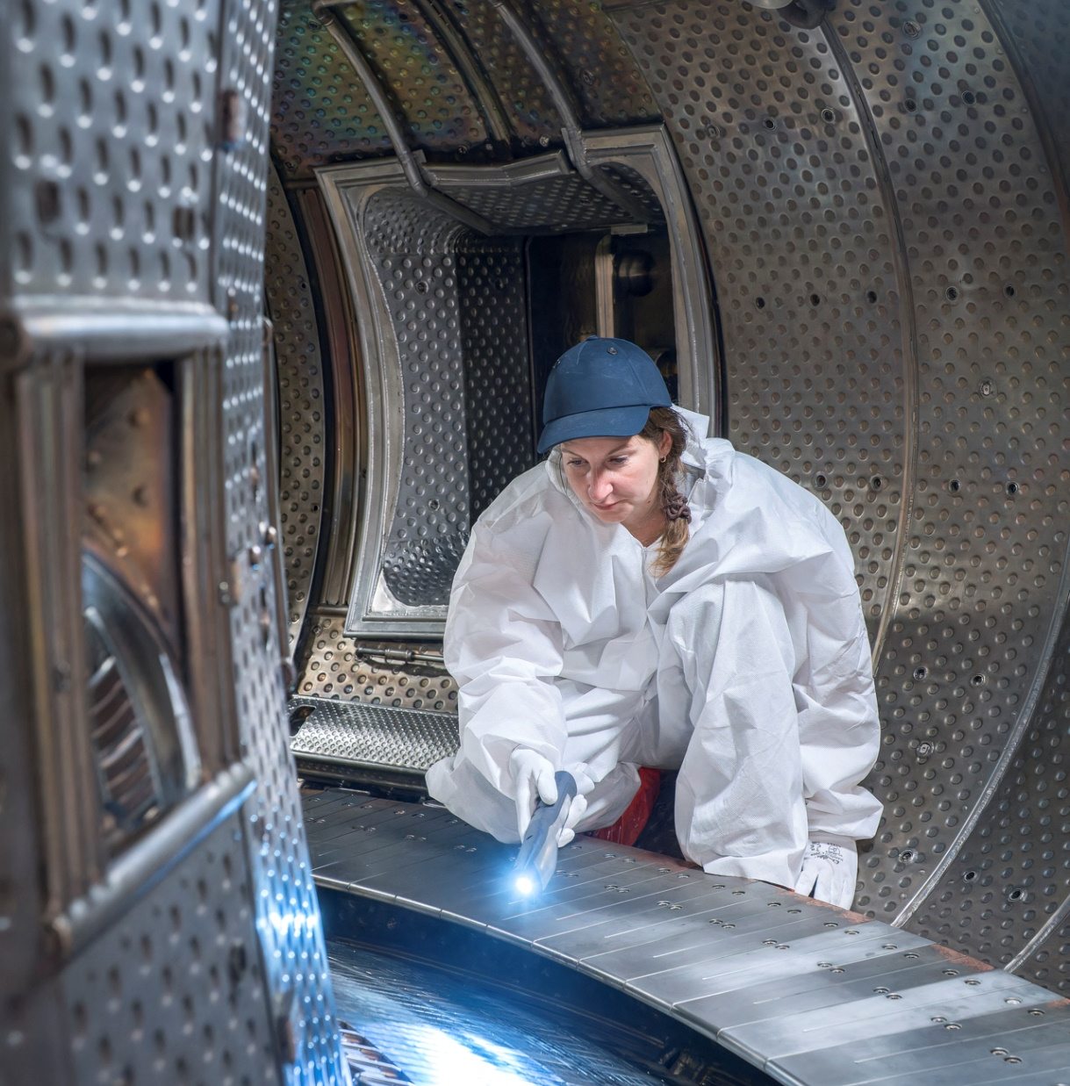

Erosion and redeposition on WEST PFUs phase 2
M. Diez et al.
November 19, 2025

Slide 2
Outline
Erosion of the lower divertor
Redeposited layers on the HFS of the divertor

Slide 3
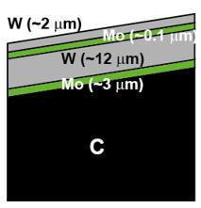
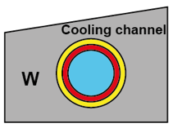
Introduction / Context / Objectives
WEST phase 1 (2016-2020)
WEST phase 2 (2021-present)
W-coated graphite PFUs
Bulk W ITER-like PFUs
Erosion depends on toroidal position (ripple)
Erosion in the orders of 10µm
  8µm at ISP > 6 µm et OSP
  eroded area at OSP > eroded area at ISP
Total eroded volume ~2,5 cm³ over the whole divertor after 7h of plasma
Erosion behaviour of W coating vs bulk W ?
Erosion rate phase 1 vs phase 2 ?
No marker layers on PFUs phase 2
how to measure erosion ?
[M. Balden Phys. Scripta 2021]
[M. Balden PFMC 2025]
[A. Huart PFMC 2025]
[A. Hakola IAEA 2025]

Slide 4
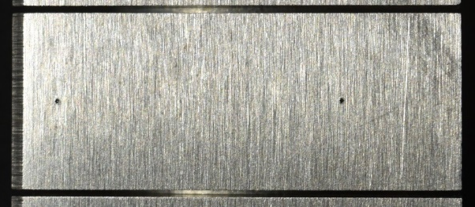
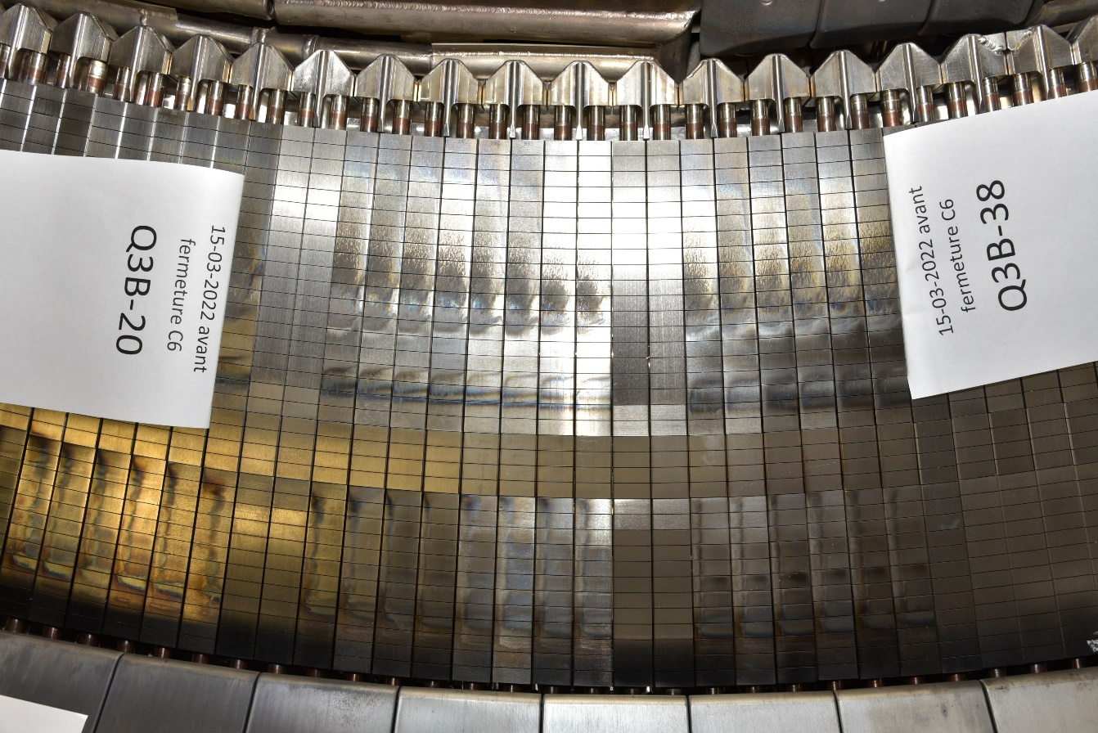
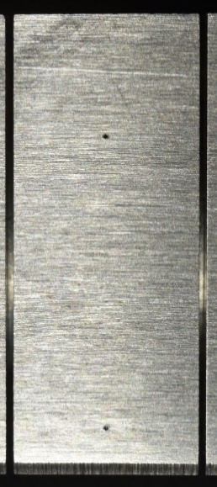
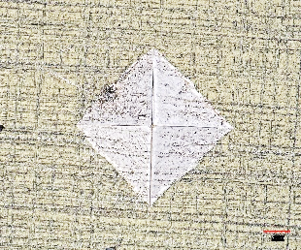
Indentations used as erosion markers
Q3B
Plasma-exposed area
plasma
PFU#356
PFU#355
PFU#361
PFU#357
Reference indentation
Width : 350 µm
Depth: 50 µm
Min ISP
Max ISP
Markers on the plasma-exposed are of the monoblocks
Change of morphology (depth, shape) → information about erosion
Hardness machine to make the markers (indentations)
4 PFUs equipped with « erosion markers » installed in sector Q3B
Min OSP
#21
#22
#31
Max OSP
#32

Slide 5
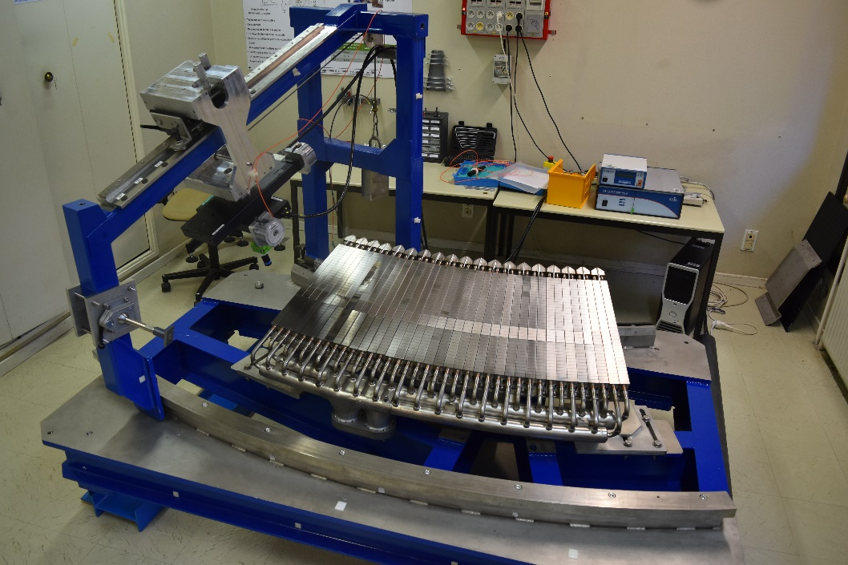
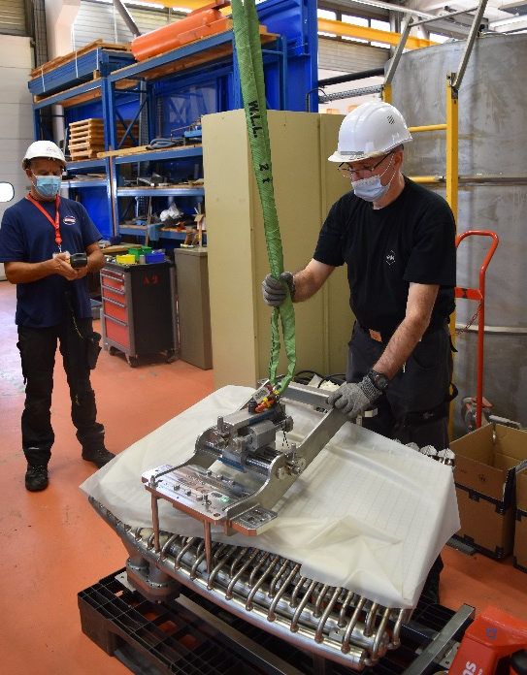
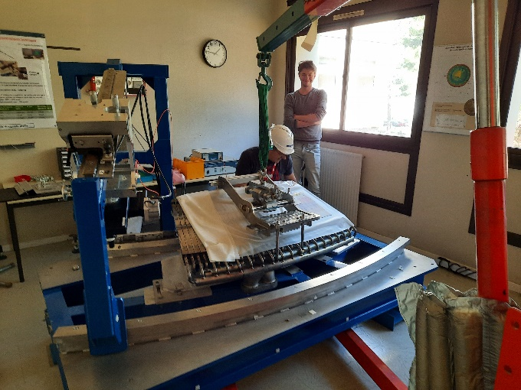
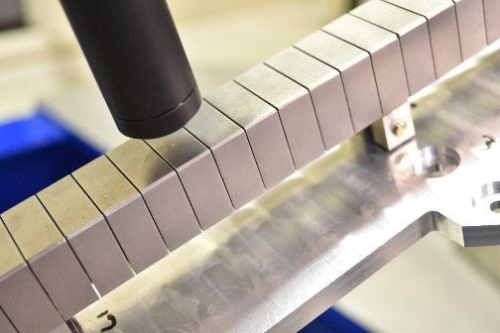
Erosion monitoring directly on divertor sector
At each shutdown the sector is put on the confocal microscopy bench to acquire 3D mapping of each indentation (no PFUs removal + non destructive)

Slide 6
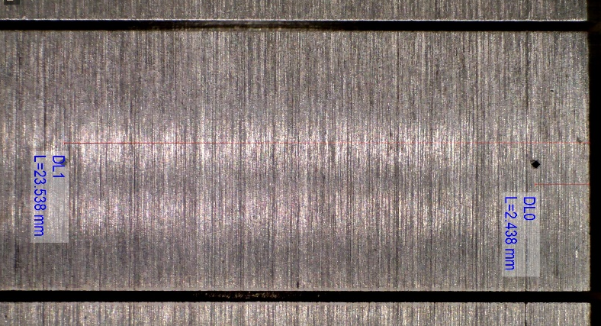
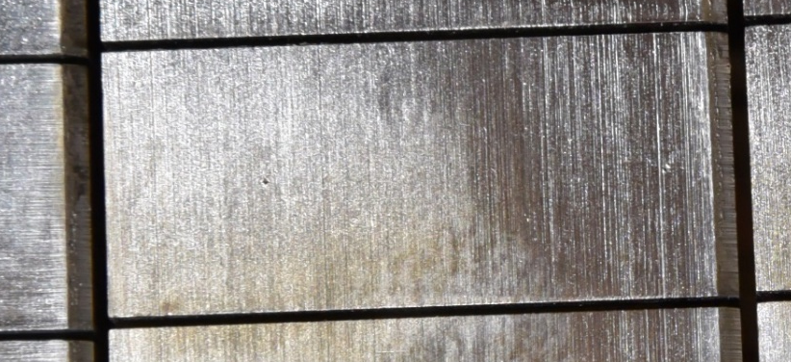

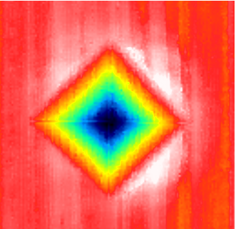
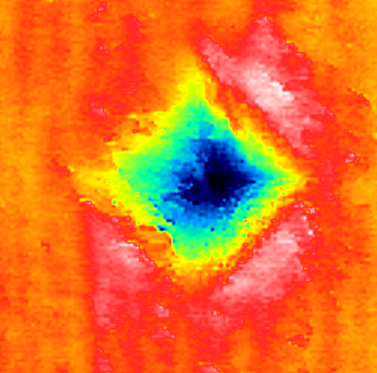
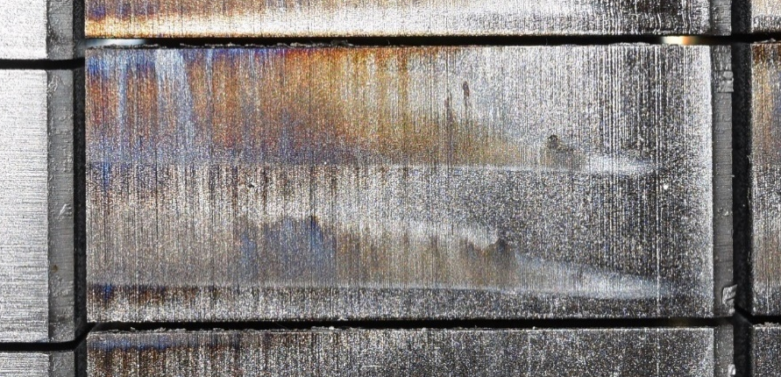
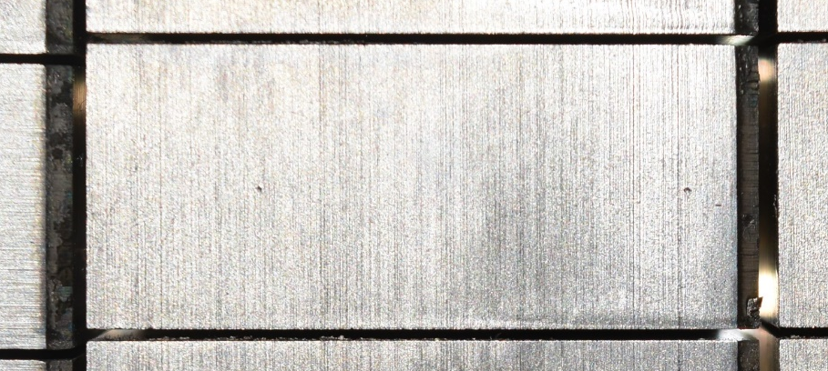
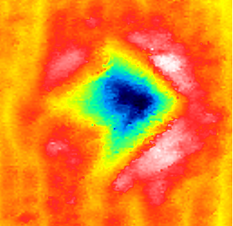
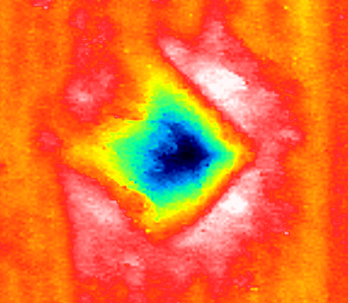
Erosion monitoring directly on divertor sector
2022 - PFU356, MB14 – initial
2023 - PFU356, MB14 - Post C7
plasma
100 µm
100 µm
2025 - PFU356, MB14 - Post C11
2024 - PFU356, MB14 - Post C9
plasma
plasma
100 µm
100 µm
6

Slide 7
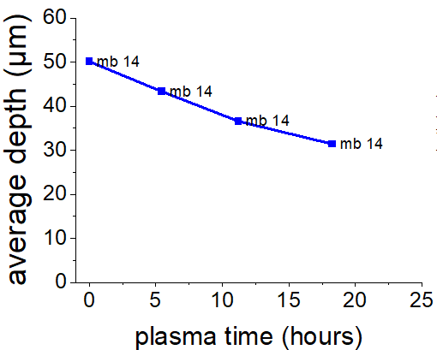
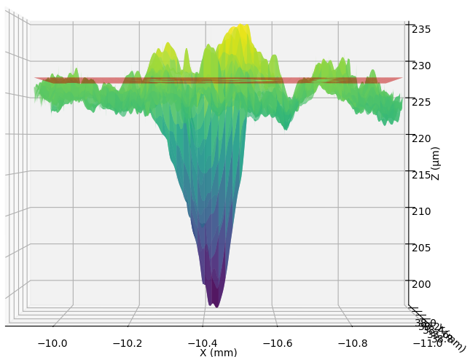
The average depth is determined using Python
Each CLSM 3d map is then post treated using Python to determine the average depth of the indentation
3D mean plane
Average depth
C6-C7
C8-C9
C10-C11
2023
2024
2025
lowest point

Slide 8
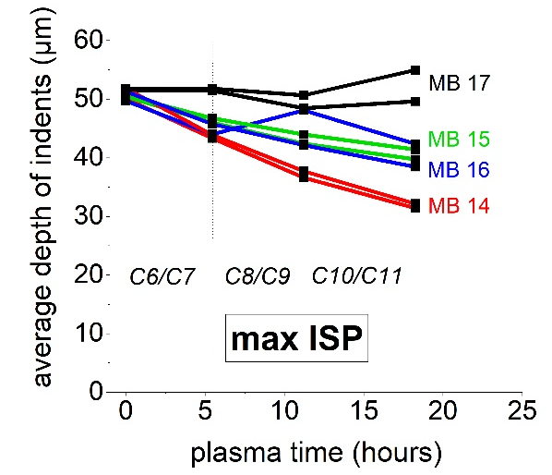
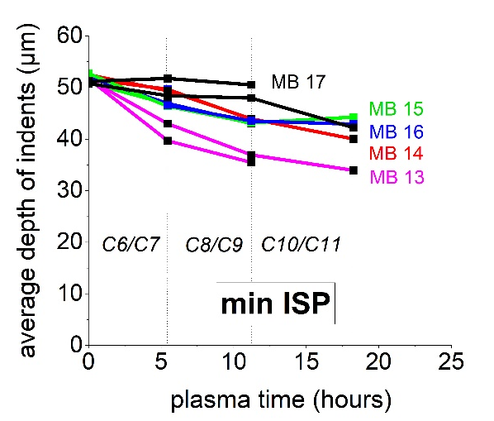
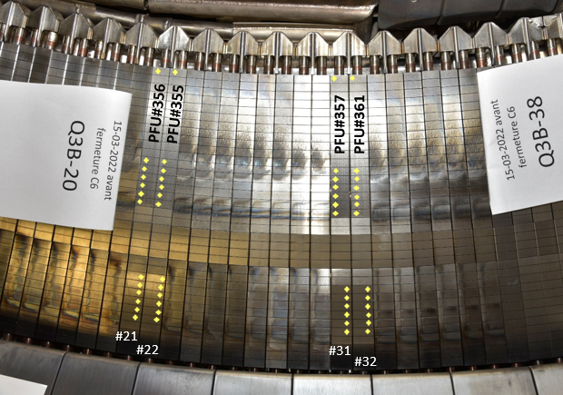
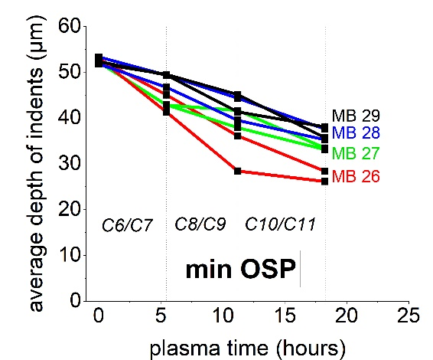
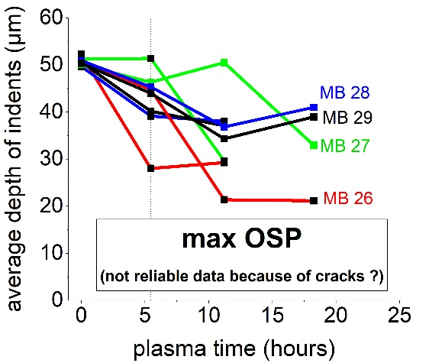
Results
Results at ISP
No erosion on MB 17
Erosion MB 14 > MB 15 > MB 16
15-20 µm of erosion ?
Results at OSP
Erosion MB 26 > MB 27 > MB 28, MB 29
Erosion at max OSP (30 µm) > min OSP (20µm) ?

Slide 9
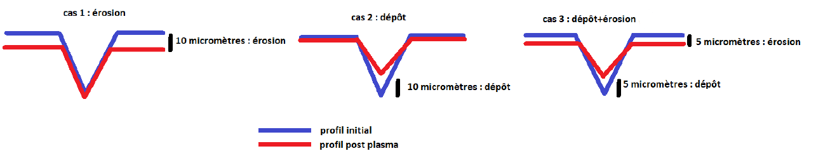
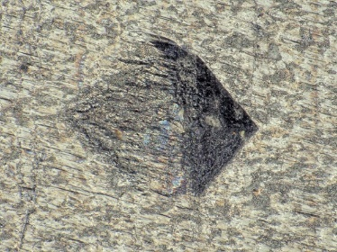
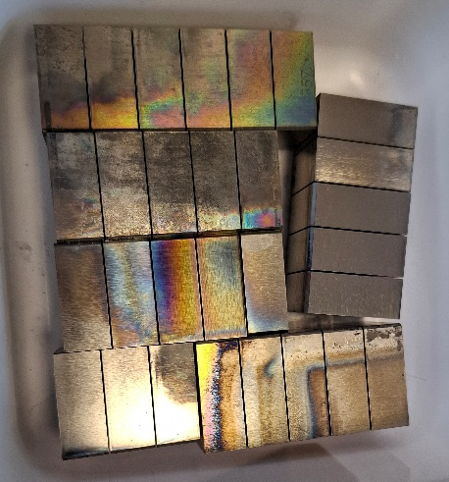
Future steps (2026)
How can we be sure that a change of depth necessarily represents erosion ?
MB 13
Analysis plan
1 PFU removed from the sector after C9
PFU cut into samples
High magnification observation of the indentations (CEA)
HR CLSM (MPG)
Destructive analysis (FIB) to observe the cross section of the indentations and see whether there is deposited layers inside (MPG)
MB 15
[C. Martin]

Slide 10
Outline
Erosion of the lower divertor
Redeposited layers on the HFS of the divertor

Slide 11
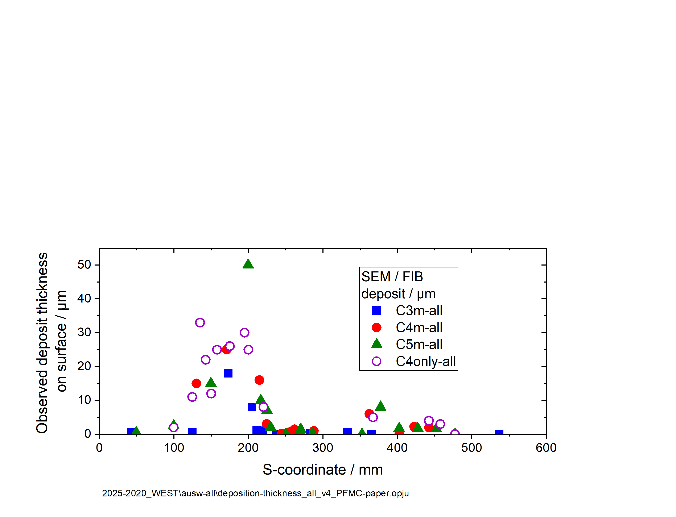
Introduction / Context / Objectives
WEST phase 1 (2016-2020)
WEST phase 2 (2021- now)
W-coated graphite PFUs
Bulk W ITER-like PFUs
~ 50 µm deposits after 7 hours of plasma
Complex structure, multi layers / difficult to relate with plasma history
Mainly W + traces of Mo, Fe, Cu, O, B
Main source of D retention
Layers may not be much different from those of phase 1 BUT:
Same deposition rate as during phase 1 ?
Effect of the ripple on the deposited layers ?
Effect of the toroidal bevel on the deposited layers?
[C. Martin Phys. Scripta 2021]
[M. Balden Phys. Scripta 2021]
[A. Hakola NME 2025]
[R. Mateus PFMC 2025]
[I. Jogi JNE 2023
[I. Jogi NME 2025]
[J. Gaspar NME 2024]
[C. Martin NME 2024]
[A. Marin JNM 2025]

Slide 12
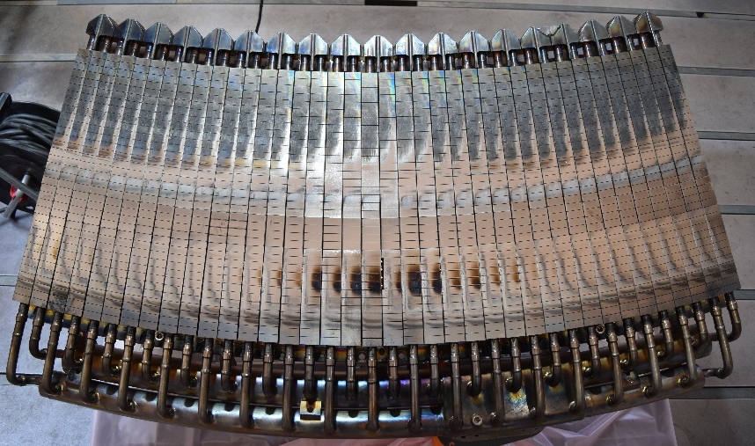
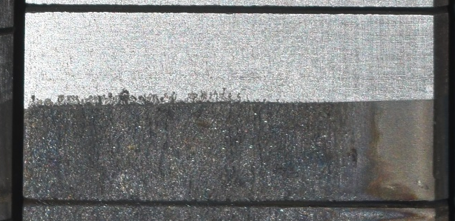



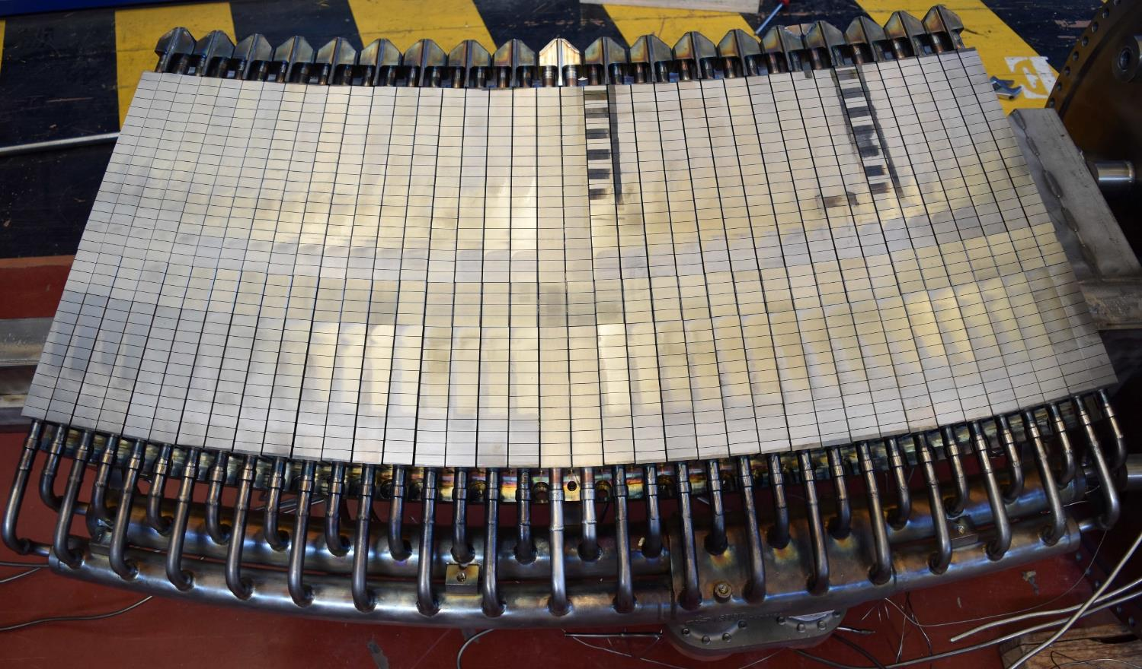
Experimental procedure
[M.Firdaouss ICFRM 2025]
Q1A, before cleaning, june 2025
Laser cleaning of the divertor for scientific purposes
Sector Q1A : completely cleaned, except for 2 PFUs that were partially cleaned in order to study deposition
1 divertor target at min ISP (#391)
1 divertor target at max ISP (#419)
Evaluation of the thickness of the deposited layers using confocal microscopy
MB 1 to MB 12 → radial profile
3 measurements / MB → toroidal profile
100
Q1A, after cleaning, july 2025
110 µm
46 µm
42 µm
50
MB 6
PFU#419
#391
(min ISP)
#419
(max ISP)
-7 mm
0
0 mm
7 mm

Slide 13
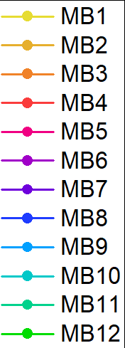
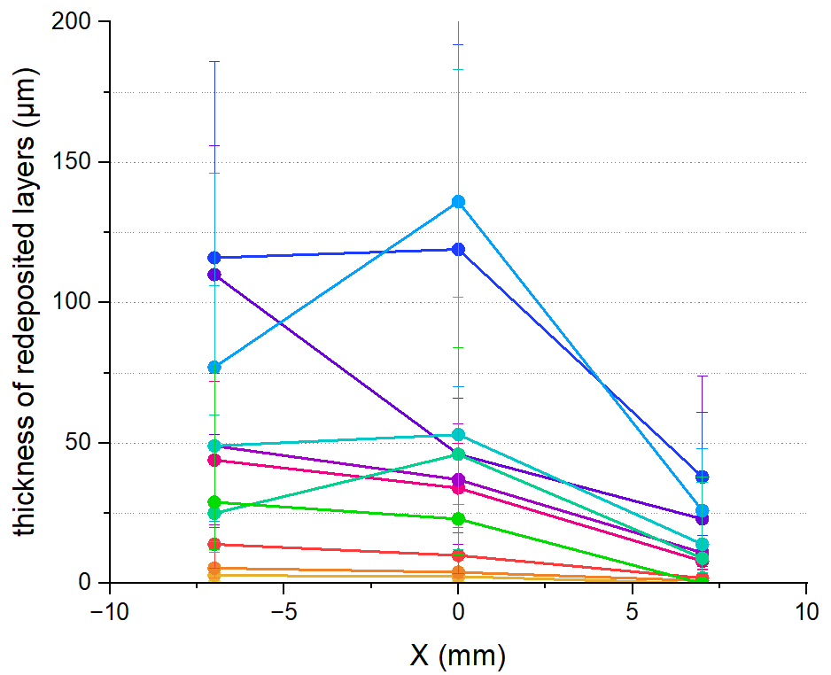
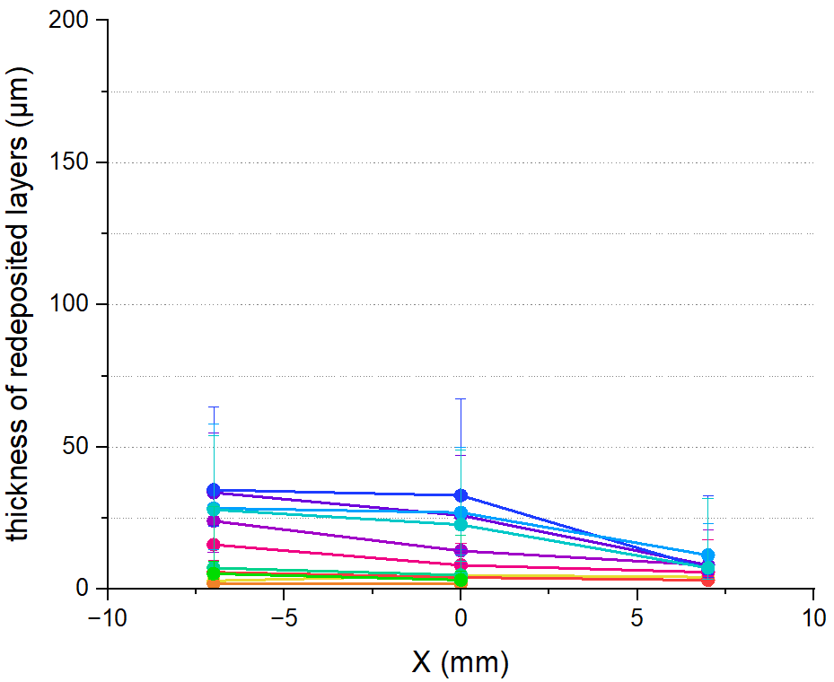
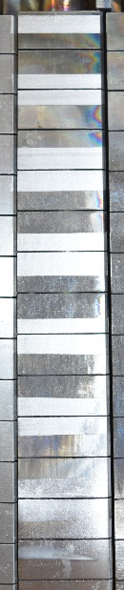
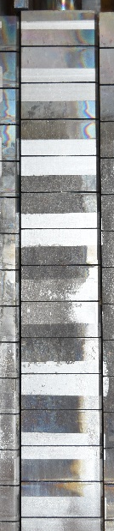

Results – thickness of the layers
MB 1
#391
(min ISP)
MB 1
#419
(max ISP)
MB 5
MB 5
MB 10
MB 10
MB 14
MB 14
Clear effect of the ripple : thicker layers at max ripple (~100µm)
Clear effect of the toroidal bevel : non uniform thickness
  very thin on the magnetically shadowed area
  grow linearly toward the exposed area
Maximum thickness on MB 8 and MB 9
plasma

Slide 14
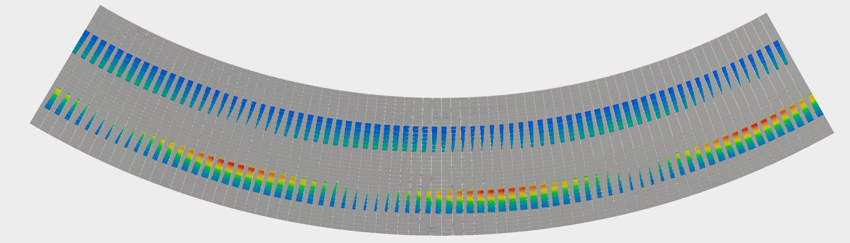
Results – amount of redeposition on the divertor
1 ripple pattern
Min ISP
Max ISP
42 mm³
121 mm³
Volume of redeposited layers over a 1/2 ripple pattern ~ 0,98 cm³
Over 1 ripple pattern ~1,9 cm³
1,9 cm³ x 19 ripple patterns = total amount on the divertor ~ 37 cm^{3 *}
The erosion of the divertor alone cannot explain such a large amount of deposited layers in the HFS!
* Layers formed between C6-C11 (18 hours of plasma) with partial cleaning after C7 and C9

Slide 15
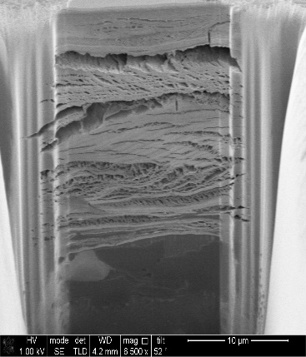
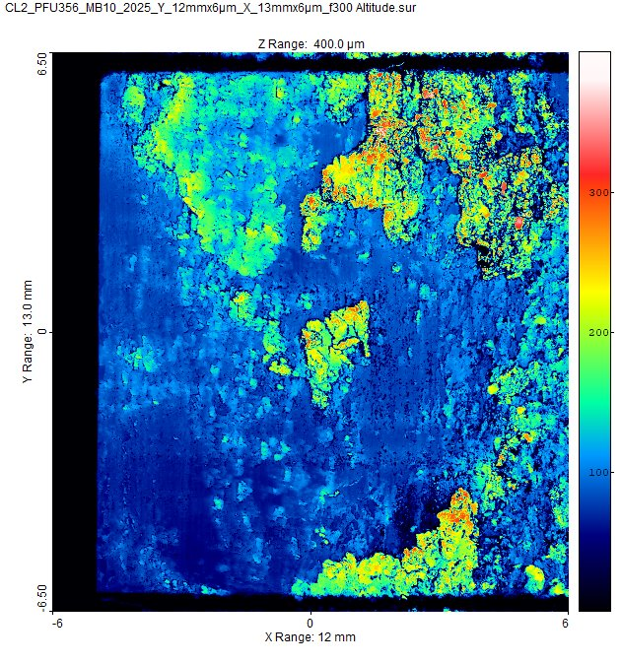
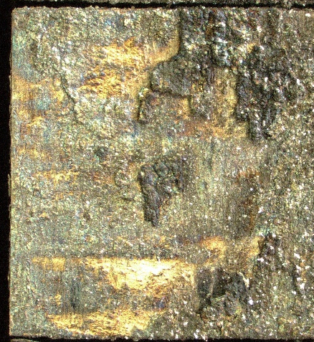
Results – amount of redeposition on the divertor
With partial cleaning ~100 µm thick layers – 37 cm³
If layers 100% dense and made of W → 714 g of W
If layers 80% made of W → 573 g of W
If layers 50% made of W → 357 g of W
No cleaning at all ~ 300 µm thick layers
[C. Martin et al., NME 2024]
If no cleaning performed → > 1 kg of W on the lower divertor of WEST after 18h of plasma?
2 mm
W density : 19,3 g/cm3

Slide 16
Thank you

Slide 17
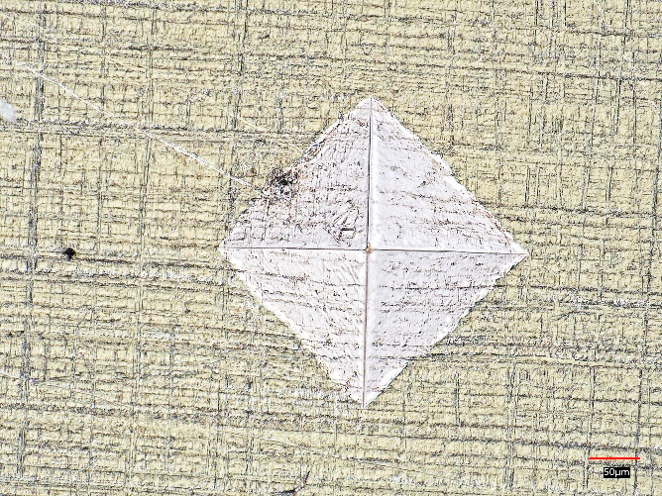
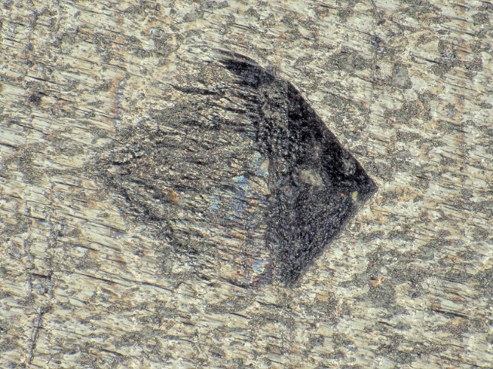
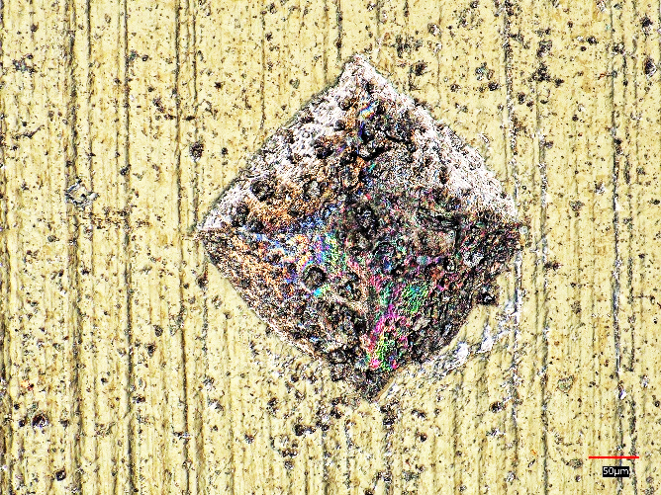
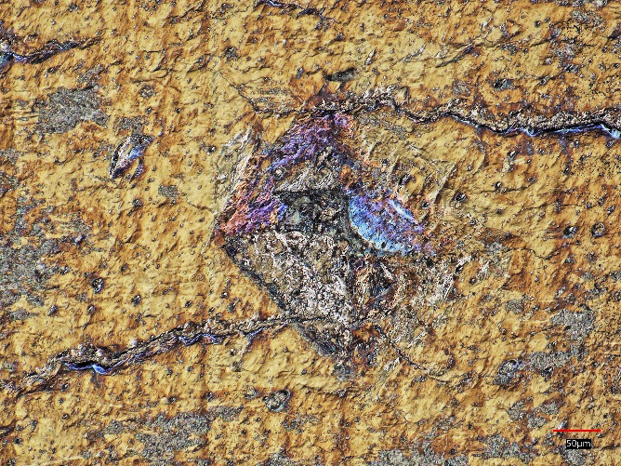
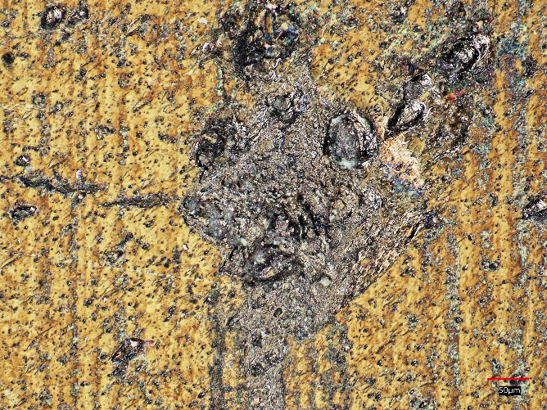
Optical images – PFU#357 min ISP, 2024
REF
MB 13
MB 15
MB 26
MB 28

Slide 18
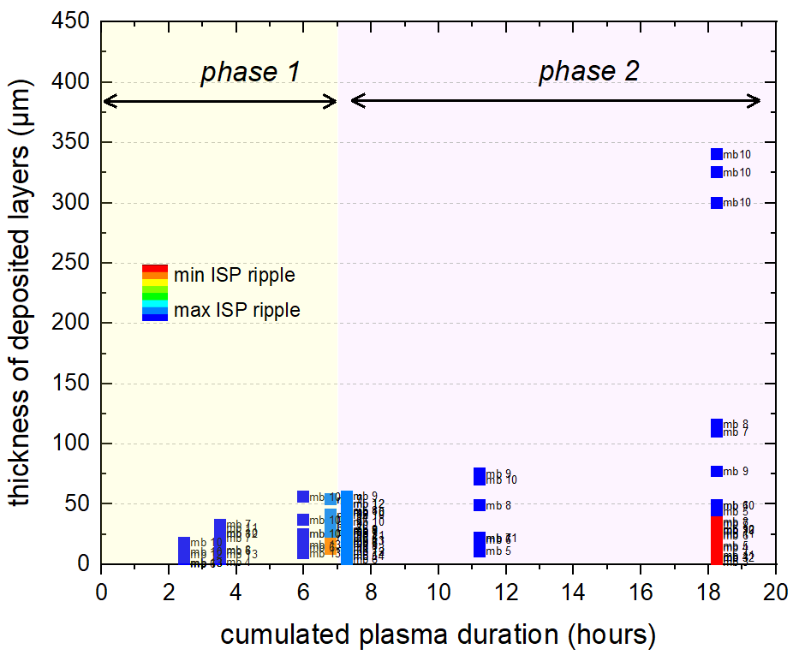
Results – evolution of layers with plasma time
The layers grow with plasma time
end of phase 1: 50 µm
phase 2 : > 100 µm when cleaning is performed but can reach > 300 µm with no cleaning
2 mm
> 1 kg of W after 18 hours of plasma when no cleaning is performed ?

Slide 19
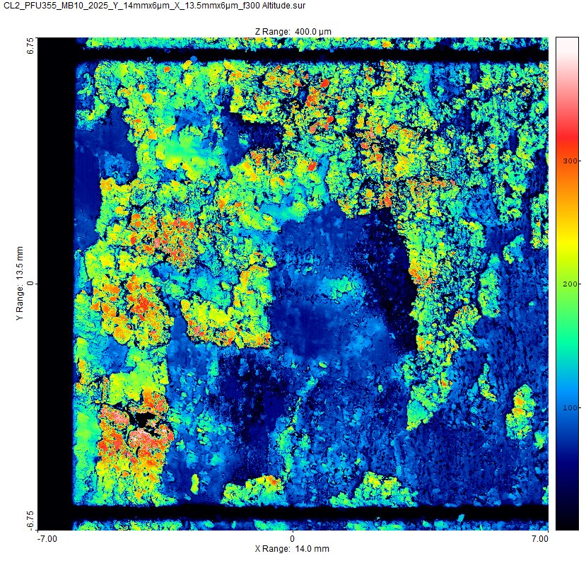
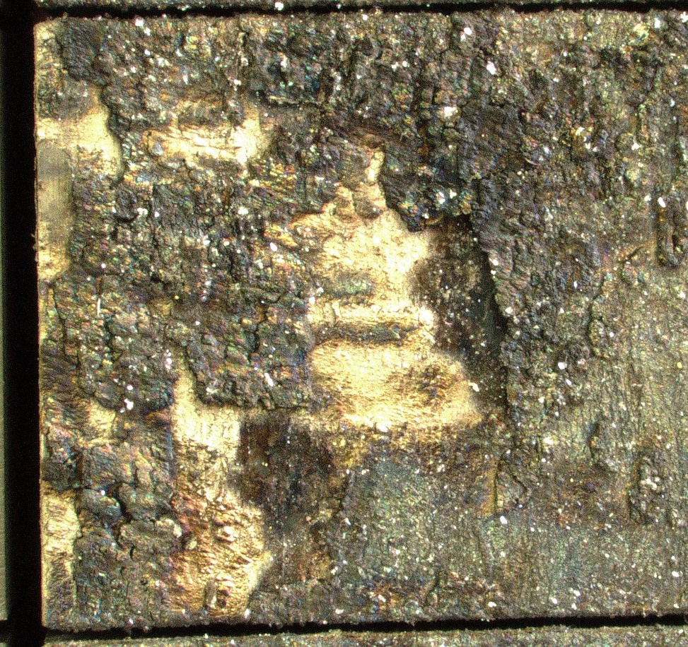
Desalignement ?
PFU 355 MB10 - depots

