Slide 1



Ion-beam analyses of boronization samples originating from WEST
WPPWIE Review Meeting 2025
E. Pitthan¹, P. Petersson², D. Gautam¹, M. Rubel^{1,2}, D. Primetzhofer¹, M. Diez³
¹Department of Physics and Astronomy, Uppsala University, 751 20 Uppsala, Sweden
²Department of Fusion Plasma Physics, KTH Royal Institute of Technology, 100 44 Stockholm, Sweden
³CEA, IRFM, F-13108 Saint-Paul-Lez-Durance, France
Jülich, 19th of November, 2025

Slide 2
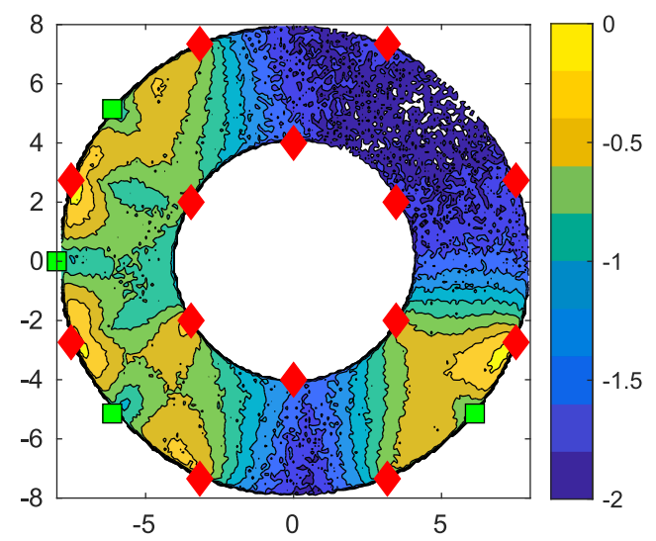
Spatially non uniform B layer predicted for ITER
Normalized B₂D₆ reaction distribution:
Recent simulations suggest strongly non-uniform B₂D₆ reaction distribution:
0.3 Pa with 88 % He and 12 % D₂
Diborane molecules injection points
4 anodes in the equatorial plane (30 A/anode)
Non-uniform B layer formation?
Enough for ITER commissioning with full-W environment?
Non-uniform boronization in WEST with 3/6 feed location (February 2025)
ITER
equatorial
plane
T. Wauters et al. Nucl. Mater. Energy, (2025) 42

Slide 3
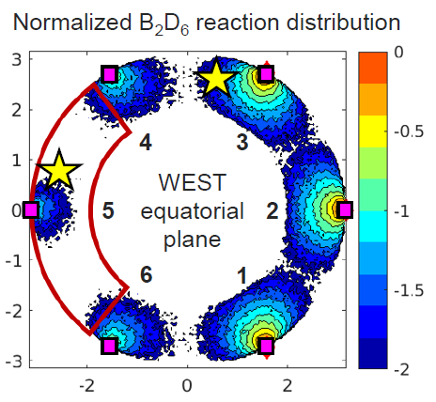
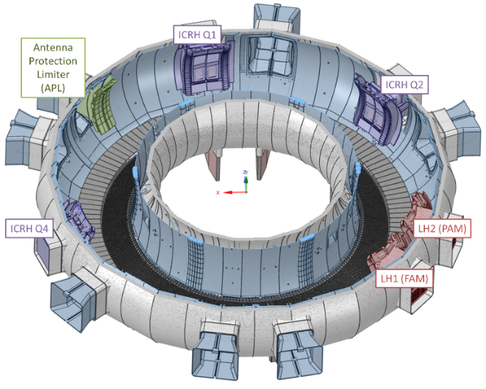
Non uniform boronization performed in WEST
(04 February 2025)
Spatially non-uniform boronization tested in WEST
→ 6 glow electrodes (anodes) on top
→ 3 (out of 6) diborane B₂D₆ feed locations
bottom LFS Q1, Q2, Q3 (half of the torus)
Boronization of ~5h, 70°C
>85% He / <15% B₂D₆, 0.5 Pa, 10 g of B
Two collector probes (cathodes) with 42 samples (W and SS) located in:
    Q3 (B-rich region)
    Q4 (B-depleted region)
Q2
Q3
Q1
Glow electrode
Q4
Q6

Slide 4
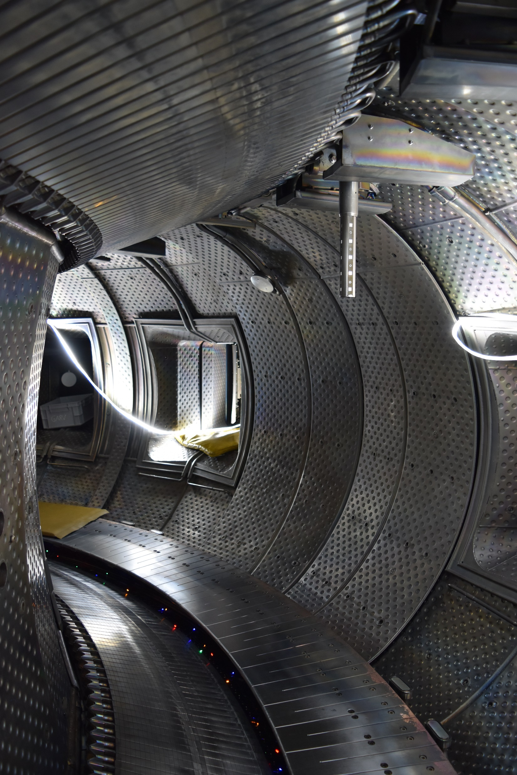
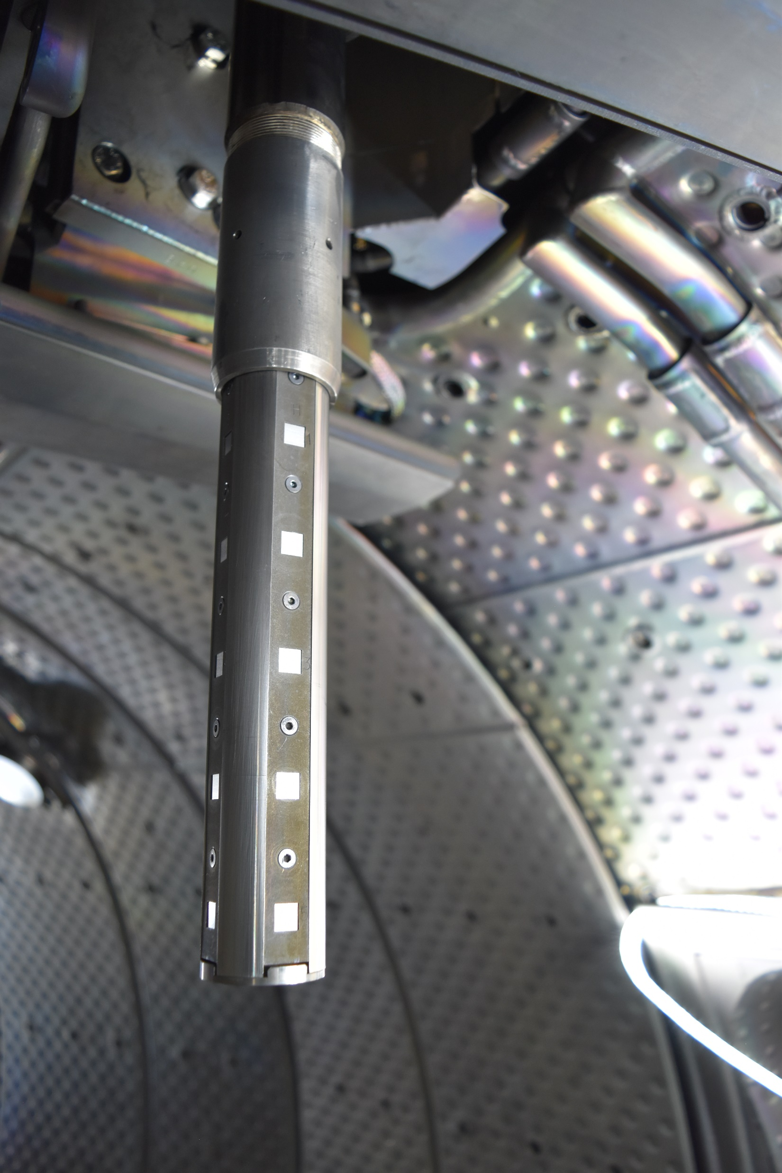
Non uniform boronization performed in WEST
Glow electrode
(anode)
Q4 probe
(cathode)
G
H
1
2
3
4
5
B₂D₆
no diborane injection at this location during the experiment
- for illustration purposes only -

Slide 5
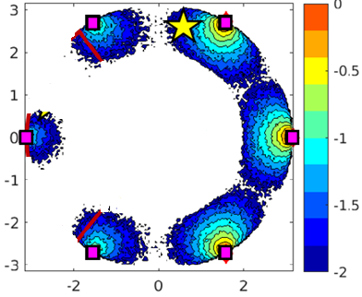
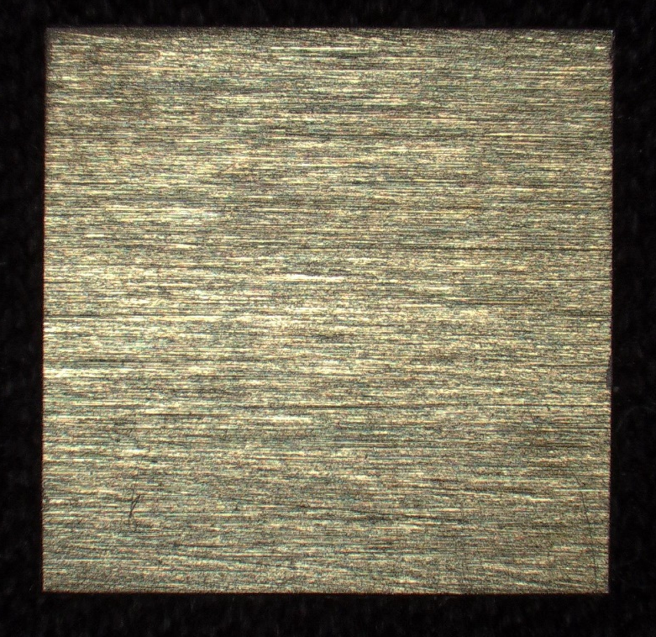

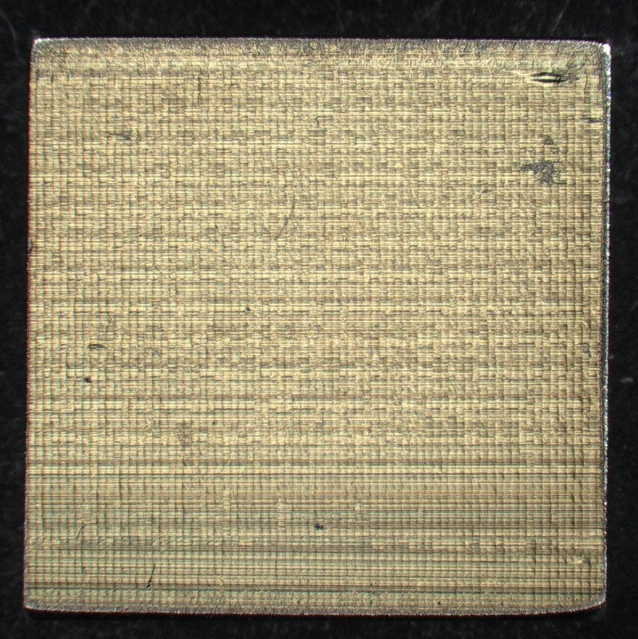
42 samples strategically positioned on the probes
Samples distributed over the 4 sides of the probes
  A,B,C,D (Q3 probe)
  E,F,G,H (Q4 probe)
21 samples / probe
  Row #1,4 : SS
  Row #2,5,bottom : W
  Row #3: mix of SS and W
A
B
Q3
D
W
H
C
E
Q4
G
Q3 probe
(A,B,C,D)
Q4 probe
(E,F,G,H)
F
1
2
3
4
5
Ra=0,65 µm
1
2
3
4
5
1
2
3
4
5
low cobalt SS
5
Ra=0,28 µm

Slide 6
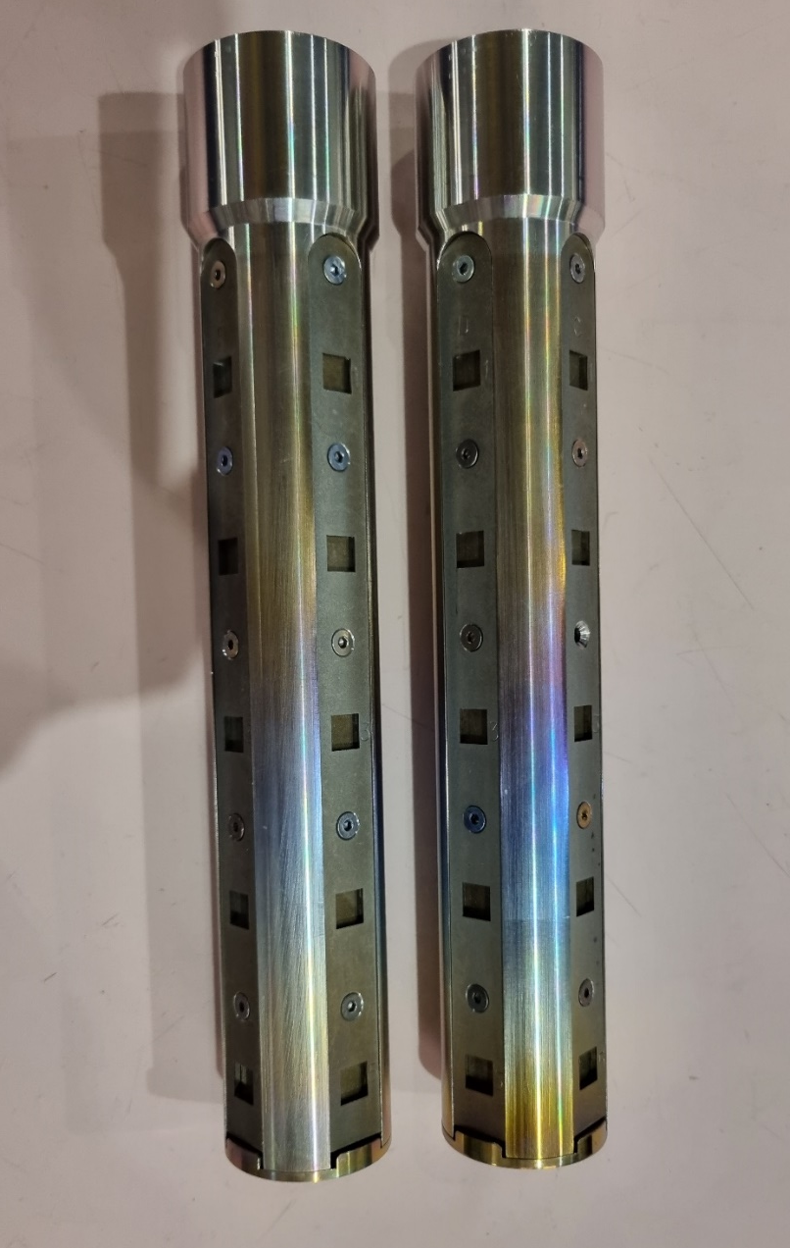
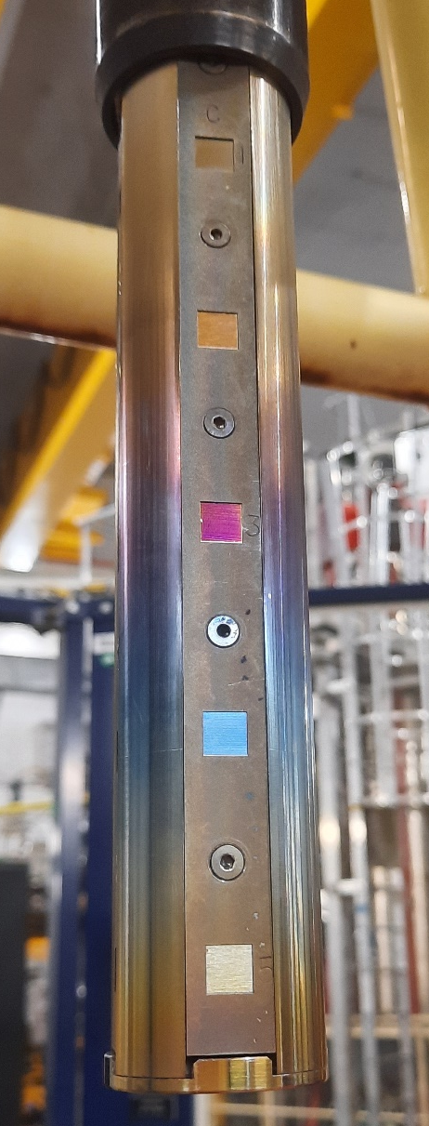
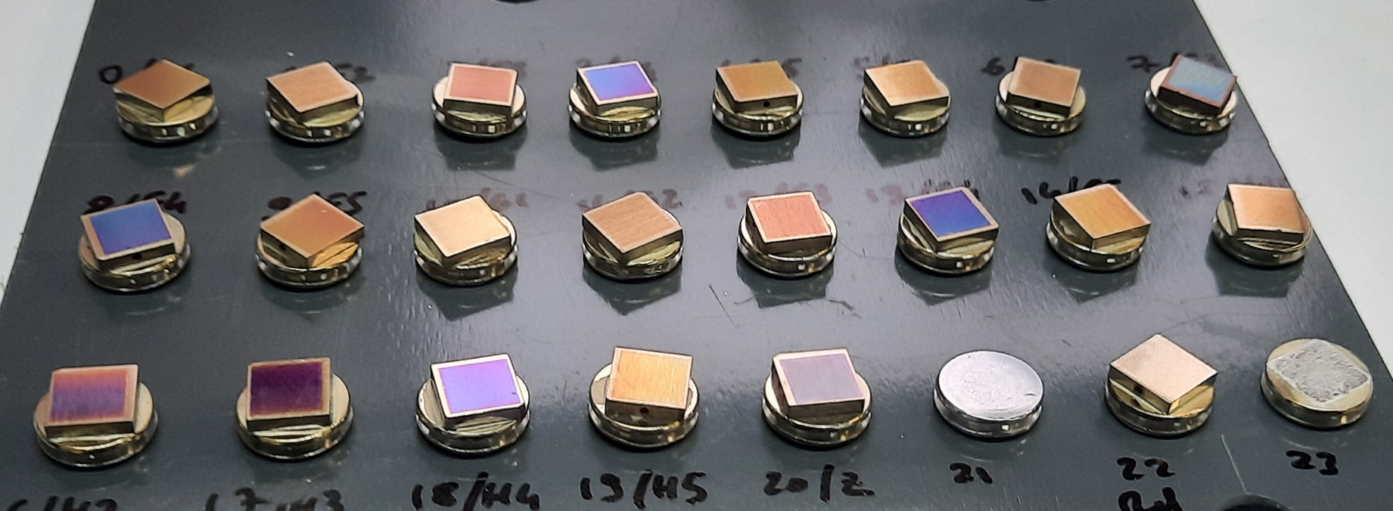
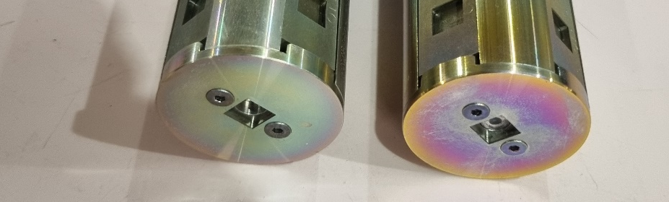
Visual observation of the probes and samples after the non-uniform boronization
Higher color contrast on the probe located near the injection point (Q3)
Color gradient visible both on the probes and on the samples
316L
W
316L
Q4 probe
(B-depleted region)
Q3 probe
(B-rich region)
316L
W
Samples extracted from Q4 probe after boronization
Q3 probe after boronization

Slide 7
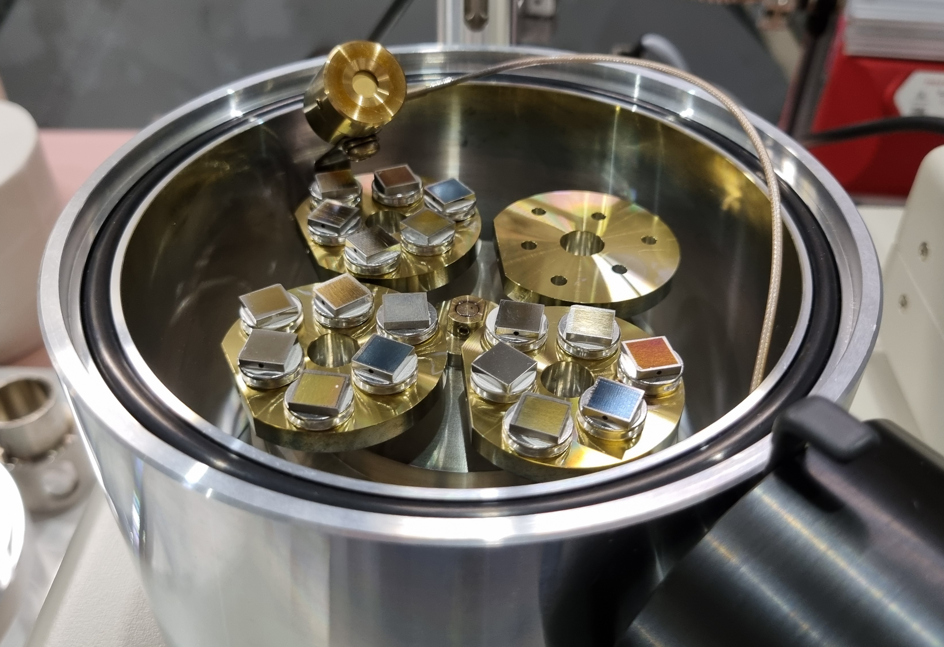
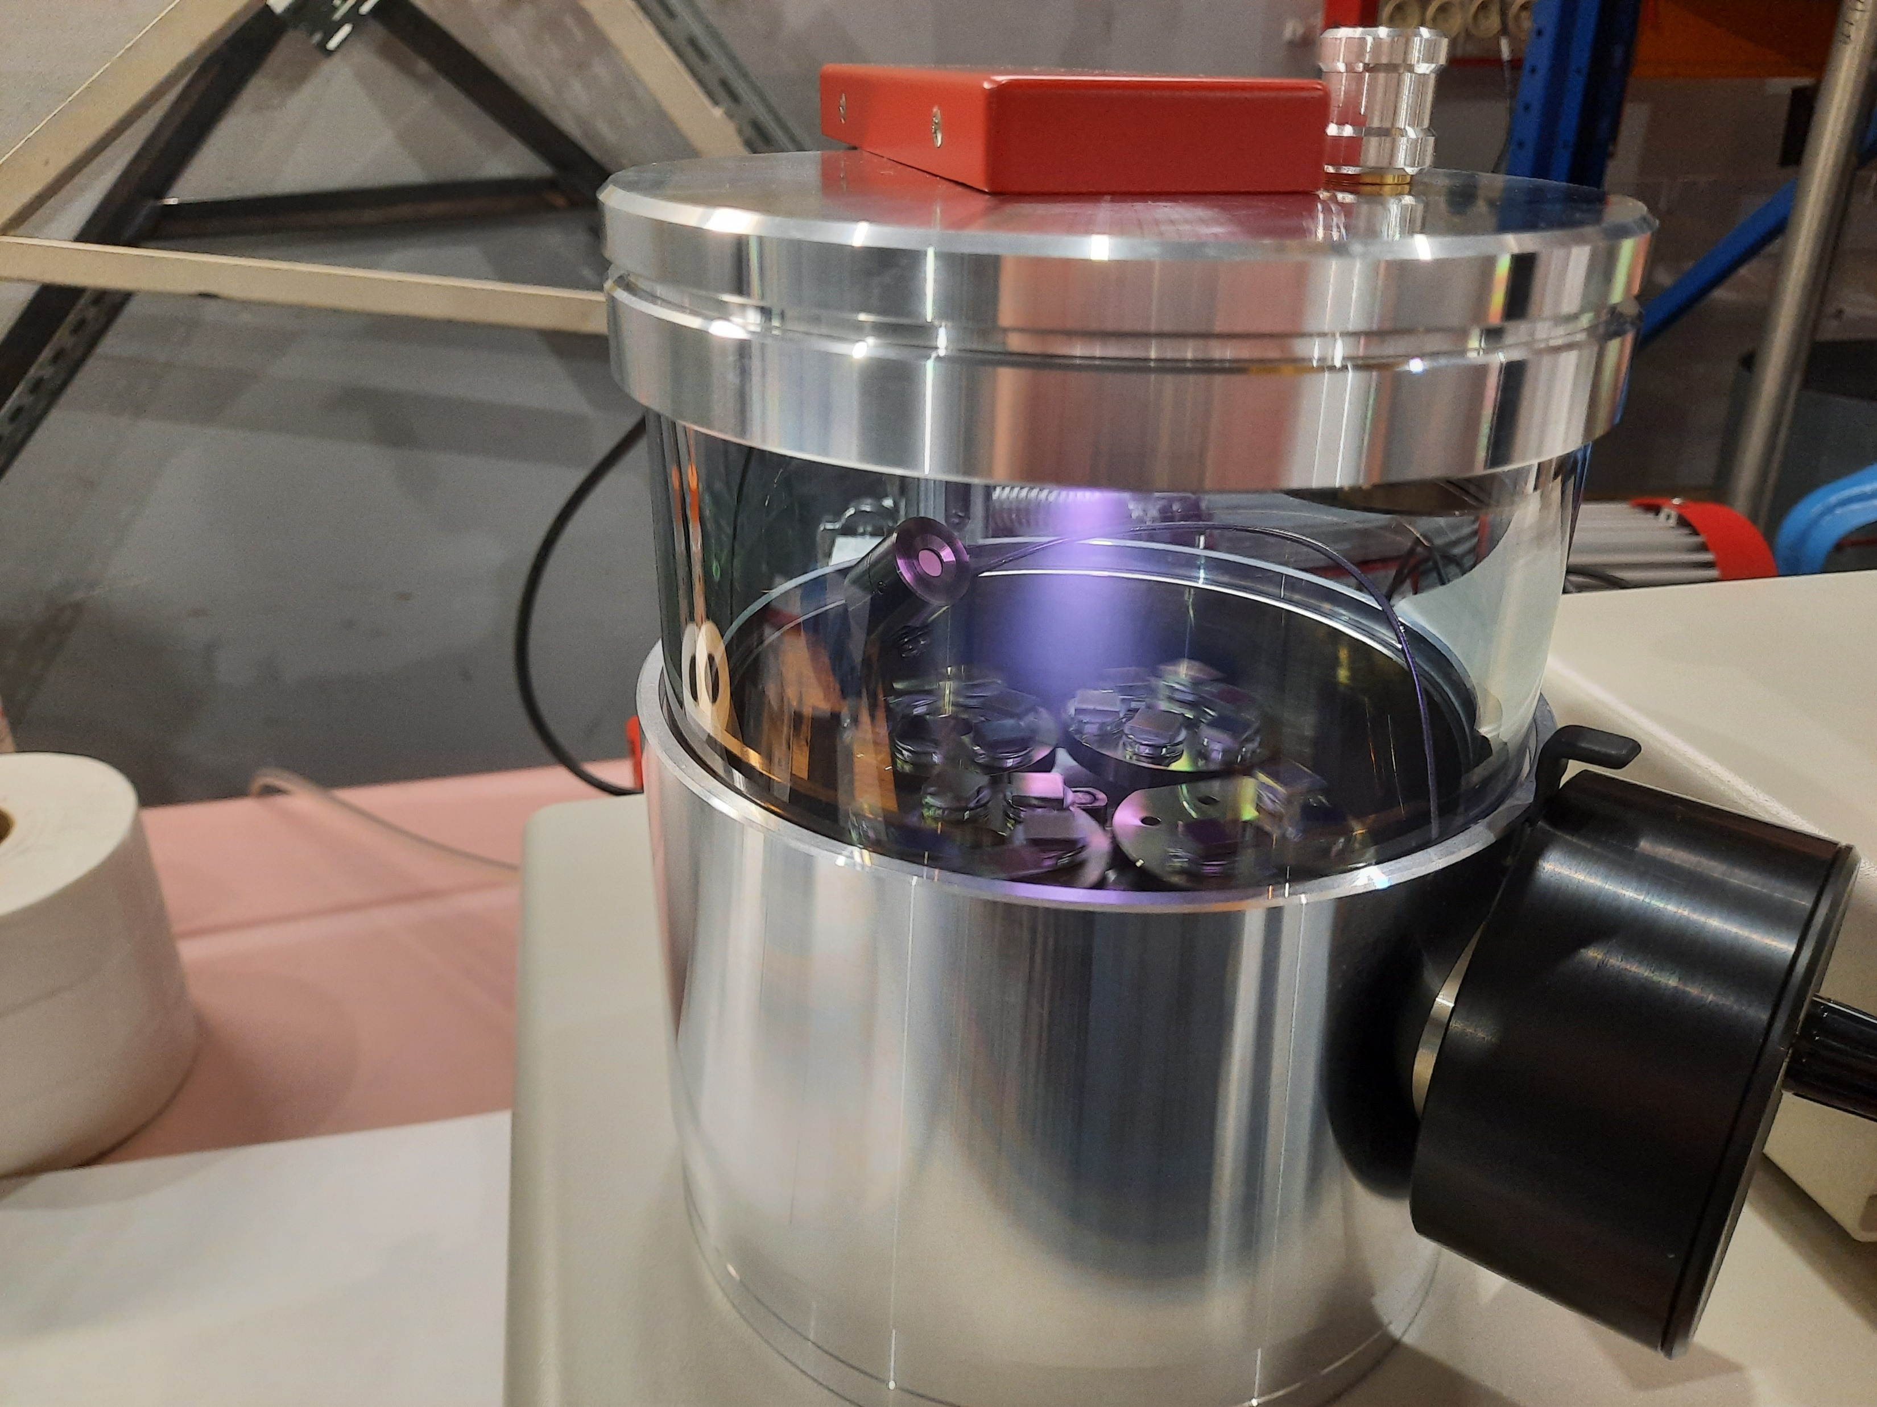
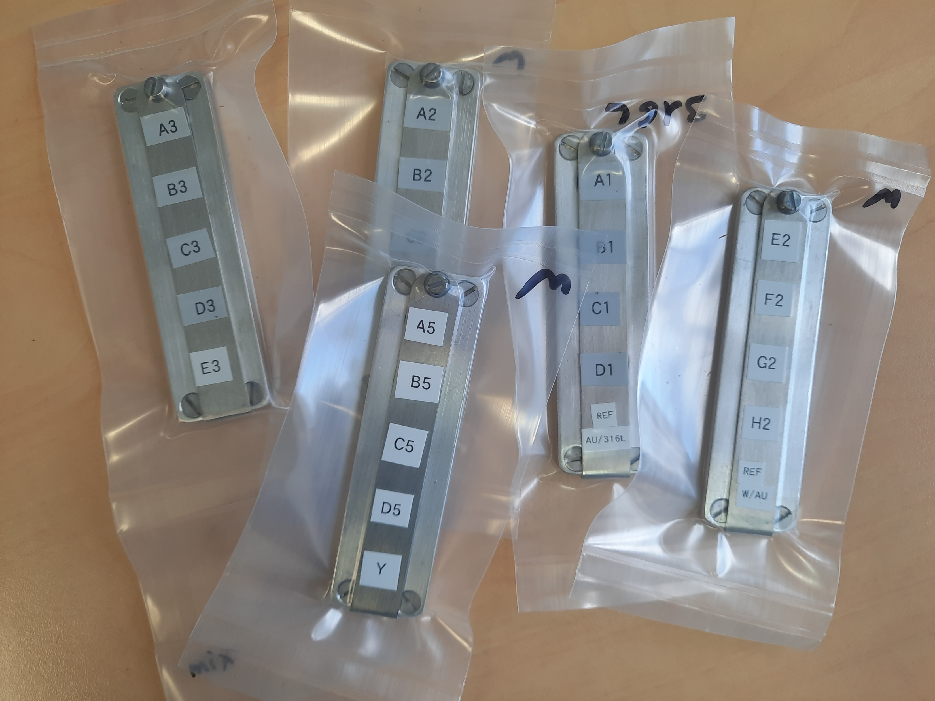
Post mortem analysis of the exposed samples
Gold coating applied on the sample surface (25 nm) to protect them from oxidation
3 batches of samples (division made by substrates and location)
Characterization at regular intervals to determine the evolution of B layers over time
IBA + SEM/FIB (+ SIMS + XPS)
VR (16 SS samples + 1 ref. sample)
Demokritos (18 W samples + 1 ref. sample)
MPG (3 W + 2 SS samples)
Gold coating process
This presentation
Transportation under vacuum sealed bags
7

Slide 8
Ion Beam Analysis of boronization samples from WEST
Non-uniform
Boronization in WEST:
Samples received: Au/boron layer/316L
Q3
Q4
A
Evaluate the uniformity of B layers in WEST:
  Homogeneity in toroidal position
  (Q3A and Q4B).
  Homogeneity along Z direction
  (vertical direction).
  Homogeneity in 4 toroidal directions.
Determine the amount of oxygen trapped in the boron layers and study how to desorb it.
Presence of He in layers?
Stability of layers in air?
B
Q3
E
H
C
D
E
316L
1
2
3
4
5
316L
Q4
G
F
316L
316L
+1 ref Au/316

Slide 9
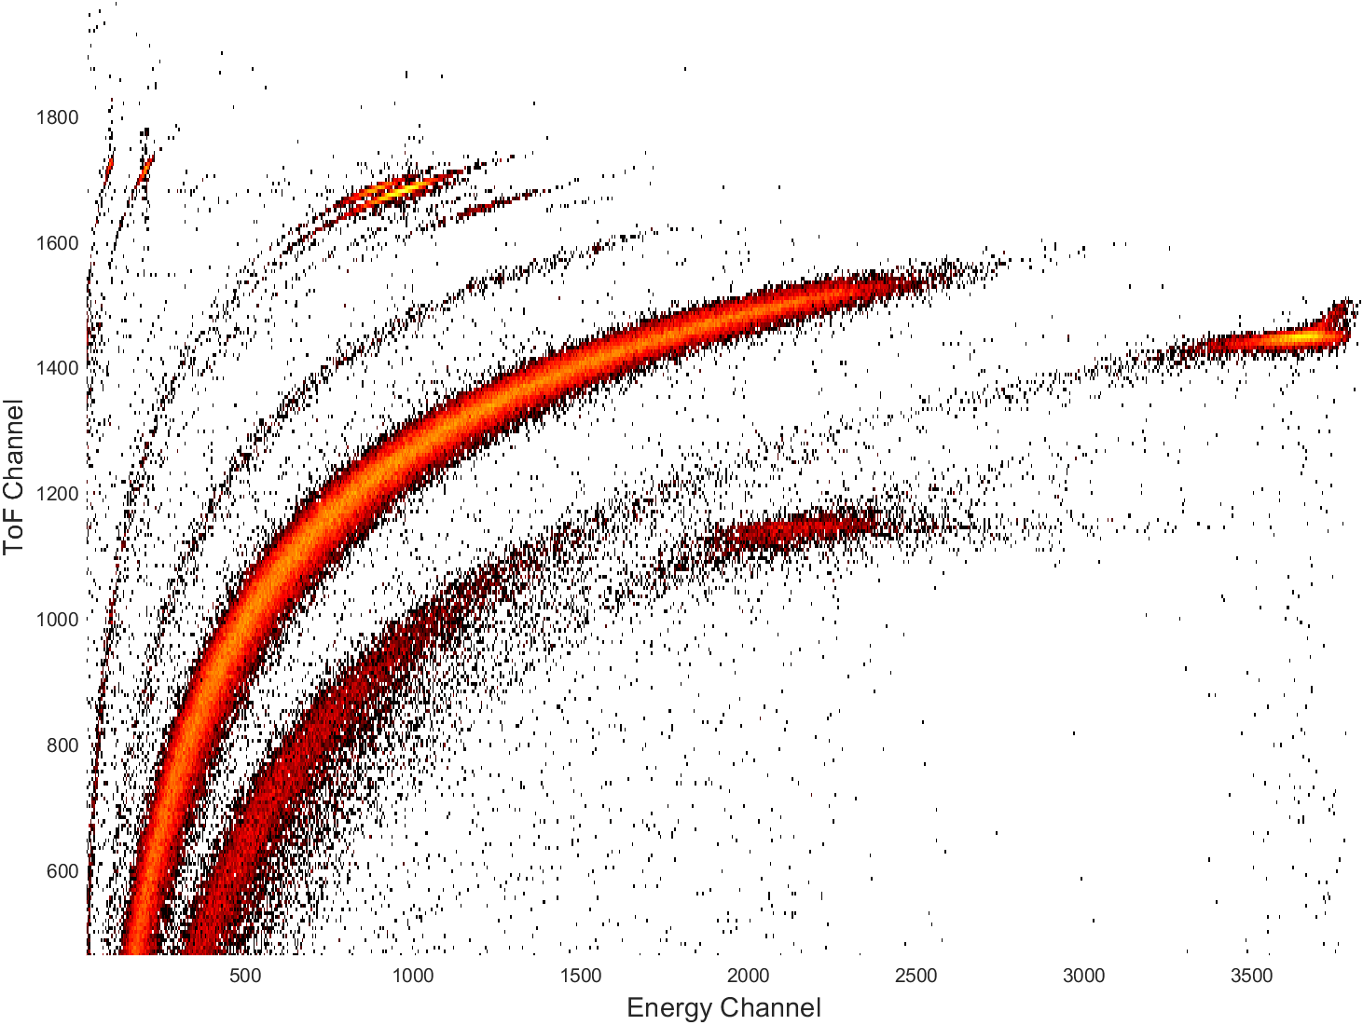
Ion Beam Analysis of boronization samples from WEST
ToF-ERDA for sample B4:
IBA measurements at Tandemlab-UU (VR):
2025-04-28 (t₀):
1st: EBS+NRA+PIXE using H⁺ 2.6 MeV (higher sensitivity to B).
2nd: ToF-ERDA I 36 MeV (depth profile of all isotopes).
2025-05-07 (t₀ + 9 days in vacuum):
1st: EBS+NRA+PIXE ³He 2.5 MeV (higher sensitivity to D).
2nd: ToF-ERDA I 36 MeV.
2025-06-26 (t₀ + 9 days in vacuum + 51 days in air):
Single measurement: ToF-ERDA ⁷⁹Br⁹⁺ 28 MeV
H
D
¹¹B
C
N
O
t₀
¹⁰B
He
Si+Al
Fe+Cr+Ni
Scattered I
Au
Measurements in different days at different spots separated by ~2 mm from each other.
× × ×

Slide 10
Ion Beam Analysis of boronization samples from WEST: PIXE
PIXE results: Identify main element (medium and high-Z) in samples
Fe was identified as most common element from substrate (Fe was used as substrate component in ToF-ERDA results); followed by Cr and Ni.
Au, Si, and was also identified in samples.
Ar was observed in samples H1 and A4.

Slide 11
Ion Beam Analysis of boronization samples from WEST: ToF-ERDA
Depth profile (t₀):
Fe was used as representative element from substrate (confirmed by PIXE).
Boron layer in samples A4-H4 significantly thicker than A1-H1.
Indication of intermixing between Au/B layer and B/316L from depth profiles is a known pitfall from multiple scattering effects for heavy atoms*.
*E. Pitthan et al., Surface &Coatings Technology, 417, 127188 (2021).
RBS does not indicate significant roughness nor intermixing in layers:
well-defined shift in Fe signal in boron layer in comparison to reference.
H and D loss during measurements are possible: comparison with ³He NRA.

Slide 12
Ion Beam Analysis of boronization samples from WEST: ToF-ERDA
Sample A4 – comparison between measurements in different days with beam spots separated by 2 mm:
Oxygen presence mainly around B/substrate region.
No indication of change in composition 1 week after open of packages (t0 + 9 days in vacuum).
H+D+O region:

Slide 13
Ion Beam Analysis of boronization samples from WEST: ToF-ERDA
H+D+O region:
Non-uniform
Boronization in WEST:
Q3
(B-rich region)
A
B
Q3
D
H
C
E
Q4
G
F
Q4
(B-depleted region)

Slide 14

Ion Beam Analysis of boronization samples from WEST: ToF-ERDA
Row 1 (thin layers):
Non-uniform
Boronization in WEST:
Main observations:
Boron layer in row 4 (A4-H4) significantly thicker than
row 1 (A1-H1):
Row 1: 9.8 nm*.
Row 4: 34.4 nm*.
*Assuming a density of 2.351 g/cm³.
Slightly thicker boron layers in Q3 samples (A-D).
Higher oxygen + hydrogen and lower deuterium in Q4 samples (E-H).
Inverse correlation between boron and oxygen.
A
B
Q3
Q4
Q3
D
H
C
A-H
1
E
Q4
G
F
Row 4 (thick layers):
A-H
4
Q3
Q4

Slide 15
Ion Beam Analysis of boronization samples from WEST: p-NRA/EBS
Proton beam 2.6 MeV used for quantification of boron and comparison to ToF-ERDA results.
Incident at 0° with the surface normal and scattering angle of 170°.
Simulation using SIMNRA.
Cross sections used in SIMNRA: M. Mayer 1998.
Gold thickness varies from 60-100×10¹⁵ atoms/cm² with average at 85.5×10¹⁵ atoms/cm², corresponding to 14.5 nm assuming density of 19.31 g/cm³.
Overall agreement between ToF-ERDA and EBS/NRA.
High background (EBS) and low statistics (NRA) hinders quantification for samples with low amounts of boron (A1-H1).
Q3
Q4

Slide 16
Ion Beam Analysis of boronization samples from WEST: ³He-NRA
³He beam 2.5 MeV used for quantification of deuterium and comparison to ToF-ERDA results. Incident at 12.5° with the surface normal and scattering angle of 135°. Simulation using SIMNRA.
Cross sections used in SIMNRA: B. Wielunska 2015.
Higher amounts of D in comparison to ToF-ERDA due to higher probing depths and D loss against the beam in ToF-ERDA.
Combination of ³He-NRA (D) and
p-NRA/EBS (B) to obtain average D/B ratios:
A-D samples (Q3): 0.32.
E-H samples (Q4): 0.13.
Q3
Q4
Q3
Q4

Slide 17
Stability in air: ToF-ERDA after 51 days in air
Average at. composition (%) in films – (t0 + 9 days in vacuum + 51 days in air):
Average composition in thin layers (A-H 1): from 50 to 200×10¹⁵ atoms/cm²
Average composition in thicker layers (A-H 4): from 200 to 400×10¹⁵ atoms/cm²
Slight increase of (O+H)/B ratio in Samples E4-H4 (Q4, row 4).
No consistent effect in deuterium/boron loss, or oxygen in air.
Average composition in films subtracting Fe and Au contribution:

Slide 18
Conclusions:
Non-uniform
Boronization in WEST:
Vertical direction: Boron layer in samples A4-H4 (row 4) significantly thicker than A1-H1 (row 1).
Toroidal position: Slightly thicker boron layers collected in Q3 in comparison to Q4.
Chemical composition: Higher contamination (O+H) and lower deuterium in E-H samples (Q4).
D/B ratios: 0.32 for A-D (Q3) samples and 0.13 for E-H (Q4) samples.
Presence of He: Indication of He in some samples but in very low concentrations (≤0.1 at.%).
Stability in air: No consistent effect in deuterium/boron loss, or oxygen.
A
B
Q3
D
H
C
A-H
1
E
Q4
G
F
A-H
4

Slide 19
Open questions and future work:
Non-uniform
Boronization in WEST:
A
Effect of homogeneity in vertical direction just from geometrical effect (higher field close to the tip of probe)?
Why samples further from B₂D₆ feed locations present different chemical composition? Lower porosity?
Can the O/B ratio be used as measure of the efficiency of oxygen gettering properties? Effect from air exposure (entire time-line)?
Inverse correlation between boron and oxygen suggests that use of thinner layers can also be efficiency. Ideal B thickness?
Comparison with uniform boronization (future work).
B
Q3
D
H
C
A-H
1
E
Q4
G
F
A-H
4

