Slide 1
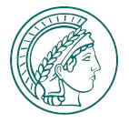


W erosion and redeposition in AUG Ne seeded experiment
M. Rasinski, Ch. Baumann, K. Krieger, R. Dux, A. Hakola, J. Karhunen, V. Rohde, S. Samuli

Slide 2
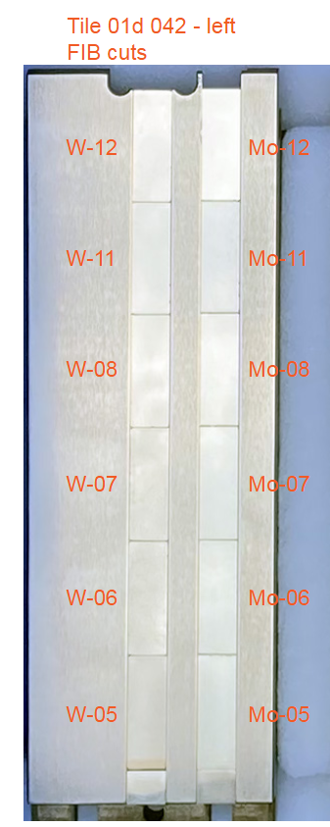
Preparation
2
17mm
On each sample 2-4 FIB cross-sections with line marking were prepared
Cross-section examined after AUG Ne campaign to determine the erosion and redeposition
Results will be used for ERO 2.0 modeling
AUG exposure
H-mode and L-mode D plasma with Ne seeding
Set of W and Mo samples for each experiment
1
2.5mm
6 mm

Slide 3
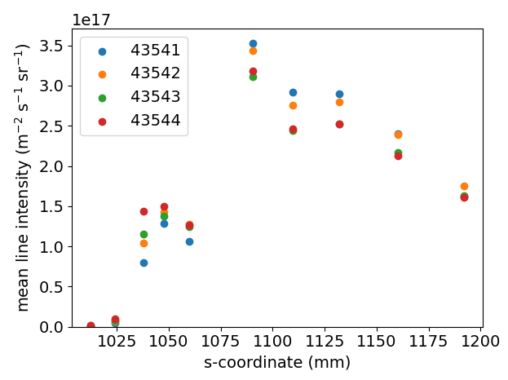
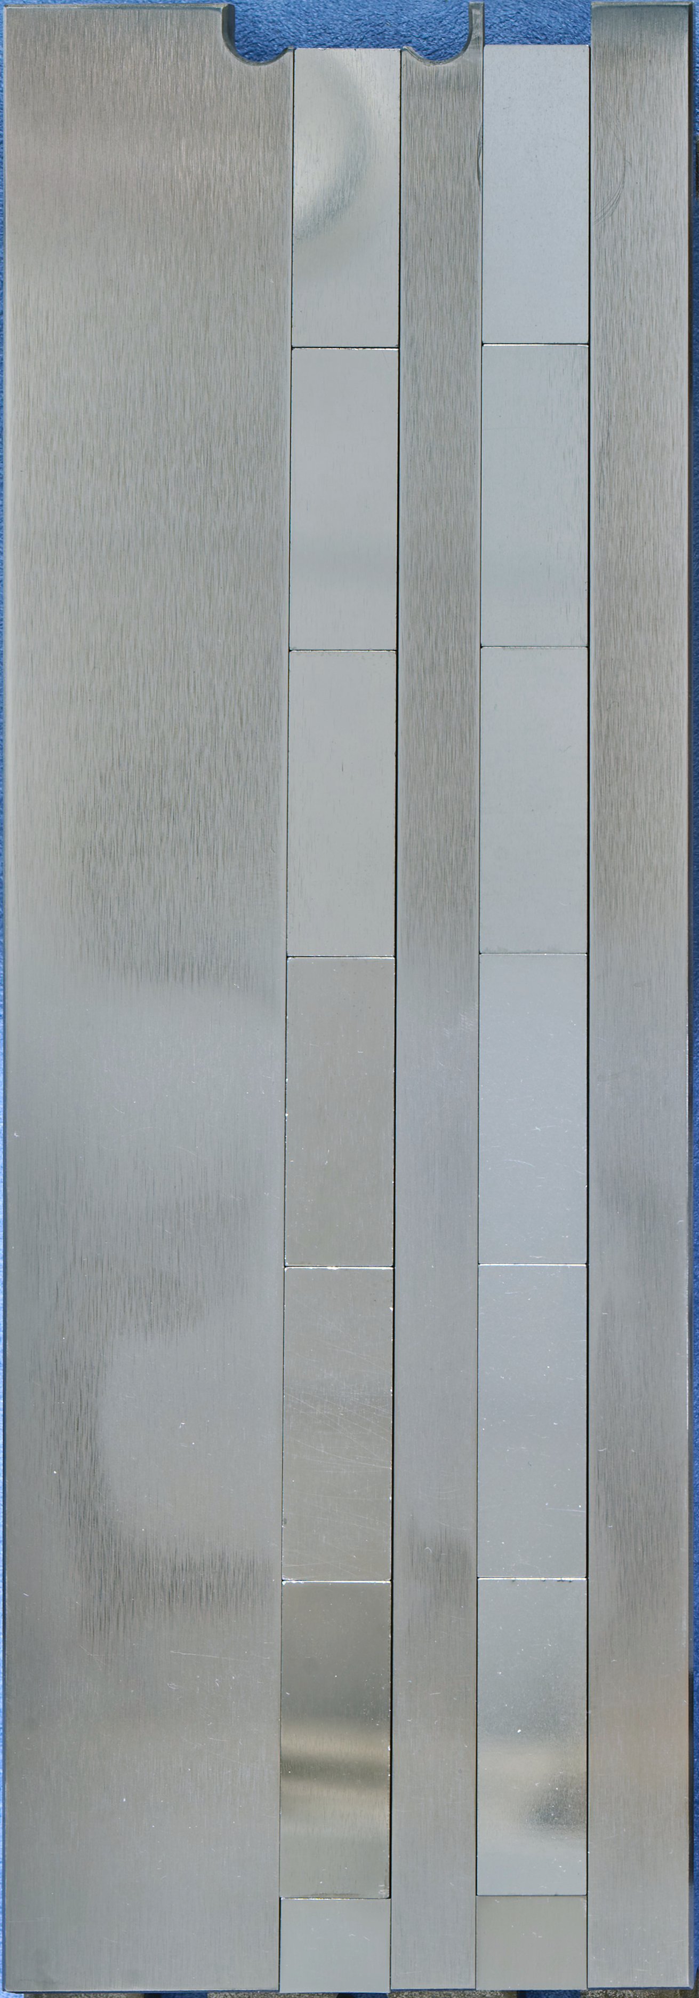
H-mode
W
Mo
H-mode series – Mo I line intensity (5528 A)
VIS
OSP
OSP

Slide 4
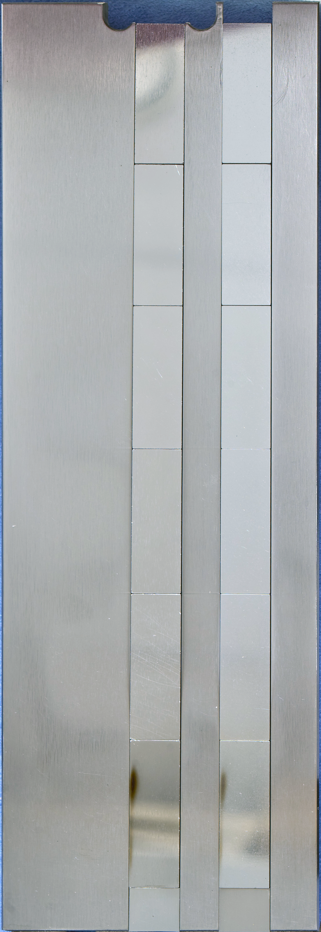
H-mode results
before
after
W
Mo
W
W
Erosion– not possible to measure due to technique sensitivity
Mo
Erosion ~ 80 nm
Mo
80 nm
H-mode
x
x

Slide 5
H-mode results
before
after
W
Mo
W
W
Erosion below 50 nm – not possible to measure due to technique sensitivity
Mo
Erosion ~ 50 nm
Mo
x
x
50 nm
H-mode

Slide 6
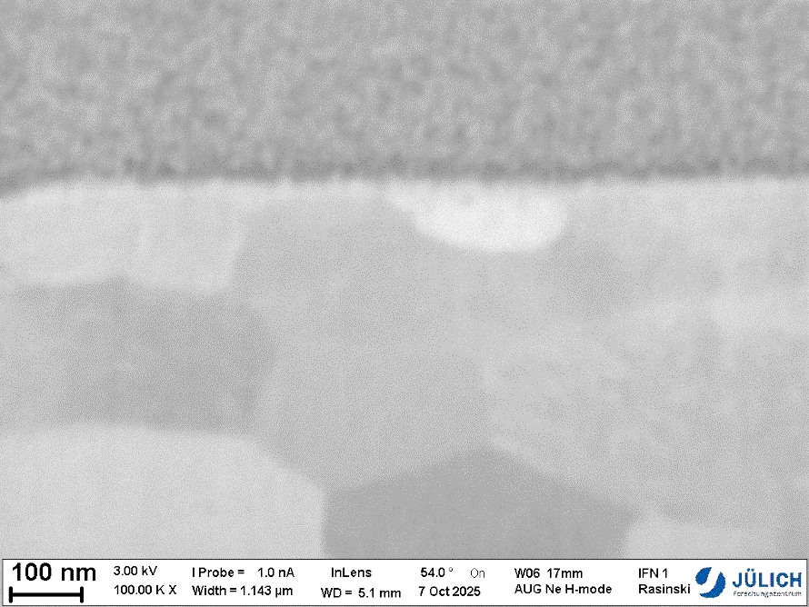
H-mode results
W
Mo
Deposition – thin layer of deposition present on the surface of W, at location above the OSP
The thickness is too thin for detailed analysis using FIB sectioning.
TEM lamella preparation in progress in order to assess the thickness and composition.
x
H-mode

Slide 7
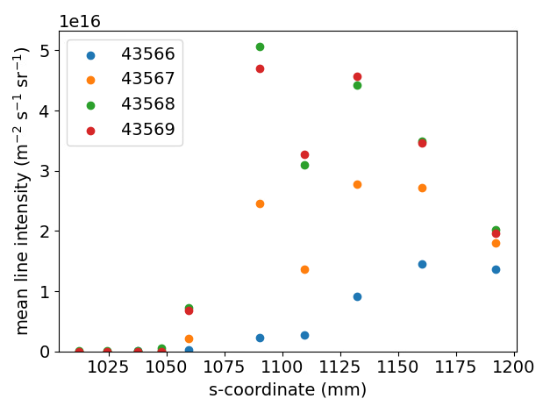
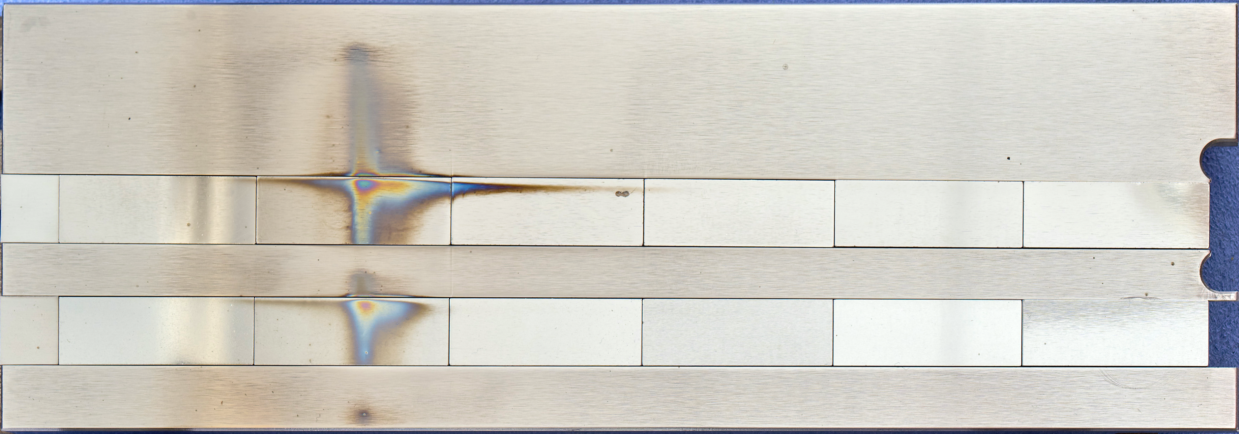
L-mode
W
Mo
L-mode series – Mo I line intensity (5528 A)
VIS
OSP
OSP

Slide 8
L-mode results
before
after
W
Mo
W
W
Erosion – not possible to measure due to technique sensitivity
Mo
Erosion – not possible to measure due to technique sensitivity
No visible surface modification on both W and Mo
Mo
x
x
L-mode

Slide 9
L-mode results
before
after
W
Mo
W
W
Erosion – not possible to measure due to technique sensitivity
Mo
Erosion – not possible to measure due to technique sensitivity
Deposition – present due to disruptions
Mo
L-mode
x
x

Slide 10
L-mode results
a)
W
Mo
230 nm
W
Mo
b)
a)
b)
L-mode
170 nm

Slide 11
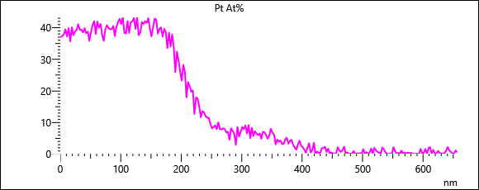
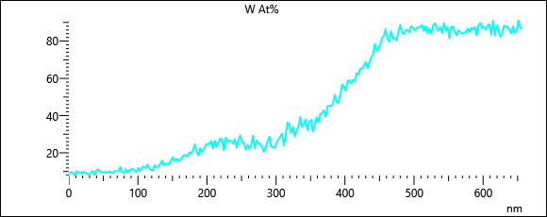
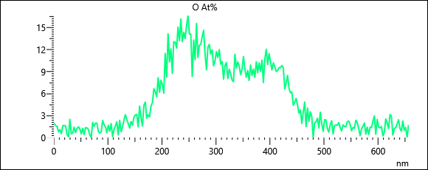
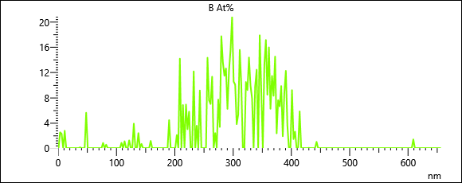
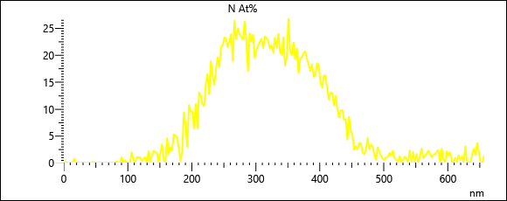
L-mode results
Pt
W
O
N
B

Slide 12

Sp B.1 Exposure of W-nano samples to PSI-2 plasmas
O. Marchuk, M. Sackers, M. Rasinski, S. Brezinsek, A. Houben, M. Klein and A. Kreter
Forschungszentrum Jülich GmbH – Institute of Fusion Energy and Nuclear Waste Management - Plasmaphysik,
Partner of the Trilateral Euregio Cluster (TEC), 52425 Jülich, Germany

Slide 13
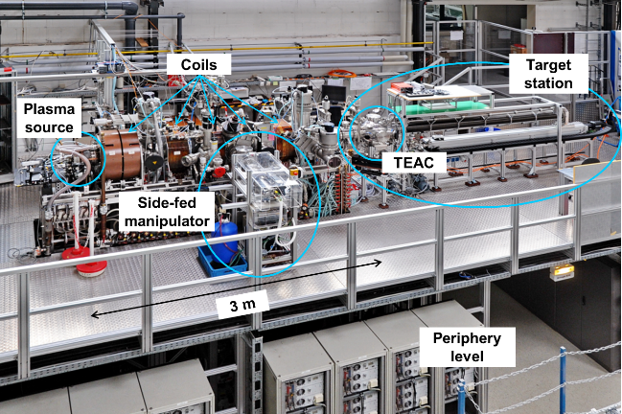
Setup of Psi-2

Slide 14
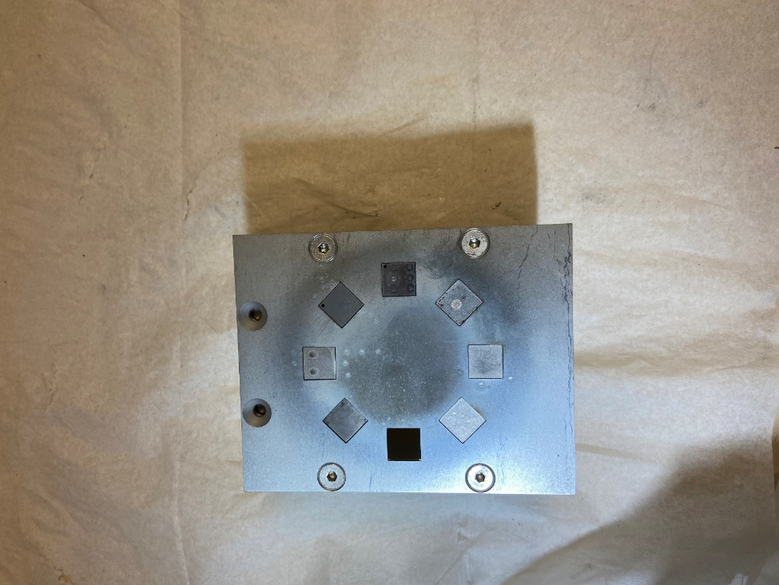
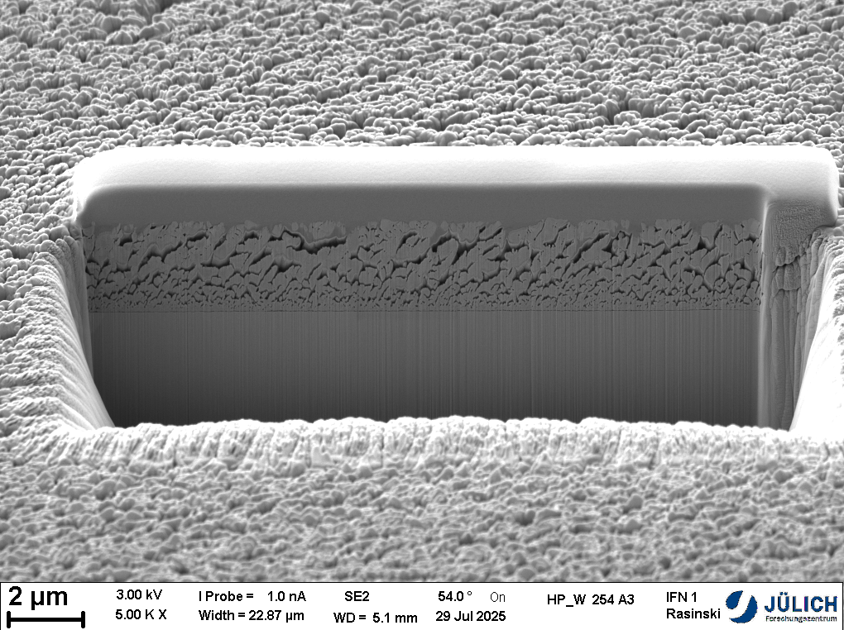
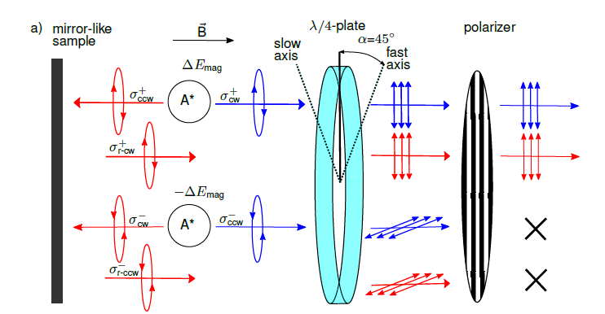
Spectroscopic studies on W-nano in PSI-2
A3 sample (B on W sample) was put to the top
5
The A3 sample was exposed to 25 minutes in Ar
Front optics of the LOS (#5, along the normal to the target) :
Two type of lines:
direct photons
reflected photons

Slide 15
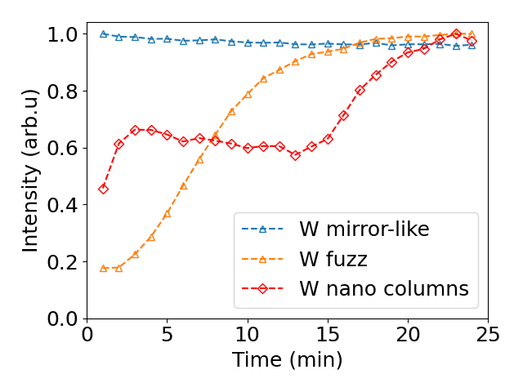
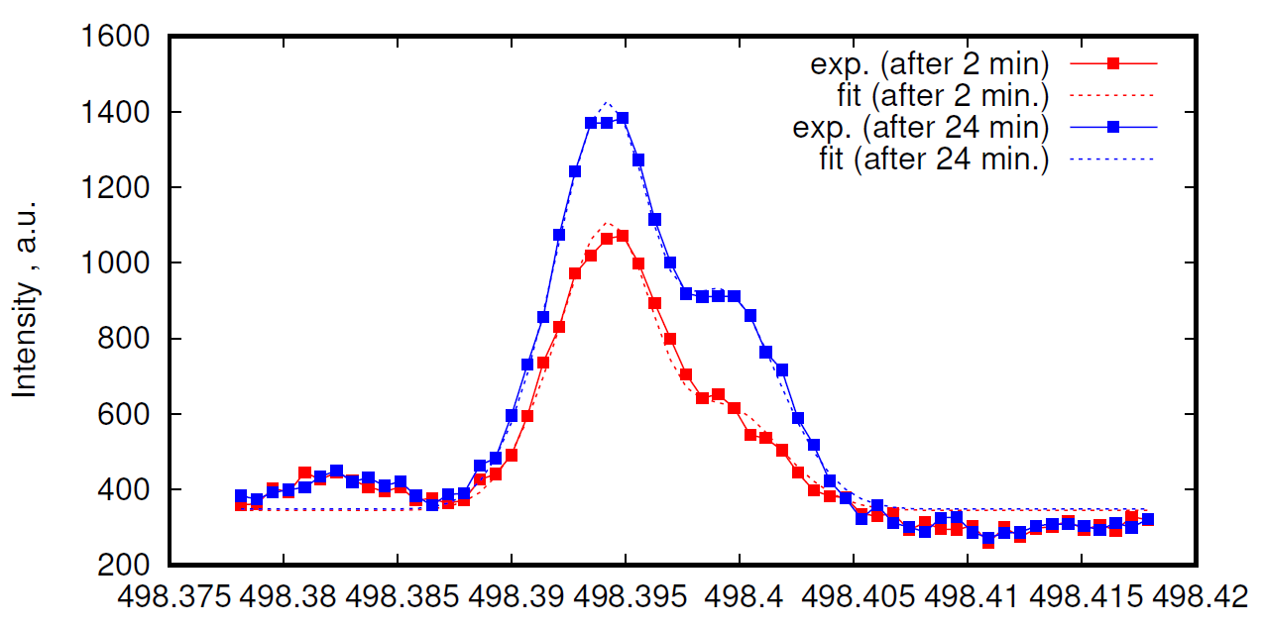
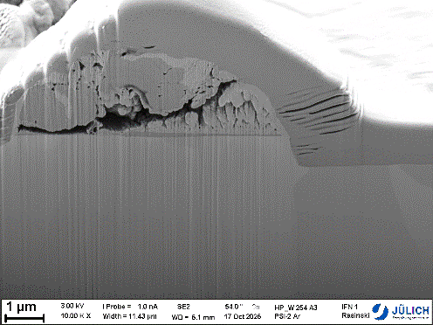
First results (A3)
Variation in intensity /Sputtering yield
Variation in reflectance /optical properties
Wavelength, nm
SEM image of the surface and cross-section after PSI-2 exposure. Spot with coating leftover presents lower erosion rate as compared to bulk surrounding.

Slide 16
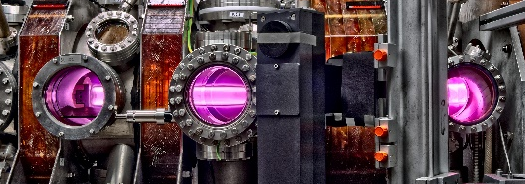
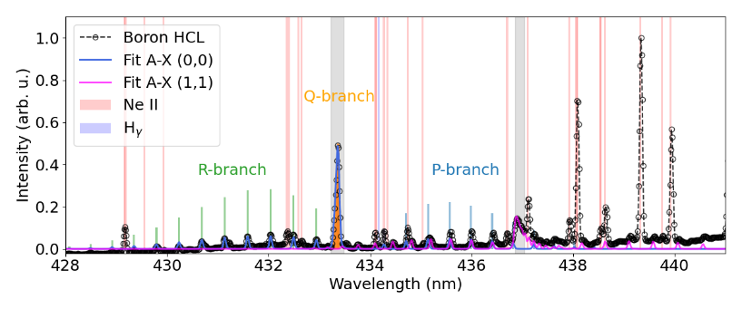
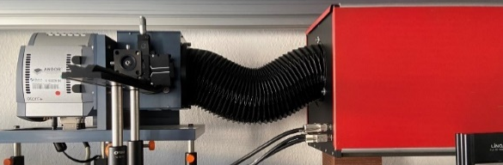
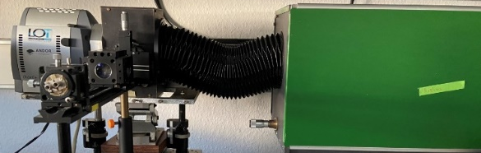
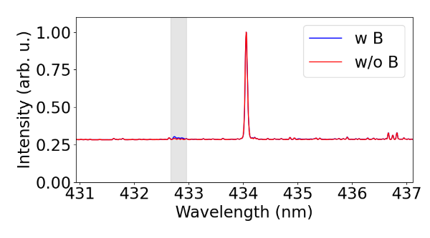
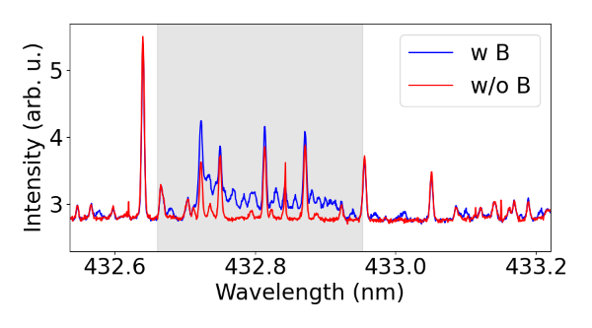
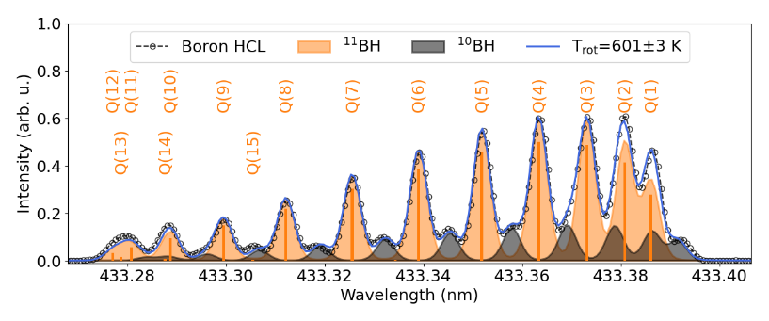
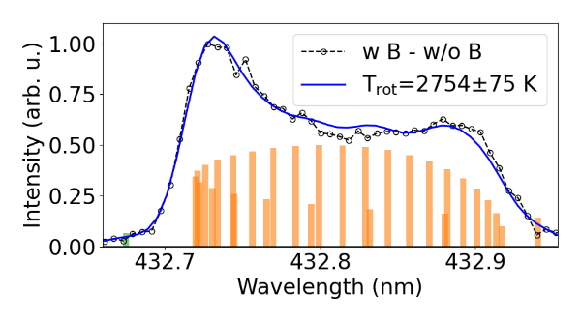
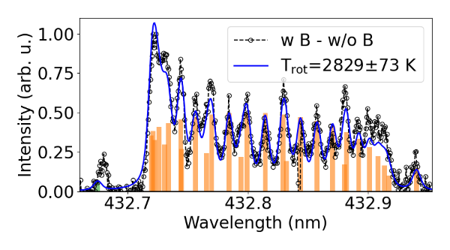
Example of Molecular spectroscopy: BD A-X (B on W)
PSI-2
Calibration
Overview Littrow
High-resolution Littrow
Hγ
Excellent agreement at several spectral resolutions
Marcin Rasiński | WPPWIE Review Meeting 2025 | Page 16

Slide 17
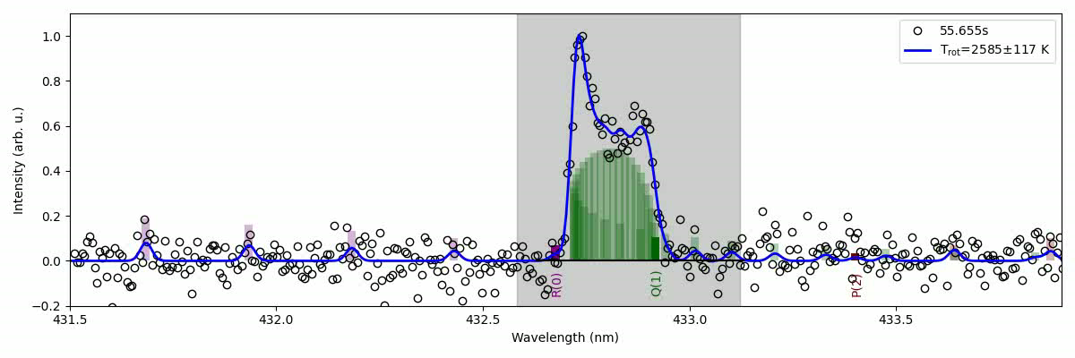
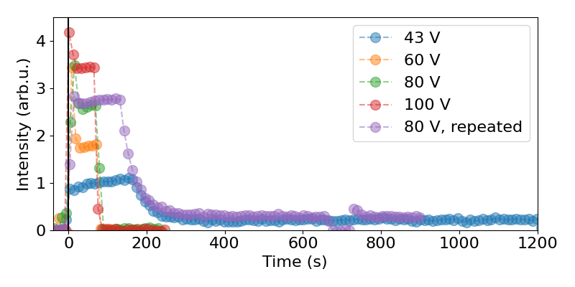
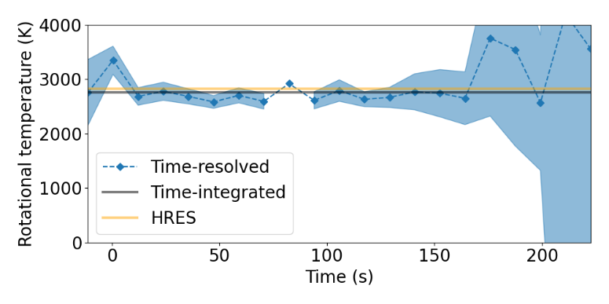
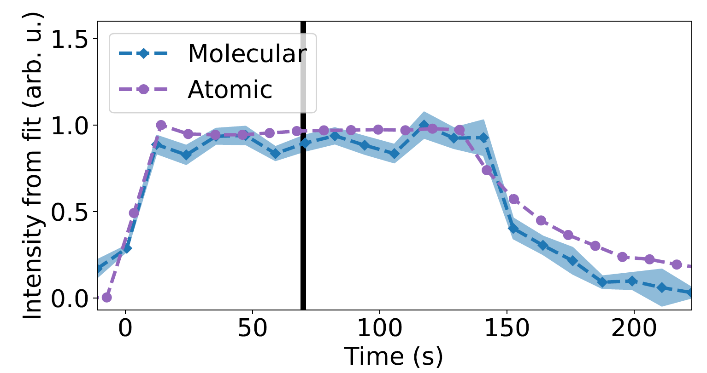
Molecular spectroscopy: time-resolution
Sackers M et al, NME 45 (2025)
B I 250 nm
Marcin Rasiński | WPPWIE Review Meeting 2025 | Page 17

