Slide 1
Review of previous characterization of collected dust particles from different machines
Marek Rubel
With very important contributions from nearly 70 colleagues coworking on the topic for over 40 years

Slide 2























This talk could be prepared thanks to the work of many, many colleagues.
Thank you!
B. Emmoth†, H. Bergsåker, N. Almqvist, J.R. Drake, J. Malmberg, M. Cecconello, D. Hasselbrunner†, H. Ferm, A. Hedqvist, P. Sundelin, P. Petersson, D. Ivanova, A. Weckmann, P. Ström, A. Garcia-Carrasco, S.W. Moon, L. Dittrich, E. Pitthan, D. Primetzhofer, D. Gautan
P. Wienhold, M. Freisinger, H. Reimer, V. Philipps, G. Sergienko, A. Huber, E. Wessel, H. Penkalla, M. Rödig, W. Biel, J. Linke, S. Brezinsek
E. Fortuna-Zaleśna, M. Psoda†, J. Grzonka, T. Płociński, A. Balcerzak
J.P. Coad, A. Widdowson, G.F. Matthews, A. Baron-Wiecheć, I. Jepu, A. Zayachuk
N. Ashikawa, T. Otsuka, Y. Hatano, Y. Torikai, S. Masuzaki, K. Osobe, M. Oyaidzu, N. Asakura, T. Hayashi, M. Hara
B. Pegourie
S. Fazinić, I. Božičević Mihalić, G. Provatas, T. Tadić
C. Lungu, C. Porosnicu
J. Varju, J. Adamek, M. Hron
L. Dittrich, C.P. Dhard

Slide 3
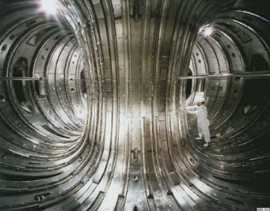
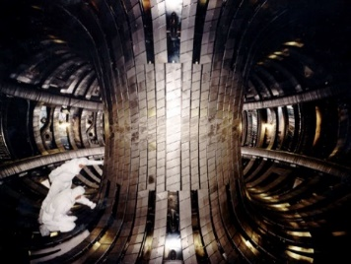
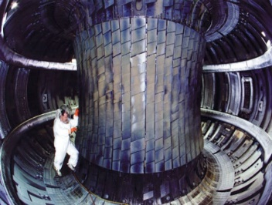
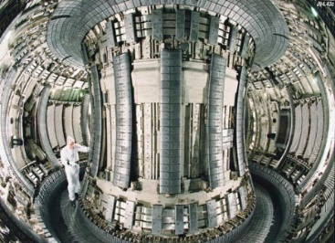
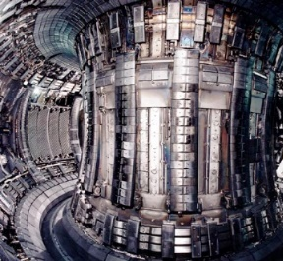
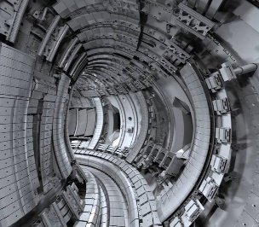
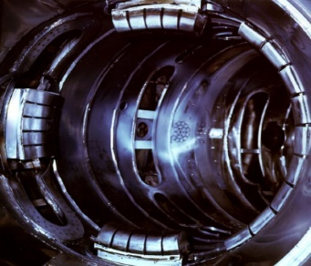
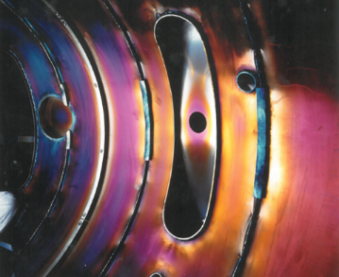
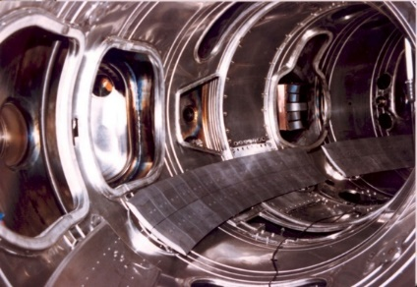
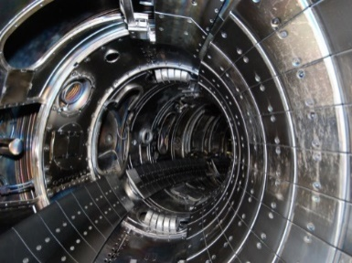
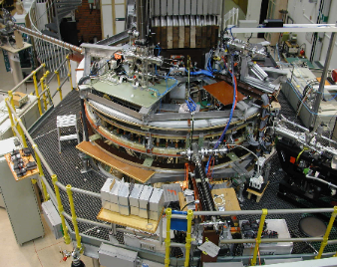
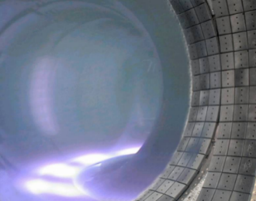
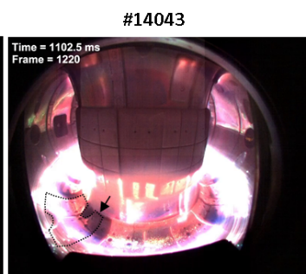
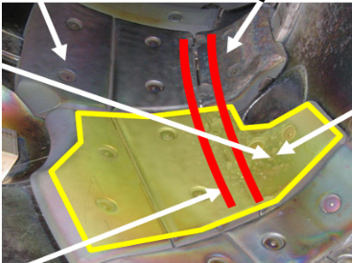
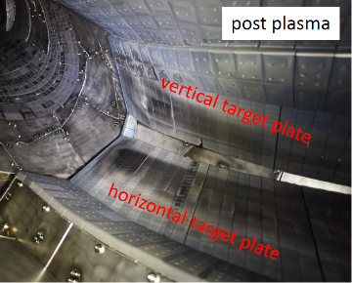
Studies over the years 1984 - 2025: The devices
1983
1987
Graphite cladding and belt limiters
1989-1992
1994-1995
1997-1998
2011- 2023: ILW
JET
TEXTOR
EXTRAP-T2
Tore Supra
COMPASS
Graphite
cladding
c
d
Be
a
b
Mk-IIA
Limiters & wall: all metal
Beryllium: limiters and open divertor Mk-0
Mk-I
e
W
i
1982
a
1986
b
c
Graphite poloidal & toroidal limiters
h
Metal liner and metal poloidal limiters
With Dynamic Ergodig Divertor
Carbonised wall
1988
2013
C wall
W7-X

Slide 4
Interest in Dust
Driving force in studies: Safety & economy of reactor operation
Safety hazard: ignition, H₂ generation, Be, tritiated matter
Impact on operation:
mobilization (disruptions),
degradation of optical diagnostics,
impact on pumping systems.
Dust/metal splashing studies started in 1984 (e.g. JET),
very systematic studies since 1997 (TEXTOR, JET)
Key points:
quantity and fuel retention properties,
behaviour in plasma.

Slide 5
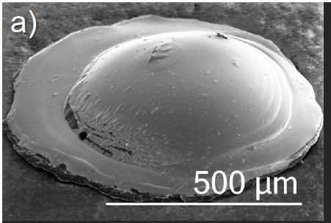
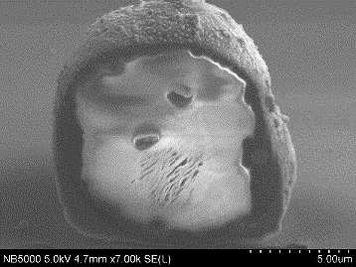
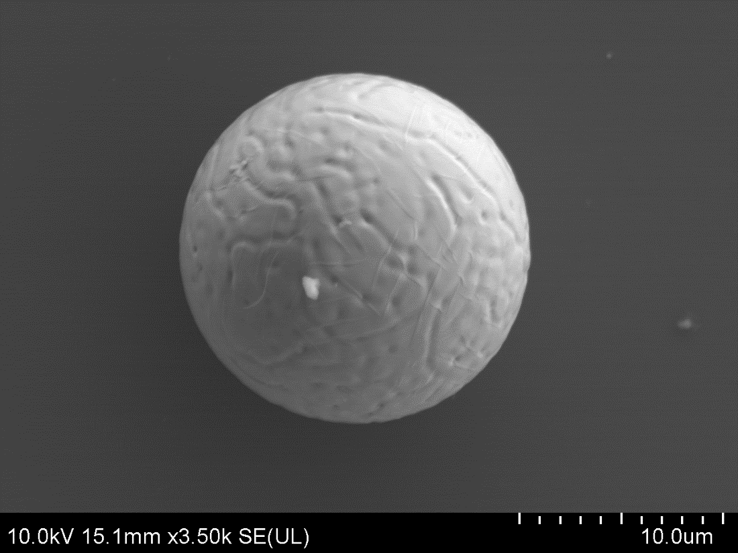
Dust is fascinating
PARTICLE FROM A DIESEL ENGINE
A mix of everything
Inconel
Dr. Tricard, ELF Acquitaine, France
Boiling Be ”hives”
W sphere
empty inside
Be-rich tubes
10 μm
2 μm
r: 7.5 µm
V: 1767 µm³
There will be many pictures, but this work is far beyond ”picturology”.
Dust is unpleasant, difficult in handling, in many cases just dangereous.

Slide 6
Integrated / Holistic Approach
Dedicated
in-situ
&
ex-situ experiments
Dust diagnosis in plasma
Ex-situ analyses
Impact on diagnostic components
Collection
and retrieval methods
Mobility under machine
maintenance
Fuel (tritium)
retention studies
Mechanism of formation/
generation
Quantity assessment
Dust generation under laser impact
Moisture impact on dust generation

Slide 7
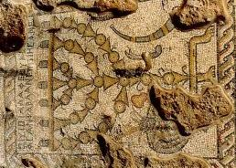
IR Cameras
Fast Cameras
In-Vessel
HR Imaging
Optical
spectroscopy
Performance of Optical
Components:
Mirrors
Windows
Long Distance
Microsccopy
Magnetic
Diagnostics
Marker
Techniques
Thermocouples

Slide 8
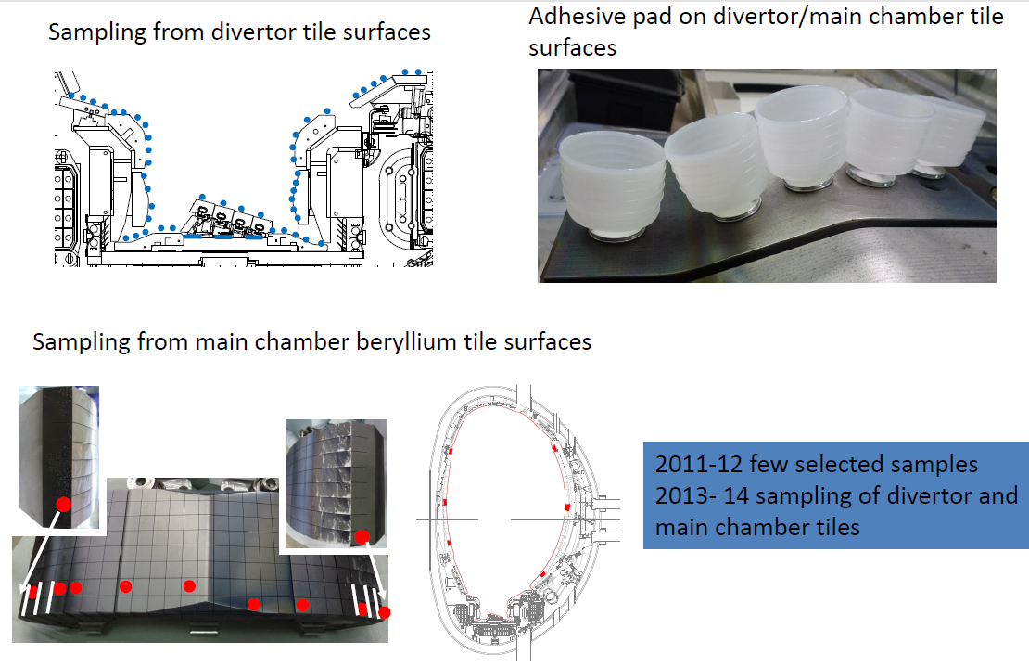
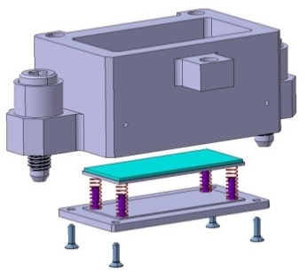
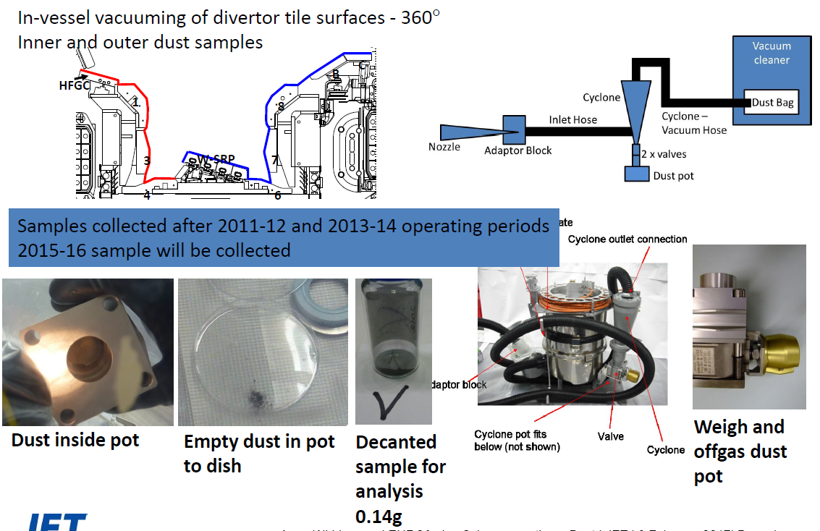
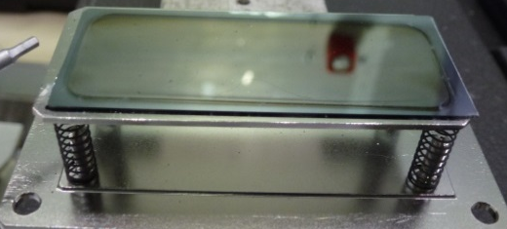
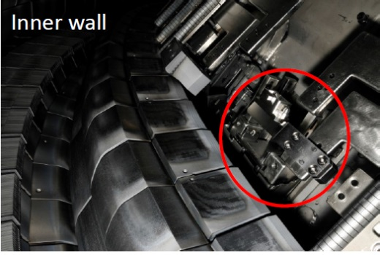
Dust Collection: Facts, Advantages, Drawbacks
Vacuum cleaning: 360 º
Local sampling: sticky pads
Dust monitors
Silicon plate
Messages:
Fairly small amount sampled.
Good adherence of particles to tiles.
Message:
Around 1 g found after each campaign (20 h of plasma)
Drawbacks:
Composition: a mix of all particles.
Not possible to associate dust morphology with a place of collection.
Advantage: Detailed local analyses.
Drawbacks:
The top layer of samples represents
the bottom of deposits.
Force is applied during the collection;
more than just dust may be collected.
Message:
Tiny amount collected.
Advantages:
Collection of undisturbed mobilized particles.
Precise analyses.

Slide 9
AMS
Raman
µ-RBS
TEM
STEM
ICPOS
EPMA
LSC
Radiography:
BIX
SIMS
MS
Full
Combustion
OM
Colorimetry
XRD
XPS
STM
Radiography:
Imaging plate
µ-NRA
TDS
Laser
Profilometry
AES
FIB
AFM
µ-PIXE
GDMS
SEM
µ-EPS
EELS
WDS
ERDA
HIERDA

Slide 10
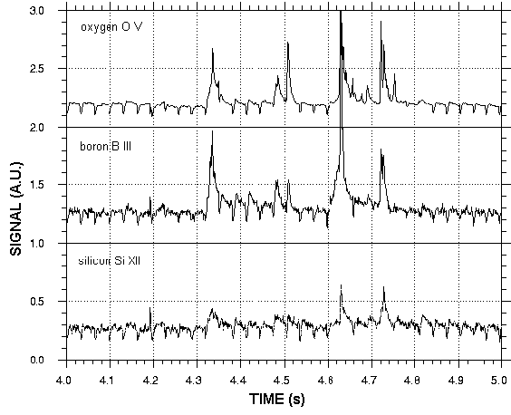
TEXTOR plasma: detachment of co-deposits
A debris motion caused by the rocket effect.
Time sequence showing a cloud of particles
Dust release is immediately
detected by spectroscopy.
4.64 s
4.66 s
4.70 s
4.74 s
(b)

Slide 11
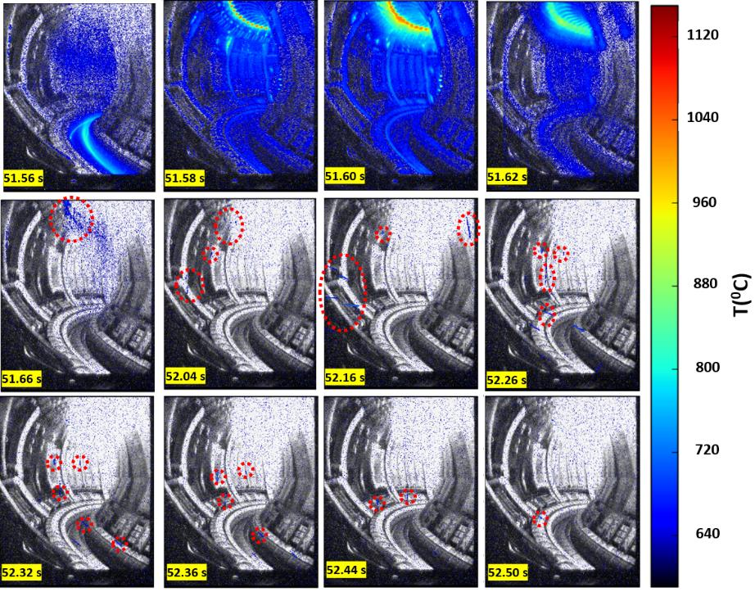
JET-ILW: Beryllium melting and splashing. A rain of droplets from the upper limiters
#84832

Slide 12
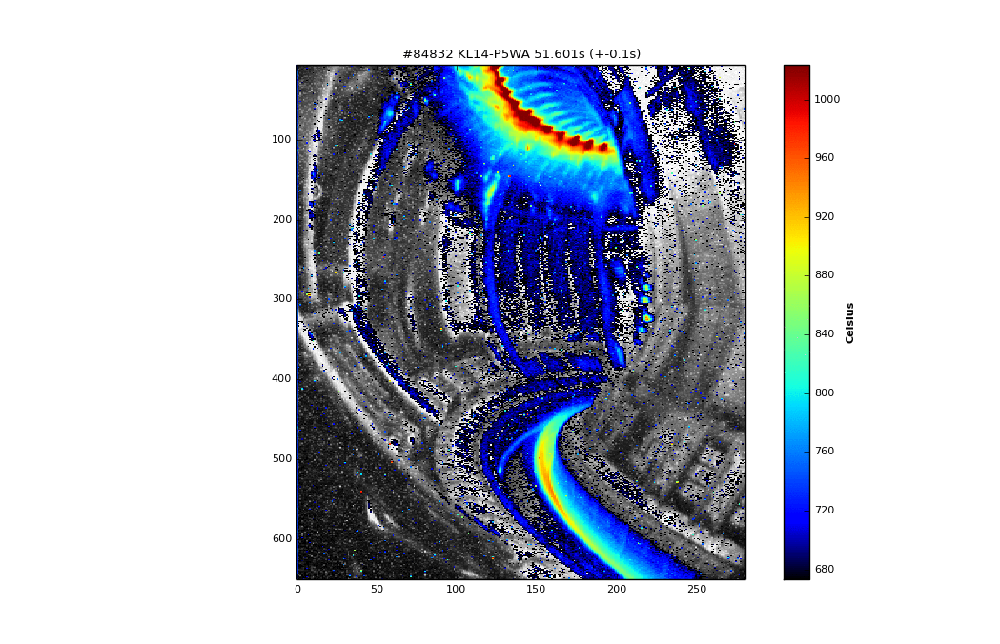
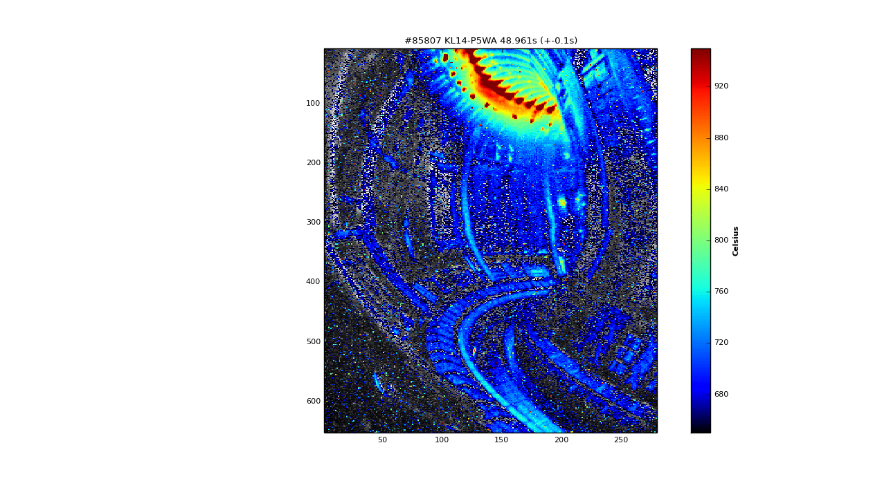
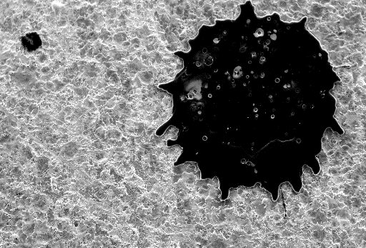
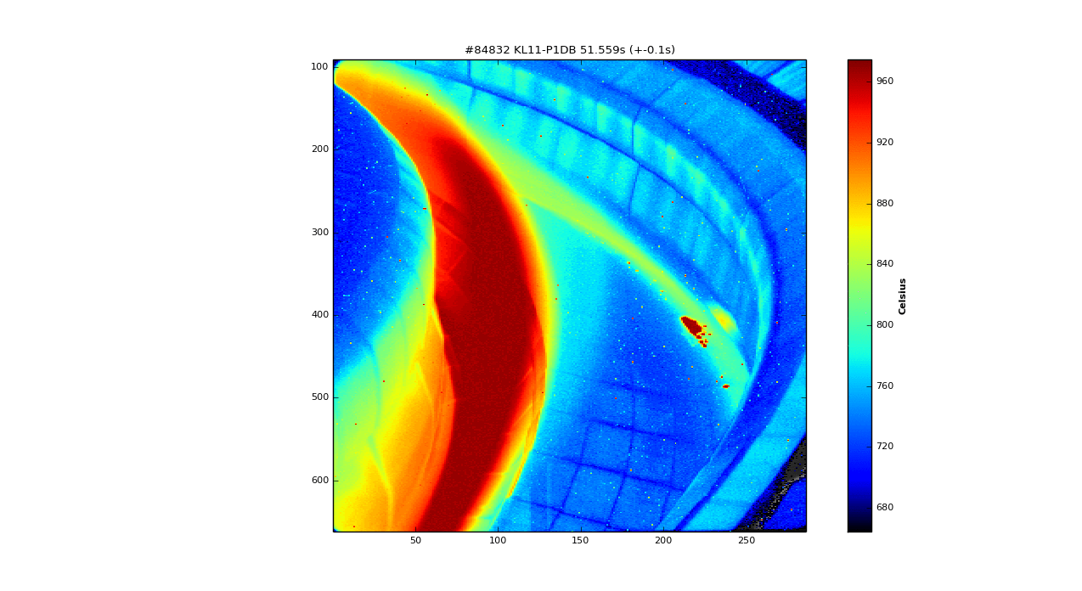
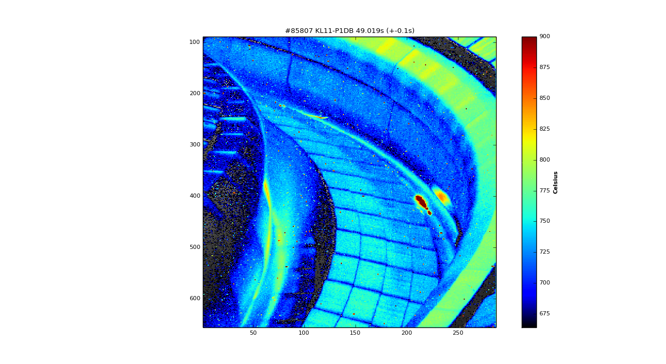
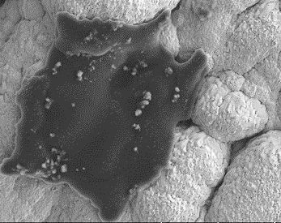
Beryllium splashes
#85807
On dust monitors
80 μm
#84832
On a diagnostic mirror
500 µm
On the outer divertor tiles
e
30 µm
Messages:
Be droplets and splashes adhere fairly well to surfaces.
Splashes are mostly round and only very thinly coated by deposits ➔ ”rain” of fine droplets at right angle from dump plates in the run-away experiment, last in ILW-2.

Slide 13
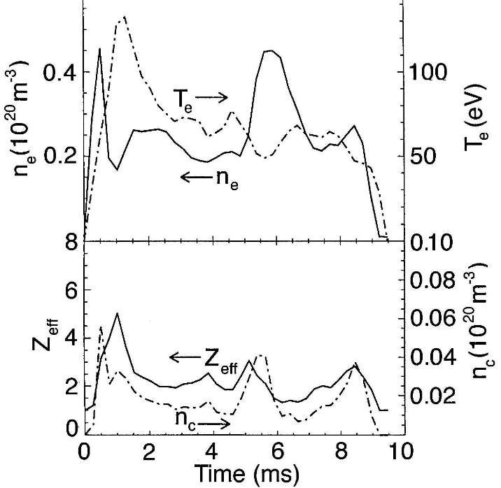
Brittle destruction of carbon by wall locking modes at the EXTRAP-T2 RFP device
Magnetic diagnostics
A burst of particles is caused by wall locking mode → extreme local energy deposition.
Particles’ release from the wall is accompanied by a drastic increase of all spectroscopy signals: n_{e} T_{e} Z_{eff} n_{carbon}

Slide 14
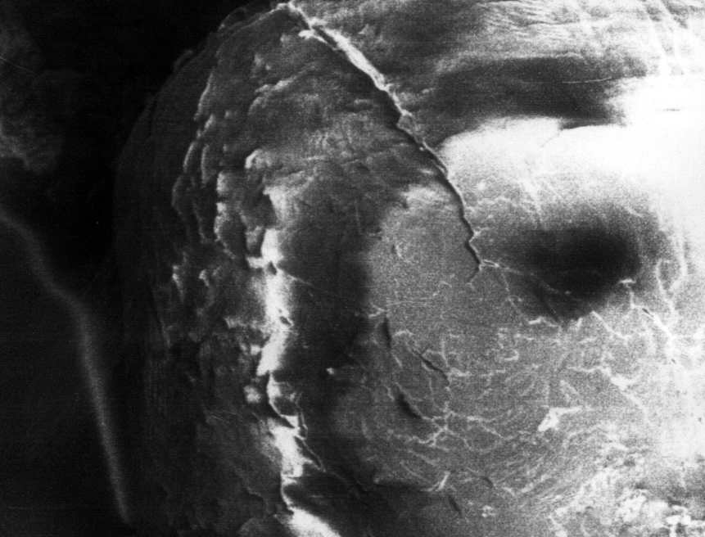
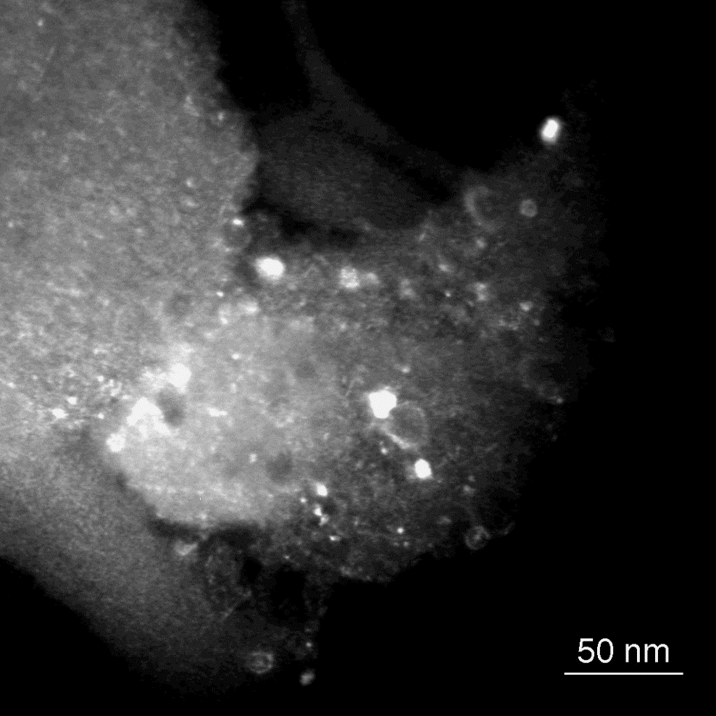
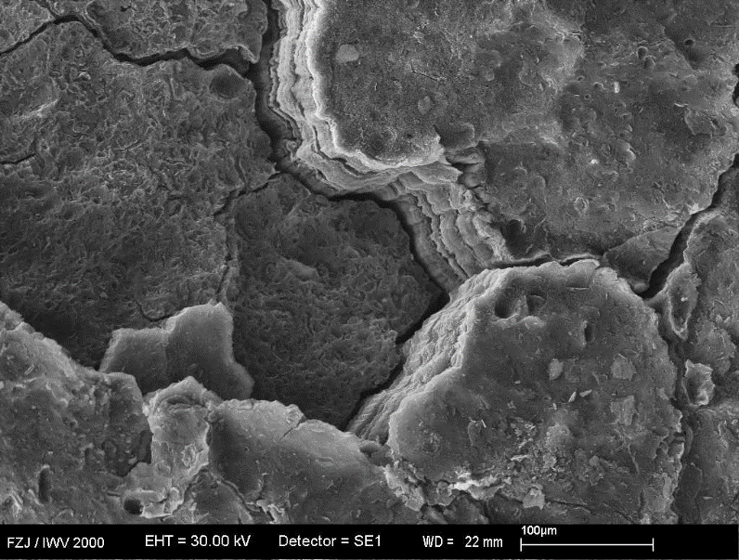
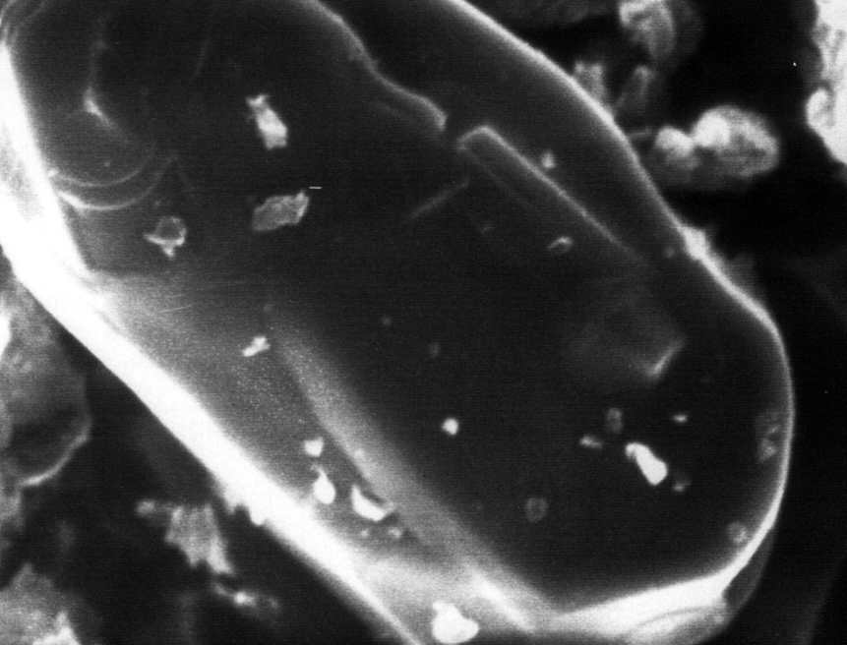
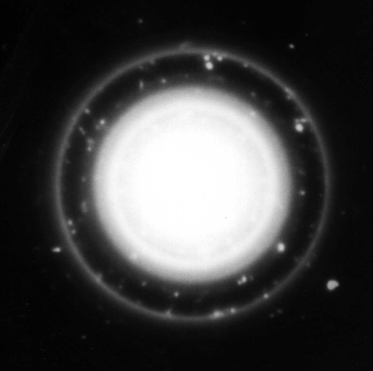
Extrap-T2 RFP: crystalline debris and co-deposits
a
(
15 μm
b
Large graphite debris (2 mm) with a co-deposit.
(b)
15 μm
Debris after passing through the plasma.
Dark field image of a co-deposit with embedded crystallites (bright spots) and a diffraction pattern.

Slide 15
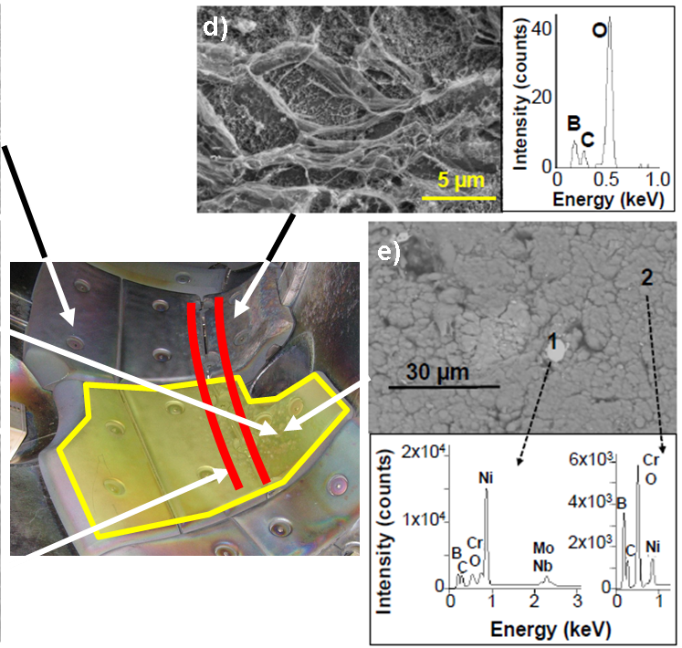
Carbon-based polymer-like films. Precursors of co-deposits?
20 µm
20 µm
TEXTOR
20 µm
EXTRAP-T2
COMPASS

Slide 16
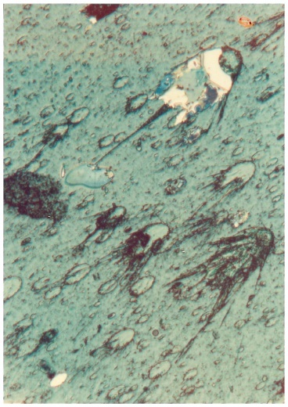
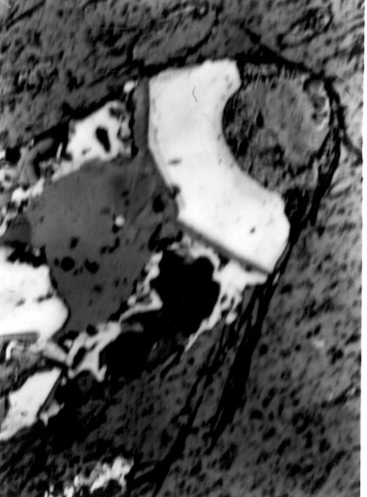
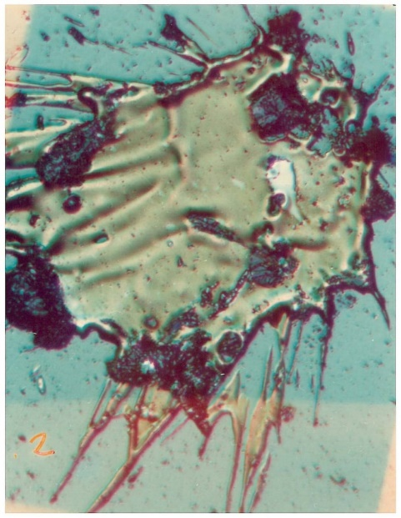
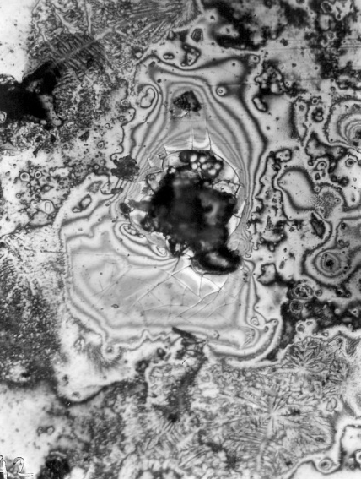
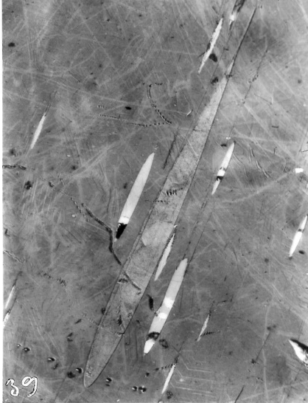
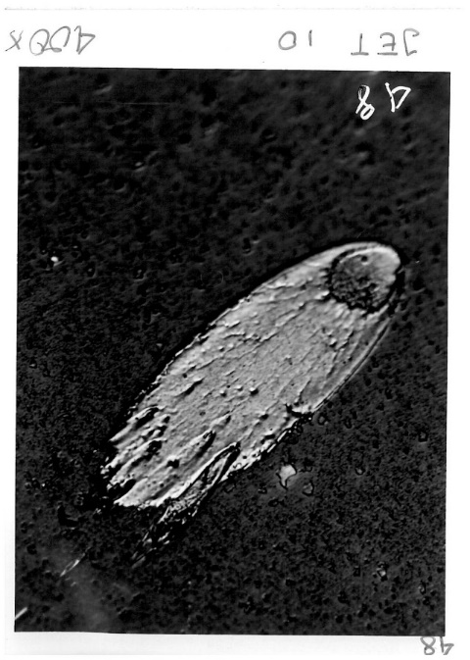
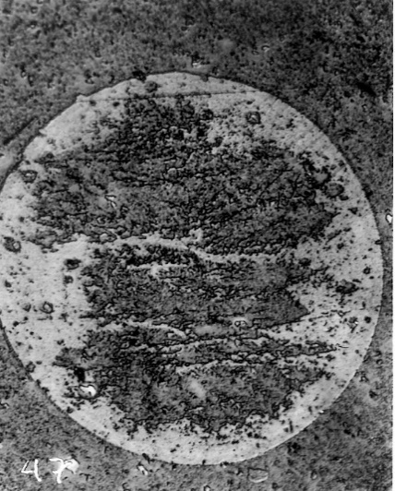
Metal splashes: JET with full metal wall (1984)
Limiters & wall: all metal
1983
500 μm
125 μm
125 μm
200 μm
600 μm
125 μm
125 μm

Slide 17
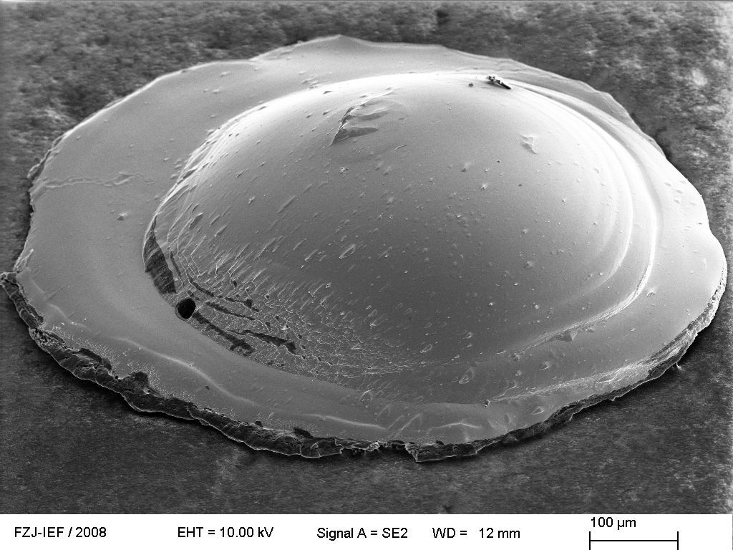
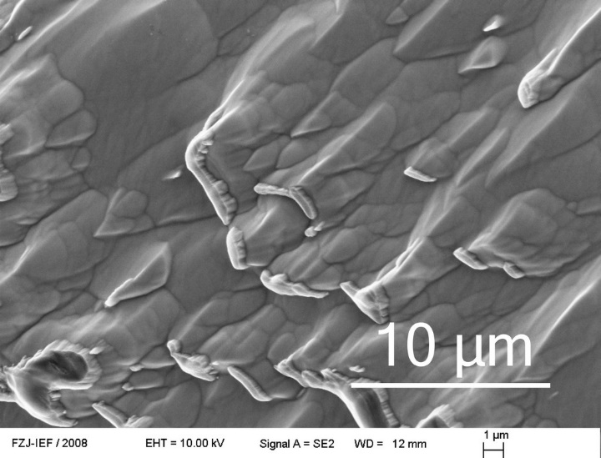
Metal splashes: TEXTOR
Inconel splash on the graphite limiter.
Origin: the liner or the ICRH antenna grill.
Arc track
v
ω
112 µm
X
Rotation of molten
material after splashing.
300 μm
b
c
Carbon deposits

Slide 18
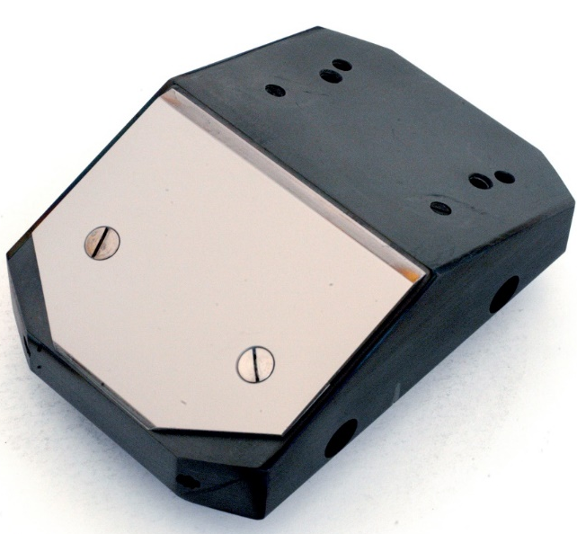
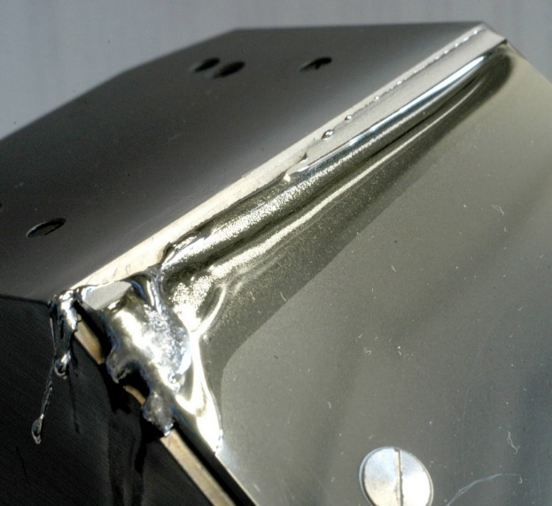

Metal melting & splashes: What about tungsten?
Dedidated experiments on W melting
TEXTOR: Test limiter with W plate)
JET-ILW: special lamella in bulk W divertor
G. Sergienko et al.,
Phys. Scr. T128 (2007) 81
J.W. Coenen et al., JNM 463 (2015) 78
W plate, 2 mm thick
Evolution of melt damage.
No single loose W droplet has been found on that damaged piece and on the adjacent lamellae.
Nothing in other regions of JET-ILW.
W droplets in the melt zone.
No W droplets found in the collected debris.
Melt zone

Slide 19


Metal melting & splashes: What about tungsten?
JET-ILW: Langmuir probes
Deficit of W: blown out?
Boiling W
No single loose W droplet found in the matter retrieved from JET-ILW.
Exfoliation of the
overheated surface?

Slide 20
Metal melting & splashes: What about tungsten?
JET-ILW: Langmuir probes
> 0.5 µm
> 0.5 µm
Metal exfoliation in the overheated region. This may be a real contributor in the W erosion.
Are these pure W flakes or …?
LP26, Tile 6, 16BW

Slide 21



Comparison of W and C flaking. Identical?
W
JET-ILW
> 0.5 µm
~ 15 000 s of plasma operation
Top surface
C
TEXTOR
43 μm
Single
flaking
layer
170 nm
Cross - section

Slide 22


W melting: Castellated W test limiter in TEXTOR
Deliberate melting.

Slide 23




W melting: Castellated W test limiter in TEXTOR The role of chemistry in W transport.
melt zone
1500
W
b
W
Toroidal
gap
W
WO₂
WO₂
W + WO
1000
Cu
2
Intensity
WO₂
W + WO
2
W
Cu base
500
Poloidal direction
Cu
WO₂
Cu
0
30º
40º
50º
2 Θ scale
Evolution of signals when melting occured at 2.34 s.
WO₂
W
10 μm
What is the source of oxygen?
O₂ or H₂O desorption from bulk Cu or W?
WO₂ “leaves”

Slide 24



Categories of dust in JET-ILW
ITER not relevant
Be flakes of coatings from inner wall cladding tiles
Debris of CFC or BN (probes heads)
W-Mo coatings from CFC
Small debris, flakes not molten.
Partly molten (glassy structure)
Spheroids by aggregation of W flakes .
ITER relevant
Be-rich flakes of co-deposited layers
Be droplets and splashes
W droplets and splashes
Steel (and Inconel) droplets and splashes e.g. from antennae grills
Swarf from in-vessel work
Cu chunks from NBI systems, etc
5 μm
5 μm
2 μm
Formation phase

Slide 25
Fuel tracing in individual dust particles

Slide 26
JET-ILW: Deuterium in particles on dust monitors
Combination of several methods: µ-NRA, µ-PIXE with SEM and EDX (different laboratories).
Main difficulty: identification of the same study object in the two labs.
Message:
Only traces of deuterium detected in/on metallic dust particles
S. Fazinić et al., Anal. Chem. 90 (2018) 5744; Nucl. Fusion 60 (2020) 126061; MDPI Materials 15 (2022) 08353.

Slide 27
JET-ILW: Deuterium in particles on dust monitors
Messages: Deuterium presence is amainly associated with carbon.
In quantitative terms, the D content even in C dust is small, 0.01-0.05 (also experience from TEXTOR)
S. Fazinić et al., Anal. Chem. 90 (2018) 5744; Nucl. Fusion 60 (2020) 126061; MDPI Materials 15 (2022) 08353.

Slide 28



JET-ILW: Tritium in individual particles
Radiography of T in different particles (ILW-1)
Beryllium
Tungsten
Dust particles are placed on In disk.
Composition of individual particles is identified with EPMA (WDS).
Note the scale. 100x more in C than in metals
β ⁻ (T) recorded by radiography.
Superposition of profiles.
Carbon
Message:
T presence is associated with C (legacy from JET-C)
T. Otsuka, Osaka-Kindai U. / IFERC

Slide 29



Boron dust crystals
30 μm
20 μm
4 μm
Precipitation of boron from co-deposit?
T _{plates} ~600 – 700 ºC (thermocouples)
T _{deposit} >2000 ºC (still below T_{m} of B and/or B₄C)

Slide 30
Boron/Boronisation as a marker
A flake of a stratified co-deposit with three boronisation layers: SEM and SIMS.
P. Wienhold et al., JNM 313-316 (2003) 311.

Slide 31
Ion beam analyses of dust from W7-X (VR)
Sample-holder at Tandem Laboratory
Example of data for from sample 209:
Sample from Module M1, Divertor (DU18).
Identified the presence of B, Fe, Cr, and W in sample. Ti, Ni, and Cu also present in tape.
E. Pitthan et al., VR
W originates from a marker tile.
Dust with W is a material transport tracer.
Boronisation with B-10 diborane would contribute to transport studies.

Slide 32

Outlook: Proposal for studies of W7-X dust
Sample-holder at Tandem Laboratory
W7-X dust is deuterium free → good chance for:
stepwise desorption – re-saturation exercise;
H-D isotope exchange
…
SIGMA apparatus for in-situ experiments and measurements.
IBA
Heating to 1000 ºC
QMS
Gas inlets (gas mixing)
Ion source

Slide 33
Extra slides
Sample-holder at Tandem Laboratory

Slide 34
ILW 2011-2012 Dust studies: Beryllium flakes
Dust removed by vacuum cleaning. Studies performed at IFERC- Rokkasho
Top
Messages:
TEM Dark Field images reveal heavy particles (white) of nm size in deposits.
Particles of nm size identified by EDS as Tungsten.
The amount of particles increases towards the top, i.e. rises with the power of the JET-ILW operation.
Large amount of tiny W particles
8.9 μm
Middle – 1 μm from top
Very few W particles
M. Rubel et al., Fusion Eng. Design 2018.
0.4 μm
Bottom
Tile side

Slide 35


ILW 2013-2014: Be splashes on test mirrors
1 cm
5 μm
Droplets or bubbles?
(boiling beryllium)
2 μm
80 μm
Mirror 127, Mo bulk, Main chamber wall
A. Garcia-Carrasco at al. Nucl. Mater. Ener. 2017
X. Litaudon, IAEA-27, Nucl. Fusion 57 (2017)

Slide 36
Tungsten: Droplets (?)

Slide 37



W on dust collector (outer divertor)
10 μm
5 μm
1 μm
V: 0.21 µm³
r: 0.37 µm
V: 131 µm³
r: 3.15 µm
V: 1767 µm³
r: 7.5 µm
Most probably ”spheroids” (shell with empty interior) in the phase of formation by agglomeration of W flakes detached from the coatings.
2 μm
Message: There is no evidence of W droplets which would indicate tungsten melting (either W coatings or Tile 5).
E. Fortuna, M. Rubel, Phys. Scr. 2017

Slide 38
LPs in JET

Slide 39
JET-C and JET-ILW: Tritium in dust
Specific T activities in dust from JET-C, ILW-1 and ILW-3 measured by FCM.
STEP 1: Compare total amount of dust in the JET-C and JET-ILW campaigns
>200 g of dust from JET-C versus 1 g (total) after ILW campaign!
STEP 2: Find the location of tritium.

Slide 40
Categories of dust in JET-ILW
ITER not relevant
Be flakes of coatings from inner wall cladding tiles
Debris of CFC or BN (probes heads)
W-Mo coatings from CFC
Small debris, flakes not molten.
Partly molten (glassy structure)
Spheroids by aggregation of W flakes .
ITER relevant
Be-rich flakes of co-deposited layers
Be droplets and splashes
W droplets and splashes
Steel (and Inconel) droplets and splashes e.g. from antennae grills
Swarf from in-vessel work
Cu chunks from NBI systems, etc
5 μm
5 μm
2 μm
Formation phase

