Slide 1

WP PWIE: SP D Reporting 2025
Andreas Kirschner & SP D task holders
Notes:
Please Indicate your subproject

Slide 2
SP D Deliverables 2025
SP D.1 Plasma Boundary Modelling
D001: Plasma background parameters of WEST for modelling of impurity migration experiments (focus on long-pulse, high fluence discharges, impact of magnetic field ripple and drifts). (CEA) 2PM
D002: Plasma background parameters of MAGNUM-PSI and UPP for modelling of impurity migration experiments (improvement of boundary conditions in particular for UPP). (DIFFER) 2PM
D003: Plasma background parameters of GyM for modelling of impurity migration experiments (focus on Ar plasmas, validation against cross-machine experiments under SP B). (ENEA) 2PM
D004: Plasma background parameters of W7-X (based on OP2.2 and OP2.3) and linear device PSI-2 (plasma source, fluid runs, neutral kinetics) for modelling of impurity migration experiments. (FZJ) 4PM
D005: PIC modelling: sheath for collisional boundary conditions, study of inverse sheath. (IPP.CR) 5PM
D006: Plasma background parameters for JET for impurity migration experiments (consideration of limiter configurations, characterisation of ELMs and SOL flows e.g. for Ni/W migration). (VTT) 3PM
D007: Parametric SOLPS-ITER simulations, optimised divertor operation point (magnetic field arrangement, geometry, and divertor leg length), and exhaust capabilities compared with reference single null divertor (JT-60SA full-C) arrangement. (LPP-ERM/KMS) 12PM

Slide 3
SP D Deliverables 2025
SP D.2 Production of Atomic/Molecular and Surface Data
D001: Dust production from anomalous events and detached divertor conditions, identify possible dust formation mechanisms like nucleation in fusion-relevant plasmas. Cross section determination for neutral and charged W clusters. Connection to exp. data (e.g. dust studies in WEST). (CEA) 2PM
D002: Sputtering and reflection data for surface systems including boron (e.g. W-B, B-O, and other combinations also containing D), including seeding projectiles (e.g. Ar, Kr, Xe). Development of according interaction potentials. (ÖAW) 3PM
D003: Erosion information (SPRAY code, SDTrimSP-3D) of surfaces including morphology, roughness, fuzz. Influence of structure (oriented vs. random) and porosity. Comparison to experiments (e.g. PSI-2) and MD results. (ÖAW) 2PM
D004: Modelling of tungsten gap melting and bridging including comparison to experiments (e.g. from AUG and WEST). Gap melt scenarios for ITER. (VR) 6PM
D005: Sputtering and reflection yields from MD for W, W-D(H, T) and W-B surfaces. Application of more advanced (accurate) (ML, AI) interaction potential for tungsten and boron sputtering/reflection modelling. Comparison to BCA. (VTT) 5PM

Slide 4
SP D Deliverables 2025
SP D.2 Production of Atomic/Molecular and Surface Data … cont´d
D006: Reflection/erosion information of 2D/3D surfaces with focus on lattice effects, comparison to MD simulations and/or experiments. (MPG) 2PM
D007: Sputtering of W-D(H, T) surfaces, release of W-D molecules (study of impact energy and surface temperature). Study of interaction potentials: gauge, which is most reliable. Analyse the effect of electronic energy losses. (VTT) 3PM

Slide 5
SP D Deliverables 2025
SP D.3 Impurity Migration Modelling
D001: SOLEDGE3X-ERO2.0 simulations of tungsten transport in WEST. Determination of main tungsten sources and core contamination in WEST. Comparison with spectroscopy and post-mortem data. One focus on long-pulse, high-fluence discharges and full 3D treatment (antennae, magnetic field ripple). (CEA) 2PM
D002: ERO2.0 simulations of tungsten dynamic morphology studies in GyM with Ar (see also SP B). Global ERO2.0 migration simulations in GyM, also for the design of diagnostics. ERO2.0 modelling of global erosion/deposition experiments in AUG He H-mode scenarios (connected to WP TE SOLPS modelling). (ENEA) 5PM
D003: ERO modelling of ¹³C injection experiments (local) in comparison to post-mortem data in W7-X and steady-state simulations. ERO2.0 predictive modelling for full W environment in W7-X (inclusive role of CX neutrals). ERO and ERO2.0 modelling of W prompt redeposition (focus on JET experiment with varying B field), in combination with sheath characteristics from PIC. Initial simulations of ITER with full-W plasma-facing components and Ne seeding. Modelling of tungsten (prompt) redeposition at inner wall during ITER ramp-up phases. (FZJ) 17PM

Slide 6
SP D Deliverables 2025
SP D.3 Impurity Migration Modelling … cont´d
D004: Predictive material migration in full-W ITER including B transport resulting from boronisation using new SOL plasma solution with self-consistent far SOL. (MPG) 2PM
D005: ERO2.0 simulations of AUG erosion and migration experiments in L- and H-mode D plasma and comparison with experimental data and former simulations. Assess impact of uncertainty of OSP position and plasma conditions. (VTT) 4PM
D006: Self-charging properties for (tritiated) boron dust. (VR) 3PM
D007: ERO2.0 of Ni/W migration modelling in JET. (VTT) 2PM

Slide 7
SP D Deliverables 2025
SP D.4 Neutral Particles Modelling
D001: DIVGAS modelling: effect of 3D poloidal and toroidal leakages for the DEMO baseline SN divertor case including impurities, pVT characteristics (KIT) 4PM
D002: Atomic and molecular fluxes spatially resolved to the wall surfaces (including divertor) in JET. Explore pressure range, sub-divertor geometry and conclusions for effective pumping speed in JET. (VTT) 2PM
SP D.5 Plasma Background and PWI Modelling for COMPASS-U
D001: SOLPS-ITER plasma backgrounds for full-W COMPASS-U H-mode scenarios (gradual consideration of drifts, currents, pump feedback and Ne seeding). Sheath characteristics from PIC simulations, strike-line plasmas. (IPP.CR) 12 PM
D002: Supervision of ERO2.0 modelling. (FZJ) 1PM
D003: SOLEDGE3X plasma backgrounds in comparison to SOLPS-ITER. (CEA) 3 PM

Slide 8
SP D.1 Plasma Boundary Modelling

Slide 9
SP D.1 Plasma Boundary Modelling: CEA
SOLPS-ITER modelling for WEST
G. Ciraolo
D001
3D plasma backgrounds: ripple effect correctly recovered with SOLEDGE3X
  New plasma and wall mesh generated
  Power and density scans performed → results close to the experimental values with ripple effect
  Similar values for T_{e,max} in both SP → feature found in experiments but not present in previous SOLEDGE3X simulations with ripples
  ERO2.0 data analysis on going → post-processing tools generating artifacts with the new meshes
More details: talk by D. Sales de Oliveira

Slide 10
SP D.1 Plasma Boundary Modelling: DIFFER
SOLPS-ITER modelling for UPP and MAGNUM-PSI
E. Westerhof,
H.J. de Blank
D002
SOLPS-ITER modelling of relevant range of UPP and Magnum-PSI discharges are continuing
Still: SOLPS-ITER modelling of UPP relies on the existence of measurements of radial density and temperature profiles in the Magnum-PSI beam at same source parameters (gas flow and current) and magnetic field …
… or adjusting boundary conditions of UPP-simulations iteratively to fit UPP's profile measurements which are halfway the beam, not at the boundary of the computational domain.
Aim: these two approaches should lead to a parametrization of UPP source boundary conditions based on the source parameters and magnetic field.

Slide 11
SP D.1 Plasma Boundary Modelling: ENEA
SOLPS-ITER modelling of Ar plasmas in GyM
M. Passoni
D003
Approach
Optimise SOLPS-ITER simulation setup for Ar plasma investigation in GyM
Validate SOLPS-ITER against experimental plasma profiles
Exploit validated SOLPS-ITER simulations as a testbed for 0D models
Results
Parametric scan performed: absorbed power identified as main driver for electron density and ionization degree. Pumping speed set to reproduce neutral pressure at baratron position.
Post processing: low-ionized plasma (α ≃ 0.02), dominant ionic species is Ar⁺, complete thermal decoupling between electrons and ions/neutrals.
Tested 0D plasma models provided good agreement against optimised SOLPS-ITER simulations for electron and neutral densities, electron temperature and ionisation degree (deviations < 30%) over a wide parametric scan.
More details: talk by G. Alberti

Slide 12
SP D.1 Plasma Boundary Modelling: ENEA
SOLPS-ITER modelling of Ar plasmas in GyM
M. Passoni
D003
Comparison betweeen Langmuir probe and optimised SOLPS-ITER radial plasma profiles
F. Mombelli, A. Uccello, M. Passoni
More details: talk by G. Alberti

Slide 13
SP D.1 Plasma Boundary Modelling: FZJ
EMC3-EIRENE plasma backgrounds of W7-X
S. Xu
D004
EMC3-EIRENE modeling with Nitrogen seeding based on experiments in OP2.3. (#XP_20250522.*)
Input:
P_{in} = 3.5 MW
D⊥ = 0.5 m²/s
χ⊥ =1.5 m²/s
n_{LCFS}= 2.7E13 cm⁻³
Impurity:
C from divertor: sputtering yield 4%
N from seeding: P_{_imp_N}= 0 MW, 0.5 MW, 1.0 MW

Slide 14
SP D.1 Plasma Boundary Modelling: FZJ
EMC3-EIRENE plasma backgrounds of W7-X
S. Xu
D004
Heat flux distribution at divertor
depending on N seeding flux

Slide 15
SP D.1 Plasma Boundary Modelling: FZJ
PSI-2 simulations using SOLPS-ITER
D. Reiser
D004
Basic Steps to a Running System for PSI-2 Simulations:
Examples for starting guesses for sheath:
Installation of Code Package
Preparing Geometry Input
Test Run B2.5 Standalone
Preparing Visualization Tools
Preparing Source Input Files
Adjustment of Physics Parameters
B2.5 Standalone Runs
B2.5-Eirene Runs
Densities vary only about a factor of 2, exception: run3 with negative biasing
More details: talk by D. Reiser

Slide 16
SP D.1 Plasma Boundary Modelling: IPP.CR
Simulations of emissive sheaths in SPICE2
D. Tskhakaya
D005
Simulations of ITER-relevant intra-ELM plasmas at hot W PFCs including electron thermionic emission (TE), secondary electron emission (SEE) and electron back-scattering (EBS)
The objective: characterize the magnitude of escaping electron current, which is an important input to MEMENTO code and better understanding of the emissive sheath
At grazing angles the electron prompt re-deposition is essential; from [Costin SciRep 2021]
Outcomes:
We have validated the Costin formula
We found a semi-empirical relation between the net electron yield Y and the surface E field
M. Komm, S. Ratynskaia, P. Tolias, A. Podolnik

Slide 17
SP D.1 Plasma Boundary Modelling: VTT / Aalto U
JET He plasmas
M. Groth
D006
Horiz. and vert. target configuration, 1-5 MW → ERO2.0 for W sputtering, transport
SOLPS-ITER underpredicts the total radiation (helium emission) by 2x, consequentially, overpredicts total heat flux to low-field side plate by 2-3x
D. Rees

Slide 18
SP D.1 Plasma Boundary Modelling: VTT / Aalto U
JET He plasmas
M. Groth
D006
SOLPS-ITER underpredicts the total radiation (helium emission) by 2x, consequentially, overpredicts total heat flux to low-field side plate by 2-3x
Performed first comparison of measured He⁺ Lyman-alpha emission (dominant radiator) from VUV spectroscopy to SOLPS-ITER / Cherab for helium plasma
Observed same issue as for hydrogenic plasmas: divertor plasma too hot, too sparse?
Discrepancy in total heat to LFS plate is in part due to lack of radiation and more peaked heat flux profiles in simulations
Modification to radial transport for addressing heat flux profiles, analyses to be presented at PSI 2026
D. Rees

Slide 19
SP D.1 Plasma Boundary Modelling: LPP-ERM/KMS
SOLPS-ITER modelling for JT-60SA W divertor
W. Dekeyser
D007
Provide support for the possible transition to W divertor through SOLPS-ITER exhaust scenario assessment
Previous work (G. Rubino, L. Balbinot): high temperatures at OT restrictive for current baseline scenario
Refine predictions through simulations with drifts, and extending grid up to the full vessel wall (extended grid: technically running but not converged yet …)
Explore whether divertor shape modifications can mitigate this problem
Note: successful backwards compatibility testing with structured code version; small bugs in structured version and model discrepancies identified.
W. Van Uytven, S. Van den Kerkhof, W. Dekeyser

Slide 20
SP D.1 Plasma Boundary Modelling: LPP-ERM/KMS
SOLPS-ITER modelling for JT-60SA W divertor
W. Dekeyser
Results from drift simulations: non extended grid, 3 MW input, n_{e,sep} = 2E19m⁻³
D007
Drifts aggravate situation w.r.t. W sputtering at OT: even higher Ti at outer baffle
To be repeated with feedback on n_{e,sep} to recover exact density from reference case
W. Van Uytven, S. Van den Kerkhof, W. Dekeyser

Slide 21
SP D.1 Plasma Boundary Modelling: LPP-ERM/KMS
SOLPS-ITER modelling for JT-60SA W divertor
W. Dekeyser
Results from drift simulations: non extended grid, density scan
D007
Pushing separatrix density of reference scenario up to 3.5e19 m⁻³ at fixed Ne puff of 4.1e20 s⁻¹ still leads to (unacceptably) high OT temperatures
Compatibility with core to be investigated for these higher-density cases
W. Van Uytven, S. Van den Kerkhof, W. Dekeyser

Slide 22
SP D.1 Plasma Boundary Modelling: LPP-ERM/KMS
SOLPS-ITER modelling for JT-60SA W divertor
W. Dekeyser
Results from drift simulations: alternative geometries
D007
Need new equilibrium in order to rotate target plate around ‘upper hinge point’ at baffle without moving strike point onto reflector plates
W. Van Uytven, S. Van den Kerkhof, W. Dekeyser

Slide 23
SP D.2 Production of Atomic/Molecular and Surface Data

Slide 24
SP D.2 Production of Atomic/Molecular and Surface Data: CEA
Molecular Dynamics of Neutral Tungsten Cluster Growth
A. Michau
D001
Structure of cluster formed by the growth via the reaction: Wn + W → Wn+1
Computed up to n=40 using Molecular Dynamics (Lammps, EAM potential)
plateau after n=20 atoms
=> Interpolation possible for larger size

Slide 25
SP D.2 Production of Atomic/Molecular and Surface Data: CEA
Molecular Dynamics of Neutral Tungsten Cluster Growth
A. Michau
D001
How likely two clusters are to coalesce under collision conditions?
Thousands of trajectories simulated with
different potentials: case of W-W5

Slide 26
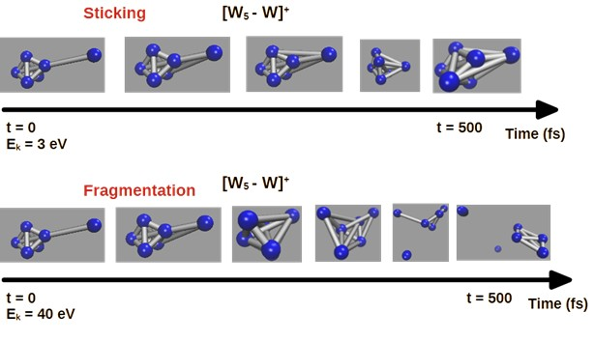
SP D.2 Production of Atomic/Molecular and Surface Data: CEA
DFT Investigation of collision between charged tungsten clusters
A. Michau
D001
Thousand trajectories:
highly time-consuming

Slide 27
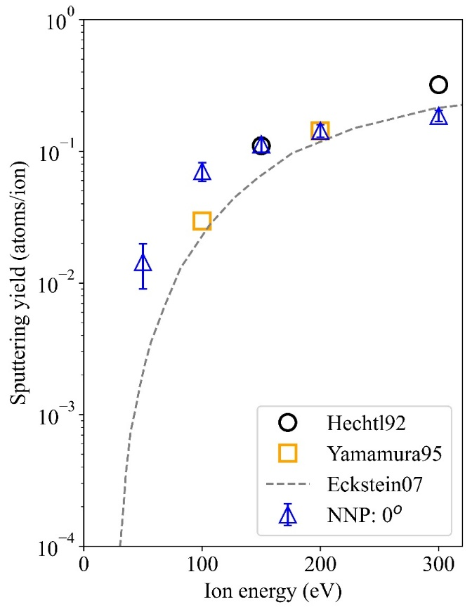
SP D.2 Production of Atomic/Molecular and Surface Data: ÖAW
MD for B surface: sputtering of B by D and B
M. Probst, S. Shermukhamedov
D002
D on B
B on B

Slide 28
SP D.2 Production of Atomic/Molecular and Surface Data: ÖAW
MD for B₂O₃ surface: sputtering by D
M. Probst, S. Shermukhamedov
D002
Sputtering of B
Sputtering of O
Differences between B and O can be attributed to the energy transfer factor 4M₁M₂/(M₁ +M₂)²
Yields of oxygen atoms increase monotonously with the energies and angles

Slide 29
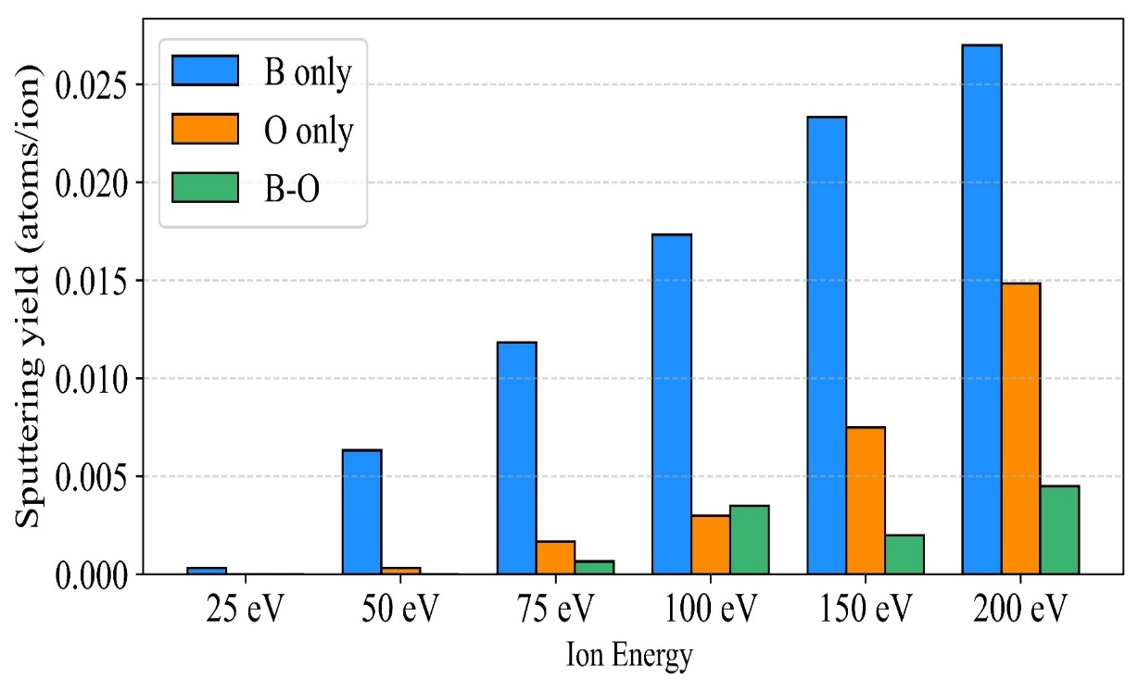
SP D.2 Production of Atomic/Molecular and Surface Data: ÖAW
MD for B₂O₃ surface: chemical sputtering by D
M. Probst, S. Shermukhamedov
D002
Ony B-O radicals were detected, no O-D
Different from B surfaces where B-D is formed (however, here B₂O₃ was sputtered)
The result might therefore be different for cumulative MD simulations where a coating of adsorbed D might already be present on the surface

Slide 30
SP D.2 Production of Atomic/Molecular and Surface Data: ÖAW
Influence of morphology & porosity on erosion
F. Aumayr, J. Brötzner
D003
Generation of fuzzy model surfaces after SEM input data. Variation of the fuzz porosity/volume filling factor. Simulations with SDTrimSP-3D for Ar and D projectiles.
Suppression of the angular dependence of the sputter yield.
Decrease in sputter yield over wide range of incidence angles.
Stronger effect for more porous samples, i.e. lower volume filling factor.
Observed for all studied projectiles and energies.
Example: 1 keV Ar -> W

Slide 31
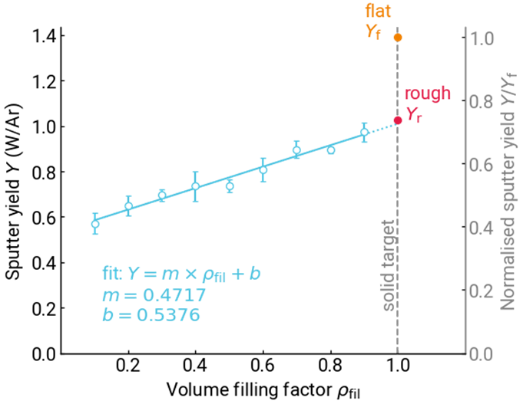
SP D.2 Production of Atomic/Molecular and Surface Data: ÖAW
Influence of morphology & porosity on erosion
F. Aumayr, J. Brötzner
D003
Sputter yield is a linear function of porosity/volume filling.
Intercept with a solid target is not given by the flat sample sputter yield, but rather the rough sample sputter yield when hollows are not considered.
Results in line with measured and simulated data for nano-columnar tungsten.

Slide 32
SP D.2 Production of Atomic/Molecular and Surface Data: VR
Gap melting simulations
S. Ratynskaia
D004
Completed
Compared Fluent simulations of in-place gap filling scenarios (melt produced symmetrically on both sides of a castellation gap) in JET with experimental observations (see pinboard manuscript #120517)
Implementation and testing of volume forces from surface-integrated thermionic emission current in Fluent (necessary for in-place W gap filling scenarios)
Carried out first in-place gap filling simulations for an ITER W monoblock gap during unmitigated current quenches, with a large B field inclination angle (i.e. strong driving force from thermionic emission)
Ongoing until the end of 2025
Repeat ITER-like simulations with shallower B field inclinations to sample the relation between driving force and time required to bridge the gap during a single exposure

Slide 33
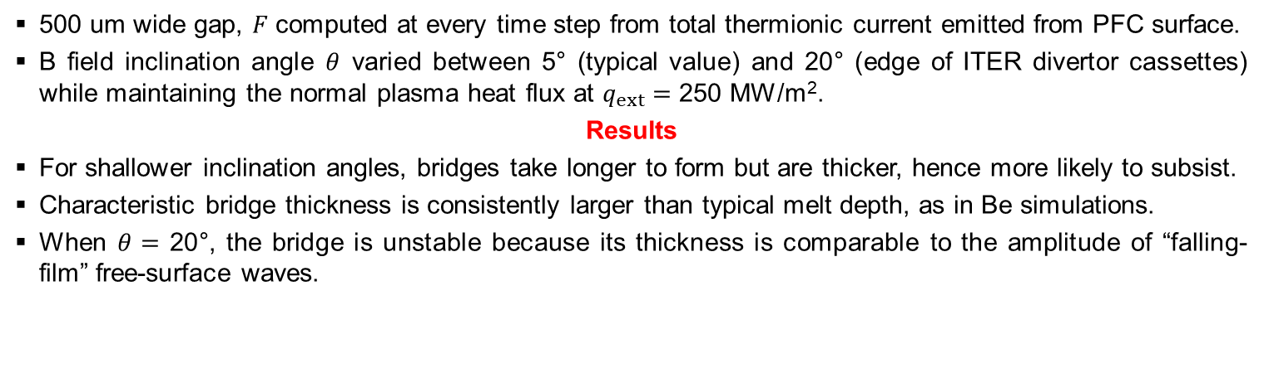
SP D.2 Production of Atomic/Molecular and Surface Data: VR
W gap bridging predictions for ITER
S. Ratynskaia
D004
500 um wide gap, $F$ computed at every time step from total thermionic current emitted from PFC surface.
B field inclination angle $θ$ varied between 5° (typical value) and 20° (edge of ITER divertor cassettes) while maintaining the normal plasma heat flux at $q_{ext}=$ 250 MW/m².
Results
For shallower inclination angles, bridges take longer to form but are thicker, hence more likely to subsist.
Characteristic bridge thickness is consistently larger than typical melt depth, as in Be simulations.
When $θ=$ 20°, the bridge is unstable because its thickness is comparable to the amplitude of “falling-film” free-surface waves.
α_{B} = 5°
α_{B} = 20°

Slide 34
SP D.2 Production of Atomic/Molecular and Surface Data: VTT
MD for W surfaces including B, O, H and for alloys
K. Nordlund / F. Granberg
D005
Development and testing of W-B ML interatomic potential
Initial sputtering and B deposition simulations successfully done
W-O-H potential finished within TSVV-7
It seems that D decoration will increase slightly sputtering of W (D weakens bonds)
Sputtering of alloys (HEAs): preferential sputtering and surface enrichment observed, some increased sputtering for alloys compared to elemental W
More details: talk by F. Granberg

Slide 35
SP D.2 Production of Atomic/Molecular and Surface Data: MPG
Erosion of surfaces with SDTrimSP: amorphization
U. von Toussaint
D006
  Status: SDTrimSP capable of handling crystalline structures (calc. erosion yields validated): code diseminated and in production use
  Enhancement: Amorphization of crystalline structures by irradiation (in non-channeling regime) (see Fig.)
  Implemented (but still waiting for TD-DFT data on electron density): reduced stopping in channels

Slide 36
SP D.2 Production of Atomic/Molecular and Surface Data: MPG
Erosion of surfaces with SDTrimSP: improved potentials
U. von Toussaint
D006
Example: sputtering of Cu
  Status: SDTrimSP provides several (semi-) empirical binary collision potentials (KrC, ZBL etc.)
  Enhancement : Recently complete set of DFT-based pair potentials (NLH, Nordlund et al.) have been published with promise of improved accuracy
  These ‚ab-initio‘ potentials have been implemented and partly evaluated (ie. with respect to sputtering)

Slide 37
SP D.2 Production of Atomic/Molecular and Surface Data: VTT
MD modelling of W surfaces
A. Sand, N. Fakhrayi Mofrad
D007
Study of interaction potentials and molecular sputtering
Results of MD sputtering simulations significantly dependent on interatomic potential.
Compared three potentials capable of describing W-H/D/T molecules:
  Dimer bond strength and distance, surface binding energies, surface energies, cohesive energy elastic constants
  Tersoff bond-order potential (BOP-1) performs best
Molecular sputtering of W surfaces depends on impact energy and surface temperature
More details: talk by N. Fakhrayi Mofrad

Slide 38
SP D.2 Production of Atomic/Molecular and Surface Data: VTT
MD modelling of W surfaces
A. Sand, N. Fakhrayi Mofrad
D007
Molecular sputtering of W surfaces depends on impact energy and surface temperature
More details: talk by N. Fakhrayi Mofrad

Slide 39
SP D.2 Production of Atomic/Molecular and Surface Data: VTT
MD modelling of W surfaces
A. Sand, N. Fakhrayi Mofrad
D007
Effect of electronic energy losses
Using electronic stopping dependent on local electron density (β(ρ)) gives a higher sputtering yield compared to SRIM stopping.
β(ρ) model fitted to TDDFT, generally enhances agreement with experiments.
Reason: SRIM overestimates the energy losses for channeling ions.
More details: talk by N. Fakhrayi Mofrad

Slide 40
SP D.3 Impurity Migration Modelling

Slide 41
SP D.3 Impurity Migration Modelling: CEA
SOLEDGE3X + ERO2.0 for WEST erosion/deposition data
G. Ciraolo
D001
  Both location and magnitude of the ISP erosion matching the post-mortem analysis
  Large region with re-deposited W in the ISP far-SOL → weakly predicted in the simulations
More details: talk by D. Sales de Oliveira

Slide 42
SP D.3 Impurity Migration Modelling: ENEA
Migration experiment design and ERO2.0 code validation in GyM Ar plasma
M. Passoni
Approach
Migration experiment: erosion of the exposed target and re-deposition on Si wafers (catchers)
Preliminary simulations using background plasma from SOLPS-ITER SP D.1 activity to optimize the experimental setup (target material choice, exposure time, biasing voltage, catchers positioning...)
Experiment performed under SP B.1 and produced erosion/ deposition data are compared to ERO2.0
Results
Final experimental setup: two Cr coatings exposed for 5 hours in total at –70V, with catchers in different positions in proximity of sample-holder (SH)
Factor ~1.5 higher erosion rate of Cr target in modelling compared to exp, due to higher ion flux on target surface computed by ERO2.0
Good agreement between exp and ERO2.0 deposited thickness on catcher surface (30-40 nm)
D002
ERO2.0 morphology modelling of Ar plasma exposed W samples
Results
Good agreement with exp -> lower dynamic retention effect wrt He plasma
G. Alberti, C. Tuccari,
A. Uccello, M. Passoni
More details: talk by G. Alberti

Slide 43
SP D.3 Impurity Migration Modelling: ENEA
Modelling of H-mode He plasma discharges in AUG
M. Passoni
D002
Approach
SOLPS-ITER background plasma produced under WP TE and imported in ERO2.0
Estimate of the impact of He^{+/2+} fraction, H⁺ (as a result of NBI) and O concentration on divertor erosion in inter-ELM conditions
Modelling of ELMs as 1 keV D⁺ ions impacting in OSP region as a function of impact angle
Results
No significant effect on erosion profile of He⁺ and H⁺ inclusion
Important impact of O⁶⁺ inclusion but far from OSP and lower erosion than experiments (150-250 nm net erosion close to OSP, net deposition in private flux region)
Good match with experiments considering 85° ELM impact in OSP area
G. Alberti, C. Tuccari,
A. Uccello, M. Passoni
More details: talk by G. Alberti

Slide 44
SP D.3 Impurity Migration Modelling: FZJ
ERO2.0 (ERO) modelling for W7-X, ITER, JET …
J. Romazanov
D003
W7-X: predictive modelling for full W environment in Ne-seeded plasma.
ITER: erosion and deposition on mirrors in remote areas: updated simulations for full-W, boronized ITER.
JET: simulation of tungsten erosion and edge-to-core transport in Ne-seeded JET plasmas.
ITER full-W simulations performed with Ne seeded SOLPS-ITER wide-grid plasma backgrounds.
ITER ramp-up simulations.
C. Baumann, S. Rode, H. Kumpulainen, A. Kirschner

Slide 45
SP D.3 Impurity Migration Modelling: FZJ
ERO2.0 (ERO) modelling for W7-X, ITER, JET …
J. Romazanov
D003
Work has been presented at various conferences in 2025

Slide 46
SP D.3 Impurity Migration Modelling: FZJ
ERO modelling: W prompt redeposition at inner wall during ITER ramp-up
A. Kirschner
D003
Example: W redeposition profiles for medium density case – influence of D_{perp}
Accepted NME

Slide 47
SP D.3 Impurity Migration Modelling: MPG
WallDYN3D modelling of B layer lifetime in ITER
K. Schmid
D004
Lifetime of boronization layers will determine frequency of boronizations in ITER
How long does a 100 nm B layer survive in ITER?
First lifetime estimates were presented in PSI-2024 contribution:
First predictions based on surface concentration but no closed material balance because of simple WallDYN3D surface model
New surface model with reservoir layer allows to close material balance

Slide 48
SP D.3 Impurity Migration Modelling: MPG
WallDYN3D modelling of B layer lifetime in ITER
K. Schmid
New surface model with reservoir layer allows to close material balance
D004
Surface concentration result qualitatively the same…
…but now with closed material balance
B ends up at inner target but is covered by W once main chamber B source depletes
submitted to NME

Slide 49
SP D.3 Impurity Migration Modelling: VTT
A. Hakola, J. Karhunen, S. Saari
ERO2.0 for AUG marker experiments
D005

Slide 50
SP D.3 Impurity Migration Modelling: VTT
A. Hakola, J. Karhunen, S. Saari
ERO2.0 for AUG marker experiments
D005

Slide 51
SP D.3 Impurity Migration Modelling: VR
Self charging properties of tritiated dust
S. Ratynskaia
D006
Completed: Results for W dust (W is already embedded in MicroElec)
Tuned the surface barrier model so that experimental results on secondary electron emission and electron backscattering from W are accurately reproduced.
Added physics list transition from 10 to 20keV, since MicroElec cannot be employed above 10keV.
Performed extensive simulations including the beta electron angular distribution, the beta electron energy distribution, the depth of implantation and the dust size.
For each dust size, obtained simple analytical formulas that perfectly fit simulation results for depth resolved β−electron induced emission yields.
Derived a general expression for the self-charging rate that is expressed as a radial integral of the depth resolved β−electron induced emission yields.
Performed comparison between new MicroElec results and previous EMOpt4 results, which reveal that EmOpt4 results strongly underestimate W dust self-charging rate
Ongoing: Results for B dust which is not included in the material library of MicroElec.
More details: talk by P. Tolias

Slide 52
SP D.3 Impurity Migration Modelling: VR
Self charging properties of tritiated dust
S. Ratynskaia
D006
Basic physics:
Tritium radioactivity implies that tritiated dust will self-charge positively due to the continuous loss of fast internal electrons that are generated by the beta-decay.
Methodology:
The MicroElec package of Geant4 (Monte Carlo simulations) is the most appropriate being based on single scattering implementations, following the dielectric formalism that well captures secondary electron production and including a surface barrier model.
More details: talk by P. Tolias

Slide 53
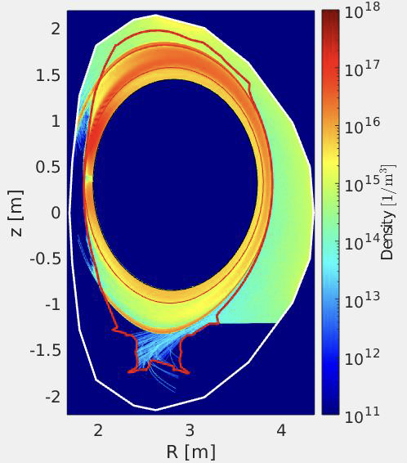
SP D.3 Impurity Migration Modelling: VTT
Ni erosion and deposition in JET – Ni density in limited plasma
M. Groth
D007
JET-ILW scenario simulations for Ni → limiter plasmas
For HFS limited plasmas, the ERO2.0 predicted Ni erosion peaks at LFS vessel wall at a rate of 1.12x10²⁰/s, similar to low-power diverted scenarios
P. Virtanen

Slide 54
SP D.3 Impurity Migration Modelling: VTT
Ni erosion and deposition in JET – net deposition in divertor
M. Groth
D007
For HFS limited plasmas, the net deposition of Ni into the divertor HFS default scenario is negligible compared to diverted phase
P. Virtanen

Slide 55
SP D.4 Neutral Particles Modelling

Slide 56
SP D.4 Neutral Particles Modelling: KIT
DIVGAS modelling: effect of 3D poloidal and toroidal leakages for 2022 DEMO baseline SN divertor case including impurities (He)
Ch. Tantos,
Th. Giegerich
D001
  DIVGAS used to simulate flow of helium-deuterium mixture in DEMO sub-divertor region
  At divertor entrances, the neutral inlet pressure ranged from 1 to 4 Pa, pumping probability (ξ) from 1% to 10%, and helium mole fraction from 5% to 10%.
  As with deuterium, poloidal gaps have stronger effect than toroidal gaps, with pumped flux (for inlet divertor pressures up to 10 Pa) expected to remain well below 20% of incoming flux.
  Helium’s albedo are similar to deuterium’s: 0.78 and 0.72 for weak (ξ=1%) and strong (ξ=10%) pumping at 4 Pa.
  The change in helium mole fraction was minor, likely due to similar mass, same pumping probability and most probable speed of helium and deuterium.
  The helium partial pressure was found to range from 0.04 Pa to 0.17 Pa when the overall inlet pressure is 4 Pa and the mole fraction varies from 5% to 10%.

Slide 57
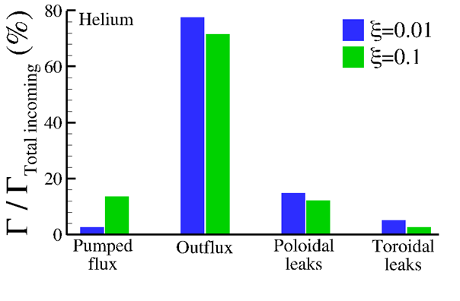
SP D.4 Neutral Particles Modelling: KIT
DIVGAS modelling: effect of 3D poloidal and toroidal leakages for 2022 DEMO baseline SN divertor case including impurities (He)
Ch. Tantos,
Th. Giegerich
D001
  Distribution of the overall incoming flux across various gaps and leakages

Slide 58
SP D.4 Neutral Particles Modelling: KIT
DIVGAS modelling: gas distribution in JET vessel
Ch. Tantos,
Th. Giegerich
Aim: support accurate interpretation of the in-vessel pVT calibration.
D001
  DIVGAS was applied to study neutral gas dynamics in JET, including the sub-divertor and vessel. The effect of the thermal accommodation coefficient was analyzed for three pressures (1 Pa, 2.5 Pa, 5 Pa) and two reference temperature conditions.
  Macroscopic distributions were found to be insensitive to the thermal accommodation coefficient, due to low Knudsen numbers.
  Density increases by a factor of 1.5 from the vacuum vessel to the pipes, with a much larger increase—about fivefold—near the cryopump surface.
  Macroscopic distributions remain uniform in lower sub-divertor region and L-shaped pipe.

Slide 59
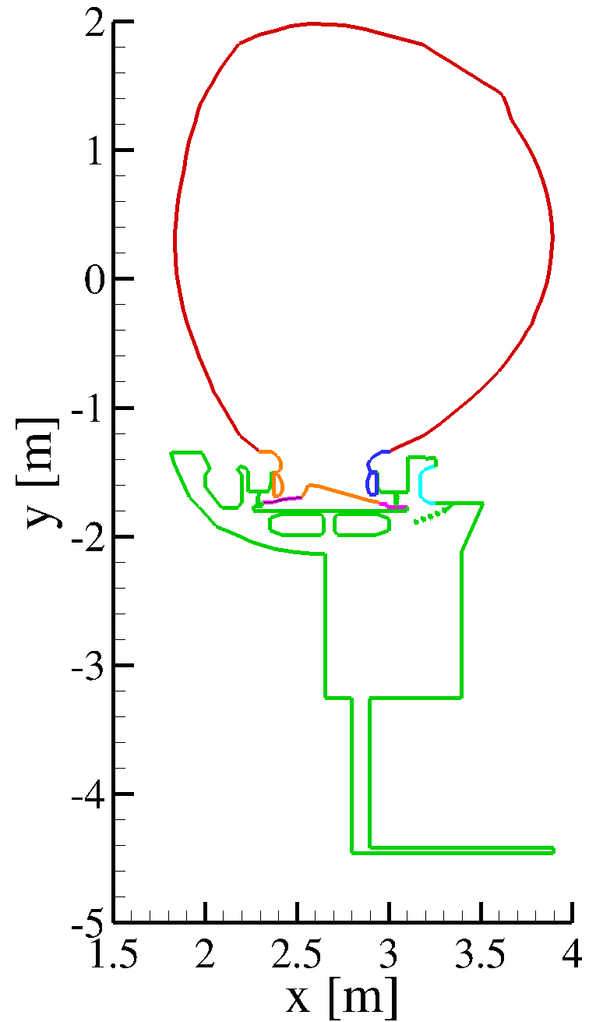
SP D.4 Neutral Particles Modelling: KIT
DIVGAS modelling: gas distribution in JET vessel
Ch. Tantos,
Th. Giegerich
Aim: support accurate interpretation of the in-vessel pVT calibration.
D001
Temperature conditions (°C)
case A case B
(standard) (baking)
(nom. 200) (nom. 320)
----------------------------------------------------------------------
180 280
----------------------------------------------------------------------
80 140
----------------------------------------------------------------------
55 100
----------------------------------------------------------------------
45 45
----------------------------------------------------------------------
20 20
  Density for 1 Pa
DIVGAS JET model, with temperatures indicated by different colours

Slide 60
SP D.4 Neutral Particles Modelling: VTT / Aalto U
JET neutral dynamics using EIRENE – isotope effect
M. Groth
D002
Explore pressure range, sub-divertor geometry
→ effective pumping speed
→ DIVGAS comparison for simplified geometry
A. Vesa

Slide 61
SP D.4 Neutral Particles Modelling: VTT / Aalto U
JET neutral dynamics using EIRENE – isotope effect
M. Groth
D002
Adjust conductance at sub-divertor entrance to force agreement w/ exp.
⇒ next: replace sub-divertor with calibrated pump surface in divertor corner
Time-dependent EIRENE simulations of pumping speed for H₂, D₂, T₂ injection into JET empty vessel are within a factor of 2 of the measurements
A. Vesa

Slide 62
SP D.5 Plasma background and PWI Modelling for COMPASS-U

Slide 63
SP D.5 Plasma background and PWI Modelling for COMPASS-U: IPP.CR
Strike point sheath simulations for COMPASS-U
D. Tskhakaya
D001
SPICE2 w/nonuniform injection scheme (2D PIC), inputs: BIT1 (injection VDF, Tskhakaya) + SOLPS-ITER (target profiles, Shyshkin / Švorc)
(i) Simulations of strike-line plasma w/rt divertor design and sheath physics
Simulations with reduced parameters finalized in Q3/2025, full parameters. starting soon (new SOLPS profiles necessary).
To be done: new SOLPS profiles upcoming – re-run few cases
Conclusions: reduction of parameters is too restricting – wider simulations necessary to reduce periodic boundary effects, code updates were performed to enable this strategy (2025).
(ii) Evaluation of simulated results, possible code updates for full-scale simulations
A. Podolnik

Slide 64
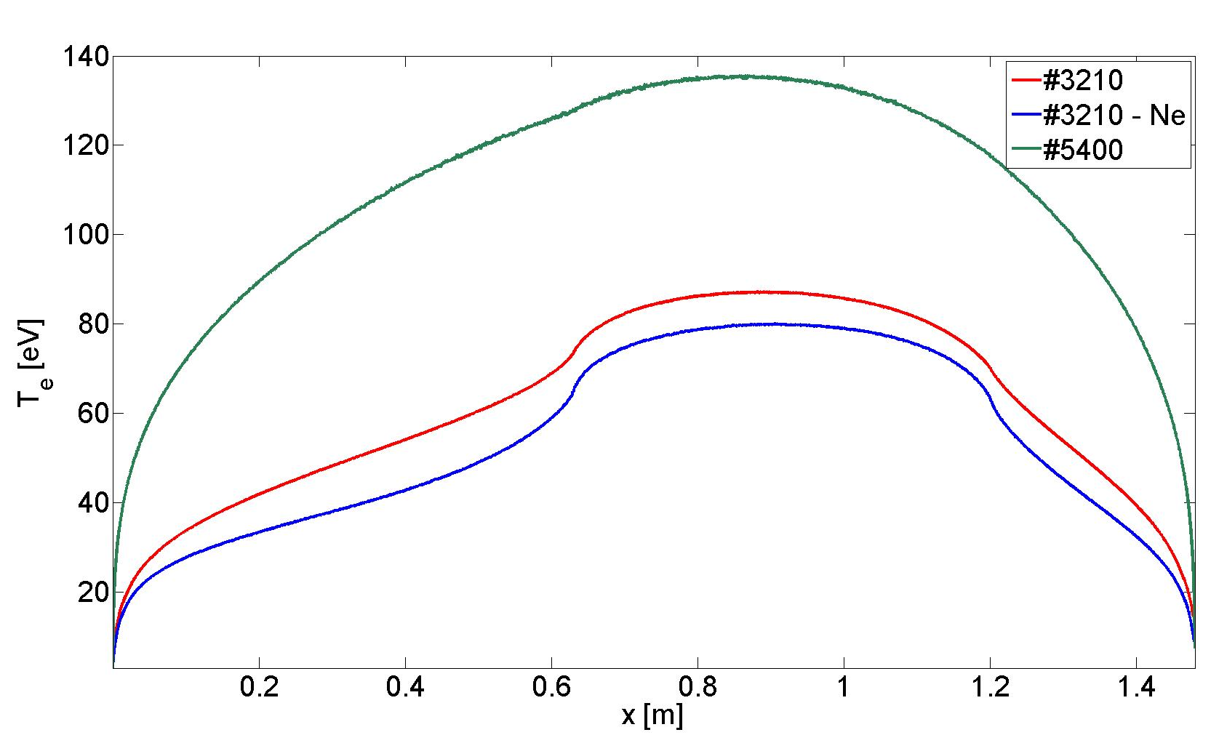
SP D.5 Plasma background and PWI Modelling for COMPASS-U: IPP.CR
Kinetic model of the COMPASS-U flux tube in the SOL
D. Tskhakaya
D001
Two sets of simulations have been performed #3210 (Ne seeded) and #5400 moderate and high density shots (H-mode)
#3210: completed; Ne seeded ID and OD are (partially) detached, with strong reduction of Γ_{w, net}.
#5400: w/o Ne seeding – completed; formation of the collisional sheath at the ID; significant W outflux, Γ_{w, net} ~ 10²⁰ m⁻²s⁻¹. Ne seeded – ongoing (2025 – 2026?)
Future plans (2026/2027): ELM modeling (started); different injection rates of Ne and Ar

Slide 65
SP D.5 Plasma background and PWI Modelling for COMPASS-U: IPP.CR
SOLPS-ITER wide-grid modelling of the background plasma
D. Tskhakaya
D001
#5400
(high density / performance shot)
Example:
radial profiles of n_{e} at the OMP
Full vessel mesh
Fluid neutrals, no currents and drifts, no impurities
Good matching of P_{SOL} (T_{ped}), n_{ped} from core model (METIS) and e-folding lengths based on l_{q} scaling
#24300
(H mode with moderate density)
Ongoing, convergence problems …
D. Svorc

Slide 66
SP D.5 Plasma background and PWI Modelling for COMPASS-U: IPP.CR
ERO2.0 modelling of the W transport COMPASS-U
D. Tskhakaya
D001
Q1: A preliminary ERO2.0 parametric study and an investigation of basic dependencies and phenomena ✔ (presented at PET-20)
Q2: ERO2.0 simulations with liquid metals and their influence on W erosion ✔ (presented at PSI-26)
Addition of global electric field and thermal force from SOLPS-ITER background plasma✔
Q3: W erosion and transport modelling using SOLPS ITER-ext. background plasma ✘ (some delay in SOLPS ITER-ext results)
We expect all tasks to be finished till the end of 2025
S. Lukes

Slide 67
SP D.5 Plasma background and PWI Modelling for COMPASS-U: IPP.CR
ERO2.0 modelling of the W transport COMPASS-U
D. Tskhakaya
D001
S. Lukes

Slide 68

SP D.5 Plasma background and PWI Modelling for COMPASS-U: FZJ
ERO2.0 support to IPP.CR
J. Romazanov
D002
Has been done !

Slide 69
SP D.5 Plasma background and PWI Modelling for COMPASS-U: CEA
Simulation of COMPASS-U in L-mode conditions with SOLEDGE3X
P. Tamain
D003
R. Düll

Slide 70
SP D.5 Plasma background and PWI Modelling for COMPASS-U: CEA
Simulation of COMPASS-U in H-mode conditions with SOLEDGE3X
P. Tamain
D003
R. Düll

Slide 71
WP PWIE SP D: Plans for 2026/27

Slide 72
WP PWIE SP D: Plans for 2026/27
SP D1 Plasma background modelling
SOLPS-ITER, SOLEDGE3X, PIC codes, …
WEST, AUG, JET, COMAPSS-U, ITER
W7-X
GYM, PSI-2, MAGNUM, UPP
CEA, DIFFER, ENEA, FZJ, IPP.CR, IPP.LM, VTT
15PM
+3PM
37PM
SP D2 Production of surface data
MD, SDTrimSP, SPRAY, …
Sputtering, reflection, morphology
W, B, steel, D, seeding species, O, He, …
CIEMAT, ENEA, MPG, ÖAW, VTT, UKAEA
SP D3 Atomic/molecular data
CRM, neutrals
ENEA, FZJ
SP D4 Impurity migration modelling
WallDYN, ERO2.0, core modelling
WEST, AUG, JET, COMAPSS-U, ITER
W7-X
GYM, PSI-2, MAGNUM, UPP
CEA, ENEA, FZJ, IPP.CR, IPP.LM, MPG, VTT
4PM
32PM
Strong connection to:
ITER, TSVV, SP B, WP TE, WP W7X, …
PMs per year …

Slide 73
WP PWIE SP D: Agenda – SP D Highlight Talks
Tue Nov. 18th
Thu Nov. 20th

Slide 74

WP PWIE: SP D Reporting 2025
Thank you very much for your patience !!!

