Slide 1
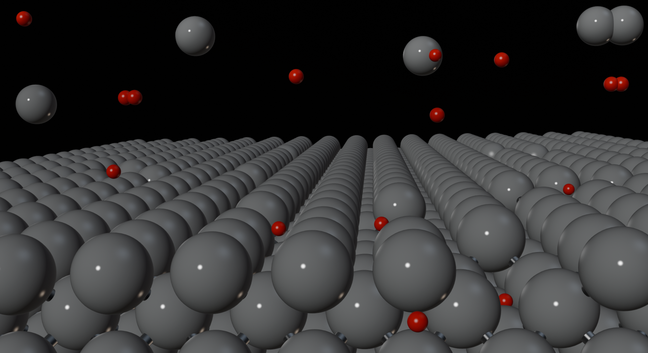


Modelling Plasma–Wall Interactions in Tungsten: Chemical Erosion and Recycling
Nima Fakhrayi Mofrad, Evgeniia Ponomareva, Akseli Aro, Antoine Clement, Andrea E. Sand
Department of Applied Physics, Aalto University, Finland
WPPWIE Review Meeting - 20.11.2025

Slide 2
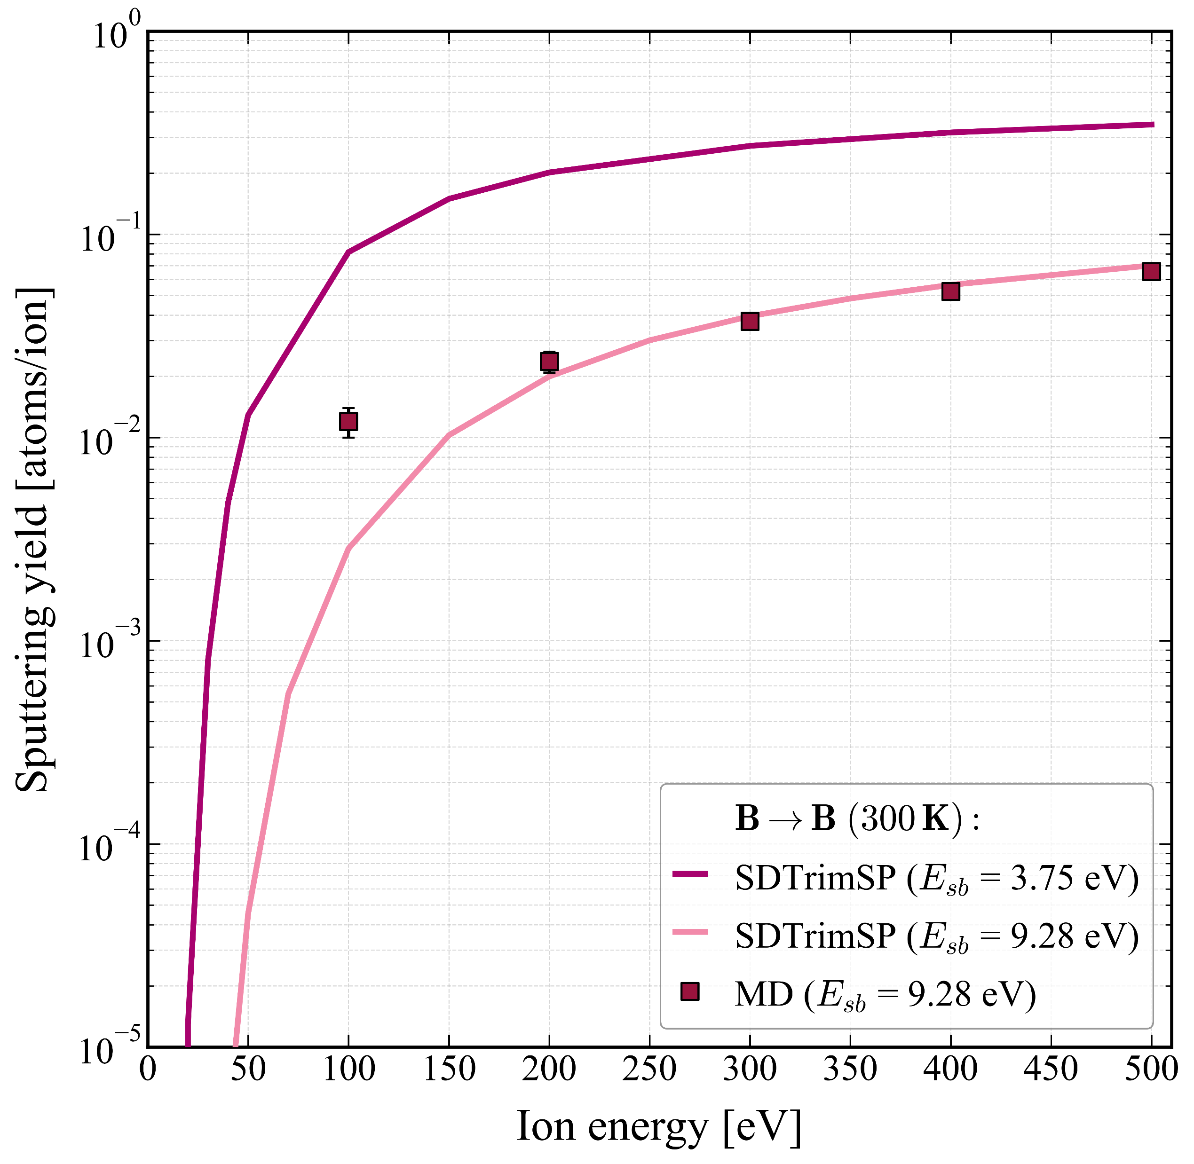
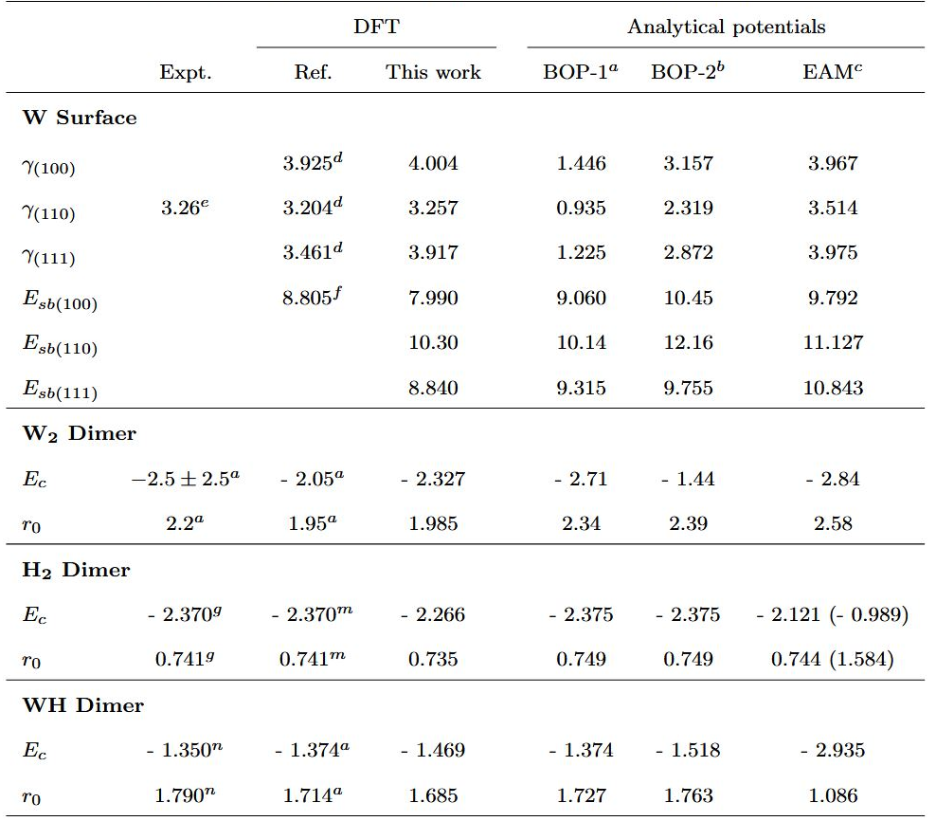
Interatomic potential
The selection of an interatomic potential critically affects the precision of MD simulations of irradiation.
The (110) surface exhibits the lowest surface energy and is thus expected to be the dominant crystal orientation in a real surface.
BOP-1 provides surface binding energy, E_{sb}, values that are more closely aligned with the DFT data.
The predictive accuracy of BOP-1 in terms of the cohesive energy, E_{c}, and the bond length, r₀, of the dimers is more accurate.
ª N. Juslin et al., J. App. Phys. 98.12 (2005).
^{b} Xiao-Chun Li et al., J. Nucl. Mat. 408.1 (2011).
^{c} Daniel R Mason et al., J. Phys.: Cond. Matter 35.49 (2023).
^{d} Robert C. Ehemann et al., Phys. Rev. B 95 (2017).
^{e} L. Vitos et al., Surface Science 411.1 (1998).
^{f} Michael Gyoeroek et al., J. Nucl. Mat. 472 (2016).
^{g} K. P. Huber and G. Herzberg, Constants of Diatomic Molecules (1979).
^{m} Hideaki Takahashi, J. Phys. B: At. Mol. Opt. Phys. 51 055102 (2018).
^{n} Zhongxin Ma and K. Balasubramanian., Chemical Physics Letters 181.5, (1991).

Slide 3
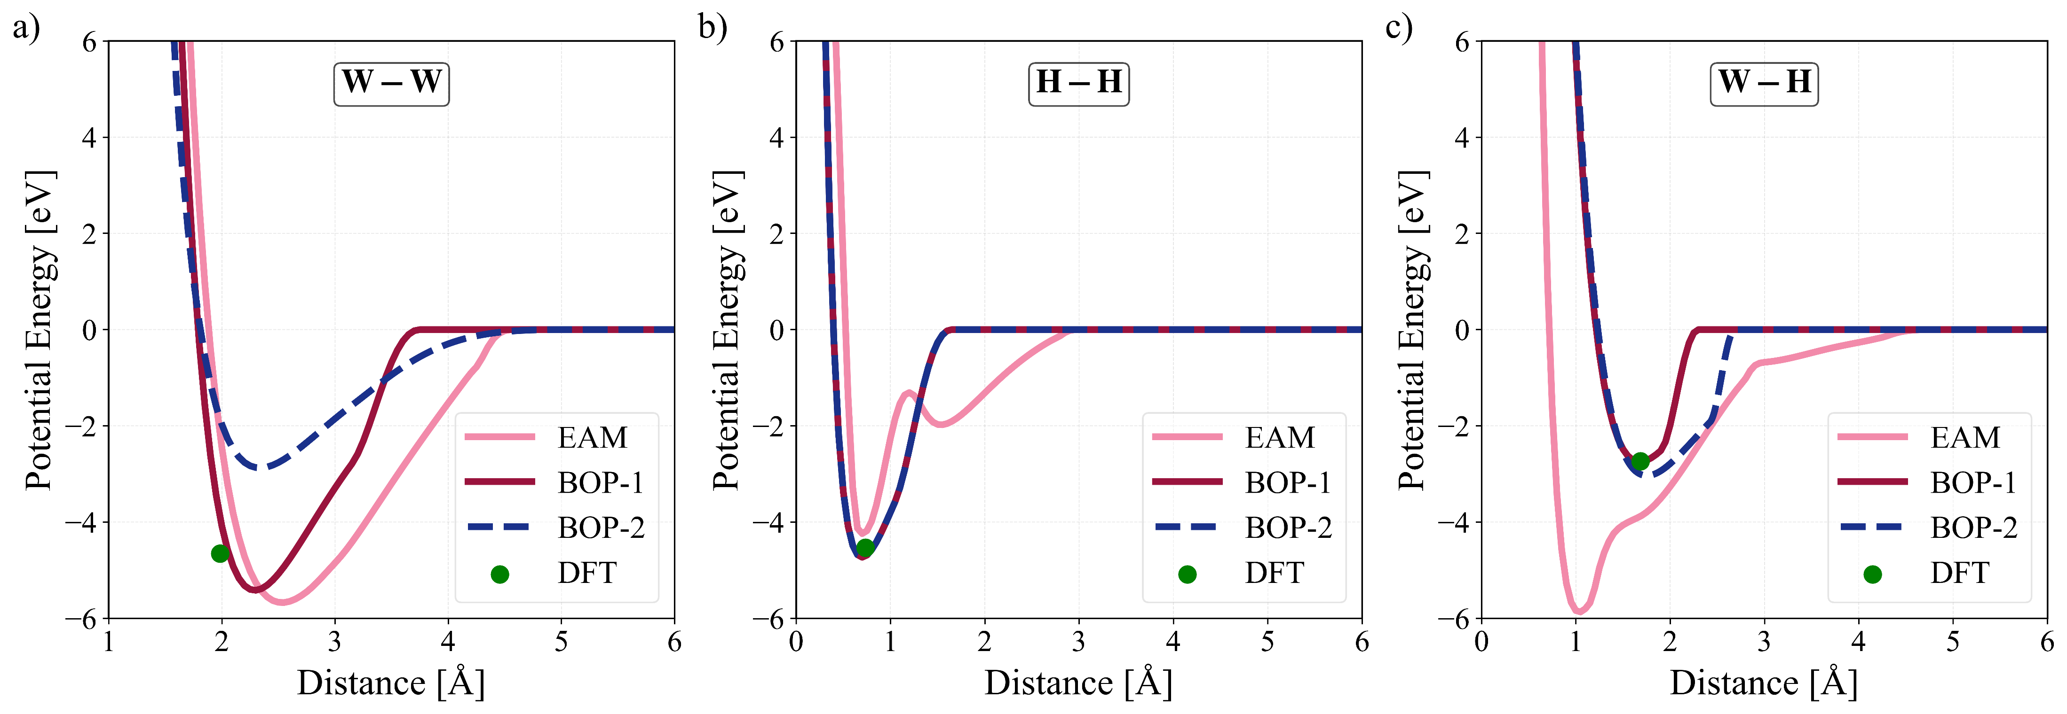
Interatomic potential
The depiction of pairwise interactions in BOP-1 is also better compared to both BOP-2 and EAM.
The primary interatomic potential utilized in this study is BOP-1, which is henceforth called Tersoff.
To highlight the impact of potential on MD simulations, the EAM potential is also applied in some cases.

Slide 4

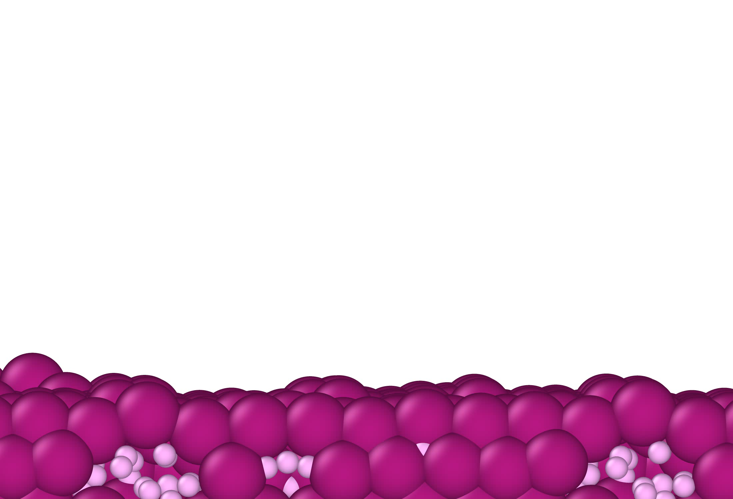
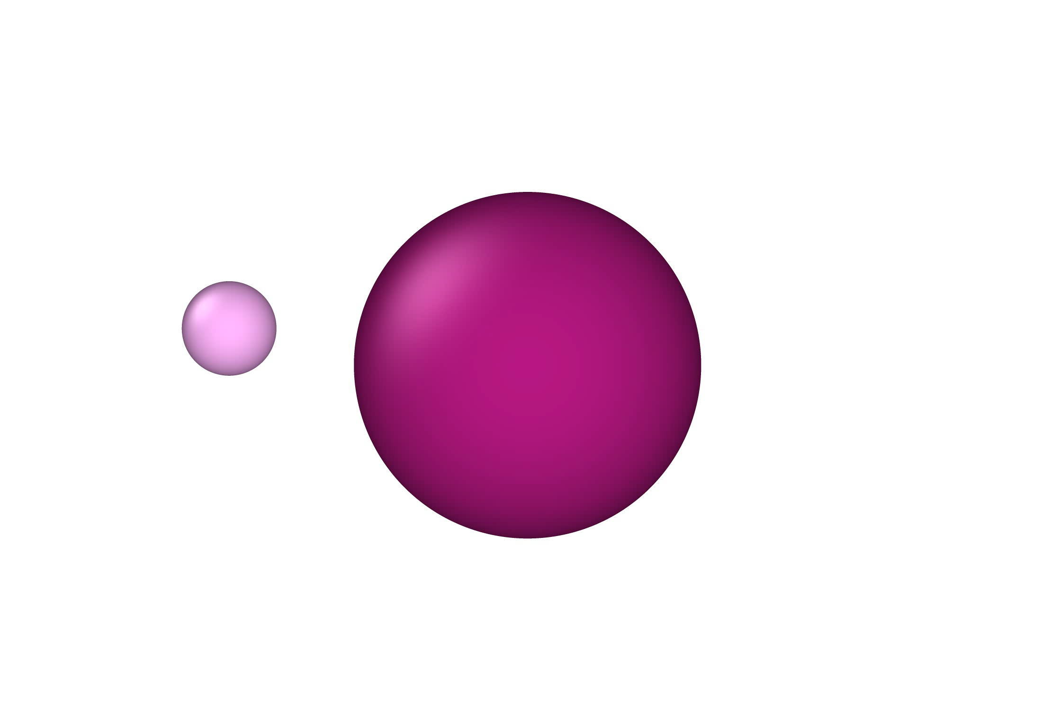
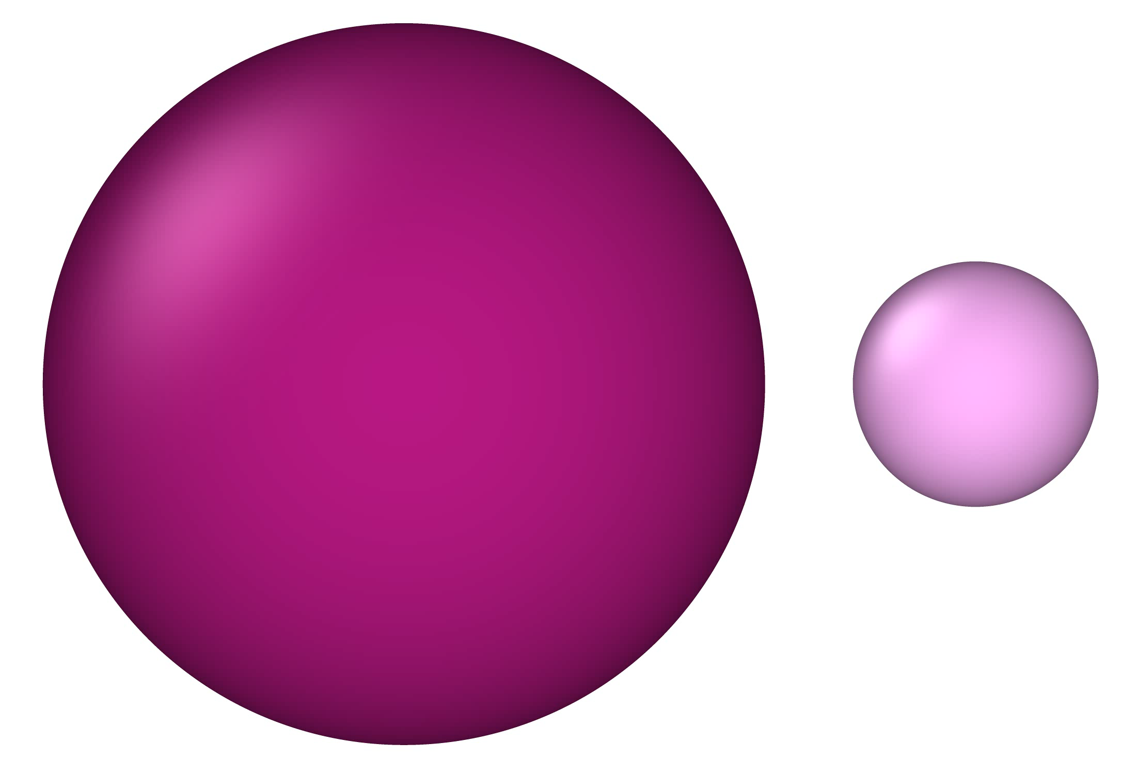


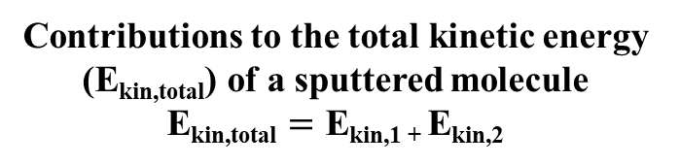








Ro-vibrational states: Approach
Translational (E_{kin,trans}):
E_{kin,trans}$=\frac{1}{2}mtot {Vcom}^{2}$
Contributions to the total kinetic energy (E_{kin,total}) of a sputtered molecule
E_{kin,total} $=\text{E}\text{kin}\text{,1 + }\text{E}\text{kin}\text{,2}$
$mtot =m1$ + $m2$
V_{com} : center of mass velocity
Rotational (E_{kin,rot}):
E_{kin,rot}$=\frac{1}{2\text{μ}}{\left(\frac{L}{r}\right)}^{2}$
$$\text{μ} =\frac{m1×m2}{m1+m2} ,$$
$$L =mvr ,$$
r : bond length
$$\text{J} =\frac{1}{2} (\sqrt{1+4{\left(\frac{L}{\frac{h}{2π}}\right)}^{2}} −1)$$
Vibrational (E_{kin,vib}):
E_{kin,vib} $=\text{E}\text{kin}\text{,}\text{total}\text{ − }\text{E}\text{kin}\text{,}\text{trans}$ - E_{kin,rot}
E_{pot,vib} $=\text{E}\text{pot}\text{,1 + }\text{E}\text{pot}\text{,2}$ - E_{pot,1-2}
Numbers J and n obtained from the MD simulations are often not integer values, and they are rounded to the closest integer.
E_{vib} $=\text{E}\text{pot}\text{,}\text{vib}\text{ + }\text{E}\text{kin}\text{,}\text{vib}$
$$\text{n}= \frac{Evib}{hνe} −0.5$$

Slide 5


Ro-vibrational states: Approach
Translational (E_{kin,trans}):
E_{kin,trans}$=\frac{1}{2}mtot {Vcom}^{2}$
Contributions to the total kinetic energy (E_{kin,total}) of a sputtered molecule
E_{kin,total} $=\text{E}\text{kin}\text{,1 + }\text{E}\text{kin}\text{,2}$
$mtot =m1$ + $m2$
V_{com} : center of mass velocity
Rotational (E_{kin,rot}):
E_{kin,rot}$=\frac{1}{2\text{μ}}{\left(\frac{L}{r}\right)}^{2}$
$$\text{μ} =\frac{m1×m2}{m1+m2} ,$$
$$L =mvr ,$$
r : bond length
$$\text{J} =\frac{1}{2} (\sqrt{1+4{\left(\frac{L}{\frac{h}{2π}}\right)}^{2}} −1)$$
Vibrational (E_{kin,vib}):
E_{kin,vib} $=\text{E}\text{kin}\text{,}\text{total}\text{ − }\text{E}\text{kin}\text{,}\text{trans}$ - E_{kin,rot}
E_{pot,vib} $=\text{E}\text{pot}\text{,1 + }\text{E}\text{pot}\text{,2}$ - E_{pot,1-2}
Numbers J and n obtained from the MD simulations are often not integer values, and they are rounded to the closest integer.
E_{vib} $=\text{E}\text{pot}\text{,}\text{vib}\text{ + }\text{E}\text{kin}\text{,}\text{vib}$
$$\text{n}= \frac{Evib}{hνe} −0.5$$

Slide 6




Ro-vibrational states: Approach
Translational (E_{kin,trans}):
E_{kin,trans}$=\frac{1}{2}mtot {Vcom}^{2}$
Contributions to the total kinetic energy (E_{kin,total}) of a sputtered molecule
E_{kin,total} $=\text{E}\text{kin}\text{,1 + }\text{E}\text{kin}\text{,2}$
$mtot =m1$ + $m2$
V_{com} : center of mass velocity
Rotational (E_{kin,rot}):
E_{kin,rot}$=\frac{1}{2\text{μ}}{\left(\frac{L}{r}\right)}^{2}$
$$\text{μ} =\frac{m1×m2}{m1+m2} ,$$
$$L =mvr ,$$
r : bond length
$$\text{J} =\frac{1}{2} (\sqrt{1+4{\left(\frac{L}{\frac{h}{2π}}\right)}^{2}} −1)$$
Vibrational (E_{kin,vib}):
E_{kin,vib} $=\text{E}\text{kin}\text{,}\text{total}\text{ − }\text{E}\text{kin}\text{,}\text{trans}$ - E_{kin,rot}
E_{pot,vib} $=\text{E}\text{pot}\text{,1 + }\text{E}\text{pot}\text{,2}$ - E_{pot,1-2}
Numbers J and n obtained from the MD simulations are often not integer values, and they are rounded to the closest integer.
E_{vib} $=\text{E}\text{pot}\text{,}\text{vib}\text{ + }\text{E}\text{kin}\text{,}\text{vib}$
$$\text{n}= \frac{Evib}{hνe} −0.5$$

Slide 7




Ro-vibrational states: Approach
Translational (E_{kin,trans}):
E_{kin,trans}$=\frac{1}{2}mtot {Vcom}^{2}$
Contributions to the total kinetic energy (E_{kin,total}) of a sputtered molecule
E_{kin,total} $=\text{E}\text{kin}\text{,1 + }\text{E}\text{kin}\text{,2}$
$mtot =m1$ + $m2$
V_{com} : center of mass velocity
Rotational (E_{kin,rot}):
E_{kin,rot}$=\frac{1}{2\text{μ}}{\left(\frac{L}{r}\right)}^{2}$
$$\text{μ} =\frac{m1×m2}{m1+m2} ,$$
$$L =mvr ,$$
r : bond length
$$\text{J} =\frac{1}{2} (\sqrt{1+4{\left(\frac{L}{\frac{h}{2π}}\right)}^{2}} −1)$$
Vibrational (E_{kin,vib}):
E_{kin,vib} $=\text{E}\text{kin}\text{,}\text{total}\text{ − }\text{E}\text{kin}\text{,}\text{trans}$ - E_{kin,rot}
E_{pot,vib} $=\text{E}\text{pot}\text{,1 + }\text{E}\text{pot}\text{,2}$ - E_{pot,1-2}
Numbers J and n obtained from the MD simulations are often not integer values, and they are rounded to the closest integer.
E_{vib} $=\text{E}\text{pot}\text{,}\text{vib}\text{ + }\text{E}\text{kin}\text{,}\text{vib}$
$$\text{n}= \frac{Evib}{hνe} −0.5$$

Slide 8
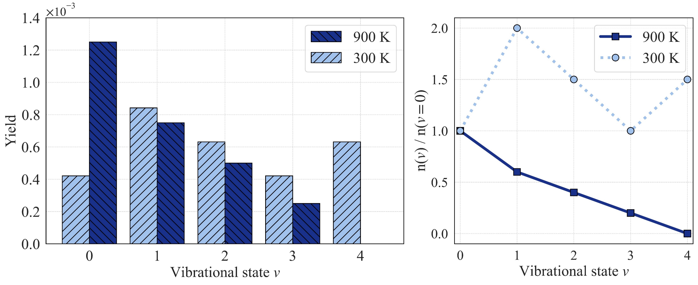
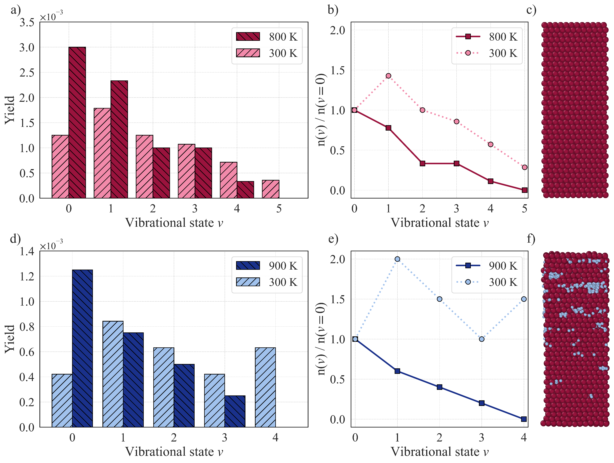
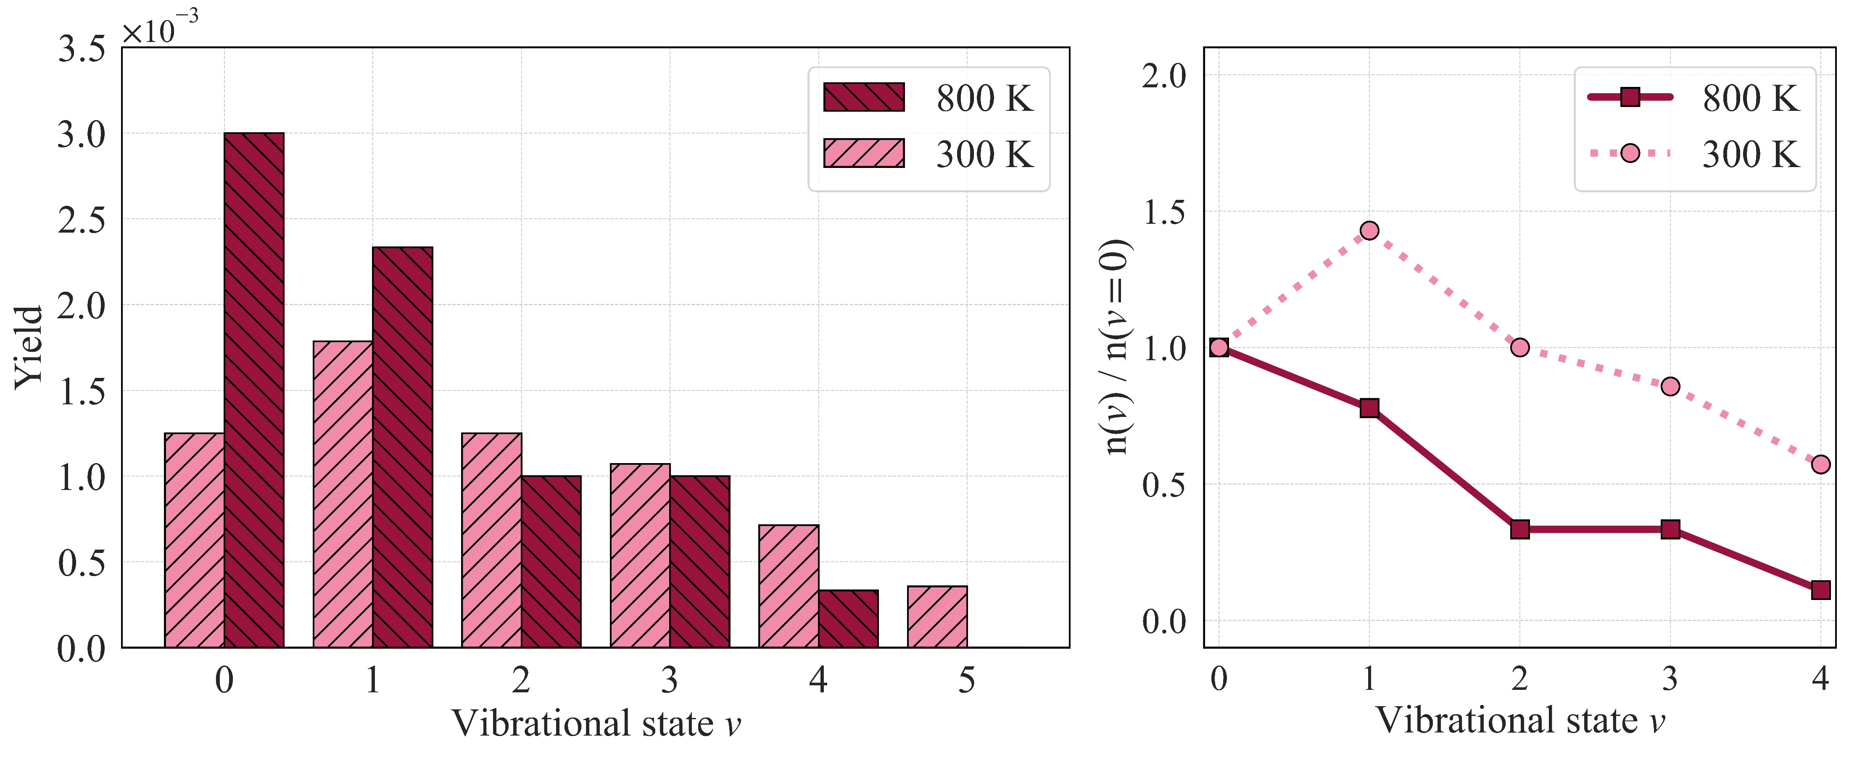
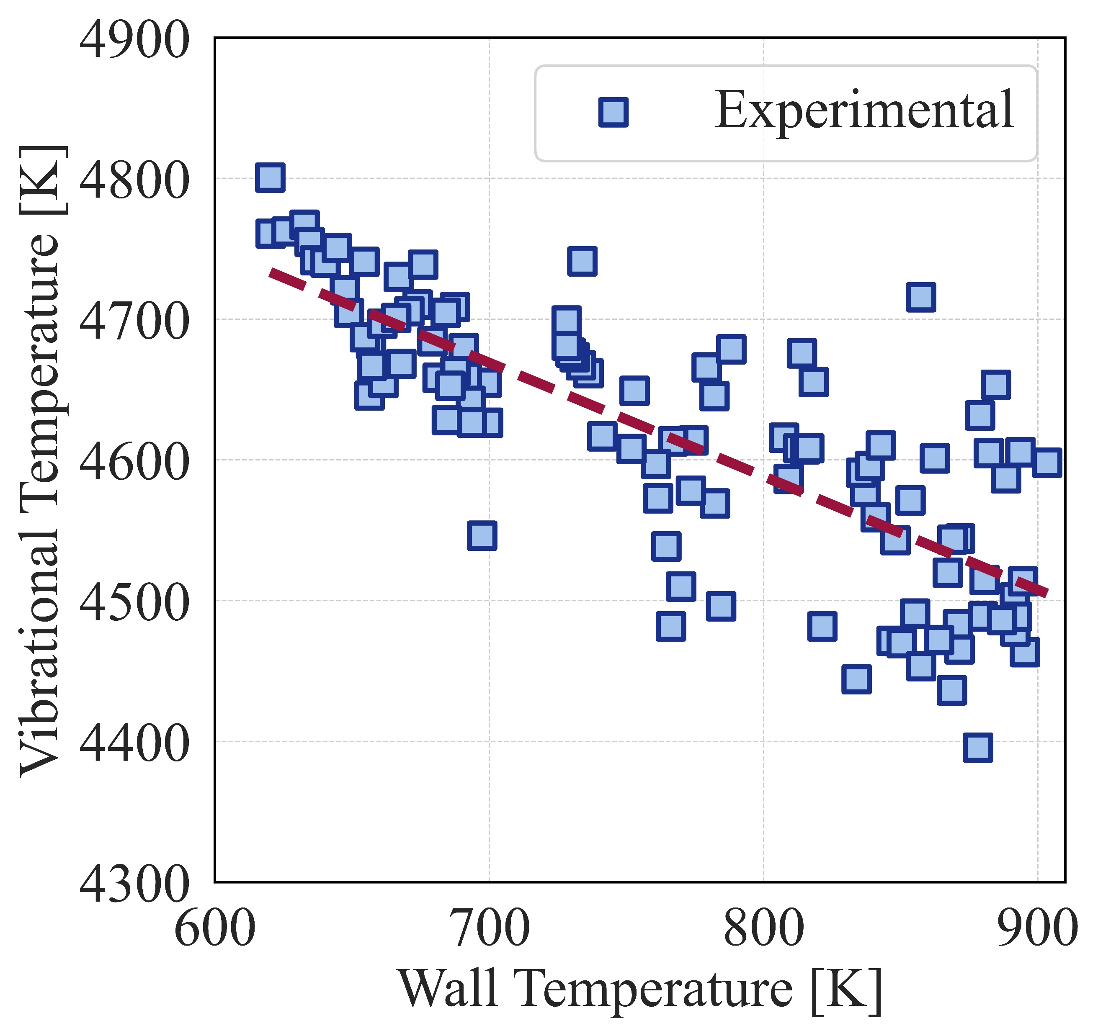
Ro-vibrational states: Validation
Spectroscopic studies of Be limiters revealed that as the wall temperature increases, the vibrational temperature of the BeD molecular band decreases.
To examine this phenomenon within the context of our MD simulations, we analyzed two distinct cases.
In the first scenario, a Be surface without D concentration was subjected to irradiation using 30 eV D atoms.
In the second scenario, a Be surface with pre-existing D concentration was irradiated by 100 eV D atoms.
E. Pawelec et al., Physics of Plasmas 31.4 (2024).

Slide 9
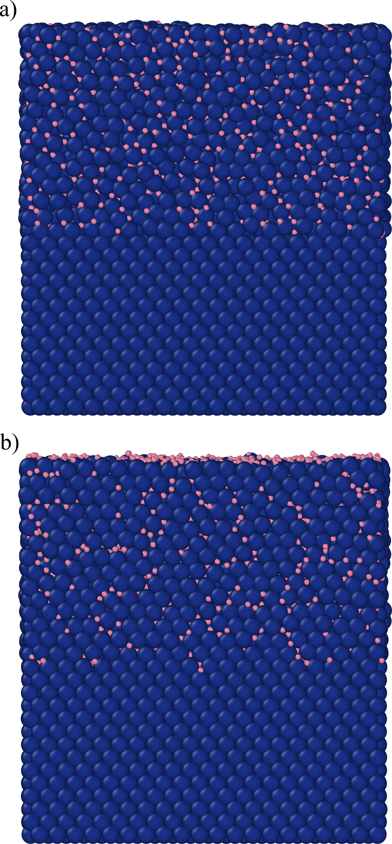
Ro-vibrational states: Sputtered W molecules
After selecting the best potential and validating our approach we perform irradiation simulations for W.
Our target is a (110) W surface with pre-existing D concentration ion the upper half of the cell (D/W = 1).
For each case for perform 10000 simulations to gather sufficient statistics.

Slide 10
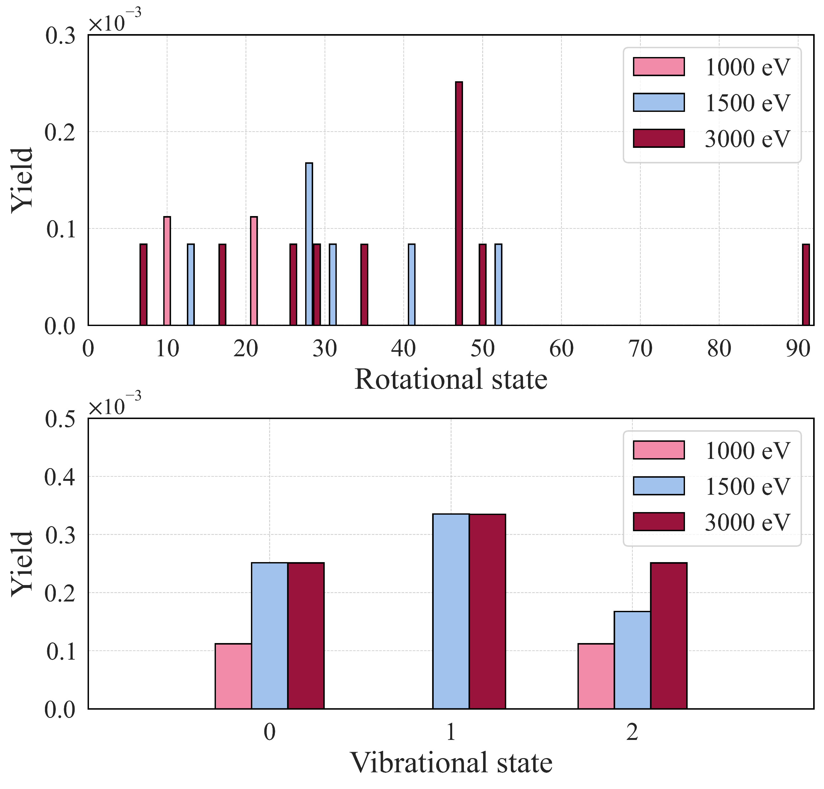
Ro-vibrational states: Sputtered W molecules
Impact energy
An increase in impact energy leads to a higher molecular sputtering yield.
Moreover, an increased impact energy is associated with a higher number of molecules in vibrational excitation and elevated rotational energy levels.
This is due to the higher transferred energy from the projectile to the system at higher impact energies.
WD molecules for different impact energies (300 K, normal incidence angle )

Slide 11
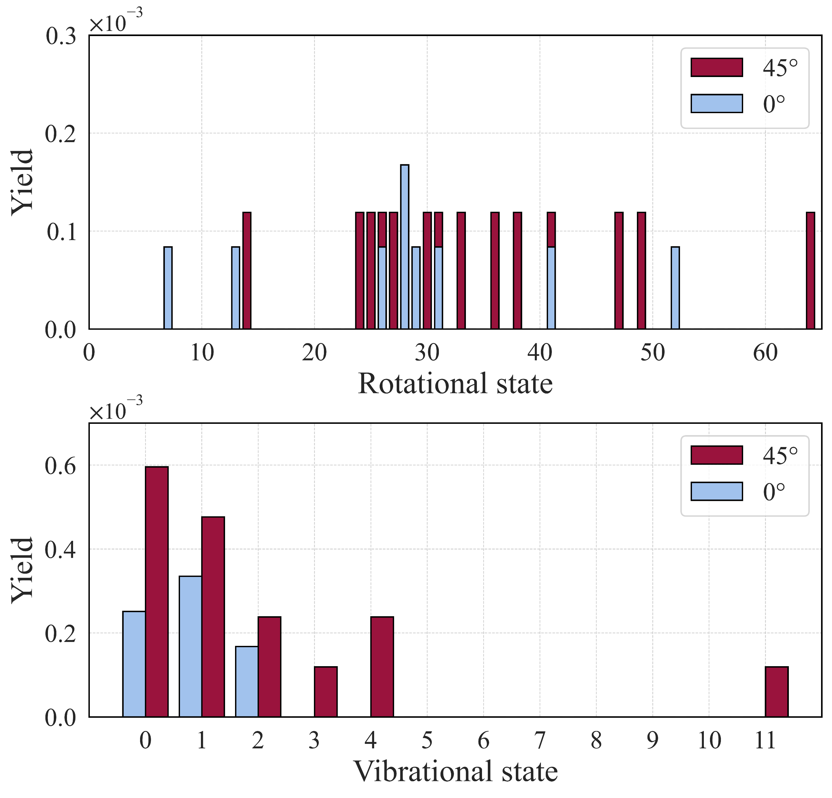
Ro-vibrational states: Sputtered W molecules
Impact angle
The angle of incidence determines the penetration depth of the projectile.
An increase in the impact angle (with respect to the normal of the surface) increases both the total yield of molecular sputtering and their vibrational.
When the angle of incidence is 45 degrees, a higher fraction of the transferred energy of the projectile will be distributed within the upper layers and near the surface.
WD molecules for different impact angles (300 K, 1500 eV)

Slide 12
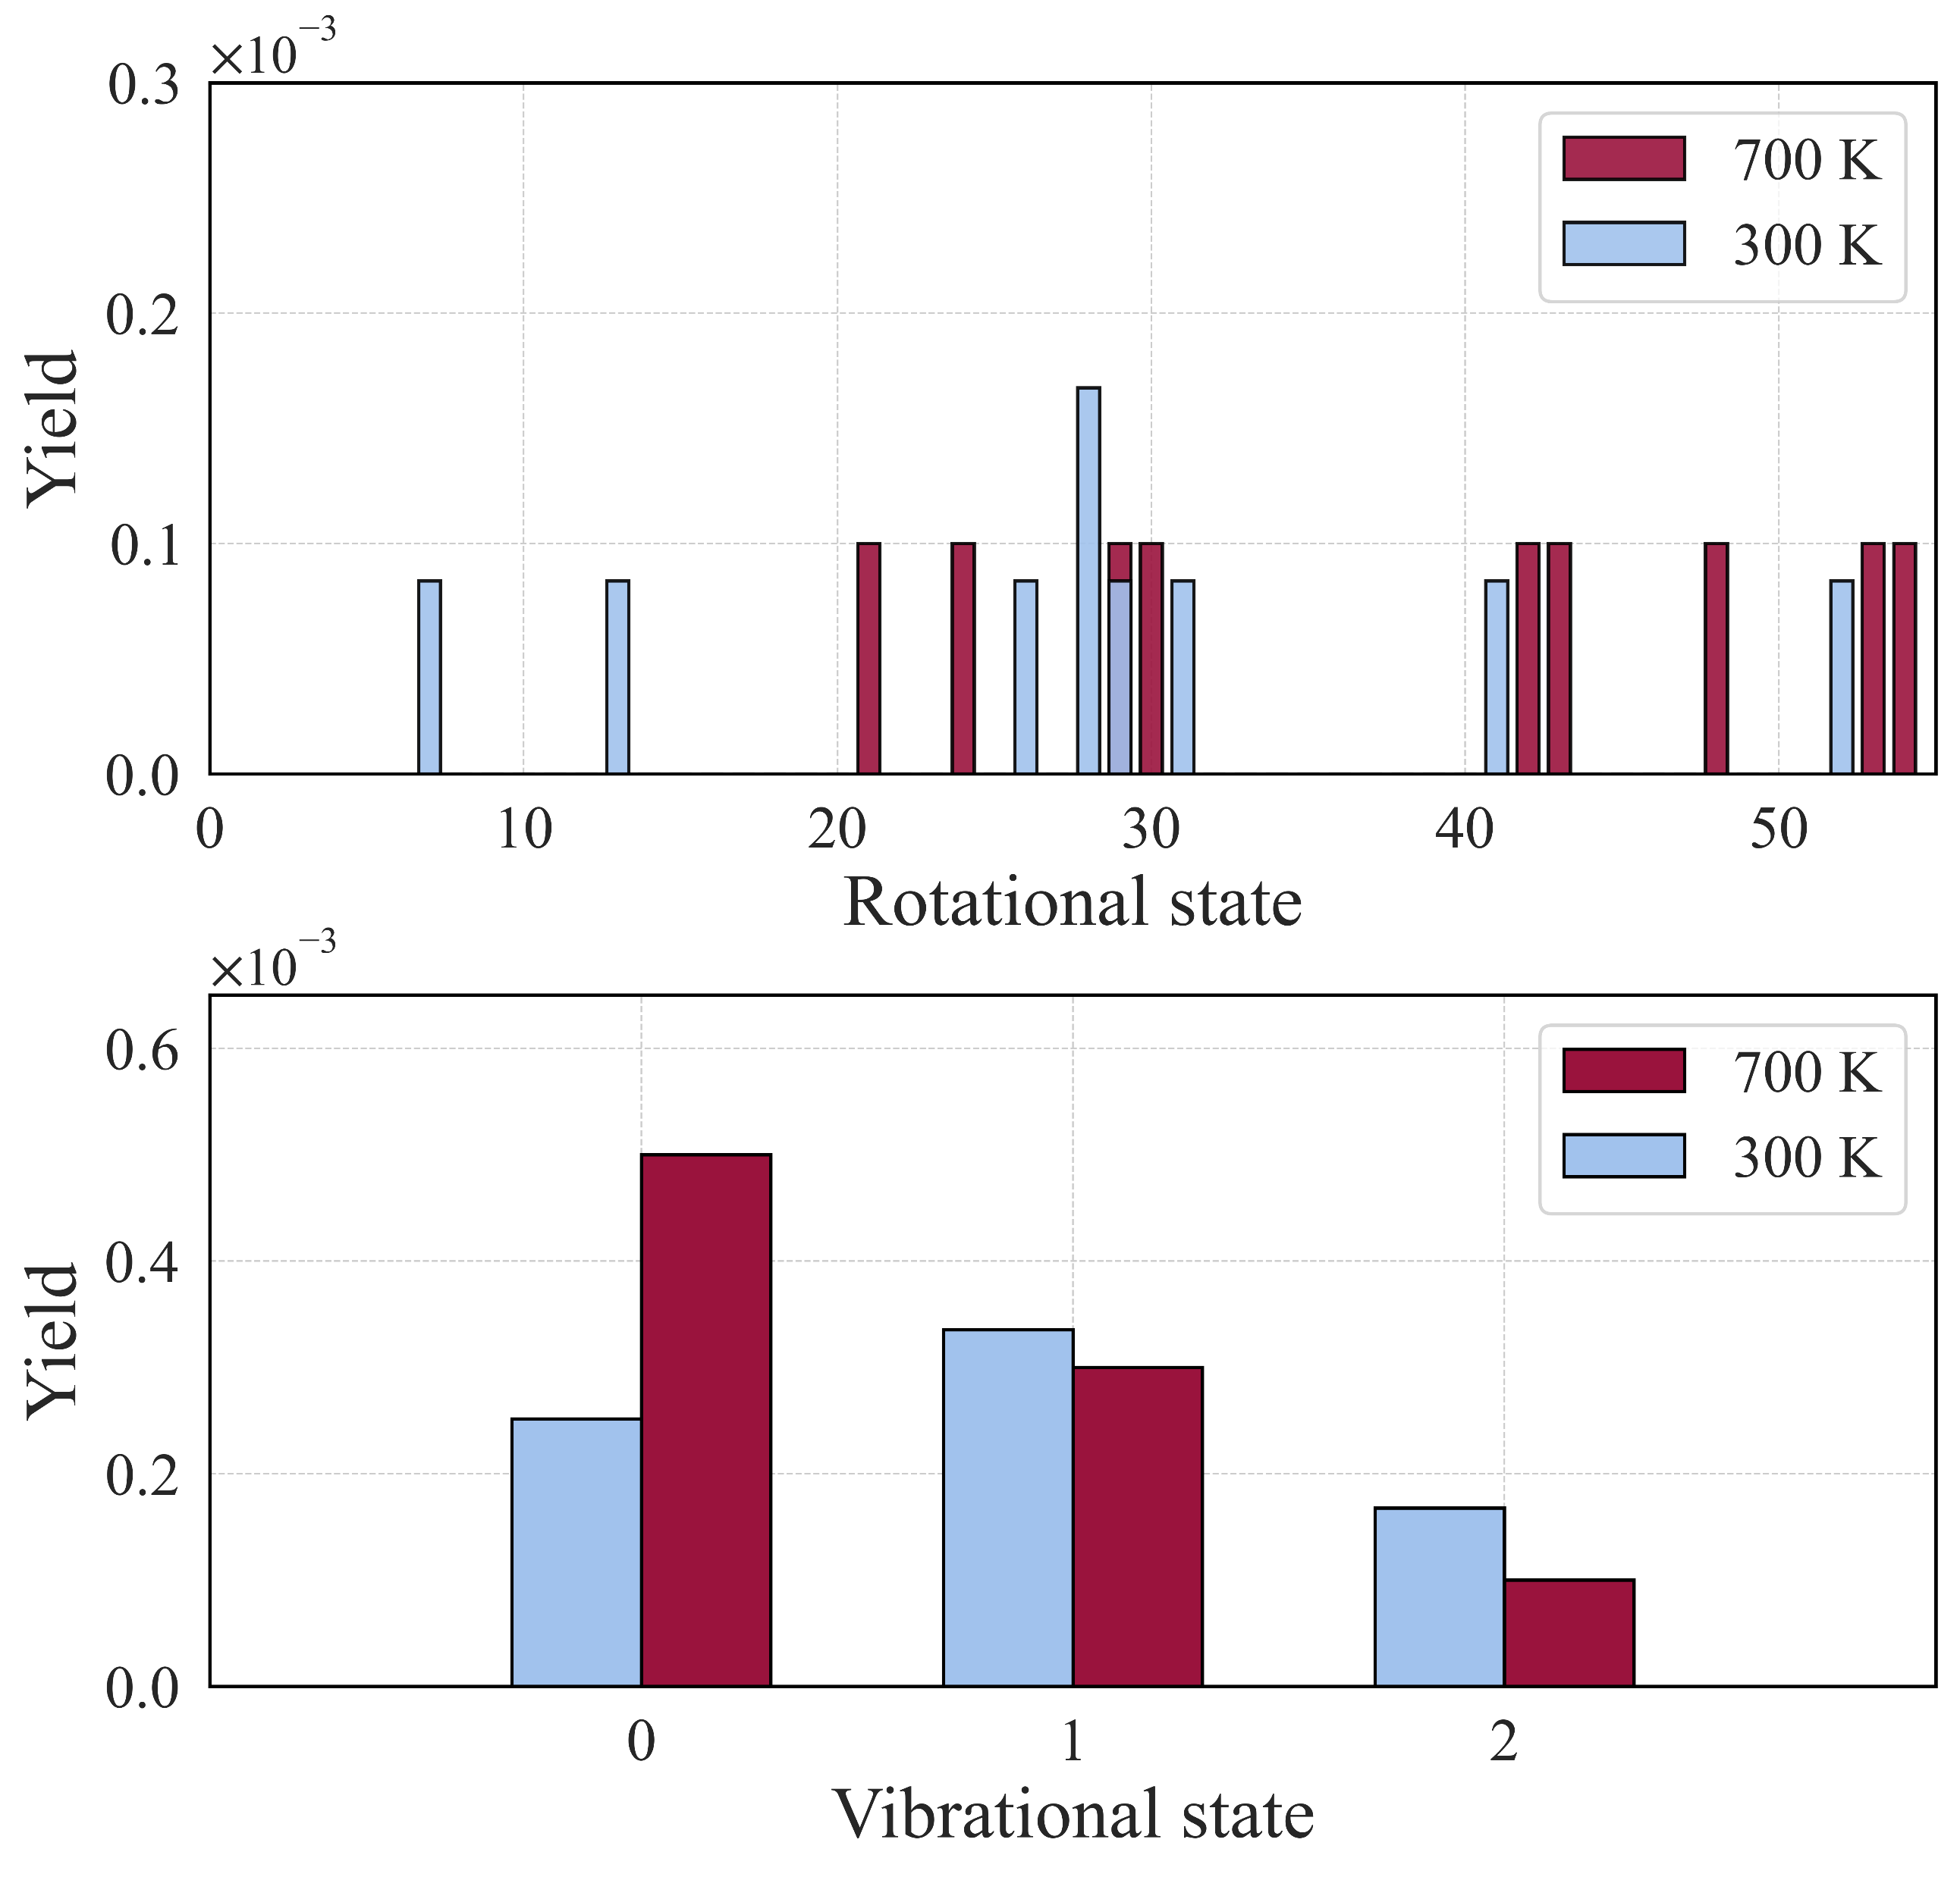
Ro-vibrational states: Sputtered W molecules
Surface temperature
An increase in surface temperature increases the formation of molecules in the vibrational ground state, while simultaneously reducing the yield of molecules in the excited vibrational states.
This result is consistent with the experimental findings from the Be limiters within the JET tokamak and our MD simulations of Be surfaces.
WD molecules for different surface temperatures (1500 eV, normal incidence angle )

Slide 13
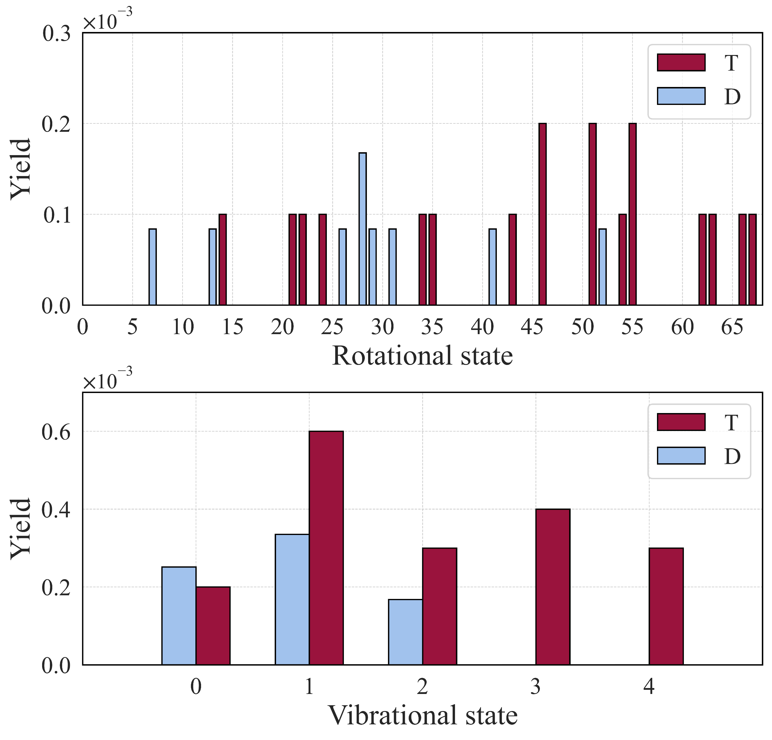
Ro-vibrational states: Sputtered W molecules
Hydrogen isotope
An increase in isotope mass corresponds to a rise in the number of molecules sputtered, moving from H with no sputtering to T with the highest molecular yield.
This is because of the significant improvement in the energy transfer efficiency between hydrogen isotopes and W atoms as the mass of the isotope increases.
The energy transfer from a T atom to a W atom is 1.5 times greater than from a D atom and 3 times greater than from an H atom.
Molecules with different hydrogen isotope (300 K, 1500 eV, normal incidence angle )

Slide 14
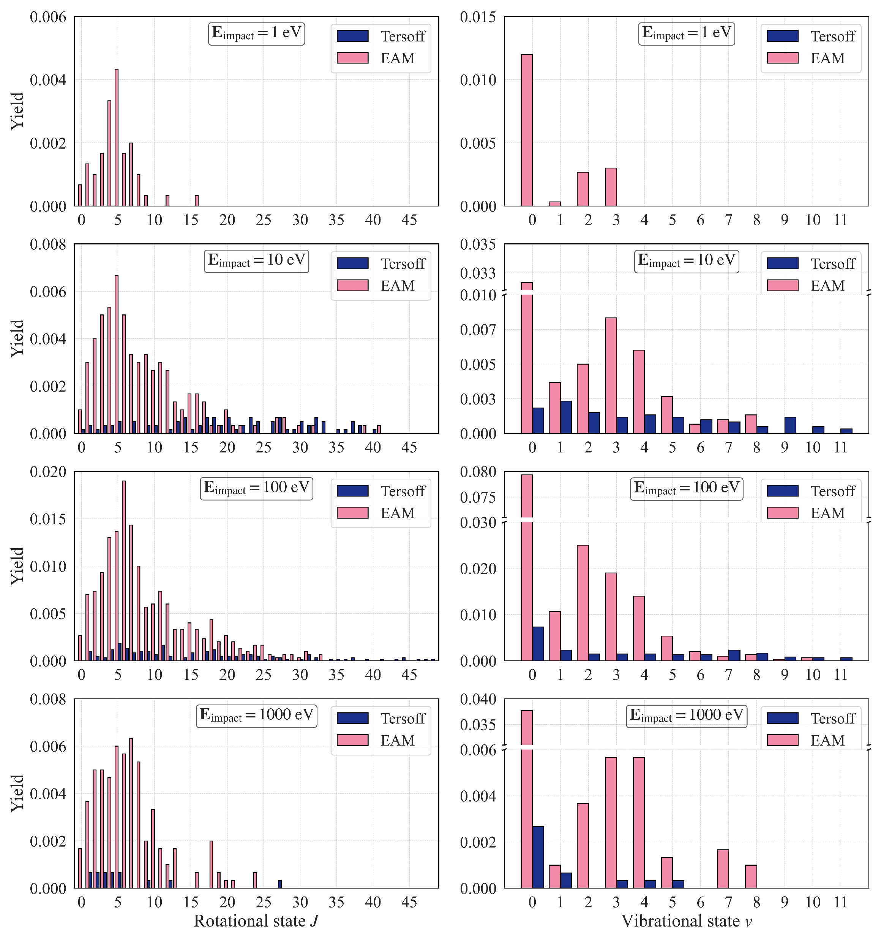
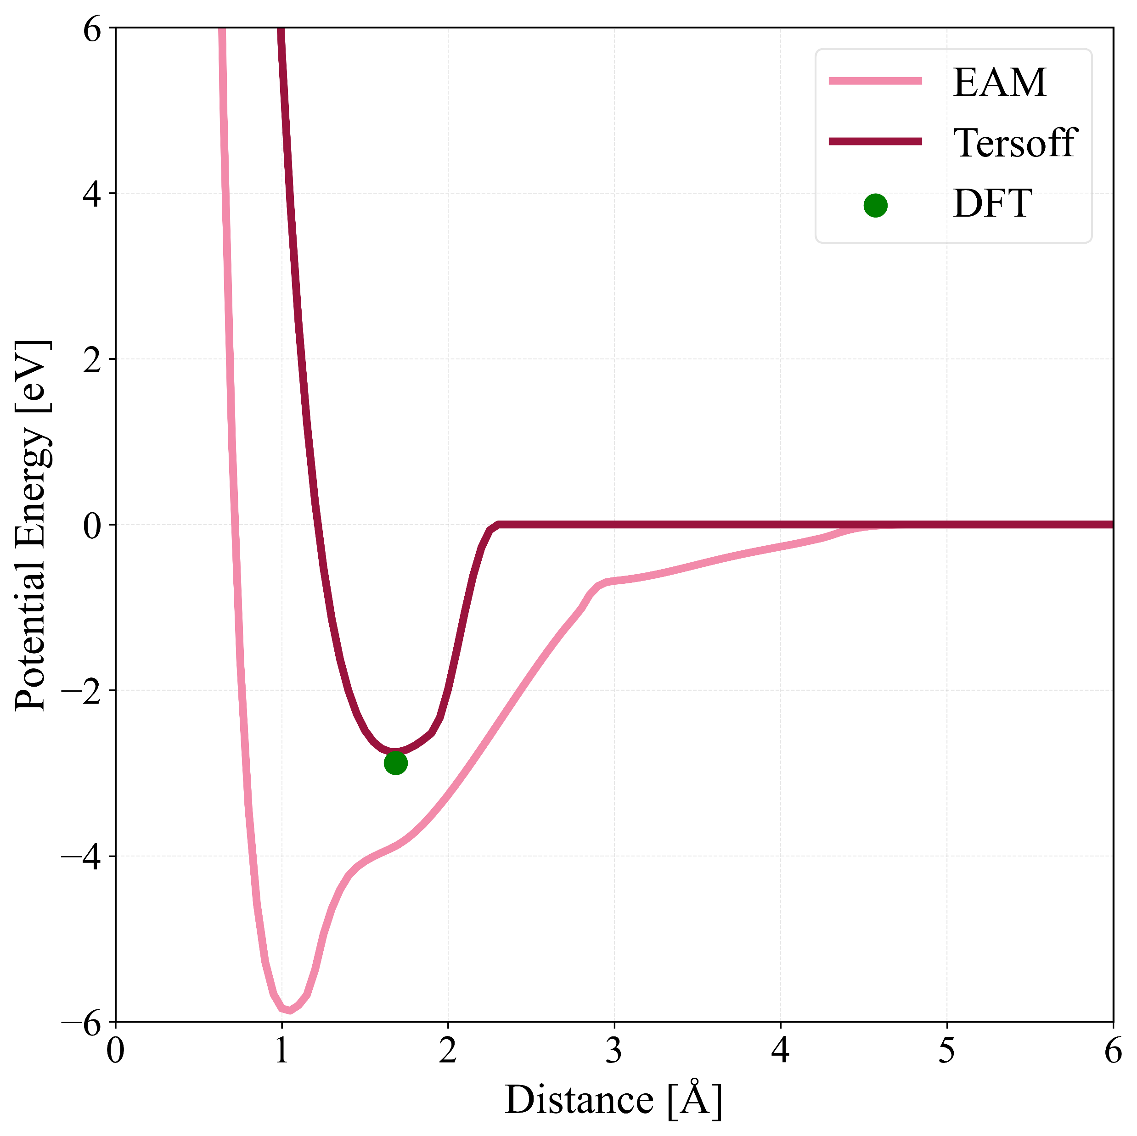
Ro-vibrational states: Recycled D₂ molecules
As the impact energy rises from 1 to 100 eV, a corresponding increase in the quantity of recycled molecules and their rotational and vibrational states is observed.
When the impact energy reaches 1000 eV, there is a notable reduction in the recycling yield due to the increased penetration depth of the projectile.
The recycling yield is significantly increased when the EAM potential is used.
Tersoff
EAM

Slide 15
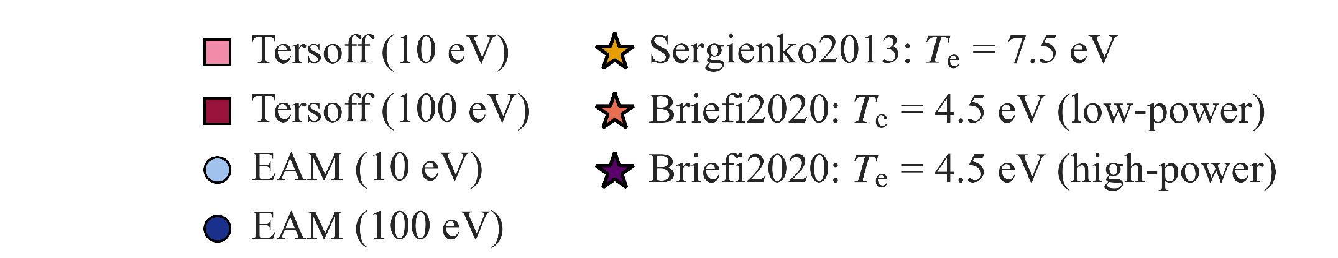
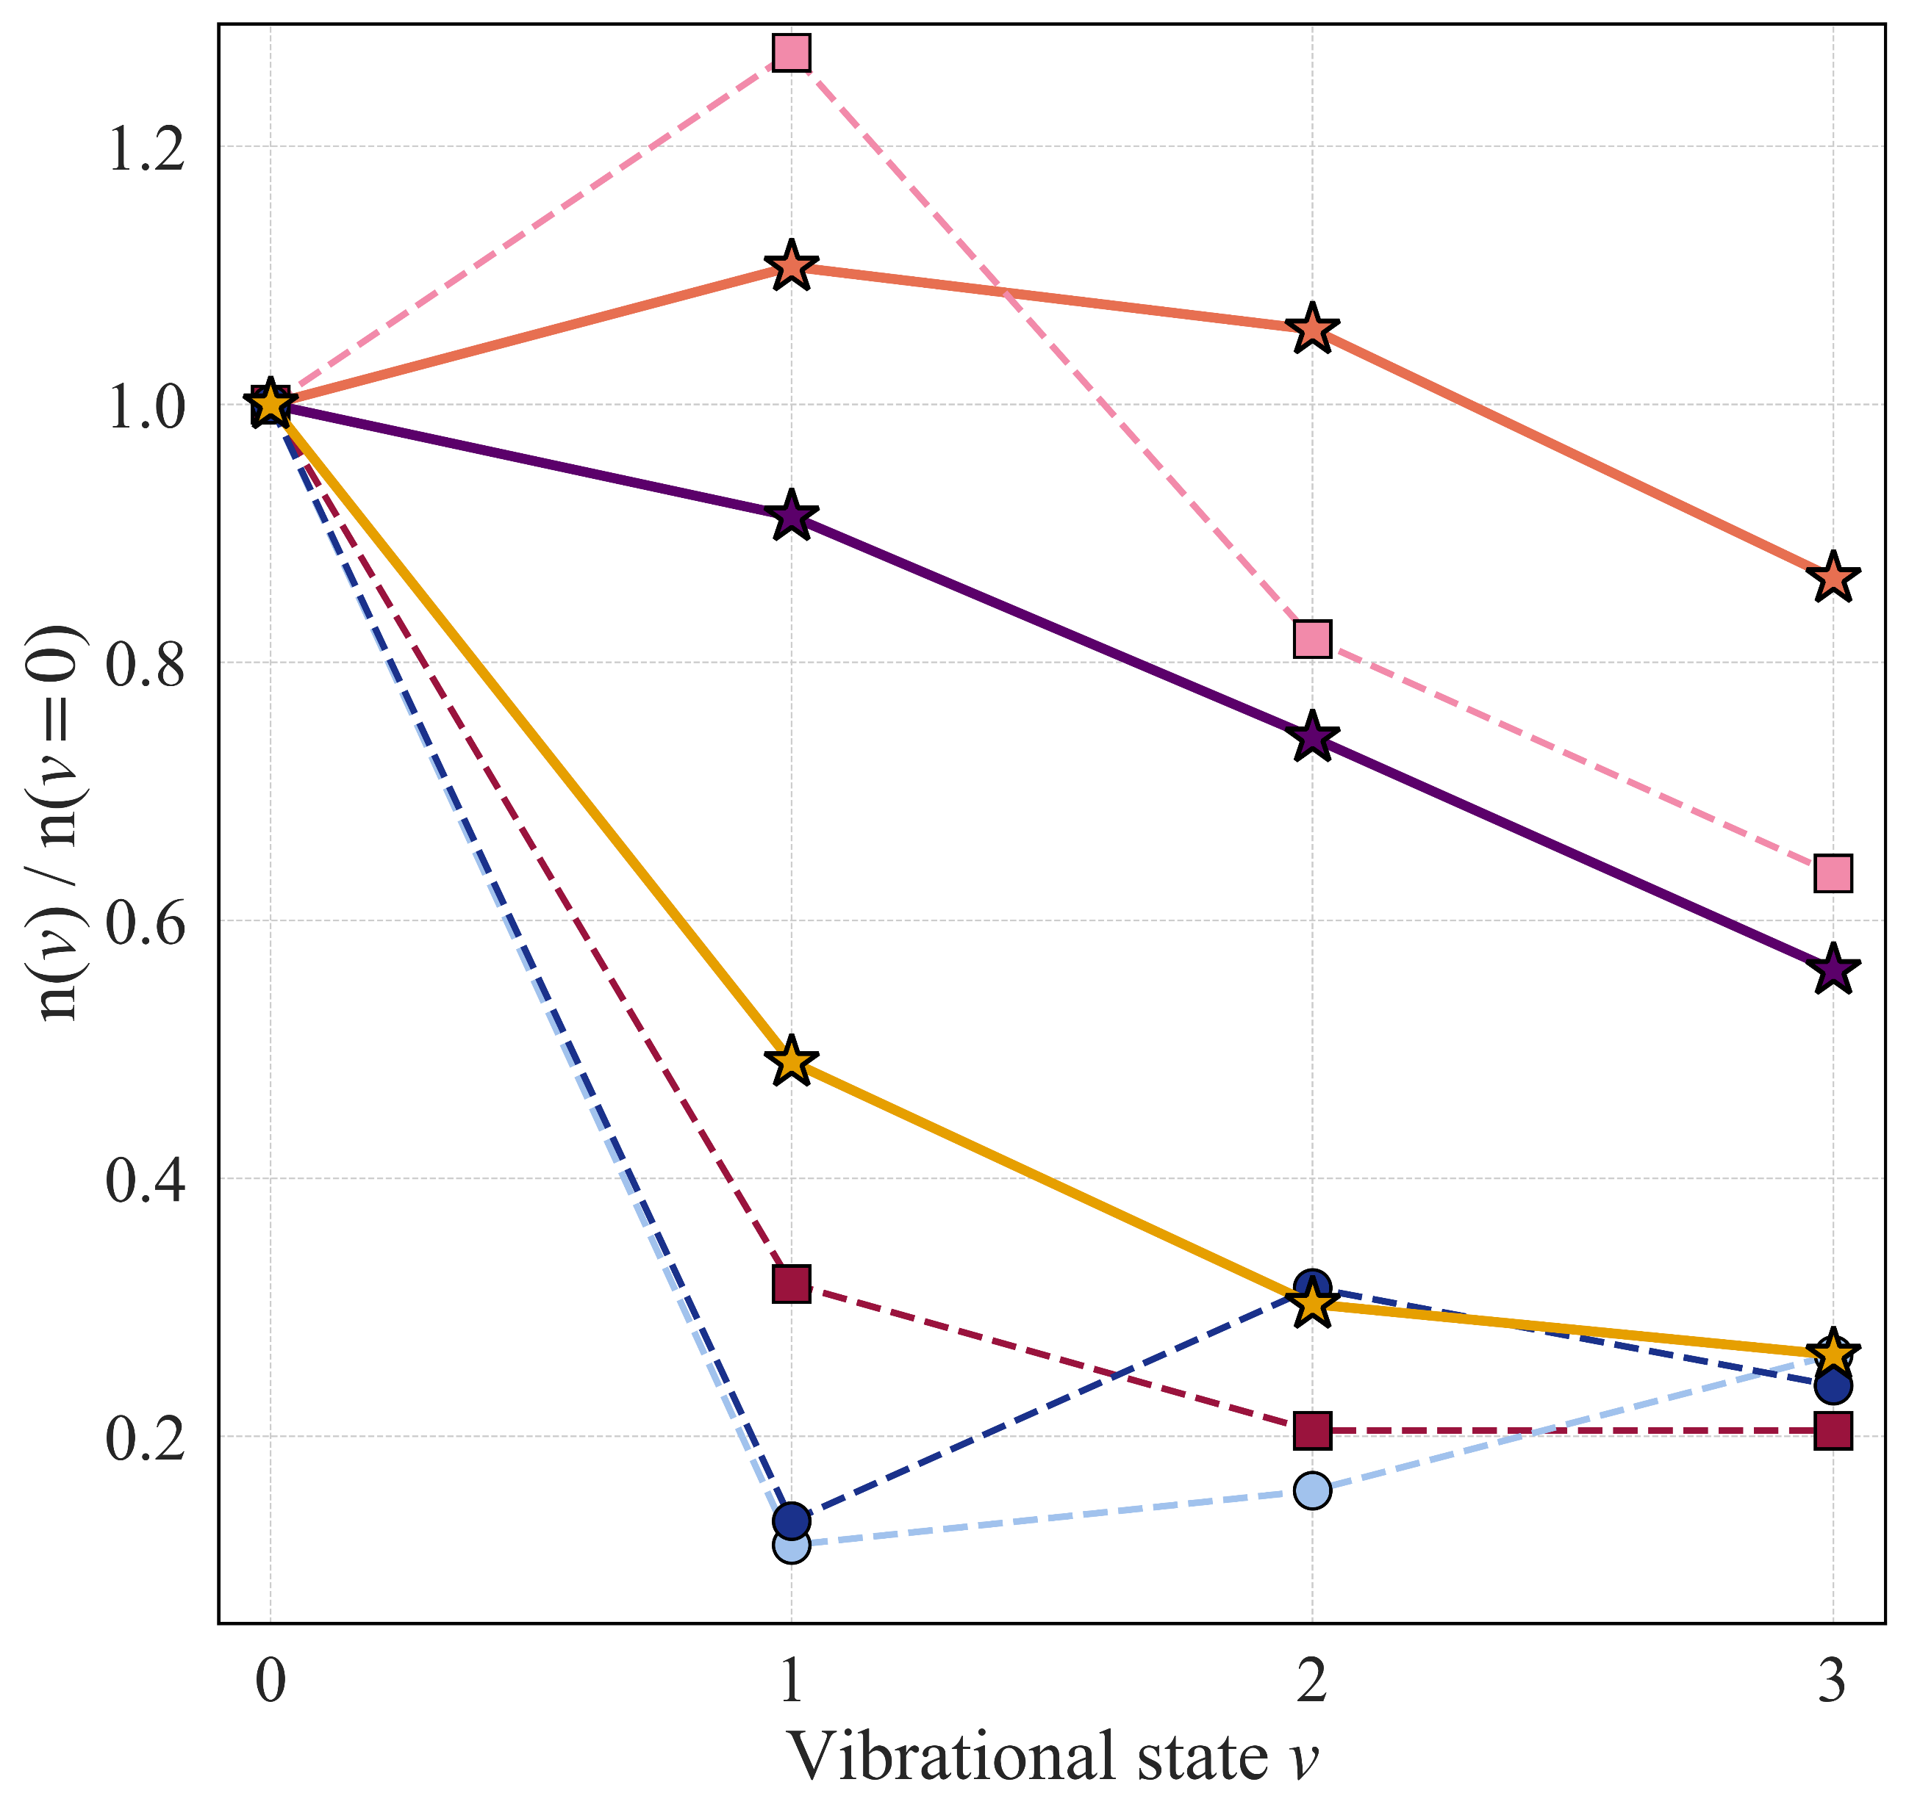
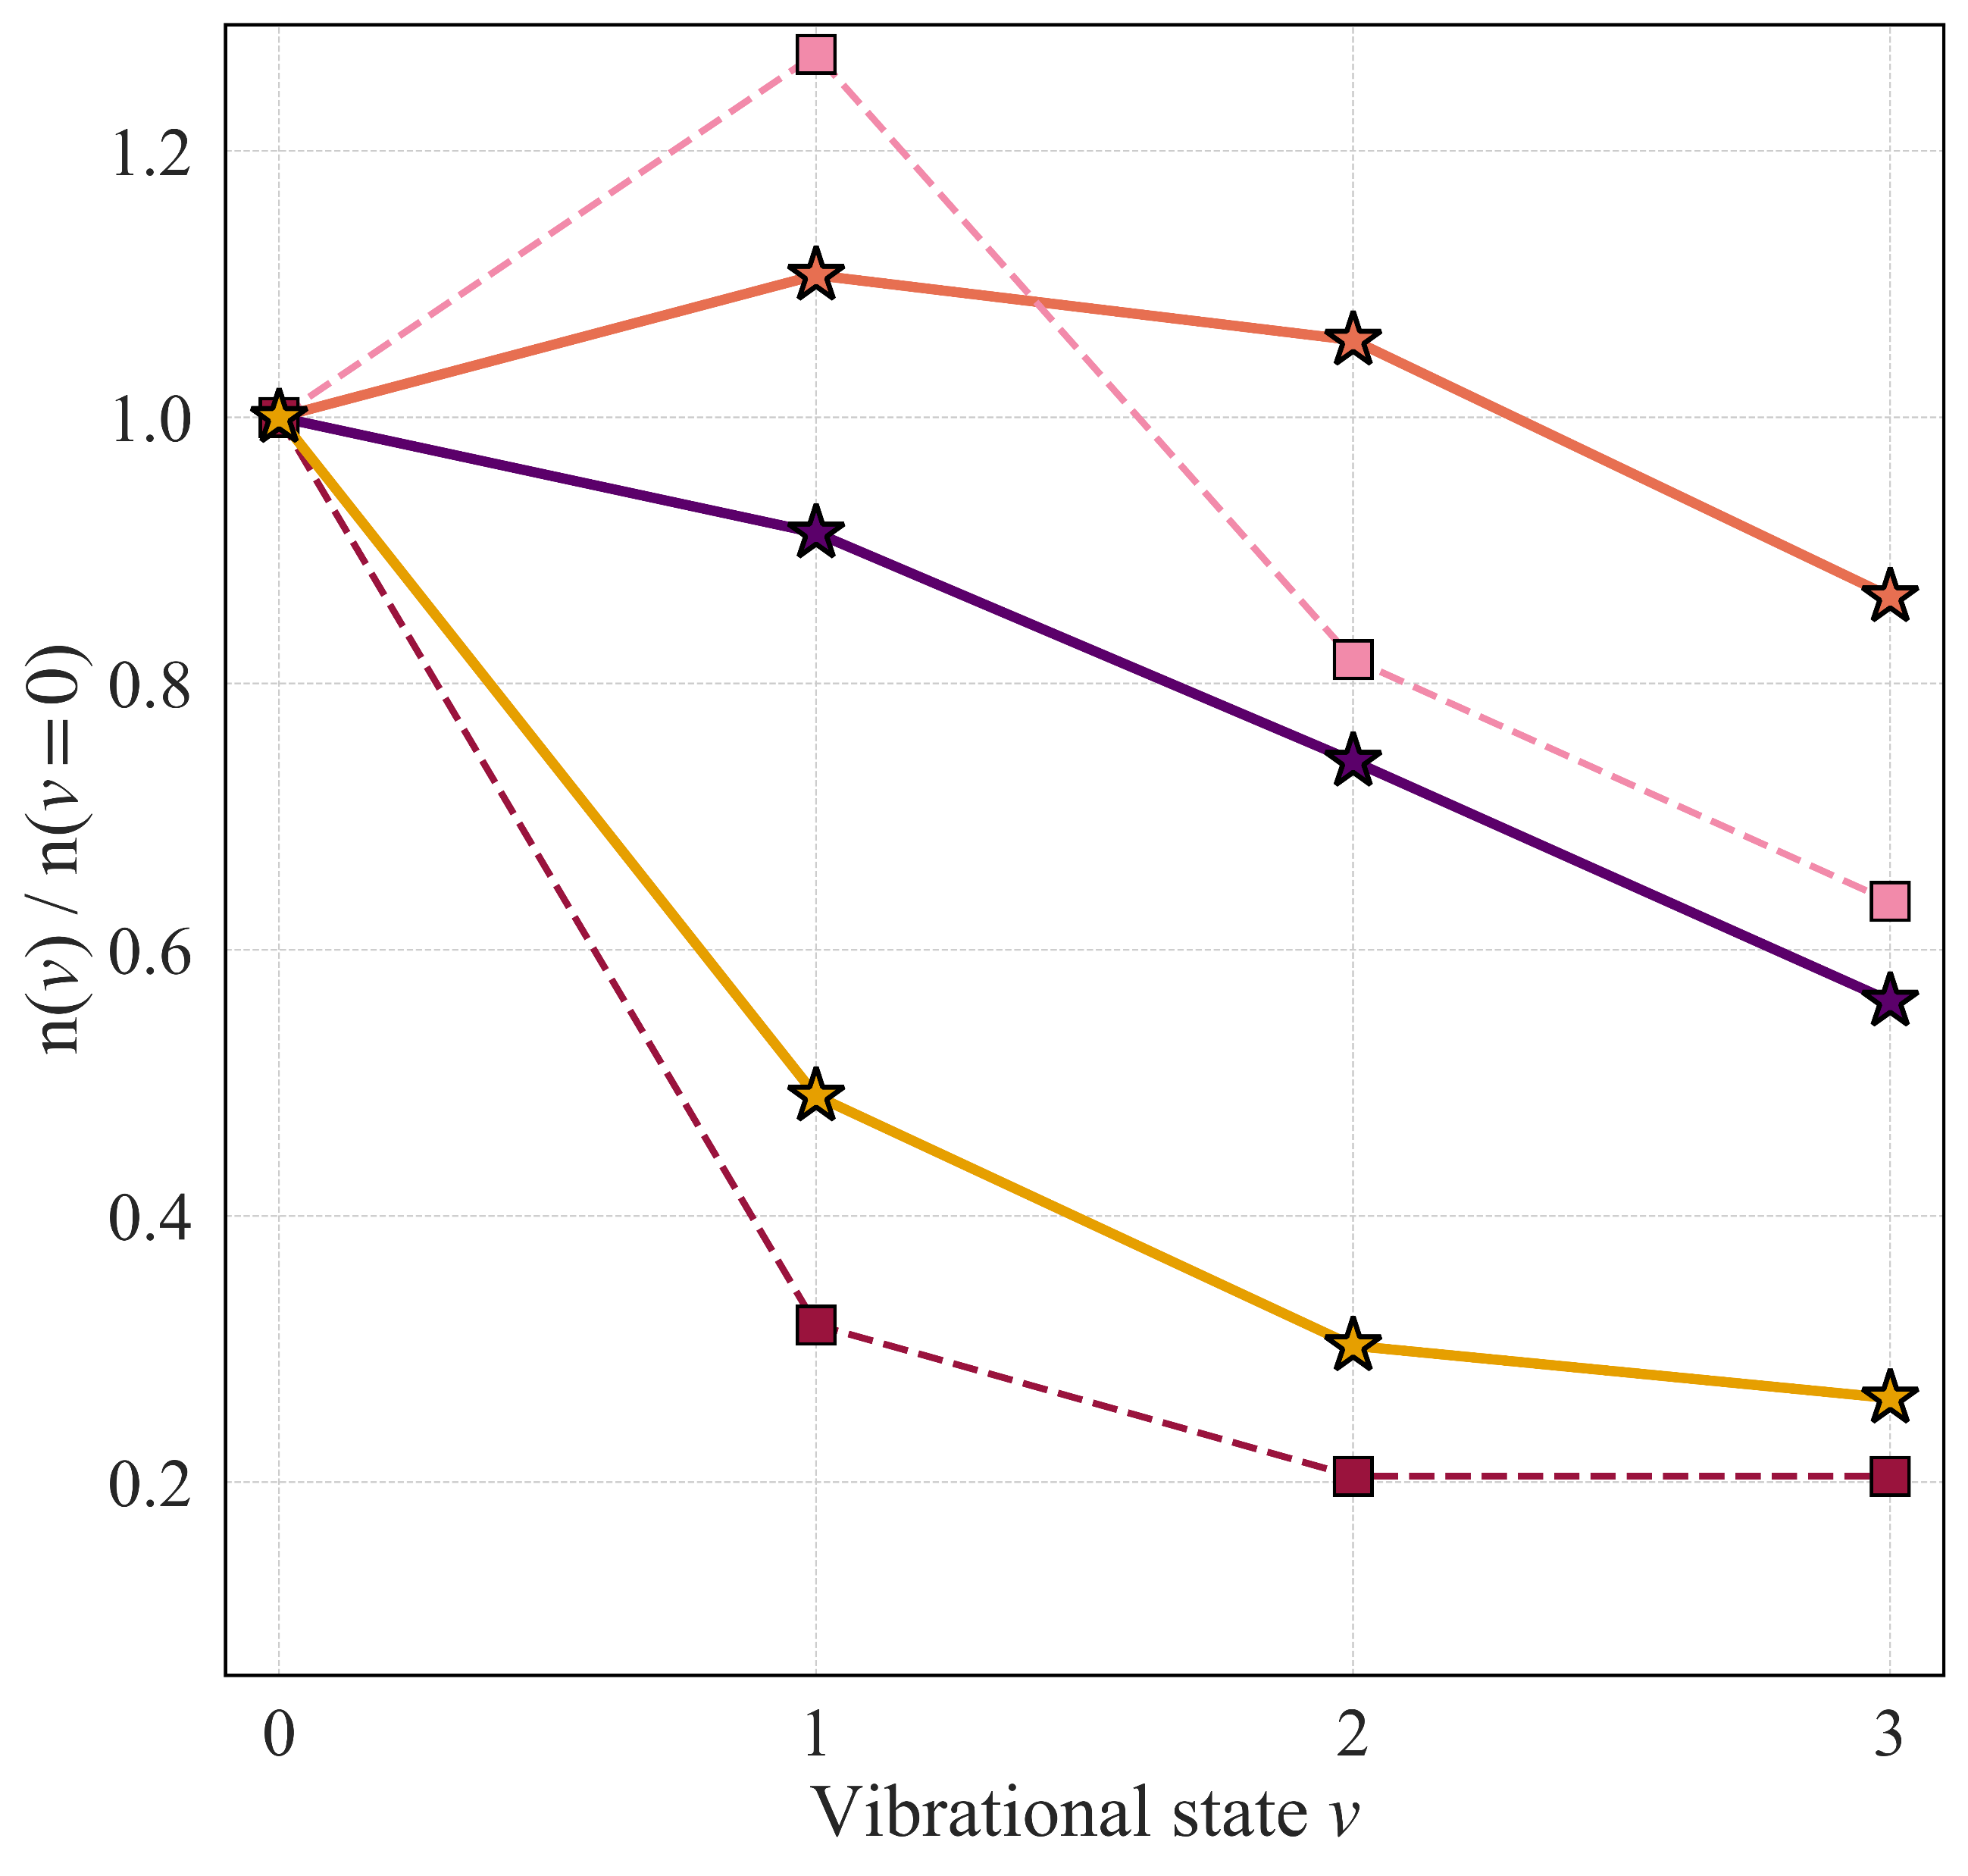
Ro-vibrational states: Recycled D₂ molecules
The Tersoff potential gives a higher population of vibrational states with respect to the ground state of the D₂ molecule.
The Tersoff potential exhibits better performance compared to the EAM, resulting in populations that align well with the experimental observations.
Both Tersoff and experiments suggest that when the impact energy increases, there is a subsequent decrease in the number of molecules in excited states, an effect that the EAM potential does not adequately predict.
G. Sergienko et al, J. Nucl. Mat. 438, S1100–S1103 (2013).
S Briefi and U Fantz, Plasma Sources Sci. and Tech. 29.12 , p. 125019 (2020).

Slide 16
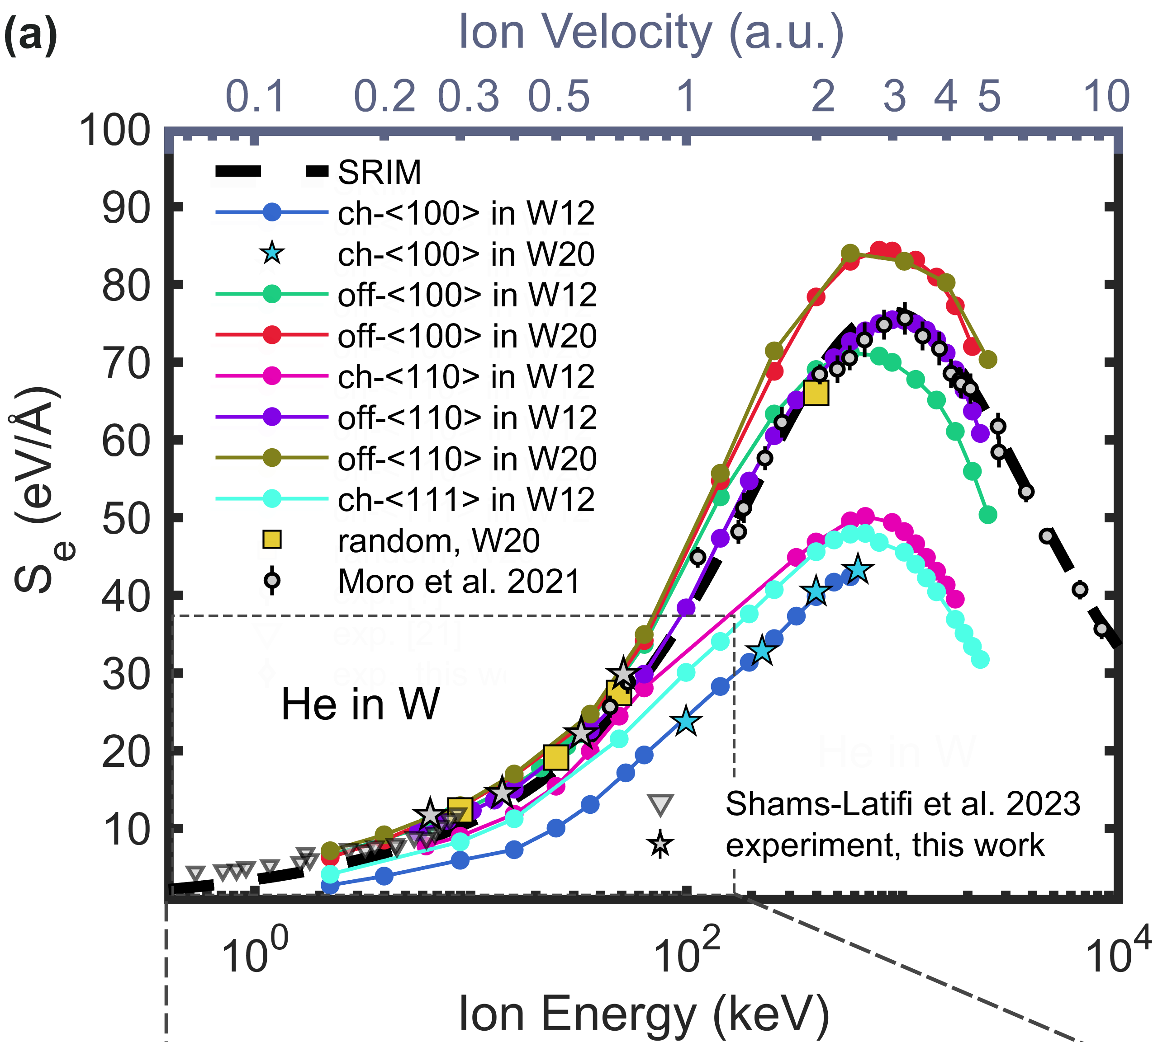
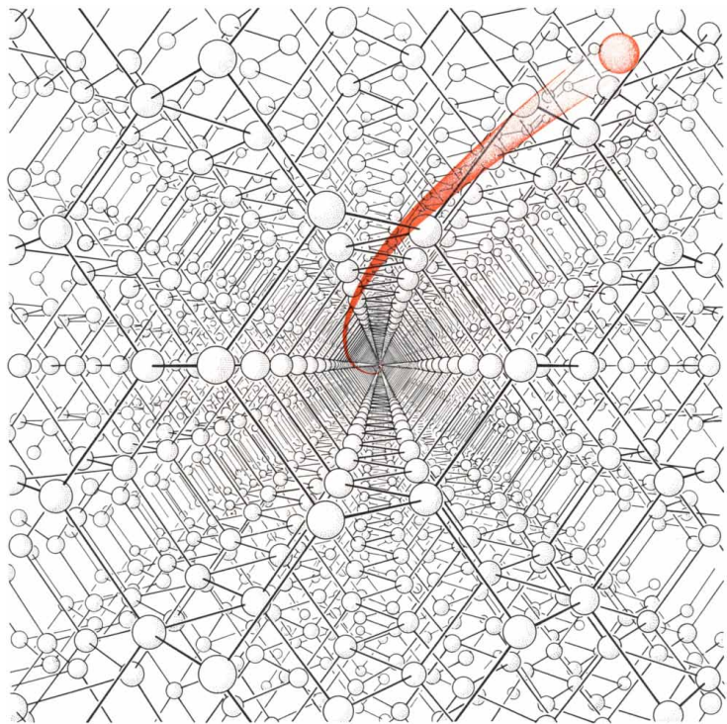
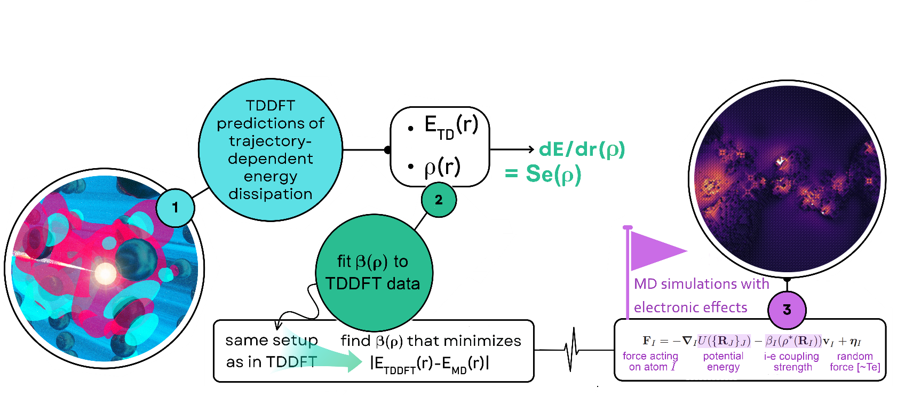
Trajectory-dependent electronic stopping
insights from TDDFT calculations
Pronounced trajectory dependence of electronic stopping even at low ion energies
Trajectory-dependent Bragg peak position
a framework for incorporating electronic effects into MD
standard models (e.g. SRIM) use orientation-averaged stopping, overlooking ion channeling, while our approach captures directional effects
M. Moro et al., Nucl. Instrum. Methods. B 498, 1 (2021).
J. Shams-Latifi et al., Nucl. Mater. Energy 36, 101491 (2023).
Tamm, Artur et al., Physi. Rev. Lett. 120.18 (2018): 185501

Slide 17
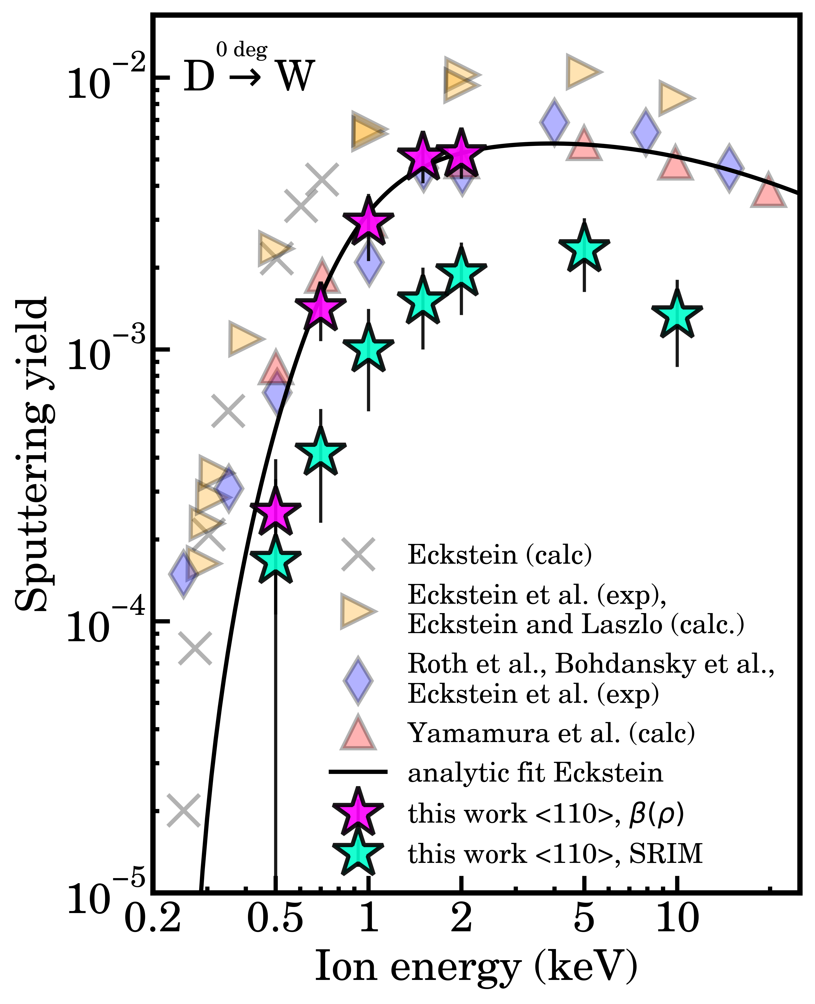
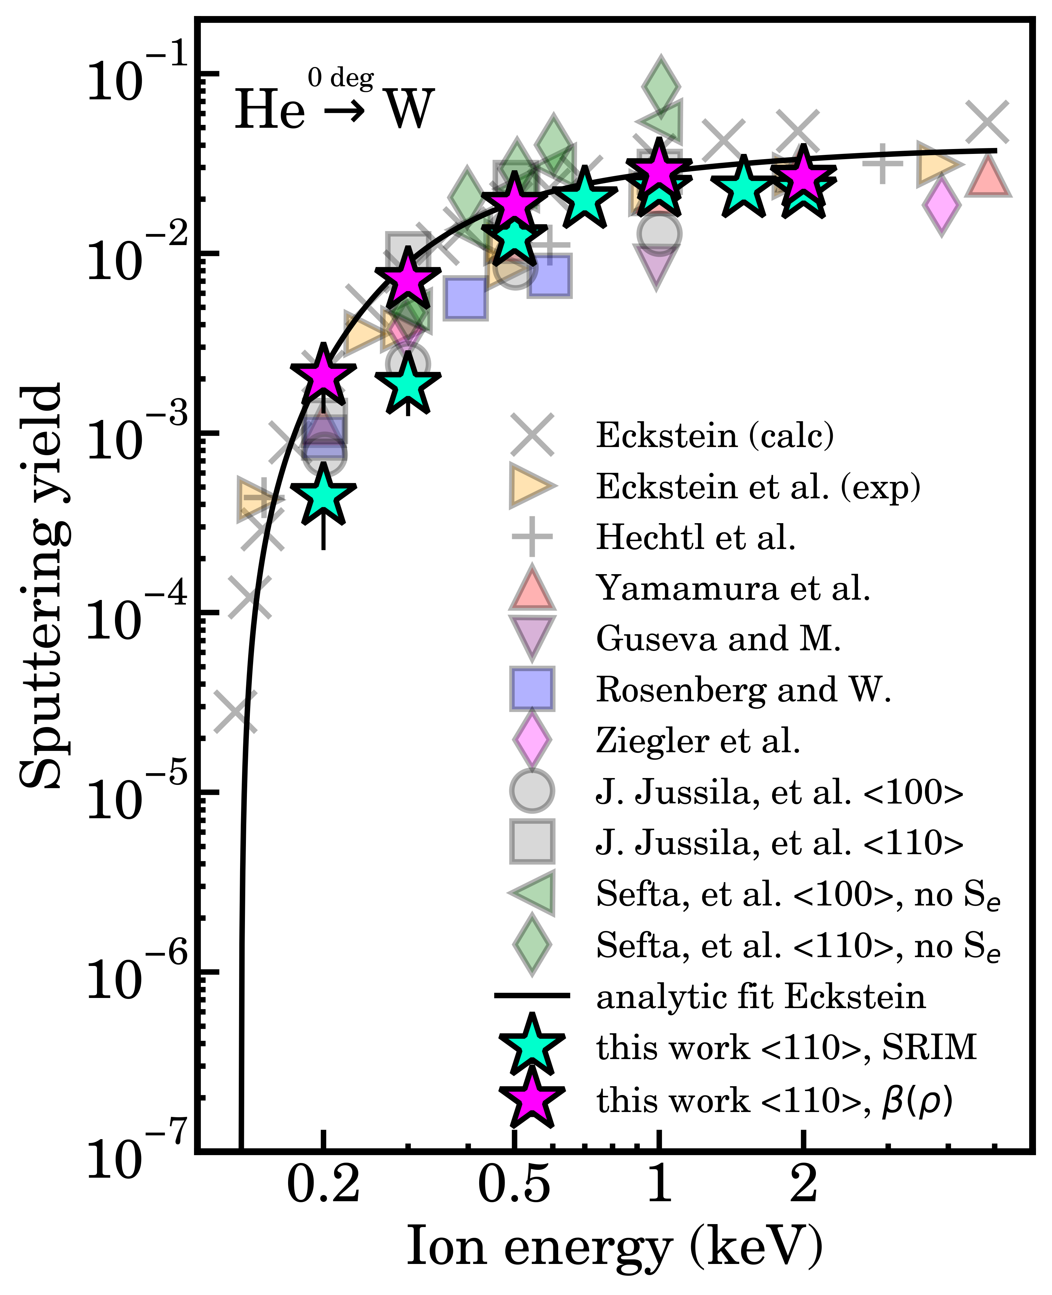
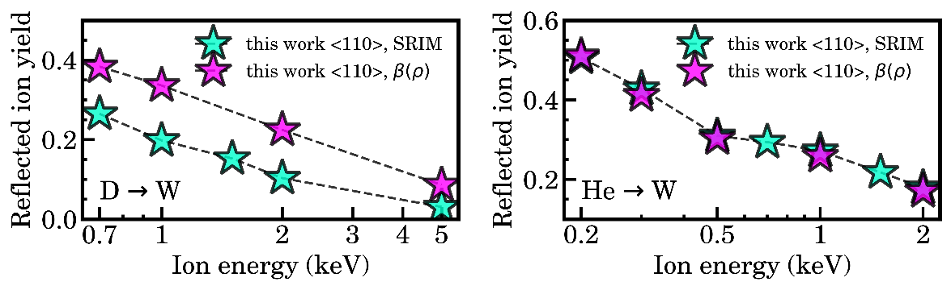
Electronic stopping in sputtering simulations
In our approach, the predicted sputtering yields for W irradiated by D are elevated and align more closely with experimental results.
A comparable trend is evident with He, although it is less pronounced.
Trajectory-dependent electronic stopping generally enhances agreement with experiments.
This happens because SRIM overestimates the energy losses for channeling ions.
R. Behrisch and W. Eckstein, Springer (2007).
Y. Yamamura at al., National Inst. for Fusion Science (1995).
F. Sefta et al., J. Nucl. Mat. 438, S493-S496 (2013).
J. Jussila et al., Nucl. Mater. Energy 17, 113-122 (2018).

Slide 18
Thank you for your attention!
nima.fakhrayimofrad@aalto.fi

