Slide 1
WPTE – highlights in 2025 and plans for 2026-2027
Links to WPPWIE activities
WPPWIE Review Meeting, Jülich, 17-21 November, 2025
A. Hakola for WPTE TFL team
E. Tsitrone, N. Vianello, M. Baruzzo, J. Garcia, A. Hakola, V. Igochine, D. Keeling, B. Labit
With many thanks to RT06 RTCs: Y. Corre, K. Krieger, A. Widdowson and the RT06 team

Slide 2
Outline
How does WPTE work?
Recent selected highlights
Plans for 2026-2027

Slide 3
Outline
How does WPTE work?
Recent selected highlights
Plans for 2026-2027

Slide 4
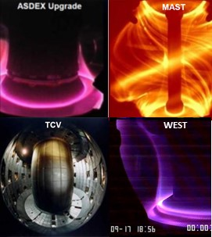
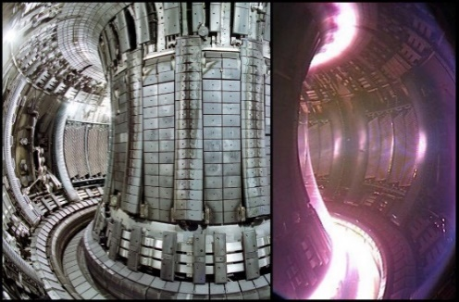
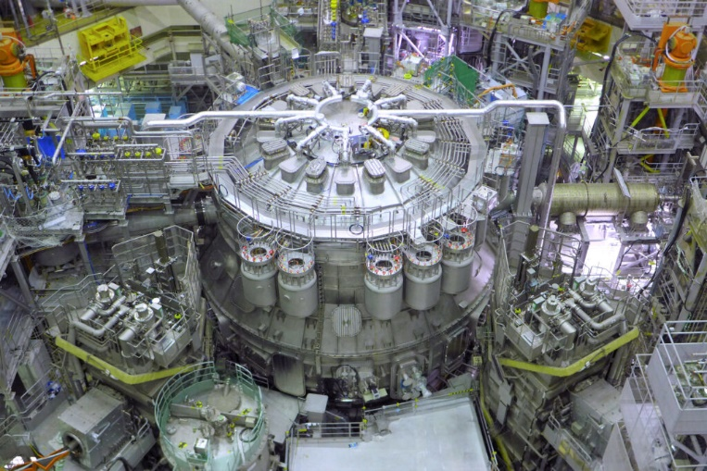
WPTE: coordinating the programme on EU tokamaks
Overarching goals of WPTE:
Preparations for ITER operation
Provide physics basis for guiding the design of future fusion devices while building a pan-European team for the scientific exploitation of fusion devices
  > 600 participants from >20 labs
-U
WPTE addresses primarily the following missions of the EUROfusion roadmap:
Mission 1 (Plasma Regimes of Operation)
Mission 2 (Heat exhaust System)
WPTE coordinates the scientific programme on complementary EU tokamaks:
Running the WPTE share of experimental time on AUG, MAST-U, TCV and WEST
Analysing data from past JET campaigns
Preparing the scientific exploitation of JT-60SA (since 2024)
JET
WPTE also involved in:
International collaboration (US: no ELM scenarios, KSTAR, EAST)
Support to WPTE device enhancements
JT-60SA

Slide 5
Tokamak Exploitation Research Structure pillars
We can also express the goals in a graphical form, using four pillars:
ITER Research Plan (now considering the rebaselining)
Input from discussion on FPP or FOAK EUROfusion discussion
PEX exploitation
Preparation of future JT-60SA, identified EUROfusion priorities including
Development and investigation of high performance scenarios compatible with future W-PFCs
Avoidance and mitigation of disruptions and runaway electrons
Fast ion physics
Development and validation of (high-level) real-time control strategies
01
ITER Research Plan, including Rebaselining and ITPA
02
Next step physics gaps
03
PEX exploitation
04
Preparatory work for future JT-60SA exploitation

Slide 6
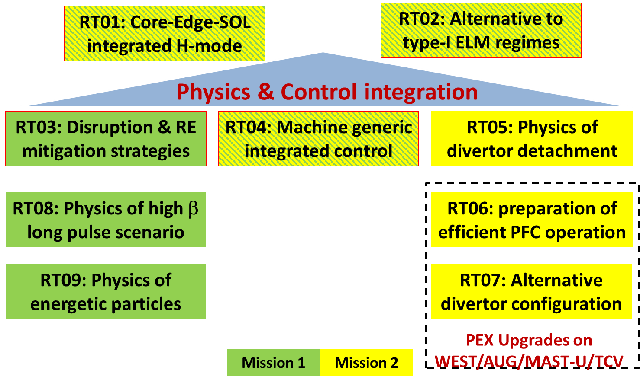
WPTE is organized in 9 programmatic Research Topics
Of main interest for PWIE
JET RT :
RT10 : JET data validation
RT11 : experiments run before 2023 and not included in the main RTs
JT-60SA RT :
RT12 to RT18, reflecting the structure of the EU-JA Experimental Team (RT17 : Divertor, Scrape Off Layer and Plasma-Material Interaction)

Slide 7



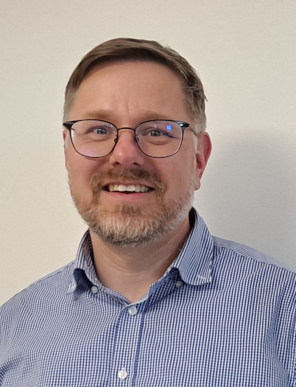
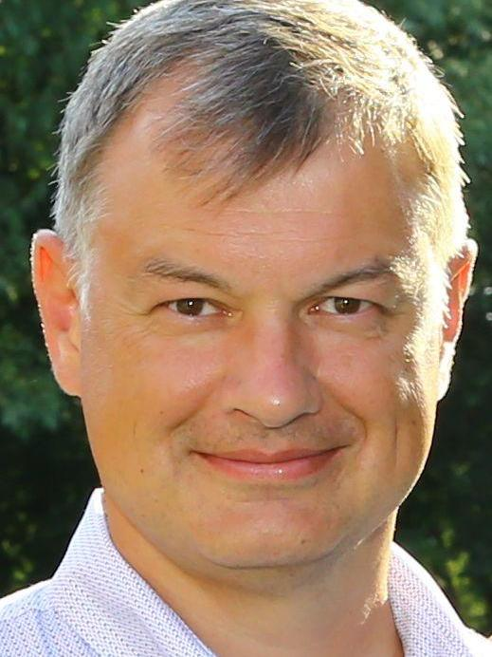

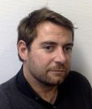
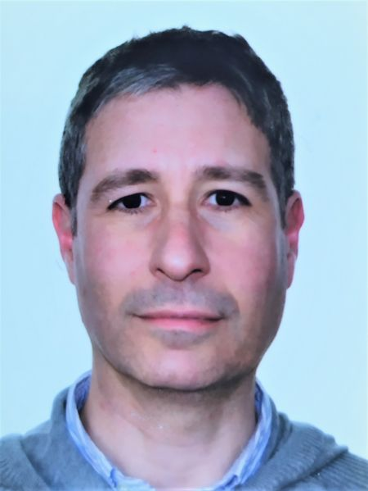
WP TE is run by a collegium of Task Force Leaders …
… and a large team of Research Topic coordinators (new selection for 2026-2027)
M. Baruzzo/ ENEA
DTFL
* Will step down in the end of 2025, new DTFL to be approved in the GA meeting in Dec
E. Tsitrone / CEA
TFL
N. Vianello / ENEA
TFL
A. Hakola / VTT
DTFL
V. Igochine / MPG
DTFL
D. Keeling / UKAEA
DTFL
B. Labit / EPFL
DTFL
J. Garcia / CEA
DTFL – JT-60SA ETL
RT06 RTCs: Y. Corre, K. Krieger, A. Widdowson (2025)
Y. Corre, A. Kirschner, K. Krieger (2026-2027)
Contact TFLs for PWIE : E. Tsitrone, A. Hakola
For more information : check the WP TE wiki
https://wiki.euro-fusion.org/wiki/WPTE_wikipages:_Tokamak_Exploitation_Work_Package

Slide 8
Building the WPTE programme: yearly cycle of calls
Call for experimental proposals for year n+1
  Review meeting : mid year status of progress (RTC) – September 2025
  Call for experimental proposals : early fall (TFL) – completed for 2026-2027
  General Planning Meeting : priority for proposals received and shot allocation within % of experimental time allocated to WPTE on each device as defined by EUROfusion GA (TFL) – held in Lausanne in 4-6 November, 2025
Year n
Call for participation for year n+1
  Call for participation (TFL) : late fall – call for 2026 staffing open until 05 December, 2025
  Staffing selection before Xmas/early January (TFL) - pending
Experimental Campaign year n+1
  Strategy meeting : early year (RTC) – tentatively 19-20 January 2026
Year n+1

Slide 9
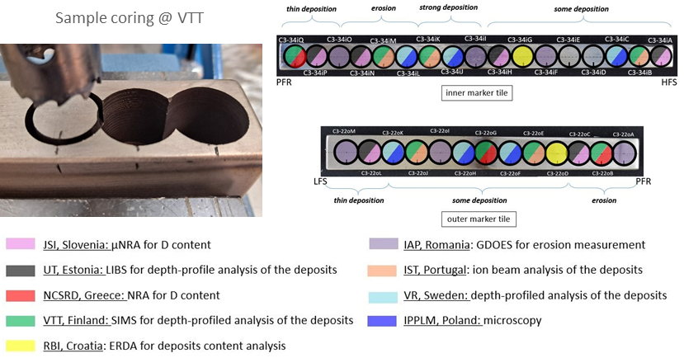
Strong links between WP TE and WP PWIE
Post mortem analysis of components exposed in tokamaks (SP B, SP E, SP A)
Key for understanding material migration / fuel retention and recovery / PFC ageing in tokamaks …
WPTE (RT06): component exposure / dedicated experiments in tokamaks
WPPWIE : pre/post exposure analysis of components from metallic machines AUG, JET, WEST (SP B, SP E) + comparison with experiments in linear devices/HHF facilities (SP A, SP B)
Plan for WEST samples analysis (SP B)
PWI modelling (SP D, SP C)
WPTE (RT06, RT05, RT07 …): dedicated PWI or plasma exhaust experiments, associated plasma background modelling (SOLEDGE, SOLPS, PIC modelling …) and targeted PWI modelling aspects (upon agreement)
WPPWIE (SP D) : PWI modelling (ERO2.0, MEMOS-U, WallDYN …) using WPTE plasma background
NB: has to be adjusted at best, given available resources in TE/PWIE
Specific topics of common interest (SP C, SP X, SP F)
Fuel retention and removal – including tritium
Alternative Divertor Configurations (ADC) in the past (now RT07)
Laser based diagnostics at JET: LID-QMS under TE, LIBS under PWIE
Topics for ITER new baseline: boronisation (WPTE metallic fusion devices, WPPWIE test devices)

Slide 10
Outline
How does WPTE work?
Recent selected highlights
Plans for 2026-2027
Not shown today :
RT05 : XPR demonstrated in all TE devices (incl JET), work on impurity mix (N₂ ➔ Ne, Ar), reduced models for divertor re-attachment
RT07 : continuation of exploration of ADCs (MAST-U, TCV) showing continuum from SN to ADC, DN in WEST, AUG new upper divertor provided promising ADC results at high powers in H-mode
RT01/RT02 : modelling of the wall sources (JET high current seeded scenario ➔ ITER baseline)

Slide 11
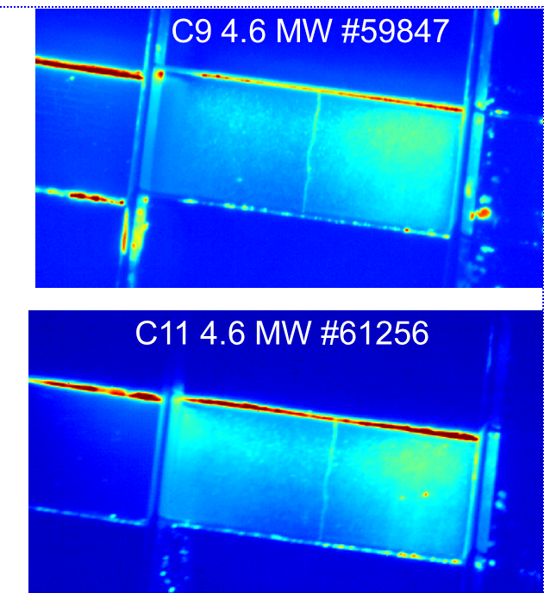
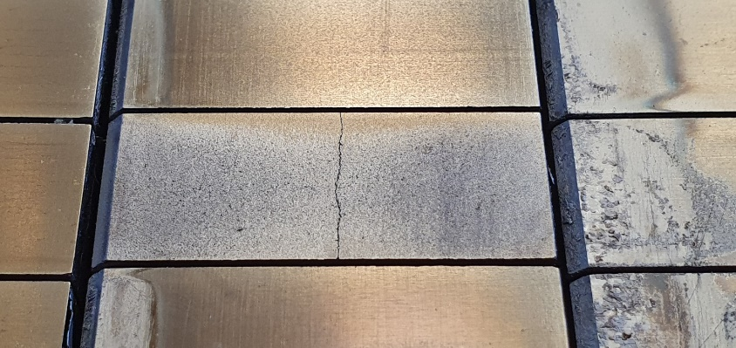

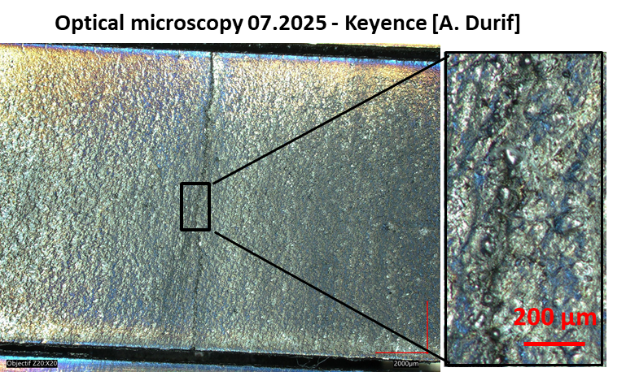
WEST | RT06 | Pre-damaged PFU exposure: Follow-up experiments
SCs: A. Durif, Y. Corre, M. Richou
1st generation: crack network tested (pre-damage induced by transients)
2nd generation: self-castellation induced by repeated steady-state thermal cycles
Pre-dam#3 (C8-C11)
1 follow-up pulse for pre-damaged#3 achieved at 4.6 MW (no apparent evolution)
Self-castellation
MB27
~12 hours of plasma
  Macro-crack now filled with deposit!?
ITER relevant plasma exposure (12 hours) and thermal cycling (3000)
  High D fluence, max heat load 11 MW/m²
  No observable evolution of the damaged surface (IR data)
IR data and post-mortem analyses ongoing

Slide 12
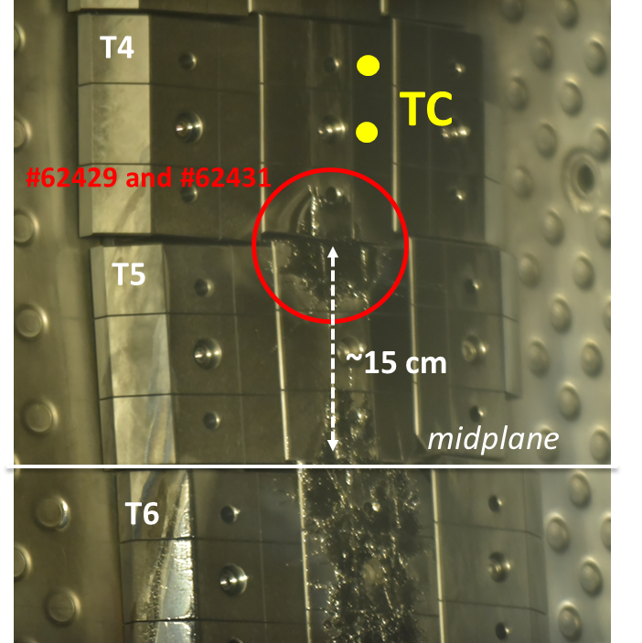
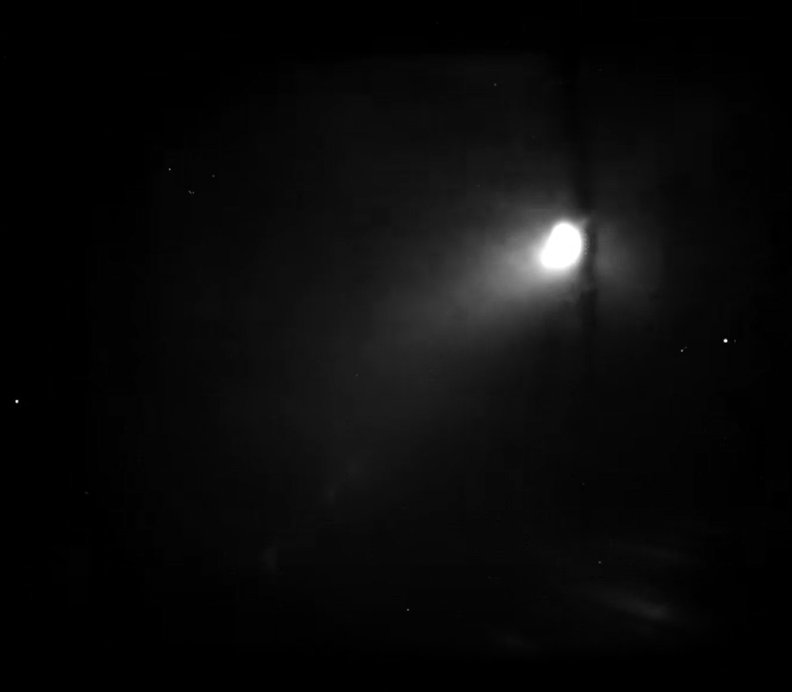
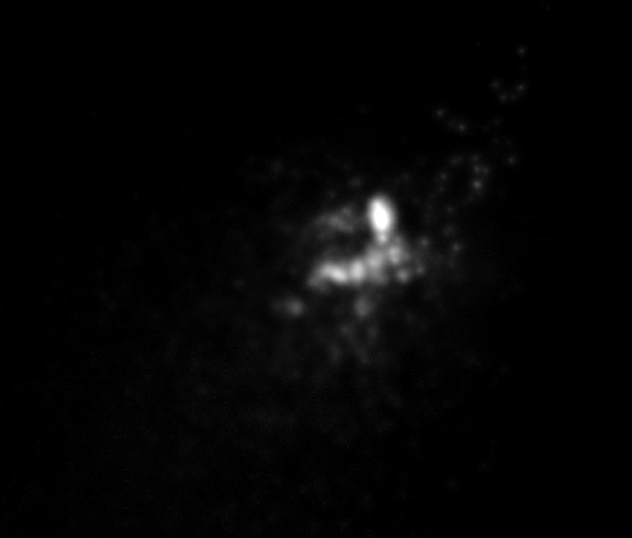
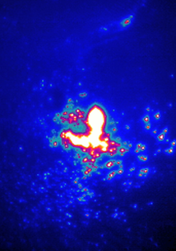
WEST | RT06+RT03 | W PFC damage induced by runaway electron incidence
SCs: S. Ratynskaia, K. Krieger, C. Reux, Y. Corre
RE formation scenario developed by RT03: post-disruption, Ar injection + I_{p} ramp-up
Move plasma in the vertical direction after disruption: ΔZ=+10 cm (62429) and +15 cm (62431)
2 RE impact achieved on upper tiles, between tile 4 and 5 (debris observed by fast visible camera)- 5 cm below the desired Z value @ middle of tile 4 (location of the embedded TCs)
PFC damages and melting confirmed by visual inspection – damages generated by two impacts 62429 & 62431
Fast visible (2KHz)
Fast IR (4KHz)
62429
62431
RE beam impact
After RE beam impact
New impact 15 cm above midplane (between tile 4 and 5 ) for modelling purpose only
RT03 impacts

Slide 13
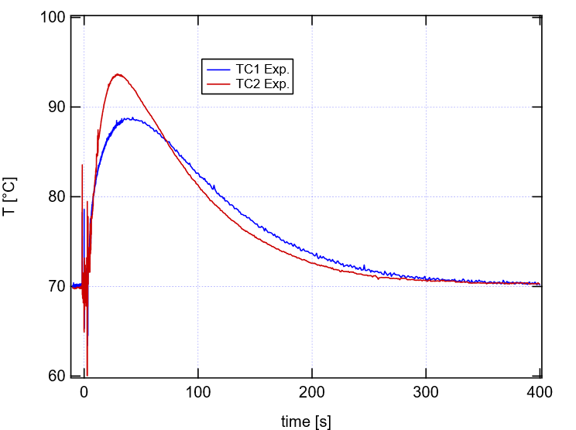
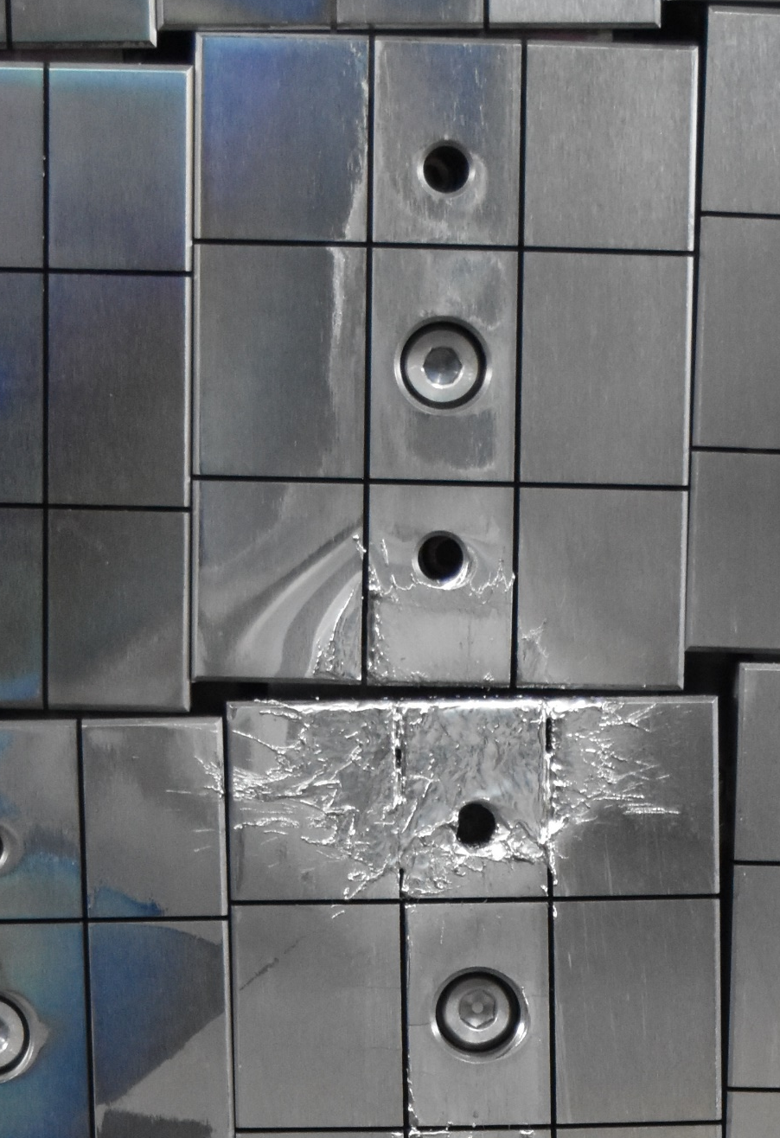
WEST | RT06+RT03 | W PFC damage induced by runaway electron incidence
SCs: S. Ratynskaia, K. Krieger, C. Reux, Y. Corre
  REIS and fast IR cameras (8 spectral filters) data collected available to compute the energy distribution and pitch angle (SOFT simulation ongoing)
  Duration of the RE impact with inner bumpers evaluated with magnetics and fast visible camera: between 2.5 and 3 ms
  Heat and energy loading during RE impact will be evaluated with thermal measurements
Temperature rise after impact ΔT ~ 23°C
Next
  Post-mortem analysis
  Fast IR data (4 kHz) analysis
  Run advanced simulation:
    GEANT4 (volumetric energy deposition)
    LS-DYNA (FEM-moothed particle hydrodym.) material fragment.

Slide 14
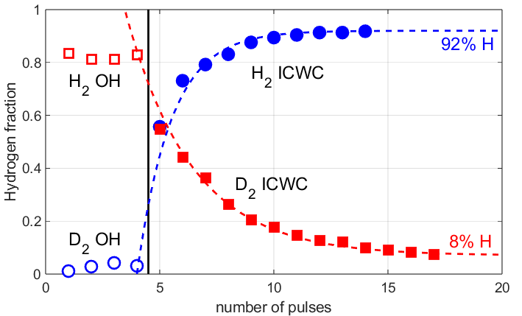
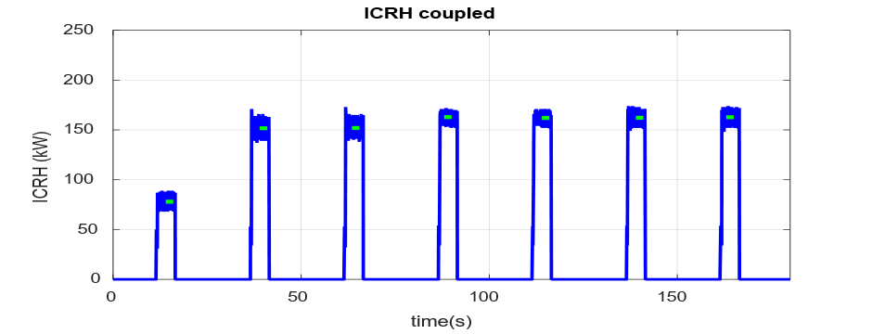
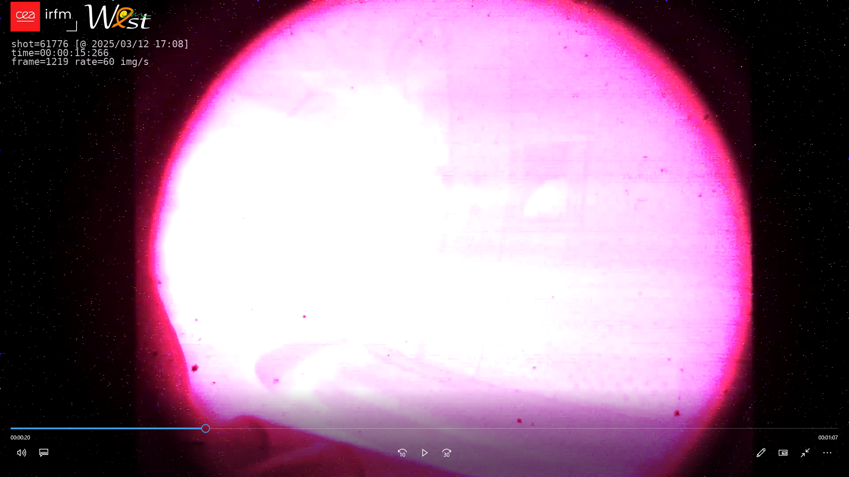
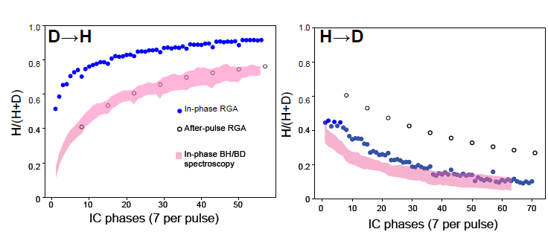
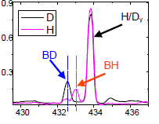
WEST | RT06 | ICWC isotope change-over studies
SCs: E. Lerche, T. Wauters, J. Hillairet
RGA
ICWC employed in the presence of B for fuel and impurity removal
Efficient D₂ → H₂ → D₂ wall changeover with ICWC achieved in WEST with 2 antennas: 160 kW, 20-25 mbar, central IC resonance, 7 × 5 s ICWC cycles
H₂ → D₂ longer than D₂ → H₂ changeover (H₂ implanted deep in the wall?)
Detailed analysis & modelling ongoing
The ICWC-Driven Isotope Exchange Pulses on The Hydrogen/Deuterium Ratio In The Boron Layer At WEST
continuous ICWC pulse realized for 120s
B_{v}=0
B_{v}>0
B_{v}<0
61776
Next :
Assessment of machine conditions after ICWC with high power diverted plasmas
[E. Pawelec, D. Mazur]
=1

Slide 15
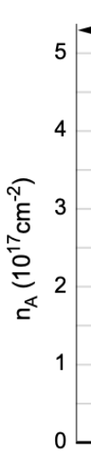
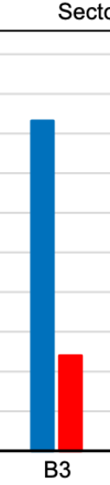
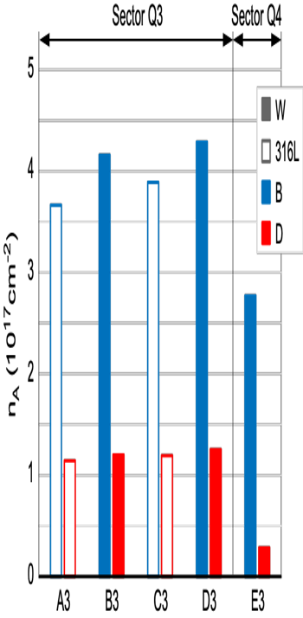
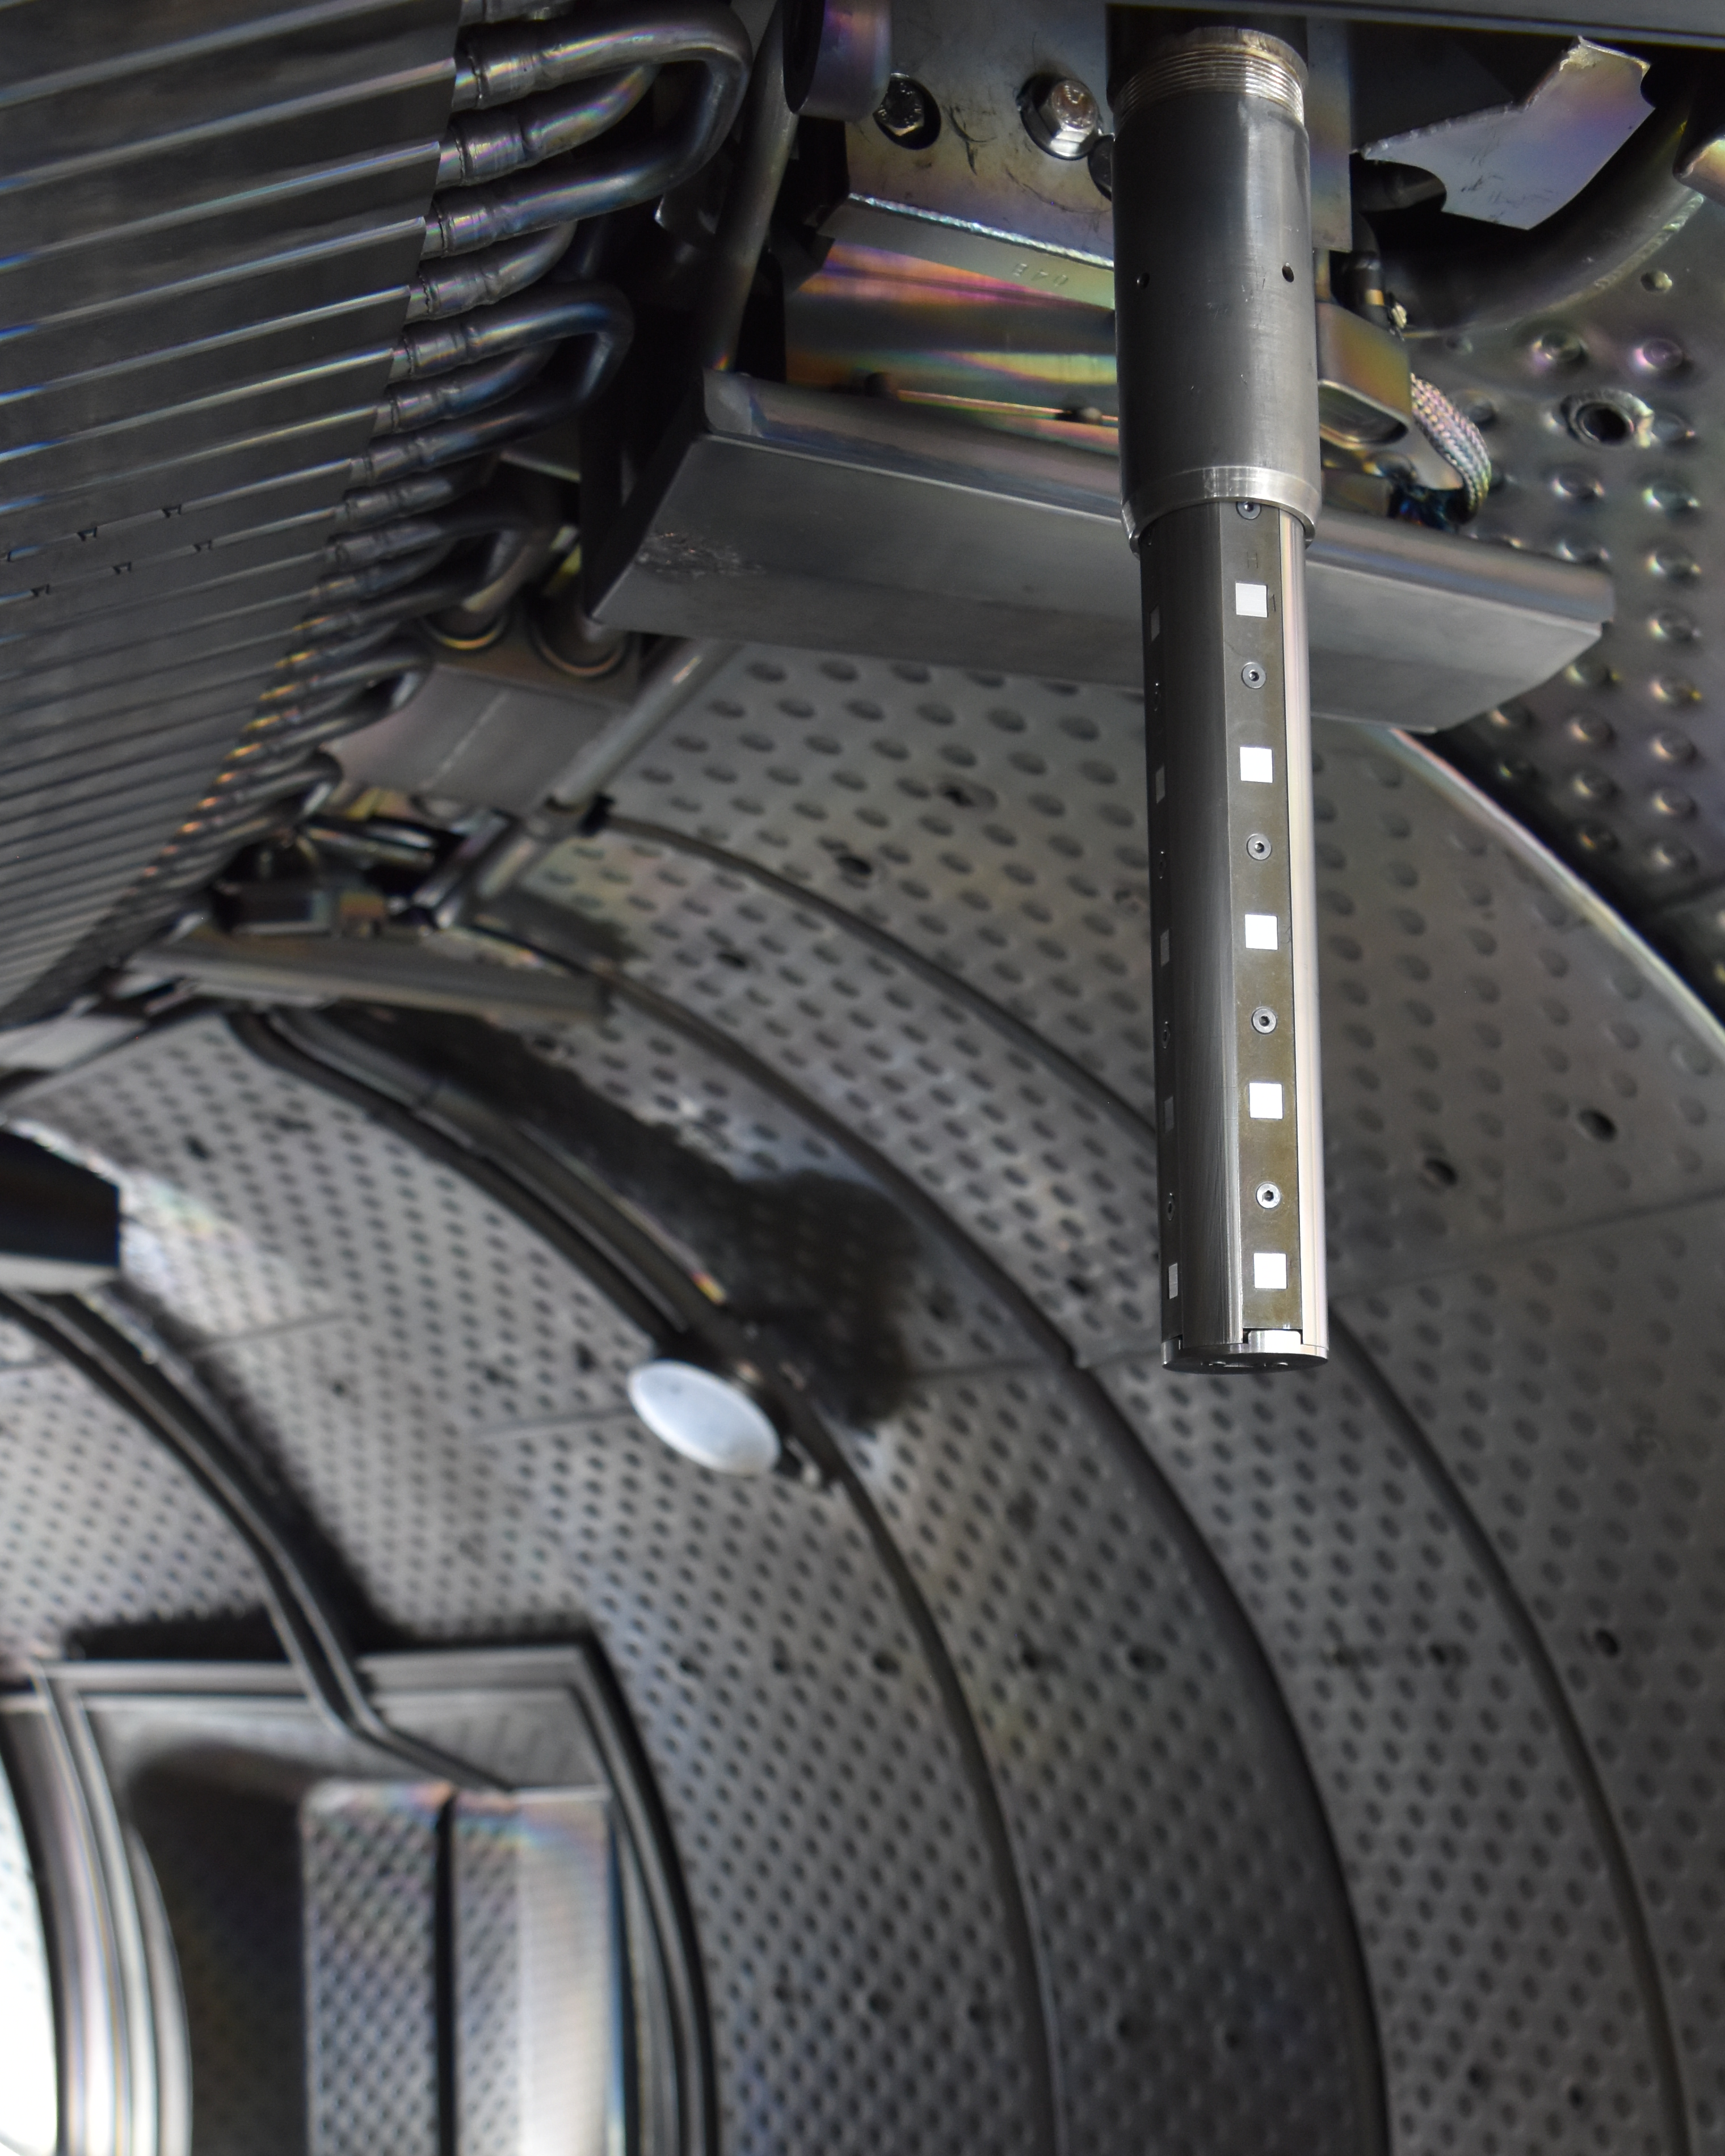
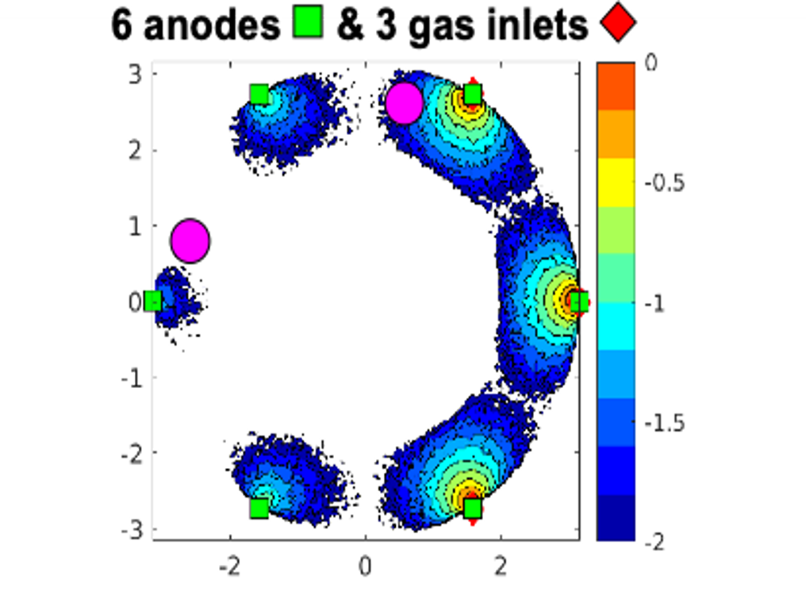
AUG+WEST | RT06+RT04 | Effect of non-uniform boronizations on operations
SCs: K. Krieger, V. Rohde, A. Gallo, E. Geulin, J. Hobirk
Plasma restart after a vent w/o boronization: challenging on both devices while start-up dramatically improved after non-uniform boronization (RT04)
Diborane dissociation / ionisation map for non uniform GDB in WEST
Q3 close to injection
Q4 away from injection
Samples probe in WEST
(TE Enhancement)
Q3 Probe
Q4
probe
T. Wauters (IO), NME 2025
P. Manas, EPS 2025, K. Krieger et al., AAPPS-DPP 2025, J. Hobirk, FEC 2025, E. Geulin, FEC 2025
B deposition smaller away from injection points, but less asymmetry than predicted in preliminary modelling → new insight for improving boronisation modelling for ITER (RT06)
Next :
Studying uniform boronization with full-W-wall scheduled in C12 (late 2025)

Slide 16
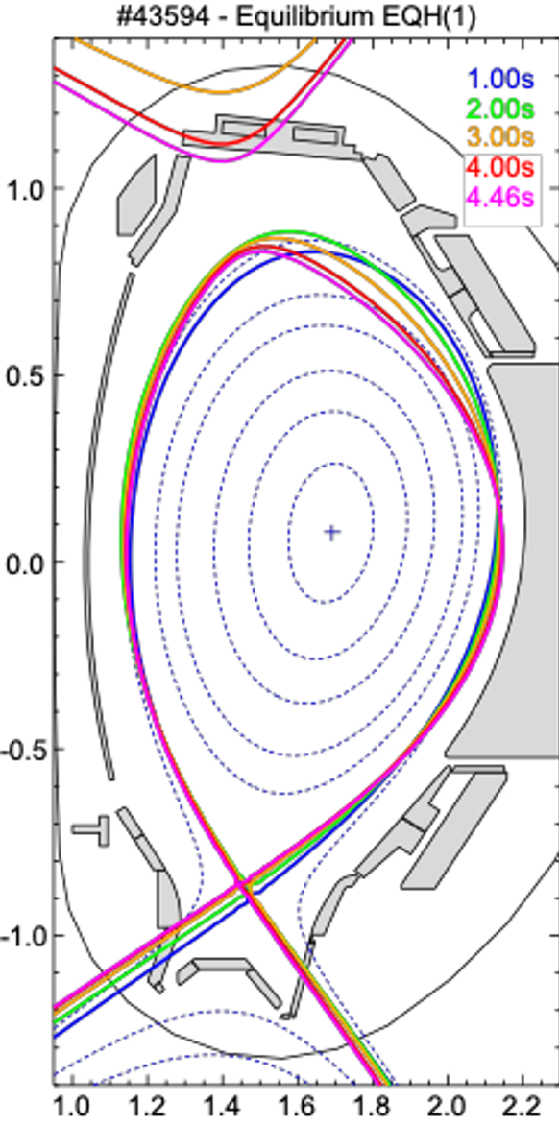
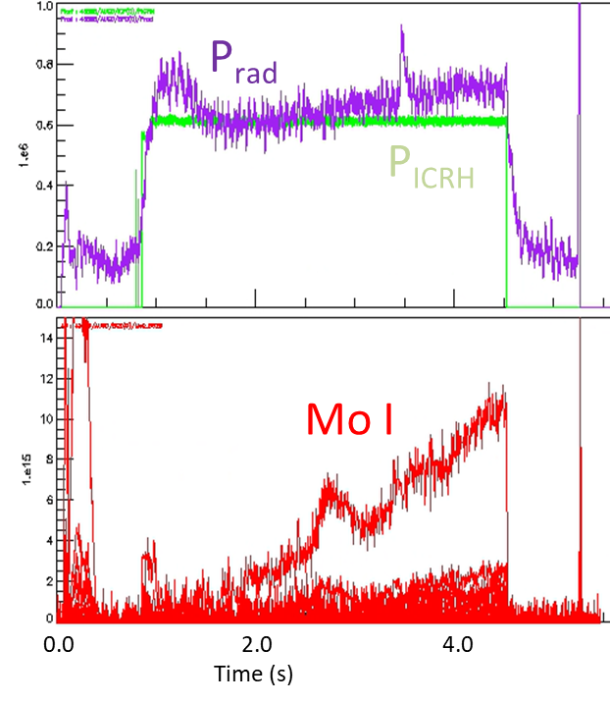
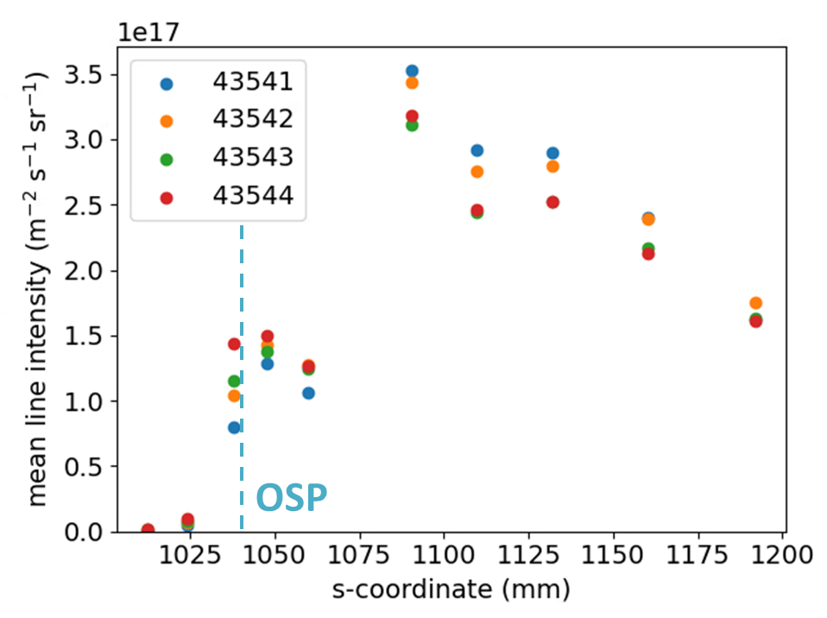
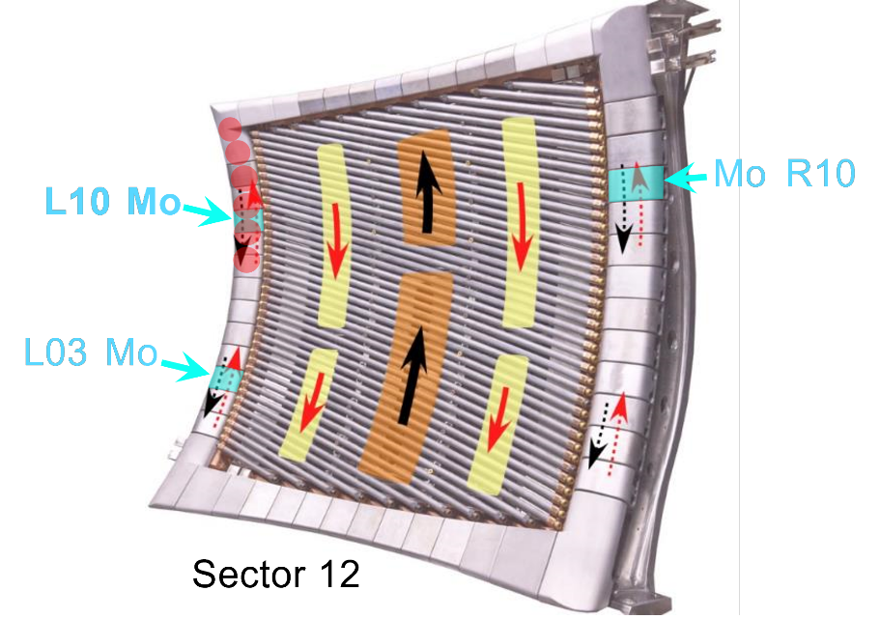
AUG | RT06 | W erosion and prompt re-deposition
SCs: K. Krieger, C. Baumann, M. Rasinski, A. Hakola, S. Saari, G. Urbanczyk
Net and gross erosion studies in Ne-seeded plasmas (see SP B talk)
Two exposure series in H-mode and L-mode
Post-exposure analysis ongoing (MPG, VTT, FZJ, RBI)
Gross-erosion from VIS spectroscopy → clear profile seen
Interpretation by ERO2.0 (FZJ, VTT) in 2026-2027
W/Mo erosion at ICRH antenna limiter tiles
Combine VIS spectroscopy at limiter surfaces with post exposure analyses of marker tiles to obtain gross vs. net erosion
3 successful discharges, surface analyses ongoing
H-mode

Slide 17
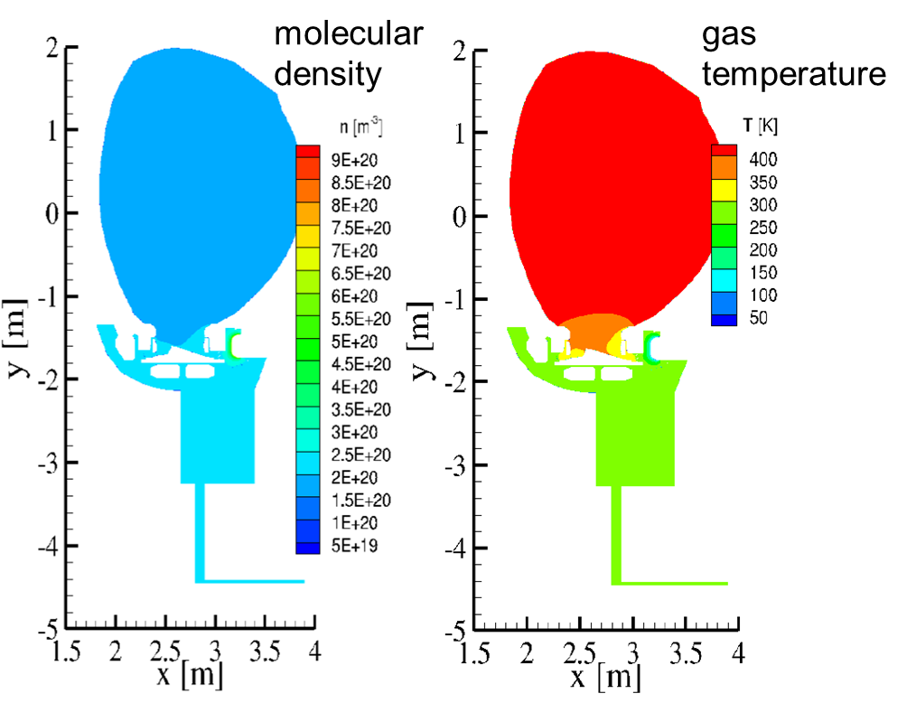
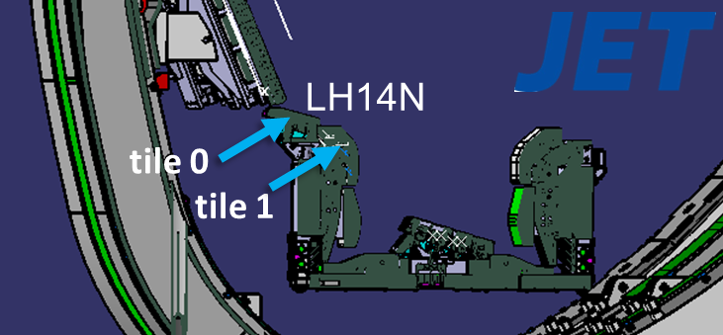
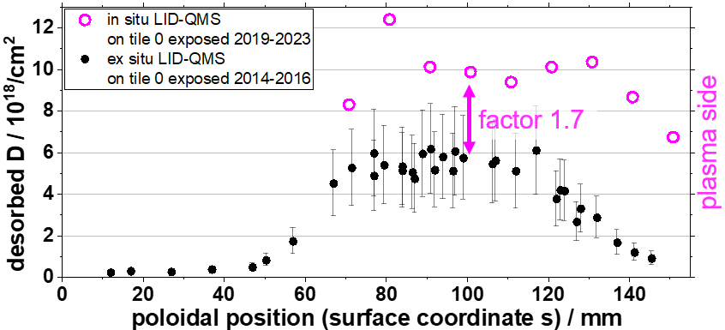
JET | RT06 | Fuel retention and Clean-up
SCs: A. Widdowson, D. Matveev, M. Zlobinski, C. Tantos
  D. Matveev et al, IAEA FEC 2025
Activities concentrated on LID-QMS calibration and DIVGAS simulations
LID-QMS used for local in-vessel fuel retention
First quantified data shown give retention values in range 10¹⁸/cm² (M. Zlobinski PFMC 2025)
Focus for next years: finalising calibration analysis
DIVGAS for global fuel retention and T inventory analyses
Simulations inside the isolated torus started
  Aim: reduce uncertainty in the PVT gas balance - simulate gas temperature gradients between the main chamber and the location of pressure measurements
Neutral gas distribution following the release of D₂ gas from divertor cryo-panels
(for 1 Pa total pressure)

Slide 18
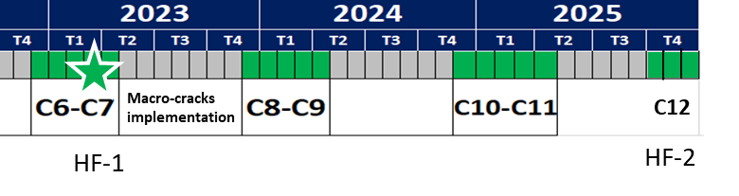
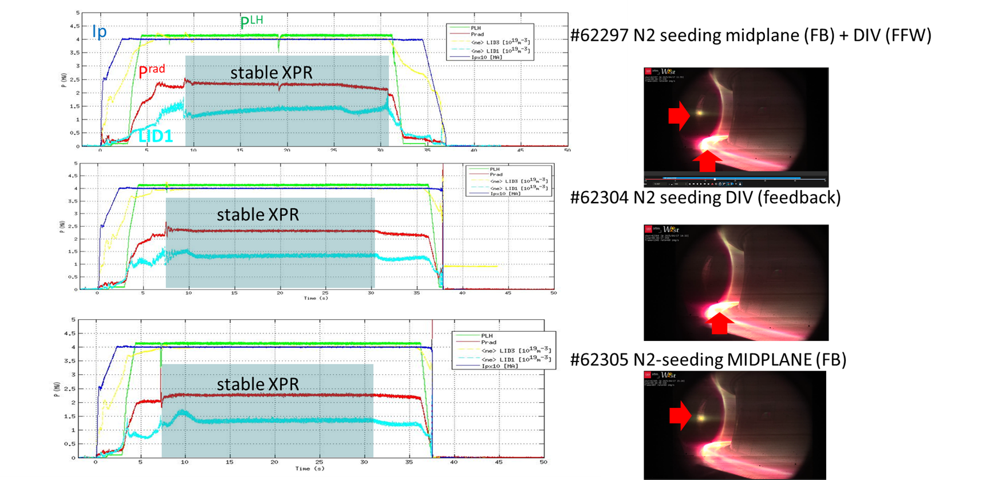
WEST | RT06 | Developments for the high fluence XPR scenario
SCs: Y. Corre, N. Fedorczak, K. Krieger, E. Tsitrone, J. Gaspar
  ITER divertor lifetime >10 years → need component testing in tokamaks → impact of particle fluence : attached plasma condition (C7), HF2-XPR (C12)
Joint effort RT06+RT05
50 µm thick deposits
Laser cleaning
XPR exploration for High Fluence campaign completed – stable XPR successfully achieved with the hepl of N₂ injection from OMP
Other work performed
  Estimated that 300 pulses required to reach the C7 fluence of 6×10²⁶ D m⁻²
  Laser cleaning for the divertor deposits in S11
  1 new PFU installed for post-mortem analysis
High fluence XPR campaign currently scheduled in weeks 48-51
0 5 10 15 20 25 30 35 40 45 50
Time [s]

Slide 19
Outline
How does WPTE work?
Recent selected highlights
Plans for 2026-2027

Slide 20
Strongly streamlined programme for WP TE in 26-27
High level objectives for 2026-2027
Address urgent R&D issues related to the new ITER baseline / Research Plan (full tungsten wall) : far SOL physics and wall loads; tungsten sources, transport and screening; startup on tungsten limiters; runaways damage of tungsten first wall components and efficiency of boronisation in full tungsten devices.
Provide a full qualification of the most promising no ELM scenario, focusing on X-point radiator (XPR) and quasi-continuous exhaust (QCE) now considered as a viable option for ITER / DEMO.
Support modelling efforts for interpretation of available data from TE devices (including JET DD and DT last campaigns)
Prepare the JT-60SA scientific exploitation in the OP2 and OP3 campaigns, pending resources becoming available.
Same structure retained for the next two years – with adjustments made due to the overall budget restrictions

Slide 21
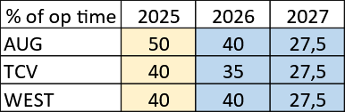
Machine availability for 2026-2027
Tentative timeline for TE devices in 2026-2027
AUG facing late restart in 2026 whereas usual campaign length in 2027; WEST running in the usual campaign mode
TCV running in ~continuous mode but longer shutdown foreseen to install Tightly Baffled Long Leg Divertor (TBLLD)
MAST-U only available for ~ 3 months early 2026
PEX enhancements now fully available (upper divertor in AUG, ITER grade divertor in WEST) + further upgrades (cryopump in MAST-U, ECRH in WEST and TCV + TE ENH diags)
Reduced WPTE Operational time in 2027 w.r.t. previous years due to budget constraints
JT-60SA
call for experimental proposals
call for participation
[BASC-34, December 2024]
Timeline for JT-60SA to be updated in December

Slide 22
Overview of experimental proposals received for 2026-2027
Call for proposals : WP TE scientific objectives + reference documents on ITER new baseline and R&D priorities + indicative distribution of machine time provided to Beneficiaries
> 200 proposals received, distributed over TE devices / RT
RTA | AUG (Scientific Pulses) | AUG (Pulse Sce. Dev) | AUG (Total Session) | TCV (Scientific) | TCV (Sce. Dev) | TCV (Total) | MAST-U (Scientific) | MAST-U (Sce. Dev) | MAST-U (Total) | WEST (Scientific) | WEST (Sce. Dev) | WEST (Total)
RT-01 | 127 | 29 | 156 | 157 | 10 | 167 | 36 | 0 | 36 | 75 | 3 | 78
RT-02 | 180 | 8 | 188 | 280 | 101 | 381 | 70 | 16 | 86 | 210 | 10 | 220
RT-03 | 129 | 20 | 149 | 190 | 65 | 255 | 0 | 0 | 0 | 96 | 20 | 116
RT-04 | 134 | 4 | 138 | 350 | 60 | 410 | 102 | 8 | 110 | 184 | 23 | 207
RT-05 | 101 | 36 | 137 | 135 | 54 | 189 | 62 | 12 | 74 | 194 | 19 | 213
RT-06 | 90 | 9 | 99 | 0 | 0 | 0 | 0 | 0 | 0 | 745 | 59 | 804
RT-07 | 162 | 31 | 193 | 321 | 83 | 404 | 156 | 43 | 199 | 32 | 0 | 32
RT-08 | 45 | 55 | 100 | 96 | 80 | 176 | 80 | 16 | 96 | 125 | 20 | 145
RT-09 | 115 | 8 | 123 | 200 | 60 | 260 | 98 | 20 | 118 | 115 | 0 | 115
Total |  |  | 1283 |  |  | 2242 |  |  | 719 |  |  | 1930
Overbooking |  |  | ~ 2 |  |  | ~ 1.3 |  |  | ~ 4 |  |  | ~ 3

Slide 23
RT06 will address several ITER-relevant objectives and contributes to one Grant Deliverable in 2026-2027
Scientific Objectives
D1 | Quantify local power load distributions on castellated and shaped PFCs for ITER and DEMO, including melting events
D2 | Assess the impact of sustained high power / high particle fluence plasma exposure on the thermo-mechanical properties of metallic PFCs as well as on plasma operation
D3 | Quantify material erosion sources from metallic walls under ITER relevant plasma conditions and determine material migration pathways, in particular to assess W sources from the first wall and the net erosion rates.
D4 | Quantify fuel retention in devices with metallic walls, with a focus on long pulse operation, including the impact of boronisations and using laser-based diagnostics where available
D5 | Assess fuel-removal efficiency in metallic devices, including the impact of boronisations and propose fuel removal procedures for next step metallic devices
D7 | Assess the efficiency and lifetime of wall conditioning methods in metallic devices, with a focus on boronisation
PFC evolution / damage under plasma exposure
(Focus : impact of RE on first wall)
Material migration
(Focus : W first wall source)
Fuel retention / recovery and vessel conditioning (Focus : complete boronisation related work, GD for Dec 2026)
ID | Deliverables Table | Date
TE.D.18 | Report on providing input on design and operation of conditioning systems for next step full W devices and focus on standard boronization systems | Dec 2026

Slide 24
Similarly to all other RTs, RT06 is strongly overbooked – prioritization necessary
Priority 1 (P1) proposals following GPM
Proposals covering high priority issues for ITER new baseline with AUG/WEST cross machine comparison : runaway impact on first wall, boronisation
Strong overbooking of both machines, so that only P1 proposals could be accomodated as main programme
P1 proposals for WEST will need to be further streamlined (focus → reduced number of shots) and/or refined (proposals in italic)
RT06 R&D area | AUG | WEST
PFC evolution / damage (D1-D2) | Runaway impact on first wall
 | Melting : gaps + W alloy | Self castellation exposure OHS and gap loads
 |  | Power balance calorimetry
Material migration (D3) |  | Divertor T_{i}/T_{e}
 |  | TWA W source
 |  | W migration 3D (PB)
Fuel retention/recovery/ wall conditioning (D4-D5-D7) | ICWC boronisation + sample (PWIE)
 | Boron powder injection | Non-uniform boronization and other boro studies H/D retention from boro
Proposed P1 shots | 49 | 364
Shot allocation* | 56 | 240
Missing items : first wall W source (analysis of first wall samples exposed in AUG in 2025 : campaign integrated net erosion/redeposition), disruption heat loads (RT03) (fast IR in WEST)
In addition: continuing analysis related to high-priority items from JET
  Fuel retention/recovery: Further analysis of overall gas balance in DTE3 (+DTE2); modelling of fuel retention; LID-QMS – qualitative → quantitative + comparison against LIBS data
  Material migration: Further analysis and modelling of W prompt re-deposition experiments + completion of Be erosion studies
  Helium campaign: Further analysis / modelling of the (no) W fuzz formation → more insights once post mortem results available

Slide 25
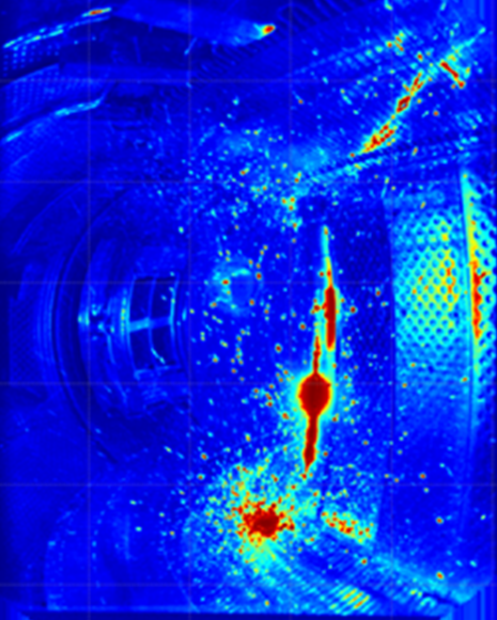
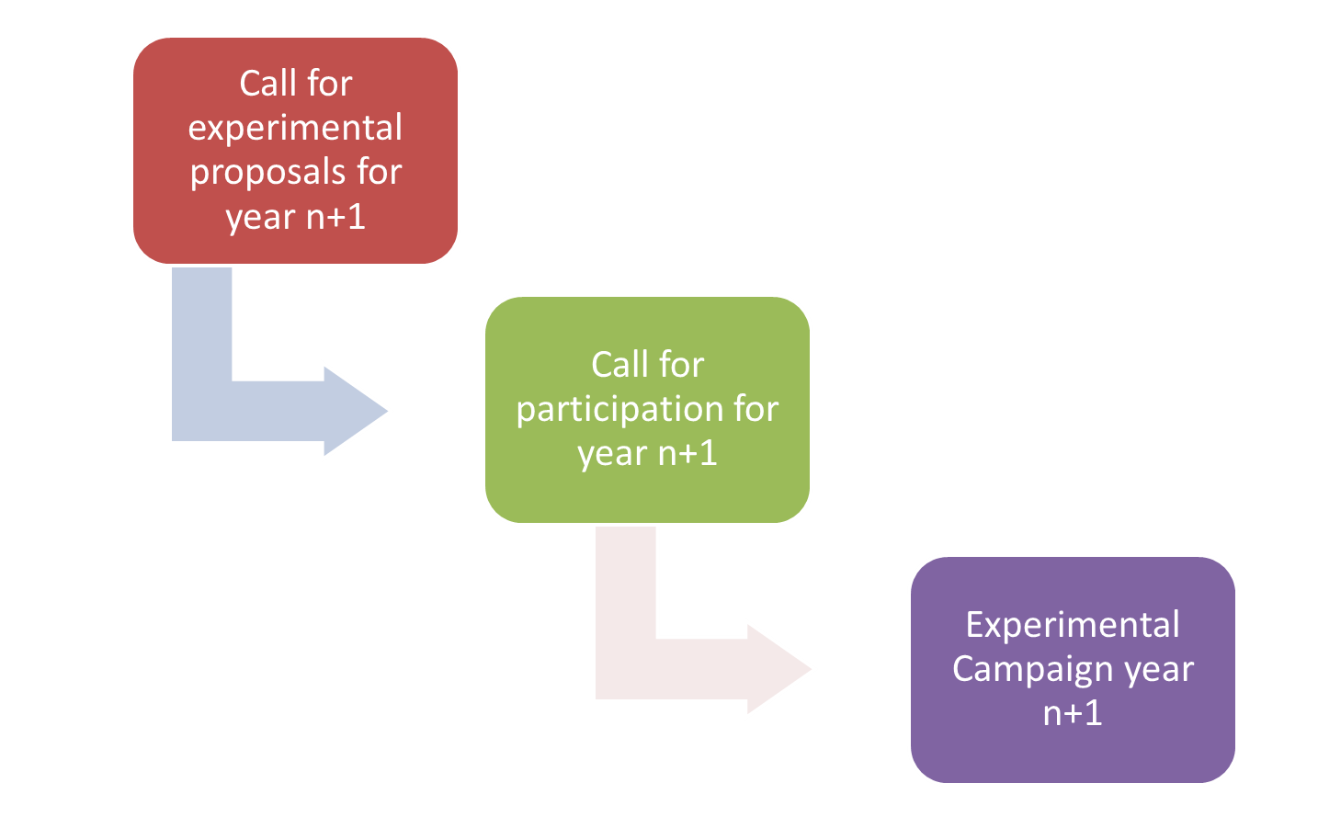
In summary …
Strong links between WPTE and WPPWIE :
  Post mortem analysis of samples exposed in tokamaks
  Comparison of component behaviour under tokamak conditions versus HHF and linear devices
  Modelling of material migration / W melting and RE impact under tokamak conditions
  Boronisation (coordination between RT06 and SP F) → exciting experiments on AUG/WEST
  Wealth of data available from JET
RE impact in WEST
Prospects for 2026-2027 :
  Reduced budget compared to 2025 → affects machine operation, allocation of resources (to some extent) and quite strongly on supporting mission trips to join the experiments
  BUT focus on ITER urgent R&D issues for the full W baseline: boronisation, W wall sources, screening, transport, start up on W limiters, impact of RE on W walls,… → high chances in continuing the good collaboration
  You are welcome to participate !

