Slide 1
AIP: LIBS Data Processing Presentation
Paweł GĄSIOR
Damian SOKULSKI, Pavel VEIS, Sanath SHETTY, Matej VEIS, Rongxing YI, Sebastijan BREZINSEK
IPPLM, CU, FZJ

Slide 2
Last year’s meeting summary
Application of autoencoders brings a decent progress in experimental spectra analysis.
There is a big role of pre-processing which was not fully addressed in this short presentation.
Tests on the spectra collected at the VTT bring interesting results which will be addressed in the PFMC contribution.
The models will be applied on data from LIBS@JET experiments
The spectra obtained from locations of determined composition may serve for training models for chemical contents estimation

Slide 3

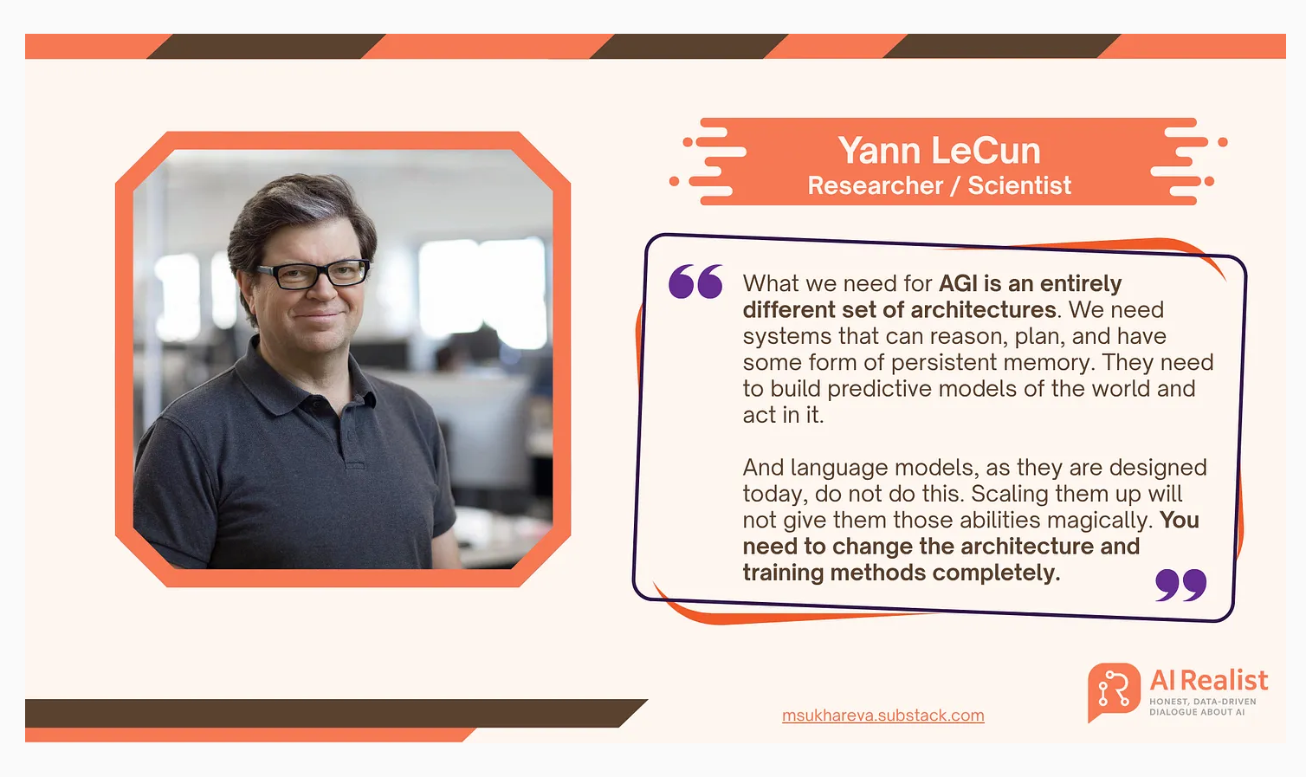

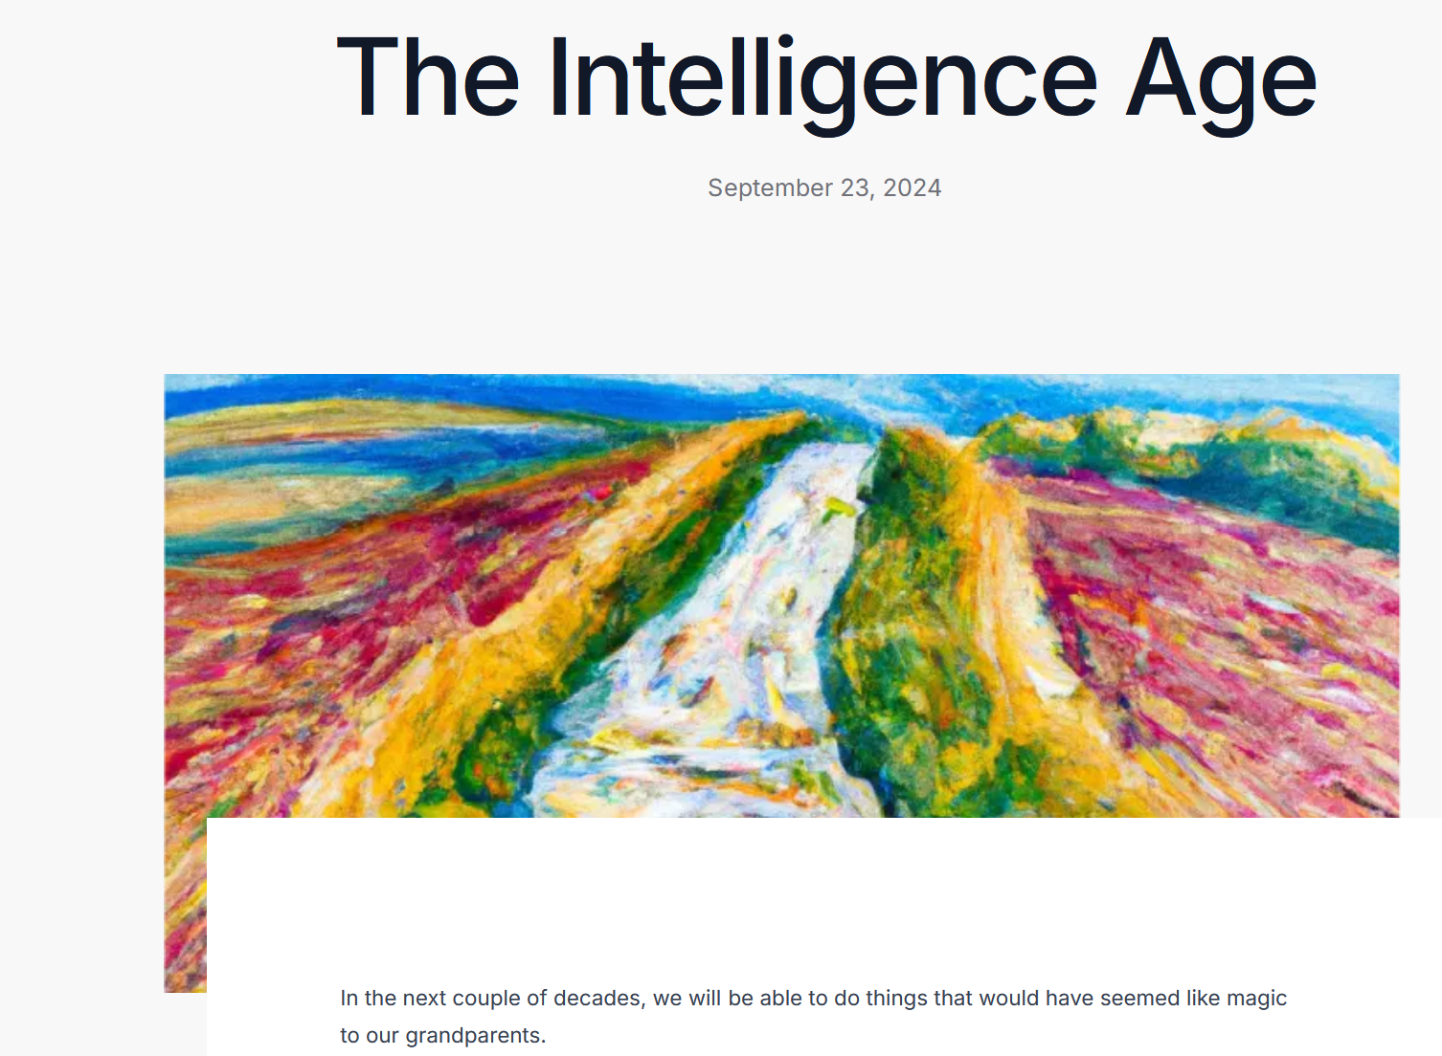

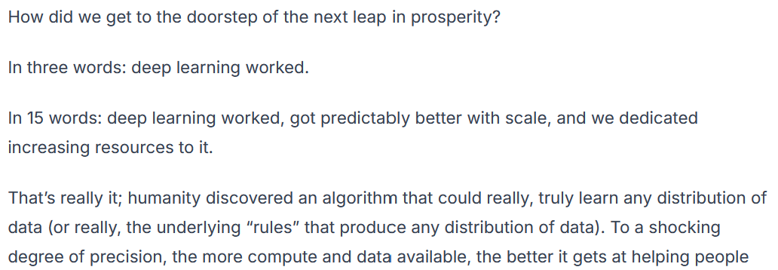
Meanwhile…
"people understand very little about how LLMs actually work, so they still think LLMs are very different from us. But actually, it's very important for people to understand that they're very like us." LLMs don’t just generate words, but also meaning.

Slide 4


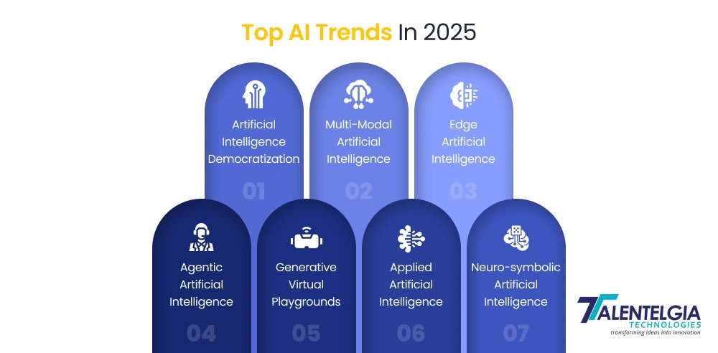
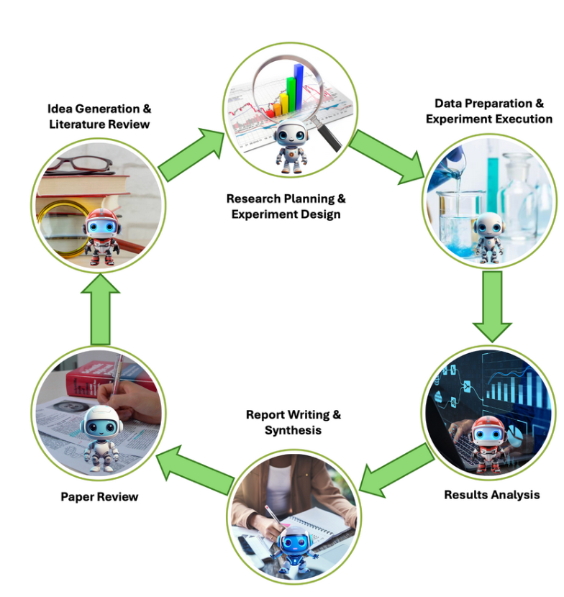
What happend in AI in 2025?

Slide 5
Experiments with AI for LIBS at the IPPLM, CU and FZJ in 2025
Preprocessing of (huge amounts) experimental data
Selection of data format for storing the data
Selection of examples for training models
Training with huge amounts
First level anomaly detection before training
Hyperparameter tuning with evolutionary algorithms
Reconstruction and data analysis
Extraction of datasets for reconstruction and visualisation
Second step of anomaly detection
Selection of features for data representation
Hyperparameter tuning with AI tools
Integration with chemical contents analysis
5

Slide 6
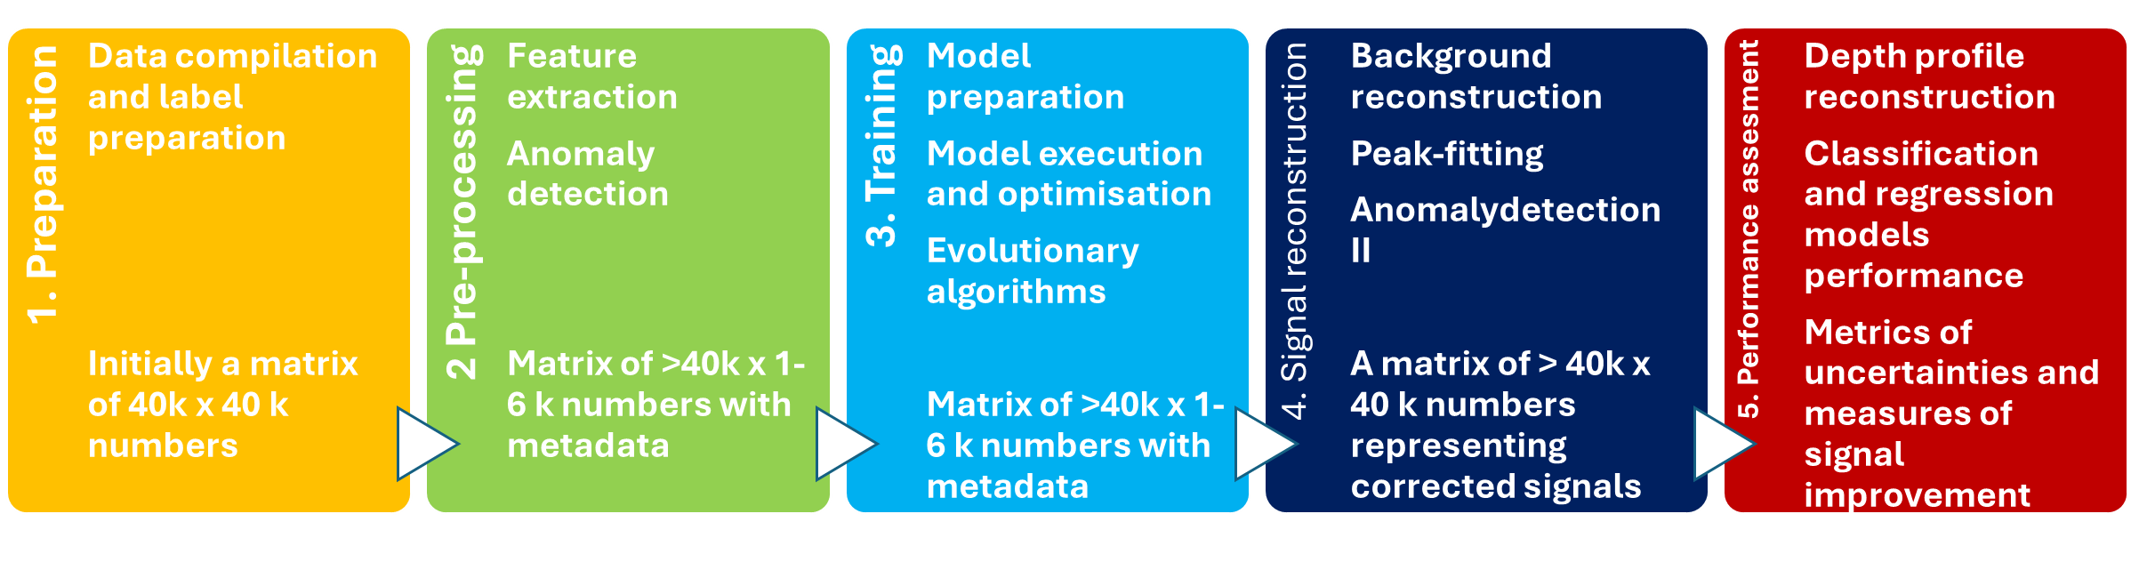
Typical workflow
Preparation
Original data is in the spectrometer native format, thus it needs to be converted to digital arrays. Since there are tens of thousands files it requires batch conversion and multi-processing algorithms.
6

Slide 7
Typical workflow
2. Pre-processing
Although it is considered that deep learning performs feature selection automatically, it is important to feed it with meaningful which means that non-informative fragments of spectra need to be removed. It is realised by automatic peak extraction.
First step of anomaly detection is implemented here: algorithm checks if the spectrum contains unexpected peaks and gives their coordinates.
7

Slide 8
Typical workflow
3. Model preparation and training
Data needs to be devided into training, validation and test sets.
Instead of standard division in which most of data is taken for training, here less than 50 % of data serves for test to simulate real time data processing on previously trained model.
Data processing engine is based on autoencoders and model optimisation is performed on genetic algorithms and novel AI based tools.
8

Slide 9
Typical workflow
4. Signal reconstruction
After the models are optimised and tested they need to be used to predict selected data-sets. First step is inference of data for all the measured spectra, however, the raw result of this operation are extracted figures which yet have to be arranged in spectra waveforms by complementing by previously removed fragments and curve fitting.
Second step of anomaly detection is implemented here: the algorithm checks if the reconstructed singals differs from the input signals more than by 3 * standard deviations and gives their coordinates.
9

Slide 10
Typical workflow
5. Performance assessment
Based on the reconstructed signals depth profiles can be calculated and compared with those original.
The processed data can server for quantification and clasification models which can be veryfied based on the results obtained by other techniques as e.g. SIMS.
The performance of all the models may be assessed by means of various metrics available in Scikit-learn.
10

Slide 11
Typical workflow
Preparation
Original data is in the spectrometer native format, thus it needs to be converted to digital arrays. Since there are tens of thousands files it requires batch conversion and multi-processing algorithms.
2. Pre-processing
Although it is considered that deep learning performs feature selection automatically, it is important to feed it with meaningful which means that non-informative fragments of spectra need to be removed. It is realised by automatic peak extraction.
First step of anomaly detection is implemented here: algorithm checks if the spectrum contains unexpected peaks and gives their coordinates.
3. Model preparation and training
Data needs to be devided into training, validation and test sets. Instead of standard division in which most of data is taken for training, here 50 % of data serves for test to simulate real time data processing on previously trained model.
Data processing engine is based on autoencoders and model optimisation is performed on genetic algorithms.
4. Signal reconstruction
After the models are optimised and tested they need to be used to predict selected data-sets. First step is inference of data for all the measured spectra, however, the raw result of this operation are extracted figures which yet have to be arranged in spectra waveforms by complementing by previously removed fragments and curve fitting.
Second step of anomaly detection is implemented here: the algorithm checks if the reconstructed singals differs from the input signals more than by 3 * standard deviations and gives their coordinates.
5. Performance assessment
Based on the reconstructed signals depth profiles can be calculated and compared with those original.
The processed data can server for quantification and clasification models which can be veryfied based on the results obtained by other techniques as e.g. SIMS.
The performance of all the models may be assessed by means of various metrics available in Scikit-learn.

Slide 12
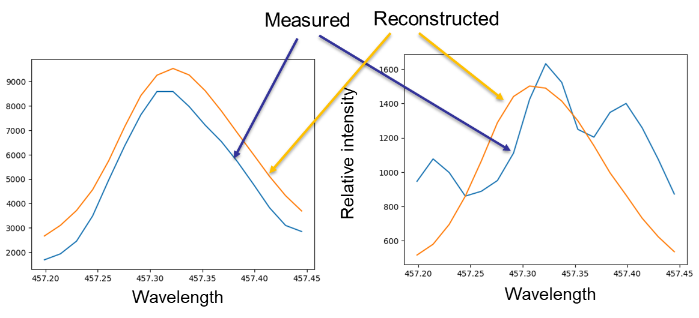
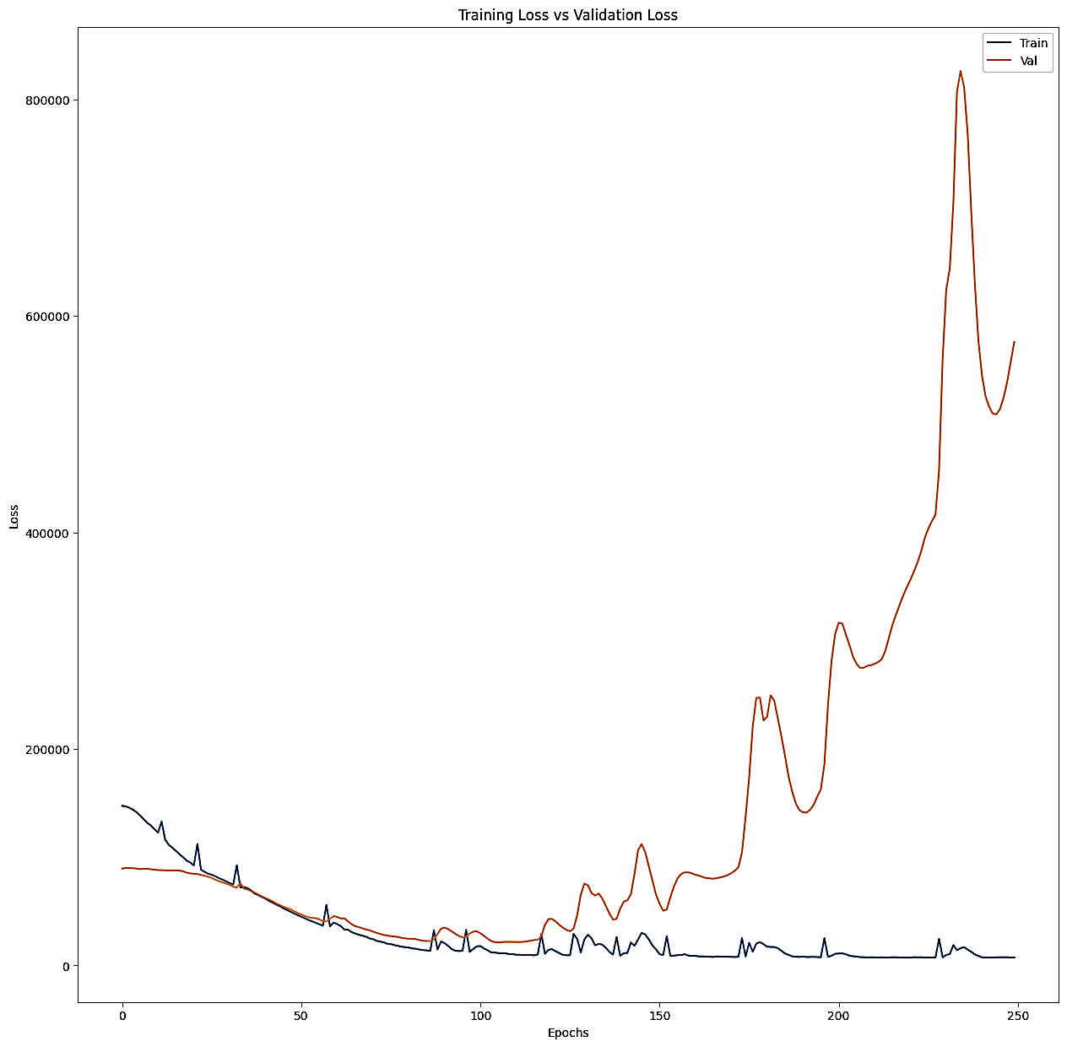
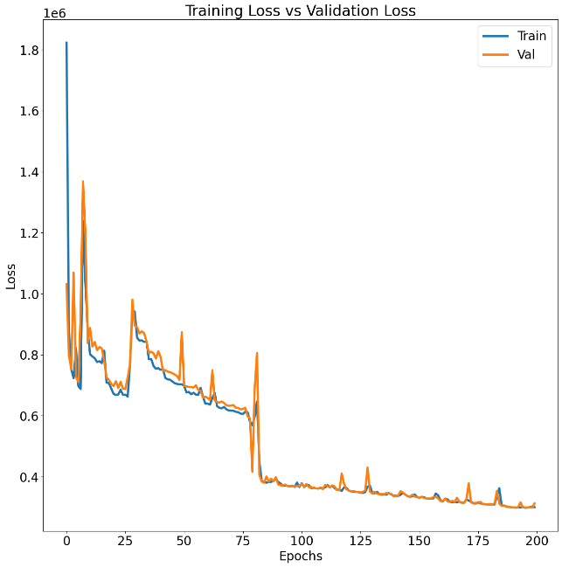
Line reconstruction and why we think it works
Memorisation
vs
Generalisation
Reconstructed lines have shape more similar to theoretical, the influence of fluctuations is decreased, on the other hand, the anomaly detection algorithm checks if the discrepancy is not questionable.
When fitting a model with millions of parameter there is a risk of overfitting in which the model „remembers” the noise.
In the learning curves it is manifested by divergent training and validation curves.

Slide 13
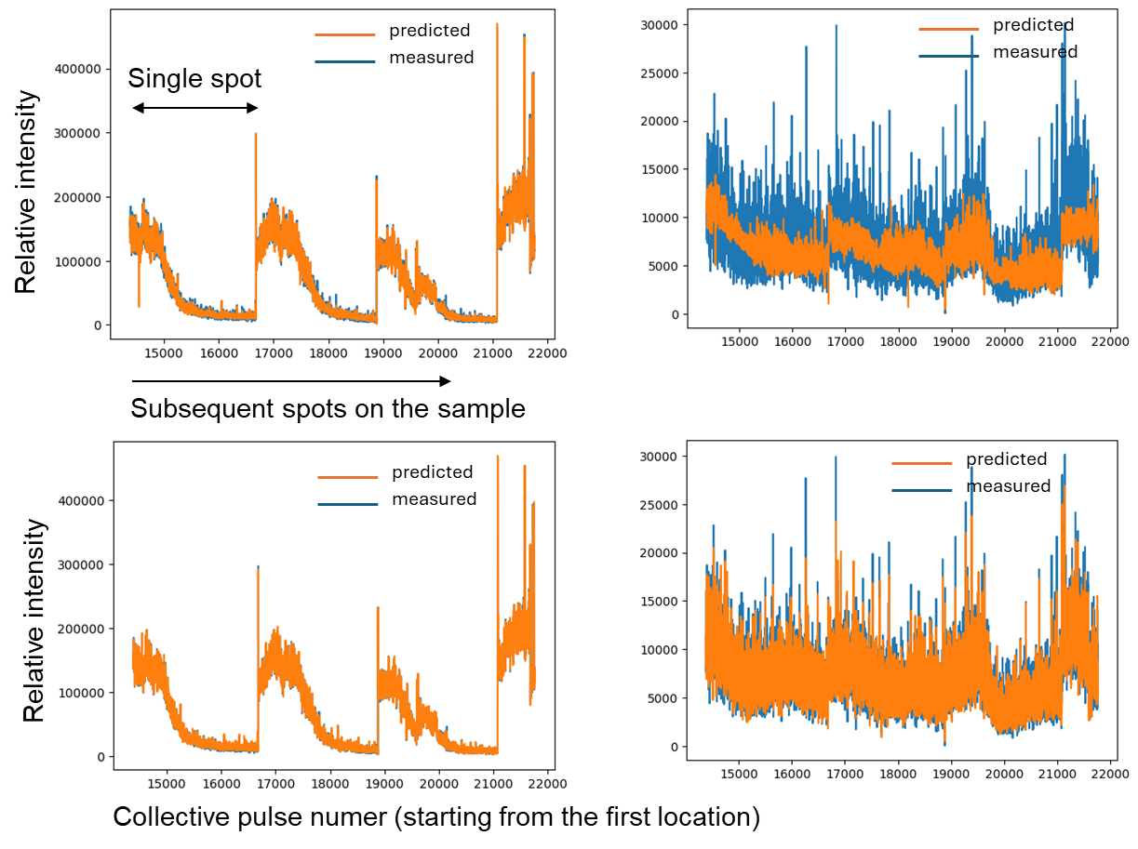
Profile reconstruction
Diagrams show collective profiles for Be and H for HGFC_1c sample through subsequent locations. The difference between the upper and lower models are in the numer of parameters in the latent layer.
Both models are capable of tracking changes in Be, however, the upper model is not sufficient to track H due to its lower representation in training data.
The models with sufficient numer of parameters are capable of tracking fluctuations of the major lines filter out the stochastic parts of the signals.

Slide 14
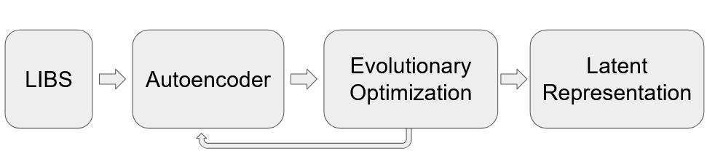
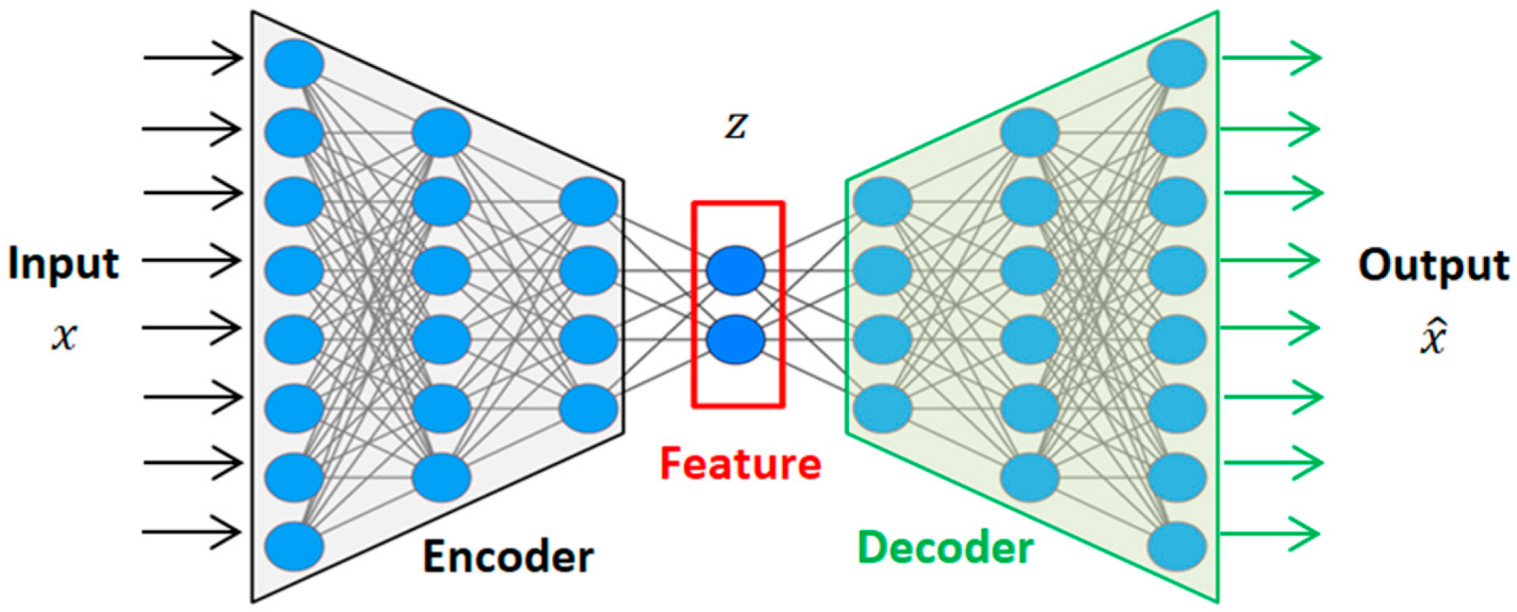
Hyper parameter tuning
Spectra provided by Rongxing Yi, FZJ Juelich
Nd:YAG laser (5 ns, 50 mJ, 1064 nm)
Pure elemental samples of Al, Cr, Fe, Mo, Ni, W, and Zn
200 - 900 nm range, 26 000 wavelengths sampled
Linear combination of spectra simulating varying composition

Slide 15
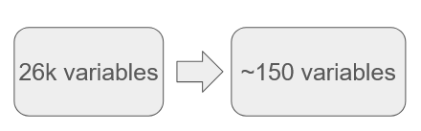
Compression ration of 170
For reference:
zip: 2-10
JPEG: 10-20
MP4: 50
Hidden | Latent | Regularizer | Activation | MSE | CosSim | Relative Error
1621 | 195 | 0.0 | leaky ReLU | 0.021 | 0.23 | 6.4%
1377 | 136 | 0.0012 | tanh | 0.20 | 0.041 | 11%
There are different hyperparameters for minimizing
the error and the cosine similarity, which can have
Advantages when taking into account different goals.

Slide 16
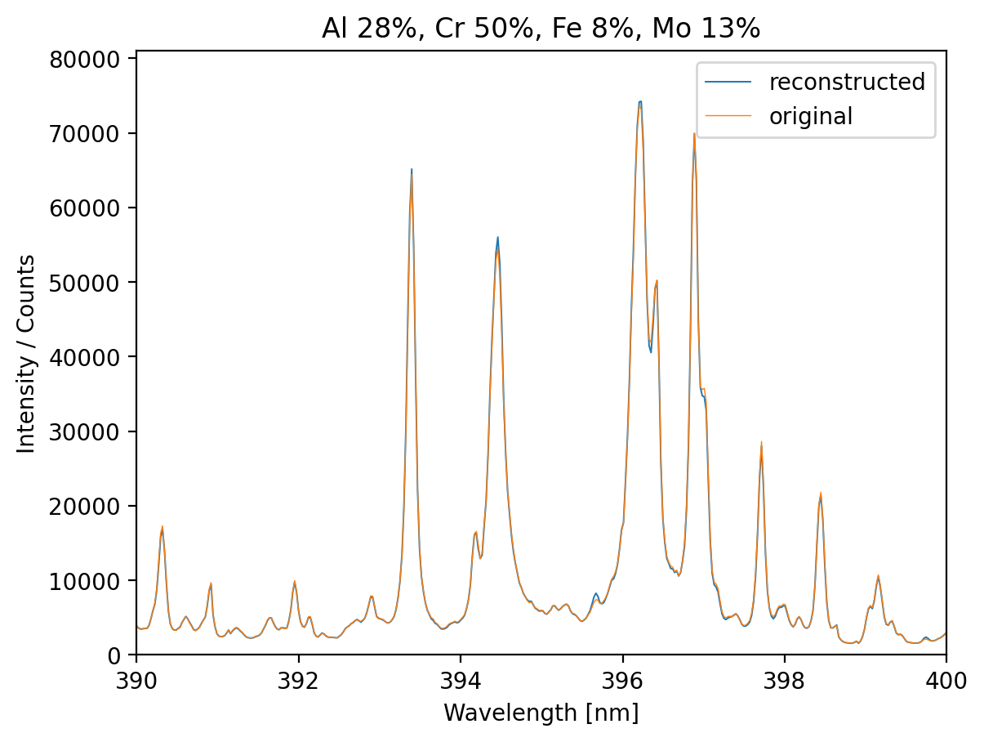
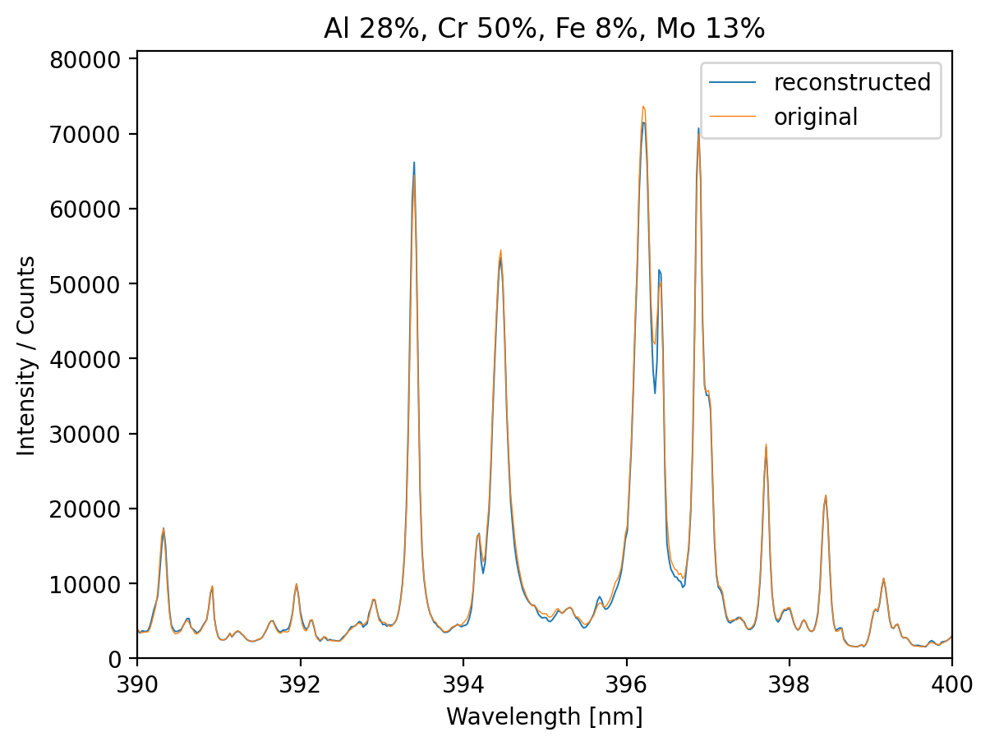
Performance of reconstruction
Reconstruction
Without autoencoder:
MSE = 1.7 x 10⁻⁵
RMSE = 0.27%
R² = 0.9993
Training time = 20 min
With autoencoder:
MSE = 2.3 x 10⁻⁵
RMSE = 0.31%
R² = 0.9993
Training time = 30 s
With the autoencoders the accuracy is insignificantly lower, but still excellent and the computative cost is substantially lower.

Slide 17
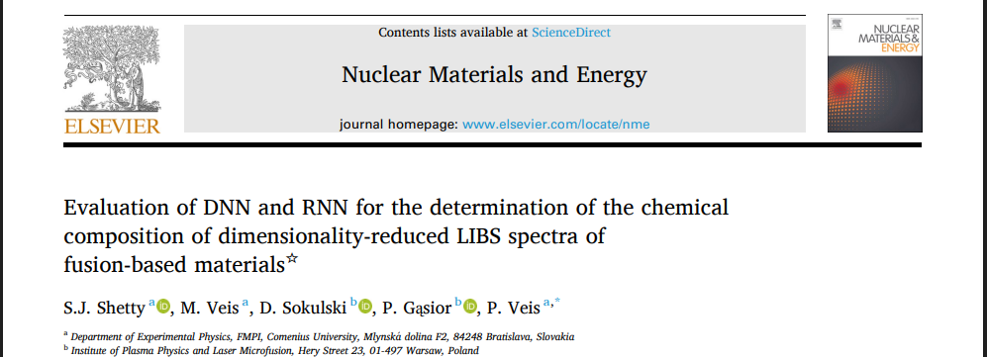
AI - Preparation and validation of deep learning models for pre-processing experimental data (CU)
Work done in 2025:
A comparative study was carried out on DNN and RNN methods for the analysis of simulated LIBS spectra of fusion-relevant elements derived from the NIST database.
A dataset consisting of 7400 spectra with a spectral resolution λ/Δλ=4000 was generated for training and testing.
The dimensionality of the data was reduced from 41730 to 1024 points using encoder style architecture and the reduced dataset (latent) was trained using DNN, GRU and Bi-LSTM.
Model hyperparameters were optimized using the Polar Bear Optimization Algorithm, a population-based heuristic optimization technique.
10 target elements (which one ) and T_{e} (from to) were quantified using DNN and RNN algorithms with R² of 0.96 and 1.00 (for W and T_{e} respectively.

Slide 18
Summary, conclusion, plans
AI worked.
Reconstruction is suprisingly good for signals which look really bad, showing that they are deterministic and their information can be deconvoluted
Application of autoencoders can substantially reduce the amount of data and initial preprocessing may reduce the training time
Still need precise measurements to accurately predict chemical concentration (may be obtained thank to experiment at VTT → Jari’s talk)
Plans for 2026
Test machine learning algorithms with experimental LIBS spectra from the new VTT experiment as well as from meauremments from CU and FZJ in order to determine electron density and plasma parameters
Use of Conditional Generative Adversarial Network (cGAN) and VAE (Variational Autoencoder) to create experimental like spectra for better model training.
Find the optimal normalisation techniques based on the correlations in the latent layer of autoencoders
Proposed deliverables:
Evaluation of machine learning models to determine plasma parameters.
Determine the normalisation techniques
Verify the predictions of chemical compositions based on data from the new VTT experiment

Slide 19
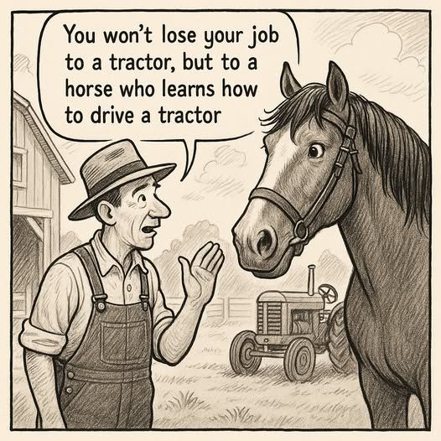
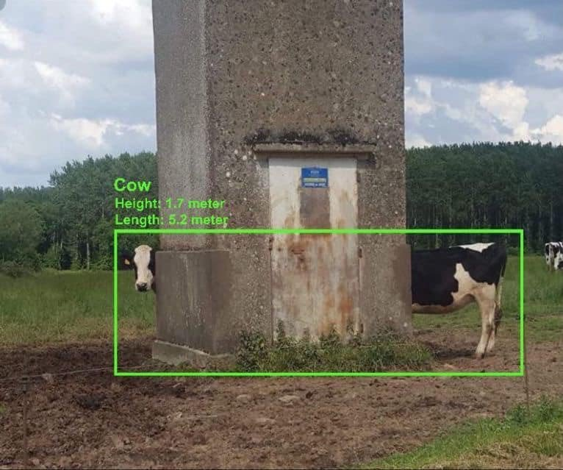
Thank you for your attention

