Slide 1

“Theory, Simulation, Verification and Validation” TSVV Task 7: Plasma-Wall Interaction in DEMO WP PWIE Meeting | 20.11.2025 D. Matveev on behalf of TSVV-7 team

Slide 2








TSVV-07 Plasma-Wall Interaction in DEMO
Acknowledgements
Christoph Baumann, Juri Romazanov, Michael Gordon, Henri Kumpulainen
Svetlana Ratynskaia, Ladislas Vignitchouk, Panagiotis Tolias, Konstantinos Paschalidis, Tommaso Rizzi
Ales Podolnik, David Tskhakaya, Michael Komm
Jonathan Mougenot, Yann Charles Etienne Hodille, Jonathan Dufour
Udo von Toussaint, Klaus Schmid
Faith Kporha, Frederic Granberg
Jernej Kovacic
DEMO Central Team: Sven Wiesen, Fabio Subba, Jonathan Gerardin, Francesco Maviglia
Thrust 2 (WP PWIE) Facilitator: Sebastijan Brezinsek

Slide 3
TSVV-07 Plasma-Wall Interaction in DEMO
Aims of the project
Establish an integrated modelling suite capable to treat complex 3D wall geometry to predict steady-state PWI in DEMO
Provide safety-relevant information for DEMO reference scenarios concerning first-wall erosion, dust, and fuel inventory
Develop and apply modelling capabilities to treat PWI in DEMO-relevant transients regarding their impact on PFC integrity

Slide 4
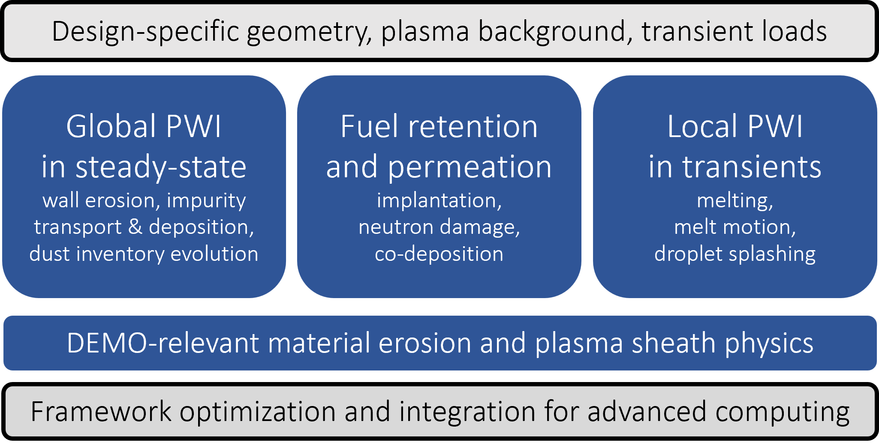
TSVV-07 Plasma-Wall Interaction in DEMO
Objectives
Assessment of
Steady-state W erosion rates
Preferential W re-/co-deposition locations
Dust mobilization, survival and accumulation
PFC response to transients: melting, splashing
W erosion for locations affected by transients
Tritium inventory: co-deposition, bulk retention
Project overview papers D. Matveev et al, Nucl. Fusion 64 (2024) 106043
+ Presented at IAEA FEC 2025, Chengdu, China

Slide 5

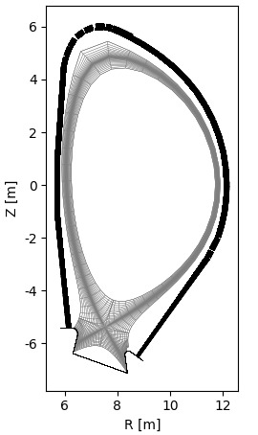
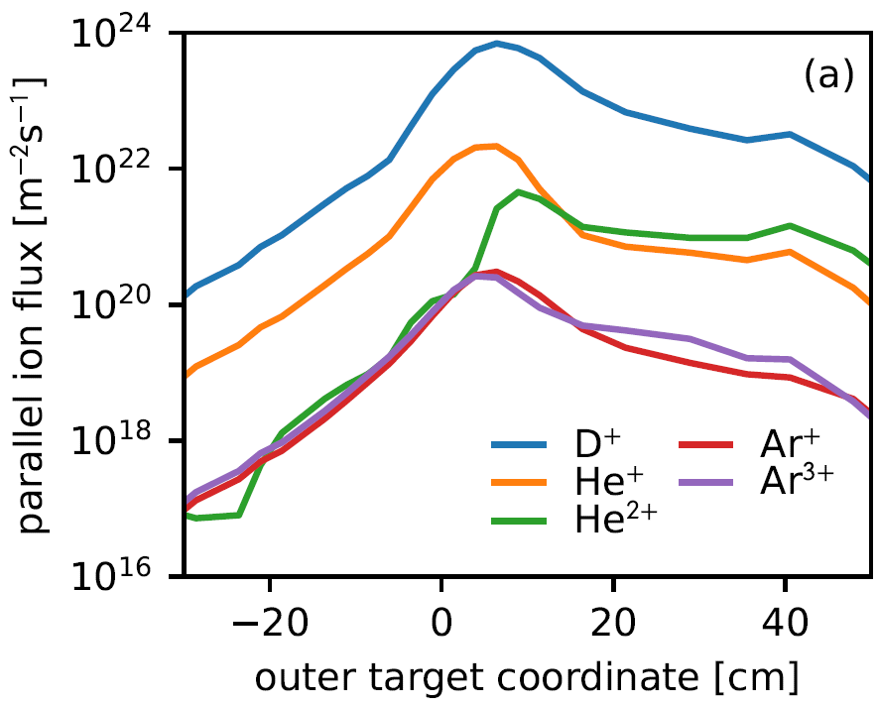
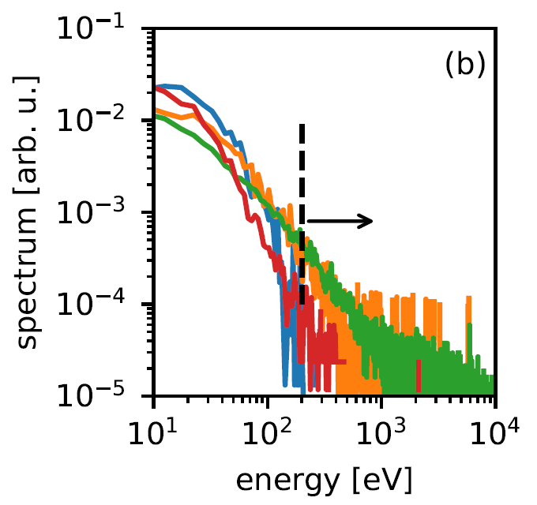
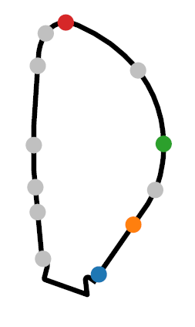
ERO2.0 modelling of W erosion, transport and re-deposition
Brief reminder of challenges for DEMO
Large plasma extrapolation volume
Charge-state resolved impurity fluxes to the wall
Energy and angular resolved fluxes of charge-exchange neutrals (CXN)
W sputtering threshold
up to 80 cm
+ common ion sound speed for all background species, in agreement with SOLPS-ITER modelling

Slide 6
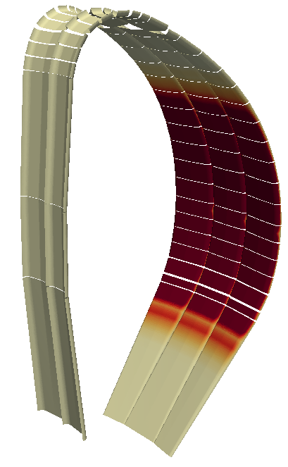
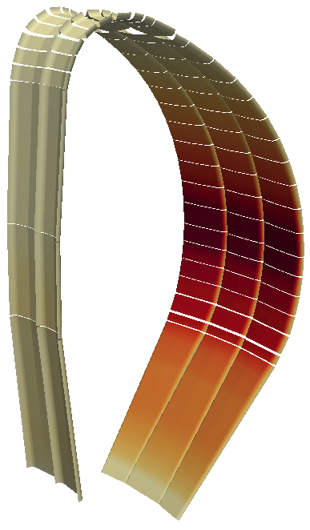
ERO2.0 modelling of W erosion, transport and re-deposition
Brief reminder of challenges for DEMO
Large plasma extrapolation volume
Charge-state resolved impurity fluxes to the wall
Energy and angular resolved fluxes of charge-exchange neutrals (CXN)
mean energy
energy distribution
up to 80 cm

Slide 7
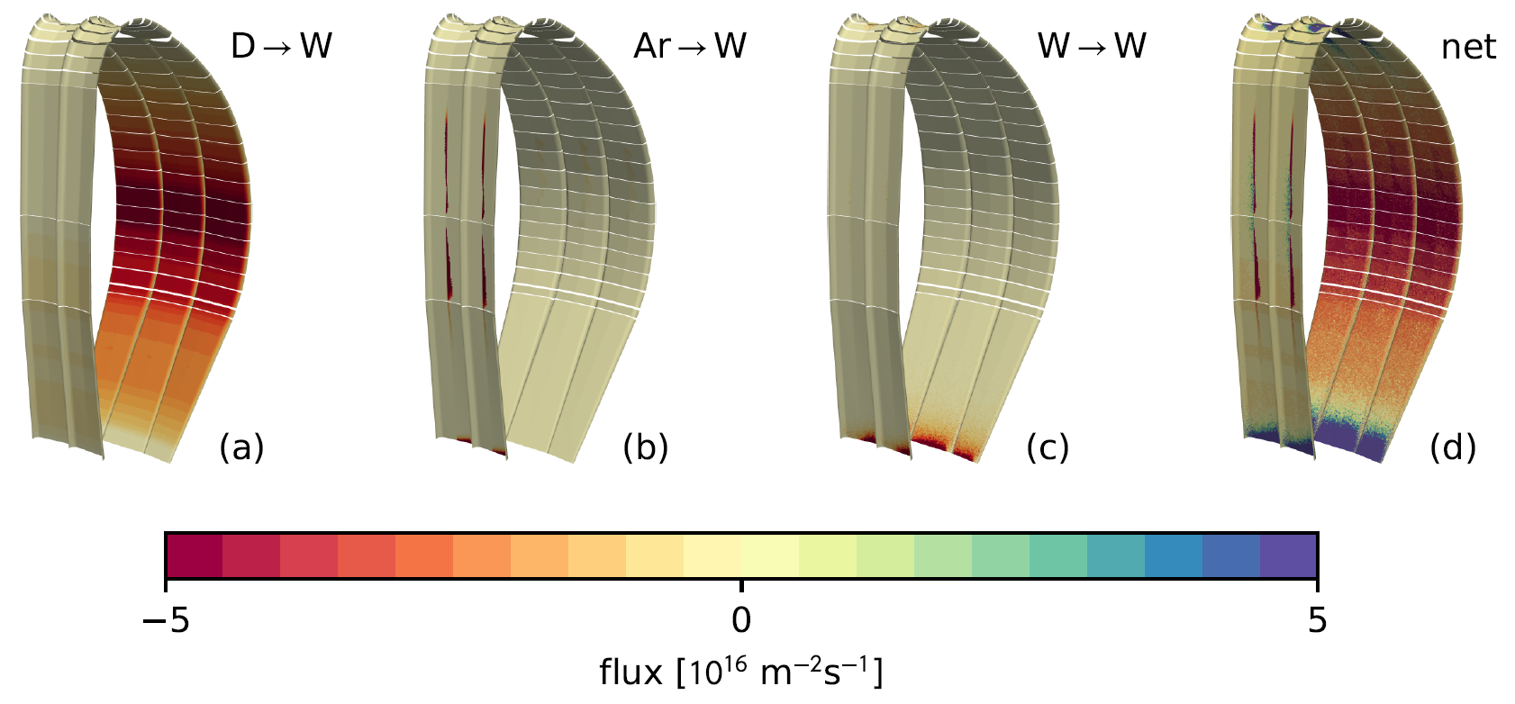
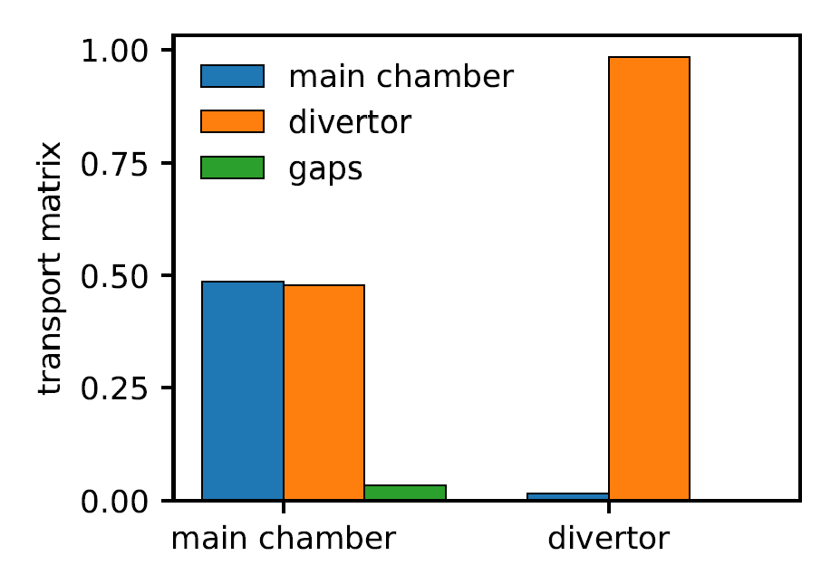
ERO2.0 modelling of W erosion, transport and re-deposition
Example of resulting erosion-deposition maps by species (for T_{e} cut-off at 2 eV in the far-SOL)

Slide 8
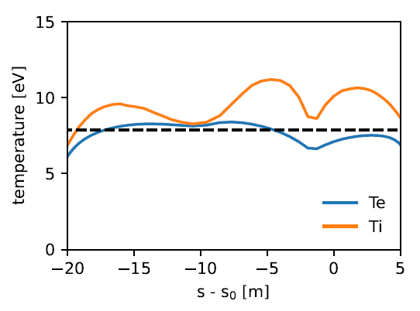
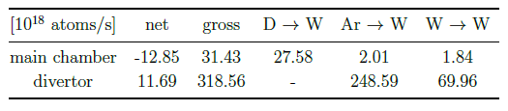
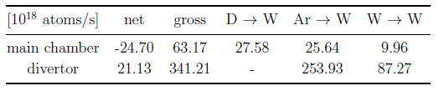
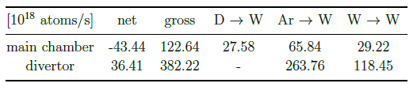
ERO2.0 modelling of W erosion, transport and re-deposition
Role of far-SOL extrapolation assumptions (T_{e} cut-off: 2 eV / 5 eV / last plasma grid value)
--- 7.68 eV (1st W ionization potential)
2 eV
5 eV
const
C. Baumann, NF (2025) under review

Slide 9
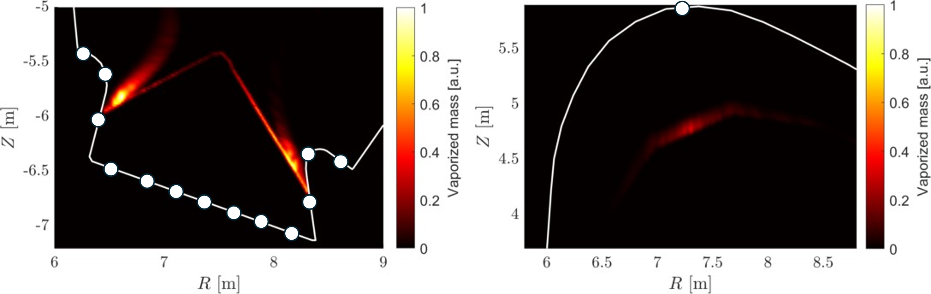
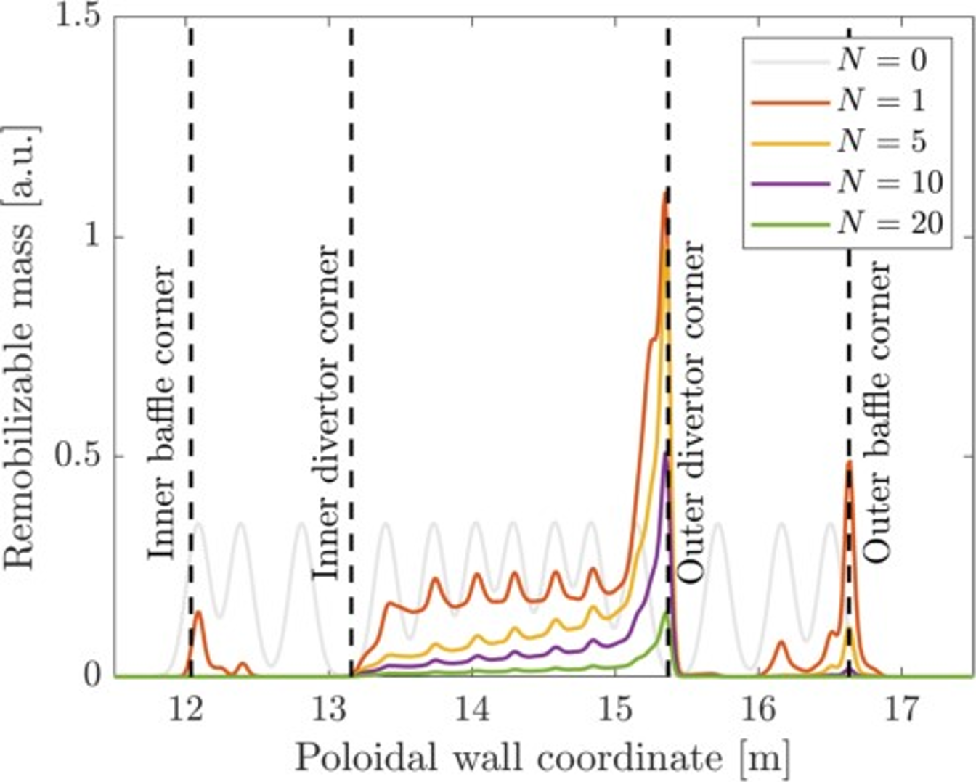
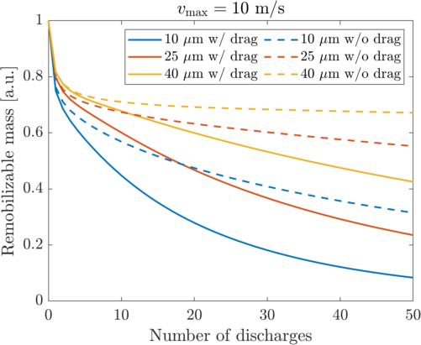
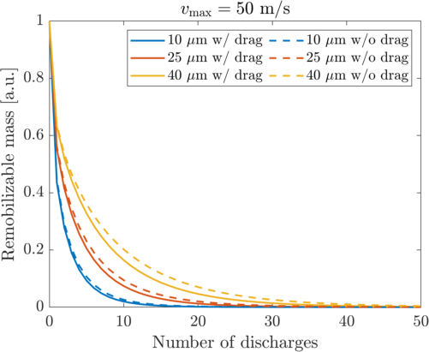
MIGRAINe modelling of DUST transport and inventory evolution
Dust starting locations and evaporation maps
Dust redistribution
Dust inventory evolution

Slide 10
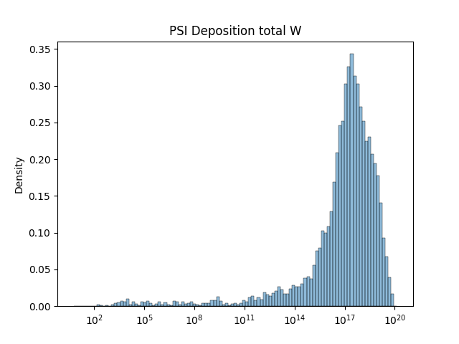
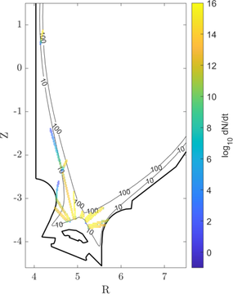
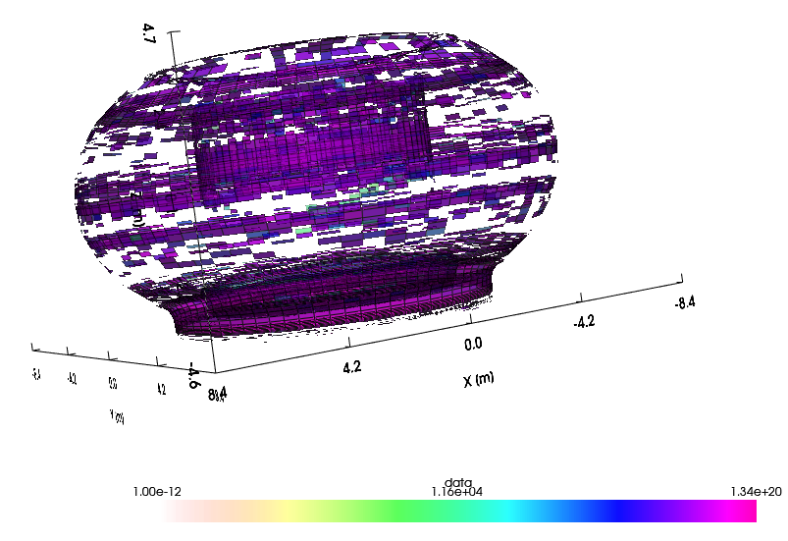
MIGRAINe to ERO2.0 data exchange framework
Dust evaporation maps via IMAS – ITER as setup for testing (same geometry and plasma solution via IMAS)
W dust re-mobilization source in the divertor → atomic W source due to dust ablation → impurity tracing in plasma → gross deposition (the shown case does not account for reflection and re-erosion)

Slide 11
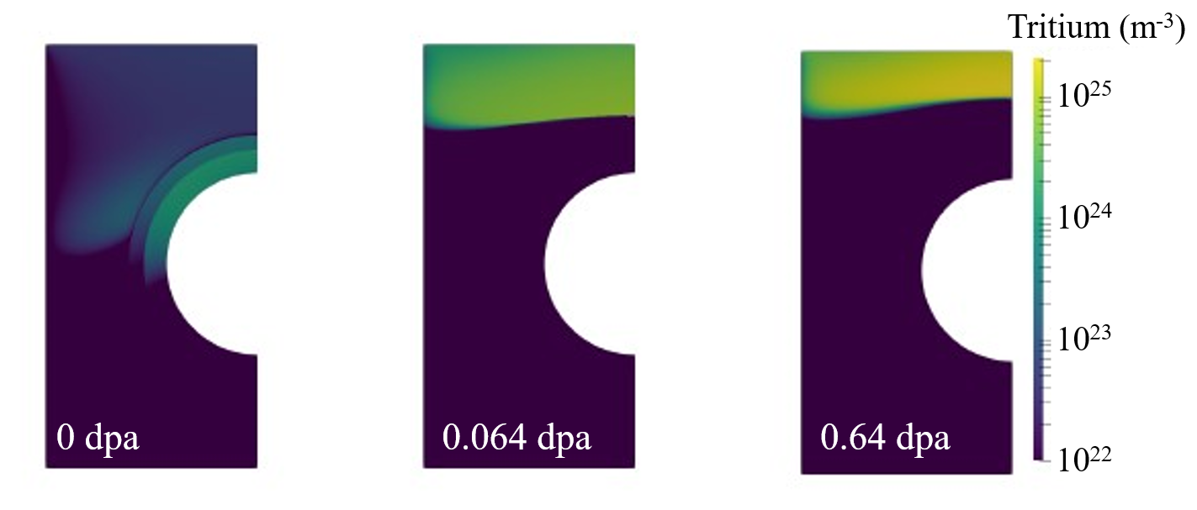
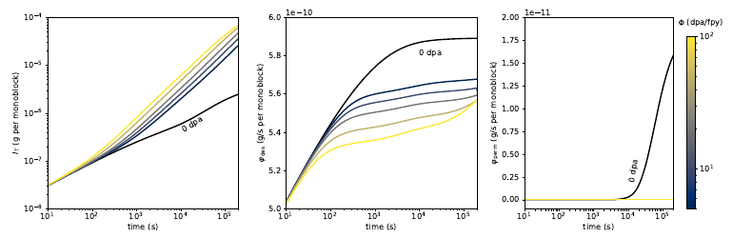


FUEL RETENTION ANALYSIS with festim
2D modelling of n-damaged divertor monoblock
10 MW/m²
5.0$×$10²³ T/m²/s, 115 eV/D, 5-100 dpa/fpy
n
T
1414 K
n
T
x 28
Instant.
outgassing
Recomb
Coolant (water)
Includes trap creation/annealing model by J. Dark et al, NF 64 (2024)
Tritium retention field after 200,000 s of plasma exposure for different neutron fluxes (damage rates) compared to undamaged case (0 dpa): resulting damage up to 0.064 dpa (10 dpa/EFPY), and 0.64 dpa (100 dpa/EFPY)
Ratio of T inventory with and without
n-damage
E. Hodille, submitted

Slide 12
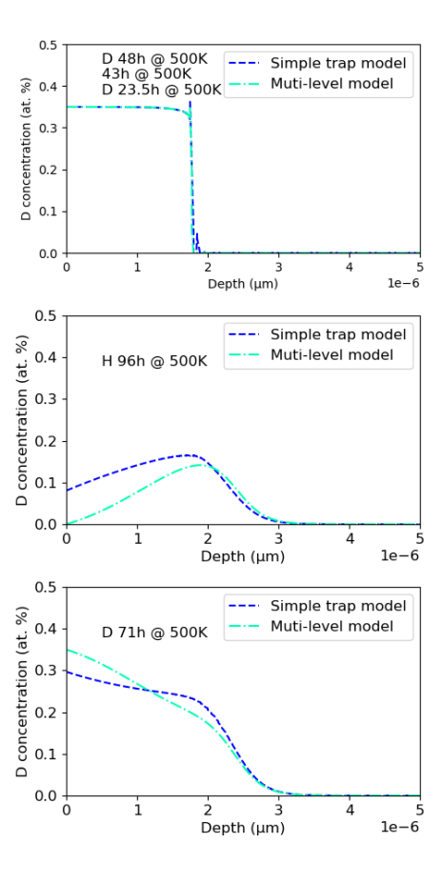
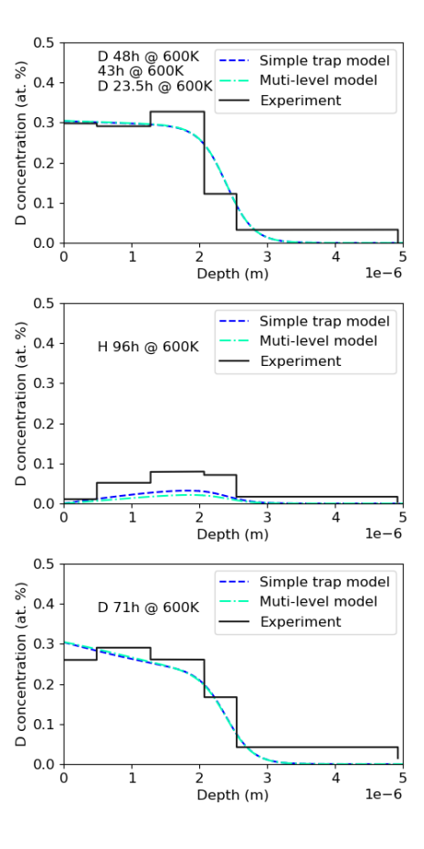
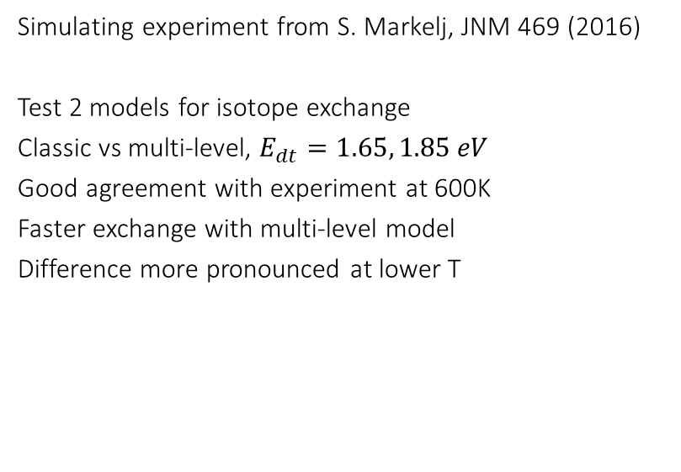
FUEL RETENTION ANALYSIS with festim
Modelling of isotope exchange in damaged W
Simulating experiment from S. Markelj, JNM 469 (2016)
Test 2 models for isotope exchange
Classic vs multi-level, $E_{dt}=1.65, 1.85 eV$
Good agreement with experiment at 600K
Faster exchange with multi-level model
Difference more pronounced at lower T

Slide 13
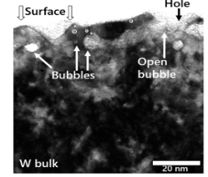
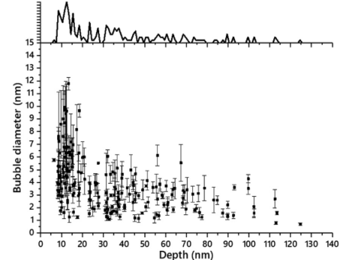
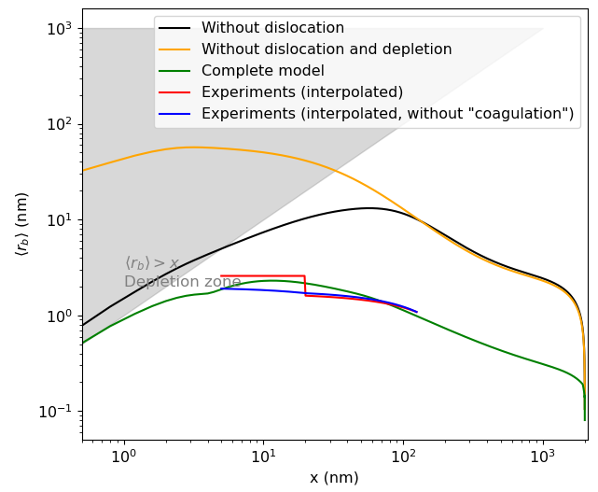
FUEL RETENTION ANALYSIS with festim/FENICS
He clustering model including dislocations
Simulations done with an extented model from Delaporte-Mathurin, Scientific Reports 11 (2021) and solved with FenicsX
Model includes now dislocations and pre-existing vacancies as source of trapping and nucleation of He bubbles
Coagulation and bubble migration are being developed
Paper submitted to Journal of Physics D: Applied Physics comparison to experimental data including the temporal evolution of porosity
Experiments: Ialovega et al. NF 62 (2022) 126022

Slide 14
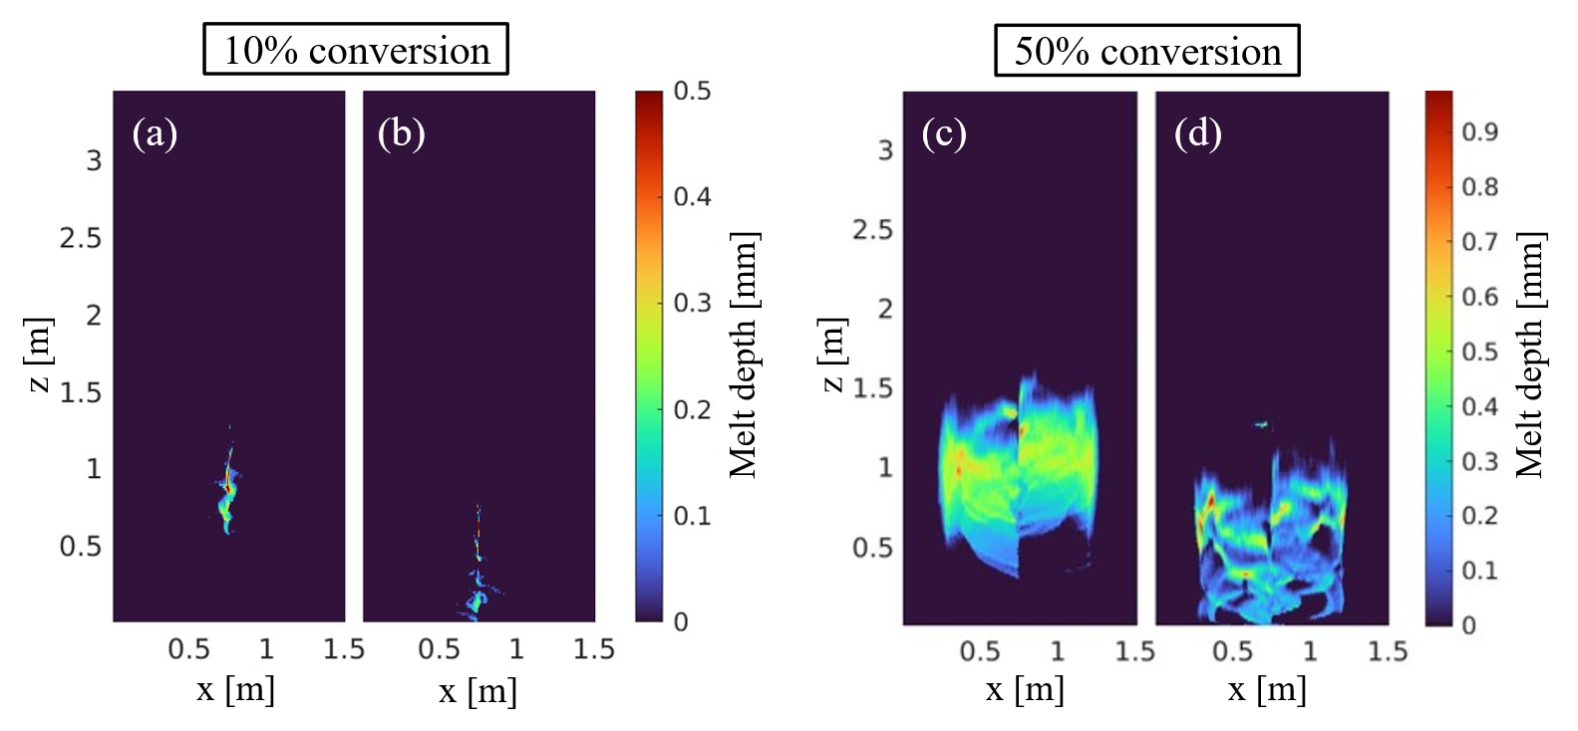
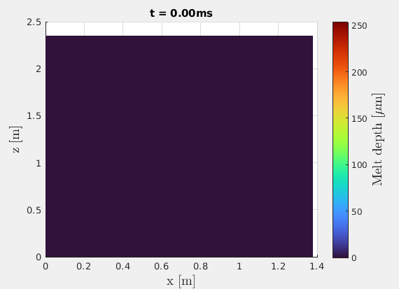
PFC Response to transient events – melting with memento
Thermionic emission scaling laws provided by dedicated PIC simulations
Addressing upper limiter damage under vertical displacement event (VDE)
No vapor shielding in the model – mockup for by capping the heat flux
Thermal quench up to 63 GW/m2 ~10 ms
Melt velocity ~0.5 m/s, pool lifetime ~5ms → expected small displacements compared to characteristic scales of the limiter
At the edge, 60 μm melt depth and 1 cm/s velocity, Weber number ~5×10⁻⁵ → melt should remain attached
Current quench up to 5.6 GW/m² (10%) or 28 GW/m² (50%) ~100 ms
Melt depth up to ~250 μm
40 ms 60 ms
40 ms 60 ms
Instantaneous melt pools up to 0.3 - 0.5 mm depth Weber number ~10 → prone to splashing

Slide 15
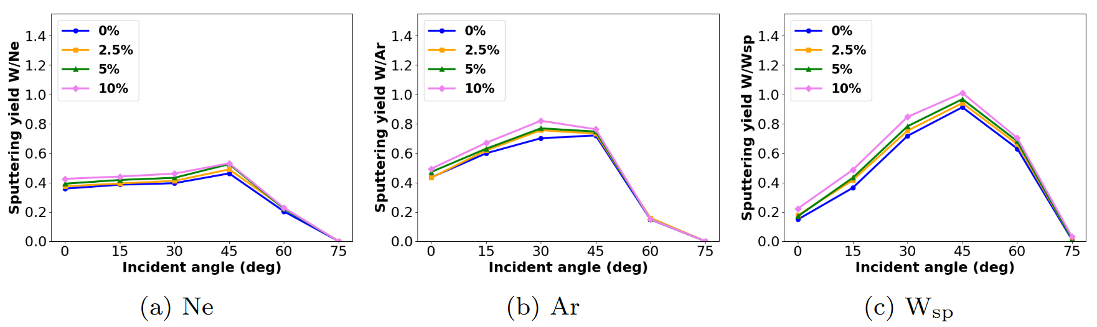
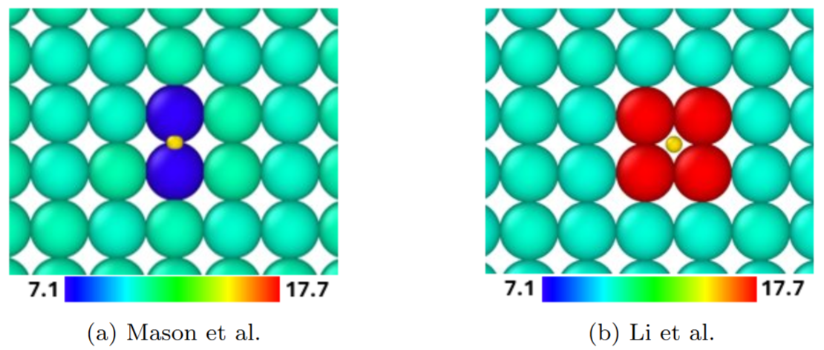
DEMO-relevant material and plasma sheath physics
Sputtering of D-decorated W surfaces
200 eV / (100) surface
Energy required for sputtering (eV)
Both above and below figure/table
F. Kporha, JNM 613 (2025) 155856

Slide 16
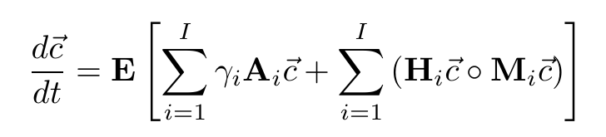
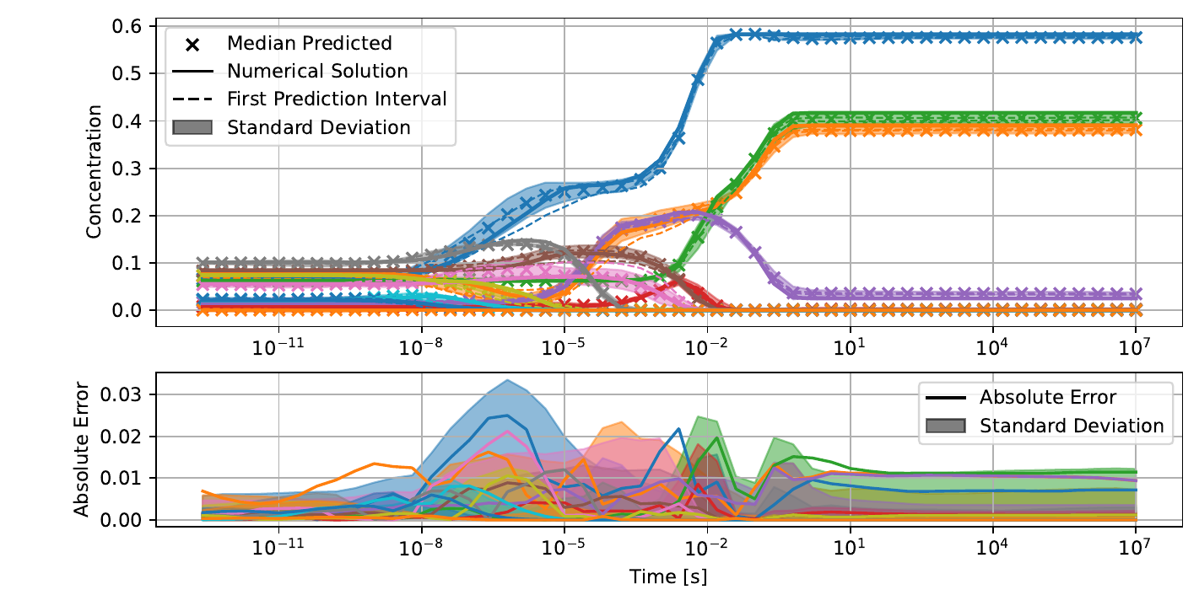
DEMO-relevant material and plasma sheath physics
Trap equations with physics-informed neutral networks (PINNs)
Training data from RAVETIME-Code : 3-D Advection-Diffusion-Reaction Solver for hydrogen (finite volume) transport in matter
Vector-Riccati-Equation Generalisation to ‘fill-level’ dependent traps and multiple isotopes
Proof of principle successful
so far only reaction terms
still on the scale of single volume element
less suited for evolving scenarios
to be assessed for joint reaction-diffusion

Slide 17
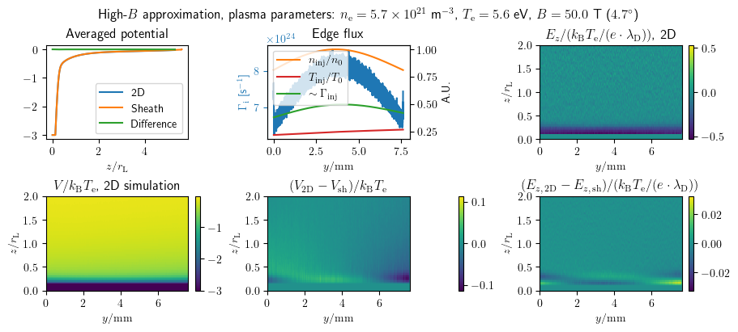
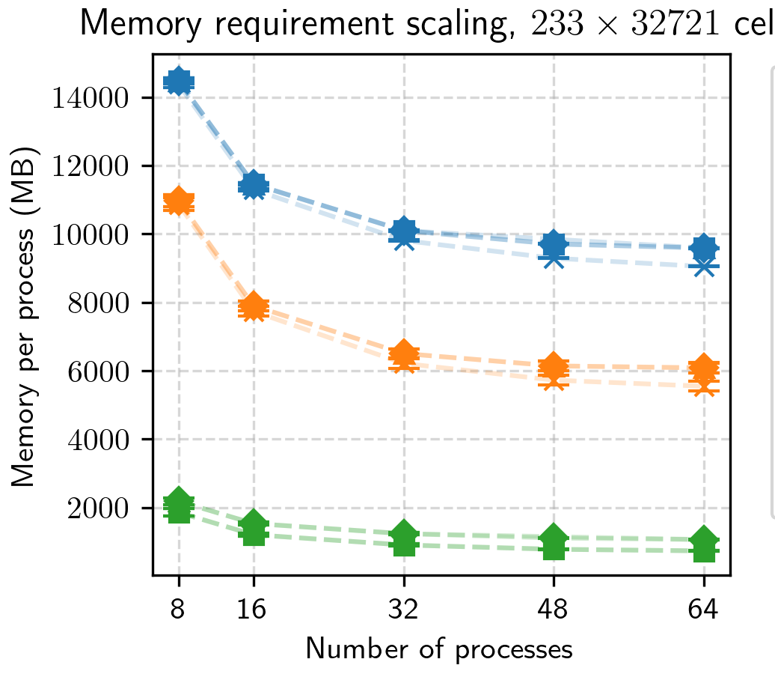
DEMO-relevant material and plasma sheath physics
2D Particle-in-Cell simulations (e.g. castellated tiles)
2024: SPICE2 w/nonuniform injection scheme (2D PIC) routinely applicable; memory optimization was found to be extremely important for DEMO-scale
Code updates finalized
Memory footprint reduction ~ 10x (new, before update, intermediate)
Simulations performed with strikepoint-like plasma
Increased electric field at the strikepoint location observed
Summary: Scalability substantially improved, reducing time req. 2-5x. Down to ~ month per simulation.

Slide 18
2026-2027 outlook – TSVV-D: Motivation and context
Need to address design and safety relevant information in view of PWI
W sources and their screening during steady-state operation as core impurity and wall lifetime concern
Formation of redeposited layers as undesirable reservoir for fuel retention and potential dust source
Evolution of dust inventory and its role as impurity source and on impurity redistribution
Evolution of fuel retention and permeation by implantation and co-deposition, accounting for neutron-induced damage evolution under realistic plasma operation scenarios and throughout implementation of fuel removal strategies
Consequences of transient events in terms of PFC integrity and potential for catastrophic PFC damage, in particular deep volumetric melting and explosion-like material response to impact of runaway electrons
Need to enhance codes capabilities in terms of physics description, framework integration and practical performance requirements

Slide 19
2026-2027 outlook – TSVV-D: Summary of scientific tasks
Steady-state PWI with ERO2.0
Surrogate models for PWI
W to core, field-aligned grid
Time-dependent dust evaporation sources
Validation in AUG
Predictive modelling and comparison (TSVV-E)
Dust transport
Improved electron collection model
Remobilization by plasma-induced forces
Time-dependent dust evaporation sources
Validation in AUG
Predictive modelling
Fuel retention
Physics-informed defect annealing model
Optimization of numerical convergence (large eq. sys.)
HISP framework: retention & outgassing (reactor scale)
Validation in AUG
Predictive modelling
Transient events → RE
Surrogate models for RE energy deposition and secondary products
Full thermo-mechanical response model with explosive fragmentation
Validation in AUG
Predictive modelling
Thank you for your attention!

