Slide 1
Update and Plans SPX
Ivo Classen
DIFFER

Slide 2
WP-PWIE SPX: Plasma characterization, laser based diagnostic development
In 2025 SP X consists of 2 parts:
SP X.1: Atomic and molecular processes in attached/detached plasmas
SP X.2: Optimization of laser-based surface analysis diagnostics

Slide 3
SP X.1
Deliverable ID | Beneficiary/ PM | Deliverable Title
D001 | DIFFER 8 | CARS results in Magnum-PSI. Flow velocity measurements with CIS and multispectral imaging using MANTIS on Magnum-PSI/UPP. (DIFFER)
D002 | FZJ 4 | VIS/VUV molecular and atomic spectroscopy on H and D in PSI-2. Comparison of MANTIS to hyperspectral camera in UPP. (FZJ)
D003 | CU 2 | VUV OES measurements in MAGNUM-PSI/UPP with focus on H/H2 (CU)
D004 | MPG 2 | Interpretation spectroscopy results using spectra simulation and (CR) modelling with YACORA and development VUV-OES (MPG)
Device | Beneficiary | Days | Related Deliverable
MAGNUM-PSI | DIFFER | 11 | D001, D002, D003, D004
UPP | DIFFER | 11 | D001, D002, D003, D004
PSI-2 | FZJ | 9 | D002
JULE-PSI | FZJ | 0 | D002

Slide 4

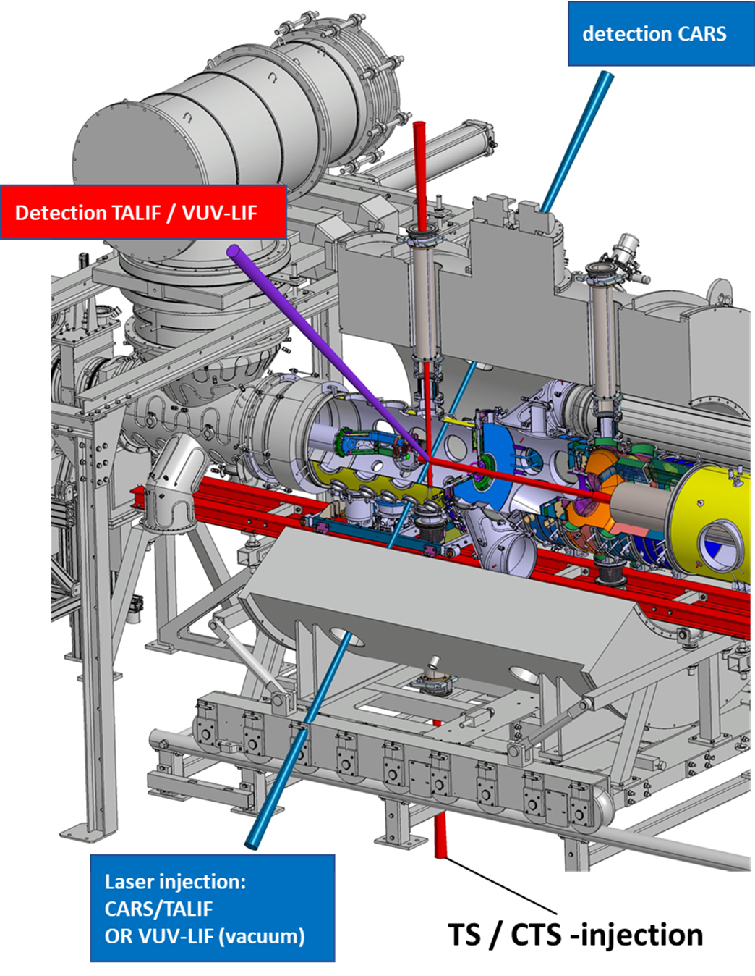
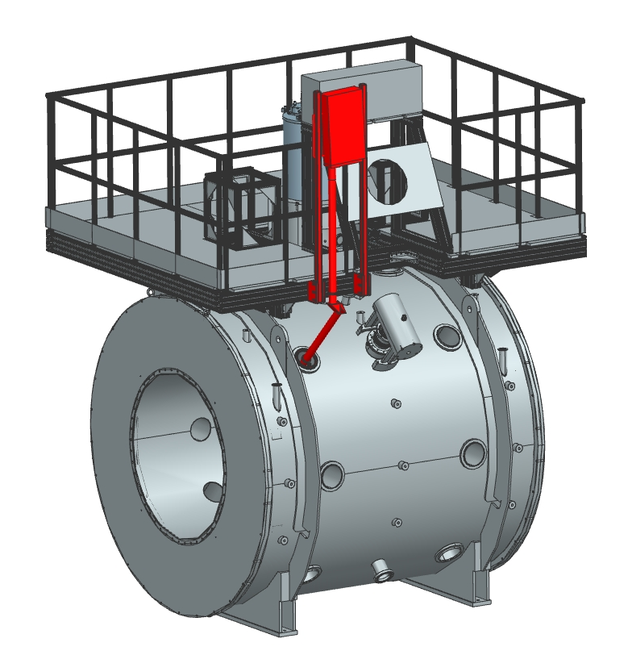
D001: Diagnostic developments for plasma characterization in Magnum-PSI
SP X.1
D001
MANTIS
TALIF
CARS
MANTIS
CIS

Slide 5
D001: TALIF for H measurements
SP X.1
D001
Plasma column
TALIF chord
Example acquisition from Magnum-PSI showing raw image (left), background-subtracted image (right)
Spectra above and below plasma column with two H populations (left). Average rotational velocity of H atoms in various B-fields (right) .
Publications in progress:
Comparison of Xenon- and Krypton-based TALIF Calibration Schemes for Hydrogen Density Determination
TALIF Diagnostic design for divertor relevant linear plasma devices Upgraded Pilot-PSI and Magnum-PSI
Measurements of atomic hydrogen density, temperature, and velocity in Magnum-PSI and UPP
1D H density profiles in Upgraded Pilot-PSI (UPP)

Slide 6
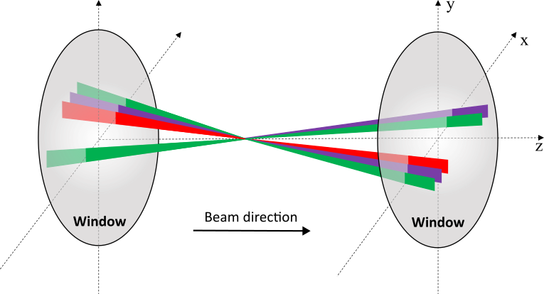
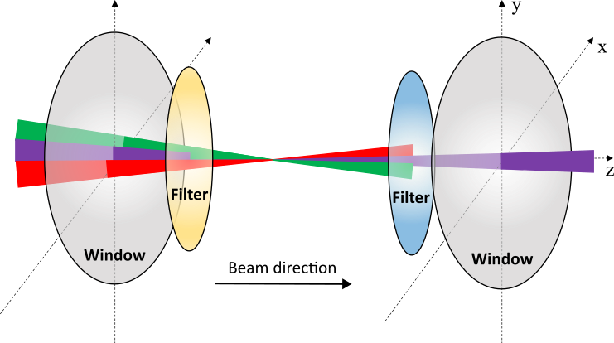
D001: CARS for H2 measurements
SP X.1
D001
Last experimental campaign (Feb-March 2025) unsuccessful
Imperfect laser components; hotspots caused optical damage
Large distance at Magnum-PSI combined with implemented BOXCARS scheme worsened detection sensitivity
Technician visited last month to fix laser (6-month laser downtime)
CARS setup improvements still needed. Work performed last year:
Built and tested ‘Filtered CARS’ setup → Similar sensitivity to BOXCARS → less sensitive to large distances → Will be applied to Magnum-PSI
Tests performed with ‘polarization CARS’ during laser downtime → Use specifically polarized input lasers and add a polarization filter to remove background → Observed issues with ellipticity of output lasers due to coated components - Will not be tested during new Magnum-PSI experiments

Slide 7
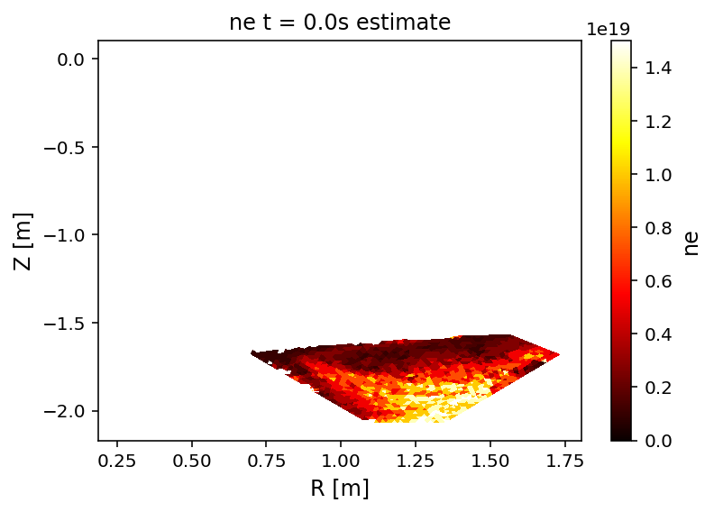
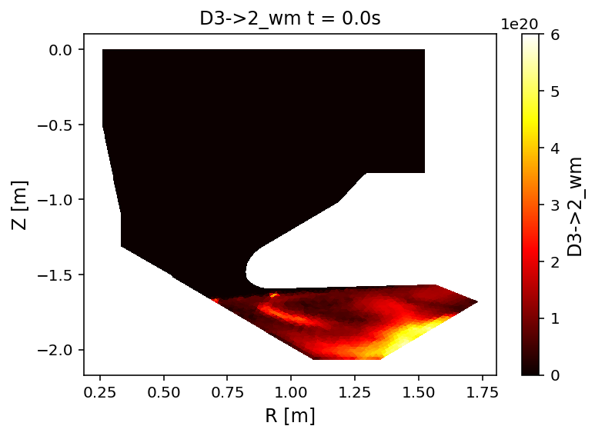
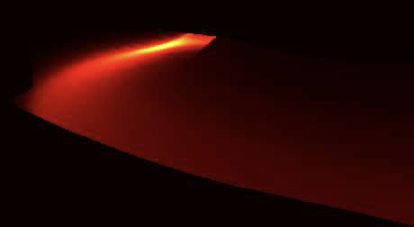
D001: MANTIS @ Magnum-PSI
SP X.1
D001
MANTIS: multispectral camera imaging^{[1]}
6 visible light cameras with unique filters, providing absolutely calibrated emissivities (photons/m³ sec)
Hydrogen Balmer, H₂ Fulcherband, Ar-I/II, Ne-I, C-II/III, N-II
Inference of electron temperature and density, neutral hydrogen density, ionization rates, recombination rates, hydrogenic plasma-molecular interaction rates^{[2-5]}.
Aims:
Test modifications to CRM through comparison against extensive set of Magnum-PSI diagnostics.
Port improved parameter inference results to exhaust experiments equipped with MANTIS:
TCV, MAST-U, AUG, W7-X, Magnum-PSI, RFX
First data next week
parameter estimate
Thomson, TALIF
validation
update
collisional-radiative model
Bayesian inference
(grid search or NN)
emissivity reconstruction x6
recorded emission x6
inversion
(SART or NN)
[1] A. Perek et al. Review of Scientific Instruments, 90(12):123514, 2019.
[2] A. Perek, et al. Nuclear Materials and Energy, 26, 2021.
[3] T.A. Wijkamp et al. Nuclear Fusion, 63(5):056003, 2023.
[4] A. Perek et al. Nuclear Fusion, 62(9):096012, 2022.
[5] B.L. Linehan et al. Nuclear Fusion, 63(3):036021.

Slide 8
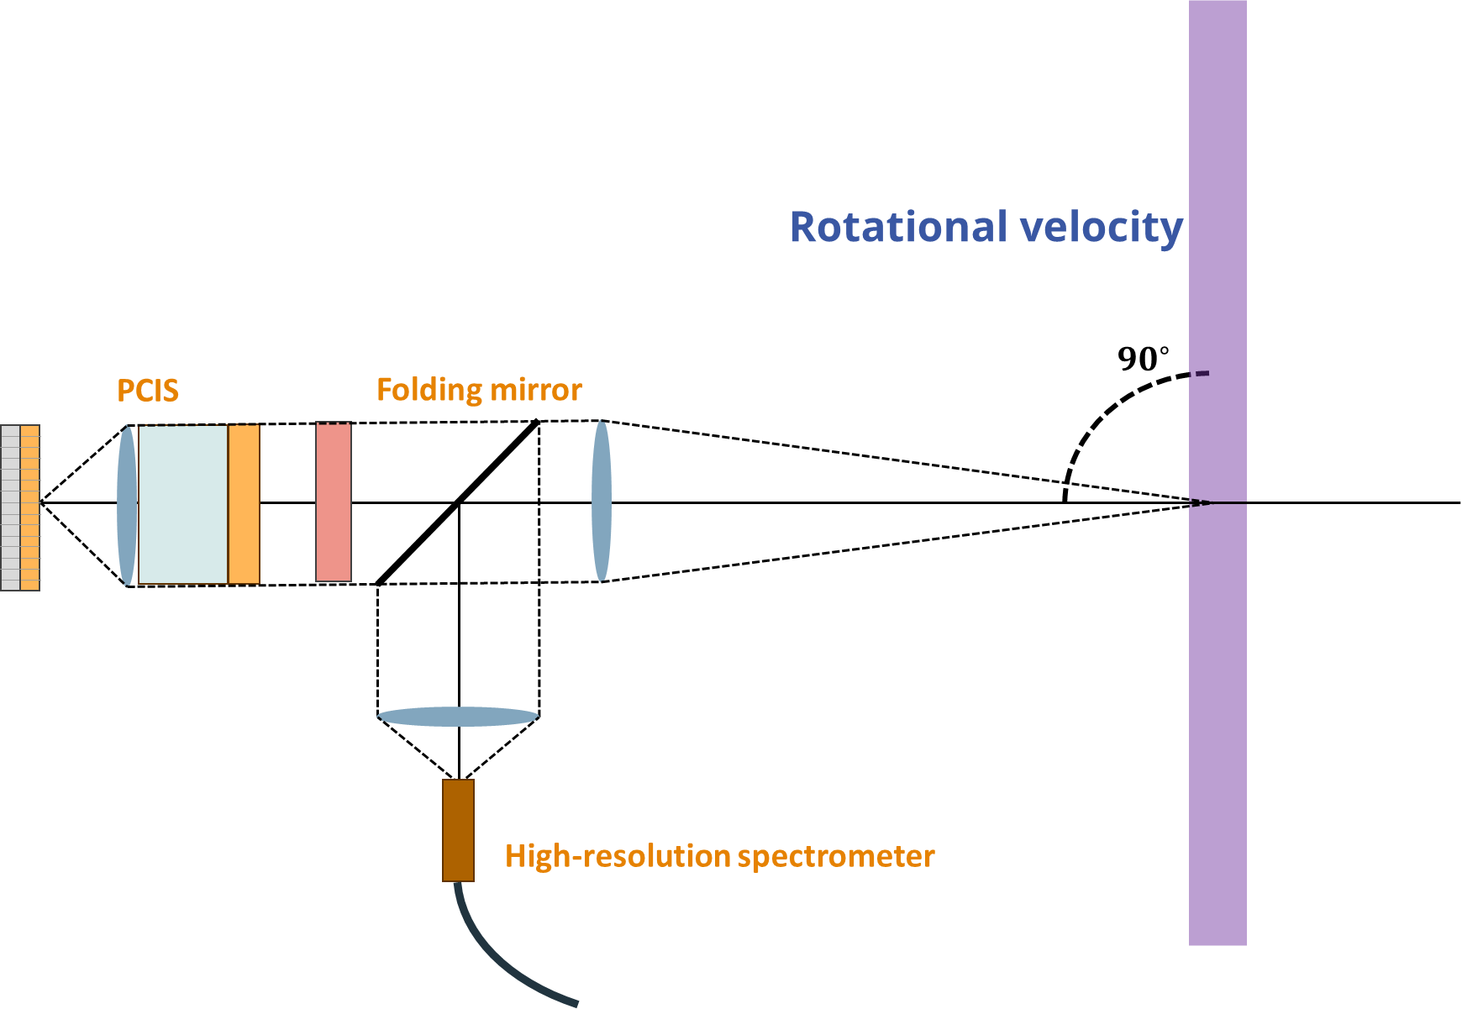
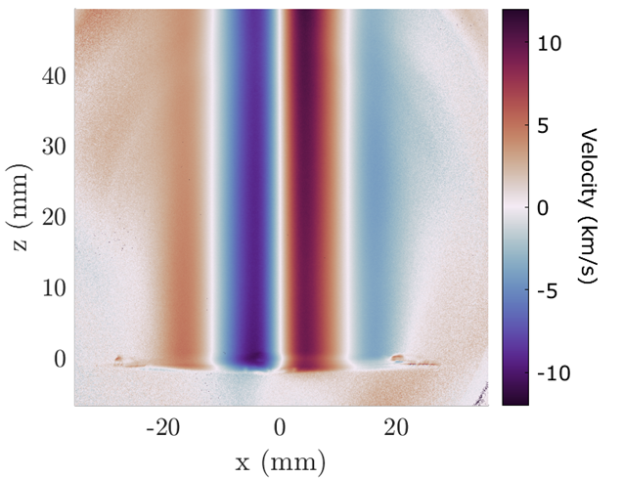
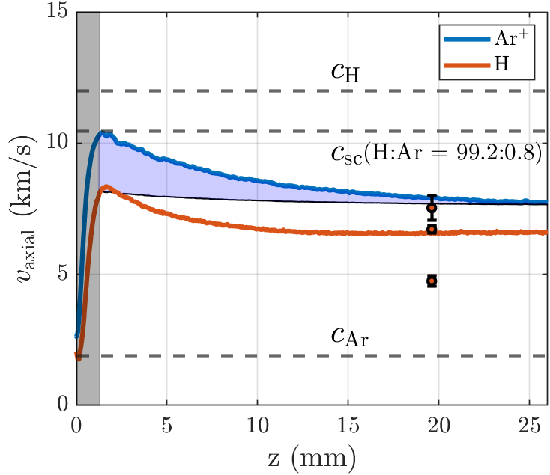
D001: Coherence imaging spectroscopy @ Magnum-PSI
SP X.1
D001
Coherence Imaging Spectroscopy is a camera-based polarization interferometer, enabling the acquisition of the 2D plasma flows.
Examples of use cases @ Magnum-PSI
Visualize the pre-sheath plasma flows.
Identify the entrainment of impurities with the main plasma flows.
Quantify the momentum losses from attached to detached conditions.

Slide 9

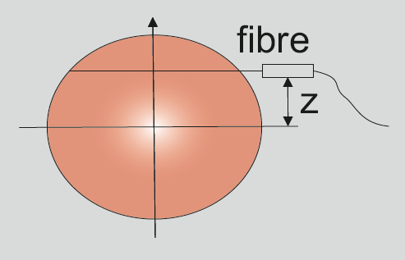
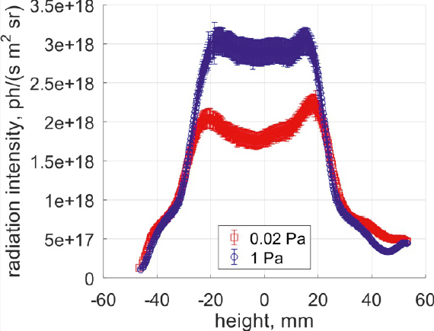
D002: VIS/VUV molecular and atomic spectroscopy on H and D in PSI-2
SP X.1
D002
Absolutely calibrated measurements of Balmer lines at PSI-2 using high resolution spectrometer and imaging spectrometer:
z=0 mm
z=24 mm
Experimental setup
2 components of the H_{α} line were found (unshifted cold component (0.2-0.6 eV) and rotating hot component (3-4 eV, ionic nature doppler-shifted due to rotation of the plasma)).
Line-integrated emission profile of the Balmer lines, absolutely calibrated by integrating sphere. Spatial resolution across plasma column.

Slide 10
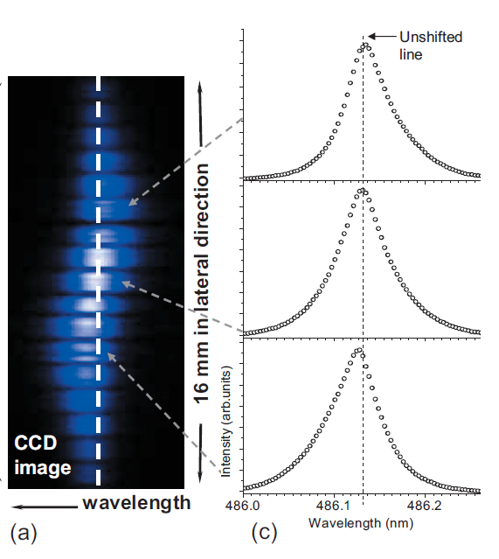
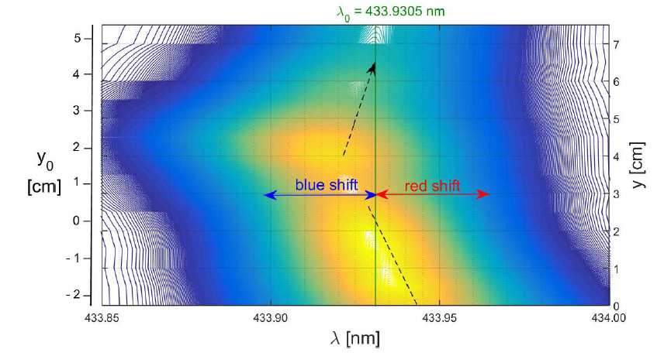
D002: Benchmarking plasma chemistry at PSI-2
SP X.1
D002
MAGNUM-PSI
Hβ line
Two component hydrogen lines are observed at linear plasmas (MAGNUM-PSI, PSI-2, PISCES-A)
The most probable sources of the broad (rotating) component:
e + H₂⁺ → H + H (n=2,3,4,..) (dissociative recombination)
e + H₂⁺ → H + H (n=2,3,4,..) (dissociative excitation)
(charge-exchange reaction is too weak)
The comparison of the Balmer lines emission with Yakora and AMJUEL
codes was performed using the new experimental data from imaging and high resolution spectrometers /Kotov V, EPS Conference P4.210 (2025)/.
A Schumack PHYSICAL REVIEW E 78, 046405 2008
PSI-2
Dγ line, Klevarova V. Masterthesis (2015)

Slide 11
SP X.1
D002
D002: VIS/VUV molecular and atomic spectroscopy on H and D in PSI-2
Comparison/verification with CR modelling (Yakora, AMJUEL):
Dominant role of excitation due to dissociative recombination of the H₂⁺ molecule and dissociation of molecules. Electron excitation and recombination negligible. Contribution of H₂⁺ ions to the excitation of the H _{α} line is ~ 60%. Contribution of H₂⁺ ions to the H_{β} line is ~80%. The second strong channel is the H2 dissociation.
The bands of molecular spectra of H and D measured at the PSI-2 in the VIS and VUV range are going to be analyzed until the end of 2025.
height, mm

Slide 12
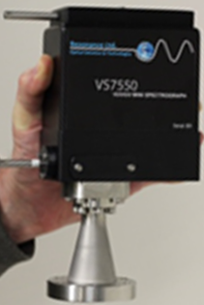
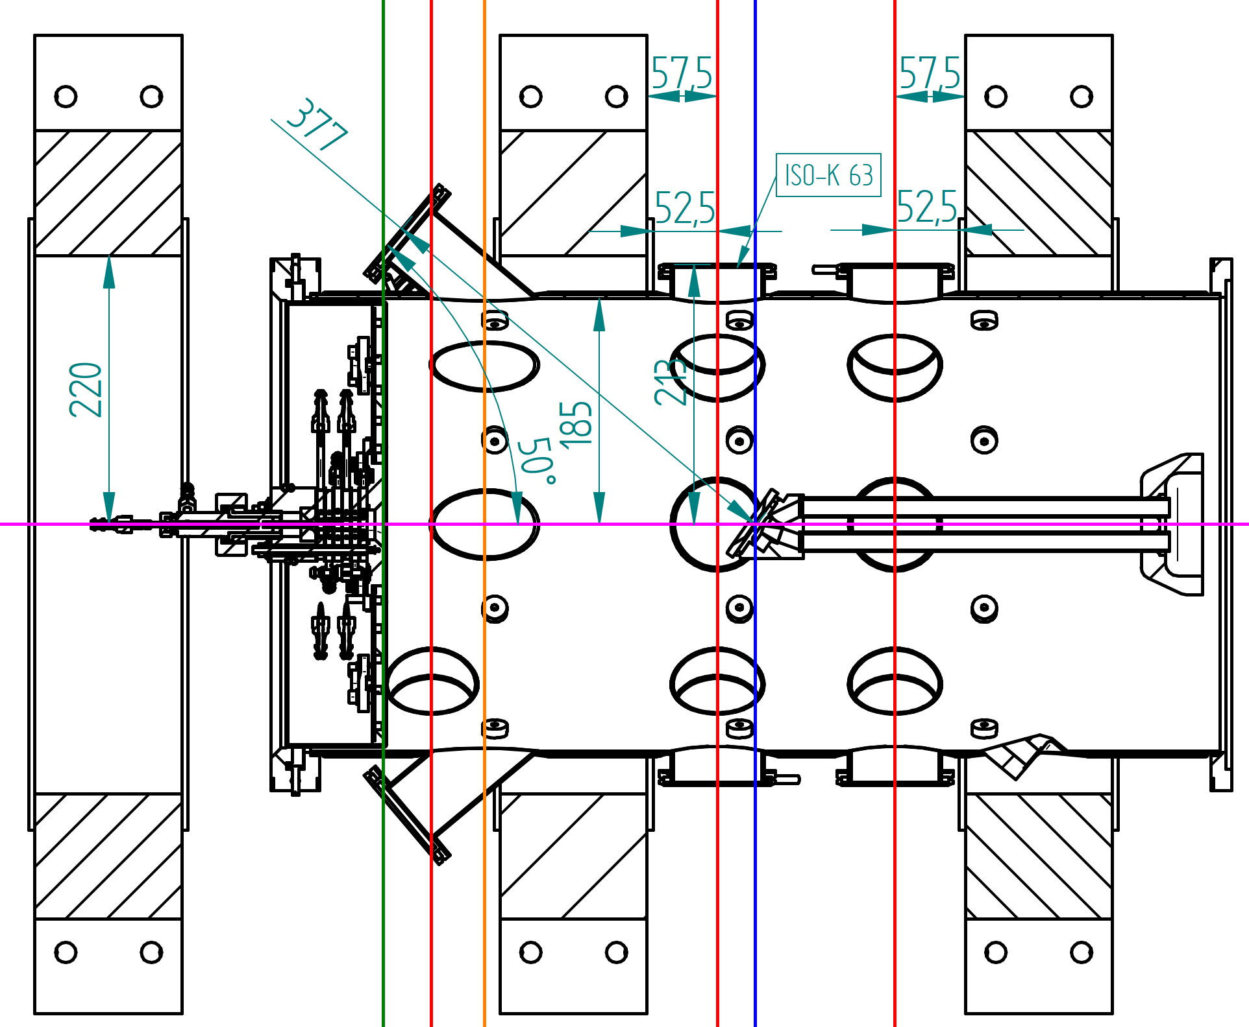

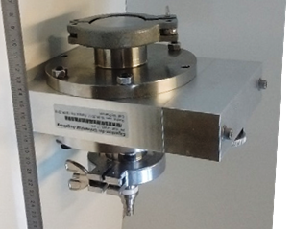
D004: VUV spectroscopy at UPP
VUV spectrometer
SP X.1
D004
Two devices applied:
VUV mini-spectrometer: 117-420 nm, 0.2 nm FWHM
VUV diode system with interference/edge filters: access to spectral range <113 nm
Fröhler-Bachus et al., JQSRT 259 (2021) 107427
Friedl et al., Meas. Sci. Technol. 34 (2023) 055501
Ø 2.1 cm
Ø 13 cm  clipped to ~ 10 cm
VUV diode system

Slide 13
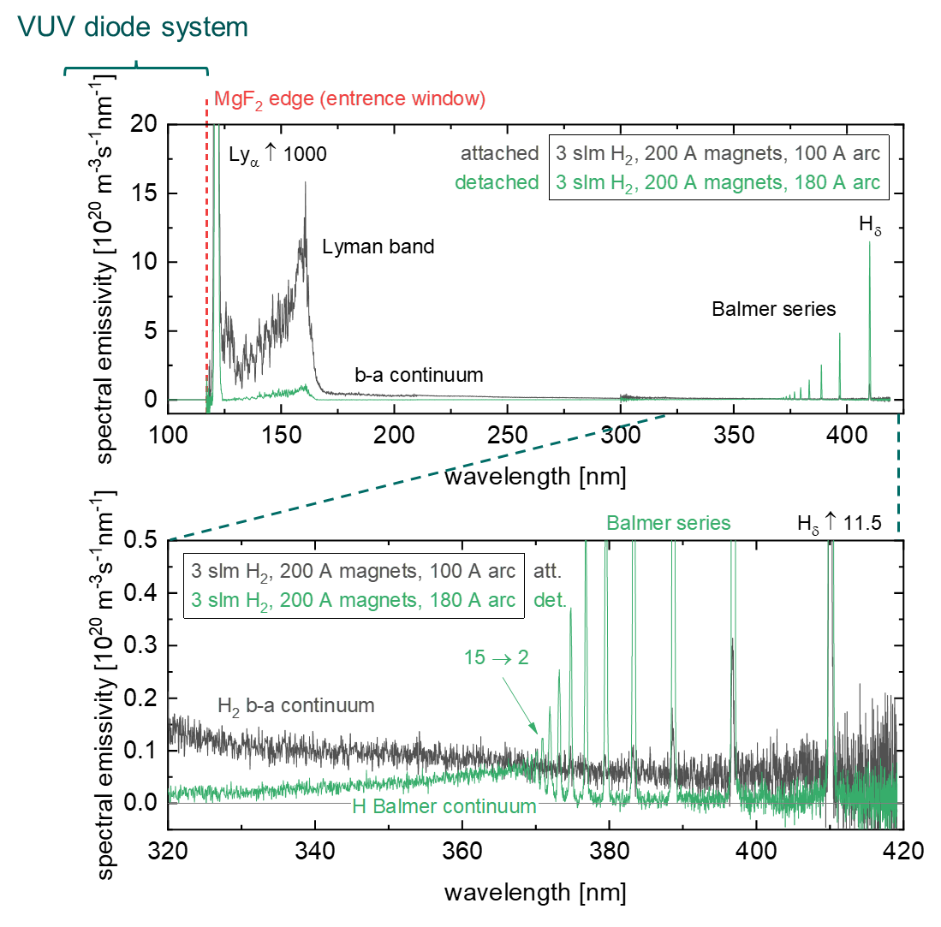
D004: VUV spectroscopy at UPP
SP X.1
D004
Two devices applied:
VUV mini-spectrometer: 117-420 nm, 0.2 nm FWHM
VUV diode system with interference/edge filters: access to spectral range <113 nm
Absolutely calibrated spectra
Ly_{α} dominates spectrum
Detachment clearly to be seen in spectra (green vs. black):  H₂ molecular systems (Lyman band, a-b continuum) decrease  Balmer series (n > 6) strongly increases, Balmer continuum appears instead of a-b continuum
Werner band + Ly series accessible with diode system
Fröhler-Bachus et al., JQSRT 259 (2021) 107427
Friedl et al., Meas. Sci. Technol. 34 (2023) 055501

Slide 14
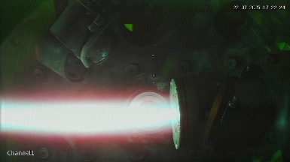
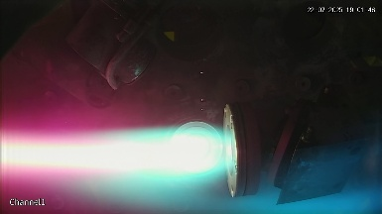
D004: VUV spectroscopy at UPP
SP X.1
D004
Two devices applied:
VUV mini-spectrometer: 117-420 nm, 0.2 nm FWHM
VUV diode system with interference/edge filters: access to spectral range <113 nm
Absolutely calibrated spectra
Ly_{α} dominates spectrum
Detachment clearly to be seen in spectra (green vs. black):  H₂ molecular systems (Lyman band, b-a continuum) decrease  Balmer series (n > 6) strongly increases, Balmer continuum appears instead of b-a continuum
Werner band + Ly series accessible with diode system
Detached regime dominated by atomic radiation  Lyman series leads to high flux of high-energy photons (> 12 eV) even under detached conditions!
VUV applicability demonstrated  Insights into molecular radiation and recombination t.b.d.
Fröhler-Bachus et al., JQSRT 259 (2021) 107427
Friedl et al., Meas. Sci. Technol. 34 (2023) 055501

Slide 15
SP X.2
Deliverable ID | Deliverable Title
D001 CEA | Comparison of ps vs. ns LIBS: absolute content and composition. Comparison SP vs. DP LIBS, or alternative LIBS signal enhancement methods: absolute fuel content in W samples and composition (CEA)
D002 DIFFER | In-situ LIBS and NRA in Magnum-PSI. Reference measurements of outgassing and retention after D plasma loading: absolute content and composition in W and reference samples (DIFFER)
D003 ENEA | Comparison SP vs. DP LIBS, or alternative LIBS signal enhancement methods: absolute fuel content in W samples and composition / (CF)-LIBS results on H-D loaded samples and surface modifications. Investigation of the possibility to detect He with LIBS on He-loaded samples at ambient pressure and RT (ENEA)
D004 FZJ | Comparison of ps vs. ns LIBS: absolute content and composition / Comparison SP vs. DP LIBS, or alternative LIBS signal enhancement methods: absolute fuel content in W samples and composition / Reference measurements of outgassing, recycling, and retention after D plasma loading: absolute content and composition in damaged and undamaged Wsamples / LAMIS measurements and identfication of C and N containing molecules /Explore TALIF and LIBS for H isotope identification (FZJ)
D005 IPPLM | Report on LIBS analysis by application of machine learning algorithm: focus on development of the models for chemical contents estimation and reconstruction of experimental signals. (IPPLM)
D006 CU | ps/ns LIBS analysis of B, W, (Be) containing coatings. CF quantification and depth profile analysis. Re-excitation of weak ps laser induced plasma by 2nd ns laser pulse (DP LIBS ). Analysis of JET and ITER related samples. He-loaded and deuterium-exposed coatings with differing surface morphologies. Ablation rate analysis. (CU)
D007 UT | Analysis of B containing coatings and/or W coatings with (CF)-LIBS: absolute content and composition / (CF)-LIBS results He loaded samples and surface modifications / In-situ LIBS and NRA in Magnum-PSI: Reference measurements of (LIBS induced and natural) outgassing and retention after D plasma loading: absolute content and composition in W based samples. (UT)
D008 ISSP UL | Comparison of ps vs. ns LIBS: absolute content and composition / Analysis of B containing coatings and/or W coatings with (CF)-LIBS: absolute content and composition (ISSP-UL)
D009 VTT | LIBS measurements on W and Be containing reference layers in support of the SP E.1 activities (VTT)

Slide 16
SP X.2
Device | Beneficiary | Days | Related Deliverable
MAGNUM-PSI | DIFFER | 7 | D002, D007
PSI-2 | FZJ | 15 | D004
Accelerator | DIFFER | 12 | D002

Slide 17


SP X.2
D001
LIBS developments
of the CORIA-CEA group in 2025
Arnaud Bultel‡, Vincent Morel, Aurélien Favre, Benjamin Quevreux
CORIA, UMR CNRS 6614, Normandie Université, 76801 Saint-Etienne du Rouvray cedex, France
‡arnaud.bultel@coria.fr
Floriane Montupet-Leblond, Elodie Bernard, Stéphane Vartanian, Marc Missirlian, Christian Grisolia

Slide 18
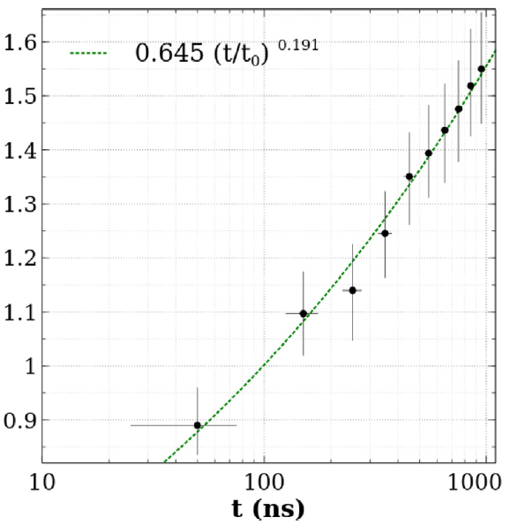
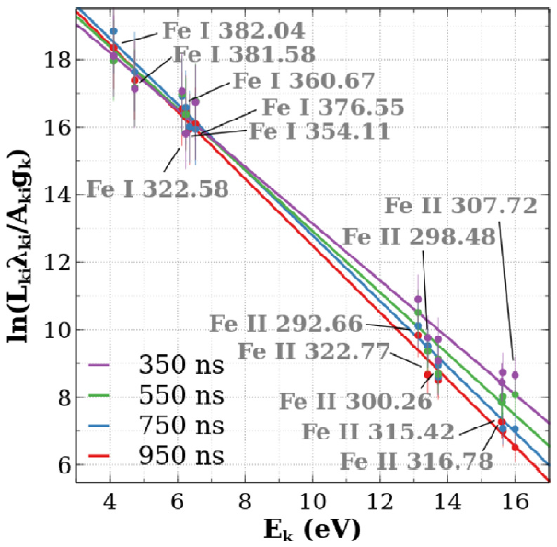
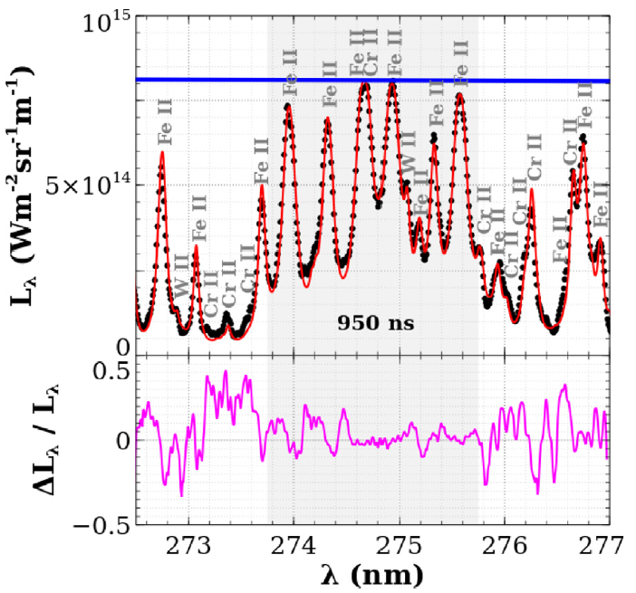
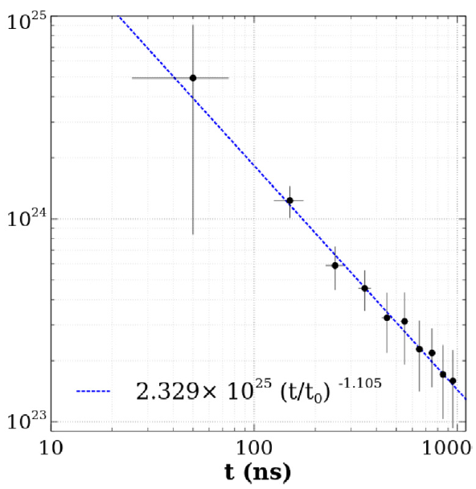
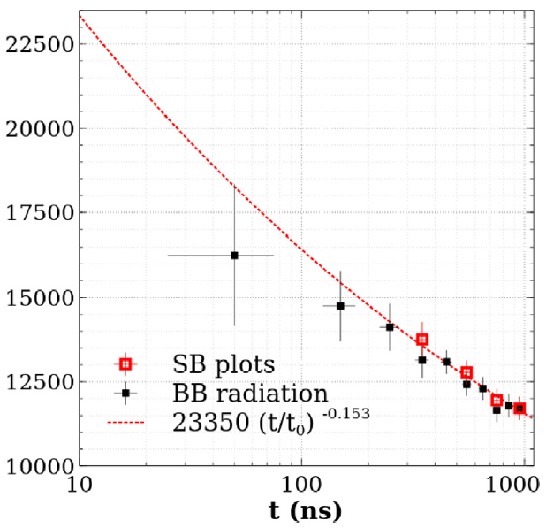
SP X.2
D001
Validation of the MERLIN code (spectra calculations)
On Eurofer97 containing
Fe, Cr, Cu, W, Na, Mn, V measured by XRF
At time t = 950 ns:
experimental spectrum
reconstruction by MERLIN
blackbody radiation
Plasma thickness (mm)
Saha-Boltzmann plot
t₀ = 10 ns
t₀ = 10 ns
t₀ = 10 ns
Spectral radiance
Electron density (m⁻³)
Temperature (K)
Spectral radiance
relative difference
A. Favre, A. Bultel, V. Morel et al. JQSRT 330 (2025) 109222
https://doi.org/10.1016/j.jqsrt.2024.109222

Slide 19
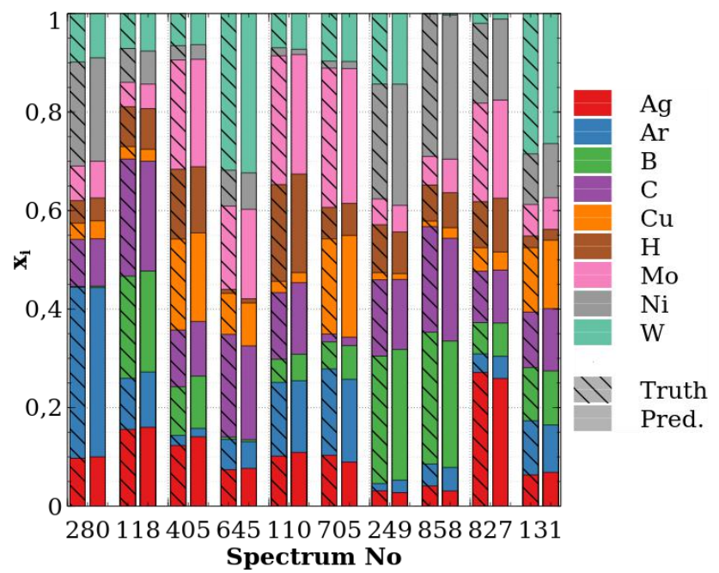
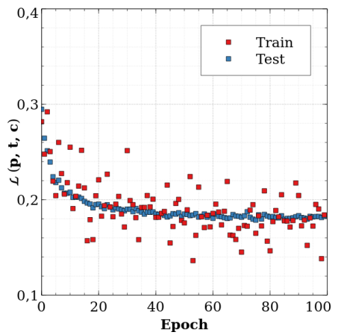
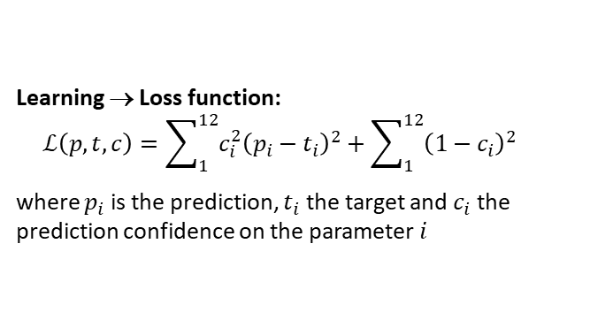
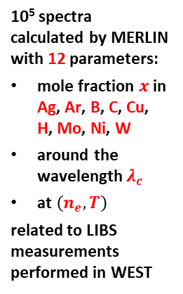
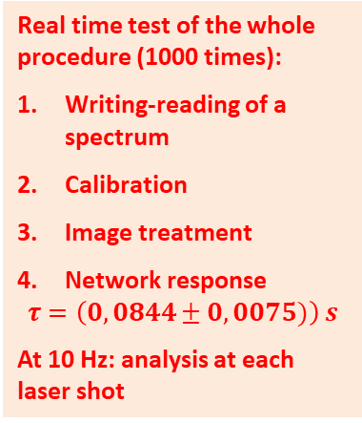
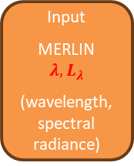

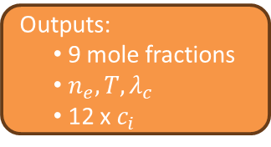
SP X.2
D001
Coupling between Machine Learning and MERLIN for real time CF-LIBS
x 6
Tests for the quantification:
Best prediction!
Lowest predicted value for H: $x_{H}=0,1 \%$
Input
MERLIN
$$λ, L_{λ}$$
(wavelength, spectral radiance)
DENSE + ReLU + DENSE
CONVOLUTION
DENSE + ReLU x5
RESIDUAL BLOC x4
MAX POOL
FLATEN
DENSE + ReLU + DENSE
DENSE + ReLU + Softmax
10⁵ spectra calculated by MERLIN with 12 parameters:
mole fraction $x$ in Ag, Ar, B, C, Cu, H, Mo, Ni, W
around the wavelength $λ_{c}$
at $\left(n_{e}, T\right)$
related to LIBS measurements performed in WEST
Multi-layer perceptrons: decision
Outputs:
9 mole fractions
$n_{e}, T, λ_{c}$
12 x $c_{i}$
Real time test of the whole procedure (1000 times):
Writing-reading of a spectrum
Calibration
Image treatment
Network response
$$τ=\left(0,0844±0,0075)\right) s$$
At 10 Hz: analysis at each laser shot
NORMALISATION
CONVOLUTION
ReLU
STACK
Learning → Loss function:
$$ℒ\left(p,t,c\right)=\sum_{1}^{12}{c_{i}^{2}{\left(p_{i}−t_{i}\right)}^{2}}+\sum_{1}^{12}{{\left(1−c_{i}\right)}^{2}}$$
where $p_{i}$ is the prediction, $t_{i}$ the target and $c_{i}$ the prediction confidence on the parameter $i$
Convolutional Neural Network: information extraction
A. Favre, A. Bultel… V. Morel et al. Phys. Scr. 99 (2024) 035609
https://doi.org/10.1088/1402-4896/ad2826
A. Favre, V. Morel… A. Bultel. Spectrochim. Acta Part B 224 (2025) 107082
https://dx.doi.org/10.1016/j.sab.2024.107082

Slide 20
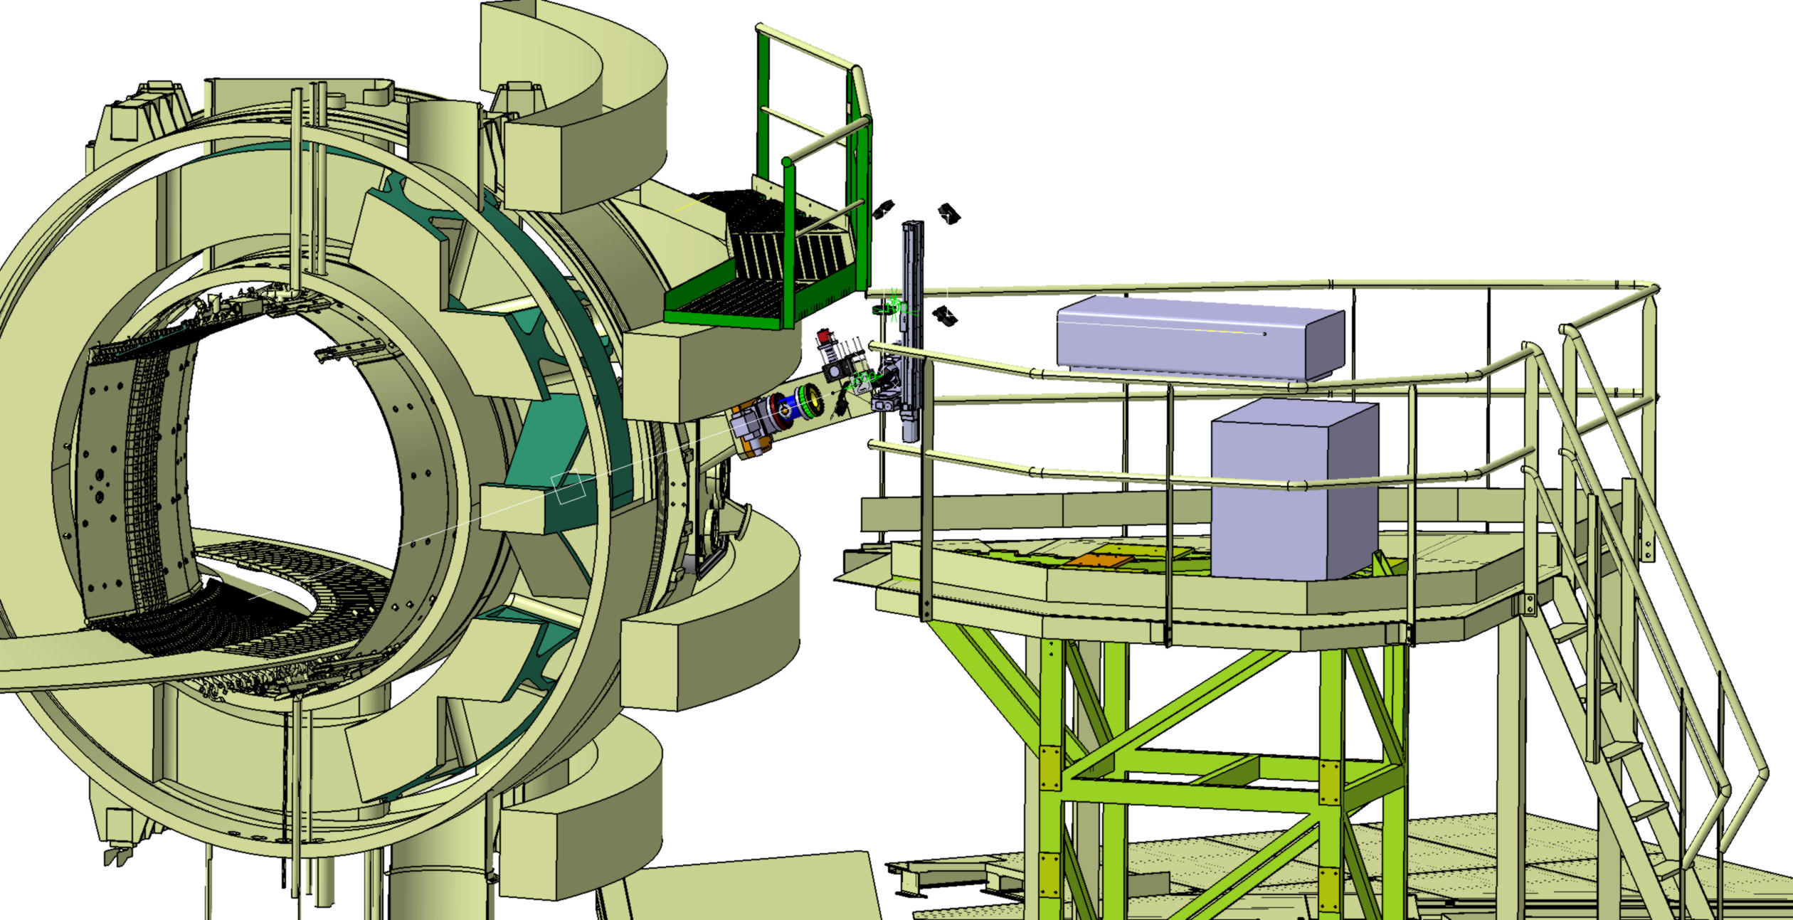
View system
Periscope
Preparation of a LIBS device within WEST: the LIBS4FUSION project
Tokamak window
Movable lens
Plasma light collection system
Nd:YAG laser source
Power supply

Slide 21
D002: LIBS on Magnum Closely linked to D007, see talk by Indrek
SP X.2
D002

Slide 22

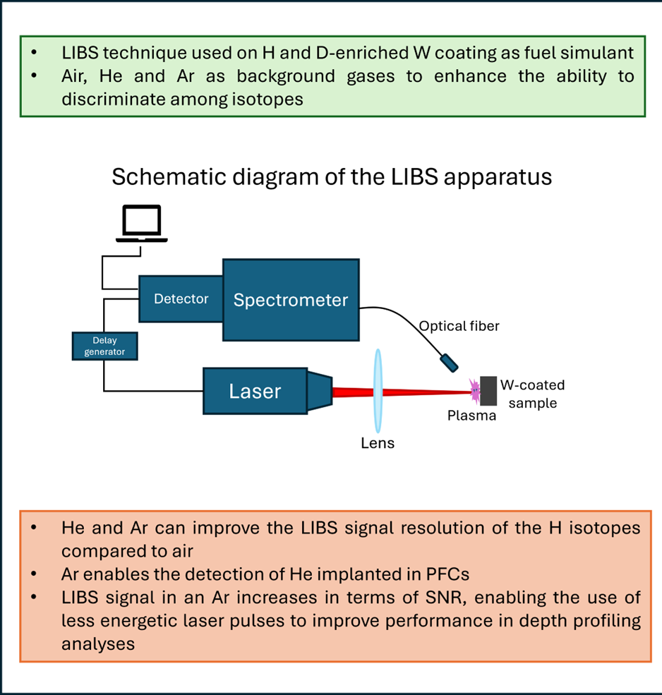
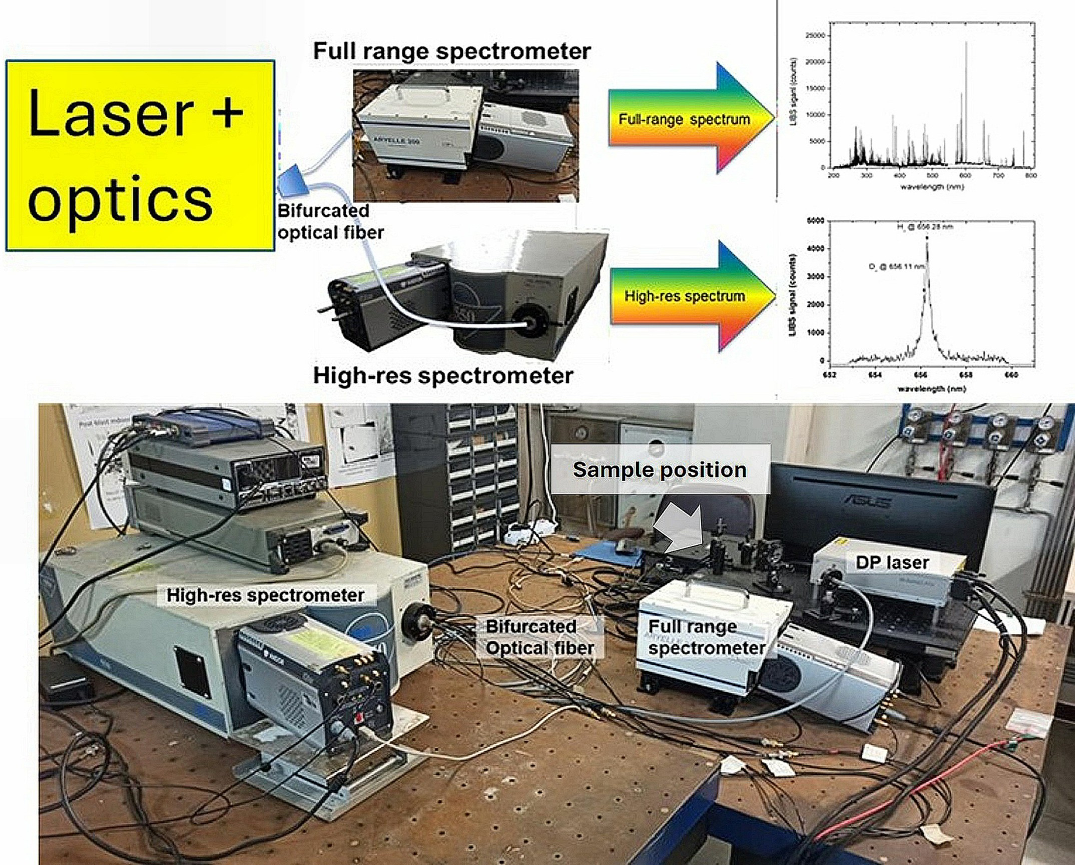
D003: Optimization of the LIBS technique in Air, He, and Ar
SP X.2
D003

Slide 23
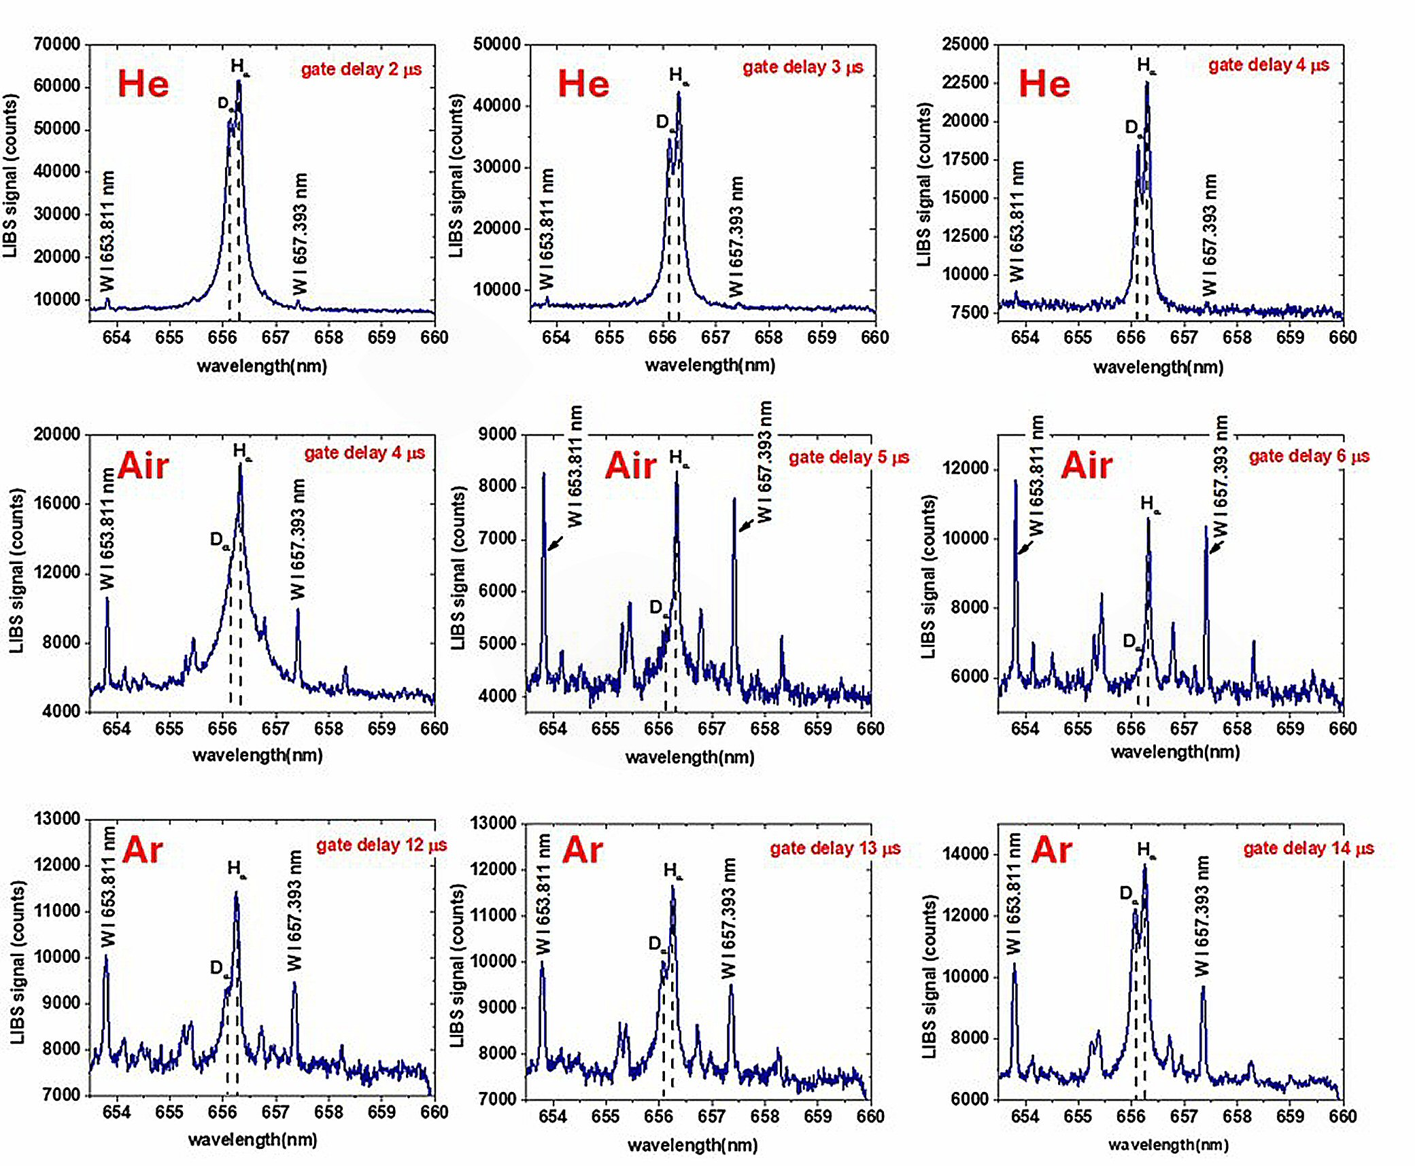
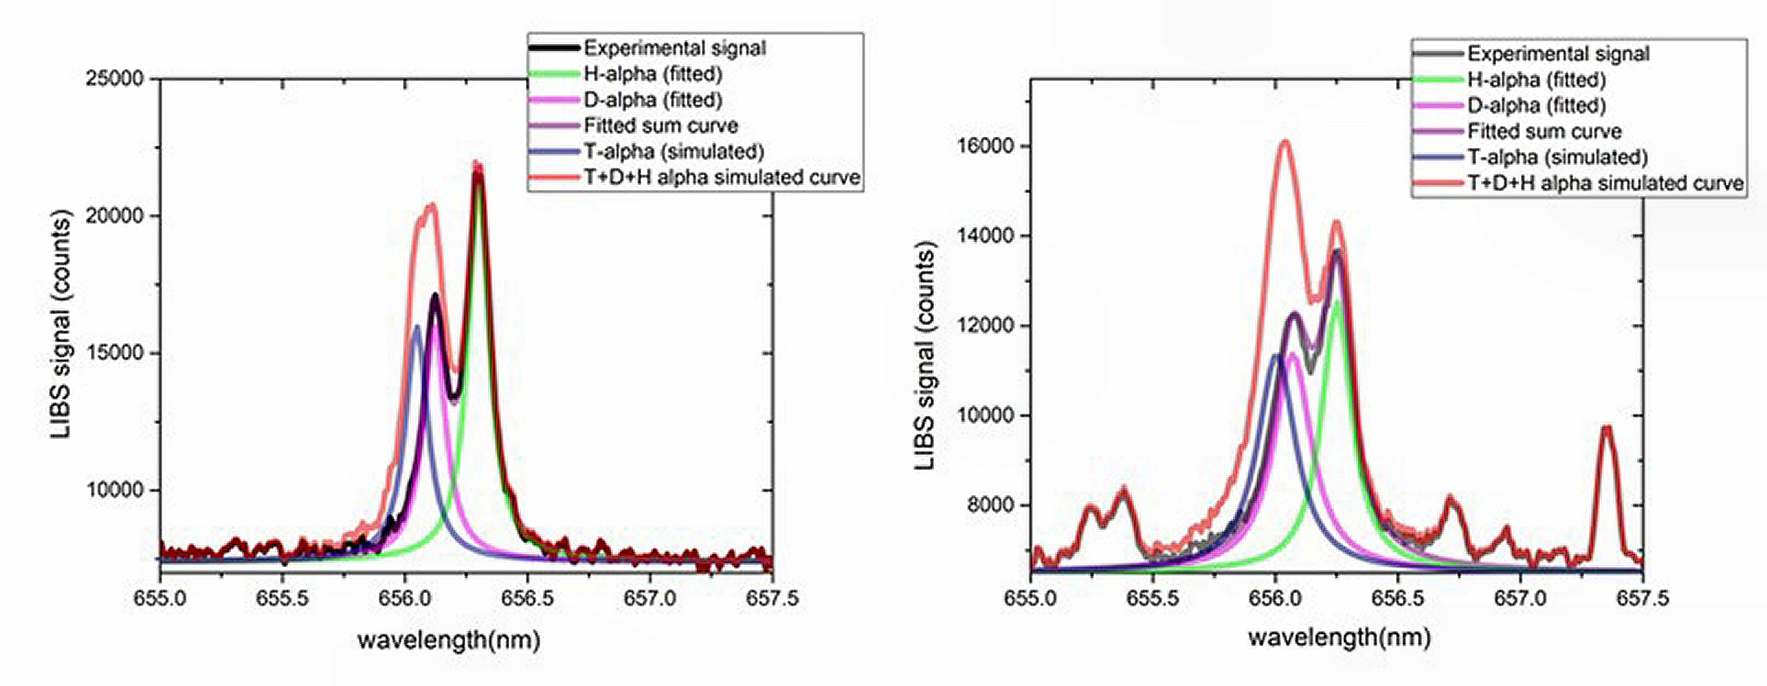
D003: Optimization of the LIBS technique in Air, He, and Ar
SP X.2
D003
The use of He and/or Ar as background gases allows for the separation of the H_{α} and D_{α} emission lines of hydrogen and deuterium with higher resolution than traditional LIBS in air, as soon as the acquisition parameters (ICCD camera gate delay and width) have been optimized.
The simulated T_{α} spectral emission of Tritium, having an intensity comparable to the D_{α} emission of deuterium allows to conclude that the detection of both lines requires a system with a high resolution be clearly detected, but the detection is feasible with post-measurement fitting procedure.

Slide 24
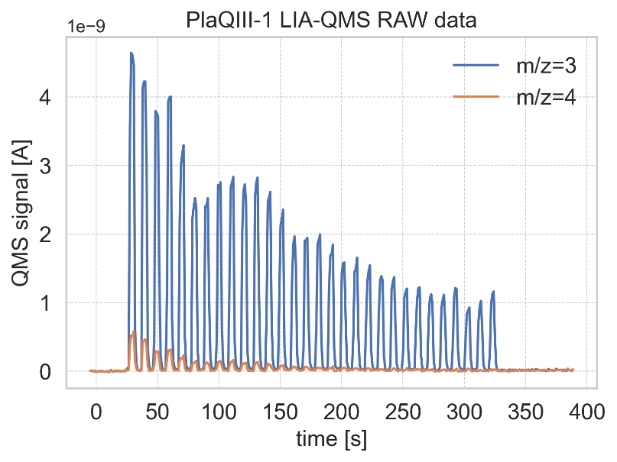
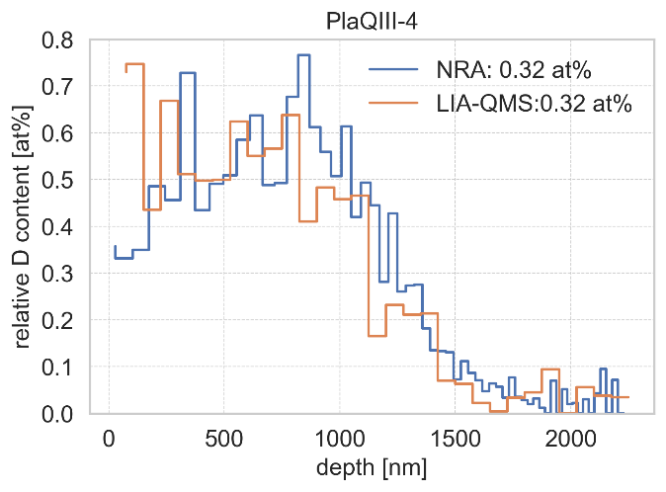
D004: Cross comparison LIA-QMS and NRA
SP X.2
D004
General Information
Pre-damaged tungsten material could have enhanced reservoir for hydrogen isotopes
Depth profile of the D content in near surface damaged W sample can be measured by LIA-QMS
Task and questions to be addressed
Cross comparison of D content depth profiles measured by LIA-QMS and NRA
Approach
W sample damaged with the same dpa doses are loaded in PSI-2 with deuterium
LIA-QMS(λ=355 nm, 35 ps, 5 mJ, spot ∅ 0.46 mm) is applied for each sample
Calibration with H₂ and D₂ calibration leaks and , in addition, sample PlaQIII-1 total D content used for scaling factor measurement
Fig. 1. Reference sample QMS signals
Results
QMS HD⁺ signal (m/z=3) about 10 times larger D₂⁺ signal (m/Z=4) ⇒ strong interaction of LIA released D with wall ⇒ reference sample with known content D is required
Usage H₂ and D₂ calibration leaks in combination with reference sample provided accuracy of the D retention measurement about 20%
LIA-QMS depth profile almost coincides with NRA profile except first 350 nm due to , probaly, thermal effect. Measured sensitivity of LIA-QMS < 0.05 at%.
Fig. 2. Test sampe depth profile

Slide 25
D004: Investigation of hydrogen adsorption dynamics by LIBS
SP X.2
D004
General Information
Adsorption of the background hydrogen may influence on LIBS measurement in vacuum
Hydrogen adsorbed on tungsten surface can be used as LIBS calibration sample
Task and questions to be addressed
Investigation of hydrogen adsorption dynamics by LIBS at different background pressures
Approach
Annealed tungsten sample without H content were used
Single pulse LIBS (λ=355nm, 35 ps, 26mJ) in LIBS in 10⁻⁷ – 10⁻⁶mbar vacuum
5 laser pulses at the same laser spot were used to clean surface before start of measurements
Hα line was used for hydrogen detection in LIBS plasma
Results
Plasma continuum and tugsten spectral lines measured at 0.5 s time interal between laser pulses ( Hα line is invisible ) was used for background substraction from the spectra measured with longer intervals
LIBS Hα spectral line has two component blue and red shifted due to Dopler effect.
Total Hα intensity is increased with time interval for short intervals until it is saturated
Time interval reqired for saturation decreases with pressure increase
Fig. 1. LIBS Hα spectrum
Fig. 2. LIBS intensity vs adsorption time

Slide 26
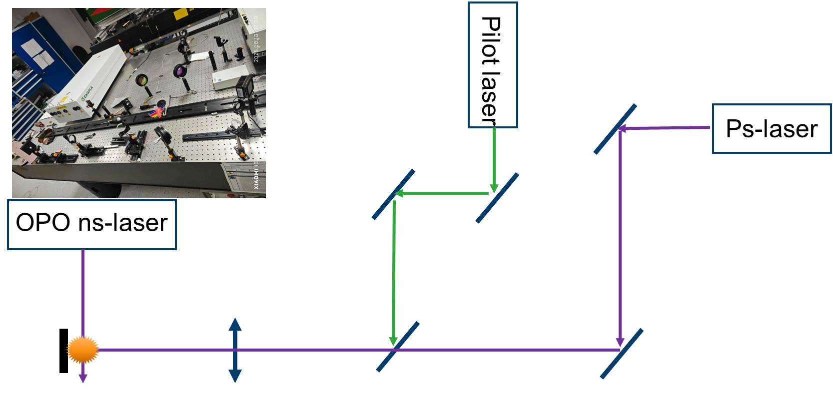
D004: Explore TALIF and LIBS for H isotope identification
SP X.2
D004
spectrometer
General Information
Spectral interference by W, Ti … and hydrogen isotopes reduce SNR with increase of delay time
Combination of LIBS plasma with TALIF will improve detection limit for hydrogen isotopes measurement
Task and questions to be addressed
Feasibility study of hydrogen detection by LIBS-TALIF
Approach
Tungsten sample with natural H content were used for LIBS-TALIF in air
Single pulse LIBS (λ=355nm, 35 ps, 10mJ) in air atmospheric pressure
OPO (Optical Parametric Oscillator) laser with λ=205.14nm, λ<0.042nm, τ=3-5ns, E=2mJ
OPO laser beam was ortoganal to λ=355nm laser beam
Results
First measurements were performed in air
There is no W line interference at all
H and D lines can be excited separately
Low noise in comparison with LIBS spectra
Fig. 1. LIBS-TALIF set-up
H_{α}
Gate 100 ns
Delay 20 μs
Fig. 2. TALIF spectrum

Slide 27
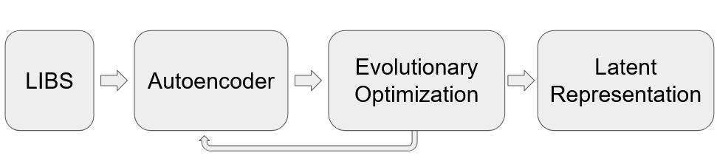
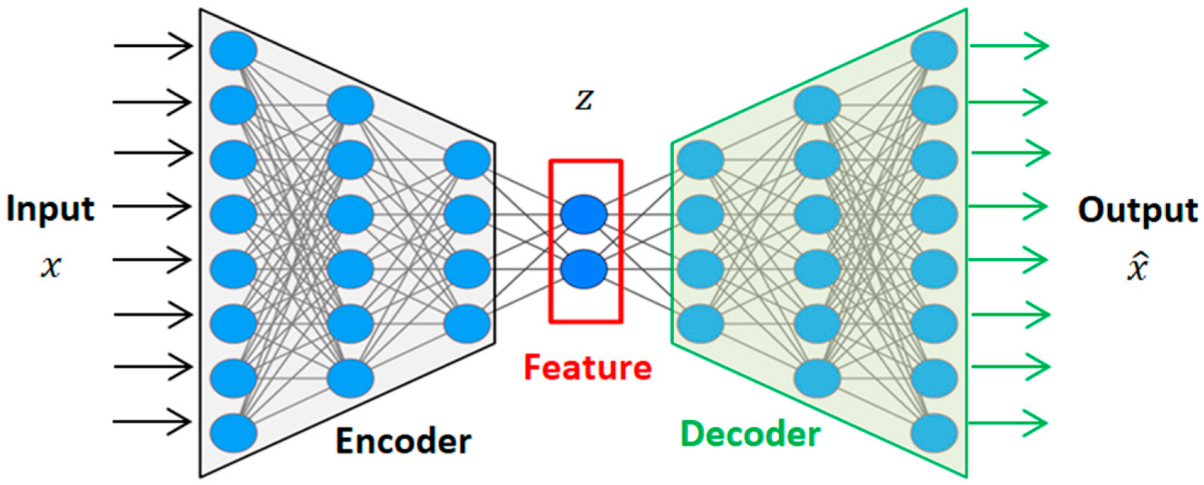
D005: ML models development at the IPPLM – autoencoder models for experimental data
SP X.2
D005
Spectra provided by Rongxing Yi, FZJ Juelich
Nd:YAG laser (5 ns, 50 mJ, 1064 nm)
Pure elemental samples of Al, Cr, Fe, Mo, Ni, W, and Zn
200 - 900 nm range, 26 000 wavelengths sampled
Linear combination of spectra simulating varying composition

Slide 28
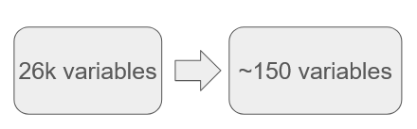
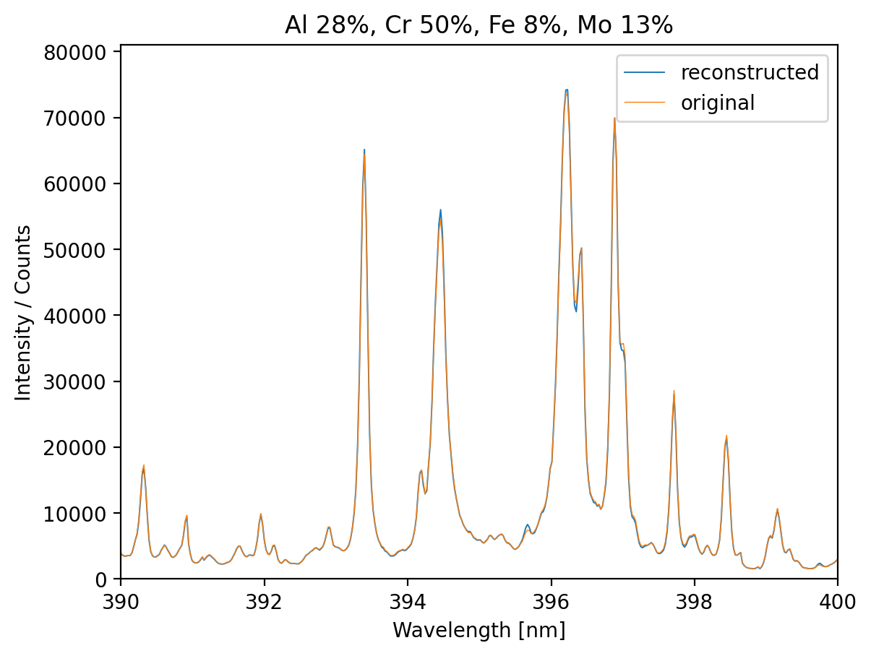
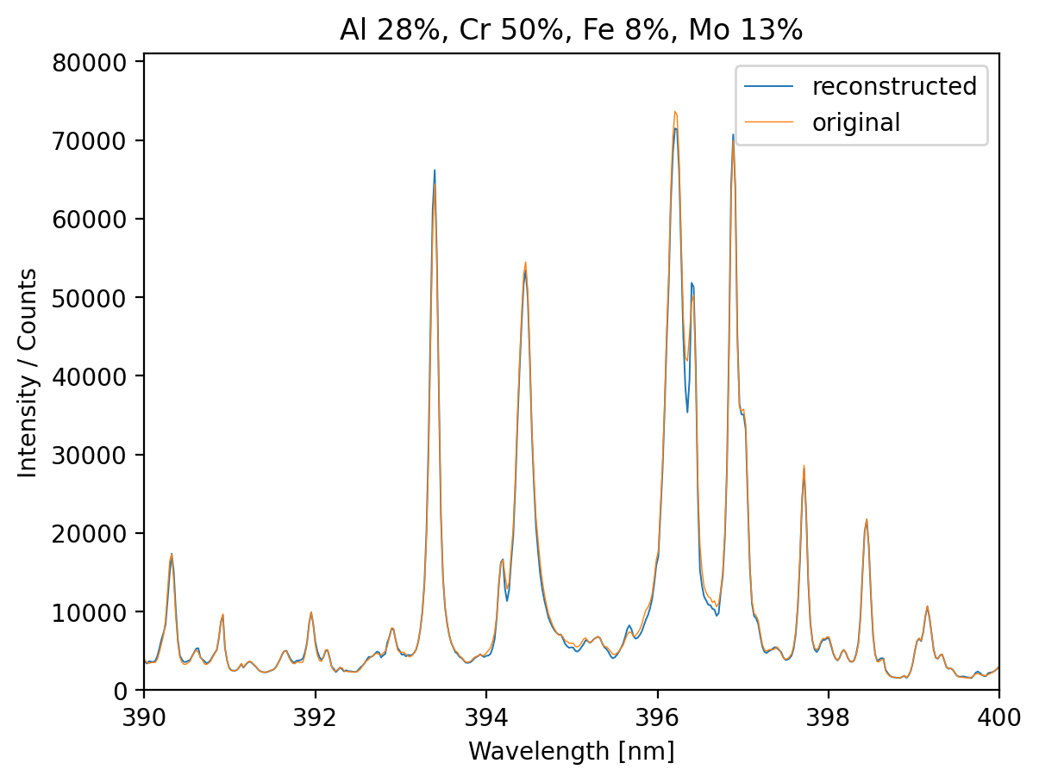
D005: ML models development at the IPPLM – results
SP X.2
D005
Autoencoder as Compression Algorithm
Compression ration of 170
For reference:
zip: 2-10
JPEG: 10-20
MP4: 50
Hidden | Latent | Regularizer | Activation | MSE | CosSim | Relative Error
1621 | 195 | 0.0 | leaky ReLU | 0.021 | 0.23 | 6.4%
1377 | 136 | 0.0012 | tanh | 0.20 | 0.041 | 11%
Reconstruction
Without autoencoder:
MSE = 1.7 x 10⁻⁵
RMSE = 0.27%
R² = 0.9993
Training time = 20 min
With autoencoder:
MSE = 2.3 x 10⁻⁵
RMSE = 0.31%
R² = 0.9993
Training time = 30 s
With the autoencoders the accuracy is insignificantly lower, but still excellent and the computative cost is substantially lower.

Slide 29

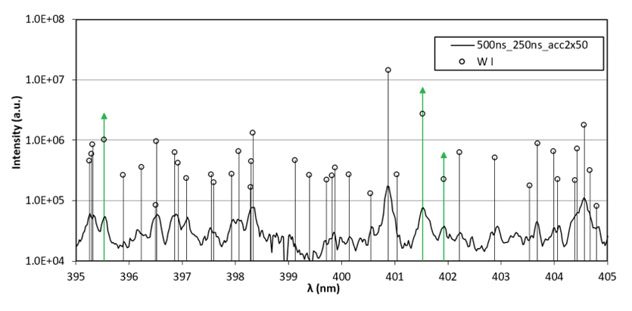
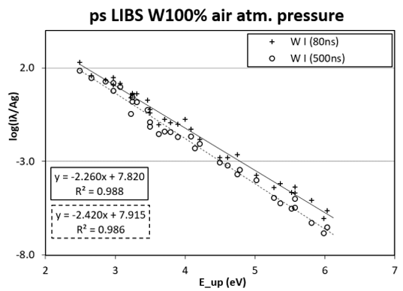
D006: Single pulse ps LIBS for laser ablation- plasma characterization
SP X.2
D006
• Pure W was firstly studied by ps LIBS (250 ps, 2 mJ) , where suitable W lines were identified and selected (depending on LIP parameters such as fluence).
• For the BP lines selection, we used only lines not affected by self-absorption and interference (e.g. green markers in the figure are the suitable lines).
• The evaluated Te of ps LIBS plasma generated by W ablation in air at atmospheric pressure were: 0.44 eV (for 80 ns / 40 ns) and 0.41 eV (for 500 ns / 250 ns). The observe Te is lower in early plasma afterglow comparing to our previous ps LIBS plasma measurements of W and Mo using 30 ps laser (pulse energy 0.3 mJ), where the fluency was similar

Slide 30
D006: Double Pulse ps-LIBS for depth analysis
SP X.2
D006
• Investigated D retention in W based coated materials with different surface morphologies, exposed to D plasma in the Magnum-PSI device.
• Employed a dual-laser LIBS setup: a ps laser (250 ps, 2 mJ) for gentle ablation and a secondary ns Nd:YAG laser (8 ns, 40 mJ, 100 ns delay) under 200 mbar Ar to enhance plasma excitation and D-line detection, with spectra recorded using an Andor ME5000 echelle spectrometer and iStar DH743 iCCD (5 ns resolution). This was done after the single pulse ps LIBS studies.
• The depth profiles suggest a thin near-surface D/H deposition layer of about 100 nm, but the depth values carry large uncertainty. The spot size of ~40– 60 μm was consistent and correct across measurements
• Clear depth profiles were obtained, showing morphology-dependent differences in retention behaviour between compact, porous, and nanocolumnar structures.

Slide 31

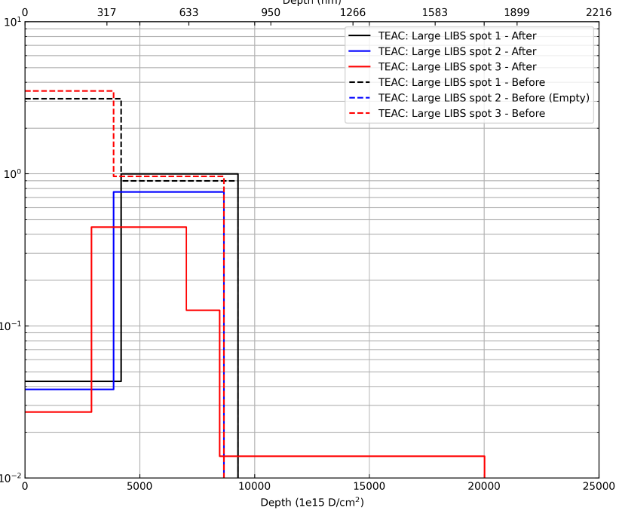
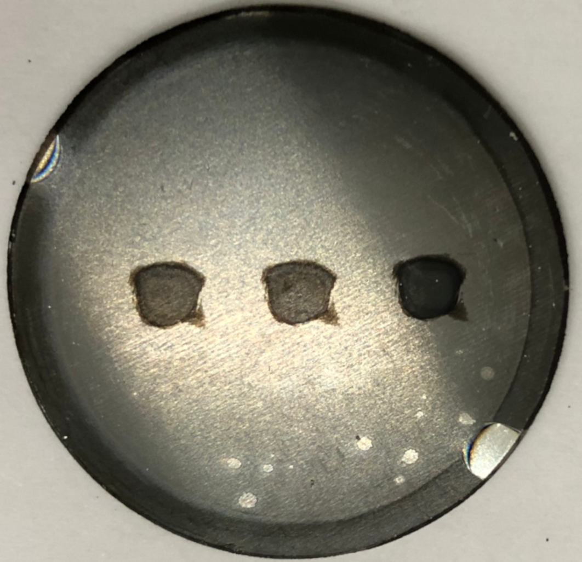
D007: In-situ LIBS and NRA in Magnum-PSI: LIBS induced outgassing
SP X.2
D007
DIFFER, UT, CU
Material
Depth (nm)
Laser pulse
0
317
633
950
1266
1583
1899
2216
10¹
Before LIBS shot
p-WO coating
NRA
10⁰
D concentration (at.%)
Ablation
Outgassing
10⁻¹
Large LIBS crater to fit NRA!
10⁻²
After LIBS shot
0
5000
10000
15000
20000
25000
Depth (10¹⁵ D/cm²)
LIBS crater
Both LIBS induced outgassing and diffusion observed
LIBS ablation 150-200 nm
NRA area
Plans (Dec. 2025): consecutive laser shots and NRA measurements at the same position

Slide 32
D007: In-situ LIBS and NRA in Magnum-PSI: D retention after loading
SP X.2
D007
DIFFER, UT, CU
Compact 1 µm, 1.5 µm and 2 µm tungsten (c-W) coatings on Mo substrate
W/Mo interface?
LIBS spectra show a poorly defined interface between W coating and Mo substrate
SEM/EDX and RBS suggest mixing of W and Mo after LIBS shots
NRA/RBS shows 4-5 at. % D on c-W surface and slow D reduction to negligible value inside the c-W coating
D retention increases for thicker c-W coatings and the sum of LIBS D intensity follows the trend

Slide 33

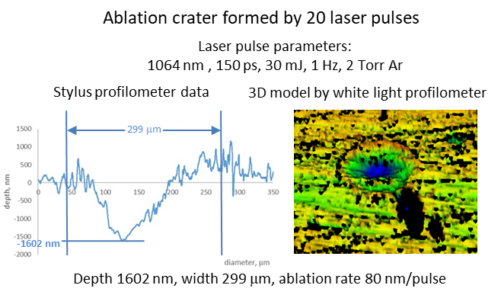


D008: ps-LIBS on Boron
SP X.2
D008
ps-laser LIBS has been applied to the magnetron-sputtered B coatings on W substrate
Samples: 30…50 nm B coating was applied on W substrate by magnetron sputtering at the ISSP UL (Laboratory of Thin films)
White light profilometry procedure has been obtimised to obtain 3-D profiles of the laser ablation craters
Elemental depth profiling shows that it was possible to detect B singal only at the first pulse. The is due to the fact that B detection has required increased laser pulse energy, and the best ablation rate achieved now is 80 nm/pulse @30 mJ, according to the profilometry data
Improving of ablation rate for B detection is planned early next year
Elemental depth profiling

Slide 34
Call for participation 2026 / 2027 Preliminary outcome
2026
 | TASK | 4 | CEA | CU | DIFFER | ENEA | FZJ | IPP_LM | ISPP_UL | MPG | NCSRD | RBI | UT | VR | VTT
SPX | X1 | Atomic and molecular data expert |  |  |  |  | 2 | 0 |  | 2
 | X2 | Laser-induced ablation and spectroscopy expert | 3 | 5 | 2 |  | 8 | 5 | 3 | 3 |  |  | 5 |  | 2
 | X2 | Surface-analysis expert | 0 |  | 2 |  | 2 |  |  |  | 0 | 0 |  | 0 | 0
 | X1 | Spectroscopy expert | 0 |  | 7 |  | 4 |  |  | 1
2027
SPX | X1 | Atomic and molecular data expert |  |  |  |  | 2 | 0 |  | 2
 | X2 | Laser-induced ablation and spectroscopy expert | 3 | 6 | 2 | 3 | 8 | 5 | 3 | 3 |  |  | 6 |  | 2
 | X2 | Surface-analysis expert | 0 |  | 2 |  | 2 |  |  |  | 0 | 0 |  | 0 | 0
 | X1 | Spectroscopy expert | 0 |  | 7 |  | 4 |  |  | 1

Slide 35

Thank you for your attention 3 Highlight talks:

