Slide 1
LIBS induced D outgassing in Magnum-PSI exposed samples
Indrek Jõgi, Peeter Paris, Jasper Ristkok, Jort van Kesteren, Beata Tyburska-Pueschel, Jordy Vernimmen, Sanath Jagannath Shetty, Pavel Veis, Hennie van der Meiden
University of Tartu, DIFFER, Comenius University

Slide 2
Motivation
LIBS – in-situ measurement of elemental depth profiles in the plasma facing components of fusion reactors
Calculations:
Material with D/T
Laser pulse
D. Matveev et al. Phys. Scr. 96 (2021) 124079
Laser pulse heats the material below ablated layer
D will diffuse out – LIBS induced outgassing
D. Matveev et al. „thermal outgassing removes about 50% of D from a 100 nm thick W layer below the LIBS crater, contributing at least 25% to the amount of D released by ablation itself“

Slide 3
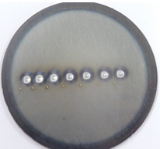
Motivation
LIBS induced outgassing not always apparent – example of 1 µm porous WO on Mo exposed to D₂ plasma in Magnum PSI

Slide 4
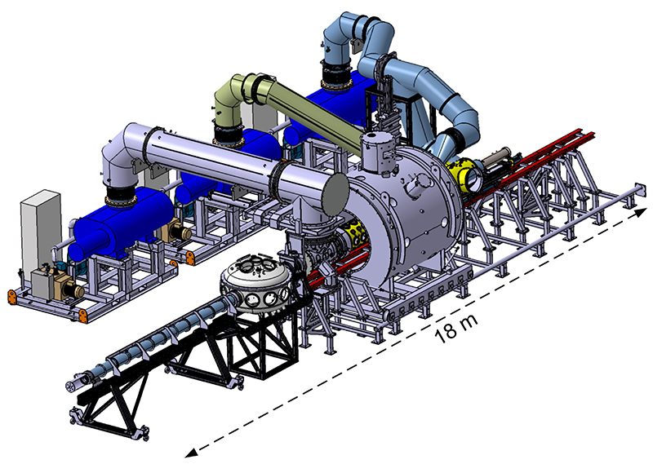
Motivation
Experimental validation?
Magnum-PSI
Nuclear Reaction Analysis (NRA) for D depth profiles
NRA fresh surface
D (at.%)
new NRA at LIBS spot
Depth (nm)
TEAC (Target Exchange and Analysis Chamber)
LIBS + NRA/RBS

Slide 5
Feasibility of the approach?
Depth resolution and sensitivity of NRA is sufficient?
Relative importance of ordinary outgassing?
D retention is sufficiently uniform along the surface?
LIBS crater with diameter 1 mm is comparable with NRA area (0.5x0.5 mm)

Slide 6
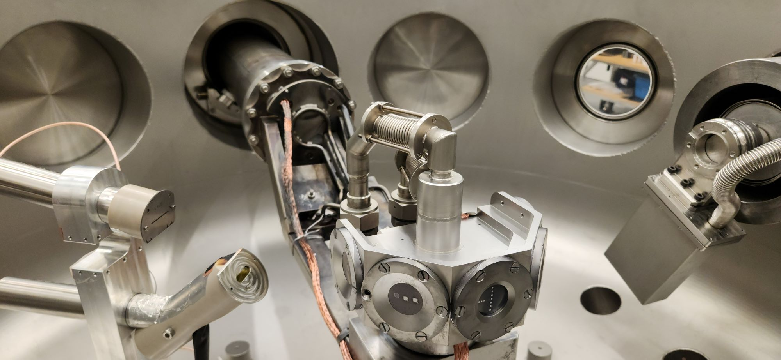
Experimental setup
TEAC
Sample holder
Magnum-PSI
Magnum-PSI plasma parameters
6 slm D₂ plasma
Exposure time 3000 s
Magnetic field 0.6 T
Voltage -40 V
Electron temp. T_{e} ≈ 1 eV
Electron density n_{e} ≈ 2.6·10¹⁹ cm⁻³
Plasma beam FWHM ≈ 21 mm
Surface temp. ≈ 160/255°C
Ion-Beam channel for NRA/RBS
Laser beam
Mirror
Fiber
Spectrometer
Notes:
Low surf temp for high D retention

Slide 7
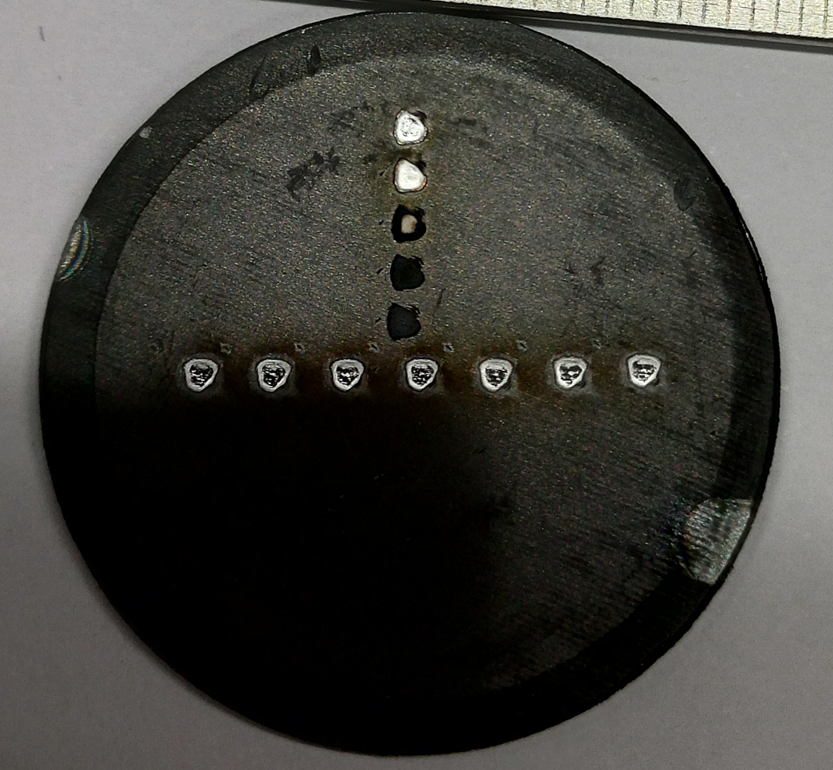
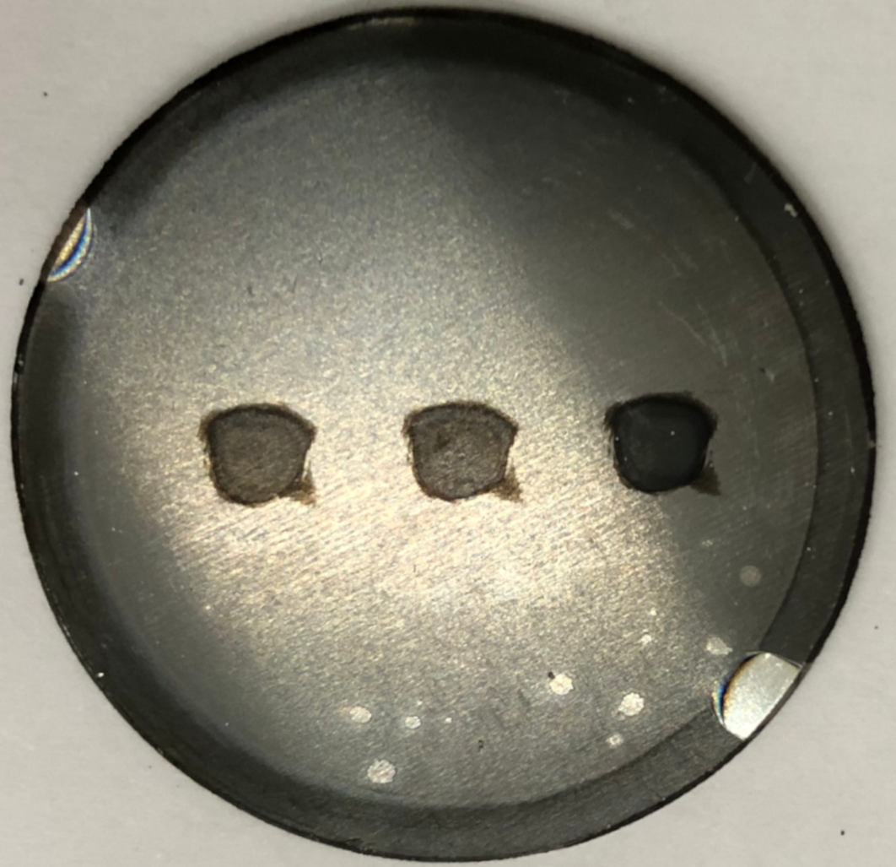
Experimental setup
LIBS at TEAC
1064 nm, 8 ns ja 180/760 mJ (fluence 14/7 J/cm²)
Delay time 1300 ns and gate width 2000 ns
Pressure 1 mbar Ar
Spectral window 10 nm around 656 nm H_{α} line
TEAC
Sample holder
Magnum-PSI
Larger LIBS spot size for NRA!
Ion-Beam channel for NRA/RBS
LIBS
LIBS
Laser beam
Mirror
NRA
NRA
Fiber
Spectrometer
LIBS crater 1 mm
NRA area 0.5 mm
new LIBS crater 3 mm
Notes:
Usually NRA measurements 2-3 mm outside from the crater

Slide 8
Experimental setup
NRA (in-situ in TEAC, 4-8 dec.2024)
2300 keV, 0.5 x 0.5 mm, (α = 41°)
RBS: depth limit 0.9 μm
NRA: depth limit 1.8 μm
TEAC
Sample holder
Magnum-PSI
Ion-Beam channel for NRA/RBS
Laser beam
Mirror
Fiber
NRA (ex-situ in IBAS, 13 and 18 dec.2024)
2300 keV, 0.5 x 0.5 mm (α = 0°)
RBS depth limit 1.4 μm
NRA depth limit 3.1 μm
Spectrometer
Notes:
Usually NRA measurements 2-3 mm outside from the crater

Slide 9
Investigated samples and SEM/EDX measurements
1 μm compact W (c-W) on Mo substrate (160 °C)
Center of crater
c-W
EDX:
66%W, 34% Mo
1 mm
10 µm
1 μm porous WO (p-WO) with 150 nm c-W interayer on Mo substrate (255 °C)
Center of crater
p-WO
EDX:
24%W, 76% O
1 mm
10 µm

Slide 10
RBS results for W and O concentrations
c-W coating
W and Mo are mixed after first shot (60%-40%)
O increased from initial 0-3% to 20 %
Crater depth can’t be determined
p-W coating
Crater depth 300-400 nm when assuming 50%W-50%O

Slide 11
LIBS induced D outgassing in c-W coating (NRA)
Depth (nm)
Depth (nm)
0
443
886
1330
1773
0
443
886
1330
1773
Strong LIBS induced outgassing
D diffusion into c-W coating
Comparable results by TEAC and IBAS (made a week later)
D depth profiles at 3 spots quite similar

Slide 12
LIBS induced D outgassing in p-WO coating (NRA)
Depth (nm)
Depth (nm)
0
443
886
1330
1773
0
443
886
1330
1773
Strong LIBS induced outgassing
Somewhat thicker D deficient layer in p-WO
considerably lower D by IBAS (made a week later) – ordinary D outgassing
D depth profiles at 3 spots vary more for p-WO coating

Slide 13
LIBS results
c-W
p-WO
W line intensities are considerably larger in the case of large crater
W and D intensities are comparable for different craters
LIBS D intensity correlates with D concentration in 300-400 nm surface layer

Slide 14
Summary
LIBS induced D outgassing can be studied in Magnum-PSI TEAC
ns-LIBS at relatively small fluence resulted in strong LIBS induced D outgassing in c-W and p-WO coatings
p-WO coating has considerable long-term ordinary outgassing
Mo/W mixing in the LIBS crater of c-W coating was an unexpected finding
CONCLUSION: experiments confirmed that actual D retention may be considerably larger than predicted by LIBS after 1st laser shots

Slide 15
Future plans
Application of several consecutive LIBS shots to study the cumulative effect
Experiments with ps-LIBS with expectedly smaller LIBS induced outgassing
Investigate the effect in different types of W coatings
Thank you for your attention!

