Slide 1
Optimization of the LIBS technique in air, He, and Ar at atmospheric pressure for hydrogen isotopes detection on tungsten coatings
WP-PWIE Review Meeting 17-21 November 2025
Salvatore Almaviva
ENEA, Italian National Agency for New Technologies, Energy and Sustainable Economic Development

Slide 2
Summary
Motivation
The «as JET» new double-spectrometer LIBS system setup in ENEA Frascati
Detection of D by LIBS on a W coating under Ar and He as background gas: comparison with standard LIBS in air
Calibration free (CF) procedure for the estimation of the D content
Conclusions
Next steps

Slide 3
Introduction and motivation
The detection of Hydrogen isotopes by LIBS is generally accomplished by recording the spectral emission of the Balmer alpha lines (T_{α}− D_{α} − H_{α}) located at approximately 656.045 – 656.11 and 656.28 nm.
Detecting hydrogen isotopes is for LIBS substantially equivalent in terms of spectral signal, therefore it is possible to perform in-lab measurements on samples without T but with D (or H) in safety conditions, obtaining useful information for the detection of T on real PFCs.
However, in simultaneous presence of T, D and H, the T_{α} line can be detected superimposed to the D_{α} and difficult to resolve from the latter. Therefore, methods for enhancing the spectral resolution enhancement are advisable.
One of these method is based on the use of background gases that provide LIBS plasmas with different properties than in air.
In this contribution we have studied the LIBS plasmas in He and Ar as background gases and compared the obtained LIBS spectra in terms of spectral resolution to optimize the detection of all the Hydrogen isotopes.

Slide 4
How Ar and He could increase spectral resolution and SNR in LIBS
He
Reduced Electron Density and Stark Broadening: the primary reason for improved resolution is that plasma generated in a helium atmosphere generally has a lower electron density and lower temperature compared to plasmas in other gases like argon or nitrogen at the same pressure. Lower electron density in helium results in narrower spectral lines and thus better resolution.
Lower Thermal Conductivity: Helium has high thermal conductivity at low pressures, which can cool the plasma more quickly, at atmospheric pressure this effect leads to a shorter-lived, more confined plasma plume. This imply the use of shorter time delays for detection, which is important for capturing rapidly decaying emission signals with higher efficiency.
Reduced Background: As in the case of Argon Helium's simple atomic structure and high ionization potential produces less background emission (continuum radiation) than air improving the SNR.
Inert Nature: As in the case of Argon, Helium is an inert noble gas. It does not react with the ablated sample material or the plasma species, which maintains the integrity of the emission signals.
Using Helium as an ambient gas in LIBS leads to a "cleaner," less dense plasma, which minimizes spectral interference and produces sharper, more resolved analytical lines, particularly at appropriate gate delays.
Ar
Plasma Confinement: Due to its higher atomic mass and lower thermal conductivity Argon reduces the rapid expansion and cooling of the laser-induced plasma plume keeping the plasma hotter and denser for a longer duration.
Increased Collisions and Excitation: The higher density of the confined plasma results in an increased number of collisions between the excited species (atoms and ions). This promotes more efficient excitation and subsequent de-excitation, leading to a stronger emission of the LIBS signal.
Inert nature and reduced Oxidation: As an inert noble gas, Ar does not react with the ablated species and displaces Oxygen, Nitrogen and environmental Hydrogen from the analysis area, preventing the formation of oxides and nitrides that can reduce the signal from the target elements and limiting the interference of H.
Higher Plasma Temperature and Electron Density: The enhanced signal intensity is directly attributed to the increase in plasma temperature and electron density under the argon environment.
Reduced Background: Argon high ionization potential produces less background emission (continuum radiation) than air improving the SNR.
Using Argon as ambient gas increases the life of the LIBS plasmas increasing the signal intensity and precision of LIBS measurements, which is especially important for the detection of trace elements.
similarities
differences

Slide 5
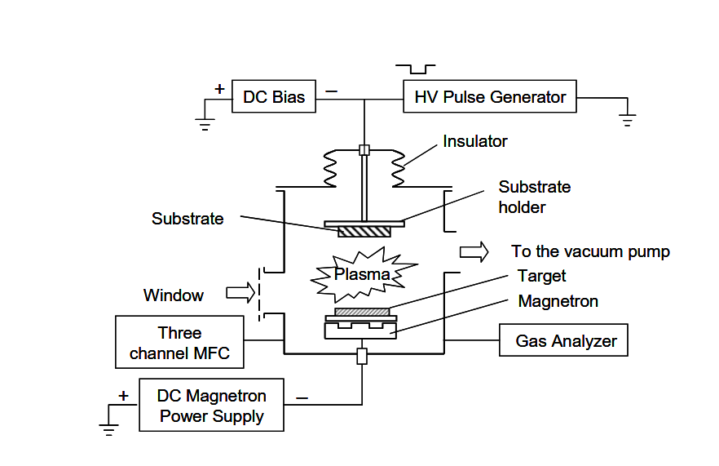
Sample preparation and composition
Samples simulating co-deposits of W, with D/H were produced at the National Institute for Laser, Plasma and Radiation Physics in Romania (NILPRP) by Combined Magnetron Sputtering and Ion Implantation (CMSII). The CMSII technique involves simultaneous magnetron sputtering and high energy ion bombardment. The samples consist of a rectangular Molybdenum (Mo) metal plate 11x15 mm² area, 1 mm thick, with a W surface layer (co-deposited with D/H), 5 μm thick, on a Mo substrate.
W-(D/H)
~ 5 µm
Mo
Bulk

Slide 6
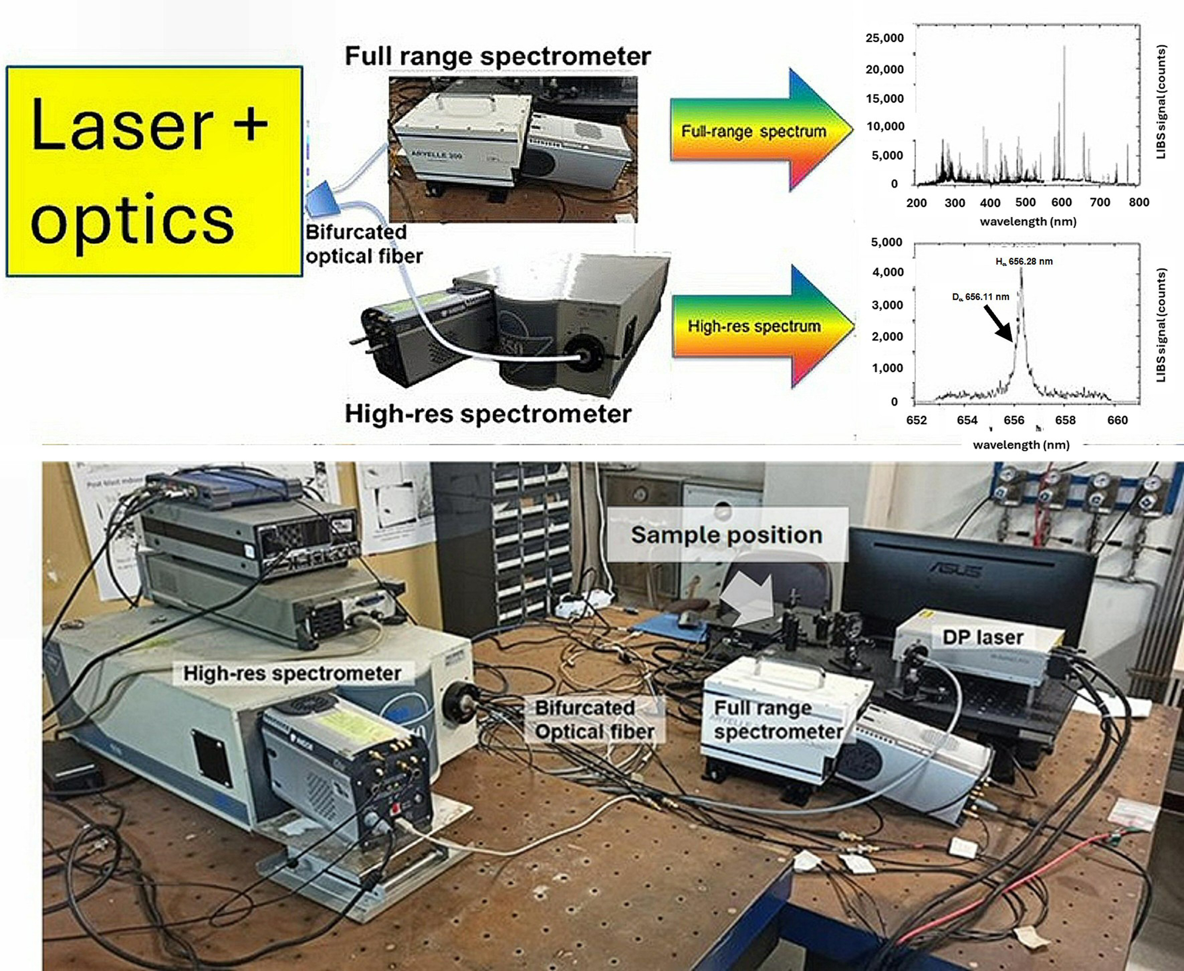
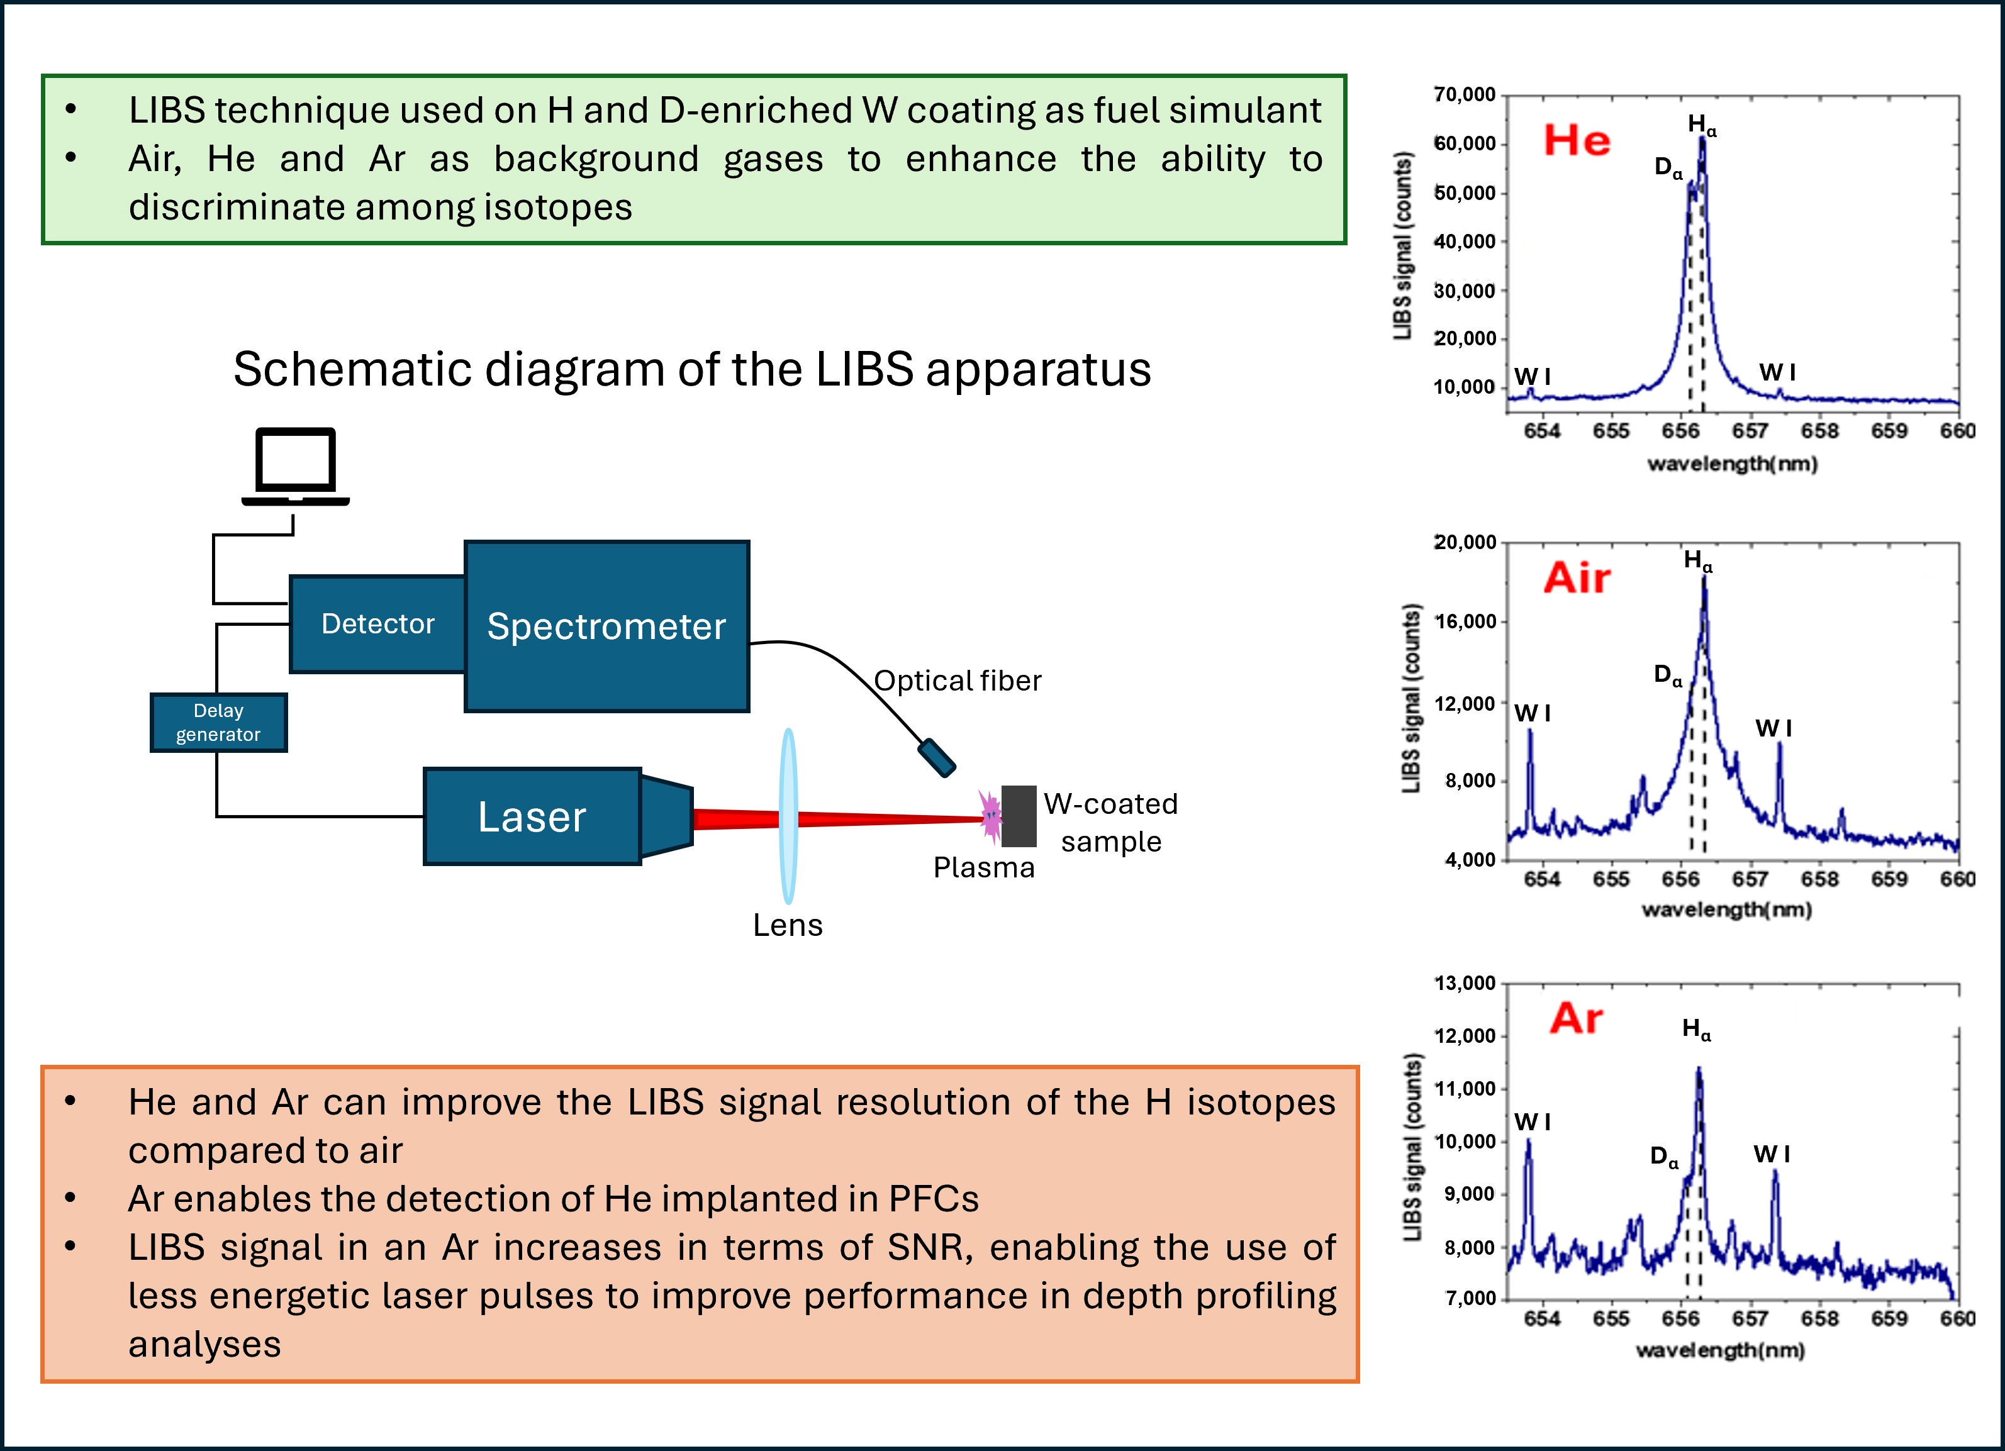
The two-spectrometers LIBS system at ENEA (Similar to the JET system)
Double spectrometers LIBS system:
High Resolution: ISA Jobin Yvon “TRIAX550” Czerny–Turner, 2400 gr/mm grating (λ/Δλ = 50,000) resolution @ 656 nm ≈ 0.013 nm, enough to resolve the D_{α} - H_{α} - (T_{α}) lines. Detector: Andor “ISTAR” ICCD camera DH534-18 F (1024 × 256 pixels)
Full range: LTB “Aryelle 100” spectrometer. Spectral range (225–760 nm), resolution up to 9000. Detector: Andor “ISTAR” ICCD camera DH334T-18 F (1024 × 1024 pixels)
Source: Nd:YAG double-pulse laser (wv = 1064 nm; τ = 8 ns; f_{max} = 20 Hz; spot ø ≈ 3 mm, max pulse energy 65 (+65) mJ, min interpulse delay = 65 ns).
Lenses: focusing lens (PCLX ø ≈ 25 mm, f = 100 mm). Collection lens (PCLX ø ≈ 25 mm, f = 150 mm, UVFS).
Fiber: 2m long bifurcated optical fiber; 1st branch 24 N.A 0.22 fibers, ø ≈ 200 μm, 2nd branch 1 N.A. 0.22 fiber, ø ≈ 400 μm
Detector
Full range
spectrometer
High-Res
Bifurcated

Slide 7
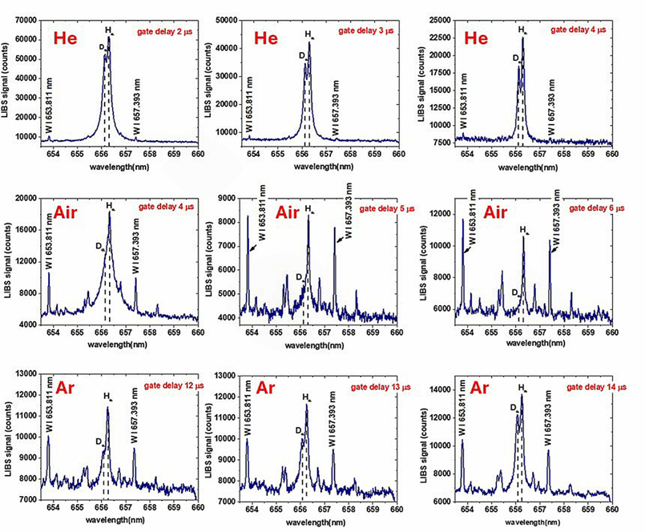
Results: High-res LIBS spectra of the D_{α} and H_{α} peaks
The W-D sample was used to optimize the detection of D in presence of the H emission from the environment (water vapour), fluxing the two background gases (He and Ar) at 2l/min on the sample surface and comparing the signal with respect to LIBS in air.
Parameters: pulse energy 50 mJ, rep. rate 2 Hz, gate width 3 μs, gate delay optimized for each gas to obtain the maximum resolution of the two D_{α} and H_{α} peaks.
He gas: Better results at shorter gate dealys with respect to air → Reduced Electron Density and temperature → reduced Stark Broadening
Ar gas: Better results at longer gate delays with respect to air → The longer lifetime of the LIBS plasma and the higher SNR allows to move at longer gate delays balancing the increased Stark broadening still preserving a good SNR
Delay 4 μs
Delay 6 μs
Delay 14 μs

Slide 8
Results: High-res LIBS spectra of the D_{α} and H_{α} peaks
The spectral emissions of atomic tungsten lines at 653.811 nm, 655.28 nm, 655.38 nm, 656.78 nm, 656.97 nm, and 657.18 nm are clearly detectable in the case of Ar and air plasma, while they are poorly detectable in the case of He plasma. This result agrees with previous results in literature, the reason being that T_{e} and n_{e} decay more rapidly in He environment compared to Ar and air because of the higher higher thermal conductivity of He than Ar and air → The condition of a stable and “long” (μs…) Local Thermodinamic Equilibrium (LTE), necessary for the quantitative estimation of the elements is harder to reach in case of He gas.
W I 655.38 nm
W I 655.28 nm
W I 656.78 nm
W I 656.78 nm
W I 655.38 nm
W I 655.28 nm
W I 655.28 nm ?
W I 655.38 nm ?
W I 656.78 nm ?

Slide 9
Results: High-Res LIBS spectra of the D_{α} and H_{α} ( and T_{α} peaks)
To quantitatively estimate the capability of resolve the two D_{α} and H_{α} peaks in the case of He and Ar, the ratio between the width of the two peaks and their spectral separation was taken into consideration according to the formula currently applied in chromatography to evaluate the resolution of two nearby peaks:
where Δλ is the spectral separation of the two peaks (0.18 nm), and w_{Dα} and w_{Hα} are the FWHMs of the two peaks, obtained fitting them with two Lorentzian functions.
Background Gas | Gate Delay (μs) | R_{s} (D_{α} − H_{α})
He | 2 | 0.95
He | 3 | 1.15
He | 4 | 1.52
Ar | 12 | 1.12
Ar | 13 | 1.15
Ar | 14 | 1.31
short-living plasma make the peaks width (and
R_{s}) quickly changing
long-living plasma make the peaks width (and
R_{s}) more stable

Slide 10
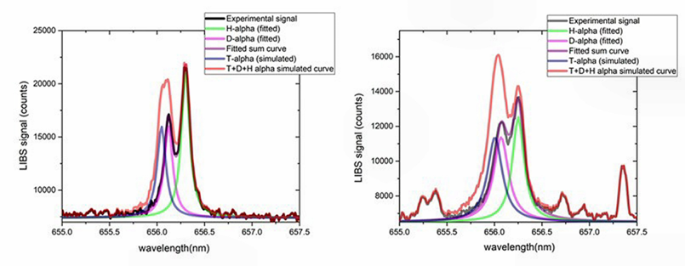
Results: simulation of a H+D+T spectrum
Starting from these values, we estimated the resolution that would be obtained if the T_{α} line were present with the same concentration as deuterium. The T_{α} line (656.045 nm) is expected to have the same linewidth as the Dα line, with a spectral separation Δλ = 656.1–656.045 = 0.055 nm.
A simulation of the LIBS signal in the presence of T was performed by adding to the experimental signal an additional, hypothetical T_{α} peak, centered at 656.045 nm with the same FWHM and intensity of the experimental D_{α} peak → to resolve the peaks longer delays (lower electron density) is necessary.
He flux
4 μs delay
Ar flux
14 μs delay

Slide 11
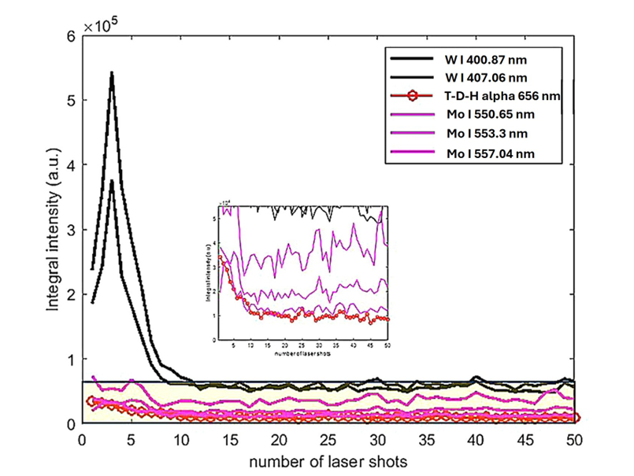
Results: depht profiling analysis
Depth profiling analysis in LIBS is an analytical technique used to determine the elemental composition of a material as a function of its depth from the surface, by sequentially ablating thin layers of sample delivering a series of laser pulses in the same point and analyzing the elemental composition of the plasma generated by each pulse.
Depth profiling was applied delivering 50 subsequent laser shots on the same point to estimate the average ablation rate of the superficial W layer with D using both the spectra acquired with the Echelle spectrometer and the TRIAX 550 monochromator
After 10 laser shots the W signal related to the two lines dropped sharply suggesting that the 5 μm thick W coating was completely ablated -> average ablation rate ≈ 500 nm/shot

Slide 12


Results: CF-LIBS analysis
The CF technique is a methodology used for a quantitative estimation of the chemical species present in a LIBS spectrum by using the experimental line intensities
CF was applied to the series of spectra in Ar as a background gas with gate width 3 μs and gate delay of 14 μs because well-resolved D_{α} − H_{α} emission lines were detected as well as W I emission lines at 653.811 nm and 657.393 nm; therefore, the quantitative estimation of D and H with respect to W was feasible.
In CF-LIBS the laser-induced plasma is required to be optically thin and in local thermo-dynamic equilibrium (LTE). In these conditions, the line integral intensities of the emission lines are related to the concentration of the species through the following expression:
$$I_{ki}= C_{s}A_{ki}g_{k}\frac{e^{−\left({E_{k}}/{\left.k_{B}T\right)}\right.}}{U_{s}\left(T\right)}$$
The optical thinness of the LIBS plasma is generally evaluated from the intensity ratio of two lines of the same chemical element in the same charge state (ionic or atomic) and should be equal to the following expression:
$$\frac{I_{ki1}}{I_{ki2}}=\frac{A_{ki1}g_{k1}}{A_{ki2}g_{k2}}e^{−\frac{\left(E_{k1}−E_{k2}\right)}{k_{B}T}}$$

Slide 13

Results: CF-LIBS analysis
The intensity ratio of the two W I emission lines at 653.811 nm and 657.393 nm, whose spectroscopic parameters were retrieved from the NIST database was used to check the optical thinness of the LIBS plasma. These parameters, together with the theoretical and the experimental intensity ratios, are reported in the table below: theorethical and experimental ratios are comparable → the plasma can be considered optically thin
$$\frac{I_{ki1}}{I_{ki2}}=\frac{A_{ki1}g_{k1}}{A_{ki2}g_{k2}}e^{−\frac{\left(E_{k1}−E_{k2}\right)}{k_{B}T}}$$
653.811 nm
657.393 nm
λ (nm) | A_{ki} (10⁻⁸ s) | g_{k} | E_{k} (eV) | I₁/I₂ (theo.) | I₁/I₂ (exp.)
653.811 | 2.7 × 10⁻³ | 9 | 4.354 | 0.975 | 1.09
657.393 | 9.9 × 10⁻³ | 3 | 4.487

Slide 14
Results: CF-LIBS analysis
To evaluate the LTE of the LIBS plasma, it is necessary to apply the so-called McWhirther criterion [31], which is a necessary but insufficient condition that can be expressed as follows:
min
where T (eV) is the plasma temperature and ΔE_{ki} (eV) is the maximum energy difference between the upper and lower energy levels. In the case of the sample under analysis made of W and H(D), ΔE_{ki} (W atomic) = 2.49 eV, ΔE_{ki} (W ionic) = 4.71 eV and ΔE_{ki} (H/D) = 10.2 eV.
In addition to the above criterium, the condition for the validity of LTE need to be also verified by calculating the diffusion length, δ (cm), of the LIBS plasma through the following relation:
with k = Boltzmann constant, M_{A} the relative mass of the species considered (M_{H}=1, M_{W}=184), $<\overline{g}>$ the Gaunt factor and comparing it with the characteristic dimension (length) of the plasma, “d”, which can be taken as the plasma diameter (≈2-3 mm). If d > 10 δ the second condition for LTE is verified

Slide 15
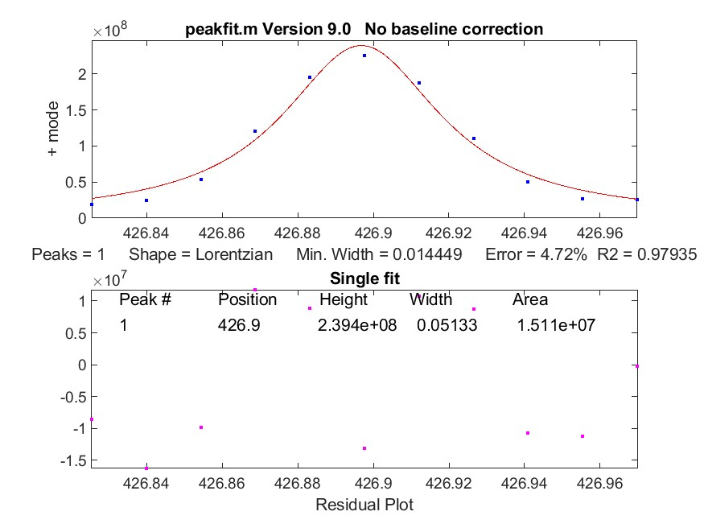
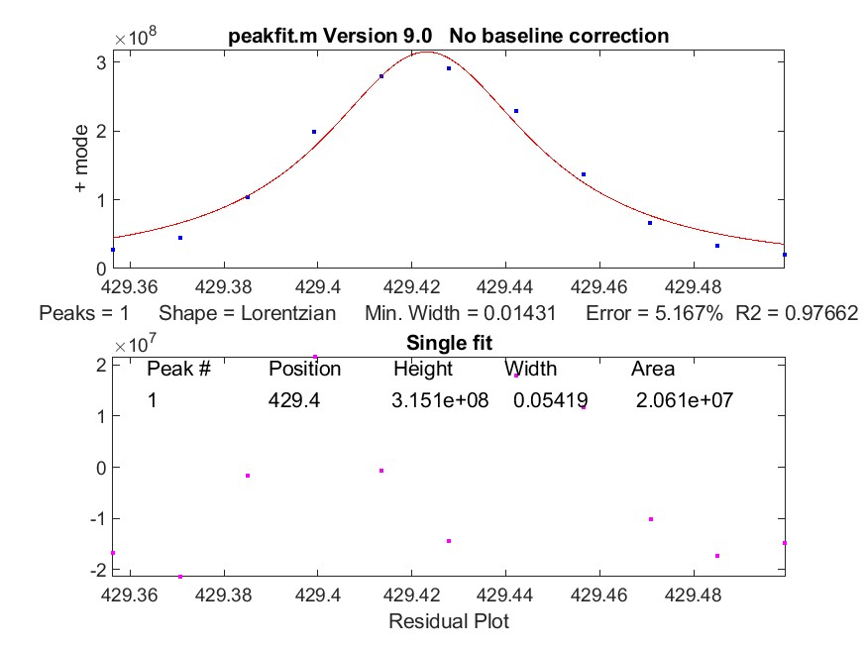
Results: CF-LIBS analysis
3) Calculation of the electron density of the LIBS plasma exploiting the line broadening of some reference lines of the above-mentioned chemical elements using the MATLAB "peakfit" function. The peakfit function compute the Lorentz width of some reference lines useful for the electron density calculation.
Two tungsten lines have been used in the peakfit function for W-based samples: typical values for electron density n_{e} ≈ 1÷3*10¹⁷ cm³
W I @ 426.94nm
W I @ 429.46nm

Slide 16
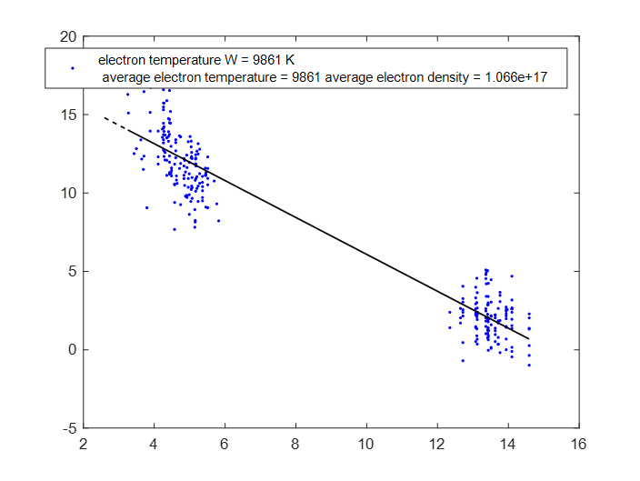
Results: CF-LIBS analysis
The electron temperature (T_{e}) of the LIBS plasma was calculated using the extended Boltzmann plot for tungsten
the calculation of T_{e} is based on implementation of the Boltzmann plot of atoms and ions typical values for T_{e} ≈ 10000÷15000 K
ln(I_{λ}λ/A_{ki}g_{k})
E_{k}(eV)

Slide 17
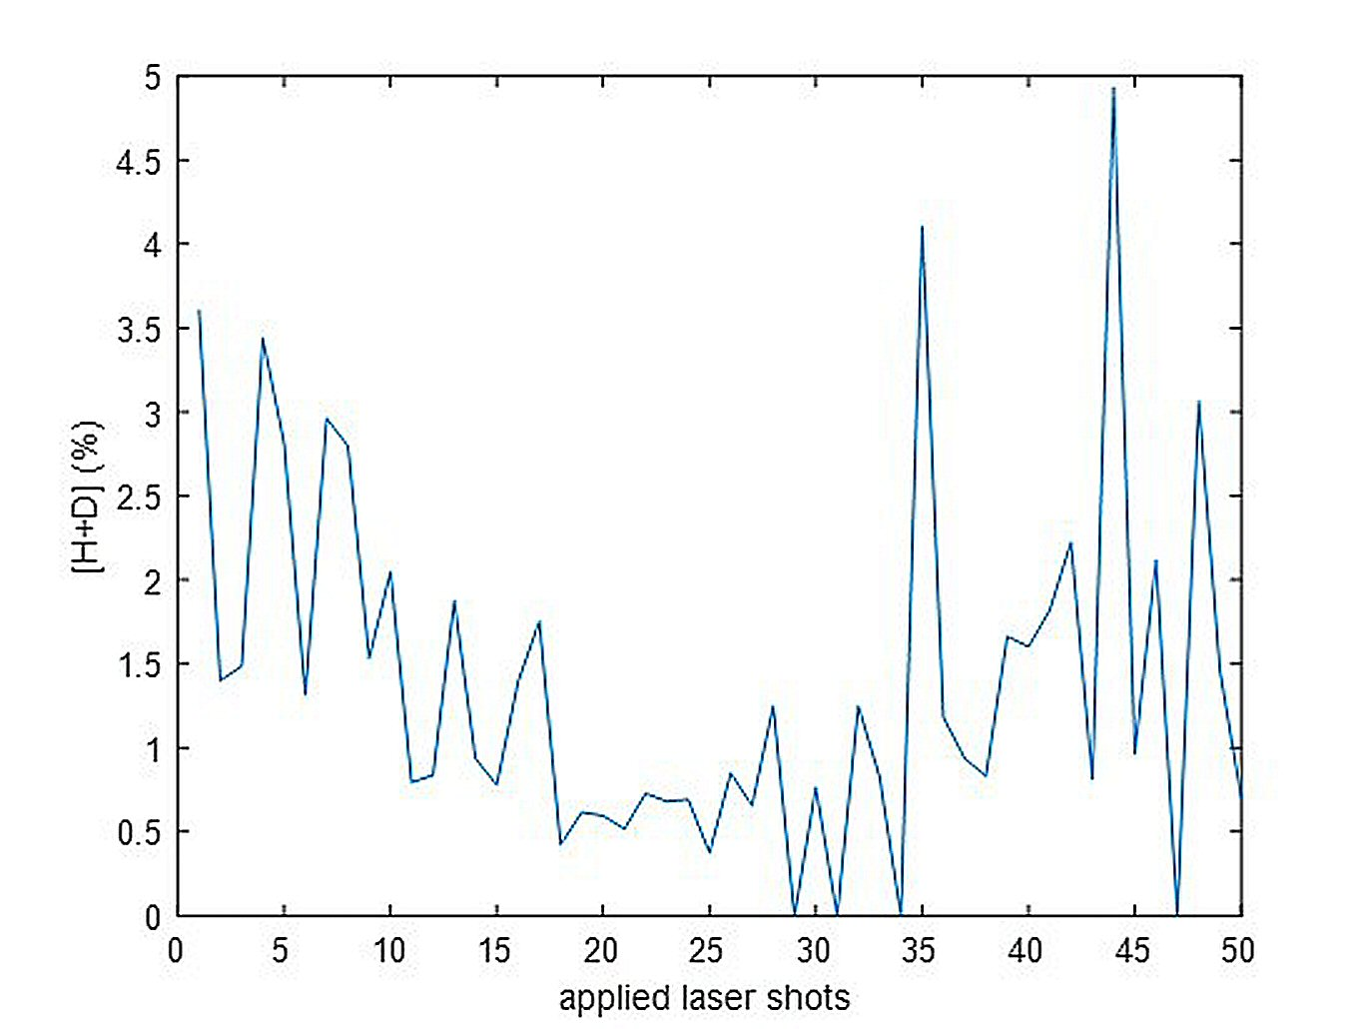
Results: CF-LIBS analysis
with n_{e} ≈ 1÷3*10¹⁷ cm³ and T ≈ 10000 – 15000 K , n_{e (min)} ≈ 2*10¹⁷ and δ ≈ 0.05 mm, so, the condition for a plasma in LTE is fullfilled.
With both conditions satisfied (plasma optically thin and in LTE), the CF-LIBS can be applied to estimate the relative concentration of H + D ([H + D]) with respect to W for all 50 spectra of the depth profiling analysis
Giving [H + D] ≈ 0.5 ± 3.5% in the surface layer, appearing enriched in hydrogen isotopes until the 10th–15th shot, consistently with the qualitative results previously shown where the surface layer with H/D and W are above the noise level of noise within the first 15 shots. Noisy values after the 35th shot depend on the low concentration of W noisy

Slide 18
Conclusions
He and Ar as background gases allows for a better separation of the H_{α}/D_{α} emission lines of hydrogen and deuterium with higher resolution than standard LIBS in air, as soon as the acquisition parameters have been optimized.
Simulation of the presence of tritium in the “H_{α}/D_{α}” spectrum, with its T_{α} spectral emission suggest that the detection and discrimination of the nearby T_{α} and D_{α} lines is feasible with a very “fine tuning” of the acquisition parameters.
LIBS simultaneous detection with both “High-Resolution” and “full range” spectrometers allows to perform depth profiling detecting all the chemical elements a Hydrogen isotopes from the Balmer-alpha spectral window with high resolution.
Measurements in Ar do not introduce an interfering signal, possibly being used to detect also He in the PFCs and:
Ar increase the plasma lifetime useful for LTE conditions to apply the CF-LIBS procedure.
H-D-T and W lines can be simultaneously detected with high SNR
The CF-LIBS technique has been performed by using dedicated software procedures developed to work on large series of LIBS spectra
These procedures will be used to perform similar and other analyses on the huge amounts of LIBS spectra acquired during the LIBS campaign at JET

Slide 19
Next steps
Focus on the study of longer plasma delays in Ar atmosphere (e.g. up to 20 μs)
Checking the signal enhancement by applying the double pulse technique
Reducing the average ablation rate reducing the laser pulse energy still maintaining a good SNR (optimization of the gate delay as a function of the pulse energy)
Application of depth profiling and CF-LIBS on boronized/deuterated samples

