Slide 1
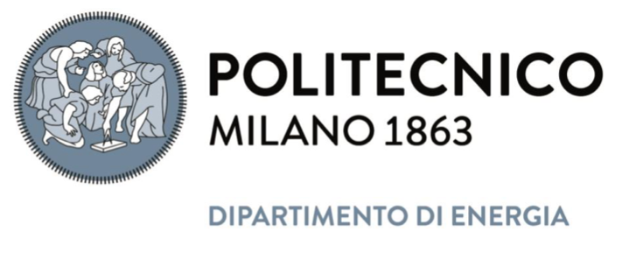


Overview of recent ENEA-PoliMi contributions to plasma-wall interaction modelling in SP D
Gabriele Alberti, Politecnico di Milano
on behalf of F. Mombelli, C. Tuccari, A. Uccello, M. Passoni

Slide 2
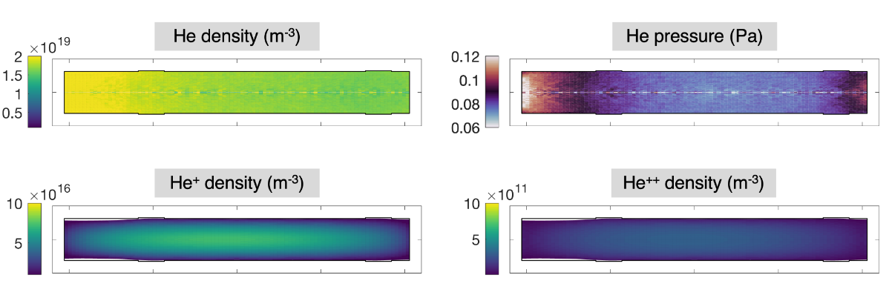
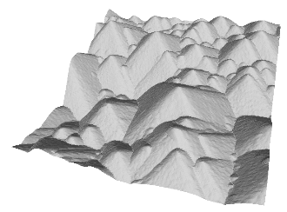
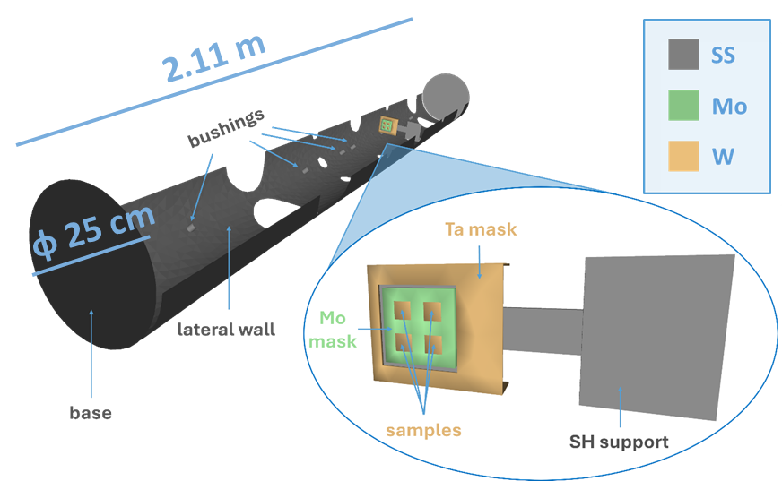
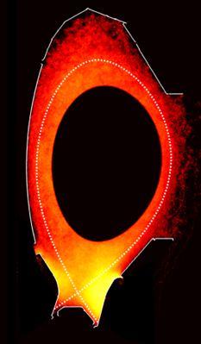
Overview of ENEA-PoliMi contribution in SP D
SP D.1
SP D.3
Production of He and Ar background plasmas with SOLPS-ITER for linear device GyM
ERO2.0 erosion studies including microscale morphology
Links to
SP B.1
Links to SP B.1 and B.4
ERO2.0 global modelling of erosion and migration in GyM
ERO2.0 modelling of L-mode and H-mode He plasma discharges in AUG
Links to
SP B.1
Links to WP TE
RT06

Slide 3
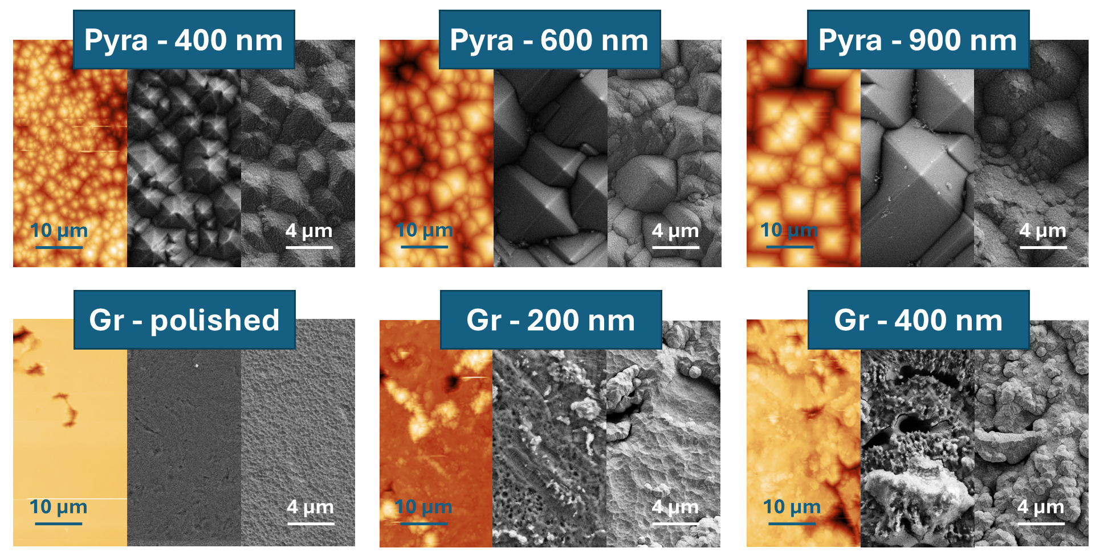

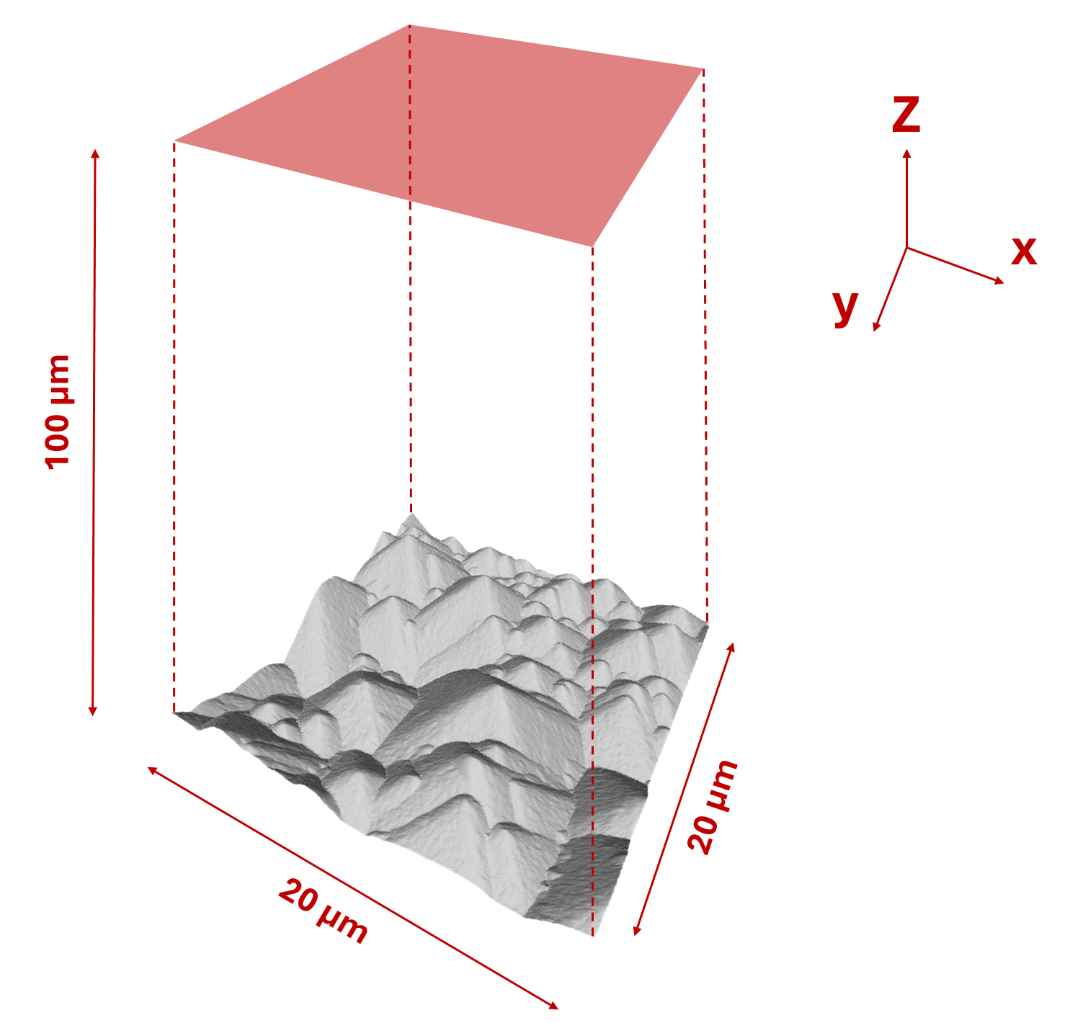
Microscale morphology studies
Investigate role of roughness and morphology on W erosion
W films with different roughness produced under SP B.4 and exposed to He or Ar plasmas in GyM under SP B.1
net erosion
=
particles leaving Z upper boundary
AFM topography of samples imported in ERO2.0 for comparison
Simulation geometry: quadrangular volume above AFM topography
Compared to mass loss measurements

Slide 4
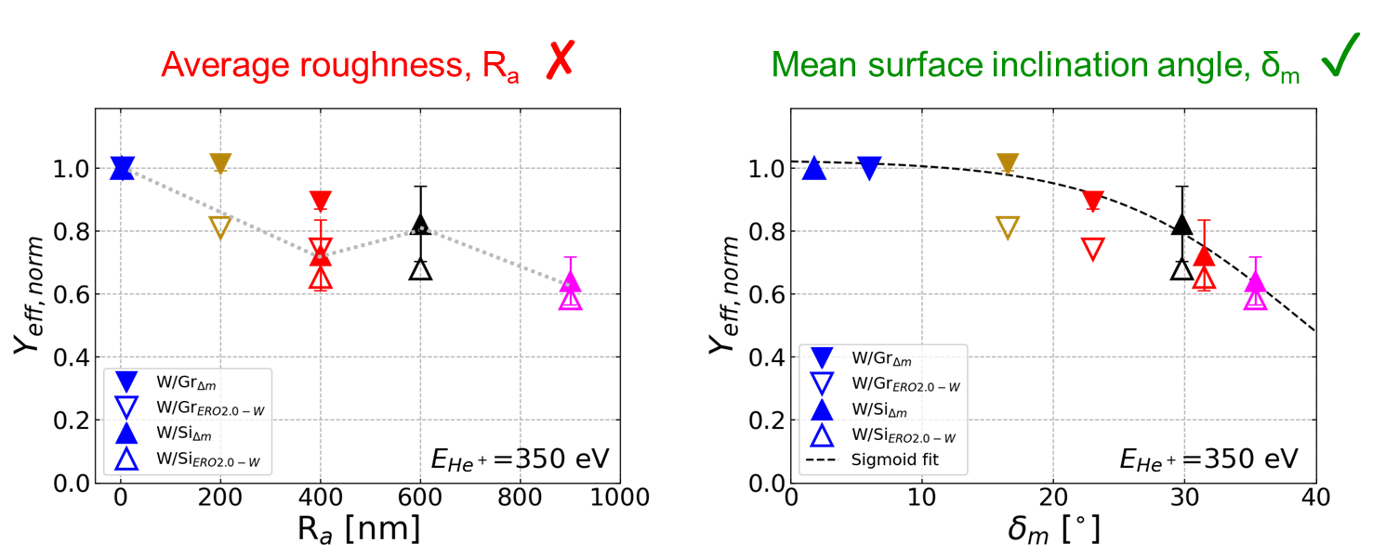
Impact of surface roughness
Y_{eff,norm} = normalised sputtering yield wrt flat surface
No clear Y_{eff,norm} dependence on average roughness R_{a}
Good sigmoid fit using mean surface inclination angle δ_{m}
C. Cupak, et al. Applied Surface Science 570 (2021): 151204

Slide 5
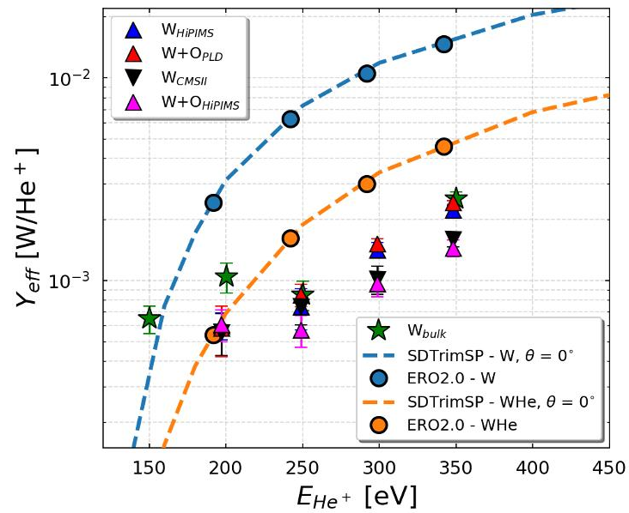
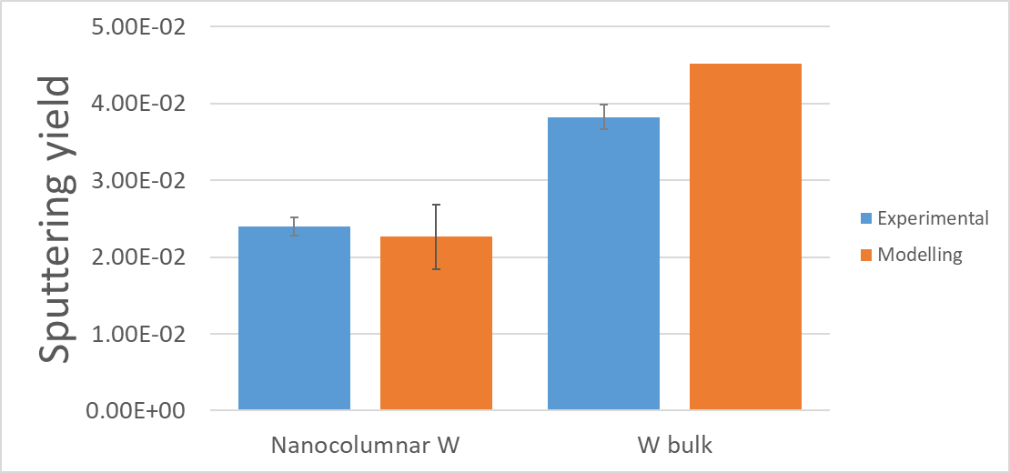

Impact of dynamic retention
(surface He observed in RBS measurements)
Role of dynamic He retention on sample surface and/or He bubble formation layer?
Generally lower absolute yields in He experiments than ERO2.0
R. P. Doerner, Scripta Materialia 143 (2018): 137-141
R. Sakamoto et al., Nucl. Fusion 64, 036008 (2024)
Not observed (or significantly reduced) with Ar plasma
Use of 50-50 W-He SDTrimSP yields reduces observed discrepancy
He plasma
Ar plasma, -70 V
x10

Slide 6

Microscale morphology studies: conclusions & perspectives
Verification of mean surface inclination angle δ_{m} as better descriptor of sputtering dependence on topography
Support to estimation of dynamic retention impact on GyM erosion results
Next: model the erosion of B samples?
G. Alberti, et al. "ERO2.0 modelling of nanoscale surface morphology evolution”, Nuclear Fusion 61.6 (2021): 066039
A. Uccello, et al. “Exploring the role of topography in the sputtering process of tungsten by GyM helium plasma”, Nuclear Fusion 65.5 (2025): 056006

Slide 7
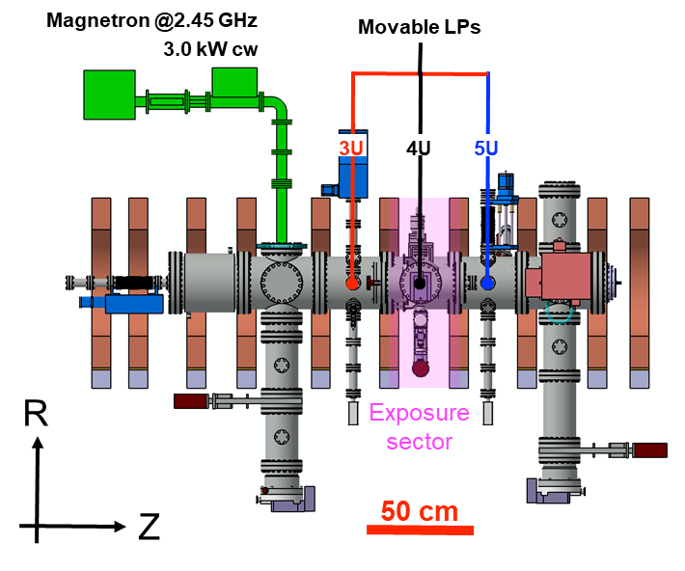
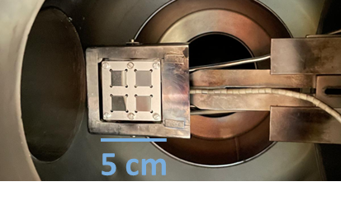
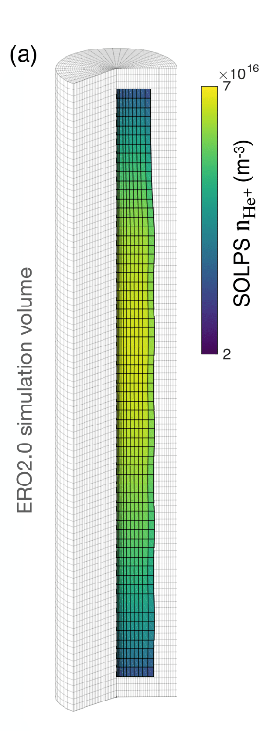
Global erosion/migration simulations in GyM
Study GyM wall erosion and its impact on exposed samples
2D SOLPS-ITER He-plasma solution (from SP D.1) imported in 3D ERO2.0 volume using axial symmetry
GyM 3D walls and sample-holder (SH) drawn in CAD and imported in ERO2.0
Stainless steel (SS) composition of GyM wall included in ERO2.0 and compared to full-Fe assumption
(not further discussed here)
Negative bias voltage applied to sample-holder as in experiments (0-320V in absolute values)

Slide 8
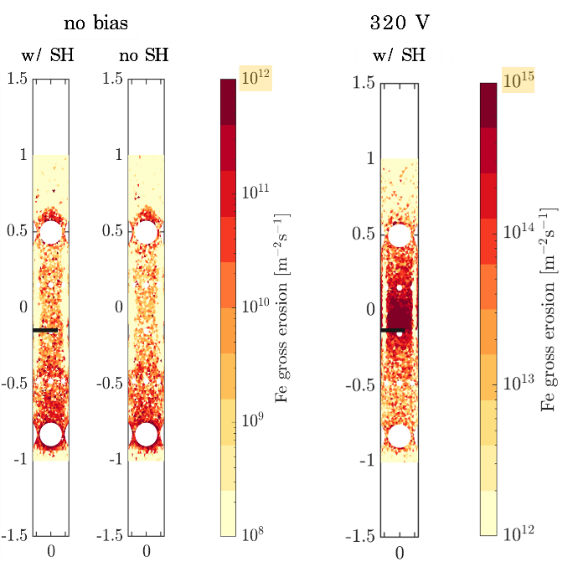
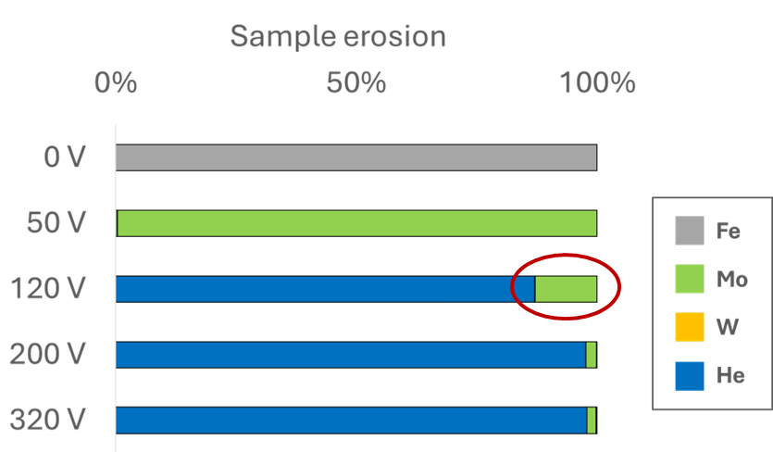
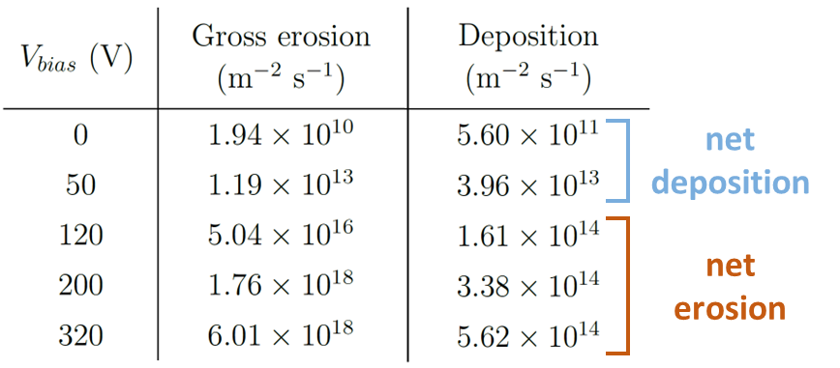
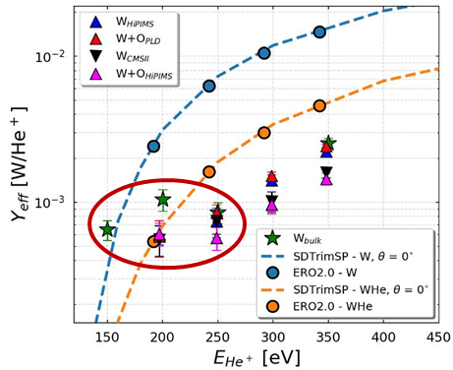
Effect of sample-holder (SH) inclusion
Impact of SH on Fe wall erosion
Low bias (0 V): negligible effect
High bias (320 V): noticeable wall erosion close to SH due to sputtering of Mo mask
Impact of Fe wall/Mo mask eroded impurities on sample erosion
Low bias (0-50 V): no He plasma erosion, net deposition on samples
High bias (200-320 V): He plasma erosion dominated
Close to He sputtering threshold (120 V): non negligible erosion from Mo

Slide 9
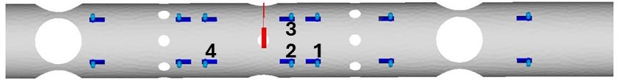
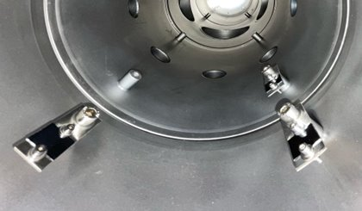

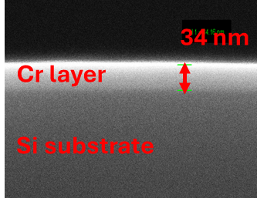

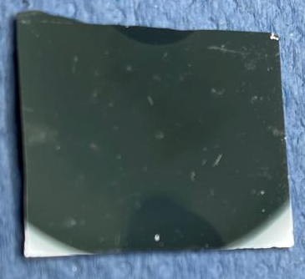
Comparison with experiments
Plasma-facing side
Back
Approach
Migration experiment: erosion of the exposed target and re-deposition on Si wafers (catchers)
Preliminary simulations using background plasma from SOLPS-ITER SP D.1 activity to optimize the exp. setup (target material choice, exposure time, biasing voltage, catchers positioning...)
Experiment performed under SP B.1
SH
Cr deposition on catcher 2
Experimental
ERO2.0
Results
Final setup: two Cr coatings exposed to Ar for 5 hours in total at –70V, with catchers shown in figure
Factor ≈1.5 higher erosion rate of Cr target in modelling compared to exp.
Good agreement in terms of deposited Cr thickness on catcher 2 (30-40 nm) and screw shadow
100 nm
Low deposition area due to screw shadow

Slide 10
Global simulations in GyM: conclusions & perspectives
Successful coupling between SOLPS-ITER and ERO2.0 in linear geometry for global erosion/migration studies
Mo eroded from biased mask identified as main impurity contributor to wall and sample erosion
Next: apply this tool to BiGyM?
G. Alberti, et al. "Global SOLPS-ITER and ERO2.0 coupling in a linear device for the study of plasma–wall interaction in helium plasma“, Nuclear Fusion 63.2 (2023): 026020
F. Mombelli, et al. "Numerical simulation of a helium plasma–material interaction experiment in GyM linear device through SOLPS-ITER and ERO2.0 codes" Nuclear Fusion 65.2 (2025): 026023

Slide 11

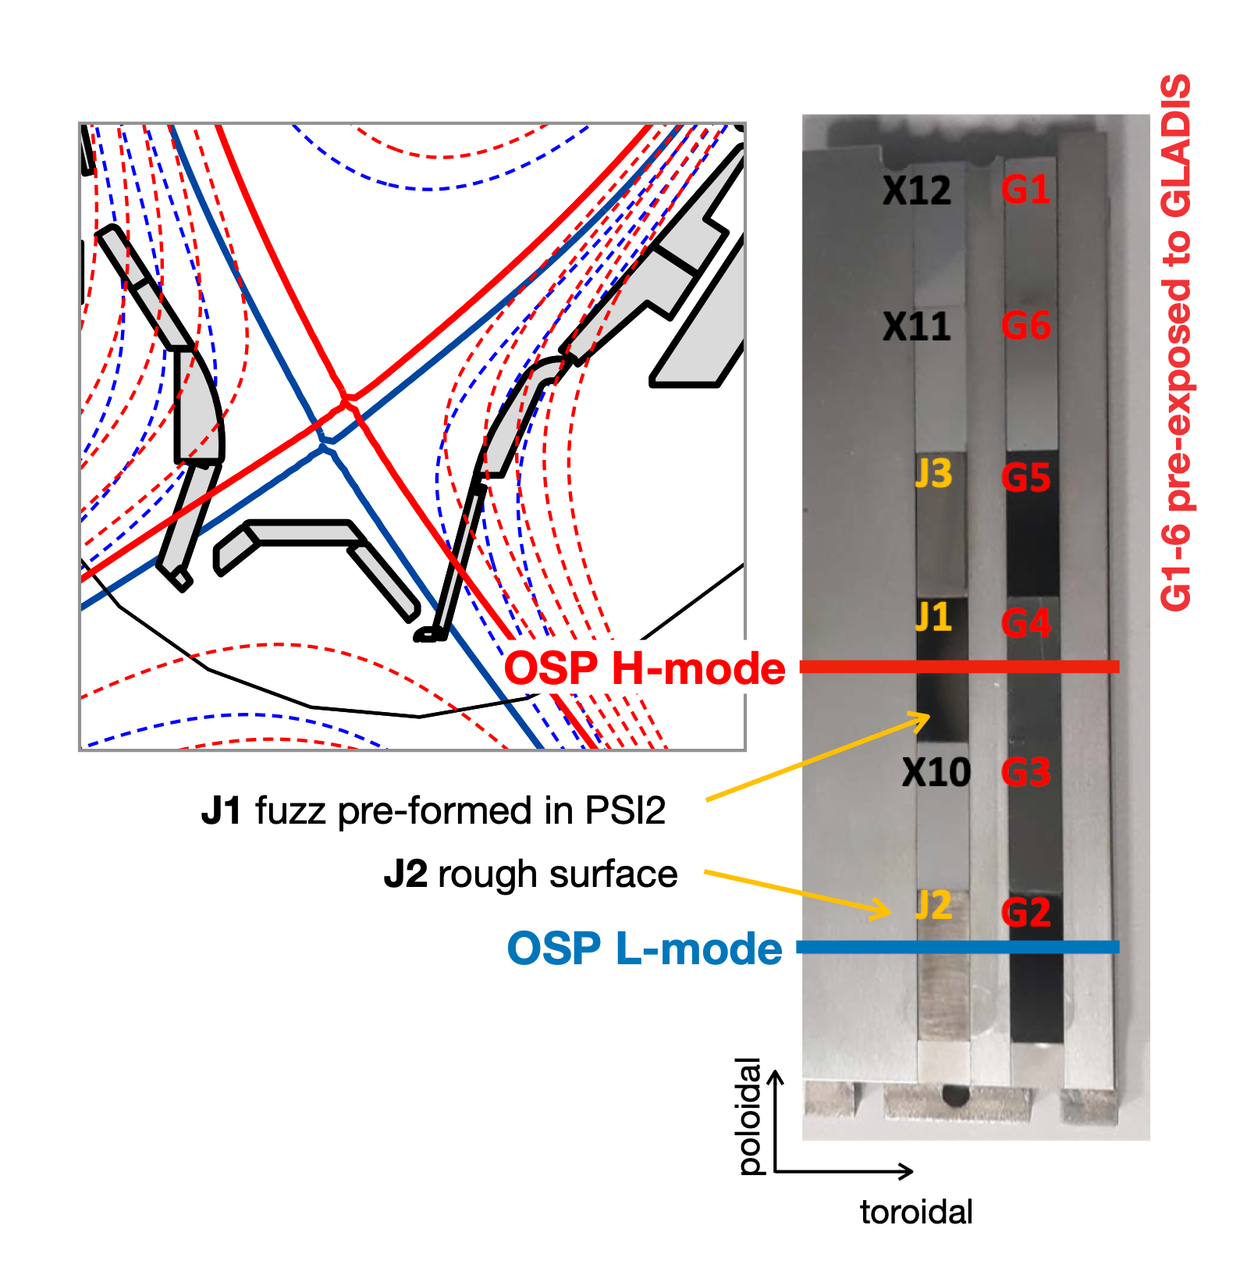
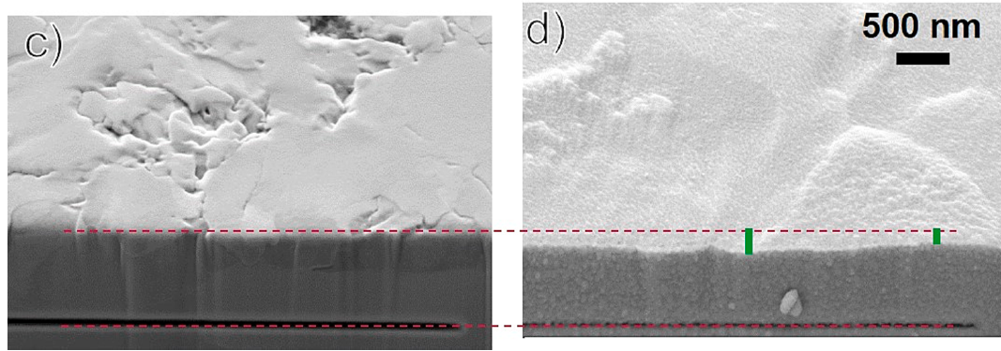
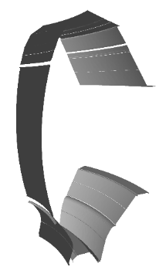
Erosion/migration in AUG He-plasma discharges
Investigate AUG W divertor erosion in L- and H-mode He plasma discharges
Picture from 2019 experiment
2019 and 2022 experiments
Poloidal shift of a few cm between L- and H-mode outer strike-points (OSP)
Post-mortem erosion measurements via focused ion beam marking on W
Net erosion near L- and H-mode OSPs, net deposition in between but little info about He^{+/2+} contribution
150 - 250 nm net erosion
(2022)
Deposition
zone
SOLPS-ITER background plasmas from WP TE
ERO2.0 wall geometry
(toroidal symmetry)
50 - 100 nm net erosion (2019)
M. Rasiński et al. NME 37 (2023) 101539
A. Hakola et al. NF 64.9 (2024) 096022
T. Vuoriheimo et al. NME 41 (2024) 101766

Slide 12
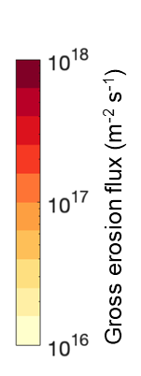
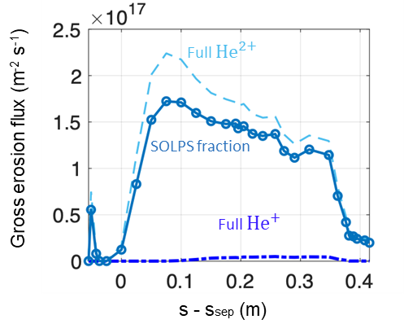
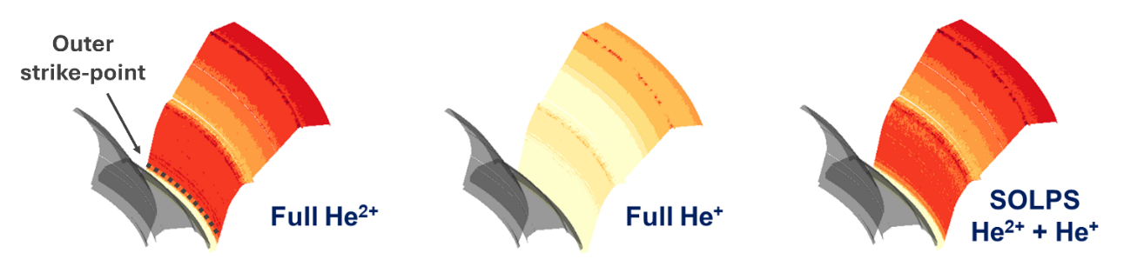
Erosion results in L-mode discharges
From SOLPS-ITER: 50-50% He^{+/2+} fraction close to OSP
Erosion with (c) SOLPS plasma vs. (b) full-He⁺ and (a) full-He²⁺ cases (fixed n_{e})
erosion contribution of the two He ions?
Results of the comparison
Significantly lower erosion with full-He⁺ wrt SOLPS-ITER fraction
30% higher erosion for full-He²⁺ close to OSP
Fairly good approximation
(a)
(b)
(c)
Comparison with experiments

Slide 13
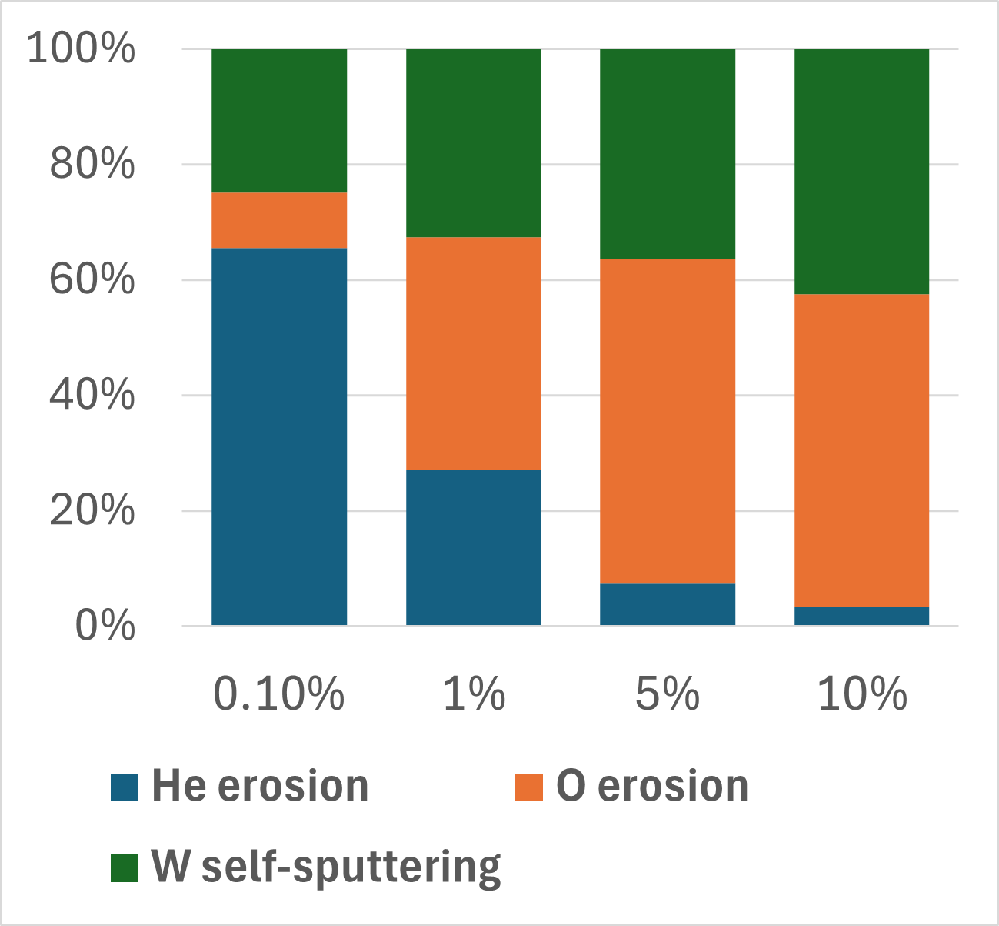
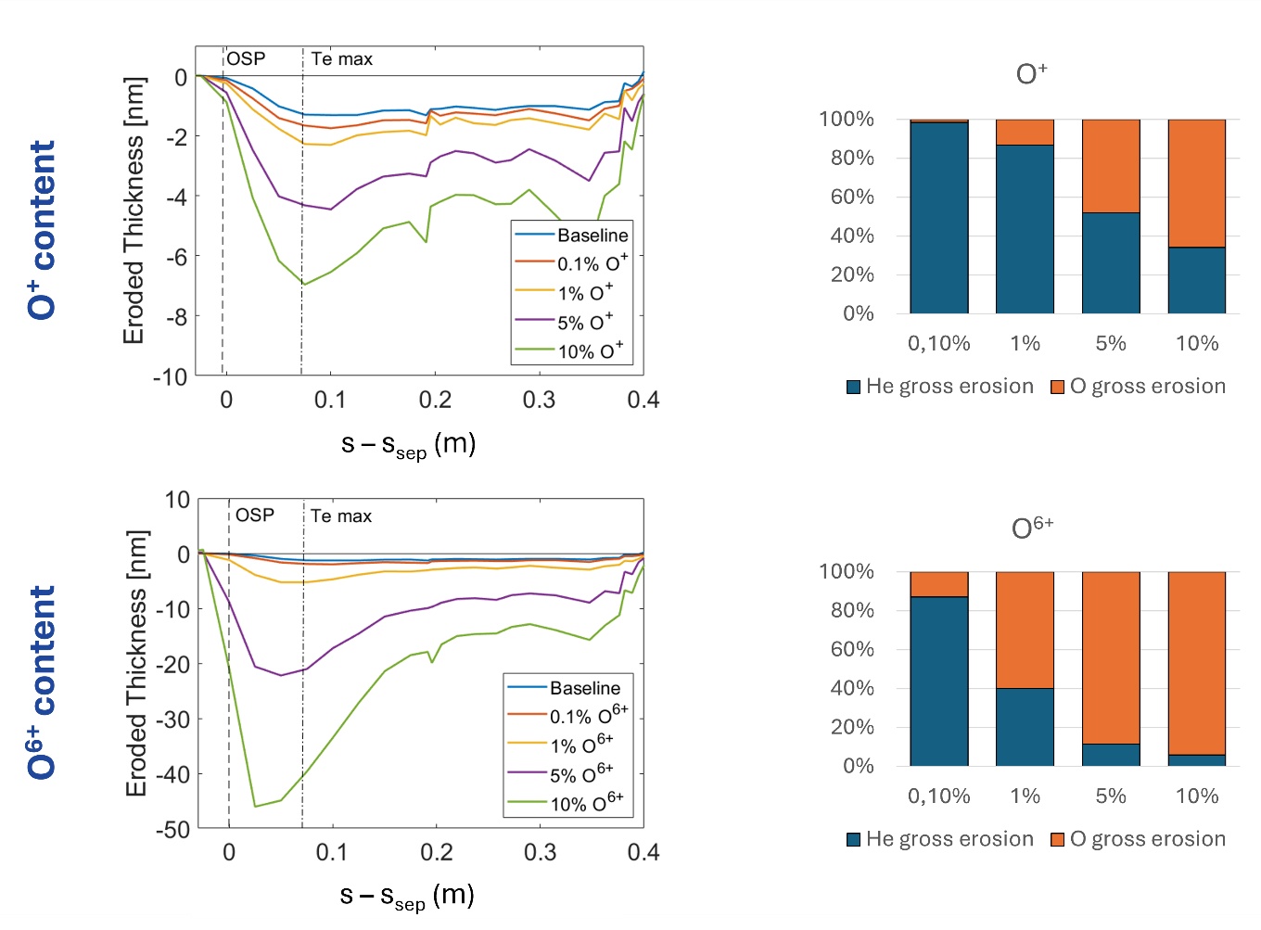
Erosion results in L-mode discharges
L-mode experiment (2019): 50-100 nm erosion near strike-point after 10²⁴ He m⁻² fluence
ERO2.0: 1-2 nm maximum erosion
Effect of impurities in plasma
Oxygen (O) used as proxy for impurities, 6+ charge (previous experience e.g. in WEST and coronal equilibrium)
O strongly impacts erosion even at 1% concentration
Stronger impact close to strike-point
BUT: good agreement only with too high concentration
Combination with other effects is needed (e.g. electron and/or ion temperature uncertainties)
See G. Alberti et al. arXiv:2506.03883

Slide 14
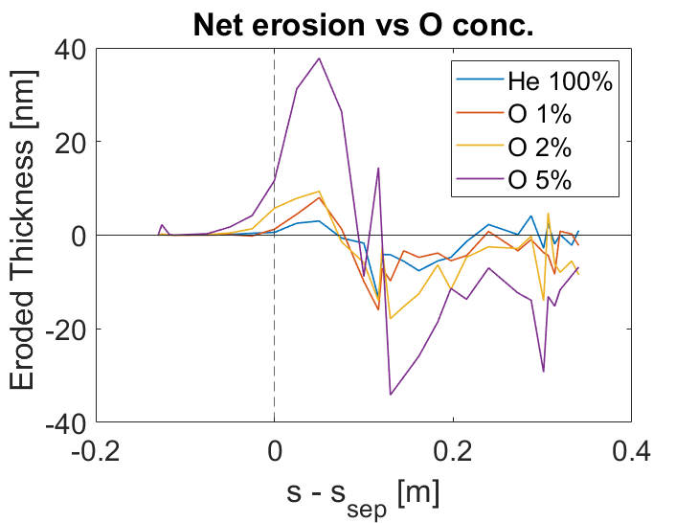
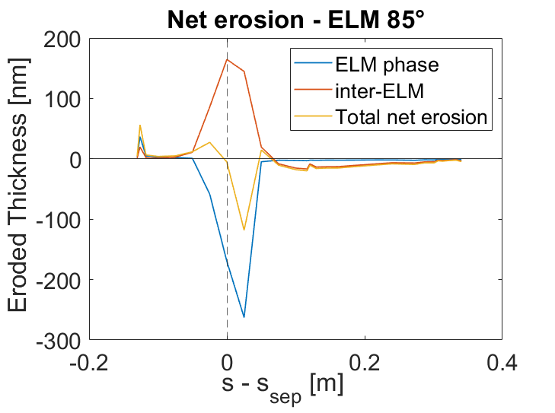
Erosion results in H-mode discharges
H-mode experiment (2022): 150-250 nm erosion near OSP after 3.4 ∙ 10²⁴ He m⁻² fluence
M. Rasiński et al. NME 37 (2023) 101539
ERO2.0: 35 nm maximum erosion far from OSP, even including oxygen (inter-ELM phase)
Effect of ELMs
A. Kirschner et al. NME 18 (2019): 239-244
Assumptions: 1 keV He in OSP area, same flux as inter-ELM, 1 ms duration, ≈ 150 Hz (5 ms between ELMs)
Incidence angle as free parameter (close to magnetic, 80°- 87°)
Observations:
Net erosion during ELMs, net deposition in inter-ELM phase
Erosion peak: 120 nm close to OSP, net deposition in private flux region with 85° incidence
from exp.
Good agreement with experiments

Slide 15
Erosion in AUG He-plasma discharges: conclusions & perspectives
He²⁺ dominates W erosion despite 50-50% He^{+/2+} fraction close to OSP
Important role of impurities (and other uncertainties) in L-mode,
of ELMs in H-mode
Next: move to other scenarios of interest for ITER
E. Tonello, et al. "Global modelling of helium Plasma-Wall Interaction experiments in ASDEX-Upgrade”, PSI-26 conference, oral
G. Alberti, et al. “Tungsten erosion and scrape-off layer transport modelling in L-mode helium plasma discharges in ASDEX Upgrade”, under review

Slide 16
Thank you for your attention

Slide 17
Impact of (110) crystallinity
MORPHOLOGY

Slide 18
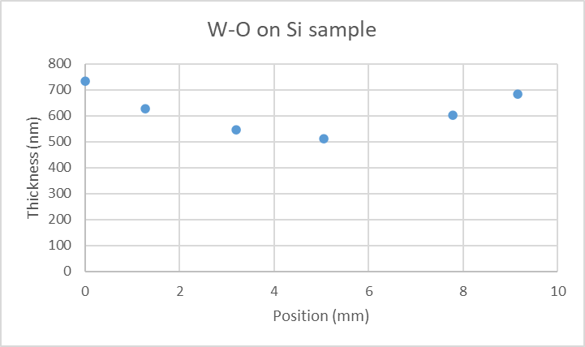
Impact of (110) crystallinity
Effect of mask shadowing

Slide 19
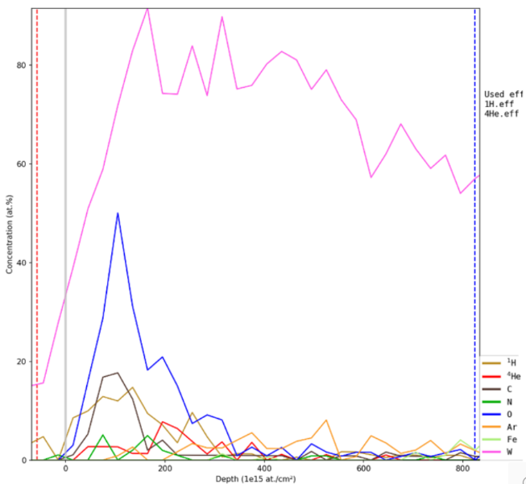
RBS measurements of He static retention after exposure
Ex. compact W sample
He retained in the first 30-50 nm for all exposed samples
Now samples at AMU for TEM analysis
By Iva Bogdanović Radović and Zdravko Siketić (RBI)

Slide 20
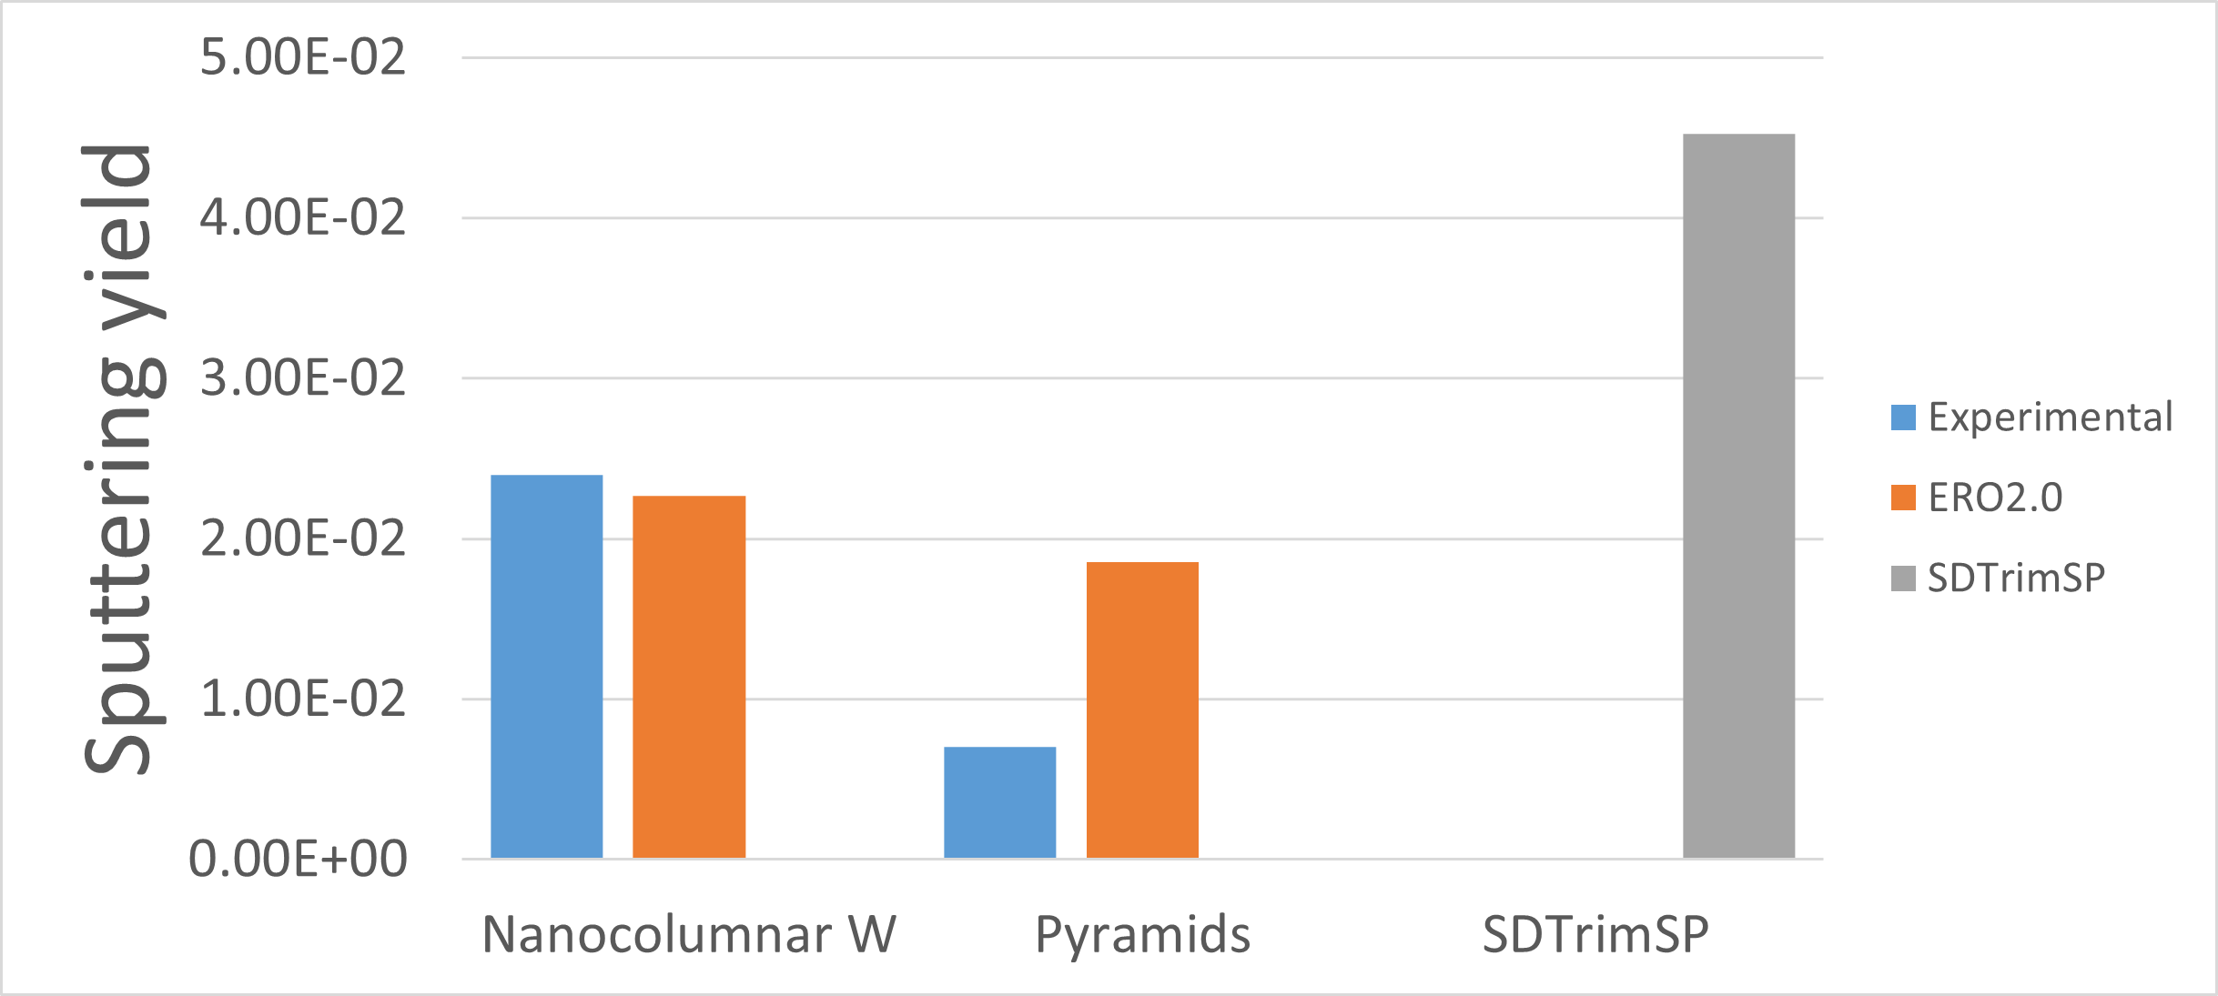

x2

Slide 21
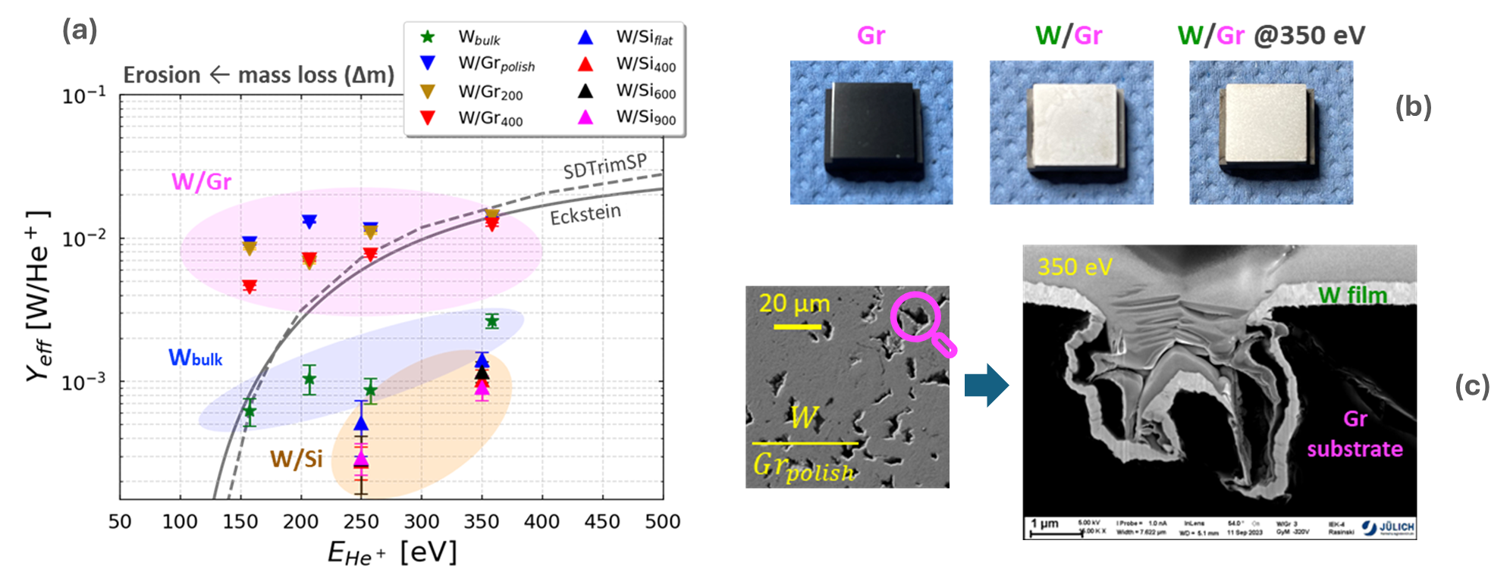

Slide 22
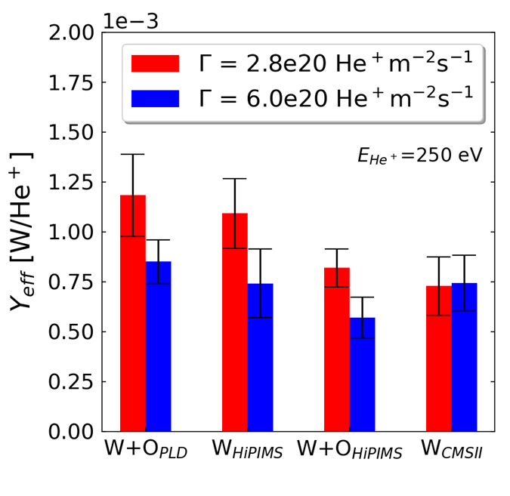

Slide 23
Impact of (110) crystallinity
GyM global simulations

Slide 24
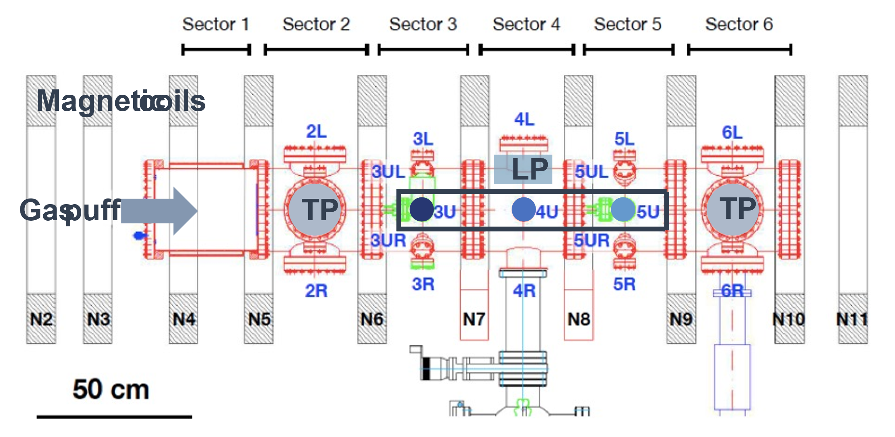
SOLPS-ITER He-plasma modelling in GyM

Slide 25
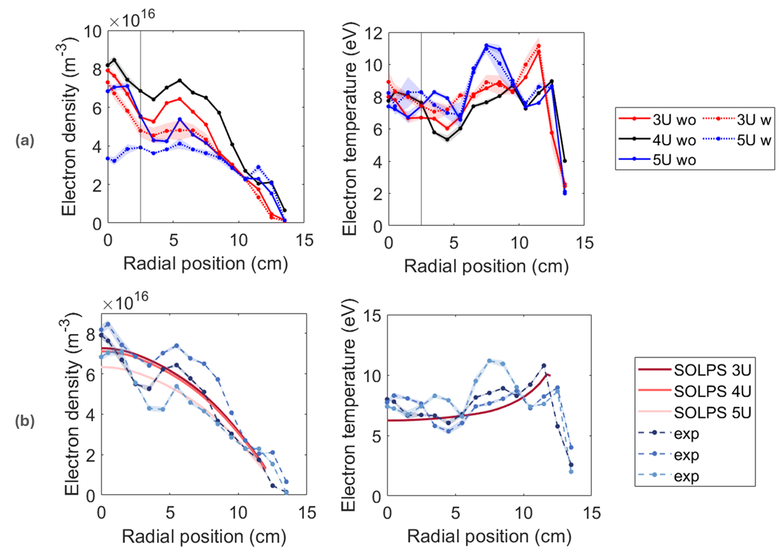
SOLPS-ITER vs He-plasma LP data in GyM

Slide 26
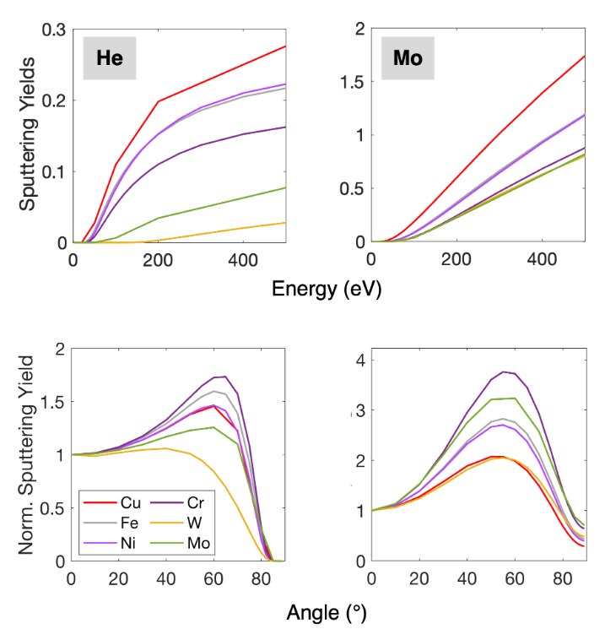
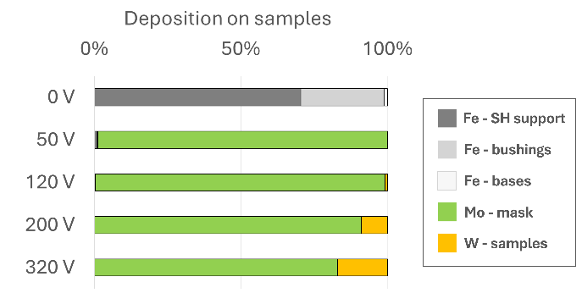
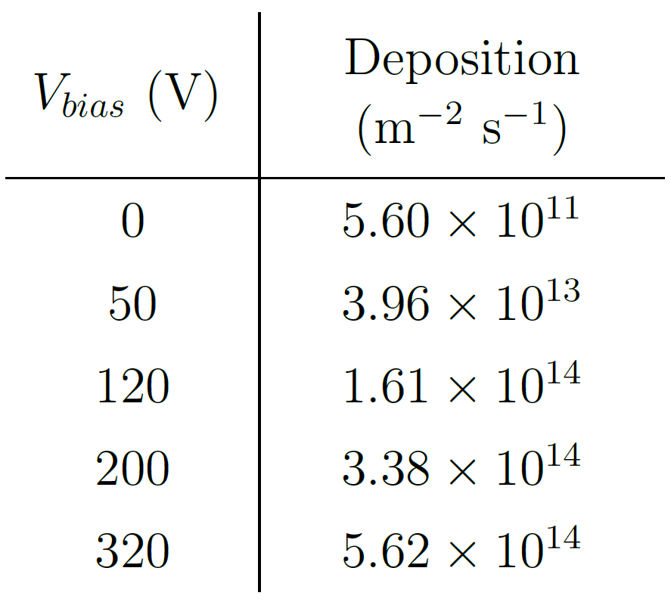
SS composition (AISI 304L): 73% Fe, 18% Cr, 9% Ni
30% higher gross erosion for Fe wall wrt stainless steel due to Cr presence

Slide 27
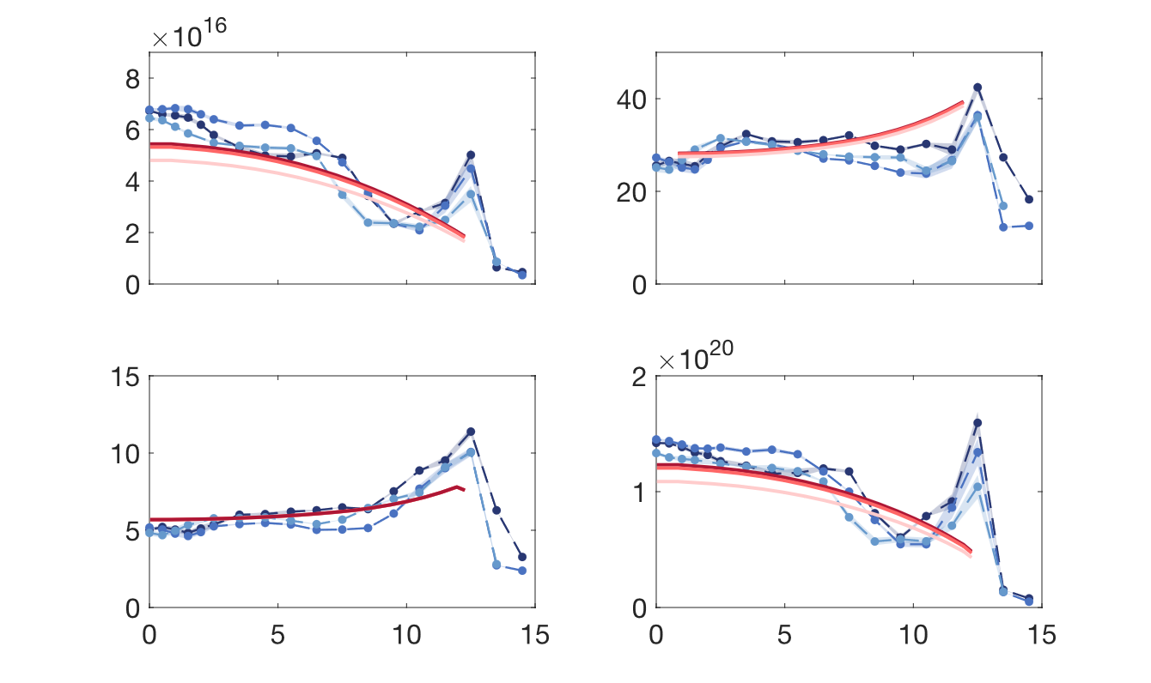
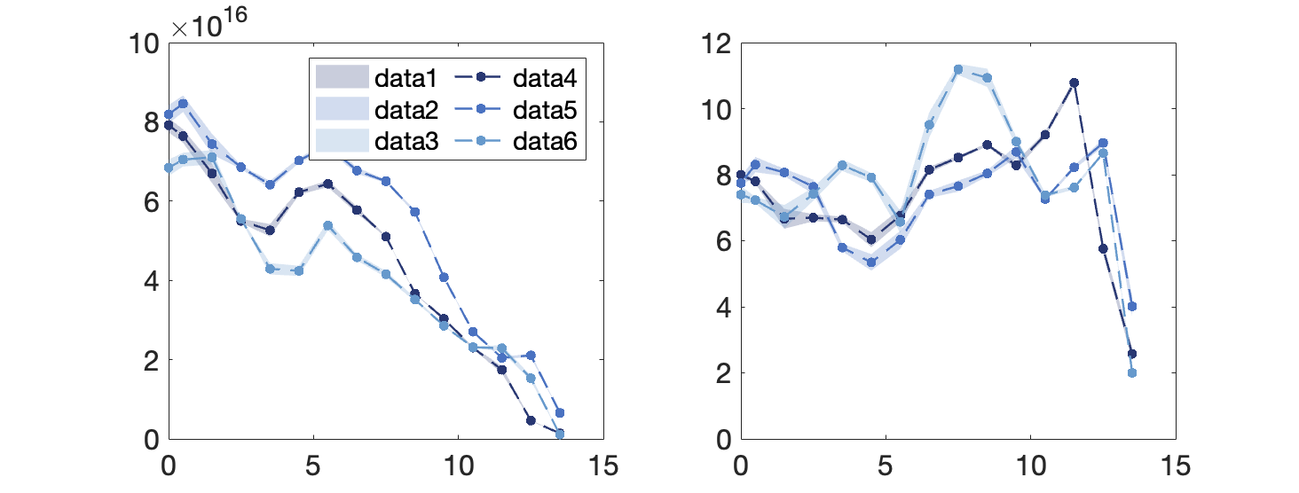
SOLPS-ITER Ar plasma modelling in GyM
A good agreement with the experimental data is found for the following choice of the SOLPS-ITER free input parameters
n_{e} (m⁻³)
V_{pl} (V)
D_{n} = 20 m²/s
χ_{i,e} = 1.50 m²/s
P = 240 W
albedo = 0.0176
λ = 3 cm
T_{e} (eV)
Γ (m⁻²s⁻¹)
exp
num
3U
exp
num
4U
exp
num
5U
R (cm)
R (cm)

Slide 28
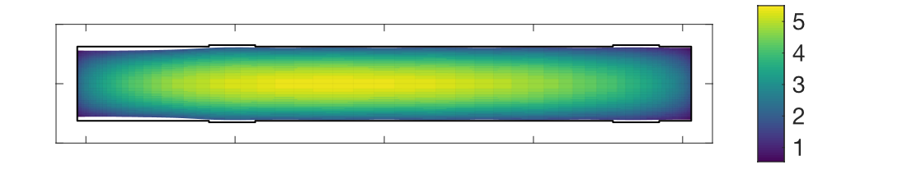
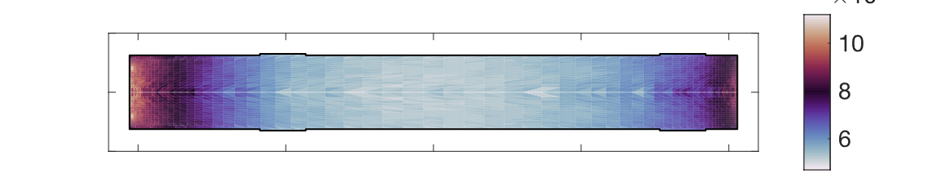
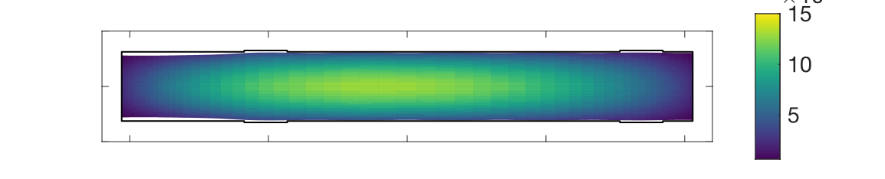
SOLPS-ITER Ar plasma modelling in GyM
Weakly ionized plasma, ionization fraction 2.39%
Ar⁺ is the only relevant plasma species
Ar^{n+} (n ≥ 3) are virtually nonexistent
Average ion temperature: 0.11 eV
Average neutral temperature: 0.03 eV
Neutral pressure peaked at the targets, where recycling occurs
Ar⁺ density map (m⁻³)
× 10¹⁶
Neutral pressure map (Pa)
× 10⁻³
Ar⁺⁺ density map (m⁻³)
× 10¹³

Slide 29
Impact of (110) crystallinity
AUG global simulations

Slide 30
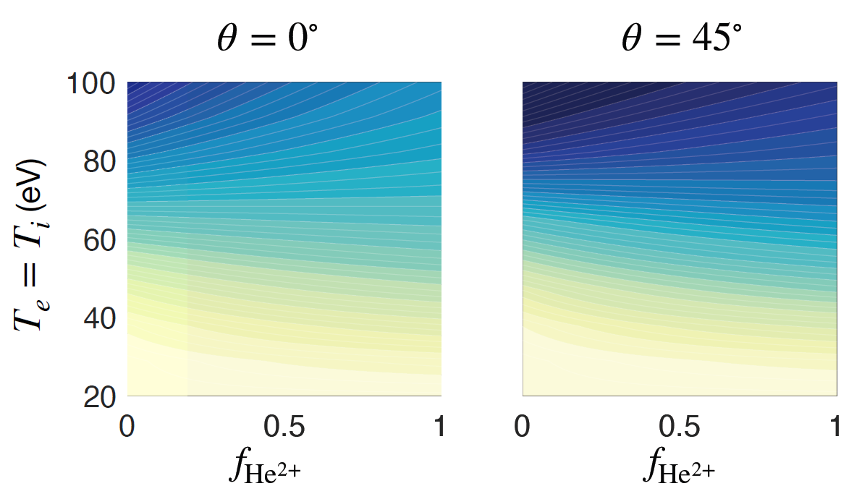
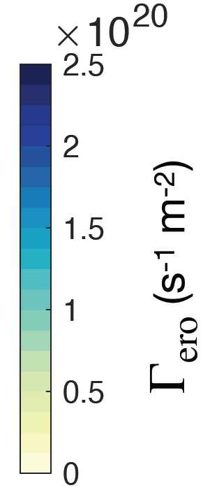


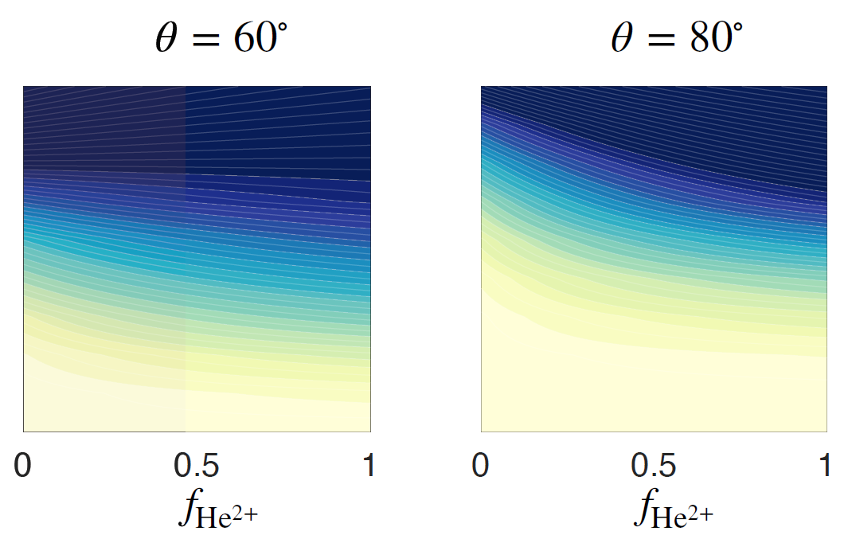
Impact of He ion concentration on divertor erosion: analytical model
Simplified model to evaluate physical sputtered flux of W, Γ_{ero}, as function of the fraction of He²⁺ ions:
Hypotheses
T_{e} ≈ T_{i} , fixed j_{sat} (if f =1, Γ_{wall} = 0.5 j_{sat} )
He²⁺ erosion
He⁺ erosion
At low T_{e} , erosion increases with the fraction of He²⁺
At high T_{e} , erosion decreases with the fraction of He²⁺: sputtering yield is flat and ion flux reduction dominates

Slide 31
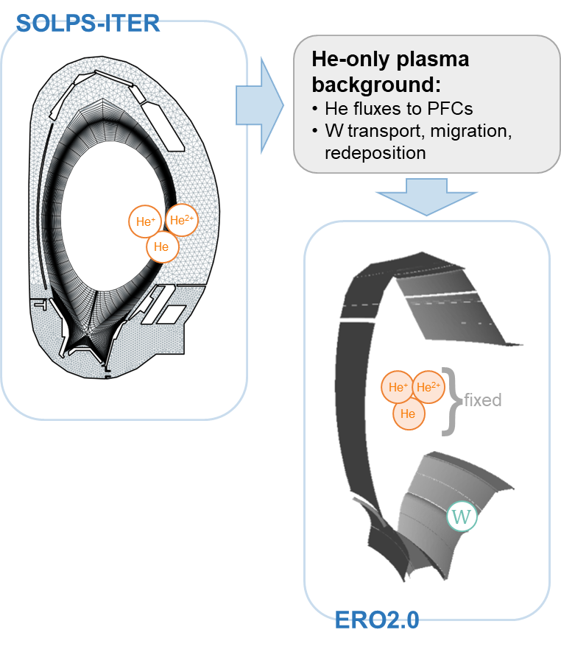

The modelling approach
SOLPS-ITER: 2D multi-fluid (main species + n. impurities) + 3D kinetic neutrals
ERO2.0: 3D kinetic Monte-Carlo transport of eroded impurities on fixed background plasma
SOLPS-ITER / ERO2.0 coupling:
Validation of SOLPS-ITER background plasma against AUG experimental profiles
Evaluation of He ion concentration (He²⁺, He⁺) by SOLPS -ITER
Impact on erosion in the divertor area by ERO2.0
S. Wiesen et al. JNM 463 (2015) 480–484
X. Bonnin et al. Plasma and Fusion Res. 11 (2016) 1403102
J. Romazanov et al. Phys. Scr. (2017) 014018

Slide 32





SOLPS-ITER results
L-mode (2019)
H-mode (2022)
ASDEX-Upgrade
OUTER MIDPLANE PROFILES
#41471
OUTER DIVERTOR PROFILES

Slide 33


Outer divertor
H-mode
Outer divertor
L-mode
OSP
He²⁺
He⁺
OSP
OSP
50% He²⁺ - 50% He⁺
@ OSP

Slide 34

ERO2.0 inputs

Slide 35



Comparison with experimental data
FIB marking: 50-100 nm erosion near strike-point after 10²⁴ He m⁻² fluence
M. Rasiński et al. NME 37 (2023) 101539
ERO2.0: 1-2 nm maximum erosion (even considering Maxwellian distributions for incidence angle and energy)
Possible uncertainties
T_{e} only benchmarked against median value of LP data
T_{i} not benchmarked in SOLPS
Presence of impurities (e.g. O)
Sputtering yields for redeposited W
Temperature variation
Stronger impact of T_{e} due to 3q factor
T_{e} effect closer to strike-point
Partial agreement only with unrealistically high T_{e}

Slide 36
Impact of uncertainties: light impurities in plasma
Assumptions
Oxygen used as proxy for light impurities
Concentration range: 0.1 – 10% (of n_{e} )
Low (1+) and high (6+) charge states (from WEST experience and coronal equilibrium)
C. C. Klepper et al. PPCF 64 (2022) 104008
R. Dufresne et al. 2021 Monthly Notices of the Royal Astronomical Society 503 1976–1986
Oxygen impact
Mild effect for O⁺, even at high concentration
O⁶⁺ has strong impact close to strike-point
Partial agreement only with very high concentration (10%)
Combination of uncertainties is needed

Slide 37

2*T_{e} and 2*T_{i}

Slide 38

Impact of other species in plasma in H-mode

Slide 39

ELMs modelling
Assumptions (from Kirschner et al, NME 2019)
1 keV He in OSP area, same flux as no-ELM simulations
Incidence angle varied between 80° and 87° (close to magnetic)
1 ms duration
≈ 150 Hz (5 ms between ELMs)
2*n_{e} in ELM phase (small impact on obtained results)
Particles traced through variable background plasma
H. Kumpulainen et al. NME 33 (2022) 101264
Good agreement found with 85° incidence
ELM impact area around OSP (image from DTT but same idea)

