Slide 2
1D to 4D tomographic inversion methods for energetic particle measurements in burning plasmas
Final report ENR-MOD.02.DTU.T001-D001
PI: Mirko Salewski
Team: Antti Snicker (VTT), Massimo Nocente (ENEA), Jacob Eriksson (Uppsala)

Slide 3
Mission goals and the team
To develop tools to exploit all available measurements of energetic particles in weakly burning plasmas at JET
To utilize ASCOT simulations to construct cogent physics-informed prior information
To enable tomographic measurements of 1D-4D phase-space distribution functions

Slide 4
Purpose of Joint Experiment EP21
Long-term goals
to measure 1D-5D fast-ion phase-space distribution functions in major machines using the available combined set of diagnostics.
to get phase-space tomography ready for ITER.
Near-term goals
to support of fast-ion physics studies relevant to each machine.
to study fast-ion physics for NBI and ICRF scenarios, AEs, NTMs, sawteeth.
Support the ITER Research Plan
B11.10: Validate reconstructions of fast ion distributions for ITER stability analysis/predictions.
B11.1 and B11.4: Advanced ICRH schemes for AFP and DT.

Slide 5
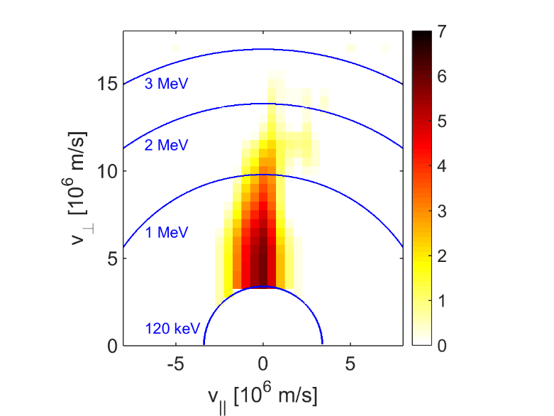
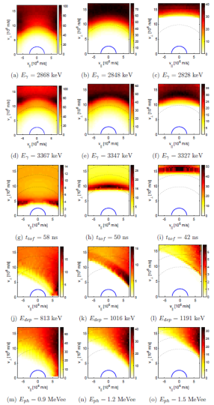
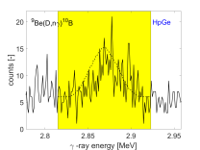
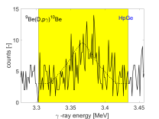
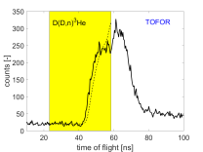
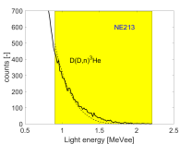
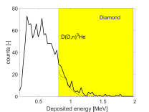

Velocity-space tomography and phase-space tomography
Forward problem
JEX-EP11: Velocity-space tomography, can find bump-on-tail and anisotropy
JEX-EP21: Phase-space tomography, can additionally find spatial gradients
Tomography in other phase-spaces
FILD tomography
INPA tomography
Orbit tomography
2D-5D phase-space tomography by collision regularization
$$WF=S$$
Distribution function F
Weight functions W
Measurements S
Inverse problem
Salewski et al (2011,12,13,14,15,16,17,18a,18b) NF

Slide 6
Summary: Scientific deliverables of this project
2024 deliverables: 6 papers published
2025 deliverables: 3 papers published, 1 submitted, 1 in progress

Slide 7
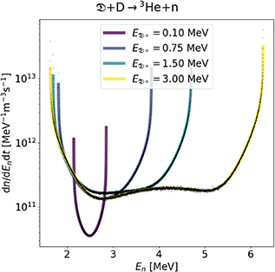
Scientific deliverables of 2024: NES & GRS
Deliverable: 2 publications on 1D energy spectra NES and GRS
Fast analytic model matches time consuming Monte Carlo simulations by DRESS and GENESIS for Neutron emission spectroscopy
Gives insight into essential physics
A. Valentini et al. (2025a) NF
A. Valentini et al. (2024) RSI
A. Valentini et al. (2025b) NF

Slide 8
Scientific deliverables of 2024: NES & GRS
Most important reaction for GRS in burning plasmas at JET
Possibly for ITER, if Be is present
Also good match for two-step reaction GRS with the Monte Carlo code GENESIS
Gives insight into essential physics
A. Valentini et al. (2025b) NF

Slide 9
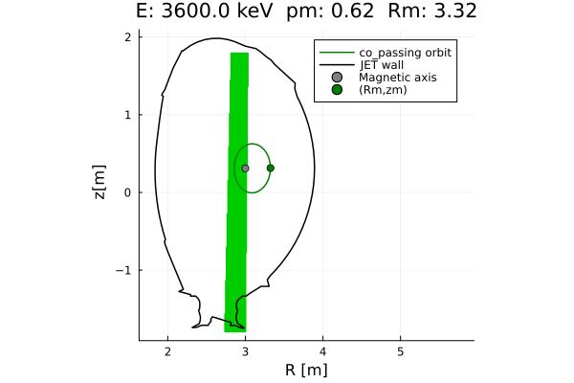
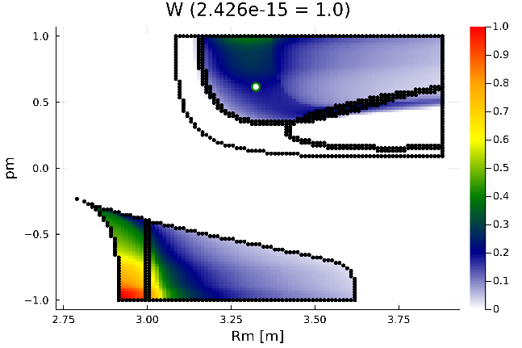
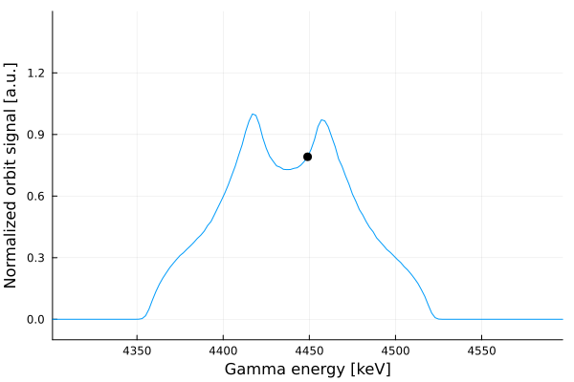
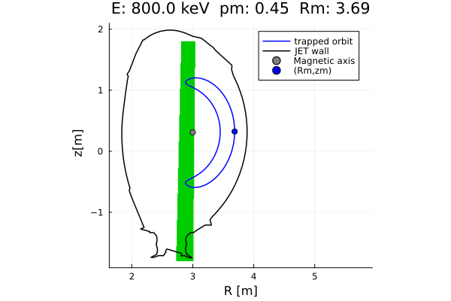
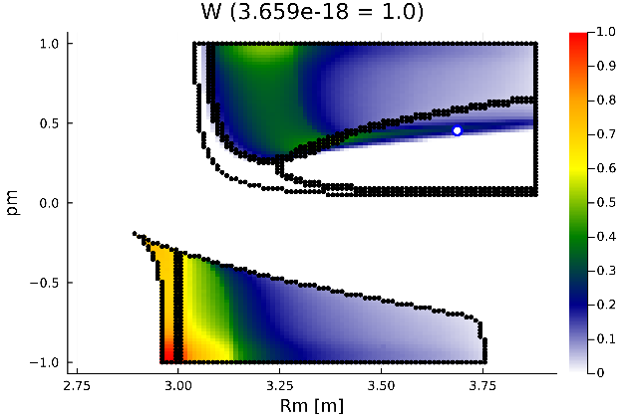
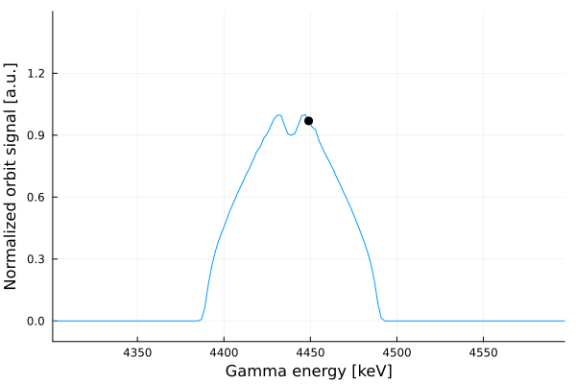
Scientific deliverables of 2024: Orbit weight functions for 2-step GRS
Orbit weight function for 2-step reaction GRS
Valentini et al. (2025c) NF

Slide 10
Scientific deliverables of 2024: Orbit tomography from synthetic spectra
Rud et al. (2024a) NF, Rud et al. (2024b) NF

Slide 11
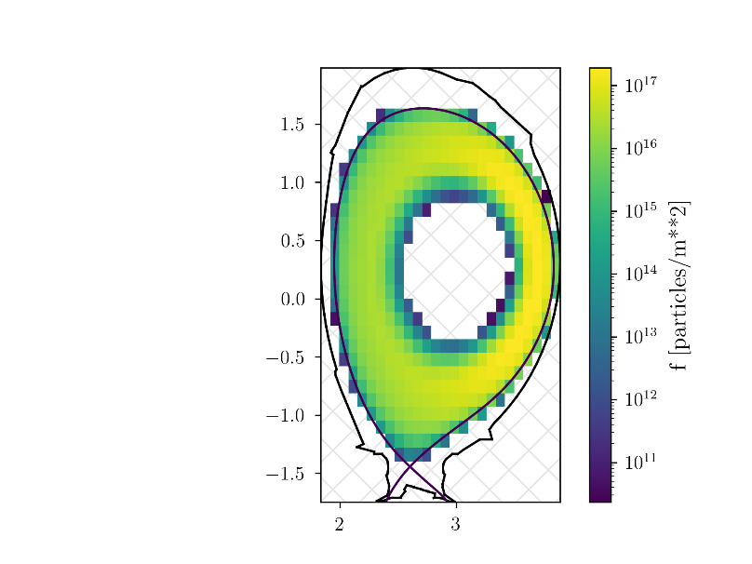
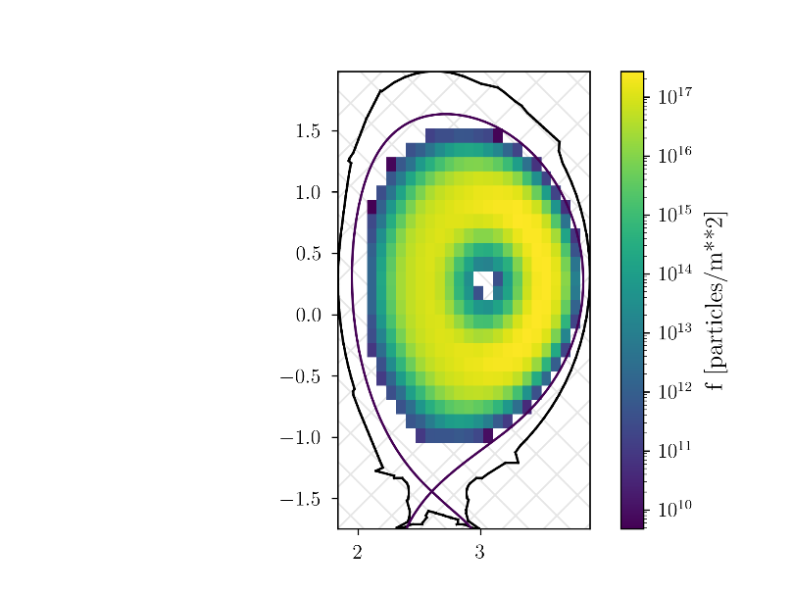
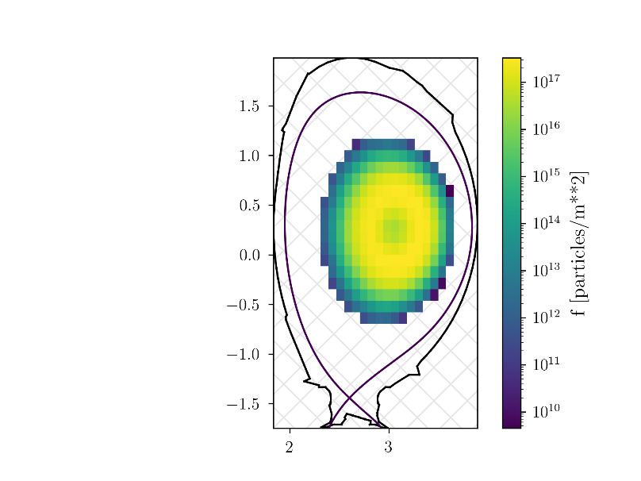
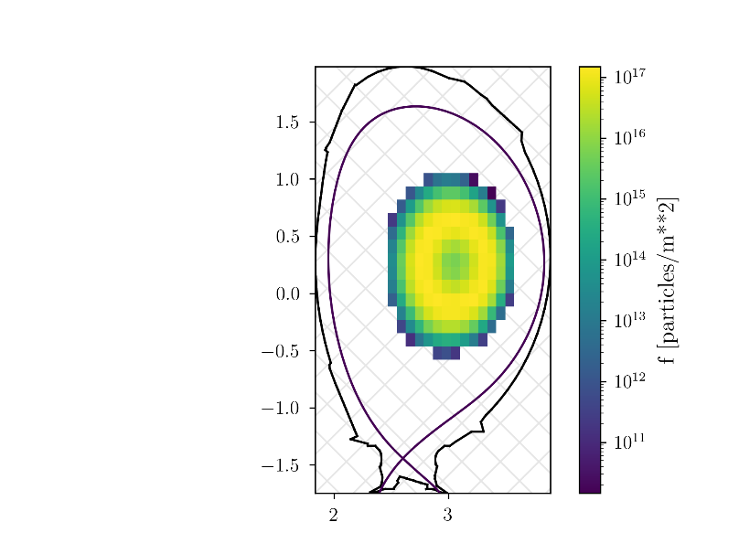
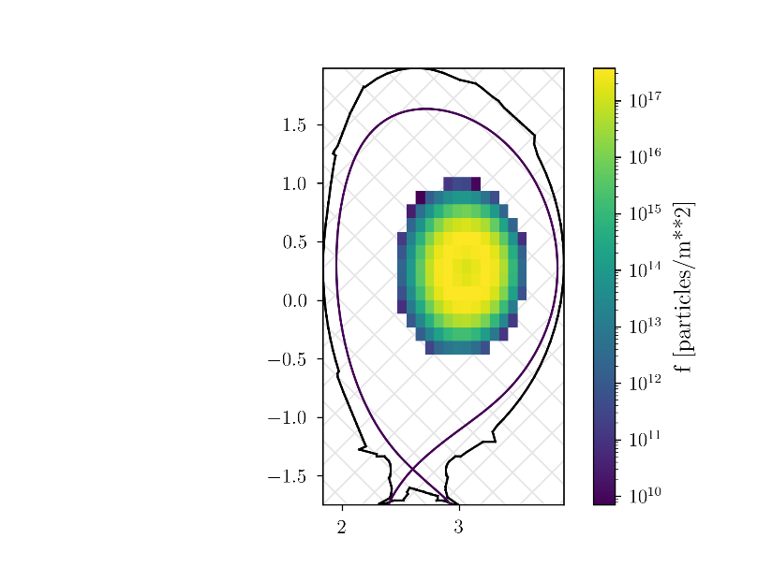
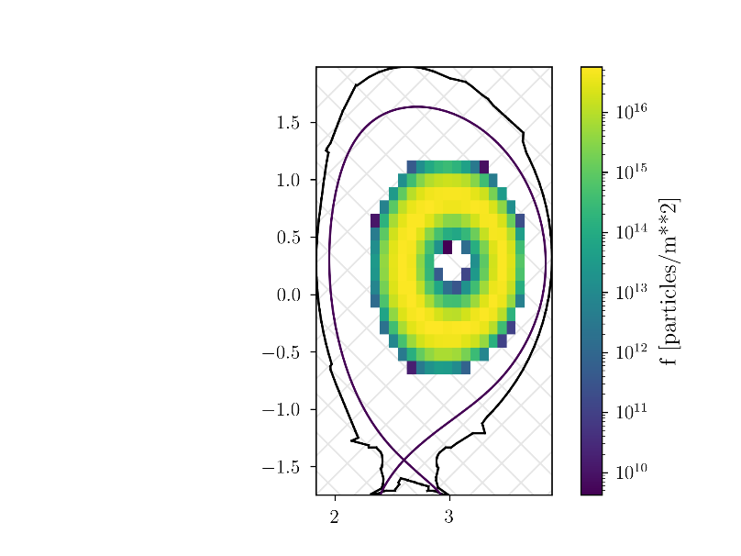
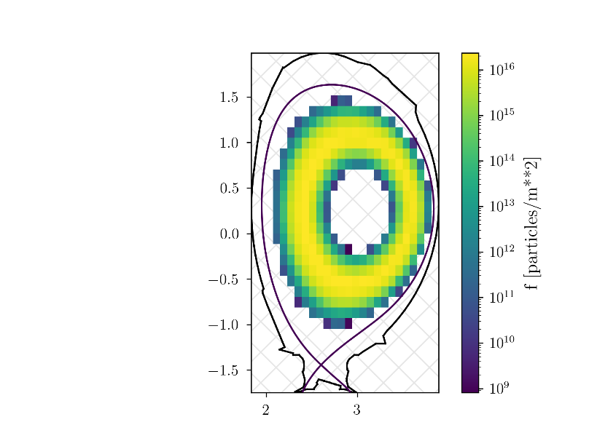
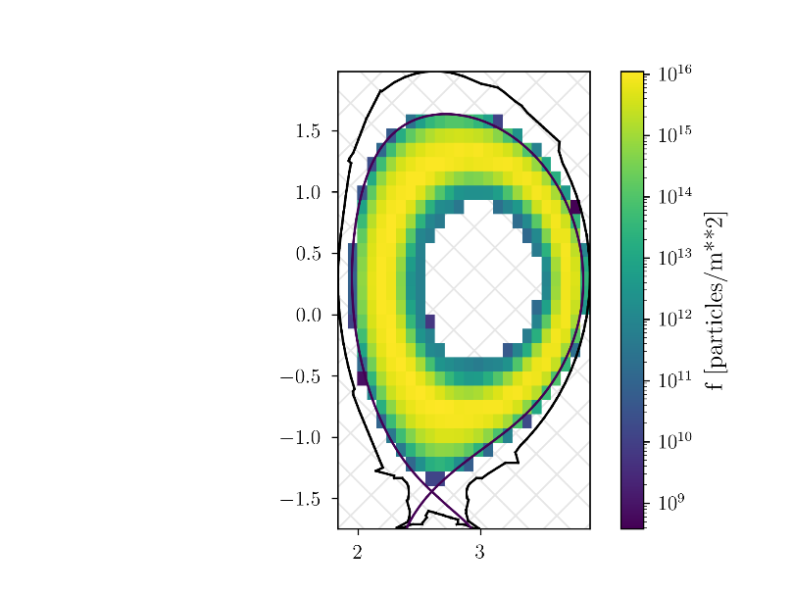
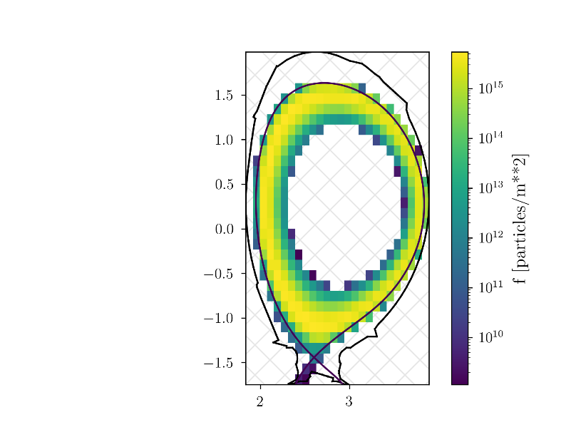
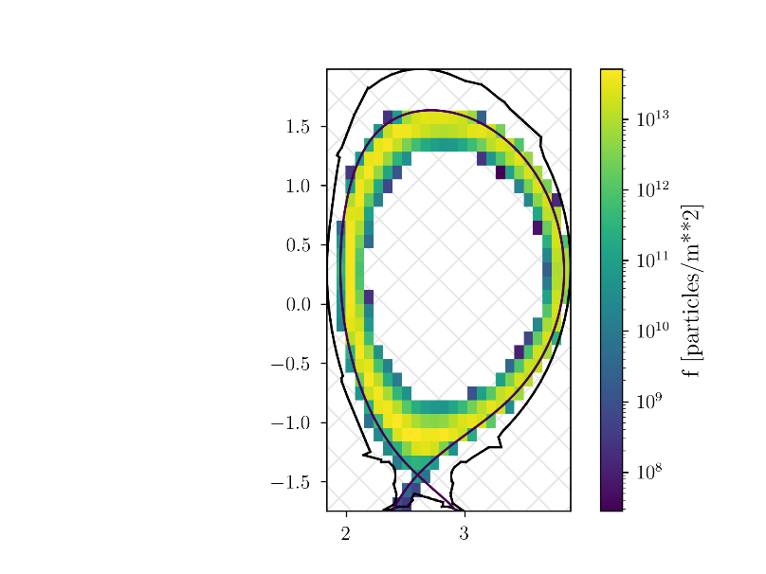
Scientific deliverables of 2024: Massive parallel ASCOT simulations
Expand the 4D phase-space distribution into basis functions computed by ASCOT
Hyväninen (2025) NF

Slide 12
Summary: Scientific deliverables of this project
2024 deliverables: 6 papers published
2025 deliverables: 3 papers published, 1 submitted, 1 in progress

Slide 13
Scientific deliverables of 2025: Reconstruction in 4D phase-space using basis function computed by ASCOT
Ground truth
Reconstruction
Relative difference
Hyväninen (2025) NF

Slide 14
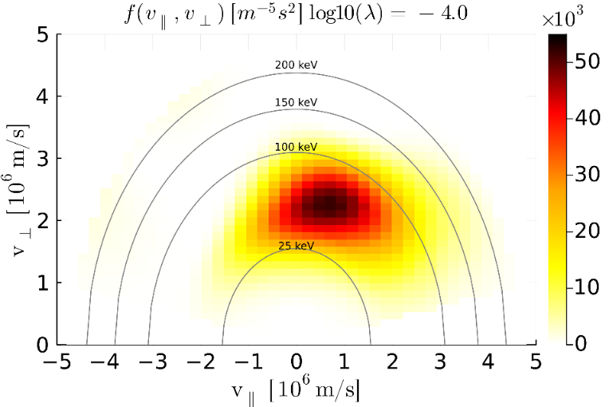
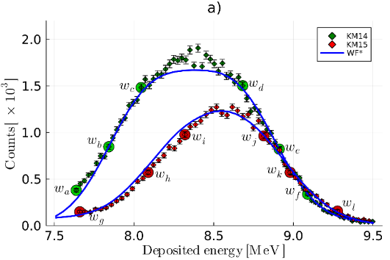
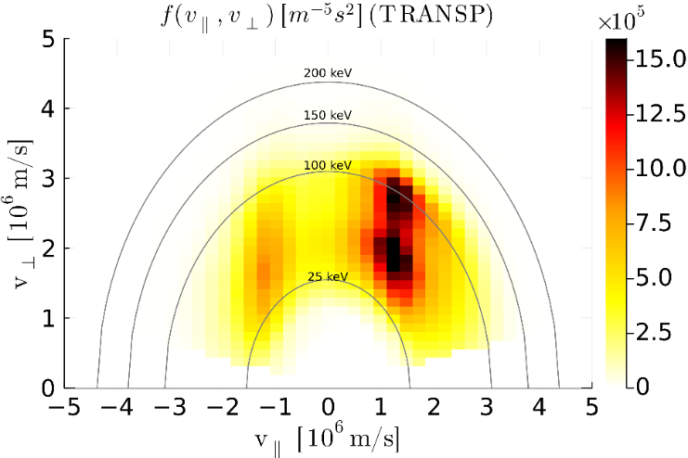
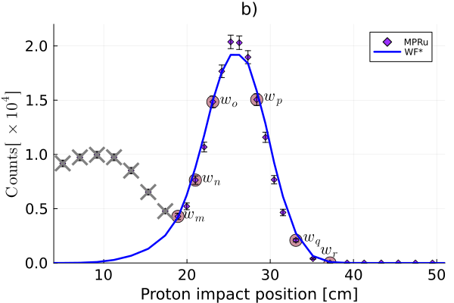
Scientific deliverables of 2025: JET shot #99971 (fusion energy record)
D NBIs shot into tritium rich plasma (~85% tritium), 28 MW NBI, 4 MW ICRF, lots of neutrons (record fusion production), excellent signal, strongly beam-target dominated
Vertical and oblique diamond detectors (deposited energy in diamond)
MPRu detector signal below 20 cm cannot be used
Inversion
TRANSP
Maslov et al. (2023) NF
Järleblad et al. (2025) NF

Slide 15
Scientific deliverable of 2025: 3-ion scheme ICRF tail at JET
D-D_{NBI}-³He 3-ion scheme in JET shot 95679
Significant increase in neutron rate, T_{e}, and W_{p} due to ICRF
Drive of TAEs, EAEs, RSAEs
NES by TOFOR and liquid scintillator detector, GRS by HpGe
First measurement of a tilted ICRF EP tail
Good match with TRANSP and theory
Without oblique view, the sign of the pitch goes wrong
Inversion
TRANSP
Nocente 2020 NF, Kazakov 2021 NF, Kazakov 2021 PoP, Dreval 2022 NF
Reman et al. (2025) NF

Slide 16
Scientific deliverables of 2025: Tilted and non-tilted ICRF tails at JET
3rd-harmonic ICRF heating at JET with a tail in vperp
3-ion scheme ICRF with a tilted tail
Inversion with collision prior and ICRF prior work best
Rud et al. (2025) NF

Slide 17
Scientific deliverables of 2025: TCV shot #65055
New collision physics prior applied in inversion at TCV
Works better than previous methods
Difficult inversion as there are only two FIDA views
Rud et al. (submitted) PPCF

Slide 18
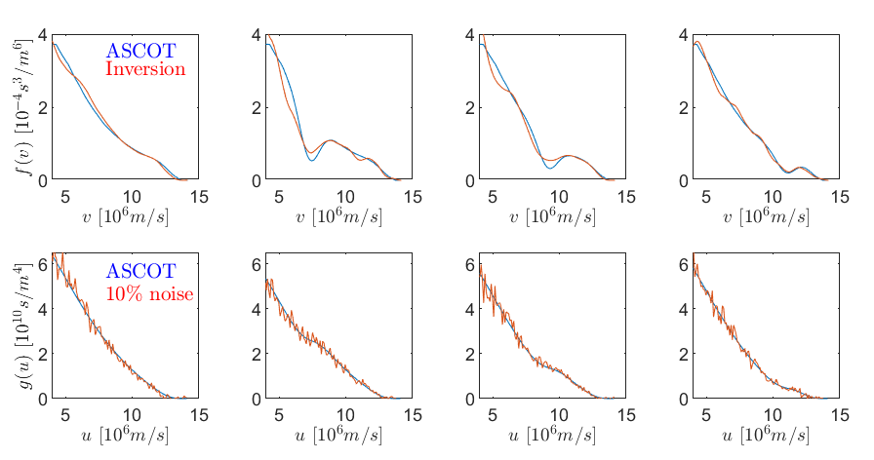
Scientific deliverables of 2025: 1D inversion
New formalism for 1D inversion based on single spectra, here for an alpha slowing-down distribution at ITER
Salewski et al. (2025) TMEP, to be submitted

Slide 19
Summary: Scientific deliverables of this project
2024 deliverables: 6 papers published
2025 deliverables: 3 papers published, 1 submitted, 1 in progress

