Slide 1

ENR-04-ENEA-03
irOn-based supeRconducting wIres for fusiON (ORION)
EUROfusion Science Meeting - EnR Final Report
Zoom, 2025/11/25
G. Celentano, on behalf of the ORION team

Slide 2
Outline
Background on Iron-Based Superconducting Powder in Tube Wires
The ORION project
Results and discussion
  progress on synthesis and materials
  progress on wires
Outcome and perspectives

Slide 3
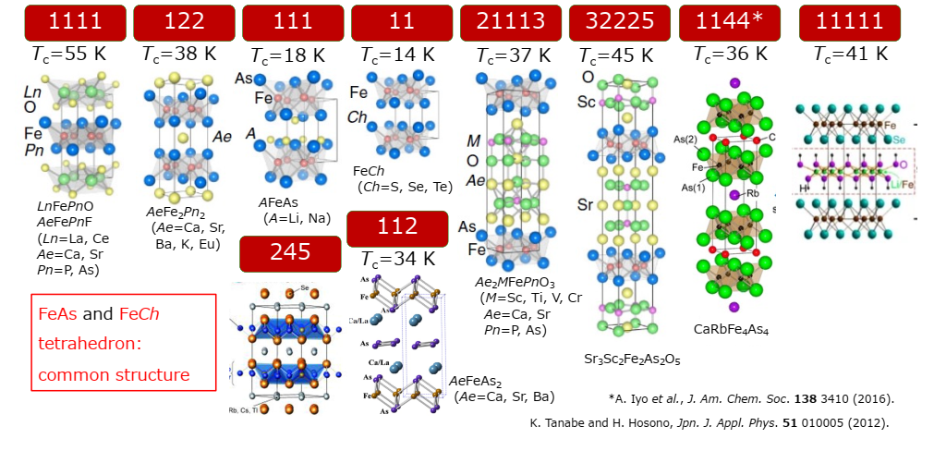
Iron Based Superconductors
There are several families of IBSC, named after their chemical composition

Slide 4
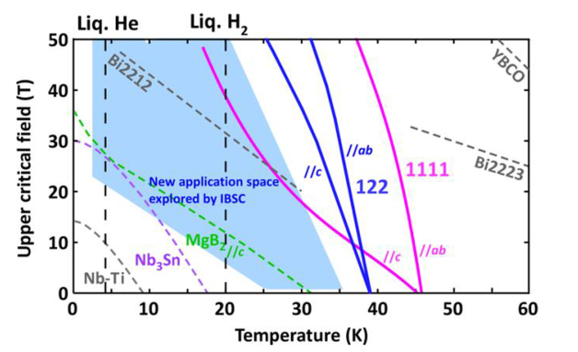
IBSCs range of applications
Compounds characterized by high critical fields at low temperature
Hosono, H., Yamamoto, A., Hiramatsu, H., & Ma, Y. (2018). Recent advances in iron-based superconductors toward applications. Materials Today, 21(3), 278–302. https://doi.org/10.1016/j.mattod.2017.09.006

Slide 5
IBSCs wires: Powder in Tube
Current state of the art
Ba/K-122 compound
Ag sheaths
10.1093/nsr/nwae122

Slide 6
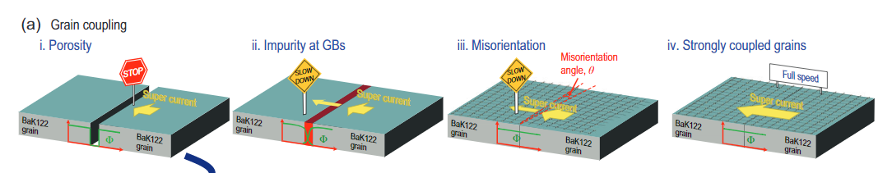
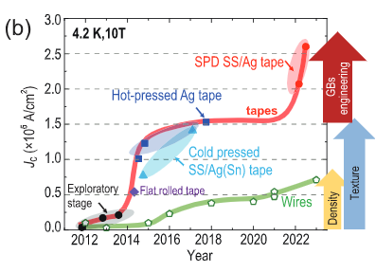
IBS Wires
Dong, C., Xu, Q., & Ma, Y. (2024). Towards high-field applications: high-performance, low-cost iron-based superconductors. National Science Review. https://doi.org/10.1093/nsr/nwae122

Slide 7



ORION - Participants
ENEA (Italy) - Superconductivity section and the “Materials and chemical-physical processes” laboratory
The SPIN Institute, part of the National Research Council (CNR).
The Microtomography Laboratory of the National Institute for Laser, Plasma and Radiation Physics (INFLPR), Bucharest, Romania,
The Center for Superconductivity, Spintronics and Surface Science (C4S) within the Technical University Cluj-Napoca (TUCN), of the Romanian EURATOM/MEdC Association
Roma Tre University, Department of Industrial, Electronic and Mechanical Engineering

Slide 8
Project aim
The general scientific objective is the fabrication of superconducting wires based on IBSCs materials, with the production of short samples characterized by high critical currents (i.e. J_{c} ~ 10⁵A/cm² @ 10 T).
To approach the goal, several aspects have been addressed, namely:
Optimization of the superconducting material properties and synthesis procedures devoted to the fabrication of wires through the PIT method
Development of composite sheaths compatible with the mechanical and thermal processes in view of the applications in fusion machines.
Implementation of microtomography techniques on IBSC wires to investigate their microstructure

Slide 9
Project aim (2)
Development of opportune mechanical and thermal processes aimed to enhance the performance of isotropic wires reducing the need for high pressure thermal treatments.
Evaluation of the wires homogeneity by means of transport measurements on samples of representative lengths (i.e. 1m) through the adoption of appropriate solutions (i.e. ITER barrels).
Technological advancement aimed in perspective of the development of multifilamentary wires.

Slide 10
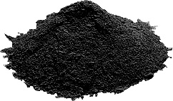
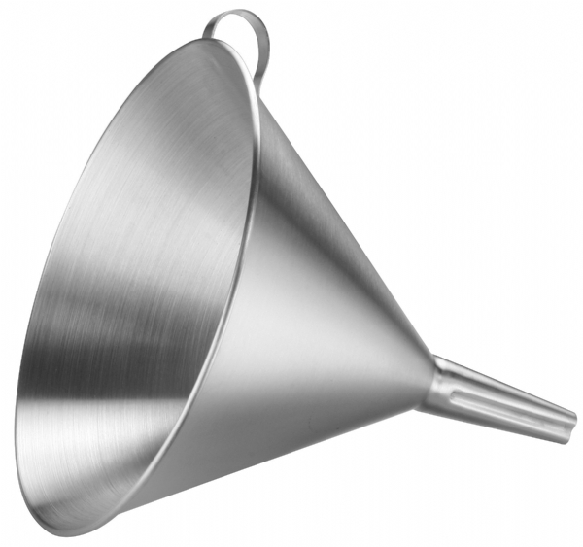


122 Ag wires (1)
The PIT technique
Groove rolling – Drawing – Groove rolling
Already used to realize denser $BiSCCO(2212)$wires
Performed in inert atmosphere @ ambient pressure
Ba-122
powder
Groove-rolling
Metallic
Tube
Flat rolling
Heat treatment
Tube Filling
Down to $400 um$
Drawing

Slide 11
122 Synthesis & optimization
Elements (Ba, K, Fe, As) are mixed with a planetary ball mill (low energy)
Powders are inserted in a Nb crucible, mechanically sealed
Nb crucible is inserted in a steel crucible that is welded
Heat treatment = 850 °C for 20 h
Spoler: Different granulometry influence the performance
Powder composition, synthesis process and thermal treatment optimized to obtain the best powder morphology

Slide 12
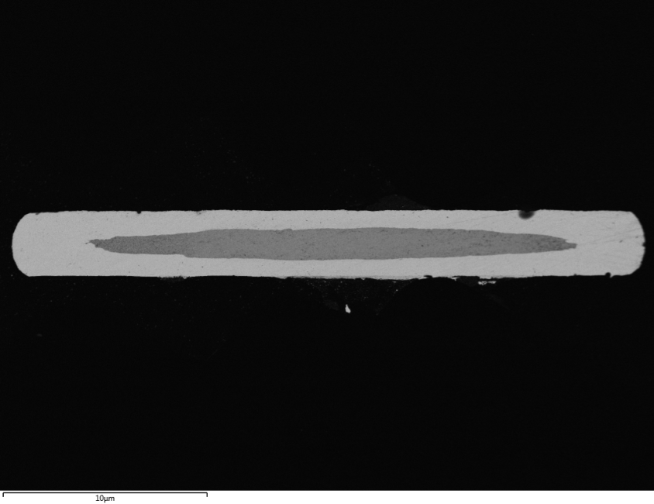
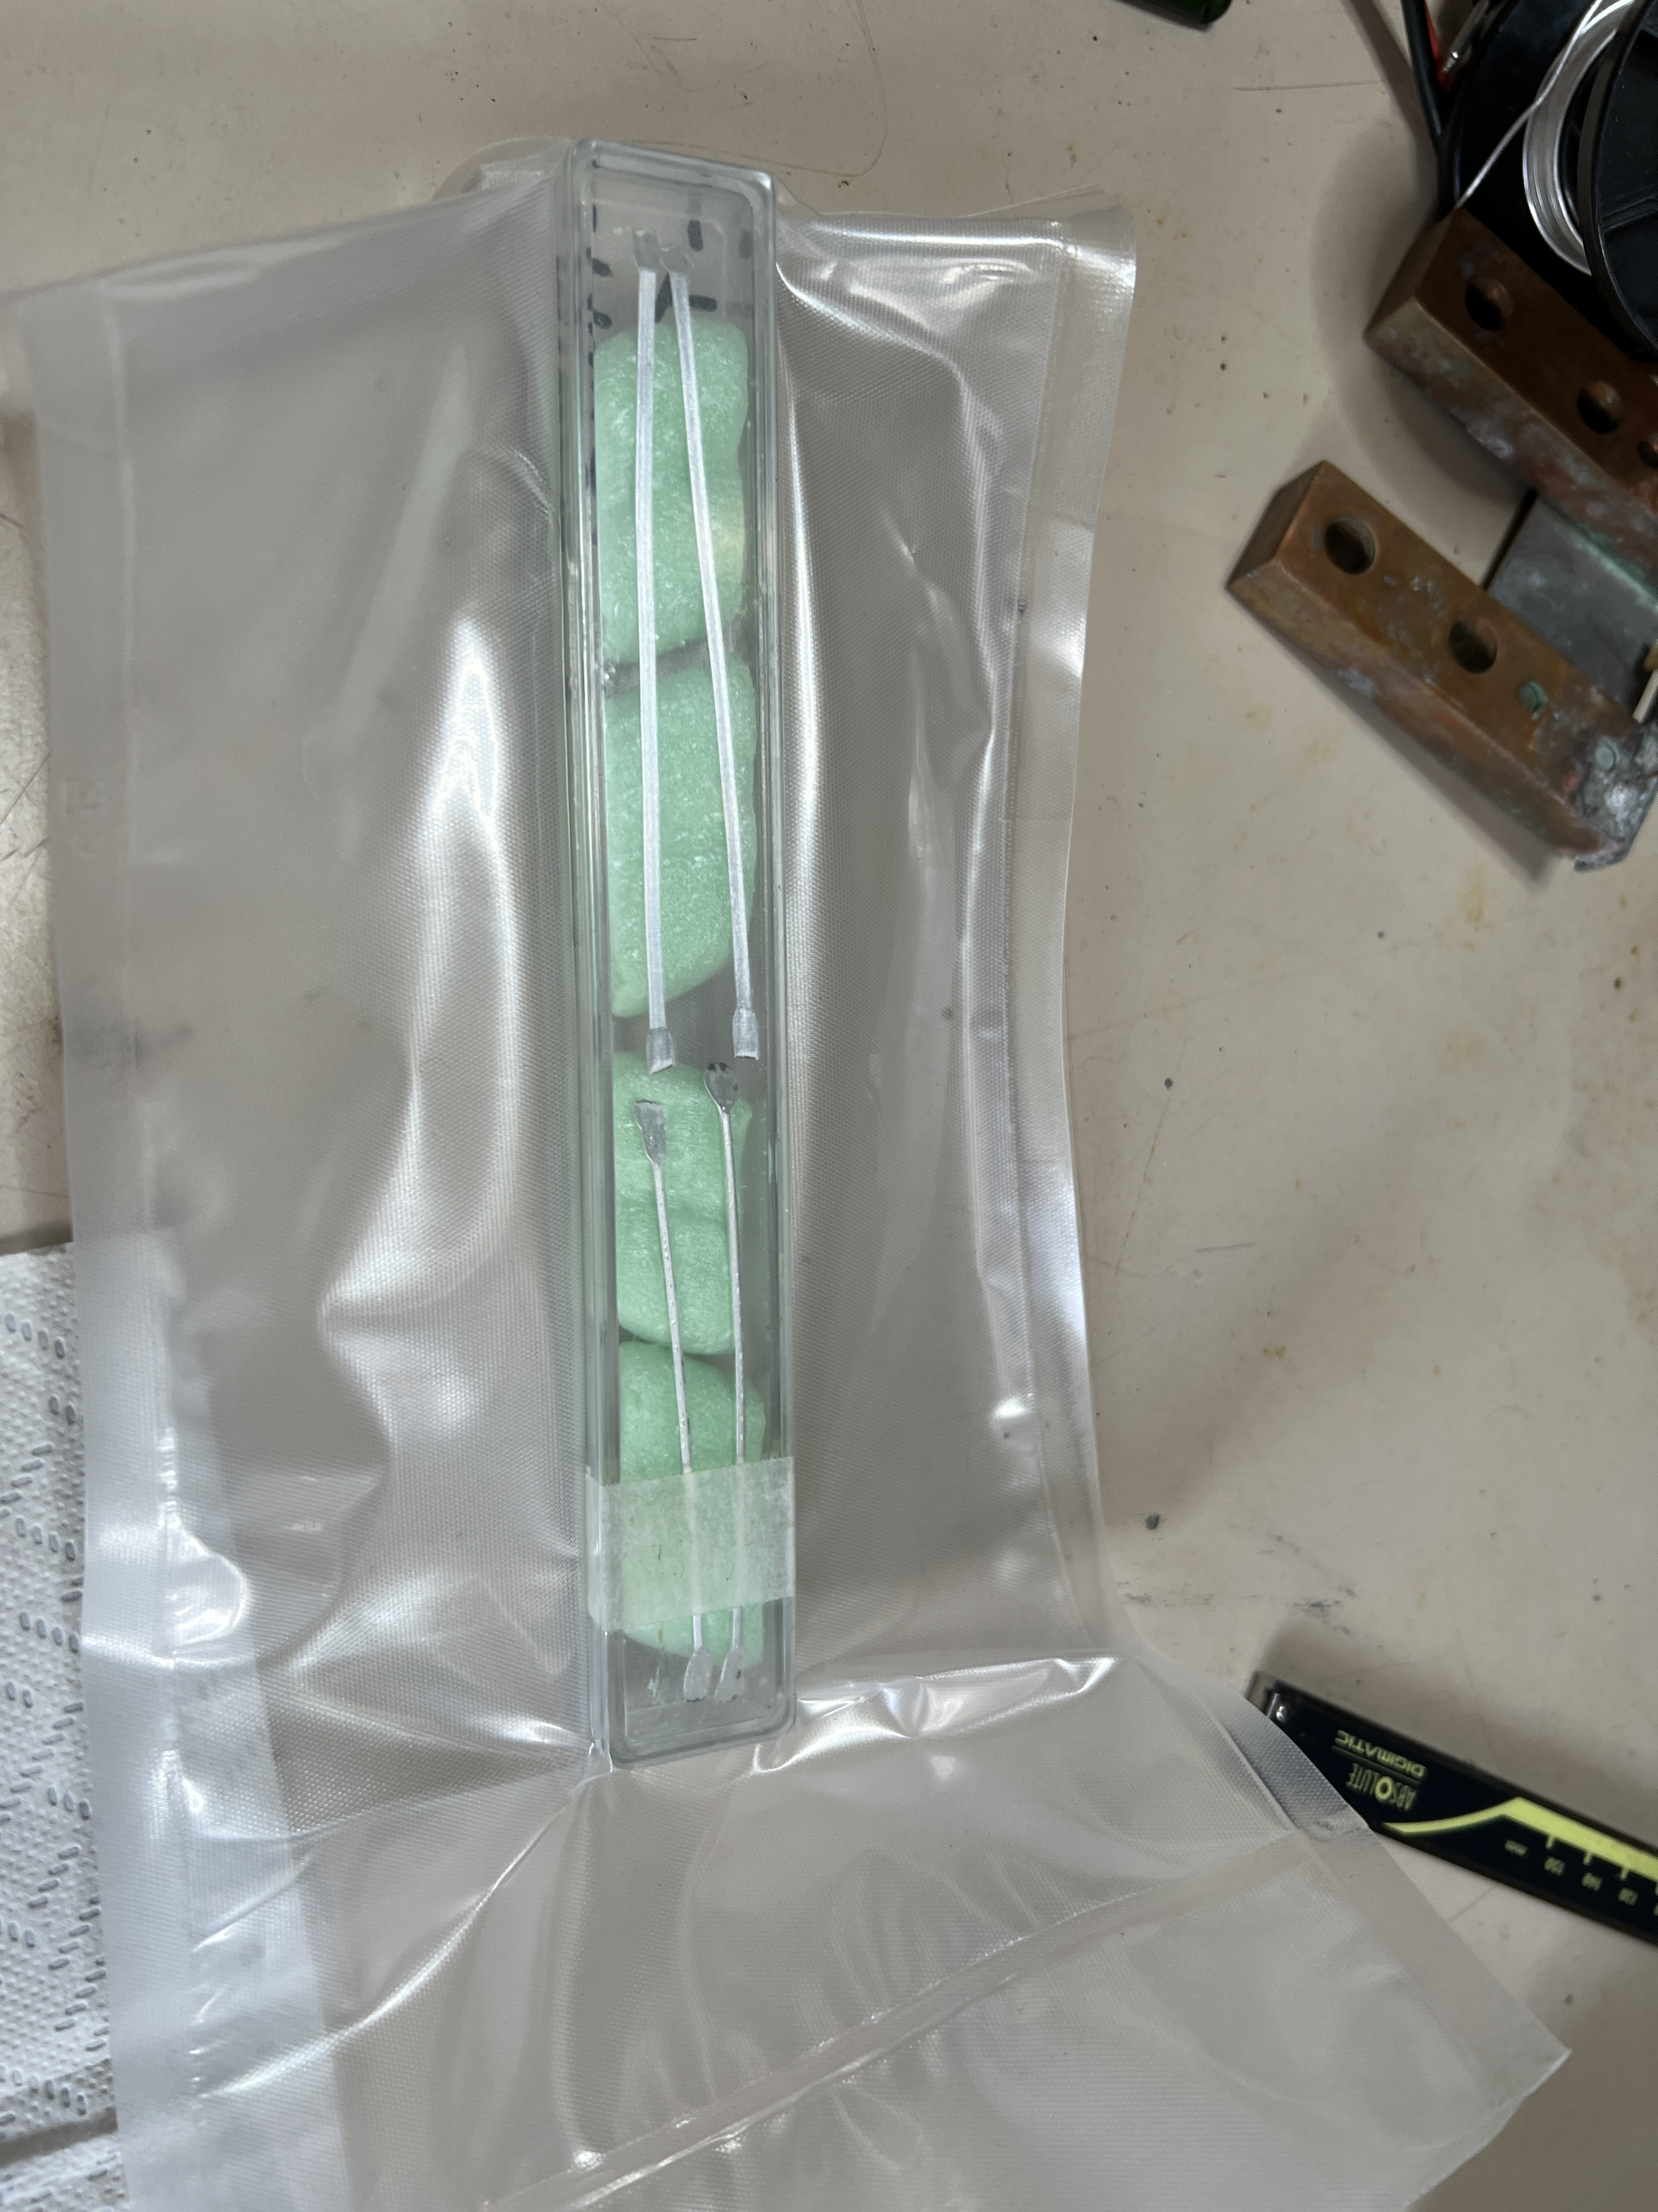
122 Ag wires (2)
1mm
Micro-tomography as powerfool tool to investigate structure of the wires and defects

Slide 13
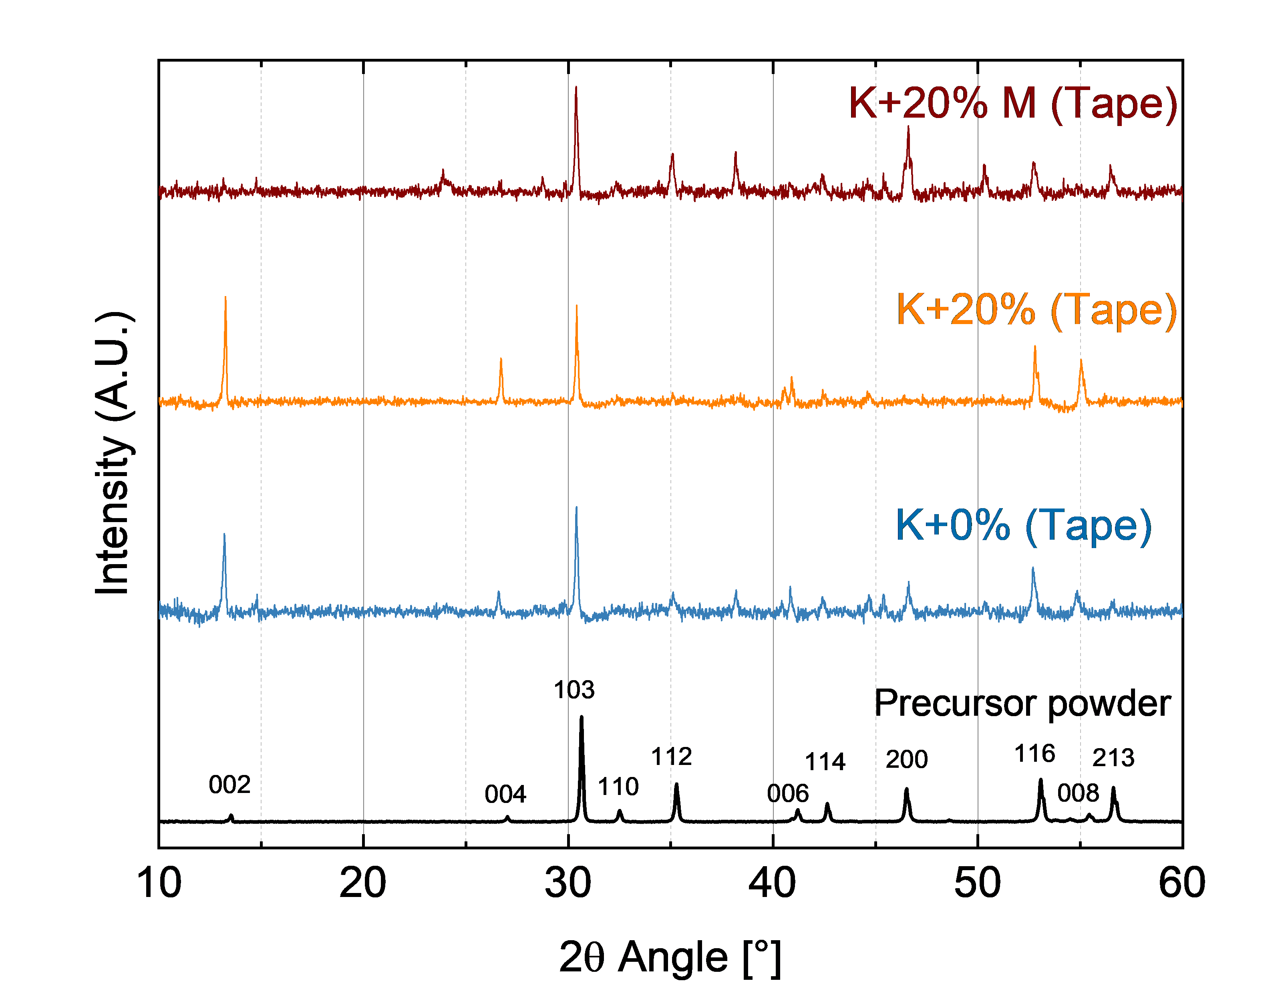
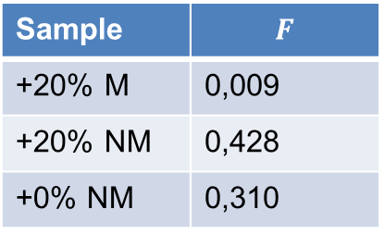
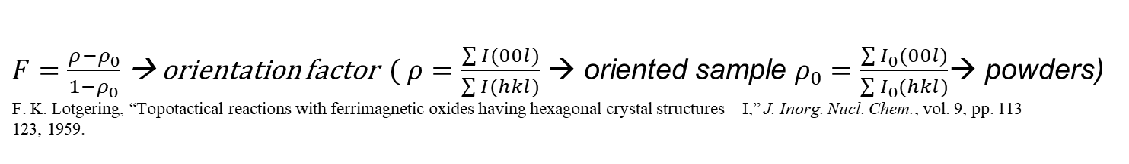
122 Ag wires (3)
$F=\frac{ρ−ρ_{0}}{1−ρ_{0}}$ → orientation factor ($ρ=\frac{\sum{I(00l)}}{\sum{I(hkl)}}$ → oriented sample $ρ_{0}=\frac{\sum{I_{0}(00l)}}{\sum{I_{0}(hkl)}}$→ powders)
F. K. Lotgering, “Topotactical reactions with ferrimagnetic oxides having hexagonal crystal structures—I,” J. Inorg. Nucl. Chem., vol. 9, pp. 113–
123, 1959.
Larger grains PITs are characterized by higher texture and higher Jc
Sample | $$F$$
+20% M | 0,009
+20% NM | 0,428
+0% NM | 0,310

Slide 14
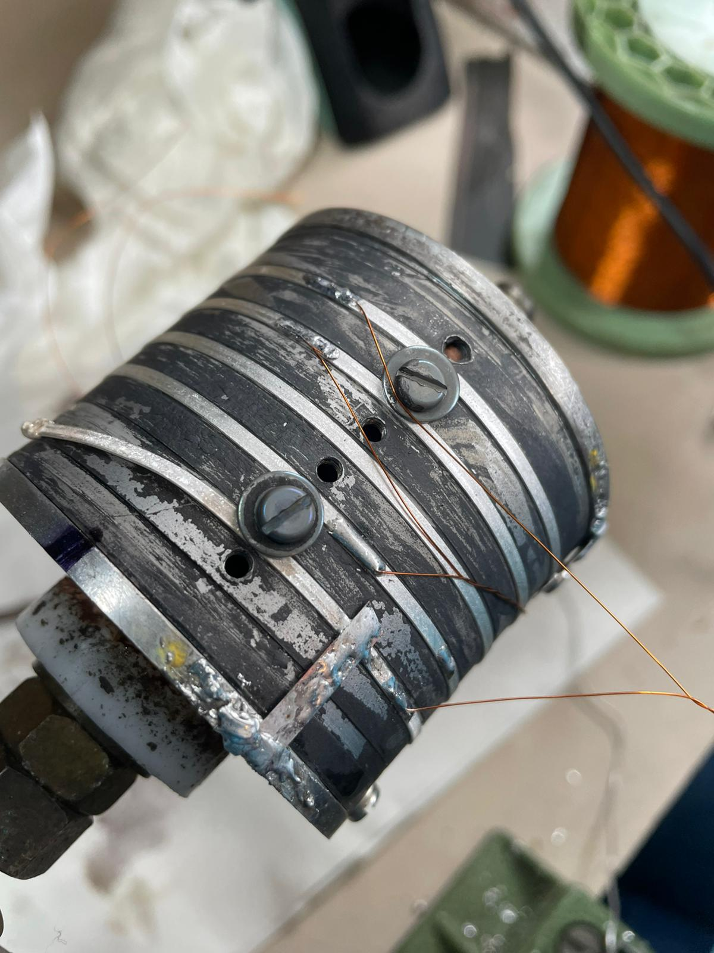
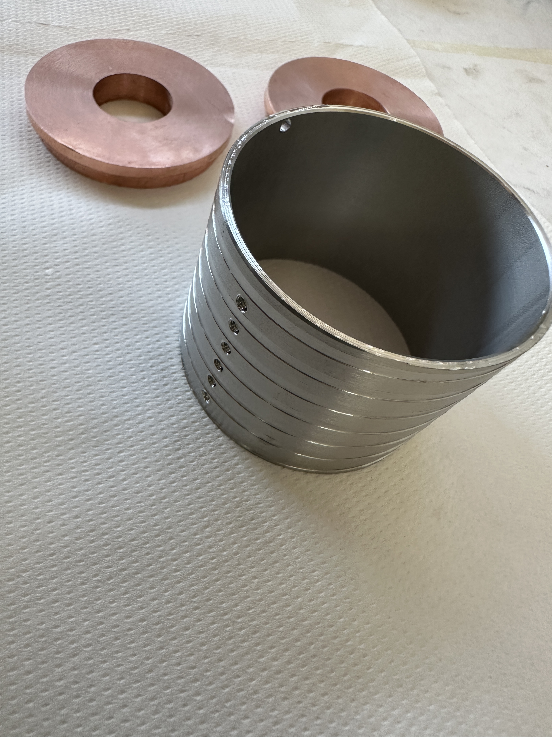
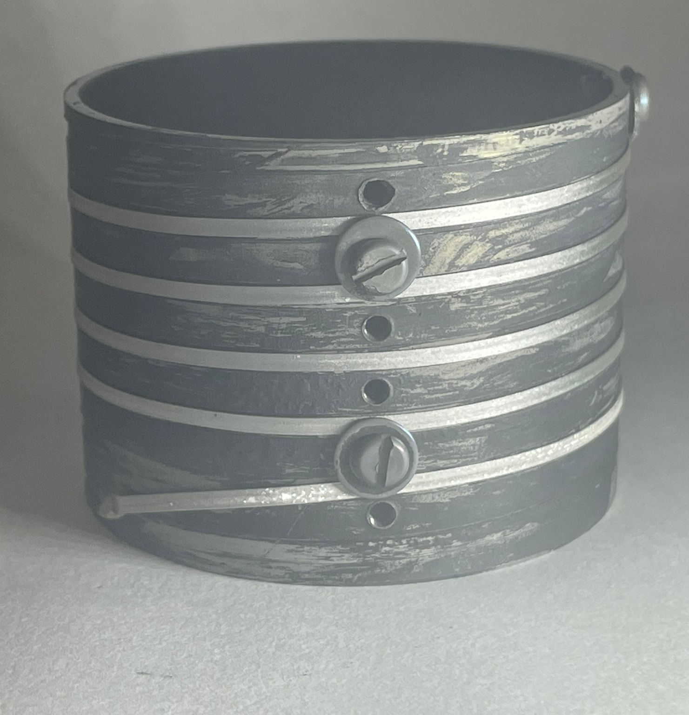
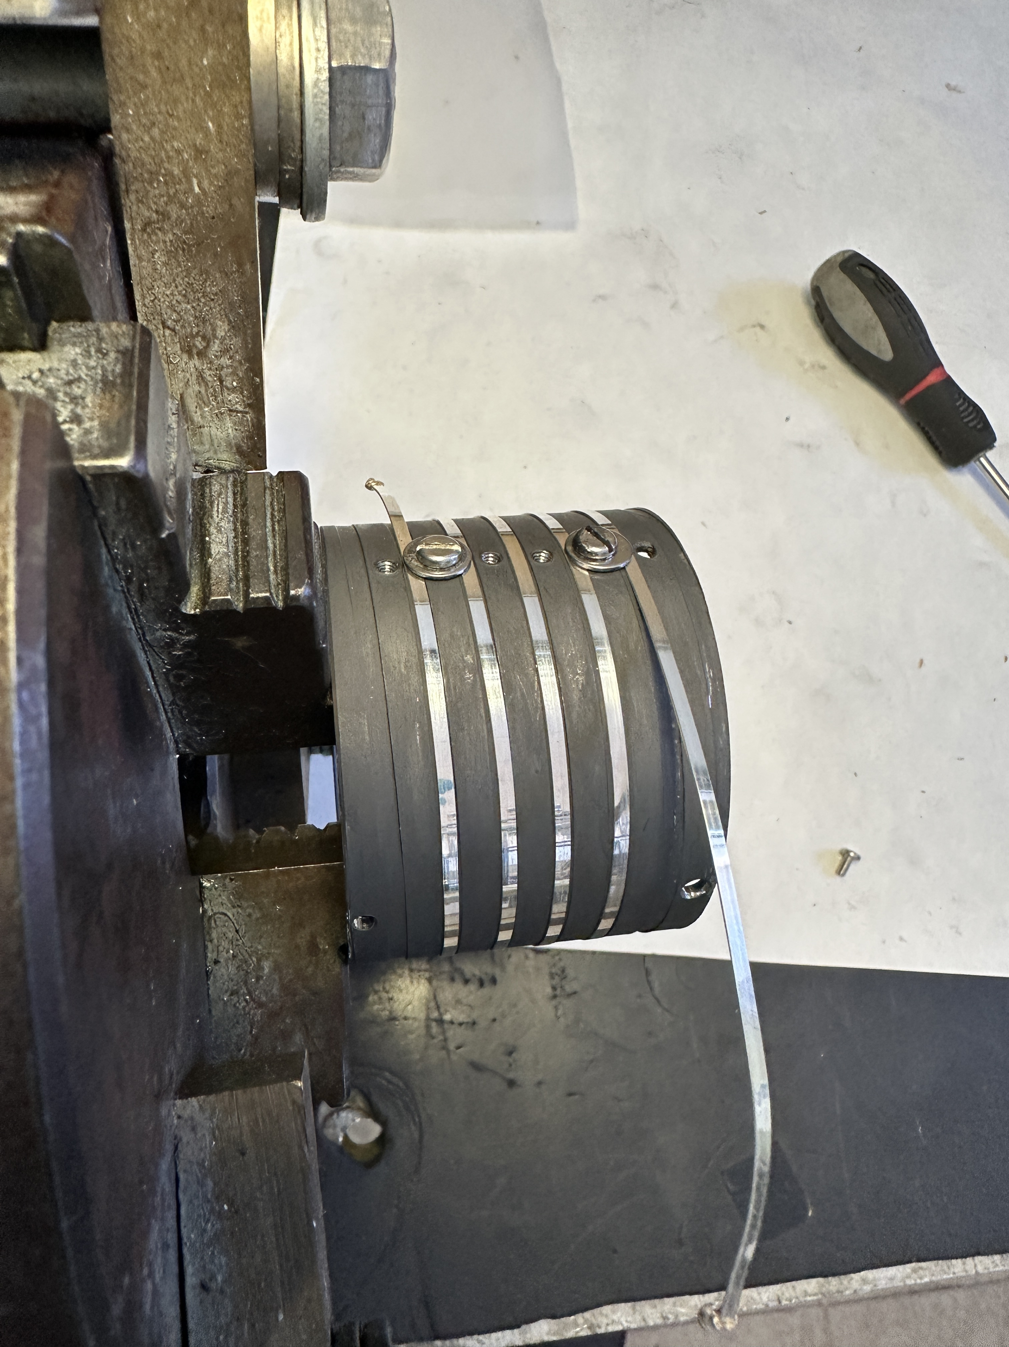
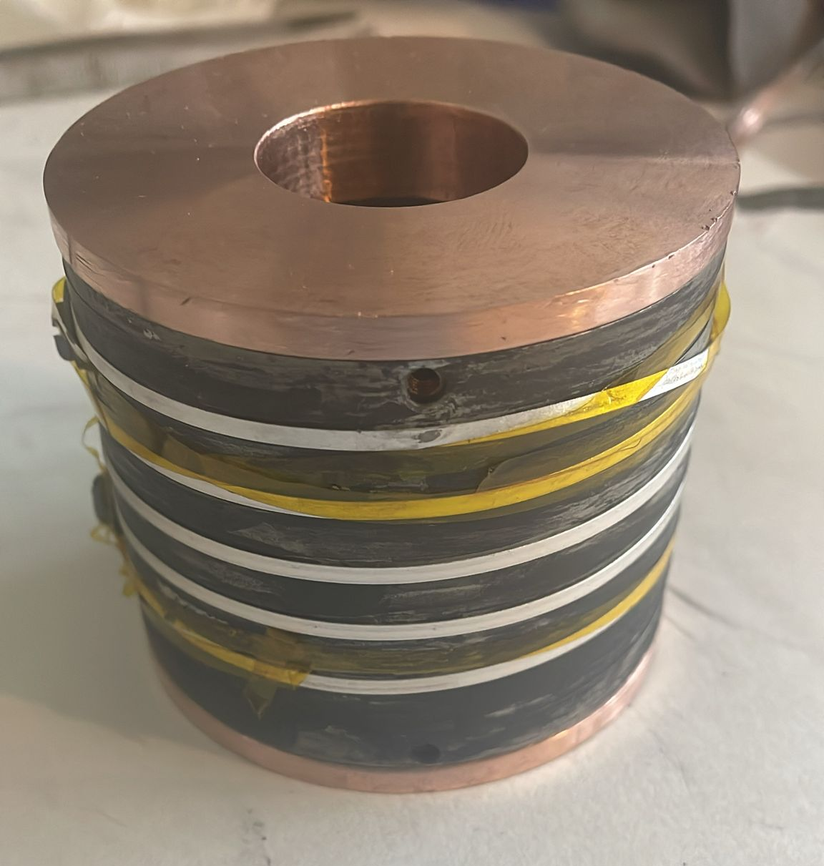
122 Ag wires (4)
Measurements carried out on long (~1m) sample
Barrel production
I and V connections
Thermal treatment
Coil on graphite
Several critical aspects:
Silver reaction with Cu and its alloys (steel support)
High fragility
Low tolerance to bending (large diameters ~ 6.3 cm)
Fine control of temperature needed
Mounting test

Slide 15
122 Ag wires performance
The long sample shows an intricate behaviour, with a portion in line with short samples and a degraded zone
Further analysis current ongoing to correlate the performance with defects

Slide 16
1144 Synthesis & optimization
Elements (Ca, K, Fe, As) are mixed with a mixer ball mill (high energy)
Powders are pelletized and inserted in an inert crucible inside a steel tube, mechanically sealed
Heat treatment = 800 °C for 10 h
The HEBM step promotes the nucleation of the phase, and nanostructured crystals are obtained in this way.
Good for pinning (eventually?)
Not good for texturing

Slide 17
1144 Synthesis & optimization (2)
A modified synthesis approach was adopted, limiting the milling energy (allowed by tailoring the precursors choice)

Slide 18
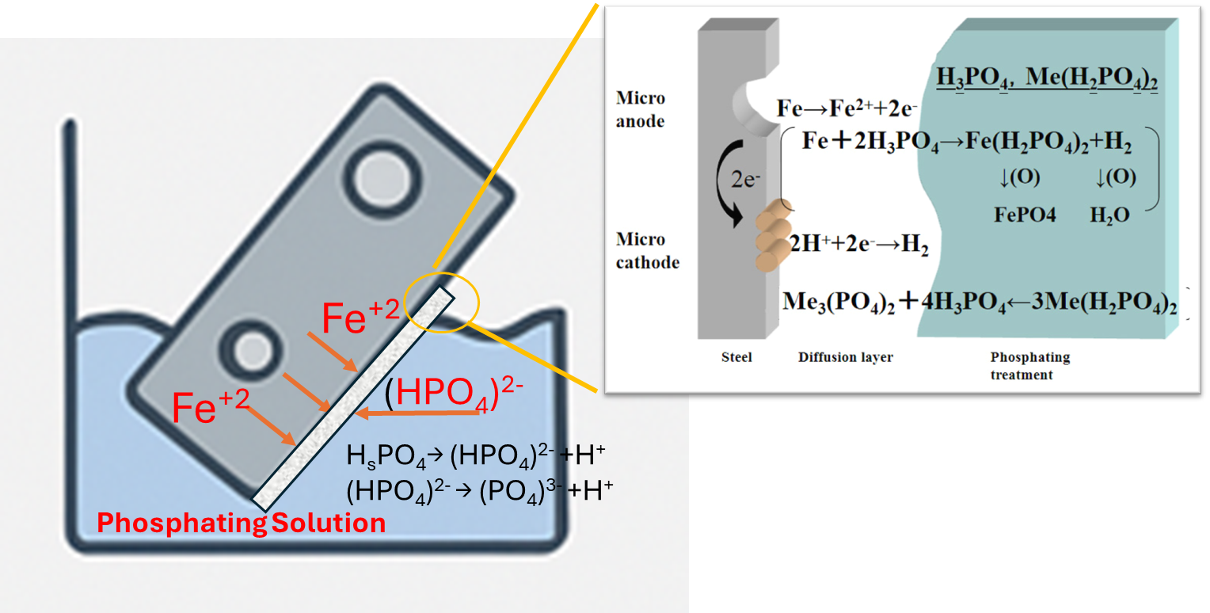
Reactors chemical compatibility
Phospate coating of the steel reactor is used to reduce reactivity of volatile elements during the synthesis
Under testing for high temperature reactions
good adhesion to metallic surfaces and the properties of the conversion layer;
compatibility with various metals
good thermal stability ~ 1050ºC

Slide 19
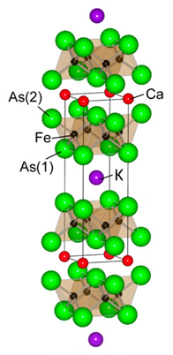
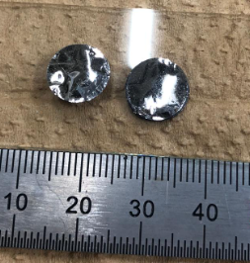
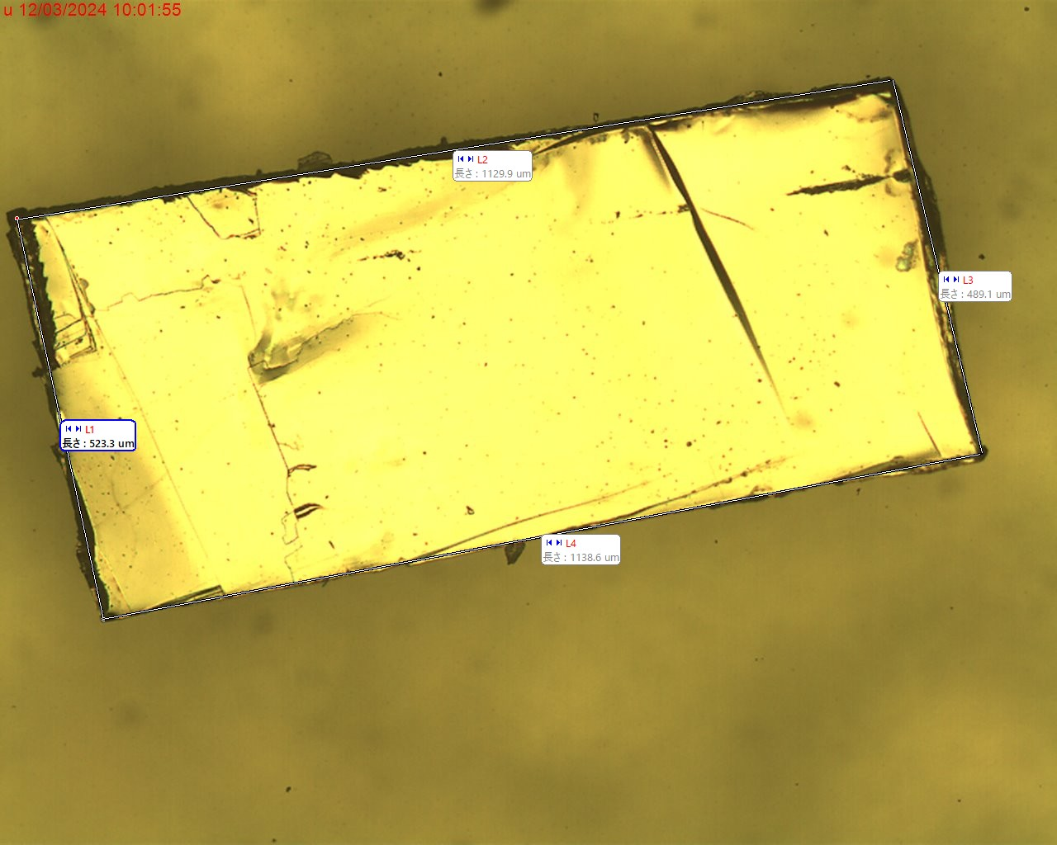
Focusing on the 1144 material
CaKFe₄As₄
(stoichiometric)
Na, La and Pr
replacing Ca
Crystal growth from the flux method.
Substituted on Ca or K site
Substituted on Fe site
Ba, Sr
replacing K
1144 compounds are relatively new, and recently it has been demonstrated the possibility to tune their chemical composition retaining the structure (that is related to defects that generate an intricated pinning landscape)

Slide 20
Focusing on the 1144 material
CaKFe₄As₄
(stoichiometric)
100K
298K
Na, La and Pr
replacing Ca
Kawashima. et al, Journal of Physics: Conference Series.
Pr-doping
La-doping
Usman, M. et al (2023) Chemistry of Materials.
Ba, Sr
replacing K
Single crystals
Powders
Duchenko. A. et al IEEE Transactions on Applied Superconductivity,
The substitution influences the critical temperature with a relation with structure

Slide 21
Focusing on the 1144 material (2)
5K and 20K
at H//c Self field
Critical current is affected as well with good improvements at low temperature and high field
5K and 20K
at H//c 15 T

Slide 22
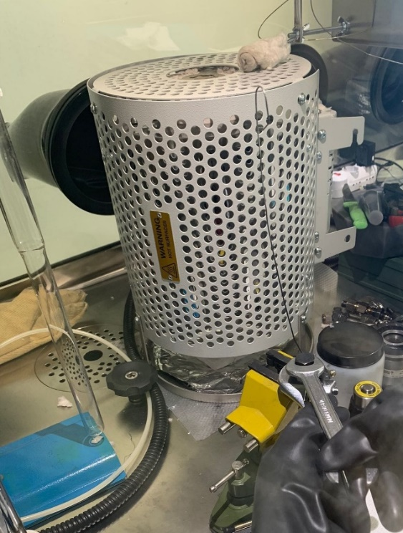
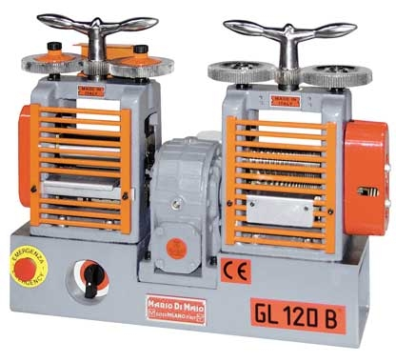
1144 PIT production
Typical process for 1144 wires
1144 inserted in a Ta tubes or foils (no Ag due to Ca reactivity)
Groove rolling + thermal treatment in a sealed reactor on small ( ≈ 1-3 cm) pieces
powders
Ta tube
Copper
Ta
Copper
Ca/K1144
Top view

Slide 23
Adoption of Ta tube
Section reduction ~ 1/35
800°C
900°C
No evidence of element interdiffusion
3
2
1
2
3
1

Slide 24
First multifilamentary approach
Section reduction ~ 1/140
4 wires inserted in a copper tube and groove rolled
Thermal treatment at 800 °C, 1h
Critical current are not much improved with respect to bulk samples (no texturing)

Slide 25
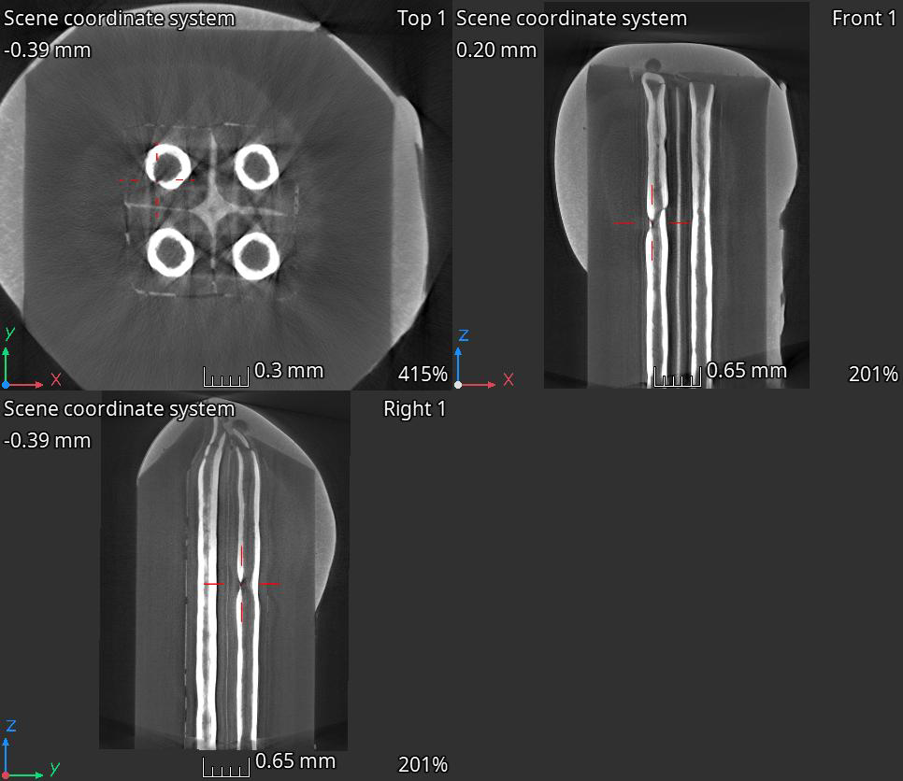
Ta fragility issues
Interaction with the hard powder or inhomogeneous stress most likely leads to thinning of Ta, eventually leading to ruptures

Slide 26
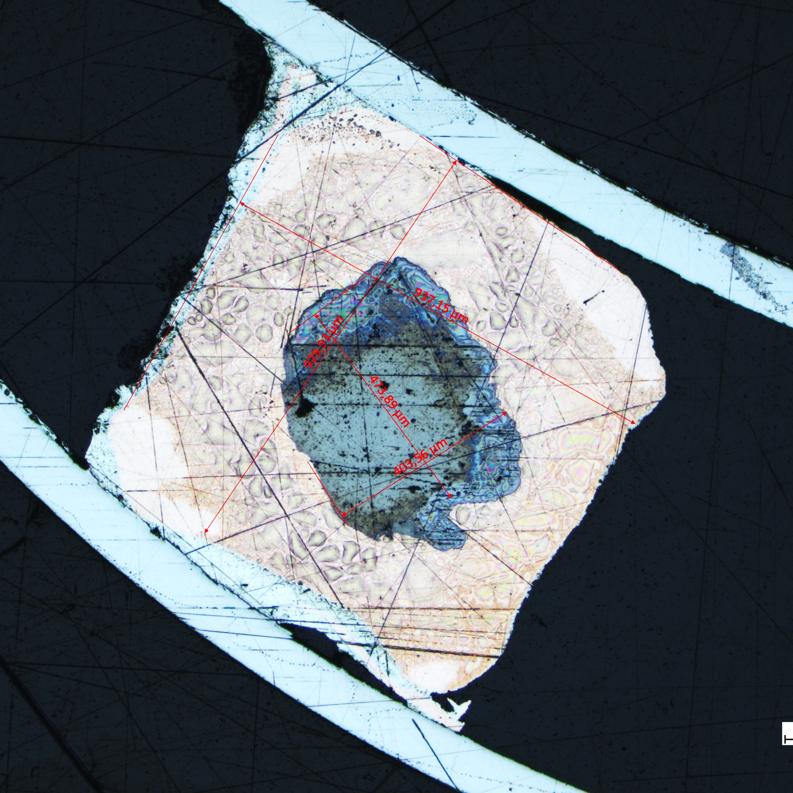
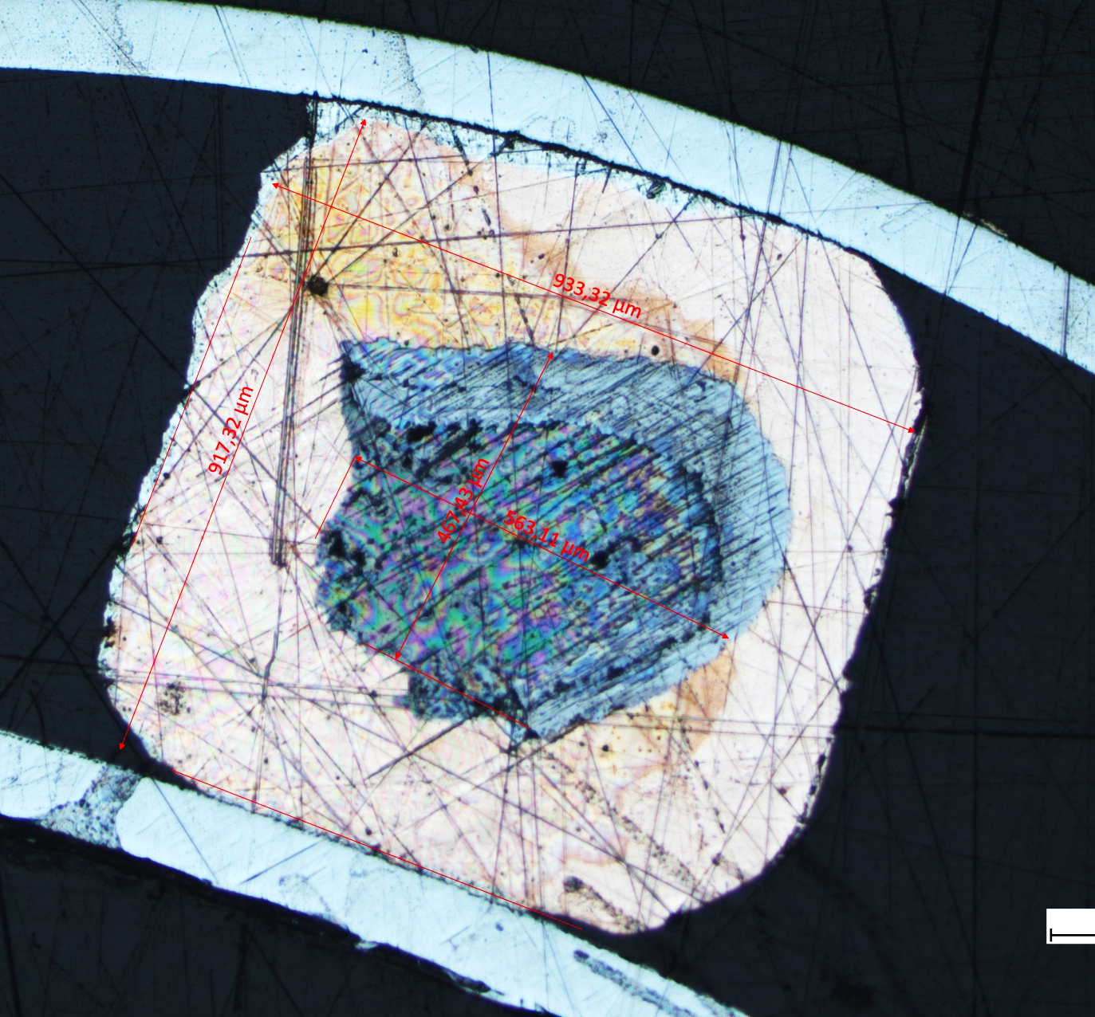
Alloy tuning
Alloying Ta with W can enhance its mechanical properties
TaW
Further groove rolling
2mmX2mm → 0.9mm x 0.9mm
Higher deformation produces an uneven and catastrofic deformation of the Ta or TaW foil, similar for the different alloys
Ta

Slide 27
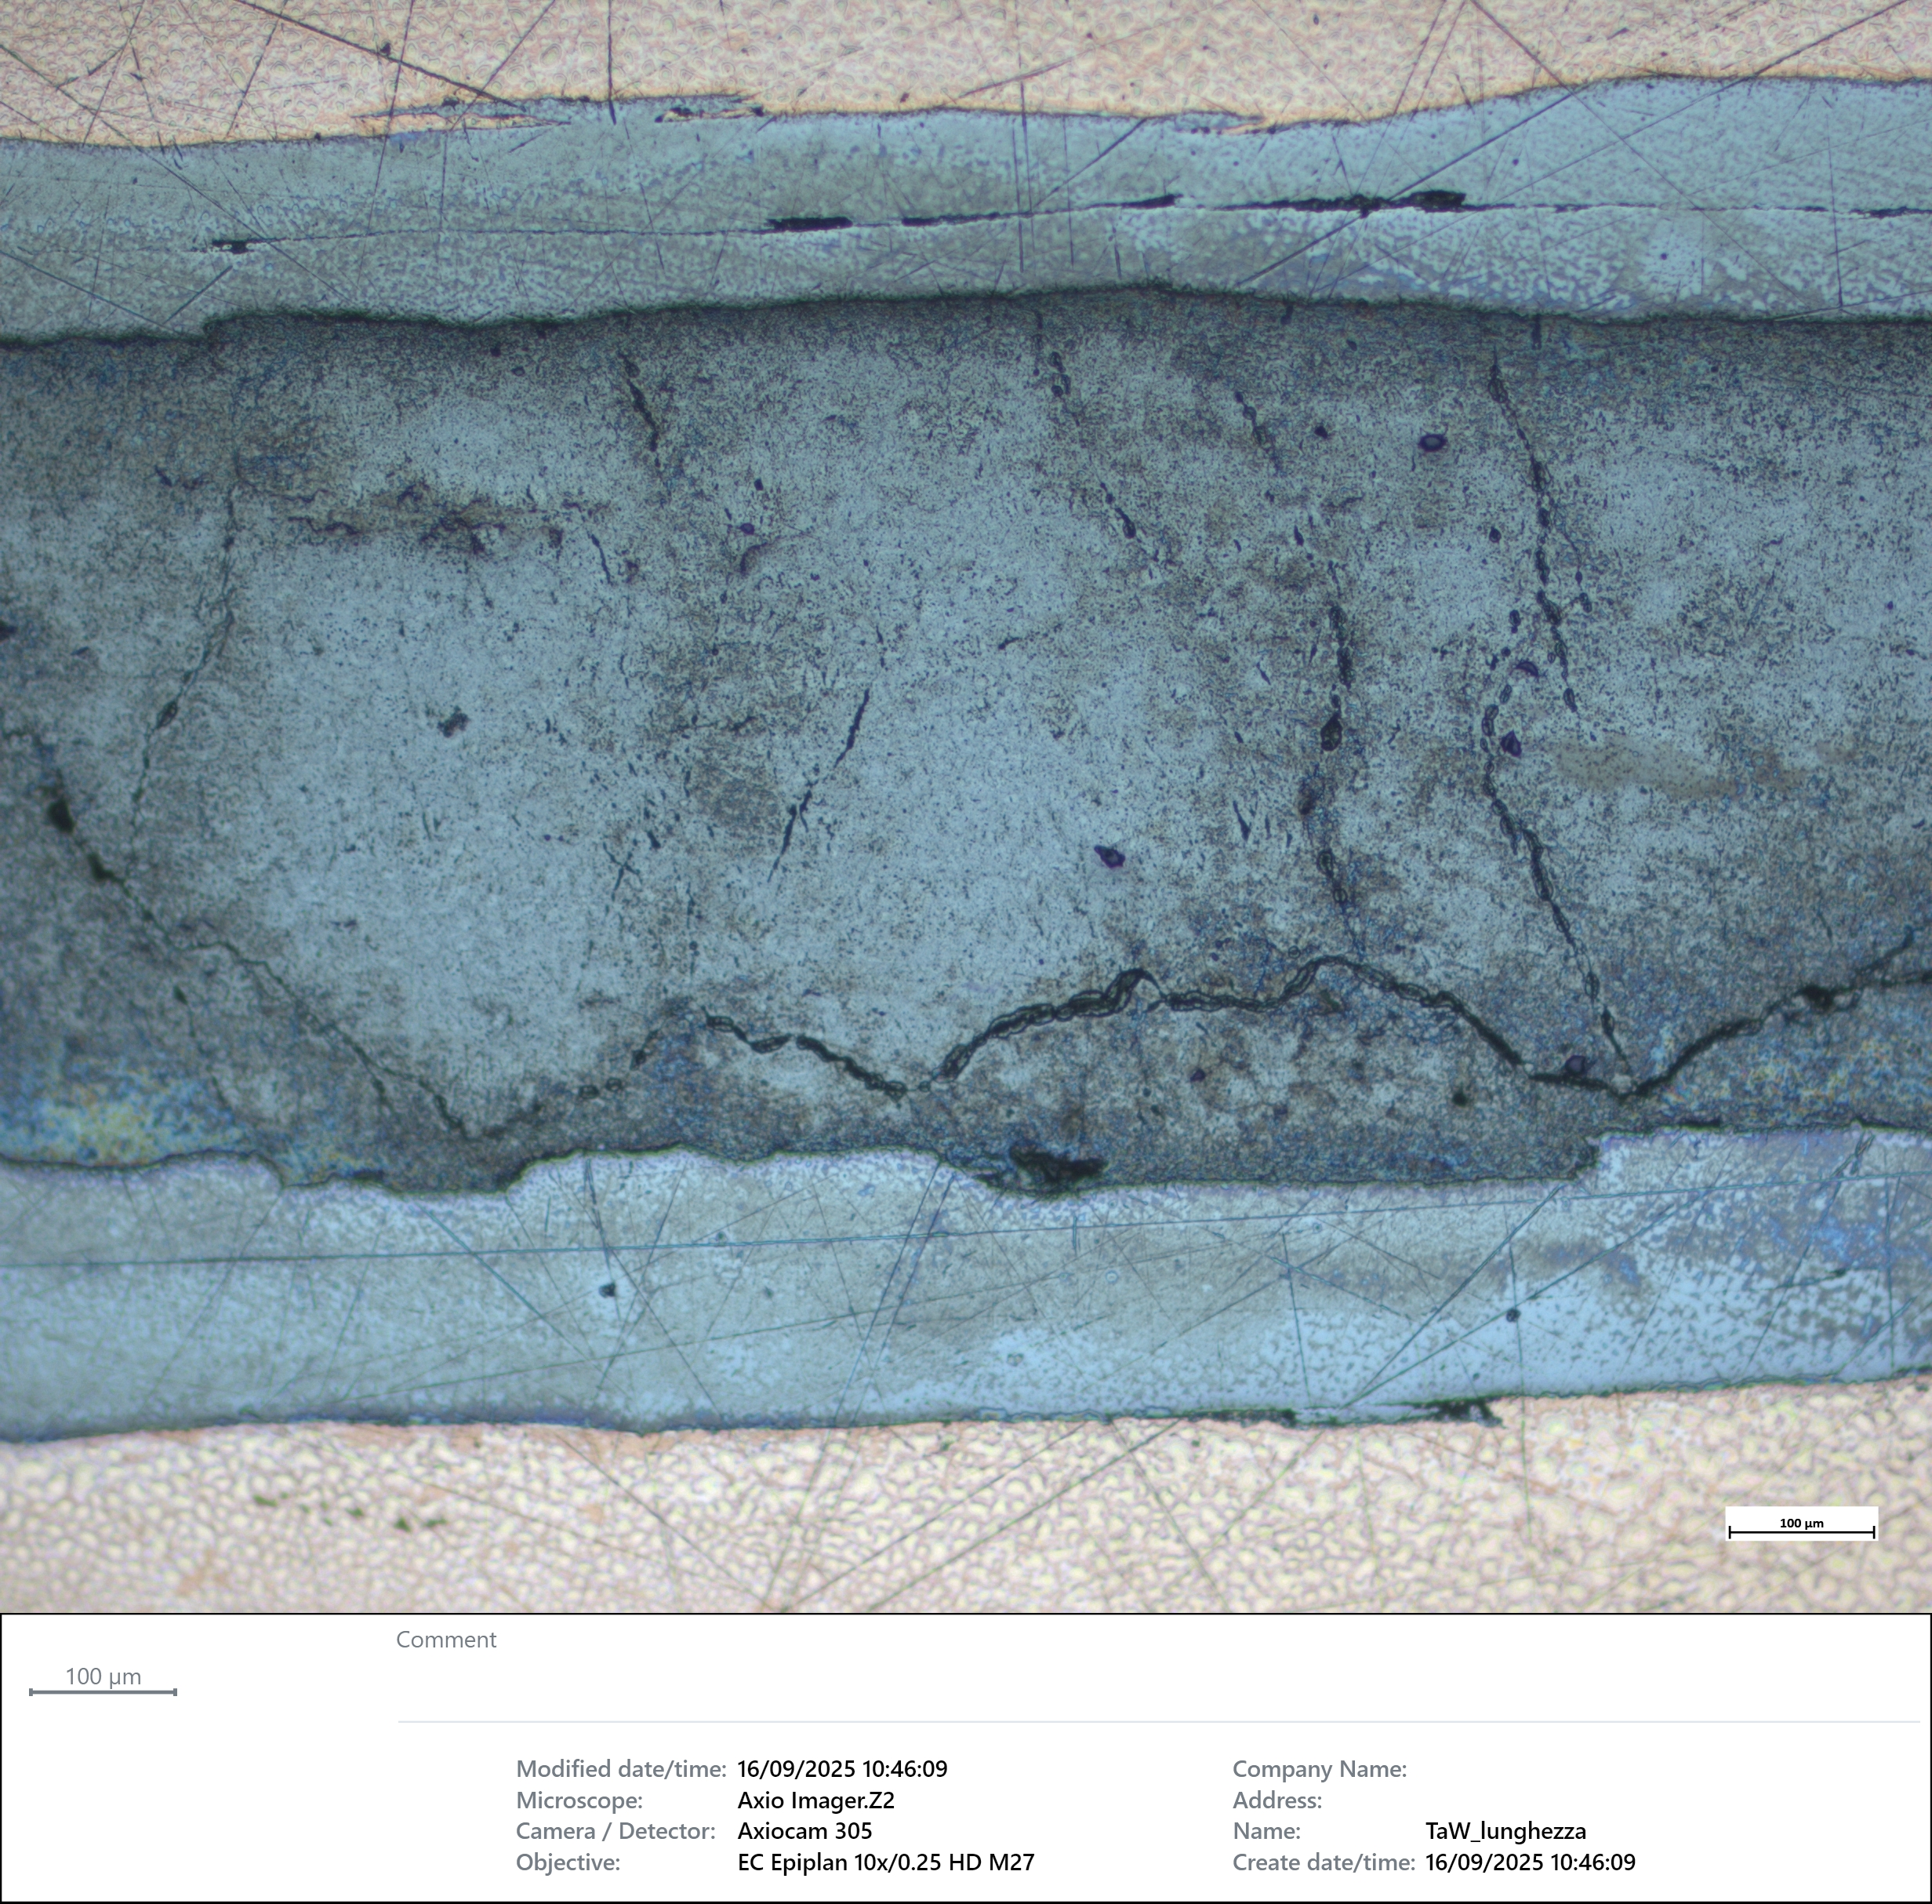
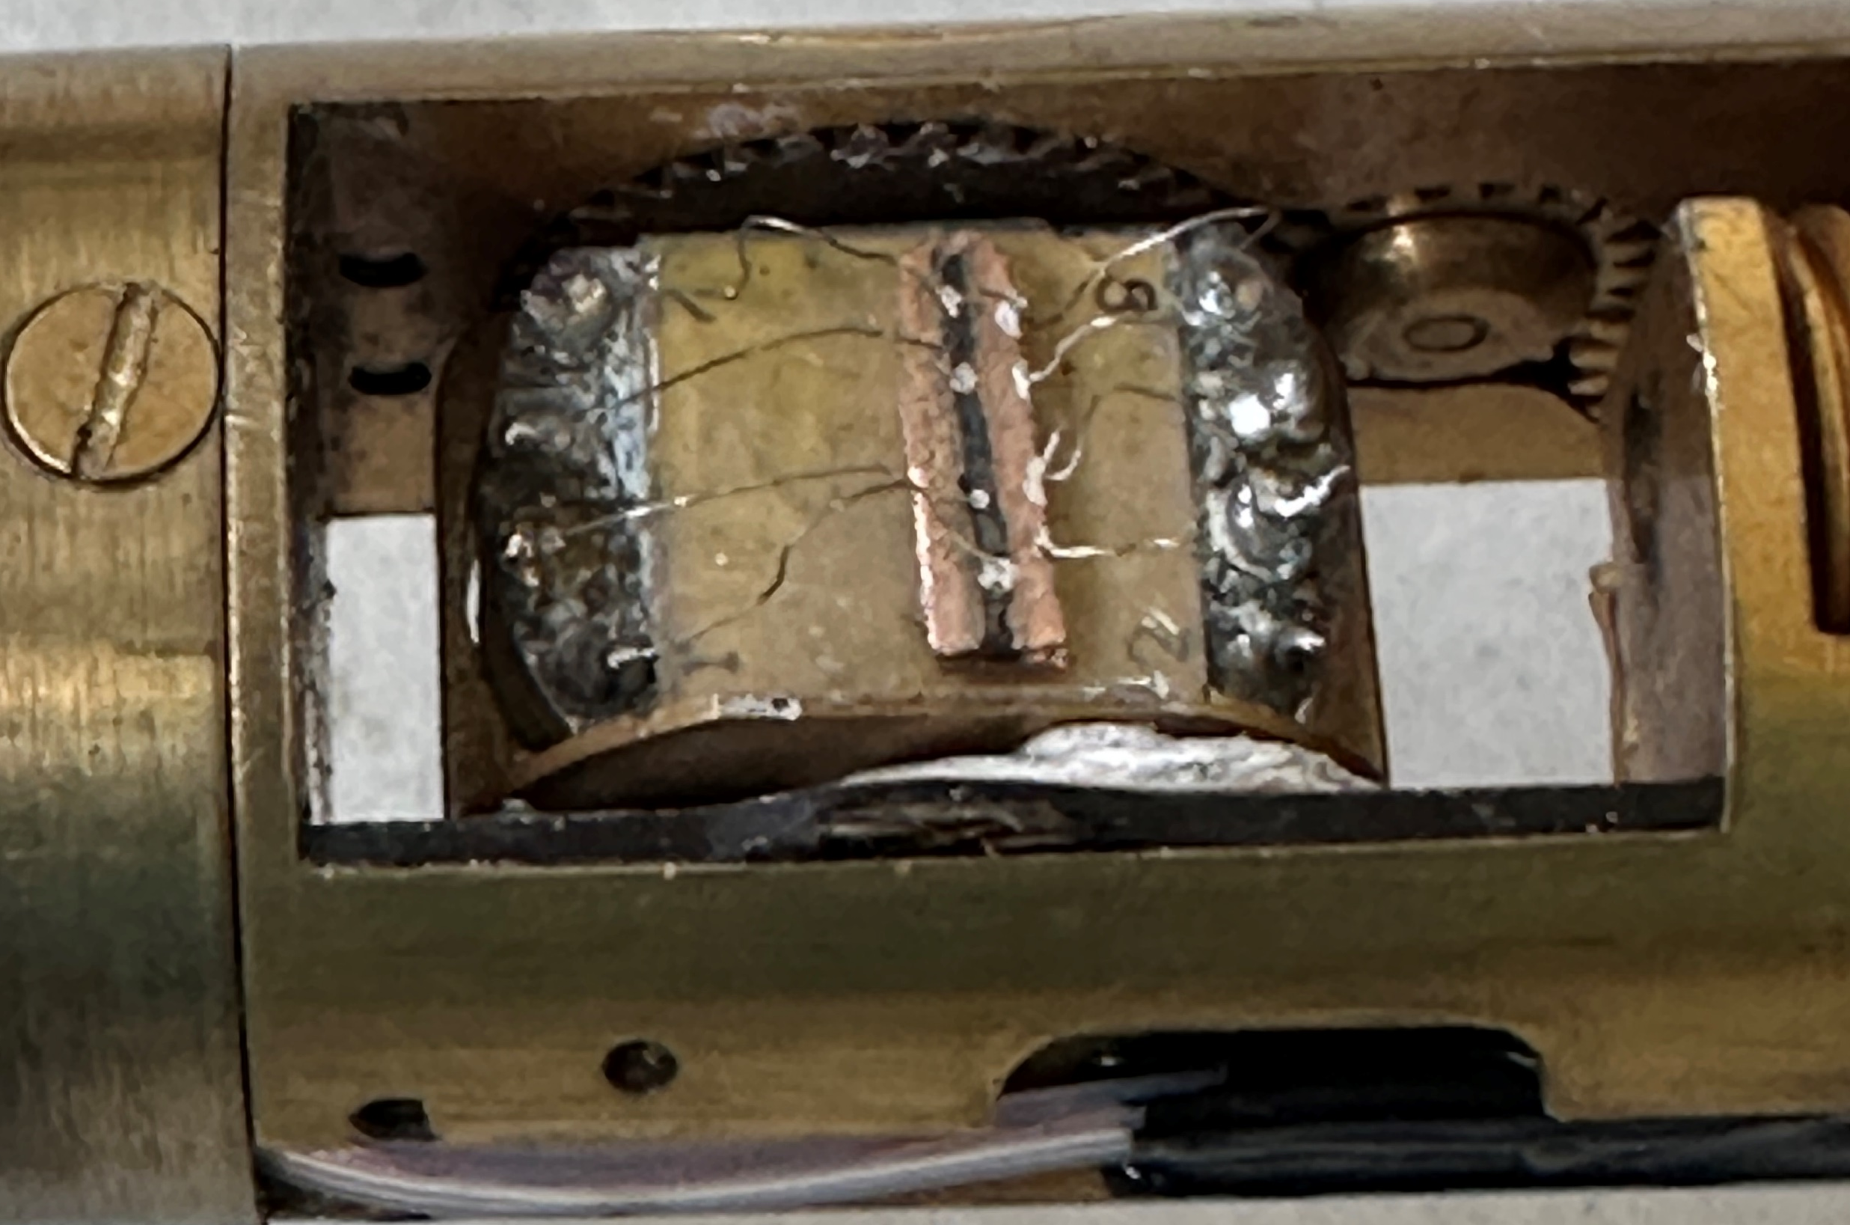
Crucial issue: current transfer
Approx. Ta (alloy) thickness 160 µm
Tens of µΩ at low temperature for 5-10mm long samples
Factor of 100 between Cu and inter-element resistance

Slide 28
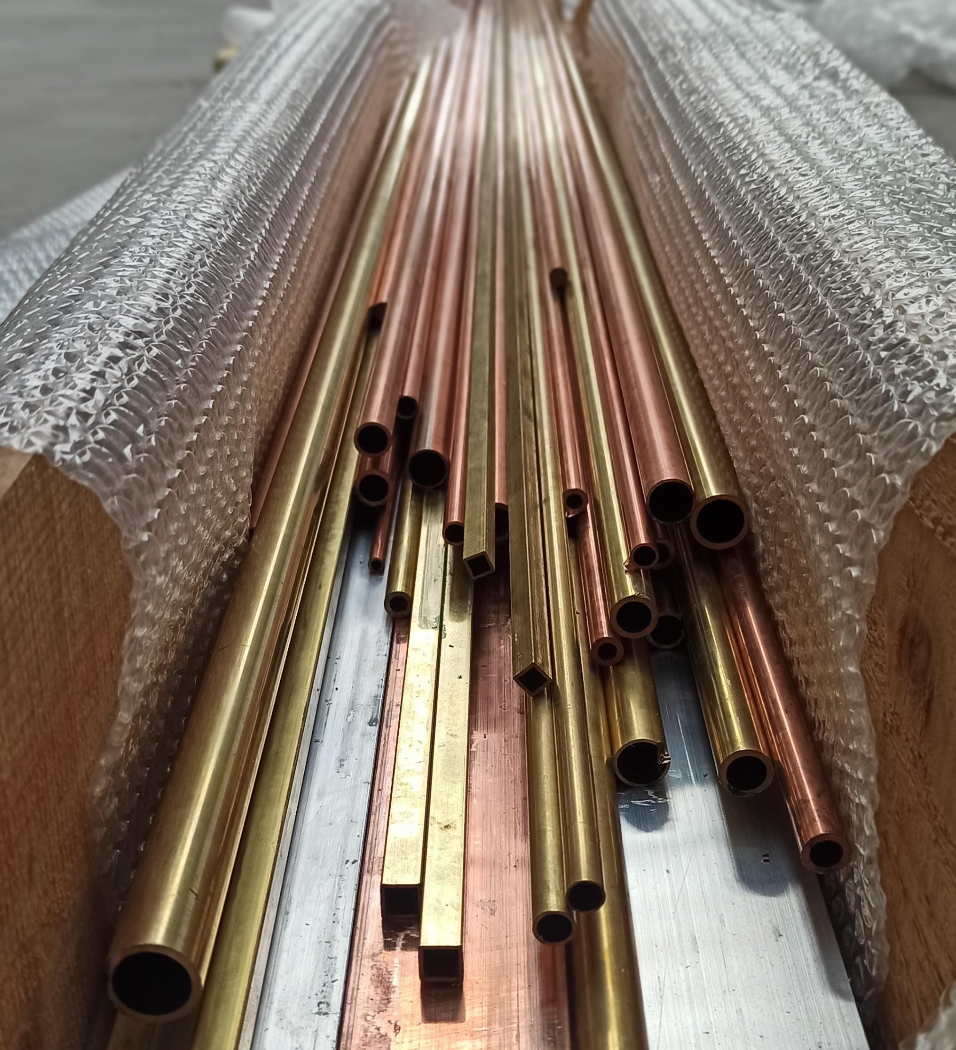
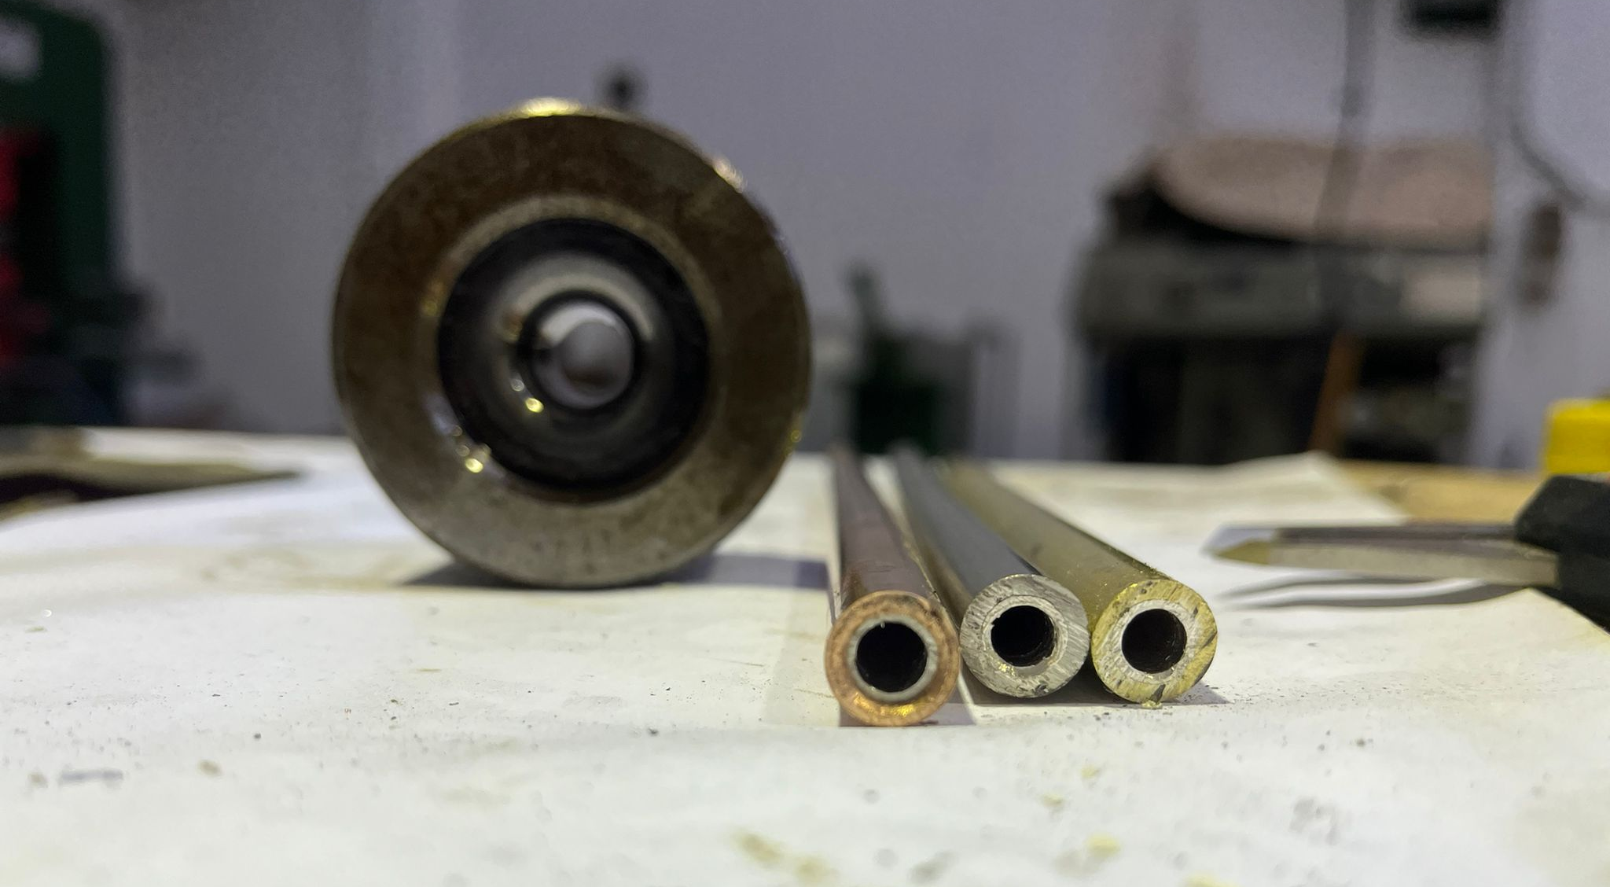
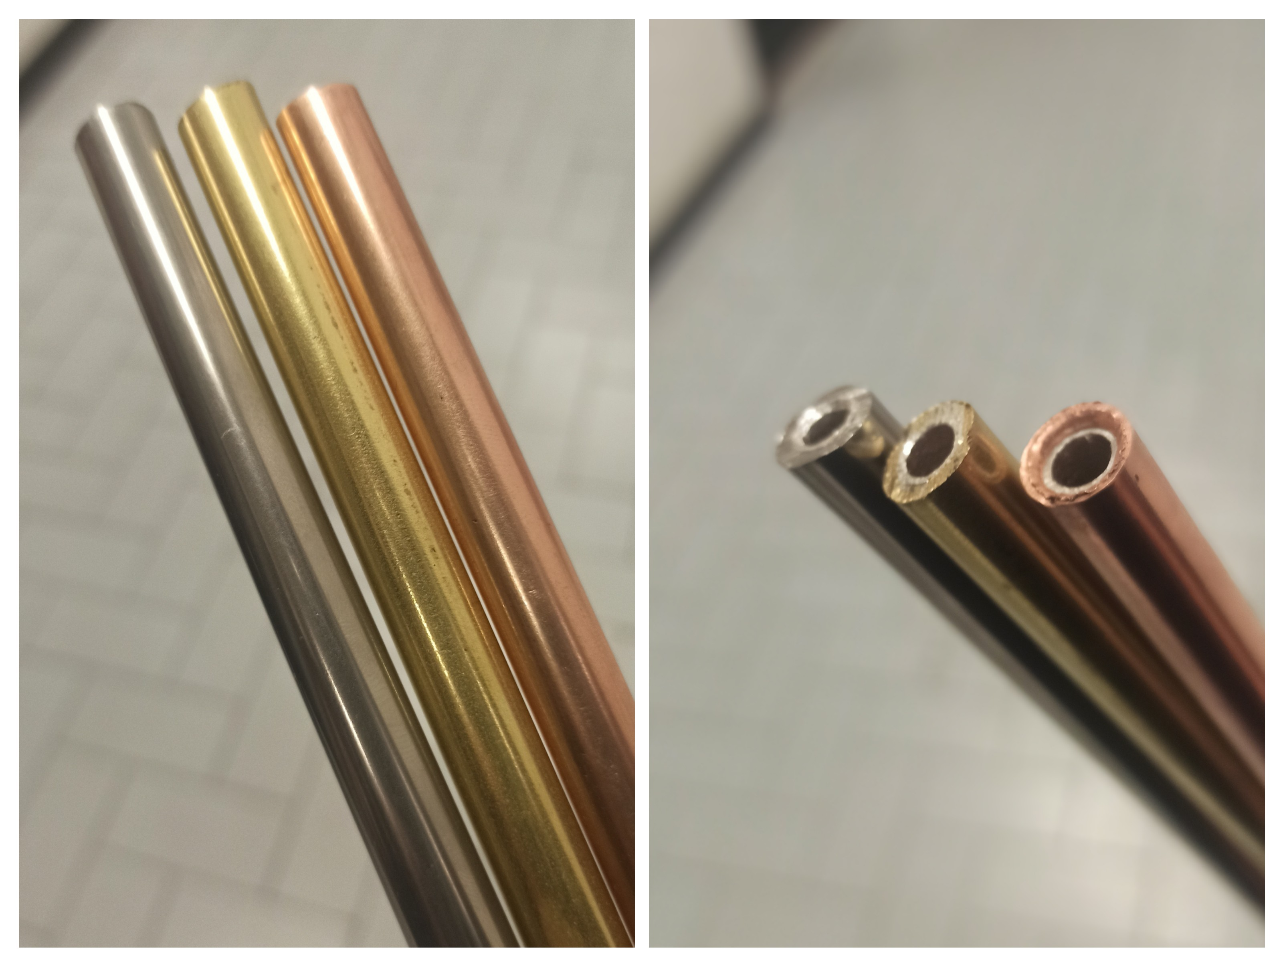
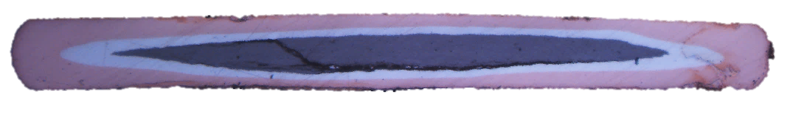
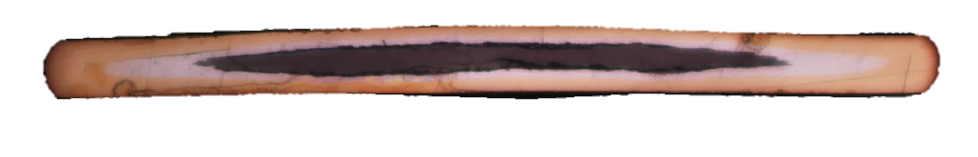
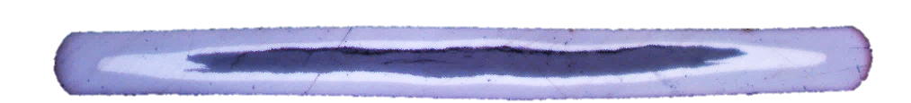
122 composite sheath wires
A composite sheath approach was evaluated also for 122 wires
500 μm

Slide 29
122 composite sheath wires
The best results were obtained for a CuNi – Nb – Ag structure
Cu-alloy
Niobium
Silver
Also here current injection is not trivial

Slide 30
Internal microstructure
Furthermore, composite sheaths highlight CTE compatibility issues that lead to cracks inside the superconducting core
This is mitigated by silver
Opportune tailoring of thermal treatment is needed as well (low cooling rate)

Slide 31
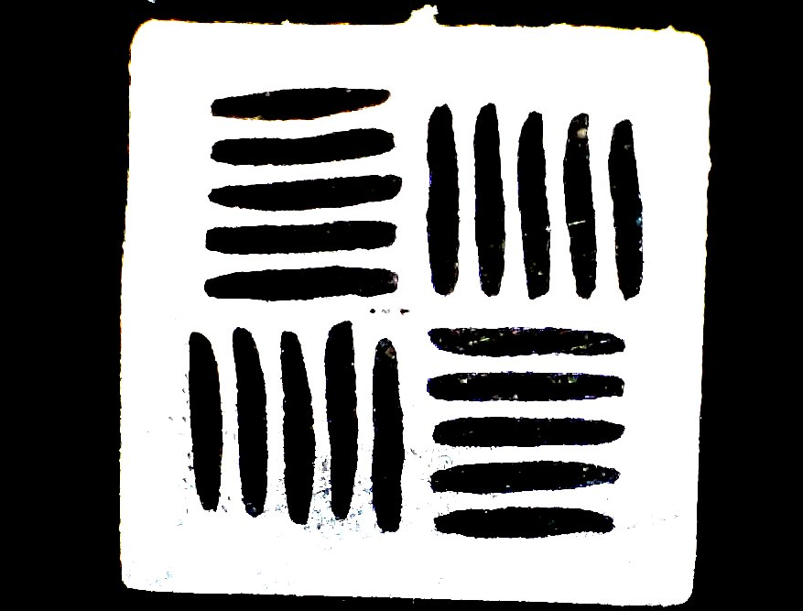
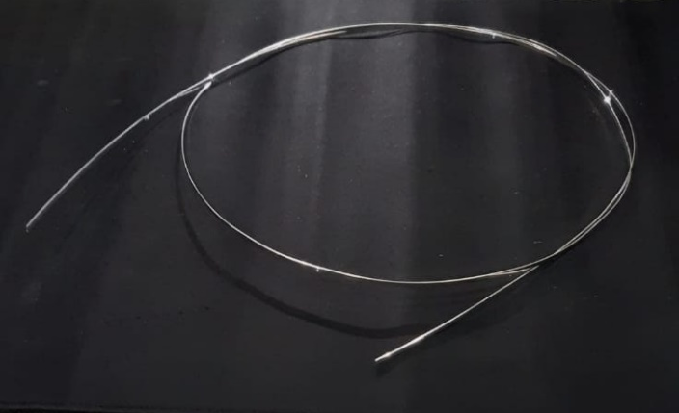

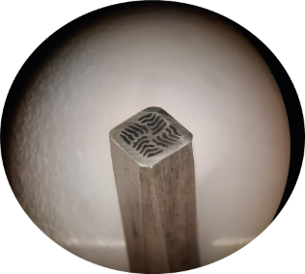

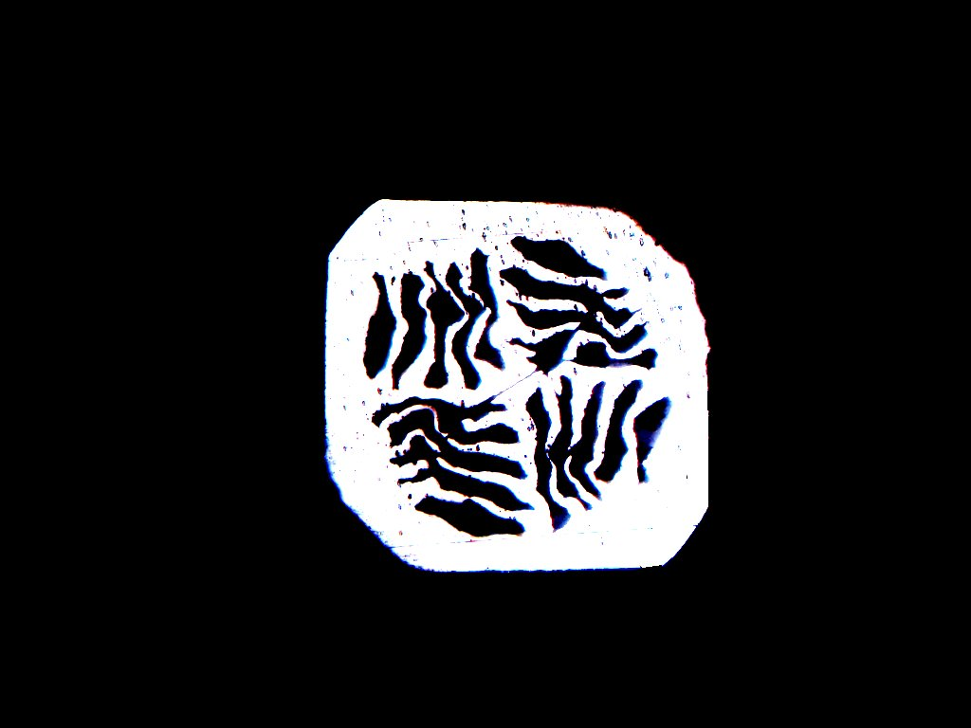
Towards multifilamentary wires
A flat textured wire can be used to produce an isotropic multi-filamentary wire
6 m of mono-filamentary tape used for the multifilamentary wire

Slide 32
1st attempt: MW01
A first sample was produced. Despite some microstructure issues, the attempt was successful (yet low Jc)

Slide 33
2nd and 3rd attempt: MW02/03
Further samples produced (with and without extrernal hard sheath) and under characterization. Preliminary results show good critical currents

Slide 34
Project summary
No | Title | Description | Expected date
M1 | Novel sheath definition | Definition of a suitable novel sheath architecture following compatibility experiments characterized by improved mechanical properties and enhanced temperature margins | M12
M2 | Optimization of standard wires | Enhancement of performance and technological appeal of standard architecture wires in terms of reduced anisotropy or high pressure requirements, with high degree of homogeneity on technologically relevant lengths | M15
M3 | Performance enhancement on improved wires | Achievement of significant enhancement of superconducting performance with technologically viable methods on improved wires | M24
Defined milestone reached relatively on time
Results presented in several conferences and worshops (2 invited, 5 oral, 3 poster, 1 paper until now and further contribution/submissions ongoing)

Slide 35
Conclusions
IBS PIT wires development is a challenging task that embraces several aspects of chemistry, physics and material science.
Flat 122 wires (CNR-SPIN) showed during the project high improvement in terms of performance and homogeneity of results. Composite flat 122 wires (CNR-SPIN) heath treated at ambient pressure approached the 10⁵A/cm² @ 4.2-10T target identified viable for application.
Squared composite 1144 wires (ENEA) optimization did not lead to a performance improvement despite the opportune evaluated strategies, most likely due to lack of texturing.
The novel architecture of IBS multi-filamentary wires developed by CNR-SPIN constitute a promising strategy to achieve high performance in multifilamentary IBS wires

Slide 36
Perspectives
IBS PIT wires are approaching the technological maturity needed to become a main actor among the high-field superconducting materials
The limitations in the performance exhibited by the PIT developed in this project are related to extrinsic issues due to manufacturing and optimization of the processes, and not intrinsically related to the material itself.
Further effort must be devoted towards the mitigation of these factors, in order to unveil the potential for the application, focusing in particular on:
  Homogeneity on long lengths
  Mechanical response to thermo-electromagnetic cycles
  Assessment of performance in real-world prototypes (i.e. small cables or coils)

Slide 37
Thank you for your attention

Slide 38
Backup Slides

Slide 39
Project Activities
WP1: Materials
    T1.1: Synthesis of Ba/K-122 compounds
    T1.2: Synthesis of Ca/K-1144 compounds
    T1.3: Sheath development and production
    T1.4: Optimization of Ba/K-122
    T1.5: Optimization of Ca/K-1144 compounds
  WP2: Wires production
    T2.1: Standard wires production
    T2.2: Optimized architecture wires production
    T2.3: Microtomography
  WP3: Wire superconducting characterization
    T3.1: Standard wire charactarization
    T3.2: Optimized wires characterization

Slide 40
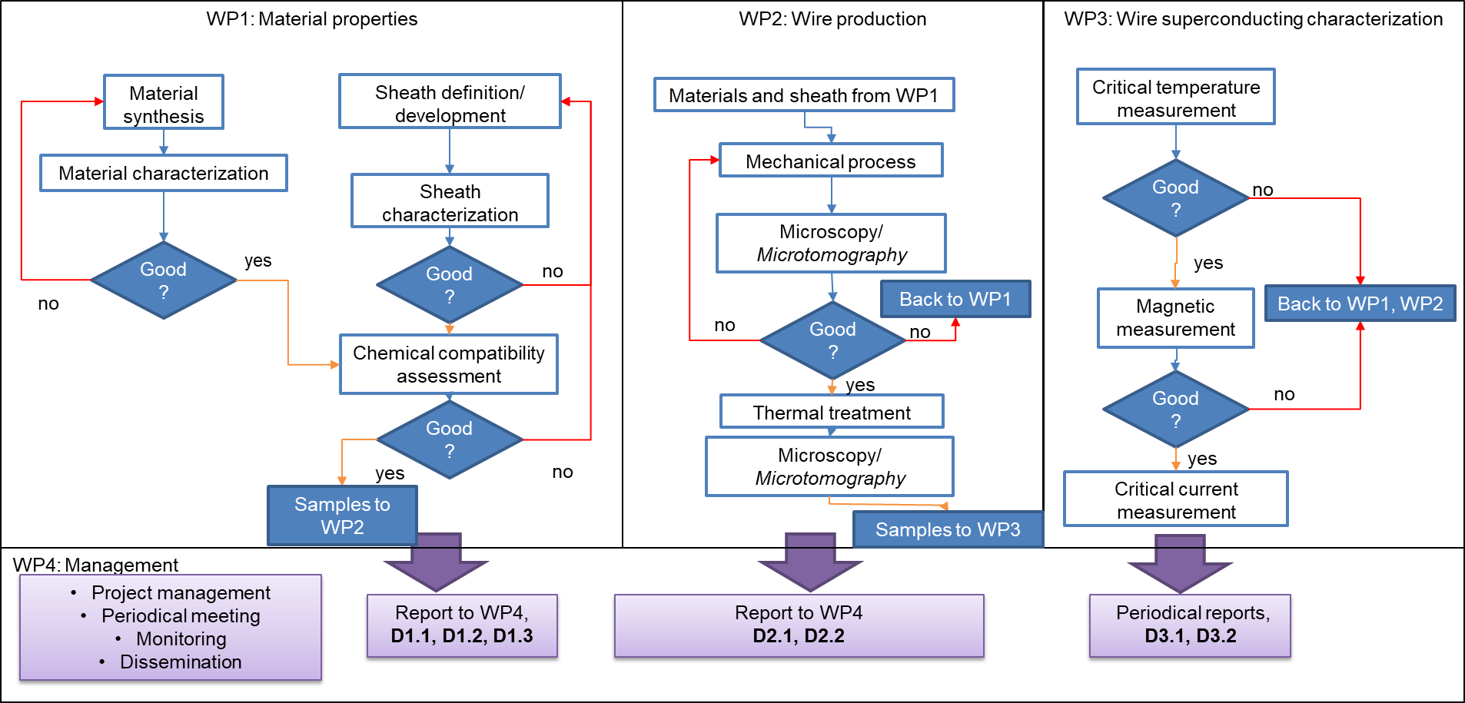
Project workflow

Slide 41
Milestones - Deliverables
No | Title | Description | Expected date
M1 | Novel sheath definition | Definition of a suitable novel sheath architecture following compatibility experiments characterized by improved mechanical properties and enhanced temperature margins | M12
M2 | Optimization of standard wires | Enhancement of performance and technological appeal of standard architecture wires in terms of reduced anisotropy or high pressure requirements, with high degree of homogeneity on technologically relevant lengths | M15
M3 | Performance enhancement on improved wires | Achievement of significant enhancement of superconducting performance with technologically viable methods on improved wires | M24

Slide 42
Milestones - Deliverables
Year | Description
2024 | D1.1: Material synthesis report (M12): report of the synthesis activity of T1.1 and T1.2 D1.2: Sheath development report (M12): report of the progress of the sheath development activity of T1.3 D2.1 standard architecture wires (M12): Delivery of wires produced in T2.1 for characterization activities of T3.1
2025 | D1.3 Material synthesis optimization report (M24): Report of the progress of activities carried out in T1.3, T1.4 and T1.5 regarding the optimization of IBSCs precursors and sheaths. D2.2 new architecture wire (M21): Delivery of wires produced in T2.2 for characterization activities of T3.2 D3.1 Standard architecture wires characterization report (M15): Report on the superconducting characterization of wires produced in T2.1 D3.2 New architecture wires characterization report (M24): Report on the superconducting characterization of wires produced in T2.2

Slide 43
GANTT chart
We are here!
 | 3 | 6 | 9 | 12 | 15 | 18 | 21 | 24
 | M1-M3 | M4-M6 | M7-M9 | M10-M12 | M13-M15 | M16-M18 | M19-M21 | M22-M24
T1.1 |  |  |  | D1.1
T1.2
T1.3 |  |  |  | D1.2 + M1
T1.4 |  |  |  |  |  |  |  | D1.3
T1.5
T2.1 |  |  |  | D2.1 | M2
T2.2 |  |  |  |  |  |  | D2.3
T2.3
T3.1 |  |  |  |  | D3.1 + M2
T3.2 |  |  |  |  |  |  |  | D3.2 + M3

