Slide 1
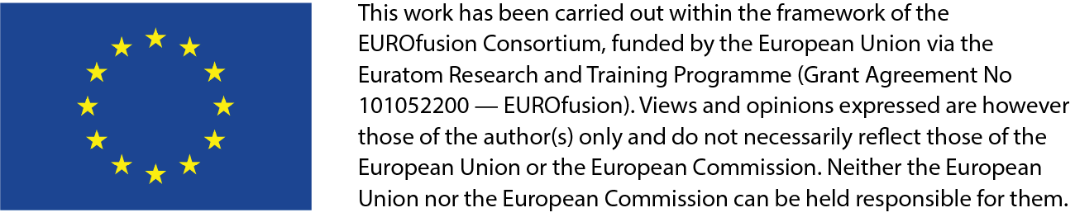
ENR-MAT.02.ISSP-UL New dielectric functional materials and interfaces (DFMI) – Theoretical and Experimental analysis (2024-2025)
Anatoli Popov – Institute of Solid State Physics, University of Latvia (UL ISSP) – Principal Investigator
Partners: Theo Scherer (KIT), Alexander Zinovev. (SCK CEN), Łukasz Ciupiński (WUT)

Slide 2
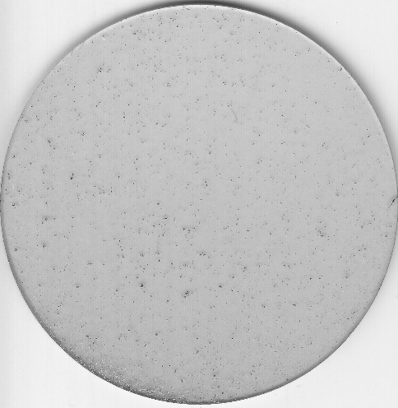
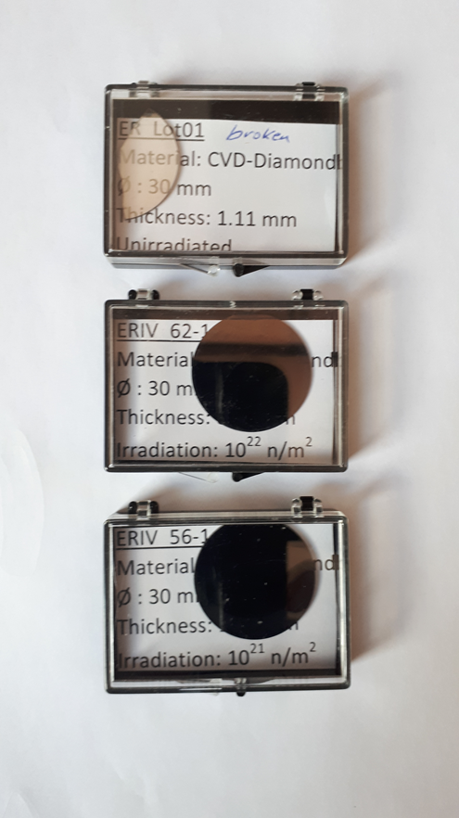
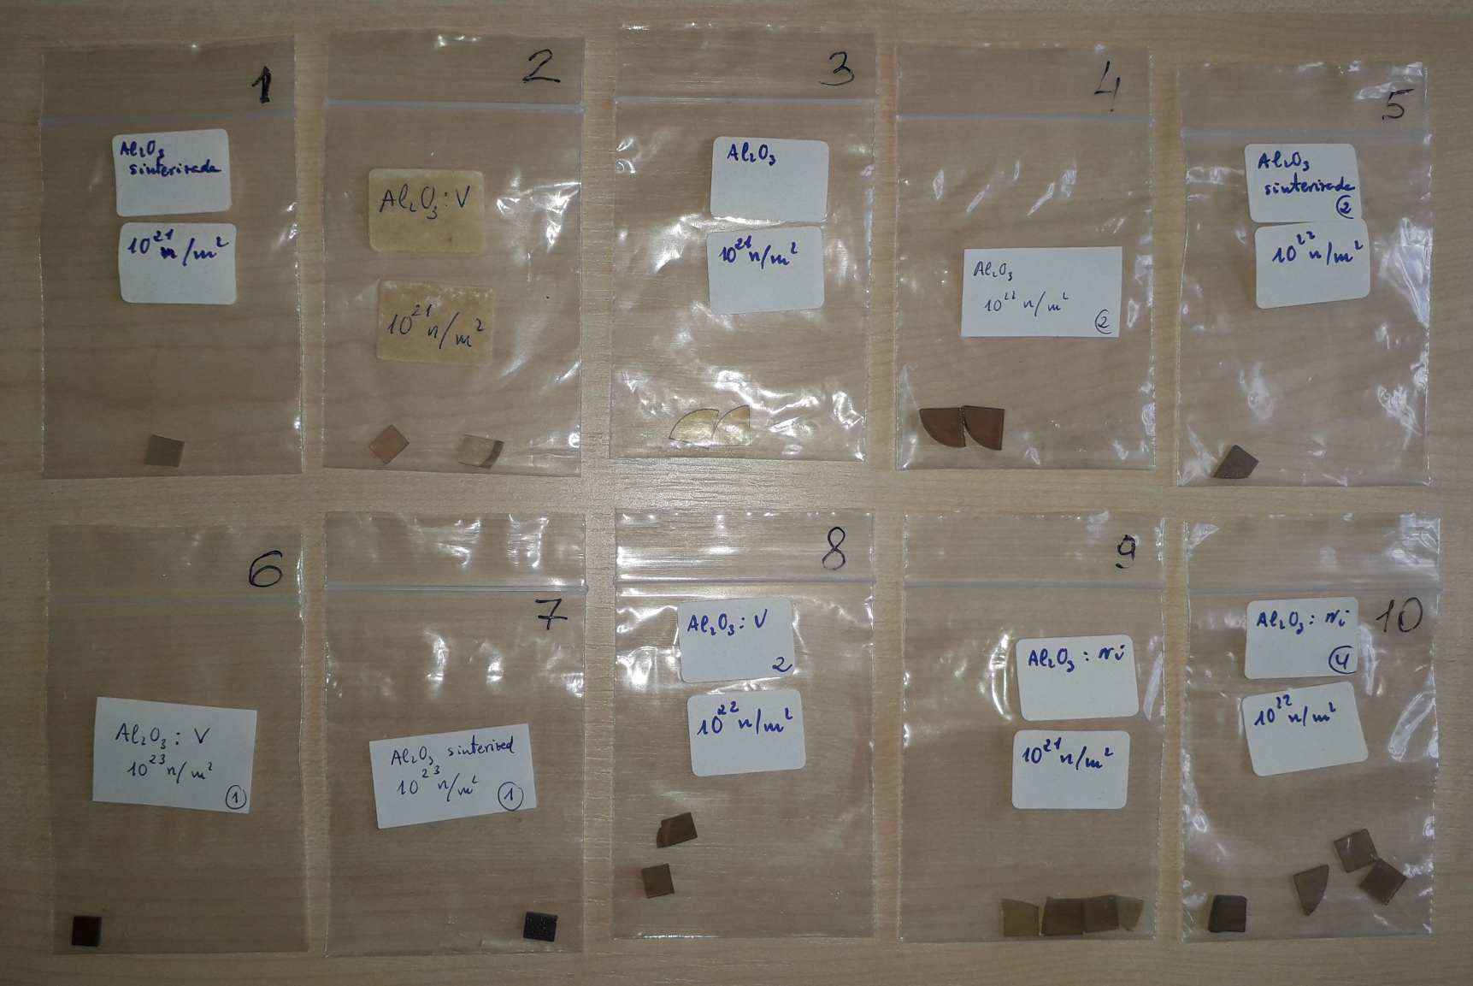
New dielectric functional materials and interfaces (DFMI) – Theoretical and Experimental analysis (2024-2025)
Polycrystalline diamond disks with a respectable size of several tens of millimetres up to 180 mm produced by plasma assisted chemical vapour deposition (PACVD) in a microwave reactor are state of the art in functional optical and dielectric windows. Diagnostics heating and current drive systems need these components as filters for well-defined frequency bands in IR, UV, VIS, Microwaves and sub-millimetre waves (THz-range) and as window materials for transmission of low and high power electromagnetic waves.
1
Al₂O₃
Sinterizada
10²¹ n/m²
1 piece
2
Al₂O_{3:}V
10²¹ n/m²
2 pieces
3
Al₂O₃
10²¹ n/m²
2 pieces
4
Al₂O₃
10²² n/m²
2 pieces
5
Al₂O₃
Sinterizada
10²³ n/m²
1 piece
6
Al₂O_{3:}V
10²³ n/m²
1 piece
7
Al₂O₃
Sinterizada
10²³ n/m²
1 piece
8
Al₂O_{3:}V
10²² n/m²
2 pieces
9
Al₂O_{3:}Ni
10²¹ n/m²
4 pieces
10
Al₂O₃:Ni
10²² n/m²
4 pieces
56 mm
Alumina
Diamond

Slide 3
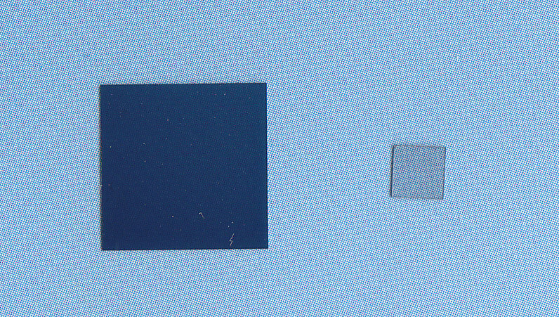
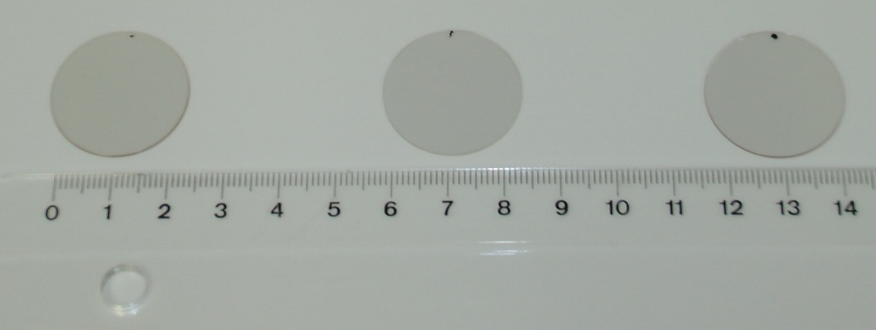
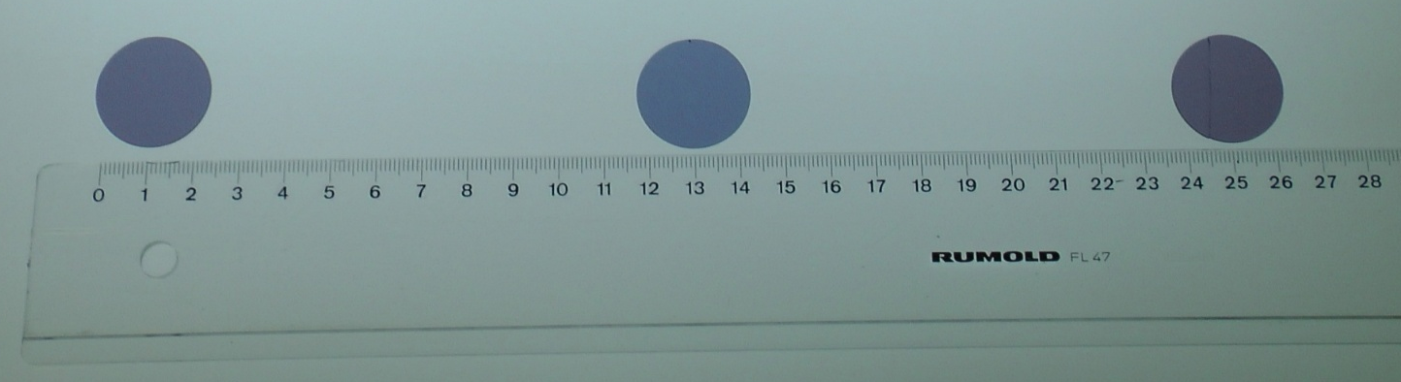
New dielectric functional materials and interfaces (DFMI) – Theoretical and Experimental analysis (2024-2025)
In the previous enabling research projects AETA and DDRM only a few number of functional materials (FM) in relation to primary radiation defects (vacancies, F-type centres, trapped holes on cation vacancies, etc.) were investigated. Especially in diamond the influence of defect structures (nitrogen, hydrogen and oxygen) to optical and dielectric material properties were considered.
For systems in plasma diagnostics, doping in diamond (Boron) has a strong influence on the optical transmission and the electrical properties of such filters and windows and even for detector applications in plasma diagnostics.
LaAlO3: 3 different crystal orientation
NdGaO3: 3 different crystal orientation
Small diamond sample:
single crystal
Large dark:
Boron-doped polycrystalline
(10x10 mm)

Slide 4
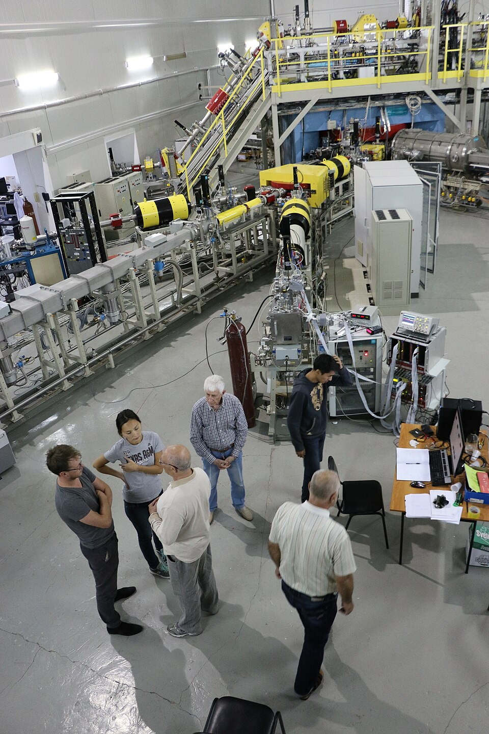
New dielectric functional materials and interfaces (DFMI) – Theoretical and Experimental analysis (2024-2025)
Project partner:
The consortium of this ENR proposal puts the efforts of Latvian, Belgian German and Polish institution perfectly together:
Institute of Solid State Physics, University of Latvia (UL ISSP)
Karlsruhe Institute of Technology (KIT)
Warsaw University of Technology (WUT)
SCK CEN- is the Belgian nuclear research centre located in Mol, Belgium,
where BR2 - a materials testing reactor will be used for irradiation.
Research object.
Functional materials already available in participating institutions:
Un-doped materials: single and poly-crystalline diamond samples (SCD, PCD),
Un-doped materials: LaAlO3, NdGaO3, Y-ZrO2 (YSZ)
Evaporation and sputtering facilities for AlN and SiOx in KIT available.
p-Boron doped diamond is available at KIT.
Main attention will be paid to diamond, silicon carbide, exotic dielectrics and
interface layers (AlN and SiO).
Irradiation:
Neutron - will be performed at SCK CEN, Mol (Belgium),
Swift heavy-ion irradiation will be carried out in Astana at DS-6 accelerator,
providing ^{6,7}Li, ¹²С, ¹³С, ¹⁴N, ¹⁶O, ²⁰Ne, ³²S, ⁴⁰Ar, ⁸⁴Kr and ¹³²Xe
in the energy range 0.35 - 1.75 MeV/nucleon.

Slide 5
Summary
The proposal of DFMI project has the goal to combine experimental investigations of new functional materials used in diagnostics and heating and current drive applications in fusion reactors with theoretical calculations to provide an exhaustive understanding of material behaviour and the corresponding properties which are of high relevance for DEMO development works in the frame of EUROfusion activities taking the fusion roadmap into account. A tremendous emphasis is put on radiation resistant functional materials (FM) used for optical systems and for microwave and THz transmission applications. The main idea is the physics understanding of that group of crystalline solid state systems.
In particular, as planned, several single crystalline exotic dielectrics: LaAlO₃, NdGaO₃, Y-ZrO₂ (YSZ) and SiC were studied before and after irradiation with neutrons at SCK CEN, Mol (Belgium) or swift heavy-ion irradiation in Astana at DS-6 accelerator, providing ⁸⁴Kr and ¹³²Xe in the energy range 0.35 - 1.75 MeV/nucleon. The corresponding radiation effect and the resulting defects were studied in details by X-ray diffraction, Raman, optical absorption, luminescence spectroscopy as well as VUV photoluminescence/reflectivity at synchrotron beamlines at DESY and MAXIV.
Comparison of obtained results with earlier irradiated/obtained MgO, Al2O3, BeO and Si3N4 were done.
Precise ab-initio calculations of defect-induced optical and vibrational properties, using first principles methods (LaAlO3, ZrO2 and diamond).
As a results, 8 papers were published and few are in preparation (will be iploaded to thr the PINBOARD by the end of the year)

Slide 6
New dielectric functional materials and interfaces (DFMI) – Theoretical and Experimental analysis (2024-2025)
Final report, including outlook for further work
a) Final technical reports on experimental/theoretical results, obtained during whole project; b) reprints and preprints of all submitted publications

Slide 7
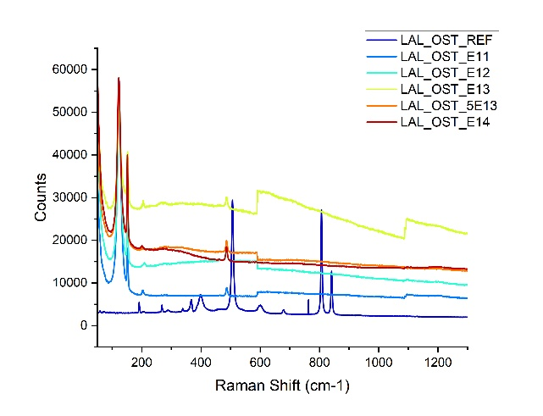
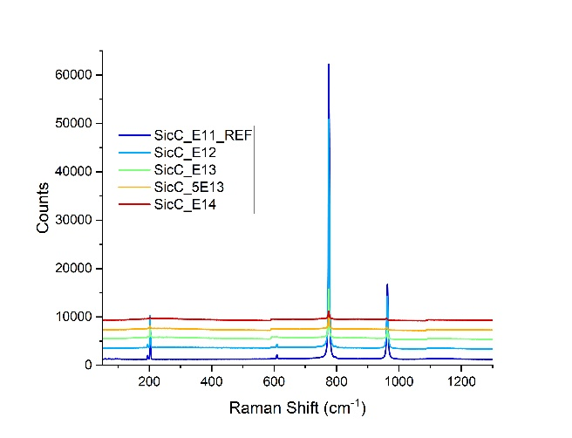
New dielectric functional materials and interfaces (DFMI) – Theoretical and Experimental analysis (2024-2025)
RESULTS
we performed their full characterization by RAMAN, XRD, UV, VUV, OA, including corresponding VUV luminescence/reflectivity measurements at synchrotrons DESY (Hamburg) and MAXIV (Lund). Furthermore, most of the samples were irradiated 231-MeV ¹³²Xe ions with four fluences from 10¹⁰ to 10¹⁴ cm⁻² (DC-60 accelerator in Astana, Kazakhstan) and then characterized and compared with non-irradiated reference samples as well as with the samples from our previous ENR projects. Some obtained results were already published (see the publication list), but the most obtained data are under treatment and corresponding publication are in preparation.
Some the most interesting results are shown below:
While in case SiC only suppression of the main Raman peaks is observed, in the second case of LaAlO3 the formation of new (for the first time) so-called defect-induced Raman modes is found.
7

Slide 8
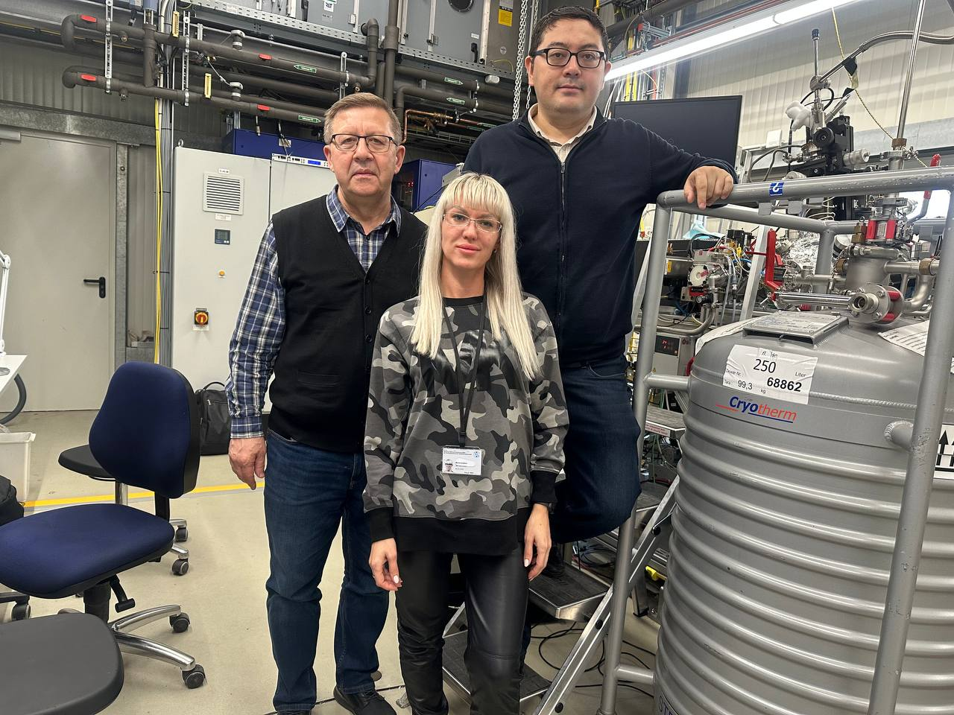
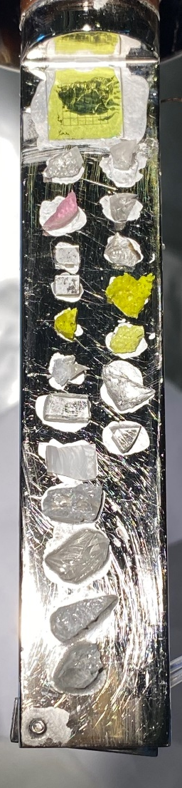
VUV measurements at DESY (Hamburg, Germany) and MAXIV (Lund, Sweden) synchrotron radiation facilities
As an example: Contour map of the excitation and emission spectra. The profiles of the emission spectra (top) and excitation spectra (right) in the maximum intensity are shown.
Experiment at DESY: Anatoli POPOV, Marina Konuhova, Zhakyp Karipbayev
9

Slide 9
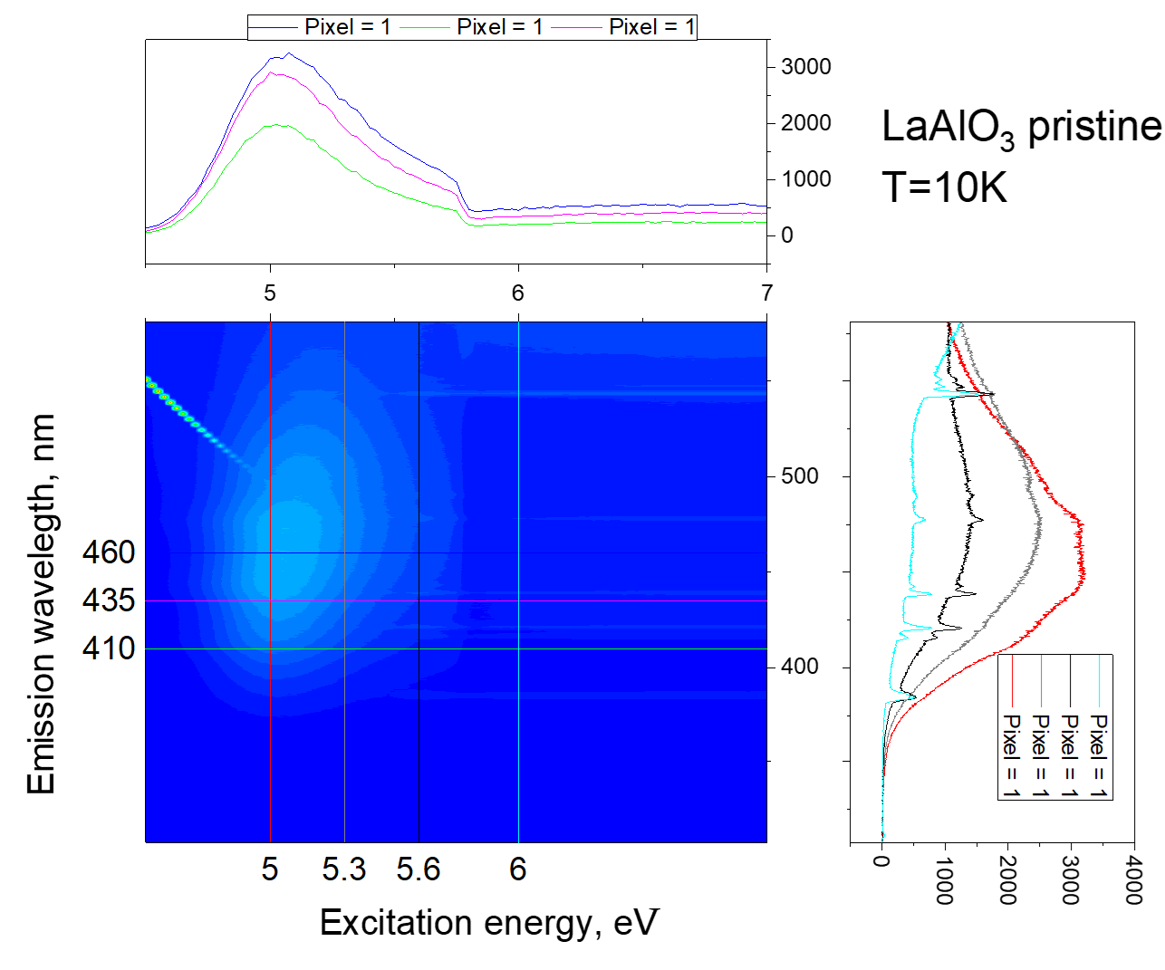
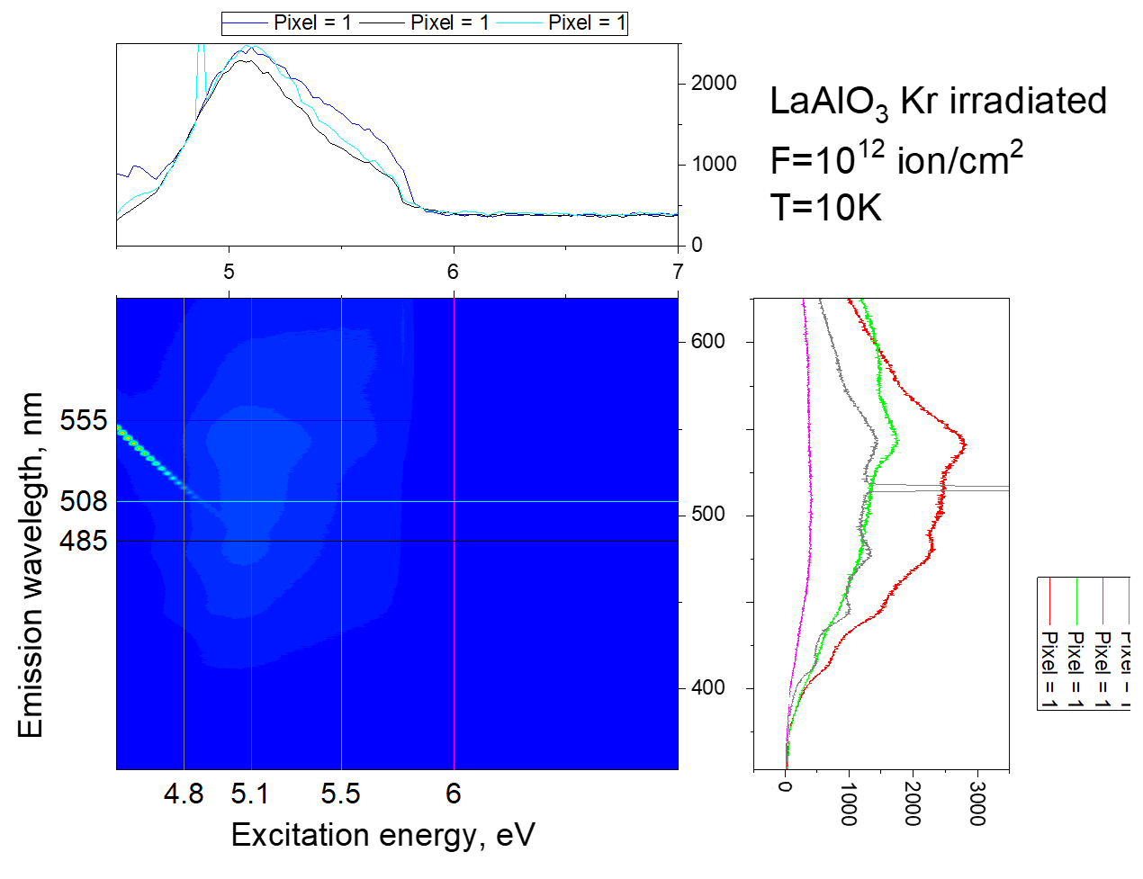
VUV spectroscopy of LaAlO₃ - effect of ion irradiation
Summary:
Several single amples were irradiated with 147 MeV ⁸⁴Kr ions at 300 K to fluences (10¹⁰–10¹⁴) ion/cm², at the DC-60 heavy ion accelerator (Astana, Kazakhstan).
The effects of ion irradiation were investigated using optical absorption and luminescence methods.
In the case of optical absorption, both a shift of the fundamental absorption edge and the emergence of new absorption bands were observed.
In the case of luminescence, a clear modification of both the luminescence spectra and their excitation spectra was observed.
10

Slide 10
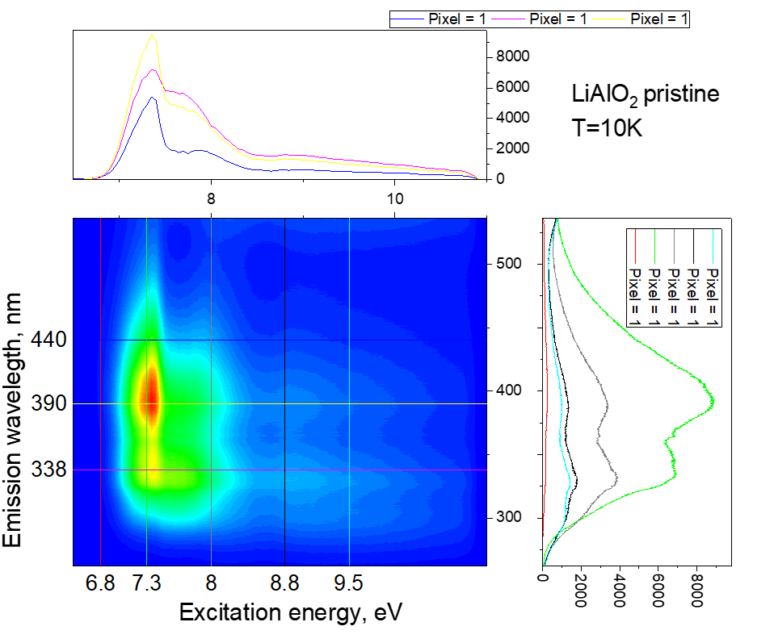
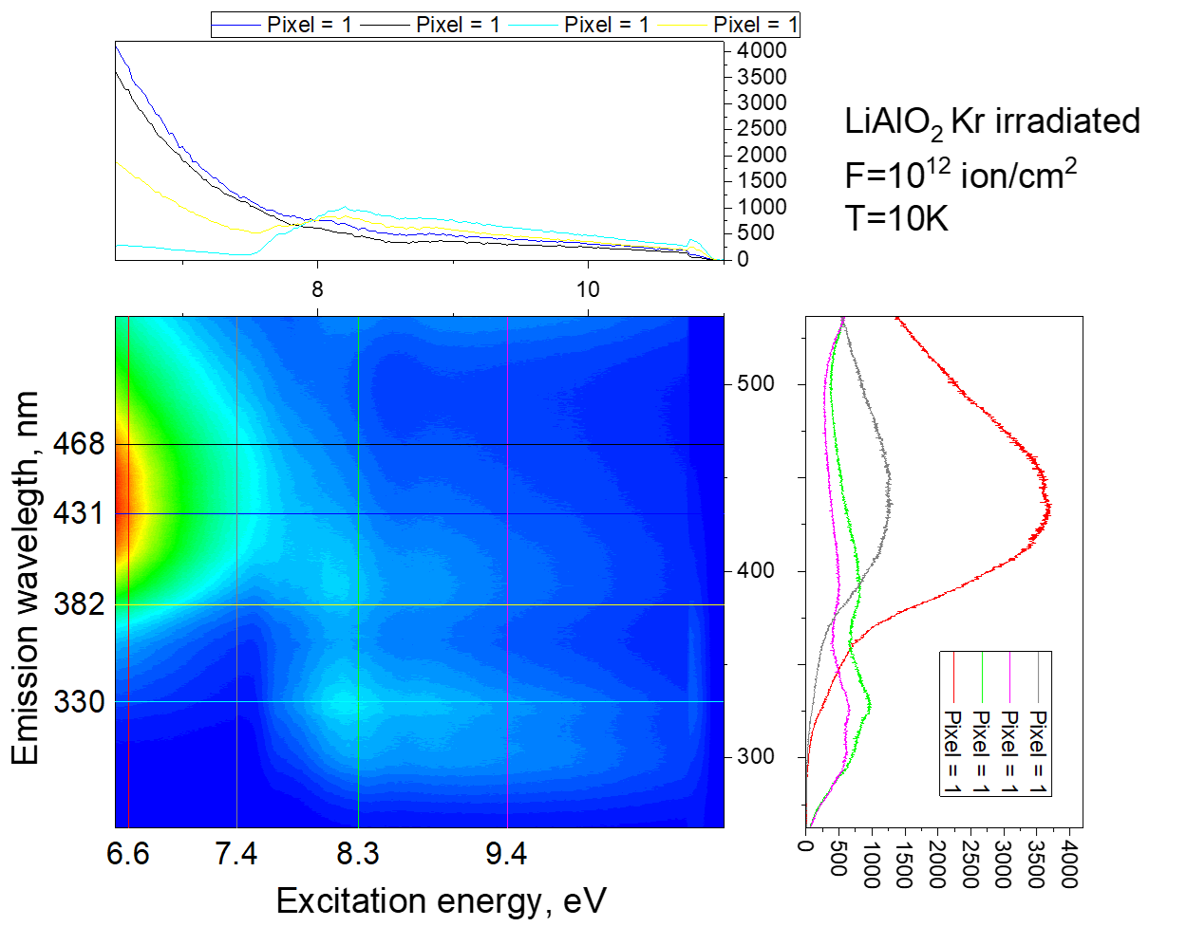
Optical and VUV spectroscopy of LaAlO₃ and LiAlO₃ - effect of ion irradiation 147 MeV 84Kr ions at 300 K
The effects of ion irradiation were investigated using optical absorption and luminescence methods.
In the case of optical absorption, both a shift of the fundamental absorption edge and the emergence of new absorption bands were observed.
In the case of luminescence, a clear modification of both the luminescence spectra and their excitation spectra was observed. This effect is much more pronounced in LiAlO2, while LaAlO3 is much more resistant.
10

Slide 11
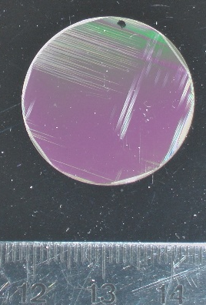
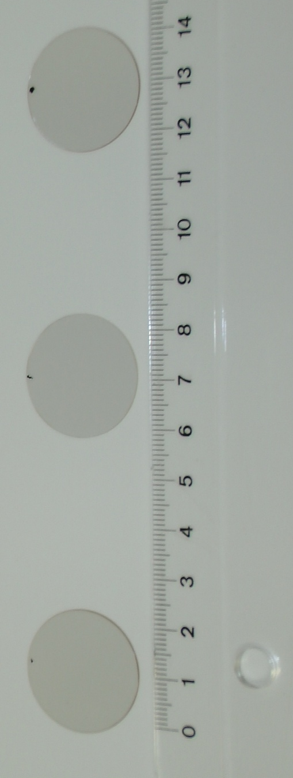
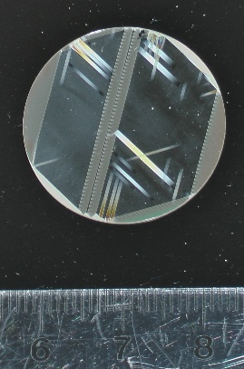
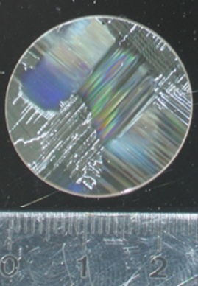
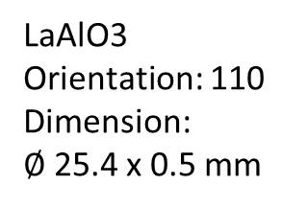
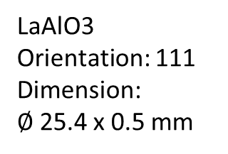
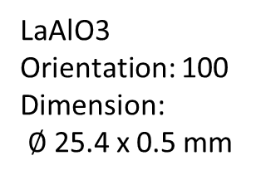
Crystal substrate - LaAlO3
Raman measurements
Excitation wavelength: 532nm
LaAlO3
Orientation: 110
Dimension:
$∅$25.4 x 0.5 mm
LaAlO3
Orientation: 111
Dimension:
$∅$25.4 x 0.5 mm
LaAlO3
Orientation: 100
Dimension:
$∅$25.4 x 0.5 mm

Slide 12
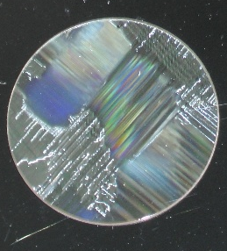


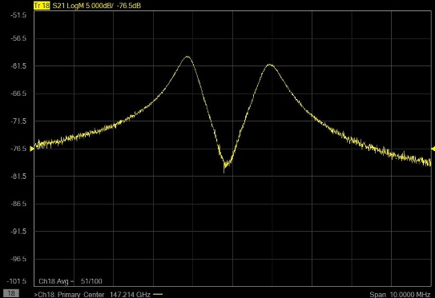
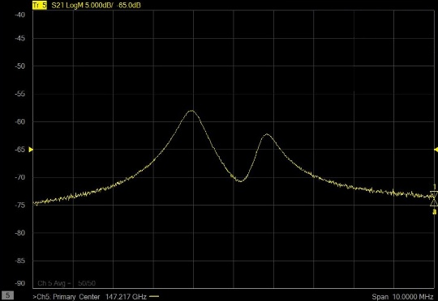
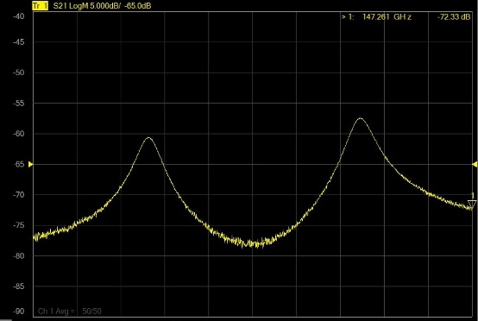
Crystal substrate - LaAlO3
Dielectric measurements
LaAlO3_100
LaAlO3_111
LaAlO3_110
Birefringence 90°
Double peak of the rhombohedral distorted perovskite structure
Results @ 95GHz
ε_{e} / ε_{o}
tanδ
LA100:
24.1 and 23.9
4*10⁻⁴
LA111:
24.4 and 23.8
2*10⁻⁴ / 8*10⁻⁴
LA110:
24.0 and 23.5
2*10⁻⁴ / 3*10⁻⁴

Slide 13


Point defects in LaAlO₃
For LaAlO₃ we modelled series of point defects: oxygen vacancies, oxygen interstitials and cation antisite defects. From our previous experience, irradiated oxide materials contain Frenkel pairs of oxygen defects – vacancy + interstitial. In MgO and Al₂O₃ these defects have optical absorption bands (5.0-6.5 eV) in the band gap.
Conduction band
Formation and binding energies of single point defects and their complexes in cubic LaAlO₃.
1.58
2.23
Defect | Formation energy, eV | Binding energy, eV
Antisite La_{Al} | 7.60
Antisite Al_{La} | 5.41
Double antisite | 11.08 | -1.9
F-center | 8.28
O_{i} | 2.66
Oi + La_{Al} | 9.56 | -0.70
Oi + Al_{La} | 6.42 | -1.65
F_{c} + La_{Al} | 15.79 | -0.09
F_{c} + Al_{La} | 14.59 | 0.90
E_{g}~ 5.4 eV
4.35
5.25
5.19
4.76
4.62
4.19
O_{i}⁰ O_{i}¹⁻ La_{Al} Al_{La} La_{Al}+Al_{La} F F⁺
VALENCE band
Defect electronic states in the band gap (PWGGA + 20% exact exchange)
Notes:
We analyzed formation energies of single defects and defect complexes. It shows that AS defects are likely to bind with each other, so their separation is unlikely. As well negative binding energy shows that defect complex formation is possible.

Slide 14
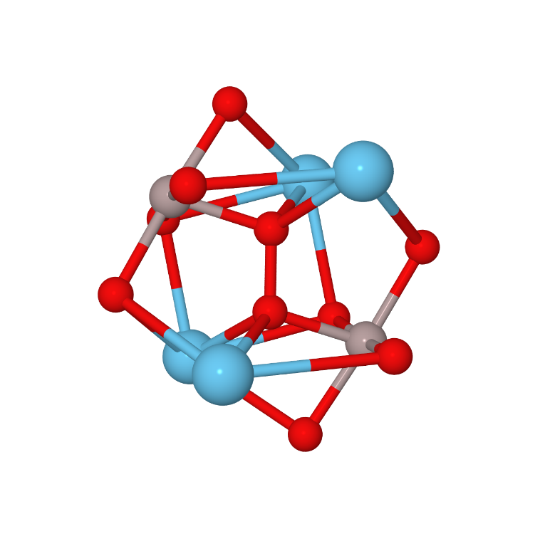
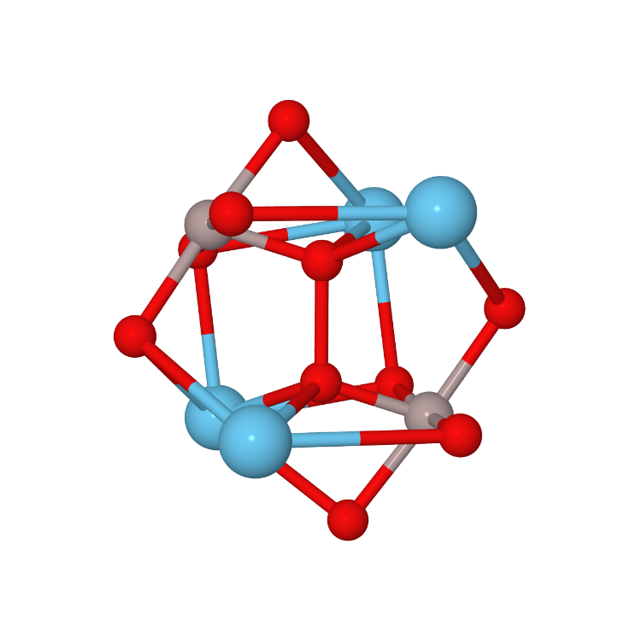
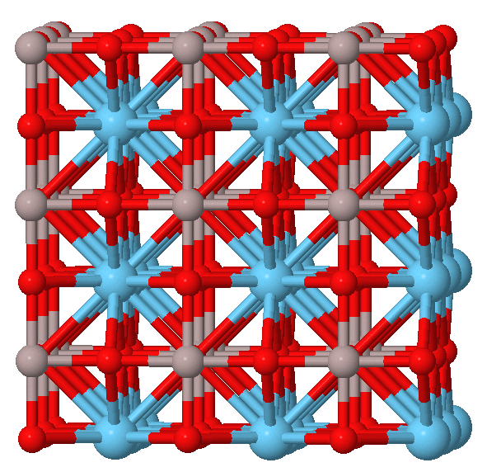
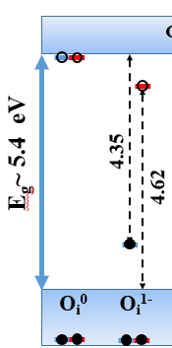
Oxygen interstitials in LaAlO₃
LaAlO₃ has a band gap of ~5.4-5.7 eV, we found that defect levels of oxygen interstitials are positioned very close to or in the conduction band, which will make them undetectable with optical absorption technics. Our calculations revealed, that interstitial defects have pronounced vibrational modes: at ~1070 cm⁻¹ for neutral oxygen defect, and ~900 cm⁻¹ for negatively charged one.
Negative O-O pair
O₂^{”3-”}
<111> oriented
d = 1.90 Å
Weak interaction,
no electron overlap
ω ~ 900 cm⁻¹
Defects are very similar to those found in Al₂O₃. But hole localization (“positive O-O pair”) seems unlikely. In calculations hole tends to localize on regular oxygen bands involved in the top of the valence band
Neutral O-O pair
O₂²⁻
<111> oriented
d = 1.43 Å
Covalent bond
ω ~ 1070 cm⁻¹
Notes:
In contrast with previously studied oxides, it seems less likely to have localized hole on interstitial oxygen defect since defect states are located mostly below the top of the valence band.
interstitial defects have pronounced vibrational modes: at ~1070 cm-1 for neutral oxygen defect, and ~900 cm-1 for negatively charged one

Slide 15
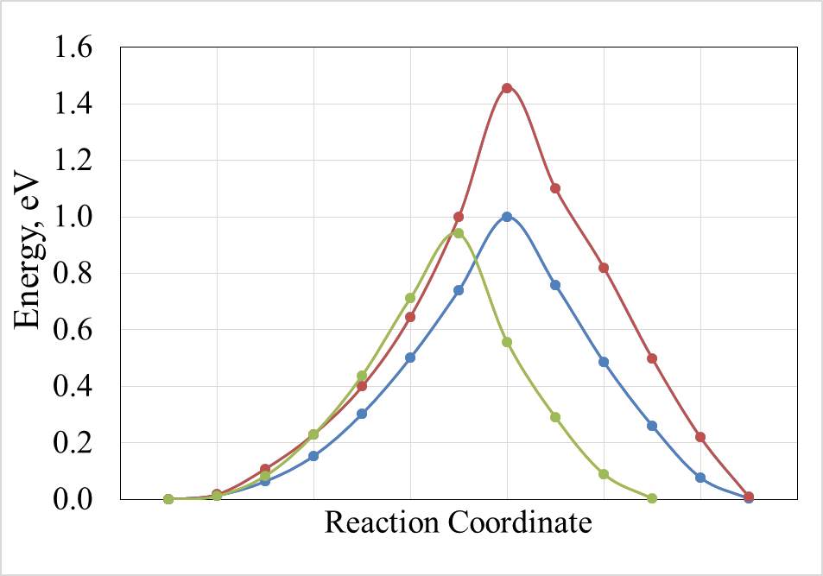
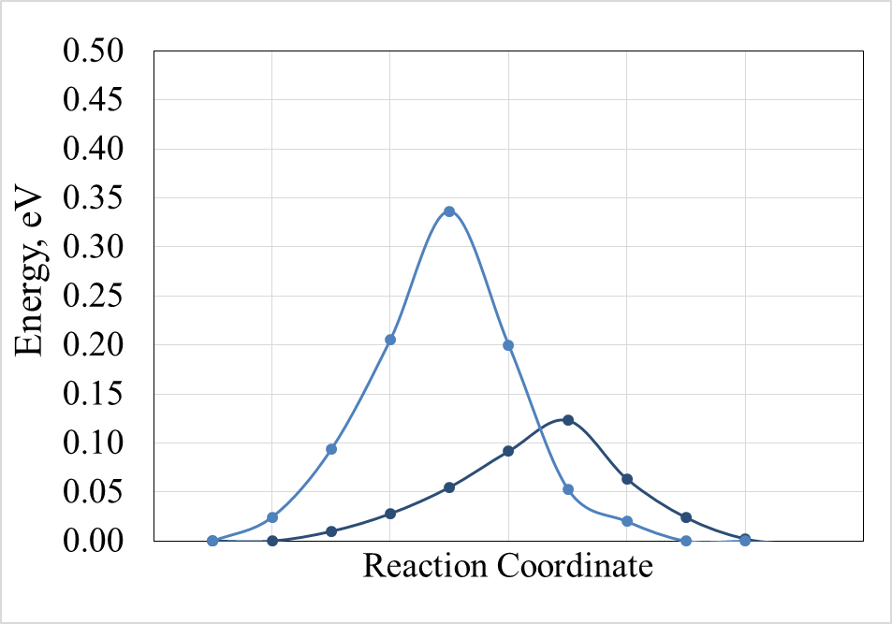
Oxygen interstitial migration in LaAlO₃
The mobility of oxygen interstitial defects were evaluated using Distinguished Reaction Coordinate method as implemented in CRYSTAL23 code. Several paths were picked as potential diffusion trajectories. In Figure 2 energy curve along two paths for neutral oxygen interstitial is shown. The obtained value is ~1.0 eV, which is by 0.3-0.4 eV smaller than for same defect in MgO and Al₂O₃. From this we can expect higher mobility and lower annealing temperatures for such defects.
Neutral O-O pair
O₂²⁻
<111> oriented d = 1.43 Å
Negative O-O pair
O₂^{”3-”}
<111> oriented d = 1.90 Å
Migration barrier ~1 eV (vs. 1.3 eV in Al₂O₃)
Migration barrier 0.1-0.3 eV (vs. 0.7 eV in Al₂O₃)
Notes:
Several paths were picked as potential diffusion trajectories. For negatively charged oxygen interstitial diffusion barriers are very low, so this results will be additionally checked. But at the same time, for Al2O3 reported activation energies of oxygen Frenkel pair recombination are in range from 0.14 to 0.89

Slide 16
NdGaO₃ - optical and luminescence study
The samples were fully characterized using VUV (MAX-IV), as well as in-house Raman and PL techniques, and they were irradiated with ions in September. The irradiated samples have already been received and are currently being analyzed in Riga. The final results will be presented in the technical report

Slide 17

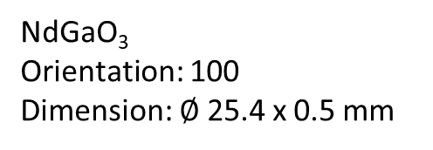
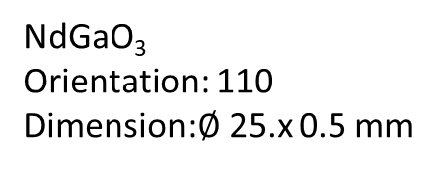
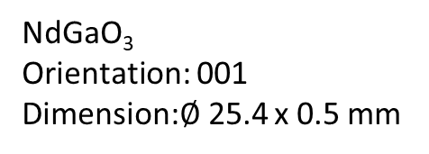
Crystal substrate windows - NdGaO3
Dielectric properties of NdGaO₃
Crystal structure: Orthorhombic perovskite
Density: ~7.57 g/cm³
Melting point: ~1600 °C
Relative dielectric constant (εᵣ): 20–25 (typically measured at ~1 MHz, 27 °C)
Dielectric loss tangent (tan δ): about 3×10⁻³
Thermal expansion coefficient: ~5.8×10⁻⁶ K⁻¹
NdGaO₃ exhibits good dielectric behavior (low dielectric losses) – Up to now there are no studies of radiation defects
NdGaO₃
Orientation: 110
Dimension:$∅$25.x 0.5 mm
NdGaO₃
Orientation: 001
Dimension:$∅$25.4 x 0.5 mm
NdGaO₃
Orientation: 100
Dimension: $∅$25.4 x 0.5 mm
Results @ 95GHz
ε
tanδ
NdGaO3_110
22.5
1.1*10⁻³
Not determined
Not determined

Slide 18
Crystal substrate - NdGaO3
Raman measurements - Excitation wavelength: 532nm
NdGaO3_110
NdGaO3_001
NdGaO3_100

Slide 19
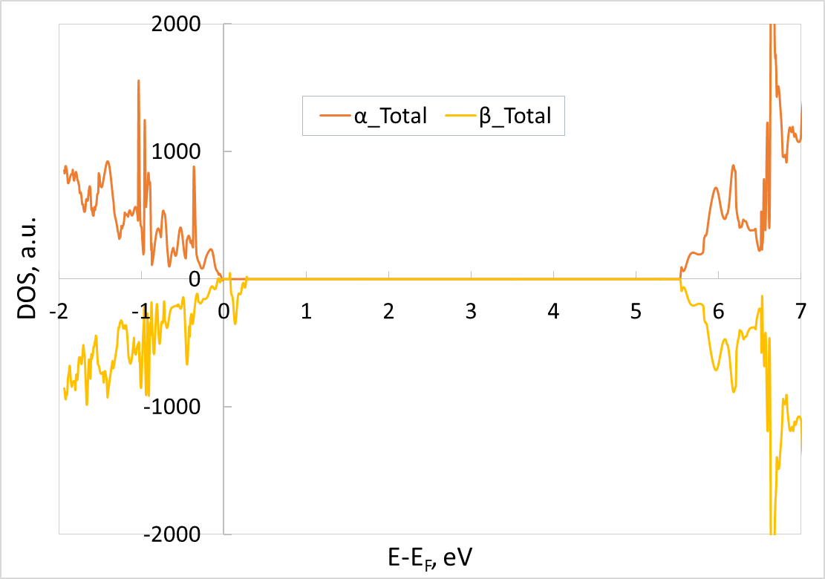
According our objectives we have performed ab-initio calculation of diamond with boron dopant. Figure shows the Total electronic DOSs of α- and β-electrons for diamond with boron dopant. Spin state S_{z} = 1/2. Part of valence band (VB), in-gap unoccupied defect band near VB band and part of conducting band (CB) are shown. The zero energy value corresponds to the Fermi level.

Slide 20
Undoped and Boron-doped diamond
Raman
Small diamond sample:
single crystal
Large dark:
Boron-doped polycrystalline
(10x10 mm)
Raman shift, cm⁻¹
Raman
NV⁻¹
NV⁰
Raman shift, cm⁻¹
Diamond lattice vibration band at 1332 cm⁻¹.
Luminescence NV⁰ and NV⁻¹ center bands.
NV⁰ (1430 cm⁻¹) : 2,157 eV, 574,8 nm.
NV⁻¹ (3120 cm⁻¹) : 1,945 eV, 637,0 nm.
The SMALL sample has a typical CVD diamond spectrum.
No luminescence is observed for the DARK sample with 532 nm excitation.
Luminescence with 532 nm excitation

Slide 21
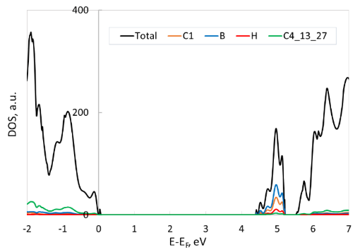
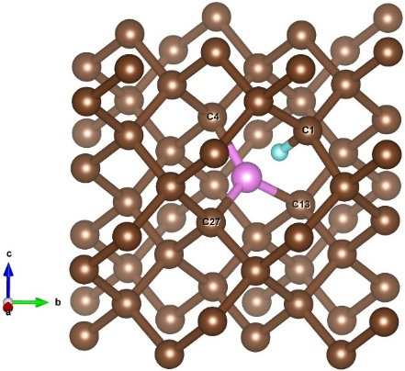
The second subject of our research was ab initio study of the boron-hydrogen complex defect in diamond. We have also performed ab initio simulations of diamond crystal with defect B+H on the base of 64- and 216-atom SC. Boron atom was considered as a substitutional atom, hydrogen as an interstitial atom. All calculations were performed in the framework of space group 1 (without taking into account symmetry of system). Our calculations revealed that diamond crystal with B+H defects really remains as dielectric system. Results of simulations of defective diamond system on the base of 64-atom SC are presented in Figure below. Fig. Defective diamond system with B+H defect. (a) Fully relaxed structure with 65 atoms: 63 carbon atoms (brown balls), 1 boron atom (pink), 1 hydrogen atom (blue). (b) Projected

Slide 22
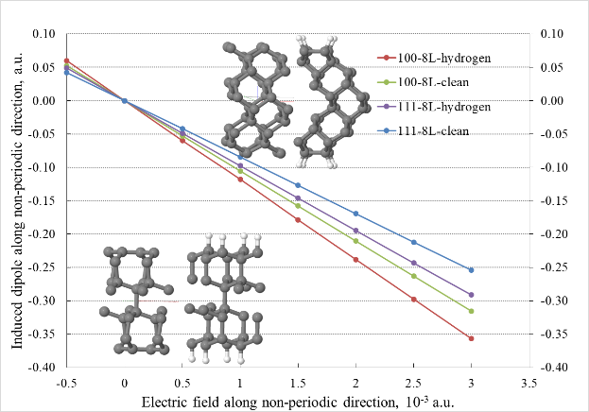
We performed computational studies on several materials employing hybrid density functional theory (DFT) as implemented in CRYSTAL23 code. Various diamond surfaces – clean and hydrogen-terminated – were analyzed in terms of surface free energy, Debye temperature, surface atoms and hydrogen electronic energy levels, polarizability and induced dipoles in constant electric field. The influence of surface termination on the dielectric and vibrational properties was assessed and compared with each other and with literature data.
Figure 1. Optimized <100> (top) and <111> (bottom) surface models and induced dipole along non-periodic direction in different diamond slabs.

Slide 23
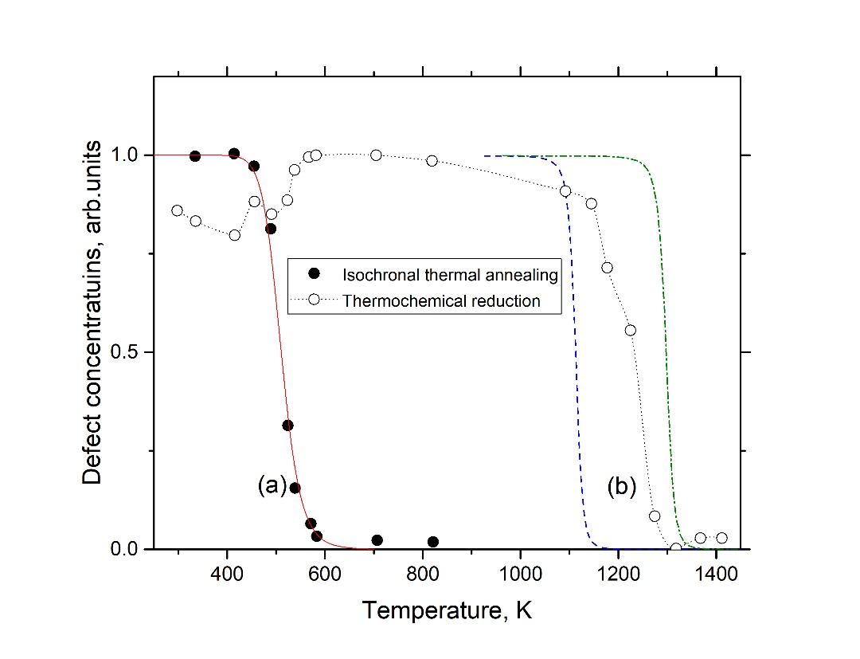
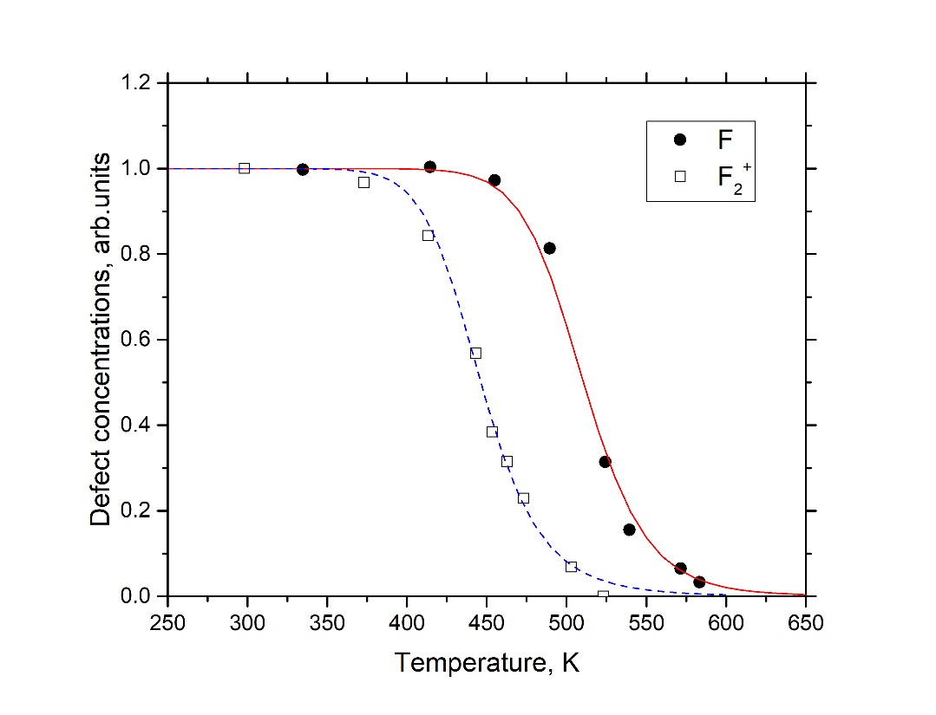
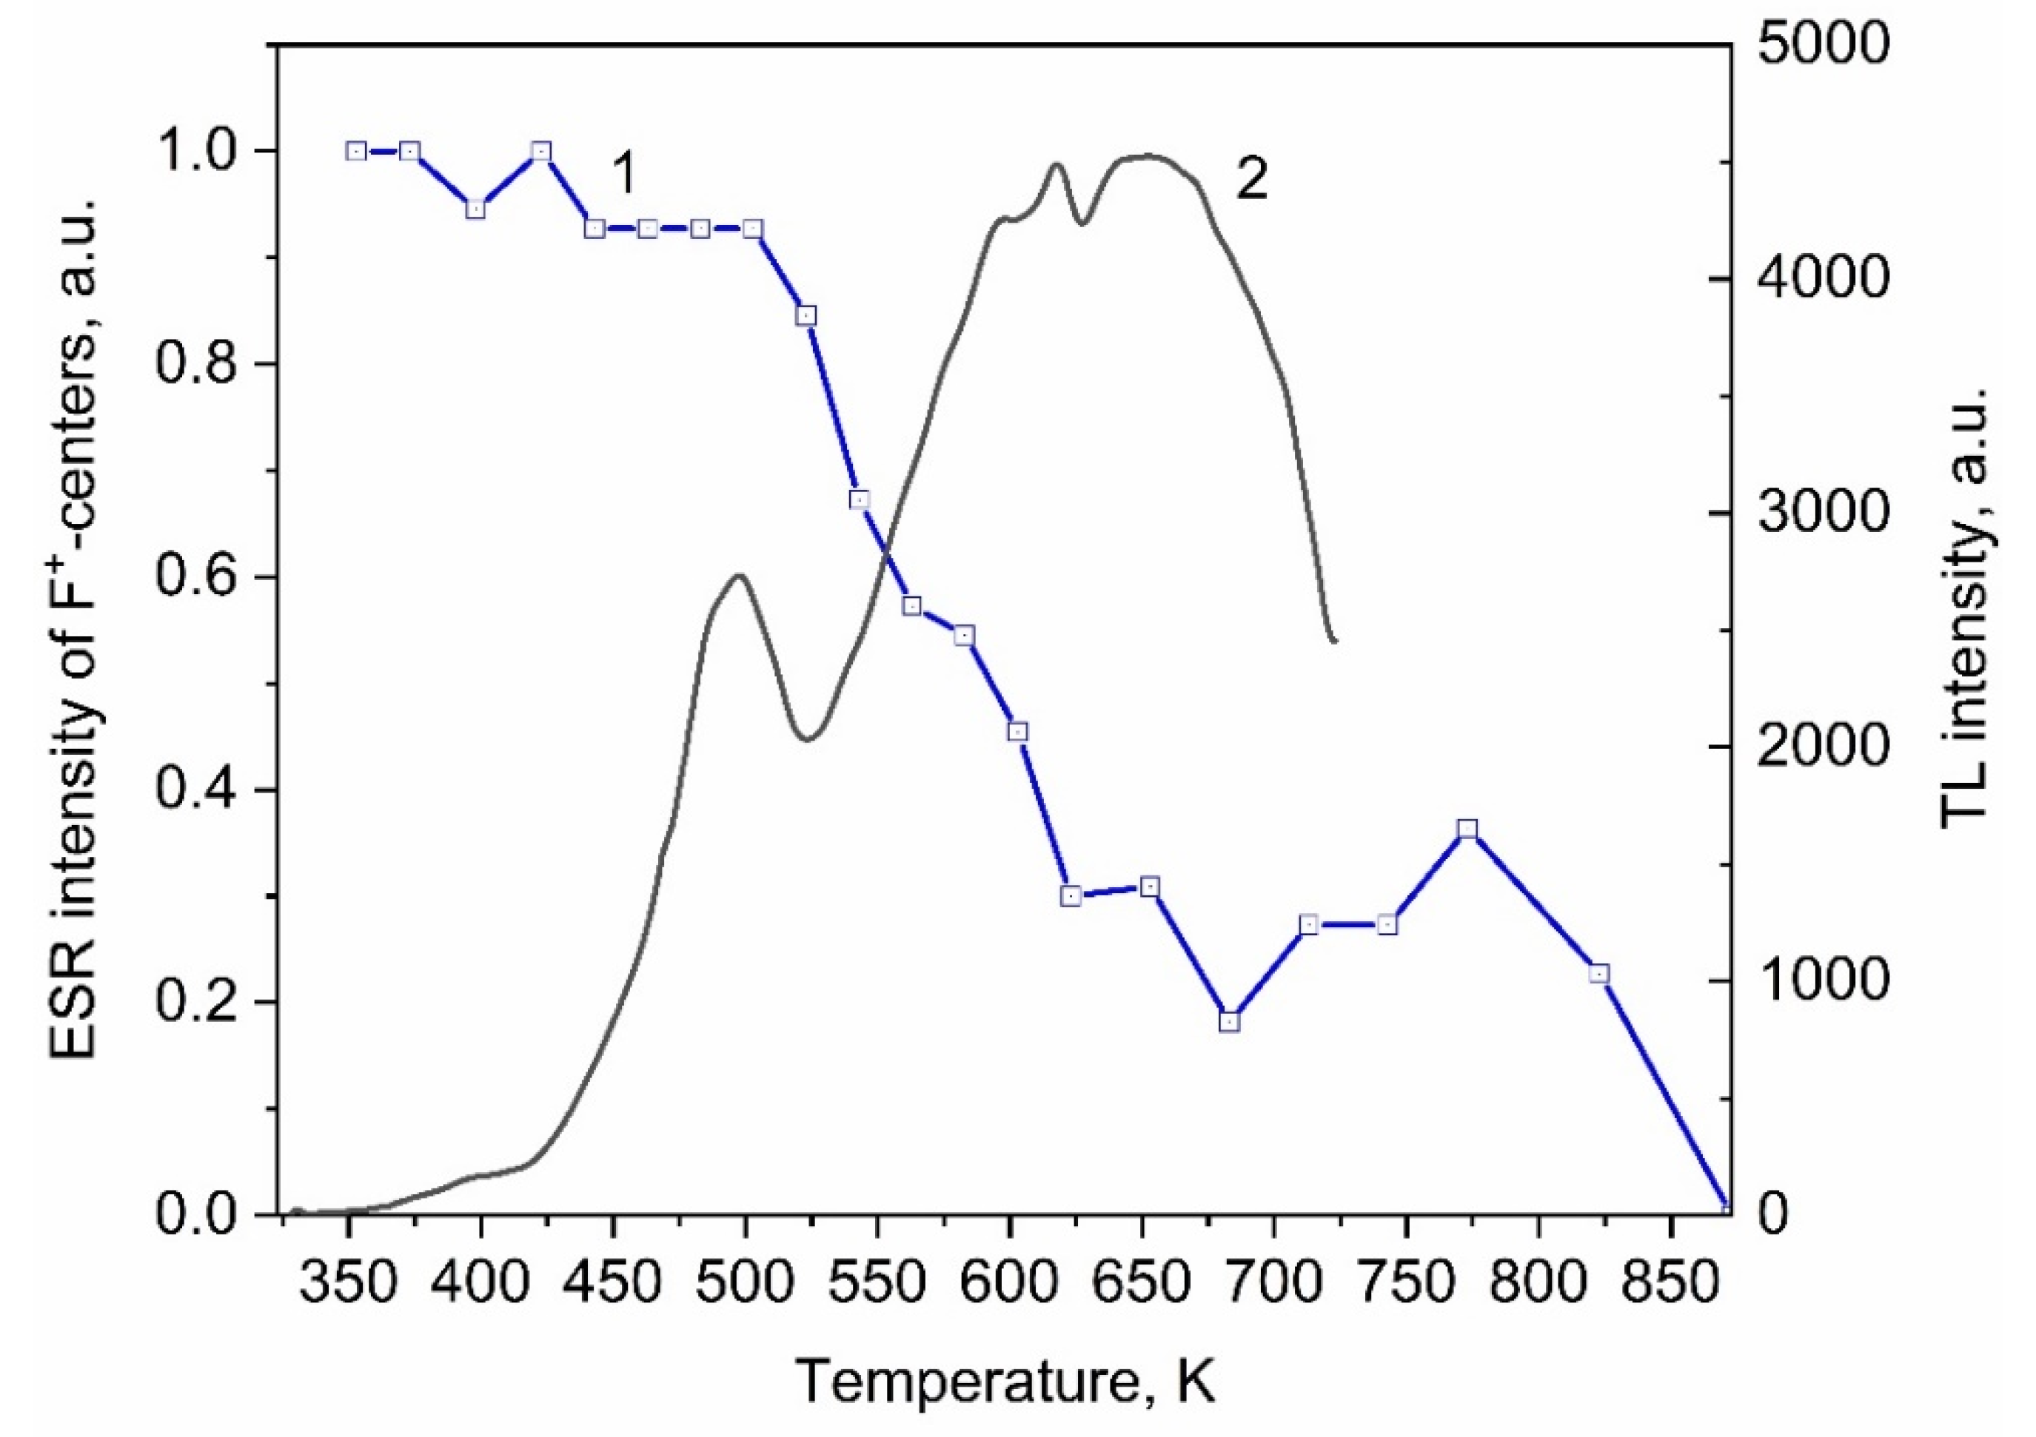
Thermal annealing of radiation defects in yttria stabilized zirconia (YSZ)
Figure 1: Thermal annealing kinetics of the F centers (470 nm optical absorption band) in YSZ : (a) the full symbols are for neutron irradiated sample, (b) emply symbols for thermochemically reduced samples, lines (solid – for a-case, dash (E_{a}=3.0 eV) and dash-dot (E_{a}=3.5 eV) for b-case) show theoretical fit.
Figure 2. A comparison of the annealing kinetics for the F centers [6] and F₂⁺ dimer centers (empty symbols) in YSZ. The symbols for experimental data: full symbols for F centers, empty symbols for F₂⁺ centers. Lines demonstrate theoretical fit: solid for F centers and dashed for F₂⁺ centers.
The performed analysis of the color center aggregation and annealing in YSZ in terms of diffusion-controlled reactions suggest the basic migration parameters for oxygen interstitials which control irradiation material long term stability. The migration energy of the neutral F centers (3.0-3.5 eV) greatly exceeds that for the complementary oxygen interstitials (0.9-1.0 eV). The small difference obtained for interstitial migration energies under neutron and swift ion irradiation could be attributed to larger lattice distortion upon ion irradiation
Figure 3. Dependence of the intensity of the ESR
signal of F⁺-centers on the heating temperature (1)
and TL (2) of ZrO₂ samples irradiated with Xe ions.
This article is ready for submission and will be submitted before the end of the project.

Slide 24
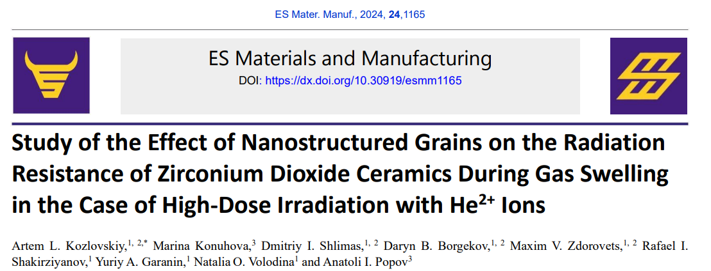
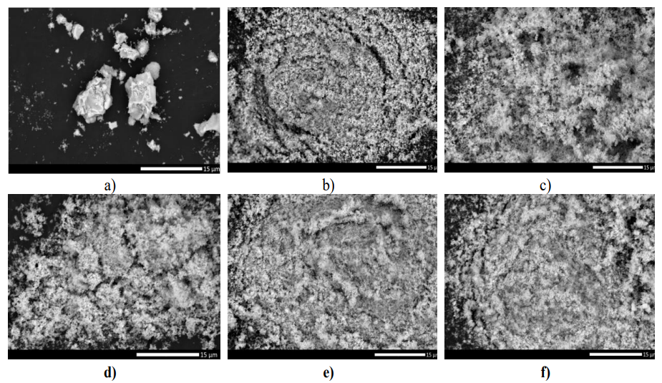
The paper is devoted to the study of the influence of variation of ZrO2 ceramics grain sizes on the resistance to radiation-induced swelling under irradiation with low-energy Не2+ ions. The choice of ZrO2 ceramics as objects of research is due to high levels of mechanical strength and hardness, as well as low rates of thermal expansion, which eliminates the effects of thermal expansion and destruction when operating at high temperatures, as well as good insulating properties, which makes it possible to use these ceramics both as radiation-resistant materials in nuclear energy in the manufacture of inert matrices of dispersed nuclear fuel, and as a basis for creation of fuel cells for the production of hydrogen. During the studies of the influence of mechanochemical grinding conditions on the change in dimensional factors in ZrO2 ceramics, it was found that increasing the grinding speed from 300 to 900 rpm does not lead to the initiation of polymorphic transformation processes of the m-ZrO2 → t-ZrO2 type, which are also not initiated during thermal annealing of samples at a temperature of 1500 °C, the choice of which was due to thermal relaxation of structural deformation distortions caused by mechanochemical grinding during grain crushing. In determining the influence of size effects (dislocation strengthening) on the resistance of ZrO2 ceramics to radiation-induced swelling under high-dose irradiation with He2+ ions, it was found that a decrease in grain size by 2.5 – 3 times leads to an increase in resistance to swelling and softening by 1.5 – 2 times. Moreover, for ZrO2 ceramic samples obtained at grinding speeds of 700 – 900 rpm, strengthening is not only due to dimensional factors, but also to the structural ordering of the crystal lattice, due to thermal relaxation of residual mechanical stresses.
SEM images of ZrO₂ ceramics after mechanochemical grinding: a) initial; b) grinding at a speed of 300 rpm; c) grinding at a speed of 400 rpm; d) grinding at a speed of 500 rpm; e) grinding at a speed of 700 rpm; f) grinding at a speed of 900 rpm.

Slide 25
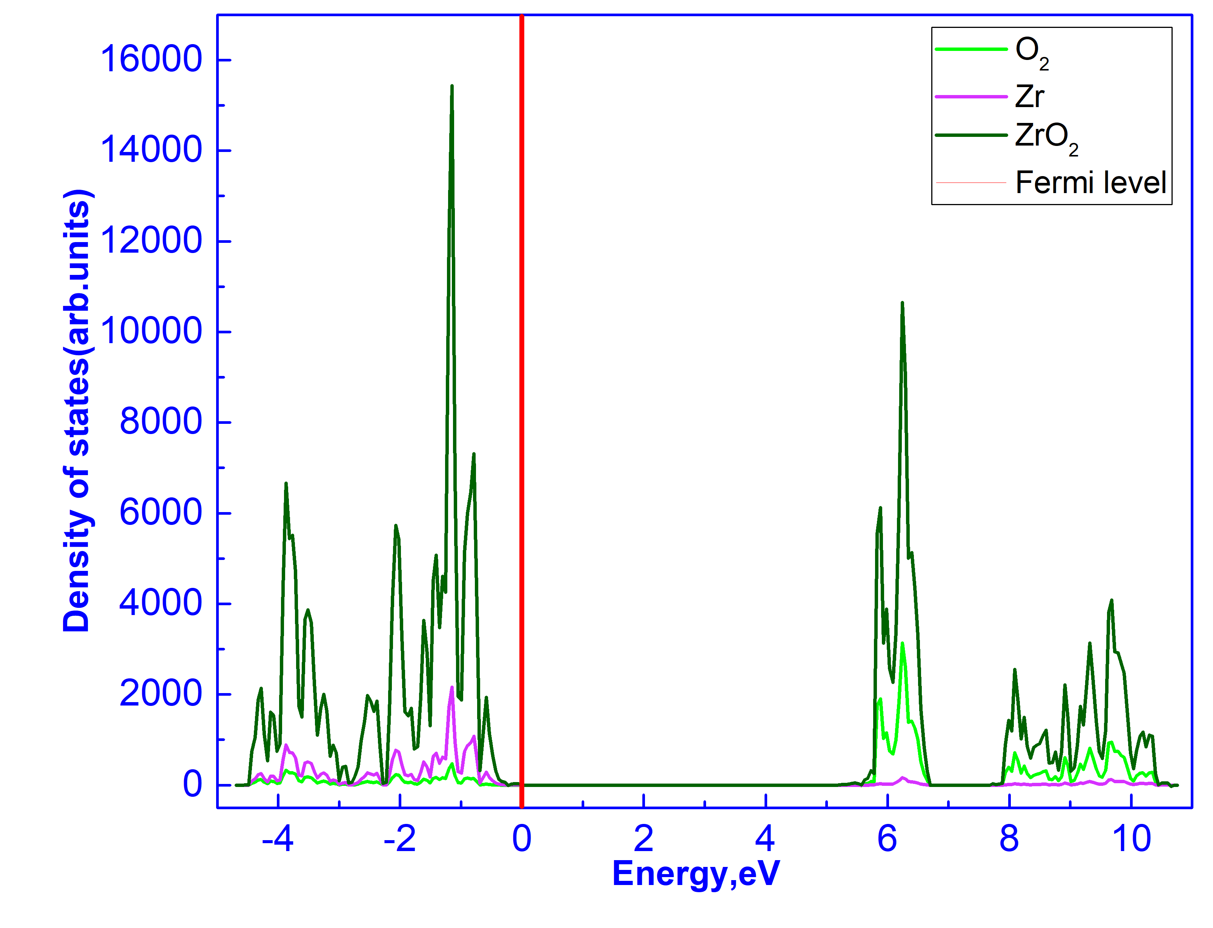
DFT Study of Pressure-Dependent Structural and Electronic Properties of Cubic ZrO₂
In this study, the structural, electronic, and elastic properties of cubic zirconium dioxide (c-ZrO₂) were investigated using the Density Functional Theory (DFT) approach. Lattice parameter optimization revealed that the lattice constant is 5.107 Å, the Zr–O bond length is 2.21 Å, and the unit cell density is 6.075 g/cm³ for the B3LYP functional. The bandgap width was determined to be 5.1722 eV. The investigation of the elastic properties of the cubic ZrO₂ crystal determined the Young’s modulus, bulk modulus, Poisson’s ratio, and hardness, which were found to be 315.91 GPa, 241 GPa, 0.282, and 13 (Hv), respectively, under zero external pressure. These results confirm the mechanical stability of ZrO₂.
Parameters | Functional
c-ZrO₂ | B3LYP | B3PW | PBE | PBE SOL | LDA | HSE06 | SCAN | Others | Exp
a=b=c | 5.107 | 5.075 | 5.104 | 5.056 | 5.020 | 5.067 | 5.076 | 5.11 | 5.11
V, Ả³ | 33.31 | 32.68 | 33.24 | 32.32 | 31.63 | 32.53 | 32.69 | 32.585 | 32.723
ρ, g/cm³ | 6.075 | 6.192 | 6.088 | 6.263 | 6.398 | 6.220 | 6.190 | 6.081 | 6.151
Table 2 Band gap of c-ZrO₂
Parameters | Functionals
c-ZrO₂ | B3LYP | B3PW | PBE | PBEsol | LDA | HSE06 | SCAN | PWGGA
E_{g} , eV (this work) | 5.1722 | 5.2065 | 3.3195 | 3.3530 | 3.3953 | 5.0088 | 3.9392 | 3.2911
Experimental LDA GGA | 6.10 3.349 3.329
How the electronic and elastic properties of undoped c-ZrO₂ respond to pressure and reveal features not previously reported in the stable cubic phase. Further research are focused on the influence of various dopants and defect structures on the material’s electronic and mechanical behavior, further broadening its application scope.
Total and partial Density of Electronic States ZrO₂
Salikhodzha, Z.M.; Bairbayeva, G.B.; Kassymkhanova, R.N.; Konuhova, M.; Zhangylyssov, K.B.; Popova, E.; Popov, A.I. Density Functional Theory Study of Pressure-Dependent Structural and Electronic Properties of Cubic Zirconium Dioxide. Ceramics 2025, 8, 41. https://doi.org/10.3390/ceramics8020041

Slide 26
Comments (shortcomings, deviations, etc.)
Ab-initio calculation were not fully completed due to weather emergency at CINECA High Performance Computing center, Marconi supercomputer was not in production in October-December. This has limited the output of WP5 due to lack of computational resources, as well inaccessibility to previously obtained results that were stored there.
There was a technical delay in obtaining the large-size windows (LaAlO3 and NdGaO3). Therefore, they were irradiated only two months ago, and not all of the planned results have been obtained yet.
Neutron-irradiated NdGaO₃ becomes easily activated and is currently unavailable; however, the same samples irradiated with ions are already available for investigation.
Data ready (Yes/No)
 | ZrO₂ (Fm-3m) |  | Y_{0.125}Zr_{0.875}O_{1.9375} (intrinsic) |  | Y_{0.125}Zr_{0.875}O_{1.9375} (extrinsic) |  | NdGaO₃ (Pnma)
 | DOS | Raman | DOS | Raman | DOS | Raman | DOS | Raman
Pristine | Yes | Yes | Yes | Yes | N/A | N/A | Yes | No
V₀ | N/A | N/A | N/A | N/A | Yes | Yes | No | No
F-center | N/A | N/A | No | No | No | No | No | No
F ⁺-center | N/A | N/A | Yes | No | No | No | No | No

Slide 27
Publication:
Kozlovskiy, A. L., Konuhova, M., Borgekov, D. B., Anatoli, Popov. (2024). Study of irradiation temperature effect on radiation-induced polymorphic transformation mechanisms in ZrO2 ceramics. Optical Materials, 156, 115994. (24 times cited)
Kozlovskiy, A. L., Konuhova, M., Shlimas, D. I., Borgekov, D. B., Zdorovets, M. V., Shakirziyanov, R. I., Popov, A. I. (2024). Study of the effect of nanostructured grains on the radiation resistance of zirconium dioxide ceramics during gas swelling under high-dose irradiation with helium ions. ES Materials & Manufacturing, 24, 1165. (24 times cited)
Ryskulov, A. E., Ivanov, I. A., Kozlovskiy, A. L., & Konuhova, M. (2024). The effect of residual mechanical stresses and vacancy defects on the diffusion expansion of the damaged layer during irradiation of BeO ceramics. Optical Materials: X, 24, 100375. (15 times cited)
Borgekov, D. B., Zhumazhanova, A. T., Kaliyekperova, K. B., Azambayev, S. B., Kozlovskiy, A. L., Konuhova, M., Shlimas, D. I. (2024). The effect of oxygen vacancies on the optical and thermophysical properties of (1-x) Si3N4–xAl2O3 ceramics. Optical Materials, 157, 116056. (8 times cited)
Rusevich, L. L., Kotomin, E. A., Popov, A. I., Aiello, G., Scherer, T. A., & Lushchik, A. (2024). The electronic, vibrational and dielectric properties of diamond crystals with neutral vacancies: First principles study. Optical Materials, 150, 115222. . (7 times cited)
Salikhodzha, Z. M., Bairbayeva, G. B., Popov, A. I., Kassymkhanova, R. N., Zhangylyssov, K. B., Popova, E., & Konuhova, M. (2025). DFT Study of Oxygen Ion Migration in Mg-Doped Cubic Zirconia. Solids, 6(4), 55. (2 times cited)
Salikhodzha, Z. M., Bairbayeva, G. B., Kassymkhanova, R. N., Konuhova, M., Zhangylyssov, K. B., Popova, E., & Popov, A. I. (2025). Density functional theory study of pressure-dependent structural and electronic properties of cubic zirconium dioxide. Ceramics, 8(2), 41. (4 times cited)
G. Aiello, C. Bonnekoh, J. Gabrusenoks, B. Gorr, A. Meier, A.I. Popov, T. Scherer, S. Schreck, K. Seemann, D. Strauss, C. Wild, E. Woerner. On the characterization of MPA CVD diamond for fracture toughness measurements. 49th International Conference on Infrared, Millimeter, and Terahertz Waves (IRMMW-THz), Perth, Australia, 2024 https://doi.org/10.1109/IRMMW-THz60956.2024.10697823

Slide 28
Deliverables:
Scientific deliverable (annual scientific deliverables as specified in the Task Agreement) | Achieved: Fully/Partly/Not | Evidence for achievement, brief reason for partial or non-achievement
1. Detailed comparative analysis of radiation-induced polymorphic transformation in ZrO2 ceramics. | Fully | Results published. One more paper is ready for submittion. Technical Report will be submitted to PINBOARD.
2. Swift heavy ion /neutron irradiation campaine (SiC, LaAlO3 and NdGaO3 | Partly/Fully | SiC, LaAlO3 both from 2 different suppliers were successfully irradiated by swift-heavy ions, NdGaO3 was irradiated by neutron and ions. Technical Report will be submitted to PINBOARD.
3. Analysis of general picture about OA, PL, RAMAN properties of heavily irradiated materials SiC and LaAlO3 | Partly/Fully | Experiments were successfully performed. Data treatment and paper preparation are in progress. Technical Report will be submitted to PINBOARD.
4. Ab initio calculations of Boron-doped diamond | Fully | Calculation are completed. Paper is in prepation. Technical Report will be submitted to PINBOARD.
5. Ab initio calculation of pure and defective LaAlO3 | Fully | Calculation are completed. Paper is in prepation. Technical Report will be submitted to PINBOARD.
6. Ab initio calculation of pure and defective ZrO2 and YSZ | Partly/Fully | Two papers are published. Calculation on Raman spectra are in progress, Due to weather emergency at CINECA High Performance Computing center, Marconi supercomputer was not running for several months. Some data were lost

Slide 29
Our plan until the end of the year
Final report
Three papers are ready for submittion:
Thermal annealing of EPR –defects in neutron-irradiated SiO2
Thermal annealing of radiation defects in zirconium oxide
Modeling of surface and defects in AlN
A novel potential application of boron-doped diamond as promising material for neutron detectors and sensor systems
Outlook for further work
1. The irradiated samples are of particular value because they contain information in the form of radiation-induced defects. Their thermal stability will be investigated only after all non-destructive characterization methods have been completed and analyzed.
2. Experience shows that although such studies sometimes take several years, they always lead to a series of interesting scientific publications.

