Slide 1

High gain direct drive ignition with Foams as a Pathway to Energy (FOPIFE) end of the term review S. Le Pape ENR-IFE.02.CEA-02, 2024-2026

Slide 2

Why could foam be a path toward IFE ?
Engineering
Foam wetted with DT are a path for high repetition rate target operations and lower cost
Physics
Getting most of the laser energy absorbed by ablator plasmas in the corona
Obtaining the best hydro-efficiency to couple as large a fraction of laser energy as possible to the kinetic energy of the imploding capsule
Increasing capsule stability

Slide 3
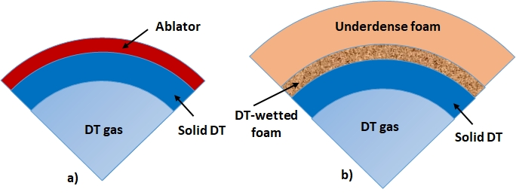
What would a foam target for IFE potentially look like?
Under dense CH foam
To increase laser absorption and mitigate imprint
Overdense CH foam
containing the DT fuel

Slide 4

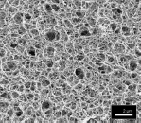
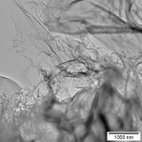
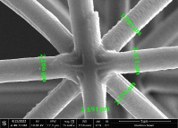
What do we mean by foam materials?
Chemical synthesis of foam from liquid gels: K. Nagai et al. Phys. Plasmas 2018: multi-stage fabrication process, random fractal structure, pore size 1-2 µm, materials: carbon, hydrogen, oxygen, wire thickness 100s nm
Carbon nanotube & graphene target fabrication technology: P. Wang et al. HPLSE 2019: catalyst chemical vapor deposition on a substrate, pore size < 1 µm, 95% of carbon, folded foil structure, sheet thickness 10s nm
Additive manufacturing of foams: J. Fischer & M. Wegener, Laser Photon. 2013: a novel technique of 3D printing 2P LL: better control of foam properties and higher rigidity, pore size 10-50 µm, wire thickness ~few microns

Slide 5
Objectives of the proposal
studying fundamental properties of foams
Developing understanding of fundamental processes of laser foam interactions
Acquiring new insights into basic ignition physics on MJ-scale laser facilities
Studying the use of advanced nanostructured materials for first wall
In 2025, 9 papers were published from experiments/simulations carried out in 2024

Slide 6
Objectives of the proposal
studying fundamental properties of foams
Developing understanding of fundamental processes of laser foam interactions
Acquiring new insights into basic ignition physics on MJ-scale laser facilities
Studying the use of advanced nanostructured materials for first wall

Slide 7
Developing understanding of fundamental processes of laser foam interactions: experiments
Transformation of a nanostructured medium into a plasma
Experimental and simulation study of foam homogenization – experiment @ GSI in September 2024, experiment @ SACLA in January 2025
Laser-plasma interaction
Impact of foam on Laser Plama Instabilities and Cross Beam Energy Transfer, broadband LPI studies @ GSI, experiment planed on LULI2000 due in February 2026
Impact of foam on proton generation experiment on LFEX japan
Basic properties of a foam plasma
Equation Of State -> experiment @ GEKKO XII in december 2024 and experiment @ LULI2000 in April 2025 (first study of wetted foam @ LULI)

Slide 8

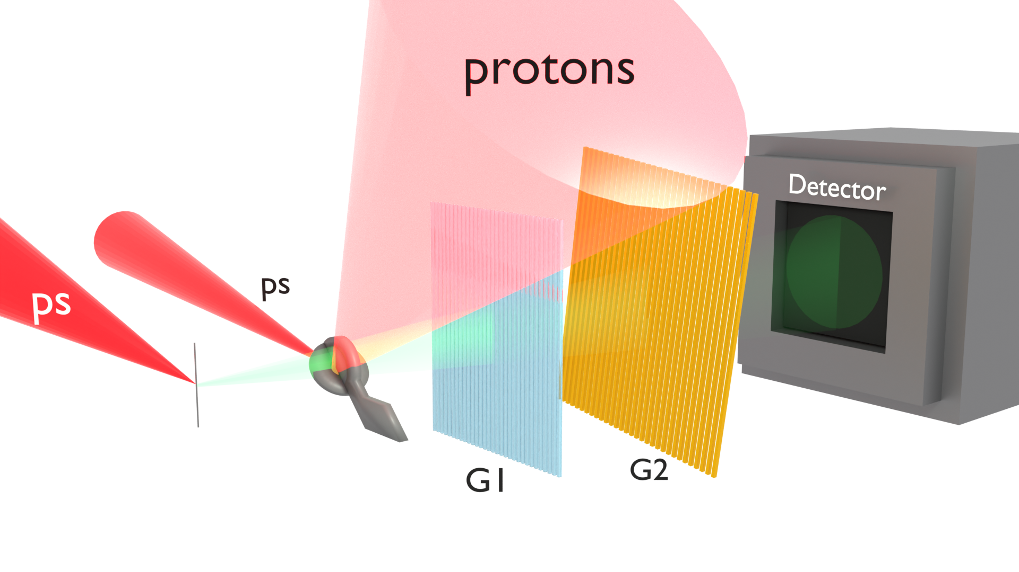
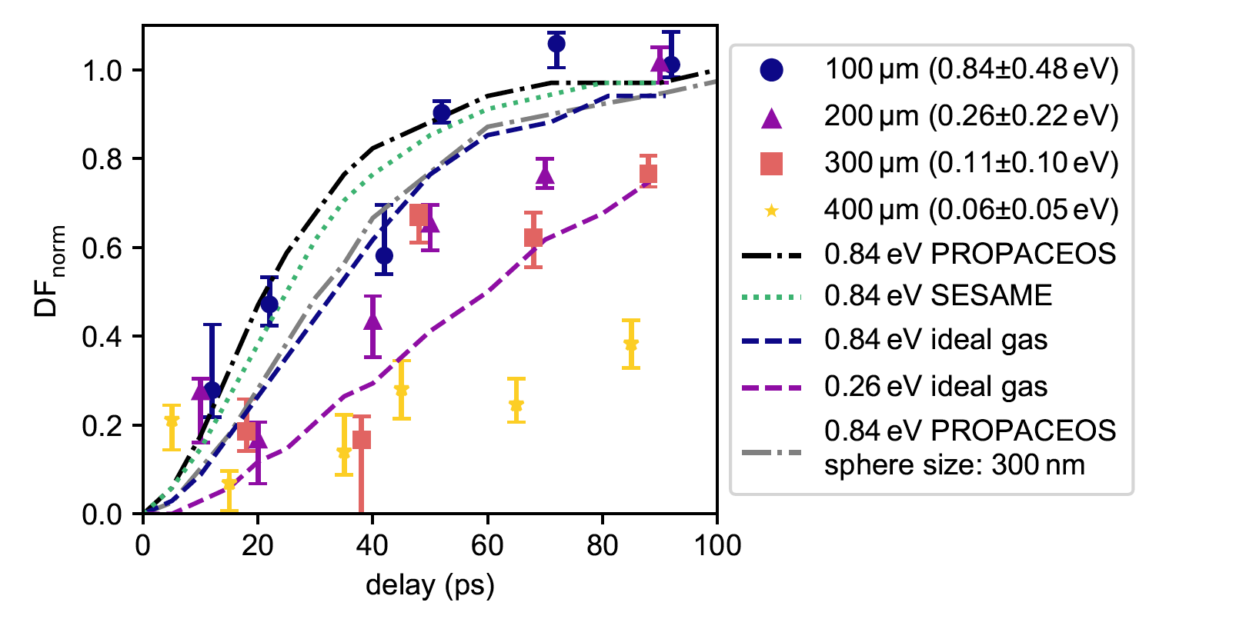

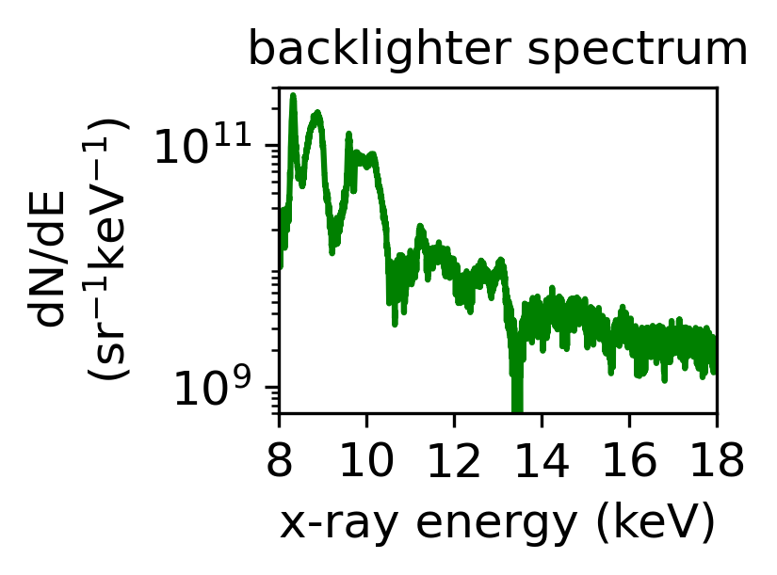
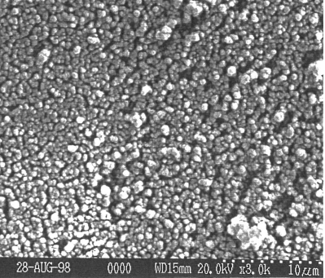
Foam homogenization study: Probing Proton Heated Foam
with X-Ray Talbot Interferometry
Experimental setup
Time evolution of dark-field values at different foam temperatures
PHELIX:
30 J, 1 ps
500µm
5µm W-wire (laser-driven backlighter)
foam
250mg/cc
TMPTA foam
Accepted for publication in scientific report (2025)
10µm

Slide 9

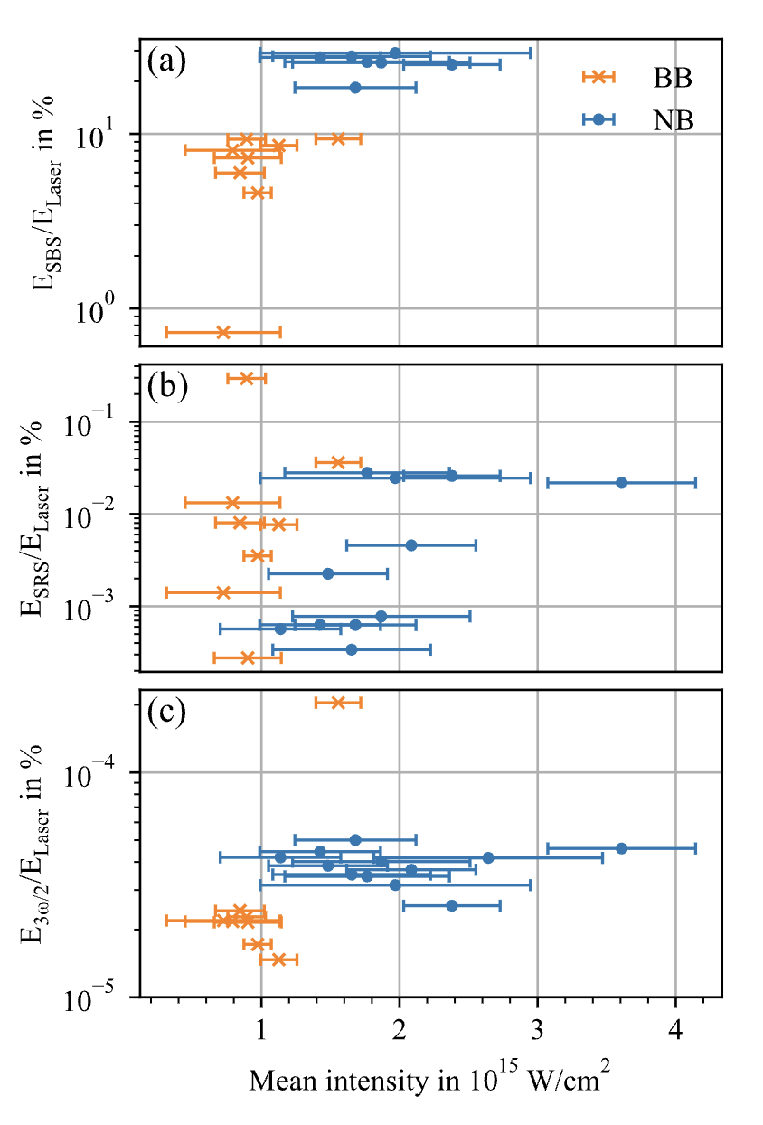
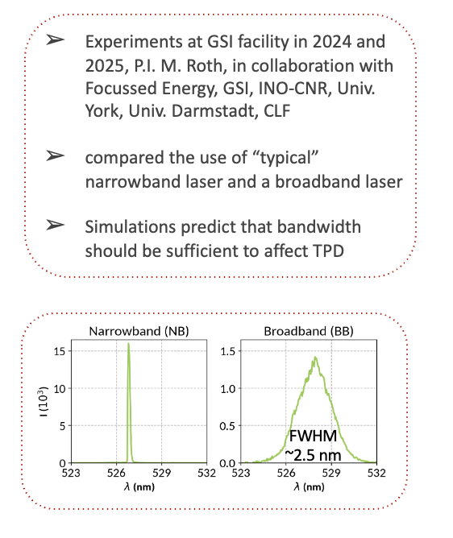

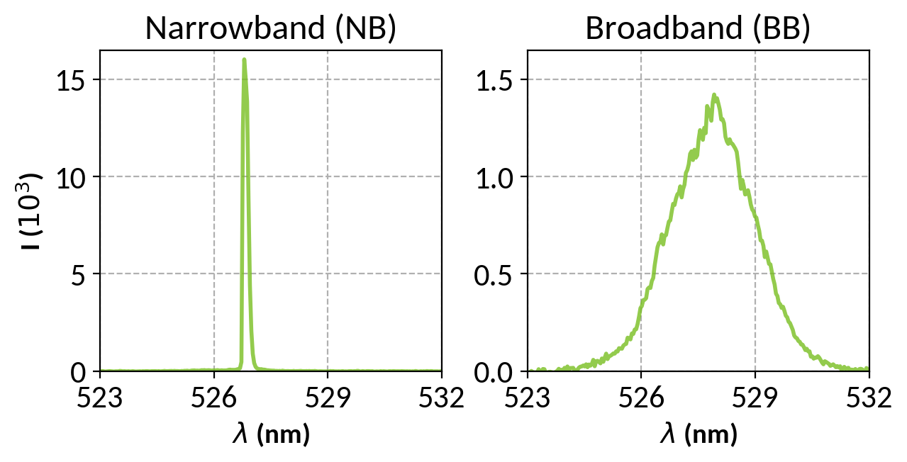
effect of broadband laser on LPI growth @ GSI
Experiments at GSI facility in 2024 and 2025, P.I. M. Roth, in collaboration with Focussed Energy, GSI, INO-CNR, Univ. York, Univ. Darmstadt, CLF
compared the use of “typical” narrowband laser and a broadband laser
Simulations predict that bandwidth should be sufficient to affect TPD
FWHM
~2.5 nm
The fractions of backscattered energy suggest a reduction
in SBS with bandwidth in the backscatter direction, and potentially decreased TPD. For SRS there is no observable difference
Plasma Phys. Control. Fusion 67 (2025)

Slide 10

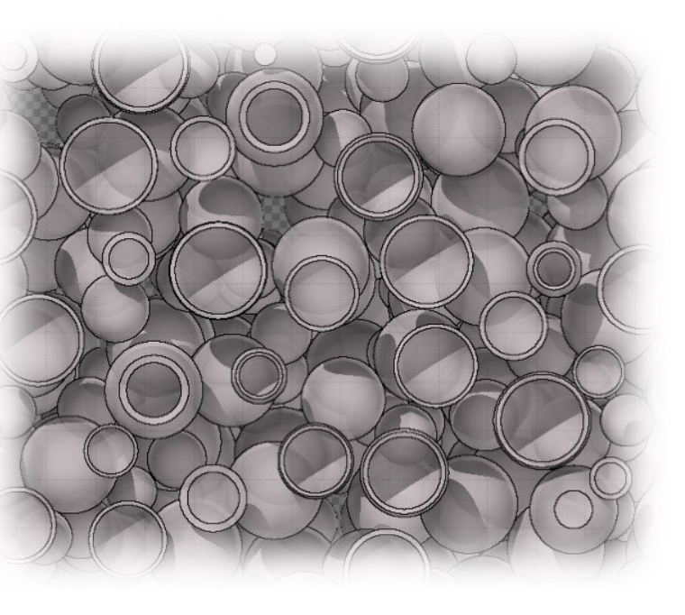
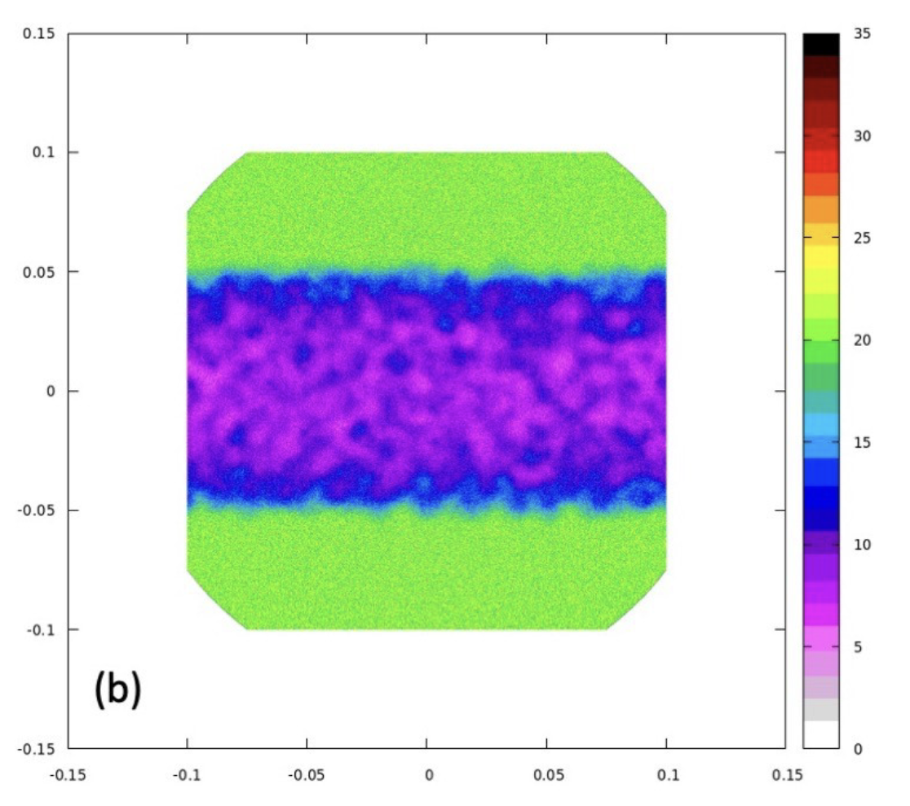

Developing understanding of fundamental processes of laser foam interactions: simulations
Transformation of a nanostructured medium into a plasma
PIC and rad hydro simulation
laser absorption into foams (PIC)
shock propagation in over dense foams (rad hydro)
FLUKA modeling of X-ray/ proton radiographies
-> define the need in term of X ray source
Development of Rayleigh Taylor instabilities in foam mediums

Slide 11
The Rayleigh-Taylor instability with foams
How does the RTI behave when a foam is involved?
One end of the theoretical spectrum: considering it a homogeneous medium of a designated average density.
The other end of the same spectrum: consider an intact foam.
Theoretical model of the RTI with an intact foam.
Mechanical properties of the foam from its inner structure (Gibson 1982, 1987)
RTI formalism (Piriz 2005)

Slide 12

Main result
The Rayleigh-Taylor instability with foams
The interface is stable against the RTI for
γ’/γ
For small deformation, the foam acts like a spring (elastic phase)
Growth rate of RTI reduced, and even stabilized for k > km
km given in terms of the foam’ internal structure
k/km
Ratio of the growth rate γ’ of the foam-RTI, to the growth rate γ of the averaged medium-RTI, in the elastic phase of the foam.
Under review, arXiv:2510.27518

Slide 13

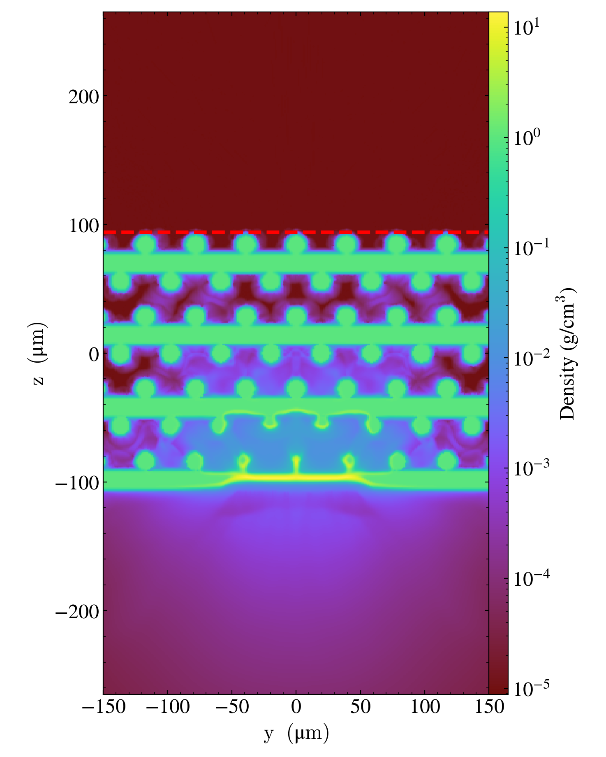
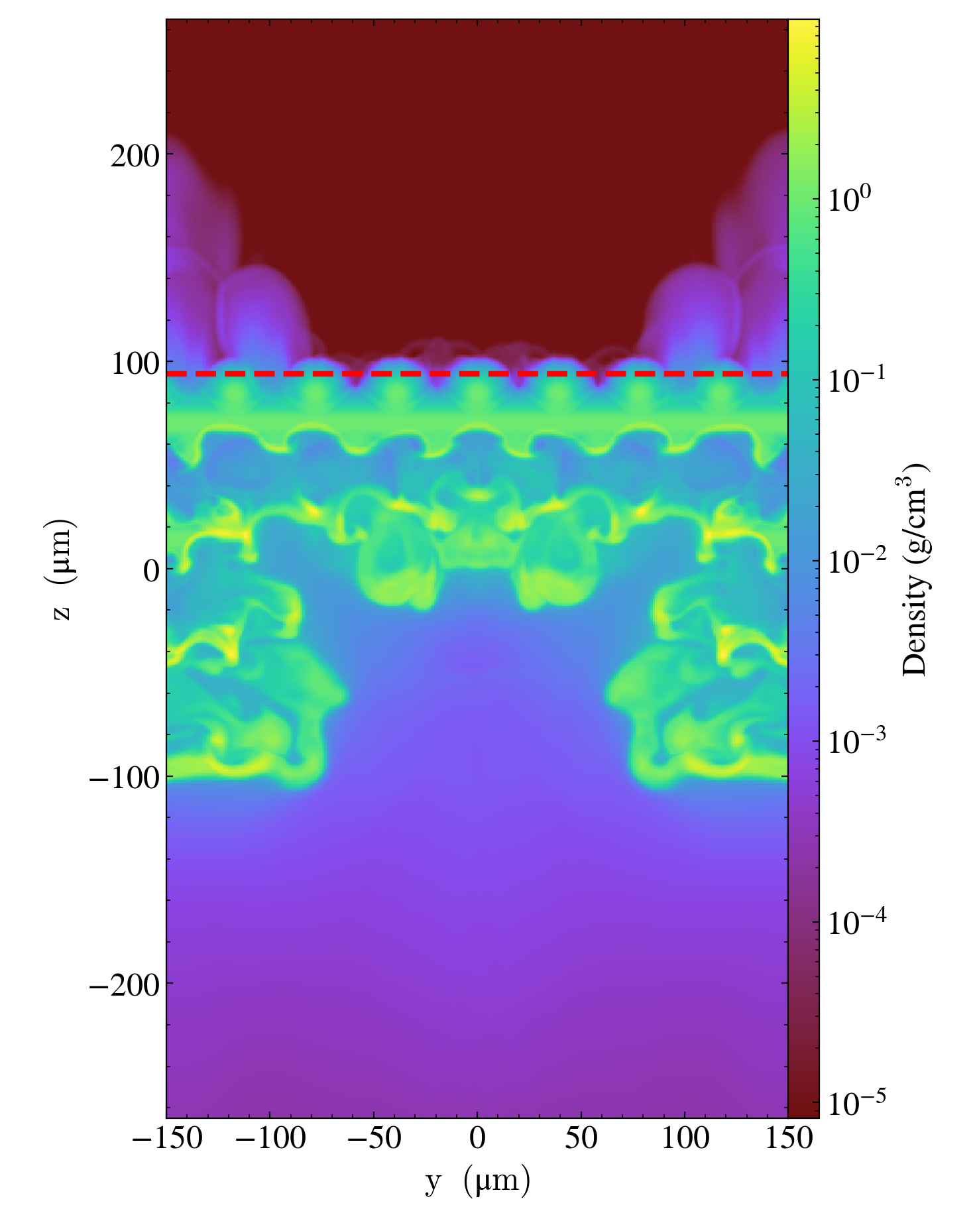
Shock propagation in overdense foam: simulation results (FLASH and PIC)
A simulative work on micro-structured foams, in collaboration with LULI (France) and with Politecnico of Turin (Italy) has been started by using the PIC code SMILEI to investigate the evolution of the laser-generated plasma in the single pore and the effect of ion-ion collisions for the colliding plasmas from neighboring pores.
A series of 3D numerical simulations with the FLASH code on the irradiation of printed log-pile structures was completed.
Good agreement with experimental data from ABC experiments
ENEA – Politecnico of Milan. A simulative work has been started to investigate the peculiar behaviour of these materials observed during an experimental campaign at the ABC laser facility in Frascati (Italy), by using PIC codes to simulate the laser-matter interaction on the nano-scale.

Slide 14

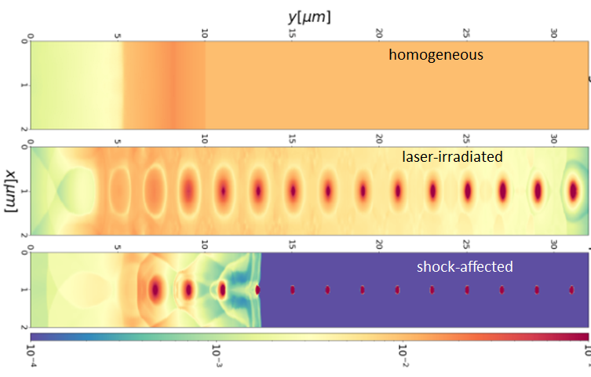
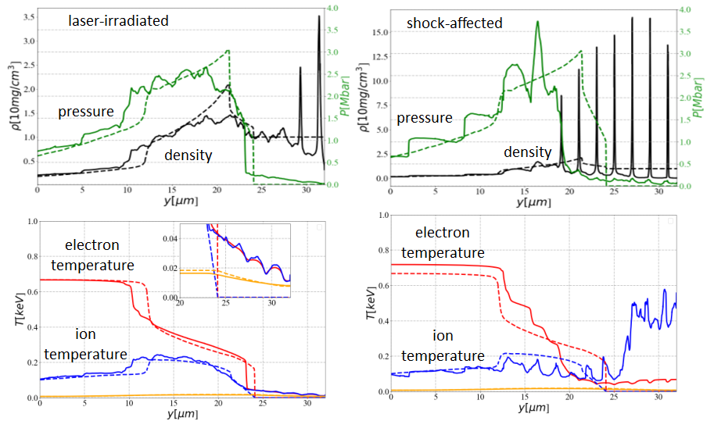
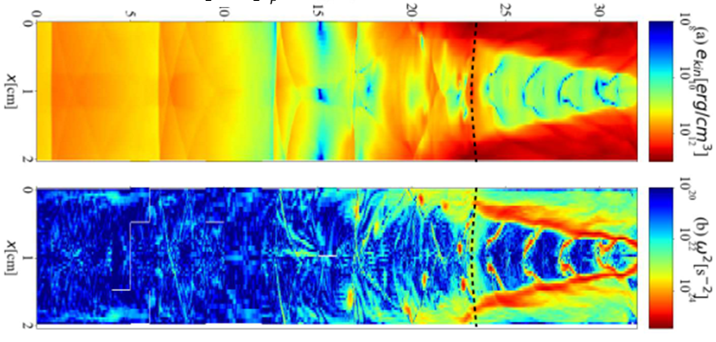
Shock propagation in overdense foam: simulation results (FLASH)
laser
Ion overheating upstream the shock front and plasma homogenization downstream the front: generation of plasma turbulence and vorticity
turbulence
vorticity
Phys. Plasmas 2025, to be published

Slide 15
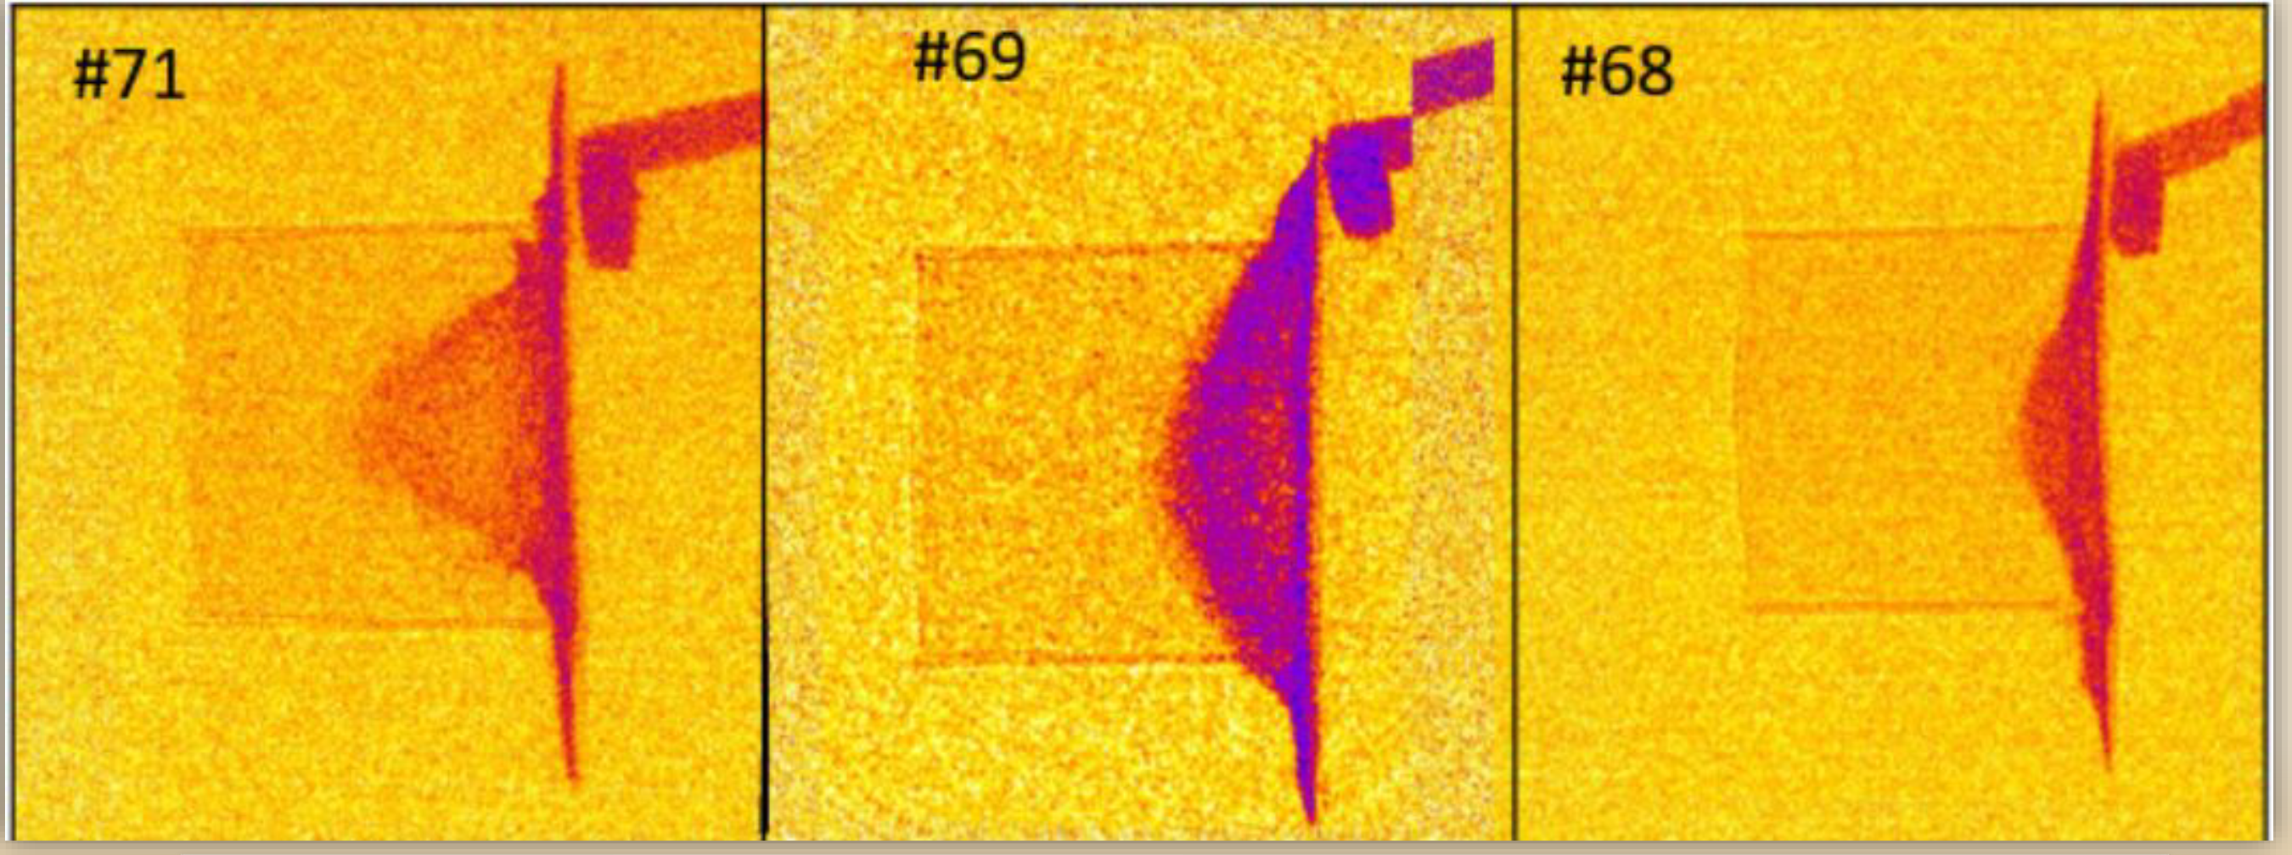

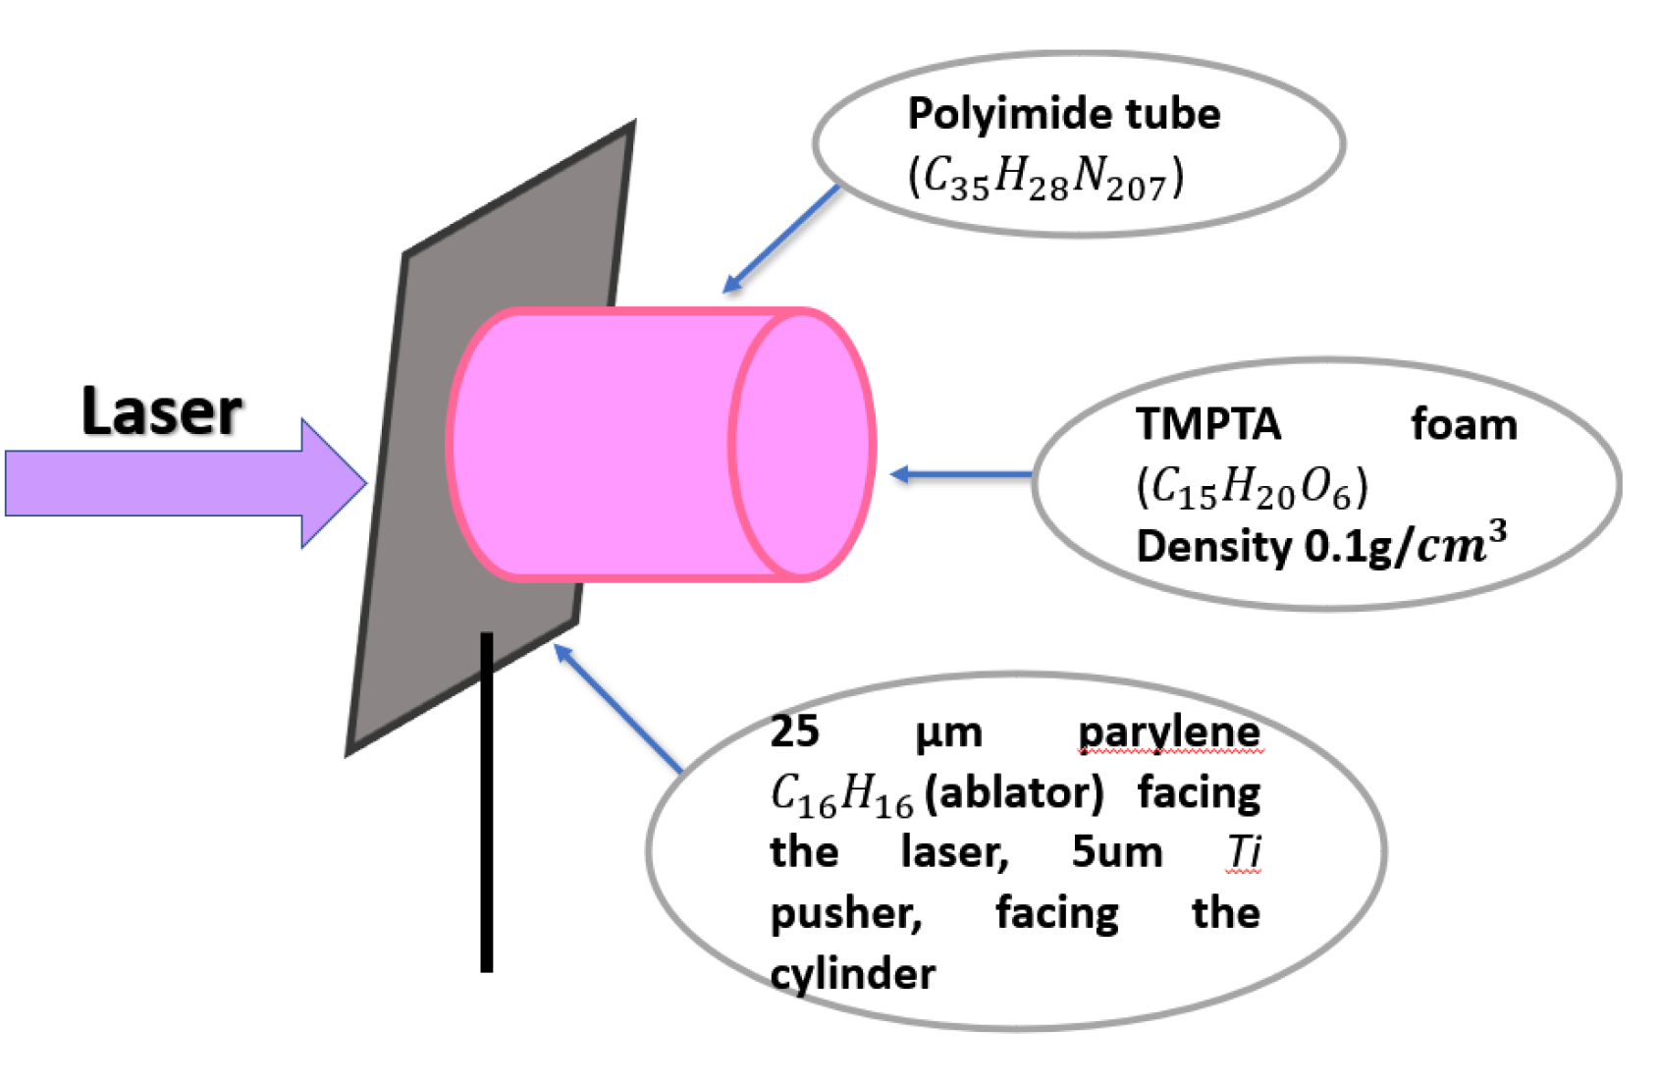
Shock propagation in overdense foam: simulation results (FLASH)
Experiment carried out @ Vulcan on 2021

Slide 16
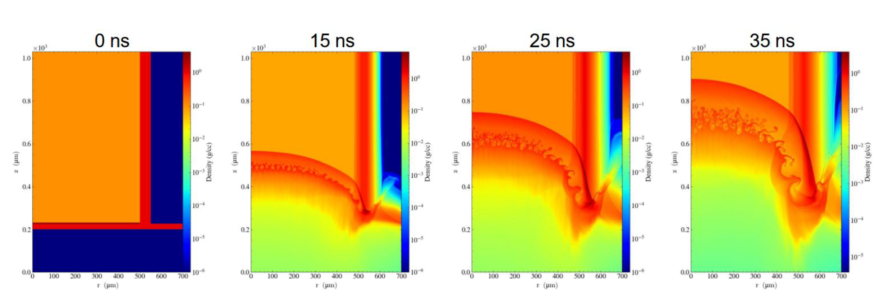
Shock propagation in overdense foam: simulation results (FLASH)
On hydro scale no impact of foam structure on shock propagation (same conclusion than EOS experiments)
Simulations done with new foam models implemented in Flash

Slide 17


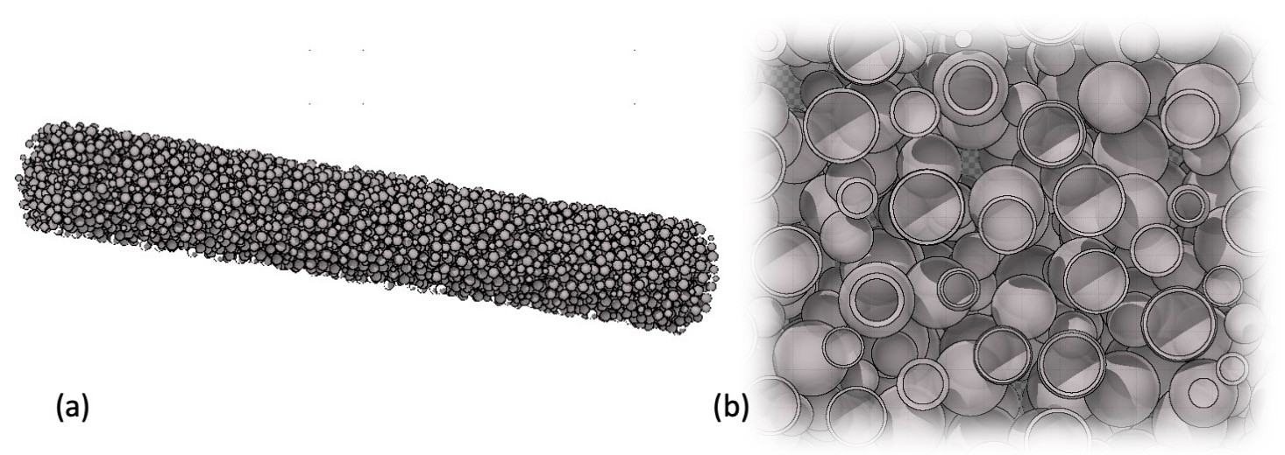
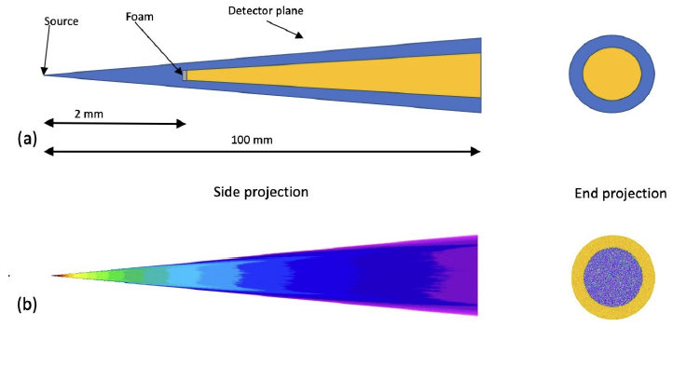
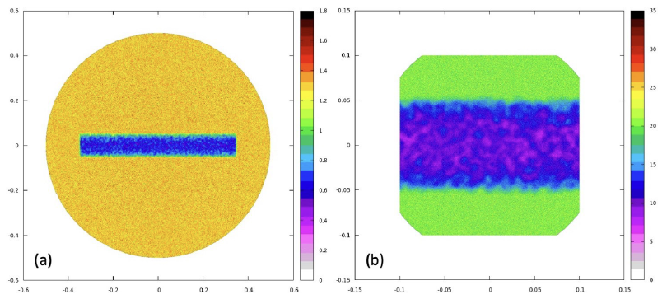
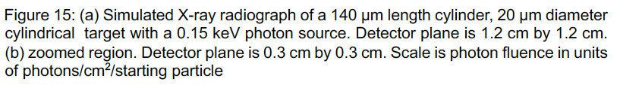
Simulated X-ray radiographs of micron scale structured
The structure of the foam is clearly resolvable and it is clear that for a real world target, it is possible to resolve the detail with a 1 μm FWHM source size.

Slide 18
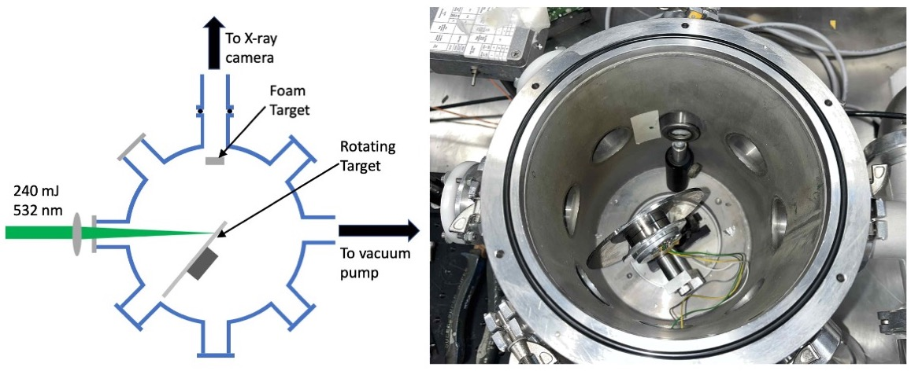
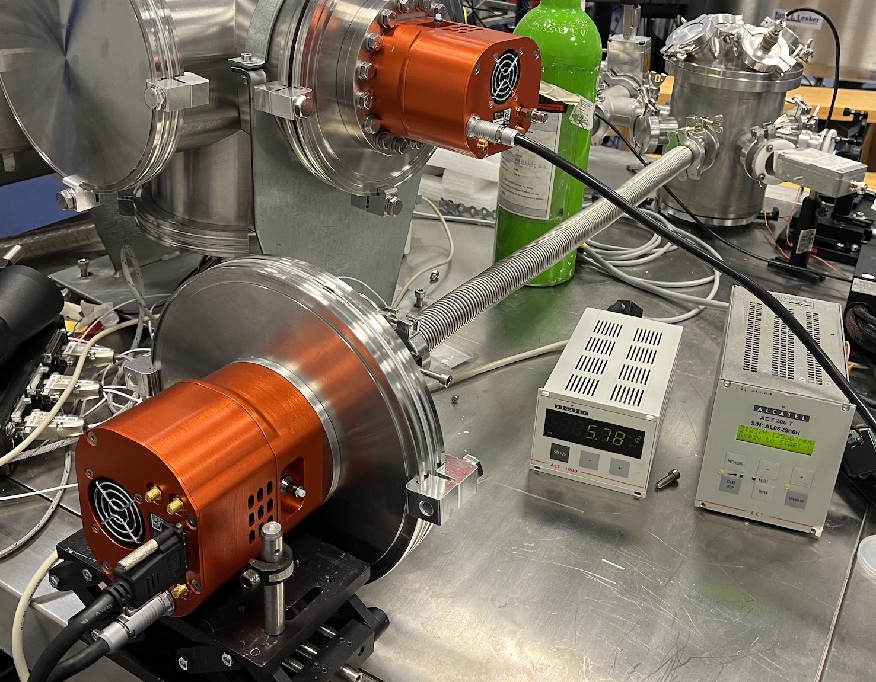
Point projection X-ray radiography of foam targets using a laser produced X-ray source.
Raptor Photonics X-ray camera
A schematic of the interaction chamber and a photograph of the chamber itself showing the rotating target and the mount for positioning the foams to be radiographed.

Slide 19
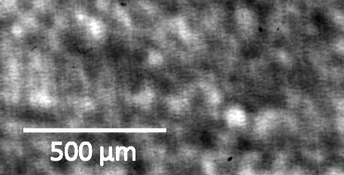
Point projection X-ray radiography of foam targets using a laser produced X-ray source.
Typical Radiograph of 5.5 mg/cm³, 1mm thick foam. Dimension indicated are the distance across the foam.

Slide 20
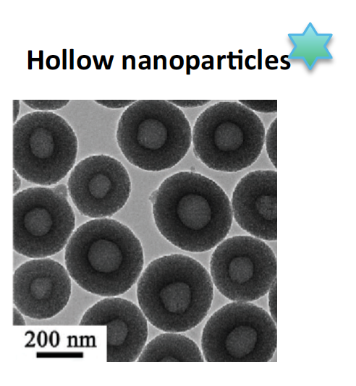

studying the use of advanced nanostructured materials for first wall
Nanostructured materials for fusion reactor first wall
Nanoparticle of W withstand high temperatures and pressures and exhbits self healing propoerties
Development of a laser-driven foam-based neutron source for material research

Slide 21

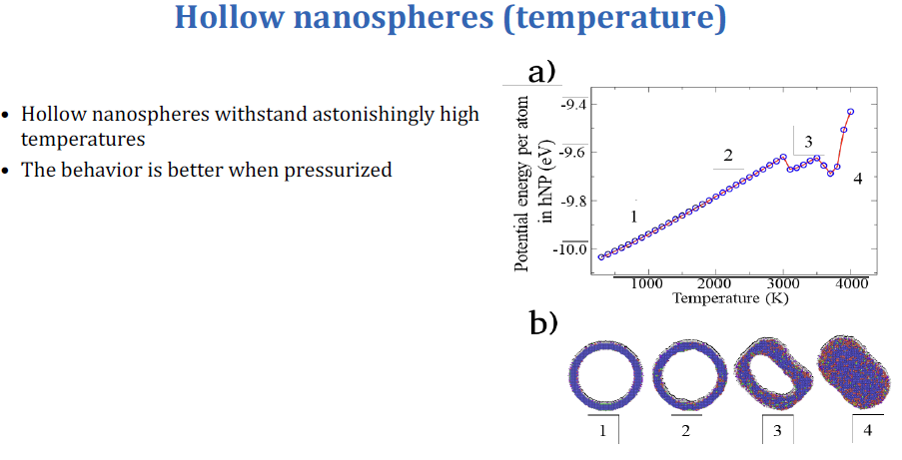
At higher temperatures the W-hNP fully collapses into a solid NP, and finally melts at 3500 K (almost the melting of bulk W)

Slide 22
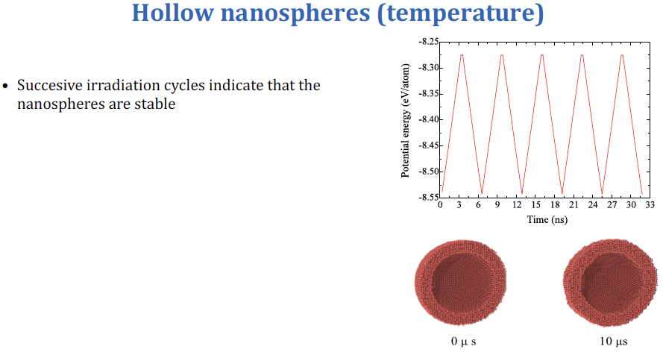
The system was heated and cooled during five successive cycles, in which the temperature was raised from 300 K to 2000 K in 3 ns, kept at that value for the following 0.3 ns, and finally cooled down again to 300 K in 3 ns.

Slide 23
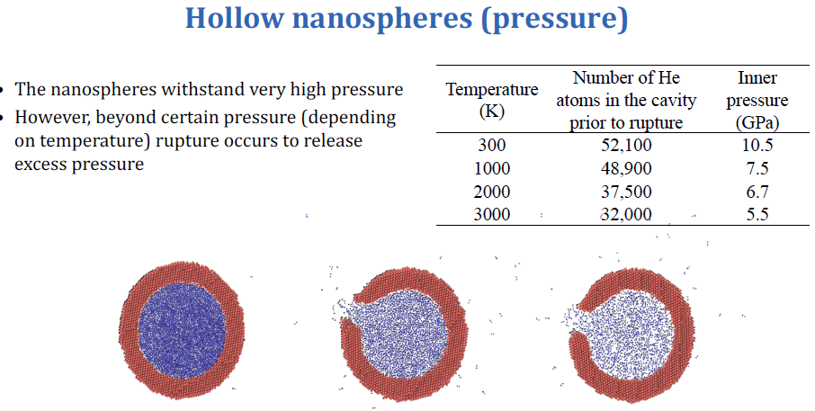

Slide 24
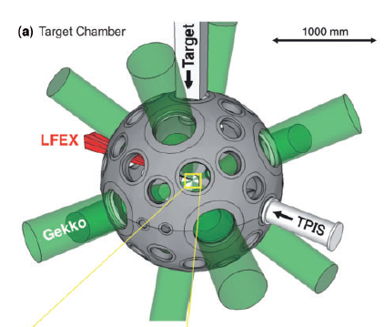
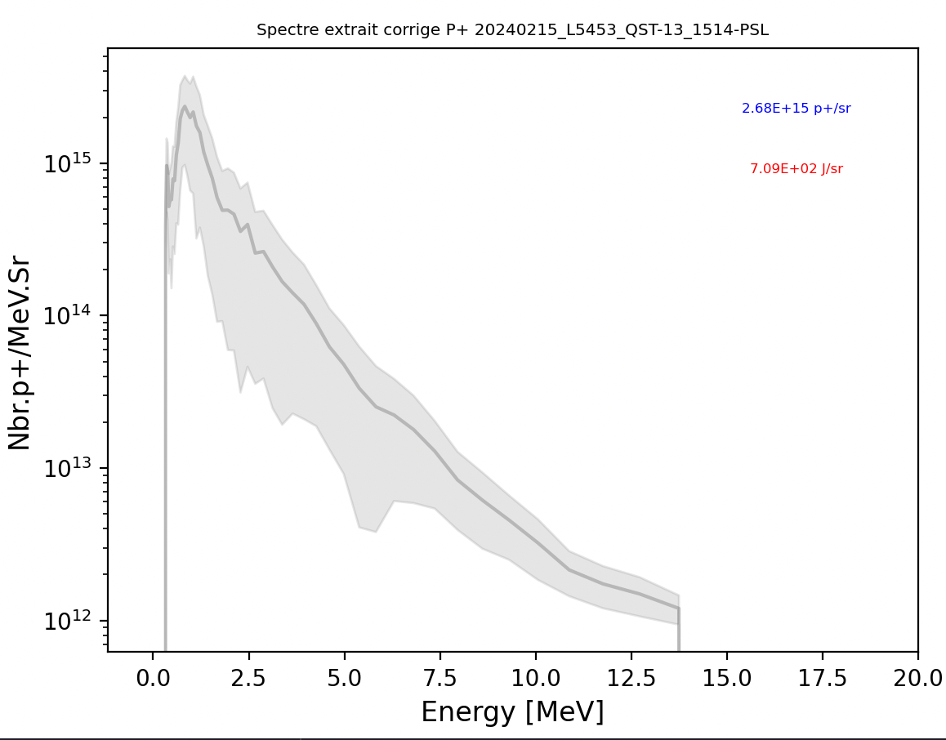
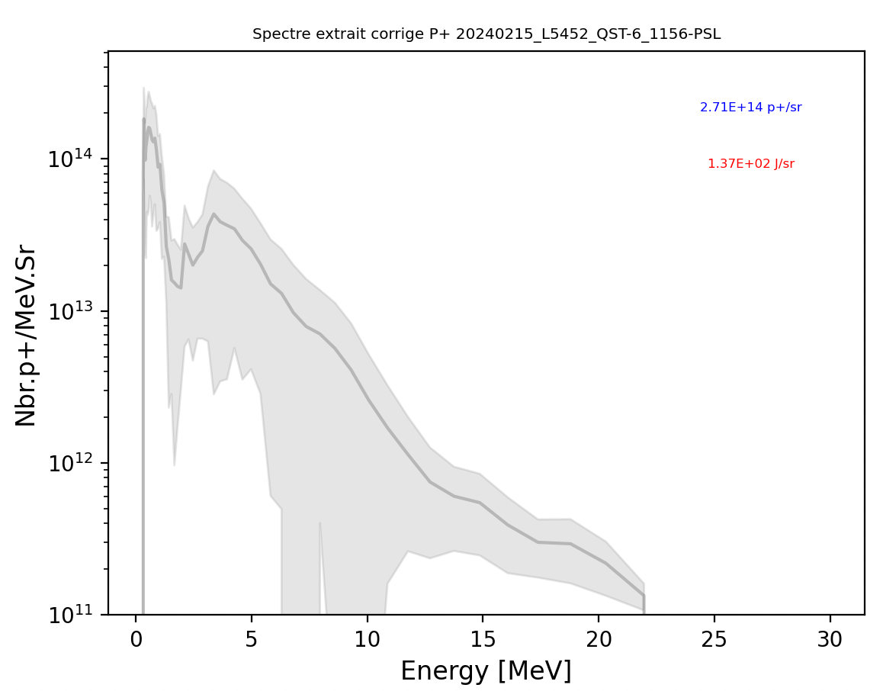
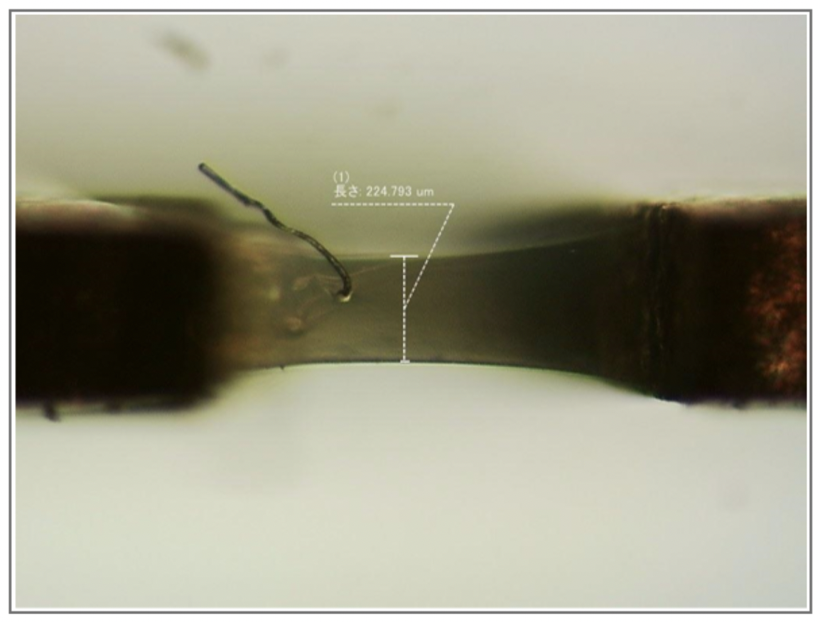
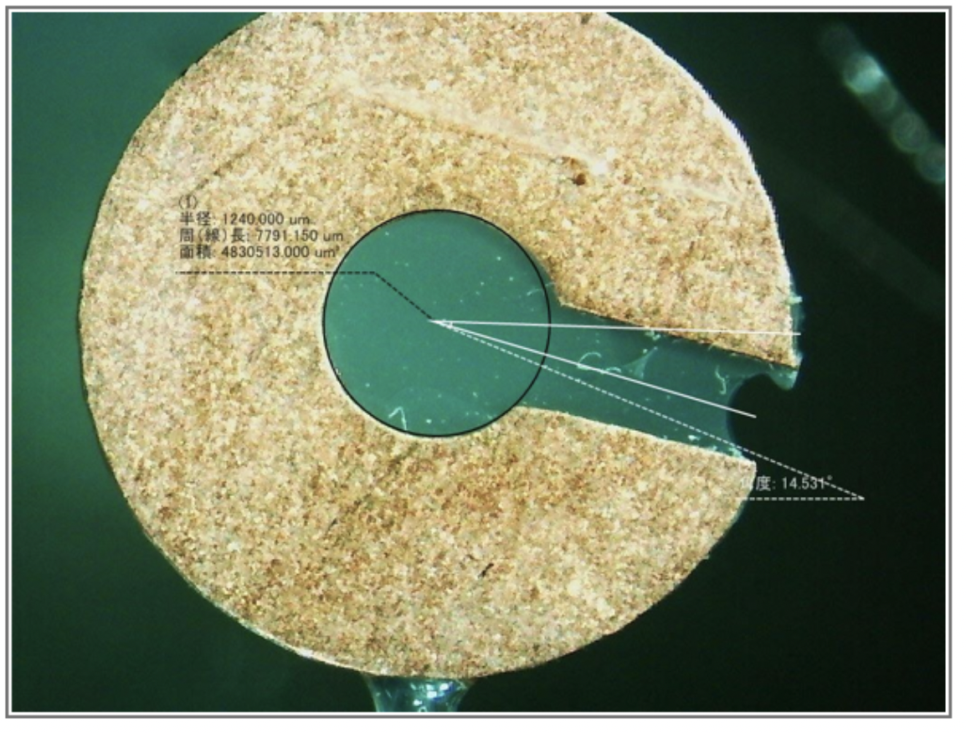
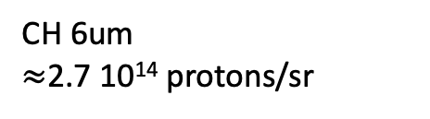
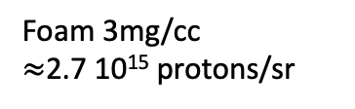
Development of a laser-driven foam-based neutron source for material research: proton generation experiment @ GEKKO XII
Proton spectra
Foam 3mg/cc
$≈$2.7 10¹⁵ protons/sr
3 mg/cc foam targets
CH 6um
$≈$2.7 10¹⁴ protons/sr
With undercritical foams, a very strong emission of protons at low energies

Slide 25

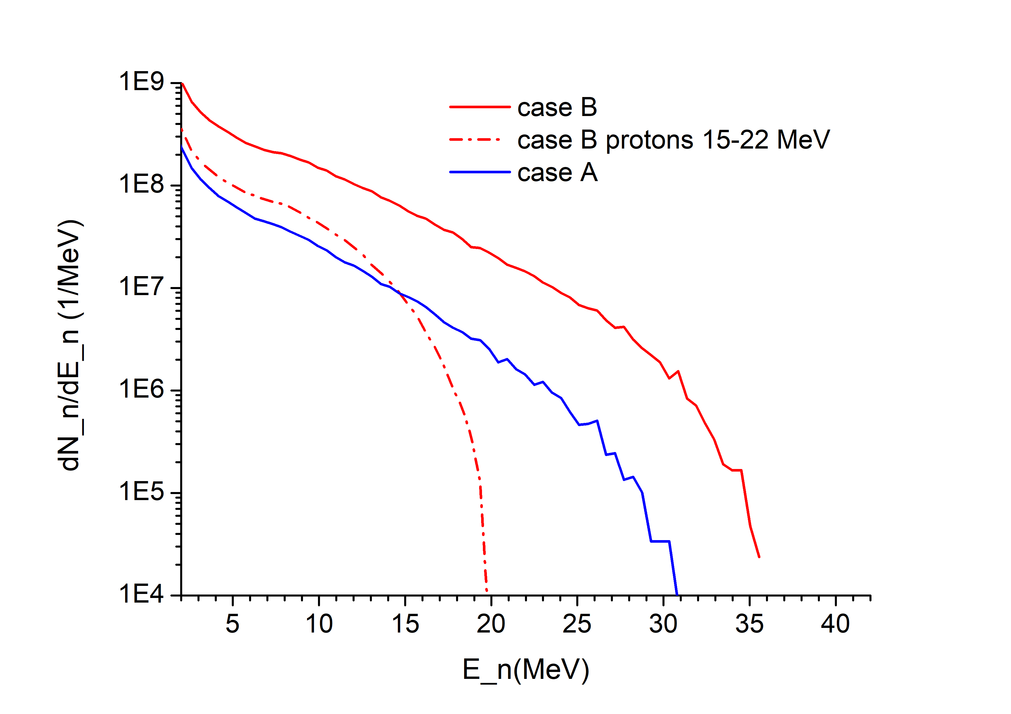
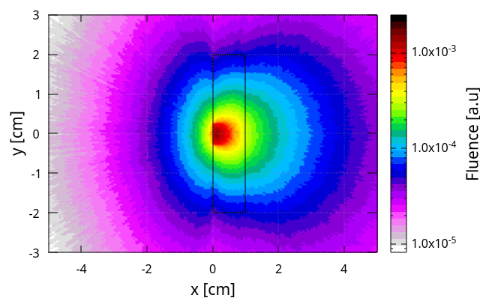
Foams in laser neutron sources for damage and activation studies: PIC simulations of neutron generation
Reference target: C foam + Al foil + CH2 contaminants
Production target: additional ~100 μm solid density CH2 layer on the rear to boost proton count.
Results (2D EPOCH):
proton cutoff ~35 MeV;
3.3e11 protons with E>10 MeV per shot;
Neutrons generated using a 0.8 cm Be converter plate (Fluka simulation):
Fig.1 a) Neutron spectra obtained with 3J (blue solid curve), and 30 J (red solid curve) and from protons restricted to 15-22 MeV interval (red dashed curve). b) Spatial distribution of neutron fluence for neutron generation off Be converter using protons accelerated with the laser B.
100 Hz rep rate => 9.5×109 n/s for 10 Hz

Slide 26
FOPIFE scientific dissemination
First Author | Title of work | Journal / Conference | Doc. Type
S. Le Pape | Foams as a Pathway to Energy from Inertial Fusion | JPP Frontiers of Plasma Physics Colloquium, December 19 | Invited talk
M. Cipriani | Foams for Inertial Confinement Fusion | Workshop on Micro- and Nano-Structured Materials for Experiments with High-Power Lasers, sept 21, 2024 | Invited talk
M. Cipriani | Foams for Inertial Confinement Fusion | Direct Drive and Fast Ignition Workshop in Paris (May 2024) | Plenary talk
V. Tikhonchuk | Physics of porous materials under extreme laser-generated conditions | ECLIM, 09/2024 | Invited talk
J. Limpouch | Laser interaction with foams of different spatial structures | ECLIM, 09/2024 | talk
L. Hudec | Investigation of ion temperature in low-density undercritical foams | EPS conference in July 2024 | Invited talk
L. Hudec | Investigation of ion temperature in low-density undercritical foams | EPS conference in July 2024 | Paper in PPCF
A. Gintrand | Laser-induced shock waves in over-critical foams | Direct Drive and Fast Ignition Workshop in Paris (May 2024) | talk
J. Limpouch | Laser interaction with foams of different spatial structures | Matter Radiat. Extrem. 10, 017402 (2025) | paper
V. Tikhonchuk | Physics of porous materials under extreme laser-generated conditions | Matter Rad. Extrem. 9, 033001 (2024) | paper

Slide 27
FOPIFE scientific dissemination
First Author | Title of work | Journal / Conference | Doc. Type
S. Le Pape | Foams as a Pathway to Energy from Inertial Fusion | Fusion energy conference, Chendgu | talk
L. Wegert | Probing Ultrafast Foam Homogenization with Grating-Based X-Ray Dark-Field Imaging | Accepted in Scientific report | paper
M. Temporal | Alpha particles range modified by hot-electrons adversely affects the energy threshold in direct drive Inertial Confinement Fusion | Eur. J. Phys. Plus 139, 2 (2024) | paper
M. Temporal | Reduction of the deceleration phase to mitigate the negative effect of hydrodynamic instabilities in direct-drive ICF implosions | Phys. Scr. 99 095601 (2024). | paper
A. R. Piriz | Nonlinear, single mode, two-dimensional Rayleigh-Taylor instability in ideal media | Phys. Rev. E 110, 025101(2024). | paper
A. R. Piriz | Quasi-irrotational approximation for the Rayleigh-Taylor instability in a solid bounded by a rigid wall | Phys. Rev. E 111, 015102 (2025). | paper
A. R. Piriz | The Rayleigh-Taylor instability in viscous fluids: the finite thickness effect revisited | Phys. Fluids 37, 022130 (2025). | Paper

Slide 28
FOPIFE scientific dissemination
First Author | Title of work | Journal / Conference | Doc. Type
A. R. Piriz | Quasi-irrotational growth rate for the Rayleigh-Taylor instability in accelerated elastic and viscous layers | Phys. Rev. E 112, 015105 (2025). | paper
A. Bret | The Rayleigh-Taylor instability with foams | Under review, arXiv:2510.27518 | paper
O. Turianska | Laser-driven shock waves propagating in foam targets: time-resolved X-ray radiography and 2D hydrodynamic simulations | Plasma 2025, Warsav | Invited talk
C Kanstein | Experimental study of laser plasma instabilities with broadband laser pulses at the GSI PHELIX laser facility | Plasma Phys. Control. Fusion 67 (2025) | paper

Slide 29
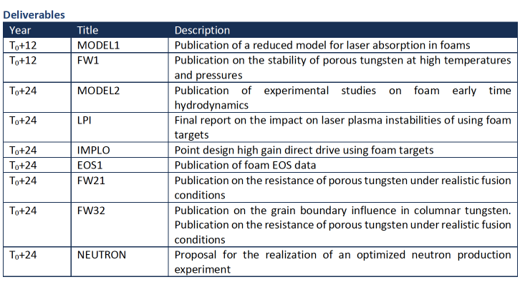
Projects deliverables
done
In progress
done
done
done
In progress
In progress
done

