Slide 1

LID target plate
1st thoughts
17.3.2020 I Miroslaw Zlobinski, G. Sergienko et al.

Slide 2
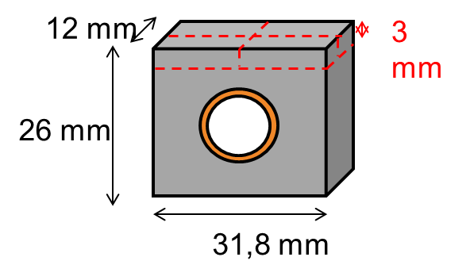
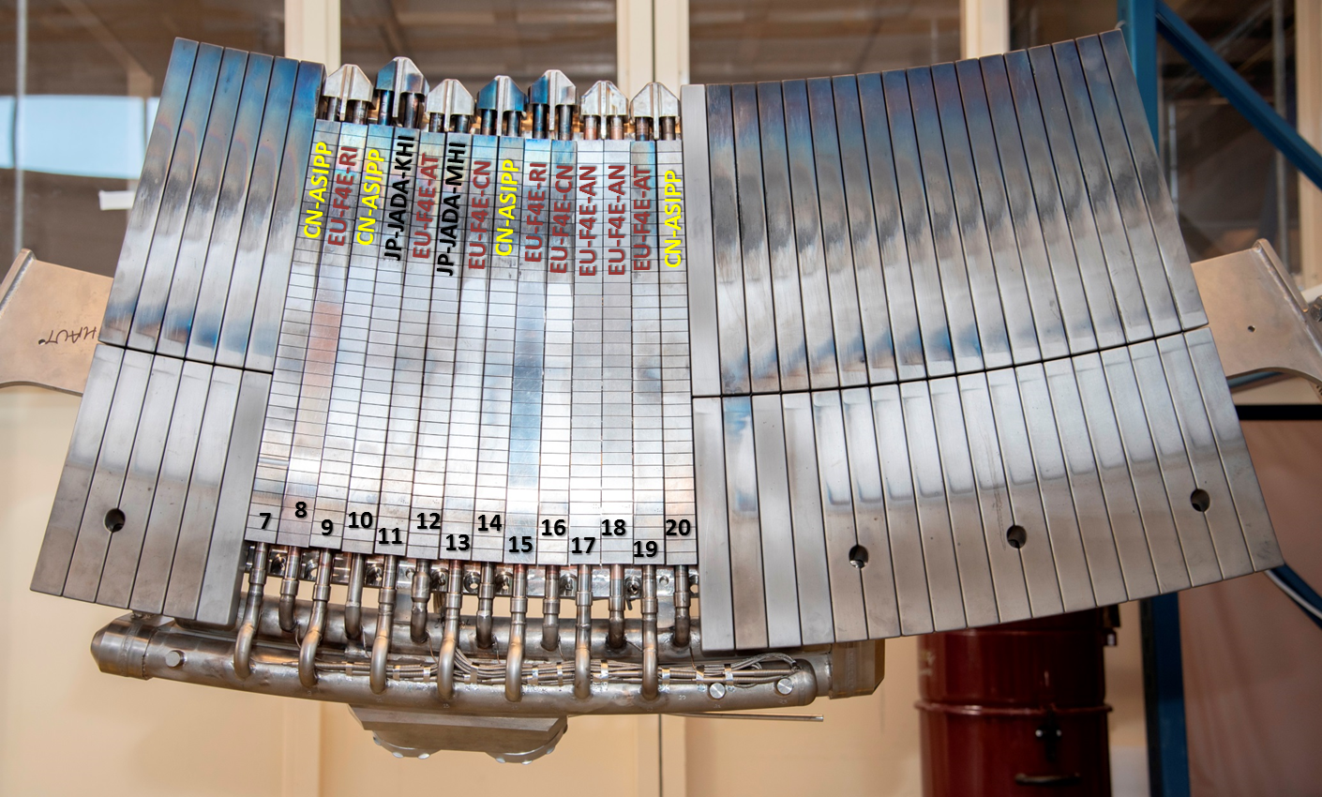
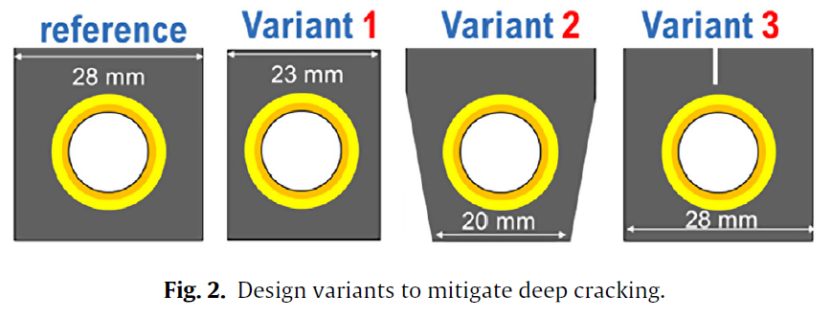

ITER like castellation
Geometry:
ITER divertor test tiles in WEST :
12 mm fixed for ITER (IEK-2 info)
28 mm probably. width fixed?
M. Li (2017) doi:10.1016/j.fusengdes.2017.01.015
2

Slide 3
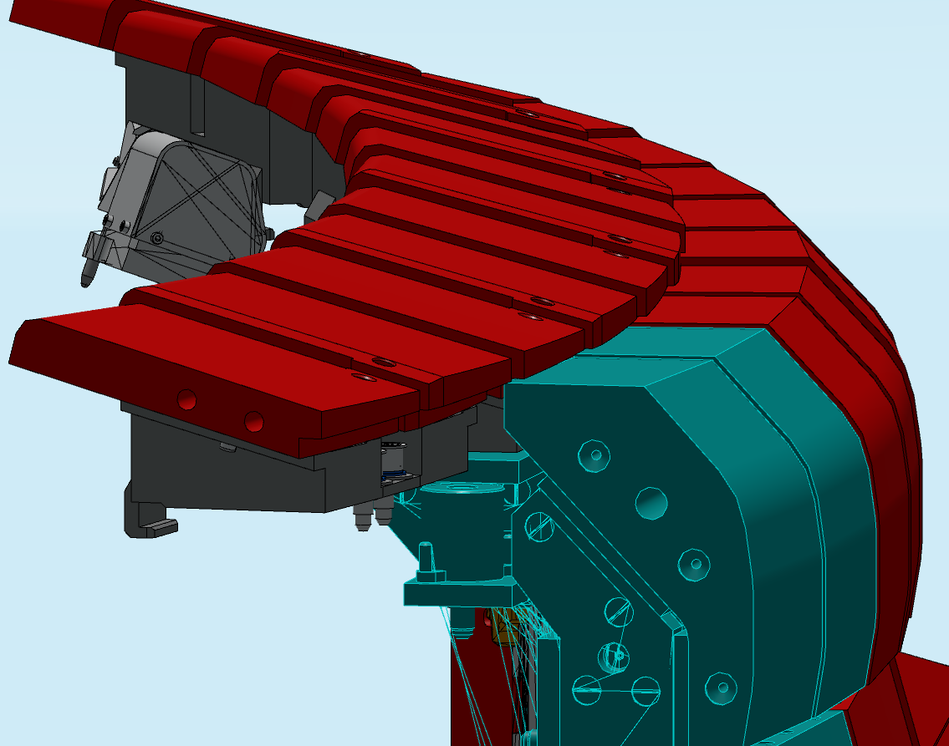
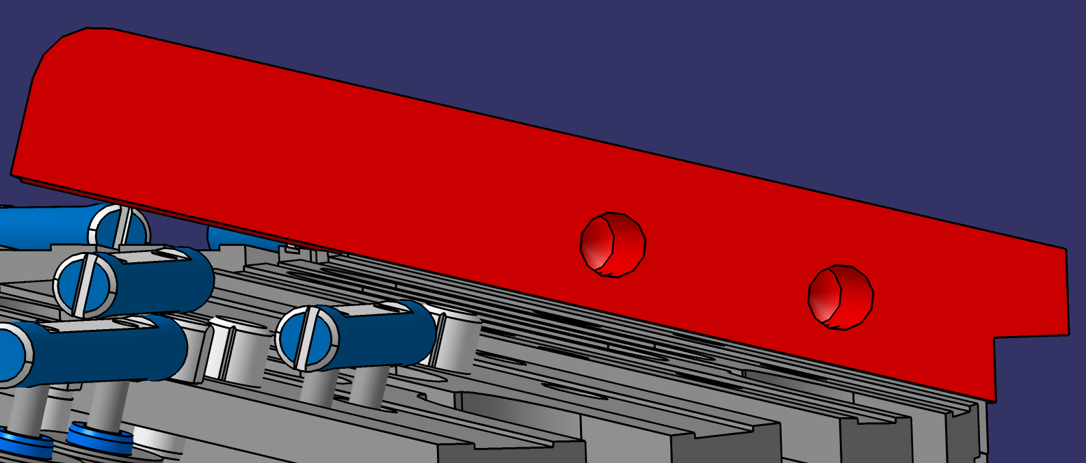
JET top inner divertor (old CAD model)
LID target tile geometry:
top surface: bulk W (ca. 4-5 mm)
with notches (ca. 2 mm deep)
in ITER castellation geometry
12 mm x 28 mm, gap: ? mm
tile 0
tile 1
side view of tile 0
3

Slide 4
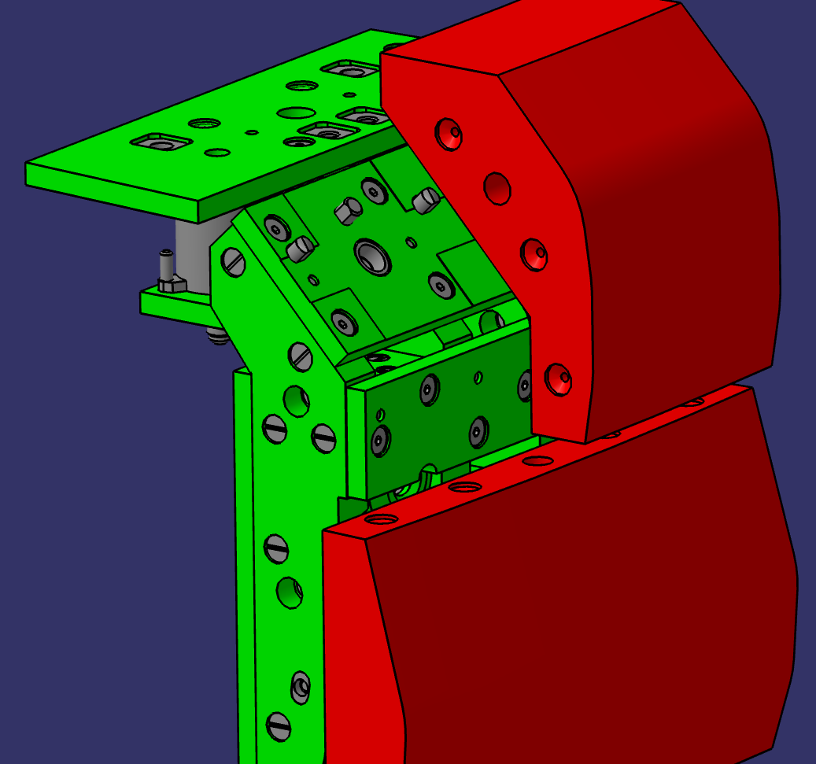
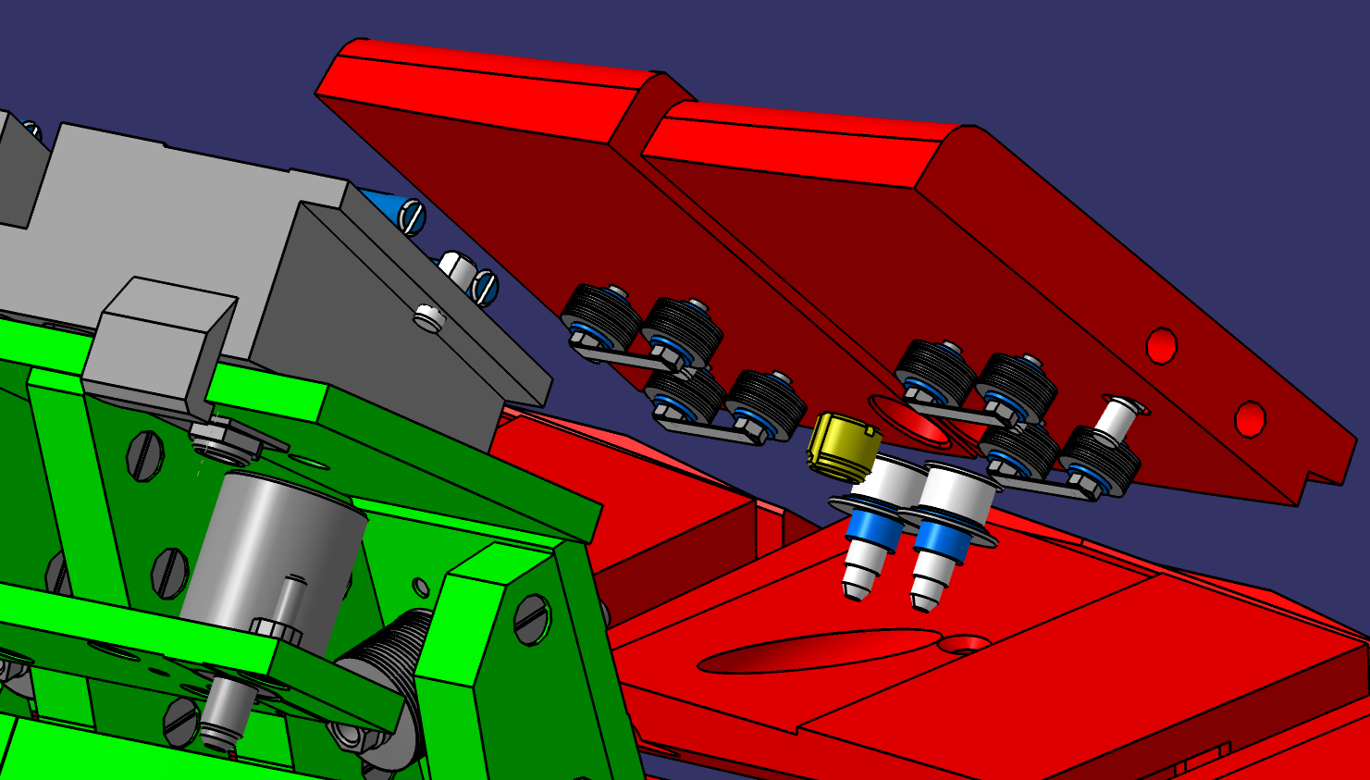
Tile mounting (old CAD model)
tile 1
tile 0
4

Slide 5
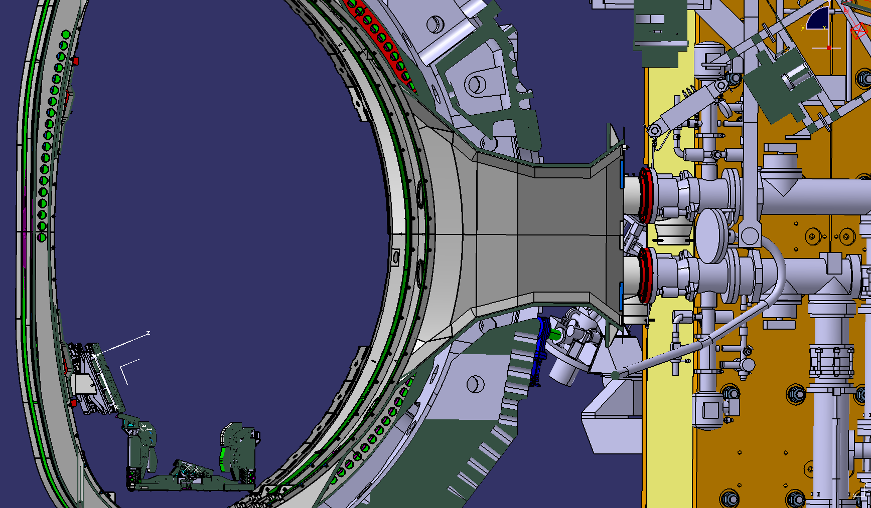
Targeting (cross section view) (new CAD2020 model)
tile 0
tile 1

