Slide 1
SP B monitoring meeting 2025
Overview, 10 October, 2025
Antti Hakola
On behalf of the SP B team and task holders

Slide 2
Overview of SP B in 2025 – high-level status of activities
Progress has been made in the following activity areas as follows
SP B.1: Physics of erosion and deposition - focus on cross-machine investigations
Several B samples exposed to plasmas (PSI-2, MAGNUM-PSI, GyM) to study physical and chemical erosion; W programme proceeding more slowly
Erosion rates at varying incident angles measured for W and B reference layers, exposure of W layers to dust impacts scheduled
SP B.2: Material migration in toroidal devices - concentrate on samples from boronization studies and WEST monoblocks
Results from WEST Phase 1 tiles and samples extensively reported (PFMC 2025), cutting of samples from Phase 2 PFUs ongoing
Several samples from AUG and WEST boronizations (full and partial) analysed
Analysis of cavity samples from W7-X completed, measurements of divertor manipulator samples from AUG started
SP B.3: Characterization of plasma-exposed materials - samples coming from SP B.1 and SP B.2 (+ SP B.4)
Focus on WEST samples as well as samples from boronization experiments and varying B reference layers
SP B.4: Reference coatings for ITER and DEMO - production of B and W layers
Large programme to compare B layers produced by different labs by different techniques – all except VTT samples produced (pure B layers)
W layers produced for targeted activities, highest interest for layers emulating re-deposits
SP B.5: Production of metallic dust in toroidal devices – re-scoping to primarily deal with dust analyses
W7-X dust samples available and their characterization chain agreed; dust samples from AUG and WEST to be clarified
Formation studies of B and W dust particles continued, this subtask will be largely finished by the end of 2025
SP B.6: B deposition on diagnostics mirrors
Post-exposure analyses of the mirrors still ongoing, samples need to be shipped to other labs before the end of 2025

Slide 3
High-level deliverables and milestones for SP B in 2025
Erosion and deposition patterns at the divertor and main-chamber structures of toroidal fusion devices following operations with and without boronizations
Reporting the role of fluence and pulse length in the erosion-deposition balance in toroidal fusion devices under reactor-relevant operational conditions
WMxx | SP B | Erosion rates of co-deposited/re-deposited W layers at reactor-relevant particle fluxes and fluences determined. (ITER+DEMO) | 31.12.2025
WMxx+1 | SP B | Material migration pathways elucidated for W and B in toroidal devices (AUG, WEST, W7-X) during and after boronizations. (ITER) | 31.12.2025
WMxx+2 | SP B | Erosion and deposition patterns on PFUs removed after Phase 1 and Phase 2 operations on WEST compared. (ITER) | 31.12.2025
WMxx+3 | SP B | Co-deposited boron layers with varying oxygen contents and surface morphologies delivered and characterized. (ITER) | 31.12.2025
WMxx+4 | SP B | W dust samples from toroidal fusion devices (AUG, WEST, W7-X) characterized and extrapolations made towards fusion reactors. (DEMO) | 31.12.2025
WMxx+5 | SP B | B contamination determined on diagnostics mirrors after AUG and W7-X boronization experiments. (ITER) | 30.06.2025

Slide 4
SP B.1 deliverables 2025 and their status
Activity | Deliverable ID(s) | Title
SP B.1 | D001 3 PM | Erosion rates of W/B model systems and re-deposited W with different morphologies and compositions as well as the formation and erosion rates of thick re-deposits in MAGNUM-PSI with flux and fluence (DIFFER) See presentation by T. Morgan
SP B.1 | D002 4 PM | Erosion rates of W/B model systems and re-deposited W with different morphologies and compositions in GyM with flux and fluence (ENEA) W samples with different morphologies and B samples exposed to Ar plasmas in GyM and their erosion assessed Samples sent to participating labs for analyses
SP B.1 | D003 7 PM | Erosion rates of W/B model systems and re-deposited W with different morphologies and compositions in PSI-2 with flux and fluence (FZJ) See presentation by M. Rasinski
SP B.1 | D004 5 PM | Erosion rates of co-deposited W- and B-based model systems following exposure to controlled ion beams (ÖAW) See presentation by R. Gurschl
SP B.1 | D005 1 PM | Erosion rates following high-energy dust impacts on W model systems and comparison to data from tokamaks (ENEA) Waiting for all the samples to arrive (status mid-September) before starting dust-impact experiments

Slide 5
SP B.2 deliverables 2025 and their status
Activity | Deliverable ID(s) | Title
SP B.2 | D001 6 PM | WEST campaigns: erosion and deposition patterns on PFUs after WEST Phase 1 (C1-C5) and Phase 2 (C6-C10) operations and thickness profile of layers originating from boronizations (CEA) See presentation by M. Diez
SP B.2 | D002 2 PM | WEST campaigns: microscopy investigations of He-exposed PFUs after Phase 1 and Phase 2 operations on WEST (CEA) See presentation by M. Diez
SP B.2 | D003 2 PM | WEST campaigns: detailed investigation of selected PFUs, including side faces of marker tiles, for their erosion, deposition, and surface-modification patterns at different locations with respect to magnetic ripple (MPG) Talk by M. Balden in PFMC 2025 (next slide)
SP B.2 | D004 5 PM | AUG manipulator experiments: pre- and post characterization of samples exposed to AUG plasmas and/or boronizations on AUG for their erosion and surface-modification patterns as well as boron deposition profiles (MPG) Experiments performed and analyses ongoing (next slide)
SP B.2 | D005 3 PM | AUG manipulator experiments: deposition profiles of B and D on samples exposed to AUG plasmas and/or boronizations on AUG at high spatial and depth resolution (VTT) See previous line

Slide 6
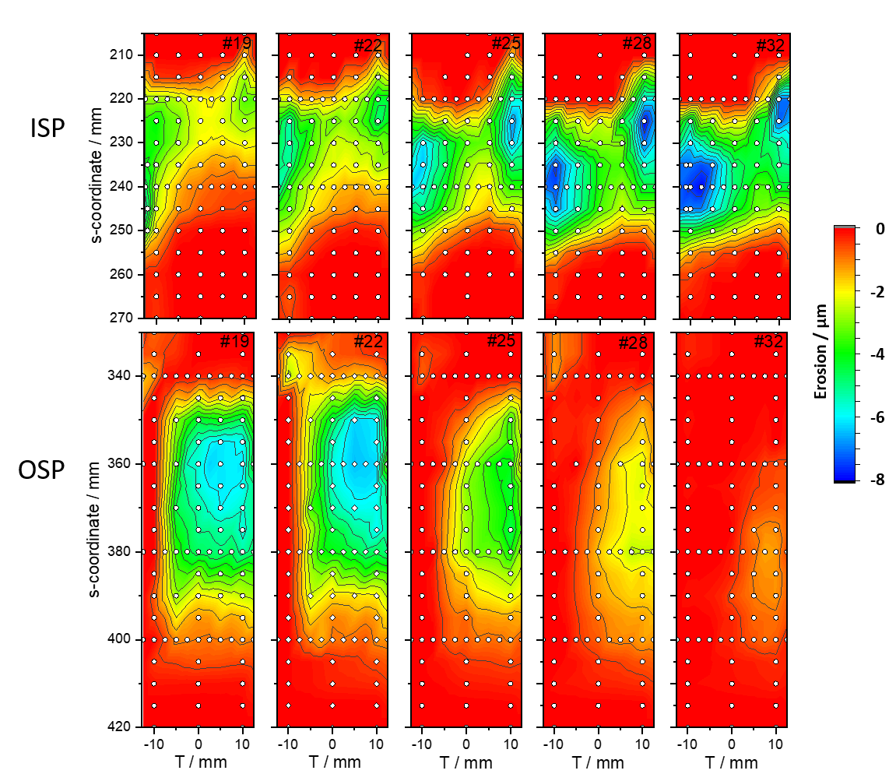
Effect of toroidal ripple on erosion at WEST (MPG + CEA)
Several standard W-coated tiles (from Phase 1) from different toroidal locations analysed for their net-erosion patterns
Some ~5-10 times different erosion rates between minima and maxima of the ripple and with strong local variations
Highest erosion on each tile is not at the toroidal central line due to the beveling and shadowing of the tiles

Slide 7
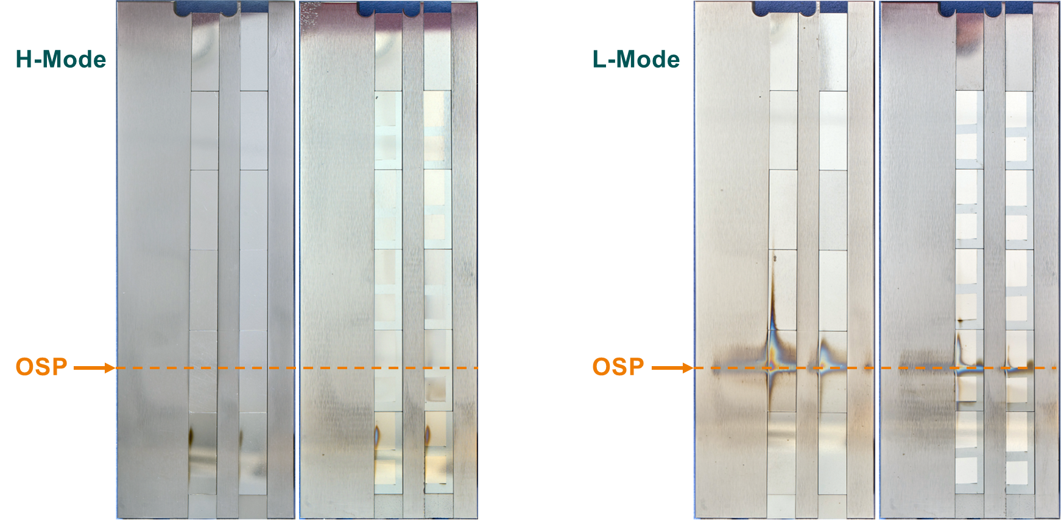
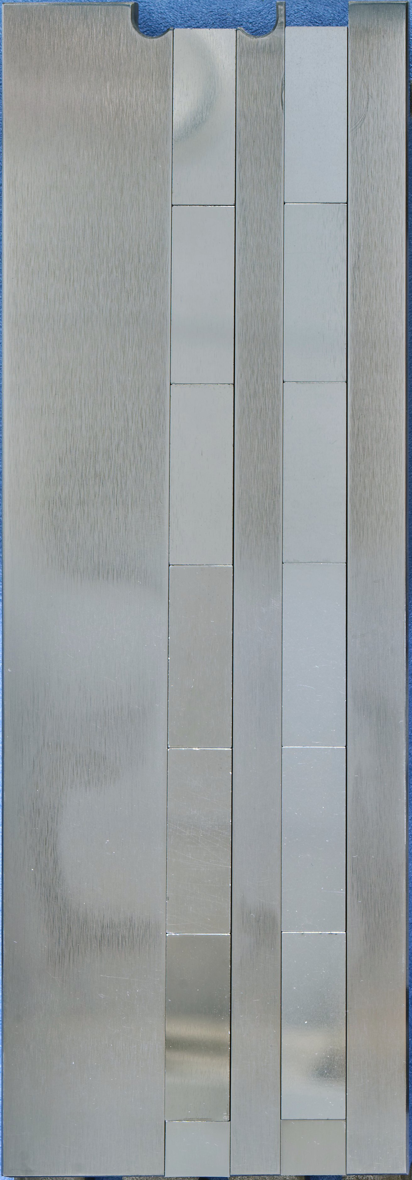
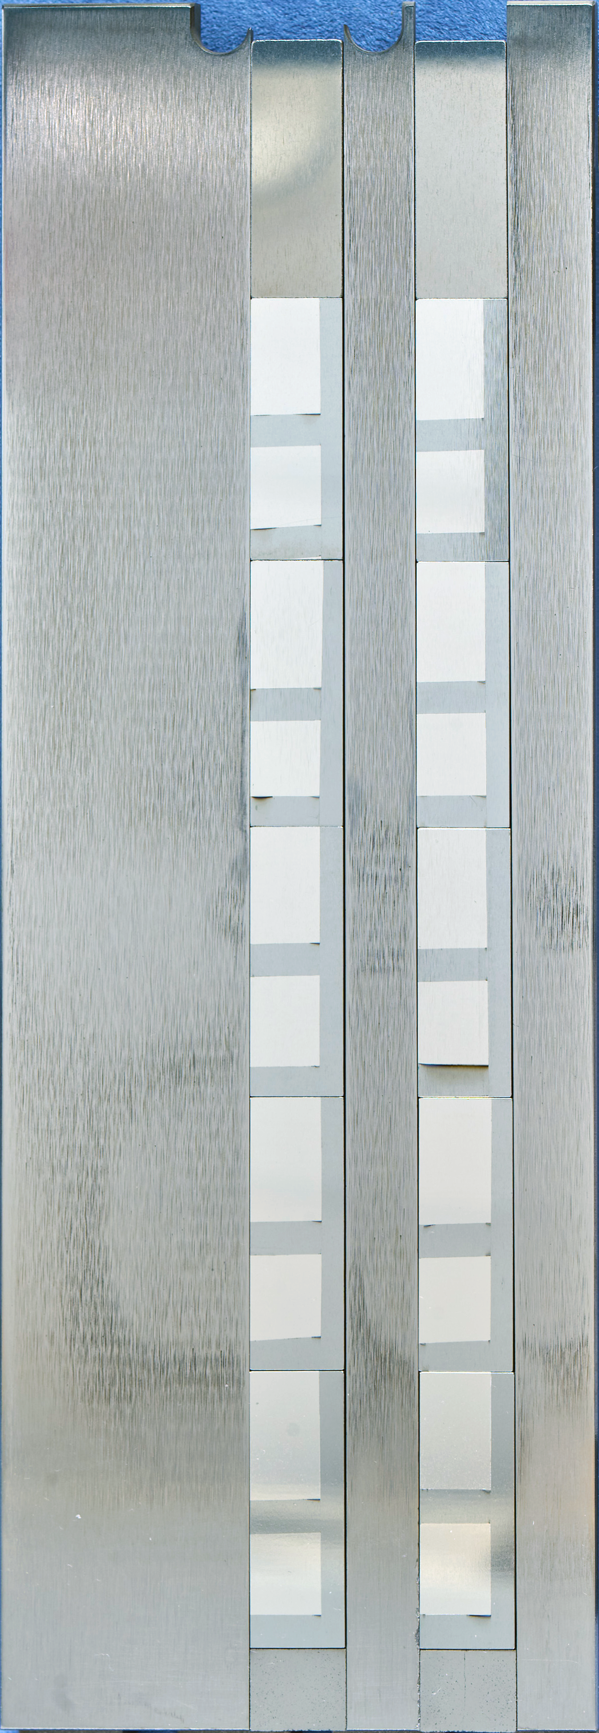
Erosion experiments on AUG (MPG + FZJ + VTT)
Before exposure
Samples exposed to L-mode and H-mode plasmas on AUG with Ne injection
Pre-characterization done, post analyses to be initiated in late 2025
VIS
After exposure
W
Mo
Pt|Mo
OSP
7

Slide 8
SP B.2 deliverables 2025 and their status
Activity | Deliverable ID(s) | Title
SP B.2 | D006 2 PM | AUG campaigns: deposition profiles on samples originating from boronizations on AUG (RBI) Scope changed to perform microbeam investigations of AUG manipulator samples
SP B.2 | D007 2 PM | AUG campaigns: changes in the surface properties of samples exposed to AUG plasmas and/or boronizations on AUG (FZJ) See talk by M. Rasinski
SP B.2 | D008 2 PM | W7-X manipulator experiments: erosion and deposition characteristics on manipulator and other samples exposed to OP2 plasmas on W7-X (FZJ) Preparation and pre-characterization of W and Mo samples before W7X OP2.3 exposures Post characterization initiated
SP B.2 | D009 3 PM | W7-X manipulator experiments: erosion and deposition patterns on manipulator samples and wall components from OP2 experiments and/or boronizations on W7-X (MPG) See presentation by C. P. Dhard

Slide 9
SP B.3 deliverables 2025 and their status
Activity | Deliverable ID(s) | Title
SP B.3 | D001 2 PM | Depth profiles and surface morphology of selected B or W layers (CIEMAT) Several B samples analyzed using SIMS
SP B.3 | D002 4 PM | Surface modifications and fuel content of selected AUG, WEST, W7-X, and PSI-2 samples (FZJ) Pending for samples from linear-machine experiments
SP B.3 | D003 2 PM | Composition of layers on selected WEST monoblock samples (IAP) GDOES and XPS analyses done for WEST samples and results included in WEST contributions
SP B.3 | D004 3 PM + 2 PM (AR) | Surface modifications of selected WEST, W7-X, MAGNUM-PSI, PSI-2, and GyM samples (IPPLM) WEST MB and boronization samples characterized
SP B.3 | D005 3 PM | Composition and fuel content of layers on selected WEST monoblock samples and on SP B.1 or SP X samples (IST) Pending for new samples from WEST, previous results reported in PFMC
SP B.3 | D006 3 PM | Micro- and macroscale composition of layers on selected AUG, WEST, MAGNUM-PSI, PSI-2, and GyM samples (JSI) Pending for new samples from WEST, instead ion-beam measurements made for several new B samples
SP B.3 | D007 2 PM | Surface modifications and erosion/deposition profiles of samples and wall tiles from AUG, WEST, and W7-X (MPG) Several AUG tiles characterized
SP B.3 | D008 5 PM | Surface modifications and composition of layers on selected WEST, MAGNUM-PSI, PSI-2, and GyM samples (NCSRD) See talk by K. Mergia
SP B.3 | D009 2 PM | Micro- and macroscale composition of layers on selected AUG, WEST, MAGNUM-PSI, PSI-2, and GyM samples (RBI) Focus on WEST MB samples
SP B.3 | D010 1.5 PM | Erosion and deposition patterns on selected WEST samples as well composition of plasma-exposed B and W layers (VR) See talk by E. Pitthan Filho
SP B.3 | D011 2 PM | Depth profiles and composition of deposited layers of selected samples from AUG, WEST, W7-X, MAGNUM-PSI, PSI-2, and GyM (VTT) Focus on compiling an overview of WEST samples (PFMC & IAEA)
SP B.3 | D012 2 PM | Depth profiles for layers on selected WEST monoblock samples (UT) No new samples could be measured (issues with laser), previous results reported in PFMC

Slide 10
SP B.4 deliverables 2025 and their status
Activity | Deliverable ID(s) | Title
SP B.4 | D001 3 PM | W- and B-based coatings with pre-defined composition and morphology for experiments in linear plasma facilities (ENEA) Most of the agreed B and W reference layers produced
SP B.4 | D002 4 PM | W-based coatings with pre-defined composition and morphology for experiments in linear plasma facilities (IAP) Most of the agreed W reference layers produced
SP B.4 | D003 6 PM | B reference layers with pre-defined composition and morphology for comparison with data from tokamaks (IAP) See talk by C. Porosnicu
SP B.4 | D004 2 PM | Raman analyses of selected B reference samples (CEA) See talk by C. Pardanaud
SP B.4 | D005 1 PM | SEM and SIMS analyses of selected B and W reference samples (CIEMAT) Several B samples analysed using SIMS
SP B.4 | D006 2 PM | LIBS and SEM analyses of selected B reference samples (FZJ) See talk by M. Rasinski
SP B.4 | D007 2 PM + 1 PM (AR) | Microscopy investigations of selected B and W reference samples (IPPLM) Several W reference layers characterized, to serve as pre-measurements for plasma experiments
SP B.4 | D008 5 PM | Ion-beam analyses of selected B and W reference samples (IST) See talk by R. Mateus
SP B.4 | D009 4 PM | XPS and TDS analyses of selected B reference samples (JSI) TDS measurements of B samples ongoing
SP B.4 | D010 5 PM | Ion-beam and structural analyses of selected B and W reference samples (NCSRD) See talk by K. Mergia
SP B.4 | D011 1 PM | TOF-ERDA analyses of selected B and W reference samples (RBI) Analyses completed
SP B.4 | D012 1.5 PM | Ion-beam analyses of selected B reference samples (VR) See talk by E. Pitthan Filho
SP B.4 | D013 1 PM | SIMS measurements and ion-beam analyses of selected B and W reference samples (VTT) Measurements of B samples completed (see next slide)

Slide 11
First TOF-SIMS depth profiles of B reference layers (VTT)
Measurements made both with positive and negative secondary ions for layers produced by VR
Layers contain several impurities
Notable O concentrations on the samples – and the interface peak becomes flat and strong when repeating the measurements after 2 months → clear oxidization of the samples with time

Slide 12
SP B.5 deliverables 2025 and their status
Activity | Deliverable ID(s) | Title
SP B.5 | D001 1.5 PM | Database of the characteristics of produced W dust particles in the presence of different gas mixtures and comparison with data from tokamaks (IAP) Dust production studied in D₂ discharges in the presence of Ne and Kr
SP B.5 | D002 1.5 PM | Database of the characteristics of produced B dust particles in the presence of different gas mixtures and comparison with data from tokamaks (IAP) No report
SP B.5 | D003 2 PM | Surface analyses of dust generated on AUG, WEST, and W7-X and comparison to the data originating from laboratory experiments (MPG) AUG dust collector analyses successfully restarted and results compared to data from a lab arc device
SP B.5 | D004 2 PM | Report on surface properties of boron dust on plasma-facing components and assessment for heat balance for boron powder injected into AUG plasmas (VR) Microphysical properties of boron dust studied to a large extent
SP B.5 | D005 4 PM | Ion-beam analyses of dust samples originating from AUG, WEST, and W7-X (RBI) Waiting for samples from W7-X
SP B.5 | D006 2 PM | Microscopy and LIBS analyses of dust samples originating from AUG, WEST, and W7-X (FZJ) Waiting for samples from W7-X
SP B.5 | D007 4 PM | Ion-beam analyses of B dust originating from AUG, WEST, and W7-X (VR) Waiting for samples from W7-X
SP B.5 | D008 4 PM | Microscopy analyses of B dust originating from WEST and W7-X (IPPLM) Waiting for samples from W7-X
SP B.5 | D009 1 PM | Report on the properties, composition, and amounts of dust produced on WEST during the Phase 1 operations (CEA) No report
SP B.5 | D010 2 PM | Fracture and strentgh properties of B and W reference layers on W (UKAEA) Failed so far, retry with new sets of samples

Slide 13
SP B.6 deliverables 2025 and their status
Activity | Deliverable ID(s) | Title
SP B.6 | D001 3 PM | Preparation and post characterization of exposed Mo mirrors (FZJ) To be completed
SP B.6 | D002 1 PM | Handling and exposure of Mo mirrors using AUG LBO-manipulator during boronizations (MPG) Completed
SP B.6 | D003 1 PM | Handling and exposure of Mo mirrors using W7-X multipurpose manipulator during boronizations (MPG) Completed
SP B.6 | D004 3 PM | Changes in the optical properties of the exposed Mo mirrors (EPFL) Not started

Slide 14
Where are we with SP B and what next?
Generally the work has progressed steadily since the kick-off meeting
Several smaller, thematic meetings organized after the Prague meeting in March (on dust, mirrors, and sample analyses) to agree on the details
Needs for W and B samples updated in July before the holidays and task descriptions adjusted accordingly
New call for 2026-2027 work programme closed and the preliminary results of selection communicated to all proposed task holders
Tight budget, practically everybody was cut with respect to the 2025 allocations and the submitted bids
In addition, some areas were completely stopped (dust, mirrors) and all the surface analyses moved under one activity area
Some new contributors but essentially the same team will continue
Possible budget adjustements can be made only in 2026
Everybody is asked to complete the tasks as much as possible – shifting resources into 2026 is very difficult (practically impossible)
What next?
WPPWIE review meeting in FZJ in 17-21 November → PLEASE PROVIDE ME WITH 1-2 SLIDES OF YOUR TASK AND ACHIEVEMENTS
If willing to give a highlight talk, there is at least one open slot on the agenda
This is also important for compiling the report of the 2025 activities → slides are not enough but a written report needed
Drafting of the 2026-2027 activity sheets ongoing

